Slide 1
PHENIX Team Highlight Slides for Joe’s DOE Budget Presentation
Ming Liu

Slide 2
High Energy Nuclear Physics Team
Staff:
  Ming Liu, Team Leader
  Patrick McGaughey*
  Kun Liu
  Hubert van Hecke*
  Cesar da Silva
  Andi Klein
  Walt Sondheim
  New hires in progress
  Matt Durham**
  Melynda Brooks**
*: Retiring in FY17(being replaced)
**: Active associate members
Postdoc and students
  Xuan Li
  Sanghoon Lim
  David Kleinjan
  Marie Boer
  Sho Uemura
  Mike McCumber (Reines Fellow)
  Jeongsu Bok (visiting student, NMSU)
  Alex Wickes (visiting student, UCLA)
  Xin-kun Chu (visiting student from PKU, stations at Fermilab)
Supported by:
DOE/NP (5 Staff, 3 PostDoc)
LANL LDRD (sPHENIX MAPS Vertex Detector, $5M, FY17-19)
LDRD(Fermilab Dark Photon, $1M, FY16-18)
LDRD Early Career(Gluon Saturation search in LHCb, $0.5M, FY17-18)
Note:
If Fermilab E1039/Pol-DY approved by DOE, rebalancing of HI/ME effort needed and support for installation

Slide 3
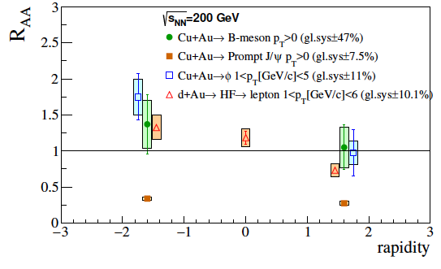
PHENIX/FVTX Highlights, Future Plan
Accomplishments:
Submitted to Phys. Rev. C
4 LANL-led papers released/drafted on heavy flavor
E.g.: first B->J/psi total yield (p_{T}>0). Nuclear modification measured in heavy ion collisions
Nuclear modification factor
Future Plan: complete analyses/publications by ~2019, transition into sPHENIX
Heavy Flavor: Open Heavy Flavor in p+p, p+A, A+A,
35B events from 2014+2016 Au+Au runs
Spin asymmetries: Drell-Yan, more constraints to quarks and gluon contribution to proton spin, transverse spin asymmetry in p+p and p+A from Run12, 13, 15 data sets

Slide 4
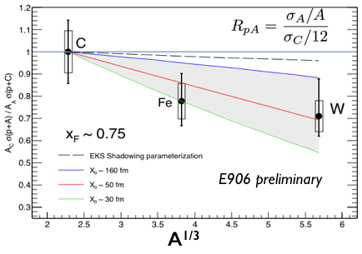
Fermilab/SeaQuest Highlights and Future Plan
Accomplishments:
First unambiguous determination of quark energy loss in p+A->Drell-Yan
Baseline reference for quark energy loss in QGP
(~ path length)
Future Plan: complete papers by 2019, transition into Pol. Target/Dark Photon program
Quark energy loss: Accumulate more stats with new DAQ upgrade (10x previous data rates); much improved CNM baseline for QGP study at RHIC and LHC. Data from Run2016 and Run2017
Dark photon search: Direct search for long-lived dark photon with a trigger upgrade (LANL LDRD funded). World’s best sensitivity in mass range 1MeV-10GeV in the next decade. Discovery potential.

Slide 5
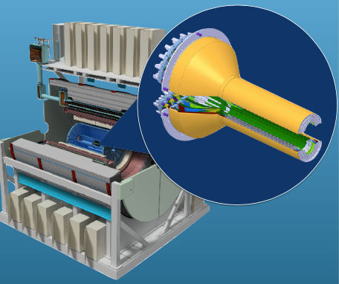
LANL-led sPHENIX MAPS Vertex Detector (MVTX)
Proposal:
A 200M channel inner vertex detector for sPHENIX using ALICE ITS design.
MVTX provides b-quark physics for sPHENIX
  microscopic tomography of QGP
  Collisional vs. radiation energy loss in QGP, heavy quark flow etc.
Accomplishments / Future Plans:
Early R&D by LANL/LDRD, $5M, FY17-19, for readout and mechanical system integration; physics simulation and analysis
18 institutions (US, China, Japan, Korea) on board
MVTX DOE pre-proposal released: US$6M project
Full DOE proposal by Dec 2017

Slide 6
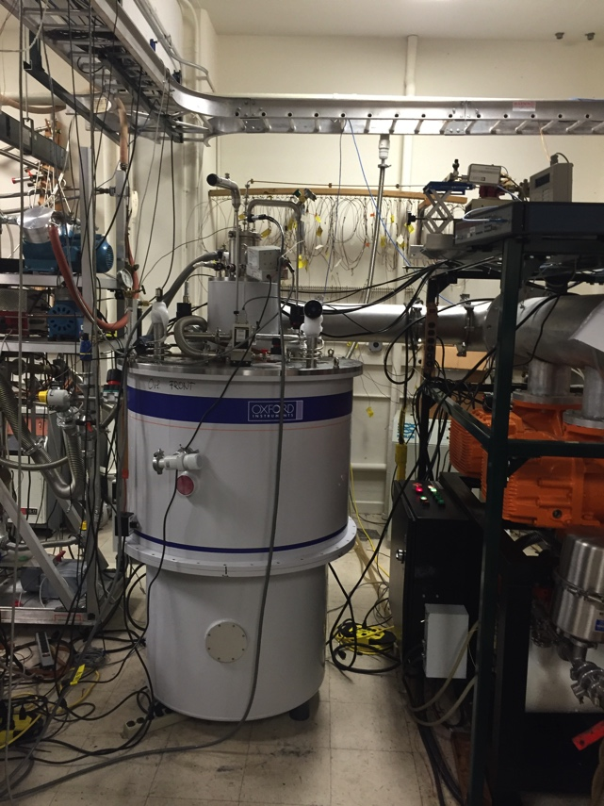
Polarized target (NH₃, ND₃) for SeaQuest - E1039
Proposal:
Spin Program at FNAL
  TMD of the seaquarks, and
  Tensor structure function of deuteron
  Helicity distributions (with polarized beam) of seaquarks ….
  World's highest luminosity target
Accomplishments:
LANL/LDRD funded: 3.5M$ (FY14-FY16)
Polarized target ready to install
  Stable 94% target polarization achieved
E1039 proposal submitted to DOE NP
Polarized target
Future Plans:
Waiting for DOE NP approval for E1039, start to run next year

Slide 7
Possible Timeline of Major Efforts
FY17
  E906 data taking/analysis
  Support for E1039 effort at Fermilab
    Funded: ramping up effort starting in the summer
    Not funded: plan alternatives, e.g.
      Extend E906 for precision dE/dx and parasitic Dark Photon search
      Gluon saturation search in LHCb, spin/CNM physics at J-Lab etc.
  PHENIX analysis: HI and Spin
  sPHENIX Heavy Flavor physics w/ MVTX
FY18
  E906 dE/dx analysis (and data taking if extended)
  E1039 (if approved) commissioning and start data taking
  PHENIX data analyses
  sPHENIX MVTX full proposal submission and reveiws
  If MVTX is not funded: keep participation in sPHENIX baseline tracker
FY19
  E1039 data taking and analysis (if funded)
  Reduced PHENIX analysis
  Reduced E906 analysis
  sPHENIX MVTX simulation/preparation/assembly

Slide 8
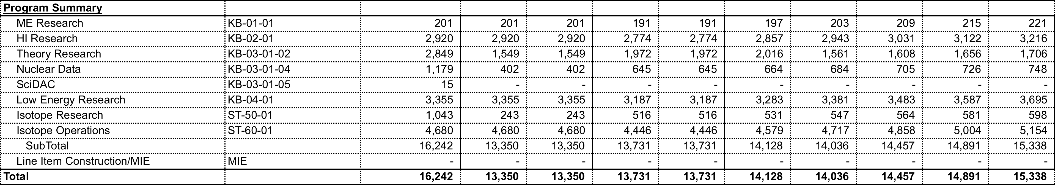
Budget Impacts
FY 2017-23 Budget Spreadsheet Scenarios:
Scenario 1
  FY17 hypothetical full year continuing resolution level provided; hypothetical 5% reduction to FY17 level in FY18; and 3% COL guidance in FY19-23
Scenario 2
  FY17 hypothetical full year continuing resolution level provided; 3% COL guidance in FY18-23
Scenario 3
  FY17 President’s request guidance provided; hypothetical 3% COL guidance from the FY17 level in FY18; and proposed for FY19-23 for a healthy NP program
We must maintain/expand NP/HI/ME programs in out years
- sPHENIX, MVTX MIE, due Feb. 2017!
- Active Fermilab programs, E1039 etc. needs support FY17

Slide 9
Scenario 1
FY17 hypothetical full year continuing resolution level provided; hypothetical 5% reduction to FY17 level in FY18; and 3% COL guidance in FY19-23
Impacts are evaluated relative to FY16 effort; the actual amount of $$ reflected
in the budget sheet
FY17: (-4% FY16), effective $130K loss due to COL
  Lose ~1 postdoc, reduced effort on PHENIX data analyses and delay in publications
FY18: (-5%-3%-3% FY16), effective loss $340K in FY16 $$
  Lose ~2 postdocs/or one staff,
  Much reduced effort on PHENIX and Fermilab data analyses, significant delays in publications
  sPHENIX MVTX design/construction compromised given the tight schedule
FY19-23 (-11% FY16), effective loss $340K in FY16 $$
  Maintain FY18 level on DOE, less LDRD/ER(ends FY18) and LDRD/DR(ends FY19)
  sPHENIX MVTX design/construction compromised given the tight schedule

Slide 10
Scenario 2
FY17 hypothetical full year continuing resolution level provided; 3% COL guidance in FY18-23
Impacts are evaluated relative to FY16 effort; the actual amount of $$ reflected
in the budget sheet
FY17: (-4% FY16), effective loss $130K FY16 $$
  Lose ~1 postdoc, reduced effort on PHENIX data analyses due to COL increase
FY18: (-4% FY16), effective lose $130K FY16 $$
  Lose ~1 postdoc, same as FY17
  Reduced effort on PHENIX and Fermilab data analyses, delays in publications
FY19-23: (-4% FY16)
  Same as FY18 level on DOE, less LDRD/ER(ends FY18) and LDRD/DR(ends FY19)
  Reduced effort on sPHENIX and future program

Slide 11
Scenario 3
FY17 President’s request guidance provided; hypothetical 3% COL guidance from the FY17 level in FY18; and proposed for FY19-23 for a healthy NP program
Impacts are evaluated relative to FY16 effort; the actual amount of $$ reflected
in the budget sheet
FY17: (-4% FY16), effective loss $130K in FY16$$
  Lose ~1 postdoc, reduced effort on PHENIX data analyses due to COL increase
FY18: (-4% FY16), $130K
  Lose ~1 postdoc, same as FY17
  Reduced effort on PHENIX and Fermilab data analyses, delays in publications
FY19-23: (+23% FY16), $700K
  Add 1 FTE + 2 Postdocs
  Lead sPHENIX and future EIC program effort at RHIC
  Lead Fermilab polarized target spin program
  Need following minimal FTEs to lead major efforts,
    4 staff + 3 PD on sPHENIX
    2 staff + 2 PD on Fermilab
    (6 staff + 6 PD) total was the average FTEs (DOE+LDRD) in the recent years to support (PHENIX+E906)

Slide 12
Backup slides

Slide 13
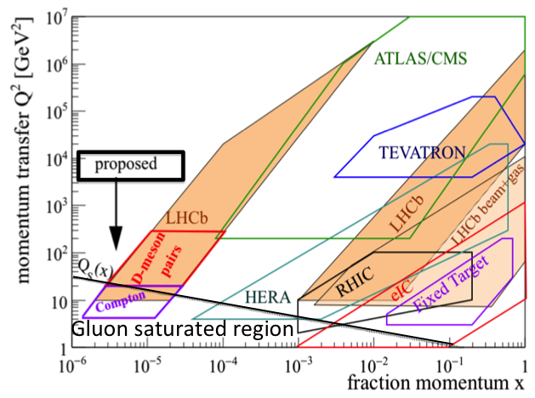
Gluon Saturation Search at LHCb
Proposal:
unique access to small-x/small Q2 where gluon saturation is expected (NP long range goal)
discovery potential
Potential for future LANL-led LHCb HI program
LANL LDRD just started - Jan 2017:
p+Pb data analysis
Magnet tracker R&D for soft particle acceptance (from small Q² processes)

Slide 14
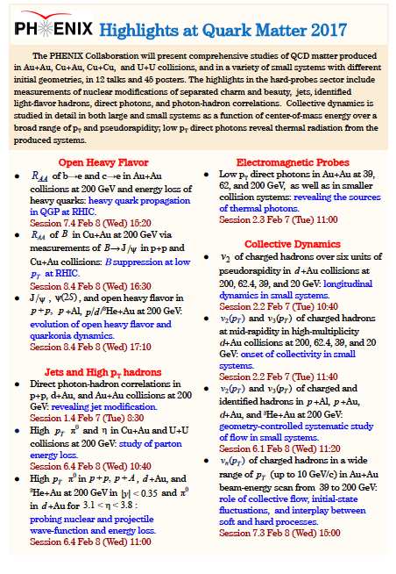
LANL led analyses

Slide 15
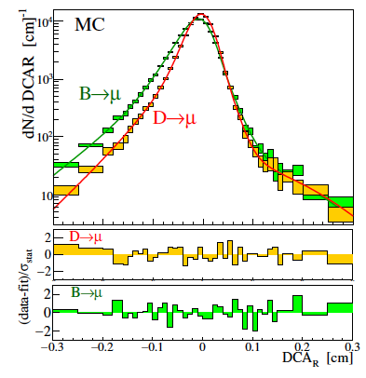
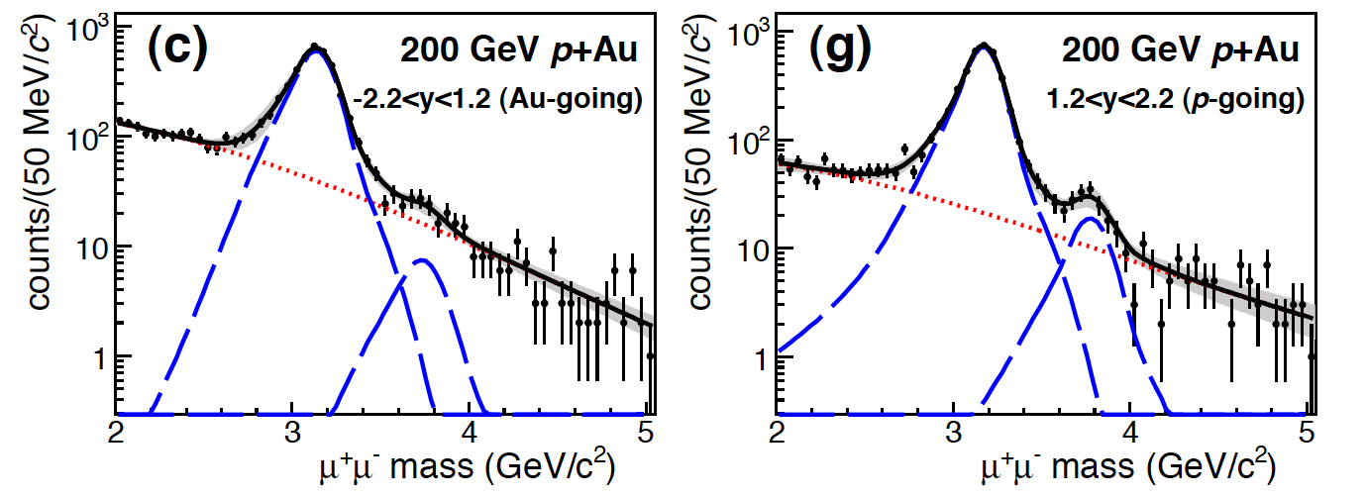
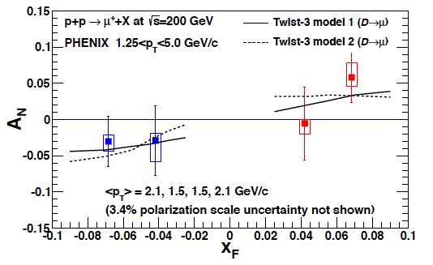

PHENIX Highlights and Future Plan
First B hadron measurements in p+p, with FVTX, X. Li
Future: take advantage of the rich data sets collected recently by the PHENIX experiment at RHIC with LANL-led FVTX/Muon Tracker, complete key physics study in coming years:
Heavy Quark production in heavy ion collisions:
  Heavy quark D and B nuclear modifications
  Heavy quarkonia nuclear modifications
  Cold Nuclear matter effects in p+A collisions
Transverse Single Spin Asymmetry physics (TSSA)
  Forward Drell-Yan to test sign change
  Heavy quark to measure gluon Sivers functions
Data sets to be analyzed:
  Run12 Cu+Au; Run14 Au+Au; Run16 Au+Au
  Run15 polarized p+p, p+Au and p+Al
  5+ high impact papers in progress
Pave the path for the future:
sPHENIX and the EIC heavy ion and spin physics
arXiv:1701.01342
DCA w/ FTVX
First B R_{AA} in Cu+Au, C. da Silva
CuAu forward hadron Rcp, S. Lim
Strong effects observed in p+Au, M. Durham
Heavy quark TSSA, J. Bok
PHENIX
sPHENIX
EIC
arXiv:1609.06550
2015
2020
2025

Slide 16
B production in p+p collisions with the FVTX
B hadron from p_{T}=0.
LANL results
PHENIX
arXiv:1701.01342
LANL results

Slide 17
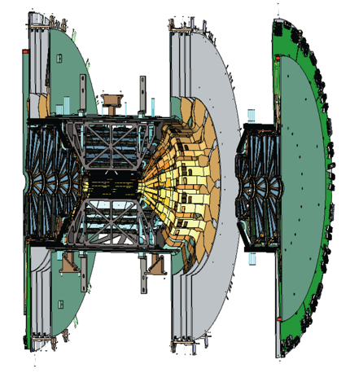
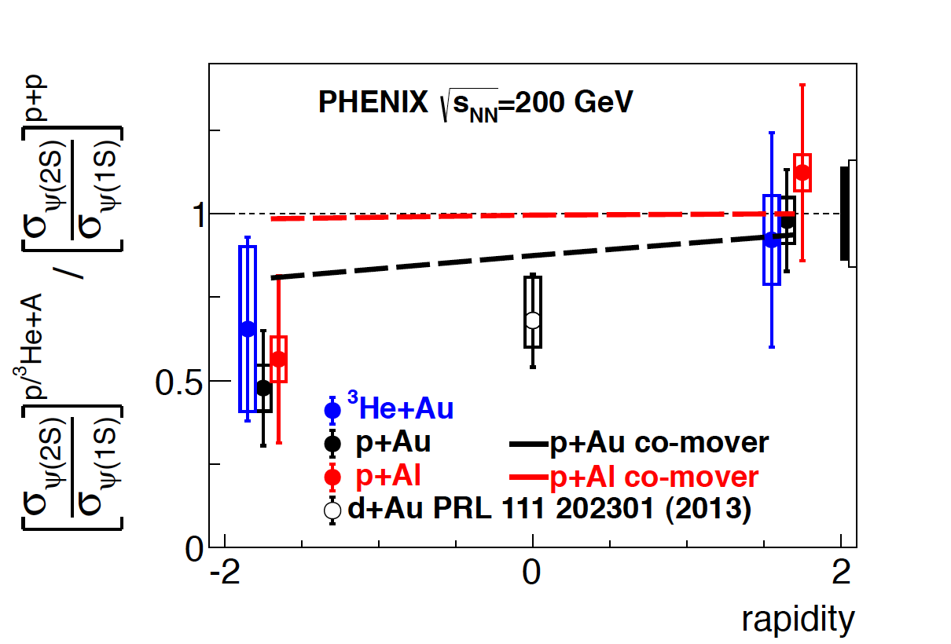
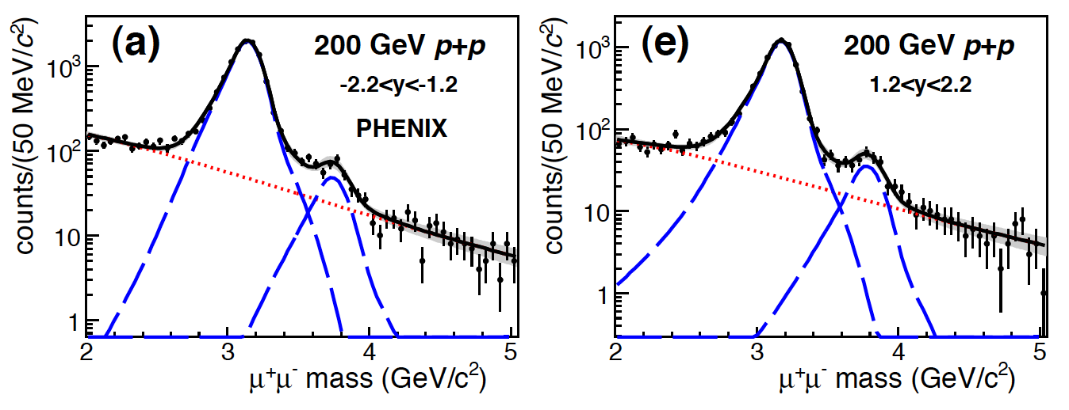
The first published heavy flavor measurements
with the FVTX
arXiv:1609.06550 submitted to Phys Rev C
The excited ψ(2s) state is preferentially suppressed by a factor of 2 more than the more tightly bound J/ ψ in the nucleus-going direction in p+A collisions
A comparison with LHC data shows that the suppression increases with co-moving particle density, indicating that final state interactions outside the nucleus have a significant impact on quarkonia suppression

Slide 18
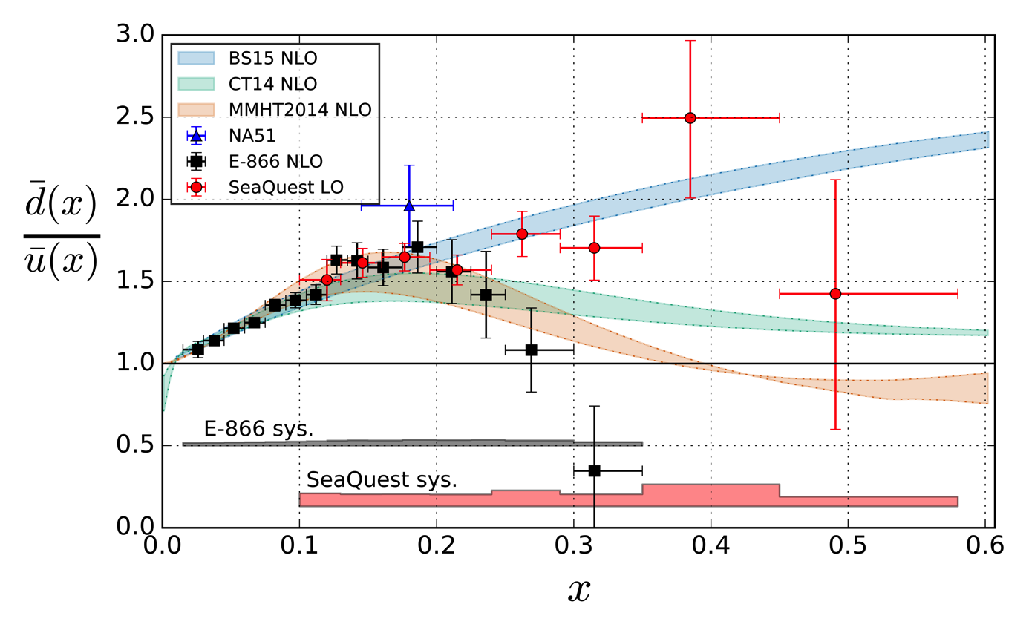

Sea Quark Flavor Asymmetry at High Bjorken-x
FY-2015 data only: expect 4x more statistics by next summer
Theory uncertainties coming from Q² evolution (1 GeV² < Q² < 100 GeV² )
First available hint of sea quark flavor asymmetry behavior beyond x ~ 0.25
Surprising difference compared with previous experiment (with much higher Q²)
With the new data being taken and analyzed, much more conclusive answer expected next summer

Slide 19
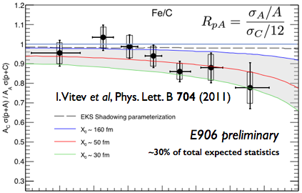
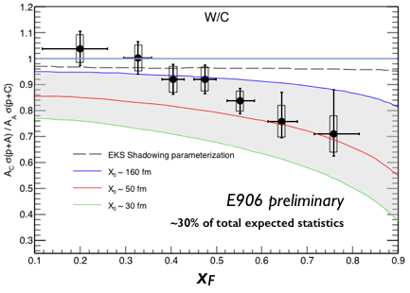
Quark Energy Loss in Cold Nuclear Matter
First ever clean indication of nuclear suppression beyond what could be explained by shadowing effects alone.
Successful conclusion of a 20+yr quest starting from E866 to understand the baseline in extracting QGP properties.
The first unambiguous sign of quark energy loss in cold nuclear matter

Slide 20
Research/Operating by Funding Scenario in FY20
Scenario 1 ($ XXX M) | Scenario 2 ($ XXX M) | Scenario 3 ($ XXX M)

