Slide 1
PHENIX Team Highlight Slides for Joe’s DOE Budget Presentation
Ming Liu

Slide 2
High Energy Nuclear Physics Team
Staff:
  Ming Liu, TL
  Patrick McGaughey*
  Kun Liu
  Hubert van Hecke*
  Cesar da Silva
  Andi Klein
  Walt Sondheim
  New hires in progress
  Matt Durham**
  Melynda Brooks**
*: Retiring in FY17(being replaced)
**: Active associate members
Postdoc and students
  Xuan Li
  Sanghoon Lim
  David Kleinjan
  Marie Boer
  Sho Uemura
  Mike McCumber (Reines Fellow)
  Jeongsu Bok (visiting student, NMSU)
  Alex Wickes (visiting student, UCLA)
  Xin-kun Chu (visiting student from PKU, stations at Fermilab)
Supported by:
DOE/NP,
LANL LDRD (sPHENIX MAPS Vertex Detector, $5M, FY17-19)
LDRD(Fermilab Dark Photon, $1M, FY16-18)
LDRD Early Career(LHCb, $0.5M, FY17-18)
Note:
If Fermilab E1039/Pol-DY approved by DOE, rebalancing of HI/ME effort needed and support for installation

Slide 3
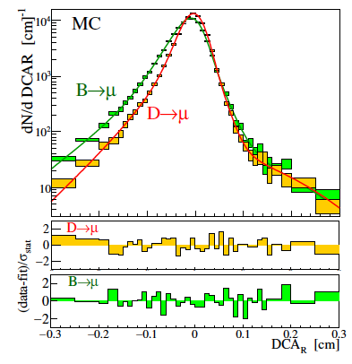
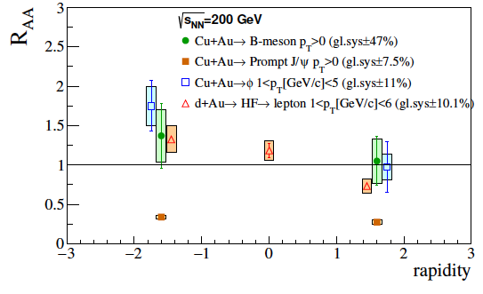
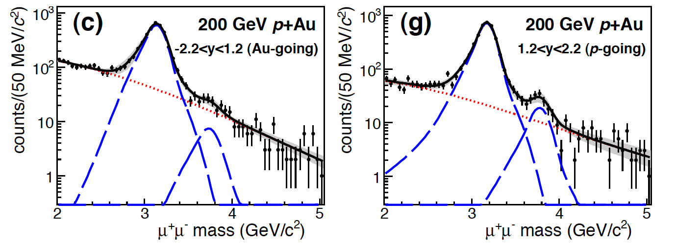
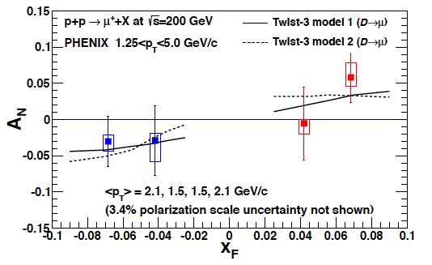

PHENIX Highlights and Future Plan
First B hadron measurements in p+p, with FVTX, X. Li
Future: take advantage of the rich data sets collected recently by the PHENIX experiment at RHIC with LANL-led FVTX/Muon Tracker, complete key physics study in coming years:
Heavy Quark production in heavy ion collisions:
  Heavy quark D and B nuclear modifications
  Heavy quarkonia nuclear modifications
  Cold Nuclear matter effects in p+A collisions
Transverse Single Spin Asymmetry physics (TSSA)
  Forward Drell-Yan to test sign change
  Heavy quark to measure gluon Sivers functions
Data sets to be analyzed:
  Run12 Cu+Au; Run14 Au+Au; Run16 Au+Au
  Run15 polarized p+p, p+Au and p+Al
  5+ high impact papers expected
Pave the path for the future:
sPHENIX and the EIC heavy ion and spin physics
arXiv:1701.01342
DCA w/ FTVX
First B R_{AA} in Cu+Au, C. da Silva
CuAu forward hadron Rcp, S. Lim
Strong effects observed in p+Au, M. Durham
Heavy quark TSSA, J. Bok
PHENIX
sPHENIX
EIC
arXiv:1609.06550
2015
2020
2025

Slide 4


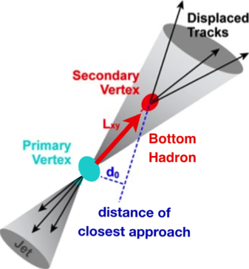
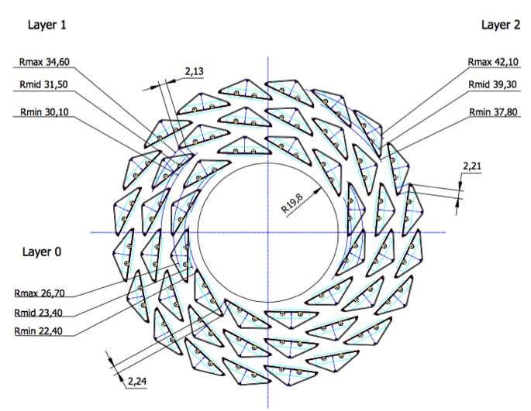
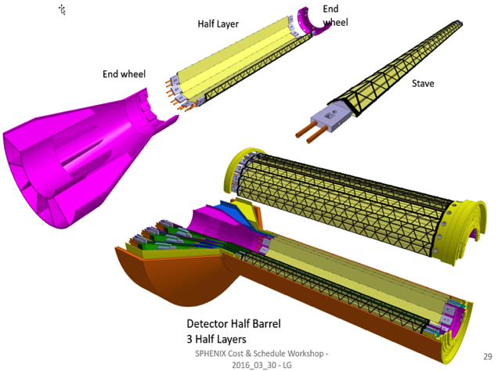
LANL Led sPHENIX MAPS Vertex Detector
sPHENIX 3 Science Pillars
Jets
Upsilons
B-jets
- MIE pre-proposal submitted to DOE;
- R&D supported by LANL/LDRD
ALICE ITS Upgrade (2021+);
Inner Tracker System
B Physics @sPHENIX
sPHENIX Inner Vertex Tracking
“Adopt” ALICE/ITS
Mini. risk,
Max. physics
Monolithic-Active-Pixel-Sensor (MAPS)

Slide 5
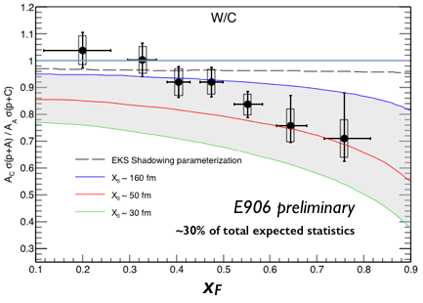
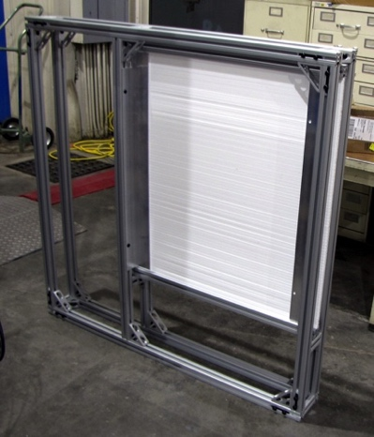
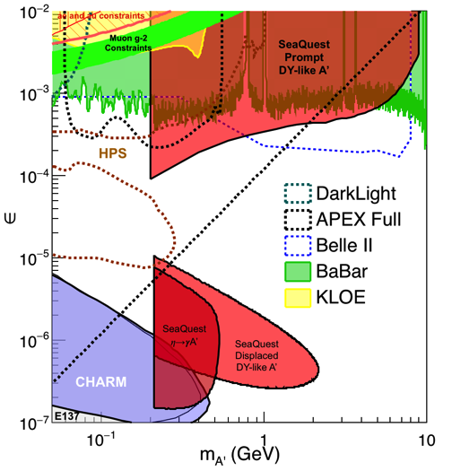
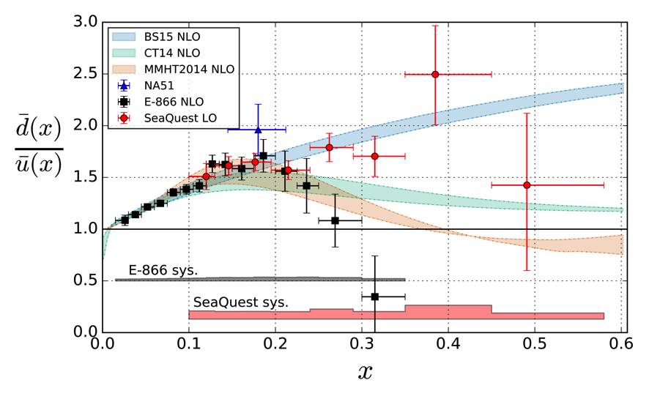
Fermilab Highlights and Future Plan
E906, LDRD/E1067, LDRD/E1039
First determination of quark energy loss in p+A, K. Liu
DAQ upgrade completed: improved by x10+
New dark photon trigger: will be ready for parasitic data taking spring 2017 with E906
Updated dark photon proposal to be submitted summer 2017 to Fermilab PAC, for future runs
Sea quark flavor asymmetry
One of 8 trigger modules
assembled at LANL
E1067: Dark Photon Search
E906/E1067
E1039/E1067
2015
2020
2025

Slide 6
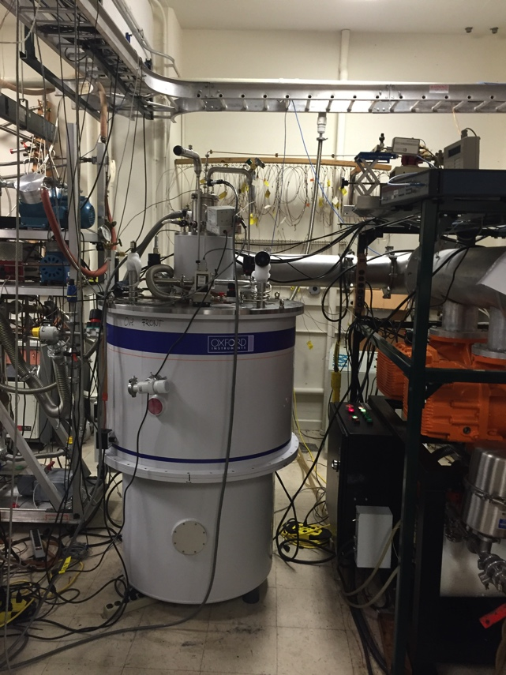
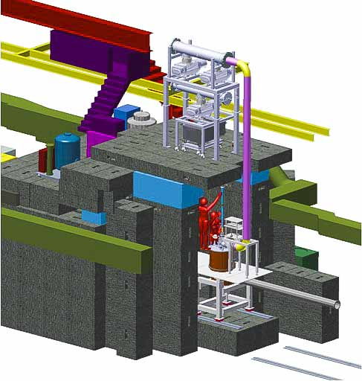
E1039/ Polarized Target (NH₃ , ND₃) Ready to Install
94 % Polarization
Fully funded by LANL LDRD program; 3.5M$ (FY14-FY16)
Proposal submitted to DOE NP in Nov 16
Spin Program at FNAL
TMD of the seaquarks, and
Tensor structure function of deuteron
Helicity distributions (with polarized beam) of seaquarks ….
Needs from DOE NP, HEP and FNAL
Support for installation (mainly labor)
  Cave modification; shielding changes
  Engineering design for cryo plumbing
  Beam Line modifications (beam spot, collimator)
Equipment
He closed loop liquefier system
Beamline components (Power supplies)
No additional funds required for LANL

Slide 7
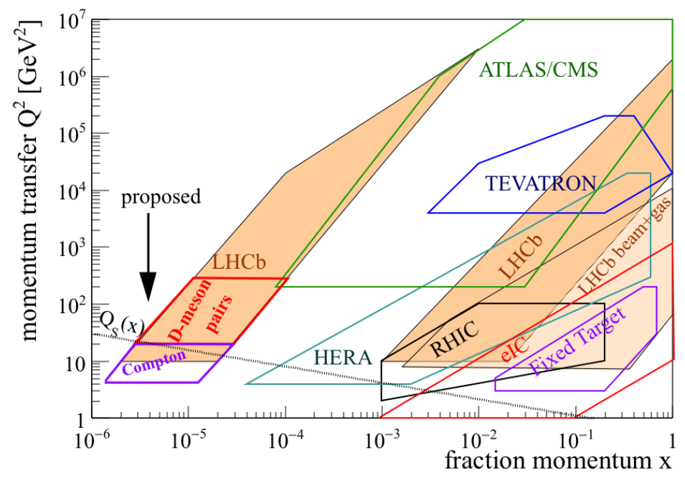
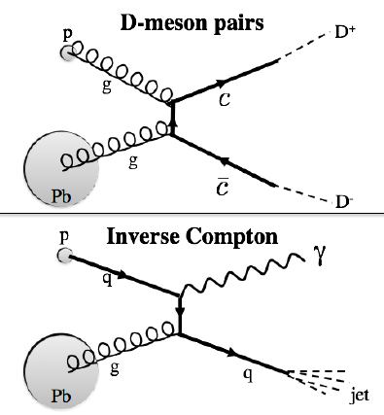
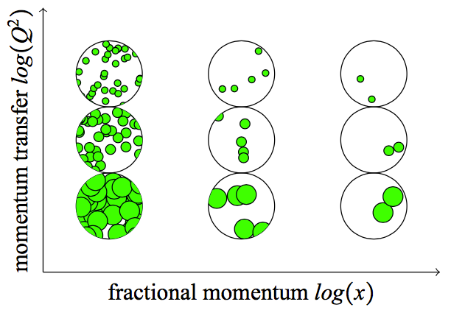

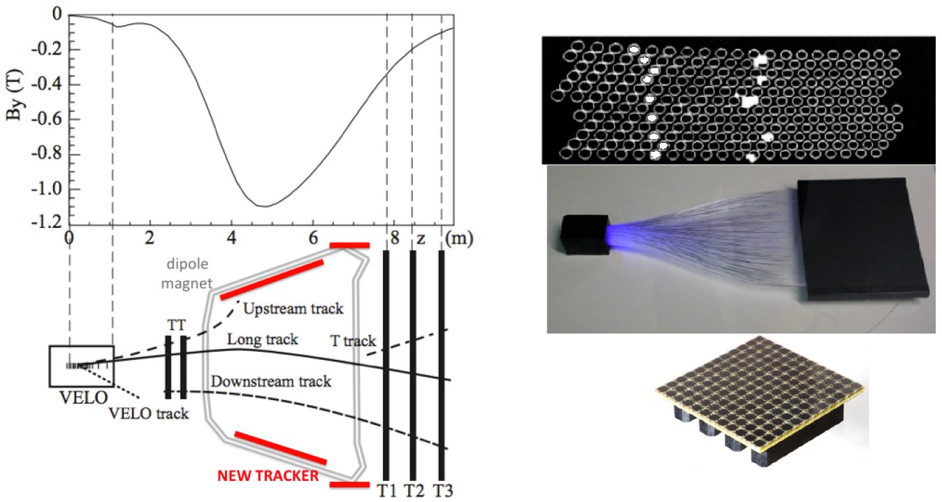
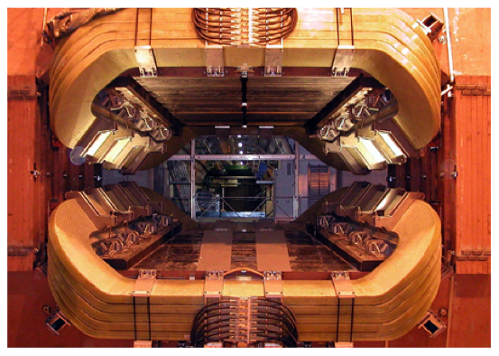
Gluon Saturation Search at LHCb – Discovery potential
Cesar’s Early Career starting in 2017, for 2 years
LANL supported early Career program.
Also applied for DOE Early Career.
Prototype tracker
R&D at LANL

Slide 8
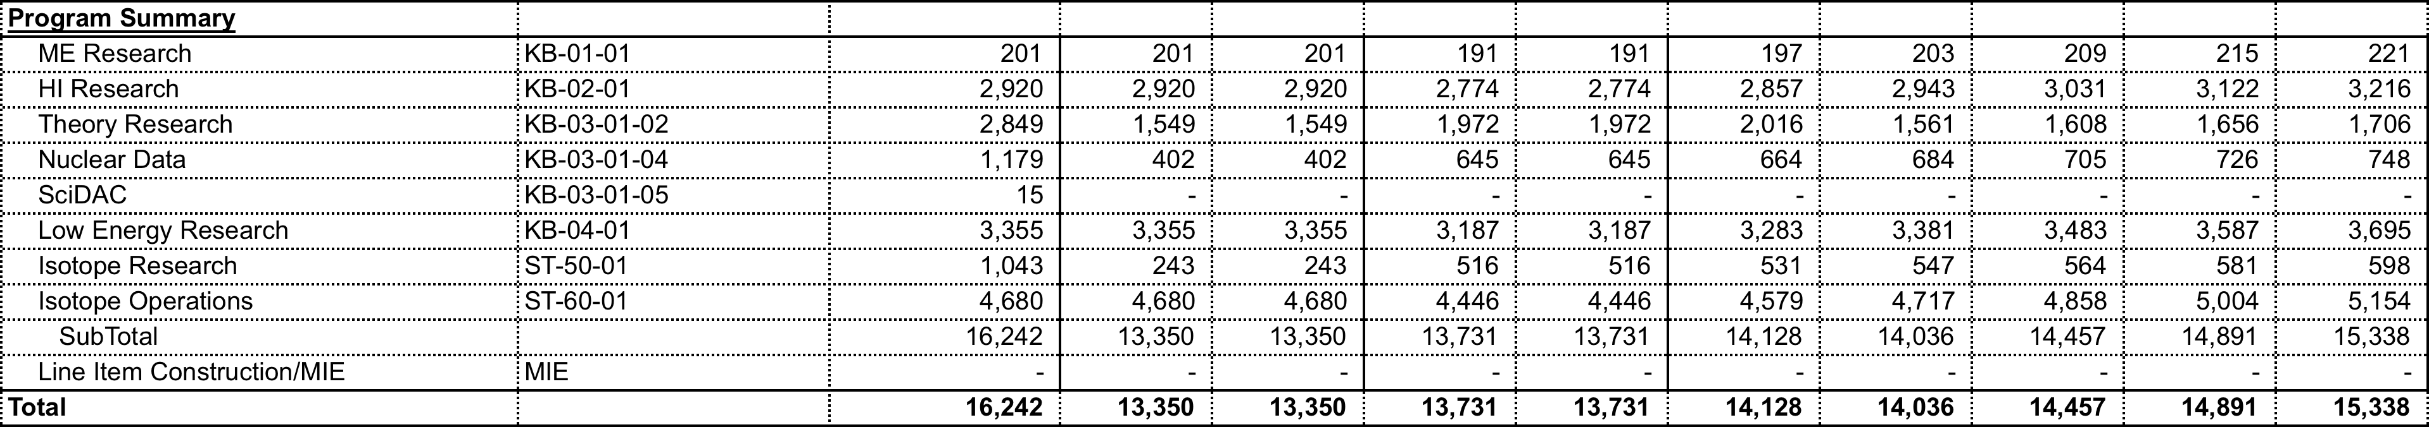
Budget
FY 2017-23 Budget Spreadsheet Scenarios:
Scenario 1
  FY17 hypothetical full year continuing resolution level provided; hypothetical 5% reduction to FY17 level in FY18; and 3% COL guidance in FY19-23
Scenario 2
  FY17 hypothetical full year continuing resolution level provided; 3% COL guidance in FY18-23
Scenario 3
  FY17 President’s request guidance provided; hypothetical 3% COL guidance from the FY17 level in FY18; and proposed for FY19-23 for a healthy NP program
We must maintain/expand NP/HI/ME programs in outer years
- sPHENIX, MVTX MIE, due Feb. 2017!
- Active Fermilab programs, E1039 etc. needs support FY17

Slide 9
Scenario 1
FY17 hypothetical full year continuing resolution level provided; hypothetical 5% reduction to FY17 level in FY18; and 3% COL guidance in FY19-23
FY17: (-4% FY16), effective $130K loss due to COL
  Lost ~1 postdoc, reduced effort on PHENIX data analyses
FY18: (-5-3-3% FY16), effective loss $340K in FY16
  Lost ~2 postdocs/or one staff,
  much reduced effort on PHENIX and Fermilab data analyses, much delayed publications
FY19-23 (-11% FY16), effective loss $340K in FY16
  maintain FY18 level on DOE, less LDRD/ER(-FY18) and LDRD/DR(-FY19)
  Much reduced effort on sPHENIX and future program,

Slide 10
Scenario 2
FY17 hypothetical full year continuing resolution level provided; 3% COL guidance in FY18-23
FY17: (-4% FY16), effective loss $130K FY16
  Lost ~1 postdoc, reduced effort on PHENIX data analyses due to COL increase
FY18: (-4% FY16), $130K
  Lost ~1 postdocs, same as FY17
  reduced effort on PHENIX and Fermilab data analyses, delayed publications,
FY19-23 (-4% FY16)
  same as FY18 level on DOE, less LDRD/ER(-FY18) and LDRD/DR(-FY19)
  reduced effort on sPHENIX and future program

Slide 11
Scenario 3
FY17 President’s request guidance provided; hypothetical 3% COL guidance from the FY17 level in FY18; and proposed for FY19-23 for a healthy NP program
FY17: (? FY16)
  ???Lost ~1 postdoc? reduced effort on PHENIX data analyses due to COS increase
FY18: (? FY16)
  ???Lost 1-2 postdocs, much reduced effort on PHENIX and Fermilab data analyses, much delayed publications
FY19-23 (? FY16)
  ???Much reduced effort on sPHENIX and future program
  less LDRD/ER(-FY18) and LDRD/DR(-FY19)
  Need
    (1staff + 2PD finish PHENIX analysis)
    2 staff + 2 PD on sPHENIX
    2 staff + 2 PD on Fermilab
    (5 staff + 6 PD) total was the average in the past to support (PHENIX+E906)

Slide 12
Backup slides

Slide 13
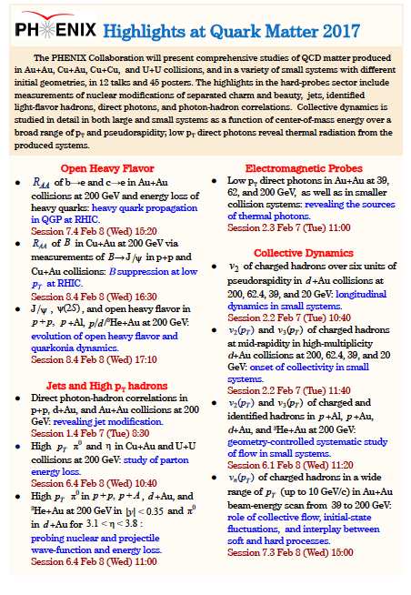
LANL led analyses

Slide 14
B production in p+p collisions with the FVTX
B hadron from p_{T}=0.
LANL results
PHENIX
arXiv:1701.01342
LANL results

Slide 15
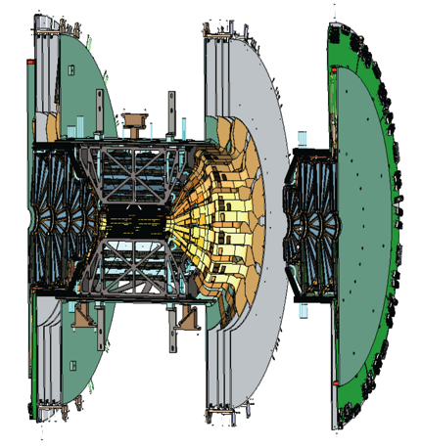
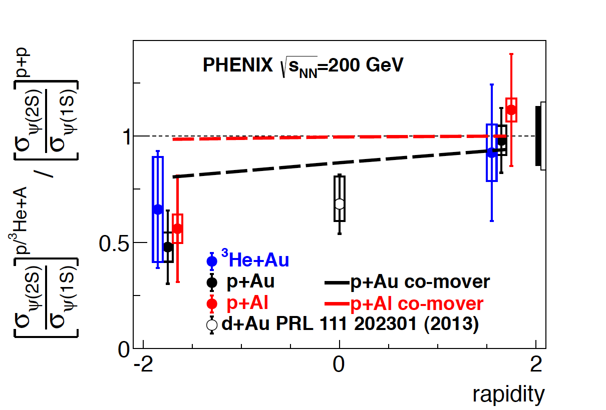
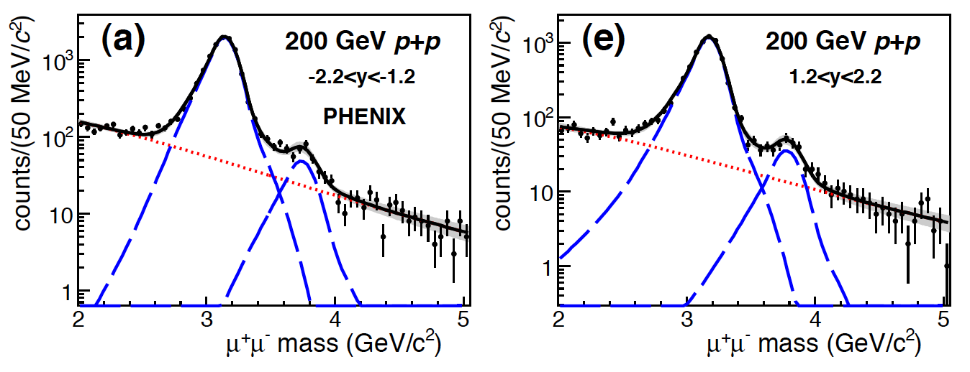
The first published heavy flavor measurements
with the FVTX
arXiv:1609.06550 submitted to Phys Rev C
The excited ψ(2s) state is preferentially suppressed by a factor of 2 more than the more tightly bound J/ ψ in the nucleus-going direction in p+A collisions
A comparison with LHC data shows that the suppression increases with co-moving particle density, indicating that final state interactions outside the nucleus have a significant impact on quarkonia suppression

Slide 16
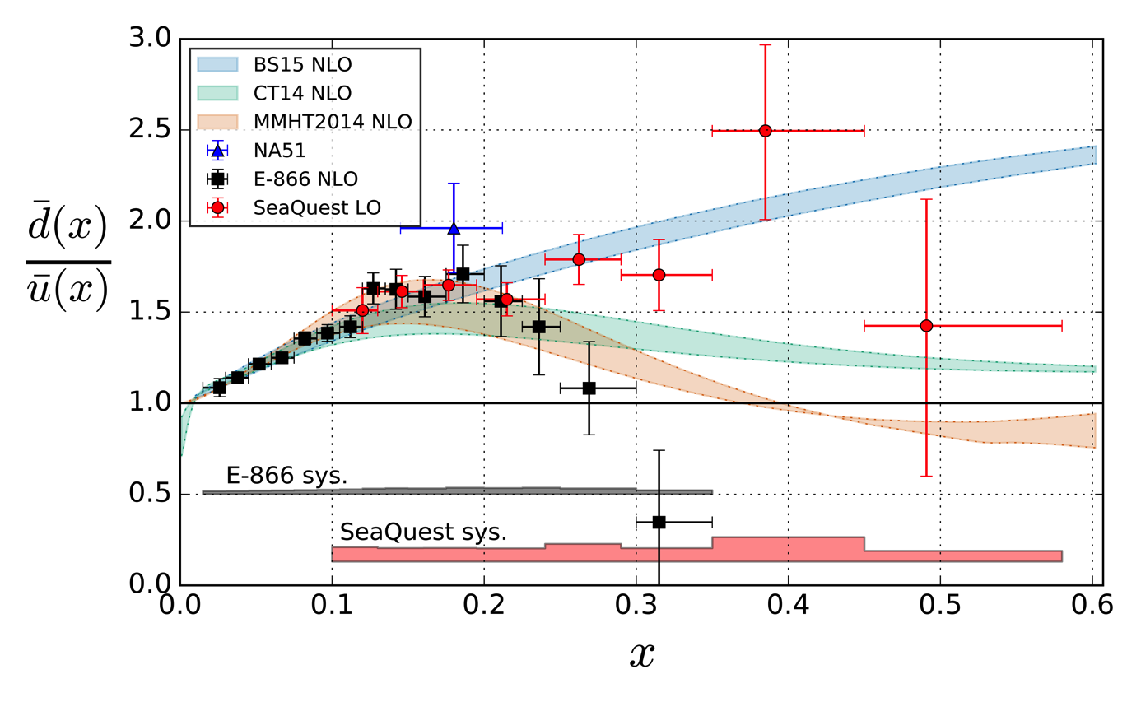

Sea Quark Flavor Asymmetry at High Bjorken-x
FY-2015 data only: expect 4x more statistics by next summer
Theory uncertainties coming from Q² evolution (1 GeV² < Q² < 100 GeV² )
First available hint of sea quark flavor asymmetry behavior beyond x ~ 0.25
Surprising difference compared with previous experiment (with much higher Q²)
With the new data being taken and analyzed, much more conclusive answer expected next summer

Slide 17
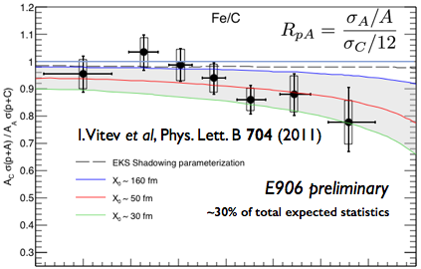
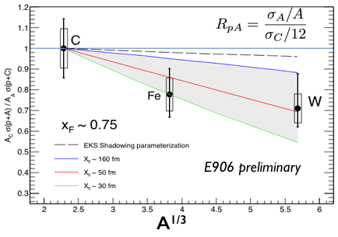
Quark Energy Loss in Cold Nuclear Matter
First ever clean indication of nuclear suppression beyond what could be explained by shadowing effects alone.
Successful conclusion of a 20+yr quest starting from E866 to understand the baseline in extracting QGP properties.
The first unambiguous sign of quark energy loss in cold nuclear matter

Slide 18
Research/Operating by Funding Scenario in FY20
Scenario 1 ($ XXX M) | Scenario 2 ($ XXX M) | Scenario 3 ($ XXX M)

