Slide 1


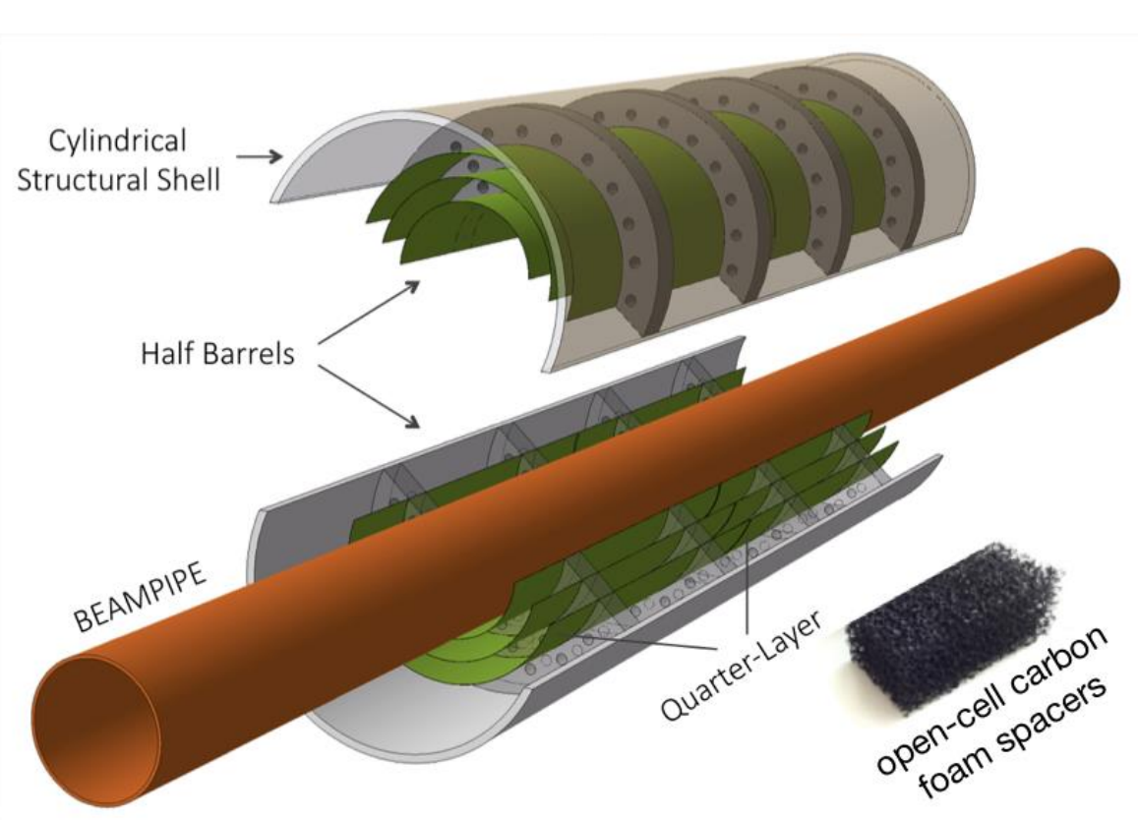
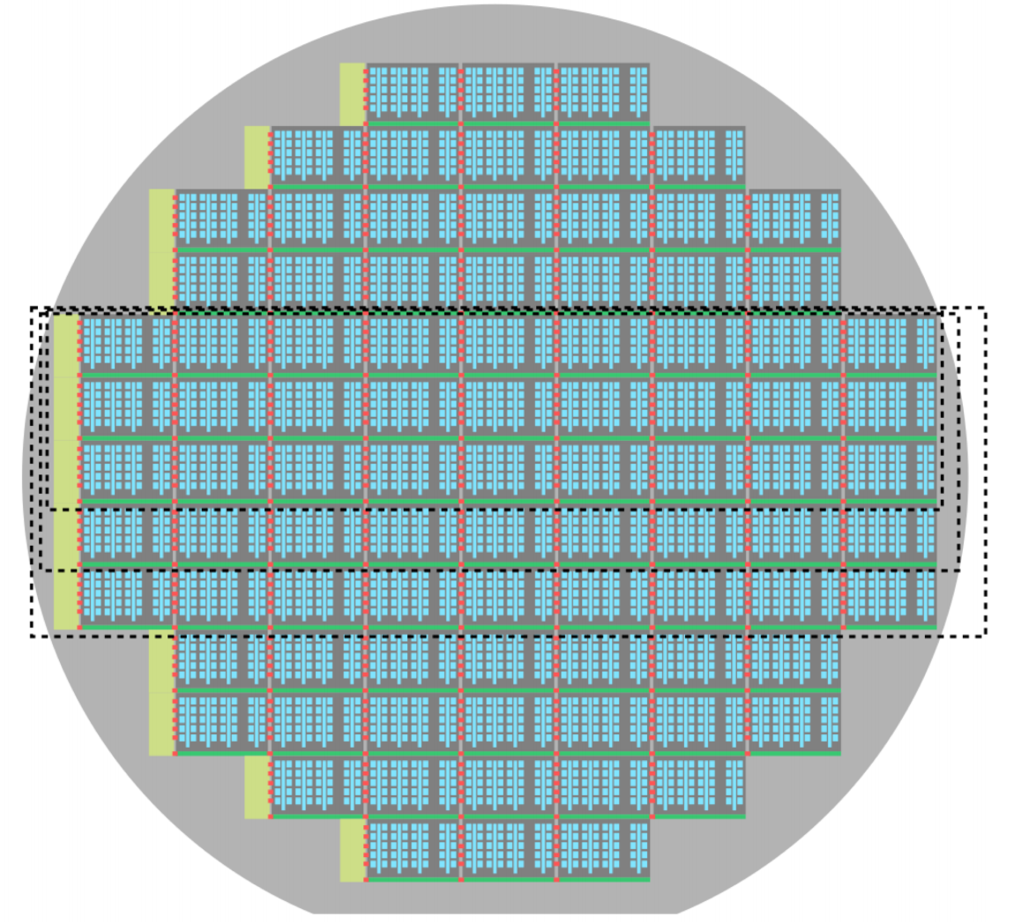
Kickoff meeting held at CERN on December 4, 2019 for “ALICE ITS Upgrade in LS3”
https://indico.cern.ch/event/860914/
The most relevant efforts in this Letter of Intent (endorsed by the LHCC in September 2019) include:
Silicon R&D for next generation MAPS sensor (with significant improvements)
coupled with
R&D into extremely low X/X0 cylindrical vertex detection with “bent” silicon
“bent” silicon
Detector
concept
“stitched” silicon
Each layer half barrel is a single stitched sensor
X/X0 ~ 0.05%

Slide 2
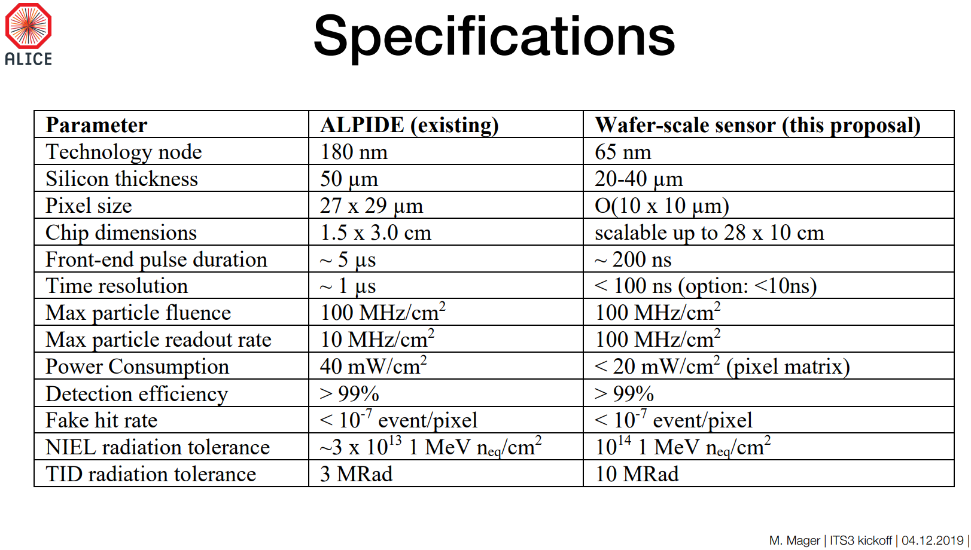
New sensor design – compared to existing ALPIDE

Slide 3
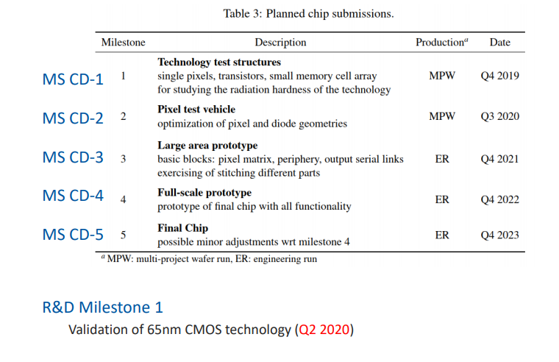
Sensor development milestones
Pre – COVID-19

Slide 4
Organization of effort for ITS3
ITS3-WP1: Physics studies, Simulation and Reconstruction alice-its3-wp1@cern.ch
Physics performance studies
Detector functional requirements
Detector model and simulation
Reconstruction
ITS3-WP2: Pixel chip design alice-its3-wp2@cern.ch
Test structures and validation of the technology
Optimization of the pixel layout
Large area building block prototypes
Full scale prototypes
Final chip
ITS3-WP3: Pixel chip characterization alice-its3-wp3@cern.ch
Development of hardware and software for the pixel chip characterization
Laboratory, Beam and Radiation tests
Pixel chip device simulation

Slide 5
Organization of effort for ITS3
ITS3-WP4: Pixel sensor thinning, bending and interconnection alice-its3-wp4@cern.ch
Tests with existing material (ALPIDE wafers)
Tests with 300 mm dummy wafers
Test with full-scale prototypes
Mechanical, electrical and functional validation of the procedures
ITS3-WP5: Mechanics and cooling alice-its3-wp5@cern.ch
Selection and characterization of carbon materials (structural and thermal properties)
Development and production of support structures
Development, production and validation of the Engineering Module based on dummy chips
Development, production and validation of the Qualification Module based on prototype chips
Production of the Final Module based on final chips
An EIC effort will require additional effort in R&D
EIC – WP6: Discs based on ITS3 sensors
EIC – WP7: Long staves based on ITS3 sensors
EIC – WP8: Support and cooling for discs and staves
+?

Slide 6
Towards an EIC silicon consortium
As already stated, we consider joining the CERN based ITS3 silicon effort as the most likely path so success for developing a sensor that meets the EIC requirements.
I have already approached the ITS3 management team and they are quite supportive of having and EIC based contingent in the contributor base. As was described before, the ITS3 project is set up from the beginning to include non - ITS/ALICE/CERN members. A MOU that codifies this is being formed in WP2.
There are existing institutions like LBNL, Bari, Trieste, Wuhan and others that are already part of ITS/ALICE who have demonstrated interest in using ITS3 developed sensors for EIC.
Other institutions such like Birmingham, RAL, BNL instrumentation, IMPCAS etc. are not part of ALICE/CERN but have a strong interest in an EIC sensor and extensive silicon experience.
We are in the process of forming a consortium of institutions to join the ITS3 effort as the primary development for an EIC based sensor. I will be meeting again with ALICE/ITS3 management next week to expand on our plans and get basic information. Any group that feels that they can contribute and is interested in joining this consortium, please get in touch with me.

