Slide 1
EIC and LANL’s Interest
Ming Liu
LANL

Slide 2
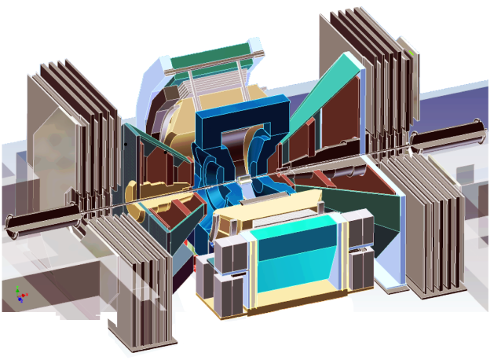
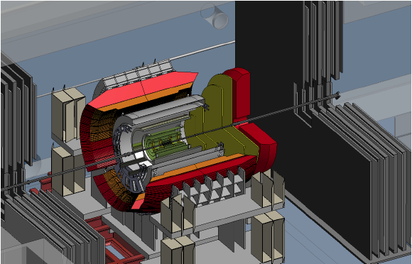
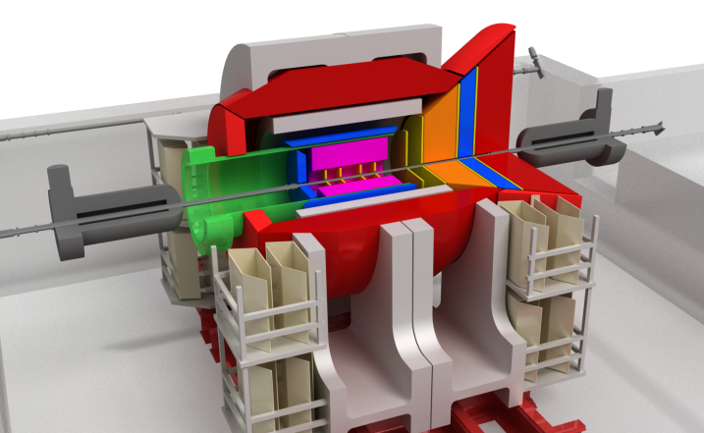
Our Vision: PHENIX -> Forward/sPHENIX->ePHENIX
Documented: http://www.phenix.bnl.gov/plans.html
Current PHENIX
f/sPHENIX
An EIC detector
PHENIX completed 2016
16y+ work
100+M$ investment
130+ published papers to date
Comprehensive central upgrade based on BaBar magnet
fsPHENIX: forward tracking, HCal and muon ID
Key study of transverse spin
New collaboration/new ideas
Path of PHENIX upgrade leads to a capable EIC detector
Large coverage of tracking, calorimetry and PID
New collaboration/new ideas
~2000
2017→2022
~2025
Time
RHIC: A+A, polarized p+p, polarized p+A
eRHIC: e+p, e+A

Slide 3
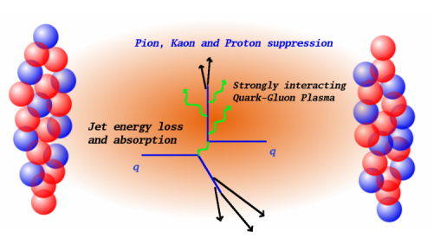
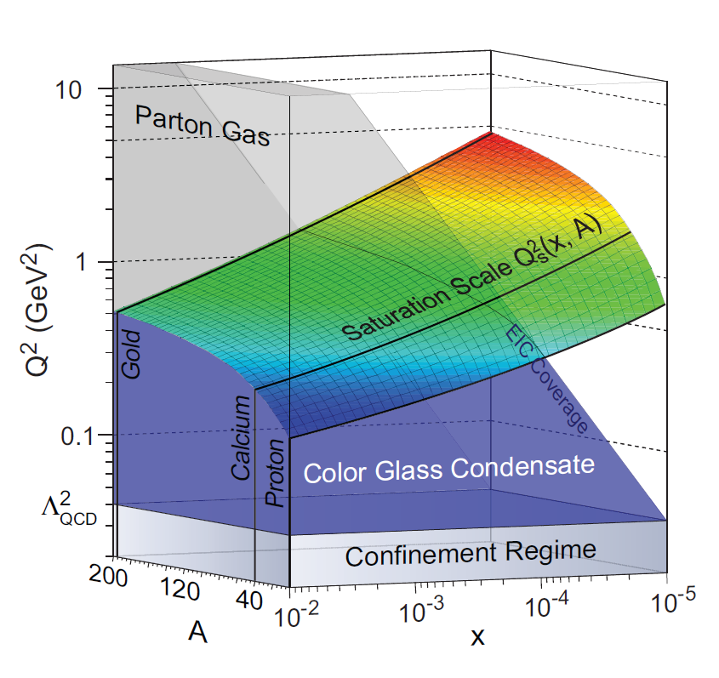
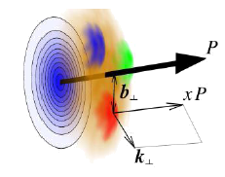
Recent Activities & Efforts
PHENIX@BNL and SeaQuest@Fermilab
  QGP, CNM and Spin; Dark photon/Higgs
  Muon Trackers, FVTX @RHIC
  MuID, Polarized NH3 target, DAQ, trigger @Fermilab
  Mechanical and electronics engineering
sPHENIX
  QGP B-jet physics
  MAPS tracking
  Si mini-strip tracking (~FVTX)
f/sPHENIX
  TMD spin physics: Jet A_{N}, Drell-Yan
  CNM physics: dE/dx, shadowing in pA
  Tracking: MAPS & GEM tracker
EIC
  TMD, GPD, CNM physics
  Tracking, MAPS & GEM
  Hadron PID, Modular Cerenkov detector

Slide 4
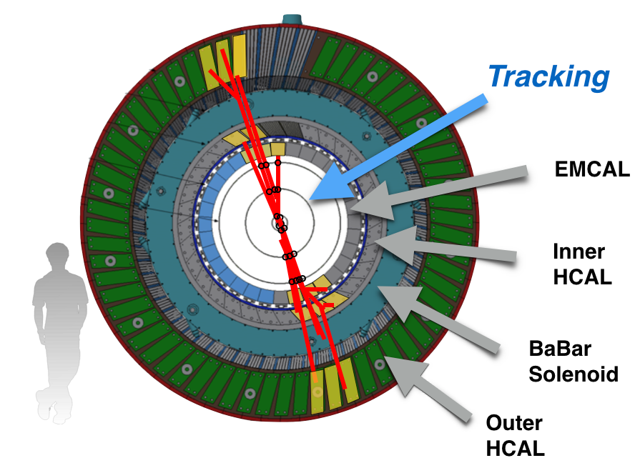
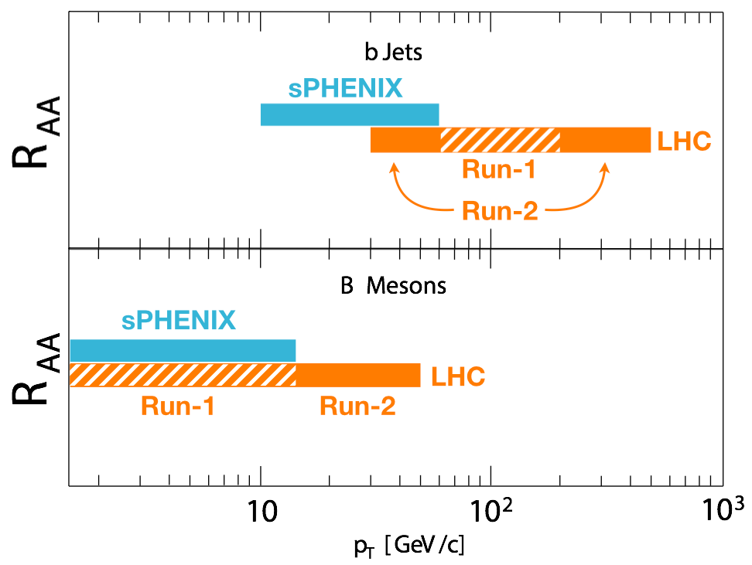
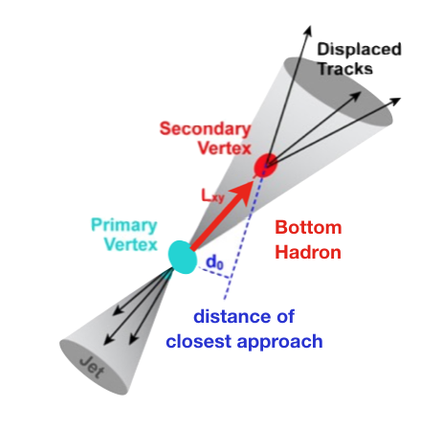
sPHENIX
B-jet Physics
Precision tracking w/ MAPS
  Low mass pixel detector
  Excellent technology for EIC

Slide 5
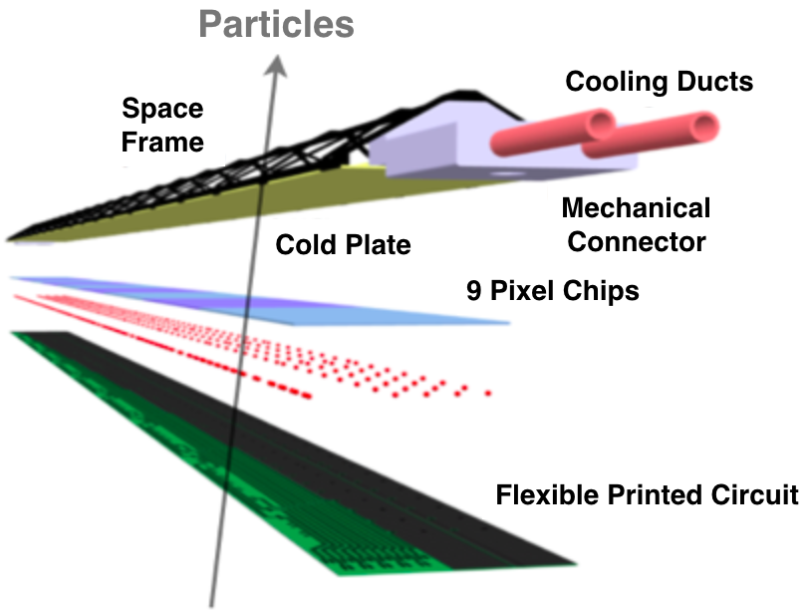
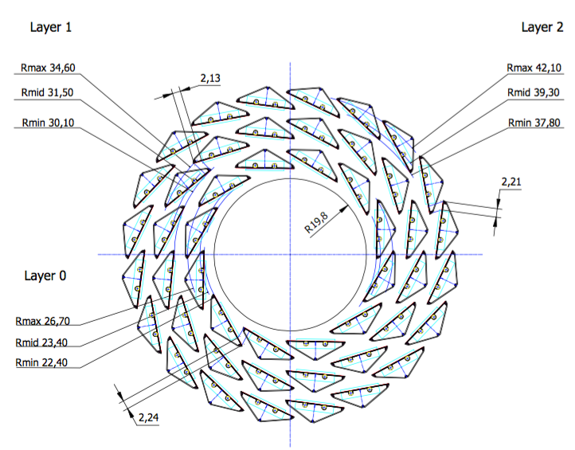
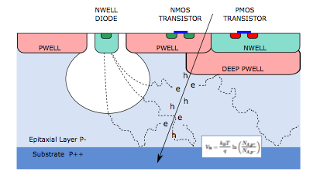
Monolithic Active Pixel Sensor (MAPS) Technology
Inner Silicon Tracker with MAPS:
0.3% X₀ per layer
15+ years R&D from ALICE
Inner Tracking Region
MAPS sensor:
Low mass, ultrathin 50um
Fine pixel 28x28 um
On-chip digitization
Excellent choice for
EIC tracking
Forward sPHENIX tracking

Slide 6

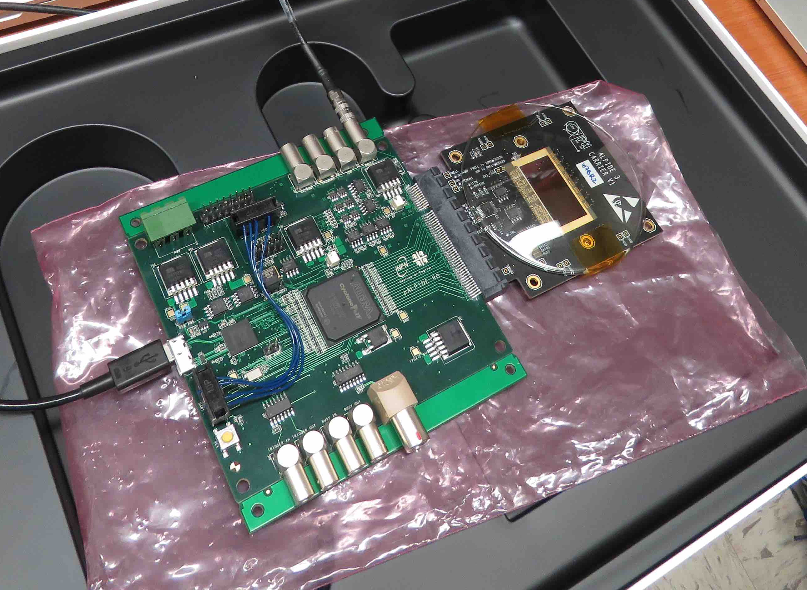

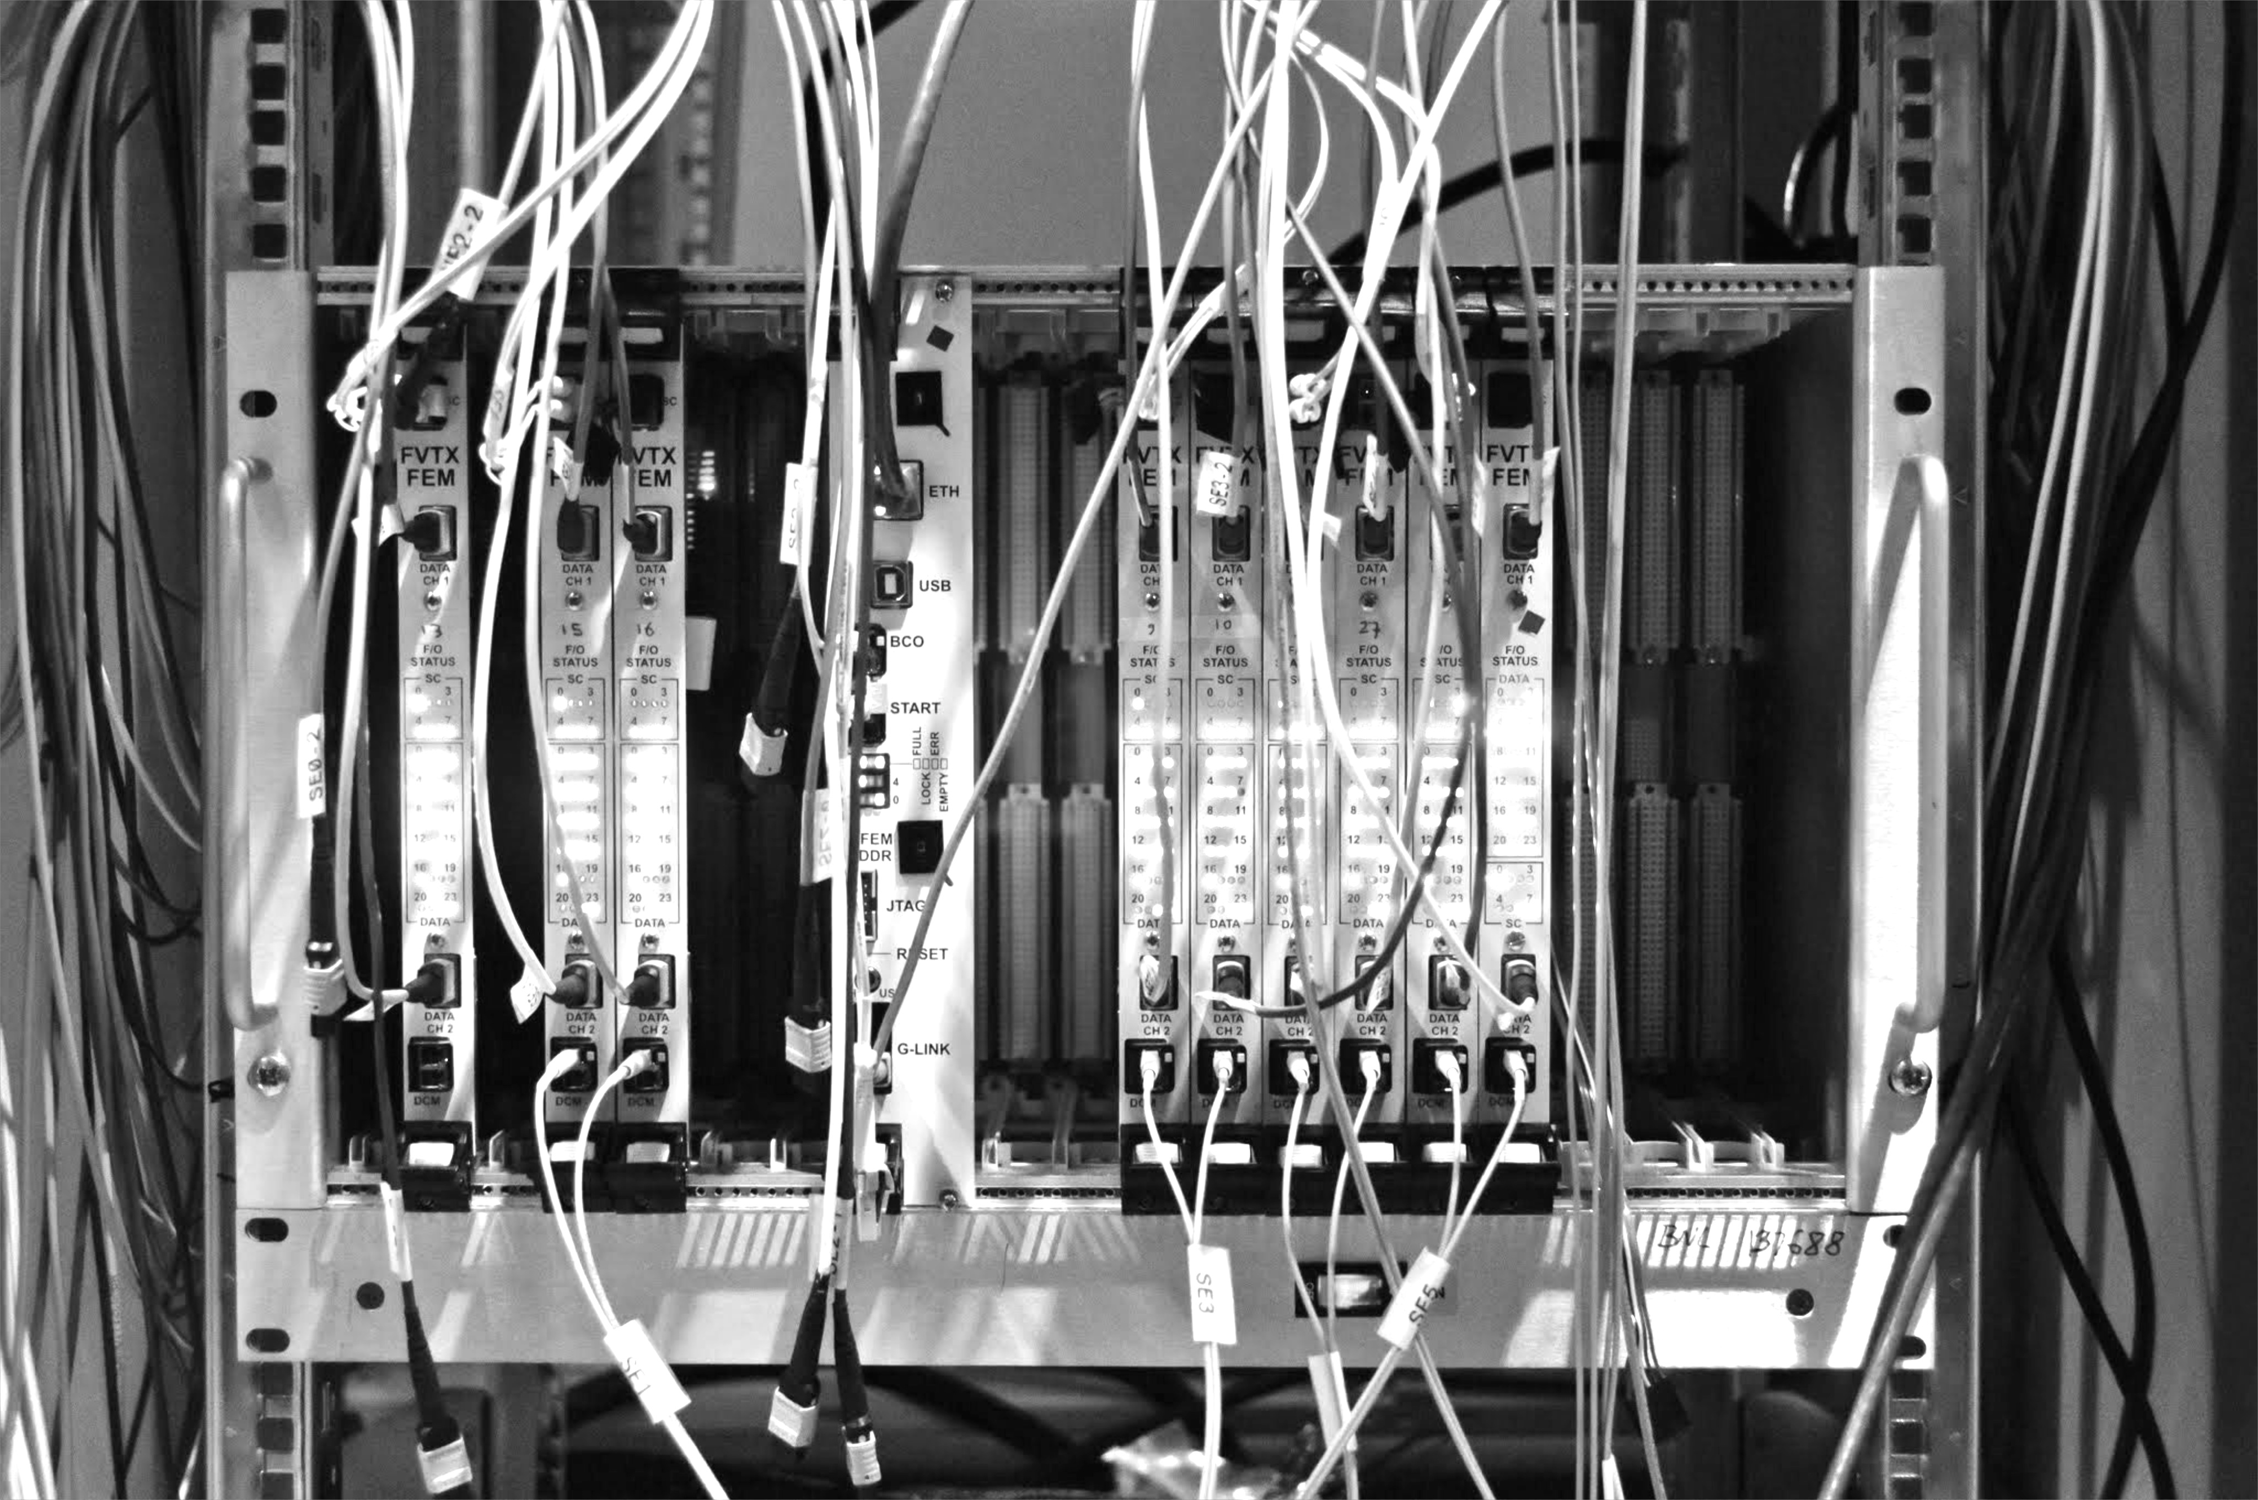
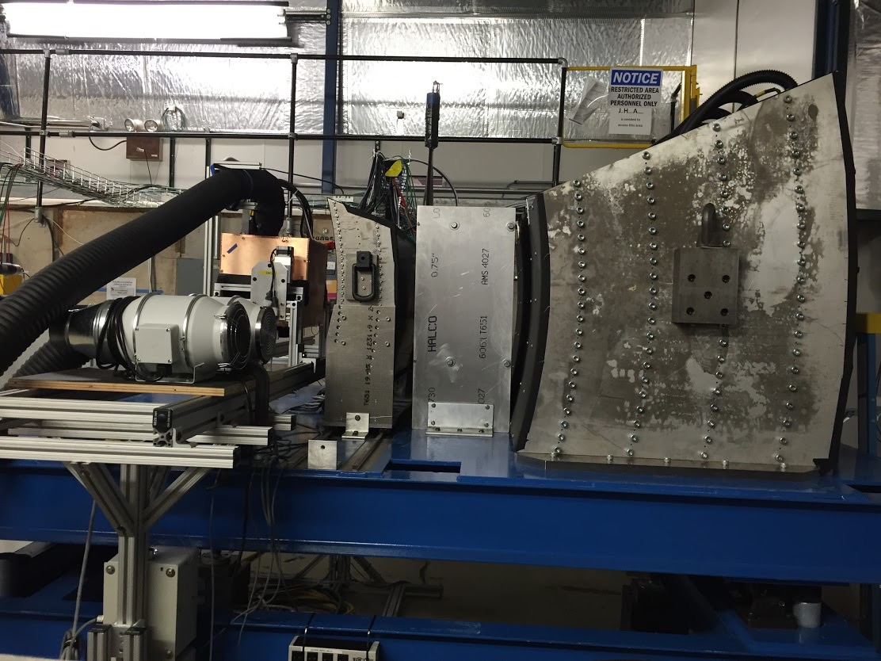
LANL LDRD: FY17-19, $5M
LDRD Experimental Goal: LANL-built 4-stave prototype tracker at test beam with custom sPHENIX readout
1st MAPS prototype sensor being studied at LANL
MAPS stave
construction
Annual Fermilab
Test beam
Test prototype tracker
Validate tracking and reconstruction
Custom front end, integrate into
sPHENIX EMCAL & HCAL prototypes – April 2016
sPHENIX readout (FVTX expertise)

Slide 7
Forward sPHENIX
-1 < eta < 4
Clearly isolate and measure
Sivers-like and Collins-like effects in p+p, and more
Interests in low mass tracking system:
MAPS for vertexing
GEM for tracking
Cerenkov PID
p
p/A
10/13/14
Ming Liu, Spinfest2014
7

Slide 8
Process Dependence of Sivers TSSA: QCD dynamics
Change of sign in flavor-tagged Jet TSSA
Included process dependence
And Q² evolution
Naïve DIS Fit Sivers
8

Slide 9
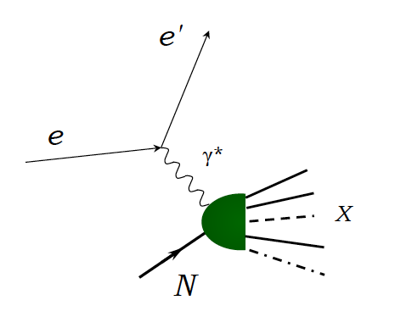
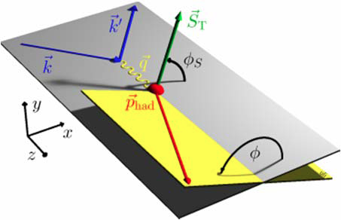
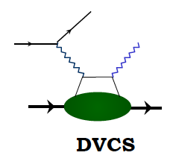
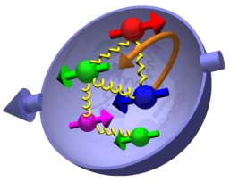
EIC Physics Interests
Physics of Gluon distributions, interactions and correlations – QCD dynamics
  Gluon polarization
  Gluon TMDs, heavy quark and di-jet
  Gluon saturation
Propagation of parton/hadron in nuclei
  Jet fragmentation and dE/dx
3D tomography of the proton
  GPDs
  DVCS and alike

Slide 10
EIC “Technical” Interests
Low mass tracking detectors
  MAPS for heavy quark physics
  GEM for general tracking
Hadron PID
  Modular Cerenkov detectors (partially supported by EIC R&D through BNL)
Other groups @LANL
  ISR: detectors
  AOT: electronics, accelerator etc
  Computing & simulations: big data?
  Theory synergy: QGP, CNM, Spin, physics BSM

Slide 11
Forward Physics Ideas for sPHENIX & Applicability for EIC
Ming Liu
LANL

Slide 12
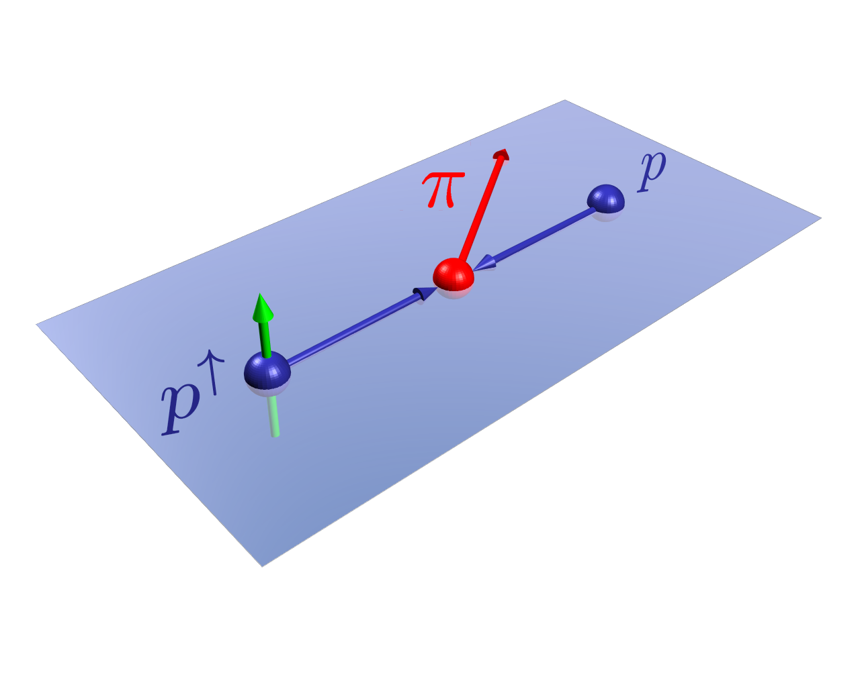
Forward sPHENIX Proposal
(An upgrade path that harvests pp, pA and AA physics and leads to an EIC era)
Transverse Spin Physics Centric in the Forward Rapidity:
Where significant novel effects observed!
10/13/14
Ming Liu, Spinfest2014
12

Slide 13
Forward sPHENIX and EIC
Address many of the same key physics of EIC
  Spin Physics and 3D structure
  CNM Physics
Complementary to EIC measurements
  TMD vs Collinear factorization
  Saturation physics
Critical to cross check of consistency among various theoretical framework
lepton
lepton
proton
μ⁻
DIS vs p+p(A)
μ⁺
proton
pion
proton

Slide 14
TSSA Physics: EIC & fsPHENIX, an example
(i) Sivers mechanism:
correlation between proton spin & parton k_{T}
(ii) Collins mechanism: Transversity × spin-dep fragmentation
S_{P}
Phys Rev D41 (1990) 83; 43 (1991) 261
S_{P}
Nucl Phys B396 (1993) 161
S_{q}
p
k_{T,q}
p
p
p
S_{q}
k_{T,π}
Collinear Twist-3: quark-gluon/gluon-gluon correlation
Sivers-like, Collins-like and more
Notes:
14

Slide 15
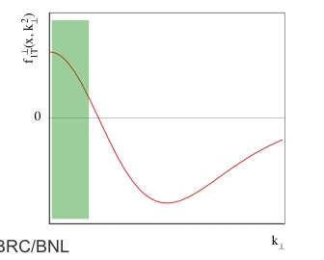
A Surprise: A_{N} Sign Mismatch?
First attempt to check the “Universality of QCD description of TSSA”
- Kang, Qiu, Vogelsang, Yuan PRD 2011
Twist-3 (RHIC) v.s. Sivers (SIDIS)
A possible solution? Kang, Prokudin PRD (2012)
SIDIS Data
unknown

Slide 16
Hadron TSSA in Twist-3 Framework
Qiu & Sterman PRD 59 (1998)
1st term: twsit-3 correlation functions, “Sivers”
2nd term: twist-2 transversity * twist-3 from unpol beam (expected small)
3rd term: twist-2 transversity * twist-3 FF, “Collins”
Need new direct measurements of Sivers and Collins TSSA in p+p!
Forward sPHENIX Upgrade Proposal
16

Slide 17
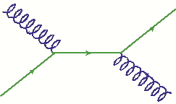
Access Sivers and Collins in p+p
in the right Kinematic region X = 0.1 ~ 0.5
Forward jet and hadron fragmentation TSSA measurement!
h^{+/-}
h^{+/-}
Forward jet
jT
x2
z
p+p
x1
x2
x1
Central or forward sub-leading jet
SIDIS
xF = (X1 – X2) ~ X1 = (pZ1 + pZ2)/100, when x1 >> x2
- q(x1) + g(x2) process dominates
- quark q(x1) Sivers and Collins asymmetry

Slide 18
Access Sivers and Collins with Jet and Hadron Azimuthal Distributions in Transversely Polarized p+p Collisions
Feng Yuan, PRL 100, 032003 (2008)
Umberto D’Alesio et al PRD 83 034021 (2011)
Experimental variables:
Jet P_{j,} xF
Hadron P_{h} , PID
Beam polarization
→ “Sivers-like”
→ “Collins-like”

Slide 19
Forward sPHENIX
-1 < eta < 4
Clearly isolate and measure
Sivers-like and Collins-like effects in p+p
p
p/A
10/13/14
Ming Liu, Spinfest2014
19

Slide 20
Jet Production Rates @NLO
200GeV pp: Lumi = 50pb⁻¹
Q ~ pT
X₁ ~ E_jet/100
Access high –x
10/13/14
20

Slide 21
Tagging Quark Flavor in SIDIS
with Leading Charged Hadron
@Z = 0.5
DSS FF
10/13/14
21

Slide 22
Jet Quark-Flavor Tagging With Leading Charged Hadrons in p+p
Inclusive jets
Jet + h⁻(z>0.5)
favors d-quark
Jet + h⁺(z>0.5)
favors u-quark
10/13/14
Ming Liu, Spinfest2014
22

Slide 23
Flavor Tagged Jet Sivers Asymmetry
Jet and leading h⁺ and h⁻
jet_eta= [1,4]
We can do this!

Slide 24
fsPHENIX Projected Jet Sivers Asymmetries
Test the universality of QCD description of TSSA: pp vs SIDIS
Naïve direct mapping
from SIDIS Sivers
- “u-quark jet” A_{N} >0
Sivers, SIDIS fit
With process-dep
from SIDIS Sivers
- “u-quark jet” A_{N} < 0
8/25/14
Ming Liu, PANIC 2014
24

Slide 25
Forward sPHENIX Collins Asymmetry Projeciton
10/13/14
Ming Liu, Spinfest2014
25

Slide 26
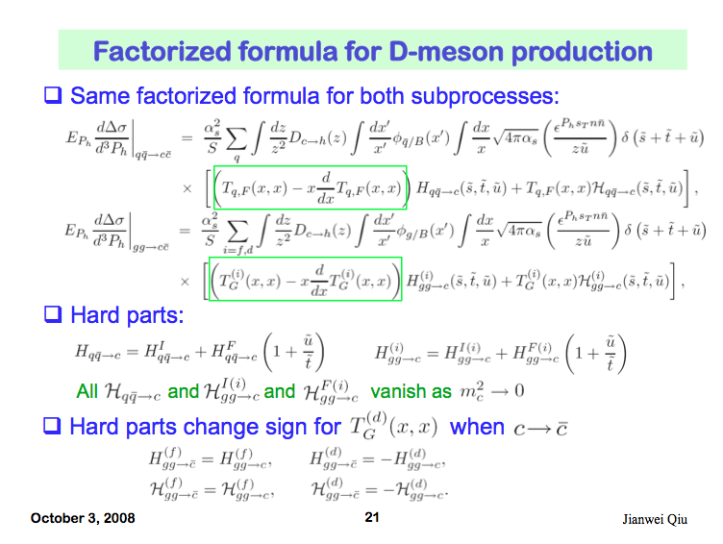
Access Gluons: Open Charm TSSA
Qiu, 2010

Slide 27
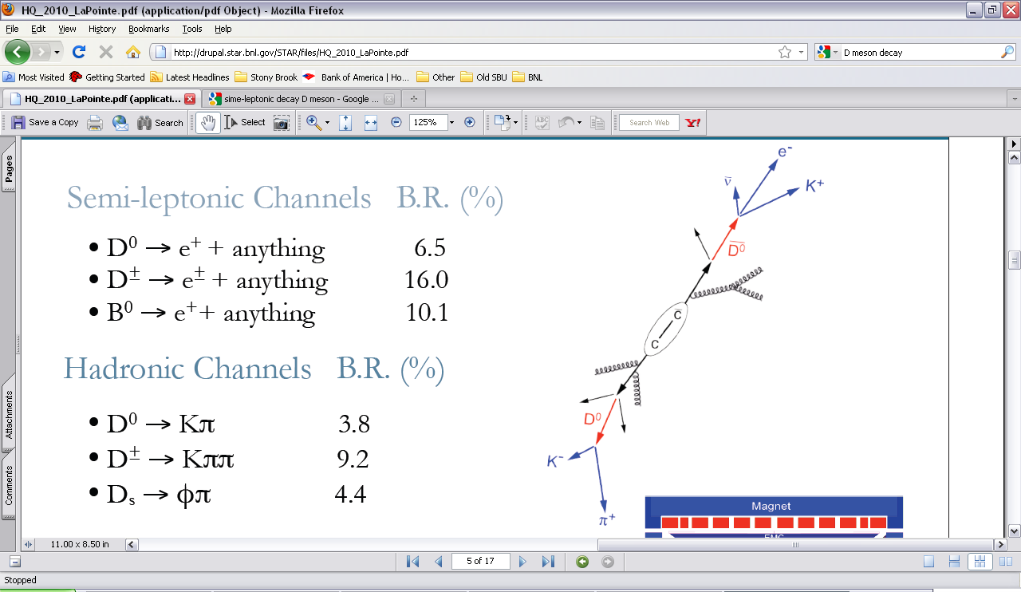
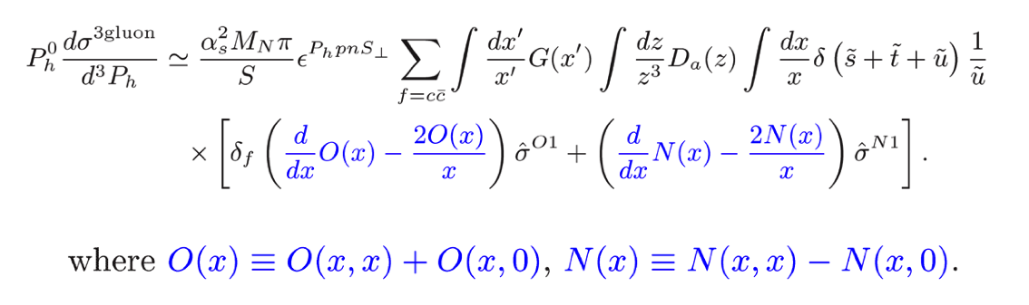
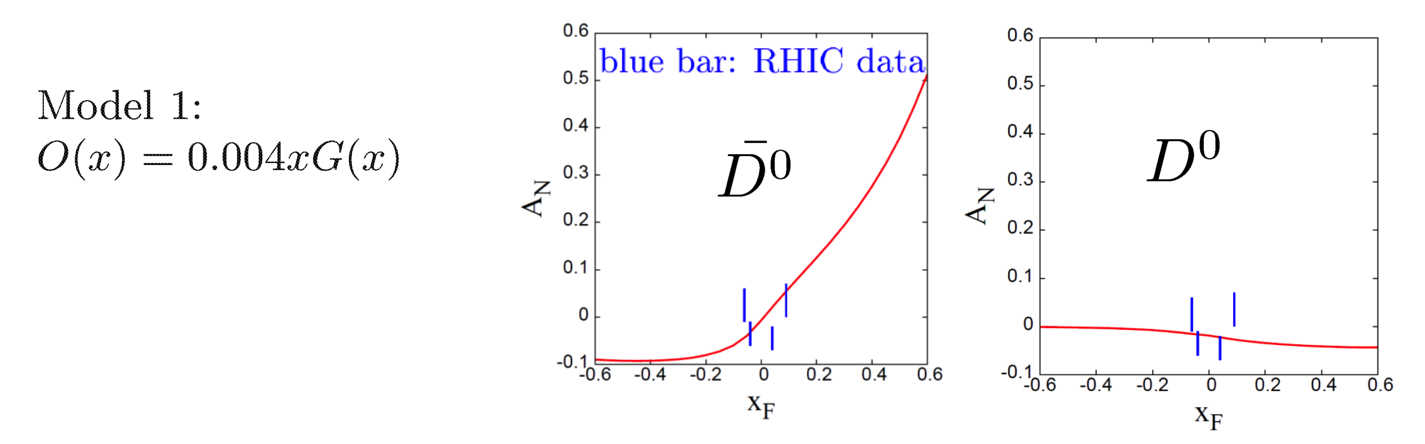
Study Novel Heavy Quark TSSA at RHIC
Twist-3 tri-gluon correlation Funs
Koike et. al. (2011)
Kang, Qiu, Vogelsang, Yuan (2008)

Slide 28
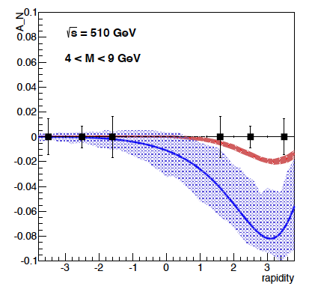
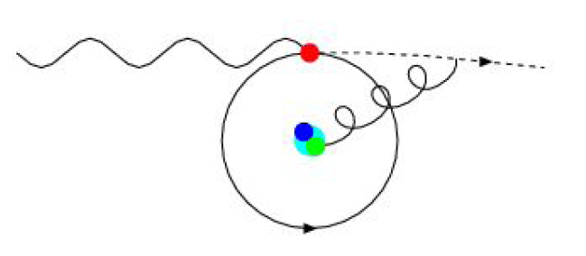
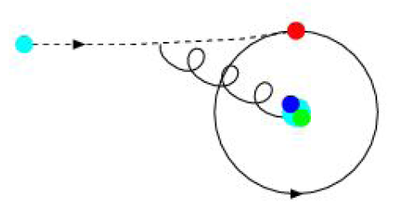
Forward Dimuon Drell-Yan A_{N}
DY A_{N} accesses quark Sivers effect (f_{1T}⊥) in proton
f_{1T}⊥ expected to reverse in sign from SIDIS to DY meas.
Semi-inclusive DIS (SIDIS)
Drell-Yan
lepton
lepton
proton
μ⁻
pion
μ⁺
proton
proton

Slide 29
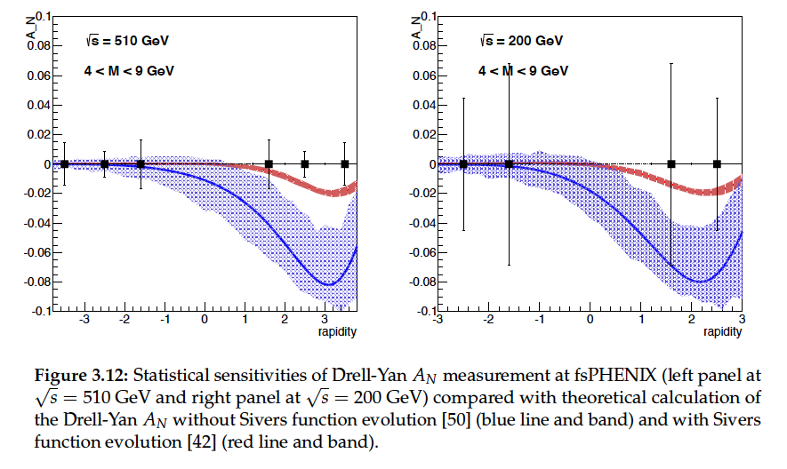
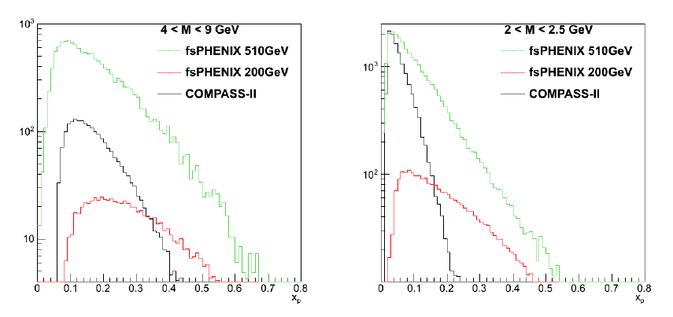
Drell-Yan

Slide 30
Forward sPHENIX – a Portal to EIC
For the first time to clearly identify and separate key spin observables in forward jet and hadron productions in p+p collisions, in the quark sector
  Forward jet TSSA (Sivers-like)
  Hadron TSSA inside a jet (Collins-like)
  Larger effect with quark-flavor tagged jets
  Test process dependence of TSSA
  High statistics and precision
Access gluon TMDs/Twist-3 via heavy quarks
  Open charm, J/Psi TSSAs etc.
Complementary to EIC physics program
  Spin physics
  CNM physics

Slide 32
Our Vision PHENIX -> Forward/sPHENIX->ePHENIX
Documented: http://www.phenix.bnl.gov/plans.html
Current PHENIX
f/sPHENIX
An EIC detector
PHENIX completed 2016
16y+ work
100+M$ investment
130+ published papers to date
Comprehensive central upgrade based on BaBar magnet
fsPHENIX: forward tracking, HCal and muon ID
Key study of transverse spin
New collaboration/new ideas
Path of PHENIX upgrade leads to a capable EIC detector
Large coverage of tracking, calorimetry and PID
New collaboration/new ideas
~2000
2017→2022
~2025
Time
RHIC: A+A, polarized p+p, polarized p+A
eRHIC: e+p, e+A

Slide 33
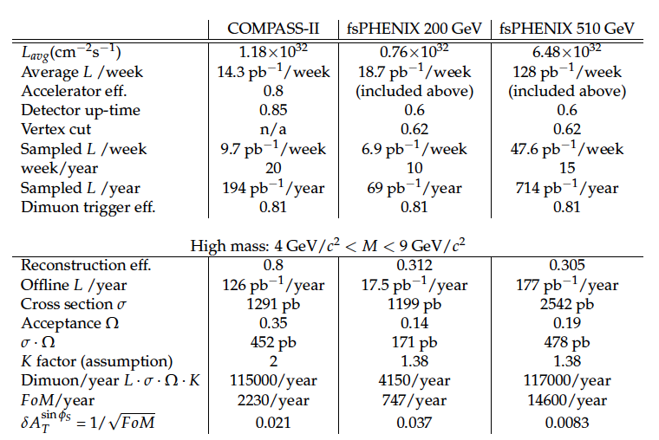
Projected Luminosities

Slide 34
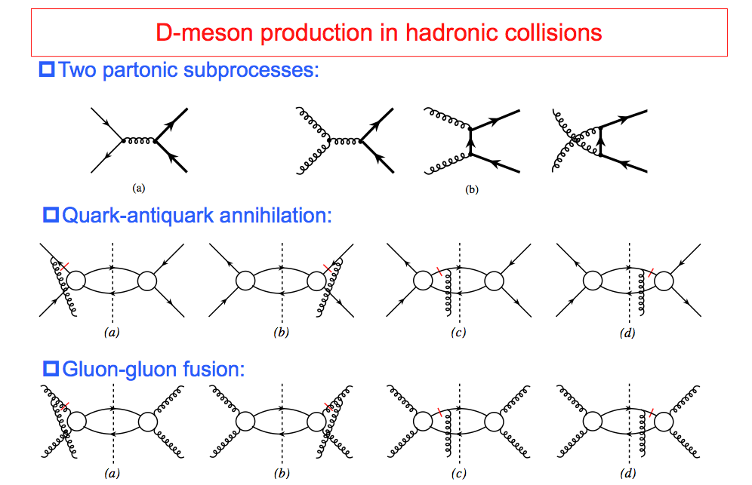
TSSA in Heavy Quark Production in p+p
Kang, Qiu, Vogelsang, Yuan, PRD 2008

