Slide 1
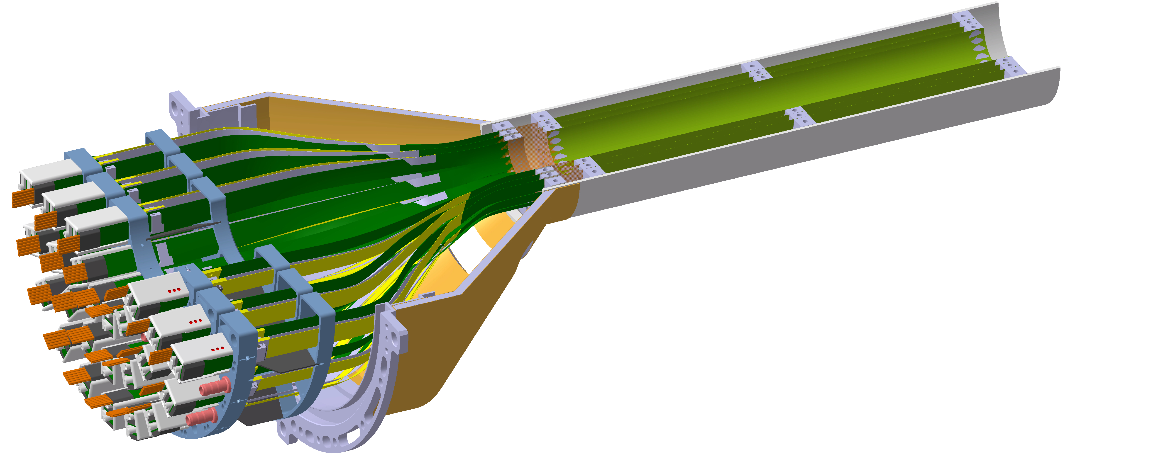
IT3 Report of Work Package 5
ITS plenary:
Mechanics and cooling
M.Angeletti, R.Barthel, G.Fiorenza, C.Gargiulo, P.Ijzermans, G.Lahu, G.Ledey, A.Lafuente, E.Laudi, P.J. Secouet, J.Van Beelen,…
Tuesday 12 May 2020

Slide 2
IT3 Report of Work Package 5
WP5 group and overall plan
Breadboard model
Engineering model

Slide 3
ITS3 WP5: Group and collaboration
Work Package:
WP responsible: C.Gargiulo.
CERN group: M.Angeletti, G.Fiorenza, P.Ijzermans, G.Lahu, G.Ledey, A.Lafuente Mazuecos, E.Laudi, P.J. Secouet, J.Van Beelen.
Institutes collaboration:
Carbon structure & cooling: St. Pietersburg→G.Fieofilov, S.Igolkin
Layer Assembly: Nikhef→R.Barthel; INFN Bari
Testing : INFN Frascati → A. Saputi, first contact, collaboration terms to be finalised
…

Slide 4
ITS3 WP5: Plan
Milestone | Description | Date
1 | Breadboard Model (BBM)
 | Selection of carbon materials based on structural and thermal properties. Production of samples for material characterization. Development of FE and CFD models for structural and thermal simulations. | Q2 2020
2 | Engineering Model (EM)
 | Production of one half-layer with dummy chips. Thermal and dynamic stability tests (including wind tunnel). Development of half-barrel assembly procedures and jigs. Production of first half-barrel with dummy chips. Thermal and dynamic stability tests (including wind tunnel). Drawings, FE and CFD reports. | Q1 2022
3 | Qualification Model (QM)
 | Production of two half-barrels with prototype chips Thermal and dynamic stability tests (including wind tunel) Electrical functional tests. Final assembly and test procedures, technical specifications and drawings. | Q4 2023
4 | Final Model (FM)
 | Production of four half barrels with final chips. Electrical and mechanical acceptance tests. | Q4 2024
ITS3 R&D is part of the CERN R&D programme on new Detector Technologies

Slide 5
ITS3 WP5: Plan
Milestone | Description
1 | Breadboard Model (BBM)
 | Selection of carbon materials based on structural and thermal properties.
 | On-going Procurement of carbon foam samples for characterization test. On-going Investigation of ultralight CFRP support starting.
 | Development of FE and CFD models for structural simulations.
 | On-going FE Modal analysis performed and dynamic analysis under development. On-going Development of CFD models for thermal simulations.
2 | Engineering Model (EM)
 | Production of one half-layer with dummy chips. On-going procurement
Breadboard Model (BM): This is the initial prototype and is only functionally representative of the final module.
Engineering Model (EM): This model is form, fit, and functionally close to the final model; however, it will use a mixture of final-grade components and commercial components.
Qualification Model (QM): This is the model that is subjected to the qualification campaign. This usually includes design updates from the EM and uses identical components to final; however, these components do not need to be screened to the final standard
Final Model (FM): The models actually to install in the Experiment; these are tested to acceptance-level testing (lower level than qualification).

Slide 6
ITS3 WP5 Breadboard model: Carbon foam & CFRP
Carbon material selection and production:
CARBON FOAM
COOLING: Low dry air/pre-cooled gas flow*
CFRP*
Stress relief gas nozzles
* Design solution under discussion with St, Pietersburg
Material | Density [g/cm3] | CTE [ppm/ºC] | K-In plane [W/mK] | K -Out of plane [W/mK] | Pore volume | [PPI] (Pores Per Inch) [µm] cell size | Elastic modulus [MPa]
Duocel® Carbon Foam | 0,03 | 2,2 | < 0,05 | < 0,05 | 97% | 5 to 100 PPI | 101,84
K9 Hi-K | 0,20-0.26 0.45-0.68 |  | 20 / 60 | 20 / 60 |  | 130 PPI
CFOAM 35 HTC | 0.4-0.5 | 1.9-2.1 | 140-180 | 140-180 | >70% | 1200 µm | 100 (Compr.)
POCO HTC | 0.9 | ̴1 | 70 | 245 | 61% | 400µm | >100 (Compr)

Slide 7
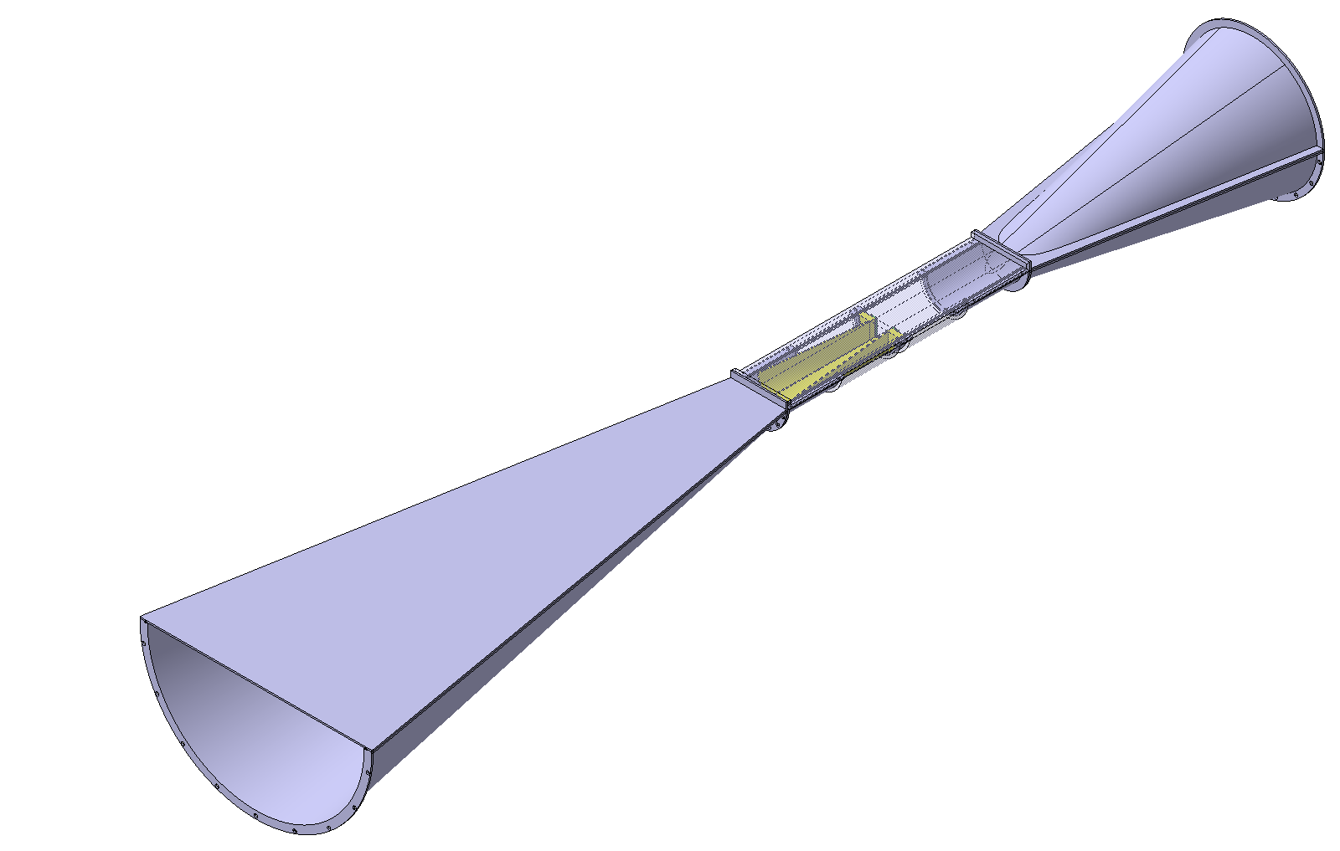
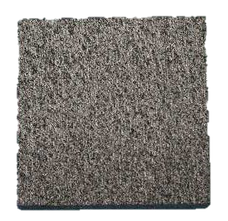
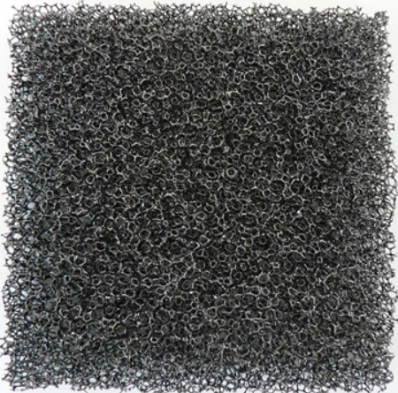
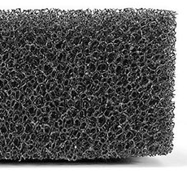
ITS3 WP5 Breadboard model: carbon foam characterisation test
Carbon material selection and production:
(1) Prototype production → ONGOING
(2) Thermal conductivity test → ASAP (CERN opening)
(3) Particles removal test from carbon foam → ASAP (CERN opening)
(4) Pressure drop by means of wind channel → ASAP (CERN opening)
Air
flow
2
CARBON FOAM
Sample
3
In vacuum
4
1
Heater →
Wind tunnel
@ CERN
4 Temp.
sensors
Cooler →
Several samples
90mm x 50mm x 10mm
with different foam cell size
Filter
for carbon particle collection

Slide 8
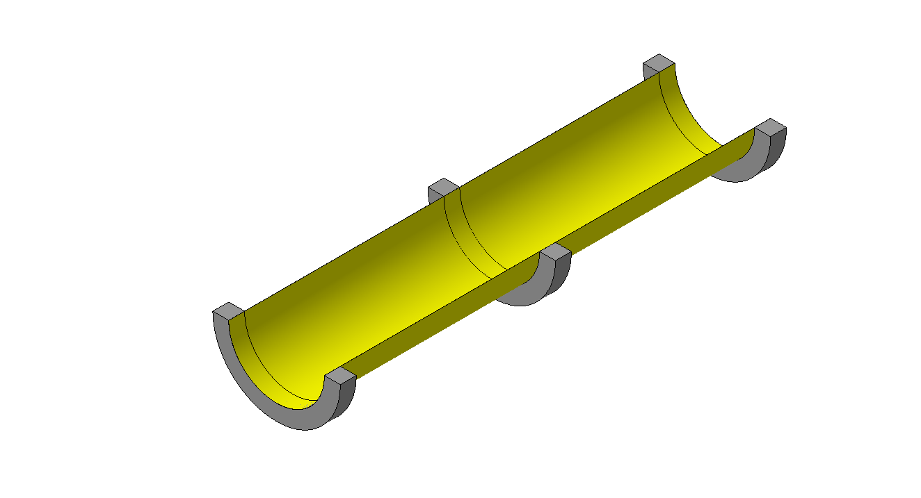
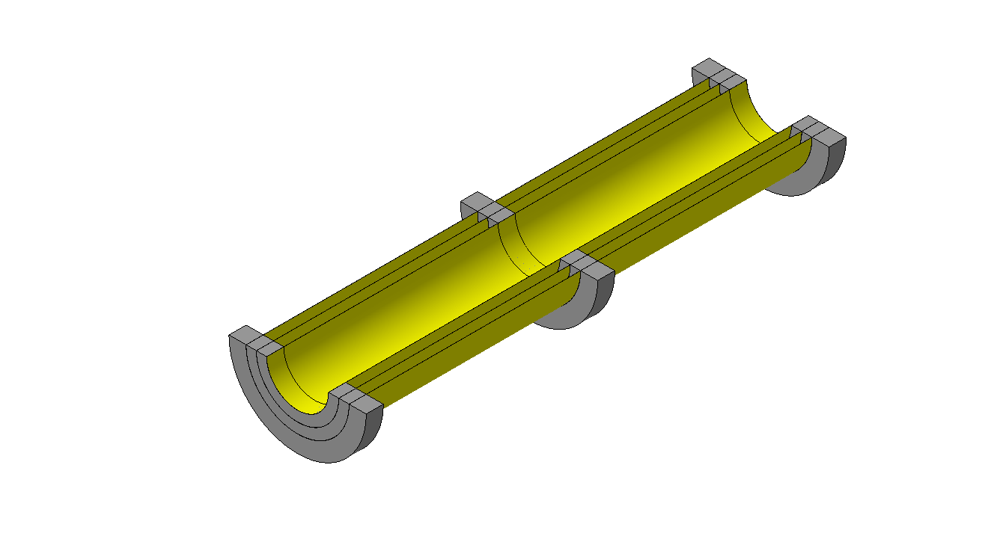
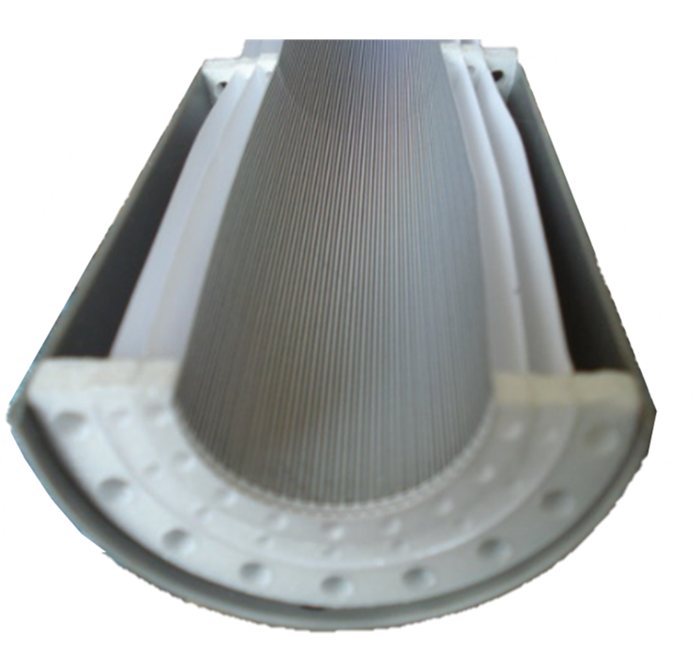
ITS3 WP5 Engineering models: layout
EM H-layer
EM H-barrel
Si chip
Carbon ring
Carbon rings
Assembly with dummy material: Glassfiber/epoxy (chips) and milled foam (rings)
Nikhef- Rene Barthel

Slide 9
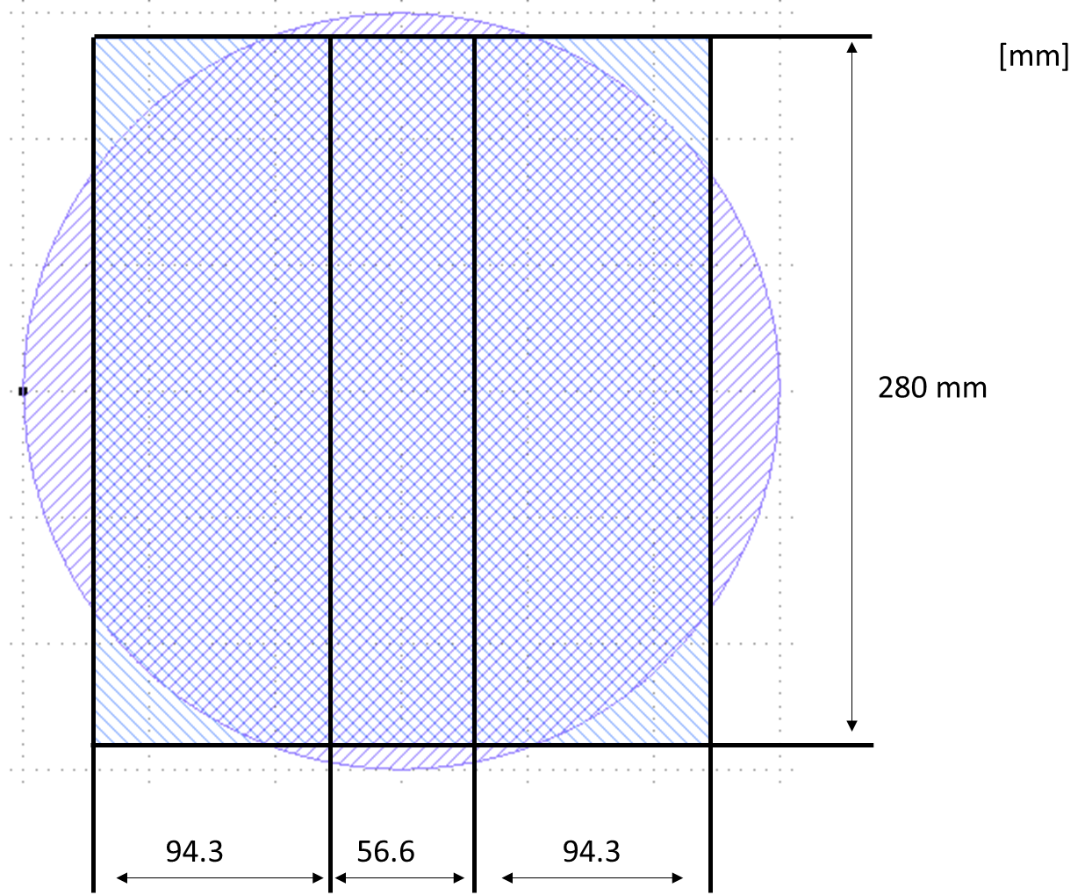
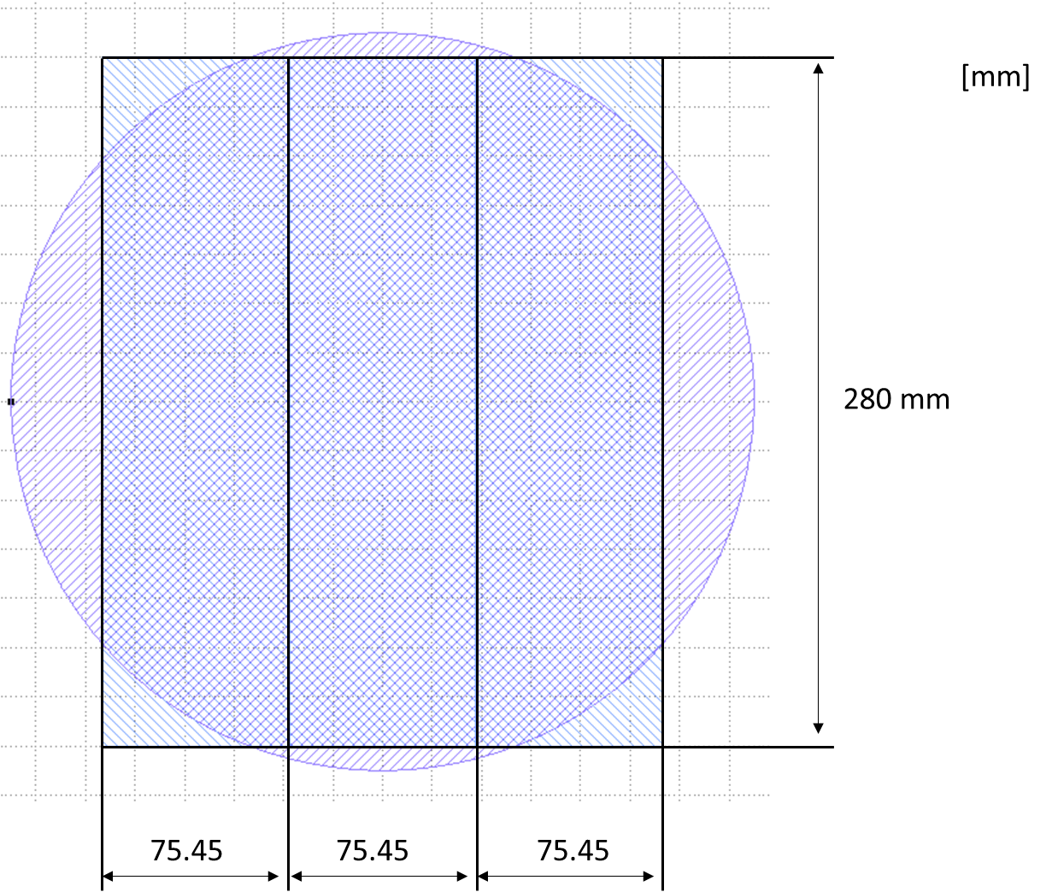
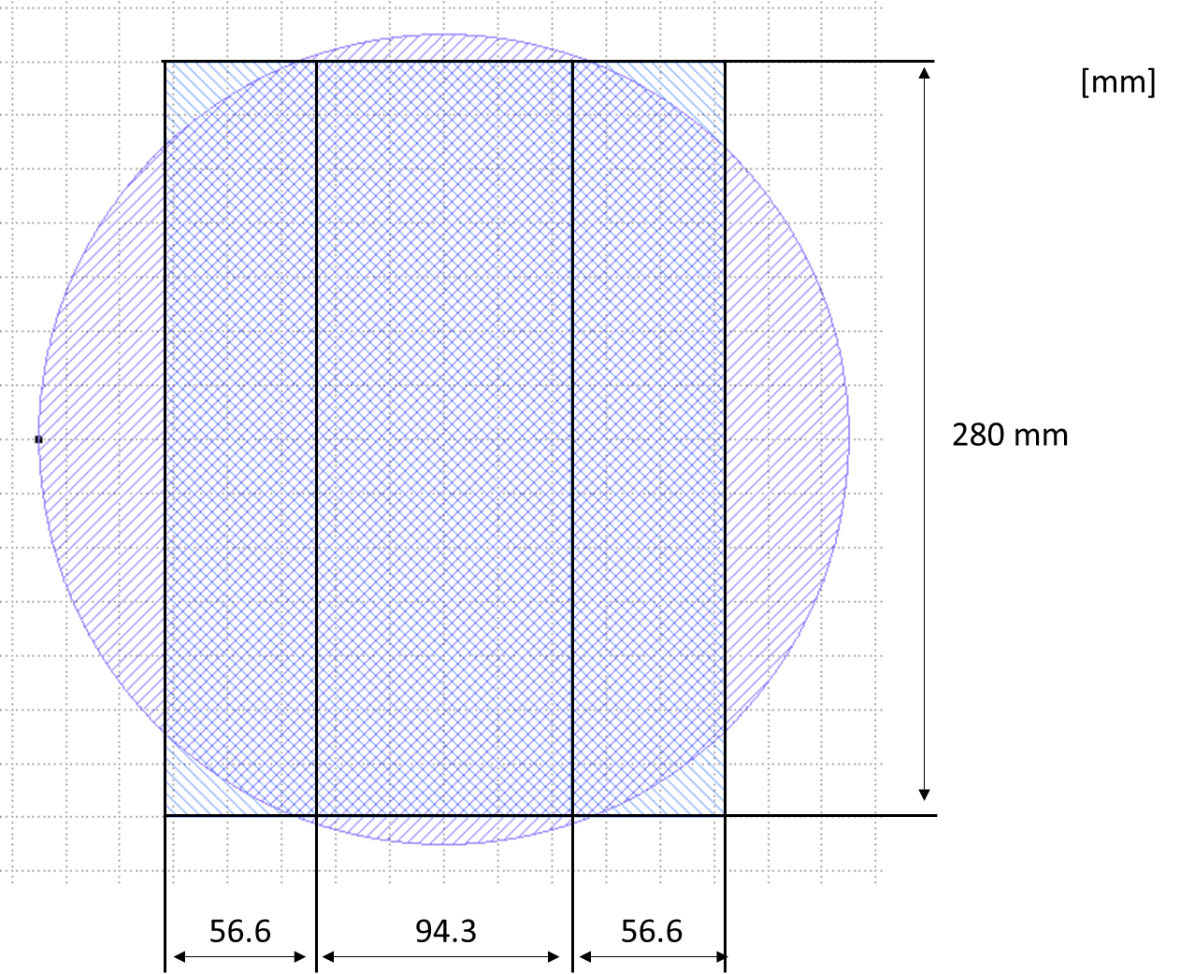
ITS3 WP5 Engineering models: dummy silicon chip
Dummy Si chip production:
12 inch Si wafer thinned down to 50 um.
Company: DISCO HI-TEC EUROPE GmbH, Germany, http://www.discoeurope.com
Dicing Before Grinding (DBG) procedure
Grinder DFG8560 (Thin down 30-40um)
Production: (2x) 3 different dummy chips (L0,L1,L2)
+ strips (different width) for gluing/assembly test.
Price 3350 Euro
Layer | Diameter [mm] | Thickness [µm] | Length [mm] | Semi-circ. [mm]
L0 | 36 | 50 | 280 | ̴56.55
L1 | 48 | 50 | 280 | ̴75.4
L2 | 60 | 50 | 280 | ̴94.25
12 inch wafer
D=300m (11.8inch)
<100> P-type
Th. = 775um
Strip
L0
Strip
Strip
L1
Strip
Strip
L2
Strip
Dicing blade 35-40um

Slide 10
ITS3 WP5 Engineering models: Carbon foam ring
Material order:
10 different companies have been contacted for the production of half annular rings sample in carbon foam.
4 out of the 10 companies have been selected for the production of the first prototypes which will be used for thermal-mechanical and assembly tests.
Carbon rings are purchased with no holes. Holes drilling or specific radiator features will be decided based on pressure drop test results on the breadboard models.
Company | Foam Name | Material Ordered | Order status | T. value (CHF) | Estimated delivery
ERG | Duocel® | 3 sets of rings + 1 sample | Approved on 24.04.2020 | 2087 | 19.06
ALLCOMP | K9 Hi-K | 1 set of rings + 1 sample for 2 different density (0.20-0.26 and 0.45-0.68) | Approved on 29.04.2020 | 5360 | 29.05
CFOAM | 35HTC | 3 sets of rings + 1 sample | Approved on 07.05.2020 | 1500 | 11.06
ENTEGRIS | POCO HTC | 3 sets of rings + 1 sample | Waiting for approval | 2735 | TBD

Slide 11
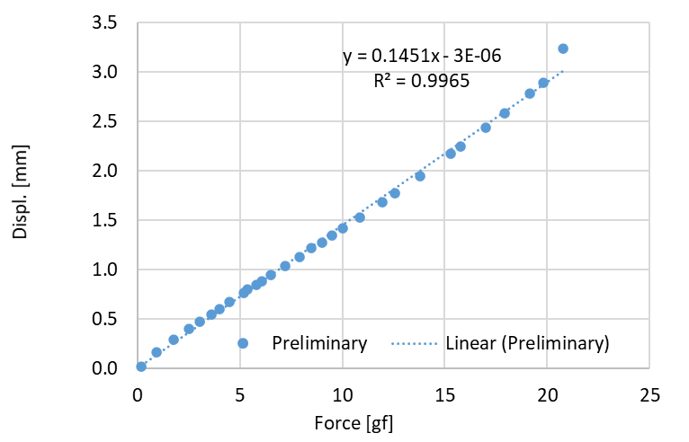
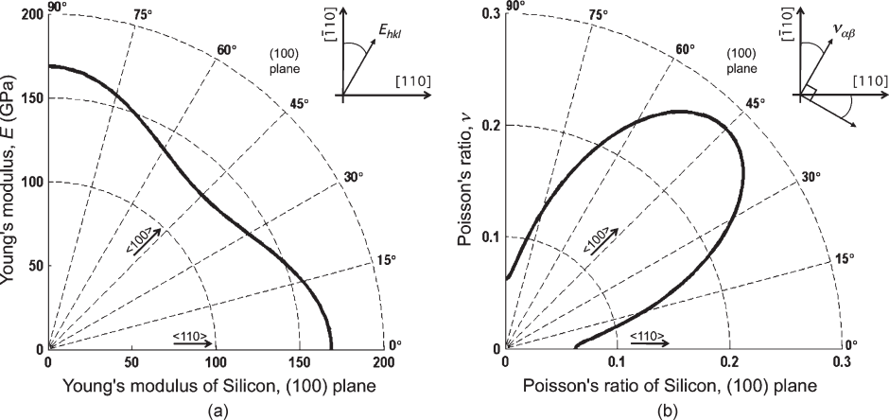
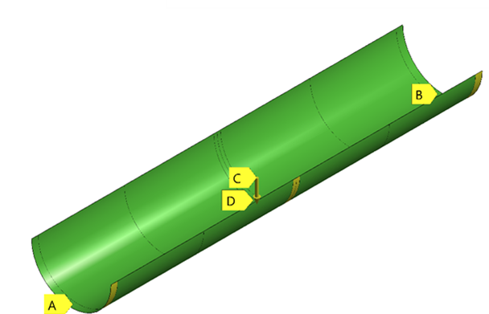
ITS3 WP5 Engineering model: FEA analysis stiffness and modal
For a fist assessment of the behaviour of a large chip, the mechanical properties of a pure Si material has been considered. Young modulus theorical values are in good agreement with specific bending test.
Preliminary 3 point bending test
Si material: Anisotropic crystalline material, (100) Oriented silicon wafer.
$$sag=\frac{1}{a}\frac{1}{EI} Fl^{3}$$
E~140GPa
ALPIDE chip
50 μm-thick
Model: shell element
Th1
 | INPUT |  |  | OUTPUT
Case | Th1[mm] | Th2[mm] | Th3[mm] | Sag[µm] | F1[Hz] | F2[Hz] | F3[Hz] | F4[Hz] | F5[Hz] | F6[Hz]
2 Carbon rings | 5 | 5 | // | 1.2 | 248 | 252 | 421 | 422 | 599 | 599
3 Carbon rings | 5 | 5 | 5 | 0.21 | 514 | 514 | 514 | 514 | 877 | 877
X$[\overline{1}10]$
Th3
$$Y [110]$$
Carbon ring
Th2

Slide 12
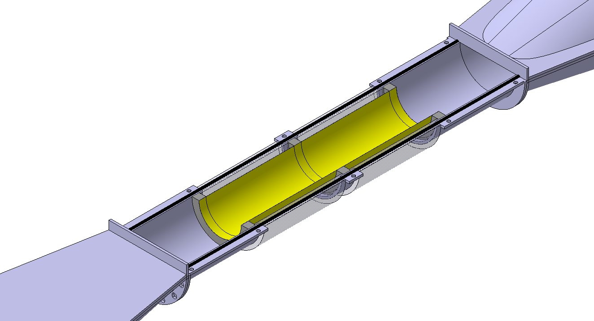
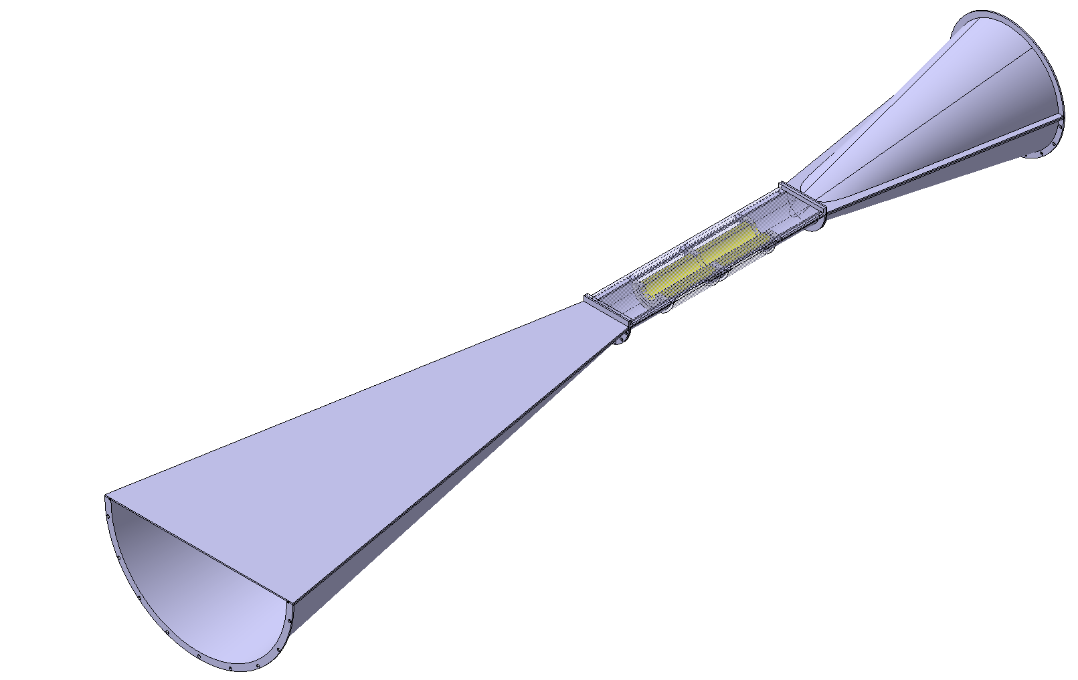
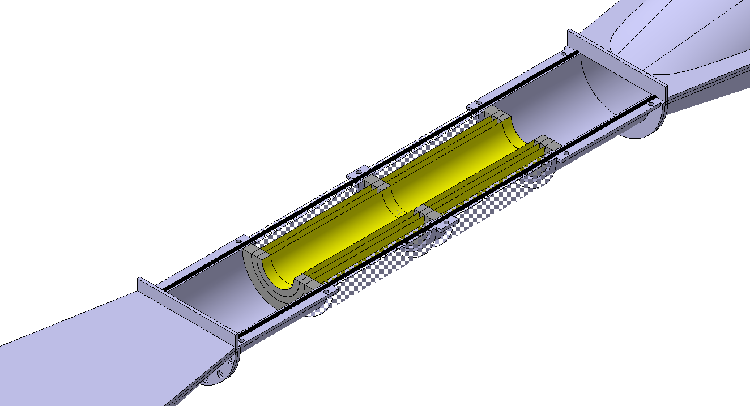
ITS3 WP5: Engineering model: Carbon foam characterisation test
Carbon material selection and production:
Half-Layer assembly →NEXT
Half-layer vibration test →NEXT
Half-Layer thermal test →NEXT
Half-barrel assembly →NEXT
Half-barrel vibration test →NEXT
Half-Layer thermal test →NEXT
EM H-layer
EM H-barrel

Slide 13
Next ➔
Bread board model BBM
-produce samples for the different characterization test
-wind tunnel test sections →BBM samples
-perform characterization test
Engineering model EM
Develop chip handling procedure finalized to EM
Develop wind tunnel test set-up
-wind tunnel test sections→ EM h-layer, EM h-barrel
-thermal→ chip heaters, thermocamera,..
-mechanical→ laser system for vibration acquisition
Perform FEA
Static→ shape uniformity of constrained chip
Dynamic →seismic and cultural noise
Perform CFD
Thermal →air/gas flow cooling

