Slide 1
Some random throughs about EIC silicon detectors
03/24/2020, Ming
Physics consideration
  HF in rapidity |eta|<4
  Spin TMD, e+p
  HF-Jet and fragmentation in e+A
IR design from recent YR workshop
  Minimal radius
  Z locations
Available silicon technologies
  MAPS like- ALPIDE, HV-MAPS, ITS3
  Other techonolgies
First EIC YR Workshop @3/2020
https://indico.bnl.gov/event/7449/timetable/#20200319.detailed
1, https://indico.bnl.gov/event/7449/contributions/35954/
2, https://indico.bnl.gov/event/7449/contributions/35955/
3, https://indico.bnl.gov/event/7449/contributions/35842/

Slide 2
IR Design
(YR workshop)
Crossing angle = 20mRad
R_min ?
Z_range?
dR ~ 20mrad x dZ
~ 20x10^-3 x 100 cm
= 2cm
Need to add ~10sigma beam_r

Slide 3
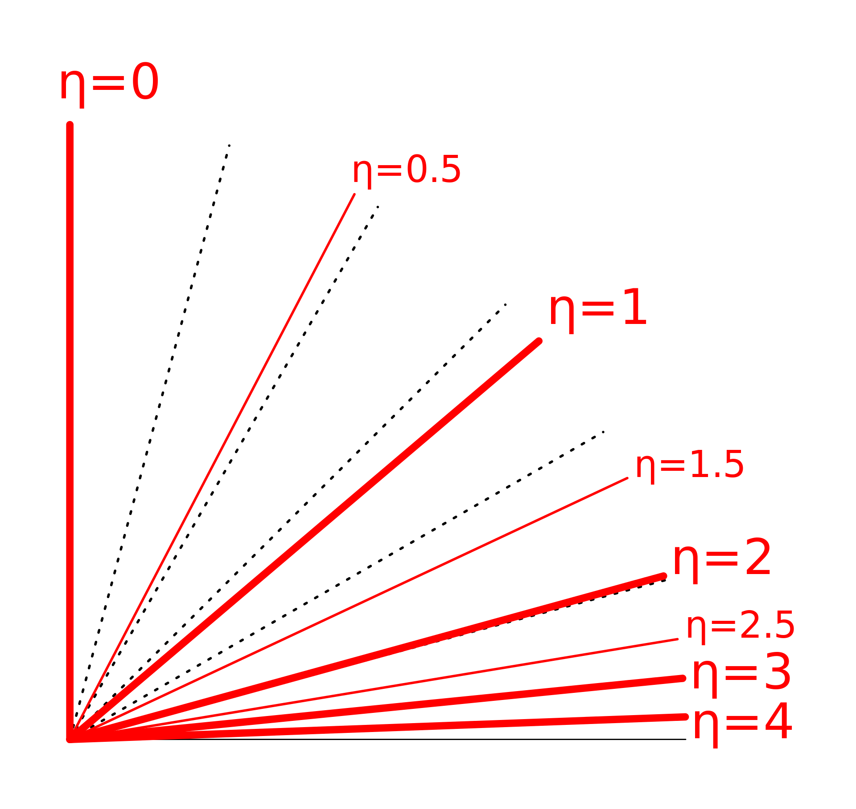
Silicon Detector Acceptance vs Beampipe R
R
Z0
L/2
R (cm) | L/2 (eta =4) (cm) | L/2 (eta =3.5) | L/2 (eta =3)
2.0 | 54.6 | 33.2 | 20.0
2.5 | 68.2 | 41.5 | 25.1
3.0 | 81.9 | 49.8 | 30.1

Slide 4
All Barrel Option – MAPS like sensors (~ITS3)
Barrel : |eta| < 4
R = 3 cm
Sensor thickness = 50um
all barrel option –
“almost no supporting structures
in the acceptance”
R
-L/2
Z0
L/2
Eta = -ln (tan(theta/2)) = 4
-> theta = 2 deg.
L = 2 x R/tan(2deg):
= 2 x 3cm x 1/0.035 = 172 cm;
= 2 x 2cm x 28.6 = 57 cm; (~double the length of MVTX stave)
Effective Silicon thickness = 50um x 28.6 = 1,430um = 0.143cm/9.37cm = 1.5% X₀
1/tan(2deg) = 28.6
Bunch-length = 24mm
Si X₀ = 9.37cm
PHENIX FVTX sensor thickness per layer (320um sensors) = 1.5% X₀

Slide 5
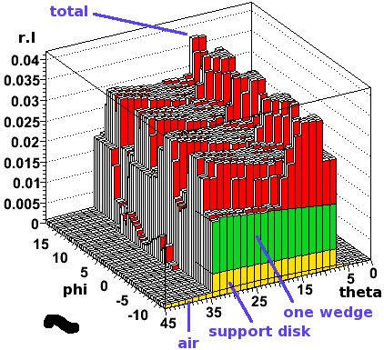
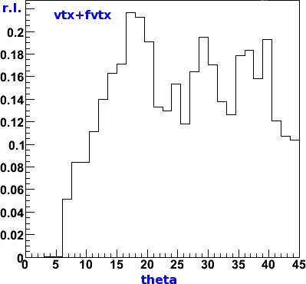
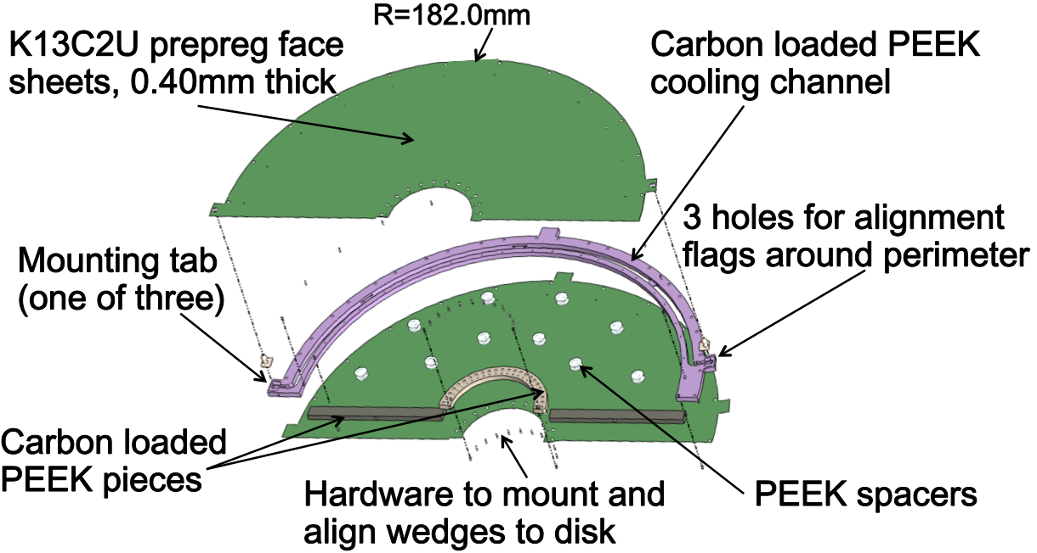
Disk Like - PHENIX FVTX Parameters
R.L. Per Layer
- 320um silicon sensors ; 4 layers with overlaps in phi
- The wedge support disks are flat sheets of 0.4 mm thick thermally con- ductive carbon fiber (K13C2U from Mitsubishi Chemical) on both sides of a carbon-loaded PEEK plastic frame.
~3%X₀ per layer, see RH figure
total of 4-layer RL ~14%X₀ (FVTX + VTX)
Detail simulations: https://p25ext.lanl.gov/~hubert/phenix/silicon/simulations/nov08/radlen.html
Total R.L.

Slide 6
Forward Region Update – 04/13/2020
@Z = 196+50 mm = 246cm
R = 7 cm
Rad = 7cm/246cm = 2.85% (eta=4.25)
2 Degrees = 3.49% (eta = 4.05)
Beam pipe R_min = 2.0 cm; |Z| < 50cm?

Slide 7
https://indico.bnl.gov/event/8291/

