Slide 1
A Compact All Silicon Tracker+mRich PID for Day-1 EIC Detector at IP-8
Ming Liu
10/2/2020
Design a Day-1 EIC detector around 1.5T Babar magnet
Maximally reuse sPHENIX infrastructure

Slide 2
sPHENIX bi-weekly 9/18/2020

Slide 3
BaBar/sPHENIX-based EOI
sPHENIX bi-weekly 9/18/2020
LANL-EOI, UC-EOI …

Slide 4
A new conceptual day-1 EIC detector build around sPHENIX at IP-8
Here is a recent discussion on this from 8/28/2020 MVTX bi-weekly meeting,
https://indico.bnl.gov/event/9265/contributions/40871/attachments/30159/47140/Reuse-MVTX-ePHENIX-08282020-v2.pptx
1)Tracking: all silicon; 2)PID: mRICH/TOF; 3)Reuse all sPHENIX EMCal and Hcal + much of supporting structures

Slide 5
EIC Detector Requirements
– updated 10/5/2020 by EIC DWG and PWG

Slide 6
8/28/2020 Presentation Slides, with updates

Slide 7
EIC Central Tracking/PID Requirements – |eta| < 3.5 https://docs.google.com/spreadsheets/d/1ahulUB4fDoaDzRu4xyNWoAxXUlphDXY0dg4_ED_er-g/edit#gid=2066614075
 |  |  |  | dp/p |  | DCA |  |  | PID
-3.5 to -3.0 |  | Central Detector | Backward Detector | σp/p ~ 0.1%⊕0.5% | ~5% or less X | TBD |  | π suppression up to 1:104 | ≤ 7 GeV/c | ≥ 3 σ | ~50%/√E
-3.0 to -2.5
-2.5 to -2.0 |  |  |  | σp/p ~ 0.1%⊕0.5% |  |  | 2%/√E
-2.0 to -1.5 |  |  |  | σp/p ~ 0.05%⊕0.5% |  |  | 7%/√E
-1.5 to -1.0 |  |  |  |  |  |  | 7%/√E
-1.0 to -0.5 |  |  | Barrel | σp/p ~0.05%×p+0.5% |  | σxyz ~ 20 μm, d0(z) ~d0(rΦ) ~ 20/pTGeV μm + 5 μm | (10-12)%/√E |  | ≤ 5 GeV/c |  | sigma_E/E ~ 85-100%/√E | TBD
-0.5 to 0.0
0.0 to 0.5
0.5 to 1.0
1.0 to 1.5 |  |  | Forward Detectors | σp/p ~0.05%×p+1.0% |  | TBD |  |  | ≤ 25 GeV |  | ~50%/√E
1.5 to 2.0 |  |  |  |  |  |  |  |  | ≤ 40-50 GeV
2.0 to 2.5 |  |  |  |  |  |  |  |  | ≤ 20 GeV/c
2.5 to 3.0 |  |  |  | σp/p ~ 0.1%×p+2.0%
3.0 to 3.5 |  |  |  |  |  |  |  |  | ≤ 45 GeV/c

Slide 8
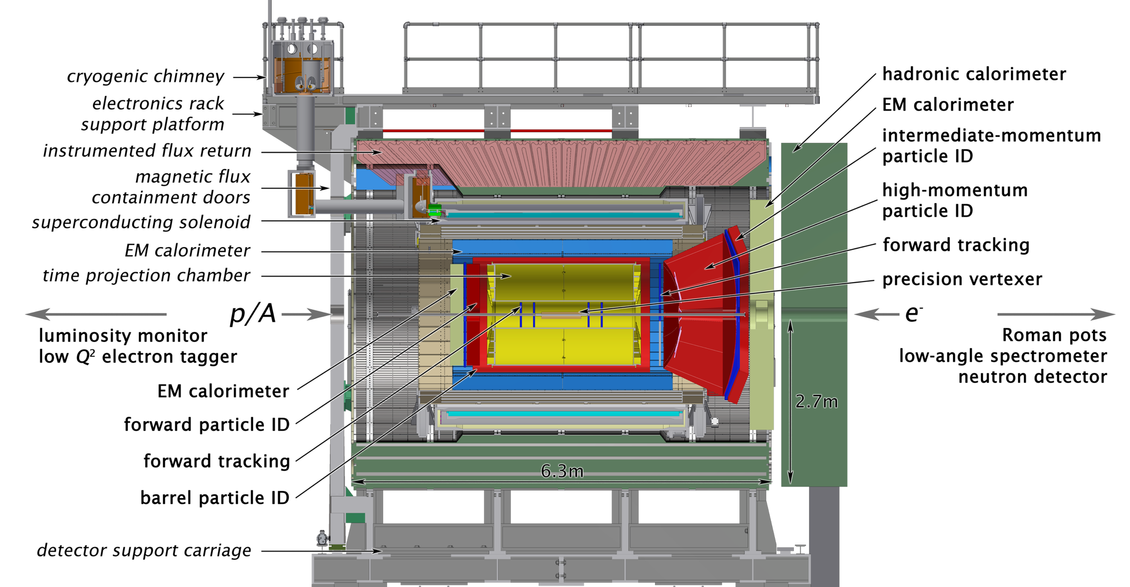
Limitations of the current ePHENIX Design
ePHENIX (updated 2018):
- Reuse all sPHENIX subsystem
TPC + EMCal + Hcal + (MVTX)
Some challenges:
HF tracking in the forward/backward beyond |eta|>1
  DCA, dp/p
Hadron PID
Bunch-Crossing Timing
TPC inner bore R ~20cm
  Very limited space for F/B Si-trackers

Slide 9
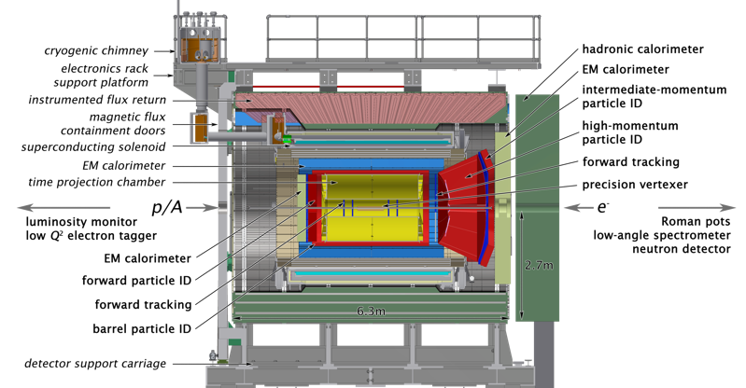
All Si-based Tracking for e/sPHENIX?
- 08/28/2020
Many good discussions with,
Jin, Xuan, Ping, Xin,
Yasser, Cameron, Walt, Huber,
Xiaochun, Murad et al.
sPHENIX has a small magnet, R < 140cm
  If we include sPHENIX EMCal + iHcal inside the magnet, useful space R < 90cm
Must have central tracking + PID detectors within:
  R < 90cm, |Z|<~ 200cm (sPHENIX magnet limit)
  All Si-based tracker possible, R < 50cm;
    DCA ~ O(10)um
    dp/p ~ 0.05% x p + 0.5%
  PID detector (TOF, RICH?):
    50cm < R < 90cm, |eta| <1
    |Z| > ~120 cm
Can we do better than this?

Slide 10
All silicon tracking for ePHENIX
- update 08/24/2020
All EMCal+Hcal
  new readout?
“ITS-3” like sensor is a preferred option;
  But if not ready (technology or $$)
  MVTX reconfigured for the inner detector;
  Outer faster Si-detectors
Hadron and e/mu PID
  Central |eta|< 1, P < 5GeV @3Sigma
  F/B, p < 20
MuonID?: R = 270 – 320 cm
oHCal: R = 182 – 269 cm
NOT to scale!
Magnet: 142 – 178 cm
iHCal: R = 113 – 137cm
EMCal: R = 90 – 108cm
Service: |eta|~1.5
Service: |eta|~1.5
All Si-tracking: dp/p, DCA okey
- R < 50cm, B = 3T
- Expect works for B=1.4 for |eta| < 1.5
PID: R = 50 -90cm
sPHENIX:
PID: Z = 130 - 200
Xin’s talk @EIC HF/Jet
08/2020
EMCal: Z = 200 - 300
EMCal: Z = 200 - 250
PID: Z = 130 - 200
HCal: Z = 250-350
MuonID?: Z = 350 – 400 cm
2<|eta|<2.5
p/A
e

Slide 11
Forward Silicon Tracker (FST) in Fun4All
– Ping, Xuan et al, LANL EIC LDRD
Same as reconfigured MVTX for EIC in “R”

Slide 12
Forward Tracking with FST: dp/p @B=1.4T
Ping, Xuan et al
@EIC HF/Jet 08/2020
ePHENIX:
- B = 1.4T

Slide 13
Next: Simulations for DCA, pd/p and PID @B=1.4T
Finish a preliminary design with selected technologies to show performance in forward/backward and central
  DCA, dp/p
  Central hadron PID, |eta| <~1
MVTX stave (L=27cm) at new locations (ePHENIX config, done)
  - including all supporting materials
    R = 3.6, 4.8, 6.0 cm (|eta| <1.1)
Add a few (~4) layers of faster silicon (ITS3 or strips)
  R = 20.0, 22.0; 40, 42cm (or something like them, R < 50cm),
  for maximum sagitta measurements, |eta| <~ 1
  Buch crossing timing
Add Si-disks as discussed in Xin and Ping/Xuan’s FST design
- in both forward and backward
  Z = 35, 53, 77, 101, 125, (270) cm, or something similar
  R < 45cm
Hadron PID detectors
  R = 50 -90cm, |eta| ~<1 in the central, mRICH, TOF etc
  |Z| >~ 1m, |eta| > 1 in the forward/backward (could be similar to the current ePHENIX design)

Slide 14
Backup Slides

Slide 15
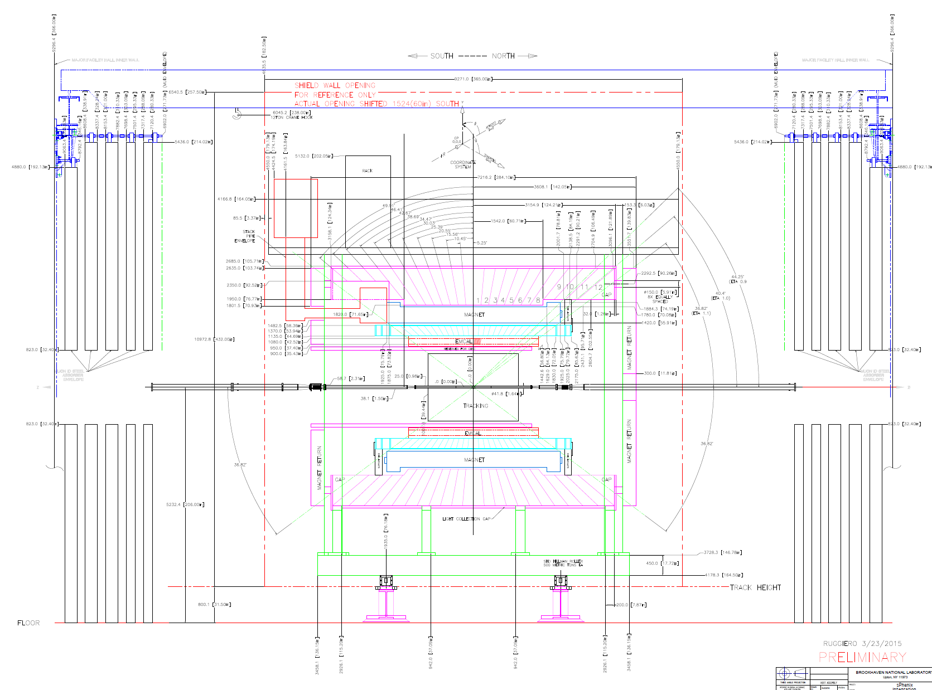
MVTX: 2.5 – 4.0 cm
INTT: 8 -12 cm
TPC: 20 -78 cm
Gap: 78 – 90 cm
EMCal: 90.0 – 108.0 cm;
iHcal: 113.5 – 137.0 cm ;
Magnet: 142.0 – 178.0cm
oHCal_R = 182.0 – 268.5cm

Slide 16
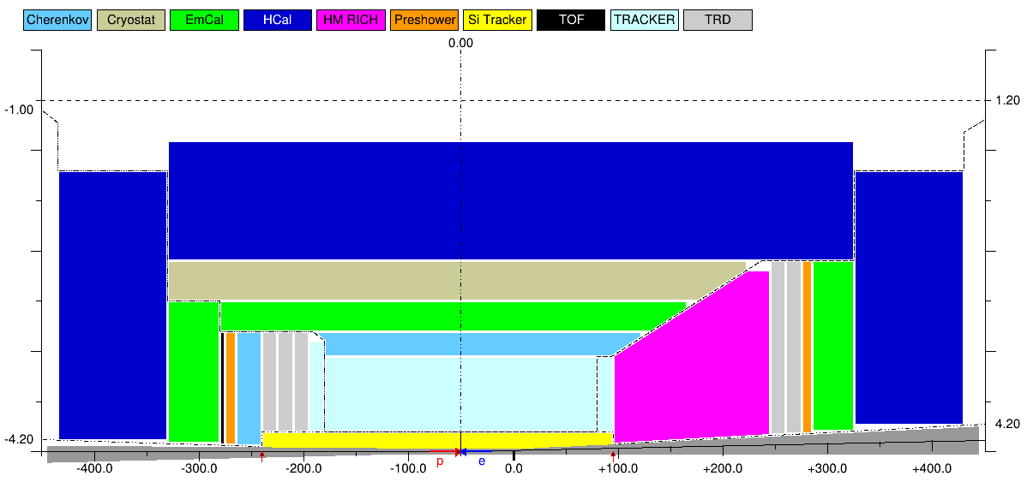
EIC Design – “1”: https://github.com/eic/EicToyModel/blob/master/doc/EIC-IR1-XX-v01.png

Slide 17
From Xin Dong,
EIC Jet/HF
08/17/2020
Can we do all Si-tracking with sPHENIX
Magnet + EMCal+Hcal
- with PID?

Slide 18
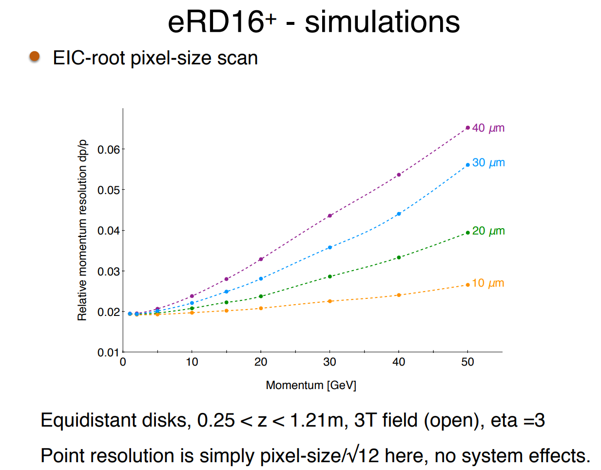
Heavy Flavor physics based on direct topological reconstruction of charm decays (D₀ (cτ ≅123 µm) , λ_{c} (cτ ≅ 60 µm)…) requires DCA pointing resolutions significantly better than the cτ of the meson of interest at momentum < 1 GeV/c. To achieve this, small pixels and low radiation length are needed, especially in the vertexing layers (i.e. innermost barrel layers). Momentum resolution of 2-3% (3T) requires small pixels in the disc layers.
Please see:
https://indico.bnl.gov/event/7689/contributions/35412/attachments/26828/40846/Simulation_report_Feb2020.pdf
and
https://indico.bnl.gov/event/7892/contributions/36938/attachments/27856/42740/20200430-EICUG_Tracking_WG_-_eRD16.pdf
From Leo, YR
ERD-18 Discs (1.5T)
ERD-18 Discs (3T)
ERD-18 Barrel (1.5T)

