Slide 1
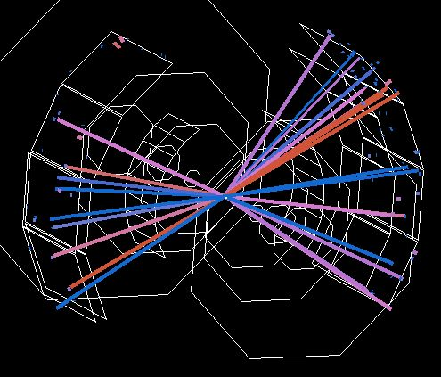
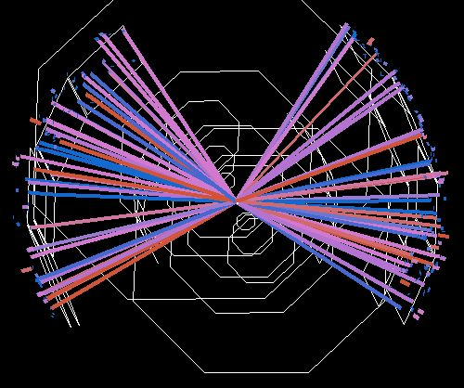
PHENIX Results from the RHIC Beam Energy Scan Program
Jeffery T. Mitchell
Brookhaven National Laboratory

Slide 2
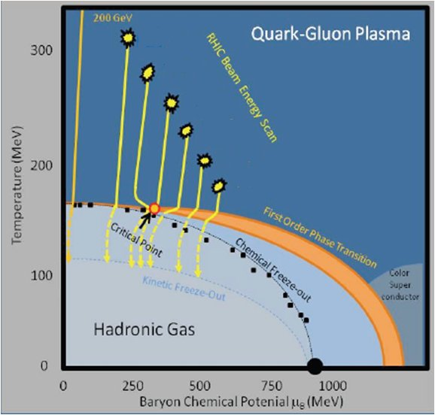
The RHIC Beam Energy Scan Program: Probing the Nuclear Matter Phase Diagram
By systematically varying the RHIC beam energy, heavy ion collisions will be able to probe different regions of the QCD phase diagram.
Searching for signatures of the onset of deconfinement.
Searching for signatures of the critical point.
decreasing √s_{NN}
2

Slide 3
The RHIC Beam Energy Scan Program: Overview
Species: Gold + Gold
Collision Energies [sqrt(s_{NN})]:
200 GeV (2010), 130 GeV (2001), 62.4 GeV (2010),
39 GeV (2010, 250M events), 27 GeV (2011),
19.6 GeV (2002 for 1 day, 2011 13M events),
11 GeV (2010, STAR only)
9.2 GeV (2009, short test run), 7.7 GeV (2010, 1.5M events)
Species: Copper + Copper
Collision Energies [sqrt(s_{NN})]:
200 GeV (2005), 62.4 GeV (2005), 22 GeV (2005)
Species: Deuteron + Gold
Collision Energies [sqrt(s_{NN})]:
200 GeV
Species: Proton + Proton
Collision Energies [sqrt(s_{NN})]:
500 GeV, 200 GeV, 62.4 GeV
3

Slide 4
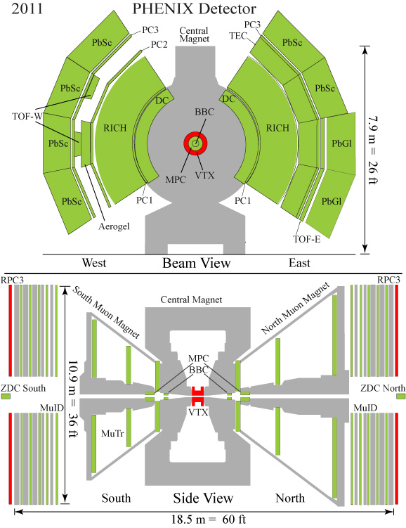
The PHENIX Detector at RHIC
Central arms:
Hadrons, photons, electrons
J/ψ→ e⁺e⁻; ψ’ → e⁺e⁻;
χ_{c} → e⁺e⁻ϒ;
|η|<0.35
p_{e} > 0.2 GeV/c
Δφ=π(2 arms x π/2)
Forward rapidity arms:
Muons
J/ψ→ μ⁺μ⁻ ; ϒ → μ⁺μ⁻
1.2<|η|<2.2
p_{μ} > 1 GeV/c
Δφ = 2π
RPC1
4

Slide 5
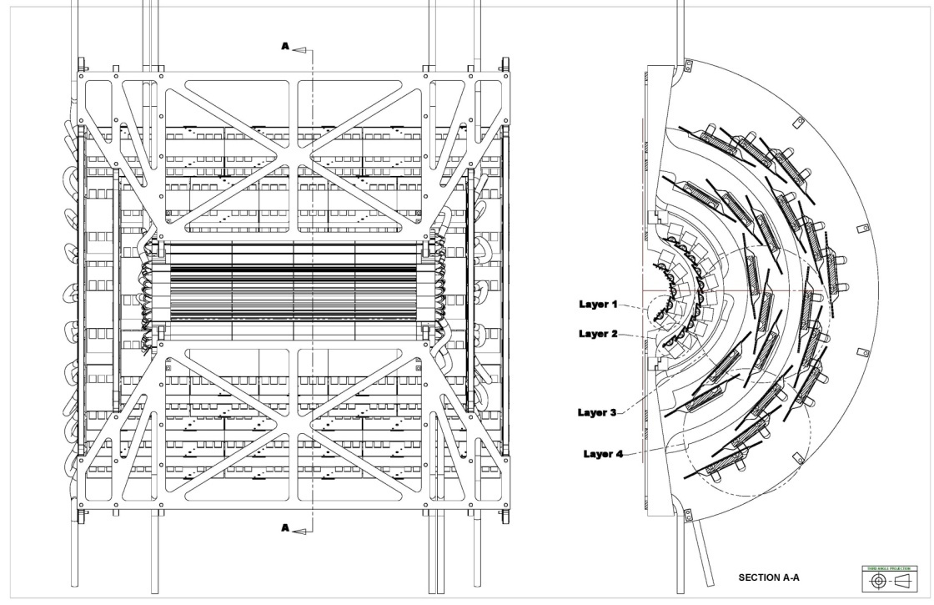
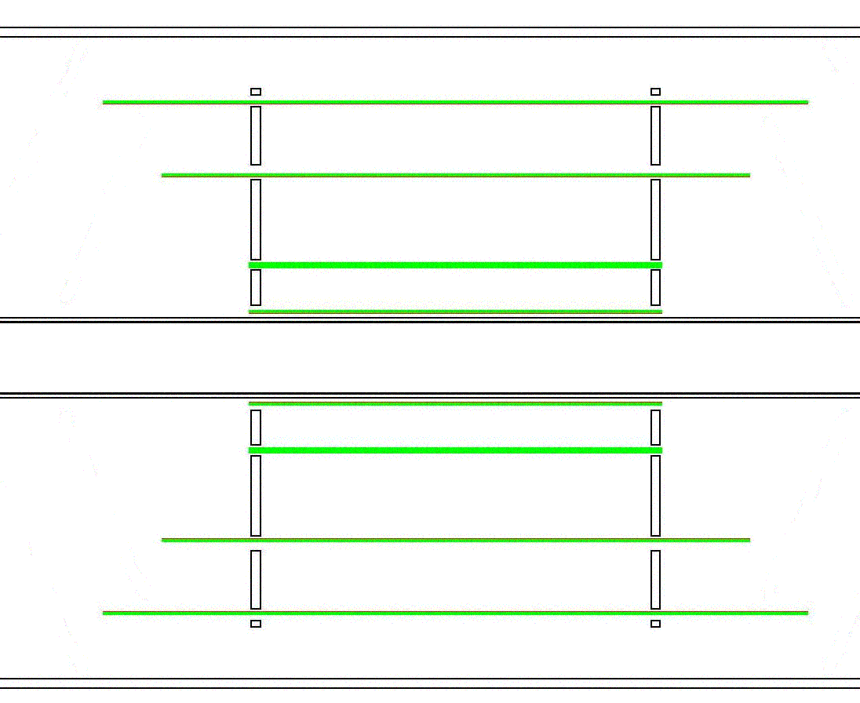

New in 2011: The VTX Detector
Fine granularity, low occupancy
50μm×425μm pixels for L1 and L2
R1=2.5cm and R2=5cm
Stripixel detector for L3 and L4
80μm×1000μm pixel pitch
R3=10cm and R4=14cm
Large acceptance
|η|<1.2, almost 2π in φ plane
Stand-alone tracking capability
Pixel
Will help with background rejection at low energies
Strip
The VTX was installed in PHENIX in Nov-Dec 2010.
z plane
φ plane
5

Slide 6
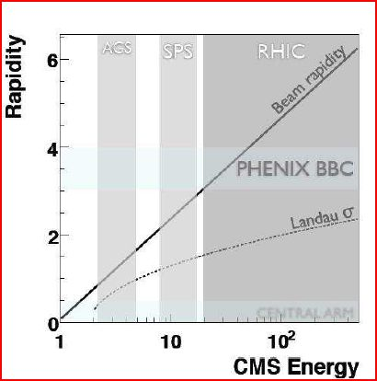
Triggering at Low Energy
The placement of the trigger detectors (BBCs) are not optimized for low energy running.
They have a reduced acceptance, especially below RHIC energies of ~ 20 GeV.
Fermi motion comes to the rescue!
At low energies, Fermi motion is enough to bring nucleons back into the BBC acceptance.
6

Slide 7
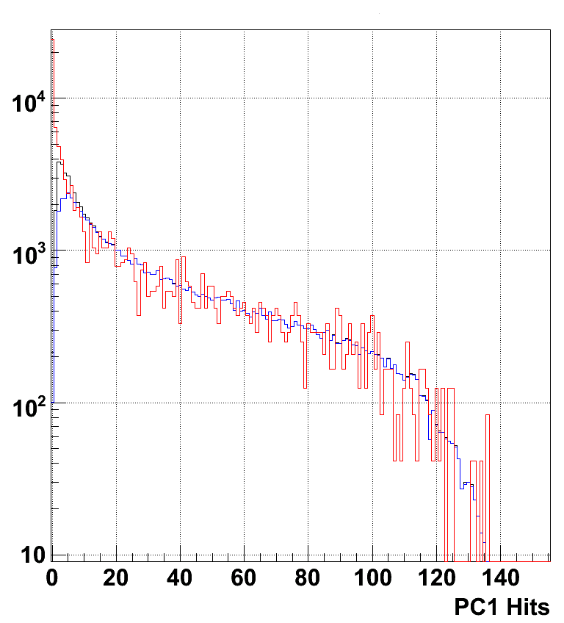
PHENIX Trigger Performance at 7.7 GeV
Tight timing cut on BBC North vs. South
URQMD AuAu @ 7.7 GeV through PHENIX full simulation
URQMD normalized to match real data integral for PC1 hits > 40.
URQMD not matched to z distribution in real data.
The trigger fires on 75% of the cross section.
No indication of deviation of low multiplicity events from background.
Centrality determination uses the outer ring of the Reaction Plane detector: 1.5<|η|<2.8
PHENIX AuAu @ 7.7 GeV Data
w/ BBCLL1(>0 tubes) |z| < 30 cm
PHENIX AuAu @ 7.7 GeV Data
w/ BBCLL1(>1 tubes) |z| < 30 cm
7
Notes:
From Bathe AGS

Slide 8
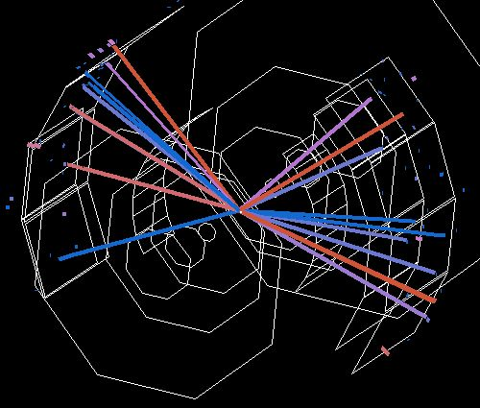
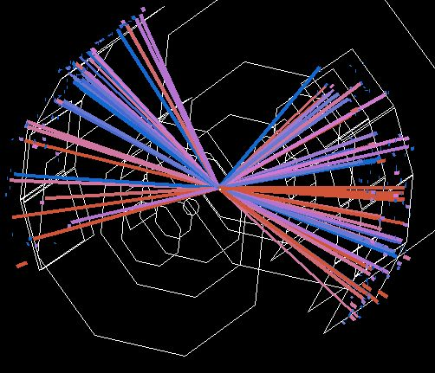
PHENIX 39 GeV Au+Au Event Displays
8

Slide 9
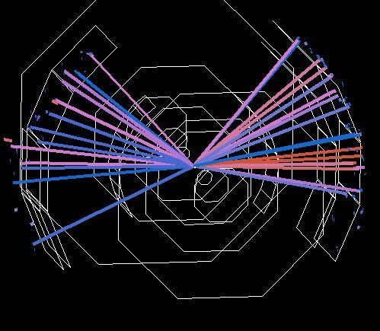
PHENIX 7.7 GeV Au+Au Event Displays
9

Slide 10
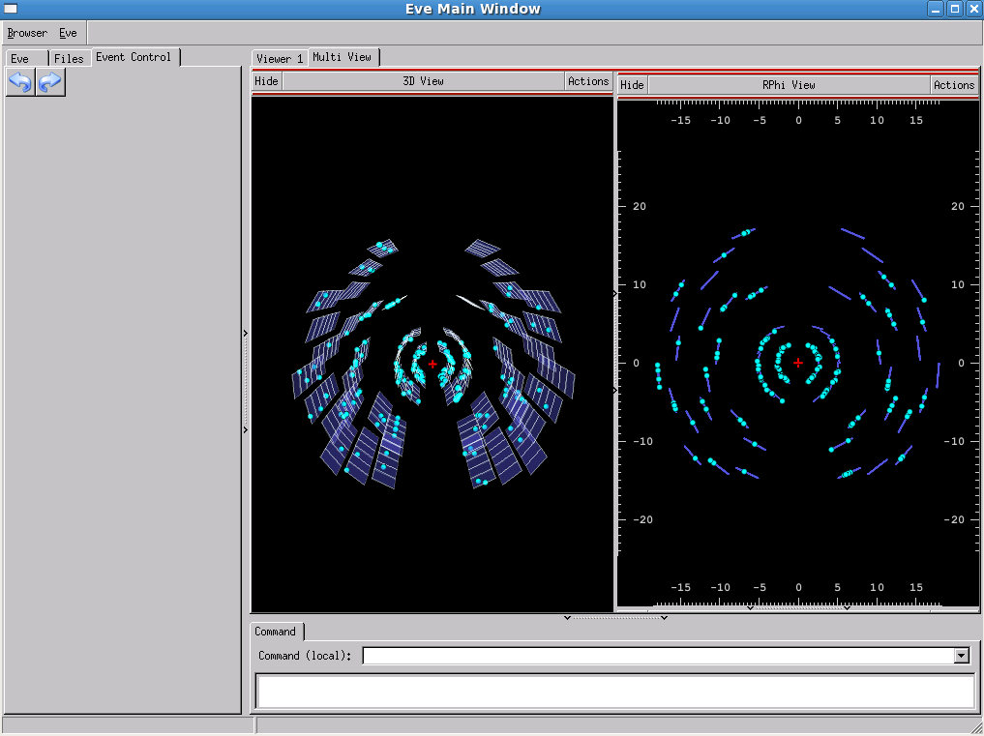
VTX Event Display – 19.6 GeV Au+Au
10

Slide 11
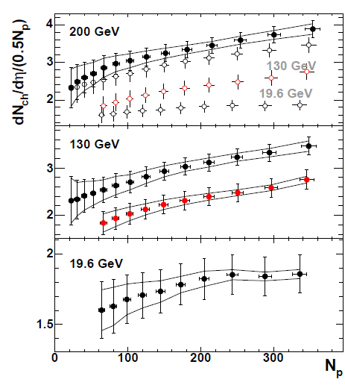
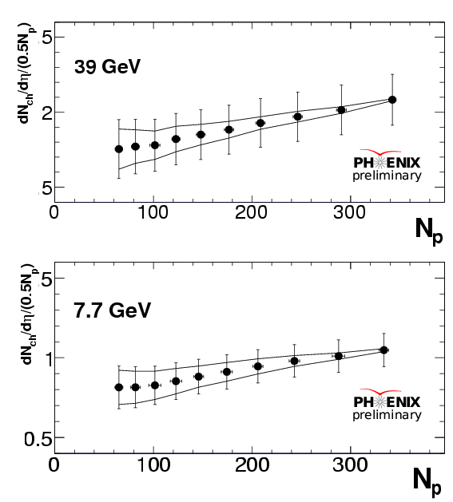
Au+Au Charged Particle Multiplicity
Black points from Phys. Rev. C71 (2005) 034908
62 GeV
PHENIX Preliminary
Error bars represent the systematic errors. The lines represent the “tilt” error due to the uncertainty in the trigger cross section.
11

Slide 12
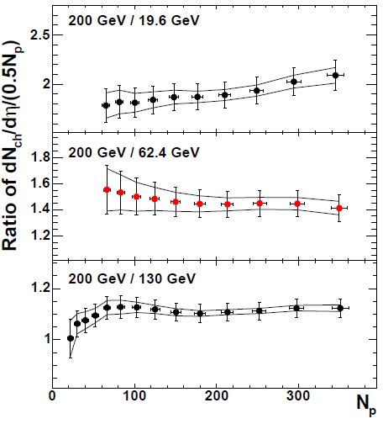
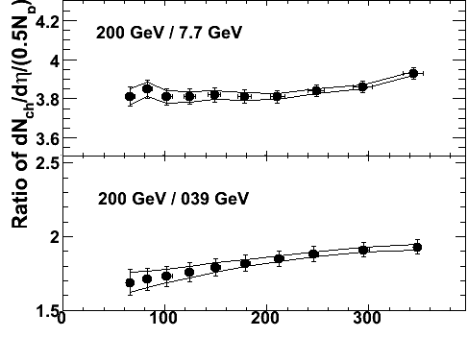

Au+Au Charged Particle Multiplicity Ratios
There is relatively little variation in the centrality-dependent shape of the multiplicity from 200 to 7.7 GeV.
12

Slide 13
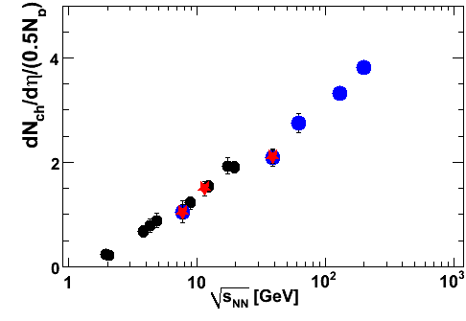
Charged Particle Multiplicity:
Excitation Function
The multiplicity per participant pair increases linear with log(sqrt(s_{NN})).
PHENIX and STAR results from the Run-10 RHIC beam energy scan are in agreement.
Blue: PHENIX
Red: STAR
Black: AGS/SPS
13

Slide 14
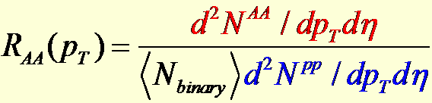
Searching for the Onset of Deconfinement: Energy Loss Measurements
14

Slide 15
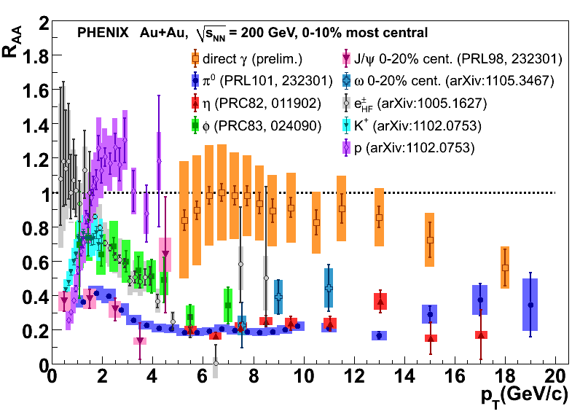
PHENIX R_{AA} Measurements in 200 GeV Au+Au Collisions
From the 200 GeV Au+Au π⁰ measurement:
Strong suppression (x5) in central Au+Au collisions
No suppression in peripheral Au+Au collisions
No suppression (Cronin enhancement) in control d+Au collisions
Convincing evidence for final state partonic interactions
15

Slide 16
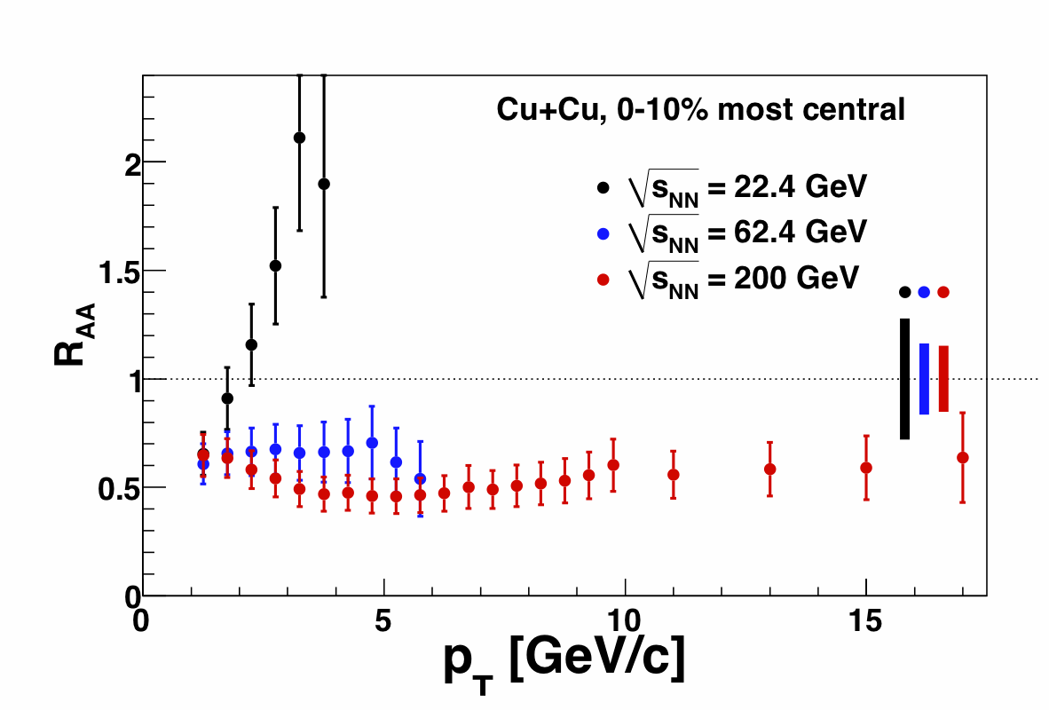
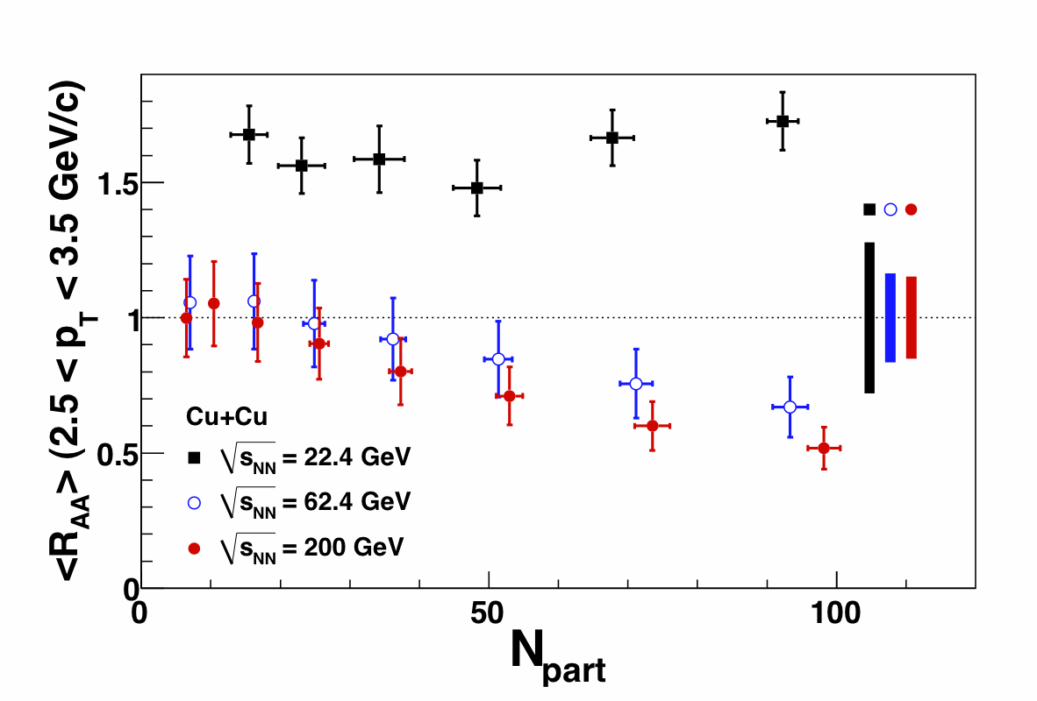
PHENIX π⁰ Energy Loss Measurements in Cu+Cu Collisions
PRL101, 162301
From the Cu+Cu energy scan:
Significant suppression at √s_{NN} = 200 and 62.4 GeV
Moderate enhancement at √s_{NN} = 22.4 GeV
16

Slide 17
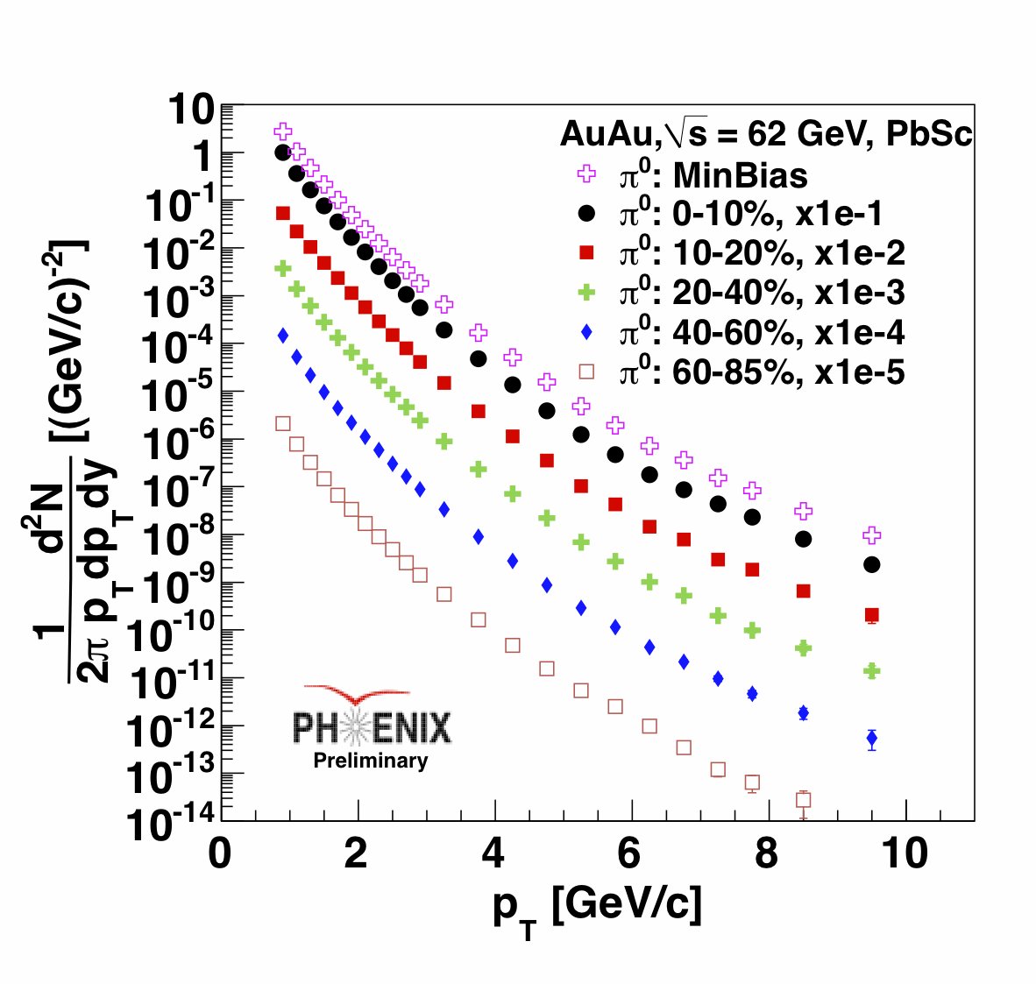
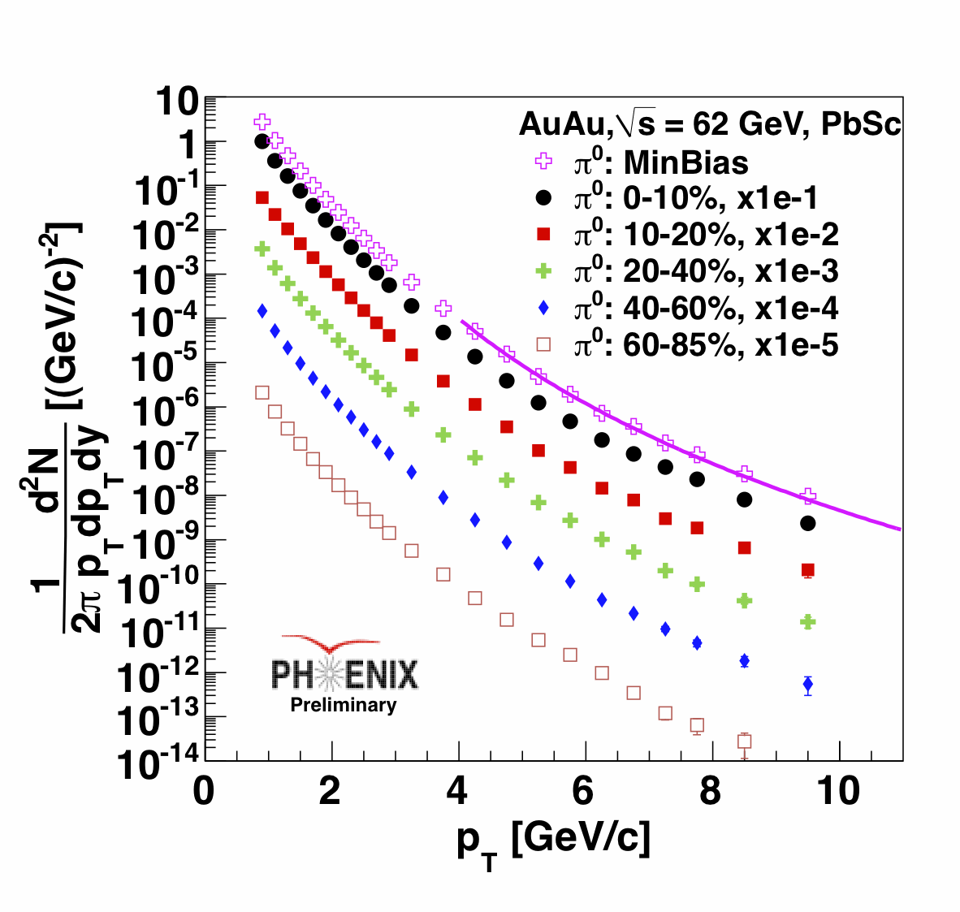
π⁰ invariant yields:
Au+Au Collisions at 62.4 GeV
62.4 GeV
At lower √s the contribution from some processes are larger:
Running α(Q²)
PDF evolution
k_{T} smearing
Higher-twist phenomena
17

Slide 18
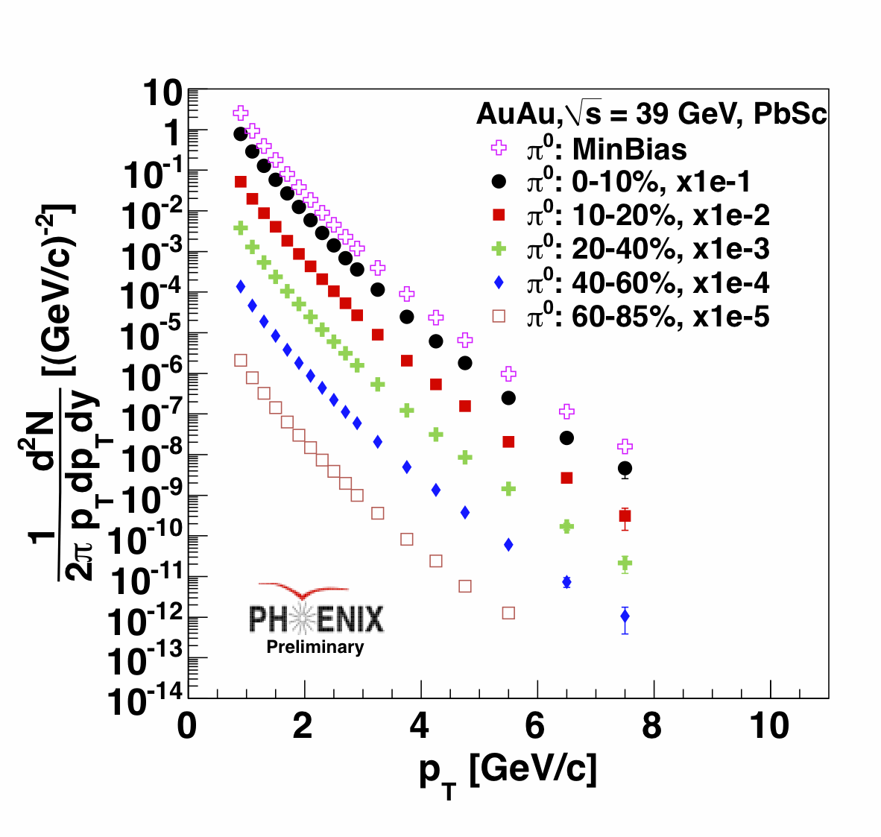
π⁰ invariant yields:
Au+Au Collisions at 39 GeV
39 GeV
The minimum bias spectra are fit with a power-law shape function for p_{T} > 4 GeV/c :
n_{200GeV}=8.1 ± 0.03
n_{62GeV} =10.9 ±0.03
n_{39GeV} =12.1 ± 0.1
18

Slide 19
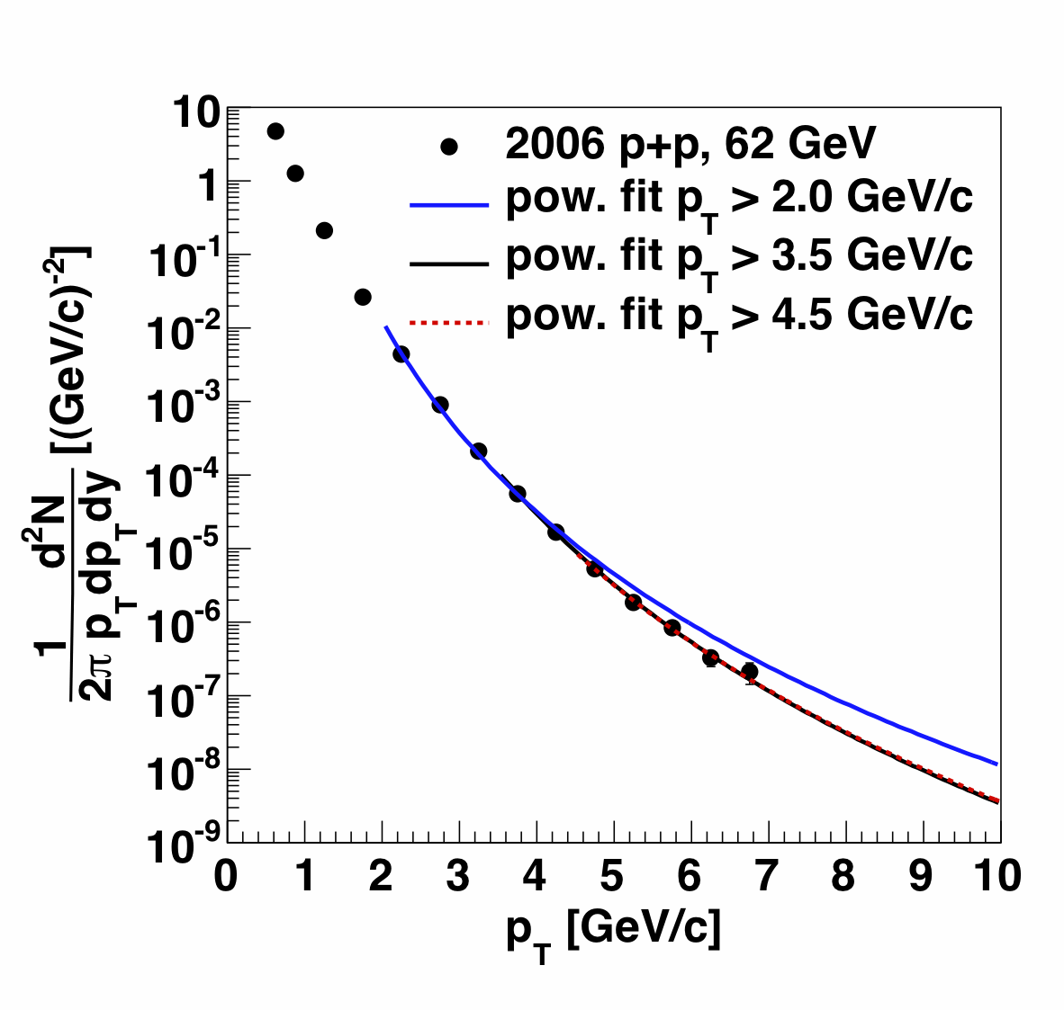
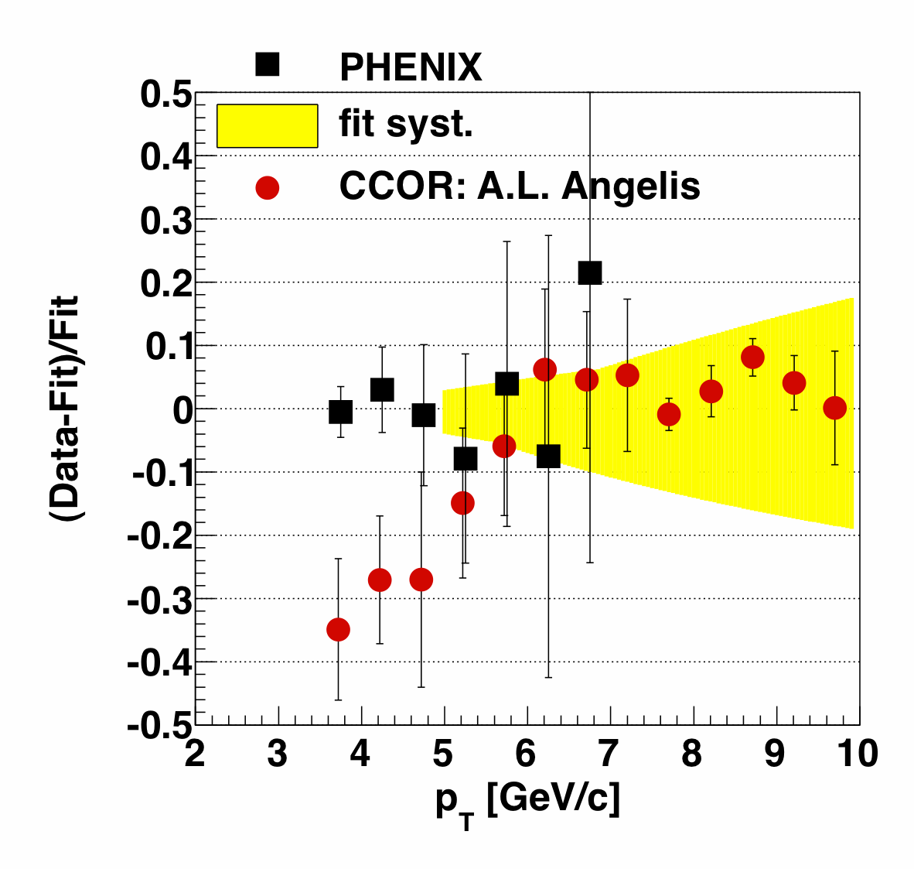
62.4 GeV p+p reference extrapolation
Data from PHENIX for p+p collisions are available up to p_{T} < 7 GeV/c
To extrapolate to higher p_{T} points, a power-law function was used:
  The limit of the fits is important and contributes to the systematic errors.
The systematic uncertainty is calculated from the errors of the power-law fit
It agrees well with the CCOR data (ISR) in p_{T} 7-10 GeV/c region
19

Slide 20
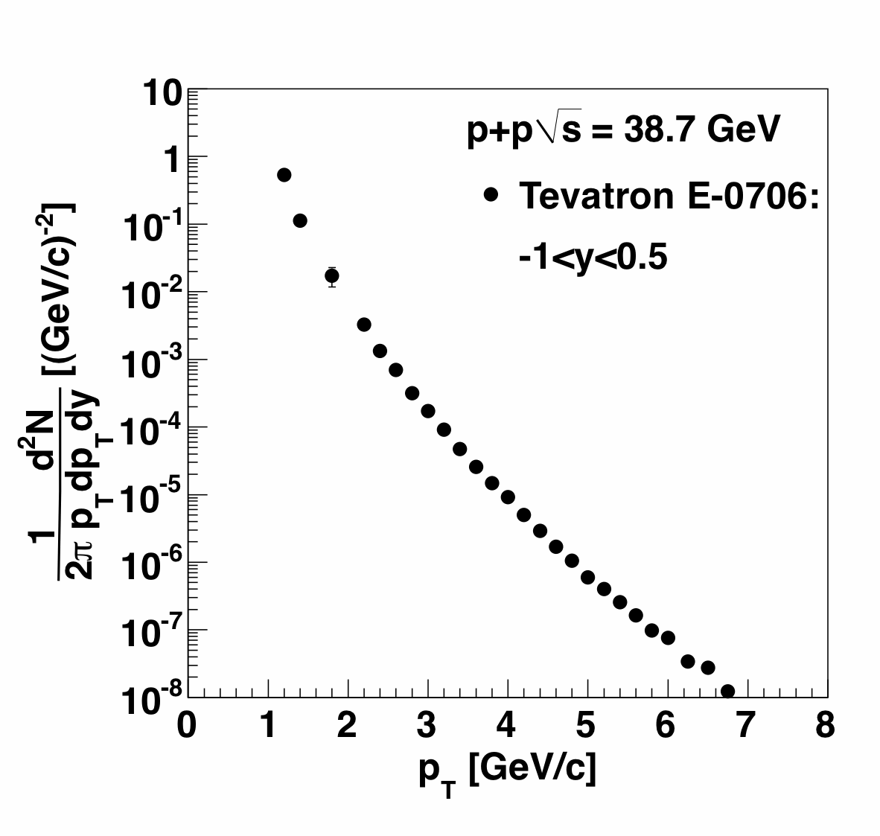
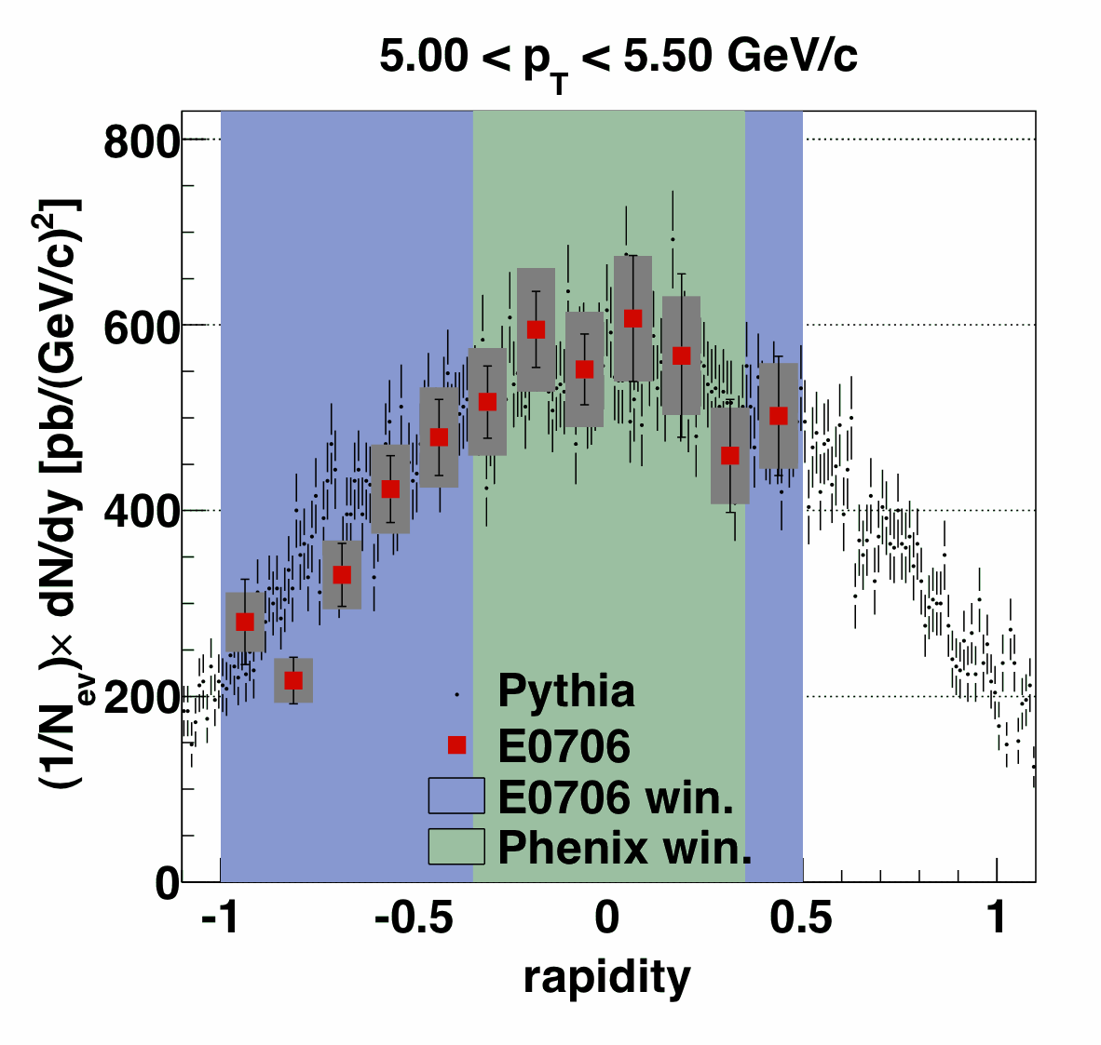
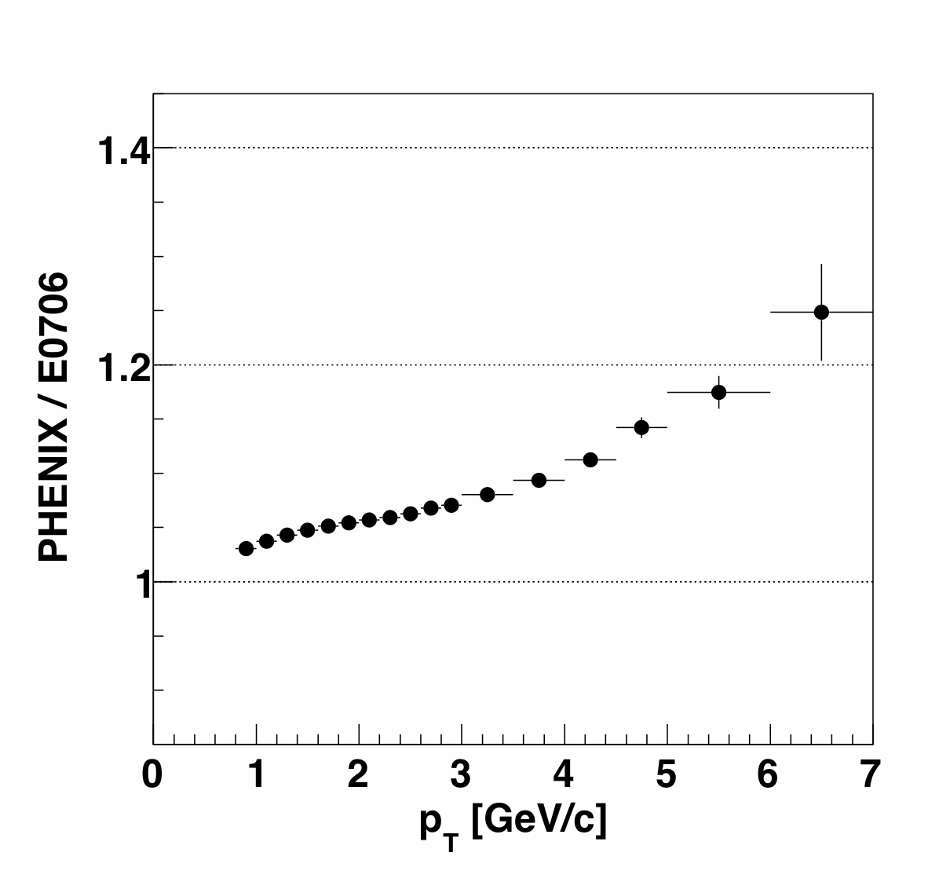
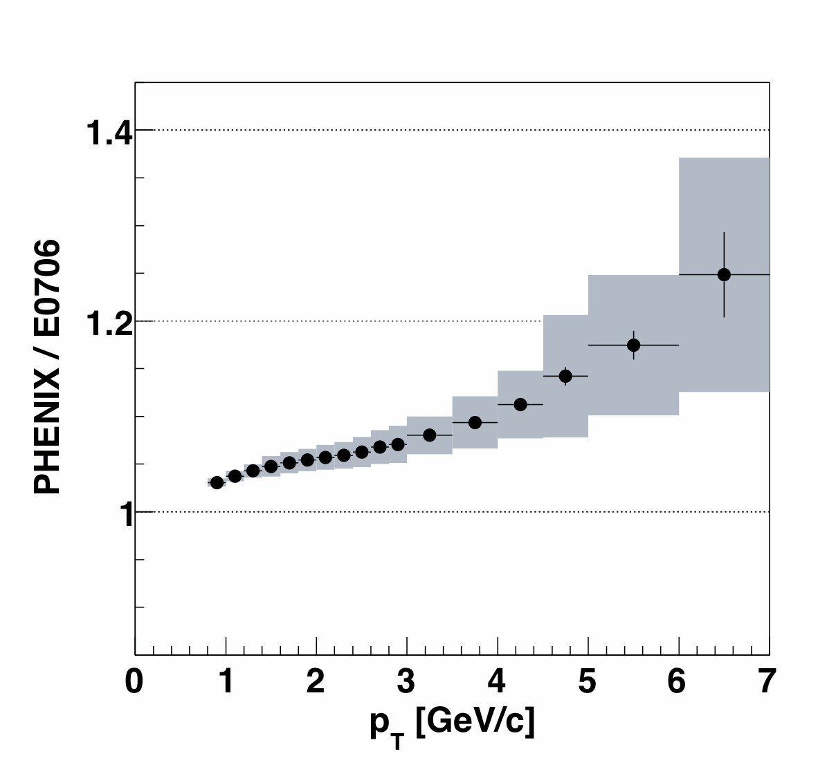
39 GeV p+p reference
p+p data are measured only in the fixed-target experiment E706 at the Tevatron at a beam energy of 800 GeV. (Phys.Rev.D68:052001,2003)
The E706 has a different rapidity acceptance:
-1.0 < y < 0.5 (PHENIX |y|<0.35).
Acceptance correction based on a PYTHIA8 simulation.
The systematic uncertainty of the correction function is calculated based on the data to PYTHIA8 comparison.
Acceptance correction function
E706 ➔ PHENIX
20

Slide 21
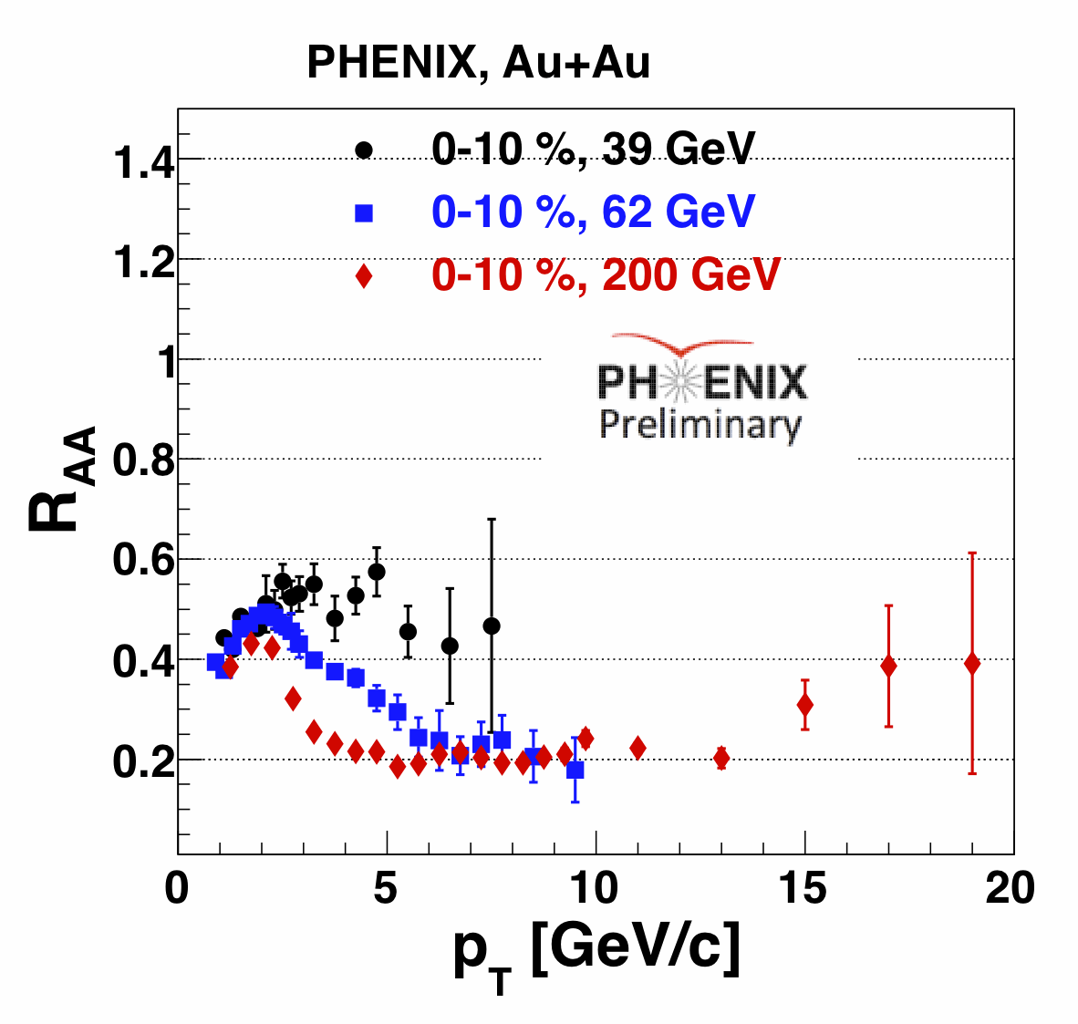
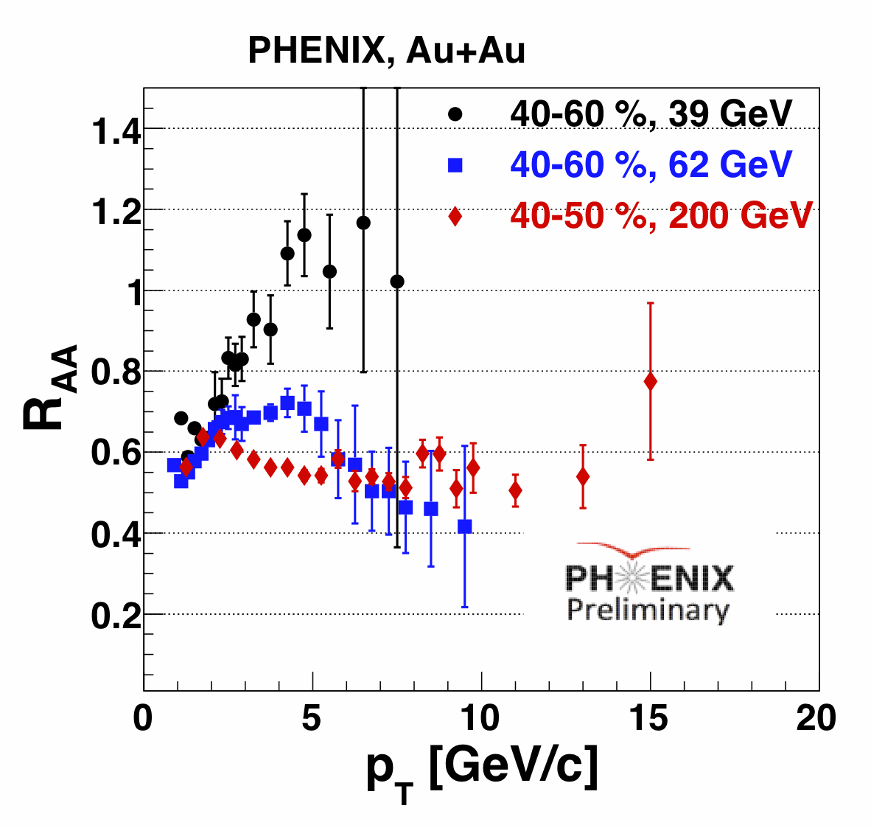
π⁰ R_{AA} in Au+Au at 39 and 62 GeV
π⁰ R_{AA} as a function of p_{T} in PHENIX at √s_{NN} = 39, 62 and 200 GeV.
Still observe a strong suppression (factor of 2) in the most central √s_{NN} = 39 GeV collisions.
R_{AA} from √s_{NN} = 62 GeV data is comparable with the R_{AA} from √s_{NN} = 200 GeV for p_{T} 6 >GeV/c.
Peripheral √s_{NN} = 62 and 200 GeV data show suppression, but the √s_{NN} = 39 GeV does not.
21

Slide 22
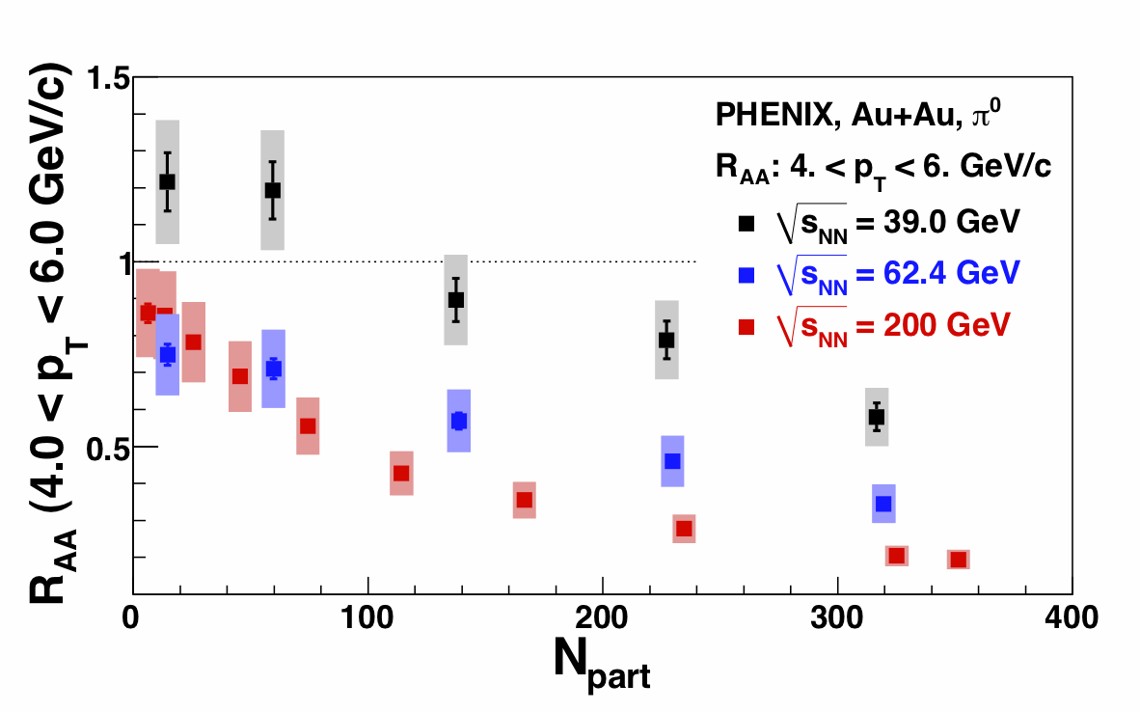
π⁰ R_{AA} : Centrality Dependence
Large suppression is observed at 200 and 62 GeV.
39 GeV Au+Au shows suppression only for N_{part}>100
22

Slide 23
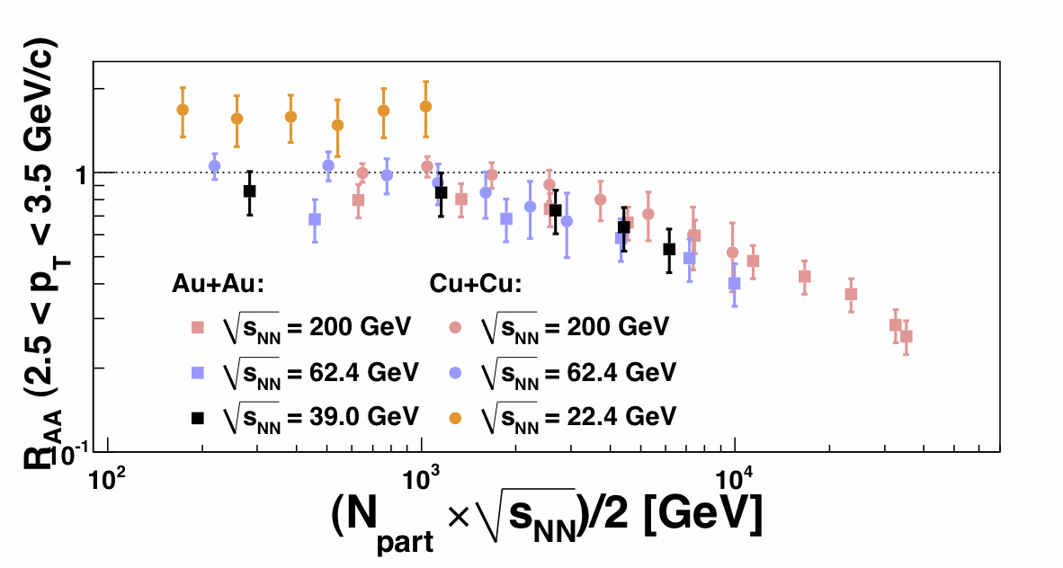
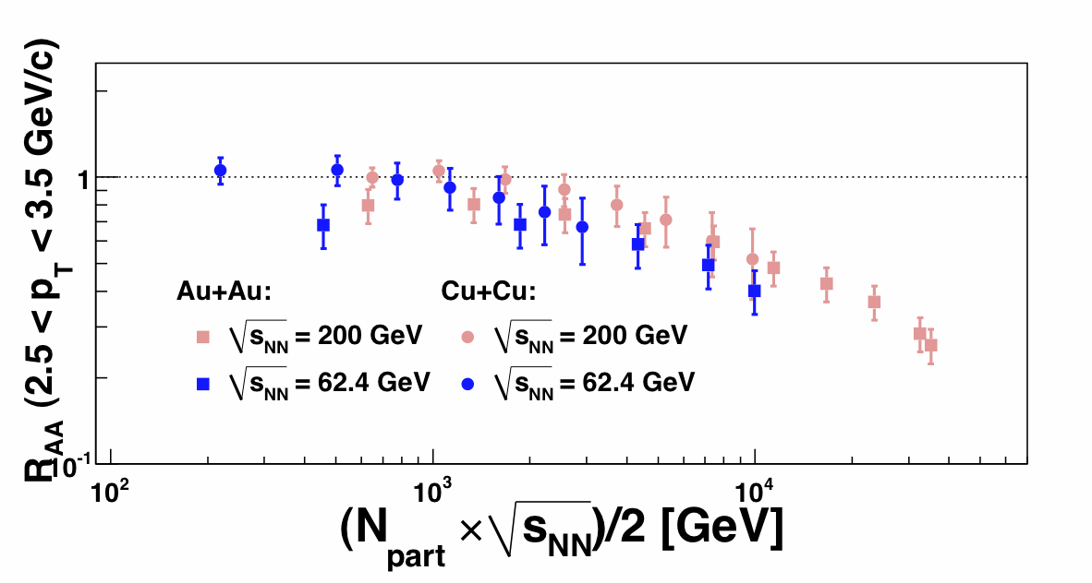
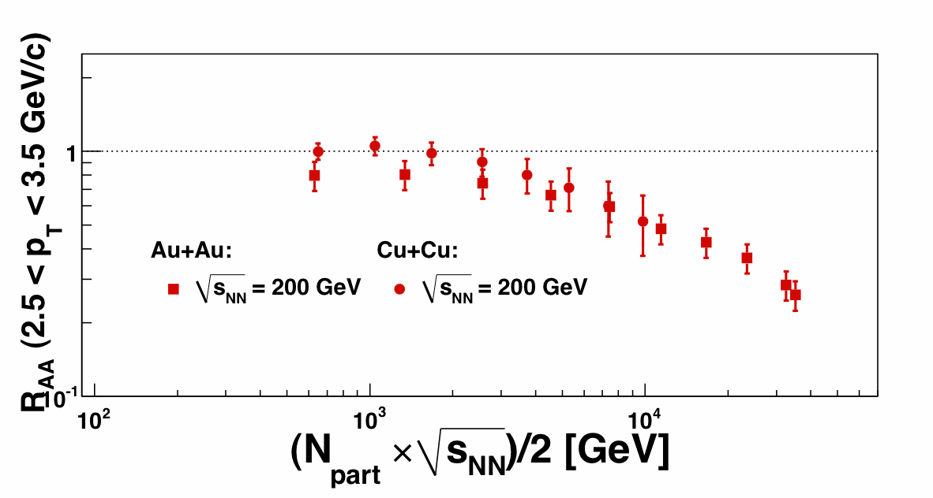
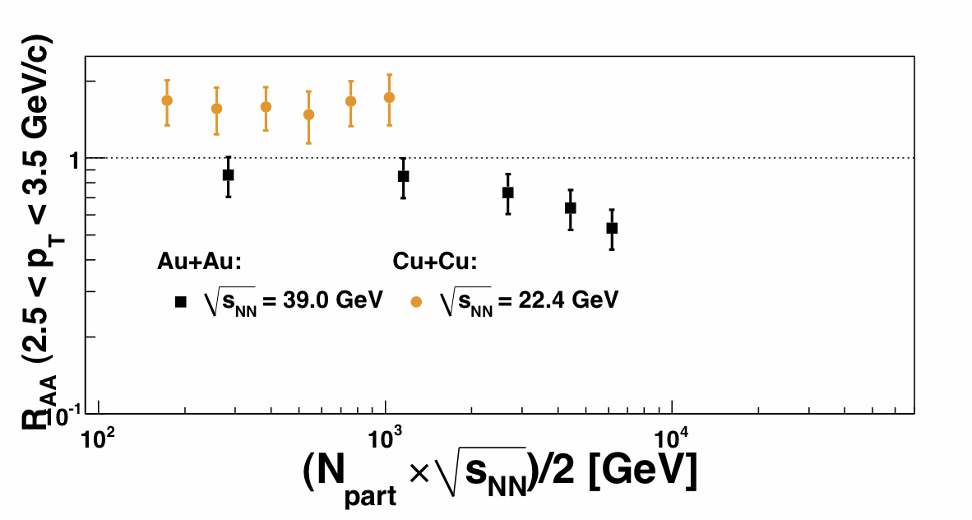
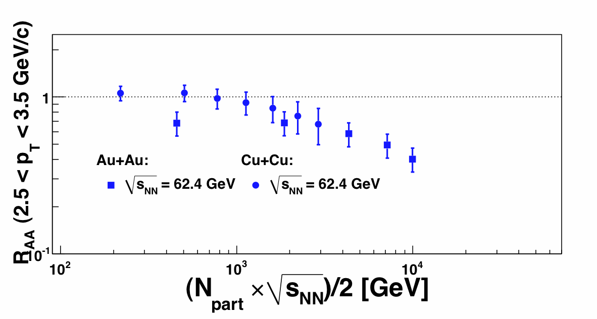
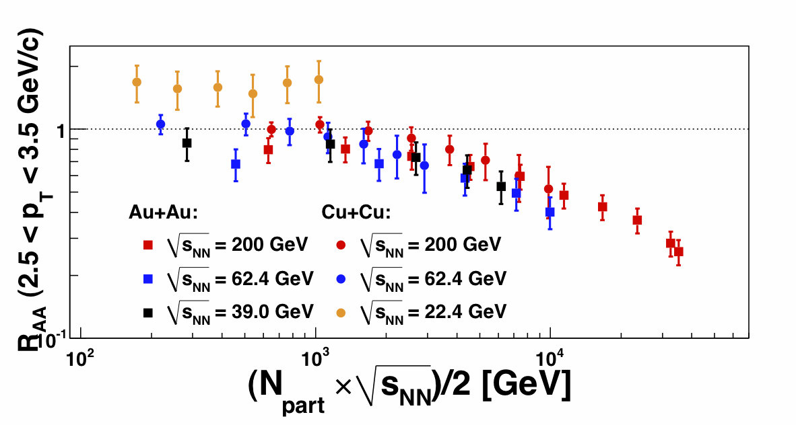
Energy and System-Dependence of π⁰ R_{AA}
System size:
Circles: Cu+Cu
Squares: Au+Au
The R_{AA} values seem to have the same trend. But, the scaling does not work for all p_{T} ranges.
SPS, max reach
SPS, max reach: 2 × 208(Pb) × 17.3 GeV (√s_{NN})/2 = 3598.4 GeV
23

Slide 24
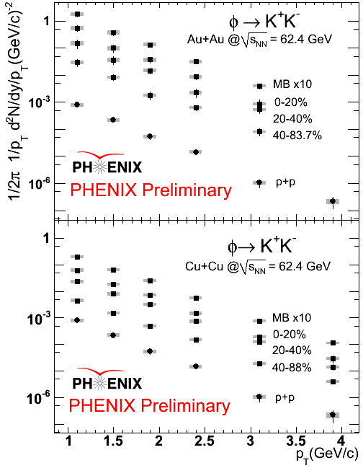
φ→K⁺K⁻ Spectra in 62.4 GeV Au+Au Collisions
24

Slide 25
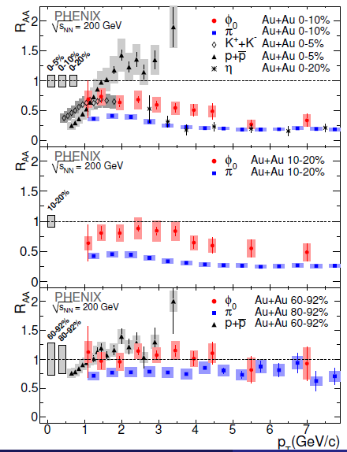
φ→K⁺K⁻ R_{AA} in 200 GeV Au+Au Collisions
The φ is suppressed in central 200 GeV Au+Au collisions.
The R_{AA} of the φ lies between that of the proton and the π⁰.
25

Slide 26
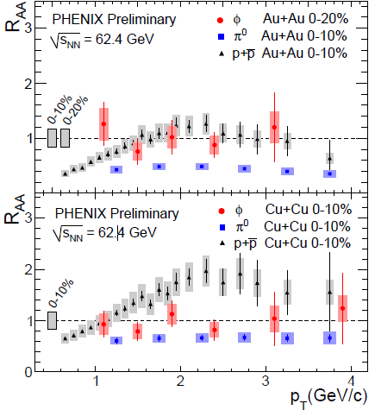
φ→K⁺K⁻ R_{AA} in 62.4 GeV Au+Au Collisions
Within the current precision, no suppression at 62.4 GeV.
Similar to the 200 GeV results, the R_{AA} of the φ lies between that of the proton and the π⁰.
26

Slide 27
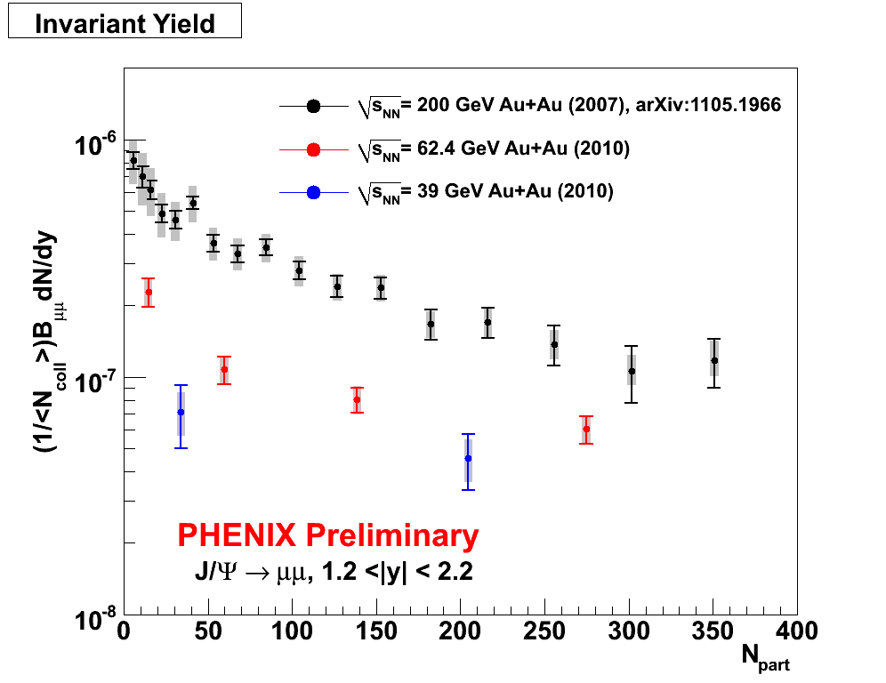
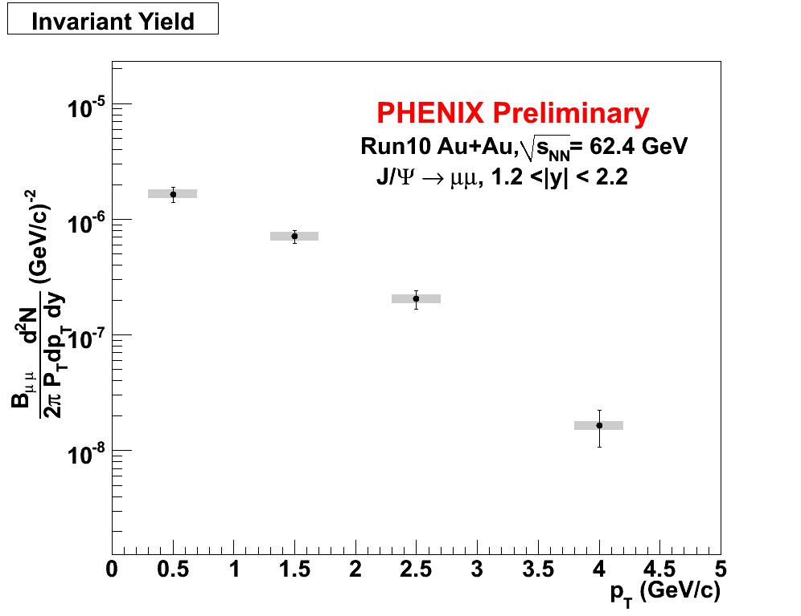
J/ψYields from 62 and 39 GeV Au+Au Collisions
In 2010, PHENIX collected 700M (250M) MB events from 62.4 GeV (39 GeV) Au+Au collision.
Rapidity 1.2 <|y| <2.2
27

Slide 28
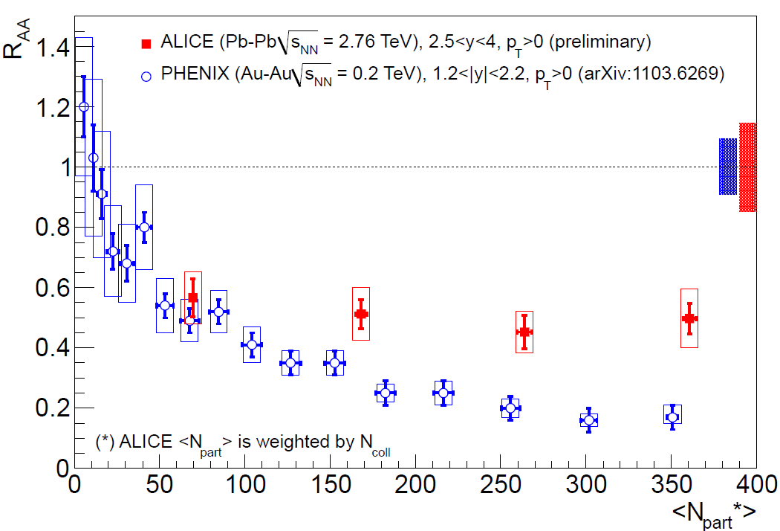
Energy Dependence of J/ψ Suppression
Less suppression is observed in central collisions at LHC energies.
28

Slide 29
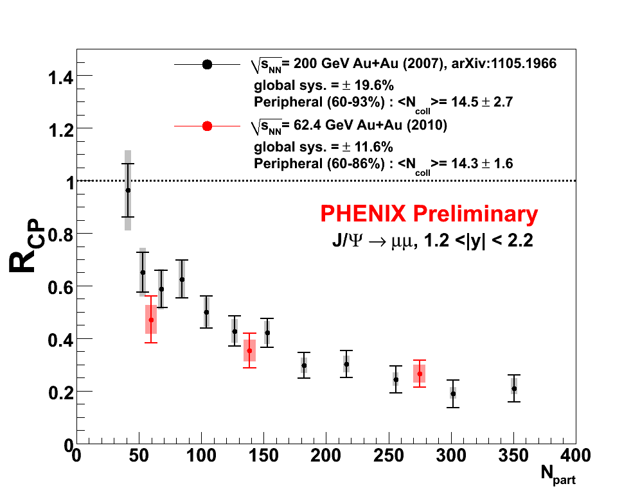
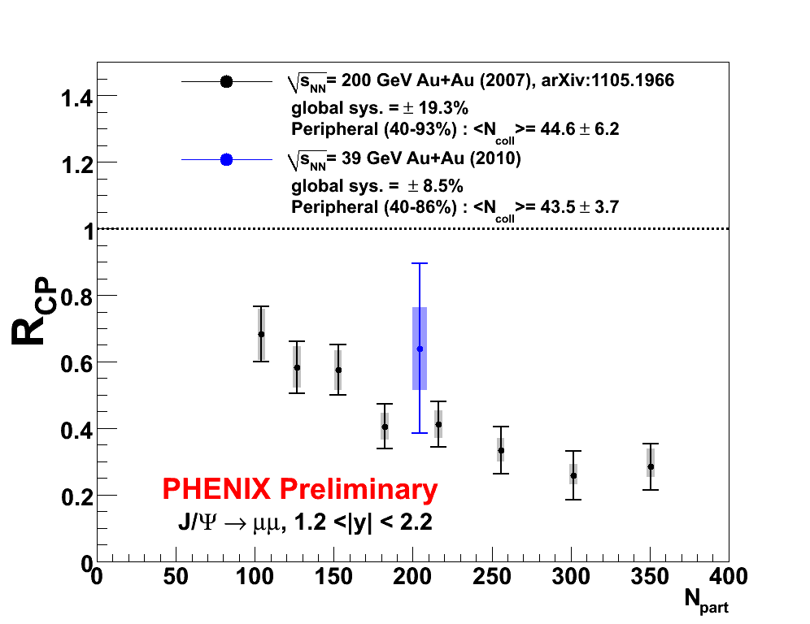
Energy dependence of J/ψ R_{CP}
Rapidity 1.2 <|y| <2.2
PHENIX does not yet have a p+p reference at 62 and 39 GeV.
Lacking a reference, R_{CP} can still give us insight about the suppression level.
The suppression is at a similar level at all energies.
29

Slide 30
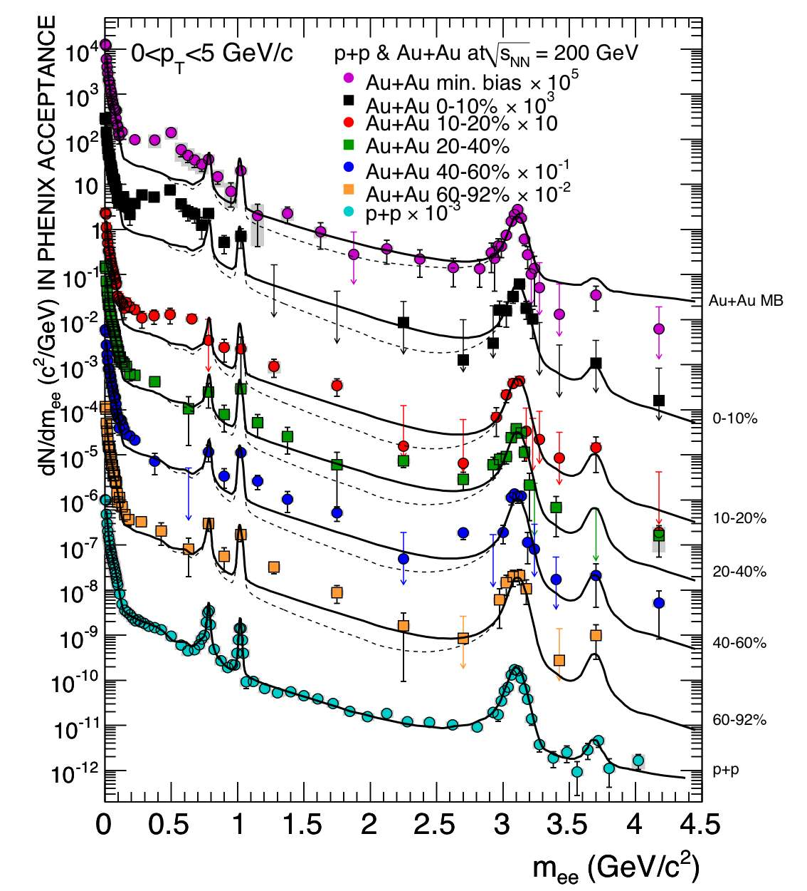
PHENIX Dilepton Expectations at 39 GeV
How does the dilepton excess and ρ modification at SPS evolve into the large low-mass excess at RHIC?
If the excess is the same at 39 GeV as at 200 GeV, we expect a 6σ result.
Addition of Hadron Blind Detector will significantly reduce background.
PRC81, 034911 (2010)
30
Notes:
From Bathe AGS

Slide 31
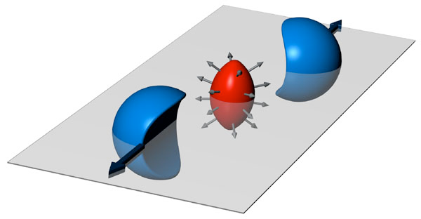
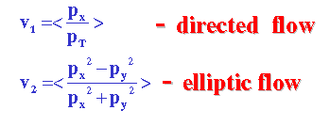
Searching for the onset of deconfinement: Flow Measurements
v₂>0: in-plane emission of particles
v₂<0: squeeze-out perpendicular to reaction plane.
31

Slide 32


Elliptic Flow at 62 and 39 GeV: π⁰
There is little change in the magnitude of v₂ from 39 GeV to 200 GeV.
32

Slide 33

v₂{Φ₂}, v₃{Φ₃}, v₄{Φ₄} at 62 GeV Au+Au
v_{n}
charged particle v_{n} : |η|<0.35
reaction plane Φ_{n} : |η|=1.0~2.8
33

Slide 34

v₂, v₃, v₄ as a function of √s_{NN}
v₂, v₃, v₄ are independent of √s_{NN} for 39, 62.4, 200 GeV
34

Slide 35

v₂ in 7.7 GeV Au+Au Collisions
The magnitude of v₂ at 7.7 GeV is significantly lower than the magnitudes at 39, 62 and 200 GeV
35

Slide 36


v₂ vs p_{T} from 39 GeV to 2.76 TeV
ALICE Experiment, PRL105,252302 (2010)
It appears that the system demonstrates similar hydrodynamic properties from 39 GeV to 2.76 TeV
36

Slide 37


Saturation of v₂ with beam energy
v₂ saturates for a given p_{T} around or below 39 GeV
Almost perfect fluidity from 39 GeV to 2.76 TeV
37

Slide 38

Saturation of v₃, v₄ with beam energy
v₂, v₃ and v₄ are measured in 39, 62 and 200 GeV. The magnitudes are similar.
The observations suggest similar initial geometry fluctuations and dynamical evolution of nuclear matter above 39 GeV.
v_{n}(Ψ_{n})
38

Slide 39


Identified hadron v₂ in 62.4 GeV Au+Au Collisions
PHENIX Preliminary
Partonic collective flow is observed down to 62 GeV and …
39

Slide 40


Identified hadron v₂ in 39 GeV Au+Au Collisions
PHENIX Preliminary
PHENIX Preliminary
Partonic collective flow is observed down to 39 GeV
40

Slide 41
Searching for Signatures of the Critical Point: Fluctuations and Correlations
41

Slide 42


Two-Particle Correlations: 200 and 62 GeV
Phys.Rev. C 77, 011901 (2008)
h - h correlations
1 < p_{Ta} < 2.5 < p_{Tt}< 4GeV/c
With increasing N_{part} the away side jets broaden and move away from each other but remain flat over most of N_{part}
PRL 98, 232302 (2007)
42

Slide 43

Two-Particle Correlations: v₃ and the Double Hump Structure
v₂ correction only
  double-hump
v₂, v₃, v₄ correction
  double-hump disappears
  Peak still broadened

Slide 44



Like-Sign Pair Azimuthal Correlations
0.2 < p_{T,1} < 0.4 GeV/c, 0.2 < p_{T,2} < 0.4 GeV/c, |Δ pseudorapidity|<0.1
200 GeV Au+Au, 0-5% Central
PHENIX Preliminary
62 GeV Au+Au, 0-5% Central
PHENIX Preliminary
C(Δφ) = (dN/dφ_{data}/dN/dφ_{mixed})*(N_{events,mixed}/N_{events,data})
Assuming that QCD belongs in the same universality class as the (d=3) 3-D Ising model, the expected value of η is 0.025 (Reiger, Phys. Rev. B52 (1995) 6659 .
The power law function fits the data well for all species and centralities.
44

Slide 45

C(Δπ) Exponent η vs. Centrality
PHENIX Preliminary, Like-Sign Pairs, |Δ pseudorapidity| < 0.1
The exponent η is independent of species, centrality, and collision energy.
The value of η is inconsistent with the d=3 expectation at the critical point (0.025 for 3-D Ising).
45

Slide 46



Multiplicity Fluctuations
200 GeV Cu+Cu
62 GeV Cu+Cu
The black points are the data. The dashed red lines are Negative Binomial Distribution fits to the data.
Multiplicity fluctuations are quantified as the scaled variance: ω_{ch,dyn} = variance/mean, corrected for impact parameter fluctuations
200 GeV p+p
22.5 GeV Cu+Cu
46

Slide 47


Multiplicity Fluctuations
Near the critical point, the multiplicity fluctuations should exceed the superposition model expectation → No significant evidence for critical behavior is observed. Low energy results are being prepared.
ω_{ch,dyn} = variance/mean, corrected for impact parameter fluctuations.
47

Slide 48
Summary and Outlook
Multiplicity: Linear scaling with log(sqrt(s_{NN})).
R_{AA}:
  π⁰ R_{AA} at 39 GeV still shows a large suppression.
  Initial measurements show suppression of J/Ψ at 39 and 62 GeV.
  No significant suppression is observed for the φ at 62 GeV.
Flow:
  v₂ ,v₃, v₄ saturates at intermediate p_{T} at 39 and 62 GeV.
  Quark number scaling holds at 39 and 62 GeV.
  v₂ at 7.7 GeV is significantly lower than v₂ at 39 and 62 GeV.
Outlook:
  Many measurements are being analyzed from the new datasets at 7.7, 19.6, 27.0, and 39.0 GeV, including:
    multiplicity, net charge, and transverse momentum fluctuations
    local parity violation
    identified particle spectra
    2-particle correlations
    dilepton spectra
  Stay tuned for much more!
48

Slide 49
Auxiliary Slides
49

Slide 50





Comparison with recent SPS R_{AA}
In previous experiment at WA98 we see only (PRL 100 (2008), 242301) suppression at “ultra”-central (0-1%) collisions of Pb+Pb.
The x_{T} is overlapping between the SPS and RHIC intervals.
The “onset” of the energy loss is dependent on system size and collision energy.
The energy loss is present in lower energies also.
The magenta closed circles are the most comparable with the PHENIX results, as they have the smaller system (p+C) for reference.
The “onset” of the suppression depends on collision energy and centrality or system size (and p_{T})
50

Slide 51


E_{AA} dependence on p_{T}
LOW p_{T}
MID p_{T}
periph. data missing
In higher p_{T} the scaling does not work.
HIGH p_{T}
51

Slide 52

How big is the target?
From a hydrodynamics calculation.
For a given chemical freeze-out point, 3 isentropic trajectories (s/n_{B}=constant) are shown.
The presence of the critical point can deform
the trajectories describing the evolution of the
expanding fireball in the (T,μ_{B}) phase diagram.
A large region can be affected, so we do not need to hit the critical point precisely.
M.Asakawa et al.,PRL 101,122302(2008)
52
Notes:
From Melkumov, CPOD 2010

Slide 53
Statistical Model Fits
Extracted T & µ_{B} values
early universe
250
200
RHIC
quark-gluon plasma
Lattice QCD
150
SPS
AGS
Chemical Temperature Tch [MeV]
deconfinement
chiral restauration
100
SIS
hadron gas
50
atomic nuclei
neutron stars
0
0
200
400
600
800
1000
1200
Baryonic Potential μ_{B} [MeV]
For √s >≈ 10 GeV , chemical freeze-out very close to phase boundary
53
Notes:
Lacey QM09

Slide 54

Statistical Model Results
Results from different
beam energies
Analysis of particle yields
with statistical models
Freeze-out points reach QGP
phase boundary at top SPS
energies
54
Notes:
From Blume, CPOD 2010

Slide 55

J/ψ: analyzed 25% of 62 GeV statistics
55
Recombination
  (e.g. Rapp et al.)
  J/ψ yield at 200 GeV is dominantly from recombination
Predict suppression greater at 62 GeV
    J/ψ yield down by 1/3
    Recombination down 1/10
per
semi
cen
600 M min. bias events → 500 J/ψ ∴ measure J/ψ suppression
Key test of recombination!
55
Notes:
From Bathe AGS

Slide 56
Comparisons to the Wounded Nucleon Model
In the Wounded Nucleon Model, multiplicity fluctuations are given by:
ω_{N} = ω_{n} + <N>ω_{Np}
ω = σ²/μ. ω_{N} = total fluctuation, ω_{n} = fluctuation of each source (e.g. hadron-hadron collision), ω_{Np} = fluctuation in number of sources (participants).
After correcting for fluctuations due to impact parameter, ω_{N} = ω_{n} independent of centrality.
Multiplicity fluctuations are also dependent on acceptance:
ω_{n} = 1 – f + fω_{ν}
f = N_{accepted}/N_{total}. ω_{n} = fluctuations from each source in 4π

