Slide 1
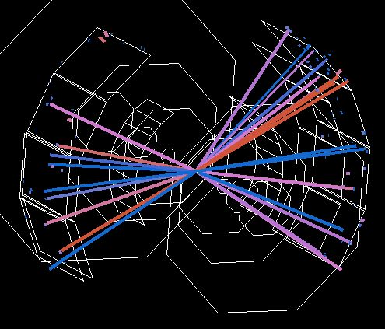
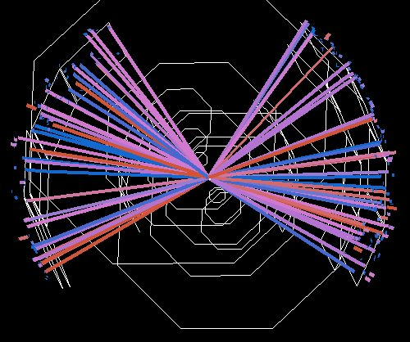
PHENIX Results from the RHIC Beam Energy Scan Program
Jeffery T. Mitchell
Brookhaven National Laboratory

Slide 2
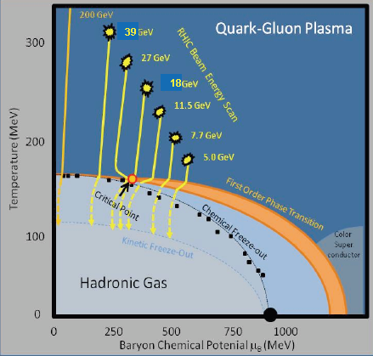
Search for the QCD Critical Point: Experimental Strategy
By systematically varying the RHIC beam energy, heavy ion collisions will be able to probe different regions of the QCD phase diagram.
2

Slide 3
The RHIC Beam Energy Scan Program: Overview
Species: Gold + Gold
Collision Energies [sqrt(s_{NN})]:
200 GeV (2010), 130 GeV, 62.4 GeV (2010),
39 GeV (2010), 27 GeV (2011 this week), 19.6 GeV (2011),
11 GeV (2010, STAR only)
9.2 GeV (2009, short test run), 7.7 GeV (2010)
Species: Copper + Copper
Collision Energies [sqrt(s_{NN})]:
200 GeV, 62.4 GeV, 22 GeV
Species: Deuteron + Gold
Collision Energies [sqrt(s_{NN})]:
200 GeV
Species: Proton + Proton
Collision Energies [sqrt(s_{NN})]:
500 GeV, 200 GeV, 62.4 GeV
3

Slide 4
PHENIX RHIC Beam Scan Results
Energy Loss: π⁰ R_{AA}, φ R_{AA}
J/Ψ : Yield, R_{CP}
Flow: v₂, v₃, v₄, participant quark scaling
Critical point signatures
4

Slide 5
Searching for the Onset of Deconfinement: Energy Loss Measurements
5

Slide 6
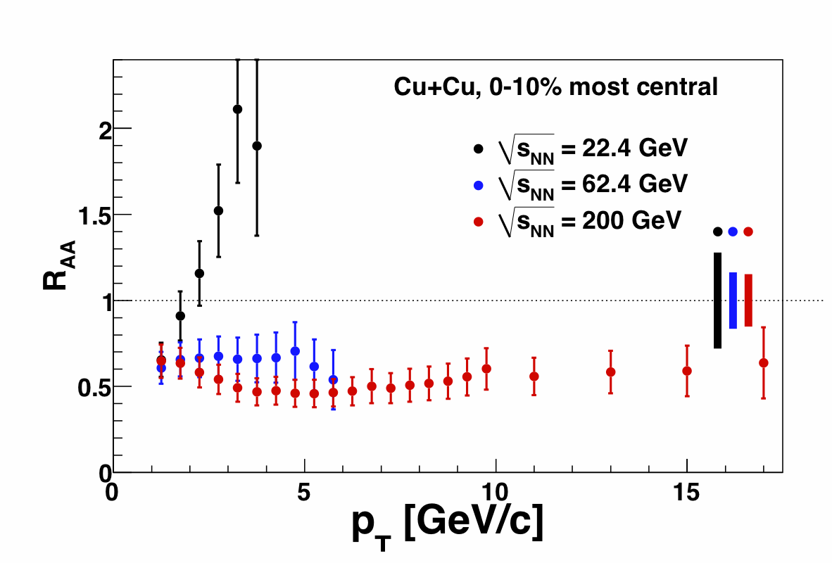
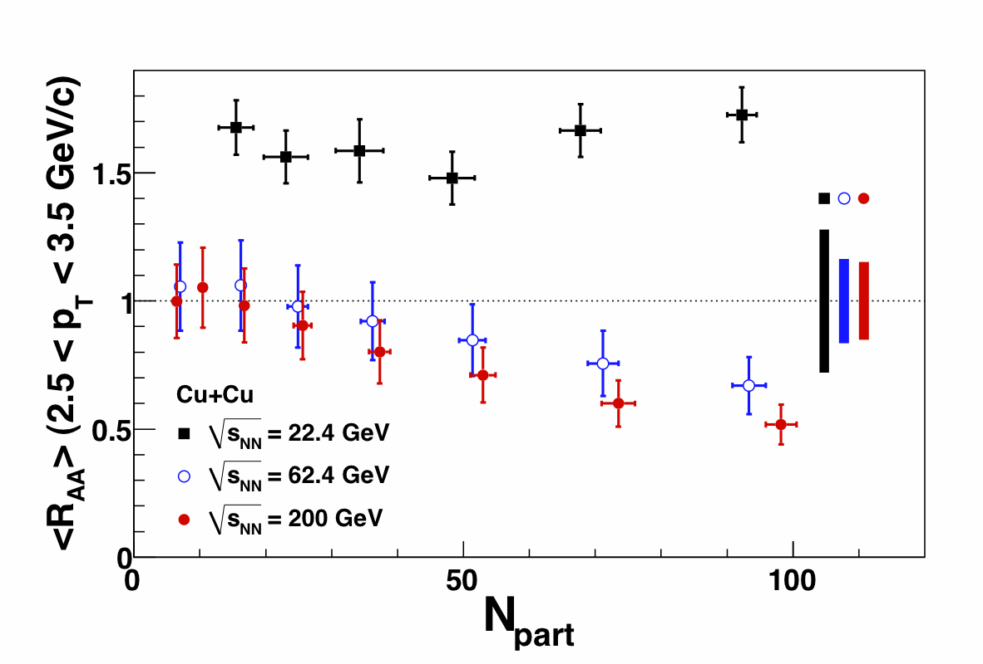
PHENIX Energy Loss Measurements in the Beam Energy Scan: π⁰
In Au+Au at 200 GeV:
Strong suppression (x5) in central Au+Au collisions
No suppression in peripheral Au+Au collisions
No suppression (Cronin enhancement) in control d+Au collisions
Convincing evidence for final state partonic interactions → emergence of sQGP
From the Cu+Cu energy scan:
Significant suppression at √s_{NN} = 200 and 62.4 GeV
Moderate enhancement at √s_{NN} = 22.4 GeV
PRL101, 162301
6

Slide 7
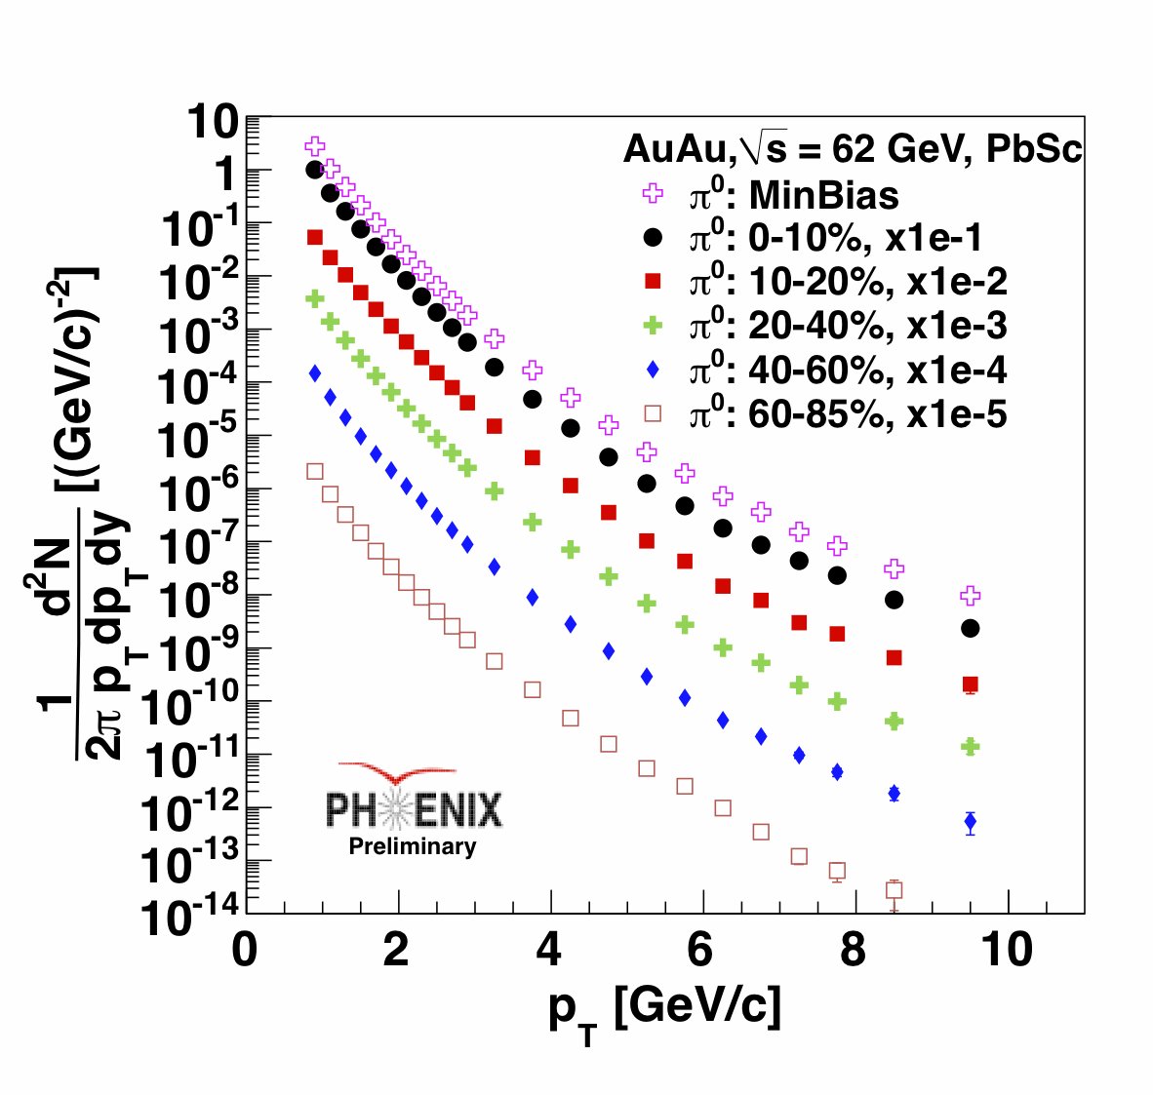
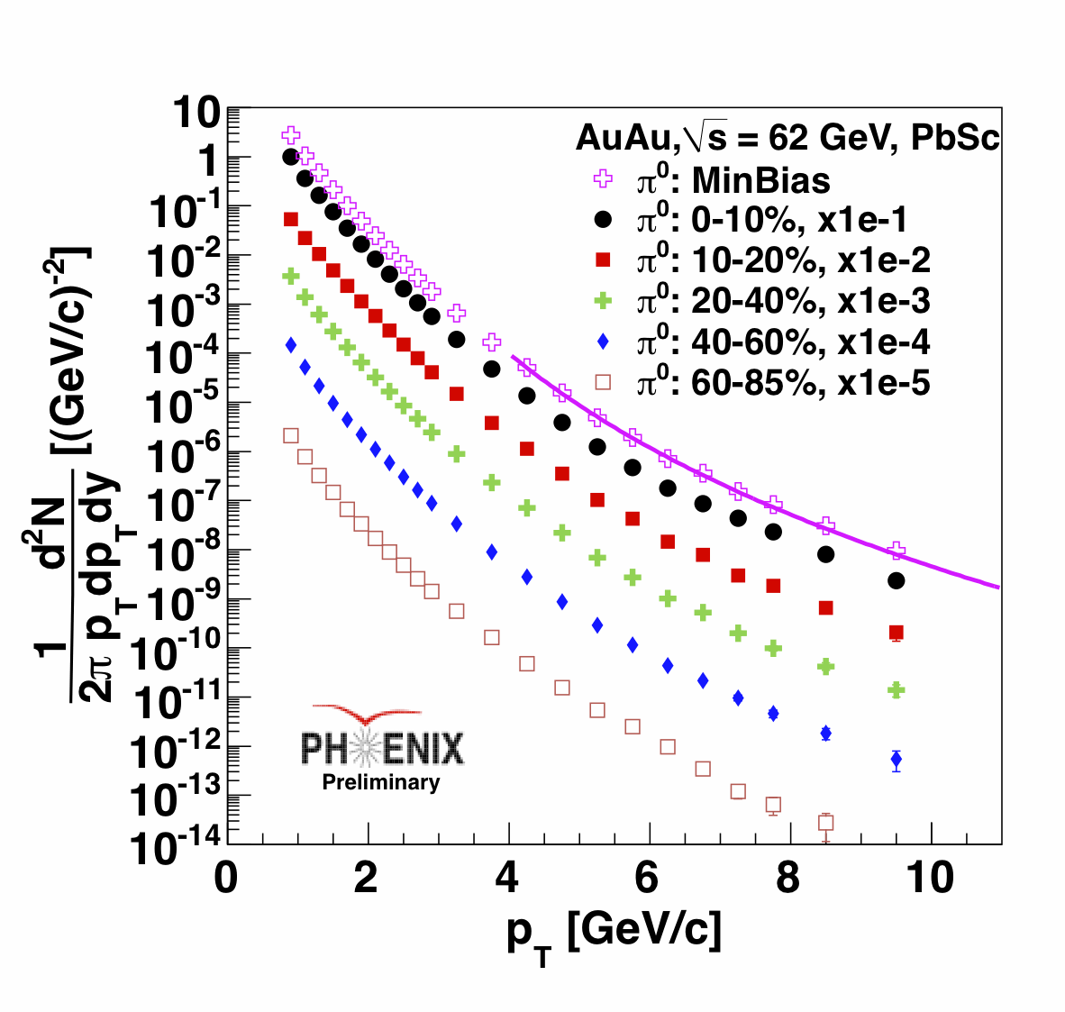
π⁰ invariant yields:
Au+Au Collisions at 62.4 GeV
62.4 GeV
At lower √s the contribution from some processes are larger:
Running a(Q²)
PDF evolution
k_{T} smearing
Higher-twist phenomena
7

Slide 8
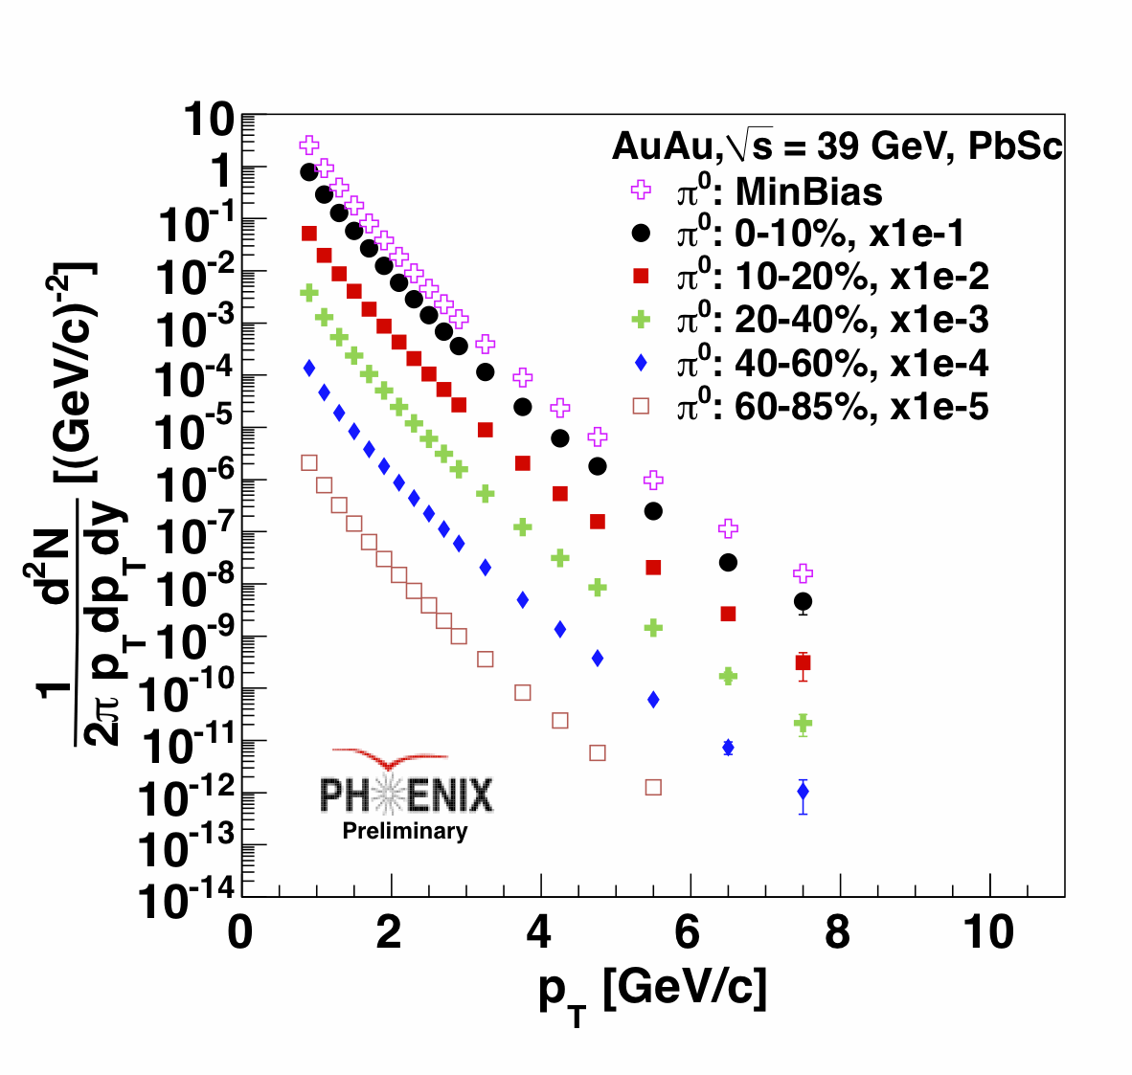
π⁰ invariant yields:
Au+Au Collisions at 39 GeV
39 GeV
The minimum bias spectra are fit with a power-law shape function for p_{T} > 4 GeV/c :
n_{200GeV}=8.1 ± 0.03
n_{62GeV} =10.9 ±0.03
n_{39GeV} =12.1 ± 0.1
8

Slide 9
Nuclear Modification Factor
For the R_{AA} measurement, obtaining a p+p reference from the same experiment is vital. External references increase systematic errors.
  62.4 GeV p+p data is available from PHENIX, however only up to p_{T} < 7 GeV/c (heavy-ion up to 10 GeV/c)
  39.0 GeV p+p data is not yet available from PHENIX, but it is on our to-do list
    Because of that we used data from a fixed target p+p experiment at the Tevatron, E0706 (√s = 39 GeV, PRD68: 052001, 2003).
9

Slide 10
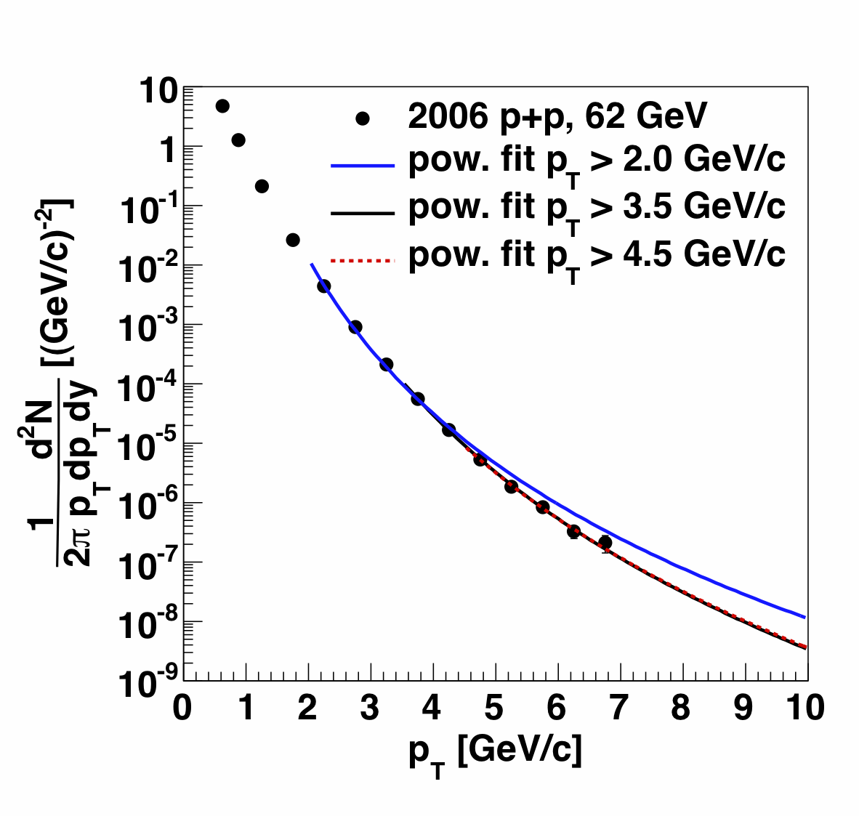
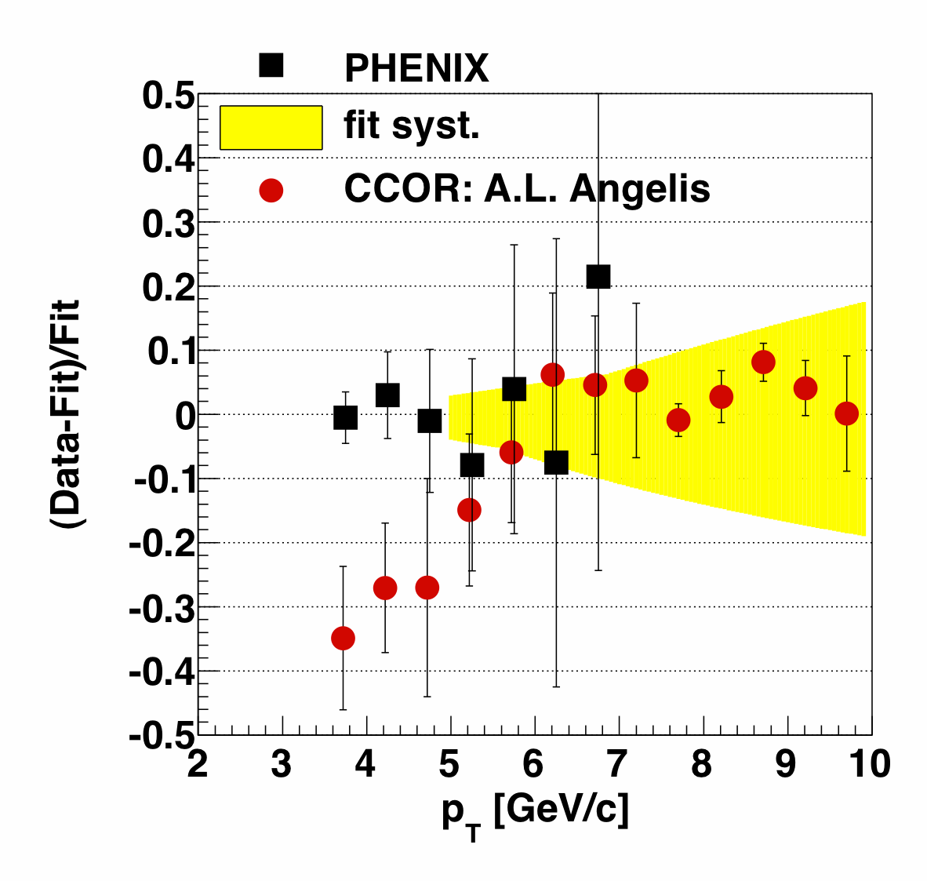
62.4 GeV p+p reference extrapolation
Data from PHENIX for p+p collisions are available up to p_{T} < 7 GeV/c
To extrapolate to higher p_{T} points, a power-law function was used:
  The limit of the fits is vital,
  Contributing to the systematic errors.
The systematic uncertainty is calculated from the errors of the power-law fit
It agrees well with the CCOR data (ISR) in p_{T} 7-10 GeV/c region
10

Slide 11
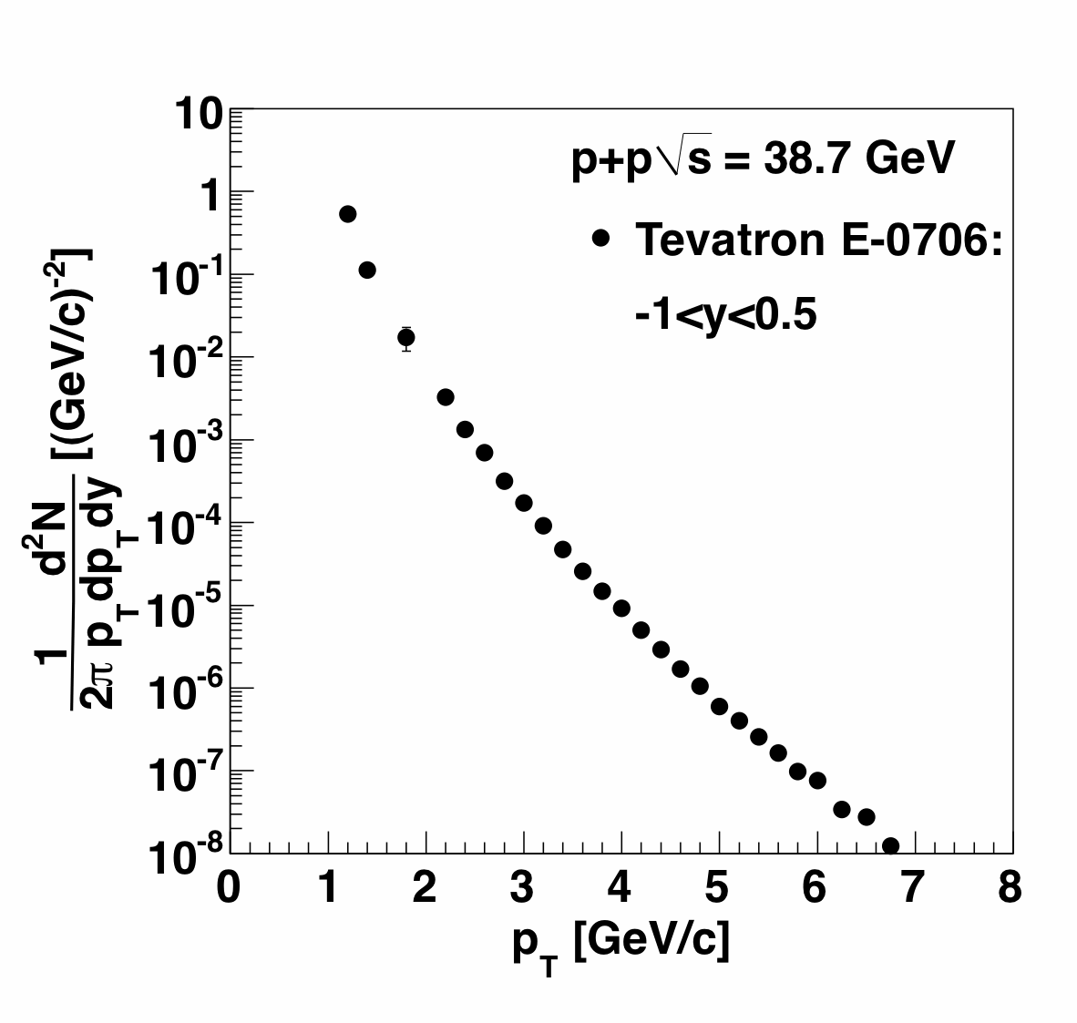
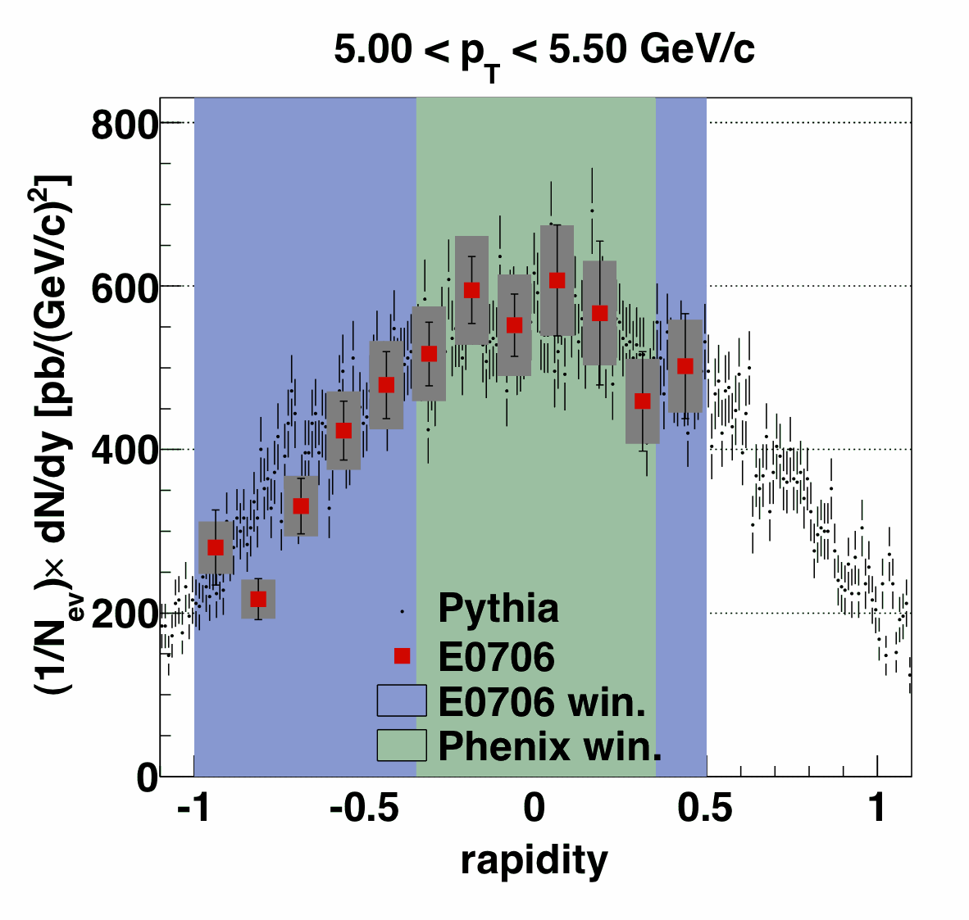
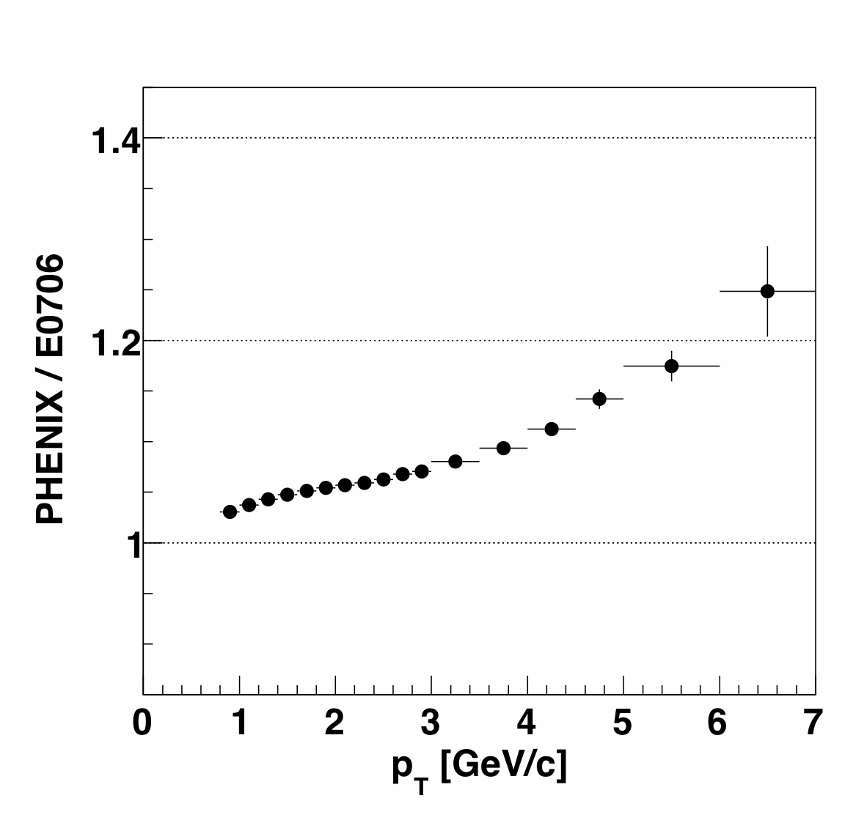
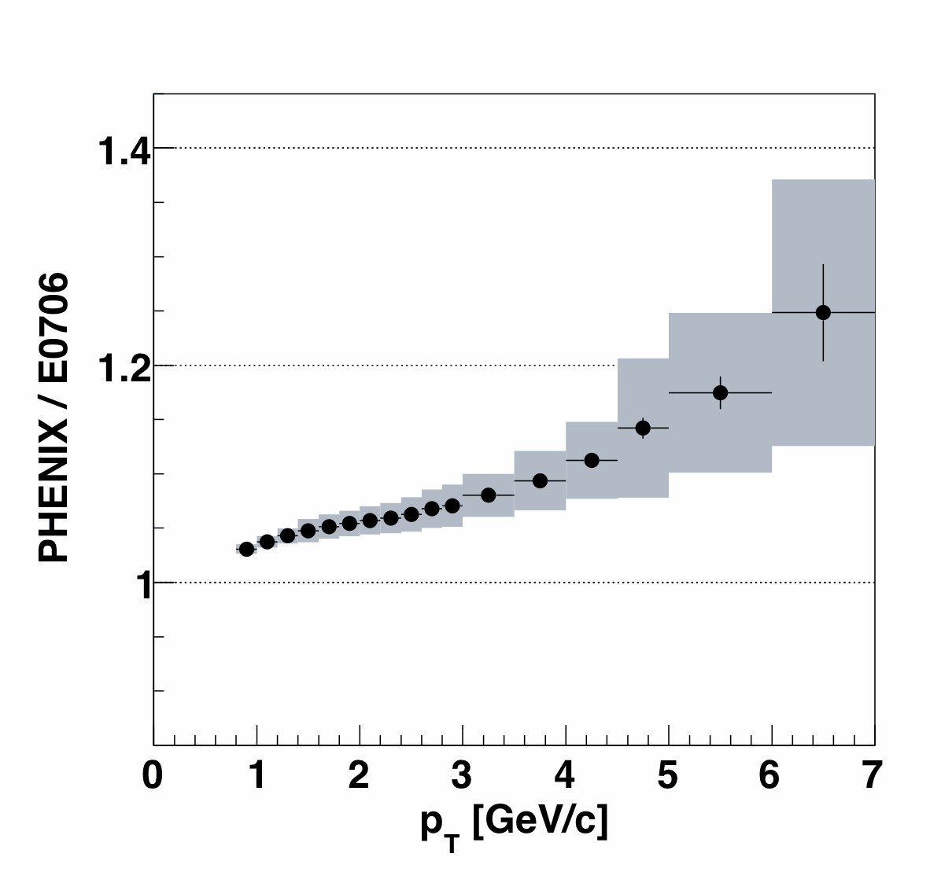
39 GeV p+p reference
p+p data are measured only in the fixed-target experiment E0706 at the Tevatron at a beam energy of 800 GeV. (Phys.Rev.D68:052001,2003)
The E0706 has a different rapidity acceptance:
-1.0 < y < 0.5 (PHENIX |y|<0.35).
Acceptance correction based on a PYTHIA8 simulation.
The systematic uncertainty of the correction function is calculated based on the data to PYTHIA8 comparison.
Acceptance correction function
E0706 ➔ PHENIX
11

Slide 12
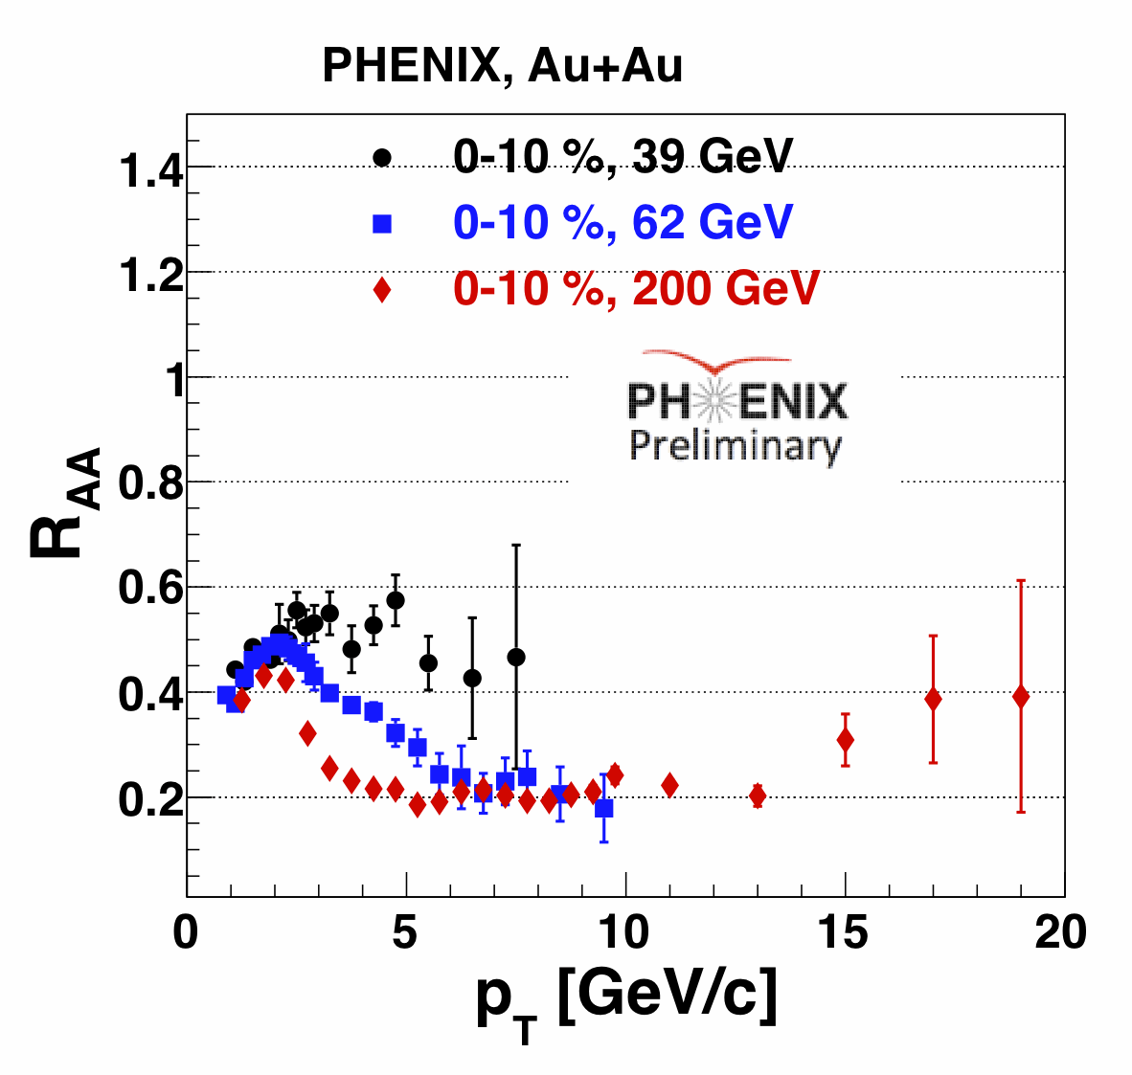
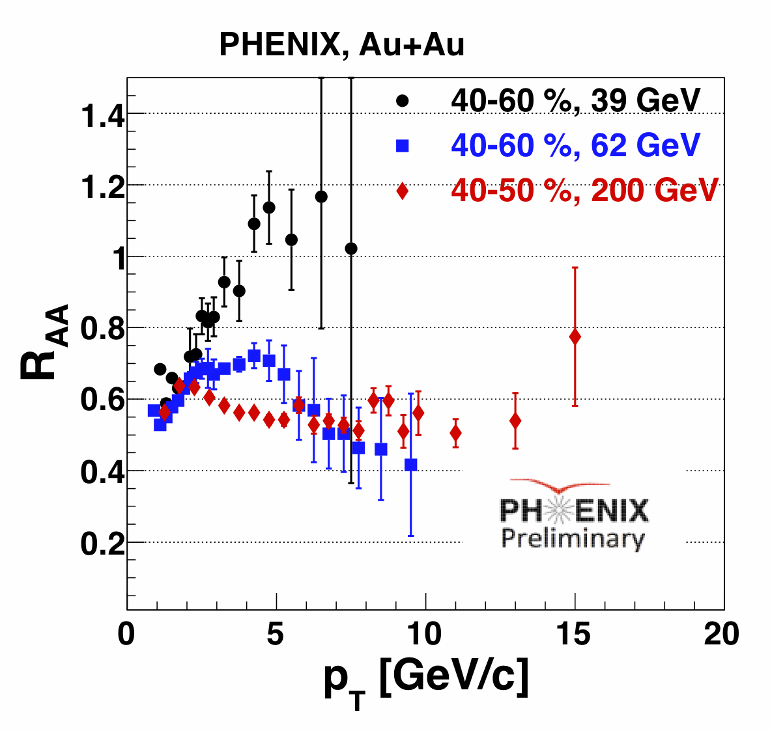
π⁰ R_{AA} in Au+Au at 39 and 62 GeV
π⁰ R_{AA} as a function of p_{T} in PHENIX at √s_{NN} = 39, 62 and 200 GeV.
Still observe a strong suppression (factor of 2) in the most central √s_{NN} = 39 GeV collisions.
R_{AA} from √s_{NN} = 62 GeV data is comparable with the R_{AA} from √s_{NN} = 200 GeV for p_{T} 6 >GeV/c.
Peripheral √s_{NN} = 62 and 200 GeV data show suppression, but the √s_{NN} = 39 GeV does not.
12

Slide 13
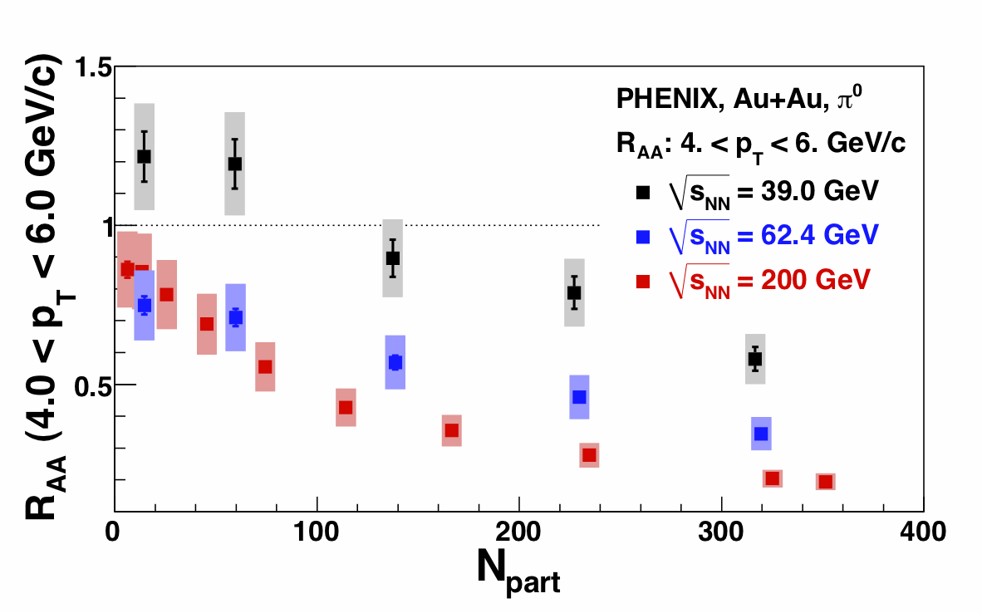
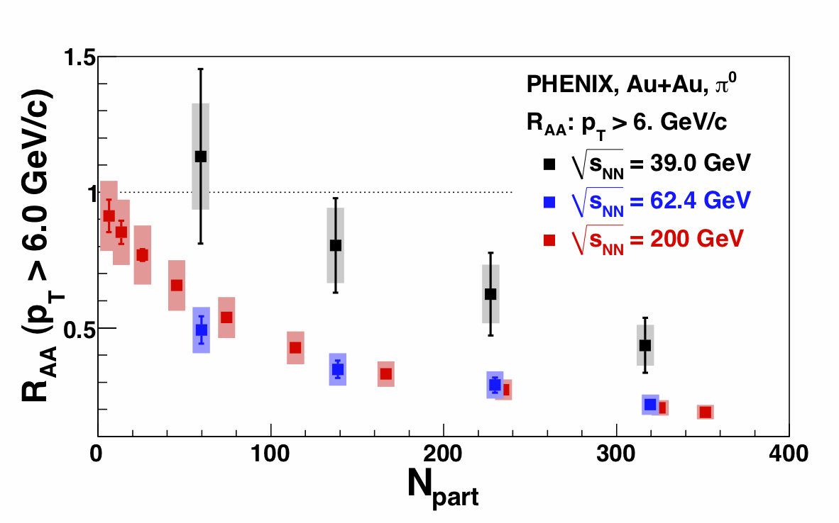
R_{AA} : Centrality Dependence
At higher p_{T} ranges, the 62 GeV points are comparable to the 200 GeV points in all centralities.
R_{AA} evolution in Au+Au at √s_{NN} = 39, 62 and 200 GeV:
62-200 GeV shows a large suppression
39 GeV shows suppression only in N_{part}>100
13

Slide 14
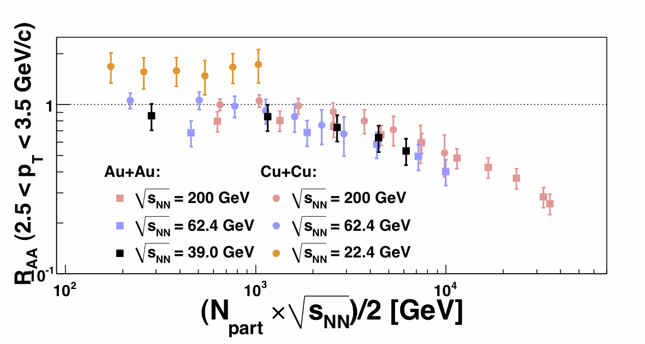
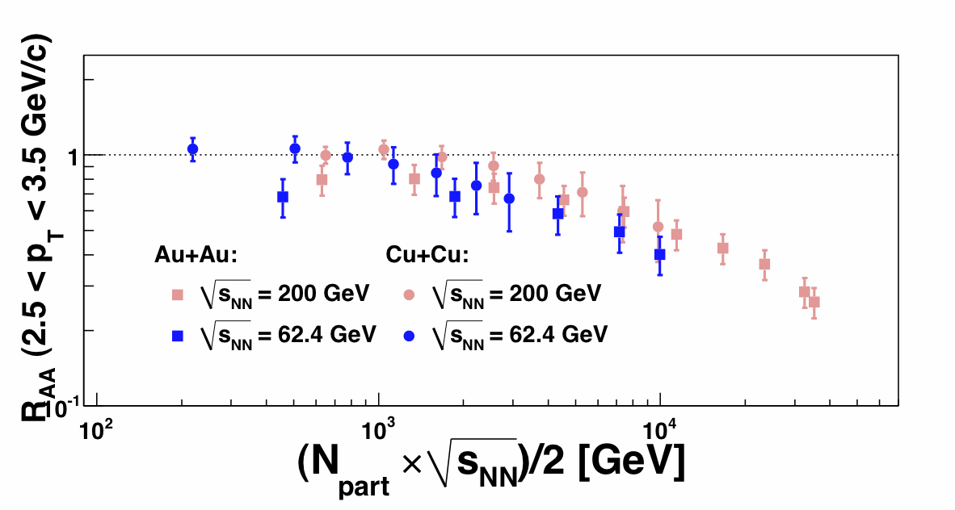
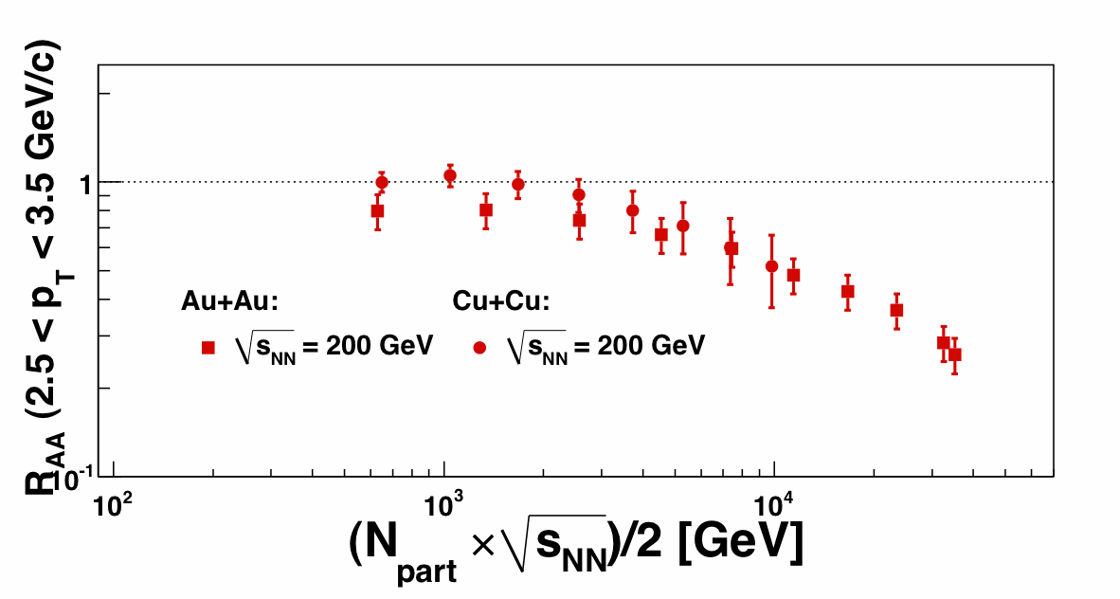
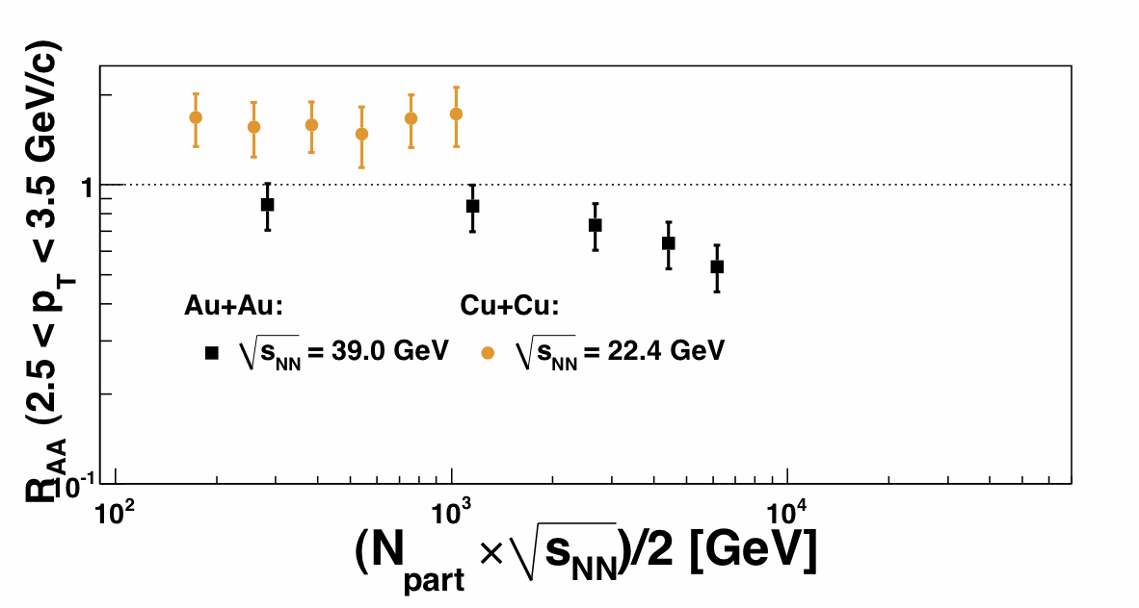
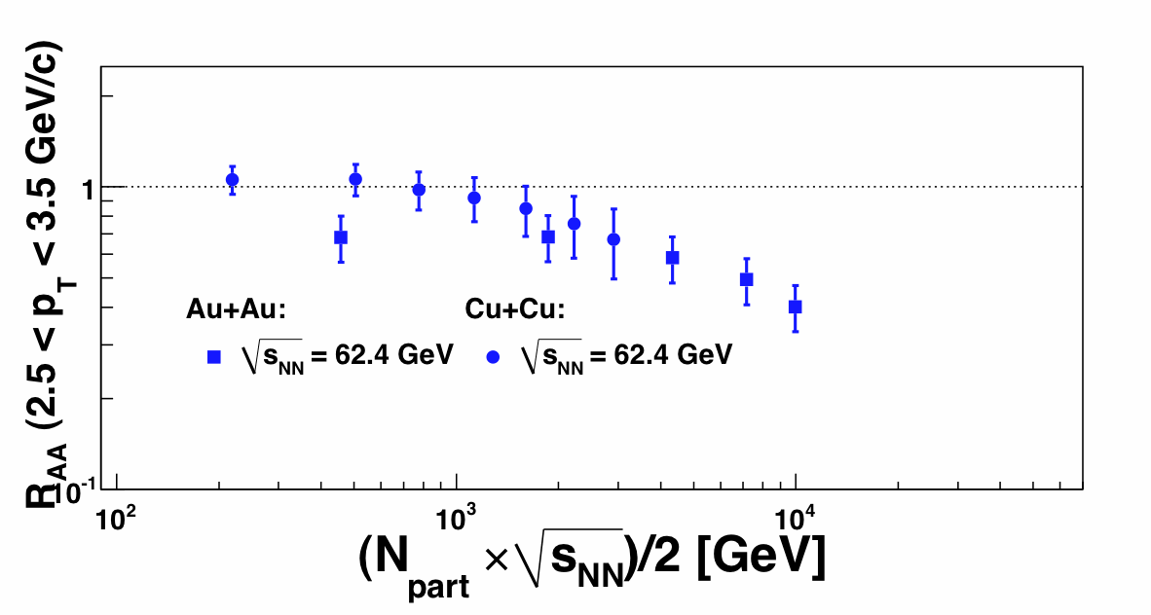
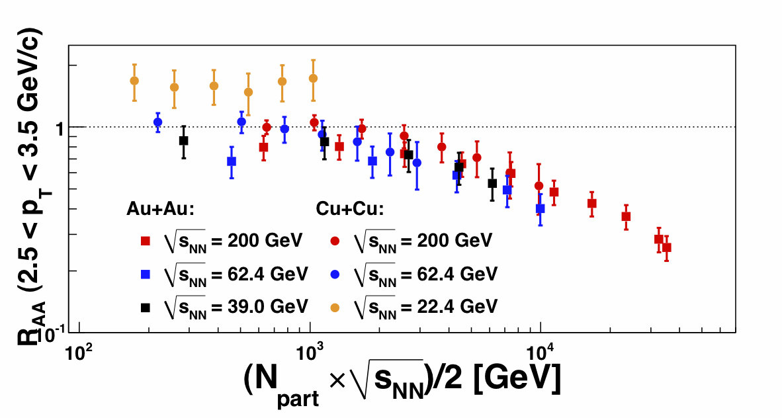
Energy and System-Dependence of π⁰ R_{AA}
Total energy available of the collision:
System size:
Circles: Cu+Cu
Squares: Au+Au
SPS, max reach
ONSET OF THE
SUPPRESSION?
The R_{AA} values seem to have the same trend.
SPS, max reach: 2 × 208(Pb) × 17.3 GeV (√s_{NN})/2 = 3598.4 GeV
E_{AA} = 2 – 5 TeV
14

Slide 15
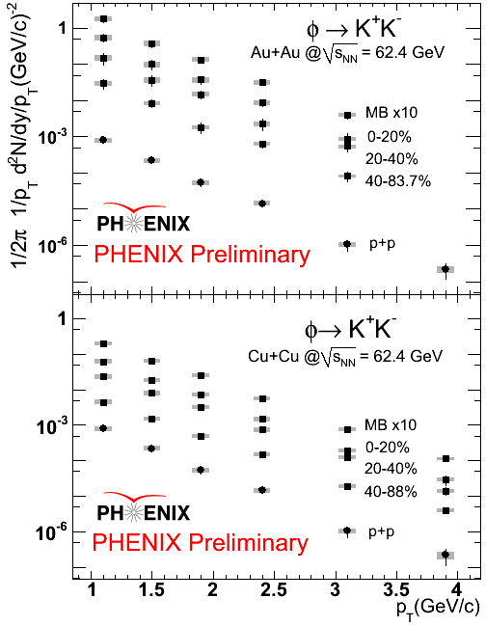
φ→K⁺K⁻ Spectra in 62.4 GeV Au+Au Collisions

Slide 16
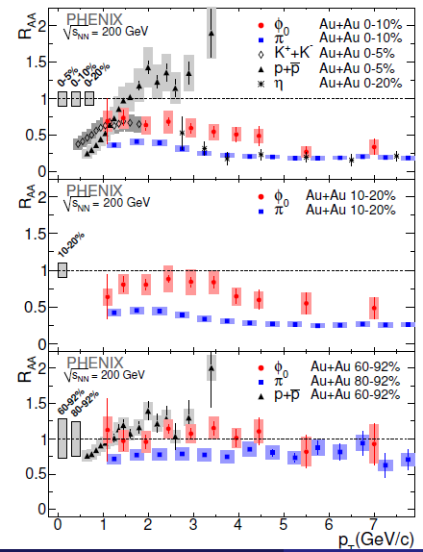
φ→K⁺K⁻ R_{AA} in 200 GeV Au+Au Collisions
The φ is suppressed in central 200 GeV Au+Au collisions.
The R_{AA} of the φ lies between that of the proton and the π⁰.

Slide 17
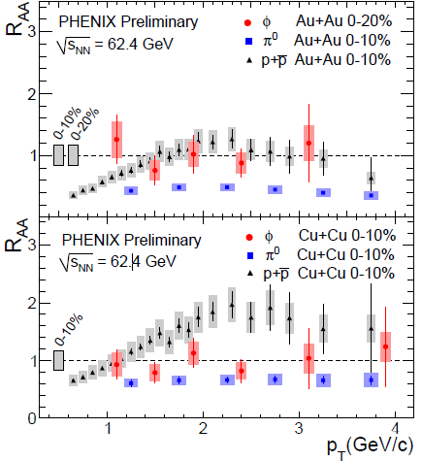
φ→K⁺K⁻ R_{AA} in 62.4 GeV Au+Au Collisions
Within the current precision, no suppression at 62.4 GeV.
Similar to the 200 GeV results, the R_{AA} of the φ lies between that of the proton and the π⁰.
17

Slide 18
Searching for the Onset of Deconfinement: J/Ψ Measurements
18

Slide 19
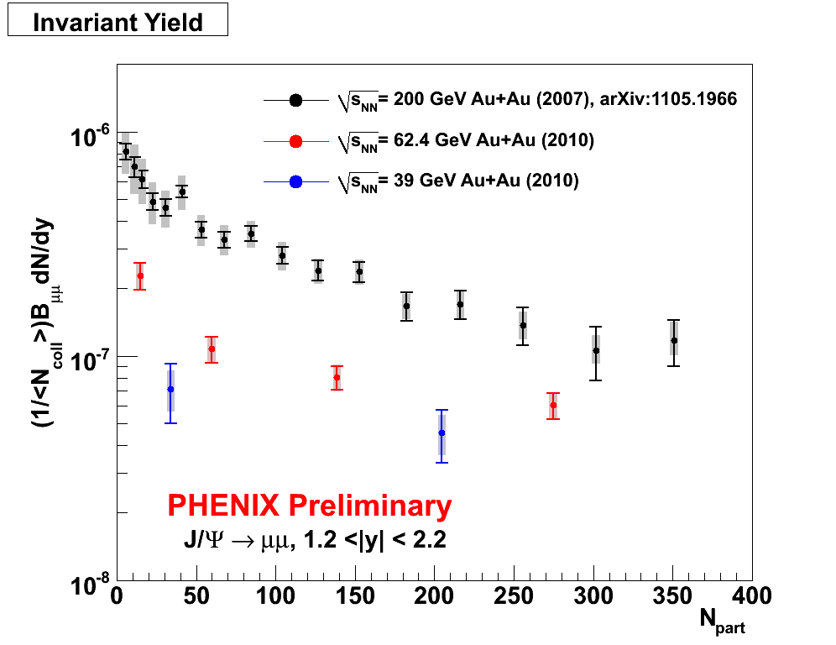
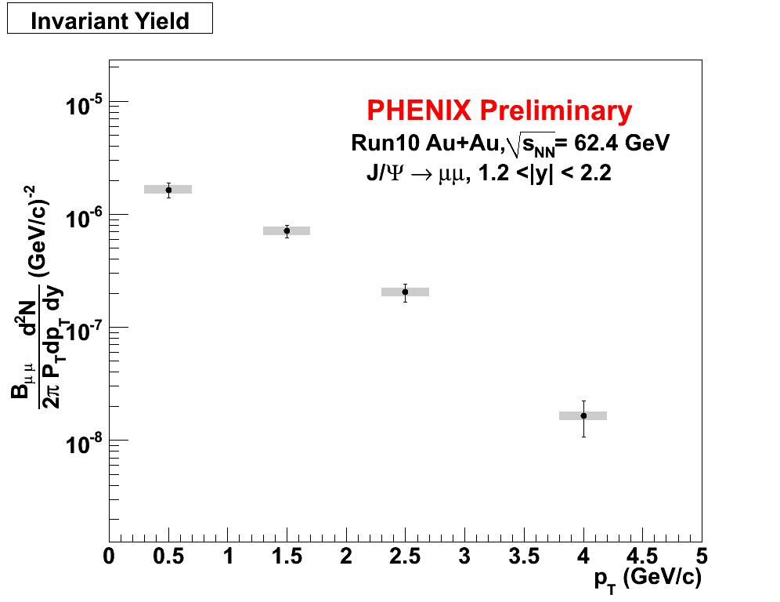
J/ψYields from 62 and 39 GeV Au+Au Collisions
In 2010, PHENIX collected 700M (250M) MB events from 62.4 GeV (39 GeV) Au+Au collision.
Rapidity 1.2 <|y| <2.2
19

Slide 20
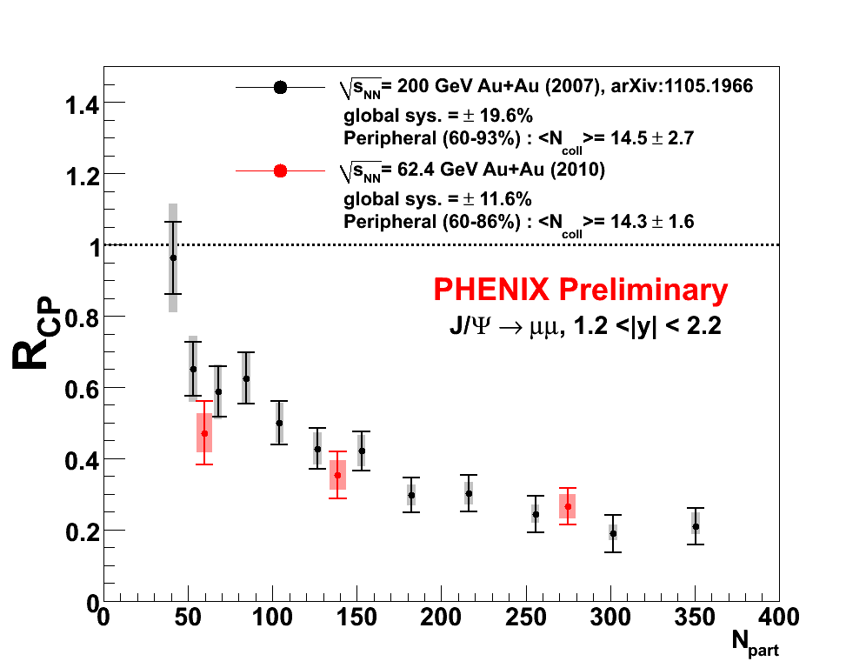
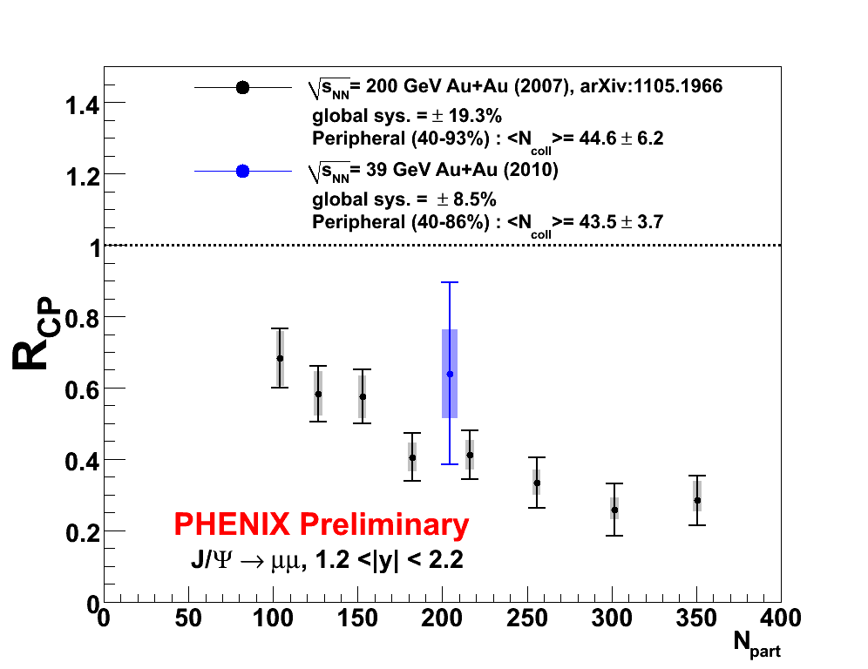
Energy dependence of J/ψ R_{CP}
Rapidity 1.2 <|y| <2.2
PHENIX does not yet have a p+p reference at 62 and 39 GeV.
Lacking a reference, R_{CP} can still give us insight about the suppression level.
The suppression is at a similar level at all energies.
20

Slide 21
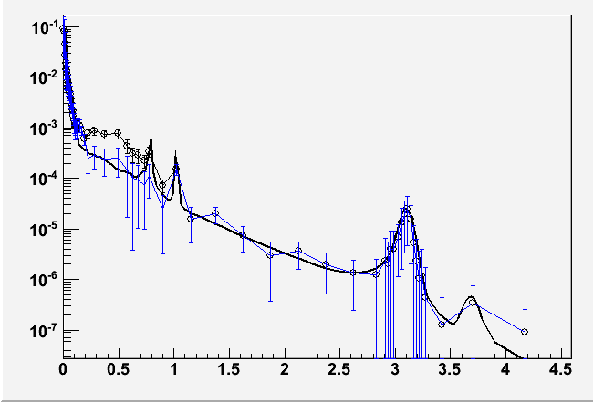
PHENIX Dilepton Expectations at 39 GeV
How does the dilepton excess and ρ modification at SPS
evolve into the large low-mass excess at RHIC?
200M simulated events in ± 20cm vertex
If excess is the same at 39 GeV as 200, expect a 6 σ result
1/N_{evt} dN/dm_{ee}
Black: simulation with same enhancement as at 200 GeV
Blue: no enhancement
m_{ee}
21
Notes:
From Bathe AGS

Slide 22
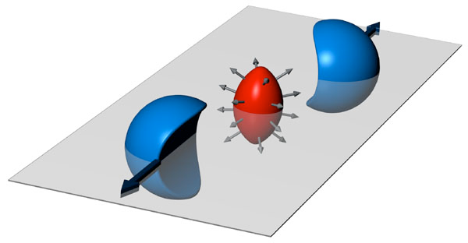
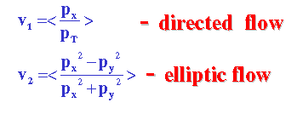
Searching for the onset of deconfinement: Flow Measurements
v₂>0: in-plane emission of particles
v₂<0: squeeze-out perpendicular to reaction plane.
22

Slide 23
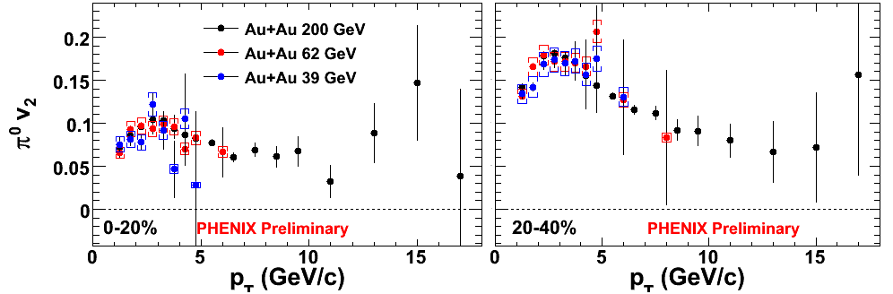
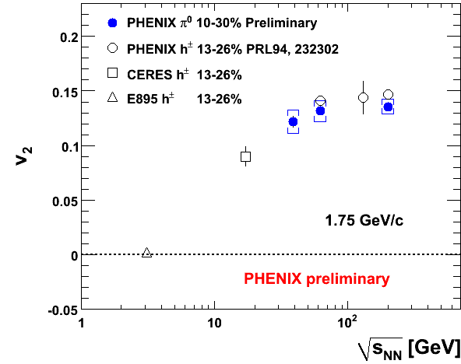
Elliptic Flow at 62 and 39 GeV: π⁰
There is little change in the magnitude of v₂ from 39 GeV to 200 GeV.
23

Slide 24
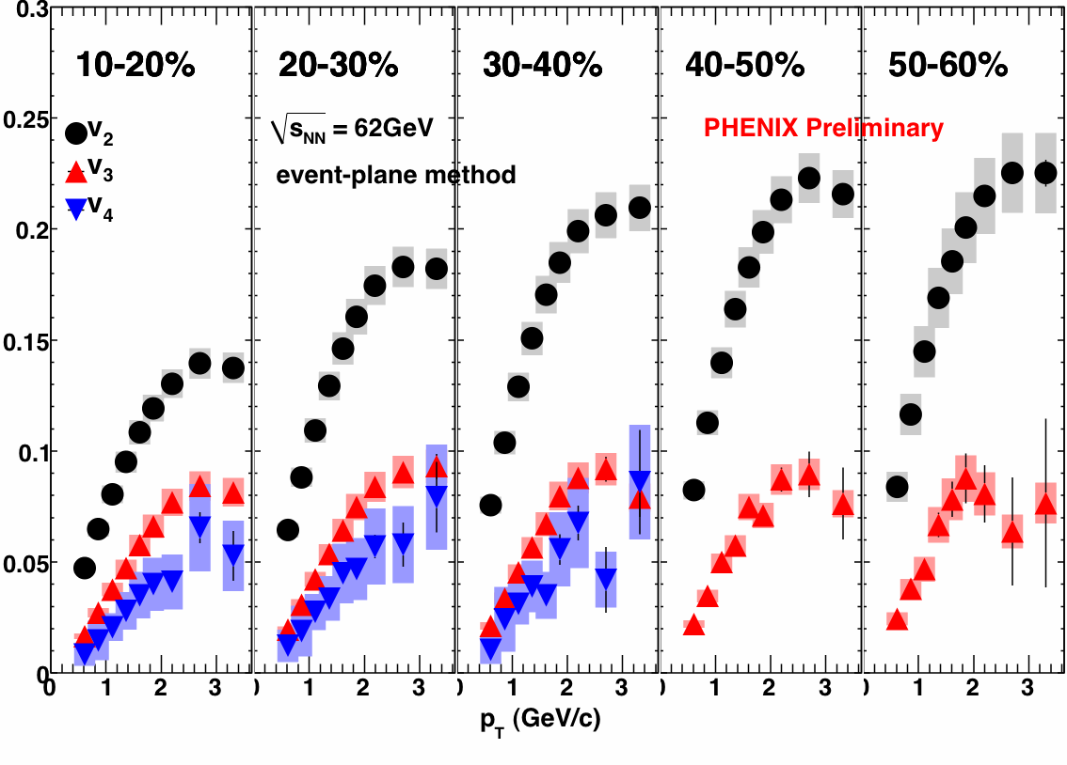
v₂{Φ₂}, v₃{Φ₃}, v₄{Φ₄} at 62 GeV Au+Au
v_{n}
charged particle v_{n} : |η|<0.35
reaction plane Φ_{n} : |η|=1.0~2.8
24

Slide 25
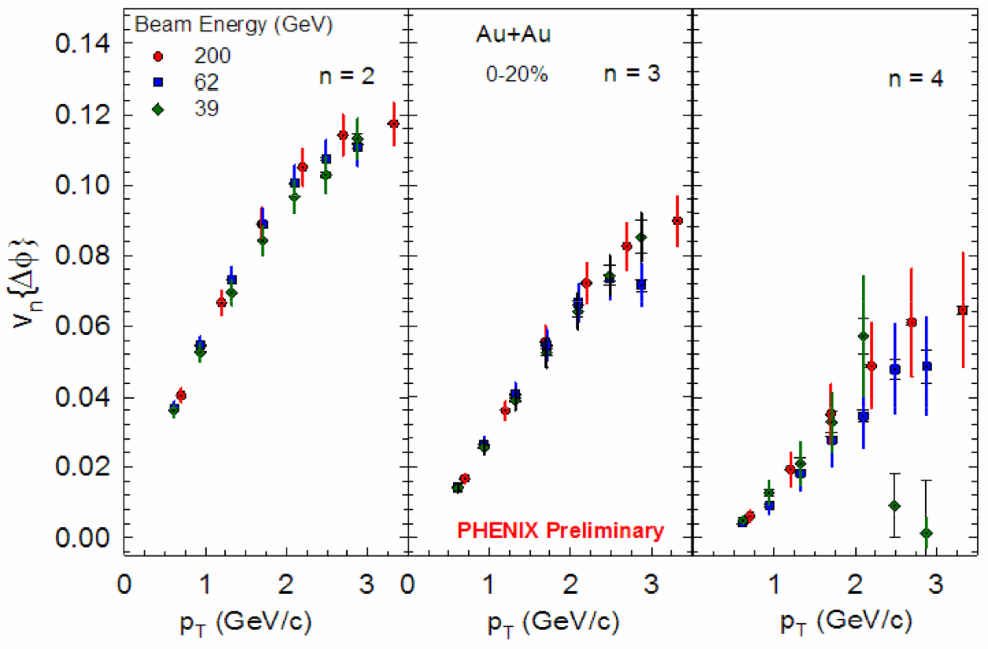
v₂, v₃, v₄ as a function of √s_{NN}
v₂, v₃, v₄ are independent of √s_{NN} for 39, 62.4, 200 GeV
25

Slide 26
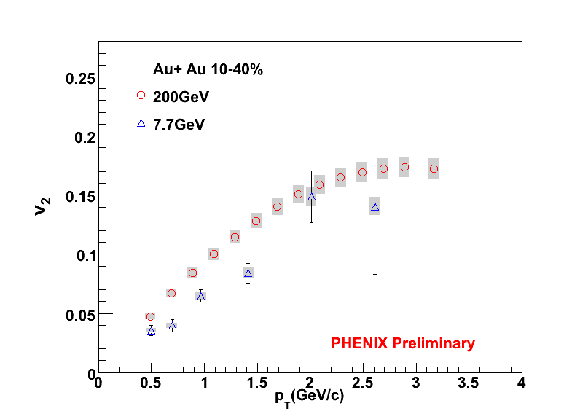
v₂ in 7.7 GeV Au+Au Collisions
The magnitude of v₂ at 7.7 GeV is significantly lower than the magnitudes at 39, 62 and 200 GeV
26

Slide 27
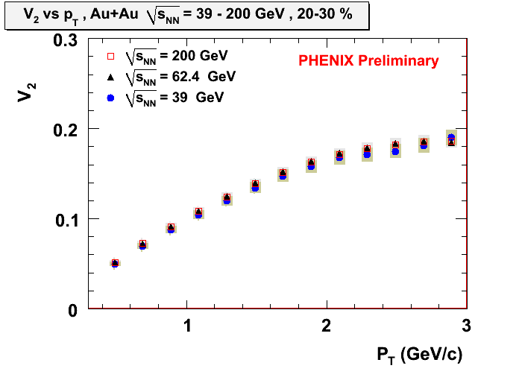
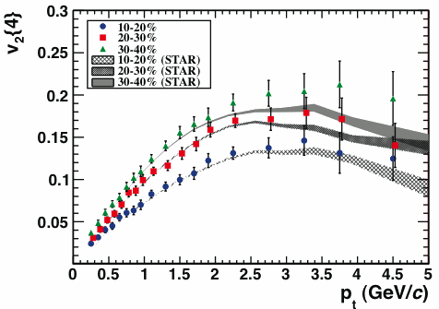
v₂ vs p_{T} from 39 GeV to 2.76 TeV
ALICE Experiment, PRL105,252302 (2010)
This implies that the system demonstrates similar hydrodynamic properties from 39 GeV to 2.76 TeV
27

Slide 28
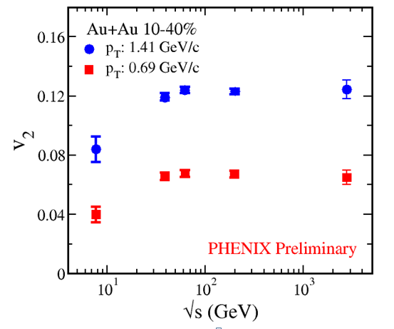
Saturation of v₂ with beam energy
v₂ saturates for a given p_{T} around or below 39 GeV
<v₂> still increases mainly because of the <p_{T}> rise.
Almost perfect fluidity from 39 GeV to 2.76 TeV
28

Slide 29
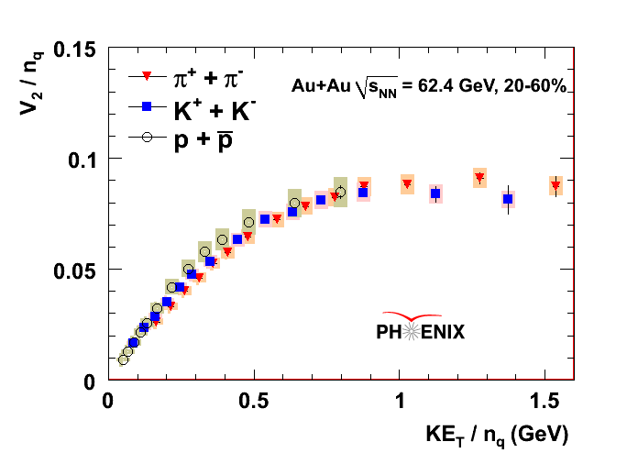
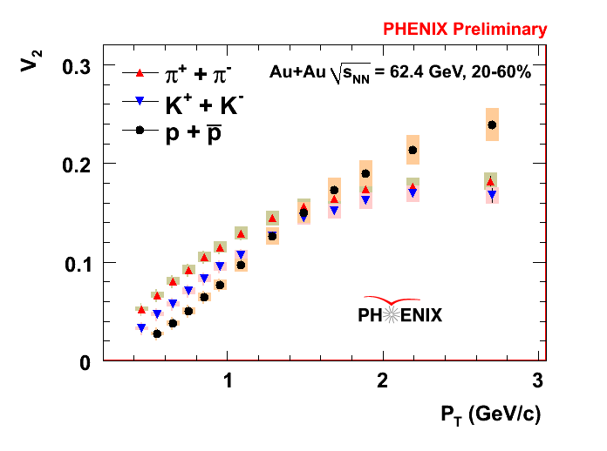
Identified hadron v₂ in 62.4 GeV Au+Au Collisions
PHENIX Preliminary
Partonic collective flow is observed down to 62 GeV and …

Slide 30
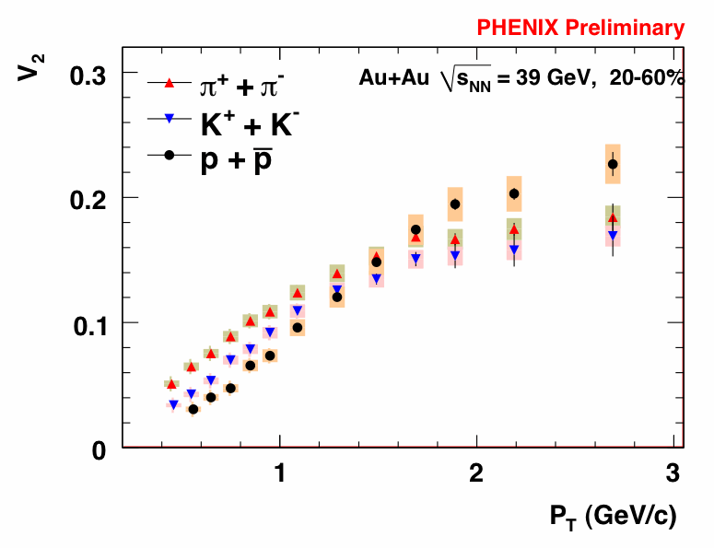
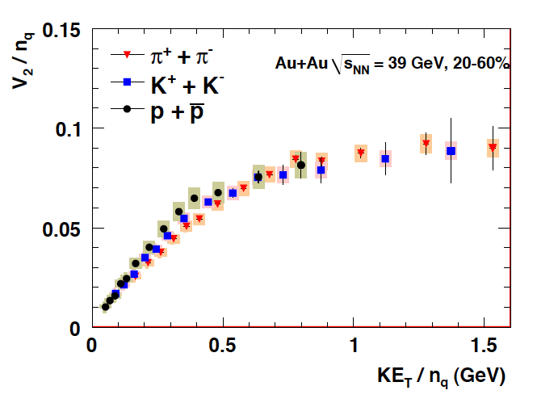
Identified hadron v₂ in 39 GeV Au+Au Collisions
PHENIX Preliminary
PHENIX Preliminary
Partonic collective flow is observed down to 39 GeV
30

Slide 31
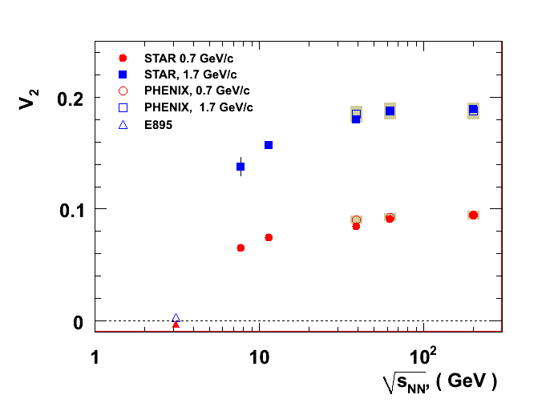
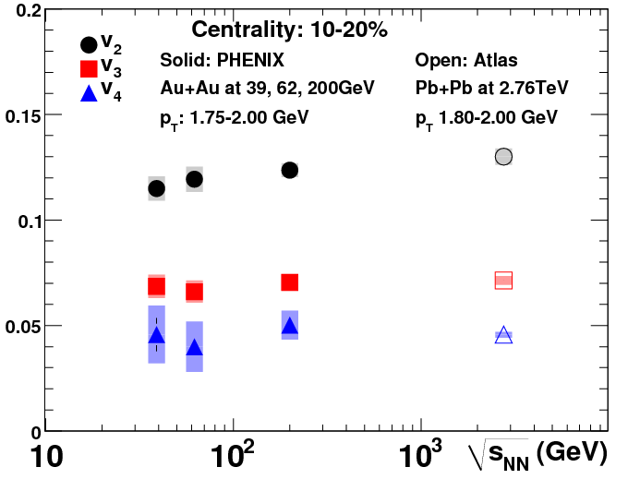
Flow Summary
v₂, v₃ and v₄ are measured in 39, 62 and 200 GeV. The magnitudes are similar.
v₂ of pion, kaon, and (anti)proton show quark number scaling down to 39 GeV.
v₂ saturates in intermediate p_{T}.
These observations suggest similar initial geometry fluctuations and dynamic evolution of nuclear matter above 39 GeV.
v_{n}(Ψ_{n})
Preliminary, STAR, PHENIX and E895 data
?
Data taken at 19.6 and 27 GeV this year will help us fill in the “gap” in the excitation function.
31

Slide 32
Searching for Signatures of the Critical Point: Fluctuations, Correlations
32

Slide 33
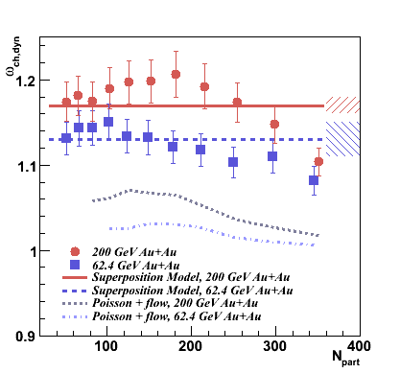
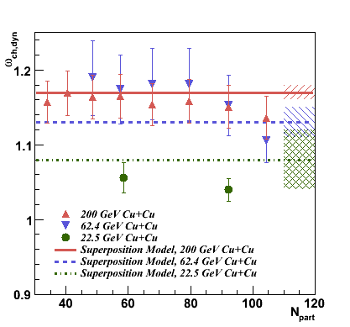

Multiplicity Fluctuations
Near the critical point, the multiplicity fluctuations should exceed the superposition model expectation → No significant evidence for critical behavior is observed. Low energy results are being prepared.
ω_{ch,dyn} = variance/mean, corrected for impact parameter fluctuations.
33

Slide 34


Searching for the Critical Point with HBT Q_{inv} Correlations
T. Csorgo,S. Hegyi,T. Novák,W.A.Zajc,
Acta Phys. Pol. B36 (2005) 329-337
This technique proposes to search for variations in the exponent η.
The exponent η can be extracted by fitting HBT Q_{inv} correlations with a Levy function:
  C(Q_{inv}) = λ exp( -|Rq/hc|^{−α})
α = Levy index of stability = η
α = 2 for Gaussian sources
α = 1 for Lorentzian sources
Measure a as a function of collision energy and look for a change from Gaussian-like sources to a source corresponding to the expectation from the universality class of QCD.
34

Slide 35


Like-Sign Pair Azimuthal Correlations
0.2 < p_{T,1} < 0.4 GeV/c, 0.2 < p_{T,2} < 0.4 GeV/c, |Δ pseudorapidity|<0.1
200 GeV Au+Au, 0-5% Central
PHENIX Preliminary
62 GeV Au+Au, 0-5% Central
PHENIX Preliminary
C(Δφ) = (dN/dφ_{data}/dN/dφ_{mixed})*(N_{events,mixed}/N_{events,data})
Assuming that QCD belongs in the same universality class as the (d=3) 3-D Ising model, the expected value of η is 0.5 (Reiger, Phys. Rev. B52 (1995) 6659 .
The power law function fits the data well for all species and centralities.
35

Slide 36

C(Δπ) Exponent η vs. Centrality
PHENIX Preliminary, Like-Sign Pairs, |Δ pseudorapidity| < 0.1
The exponent η is independent of species, centrality, and collision energy.
The value of η is inconsistent with the d=3 expectation at the critical point.
36

Slide 37
Summary and Outlook
R_{AA}:
  R_{AA} for p_{T}>6 GeV is comparable between 200 and 62 GeV.
  R_{AA} at 39 GeV still shows a large suppression.
  No significant suppression is observed for the φ at 62 GeV.
  Initial measurements show suppression of J/Ψ at 39 and 62 GeV.
Flow:
  v₂ saturates at intermediate p_{T} at 39 and 62 GeV.
  Quark number scaling holds at 39 and 62 GeV.
  v₂ at 7.7 GeV is significantly lower than v₂ at 39 and 62 GeV.
Outlook:
  Many measurements are being analyzed, including:
    multiplicity, net charge, and transverse momentum fluctuations
    local parity violation
    identified particle spectra
    2-particle correlations
    dilepton spectra
  Stay tuned for much more!
37

Slide 38
Auxiliary Slides
38

Slide 39

PHENIX Detector
Central Arm Tracking
Drift Chamber
Pad Chambers
Time Expansion Chamb.
Muon Arm Tracking
Muon Tracker
Calorimetry
PbGl
PbSc
MPC
Particle Id
Muon Identifier
RICH, HBD
TOF E & W
Aerogel
TEC
Global Detectors
BBC
ZDC/SMD Local Polarim.
Forward Hadron Calo.
RXNP
DAQ and Trigger System
Online Calib. & Production
VTX
Replaces HBD
Muon Trigger:
μTr FEE
RPC station 3
39
Notes:
From Jacak BUP

Slide 40


PHENIX 39 GeV Au+Au Event Displays
40

Slide 41

PHENIX 7.7 GeV Au+Au Event Displays
41

Slide 42

Triggering at Low Energy
The problem:
The placement of the trigger detectors (BBCs) are not optimized for low energy running.
They have a reduced acceptance, especially below RHIC energies of ~ 20 GeV.
Fermi motion to the rescue!
At low energies, Fermi motion is enough to bring nucleons back into the BBC acceptance.
42

Slide 43

PHENIX Trigger Performance at 7.7 GeV
Tight timing cut on BBC North vs. South
URQMD AuAu @ 7.7 GeV through PHENIX full simulation
URQMD normalized to match real data integral for PC1 hits > 40.
URQMD not matched to z distribution in real data.
Estimate that the trigger fires on 77% of the cross section.
No indication of deviation of low multiplicity events from background.
PHENIX AuAu @ 7.7 GeV Data
w/ BBCLL1(>0 tubes) |z| < 30 cm
PHENIX AuAu @ 7.7 GeV Data
w/ BBCLL1(>1 tubes) |z| < 30 cm
43
Notes:
From Bathe AGS

Slide 44





Comparison with recent SPS R_{AA}
In previous experiment at WA98 we see only (PRL 100 (2008), 242301) suppression at “ultra”-central (0-1%) collisions of Pb+Pb.
The x_{T} is overlapping between the SPS and RHIC intervals.
The “onset” of the energy loss is dependent on system size and collision energy.
The energy loss is present in lower energies also.
The magenta closed circles are the most comparable with the PHENIX results, as they have the smaller system (p+C) for reference.
The “onset” of the suppression depends on collision energy and centrality or system size (and p_{T})
44

Slide 45




Energy dependence of CNMs
R_{G} for J/ψ production at RHIC
A systematic analysis at y~0 using EKS98 + σ_{breakup} showed a clear collision energy dependence of σ_{breakup}.
1.2 < y < 2.2
|y| < 0.35
-2.2 < y < -1.2
JHEP 0902:014 (2009)
Proper geometry dependence need to be included.
Reduce uncertainties by measuring d+Au at the same energy.
45

Slide 46


E_{AA} dependence on p_{T}
LOW p_{T}
MID p_{T}
periph. data missing
In higher p_{T} the scaling does not work.
shadowing? Bjorken energy density?
HIGH p_{T}
46

Slide 47

Lévy fits to q_{inv} in Central 200 GeV Au+Au
PHENIX PRELIMINARY

Slide 48

How big is the target?
From a hydrodynamics calculation.
For a given chemical freeze-out point, 3 isentropic trajectories (s/n_{B}=constant) are shown.
The presence of the critical point can deform
the trajectories describing the evolution of the
expanding fireball in the (T,μ_{B}) phase diagram.
A large region can be affected, so we do not need to hit the critical point precisely.
M.Asakawa et al.,PRL 101,122302(2008)
48
Notes:
From Melkumov, CPOD 2010

Slide 49

Elliptic Flow: Excitation Function
There is a transition from squeeze-out flow to in-plane flow between AGS and SPS energies
49

Slide 50
Statistical Model Fits
Extracted T & µ_{B} values
early universe
250
200
RHIC
quark-gluon plasma
Lattice QCD
150
SPS
AGS
Chemical Temperature Tch [MeV]
deconfinement
chiral restauration
100
SIS
hadron gas
50
atomic nuclei
neutron stars
0
0
200
400
600
800
1000
1200
Baryonic Potential μ_{B} [MeV]
For √s >≈ 10 GeV , chemical freeze-out very close to phase boundary
50
Notes:
Lacey QM09

Slide 51

Statistical Model Results
Results from different
beam energies
Analysis of particle yields
with statistical models
Freeze-out points reach QGP
phase boundary at top SPS
energies
51
Notes:
From Blume, CPOD 2010

Slide 52

J/ψ: analyzed 25% of 62 GeV statistics
52
Recombination
  (e.g. Rapp et al.)
  J/ψ yield at 200 GeV is dominantly from recombination
Predict suppression greater at 62 GeV
    J/ψ yield down by 1/3
    Recombination down 1/10
per
semi
cen
600 M min. bias events → 500 J/ψ ∴ measure J/ψ suppression
Key test of recombination!
52
Notes:
From Bathe AGS

