Slide 1
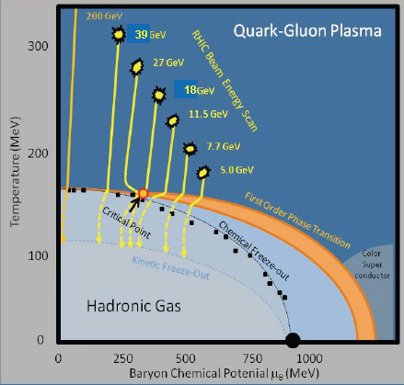
First Results from the RHIC Beam Energy Scan Program
Jeffery T. Mitchell
Brookhaven National Laboratory

Slide 2
Outline
The QCD Phase Diagram
The RHIC Beam Energy Scan Program
The Matter Created at the top RHIC Energy
Experimental Challenges at Low Energies
Recent Results from the Beam Energy Scan
2

Slide 3
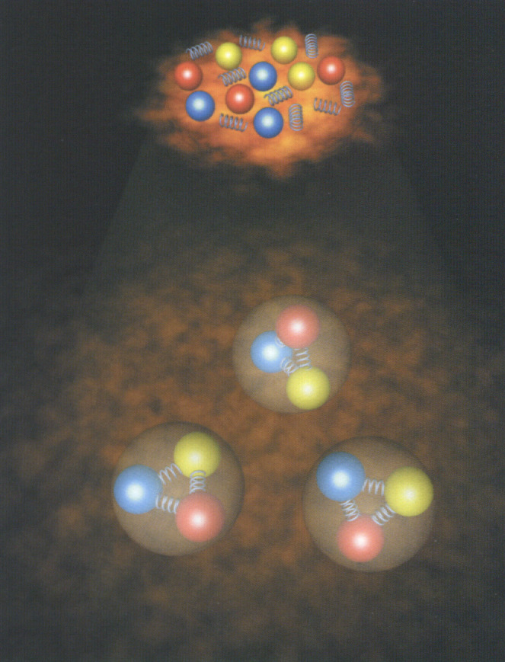
Phases of Nuclear Matter
The original goal of the relativistic heavy ion program was to create matter at high enough temperature and pressure that nucleons and mesons would decouple into quarks and gluons. Effectively, we strive to recreate the conditions immediately after the Big Bang.
3
Notes:
From Bratkovskaya, CPOD 2010

Slide 4
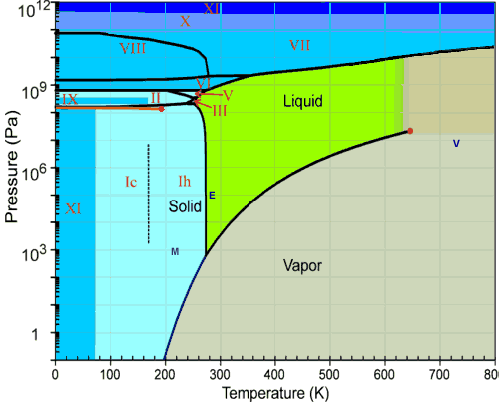
The Phase Diagram of H₂O
There are many similarities between the phase diagrams of H₂O and QCD…
Critical Point
Crossover
First order phase transition
4
Notes:
From Lacey QM09

Slide 5
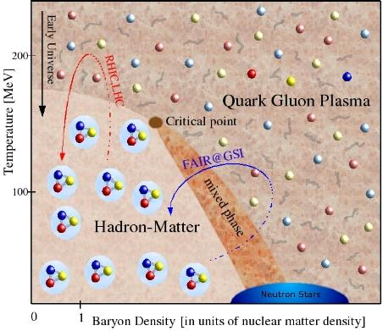
A Schematic Phase Diagram of QCD
There are many similarities between the phase diagrams of H₂O and QCD…
Crossover
Critical Point
First order phase transition
5

Slide 6
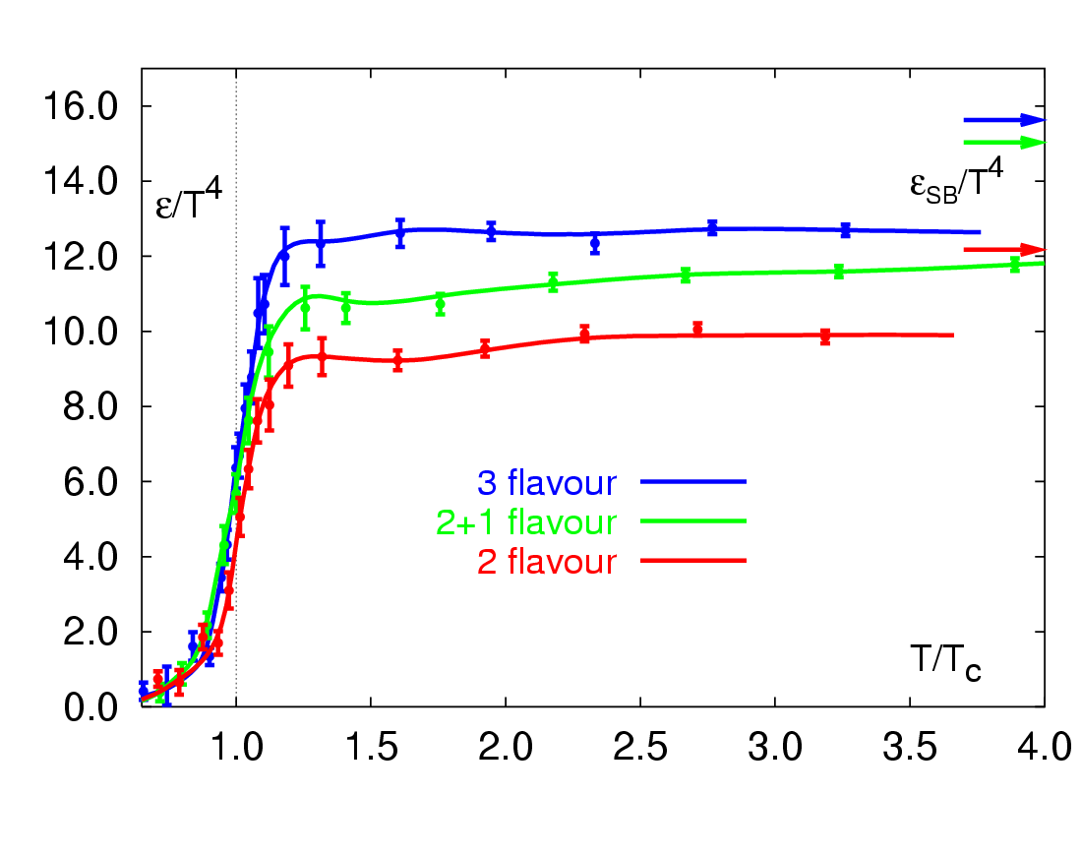
QCD Phase Transition
Quantum Chromodynamics (QCD) predicts a strong increase in the energy density ε at a critical temperature of T_{c}~170 MeV.
There is a phase transition from hadronic to partonic matter (quarks, gluons) at a critical energy density of ε₀~1 GeV/fm³
Z. Fodor et al., PLB 568 (2002) 73.
6
Notes:
From Bratkovskaya, CPOD 2010

Slide 7
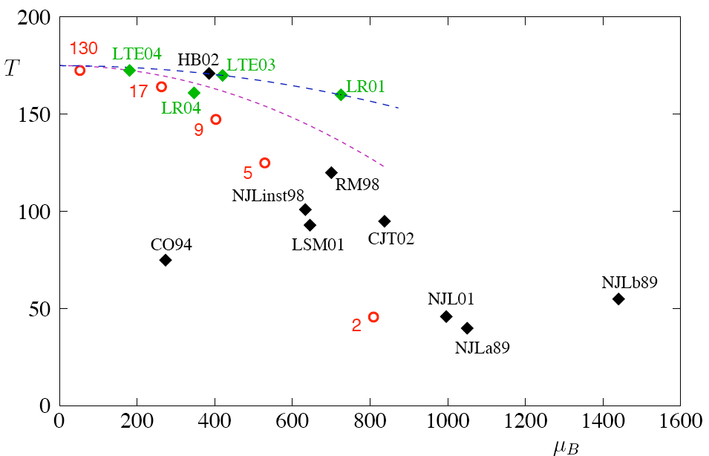
But, there is much room for experimental input…
Each black and green point represents the critical point location from different calculations.
Large sensitivity
to model inputs
(such as quark
masses), lattice
sizes, and other
assumptions
M. Stephanov hep-lat/0701002
7

Slide 8
Search for the QCD Critical Point: Experimental Strategy
By systematically varying the RHIC beam energy, heavy ion collisions will be able to probe different regions of the QCD phase diagram.
8

Slide 9
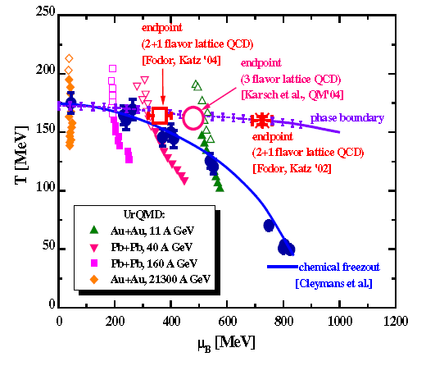
Simulated Collision Trajectories
Shown are locations on the phase diagram for collisions at different energies taken at various times after the collision occurs.
The simulation is from Ultra-Relativistic Quantum Molecular Dynamics (UrQMD).
9
Notes:
From Bratkovskaya, CPOD 2010

Slide 10
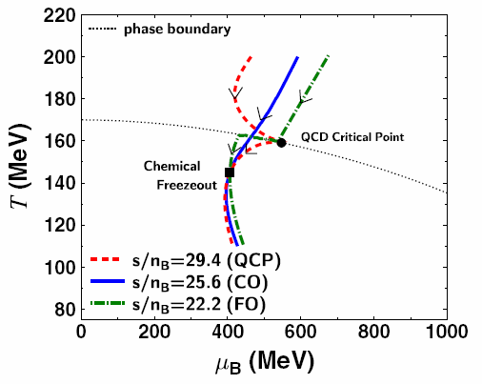
How big is the target?
From a hydrodynamics calculation.
For a given chemical freeze-out point, 3 isentropic trajectories (s/n_{B}=constant) are shown.
The presence of the critical point can deform
the trajectories describing the evolution of the
expanding fireball in the (T,μ_{B}) phase diagram.
A large region can be affected, so we do not need to hit the critical point precisely.
M.Asakawa et al.,PRL 101,122302(2008)
10
Notes:
From Melkumov, CPOD 2010

Slide 11
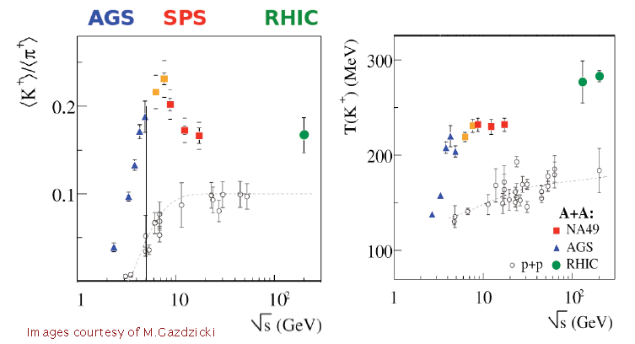
Energy Scan Results from the SPS
Discontinuities in the average K/π ratio (the horn) and the kaon spectra slope (the step) are observed.
11

Slide 12
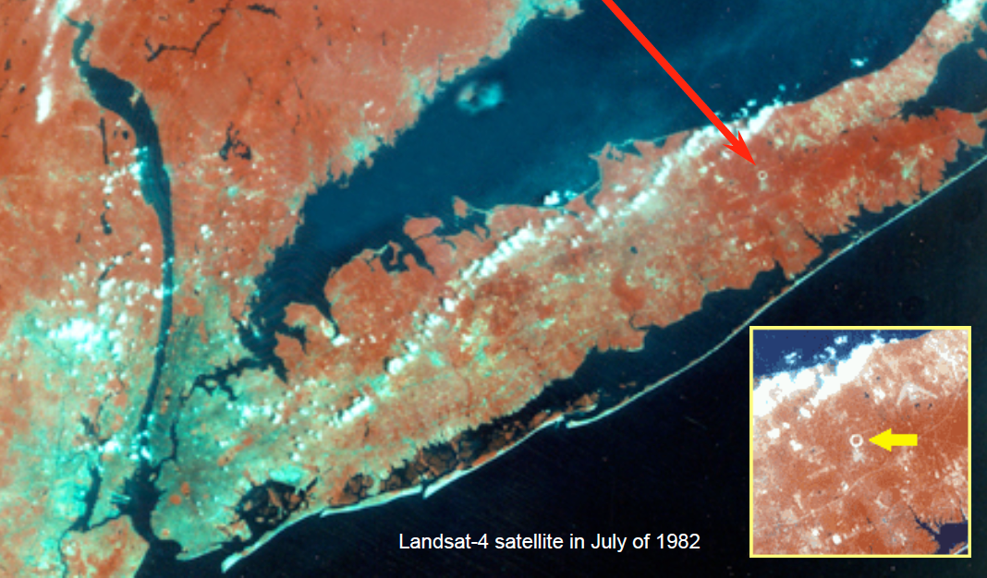
Enter the Beam Energy Scan Program at the Relativistic Heavy Ion Collider
12

Slide 13
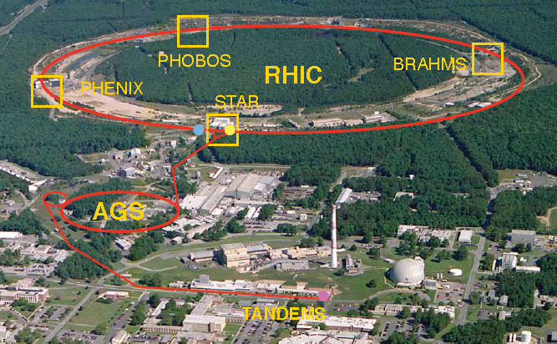
The Relativistic Heavy Ion Collider (RHIC)
13
Notes:
Slide by Mike Lisa

Slide 14
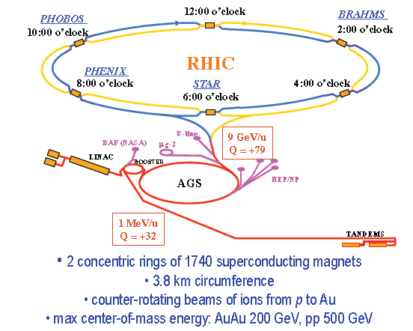
RHIC Specifications
14
Notes:
From Odyniec CPOD 10

Slide 15
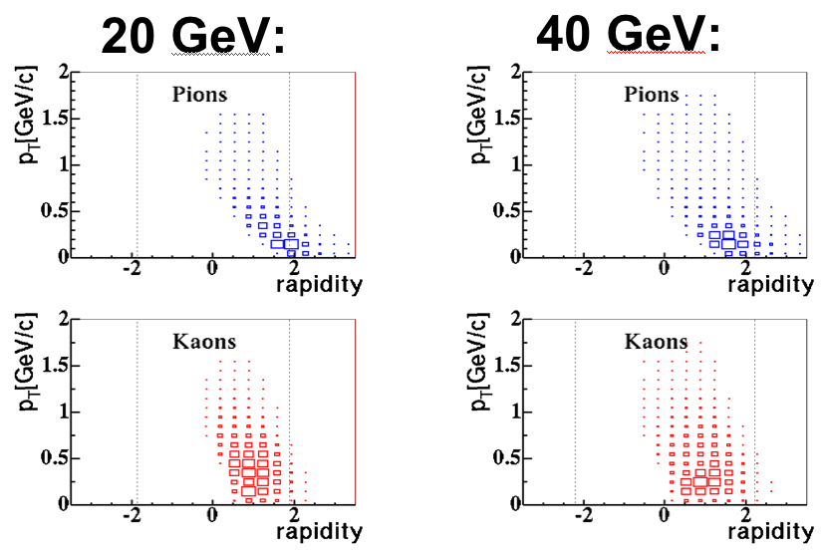
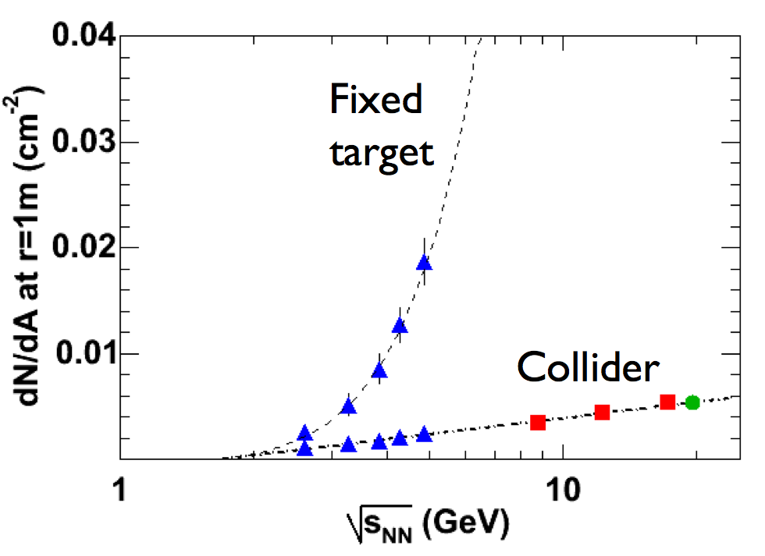
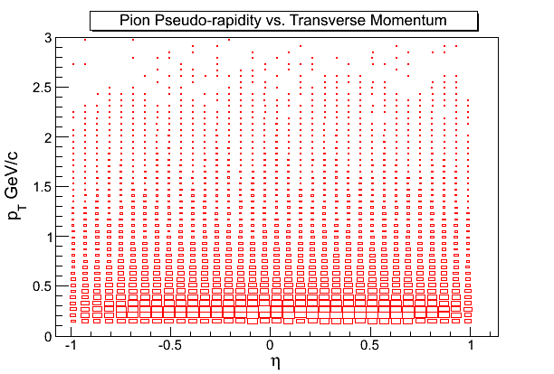
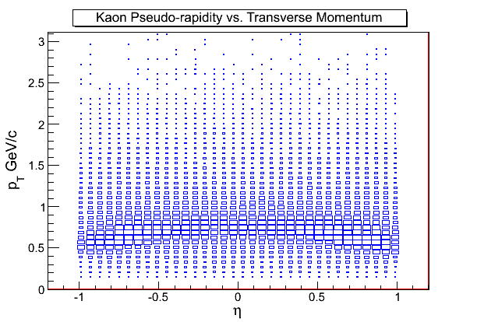
A collider is an excellent for a beam energy scan
Fixed target
Collider
The detector occupancy in a collider is much less dependent on beam energy than in a fixed target accelerator. The acceptance is independent of beam energy.
15
Notes:
From Cebra CPOD 09

Slide 16
The RHIC Beam Energy Scan Program: Overview
Species: Gold + Gold
Collision Energies [sqrt(s_{NN})]:
200 GeV, 130 GeV, 62.4 GeV, 39 GeV, 19.6 GeV,
18 GeV (2011), 11 GeV (STAR only)
9.2 GeV (short test run), 7.7 GeV
Species: Copper + Copper
Collision Energies [sqrt(s_{NN})]:
200 GeV, 62.4 GeV, 22 GeV
Species: Deuteron + Gold
Collision Energies [sqrt(s_{NN})]:
200 GeV
Species: Proton + Proton
Collision Energies [sqrt(s_{NN})]:
500 GeV, 200 GeV, 62.4 GeV
Coming Soon: Uranium + Uranium
16

Slide 17
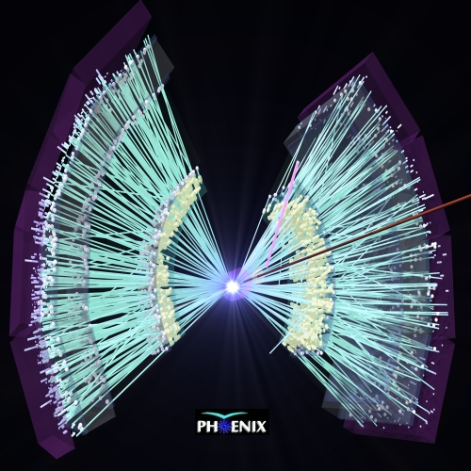
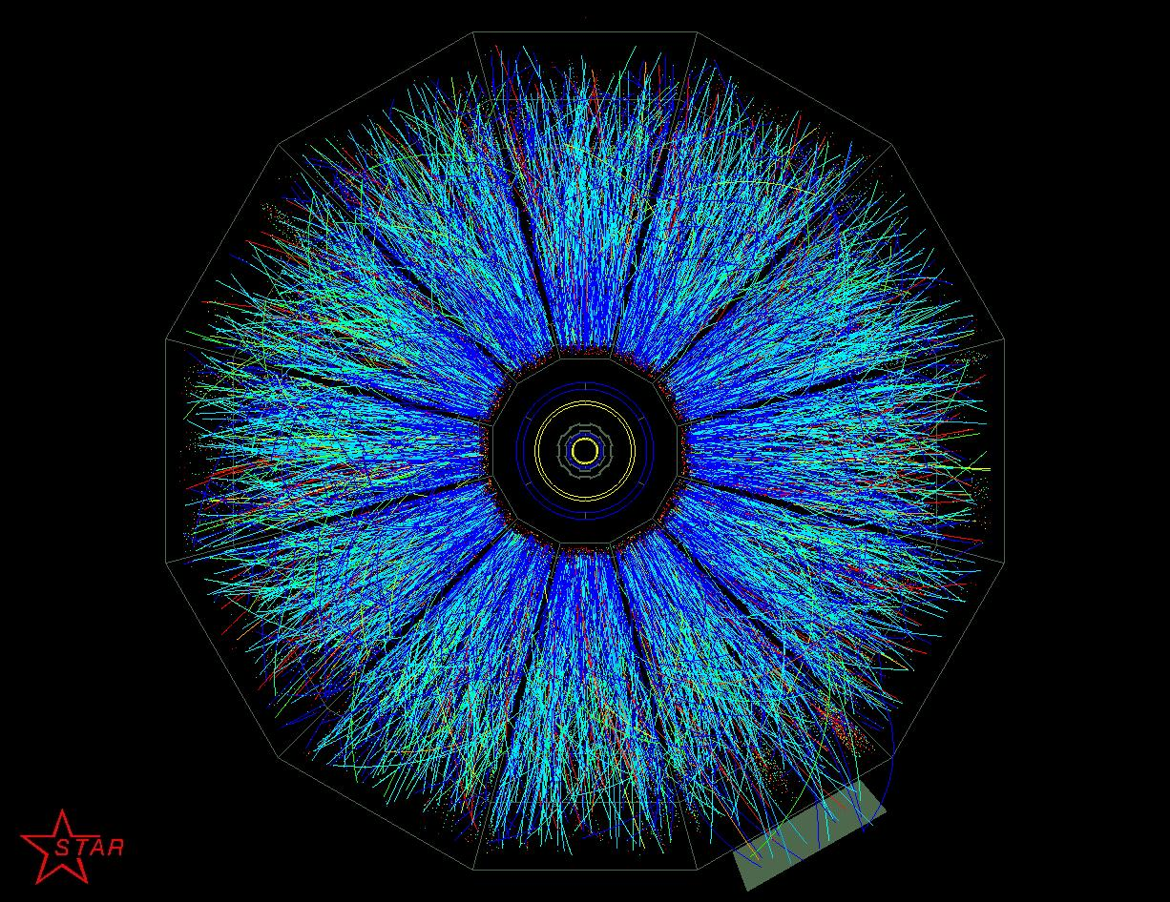
200 GeV Au+Au Event Displays
A head-on collision produces hundreds of particle tracks in the detector.
17

Slide 18
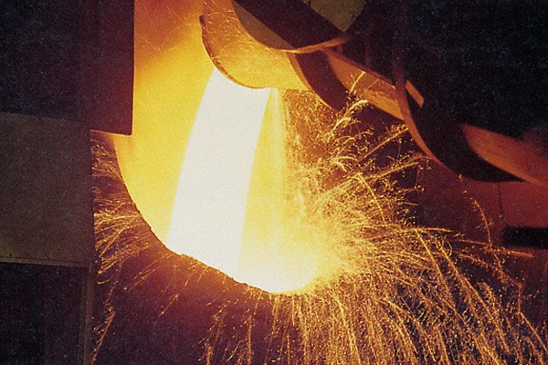
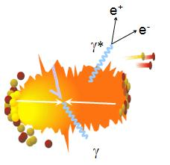
What is the initial temperature?
Hot matter emits thermal radiation, so the temperature can be measured from the emission spectrum of thermal photons.
18
Notes:
From Akiba APS

Slide 19
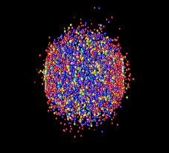
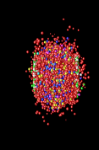
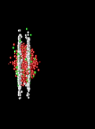


Photons as Probes of Nuclear Collisions
γ
γ
K
π
Time
π
φ
p
K
π
freeze-out
time
Hadron Gas
expansion
quark-gluon plasma
hard parton scattering
Space
Au
Au
Photons can probe the early stage of the reaction deep inside of the dense matter
19
Notes:
Akiba APS

Slide 20
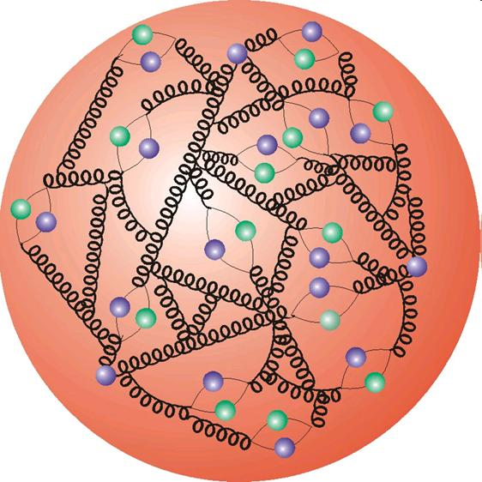
Sources of Photons
quark
gluon
pQCD direct photons from initial hard scattering of quarks and gluons
γ
Thermal photons from hot quark gluon plasma
π
π
Thermal photons from hadron gas after hadronization
ρ
γ
background
γ
Decay Photons from hadrons (π⁰, η, etc)
π
γ
20
Notes:
Akiba APS

Slide 21
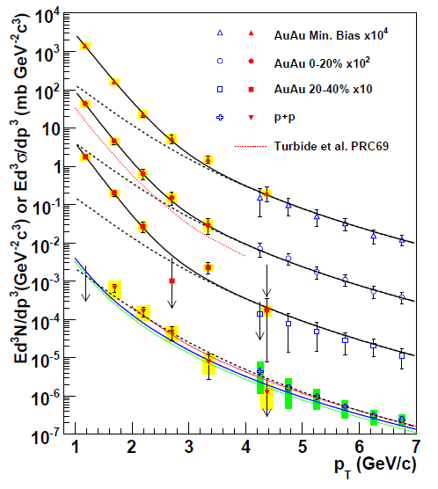
Direct Photon Spectra (PHENIX)
exp + T_{AA} scaled pp
A. Adare et al., PRL accepted
pQCD consistent with p+p data down to p_{T}=1GeV/c
Au+Au data lie above N_{coll}-scaled p+p data for p_{T} < 2.5 GeV/c
Fitting the excess data yields:
T_{AuAu} = 221 ± 19^{stat} ± 19^{syst} MeV
Lattice QCD predicts a phase transition to quark gluon plasma at T_{c} ~ 170 MeV
The initial temperature is above the predicted critical temperature.
Fit to pp
NLO pQCD (W. Vogelsang)
21
Notes:
Akiba APS

Slide 22
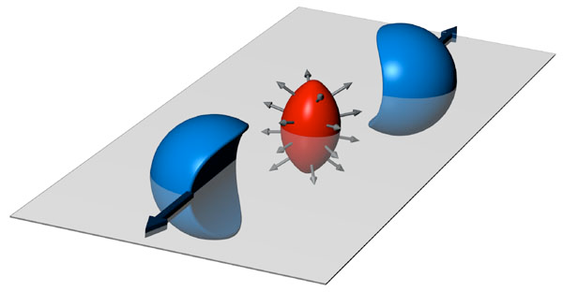
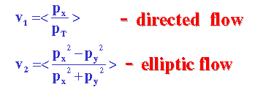
Elliptic Flow
v₂>0: in-plane emission of particles
v₂<0: squeeze-out perpendicular to reaction plane.
22

Slide 23
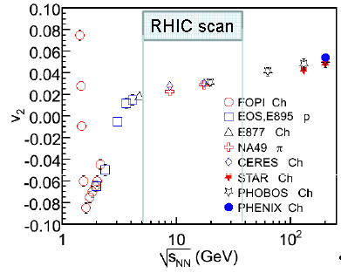
Elliptic Flow: Excitation Function
There is a transition from squeeze-out flow to in-plane flow at AGS energies
23

Slide 24
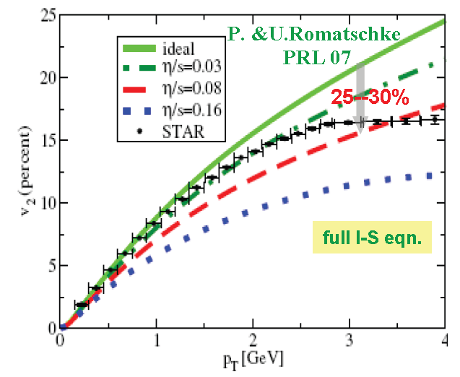

Elliptic Flow Indicates that the matter behaves like a perfect fluid!
STAR 200 GeV Au+Au data (black dots) with various hydrodynamical calculations overlayed.
The system cannot be described or simulated unless the following condition is set:
24
Notes:
From Teaney QM09

Slide 25
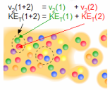
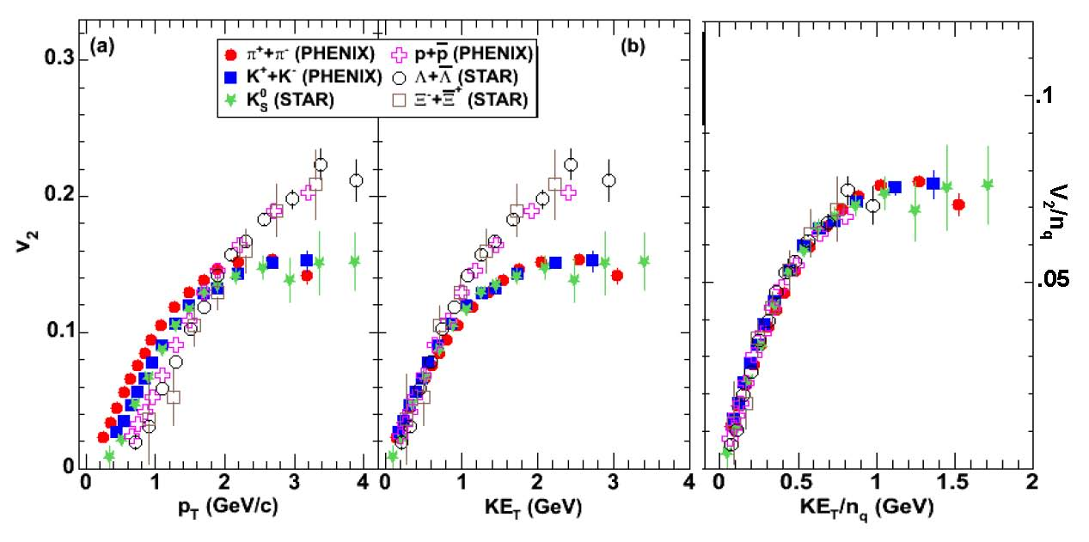
Scaling of Elliptic Flow
Quark-Like Degrees of Freedom are Evident
Baryons
Mesons
Phys. Rev. Lett. 98, 162301 (2007)
25
Notes:
Lacey QM09

Slide 26
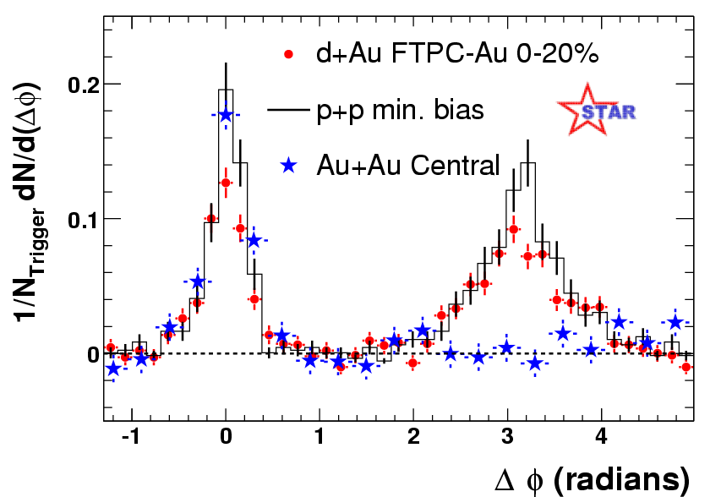
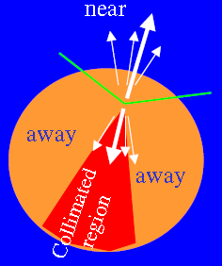
Hadron Suppression
near
away
The medium is extremely opaque
26
Notes:
From Jacak BUP. Need definition of RAA

Slide 27
Summary of RHIC 200 GeV Au+Au Collision Results
The matter is very hot with a temperature well above the expected critical temperature for a phase transition to a Quark-Gluon Plasma
The matter behaves like a strongly interacting perfect fluid
The matter is described by quark degrees of freedom
The matter is very opaque
27

Slide 28
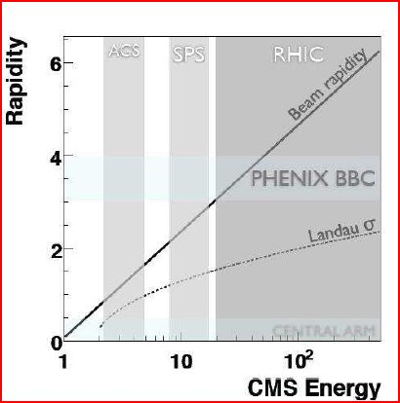
Triggering at Low Energy
The problem:
The placement of the trigger detectors (BBCs) are not optimized for low energy running.
They have a reduced acceptance, especially below RHIC energies of ~ 20 GeV.
Fermi motion to the rescue!
At low energies, Fermi motion is enough to bring nucleons back into the BBC acceptance.
28

Slide 29
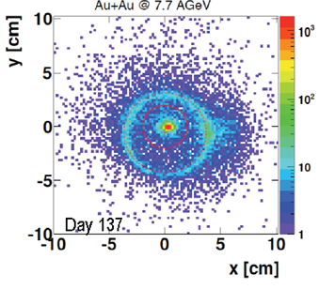
Beam Quality at Low Energy
The problem:
The quality of the RHIC beam tuning degrades at lower energies. The beam position is difficult to monitor.
Each point represents the vertex coordinate of an event reconstructed from the tracks in the STAR TPC.
Due to the lower quality beam tune, some background exists.
29

Slide 30
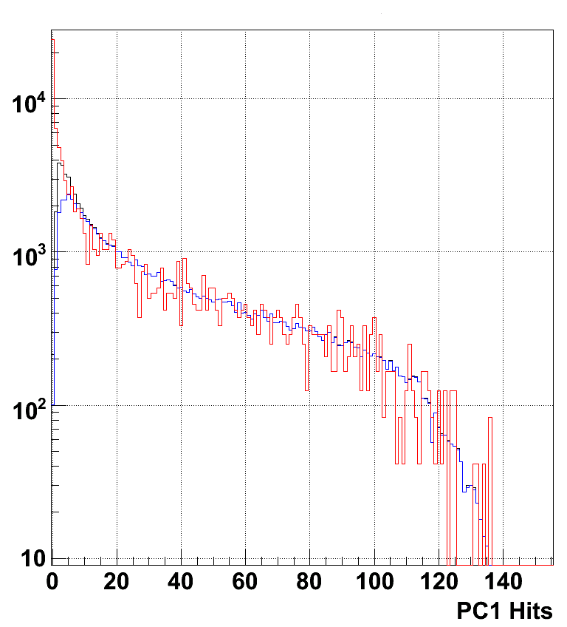
PHENIX Trigger Performance at 7.7 GeV
Tight timing cut on BBC North vs. South
URQMD AuAu @ 7.7 GeV through PHENIX full simulation
URQMD normalized to match real data integral for PC1 hits > 40.
URQMD not matched to z distribution in real data.
Estimate that the trigger fires on 77% of the cross section.
No indication of deviation of low multiplicity events from background.
PHENIX AuAu @ 7.7 GeV Data
w/ BBCLL1(>0 tubes) |z| < 30 cm
PHENIX AuAu @ 7.7 GeV Data
w/ BBCLL1(>1 tubes) |z| < 30 cm
30
Notes:
From Bathe AGS

Slide 31
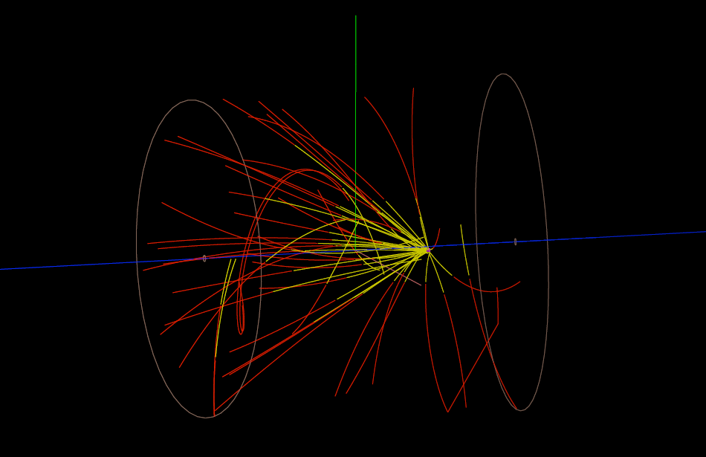
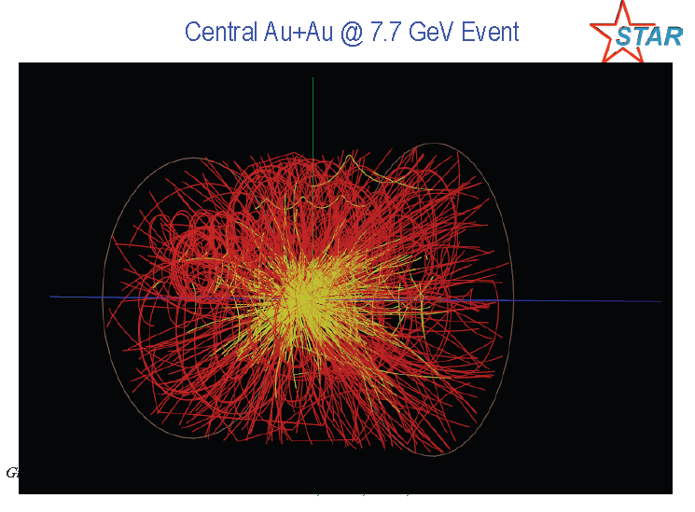
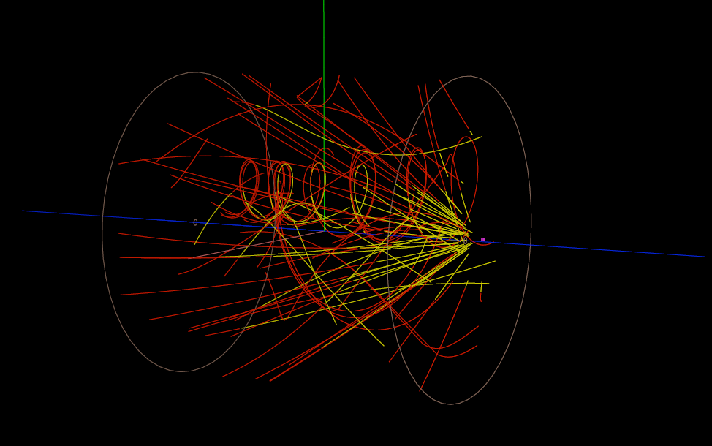
STAR 7.7 GeV Au+Au Event Displays
Beam + Beam pipe collision
Downstream collision
31

Slide 32
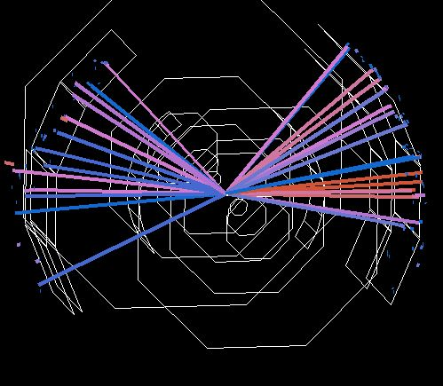
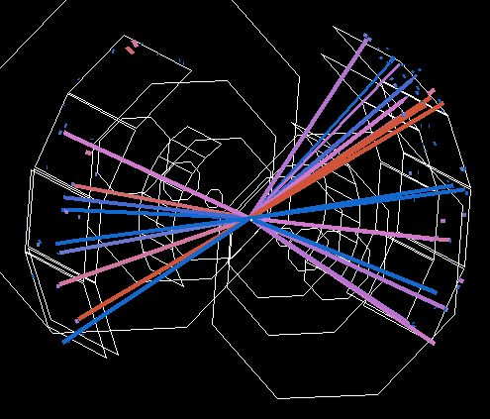
PHENIX 7.7 GeV Au+Au Event Displays

Slide 33
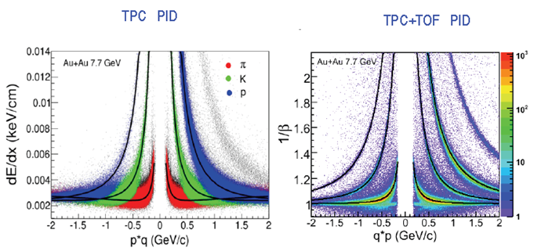
STAR Particle Identification:
7.7 GeV Au+Au
Excellent Particle Identification Demonstrated
33

Slide 34
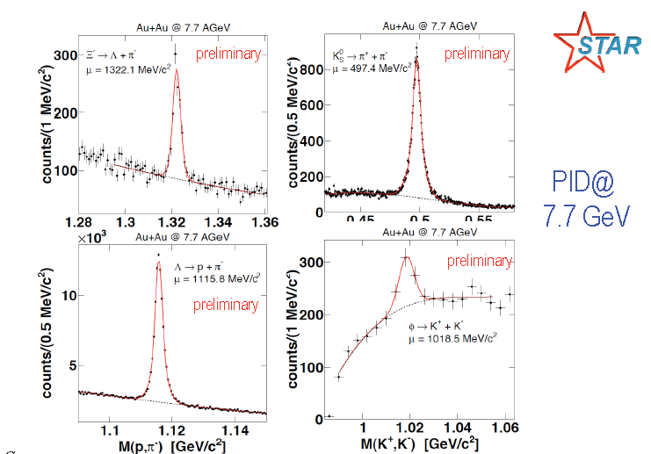
STAR 7.7 GeV Particle Identification
34
Notes:
From Odyniec CPOD 2010

Slide 35
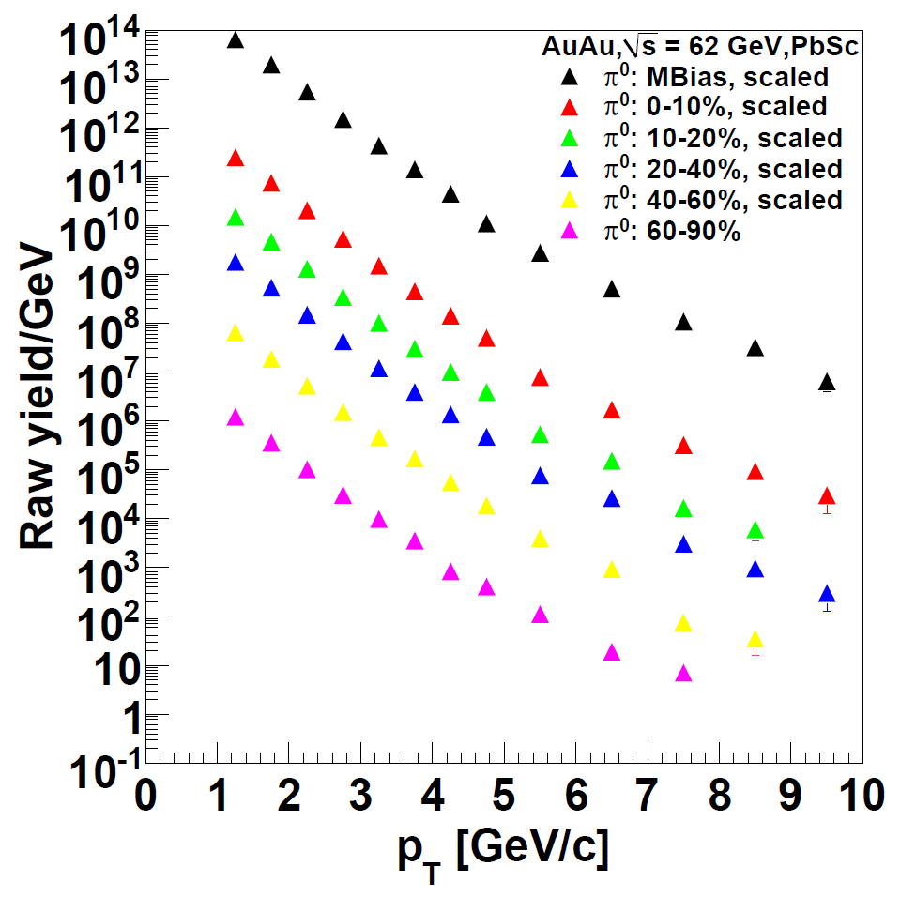
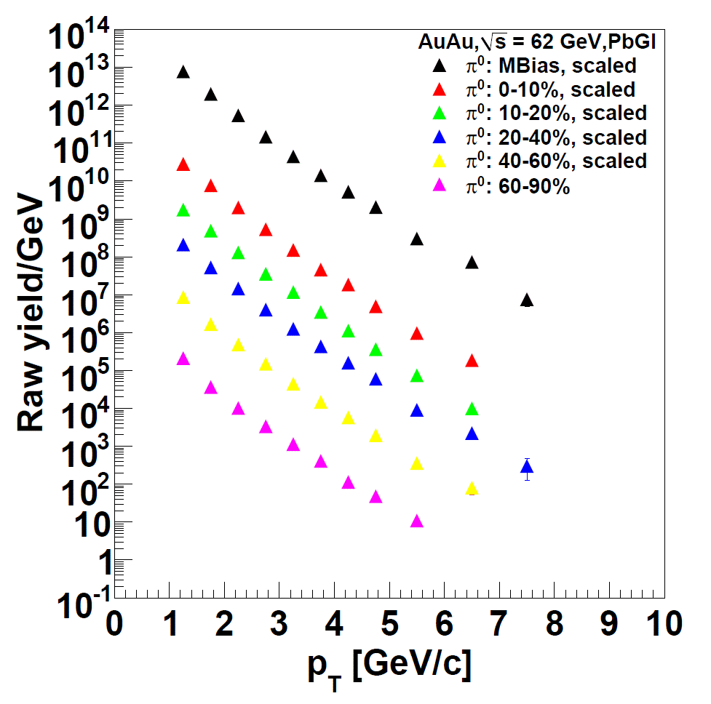
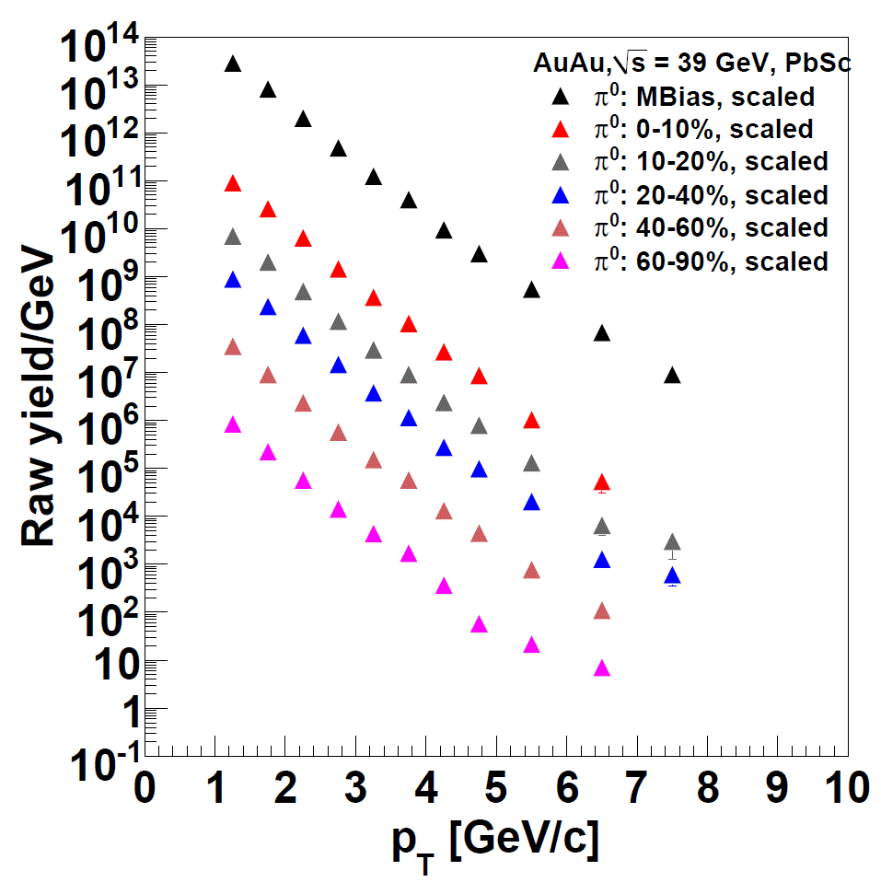
PHENIX π⁰ Yields
62 GeV
Previous p_{T} reach (Run-4)
Enhanced p_{T} reach (Run-10)
39 GeV
35
Notes:
From Jacak BUP

Slide 36
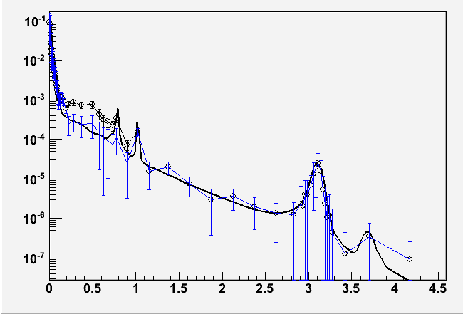
PHENIX Dilepton Expectations at 39 GeV
How does the dilepton excess and ρ modification at SPS
evolve into the large low-mass excess at RHIC?
200M simulated events in ± 20cm vertex
If excess is the same at 39 GeV as 200, expect a 6 σ result
1/N_{evt} dN/dm_{ee}
Black: simulation with same enhancement as at 200 GeV
Blue: no enhancement
m_{ee}
36
Notes:
From Bathe AGS

Slide 37
Experimental Approaches to the Beam Energy Scan
Search for the onset of deconfinement.
  Breakdown of the constituent quark number scaling of elliptic flow
  Disappearance of hadron suppression in central collisions
  Local parity violation
2. Search for direct signals of the critical point and/or phase transition.
  Fluctuation measurements
  Measurements of higher moments (kurtosis)
  Excitation functions
37

Slide 38
Searching for the Onset of Deconfinement
38

Slide 39
Charged Particle Multiplicity
The dN/dη per participant pair at mid-rapidity in central heavy ion collisions increases with ln √s from AGS to RHIC energies
The √s dependence is different for pp and AA collisions
39
Notes:
Lacey QM09

Slide 40
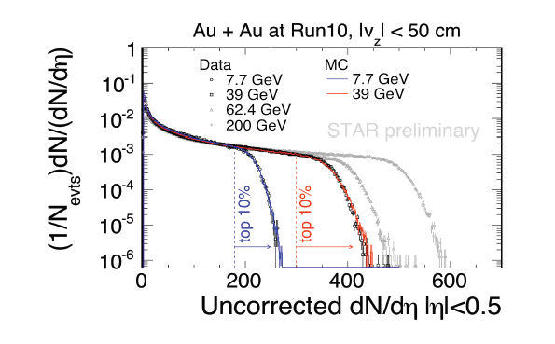

Multiplicity at 7.7 and 39 GeV (Raw)
40

Slide 41
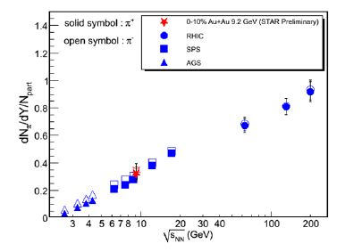

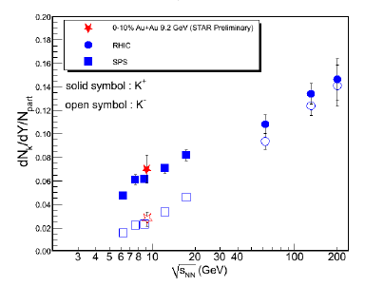

Identified Particle Yields
Pions
Kaons
Protons
Identified particle yields are consistent with measurements at the SPS.
41

Slide 42

Identified Particle Ratios
π-/π+ ~1 → similar source of production for π+ and π-. Pions mostly from Δ resonance.
K⁻/K⁺ ~ 0.4 → ~60% K⁺ associated production with Λ
No surprises observed.
pbar/p << 1 → Large baryon stopping, large net protons, higher μ_{B}
42

Slide 43

Exploring “the Horn”
RHIC results so far are consistent with the SPS results
43

Slide 44

Directed Flow (v₁)
Directed flow describes collective sideways motion.
Directed flow is sensitive to the Equation of State. Expect non-linear behavior near mid-rapidity near a 1st-order phase transition..
y_{beam} at 200 GeV = 5.4
y_{beam} at 62 GeV = 4.2
y_{beam} at 9 GeV = 2.3
The 9.2 GeV data show a different trend compared to the 200 and 62 GeV data. Results at 7 GeV coming soon.
44

Slide 45

Elliptic Flow vs. Beam Energy and System Size
The scaling of elliptic flow persists in 62.4 GeV Au+Au collisions. Data at lower energies coming soon.
45
Notes:
From Arkadij CPOD 2010

Slide 46


Elliptic Flow at 39 GeV
No surprises at these energies.
46
Notes:
From X. Gong HP2010

Slide 47

Elliptic Flow at 9.2 GeV
47
Notes:
From Odyniec, CPOD 2010

Slide 48





Pion Interferometry
STAR 9.2 GeV: Phys. Rev. C81 (2010) 024911.
adapted from
Annu. Rev. Nucl. Part. Sci. 2005.
55:357-402
Detector
Detector
Detector
x
48
Notes:
From Odyniec, CPOD 2010. Illustration from Csanad WPCF 2010

Slide 49


Freeze-out Volume from Pion Interferometry
A “freeze-out volume” can be extracted from the interferometry results:
V_{fo} = R²_{side}R_{long}
A minimum in this quantity exists at ~7 GeV
9 GeV results are consistent with SPS results.
The particle emission lifetime is related to:
τ → R_{out}/R_{side}
An increase is expected near the critical point. This is not observed.
49

Slide 50




Hadron (Neutral Pion) Suppression
Significant suppression in central collisions observed at 39 GeV AuAu.
50

Slide 51

Local Parity Violation
Under a strong magnetic field, when the system is deconfined and chiral symmetry is restored, local fluctuations may lead to parity violation.
Experimentally, look for separation of the charges in high energy nuclear collisions.
Searching for the disappearance of this effect can signal the location of the phase boundary.
D.E. Kharzeev et al., NPA 803 (2008) 227.
K. Fukushima et al., PRD 78 (2008) 074033.
51

Slide 52

Local Parity Violation Results
The signal is consistent with local parity violation in 200 GeV and 62.4 GeV Au+Au collisions. Lower energy results are coming soon.
52
Notes:
From Taryaev CPOD 2010

Slide 53



The “Mach cone” feature
PHENIX arXiv:0801.4545
STAR : Phys. Rev. Lett. 102, 052302 (2009)
From a model with relativistic dissipative hydrodynamics coupling density fluctuations to thermal energy. Thermally induced density fluctuations and sound modes get suppressed at the critical point. The disappearance of the “mach cone” feature could be a signature of the critical point.
QM09 : Teiji Kunihiro
53
Notes:
Density fluctuations (Rayleigh peak). Sound modes (Brillouin peak). From Mohanty QM09

Slide 54

The Ridge Feature
There is a “ridge” feature that extends in pseudorapidity. It persists at 62 GeV.
54
Notes:
Gorbunov CPOD 2010

Slide 55
Searching for Signals of the Critical Point and Phase Transition
55

Slide 56



Antiproton/Proton Ratio vs. p_{T}
STAR : PLB 655, 104 (2007)
PRL 97, 152301 (2006)
STAR
Phys. Rev. C73, 044910 (2006)
Phys.Rev. C78, 034918 (2008)
Observable proposed as a signature of
focusing near the critical point.
No large drop in ratio observed
for intermediate p_{T} range
Fitting Procedure :
y = a (m_{T} - m) + b
56
Notes:
Mohanty QM09

Slide 57
Divergent Quantities at the Critical Point
Near the critical point, several properties of a system diverge. The rate of the divergence can be described by a set of critical exponents. For systems in the same universality class, all critical exponent values should be identical.
The critical exponent for compressibility, γ:
The critical exponent for heat capacity, α:
The critical exponent for correlation length, ν:
The critical exponent for correlation functions, η:
(d=3)

Slide 58

Susceptibilities at the Critical Point
Consider quark susceptibility, χ_{q} at the critical point.
χ_{q} = <q†q> = ∂n(T,μ)/∂μ
This is related to the isothermal compressibility:
k_{T} = χ_{q}(T,μ)/n²(T,μ)
In a continuous phase transition, k_{T} diverges at the critical point…
B.-J. Schaefer and J. Wambach, Phys. Rev. D75 (2007) 085015.
Grand Canonical Ensemble

Slide 59






Multiplicity Distributions (PHENIX)
200 GeV Au+Au
200 GeV Cu+Cu
62.4 GeV Cu+Cu
62.4 GeV Au+Au
22.5 GeV Cu+Cu
Red lines represent the NBD fits. The distributions have been normalized to the mean and scaled for visualization. Distributions measured for 0.2<p_{T}<2.0 GeV/c
200 GeV p+p

Slide 60


Multiplicity Fluctuation Results
Near the critical point, the multiplicity fluctuations should exceed the superposition model expectation → No significant evidence for critical behavior is observed. Low energy results coming soon.

Slide 61

<p_{T}> Fluctuations Excitation Function
Fluctuations in mean p_{T} are related to the critical exponent α:
Σ_{pT} = (event-by-event p_{T} variance) – [(inclusive p_{T} variance)/(mean multiplicity per event)], normalized by the inclusive mean p_{T}. Random = 0.0.
Σ_{pT} is the mean of the covariance of all particle pairs in an event normalized by the inclusive mean p_{T}.
Σ_{pT} can be related to the inverse of the heat capacity.
No increase in <p_{T}> fluctuations have been observed. Results at 7 and 39 GeV are coming soon.
61

Slide 62


Like-Sign Pair Azimuthal Correlations
0.2 < p_{T,1} < 0.4 GeV/c, 0.2 < p_{T,2} < 0.4 GeV/c, |Δη|<0.1
200 GeV Au+Au, 0-5% Central
PHENIX Preliminary
62 GeV Au+Au, 0-5% Central
PHENIX Preliminary
C(Δφ) = (dN/dφ_{data}/dN/dφ_{mixed})*(N_{events,mixed}/N_{events,data})
Assuming that QCD belongs in the same universality class as the (d=3) 3-D Ising model, the expected value of η is 0.5 (Reiger, Phys. Rev. B52 (1995) 6659 .
The power law function fits the data well for all species and centralities.
A displaced away-side peak is observed in the Au+Au correlation functions.

Slide 63

C(Δπ) Exponent η vs. Centrality
The exponent η is independent of species, centrality, and collision energy.
The value of η is inconsistent with the d=3 expectation at the critical point.

Slide 64


Searching for the Critical Point with HBT Q_{inv} Correlations
T. Csorgo,S. Hegyi,T. Novák,W.A.Zajc,
Acta Phys. Pol. B36 (2005) 329-337
This technique proposes to search for variations in the exponent η.
The exponent η can be extracted by fitting HBT Q_{inv} correlations with a Levy function:
  C(Q_{inv}) = λ exp( -|Rq/hc|^{−α})
α = Levy index of stability = η
α = 2 for Gaussian sources
α = 1 for Lorentzian sources
Measure a as a function of collision energy and look for a change from Gaussian-like sources to a source corresponding to the expectation from the universality class of QCD.

Slide 65



Fluctuations of Particle Ratios
The event-by-event fluctuations of the kaon/pion ratio are expected to increase at the critical point.
K/π
p/π
arXiv: 0901.1795
Results consistent with previous NA49 measurements.
65
Notes:
From Tarnowsky, CPOD 2010

Slide 66

Measuring skewness or kurtosis
Skewness describes the asymmetry of the distribution
Kurtosis describes the peakness of the distribution
For a Gaussian distribution, skewness and kurtosis are both zero.
These measures are ideal for measuring non-Gaussian fluctuations.
66

Slide 67

Kurtosis of proton/antiproton ratios
STAR: PRL 105 (2010) 022302, aXiv:1004.4959
No large non-Gaussian fluctuations seen. Lower energy results coming soon.
67
Notes:
From Ritter CPOD 2010. Need Reidlich or Stephanov CPOD 09 for more details.

Slide 68
Summary and Outlook
At the top RHIC energies, the created matter is a hot, opaque, strongly interacting perfect fluid described by quark degrees of freedom.
The location of the phase transition and QCD critical point remains an open question.
RHIC has embarked on an beam energy scan program to search for the QCD critical point.
In 2010, RHIC executed a very successful run covering beam energies of 62.4, 39, 11, and 7.7 GeV.
First RHIC low energy results are consistent with measurements at similar energies from the SPS. So far, no clear signs of the critical point.
RHIC plans to run at 18 GeV in the upcoming run that will start in January 2011.
Results have only just started to appear. We are looking forward to many new results in the coming months!
68

Slide 69
Auxiliary Slides
69

Slide 70
Statistical Models: Estimating the Freeze-out Temperature
Basic assumption: System is described by a grand canonical ensemble of non-interacting fermions and bosons in thermal and chemical equilbrium
A. Andronic et al., Nucl. Phys. A772 (2006) 167.
AuAu - √s=130 GeV
Minimum of χ² for: T=166±5 MeV μ_{B}=38±11 MeV
70

Slide 71
Statistical Model Fits
Extracted T & µ_{B} values
early universe
250
200
RHIC
quark-gluon plasma
Lattice QCD
150
SPS
AGS
Chemical Temperature Tch [MeV]
deconfinement
chiral restauration
100
SIS
hadron gas
50
atomic nuclei
neutron stars
0
0
200
400
600
800
1000
1200
Baryonic Potential μ_{B} [MeV]
For √s >≈ 10 GeV , chemical freeze-out very close to phase boundary
71
Notes:
Lacey QM09

Slide 72

Statistical Model Results
Results from different
beam energies
Analysis of particle yields
with statistical models
Freeze-out points reach QGP
phase boundary at top SPS
energies
72
Notes:
From Blume, CPOD 2010

Slide 73

Direct Photons: Comparisons to Theory
Hydrodynamical models are compared with the data
D.d’Enterria &D.Peressounko
T=590MeV, τ₀=0.15fm/c
S. Rasanen et al.
T=580MeV, τ₀=0.17fm/c
D. K. Srivastava
T=450-600MeV, τ₀=0.2fm/c
S. Turbide et al.
T=370MeV, τ₀=0.33fm/c
J. Alam et al.
T=300MeV, τ₀=0.5fm/c
F.M. Liu et al.
T=370MeV, τ₀=0.6 fm/c
Hydrodynamical models agree with the data within a factor of ~2
A.Adare et al.
arXiv:0912.0244
73

Slide 74

Temperature fit summary
Significant yield of the exponential component (excess over the scaled p+p)
The inverse slope T_{AuAu} = 221±19±19 MeV (>T_{c} ~ 170 MeV)
  p+p fit funciton: A_{pp}(1+p_{t}²/b)^{-n}
  If power-law fit is used for the p+p spectrum, T_{AuAu} = 240±21 MeV
Lattice QCD predicts a phase transition to quark gluon plasma at T_{c} ~ 170 MeV
74
Notes:
Akiba APS

Slide 75

Direct Photons: Initial temperature
A.Adare et al.
arXiv:0912.0244
T_{AuAu}(fit) ~ 220 MeV
T_{C} from Lattice QCD ~ 170 MeV
From data: T_{ini} > T_{AuAu} ~ 220 MeV
From models: T_{ini} = 300 to 600 MeV for τ₀ = 0.15 to 0.6 fm/c
Lattice QCD predicts a phase transition to quark gluon plasma at T_{c} ~ 170 MeV
75
Notes:
From Akiba APS. Note: Get sun temp comparison

Slide 76

PHENIX Detector
Central Arm Tracking
Drift Chamber
Pad Chambers
Time Expansion Chamb.
Muon Arm Tracking
Muon Tracker
Calorimetry
PbGl
PbSc
MPC
Particle Id
Muon Identifier
RICH, HBD
TOF E & W
Aerogel
TEC
Global Detectors
BBC
ZDC/SMD Local Polarim.
Forward Hadron Calo.
RXNP
DAQ and Trigger System
Online Calib. & Production
VTX
Replaces HBD
Muon Trigger:
μTr FEE
RPC station 3
76
Notes:
From Jacak BUP

Slide 77

Elliptic Flow: Excitation Function
There is a transition from squeeze-out flow to in-plane flow between AGS and SPS energies
77

Slide 78

78
Notes:
From Arkadij CPOD 2010

Slide 79



PHENIX 39 GeV Au+Au Event Displays

Slide 80

STAR 9.2 GeV Au+Au Event Displays
80

Slide 81

Multiplicity Measurements!
central
central
peripheral
peripheral
energy √s
81
Notes:
Lacey QM09

Slide 82

STAR 39 GeV Particle Identification
82
Notes:
From Odyniec CPOD 2010

Slide 83

J/ψ: analyzed 25% of 62 GeV statistics
83
Recombination
  (e.g. Rapp et al.)
  J/ψ yield at 200 GeV is dominantly from recombination
Predict suppression greater at 62 GeV
    J/ψ yield down by 1/3
    Recombination down 1/10
per
semi
cen
600 M min. bias events → 500 J/ψ ∴ measure J/ψ suppression
Key test of recombination!
83
Notes:
From Bathe AGS

Slide 84

CLAN Model
A. Giovannini et al., Z. Phys. C30 (1986) 391.
The CLAN model was developed to attempt to explain the reason that p+p multiplicities are described by NBD rather than Poisson distributions.
Hadron production is modeled as independent emission of a number of hadron clusters, N_{c}, each with a mean number of hadrons, n_{c}. These parameters can be related to the NBD parameters:
N_{c} = k_{NBD} log(1 + µ_{ch}/k_{NBD}) and
<n_{c}> = (µ_{ch}/k_{NBD})/log(1 + µ_{ch}/k_{NBD}).
A+A collsions exhibit weak clustering characteristics, independent of collision energy.

Slide 85

Enhancement of low p_{T} particles?
85
Notes:
From Busza QM09

Slide 86

Velocity of Sound in the Medium
86
Notes:
From Melkumov, CPOD 2010

Slide 87

87
Notes:
From Mishustin CPOD 2010

Slide 88

Quark Number Susceptibilities
88
Notes:
From Melkumov, CPOD 2010. Look for B. Mohanty STAR kurtosid results PRL 105 (10) 022302.

Slide 89

STAR <P_{T}> fluctuations
89

Slide 90

90
Notes:
From Tarnowsky CPOD 2010

Slide 91


<p_{T}> Fluctuations
Above N_{part}~30, the data can be described by a power law in N_{part}, independent of the p_{T} range down to 0.2<p_{T}<0.5 GeV/c:

Slide 92

Lévy fits to q_{inv} in Central 200 GeV Au+Au
PHENIX PRELIMINARY

Slide 93

Kurtosis: Comparison to Lattice QCD
Lattice QCD calculations are so far consistent with the data.
R. V. Gavai, S. Gupta, arXiv: 1001. 3796
F. Karsch, K. Redlich, arXiv: 1007.2581
93
Notes:
From Ritter CPOD 2010

Slide 94


Slide 95



Mach Cone at the SPS
Wave Energy at Circle Boundary
Pb-Au 17.3 GeV 0-5%
φ = -90⁰
CERES
Preliminary
95

