Slide 1
Phase Transition Signature Results from PHENIX
5th International Workshop on the Critical Point and Onset of Deconfinement – 6/8/09
Jeffery T. Mitchell
(Brookhaven National Laboratory)
for the PHENIX Collaboration
Outline
Fluctuations: <N>, <p_{T}>, <K/π>, <p/π>
Identified Particle Spectra and v₂
HBT and Azimuthal Correlations at Low p_{T}

Slide 2
Divergent Quantities at the Critical Point
Near the critical point, several properties of a system diverge. The rate of the divergence can be described by a set of critical exponents. For systems in the same universality class, all critical exponent values should be identical.
The critical exponent for compressibility, γ:
The critical exponent for heat capacity, α:
The critical exponent for correlation length, ν:
The critical exponent for correlation functions, η:
(d=3)

Slide 3
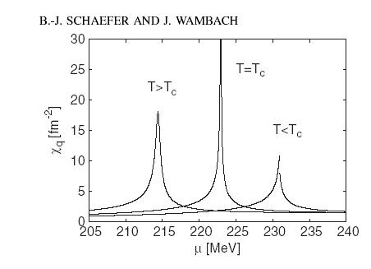
Susceptibilities at the Critical Point
Consider quark susceptibility, χ_{q} at the critical point.
χ_{q} = <q†q> = ∂n(T,μ)/∂μ
This is related to the isothermal compressibility:
k_{T} = χ_{q}(T,μ)/n²(T,μ)
In a continuous phase transition, k_{T} diverges at the critical point…
B.-J. Schaefer and J. Wambach, Phys. Rev. D75 (2007) 085015.

Slide 4
Multiplicity Fluctuations
Multiplicity fluctuations may be sensitive to divergences in the compressibility of the system near the critical point.
Grand Canonical Ensemble
Grand Canonical Ensemble
ω_{N} → “Scaled Variance”
Multiplicity fluctuations have been measured in the following systems:
  200 GeV Au+Au
  62.4 GeV Au+Au
  200 GeV Cu+Cu
  62.4 GeV Cu+Cu
  22.5 GeV Cu+Cu
  200 GeV p+p (baseline)
Survey completed as a function of centrality and p_{T}

Slide 5
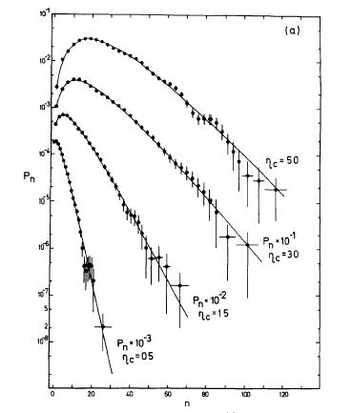
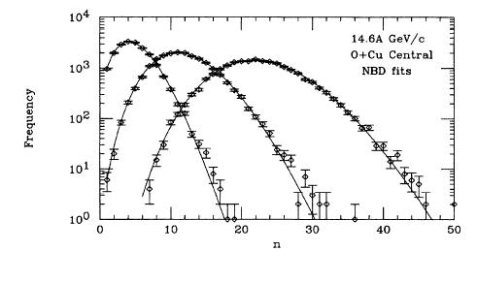
Measuring Multiplicity Fluctuations with Negative Binomial Distributions
UA5
Multiplicity distributions in hadronic and nuclear collisions can be well described by the Negative Binomial Distribution.
UA5: sqrt(s)=546 GeV p-pbar, Phys. Rep. 154 (1987) 247.
E802: 14.6A GeV/c O+Cu, Phys. Rev. C52 (1995) 2663.
E802

Slide 6
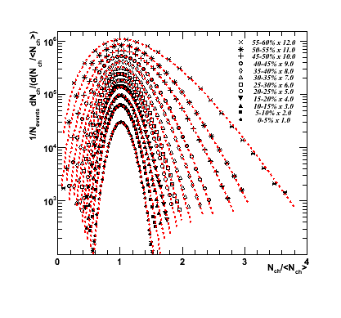
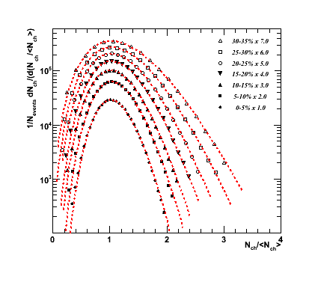
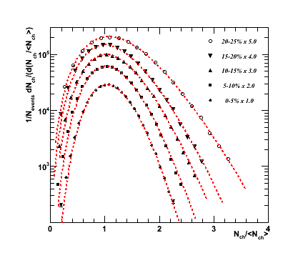

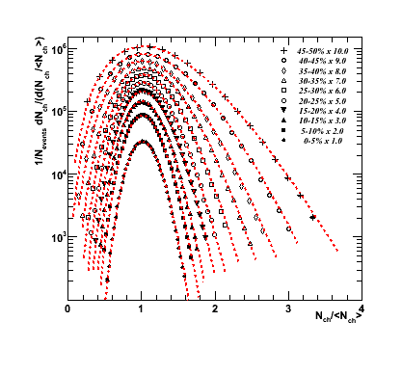
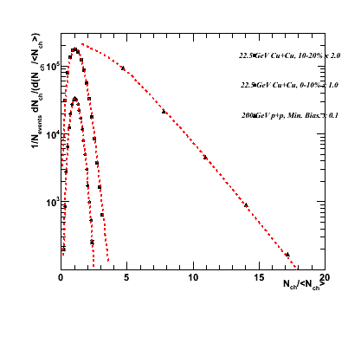
Au+Au, Cu+Cu, p+p NBD Distributions
200 GeV Au+Au
200 GeV Cu+Cu
62.4 GeV Cu+Cu
62.4 GeV Au+Au
22.5 GeV Cu+Cu
Red lines represent the NBD fits. The distributions have been normalized to the mean and scaled for visualization. Distributions measured for 0.2<p_{T}<2.0 GeV/c
200 GeV p+p

Slide 7
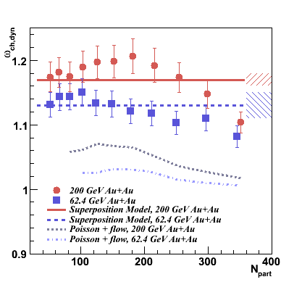
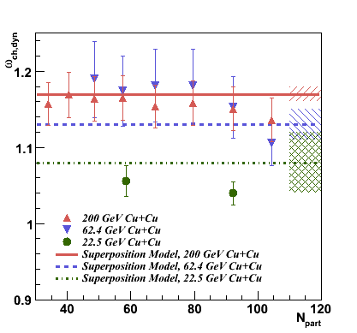
Multiplicity Fluctuation Results
Bottom line: Near the critical point, the multiplicity fluctuations should exceed the superposition model expectation → No significant evidence for critical behavior is observed.

Slide 8
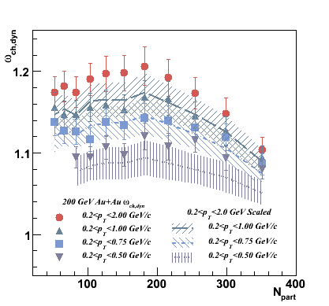
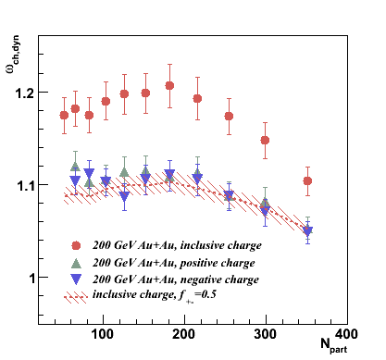
p_{T} and Charge Dependence
As with acceptance, with no charge-dependent correlation, the scaled variance will scale:
ω₊₋ = 1 – f + fω_{inclusive}
where f=0.5.
Within errors, no charge dependence of the fluctuations is seen for 200 GeV Au+Au.
If the p_{T}-dependence is random, the scaled variance should scale with <N> in the same manner as acceptance:
ω_{pT} = 1 – f + fω_{pT,max}

Slide 9
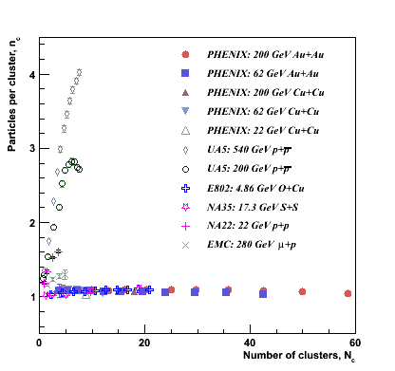
CLAN Model
A. Giovannini et al., Z. Phys. C30 (1986) 391.
The CLAN model was developed to attempt to explain the reason that p+p multiplicities are described by NBD rather than Poisson distributions.
Hadron production is modeled as independent emission of a number of hadron clusters, N_{c}, each with a mean number of hadrons, n_{c}. These parameters can be related to the NBD parameters:
N_{c} = k_{NBD} log(1 + µ_{ch}/k_{NBD}) and
<n_{c}> = (µ_{ch}/k_{NBD})/log(1 + µ_{ch}/k_{NBD}).
A+A collsions exhibit weak clustering characteristics, independent of collision energy.

Slide 10
Event-by-Event Mean p_{T} Fluctuations
<p_{T}> fluctuations may be sensitive to divergences in the heat capacity of the system near the critical point.
<p_{T}> fluctuations have been measured in the following systems:
  200 GeV Au+Au
  62.4 GeV Au+Au
  200 GeV Cu+Cu
  62.4 GeV Cu+Cu
  22.5 GeV Cu+Cu
Survey completed as a function of centrality and p_{T}

Slide 11
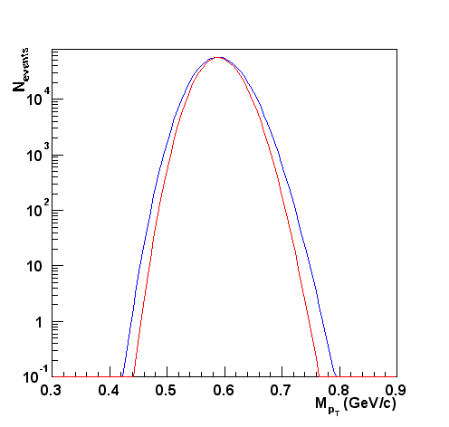
Measuring <p_{T}> Fluctuations
Σ_{pT} = (event-by-event p_{T} variance) – [(inclusive p_{T} variance)/(mean multiplicity per event)], normalized by the inclusive mean p_{T}. Random = 0.0.
Σ_{pT} is the mean of the covariance of all particle pairs in an event normalized by the inclusive mean p_{T}.
Σ_{pT} can be related to the inverse of the heat capacity.
Gamma distribution calculation for statistically independent particle emission with input parameters taken from the inclusive spectra. See M. Tannenbaum, Phys. Lett. B498 (2001) 29.
Red: Random Expectation
(Γ distribution)
Blue: STAR acceptance fluctuation of:
φ_{pT}=52.6 MeV,
F_{pT}=14%,
σ²_{pT,dyn}=52.3 (MeV/c²),
Σ_{pT}=9.8%
M_{pT} = Event-by-Event Average p_{T}

Slide 12
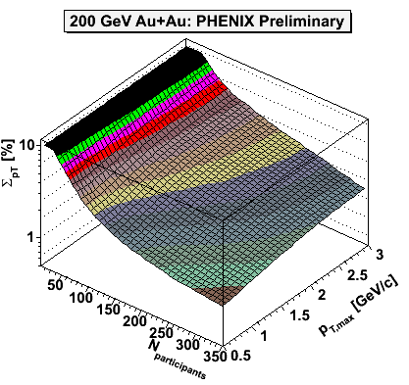
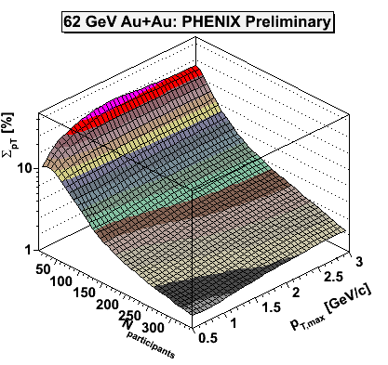
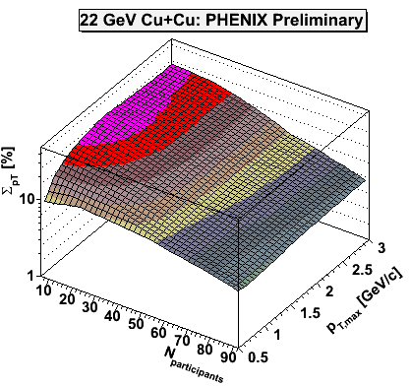
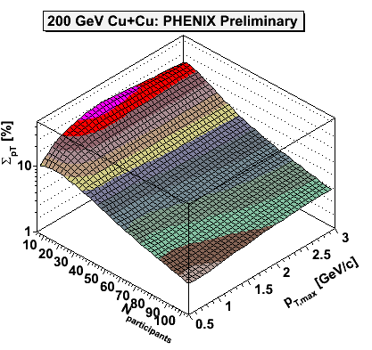
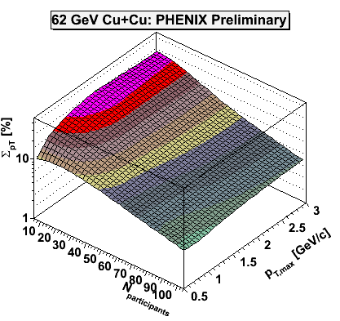
<p_{T}> Fluctuations Survey
Features: Σ_{pT} increases with decreasing centrality. Similar trend to multiplicity fluctuations (σ²/μ²). Increases with increasing p_{T}. Same behavior for all species, including 22 GeV Cu+Cu.
NOTE: Random fluctuations, Σ_{pT}=0.0.

Slide 13
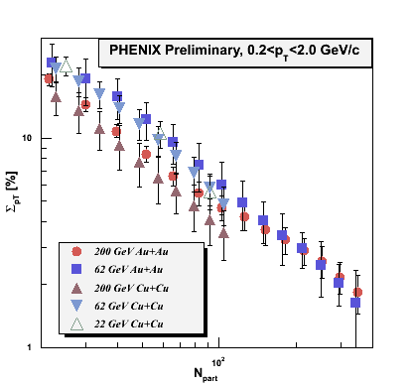
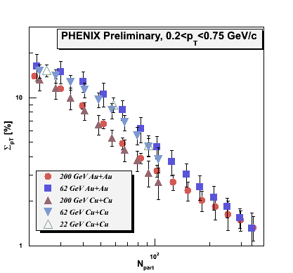
<p_{T}> Fluctuations vs. Centrality
The magnitude of Σ_{pT} varies little as a function of sqrt(s_{NN}) and species. In a simple model that embeds PYTHIA hard scattering events into inclusively parametrized events, the jet fraction necessary to reproduce the fluctuations does not scale with the jet cross section.

Slide 14
<p_{T}> Fluctuations vs. Centrality
Above N_{part}~30, the data can be described by a power law in N_{part}, independent of the p_{T} range down to 0.2<p_{T}<0.5 GeV/c:

Slide 15
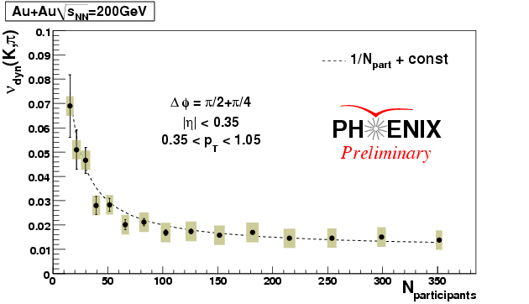
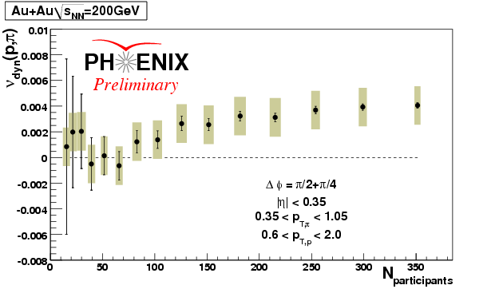
Meson-meson (strangeness) <K/π>
and baryon-meson <p/π> fluctuations
K to p fluctuations display
a clear 1/Npart dependence
with the addition
of a constant term,
while p to p fluctuations
appear flat and has
lower absolute values
Au+Au@200GeV
ν_{dyn} = 0 → No dynamical fluctuations. Independent of acceptance.
K to π fluctuations display
a clear 1/N_{part} dependence
with the addition
of a constant term,
while p to π fluctuations
appear flat and has
lower absolute values
Au+Au@200GeV
Measuring particle ratio fluctuations should cancel the contributions due to volume fluctuations.

Slide 16
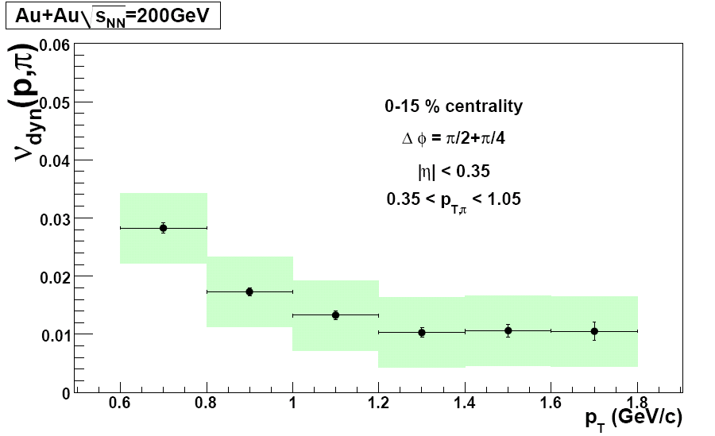
p_{T}-Dependence
The dependence on transverse momentum
is similar for K to π (top) and p to π (bottom),
weakly increasing with decreasing momentum,
but there is a large difference in absolute value.
Preliminary
Preliminary
Preliminary
Next step: Analysis of 62 GeV Au+Au data

Slide 17
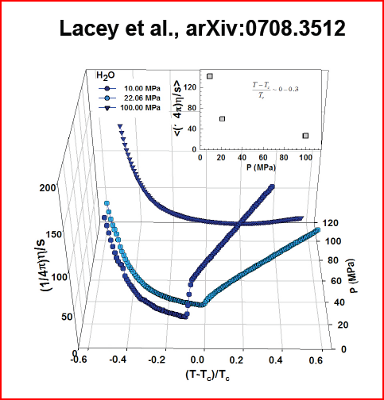
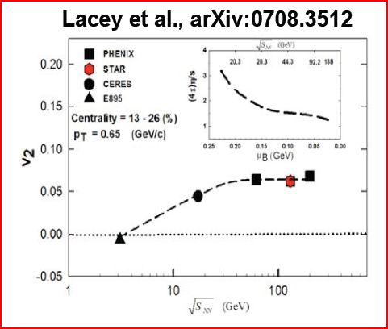
η/s as a Phase Transition Signature?
H₂O
Look for minima in η/s as a function of the reduced temperature.

Slide 18
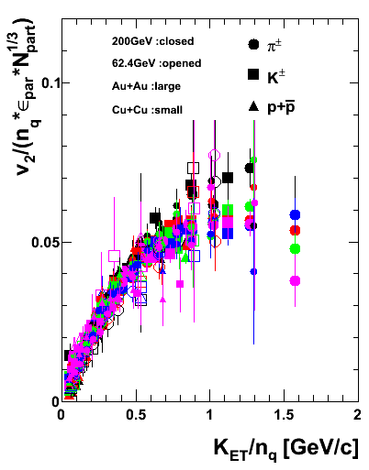
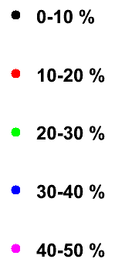
Scaling of Elliptic Flow, p_{T}<1.5 GeV
Different Energy and System
  (AuAu200, CuCu200, AuAu62)
Different Centrality (0-50%)
Different particles (π/ K /p)
v2(KET/nq)/nq/epar/Npart1/3
Preliminary
Almost scale to one curve.

Slide 19
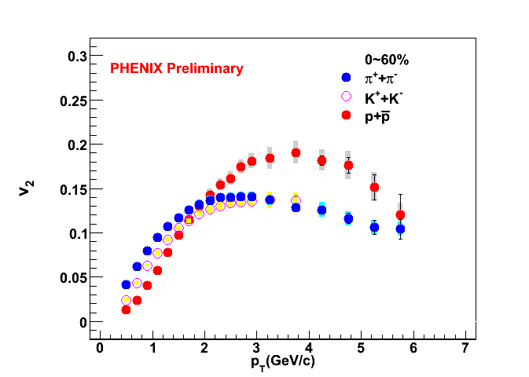
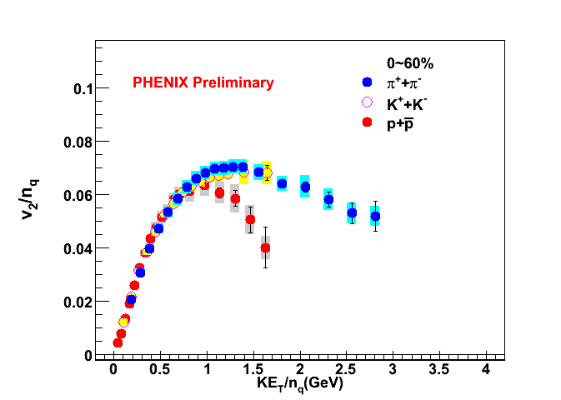
Scaling of Elliptic Flow, p_{T}>1.5 GeV
Au + Au at 200 GeV, Run 2007
S. Huang, DNP 2008
The NCQ scaling is broken at KE_{T}/n_{q} ~1GeV. Different mechanism of recombination for pions and protons at intermediate p_{T} ?

Slide 20
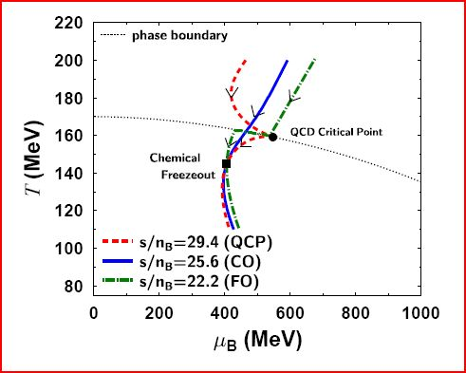
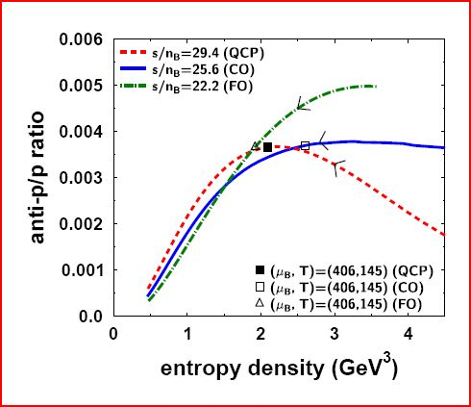
Antiproton-to-proton ratios
From Asakawa et al. (arXiv:0803.2449): The critical point may serve as an attractor for isentropic trajectories → The y_{T}-dependence of the pbar-to-p ratio may serve as an indicator in the vicinity of the critical point. Look for a drop in the ratio as p_{T} increases.

Slide 21
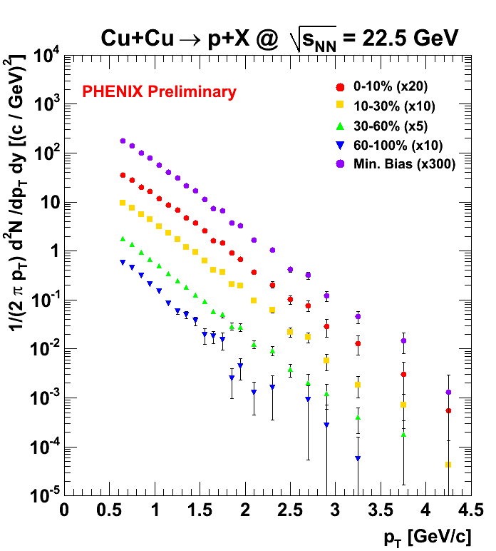
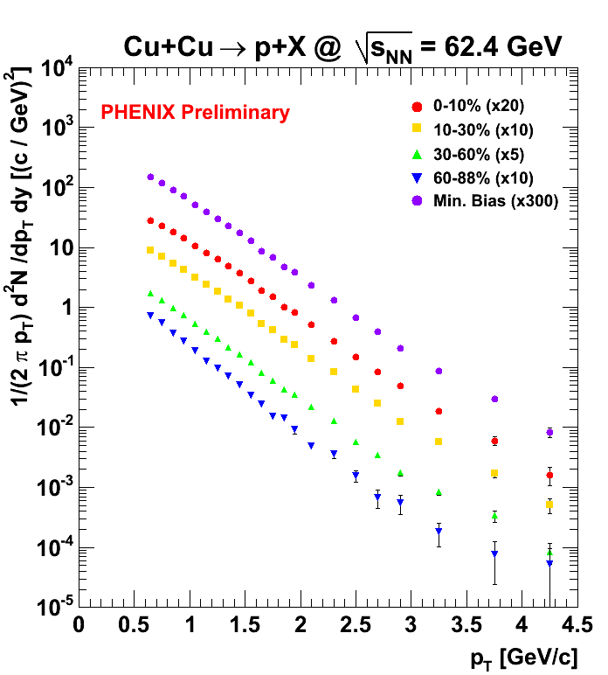
p_{T} Spectra for protons
* No weak decay feed-down correction applied

Slide 22
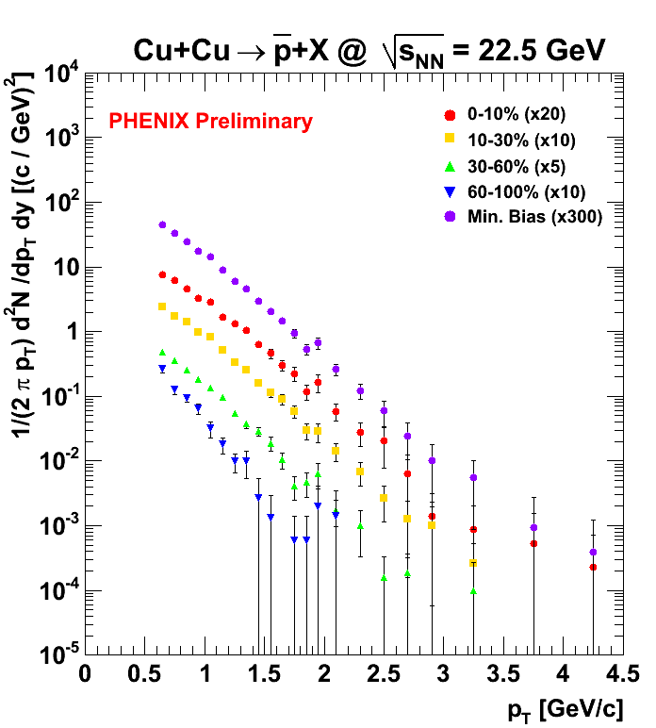
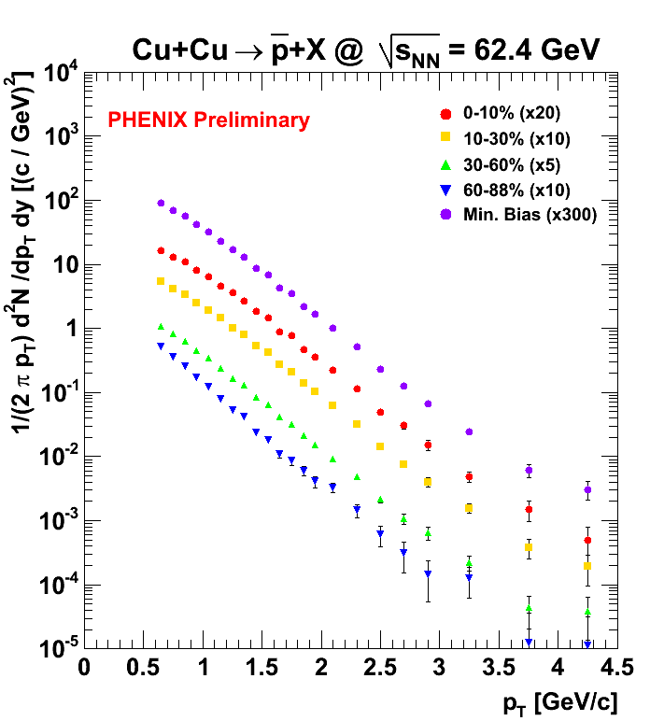
p_{T} spectra for antiprotons
* No weak decay feed-down correction applied

Slide 23
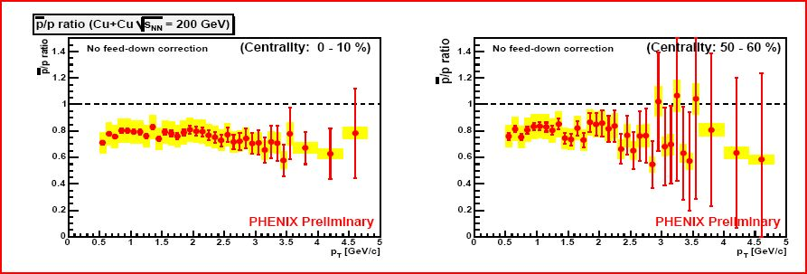
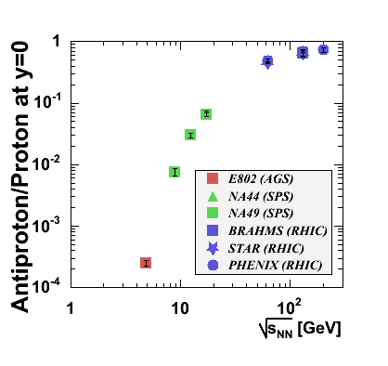
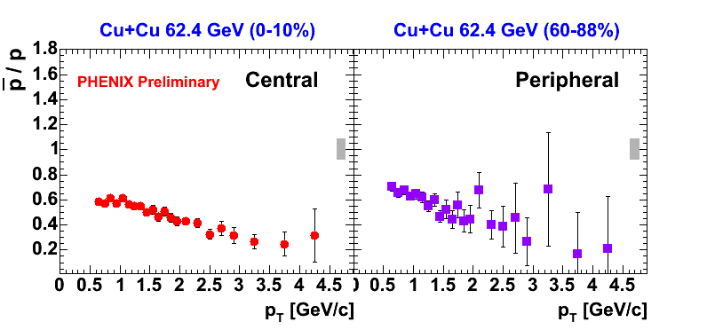
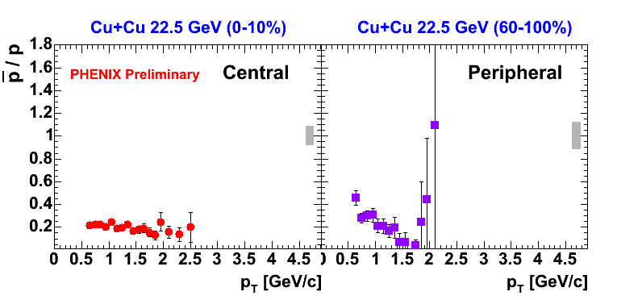
PHENIX antiproton/proton ratio vs. p_{T}
No significant changes in slope are observed at these energies. This is also true in 200 vs. 62.4 GeV Au+Au collisions.

Slide 24
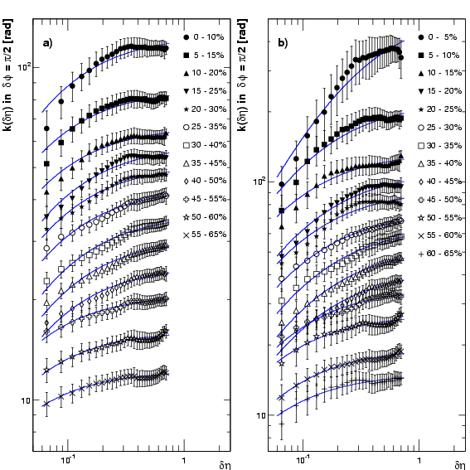
Extraction of αξ with multiplicity fluctuations
Fit with approximated functional form
Parametrization of
two particle correlation
10%
5%
C
(
η
,
η
)
≡
ρ
(
η
,
η
)
−
ρ
(
η
)
ρ
(
η
)
2
1
2
2
1
2
1
1
1
2
C
(
η
,
η
)
2
1
2
=
α
−
δη
/
ξ
+
β
e
ρ
2
1
k(δη)
absorbs rapidity independent
bias such as centrality bin width
Exact relation with NBD k
Look at
slopes
Phys. Rev. C 76, 034903 (2007)
δη
Approximated
functional form
δη
=
1
ξ
<<
δη
k
(
)
(
)
2
αξ
/
δη
+
β

Slide 25
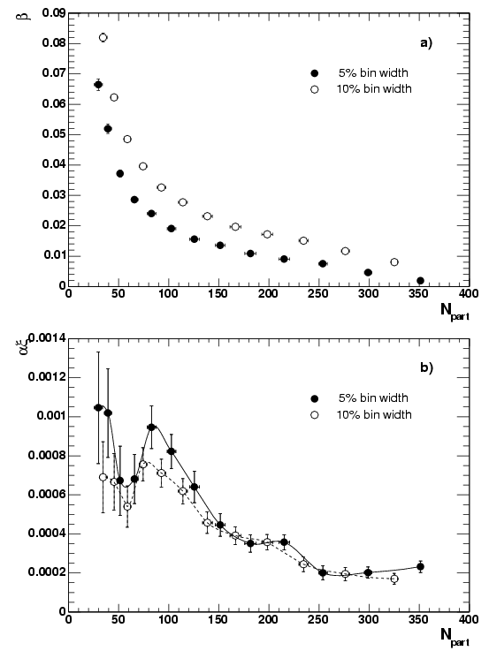
αξ, β vs. N_{part}
β is systematically shift to lower values as the centrality bin width becomes smaller from 10% to 5%. This is understood as fluctuations of Npart for given bin widths
αξ product, which is monotonically related with χ_{k=0} indicates the non-monotonic behavior around Npart ~ 90.
Significance with Power + Gaussian:
3.98 σ (5%), 3.21 σ (10%)
Significance with Line + Gaussian:
1.24 σ (5%), 1.69 σ (10%)
β
●5%
○10%
Au+Au@200GeV
αξ
●5%
○10%
N_{part}
Phys. Rev. C 76, 034903 (2007)

Slide 26
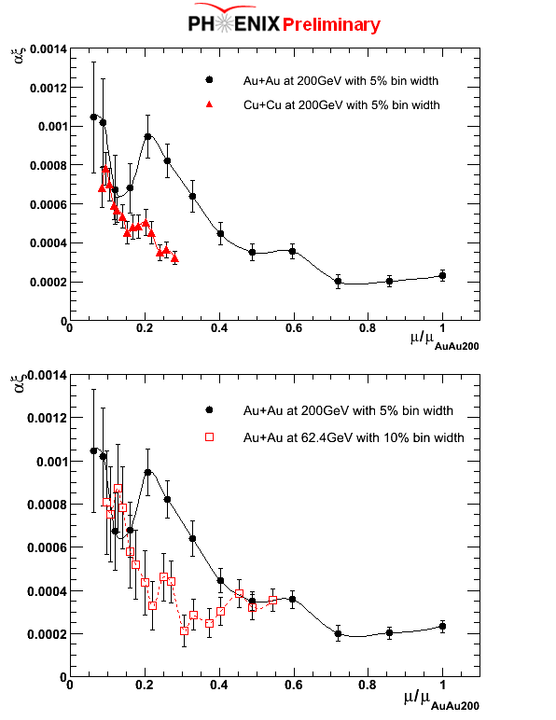
Comparison of three collision systems
Npart~90 in
AuAu@200GeV
ε_{BJ}τ~2.4GeV/fm²/c
Au+Au@200GeV
Phys. Rev. C 76, 034903 (2007)
Cu+Cu@200GeV
Normalized mean
multiplicity to that
of top 5% in
Au+Au at 200 GeV
αξ
<μ_{c}>/<μ_{c}>_{@AuAu200}
Au+Au@200GeV
Phys. Rev. C 76, 034903 (2007)
Au+Au@62.4GeV

Slide 27
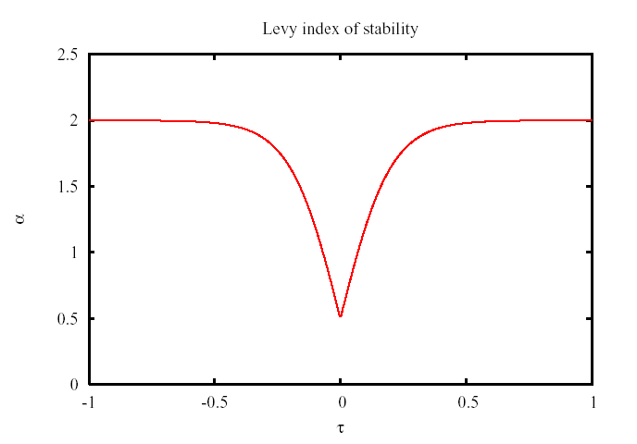

Searching for the Critical Point with HBT Q_{inv} Correlations
T. Csorgo,S. Hegyi,T. Novák,W.A.Zajc,
Acta Phys. Pol. B36 (2005) 329-337
This technique proposes to search for variations in the exponent η.
The exponent η can be extracted by fitting HBT Q_{inv} correlations with a Levy function:
  C(Q_{inv}) = λ exp( -|Rq/hc|^{−α})
α = Levy index of stability = η
α = 2 for Gaussian sources
α = 1 for Lorentzian sources
Measure a as a function of collision energy and look for a change from Gaussian-like sources to a source corresponding to the expectation from the universality class of QCD.
See T. Csorgo’s talk for more details

Slide 28
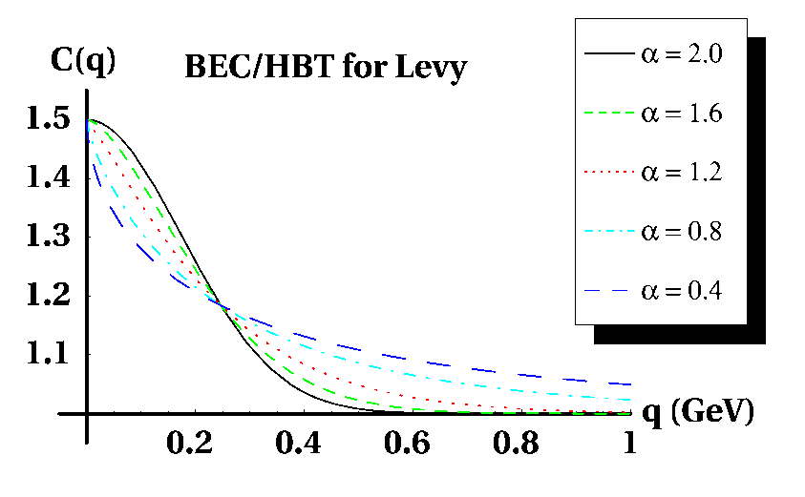
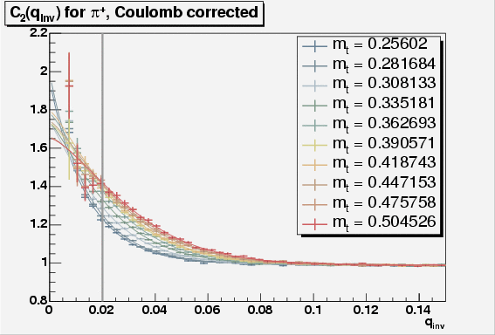

Lévy fits to q_{inv} Central 200 GeV Au+Au
Example Levy distributions
α = Levy index of stability = η
α = 2 for Gaussian sources
α = 1 for Lorentzian sources
PHENIX PRELIMINARY
Lévy
Levy function fits to PHENIX data.
Jeffery T. Mitchell – CPOD 09 – 6/8/09
Jeffery T. Mitchell – WPCF 08 – 9/12/08
28
28

Slide 29
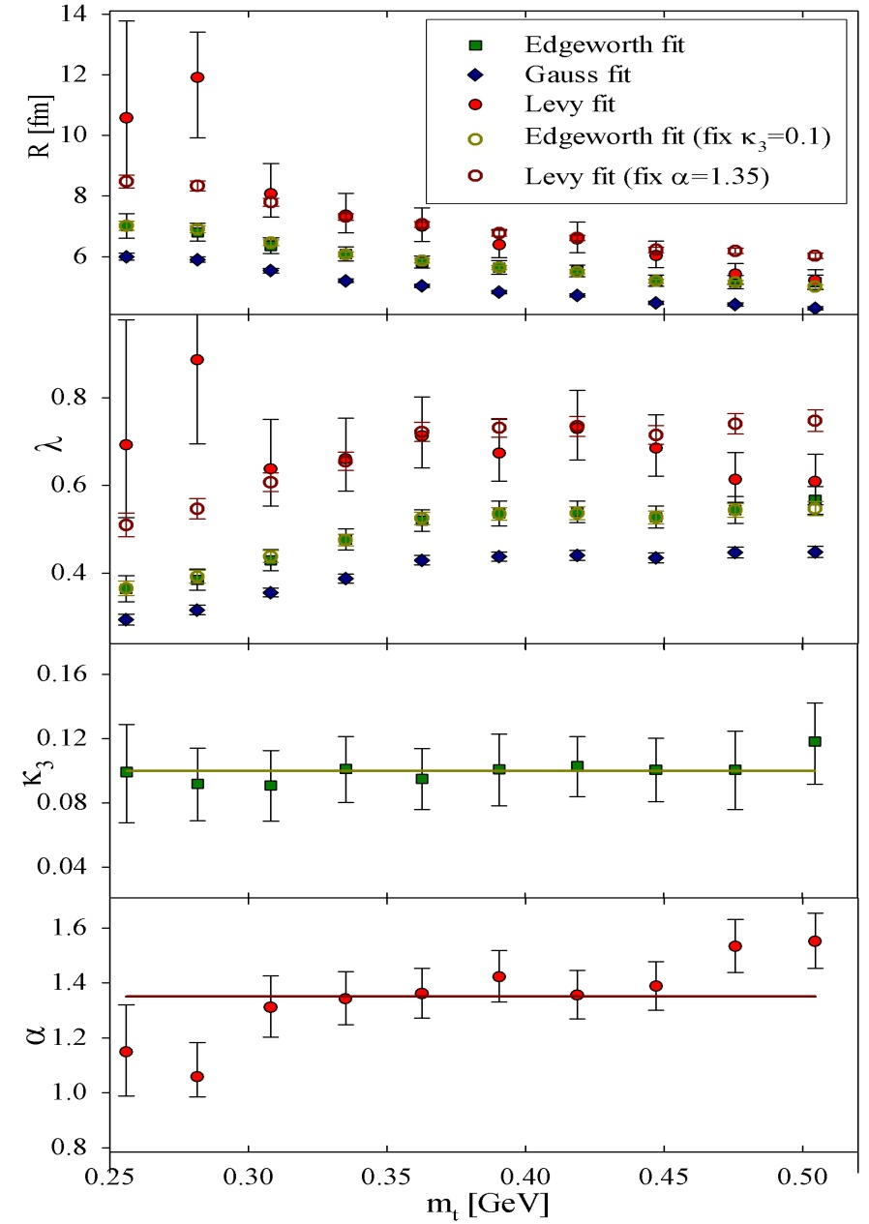
Lévy fits to q_{inv} in Central 200 GeV Au+Au
PHENIX PRELIMINARY
Jeffery T. Mitchell – WPCF 08 – 9/12/08
29

Slide 30
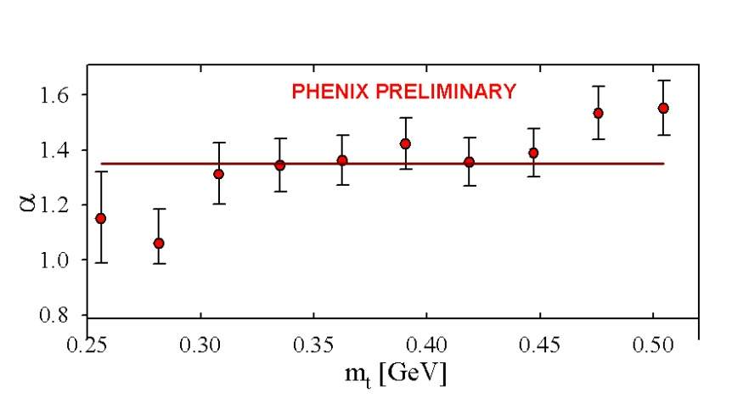
Lévy fits to q_{inv} Central 200 GeV Au+Au
PHENIX PRELIMINARY
Lévy
PHENIX PRELIMINARY
Jeffery T. Mitchell – CPOD 09 – 6/8/09
Jeffery T. Mitchell – WPCF 08 – 9/12/08
30
30

Slide 31
Azimuthal Correlations at Low p_{T}
This study will quote correlation amplitudes in a given centrality, p_{T}, and Δφ bin with no trigger particle determined using the mixed event method via:
C(Δφ) = (dN/dφ_{data}/dN/dφ_{mixed})*(N_{events,mixed}/N_{events,data})
There is no trigger particle. All particle pairs are included in the correlation function calculation.
Red dashed lines are fits to the following equation:
Shown are results for the following systems:
  200 GeV Au+Au
  62.4 GeV Au+Au
  200 GeV Cu+Cu
  62.4 GeV Cu+Cu
  22.5 GeV Cu+Cu
  200 GeV d+Au
  200 GeV p+p
Assuming that QCD belongs in the same universality class as the (d=3) 3-D Ising model, the expected value of η is 0.5 (Reiger, Phys. Rev. B52 (1995) 6659 .

Slide 32
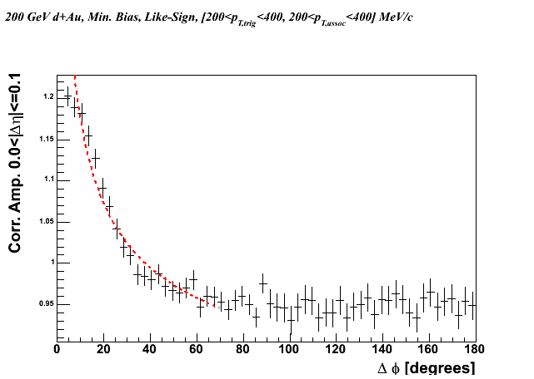
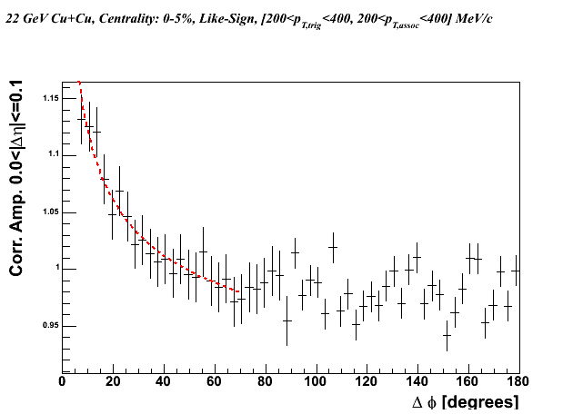


Like-Sign Pair Azimuthal Correlations: d+Au, Cu+Cu
0.2 < p_{T,1} < 0.4 GeV/c, 0.2 < p_{T,2} < 0.4 GeV/c, |Δη|<0.1
PHENIX Preliminary
22 GeV Cu+Cu, 0-10% Central
PHENIX Preliminary
200 GeV d+Au, Min. Bias
62 GeV Cu+Cu, 0-5% Central
PHENIX Preliminary
200 GeV Cu+Cu, 0-5% Central
PHENIX Preliminary

Slide 33


Like-Sign Pair Azimuthal Correlations: Au+Au
0.2 < p_{T,1} < 0.4 GeV/c, 0.2 < p_{T,2} < 0.4 GeV/c, |Δη|<0.1
200 GeV Au+Au, 0-5% Central
PHENIX Preliminary
62 GeV Au+Au, 0-5% Central
PHENIX Preliminary
The power law function fits the data well for all species and centralities.
A displaced away-side peak is observed in the Au+Au correlation functions.

Slide 34

Exponent η vs. Centrality
The exponent η is independent of species, centrality, and collision energy.
The value of η is inconsistent with the d=3 expectation at the critical point.

Slide 35


Controlling HBT: LS vs. US Pairs
0.2 < p_{T,1} < 0.4 GeV/c, 0.2 < p_{T,2} < 0.4 GeV/c, |Δη|<0.1
200 GeV Au+Au, 0-5% Central
PHENIX Preliminary
Unlike-Sign Pairs
PHENIX Preliminary
Like-Sign Pairs
The HBT peak apparent in like-sign pair correlations disappears in unlike-sign pair correlations.
The displaced away-side peak persists both like-sign and unlike-sign pair correlations.
The displaced away-side peak extends across the PHENIX acceptance in Δη.

Slide 36

Near-Side Peak Amplitude vs. p_{T}
|Δη|<0.1
|Δφ|<60º
Min. Bias 200 GeV p+p
Min. Bias 200 GeV d+Au
Points plotted in the center of each p_{T} bin.
0-5% Central 200 GeV Au+Au
0-5% Central 62 GeV Au+Au
The p_{T} bins have been chosen so that there are equal numbers of particles per event in each bin to offset the effects of statistical dilution of the correlation amplitudes.
The Au+Au amplitudes for p_{T}<1 GeV/c show a power law decrease with p_{T} not seen in p+p or d+Au.
The increase in amplitudes for p_{T}>1 GeV/c are due to the onset of the jet peak.

Slide 37

Near-Side Peak Width vs. N_{part}
200<p_{T,1}<500 MeV/c, 200<p_{T,2}<500 MeV/c
|Δη|<0.1
Weak centrality dependence on the near-side peak widths.
d+Au and Au+Au widths are narrower than p+p.

Slide 38
Summary
Multiplicity fluctuations:
  Consistent with or below the expectation of a participant superposition model based upon p+p data. No evidence for critical behavior seen.
<p_{T}> fluctuations:
  Exhibit a universal 1/N_{part} scaling.
  The magnitude of <p_{T}> fluctuations as a function of sqrt(s_{NN}) do not scale with the jet production cross section.
  Looking forward to measuring fluctuations at very low p_{T} in an energy scan.
Baryon-baryon and Meson-meson Fluctuations
  <K/π> fluctuations ~1/N_{part}, <p/π> fluctuations relatively flat with N_{part}
  Working on measurements for 62.4 GeV Au+Au.
Extraction of αξ with Multiplicity Fluctuations at low p_{T}
  Possible non-monotonic behavior at Npart~90, but only for 200 GeV Au+Au
Low-p_{T} Azimuthal Correlations:
  The exponent η extracted from the HBT peak is identical for all collision species. No evidence of critical behavior is seen.
  The width of the HBT peak does not change in 200 vs. 62 GeV Au+Au. No evidence of critical behavior is seen.
  A displaced away-side peak is observed in azimuthal correlations at low p_{T} in Au+Au collisions.

Slide 39



Outlook
PHENIX has already initiated a program to probe the QCD phase diagram in search of evidence of critical behavior. PHENIX looks forward to participating in a RHIC low energy scan.
Event displays from 9.2 GeV Au+Au data
The addition of the Silicon Vertex Upgrade will greatly improve PHENIX capabilities at low energies → larger acceptance = greater sensitivity in fluctuation measurements, also lower p_{T} acceptance. The addition of a new T0/trigger barrel will also greatly improve performance.

Slide 40
Auxiliary Slides

Slide 41
Multiplicity Fluctuations: Participant Superposition Model
In a Participant Superposition Model, multiplicity fluctuations are given by:
ω_{N} = ω_{n} + <N>ω_{Np}
where ω = σ²/μ. ω_{N} = total fluctuation, ω_{n} = fluctuation of each source (e.g. hadron-hadron collision), ω_{Np} = fluctuation in number of sources (participants).
After correcting for fluctuations due to impact parameter, ω_{N} = ω_{n} independent of centrality.
Multiplicity fluctuations are also dependent on acceptance:
ω_{n} = 1 – f + fω_{n}
where f = N_{accepted}/N_{total}. ω_{n} = fluctuations from each source in 4π
Superposition model at 200 GeV taken from PHENIX measurements of 200 GeV p+p. The results agree with UA5 measurements in PHENIX’s pseudorapidity window.
Superposition model at 22 GeV taken from NA22 measurements in PHENIX’s pseudorapidity window.
Superposition model at 62 GeV taken from interpolation of UA5 results in PHENIX’s pseudorapidity window.

Slide 42


The PHENIX Detector
Acceptance:
|η| ~ 0.35, |Δφ|~ π
Two “central arm” spectrometers anchored by drift chambers and pad chambers for 3-D track reconstruction within a focusing magnetic field.
Although the PHENIX acceptance is traditionally considered small for event-by-event measurements, the acceptance is large enough to provide a competitive sensitivity to most observables.

Slide 43

String Percolation Model
Slide by C. Pajares

Slide 44

Scaled Variance: String Percolation Model
L. Cunqueiro et al., Phys. Rev. C72 (2005) 024907.
String percolation provides a possible explanation for the decrease in the scaled variance with increasing centrality.
Shown in green are the direct predictions of the string percolation model for 200 GeV Au+Au, scaled down to the PHENIX acceptance.
Percolation still does not explain the plateau in the most peripheral Au+Au collisions.

Slide 45
Multiplicity Fluctuations: Elliptic Flow
The elliptic flow contribution estimated using a simple model as follows:
For each event, a random reaction plane angle is generated.
A particle azimuthal distribution is sampled using the PHENIX measured values of v₂ at the mean p_{T} of each bin.
The multiplicity within the PHENIX acceptance is recorded for each event and the fluctuations are determined.
The resulting contributions can be as large as 20% and can explain the centrality-dependence of the fluctuations.

Slide 46


Scaled Variance vs. URQMD
URQMD gives similar results to HIJING → Scaled variance decreases with centrality. Correction factors differ from HIJING by at most 10%. URQMD does not reproduce multiplicity as a function of centrality.

Slide 47

Location of the Displaced Away-Side Peak
PHENIX Preliminary
Like-Sign Pairs
The location of the displaced peak at low p_{T} shows little centrality dependence. The location deviates from that at high p_{T} in more peripheral collisions.

Slide 48

Fit Results to PHENIX Data
200 GeV Au+Au
Plot by Roy Lacey (QM2009)
Fits allow for an η/s estimate as a
function of centrality etc.

Slide 49


Au+Au p/pbar Ratios

Slide 50

Extracting the properties of the correlations
0.2 < p_{T,1} < 0.4 GeV/c, 0.2 < p_{T,2} < 0.4 GeV/c, |Δη|<0.7
200 GeV Au+Au, 0-5% Central, Like-Sign Pairs
PHENIX Preliminary
The blue line is a fit to a function with a v₂ component, a near-side Gaussian at Δφ=0 and an away-side Gaussian at Δφ=π-D
The dashed red line is the v₂ component.

