Slide 1
The 2010 TOUR
The Electron Ion Collider
EIC

Slide 2
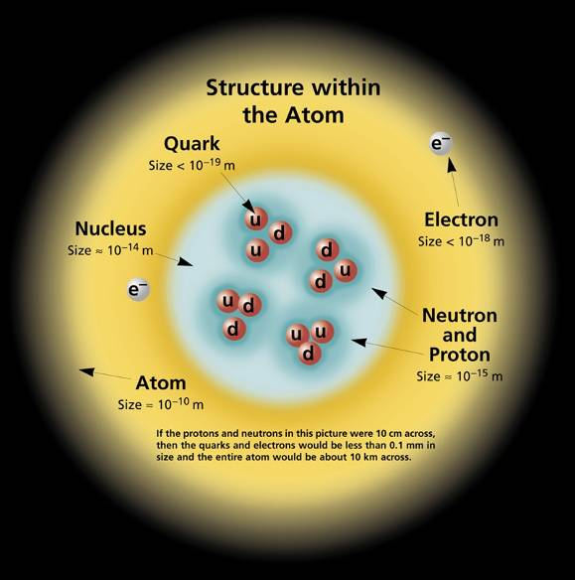
The Standard Model
QED: Theory of the Electromagnetic Interaction
QCD: Theory of the Strong Interaction

Slide 3
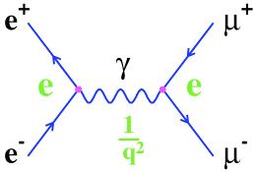
A reminder of Quantum Electro-Dynamics (QED)
Theory of electromagnetic interactions
Exchange particles (photons) do not carry electric charge
Flux is not confined: V(r) ~ 1/r, F(r) ~ 1/r2
Feynman Diagram:
e⁺e⁻ annihilation
√α
√α
Coupling constant (α): Interaction Strength
In QED: αem = 1/137

Slide 4
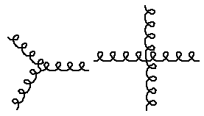
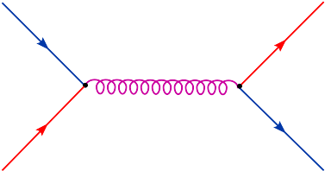
Quantum Chromo-Dynamics (QCD) - 1973
Theory of strong (nuclear) interactions
Three colour charges: red, green and blue
Exchange particles (gluons) carry colour charge and can self-interact
Flux is confined: V(r) ~ r, F(r) ~ constant
q
q
√α
√α
q
g
q
~1/r at short range
αs = strong coupling constant ≈ 0.3
gluons can self-interact - more vertices are allowed
long range force ~ r

Slide 5
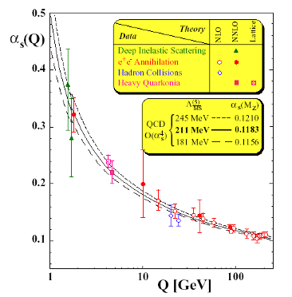
Features of Quantum Chromo-Dynamics
Confinement
At large distances, the effective coupling between quarks is large, resulting in confinement (V(r) ~ r)
Free quarks are not observed in nature
Asymptotic freedom
At short distances, the effective coupling between quarks decreases logarithmically
Under such conditions, partons appear to be quasi-free
0.2 fm 0.02 fm 0.002 fm

Slide 6
QED vs QCD
Potentials:
long range aspect of Vs(r) leads to quark confinement and the existence of nucelons
 | QED | QCD
Charges | electric (2) | colour (3)
gauge bosons | γ | g (8)
charged? | no | yes
coupling strength | αem = e²/4π ≈ 1/137 | αs ≈ 0.3

Slide 7
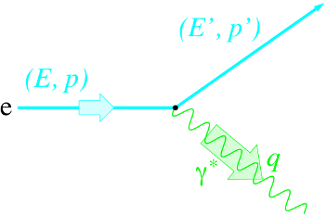
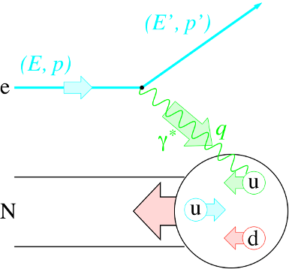
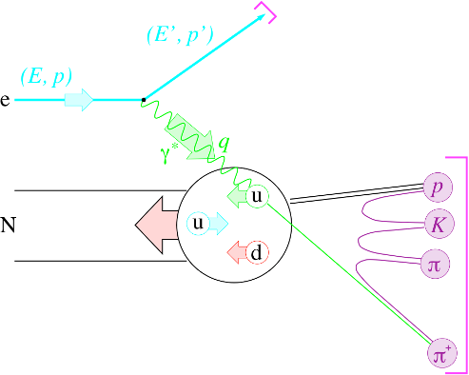
Experimental Prerequisites
longitudinally un-(polarized) lepton beam
longitudinally un-(polarized) nuclear target
large geometrical acceptance
small angles
limited by synchrotron radiation
big angles
limited by money
good particle identification
So far only “fixed target” experiments for polarized physics at:

Slide 8
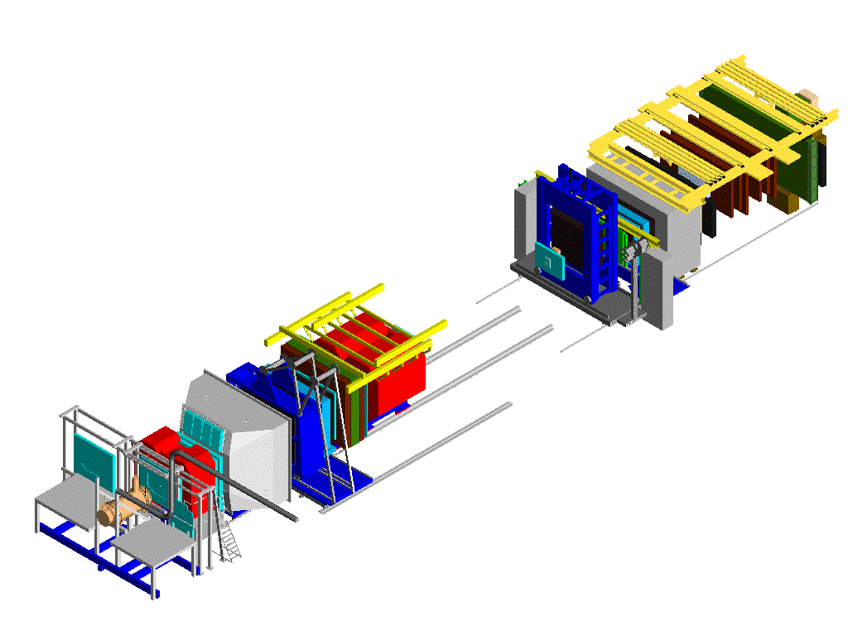
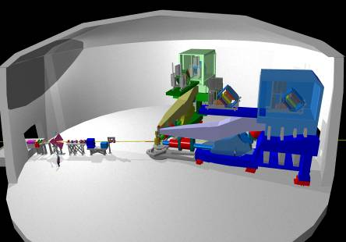
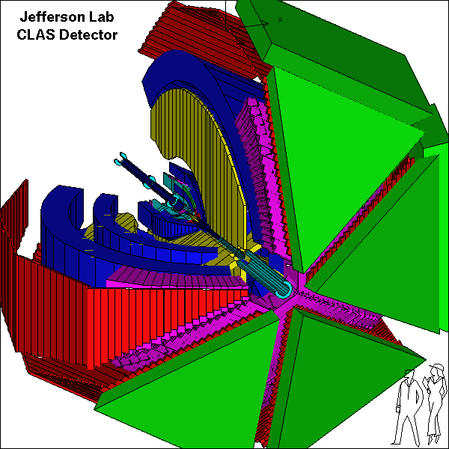
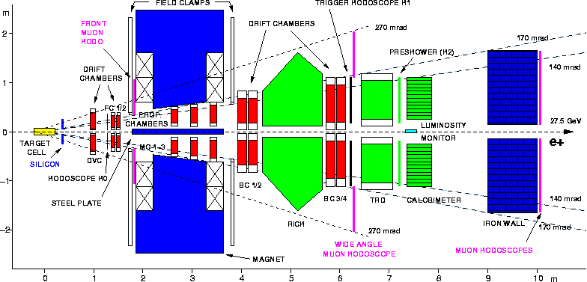
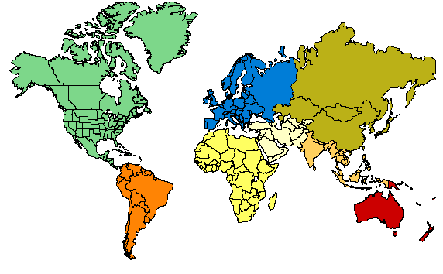
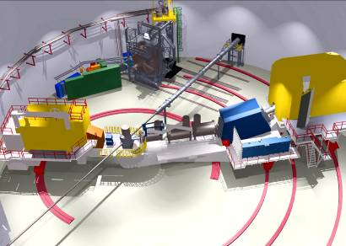
The contemporary “spin” experiments
Trigger-hodoscopes
Hall A
Hall B
μ Filter
ECal & HCal
50 m
SM2
Two high-resolution
4 GeV spectrometers
RICH
Large acceptance spect. electron/photon beams
SM1
MWPC
Straws
Beam: 27.5 GeV e±; <50>% polarization
Target: polarized gas targets H, D, <85%> He³ <50%> polarization
unpolarised gas targets H₂ to Xenon
Lumi: pol: 5x10³¹ cm⁻²/s⁻¹; unpol: 3x10³²⁻³³ cm⁻²/s⁻¹
Data taking finished June 2007
⁶LiD Target
Beam: ≤6 GeV e⁻; 85% polarization
Target: polarized targets 3He, 6LiD, NH3
several unpolarised targets
Hall C
Gems
Drift chambers
160 GeV μ
Micromegas
SciFi
Beam: 160 GeV μ: 80% polarization
Target: ⁶LiD: 50% polarization (2002-2006)
NH₃: 80% polarisation (2007)
Lumi: 5x10³² cm⁻²s⁻¹
2010 & 2011: longitudinal and transverse NH₃
Silicon
7 GeV spectrometer,
1.8 GeV spectrometer,
large installation experiments

Slide 9
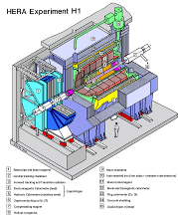
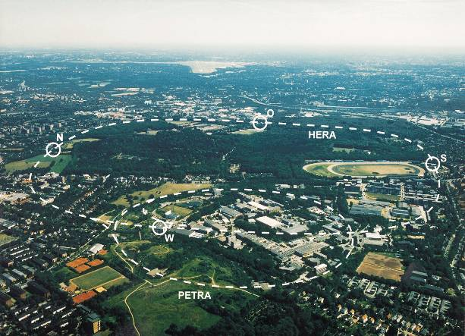
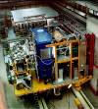
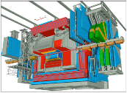
HERA @ DESY
The Experiments @ HERA
Explore the structure of
the nucleon with a lepton
beam
Deep Inelastic Scattering
(DIS)
Scattering angle and energy
of electron
→ x of the quarks
High energy =
short wave length
Scattering angle ~ Q²
mass of the exchanged
particle
Centre-of-mass energy
→ resolution;
√s = 314GeV → 10⁻¹⁸m
HERA: e⁺/e⁻ (27GeV) - proton (920 GeV) collider

Slide 10
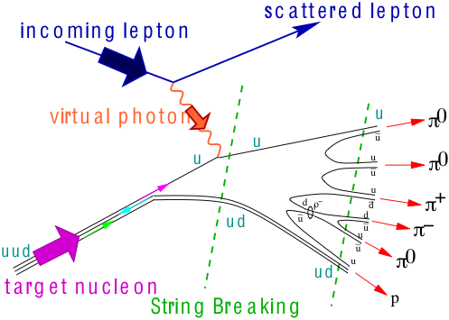
Deep Inelastic Scattering
Important kinematic variables:
Photon:
q
Quark:
Hadron:
DF
FF
cross section:

Slide 11
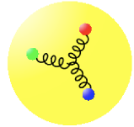
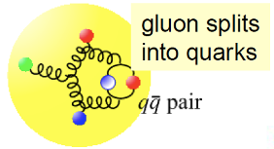
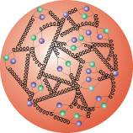
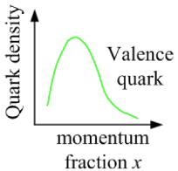
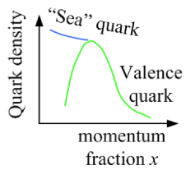
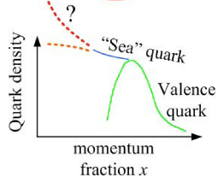
The structure of the proton – simple view
Quark splits
into gluon
splits
into quarks …
Increasing resolution (large angle scattering = large Q²)
Increasing resolution: we see “small” partons
How do the quarks behave at low-x

Slide 12
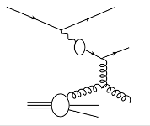
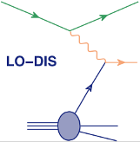
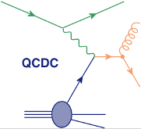
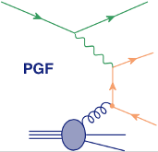
Main Underlying Processes
Q²
q
q
+
+
+
+
qg
g
g
Splitting of
γ → qq
hard QCD 2→2
scattered lepton in detector
virtual photon
know x of parton
„Soft“ & Hard VMD:
Elastic, diffractive, non-diffractive minimum bias
Scale: Q²
p_{t} can be big
Scale: p_{t} or m_{q}
x of parton is
not known
very much like pp

Slide 13
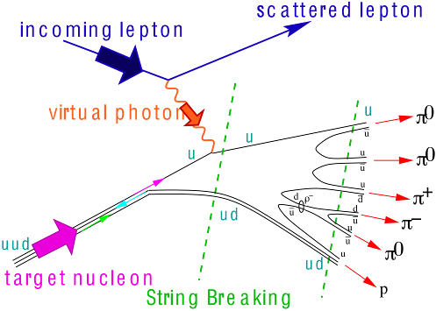
Deep Inelastic Scattering
Important kinematic variables:
Collider:
Photon:
q
Quark:
Hadron:
DF
FF
cross section:

Slide 14
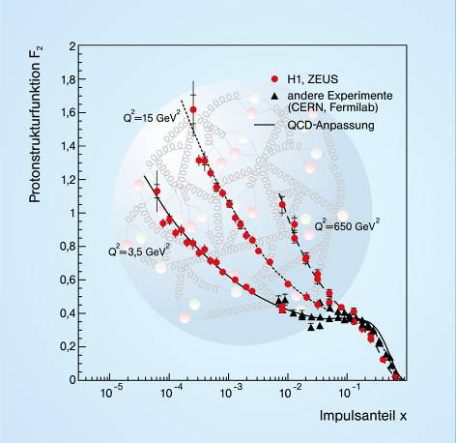
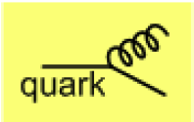
“Structure Function” & quark densities
Strong increase of sea quarks
towards low x
quark density
Density increases with Q²
more partons by magnified
view
Dynamic creation
of quarks
at low x

Slide 15
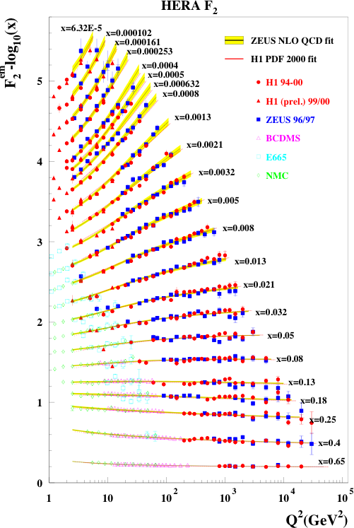
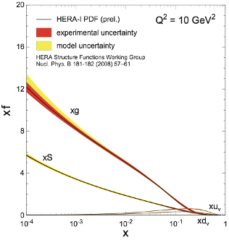
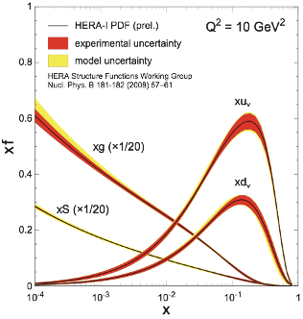
Measure Glue through DIS
small x
Observation of large
scaling violations
Gluon density dominates
large x
Notes:
Counter-intuitively the best way is through an EM process: DIS
y = inelasticity = fraction of the incoming electron energy carried by photon in the rest frame of the nucleon
The structure function F2 is sensitive to the sum of quark and anti-quark momentum distribution in the nucleon.
The apparent scaling of the data with Q2 at large x in early DIS data from SLAC was termed “Bjorken scaling” and motivated the parton model.
In the parton model, FL = 0, while in QCD, it is directly proportional to the gluon structure function, FL(x,Q2) ~ aS xG(x,Q2), at low x.
DGLAP: fixed x -> evolution along Q2
sigma (gamma N) = sig_T + sig_L
sig_L ~ FL
sig_tot ~ F2/Q^2
\frac{d^2 \sigma^{ep \rightarrow eX}}{dx dQ^2} = \frac{4 \pi \alpha^2_{e.m.}}{xQ^4} \left[ \left(1-y+\frac{y^2}{2} \right ) F_2(x,Q^2) - \frac{y^2}{2} F_L(x,Q^2) \right]

Slide 16
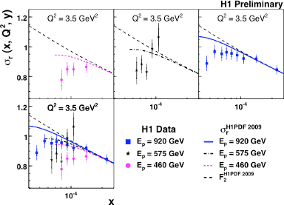
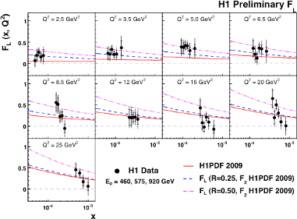
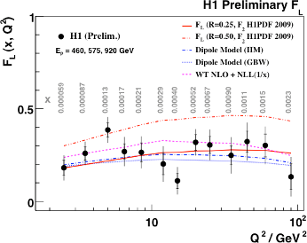
F_{L}: measures glue directly
⇒ G(x,Q²) with great precision
F_{L} ~ α_{s} G(x,Q²)
requires √s scan Q²/xs = y

Slide 17
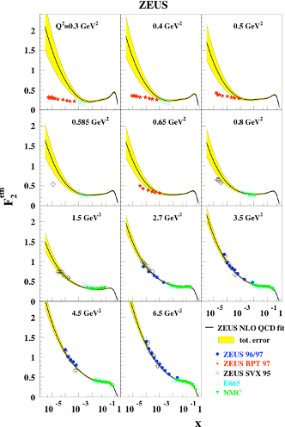
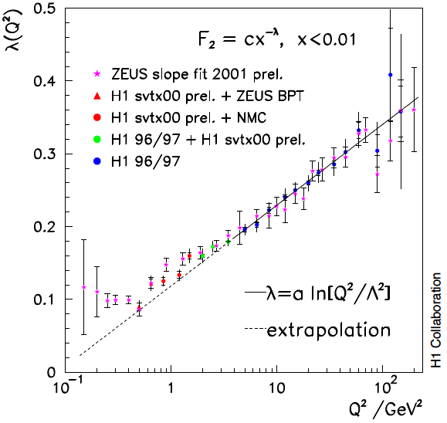
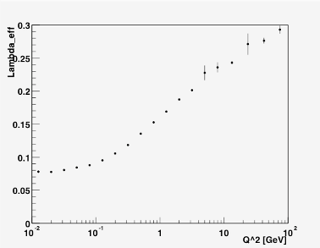
What do we know till know
F₂=C(Q²)x^{−λ}
Q² = 1GeV → 0.2fm
EM proton radius: 0.9fm
Transition, Why, How?
Does the rise of F₂ set in
at the same Q² for nuclei?

Slide 18
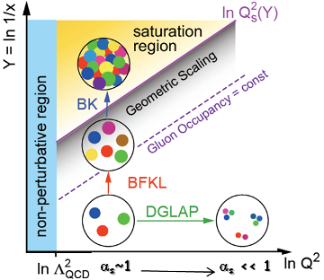
Parton Saturation
at small x linear evolution gives
strongly rising g(x)
violation of Froissart unitary bound
BK/JIMWLK non-linear evolution includes
recombination effects → saturation
Dynamically generated scale
Saturation Scale: Q²_{s}(x)
Increases with energy or decreasing x
Scale with Q²/Q²_{s}(x) instead of x and Q² separately
small x
x = P_{parton}/P_{nucleon}
Bremsstrahlung
~ α_{s}ln(1/x)
Recombination
~ α_{s}ρ
Saturation must set in at
forward rapidity/low x
when gluons start to overlap
and when recombination
becomes important

Slide 19
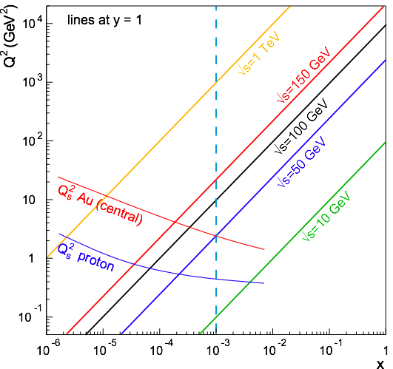
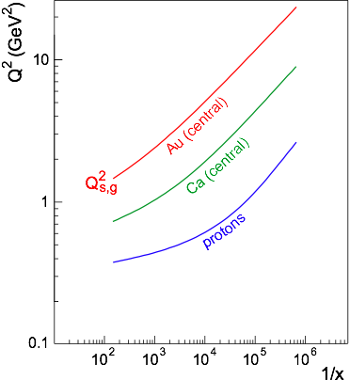
EIC - Reaching the Saturation Regime
Saturation:
Au: Strong hints from RHIC at x ~ 10⁻³
p: No (?) hints at Hera up to x=6.32⋅10⁻⁵, Q² = 1-5 GeV²
Nuclear Enhancement:
Hera
Coverage:
Need lever arm in Q² at fixed x to constrain models
Need Q > Qs to study onset of saturation
Kowalski, Lappi and Venugopalan, PRL 100, 022303 (2008)); Armesto et al., PRL 94:022002; Kowalski, Teaney, PRD 68:114005)
ep: even 1 TeV is on the low side
eA: √s = 50 GeV is marginal, around √s = 100 GeV desirable
→ 20 GeV x 100 GeV

Slide 20
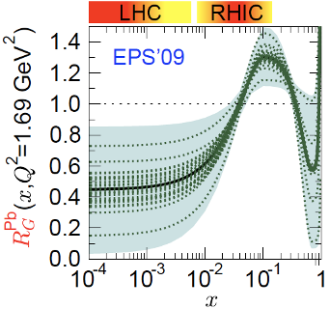
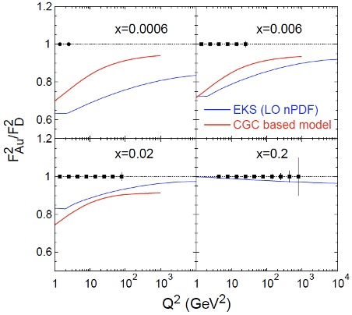
F₂: for Nuclei
shadowing
LHC η=0
RHIC η=3
Assumptions:
10GeV x 100GeV/n
√s=63GeV
Ldt = 4/A fb⁻¹
equiv to 3.8 10³³ cm⁻²s⁻¹
T=2weeks; DC:50%
Detector: 100% efficient
Q² up to kin. limit sx
Statistical errors only
Note: L~1/A
“sweet” spot
R=1
antishadowing

Slide 21
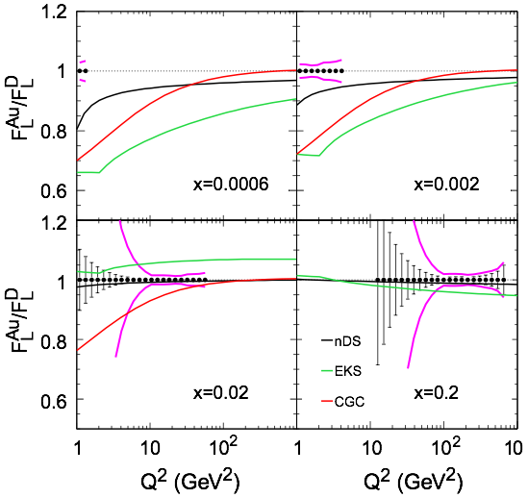
EIC - What Luminosity is Needed?
FL: inclusive measurements at different √s,
assume 1% energy-to-energy normalization
syst. uncertainties
∫Ldt = 4/A fb⁻¹ (10+100) GeV &
4/A fb⁻¹ (10+50) GeV &
2/A fb⁻¹ (5+50) GeV
All together 5 weeks at
L ~ 1x10³⁴cm⁻² s⁻¹ & 50% duty cycle
(Note: 1000x Hera L)
Conclusion from this study:
good control on systematic uncertainties critical

Slide 22
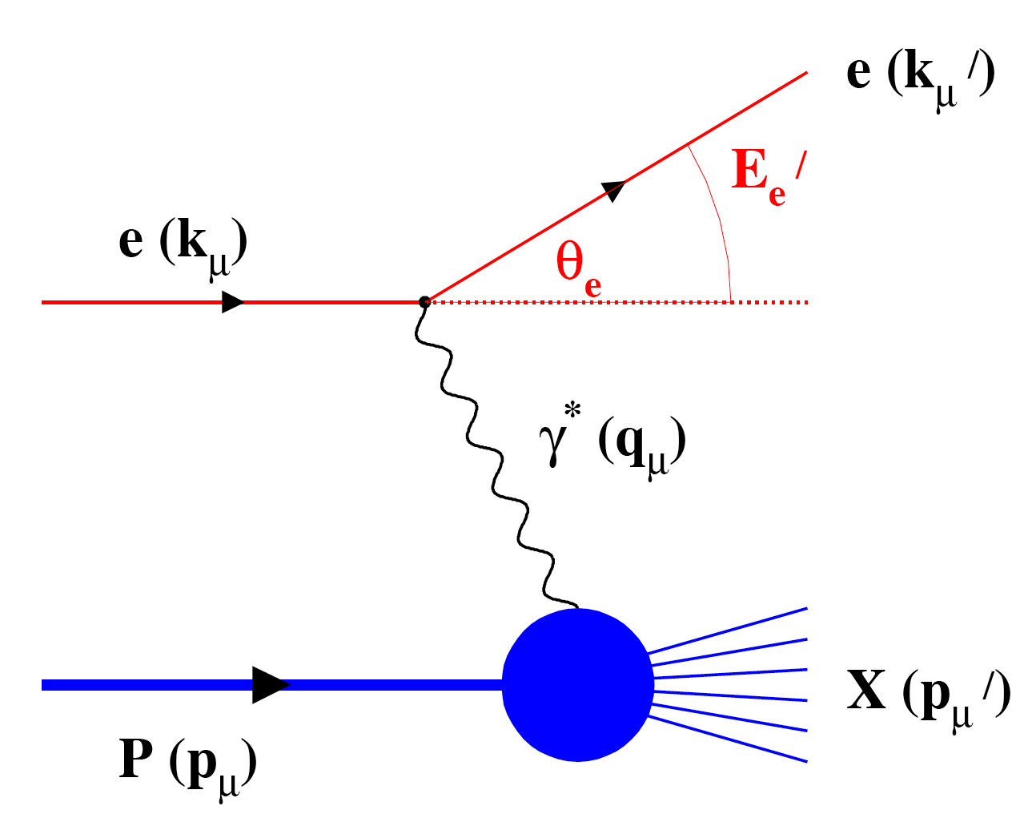
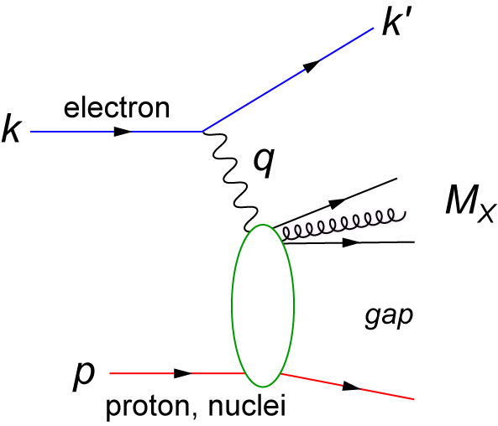
Diffractive Physics:
DIS:
Diffraction:
ρ,φ, J/ψ
?
Hit a proton at rest
with a 60 TeV e and
nothing happens to it !
It just spits out a VM.
Hera: Diffraction / DIS ~ 20%
dσ/dt ~ [xG(x,Q²)]²
experimentally very difficult need to detect proton → a long beam line
Physics extremely interesting → 3d pictures of the proton/nuclei

Slide 23
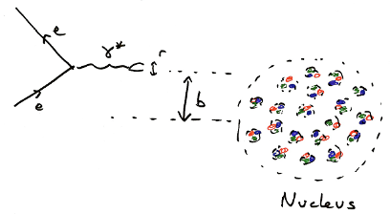
Measure the Gluon Form Factor
Basic Idea:
Studying diffractive exclusive J/ψ production
at Q2~0
Ideal Probe:
large photo-production cross section
t can be derived from e,e’ and J/ψ 4-momentum
R_{A} = 1.2A^{1/3}fm
Elastic scattering on full nucleus
→ long wavelength gluons (small t)

Slide 24
Proton Tomography
DVCS
M. Burkardt, M. Diehl 2002
FT (GPD) : momentum space → impact parameter space:
probing partons with specified long. momentum @transverse position b
p + Δ
_{T}
polarized nucleon:
u-quark
d-quark
[ξ=0]
from lattice

Slide 25
Important to understand hadron structure: Spin
Is the proton spinning like this?
ΔG
Σ_{q}L_{q}
W. Pauli
N. Bohr
L_{g}
Σ_{q}Δq
Σ_{q}L_{q}
δq
δq
Σ_{q}Δq
ΔG
L_{g}
“Helicity sum rule”
gluon
spin
Where do we go with
solving the “spin puzzle” ?
total u+d+s
quark spin
angular
momentum

Slide 26
How to measure Quark Polarizations
Virtual photon γ* can only couple to quarks of opposite helicity
Select q⁺(x) or q⁻(x) by changing the orientation of
target nucleon spin or helicity of incident lepton beam
Asymmetry definition:
inclusive DIS: only e’ info used
semi-inclusive DIS: e’+h info used

Slide 27
Δg from inclusive DIS and polarized pp
Current knowledge on Δg
Scaling violations of g₁
(Q²-dependence) give indirect access to the gluon distribution via DGLAP evolution.
DIS
EIC
RHIC polarized pp collisions at midrapidity directly involve gluons
Rule out large DG for 0.05 < x < 0.2
RHIC
constrained x-range still limited

Slide 28
How does it look at EIC
translates into
will constrain
x
EIC:
Access to ΔG at small x where uncertainties are very large
5fb⁻¹ integrated luminosity

Slide 29
Polarised quark distributions
Correlation between detected hadron and struck q_{f}
“Flavor – Separation”
Inclusive DIS:
Semi-inclusive DIS:
FF
DF
In LO-QCD:
Extract Δq by solving:
MC

Slide 30
Measured Asymmetries
Deuterium
Proton
statistics sufficient for
5 parameter fit

Slide 31
Polarized Quark Densities
First complete separation of
pol. PDFs without assumption on
sea polarization
Δu(x) > 0
Δd(x) < 0
good agreement with NLO-QCD
Polarised opposite to proton spin
Polarised parallel to proton spin
Δu(x), Δd(x) ~ 0
No indication for Δs(x) < 0
In measured range (0.023 – 0.6)

Slide 32
Polarized Quark Distributions @ EIC
eRHIC: 10GeV@250GeV at 9 fb⁻¹
0.8
0.
0.2
-0.8
X

Slide 33
Why is Δs interesting
e.g. elastic scattering of SUSY dark matter
neutralino χ
gives spin-dep. cross sec.
Ellis et al.
arXiv: 0801.3656

Slide 34
EIC Scope - QCD Factory
RHIC
Electron accelerator
p
Polarized protons
50-250 (325) GeV
Unpolarized and
polarized leptons
4-20 (30) GeV
e⁻
Light ions (d,Si,Cu)
Heavy ions (Au,U)
50-100 (130) GeV/u
e⁻
e⁺
70% e⁻ beam polarization goal
polarized positrons?
Polarized light ions (He³) 215 GeV/u
Center mass energy range: √s=28-200 GeV; L~100xHera
Mission: Studying the Physics of Strong Color Fields

Slide 35
The Relativistic Heavy-Ion Collider @ BNL
12 o’clock proposed
PHOBOS
BRAHMS
RHIC
PHENIX
v = 0.99995⋅c = 186,000 miles/sec
STAR
RF
LINAC
EBIS
ERL Test Facility
AGS
BOOSTER
TANDEMS

Slide 36
The latest design of eRHIC
30 GeV
eRHIC staging all-in tunnel
25 GeV
20 GeV
Polarized e-gun
Common vacuum chamber
eRHIC detector
15 GeV
Beam-dump
10 GeV
6 pass 2.5 GeV ERL
5 GeV
Coherent
e-cooler
0.1 GeV
27.5 GeV
22.5 GeV
17.5GeV
Common vacuum chamber
12.5 GeV
The most
cost effective
design
7.5 GeV
ePHENIX
RHIC: 325 GeV p
or 130 GeV/u Au
2.5 GeV
eSTAR
100m |--------|

Slide 37
IR-Design
D5
eRHIC - Geometry high-lumi IR with β*=5 cm, l*=4.5 m and 10 mrad crossing angle
Q5
Q4
325 GeV p
125 GeV/u ions
Spin
rotator
4 m
6.33 mrad
0.44 m
3.67 mrad
18.8 m
16.8 m
0.329 m
0.188036 m
10 mrad
30 GeV e⁻
10
20
30
60 m
90 m
m
© D.Trbojevic

Slide 38
eRHIC – Geometry high-lumi IR
 | eRHIC IR1
 | p /A | e
Energy (max), GeV | 325/130 | 20
Number of bunches | 166 | 74 nsec
Bunch intensity (u) , 10¹¹ | 2.0 | 0.24
Bunch charge, nC | 32 | 4
Beam current, mA | 420 | 50
Normalized emittance, 1e-6 m, 95% for p / rms for e | 1.2 | 25
Polarization, % | 70 | 80
rms bunch length, cm | 4.9 | 0.2
β*, cm | 5 | 5
Luminosity, cm⁻²s⁻¹ | 1.46 x 10³⁴ (including hour-glass effect h=0.851)
0.85 m
1.6 m
1 m
8.4 cm
10.4 cm
5.4 cm
10 mrad
m
1
2
3
4
5
6
7
© D.Trbojevic
Two designs of the IR exist for both low luminosity (~ 3x10³³) and high luminosity (~ 2x10³⁴) depends on distance IR to focusing quads
By using a crossing angle (and crab cavities), one can have energy-independent geometries for the IRs and no synchrotron radiation in the detectors
Big advantage in detecting particles at low angle
can go as low as 0.75º at hadron side → |η| < 5.5 Beam-p: y ~ 6.2
Luminosity for 30 GeV e-beam operation will be at 20% level

Slide 39
Detector Requirements from Physics
Detector must be multi-purpose
Need the same detector for inclusive (ep -> e’X), semi-inclusive (ep -> e’hadron(s)X), exclusive (ep -> e’πp) reactions and eA interactions
Able to run for different energies (and ep/A kinematics) to
reduce systematic errors
Ability to tag the struck nucleus in exclusive and diffractive eA reactions
Needs to have large acceptance
Cover both mid- and forward-rapidity
particle detection to very low scattering angle; around 1º in e and p/A direction
particle identification is crucial
e, π, K, p, n over wide momentum range and scattering angle
excellent secondary vertex resolution (charm)
small systematic uncertainty for e,p-beam polarization and luminosity measurement

Slide 40
Processes to Study Physics
γ*
γ*
π,K
u,d,s,
c,b,g
u,d,s,
c,b,g
inclusive DIS
semi-inclusive DIS
?
Diffraction
exclusive DIS

Slide 41
Diffractive Physics: p’ kinematics
t=(p4-p2)² = 2[(mp^{in}.mp^{out})-(E^{in}E^{out} - pz^{in}pz^{out})]
Diffraction:
?
4 x 50
4 x 250
4 x 100

Slide 42
A typical High Energy Detector
Particle types:
neutrinos (missing energy)
muons μ
hadrons π, Κ, p
quarks, gluons → jets
electrons, photons, π⁰
charged particles
Rough Classification
track detectors for charged particles
“massless” detectors
gas detectors
solid state detectors
beam pipe
magnet coil
(solenoid, field || beam axis)
Calorimeter for energy measurement
electromagnetic
high Z material (Pb-glas)
hadronic
heavy medium (Fe, Cu, U)
+ active material
absorber (mostly Fe)
flux return yoke +
active material

Slide 43
A detector integrated into IR
a lot of space
for polarimetry
and luminosity
measurements
ZDC
FPD
FED
Dipoles needed to have good forward momentum resolution
Solenoid no magnetic field @ r ~ 0
DIRC, RICH hadron identification → π, K, p
high-threshold Cerenkov → fast trigger for scattered lepton
radiation length very critical → low lepton energies

Slide 44
eRHIC Detector in Geant-3
Silicon Strip
detector
ala Zeus
central
tracking
ala BaBar
Drift Chambers
Drift Chambers ala HERMES FDC
EM-Calorimeter
LeadGlas
Dual-Radiator
RICH
ala HERMES
High Threshold
Cerenkov
fast trigger on e’
e/h separation
DIRC: not shown because of cut; modeled following Babar
no hadronic calorimeter in barrel yet
investigate ILC technology to combine μID with HCAL

Slide 45
MeRHIC Detector in Geant-3

Slide 46
and Summary
we have just explored the
tip of the iceberg
you are here
EIC
many avenues for further
important measurements and
theoretical developments
Δu_{tot}, Δd_{tot}
Knowledge about
Gluons in p /A
Come and join us
Δs
Δg
L_{q,g}
spin sum rule
The BNL EIC Taskforce

Slide 47
BACKUP

Slide 48
Beyond form factors and quark distributions
Generalized Parton Distributions
X. Ji, D. Mueller, A. Radyushkin (1994-1997)
Proton form factors, transverse charge & current densities
Structure functions,
quark longitudinal
momentum & helicity
distributions
Correlated quark momentum
and helicity distributions in
transverse space - GPDs

Slide 49
Diffractive physics: ep vs eA
Curves: Kugeratski, Goncalves, Navarra, EPJ C46, 413
DIS:
Diffraction:
?
xIP = mom. fraction of pomeron w.r.t. hadron
HERA/ep: ~20% of all events are hard diffractive
Diffractive cross-section σ_{diff}/σ_{tot} in e+A ?
Predictions: ~25-40%?
Diffractive structure functions
F_{L}^{D} for nuclei and p extremely sensitive
Exclusive Diffractive vector meson production: dσ/dt ~ [xG(x,Q²)]² !!
Distinguish between linear evolution and saturation models

Slide 50
How to measure coherent diffraction in e+A ?
Beam angular divergence limits smallest outgoing Θ_{min} for p/A that can be measured
Can measure the nucleus if it is separated from the beam in Si (Roman Pot) “beamline” detectors
p_{Tmin} ~ pAθ_{min}
For beam energies = 100 GeV/n and
θ_{min} = 0.08 mrad:
These are large momentum kicks, much greater than the binding energy (~8MeV)
Therefore, for large A, coherently diffractive nucleus cannot be separated from beamline without breaking up
Need to rely on rapidity gap
method
simulations look good
high eff. high purity
possible with gap alone
~1% contamination
~80% efficiency
depends critical on detector
hermeticity
improve further by veto on
breakup of nuclei (DIS)
Very critical
mandatory to detect nuclear
fragments from breakup
n: Zero-Degree calorimeter
p, Afrag: Forward Spectrometer
New idea: Use U instead of AU
species (A) | p_{Tmin} (GeV/c)
d (2) | 0.02
Si (28) | 0.22
Cu (64) | 0.51
In (115) | 0.92
Au (197) | 1.58
U (238) | 1.90

