Slide 1
Flavor Tomography
Alessandro Buzzatti
Miklos Gyulassy

Slide 2
Outline
Introduction
  Jet tomography and jet quenching
CUJET
  Analysis of the model
  Geometry, path integral, partonic spectra
Jet tomography at RHIC and LHC
  Heavy quark puzzle (RHIC)
  Surprising transparency (LHC)
Future developments
  Elliptic flow
Conclusions

Slide 3

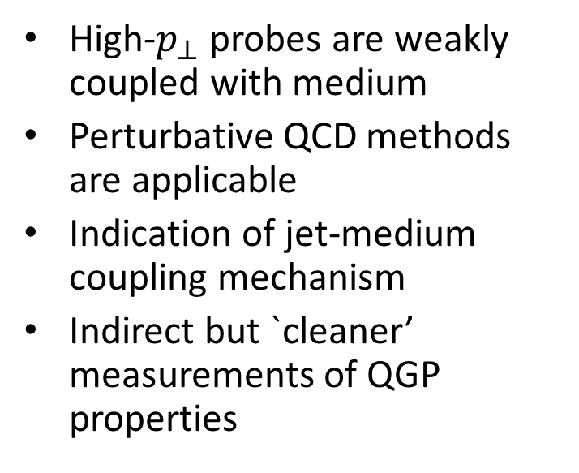


Quark Gluon Plasma
$$α_{s}(Q^{2})$$
Hydrodynamics
Perturbative QCD
$$2\sim 5 GeV$$
$$p_{⊥}$$
Medium is strongly coupled
Local thermal equilibrium is maintained
Hydrodynamic expansion and collective flow
Measurement of ‘bulk’ properties of QGP
High-$p_{⊥}$ probes are weakly coupled with medium
Perturbative QCD methods are applicable
Indication of jet-medium coupling mechanism
Indirect but `cleaner’ measurements of QGP properties

Slide 4
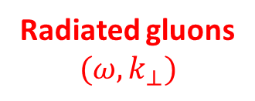


Jet Tomography
Quark of Gluon Jet probes
$$(E_{i},M_{q},{\vec{x}}_{i},φ_{i})$$
g
g
q, g
Hadron Jet fragments
$$(y,p_{⊥},φ)$$
π, η
g
Radiated gluons
$$({ω,k}_{⊥})$$
Measurement of hadronic quenching pattern provides information about QGP density
  Requires detailed knowledge of jet-medium interaction mechanism and jet transverse diffusion
  Knowledge of initial conditions, `cold’ nuclear matter effects and hadronization process

Slide 5
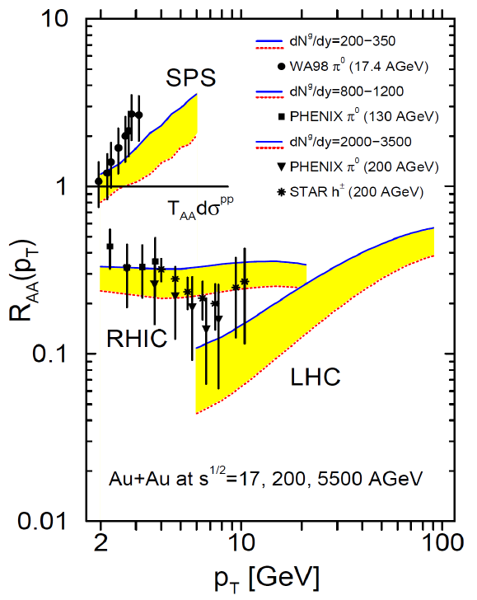
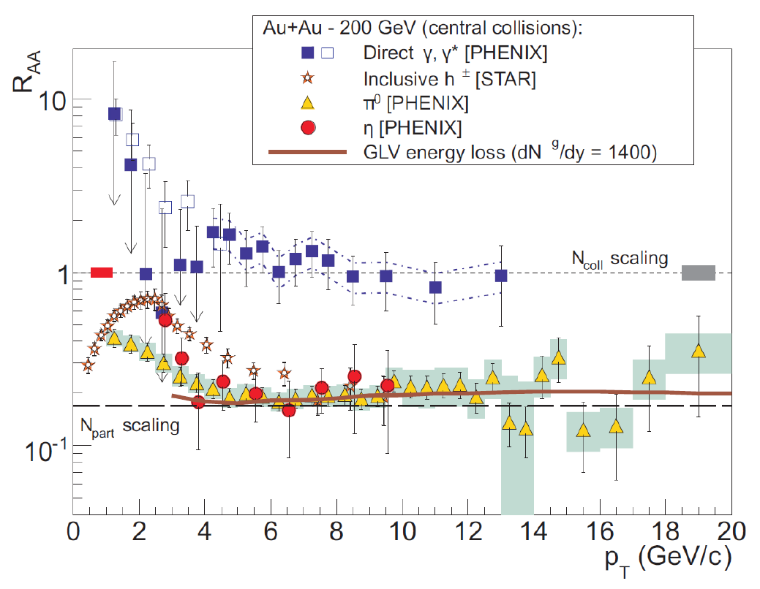
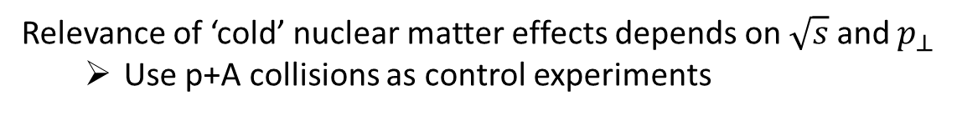

R_{AA} measurements
$γ$ control measurement
Cold nuclear effects
Jet quenching
Relevance of ‘cold’ nuclear matter effects depends on $\sqrt{s}$ and $p_{⊥}$
  Use p+A collisions as control experiments

Slide 6
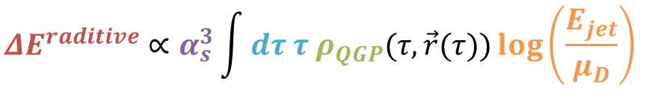
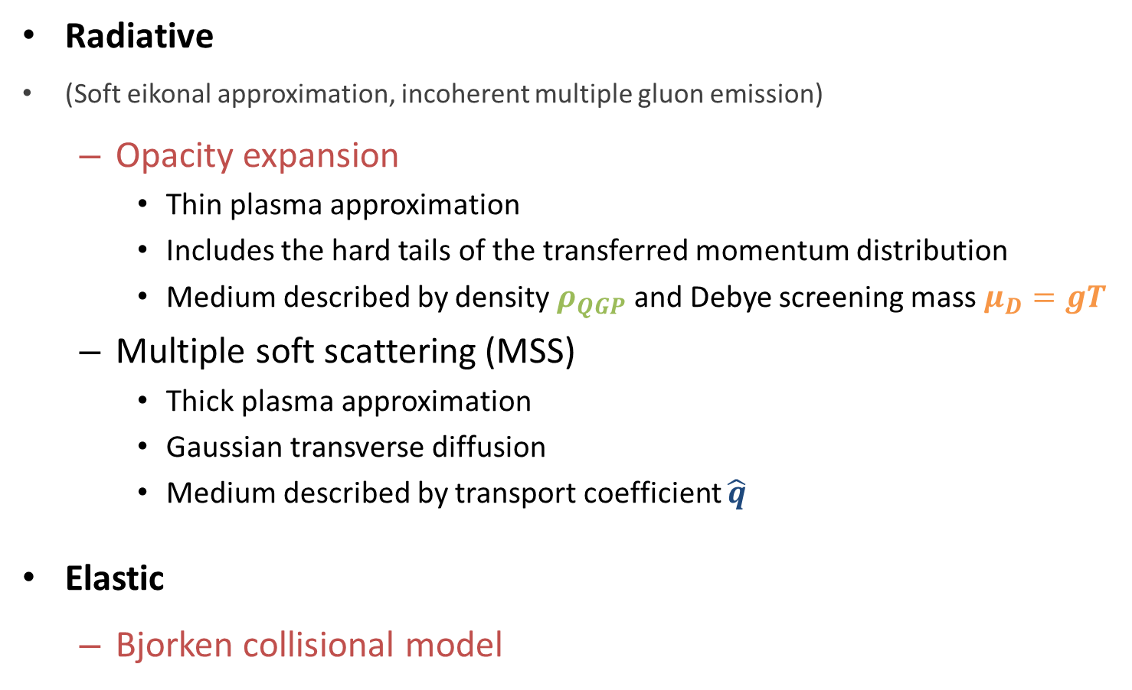
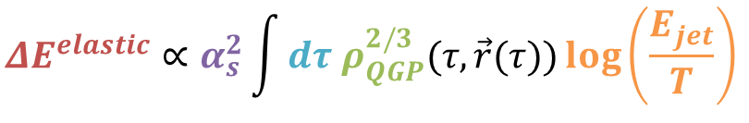
Jet quenching
$${ΔE}^{raditive}∝α_{s}^{3}\int{dτ τ ρ_{QGP}(τ,\vec{r}(τ))\log\left(\frac{E_{jet}}{μ_{D}}\right) }$$
Radiative
(Soft eikonal approximation, incoherent multiple gluon emission)
  Opacity expansion
    Thin plasma approximation
    Includes the hard tails of the transferred momentum distribution
    Medium described by density $ρ_{QGP}$ and Debye screening mass $μ_{D}=gT$
  Multiple soft scattering (MSS)
    Thick plasma approximation
    Gaussian transverse diffusion
    Medium described by transport coefficient $\hat{q}$
Elastic
  Bjorken collisional model
$${ΔE}^{elastic}∝α_{s}^{2}\int{dτ ρ_{QGP}^{2/3}(τ,\vec{r}(τ))\log\left(\frac{E_{jet}}{T}\right) }$$

Slide 7
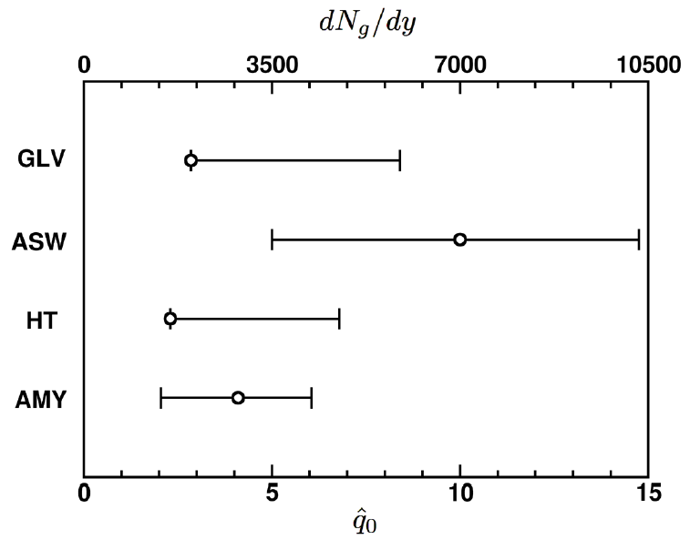

Model comparison
Characterize the medium by $\hat{q}$:
mean of the squared transverse momentum exchanged per unit path length
In the opacity expansion, $\hat{q}\sim \frac{μ_{D}^{2}}{λ}$
Need to reduce systematic uncertainties!
(Opacity expansion)
(Multiple soft scattering)
Horowitz, HP12

Slide 8
Outline
Introduction
  Jet tomography and jet quenching
CUJET
  Analysis of the model
  Geometry, path integral, partonic spectra
Jet tomography at RHIC and LHC
  Heavy quark puzzle (RHIC)
  Surprising transparency (LHC)
Future developments
  Elliptic flow
Conclusions

Slide 9
History
Genealogy of Jet tomography at Columbia University: Vitev, Molnar, Djordjevic, Adil, Wicks, Horowitz, Ficnar.
Past efforts culminated with the construction of the WHDG model
  Radiative (static potential) + Elastic energy loss
  Static medium (approximated at half the time of the expansion)
  Static jet-medium coupling parameters
  Simplified convolution over partonic spectra (spectral index approximation)
Applications of WHDG to RHIC and LHC phenomenology got mixed response
  Correct predictions of flat pion R_{AA} behavior at RHIC
  Under-quenching of non-photonic electrons at RHIC
  Over-quenching of pion R_{AA} at LHC

Slide 10


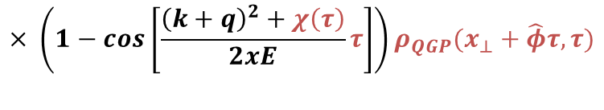

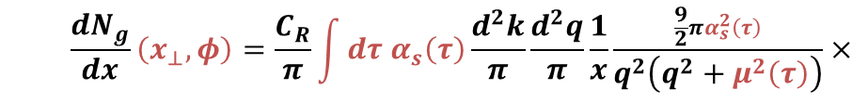
CUJET
Geometry
  Glauber model
  Bjorken longitudinal expansion
Energy loss
  Full jet path length integration
  Collisional energy losses
  Gluon emission fluctuation effects
Detailed convolution over initial production spectra
In vacuum Fragmentation Functions
  $$\frac{{dN}_{g}}{dx}\left(x_{⊥},φ\right)=\frac{C_{R}}{π}\int{dτ α_{s}\left(τ\right)\frac{d^{2}k}{π}\frac{d^{2}q}{π}}\frac{1}{x}\frac{\frac{9}{2}πα_{s}^{2}\left(τ\right)}{q^{2}\left(q^{2}+μ^{2}\left(τ\right)\right)}×$$
$$μ\left(τ\right)=gT(x_{⊥}+\hat{φ}τ,τ)$$
$$χ\left(τ\right)=M^{2}x^{2}+{m_{g}}^{2}\left(τ\right)(1−x)$$
  $$× \frac{2(k+q)}{{(k+q)}^{2}+χ(τ)}\left(\frac{(k+q)}{{(k+q)}^{2}+χ(τ)}−\frac{k}{k^{2}+χ(τ)}\right)×$$
  $$× \left(1−cos\left[\frac{{\left(k+q\right)}^{2}+χ\left(τ\right)}{2xE}τ\right]\right)ρ_{QGP}(x_{⊥}+\hat{φ}τ,τ)$$

Slide 11
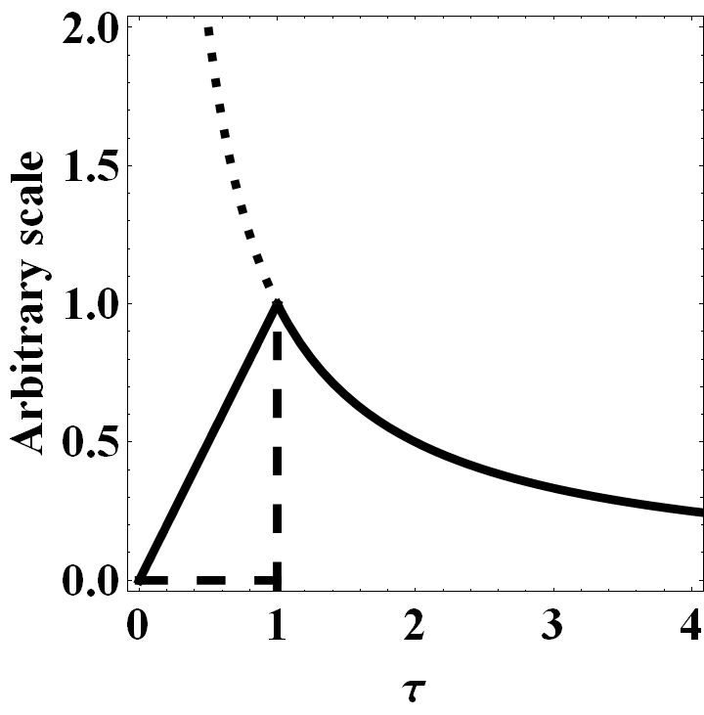
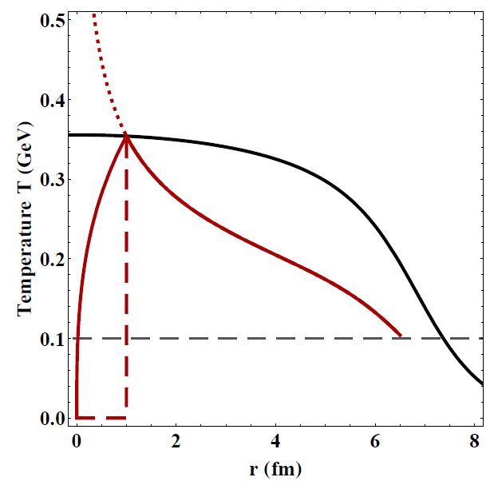
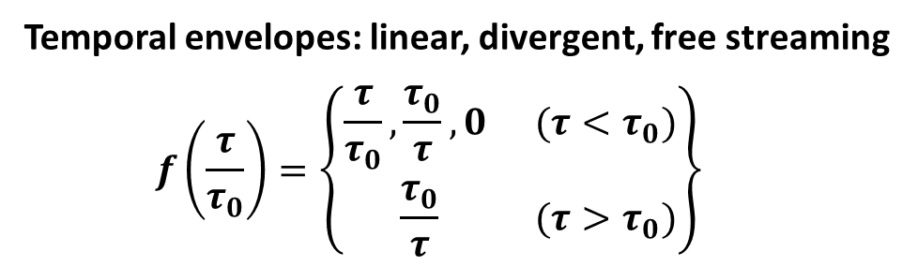

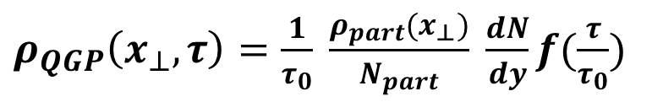

Bjorken expansion
The local thermal equilibrium is established at $τ_{0}$
Before equilibrium
$s\left(τ\right)=s_{0}\frac{τ_{0}}{τ}$ (entropy density)
$s_{0}≈3.6 ρ_{0}=3.6 \frac{1}{πR^{2}τ_{0}} \frac{dN}{dy}$ ($\frac{dN}{dy}$ is the observed rapidity density)
MONOTONIC density dependence
$ρ_{QGP}\left(x_{⊥},τ\right)=\frac{1}{τ_{0}} \frac{ρ_{part}(x_{⊥})}{N_{part}} \frac{dN}{dy}f(\frac{τ}{τ_{0}})$
Temporal envelopes: linear, divergent, free streaming
  $$f\left(\frac{τ}{τ_{0}}\right)=\left\{\begin{matrix}\frac{τ}{τ_{0}},\frac{τ_{0}}{τ},0 & (τ{<τ}_{0}) \\ \frac{τ_{0}}{τ} & (τ{>τ}_{0})\end{matrix}\right\}$$

Slide 12
CUJET
Geometry
  Glauber model
  Bjorken longitudinal expansion
Energy loss
  Full jet path length integration
  Collisional energy losses
  Gluon emission fluctuation effects
Detailed convolution over initial production spectra
In vacuum Fragmentation Functions
  $$\frac{{dN}_{g}}{dx}\left(x_{⊥},φ\right)=\frac{C_{R}}{π}\int{dτ α_{s}\left(τ\right)\frac{d^{2}k}{π}\frac{d^{2}q}{π}}\frac{1}{x}\frac{\frac{9}{2}πα_{s}^{2}\left(τ\right)}{q^{2}\left(q^{2}+μ^{2}\left(τ\right)\right)}×$$
$$μ\left(τ\right)=gT(x_{⊥}+\hat{φ}τ,τ)$$
Possibility to evaluate systematic theoretical uncertainties such as sensitivity to formation and decoupling phases of the QGP evolution, local running coupling and screening scale variations, and other effects out of reach with analytic approximations.
$$χ\left(τ\right)=M^{2}x^{2}+{m_{g}}^{2}\left(τ\right)(1−x)$$
  $$× \frac{2(k+q)}{{(k+q)}^{2}+χ(τ)}\left(\frac{(k+q)}{{(k+q)}^{2}+χ(τ)}−\frac{k}{k^{2}+χ(τ)}\right)×$$
  $$× \left(1−cos\left[\frac{{\left(k+q\right)}^{2}+χ\left(τ\right)}{2xE}τ\right]\right)ρ_{QGP}(x_{⊥}+\hat{φ}τ,τ)$$

Slide 13
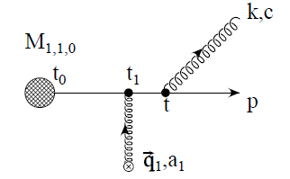
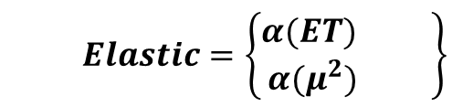
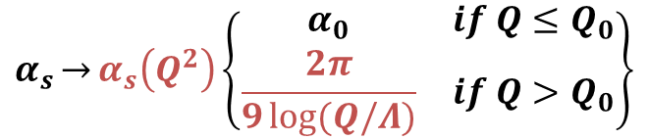
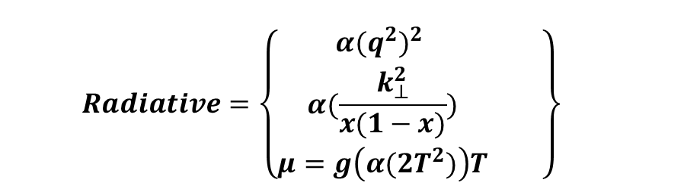


Strong running coupling
Introduce one-loop alpha running
$$α_{0}$$
$${α_{s}\overset{→}{}α}_{s}\left(Q^{2}\right)\left\{\begin{matrix}α_{0} & if Q≤Q_{0} \\ \frac{2π}{9\log{(Q/Λ)}} & if Q>Q_{0}\end{matrix}\right\}$$
$$Q_{0}$$
B. G. Zakharov, JETP Lett. 88 (2008) 781-786
  $$Radiative=\left\{\begin{matrix}{α(q^{2})}^{2} & \\ \begin{aligned}α(\frac{k_{⊥}^{2}}{x(1−x)}) \\ μ=g\left(α(2T^{2})\right)T\end{aligned} & \end{matrix}\right\}$$
  $$Elastic=\left\{\begin{matrix}α(ET) & \\ α(μ^{2}) & \end{matrix}\right\}$$
S. Peigne and A. Peshier, Phys.Rev. D77 (2008) 114017

Slide 14
CUJET
Geometry
  Glauber model
  Bjorken longitudinal expansion
Energy loss
  Full jet path length integration
  Collisional energy losses
  Gluon emission fluctuation effects
Detailed convolution over initial production spectra
In vacuum Fragmentation Functions
  $$\frac{{dN}_{g}}{dx}\left(x_{⊥},φ\right)=\frac{C_{R}}{π}\int{dτ α_{s}\left(τ\right)\frac{d^{2}k}{π}\frac{d^{2}q}{π}}\frac{1}{x}\frac{\frac{9}{2}πα_{s}^{2}\left(τ\right)}{q^{2}\left(q^{2}+μ^{2}\left(τ\right)\right)}×$$
$$μ\left(τ\right)=gT(x_{⊥}+\hat{φ}τ,τ)$$
Possibility to evaluate systematic theoretical uncertainties such as sensitivity to formation and decoupling phases of the QGP evolution, local running coupling and screening scale variations, and other effects out of reach with analytic approximations.
$$χ\left(τ\right)=M^{2}x^{2}+{m_{g}}^{2}\left(τ\right)(1−x)$$
  $$× \frac{2(k+q)}{{(k+q)}^{2}+χ(τ)}\left(\frac{(k+q)}{{(k+q)}^{2}+χ(τ)}−\frac{k}{k^{2}+χ(τ)}\right)×$$
  $$× \left(1−cos\left[\frac{{\left(k+q\right)}^{2}+χ\left(τ\right)}{2xE}τ\right]\right)ρ_{QGP}(x_{⊥}+\hat{φ}τ,τ)$$

Slide 15
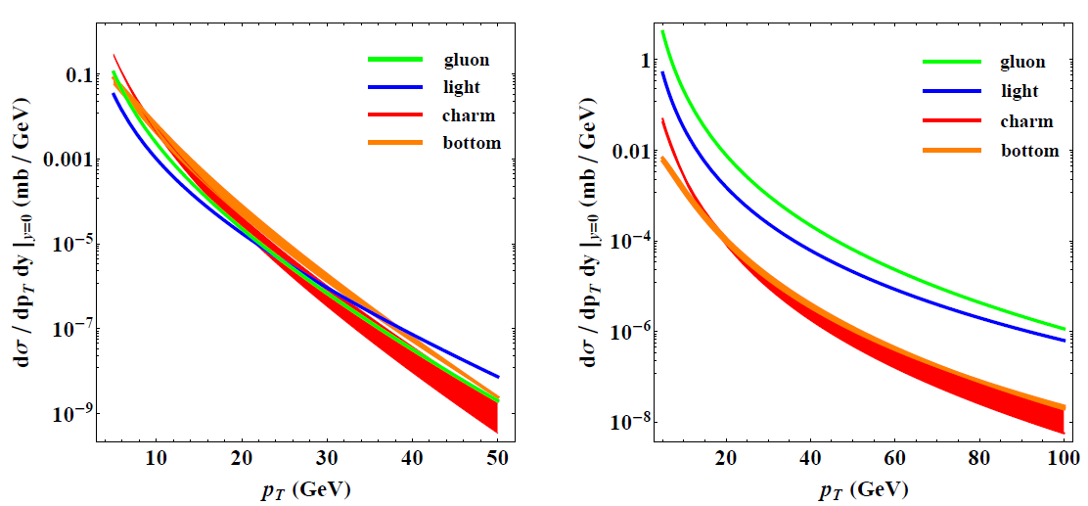

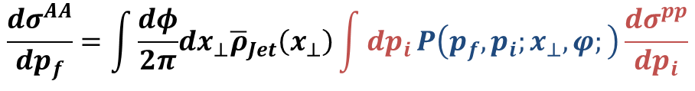
Production spectra
Convolute over $\sqrt{s}$ and flavor dependent pQCD invariant jet spectra
$$\frac{dσ^{AA}}{dp_{f}}=\int{\frac{dφ}{2π}dx_{⊥}{\overline{ρ}}_{Jet}\left(x_{⊥}\right)\int{dp_{i}}P\left(p_{f},p_{i};x_{⊥},φ;\right)\frac{dσ^{pp}}{dp_{i}}}$$
RHIC
LHC
NLO-FONLL uncertainty
Vogt, Xin-Nian

Slide 16
CUJET
Geometry
  Glauber model
  Bjorken longitudinal expansion
Energy loss
  Full jet path length integration
  Collisional energy losses
  Gluon emission fluctuation effects
Detailed convolution over initial production spectra
In vacuum Fragmentation Functions
  $$\frac{{dN}_{g}}{dx}\left(x_{⊥},φ\right)=\frac{C_{R}}{π}\int{dτ α_{s}\left(τ\right)\frac{d^{2}k}{π}\frac{d^{2}q}{π}}\frac{1}{x}\frac{\frac{9}{2}πα_{s}^{2}\left(τ\right)}{q^{2}\left(q^{2}+μ^{2}\left(τ\right)\right)}×$$
$$μ\left(τ\right)=gT(x_{⊥}+\hat{φ}τ,τ)$$
Possibility to evaluate systematic theoretical uncertainties such as sensitivity to formation and decoupling phases of the QGP evolution, local running coupling and screening scale variations, and other effects out of reach with analytic approximations.
$$χ\left(τ\right)=M^{2}x^{2}+{m_{g}}^{2}\left(τ\right)(1−x)$$
  $$× \frac{2(k+q)}{{(k+q)}^{2}+χ(τ)}\left(\frac{(k+q)}{{(k+q)}^{2}+χ(τ)}−\frac{k}{k^{2}+χ(τ)}\right)×$$
  $$× \left(1−cos\left[\frac{{\left(k+q\right)}^{2}+χ\left(τ\right)}{2xE}τ\right]\right)ρ_{QGP}(x_{⊥}+\hat{φ}τ,τ)$$

Slide 17
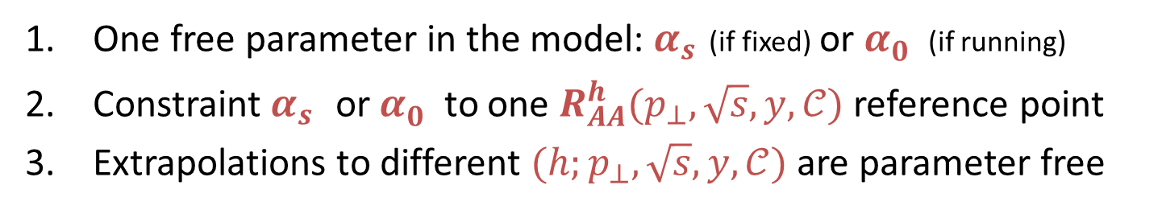
Systematic errors
Initial conditions and plasma evolution
  Thermalization phase, plasma density profile and fluctuations, plasma constituents, hydrodynamic expansion, freeze-out temperature
pp reference spectra
Jet-medium coupling
  Interaction potential, order of opacity expansion, running coupling scales, multiple gluon emission, large angle radiation
One free parameter in the model: $α_{s}^{}$(if fixed) or $α_{0}^{}$ (if running)
Constraint $α_{s}^{}$ or $α_{0}^{}$ to one $R_{AA}^{h}(p_{⊥},\sqrt{s},y,𝒞)$ reference point
Extrapolations to different $({h;p}_{⊥},\sqrt{s},y,𝒞)$ are parameter free

Slide 18
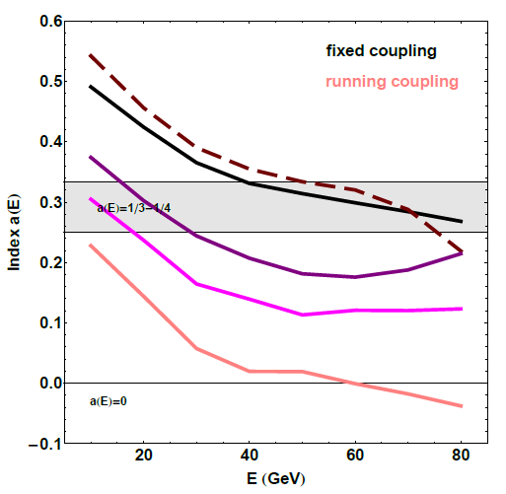
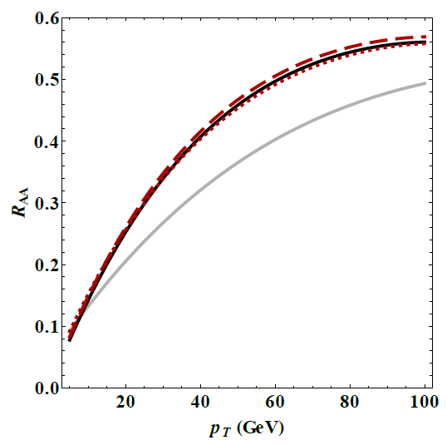






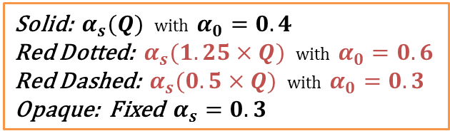

Running coupling
$$\frac{dP}{dτ}=−κP^{a}τ^{b}T^{2−a+b}$$
a-b-c model
Running scales
Gyulassy, Horowitz
fixed
only $T$
GLV
only $q_{⊥}$
$$a=\frac{1}{3}\sim \frac{1}{4}$$
$$\left(ΔE∝\log{(E/T)}L^{2}T^{3}\right)$$
only $k_{⊥}$
all
Contribution from hard $k_{⊥}$ tails
LHC
Solid: $α_{s}(Q)$ with $α_{0}=0.4$
Red Dotted: $α_{s}(1.25×Q)$ with $α_{0}=0.6$
Red Dashed: $α_{s}(0.5×Q)$ with $α_{0}=0.3$
Opaque: Fixed $α_{s}=0.3$
Increase in the slope of R_{AA} over a broad range of momenta

Slide 19
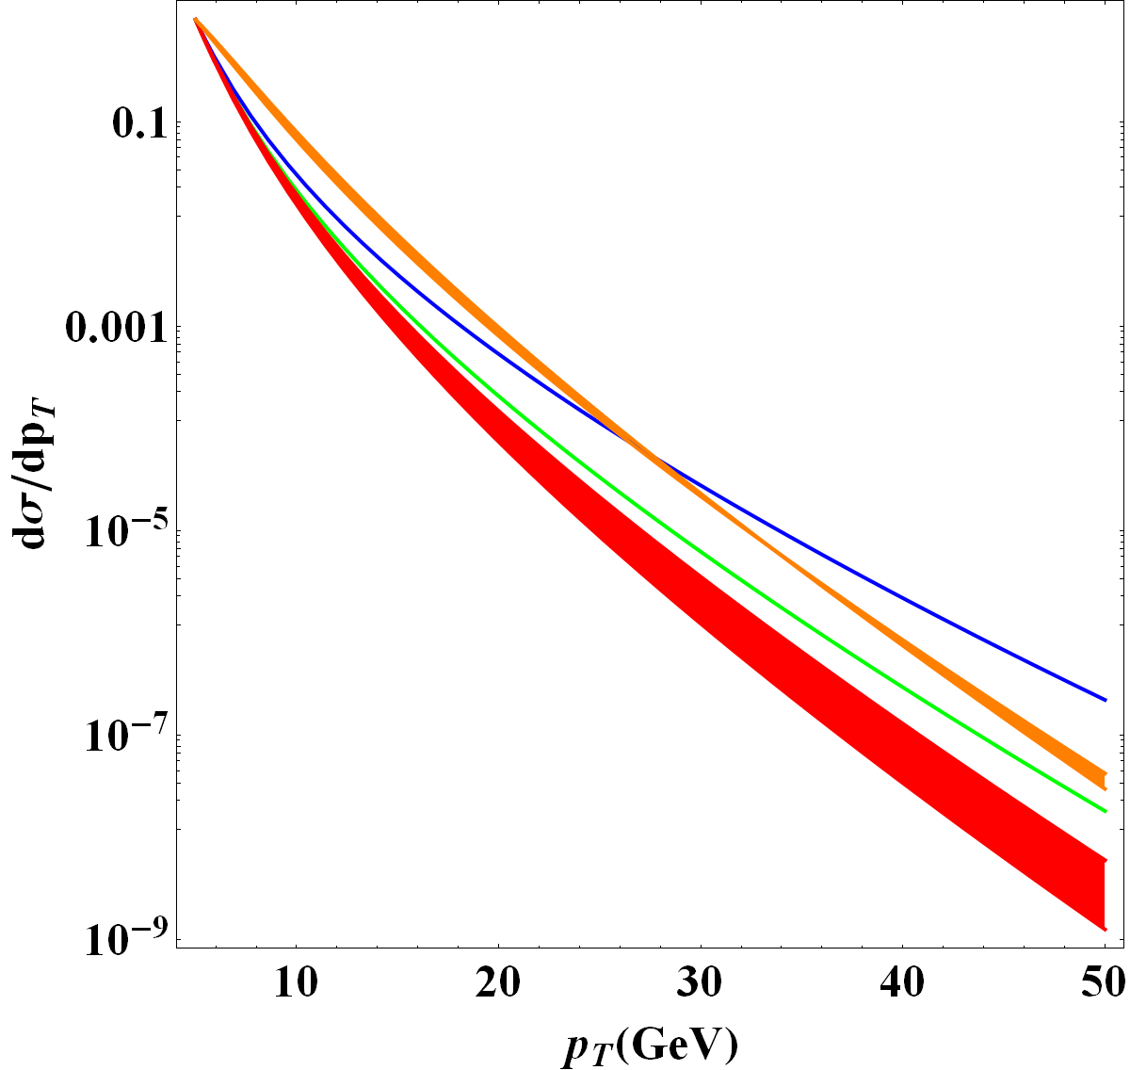
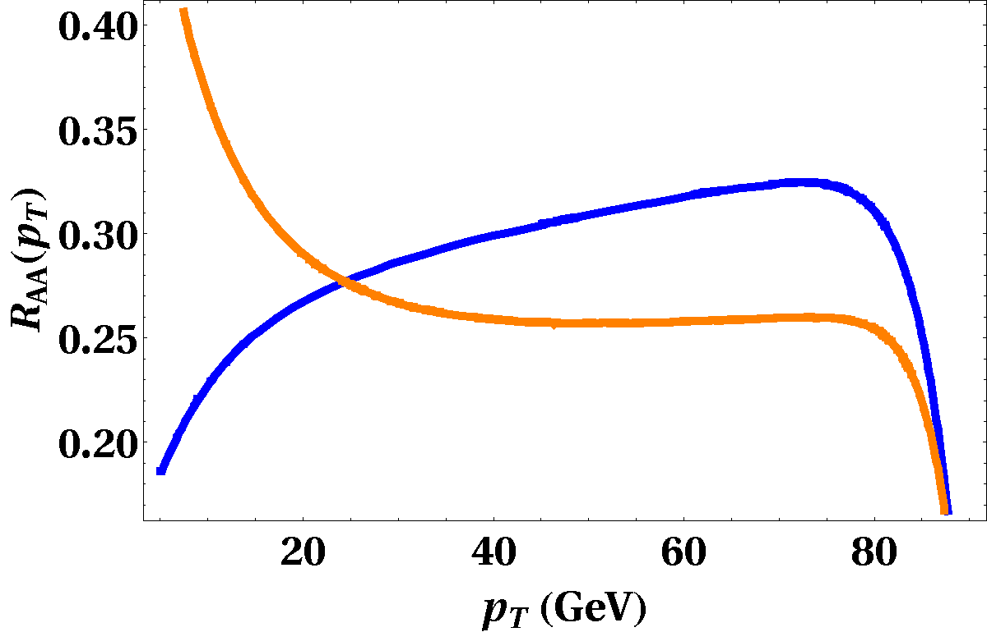
Initial pQCD spectra
Competing effects between increased density and harder production spectra
Initial quark production spectra
RHIC
  RHIC density and spectra
  LHC density, RHIC spectra
  LHC density and spectra
UP
BOTTOM
GLUE
UP
CHARM
BOTTOM

Slide 20
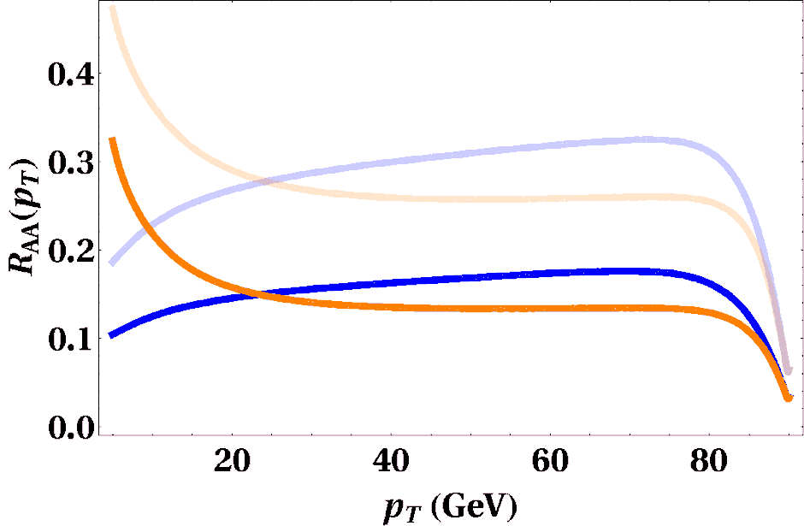
Initial pQCD spectra
Competing effects between increased density and harder production spectra
Initial quark production spectra
RHIC
  RHIC density and spectra
  LHC density, RHIC spectra
  LHC density and spectra
UP
BOTTOM
GLUE
UP
CHARM
BOTTOM

Slide 21
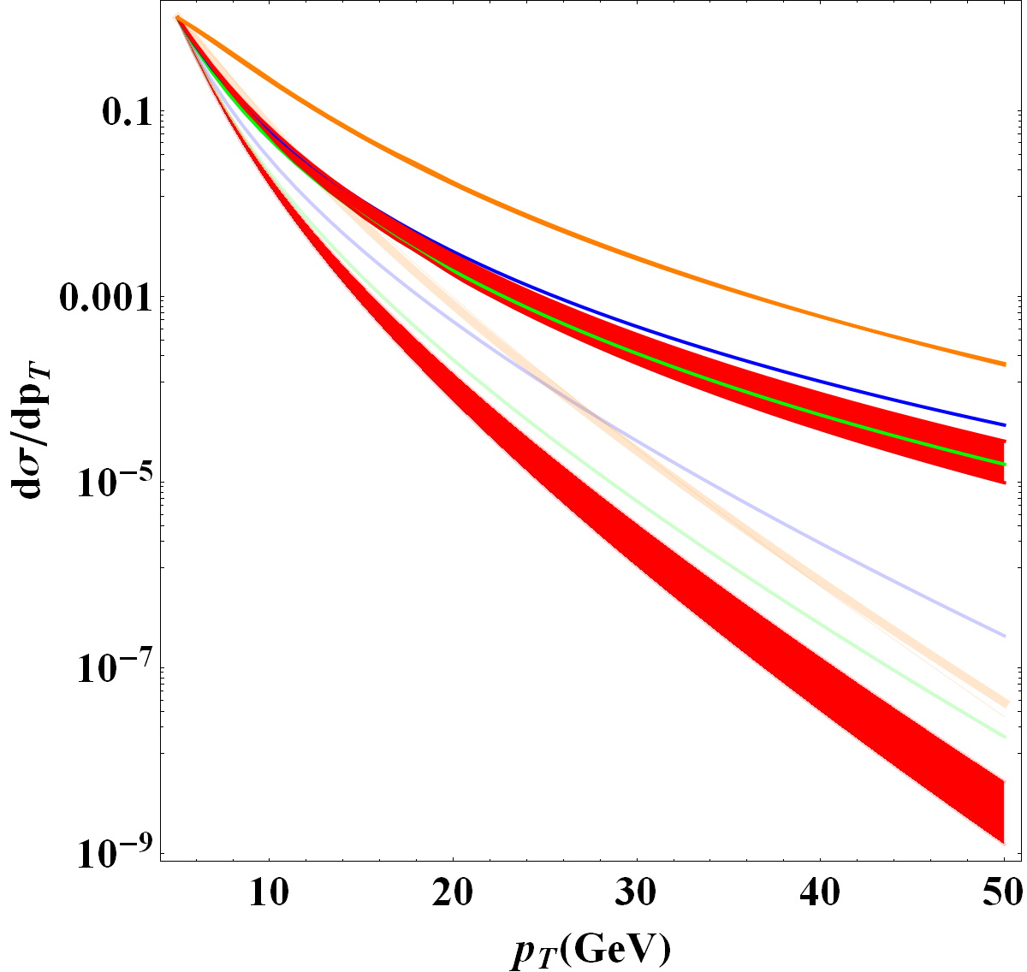
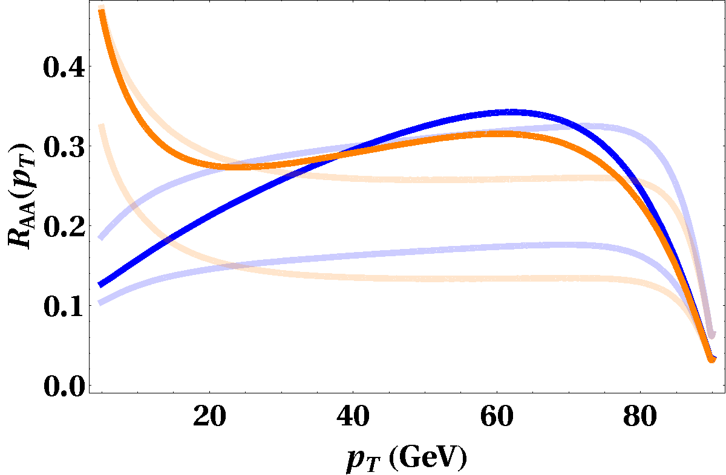
Initial pQCD spectra
Competing effects between increased density and harder production spectra
Initial quark production spectra
LHC
  RHIC density and spectra
  LHC density, RHIC spectra
  LHC density and spectra
UP
BOTTOM
GLUE
UP
CHARM
BOTTOM

Slide 22
Outline
Introduction
  Jet tomography and jet quenching
CUJET
  Analysis of the model
  Geometry, path integral, partonic spectra
Jet tomography at RHIC and LHC
  Heavy quark puzzle (RHIC)
  Surprising transparency (LHC)
Future developments
  Elliptic flow
Conclusions

Slide 23
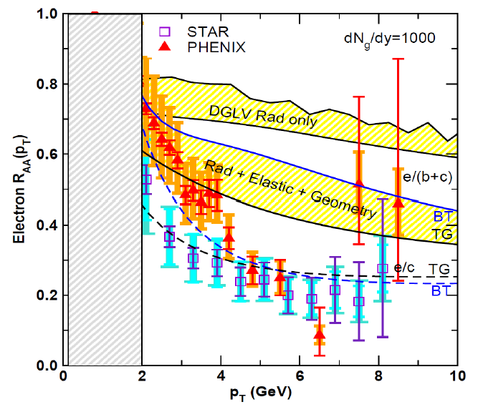
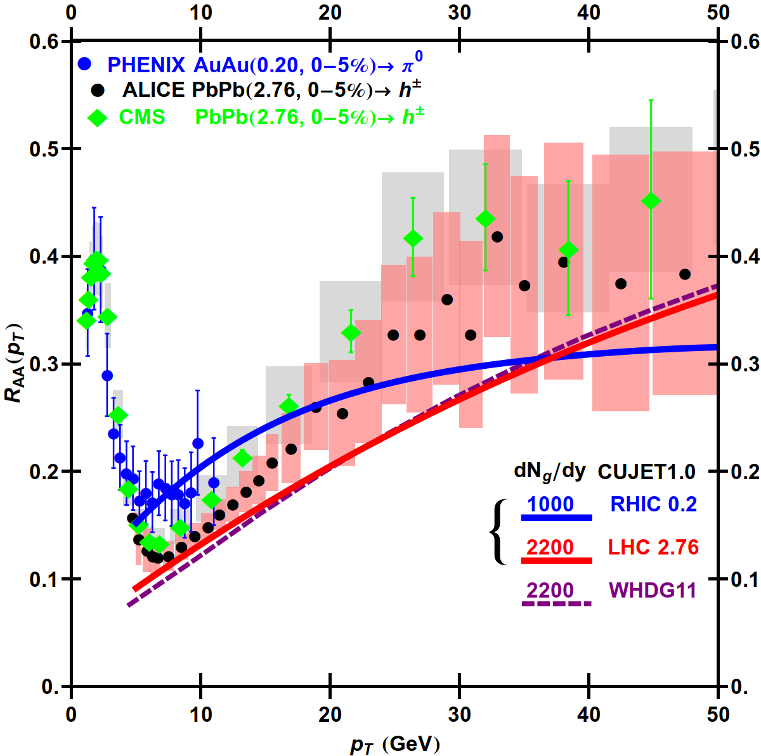
Explained issues
Heavy quark puzzle (RHIC)
Surprising transparency (LHC)

Slide 24
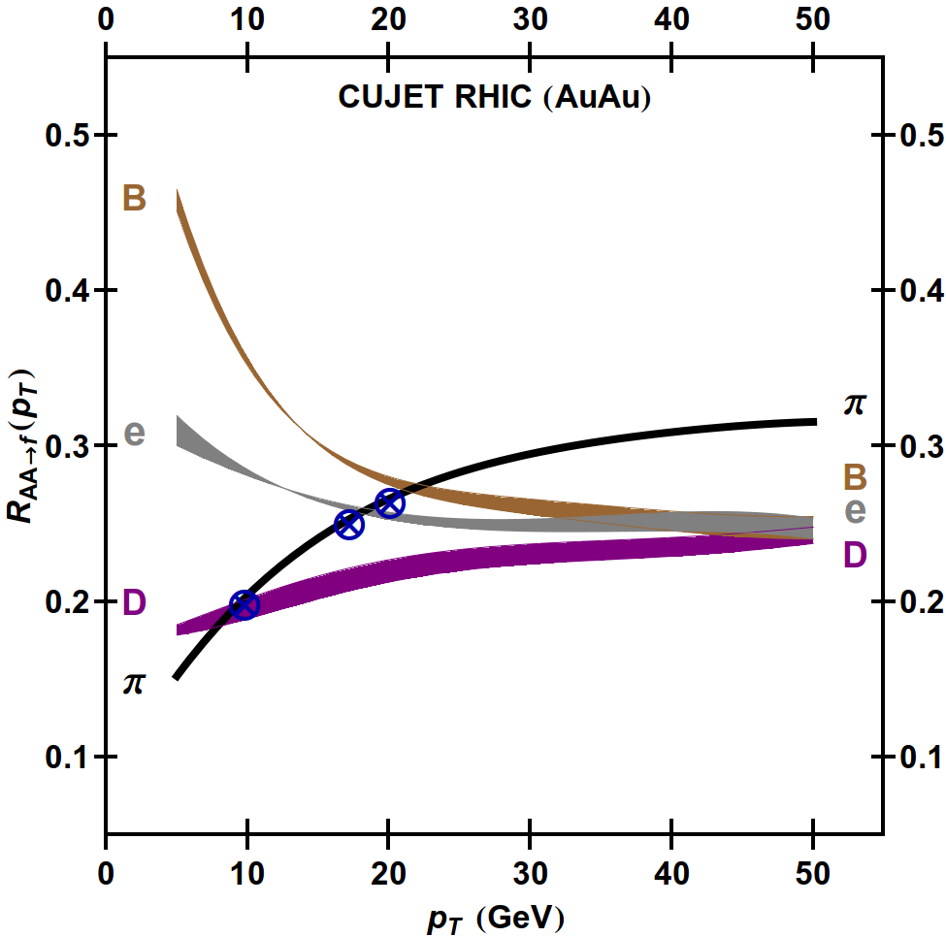
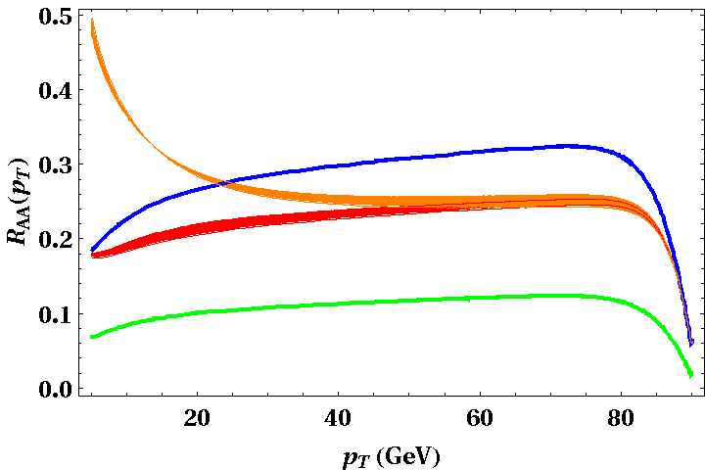
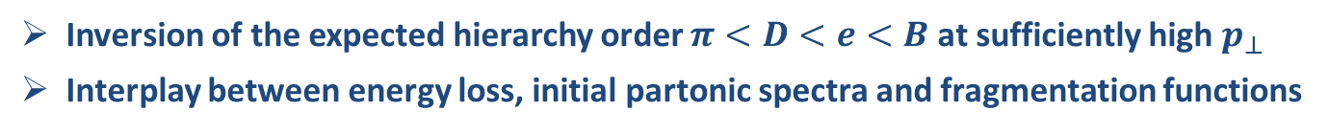
Level crossing at RHIC
RHIC fit
Glauber+Bjorken, dynamical, rad+col
central collision
dN/dy=1000
fixed coupling, α_{s}=0.3
τ₀=1 fm/c
b
u
c
g
Inversion of the expected hierarchy order $π<D<e<B$ at sufficiently high $p_{⊥}$
Interplay between energy loss, initial partonic spectra and fragmentation functions

Slide 25
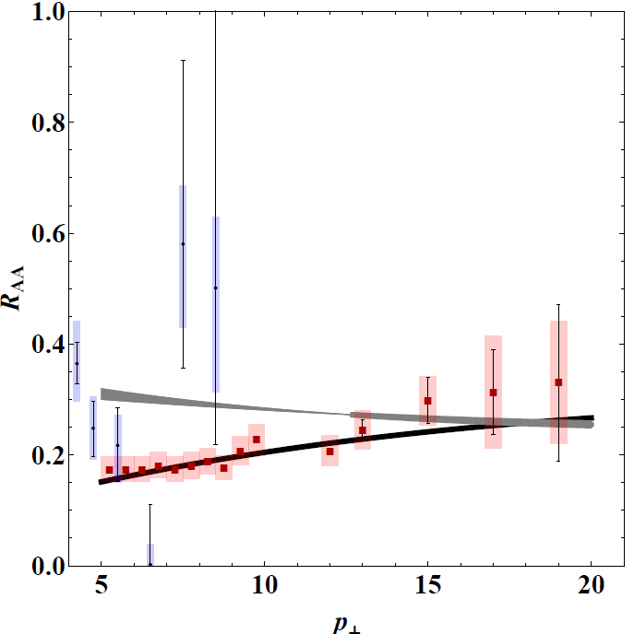
RHIC data
RHIC fit
Glauber+Bjorken, dynamical, rad+col
central collision
dN/dy=1000
fixed coupling, α_{s}=0.3
CUJET @ RHIC
ELECTRONS (PHENIX)
PIONS (PHENIX)
Reduced discrepancy between pions and non-photonic electrons

Slide 26
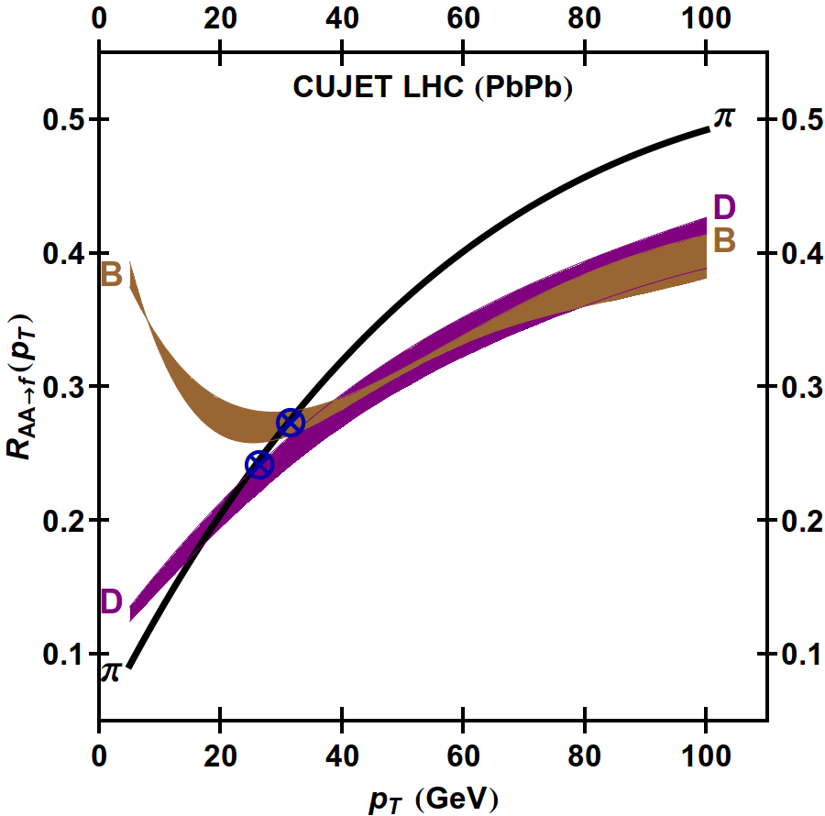
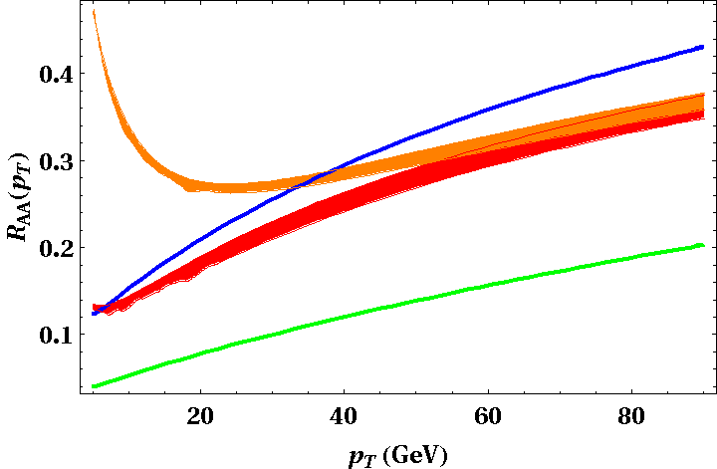

Level crossing at LHC
LHC extrapolation parameter-free
dN/dy=2200
LHC production spectra
b
u
c
g
Inversion of the expected hierarchy order $π<D<B$ at energies accessible experimentally
Steep rise of R_{AA} with $p_{⊥}$

Slide 27
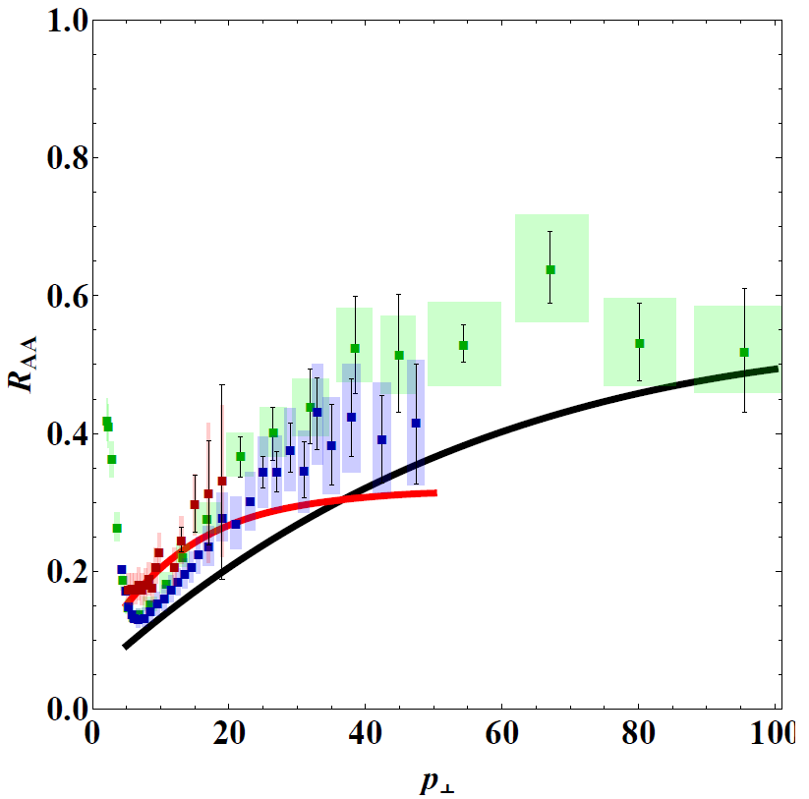
LHC data
LHC extrapolation parameter-free
(fixed coupling, α_{s}=0.3)
dN/dy=2200
LHC production spectra
CUJET @ LHC
PIONS (CMS)
ELECTRONS (PHENIX)
Predictions are over-quenched: the QGP at LHC is surprisingly transparent to hard probes
Possibility of reduced coupling?
PIONS (ALICE)
PIONS (PHENIX)
PIONS (PHENIX)

Slide 28
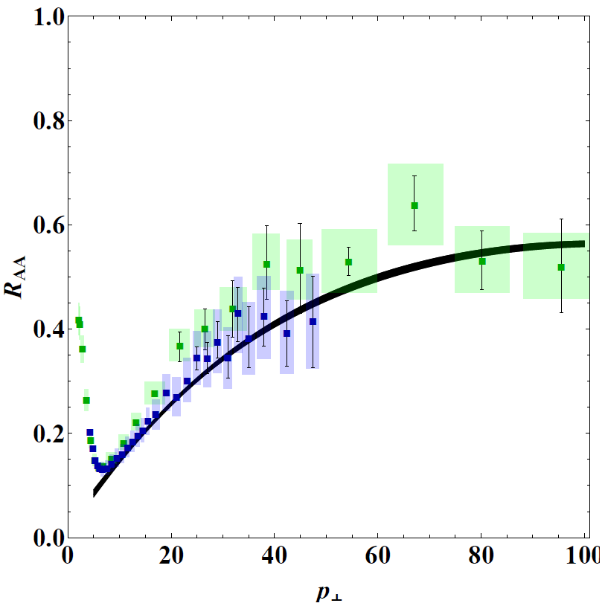
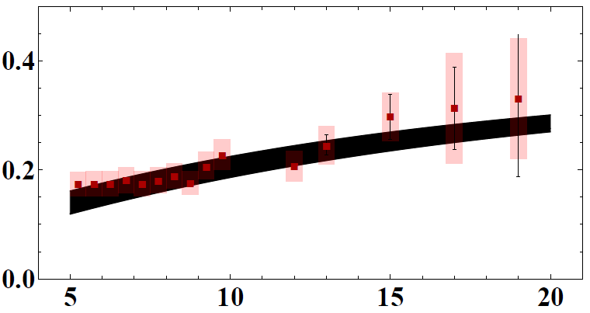
LHC data with running coupling
LHC fit, RHIC extrapolation parameter-free
Glauber+Bjorken, dynamical, rad+col
central collision
dN/dy=2200
running coupling, α₀=0.4
CUJET @ LHC
PIONS (PHENIX)
PIONS (CMS)
PIONS (ALICE)
Surprising agreement with data
Consistent with backward extrapolated RHIC predictions

Slide 29
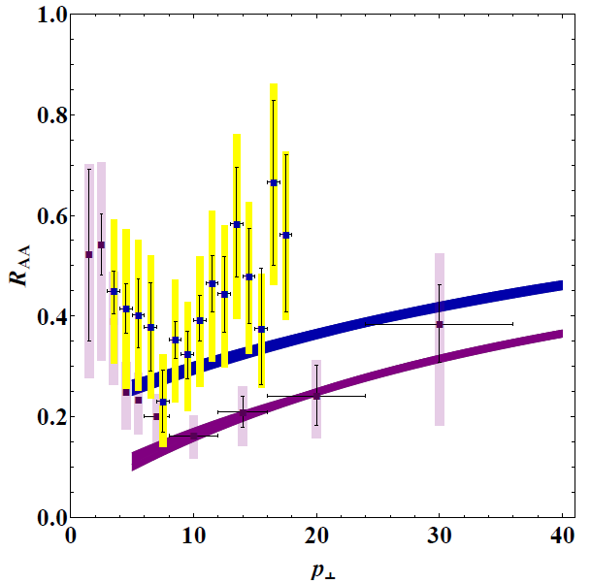
Open heavy flavor data
CUJET @ LHC
LHC fit, RHIC extrapolation parameter-free
Constrained by LHC pion fit
PIONS (PHENIX)
ELECTRONS (ALICE)
PIONS (CMS)
PIONS (ALICE)
D mesons (ALICE)

Slide 30
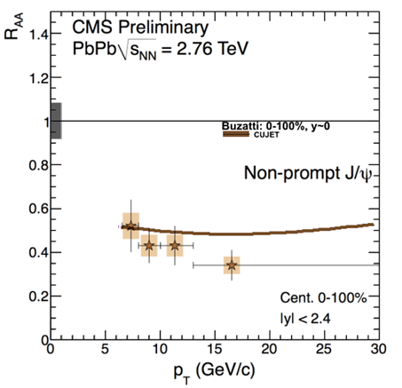
Open heavy flavor data
CUJET @ LHC
LHC fit, RHIC extrapolation parameter-free
Constrained by LHC pion fit
PIONS (PHENIX)
PIONS (CMS)
PIONS (ALICE)

Slide 31
Outline
Introduction
  Jet tomography and jet quenching
CUJET
  Analysis of the model
  Geometry, path integral, partonic spectra
Jet tomography at RHIC and LHC
  Heavy quark puzzle (RHIC)
  Surprising transparency (LHC)
Future developments
  Elliptic flow
Conclusions

Slide 32
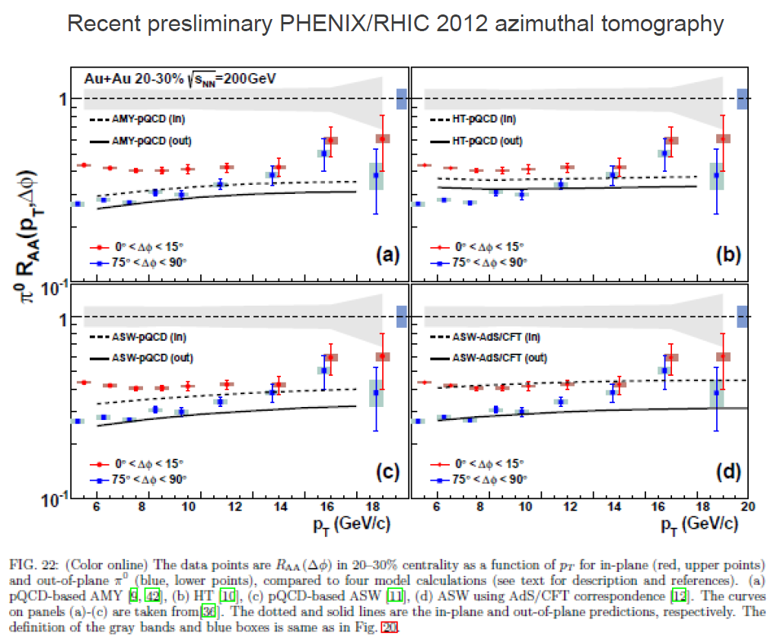
Elliptic flow

Slide 33
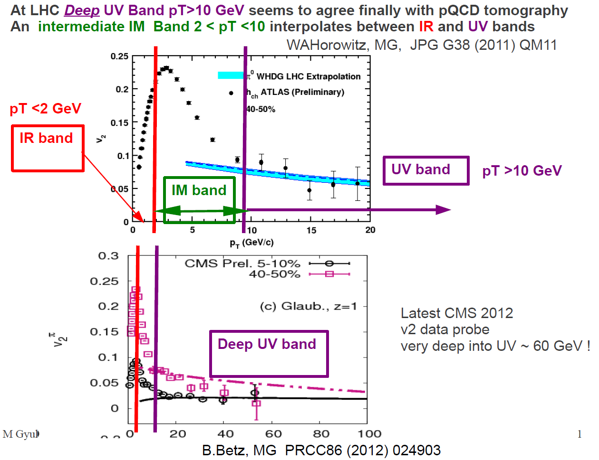
Elliptic flow

Slide 34
Hydro expansion

Slide 35
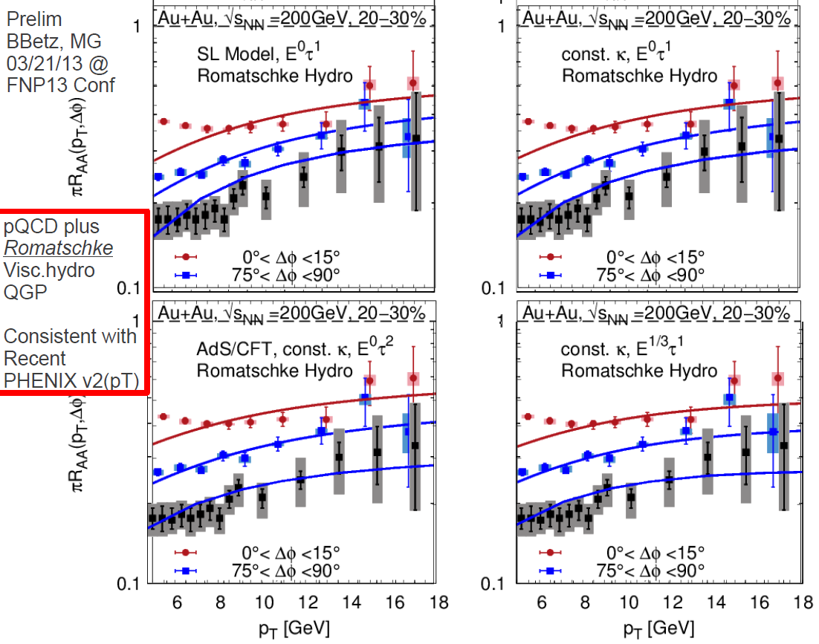
More on hydro expansion

Slide 36
Conclusions
Quark Gluon Plasma
  Low- hydro vs. high- pQCD
  QGP properties can be studied measuring high- Jets
  Jet tomography requires knowledge of: (1) initial conditions (2) plasma evolution (3) energy loss (4) jet fragmentation
CUJET
  Quantitative predictions insensitive to many of the systematic theoretical uncertainties
  Evolution over WHDG
        Geometry, Jet path integration, Partonic spectra, Dynamical potential
  Predicted level crossing pattern, reduced light-bottom quark jets discrepancy, steep rise of R_{AA} at LHC
Future
  Address azimuthal asymmetry puzzle
        Include viscous hydrodynamics
  Full jet measurements

Slide 37
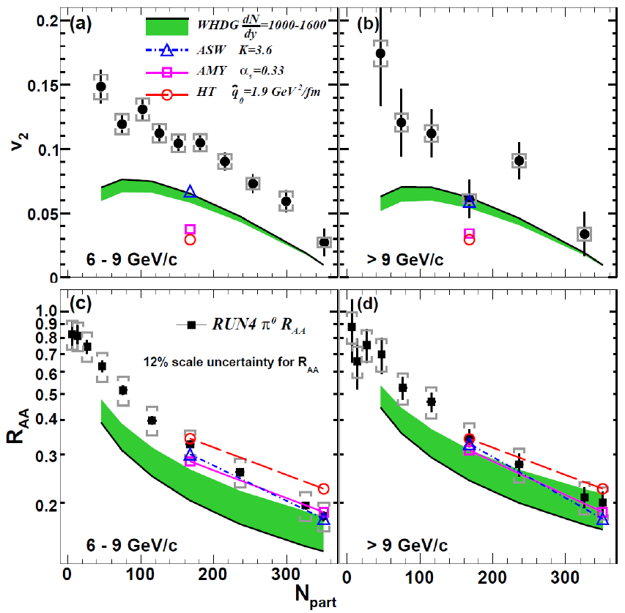

WHDG
$$\frac{dN}{dp_{⊥}dφ}=\frac{dN}{dp_{⊥}}\frac{1}{2π}(1+2v_{1}\cos{φ}+2v_{2}\cos{2φ}+…)$$
Elliptic flow
Need stronger coupling between jet and medium, but R_{AA} will be over-quenched
The agreement between data and theoretical curves worsen for higher centralities and lower transverse momenta.

Slide 38
Elliptic flow

Slide 39











Radiative energy loss
Incoherent limit: Gunion-Bertsch
$$k=[ω=xE^{+},\frac{k_{⊥}^{2}}{ω},k_{⊥}]$$
$\frac{dN}{dxdk_{⊥}}=\frac{1}{x}\frac{α_{s}C_{A}}{π^{2}}\frac{q_{⊥}^{2}}{k_{⊥}^{2}{(q_{⊥}−k_{⊥})}^{2}}$
  Non-abelian equivalent of Bethe-Heitler limit
  Flat distribution at mid-rapidity
  Multiple scattering amplitudes are summed incoherently
  Incoming quark is on-shell and massless
$$p=[E^{+},E^{+},0]$$
$$p^{′}$$
$$q=[q^{+},q^{−},q_{⊥}]$$
Formation time physics
  $τ_{f}<λ<L$ Incoherent multiple collisions
  $λ<τ_{f}<L$ LPM effect (radiation suppressed by multiple scatterings within one coherence length)
  $λ<{L<τ}_{f}$ Factorization limit (acts as one single scatterer)
$$τ_{f}\sim \frac{2ω}{k_{⊥}^{2}}$$

Slide 40


GLV interference effects
Energy loss LPM interference effects with hard production vertex (jet created at finite time)
Transverse diffusion LPM interference effects with successive scatterings (gluon cascading)

Slide 41















DGLV mass effects
Opacity series expansion $⟶ {\left(\frac{L}{λ}\right)}^{n}$
Soft Radiation ($E≫ω$, $x≪1$)
Soft Scattering ($E≫q$, $ω≫k_{T}$)
Radiation antenna $⟶ Cascade terms$
$Gunion−Bertsch$
$$Hard$$
LPM effect $⟶$
$$Inverse formation time$$
$$Mass effects$$
Scattering center distribution $⟶$

Slide 42



Effective Potential
Static potential (DGLV)
Dynamical potential (MD)
Static scattering centers
Color-electric screened Yukawa potential (Debye mass)
Full opacity series
Dynamical scattering centers
Includes screened color-magnetic effects (HTL gluon propagators)
Only first order in opacity
$${\left|{\overline{v}}_{i}(q_{i})\right|}^{2}=\frac{1}{π}\frac{{μ(z_{i})}^{2}}{{\left(q^{2}+{μ(z_{i})}^{2}\right)}^{2}}$$
$${\left|{\overline{v}}_{i}(q_{i})\right|}^{2}=\frac{1}{π}\frac{{μ(z_{i})}^{2}}{q^{2}\left(q^{2}+{μ(z_{i})}^{2}\right)}$$
Interpolating potential (CUJET)
Introduces effective Debye magnetic mass
Interpolates between the static and dynamical limits
Magnetic screening allows full opacity series
$${\left|{\overline{v}}_{i}(q_{i})\right|}^{2}=\frac{𝓝(μ_{m})}{π}\frac{{μ_{e}(z_{i})}^{2}}{\left(q^{2}+{μ_{e}(z_{i})}^{2}\right)\left(q^{2}+{μ_{m}(z_{i})}^{2}\right)}$$

Slide 43
Outline
Introduction
  QCD phase diagrams and equation of state
  Heavy ion collisions and formation of Quark Gluon Plasma
  Jet tomography and jet quenching
  Energy loss models
Opacity expansion series
  Convergence of the series
  Radiated gluon transverse momentum distribution
CUJET
  Analysis of the model
  Geometry, path integral, partonic spectra
Jet tomography at RHIC and LHC
  Heavy quark puzzle (RHIC)
  Surprising transparency (LHC)
Conclusions

Slide 44

Convergence of the series
Static brick
E=50 GeV
ω=5 GeV (x=0.1)
L=5 fm
T=250 MeV
Interfering effects dominated by n=1 order in opacity
Convergence already at n=5

Slide 45

Light-charm quark similarity
Light (dashed) and charm (solid)
Bottom
Static brick
E=20 GeV
ω=5 GeV (x=0.25)
M_{l}=0.2 GeV
M_{c}=1.2 GeV
M_{b}=4.75 GeV
L=5 fm
T=250 MeV
(vacuum rad)
Dead cone
Charm and light quark transverse momentum spectra are almost identical
Bottom quark radiation is suppressed by heavy mass
Dead cone filled by induced radiation

Slide 46


‘Thin’-‘thick’ plasma approximation
Static brick
E=20 GeV
ω=5 GeV (x=0.25)
L=5 fm
T=250 MeV
(multiple soft scattering)
At small emission angles, the opacity series converges to the m.s.s. limit
At large $k_{⊥}$, the hard power-law tail of the distribution dominates

Slide 47

n=1 approximation
Light to heavy quark energy loss ratio
Static brick
E=20 GeV
ω=[integrated]
M_{l}=0.2 GeV
M_{h}=4.75 GeV
L=5 fm
T=250 MeV
The energy loss ratio between light and heavy quark jets is insensitive to higher order in opacity corrections
Flavor tomography can be studied at n=1
Jet measurements require full transverse radiative spectrum at high orders

Slide 48

Interpolating potential
static
dynamical
Static brick
E=10 GeV
ω=[integrated]
T=250 MeV
Strong indication of similar convergence for static and dynamical potentials

Slide 49

Static and dynamical limits
Static (dashed) and dynamical (solid) energy loss ΔE/E
Static brick
E=20 GeV
M_{l}=0.2 GeV
M_{c}=1.2 GeV
M_{b}=4.75 GeV
L=5 fm
T=250 MeV
The dynamical potential increases the energy loss
Quadratic L-dependence for light and charm (LPM effect) vs. linear for bottom
Remarkably different dependence on E for bottom

Slide 50


Thermalization
RHIC
LHC
Glauber+Bjorken
dN/dy=1000 (RHIC)
2200 (LHC)
τ₀=1 fm/c
dynamical potential
fixed coupling
radiative+collisional
Solid: Linear with $α_{s}=0.3$
Dotted/Dashed: Divergent or Free streaming with $α_{s}=0.3$
Red: Divergent with $α_{s}=0.27$ or Free streaming with $α_{s}=0.325$
Large sensitivity to pre-thermalization phase, canceled by a small (±10%) rescaling of the coupling constant

Slide 51

BDMPS

Slide 52

ASW

Slide 53


Dynamical potential
Aurenche, Gelis, et al, 2002
Pisarski, 1980
Djordjevic, Heinz, 2007

Slide 54

Gunion-Bertsch

Slide 55




Elastic energy loss and Fluctuations
Bjorken elastic collisions
$$\frac{dE}{dx}=−C_{R}πα^{2}T^{2}\log{[B]}$$
Soft scattering
Thoma-Gyulassy model $⟶ B_{TG}=\frac{4pT}{E−p+4T}/μ$
Energy loss fluctuations
The probability of losing a fractional energy $ε=\frac{ΔE}{E}$ is the convolution of Radiative and Elastic contributions
  Radiative: $P_{rad}\left(ε\right)=P_{0}δ\left(ε\right)+\tilde{P}\left(ε\right)|_{0}^{1}+P_{stop}δ(1−ε)$
  Elastic: $P_{el}\left(ε\right)=e^{−<N_{c}>}δ\left(ε\right)+Ne^{−\frac{\left(ε−\overline{ε}\right)}{4T\overline{ε}}}$
$P\left(ε\right)=\int{dx P_{rad}\left(ε\right) P_{el}(x−ε)}$
Poisson expansion of the number of INCOHERENTLY emitted gluons
Gaussian fluctuations

Slide 56


Geometry of the collision
Glauber model is used to compute number of binary collisions and participant nucleons
Start from Wood-Saxon nuclear density profile…
  $ρ_{A}\left(r\right)∝{[1+Exp[(r−R)/a]]}^{−1}$
  $T_{A}\left(x\right)=\int{dz}ρ_{A}(z, x)$
…to obtain:
  $ρ_{binary}\left(x,b\right)$
  $ρ_{participants}\left(x,b\right)$
AuAu

Slide 57




k_{T} sensitivity
Collinear approximation: $x_{E}=x_{+}\left(1+O{\left(\frac{k_{T}}{x_{+}E^{+}}\right)}^{2}\right)$
  DGLV formula has the same functional form for $x_{E}$ or $x_{+}$
20 GeV, L = 5, light quark

Slide 58

Holographic models
AdS/CFT correspondence: strong coupling between jet and medium
The energy loss of a parton quenched in a thermal plasma is described by the dynamics of its dual classical string moving in a five-dimensional AdS space with a black hole

