Slide 1
Long-Range Rapidity Correlations in Heavy-Light Ion Collisions
Yuri V. Kovchegov
The Ohio State University
based on arXiv:1212.1195 [hep-ph]
with Douglas Wertepny

Slide 2
Outline
Long-range rapidity correlations in hadronic and nuclear collisions: general discussion
Two-gluon production in heavy-light ion collisions:
  Geometric correlations
  Long-range rapidity correlations
  Perturbative HBT correlations
Conclusions

Slide 3
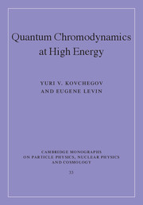
Introduction to saturation physics
Published in September 2012
by Cambridge U Press

Slide 4
Long-range rapidity correlations

Slide 5
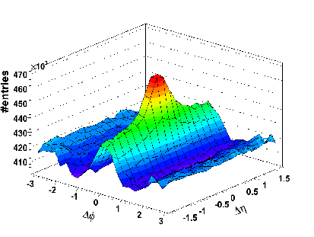
Ridge in heavy ion collisions
Heavy ion collisions, along with high-multiplicity p+p and p+A collisions, are known to have long-range rapidity correlations, known as ‘the ridge’:

Slide 6
Origin of rapidity correlations
Causality demands that long-range
rapidity correlations originate at very
early times (cf. explanation of the
CMB homogeneity in the Universe)
Gavin, McLerran, Moschelli ‘08;
Dumitru, Gelis, McLerran, Venugopalan ‘08.

Slide 7
Correlations in AdS shock wave collisions
H. Grigoryan, Yu.K. ‘10

Slide 8
Correlations in AdS shock wave collisions
Correlations grow with rapidity interval???
It is possible that higher-order corrections in shock wave strengths will modify this result, making it closer to real life.
However, such corrections are important at later times, and are less likely to affect the long-range rapidity correlation…
This could be another argument in favor of weakly-coupled dynamics in the early stages of heavy ion collisions.

Slide 9
Ridge in CGC
There are two explanations of the ridge in CGC:
  Long-range rapidity-independent fields are created at early times, with correlations generated soon after and with azimuthal collimation produced by radial hydro flow.
  (Gavin, McLerran, Moschelli ’08)
  Both long-range rapidity correlations and the azimuthal correlations are created in the collision due to a particular class of diagrams referred to as the “Glasma graphs”.

Slide 10
Glasma graphs
Generate back-to-back and
near-side azimuthal correlations.
Dumitru, Gelis, McLerran, Venugopalan ‘08.

Slide 11
Glasma graphs in LC gauge
Glasma graphs are one of the many rescattering diagrams when
two nucleons with a gluon each scatter on a nuclear target.

Slide 12
What to calculate?
To systematically include Glasma graphs in the CGC formalism it would be great to solve the two-gluon inclusive production problem in the MV model, that is, including multiple rescatterings in both nuclei to all orders (the two produced gluons only talk to each other through sources):
A very hard problem!

Slide 13
Heavy-Light Ion Collisions
Little steps for the little feet: consider multiple rescatterings
only in one of the two nuclei.

Slide 14
Double gluon production in heavy-light ion collisions

Slide 15
A. Setting up the problem: geometric correlations

Slide 16
Two-gluon production
We want to calculate two gluon production in A₁+A₂ collisions with 1 << A₁ << A₂ resumming all powers of
(multiple rescatterings in the target nucleus)
The gluons come from different nucleons in the projectile nucleus as A₁>>1 and this is enhanced compared to emission from the same nucleon.
projectile
target

Slide 17
Applicability region
The saturation scales of the two nuclei are very different:
We are working above the saturation scale of the smaller nucleus:
We thus sum all multiple rescatterings in the larger nucleus, Q_{s2}/k_{T} ~1, staying at the lowest non-trivial order in Q_{s1}/k_{T} <<1.
Multiple interactions with the same nucleon in either nucleus are suppressed by Λ_{QCD}/k_{T} <<<1.

Slide 18
Production cross-section
The single- and double-inclusive cross sections can be written as
Assume a large nucleus with uncorrelated
nucleons (MV/Glauber model). Then the
single- and double-nucleon wave functions
are (with T₁ the nuclear profile function)

Slide 19
Geometric Correlations
Assume uncorrelated interaction with the target:
For cross sections we have
Clearly
Correlations due to the integration over the impact parameter B
-> Geometric correlations!

Slide 20
Geometric correlations: physical meaning
In the same even the two nucleons are always within the smaller nucleus radius from each other (in transverse plane). In different events they can be anywhere in the larger nucleus.

Slide 21
Geometric correlations at fixed B
are zero as
which is clear from
Note that direction of B has to be fixed (to remove the geometric correlations), in other words the vector B should be fixed with respect to vectors k₁ and k₂. Maybe hard to do, but perhaps possible.

Slide 22
B. Two-gluon production

Slide 23
(i) Single gluon production in pA

Slide 24
Single gluon production in pA
Model the proton by a single quark (can be easily improved upon).
The diagrams are shown below (Yu.K., A. Mueller ’97):
Multiple rescatterings are denoted by a single dashed line:

Slide 25
Single gluon production in pA
The gluon production cross section can be readily written as (U = Wilson line
in adjoint representation, represents gluon interactions)

Slide 26
Forward dipole amplitude
The eikonal quark propagator is given by the Wilson line
with the light cone coordinates
The quark dipole scattering amplitude is

Slide 27
(ii) Two-gluon production in heavy-light ion collisions

Slide 28
The process
Solid horizontal lines = quarks in the incoming nucleons.
Dashed vertical line = interaction with the target.
Dotted vertical lines = energy denominators.

Slide 29
Amplitude squared
This contribution to two-gluon production looks like one-gluon production
squared, with the target averaging applied to both.

Slide 30
Amplitude squared
These contributions to two-gluon
production contain cross-talk
between the emissions from
different nucleons.

Slide 31
Two-gluon production cross section
“Squaring” the single gluon production cross section yields
(cf. Kovner & Lublinsky, ‘12)

Slide 32
Two-gluon production cross section
The “crossed” diagrams give

Slide 33
Two-gluon production cross section
The “crossed” diagrams give
We introduced the adjoint color-dipole and color quadrupole amplitudes:

Slide 34
Two-gluon production: properties
Note that if the interaction with the target factorizes,
we still have the geometric correlations.
The geometric correlations lead to non-zero cumulants! (Like everything that depends on geometry.)

Slide 35
Two-gluon production: properties
If we expand the interaction with the target to the lowest non-trivial order, one reproduced the contribution of the ‘glasma’ graphs:
away-side correlations
near-side correlations
(cf. Dumitru, Gelis, McLerran, Venugopalan ’08)

Slide 36
Two-gluon production: properties
Crossed diagrams at lowest
nontrivial order
Stronger correlations!

Slide 37
Two-gluon production: properties
The cross section is symmetric under (ditto for the “crossed” term)
Hence the correlations generate only even azimuthal harmonics
(just coordinate relabeling)
as

Slide 38
Correlation function
May look like this (a toy model; two particles far separated in rapidity,
jets subtracted, pA and AA):
C(Δφ)
Δφ
Δφ
Dumitru, Gelis, McLerran, Venugopalan ’08; Yu.K., D. Wertepny ‘12;
Lappi, Srednyak, and Venugopalan ‘09

Slide 39
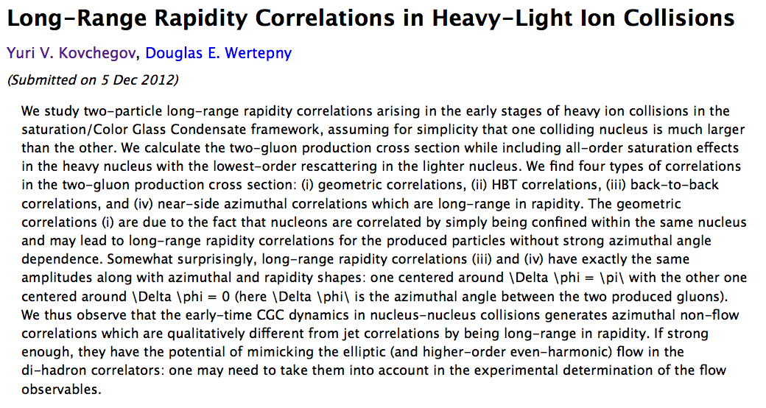
This conclusion is consistent with the data

Slide 40
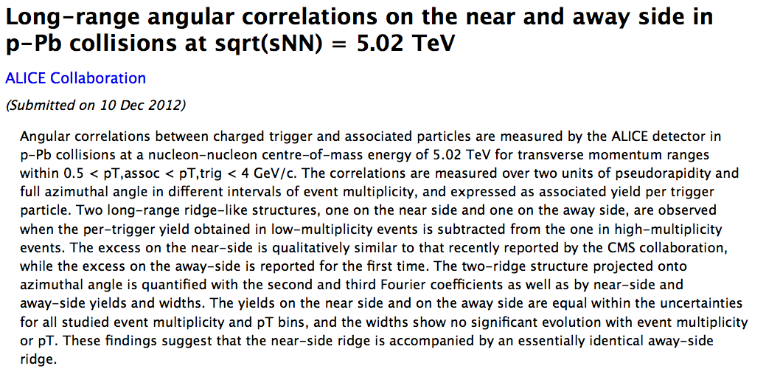
This conclusion is consistent with the data

Slide 41
LHC p+Pb data from ALICE
These are high-multiplicity collisions: it is possible that quark-gluon plasma is created in those, with the hydrodynamics contributing to these correlations.
Saturation approach is lacking the odd harmonics, like cos (3 Δφ) , etc. Can they be generated in a pure CGC approach EBE?

Slide 42
C. HBT correlations

Slide 43
HBT diagrams
There is another contribution coming from the “crossed” diagrams

Slide 44
HBT diagrams
They give HBT correlations (with R_{long} =0 due to Lorentz contraction)
Just like the standard HBT correlations
Possibly fragmentation would break phase coherence making these perturbative HBT correlations not observable.

Slide 45
Back-to-back HBT?
Note that all our formulas are symmetric under
Therefore, the HBT correlation is accompanied by the identical back-to-back HBT correlation
Note again that this correlation may be destroyed in hadronization.

Slide 46
Conclusions
In this talk I have shown a calculation of the two-gluon production cross section in nuclear collisions including saturation effects in one nucleus to all orders (heavy-light ion collisions).
Correlations we see:
  Geometric correlations ✓
  HBT correlations (along with b2b HBT ones)
  Away-side correlations ✓
  Near-side long-range rapidity correlations ✓
  (✓ = long-range in rapidity)
Near- and away-side correlations are identical to all orders in saturation effects: this is mainly consistent with the recent p+Pb data from LHC.
Seems like geometric correlations are hard to remove by cumulants!

Slide 47
Backup Slides

Slide 48
Ridge in heavy ion collisions
Heavy ion collisions, along with high-multiplicity pp collisions, are known to have long-range rapidity correlations, known as ‘the ridge’:

Slide 49
What to calculate?
To systematically include glasma graphs in the CGC formalism it would be great to solve the two-gluon inclusive production problem in the MV model, that is, including multiple rescatterings in both nuclei to all orders:

Slide 50
Forward dipole amplitude
Valid both in the quasi-classical Glauber-Mueller/McLerran-Venugopalan multiple-rescattering approximation and for the LLA small-x evolution (BFKL/BK/JIMWLK).

Slide 51
Two-gluon production
The approximation can also be formulated as resumming all powers of target color charge density ρ₂ while staying at the order- ρ₁² in the projectile charge density.
projectile
target

Slide 52
Origin of correlations
It appears that the correlation is in the connected part Δ
of the double-trace correlator
We evaluated the correlator in the Gaussian (MV) approximation in the large-N_{c} limit.
Its evolution is not straightforwards: JIMWLK gives a pretty hard to work with expression.

Slide 53
Correlations in AdS shock wave collisions
Correlations grow with rapidity interval???
It is possible that higher-order corrections in shock wave strengths will modify this result, making it closer to real life.
However, such corrections are important at later times, and are less likely to affect the long-range rapidity correlation…
This could be another argument in favor of weakly-coupled dynamics in the early stages of heavy ion collisions.

