Slide 1
eRHIC: as the Future
Thanks to
BNL EIC-Taskforce
and eRHIC –CAD-TEAM
arXiv: 1212.1701 & 1108.1713

Slide 2

What is eRHIC
RHIC
Existing = $2B
Electron accelerator
to be build
p
Polarized protons
50-250 GeV
Unpolarized and
polarized leptons
5-20 (30) GeV
e⁻
Light ions (d,Si,Cu)
Heavy ions (Au,U)
50-100 GeV/u
e⁻
e⁺
70% e⁻ beam polarization goal
polarized positrons?
Polarized light ions He³ 166 GeV/u
Center mass energy range: √s=30-200 GeV; L~100-1000xHera
longitudinal and transverse polarization for p/He³ possible
protons
electrons

Slide 3
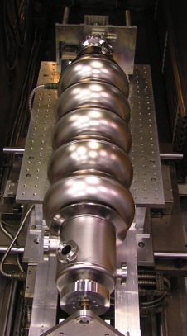

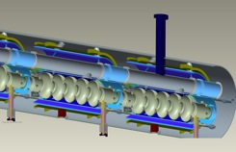

Electron beam evolution in eRHIC’s ERL
0.60 GeV
All energies scale proportionally by adding SRF cavities to the injector
0.6 GeV
Polarized
e-gun
0.6 GeV
Beam
dump
27.55 GeV
E/Eo
0.0200
0.1017
0.1833
0.2650
0.3467
0.4283
0.5100
0.5917
0.6733
0.7550
0.8367
0.9183
1.0000
New
detector
Linac 2.45 GeV
Coherent e-cooler
0.1017 GeV E₀
Linac 2.45 GeV
0.1833 GeV Eo
0.2650 GeV E₀
0.3467 GeV E₀
0.4283 GeV E₀
0.5100 GeV E₀
0.5917 GeV E₀
0.6733 GeV E₀
0.7550 GeV E₀
0.8367 GeV E₀
0.9183 GeV E₀
30 GeV
1.0000 GeV E₀
ePHENIX
All magnets would be installed from the day one and we would be cranking power supplies up as energy is increasing
100 m
ERL:
energy recovery linac
eSTAR
30 GeV
Animation is by N. Tsoupas

Slide 4
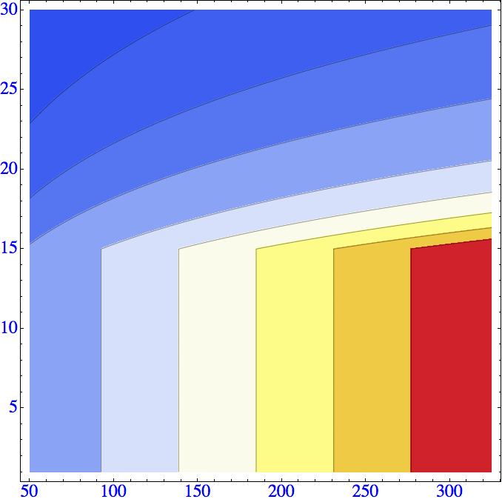

eRHIC R&D highlights and Luminosity
Challenge | Increase/reduction beyond the state of the art
Polarized electron gun | 10 x increase
Coherent Electron Cooling | New concept
Multi-pass SRF ERL | 5 x increase in current 30 x increase in energy
Crab crossing | New for hadron colliders
Understanding beam-beam effects | New type of collider
β*=5 cm | 5x reduction
Multi-pass SRF ERL | 2-3 x in # of passes
Feedback for kink instability suppression | Novel concept
Space charge effect compensation | Novel concept
E_{e} (GeV)
L.(cm⁻² sec⁻¹)
>3.10³⁴
0.1.10³⁴
3.10³⁴
0.25.10³⁴
2.5.10³⁴
0.5.10³⁴
2.10³⁴
1.5.10³⁴
1.10³⁴
1.10³⁴
1.5.10³⁴
2.10³⁴
2.5.10³⁴
3.10³⁴
0.5.10³⁴
0.25.10³⁴
0.1.10³⁴
E_{p} (GeV)
Hourglass the pinch effects are included. Space charge effects are compensated.
Energy of electrons can be selected at any desirable value at or below 30 GeV
The luminosity does not depend on the electron beam energy below or at 20 GeV
The luminosity falls as E_{e}⁻⁴ at energies above 20 GeV
The luminosity is proportional to the hadron beam energy: L ~ E_{h}/E_{top}

Slide 5
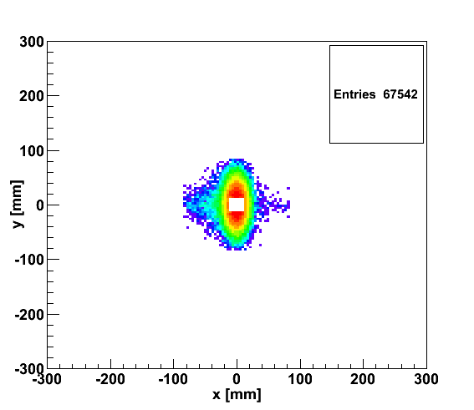
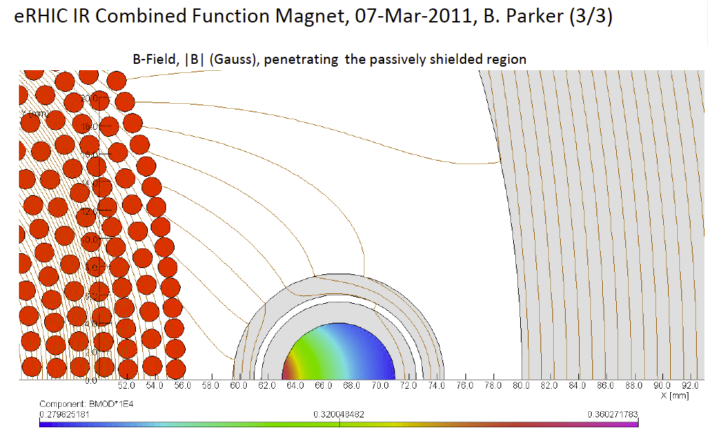
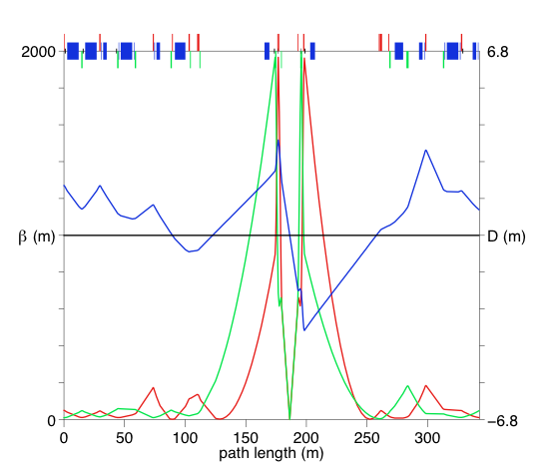
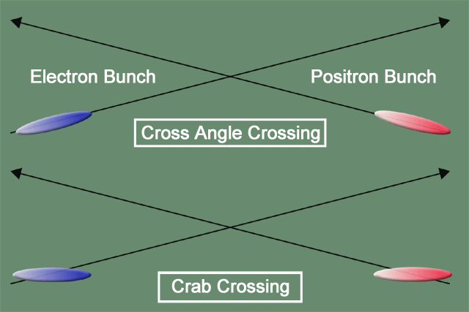
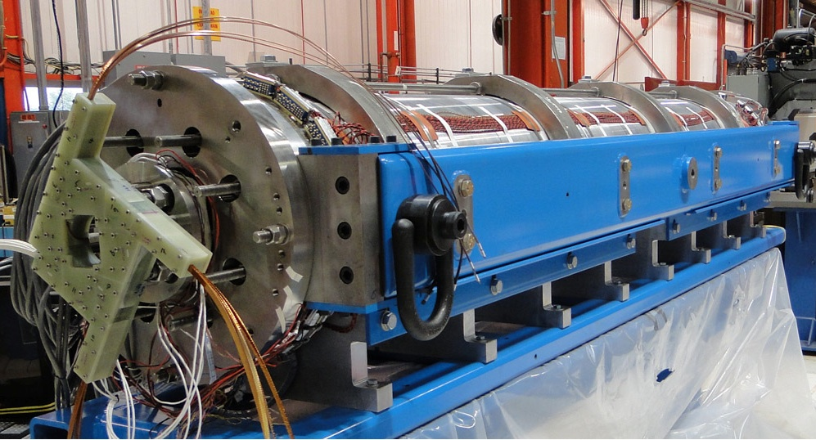
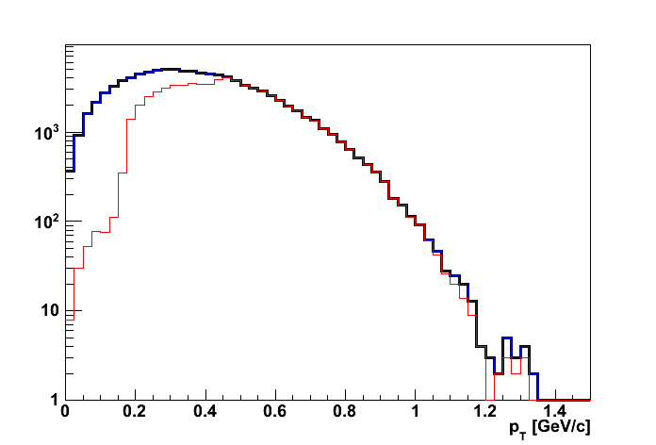
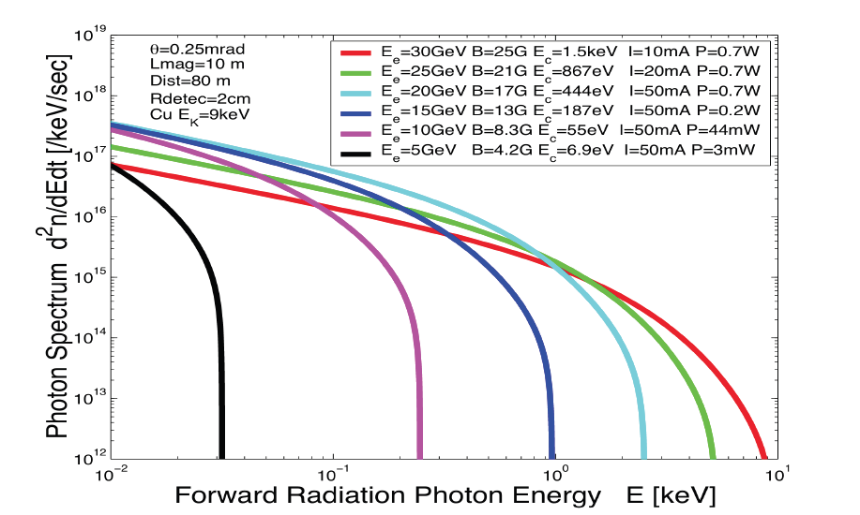
eRHIC: high-luminosity IR
20x250
p
Proton beam lattice
G.Ambrosio et al., IPAC’10
e
Nb₃Sn
20x250
200 T/m
eRHIC - Geometry high-lumi IR with β*=5 cm, l*=4.5 m
and 10 mrad crossing angle → 10³⁴ cm⁻² s⁻¹
Generated
Quad aperture limited
RP (at 20m) accepted
10 mrad crossing angle and crab-crossing
High gradient (200 T/m) large aperture Nb₃Sn focusing magnets
Arranged free-field electron pass through the hadron triplet magnets
Integration with the detector: efficient separation and registration of low angle collision products
Gentle bending of the electrons to avoid SR impact in the detector
© D.Trbojevic, B.Parker, S. Tepikian, J. Beebe-Wang

Slide 6
BNL: 1st Detector Design Concept
ECAL W-Scintillator
Upstream
low Q²
tagger
ECAL PWO
ECAL WScin
To
Roman Pots
HCAL
RICH
RICH
HCAL
DIRC/proximity RICH
−η
η
PID:
-1<η<1: DIRC or proximity focusing Aerogel-RICH
1<|η|<3: RICH
Lepton-ID:
-3 <η< 3: e/p
1<|η|<3: in addition Hcal response & γ suppression via tracking
|η|>3: ECal+Hcal response & γ suppression via tracking
-5<η<5: Tracking (TPC+GEM+MAPS)

Slide 7
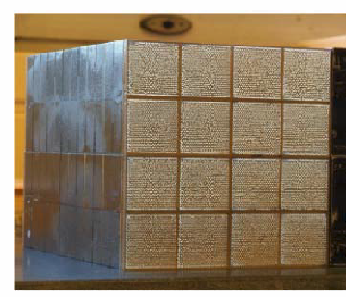
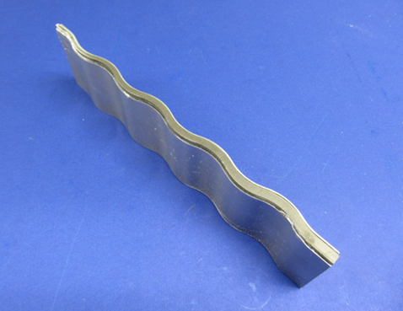
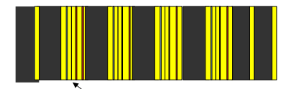
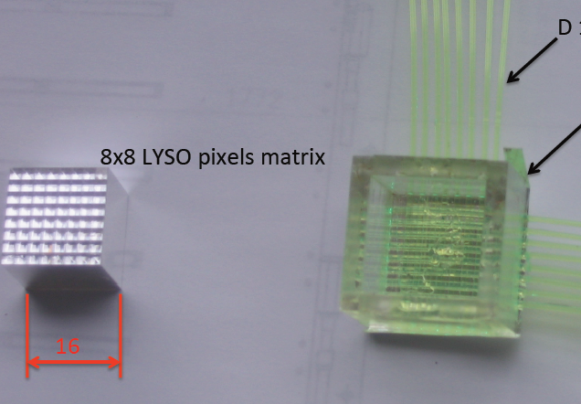
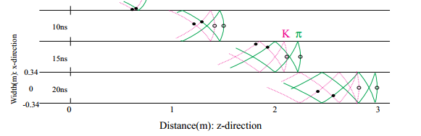
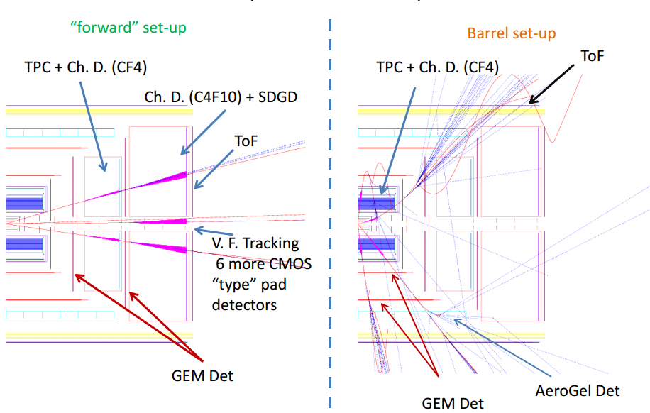
Vibrant Detector R&D Program
Calorimetry
  W-Scintillator & W-Si
    compact and high resolution
  Crystal calorimeters PbW & BGO
BNL, Indiana University, Penn State Univ., UCLA, USTC, TAMU
Pre-Shower
  W-Si
  LYSO pixel array with
  readout via X-Y WLS fibers
Univ. Tecnica Valparaiso
More Info on EIC-Detector R&D:
https://wiki.bnl.gov/conferences/index.php/EIC_R%25D
“Cartesian PreShower”
PID via Cerenkov
  DIRC and timing info
  Catholic Univ. of America, Old Dominion, South Carolina, JLab, GSI
  RICH based on GEM readout
  e-PID: GEM based TRD → eSTAR
BNL, Indiana Univ., USTC, VECC, ANL
Tracking
BNL, Florida Inst. Of Technology, Iowa State, LBNL, MIT, Stony Brook, Temple, Jlab, Virginia, Yale
  μ-Vertex: central and forward based on MAPS
  Central: TPC/HBD provides low mass,
  good momentum, dE/dx, eID
  Fast Layer: μ-Megas or PImMS
  Forward: Planar GEM detectors

Slide 8
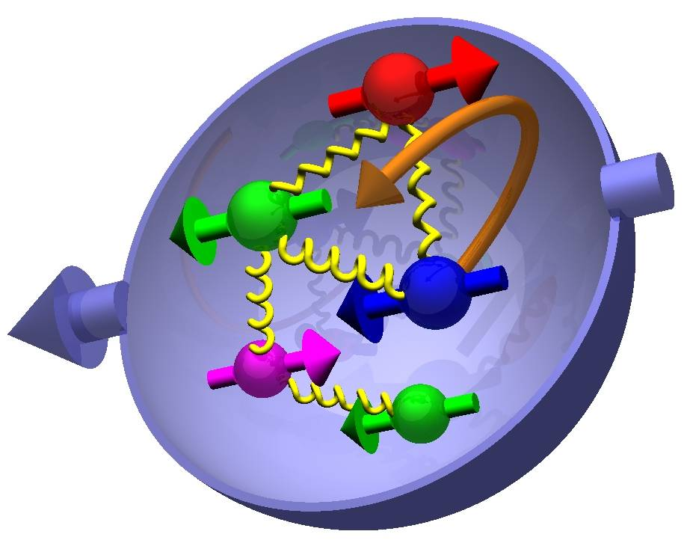

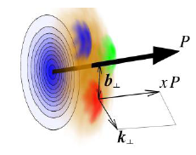
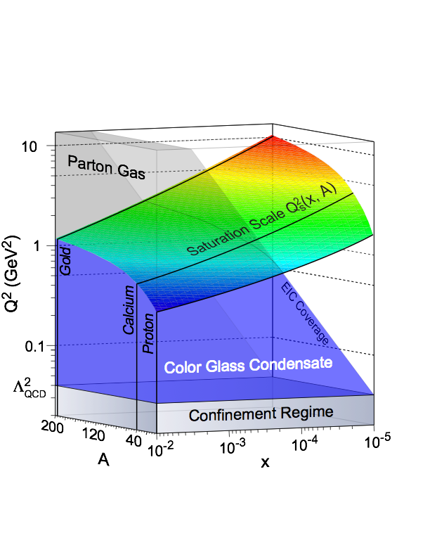
Most Compelling EIC SCIENCE Questions
How are sea quarks and gluons and their spin distributed
in space and momentum inside the nucleon?
How are these quark and gluon distributions correlated with the
over all nucleon properties, such as spin direction?
What is the role of the motion of sea quarks and gluons
in building the nucleon spin?
How does the nuclear environment affect the distribution
of quarks and gluons and their interaction in nuclei?
How does the transverse spatial distribution of gluons compare to that in the nucleon?
How does matter respond to fast moving color charge passing through it?
Is this response different for light and heavy quarks?
γ*
h
e’
q
e
Where does the saturation of gluon densities set in?
Is there a simple boundary that separates the region from the more dilute quark gluon matter? If so how do the distributions of quarks and gluons change as one crosses the boundary?
Does this saturation produce matter of universal properties in
the nucleon and all nuclei viewed at nearly the speed of light?

Slide 9



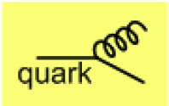
What do we know
small x
x=10⁻⁵
quark density
valence quarks
gluon density
Observation of large scaling violations
Gluon density dominates
Strong increase of sea quarks towards
low x
Density increases with Q²
  more partons by magnified view
large x
x=1
Dynamic creation
of partons
at low x
Notes:
Counter-intuitively the best way is through an EM process: DIS
y = inelasticity = fraction of the incoming electron energy carried by photon in the rest frame of the nucleon
The structure function F2 is sensitive to the sum of quark and anti-quark momentum distribution in the nucleon.
The apparent scaling of the data with Q2 at large x in early DIS data from SLAC was termed “Bjorken scaling” and motivated the parton model.
In the parton model, FL = 0, while in QCD, it is directly proportional to the gluon structure function, FL(x,Q2) ~ aS xG(x,Q2), at low x.
DGLAP: fixed x -> evolution along Q2
sigma (gamma N) = sig_T + sig_L
sig_L ~ FL
sig_tot ~ F2/Q^2
\frac{d^2 \sigma^{ep \rightarrow eX}}{dx dQ^2} = \frac{4 \pi \alpha^2_{e.m.}}{xQ^4} \left[ \left(1-y+\frac{y^2}{2} \right ) F_2(x,Q^2) - \frac{y^2}{2} F_L(x,Q^2) \right]

Slide 10
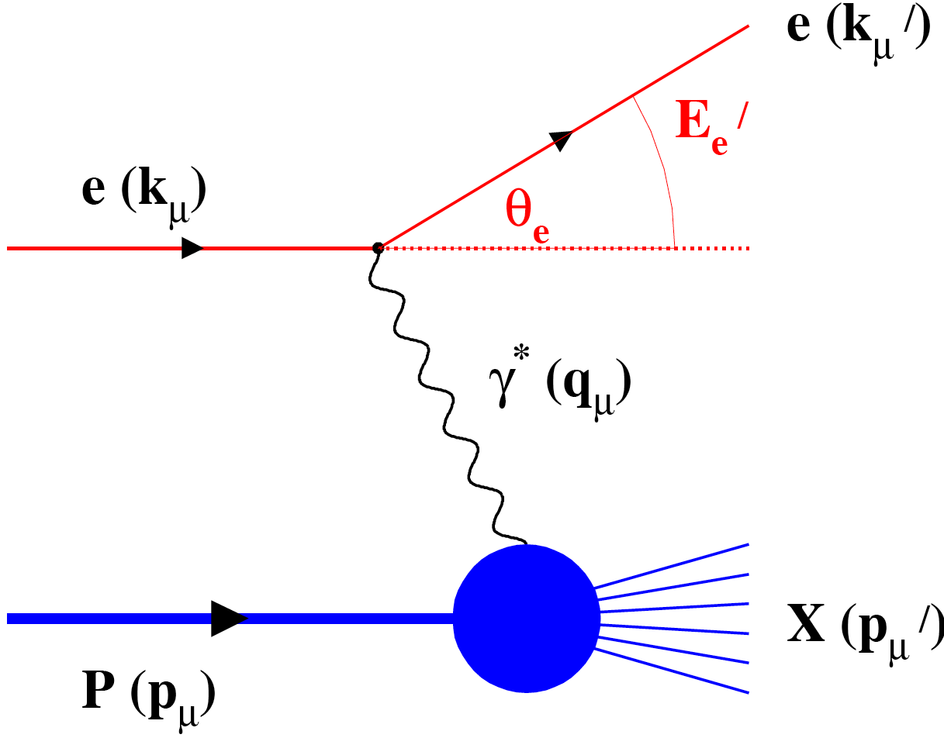
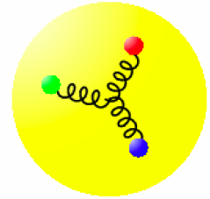
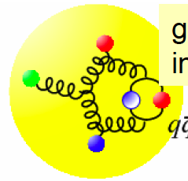
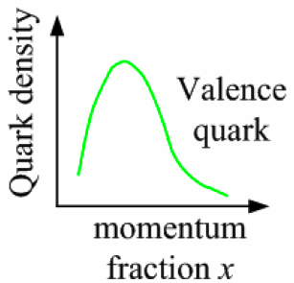
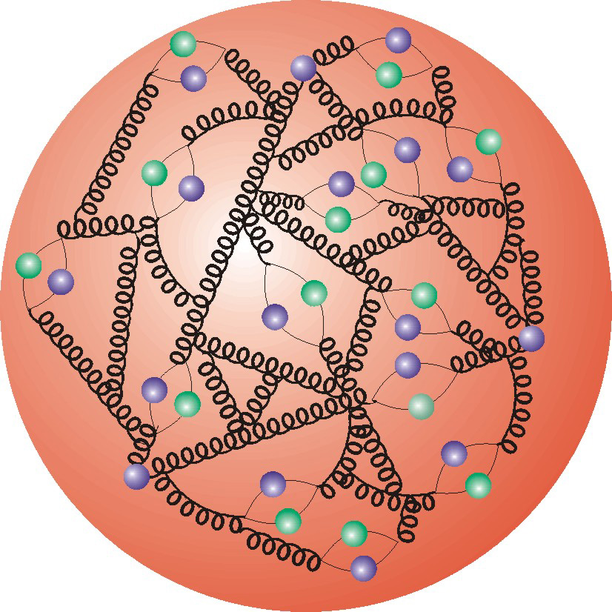
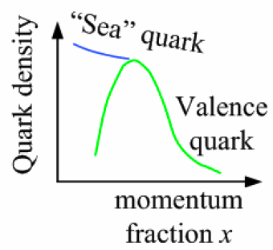
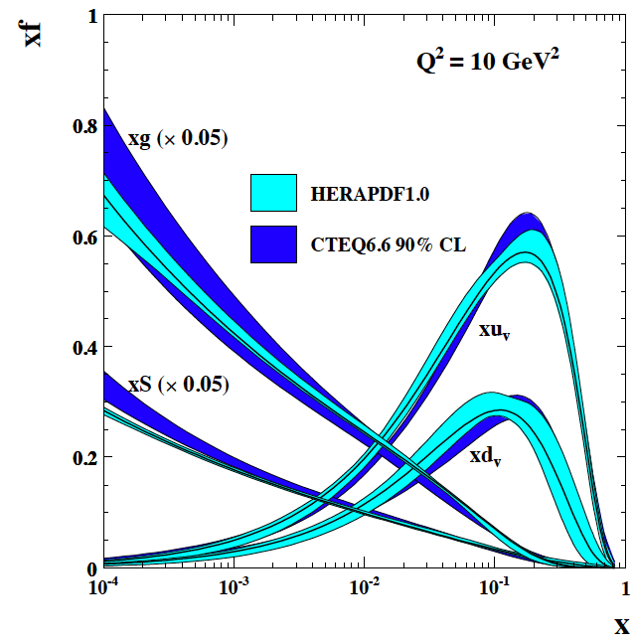
Deep Inelastic Scattering
Kinematics:
Measure of resolution power
Measure of inelasticity
Measure of momentum fraction of struck quark
Gluon splits
into quarks
Quark splits
into gluon
splits
into quarks …
10⁻¹⁶m
10⁻¹⁹m
higher √s
increases resolution

Slide 11


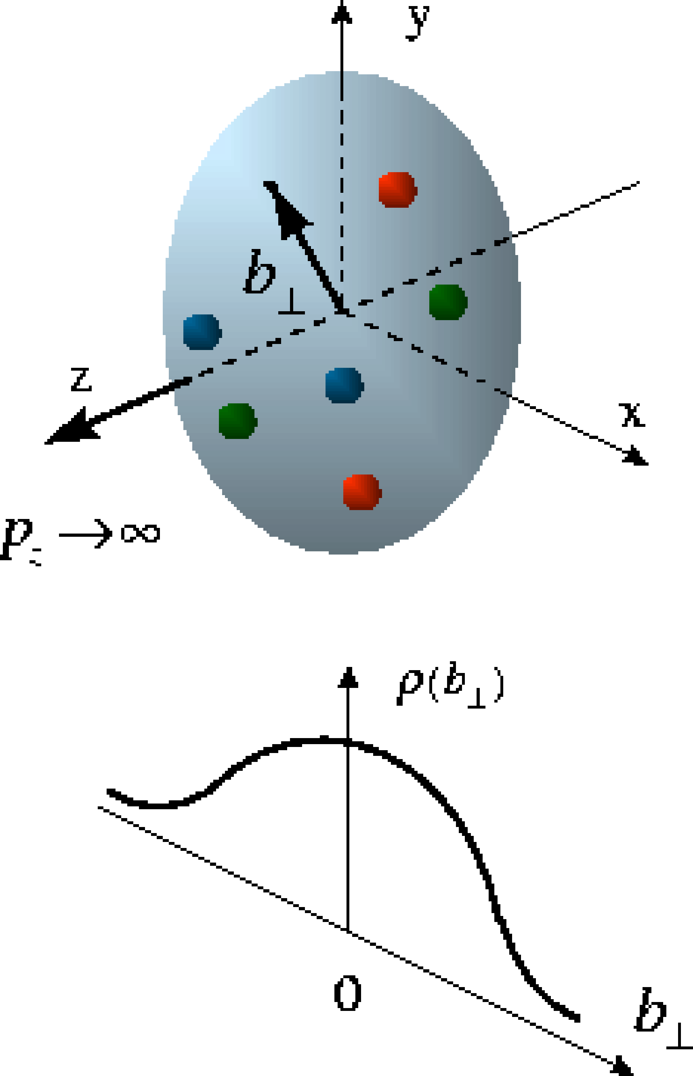
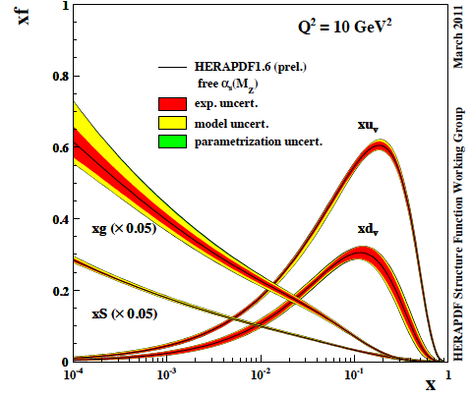


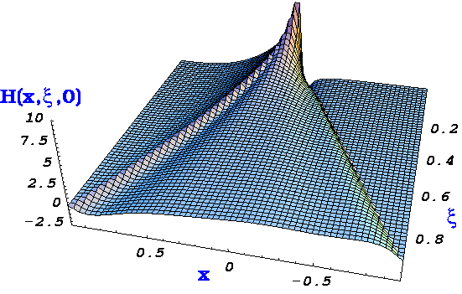
the path to imaging quarks and gluons
PDFs do not resolve transverse momenta or positions in the nucleon
transverse
plane
fast moving nucleon turns into a `pizza’ but transverse size remains about 1 fm
compelling questions
how are quarks and gluons spatially distributed
how do they move in the transverse plane
do they orbit and do we have access to spin-orbit correlations
→ required set of measurements & theoretical concepts
1-D
form factor
parton densities
not related by
Fourier transf.
2+1-D
transv. mom. dep. PDF
impact par. dep. PDF
generalized PDF
semi-inclusive DIS
exclusive processes
Wigner function
high-level connection
4+1-D
measurable ?
important in other branches of Physics

Slide 12
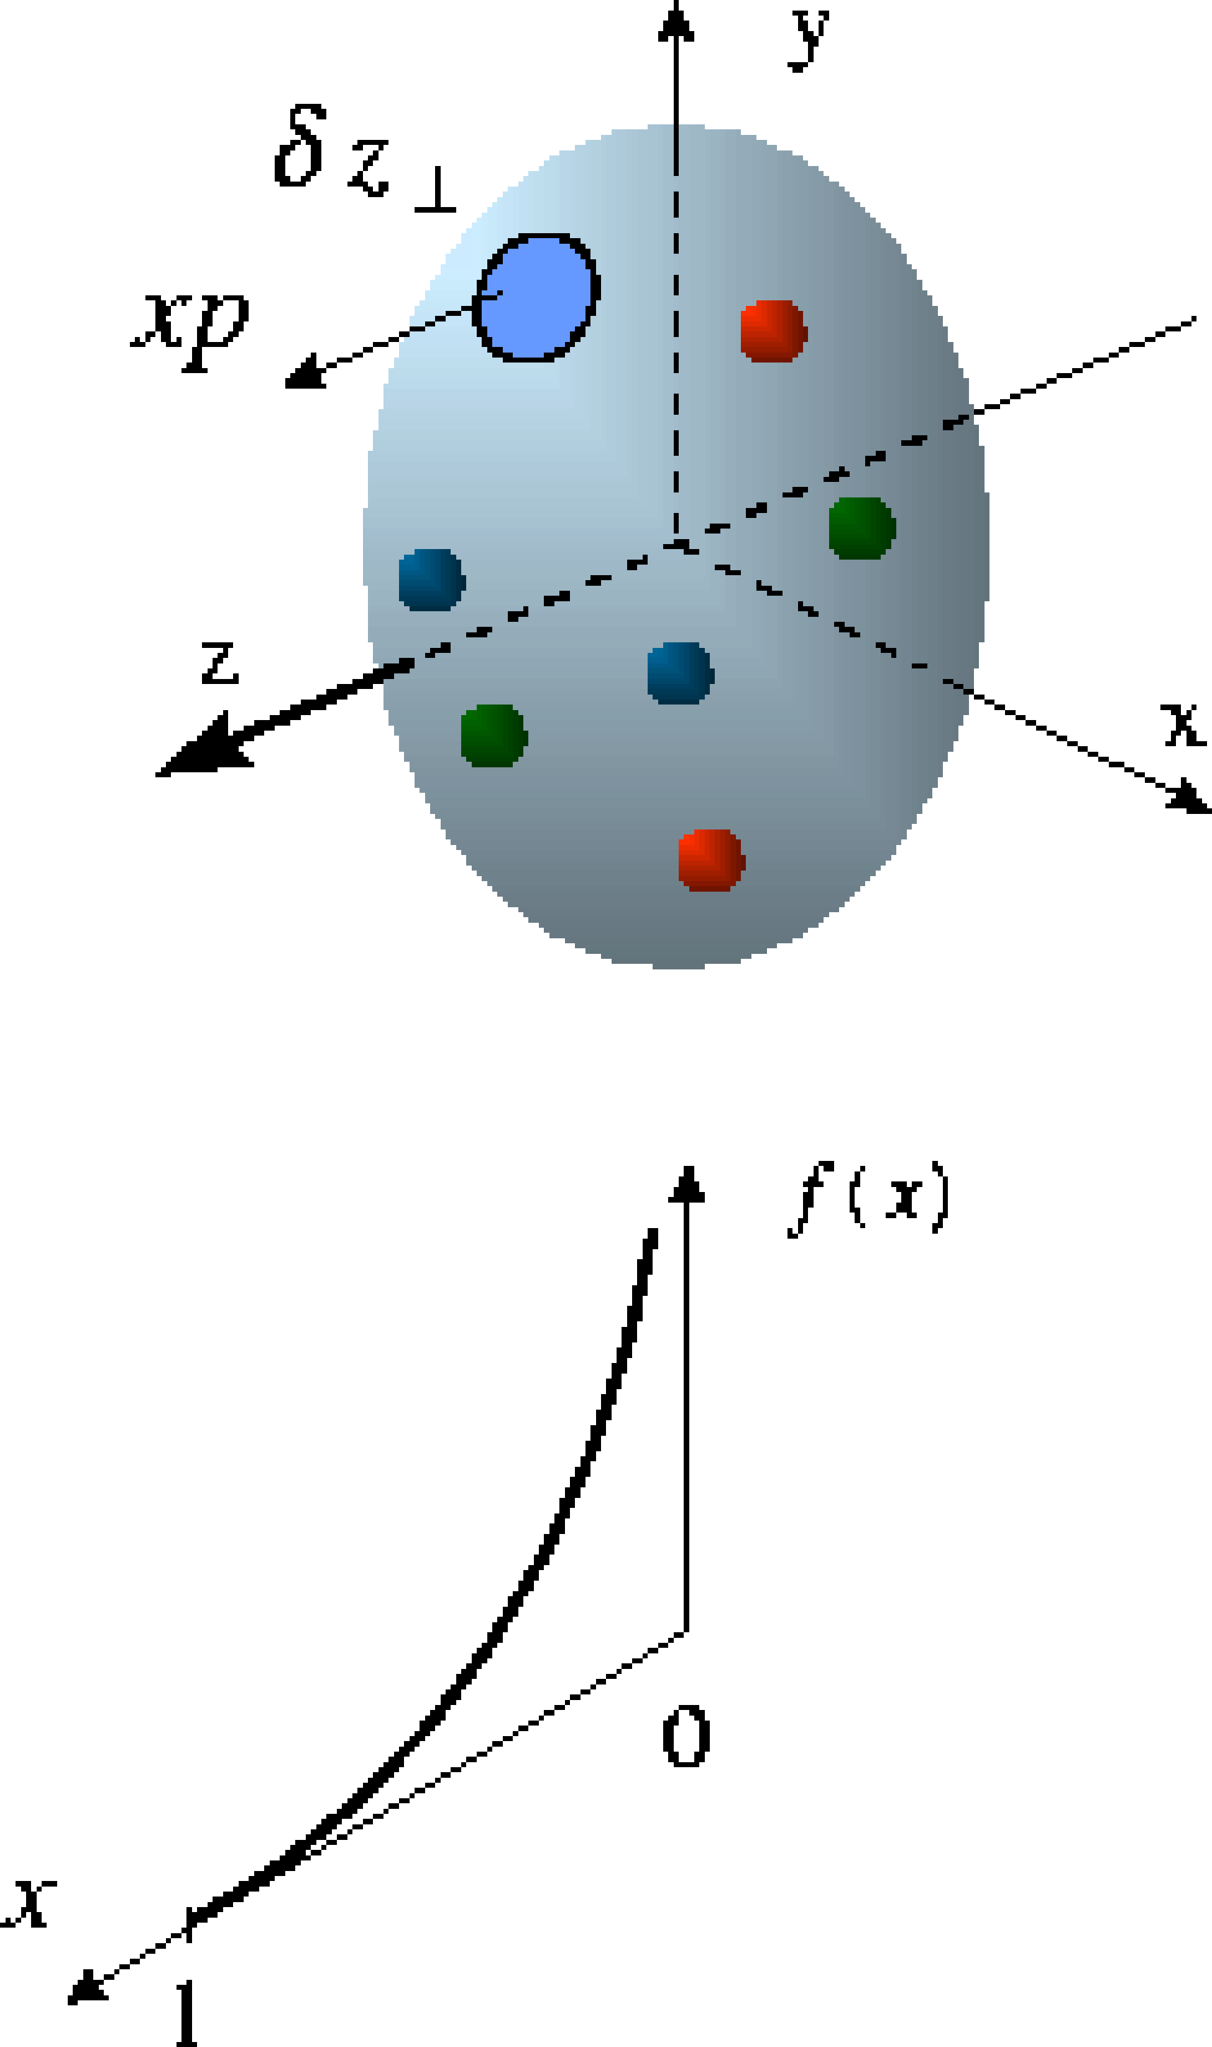
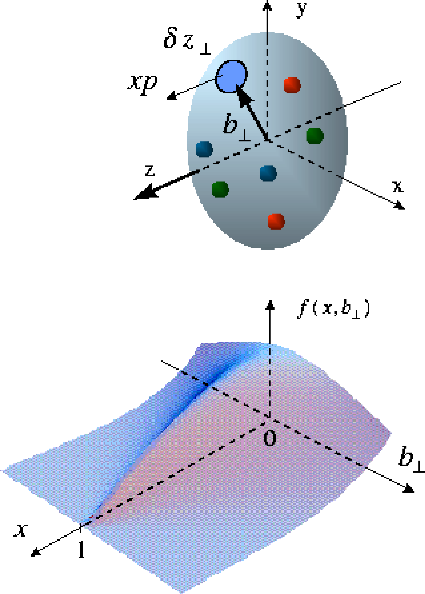
Beyond form factors and quark distributions
Generalized Parton Distributions
X. Ji, D. Mueller, A. Radyushkin (1994-1997)
Proton form factors, transverse charge & current densities
Structure functions,
quark longitudinal
momentum & helicity
distributions
Correlated quark momentum
and helicity distributions in
transverse space - GPDs

Slide 13
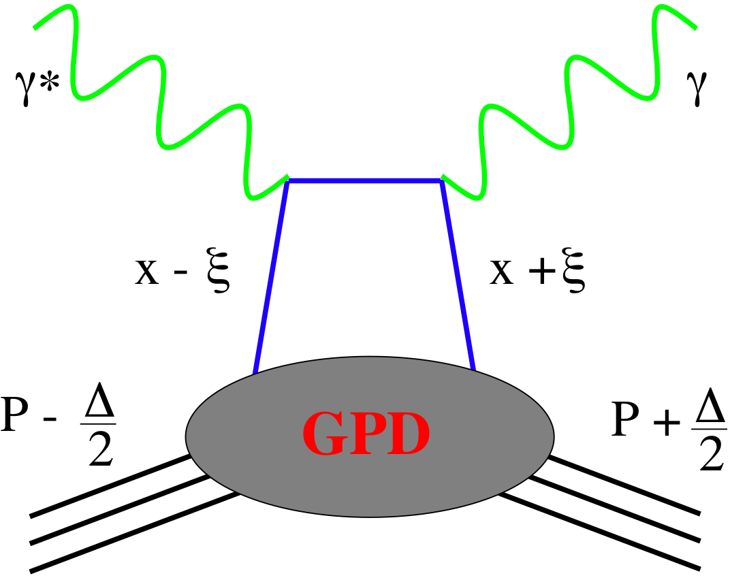
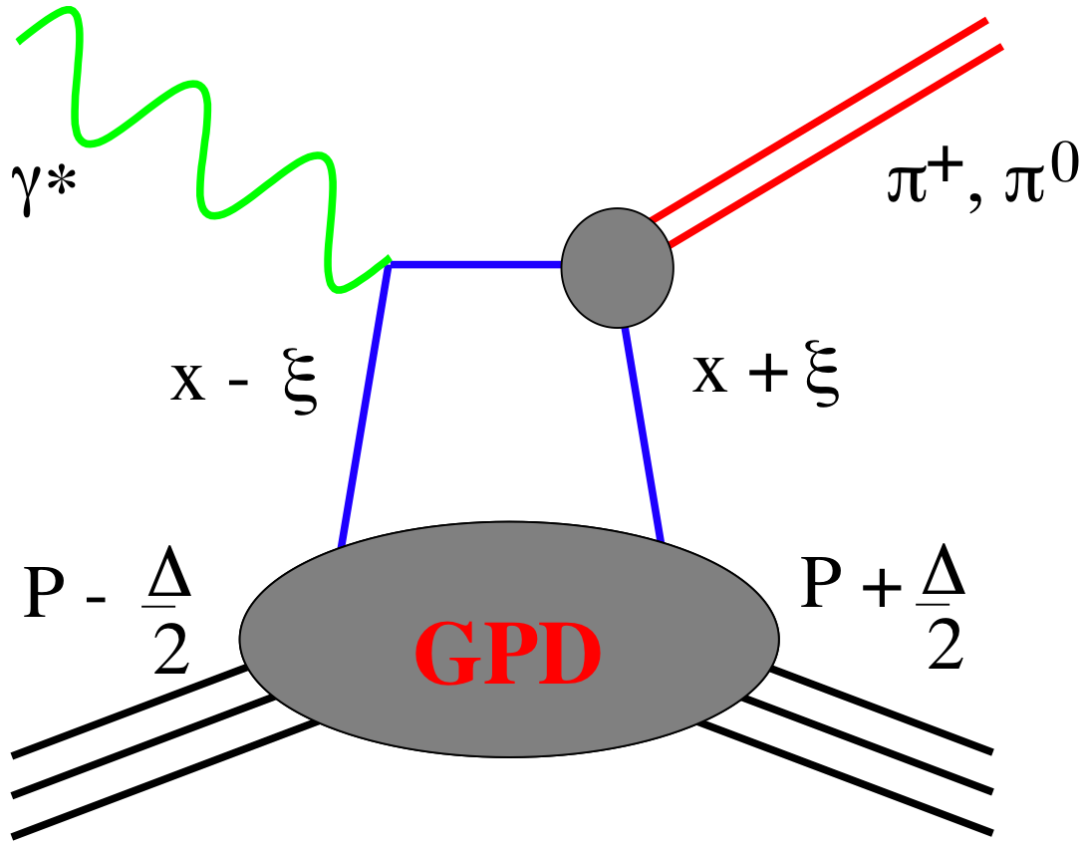
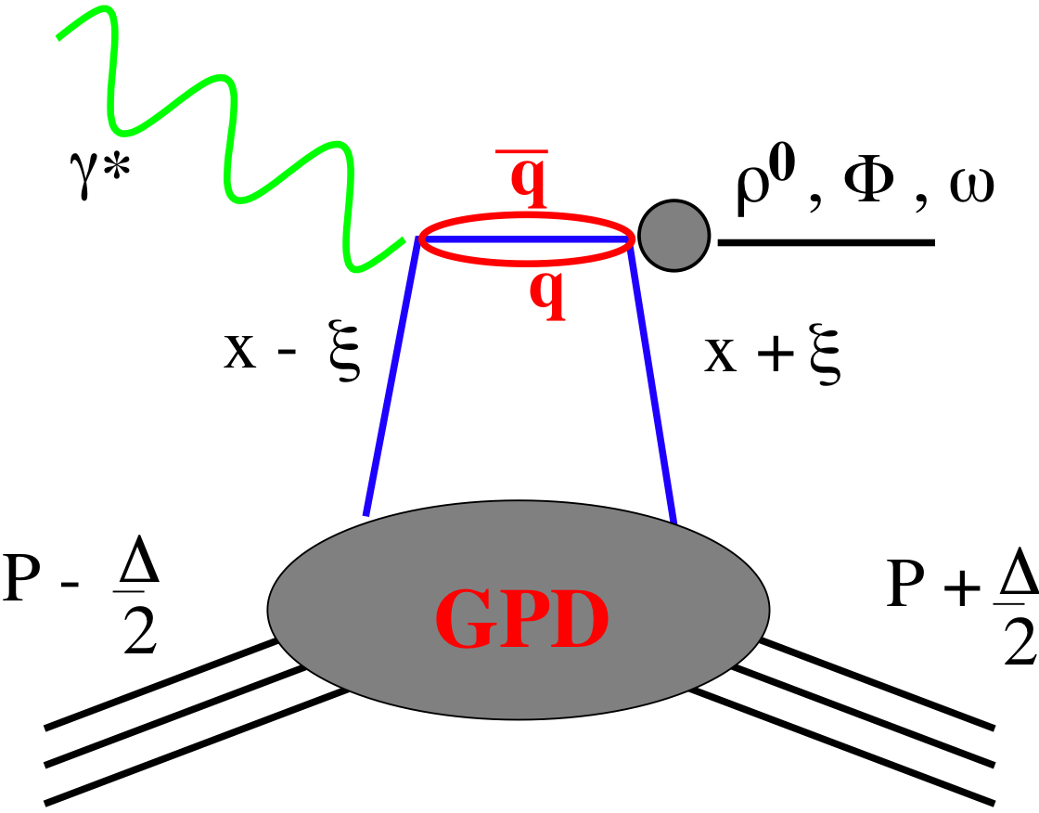
SMALL GPD Primer
How are GPDs characterized?
unpolarized polarized
conserve nucleon helicity
flip nucleon helicity
not accessible in DIS
quantum numbers of final state select different GPD
Spin-Sum-Rule in PRF:
from g₁
DVCS
pseudo-scaler mesons
vector mesons
π⁰ | 2Δu+Δd
η | 2Δu-Δd
ρ⁰ | 2u+d, 9g/4
ω | 2u-d, 3g/4
φ | s, g
ρ⁺ | u-d
J/ψ | g
Q²= 2E_{e}E_{e}’(1-cosθ_{e’})
x_{B} = Q²/2Mν ν=E_{e}-E_{e’}
x+ξ, x-ξ long. mom. fract.
t = (p-p’)²
ξ ≅ x_{B}/(2-x_{B})

Slide 14
The DVCS Phase Space
HERA results on GPDs
very much limited by
lack of statistics
imaging in
valence region
but limited t-range

Slide 15


DVCS at eRHIC
e’
γ
e
γ_{L}*
(Q²)
DVCS: Golden channel
theoretically clean
wide range of observables
(σ, A_{UT}, A_{LU}, A_{UL}, A_{C})
to disentangle different GPDs
x+ξ
x-ξ
~
~
p
H, H, E, E (x,ξ,t)
p’
t
D. Mueller, K. Kumericki
S. Fazio, and ECA
arXiv:1304.0077
DVCS data at end of HERA
Fourier
Transform
large t
small t

Slide 16
What will we learn about 2d+1 structure of the proton
GPD H and E as function of t, x and Q²
GPD H and E 1d+1
A global fit over all pseudo data was done, based on the GPDs-based model:
[K. Kumerički, D Müller, K. Passek-Kumerički 2007]
Known values q(x), g(x) are assumed for H^{q}, H^{g} (at ξ=0, t=0 forward limits E^{q}, E^{g} are unknown)
Excellent reconstruction of H^{sea}, H^{sea} and good reconstruction of H^{g} (from dσ/dt)
GPD H and E 2d+1 structure for sea-quarks and gluons

Slide 17
GPD H^{g}: J/ψ
M. Diehl & ECA
To improve imaging on gluons
add J/ψ observables
cross section
A_{UT}
…..
Fourier
Transform

Slide 18

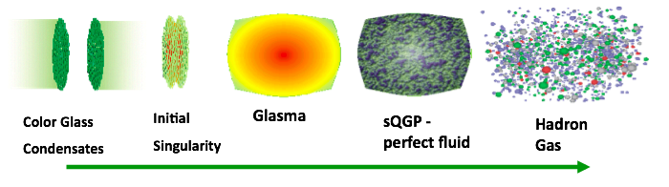
The eA Physics program
time
Hard Processes
(pQCD)
FF/coal.
CGC
JIMWLK/BK
I
Hadron
Transport
Hydro (EoS)
Our understanding of some fundamental
properties of the Glasma, sQGP and
Hadron Gas depend strongly on our
knowledge of the initial state!
The Initial Conditions
3 conundrums of the initial state:
What is the spatial transverse distributions
of nucleons and gluons?
2. How much does the spatial distribution
fluctuate? Lumpiness, hot-spots etc.
3. How saturated is the initial state of the
nucleus?

Slide 19
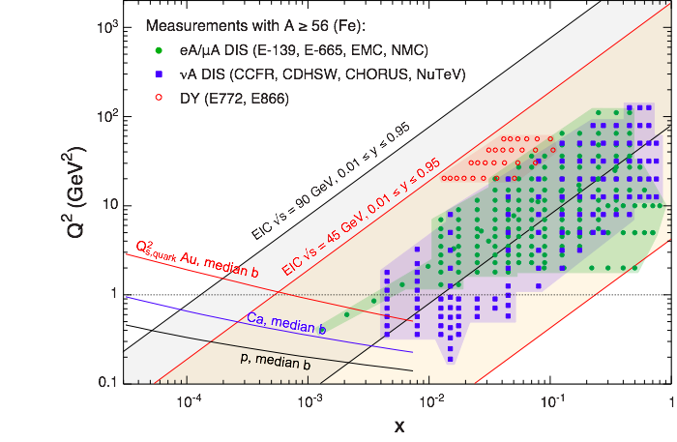
What Do We Know About xG in Nuclei?
99% of all h± have p_{t} < 2 GeV/c
“Bulk Matter” → x < 0.01
Other than in p:
G(x,Q²) for nuclei is little known
Key: F_{L} (x,Q²) ~ xG(x,Q²)

Slide 20
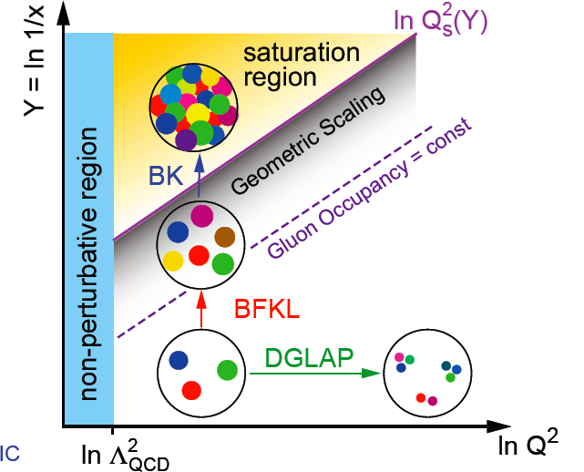
How many gluons have space in A proton?
at small x linear evolution gives strongly
rising g(x)
  cannot go on forever
BK/JIMWLK non-linear evolution includes
recombination effects → saturation
  Dynamically generated scale
  Saturation Scale: Q²_{s}(x)
    Increases with energy or decreasing x
  Scale with Q²/Q²_{s}(x) instead of x and Q²
small x / higher energy
x = P_{parton}/P_{nucleon}
Terra Incognita
Bremsstrahlung
~ α_{s}ln(1/x)
Recombination
~ α_{s}ρ
Saturation must set in at
low x → high occupancy
α_{s}~1 α_{s} << 1

Slide 21
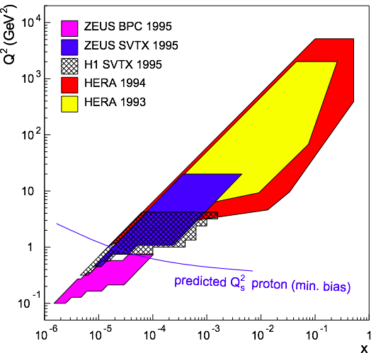
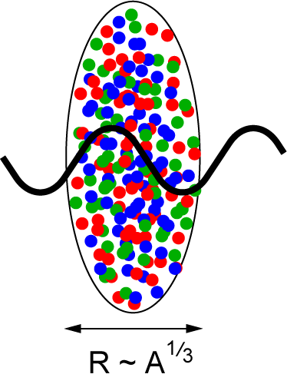
eRHIC: Reaching the Saturation Region
eRHIC (eA):
HERA (ep):
Despite high energy range:
F2, Gp(x, Q²) outside the saturation regime
Need also Q² lever arm!
Only way in ep is to increase √s
Would require an ep collider at
√s ~ 1-2 TeV → LHeC
L ~ (2m_{N} x)⁻¹ > 2 R_{A} ~ A^{1/3}
Probe interacts
coherently with all nucleons
Gold: 197 times smaller effective x !

Slide 22
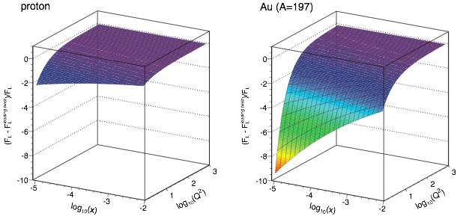
Inclusive DIS in eA: Nuclear PDFs
quark+anti-quark
gluon
  Expect strong non-linear effects in FL
Relative contributions of higher twist
effects to FL amplified in eA
Dipole model (J. Bartels et al.)
Notes:
\frac{d^2 \sigma^{eA\rightarrow eX}}{dx dQ^2} = \frac{4 \pi \alpha^2}{x Q^4} \left[ \left(1-y+\frac{y^2}{2}\right) {\color{blue}F_2(x, Q^2)} - \frac{y^2}{2} {\color{red}F_L(x, Q^2)}\right]

Slide 23
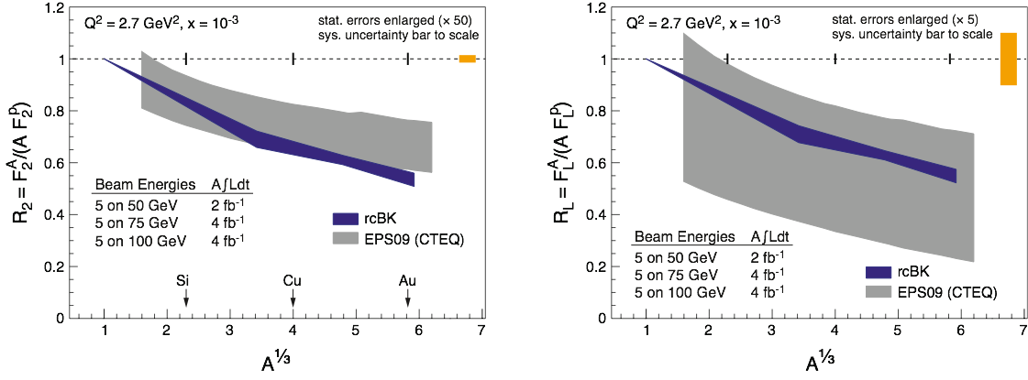
Inclusive DIS in eA: Nuclear PDFs
  measurement of FL requires running at different √s
  F2, FL: negligible stat. error, systematics dominated
  A dependence helps to discriminate between linear and non-linear (saturation) models
  Precision nPDF: Huge impact on pA, AA programs

Slide 24
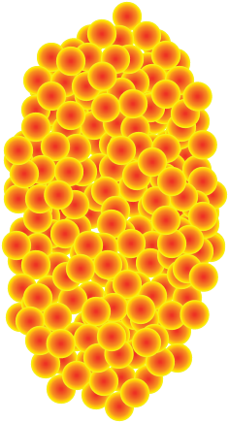
h-h Forward Correlation in p(d)A at RHIC
side-view
beam-view
large-x1 (q dominated)
p
p
A
π
low-x2 (g dominated)
Low gluon density (pp):
pQCD predicts 2→2 process ⇒ back-to-back di-jet
High gluon density (pA):
2 → many process
⇒ expect broadening of away-side
  Small-x evolution ↔ multiple emissions
  Multiple emissions → broadening
  Back-to-back jets (here leading hadrons) may get broadening in pT with a spread of the order of QS
First prediction by: C. Marquet (’07)
Latest review: Stasto, Xiao, Yuan arXiv:1109.1817 (Sep. ’11)
Notes:
Raju: Di-hadron correlations are a test of universality because the same measurement in p+A and e+A is sensitive to "dipole" and "quadrupole" operators which are the same for both processes.

Slide 25
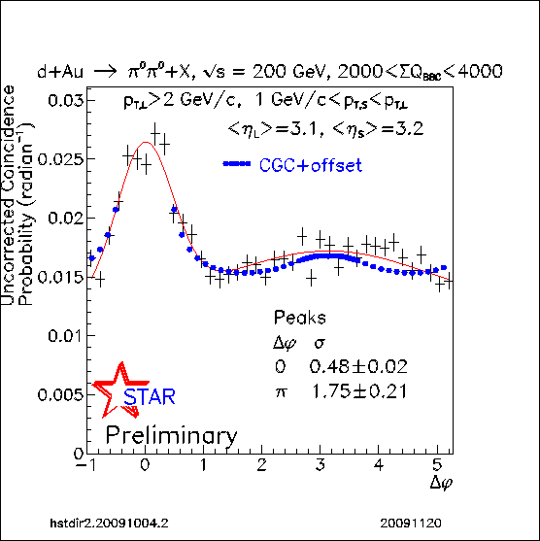
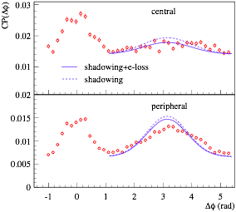
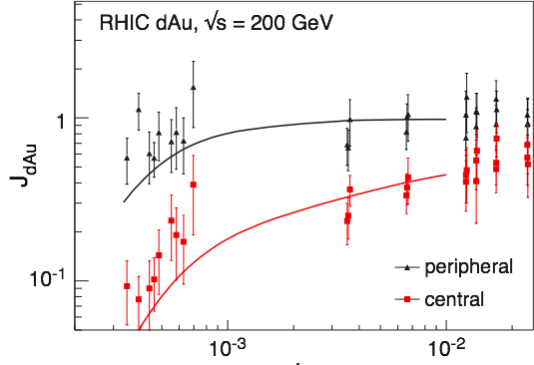
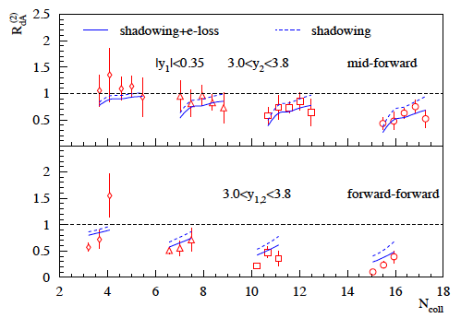

Forward Correlations in dA at RHIC
1 question, 2 answers
Initial state saturation model
“Non-initial state” shadowing model
Away side parton randomized
by strong color field
Albacete, Marquet
+offset
+offset
Kang, Vitev, Xing arXiv:1112.6021v1
B. Xiao et al. 2012
How saturated is the initial state?

Slide 26
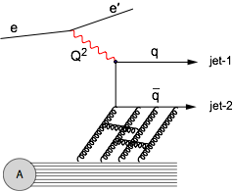
Dihadron Correlations in eA at EIC
EIC:
  Extract the spatial multi-gluon correlations and study their non-linear evolution
    essential for understanding the transition from a deconfined into a confined state.
Advantage over p(d)A:
  eA experimentally much cleaner
    no “spectator” background to subtract
    Access to the exact kinematics of the DIS process (x, Q²)
Perfect saturation signature:
Either jets or use leading hadrons from jets (dihadrons)
Notes:
Raju: Di-hadron correlations are a test of universality because the same measurement in p+A and e+A is sensitive to "dipole" and "quadrupole" operators which are the same for both processes.

Slide 27
EIC: eA Dihadron Correlations Studies
Exp: Saturation versus
“conventional” scenario
Theory: Saturation
Dominguez, Xiao, Yuan, Lee, Zheng ‘11/12
J.H. Lee, L. Zheng (CCNU) ‘11/12
eA-MC: Pythia6.4 + nPDF (EPS09) + nuclear geometry from DPMJetIII without PS
Here for 10 fb⁻¹/A (~ 20 weeks), std. experimental cuts
Clear signal, pronounced differences between sat and no-sat

Slide 28
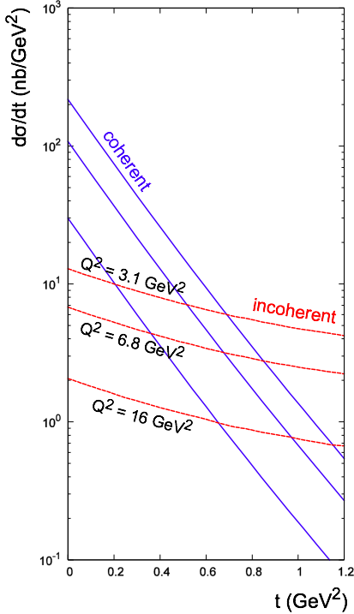
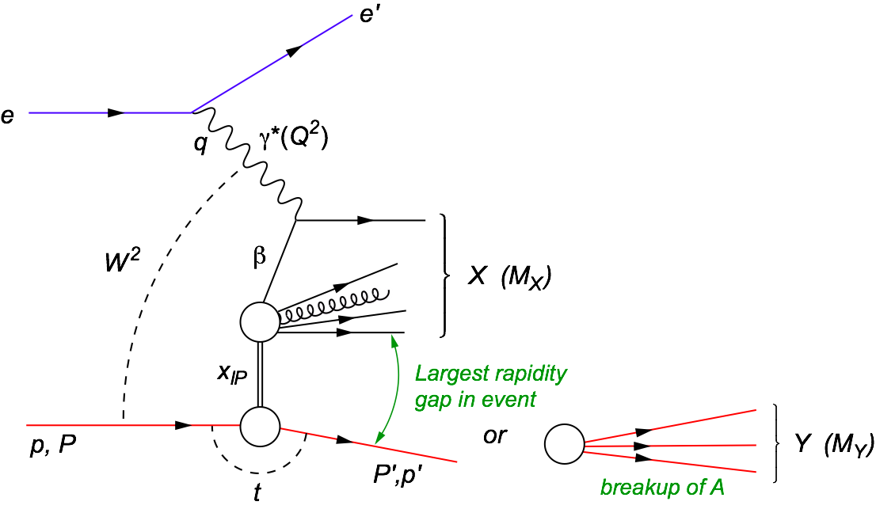

Hard Diffraction in DIS at Small x
e+p
t = (p-p’)²
β is the momentum fraction of the struck parton w.r.t. the Pomeron
x_{IP} = x/β: momentum fraction of the exchanged object (Pomeron) w.r.t. the hadron
  Diffraction in e+p:
    coherent ⇔ p intact
    incoherent ⇔ breakup of p
    HERA: 15% of all events are hard diffractive
Diffraction in e+A:
  coherent diffraction (nuclei intact)
  breakup into nucleons (nucleons intact)
  incoherent diffraction
  Predictions: σdiff/σtot in e+A ~25-40%

Slide 29
Why is DiFfraction So Important
Sensitive to spatial gluon distribution
  Hot topic:
    Lumpiness?
    Just Wood-Saxon+nucleon g(b)
  Incoherent case: measure fluctuations/lumpiness
  in g_{A}(b)
Sensitive to gluon momentum distributions
  σ ~ g(x,Q²)²

Slide 30

Ratio of Diffractive to Total Cross-Section
Black disc limit characterized by σdiff/σtot = 1/2 (Hera sees 1/7)
Large fraction of diffractive event is unambiguous signature for reaching the saturated limit
Fraction of low-mass coherent diffraction in ep and eA at EIC:
Find:
w/o non-linear effects eA/ep ratio stays roughly one
Day-1 signature for Saturation
non-linear effects enhance σdiff in eA scattering

Slide 31


Exclusive Vector Meson Production
  Unique probe - allows to measure momentum transfer t in eA diffraction
  → in general, one cannot detect the outgoing nucleus and its momentum
Dipole Cross-Section:
small size (J/Ψ): cuts off saturation region
large size (φ,ρ, ...): “sees more of dipole amplitude” → more sensitive to saturation
J/ψ
ϕ

Slide 32

Spatial Gluon Distribution Through Diffraction
  Goal: going after the source distribution of gluons through Fourier transform of dσ/dt
  Find: Typical diffractive pattern for coherent (non-breakup) part
  As expected: J/Ψ less sensitive to saturation effects than larger Φ-meson

Slide 33









Spatial Gluon Distribution Through Diffraction
  Idea: momentum transfer t conjugate to transverse position (b_{T})
    coherent part probes “shape of black disc”
    incoherent part (dominant at large t) sensitive to “lumpiness” of the source (fluctuations, hot spots, ...)
Spatial source distribution:
t = Δ²/(1-x) ≈ Δ² (for small x)
ϕ, nosat
Golden eA measurement for EIC

Slide 34

Deep Inelastic Scattering - Vacuum
h
e’
γ*
q
e
What happens if we add a nuclear medium
Observables:
Broadening:
Attenuation:
Δp_{t}² linked directly with saturation scale
ratio of hadron production in A to d
modifications of nPDF cancel out
Notes:
Example here is DIS in vacuum
Propagating quark is colored, thus emits gluons. “Free.” “Lifetime of deconfined quark.” Universal for light quarks?
Dipole is a color singlet object, thus no gluon emission. “Prehadron.” Formation time depends on hadron formed.
Heuristic arguments and models: Formation time is longer, ~ 1 order of magnitude for pions.
One of the goals of the studies I will be describing is to directly measure these two time parameters. Another is to understand the detailed mechanisms of how the hadron gets formed. The method of determining these quantities consists of studying this process embedded in a nuclear medium of well-known properties such as size and density.
Make point here - whole process is hadronization? or make that point later?

Slide 35
What do we know and what can EIC do
Hermes:
E_{e} = 27 GeV → √s = 7.2 GeV
E_{h} = 2-15 GeV
Unprecedented precision to distinguish between different models
large ν range
hadronization in and out of nucleus
first time for charm
EIC:

Slide 36

Take Away Message
The EIC will profoundly impact
our understanding of QCD
with its high energy, high luminosity
eA and polarized ep collisions
ACHIEVED
if
eRHIC is built
  ep: precision studies of PDFs, TMDs,
  and GPDs will lead to the most
  comprehensive picture of the nucleon ever:
  its flavor, spin, and spatial structure
  eA: unprecedented study of matter in
  a new regime where physics is not
  described by “ordinary” QCD:
  non-linear QCD/saturation/higher twist
  effects, properties of glue
  (momentum & space-time),
  understand how fast partons interact
  as they traverse nuclear matter,
  new insight into fragmentation processes,
  clarification of the nature of pomerons.
entire science program uniquely tied to a
future high energy electron ion collider
never been measured before & never without

Slide 37
BACKUP

Slide 38

Possible Schedule To Realize eRHIC

Slide 39

International context
Electron-“Ion” colliders in the past and future:

Slide 40
an Electron Ion Collider in the US
Requirements:
High Luminosity > 10³³ cm⁻²s⁻¹
Flexible center of mass energies
Electrons and protons/light nuclei polarised
Wide range of nuclear beams
a wide acceptance detector with good PID (e/h and π, K, p)
wide acceptance for protons from elastic reactions and
neutrons from nuclear breakup

Slide 41
eRHIC: design luminosity
 | e | p | ²He³ | ⁷⁹Au¹⁹⁷ | ⁹²U²³⁸
Energy, GeV | 20 | 250 | 167 | 100 | 100
CM energy, GeV |  | 100 | 82 | 63 | 63
Number of bunches/distance between bunches | 107 nsec | 111 | 111 | 111 | 111
Bunch intensity (nucleons) ,10¹¹ | 0.36 | 4 | 6 | 6 | 6
Bunch charge, nC | 5.8 | 64 | 60 | 39 | 40
Beam current, mA | 50 | 556 | 556 | 335 | 338
Normalized emittance of hadrons , 95% , mm mrad |  | 1.2 | 1.2 | 1.2 | 1.2
Normalized emittance of electrons, rms, mm mrad |  | 16 | 24 | 40 | 40
Polarization, % | 80 | 70 | 70 | none | none
rms bunch length, cm | 0.2 | 5 | 5 | 5 | 5
β*, cm | 5 | 5 | 5 | 5 | 5
Luminosity per nucleon, x 10³⁴ cm⁻²s⁻¹ |  | 2.7 | 2.7 | 1.6 | 1.7
Hourglass the pinch effects are included. Space charge effects are compensated.
Energy of electrons can be selected at any desirable value at or below 30 GeV
The luminosity does not depend on the electron beam energy below or at 20 GeV
The luminosity falls as E_{e}⁻⁴ at energies above 20 GeV
The luminosity is proportional to the hadron beam energy: L ~ E_{h}/E_{top}

Slide 42





Modeling the Detector in Geant
μ-vertex detector:
6 layers with [30..160] mm radius
0.37% X₀ in acceptance per layer simulated precisely;
digitization: single discrete pixels, one-to-one from MC points
Forward/backward μ-vertex detector:
3+5+3 silicon disks with up to 280 mm radius
N sectors per disk; 200 μm silicon-equivalent thickness
digitization: discrete ~20x20 μm² pixels
TPC
~2m long; gas volume radius [300..800] mm
1.2% X₀ IFC, 4.0% X₀ OFC; 15.0% X₀ aluminum endcap
digitization: assume known (gaussian) resolutions in “rφ” and “Z” and 1x5 mm GEM pads (up to 100 points per track)
Forward tracking:
3 disks behind the TPC endcap
rather precise START FGT design implemented
digitization: 100 μm resolution in X&Y; gaussian smearing

Slide 43

The Pillars of the eRHIC Physics program
Electro Weak
physics of
strong color
fields
spin Physics
2D+1 Imiging
Hadronisation
Wide physics program with high requirements on detector and machine performance

Slide 44



The Hadronic Mass Puzzle
are
C.D. Roberts, Prog. Part. Nucl. Phys. 61 (2008) 50
M. Bhagwat & P.C. Tandy, AIP Conf.Proc. 842 (2006) 225-227
In QCD, all “constants” of quantum mechanics are actually strongly momentum dependent: couplings, number density, mass, etc.
So, a quark’s mass depends on its momentum.
Mass function can calculated and is depicted here.
in agreement: the vast bulk of the light-quark mass comes from a cloud of gluons, dragged along by the quark as it propagates.
Continuum- and Lattice-QCD
Running gluon mass
  Gluon is massless in UV, in agreement with pQCD
  Massive in infrared
    m_{G}(0) = 0.67-0.81 GeV
    m_{G}(m_{G}²) = 0.53-0.64 GeV
DSE prediction confirmed by numerical simulations of lattice-regularised QCD
Mass from nothing!
m_{G}²(k²) ≈ m_{G}⁴/(k²+m_{G}²)
Qin et al., Phys. Rev. C 84 042202 (Rapid Comm.)

Slide 45

Constrain J_{q} via GPD E
observables sensitive to E:
(J_{q} input parameter in ansatz for E)
DVCS A_{UT} : HERMES
nDVCS A_{LU} : Hall A
Hermes DVCS-TTSA [arXiv: 0802.2499]:
VGG
eRHIC:
HERMES like A_{UT}
20 GeV x 250 GeV
Lumi: 2x50fb⁻¹
Notes:
AHLT: Ahmad, Honkanen, Liuti, Taneja PRD75(2007)

Slide 46
Different DVCS Asymmetries
arXiv:1304.0077

Slide 47


Hard Diffraction in DIS at Small x
e+p
t = (p-p’)²
β is the momentum fraction of the struck parton w.r.t. the Pomeron
xIP = x/β: momentum fraction of the exchanged object (Pomeron) w.r.t. the hadron
Diffraction Analogy: plane monochromatic wave incident on a circular screen of radius R
  Diffraction in e+p:
    coherent ⇔ p intact
    incoherent ⇔ breakup of p
    HERA: 15% of all events are hard diffractive
Diffraction in e+A:
  coherent diffraction (nuclei intact)
  breakup into nucleons (nucleons intact)
  incoherent diffraction
  Predictions: σdiff/σtot in e+A ~25-40%

Slide 48


Large Rapidity Gap Method (LRG)
  Identify Most Forward Going
  Particle (MFP)
    Works at HERA but at higher √s
    EIC smaller beam rapidities
Diffractive ρ⁰ production at EIC:
η of MFP
M. Lamont ’10
DIS
Hermeticity requirement:
needs just to detector presence
does not need momentum or PID
simulations: √s not a show stopper for EIC
(can achieve 1% contamination, 80% efficiency)
Diffractive

Slide 49
Best Knowledge of QS in eA
Model-I: IPSat dipole model
Model-II: BK + higher order corr.
Enhancement of Q_{S} with A
⇒ saturation regime reached at significantly lower energy in nuclei

Slide 50

Measuring FL with the EIC (I)
quark+anti-quark
momentum distributions
gluon momentum distribution
In practice use reduced cross-section:
How to extract F_{L}
  Need different values of y²/Y⁺
  FL slope of σr vs y²/Y⁺
  F2 intercept of σr vs y²/Y⁺ with y-axis
  σr
  y²/Y⁺
0
Notes:
\begin{eqnarray*}\sigma_r = \left( \frac{d^2 \sigma}{dx dQ^2}\right)\ \frac{x Q^4}{2 \pi \alpha^2 [1 + (1-y)^2]}
&=& F_2(x, Q^2) - \frac{y^2}{\color{red}{1+(1-y)^2}} F_L(x, Q^2) \\
{} &=& F_2(x, Q^2) - \frac{y^2}{{\color{red}Y^+}} \ F_L(x, Q^2) \\\end{eqnarray*}

Slide 51



Measuring FL with the EIC (II)
In order to extract F_{L} one needs at least two measurements of the inclusive cross section with “wide” span in inelasticity parameter y (Q² = sxy)
F_{L} requires runs at various √s ⇒ longer program
Need sufficient lever arm in y²/Y⁺
Limits on y²/Y⁺:
At small y:
detector resolution for e’
At large y:
radiative corrections and charge symmetric background
EIC studies:
Statistical error is negligible
in essentially whole range
Systematical Error
Calibration
Normalization
Experiment
Radiative Corrections
Notes:
Lowest value of x and Q2 :
y y2/Y+ proton p
0.7 0.44 100
0.54 0.24 130
0.28 0.28 250

Slide 52



preparation of DIS and SIDIS mock data
PEPSI MC to generate σ⁺⁺ and σ⁺⁻ with LO GRSV PDFs
DIS
SIDIS
inclusive final-state
identified charged pions and kaons
assume modest 10 fb⁻¹ for each energy, 70% beam polarizations
Q² > 1 GeV² , 0.01 < y < 0.95 , invariant mass W² > 10 GeV²
depolarization factor of virtual photon D(y,Q²) > 0.1 (cuts on small y)
scattered lepton: 1º < θ_{elec} < 179º and p_{elec} > 0.5 GeV
hadron: p_{hadr} > 1 GeV, 0.2 < z < 0.9,
1⁰ < θ_{hadr} < 179º
use rel. uncertainties of data to generate mock data by randomizing around
DSSV+ by 1-σ
SIDIS: incl. typical 5% (10%) uncertainty for pion (kaon) frag. fcts (from DSS analysis)

Slide 53


scaling violations at small x
rough small-x approximation to Q²-evolution:
spread in Δg(x,Q²) translates into
spread of scaling violations for g₁(x,Q²)
need x-bins with a least two Q² values to compute derivative (limits x reach somewhat)
smallest x bins require 20 x 250 GeV
5 x 250 starts here
error bars for moderate 10fb⁻¹ per c.m.s. energy; bands parameterize current DSSV+ uncertainties

Slide 54

DVCS ASYMMETRIES
→ different charges: e⁺ e⁻:
~
Δσ_{C} ~ cosφ ∙Re{ H + ξH +… }
H
→ polarization observables:
~
Δσ_{LU} ~ sinφ∙Im{H + ξH + kE}
H
Δσ_{UT}
~
~
Δσ_{UL} ~ sinφ∙Im{H + ξH + …}
H
beam target
Δσ_{UT} ~ sinφ∙Im{k(H - E) + … }
H, E
ξ = x_{B}/(2-x_{B} ) k = t/4M²
kinematically suppressed

Slide 55
BH Fraction
5 GeV x 100 GeV
BH subtraction will be relevant in stage 1, at large y, depending on the x-Q² bin
BUT…
5 GeV x 100 GeV
and
5 GeV x 250 GeV
are overlapping:
x-sec. measurements at 5x250 at low-y can
crosscheck the BH
subtrac. made for 5x100
20 GeV x 250 GeV
BH subtraction will be not an issue for y<0.6

Slide 56



Kinematics of Breakup Neutrons
Results from GEMINI++ for 50 GeV Au
Results:
With an aperture of ±3 mrad we are in relative good shape
• enough “detection” power for t > 0.025 GeV²
• below t ~ 0.02 GeV² we have to look into photon detection
‣ Is it needed?
Question:
For some physics rejection power for incoherent is needed ~10⁴
→ How efficient can the ZDCs be made?
by Thomas Ullrich
+/-5mrad acceptance seems sufficient

Slide 57


Diffractive Physics: p’ kinematics
Diffraction:
t=(p4-p2)² = 2[(mp^{in}.mp^{out})-(E^{in}E^{out} - pz^{in}pz^{out})]
→ “ Roman Pots” acceptance studies see later
?
5x50
p’
5x100
5x250
Simulations by J.H Lee

Slide 58




proton distribution in y vs x at s=20 m
without quadrupole aperture limit
20x250
5x50
with quadrupole aperture limit
20x250
5x50

Slide 59


Accepted in“Roman Pot”(example) at s=20m
25x250
5x50
25x250
5x50
Generated
Quad aperture limited
RP (at 20m) accepted

