Slide 1

Event-by-event flow and initial geometry from LHC
Soumya Mohapatra
Jet Quenching Workshop, BNL
16th April 2013

Slide 2

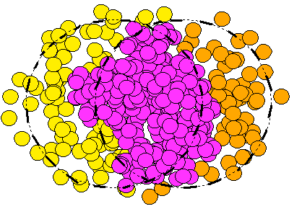


Importance of fluctuations
Initial spatial fluctuations of nucleons lead to higher moments of deformations in the fireball, each with its own orientation.
Alver, Roland (arXiv:1003.0194)
Odd harmonics present
v_{n} is a distribution, can be characterized by mean and width
Each harmonic has a separate phase (phases may be correlated)
Large acceptance of the LHC experiments coupled with the increased multiplicity has allowed for great precision is studying the nature of these fluctuations
Understanding the initial geometry is critical for understanding jet-suppression

Slide 3
OUTLINE
Multi-particle correlation measurements
  Cumulants, 2PC, LYZ
Event by Event v_{n} measurements
Event-plane correlations
Emphasis on
Removing non-flow
Comparison between experiments and methods
Theory interpretation

Slide 4
Gaussian model of flow fluctuations
arXiv: 0708.0800
For pure fluctuations v_{n}^{RP}=0
arXiv:0809.2949

Slide 5
Multi-particle correlations
Sensitive to mean geometry and fluctuations
Mean geometry only
arXiv: 0708.0800
0809.2949
Limit when v_{n}^{RP}>>δ_{n} (i.e. Average geometry
dominates over fluctuations)
Expected for v₂ in mid-central events
Limit when v_{n}^{RP}->0 (Pure fluctuations)
Expected to hold for v₂ in central events and for higher order harmonics in all centralities
Lee-Yang Zeros : Multi-particle correlations involving all particles in the event.
suppresses non-flow
Two particle correlations: similar to v_{n}{2}, but often done with dh gap to suppress
non-flow. Measures <v_{n}²>
Event Plane (EP) Method : Returns a value in between <v_{n}> and <v_{n}²>

Slide 6
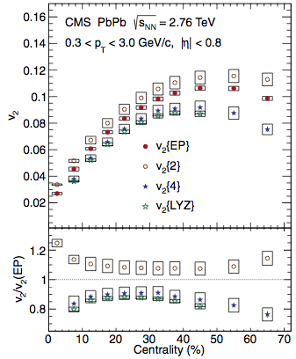
v₂ from multi-particle correlations
v₂{2} probably over-estimates <v₂²>
Due to non-flow
v₂{EP} probably under-estimates <v₂²>
Good consistency between LYZ
and 4-particle cumulants :
Reliable handle on average geometry!
arXiv:1204.1409

Slide 7
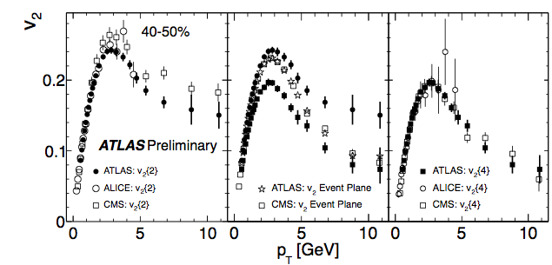
Comparison across experiments
ATLAS-CONF-2012-118
Good agreement among experiments for cumulants and even v₂{EP}

Slide 8
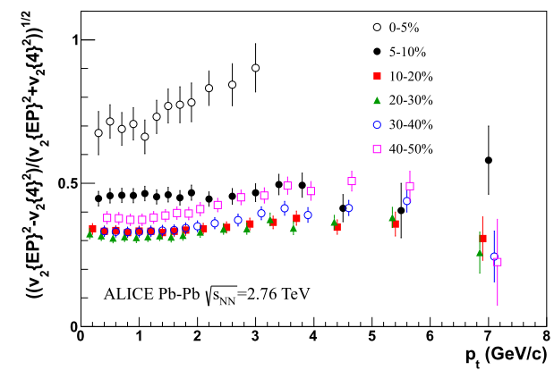
pT dependence of EbE fluctuations
arXiv:1205.5761
Ratio of fluctuations in v₂ to mean v₂ is relatively independent of p_{T}
Note that v₂{EP} changes by an order of magnitude over this p_{T} range but ratio is remarkably stable
Hydro response factorizes of function of p_{T} and initial geometry!

Slide 9
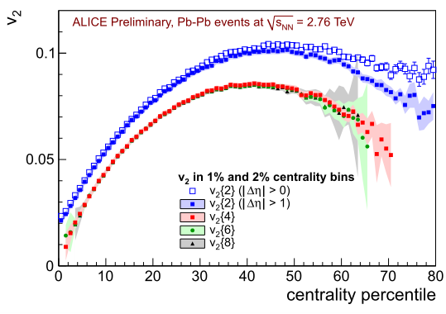
Higher order cumulants for v₂
Higher order cumulants such as v_{n}{6},v_{n}{8} all measure v_{n}^{RP}
v_{n}^{RP} is less susceptible to non-flow and so are v_{n}{4}, v_{n}{6},v_{n}{8}.
ALICE results show consistency among them
Note these measurements are done in 1% bins (Good!)

Slide 10
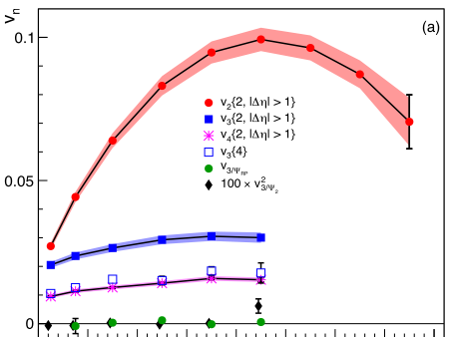
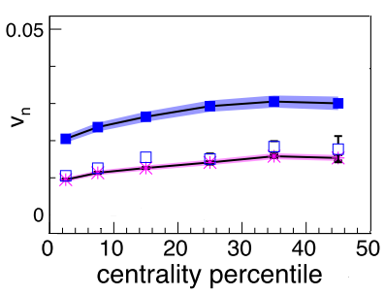
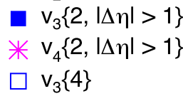

Cumulant results v3
arXiv:1105.3865
Relatively weak centrality dependence as compared to v₂
Sizable v₃{4} is seen ~50% of v₃{2}
  Implies mean geometry effects for v₃ !
v₃{4} /v₃{2}=0.5 => v₃^{RP}/δ₃ =0.8

Slide 11
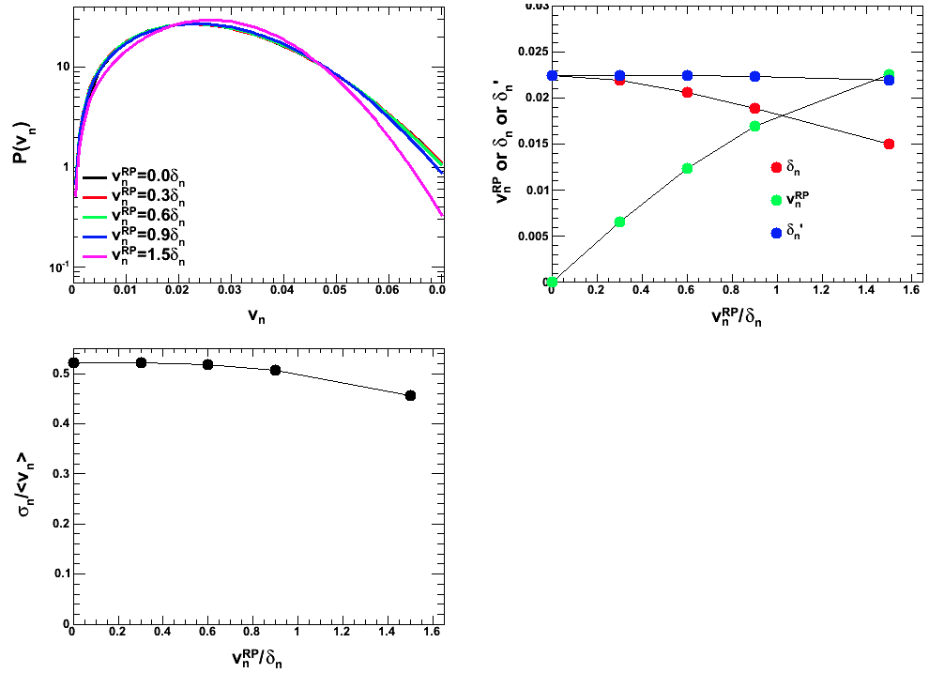
v₃{4} and average geometry

Slide 12
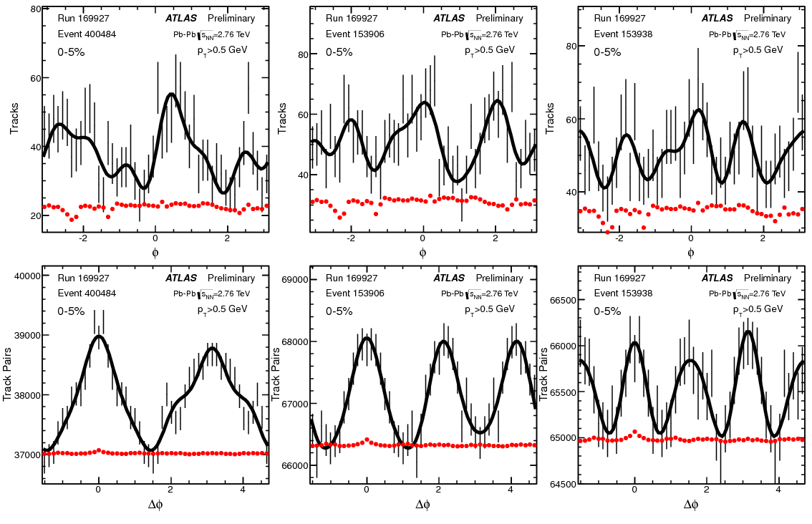
Event by Event flow measurements
Track distribution in three central events
Corresponding two-particle correlations
The large acceptance of the ATLAS/ALICE detectors and large multiplicity at LHC makes EbE v_{n} measurements possible for the first time.

Slide 13
v₂-v₃ probability distributions
v₂
v₃
v₃ distributions are consistent with pure Gaussian fluctuations
deviations in the tail (increases central->midcentral), Also see caveat in slide 11
For v₂ pure Gaussian fits only work for most central (2%) events

Slide 14
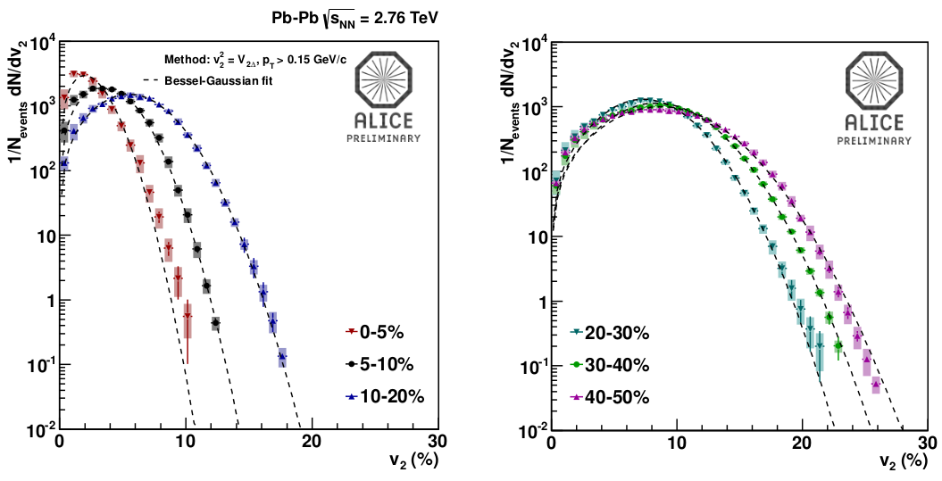
v₂ probability distributions via 2PC
A. Timmins, Hot Quarks 2012
ALICE EbE v₂ measurements obtained via 2PC followed by unfolding.
v₂ described by Bessel-Gaussian distribution: Contribution from mean geometry+fluctuations.

Slide 15
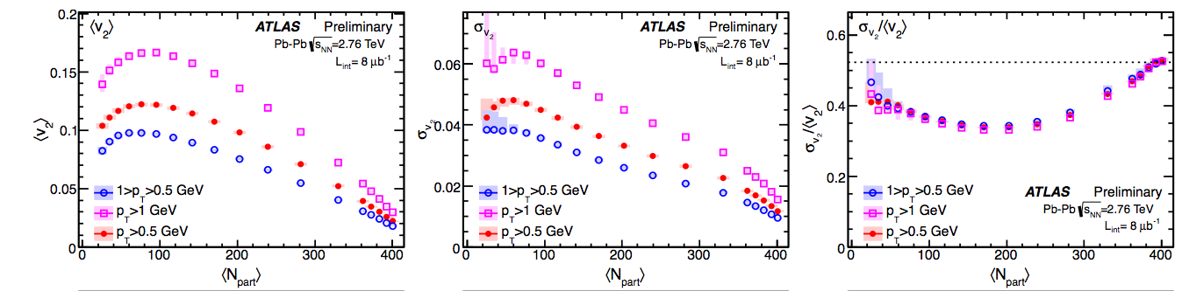


Relative fluctuations of v₂
Can obtain mean, σ from EbE distributions
And calculate σ/mean
Black points are fluctuations estimated
from cumulant method :

Slide 16
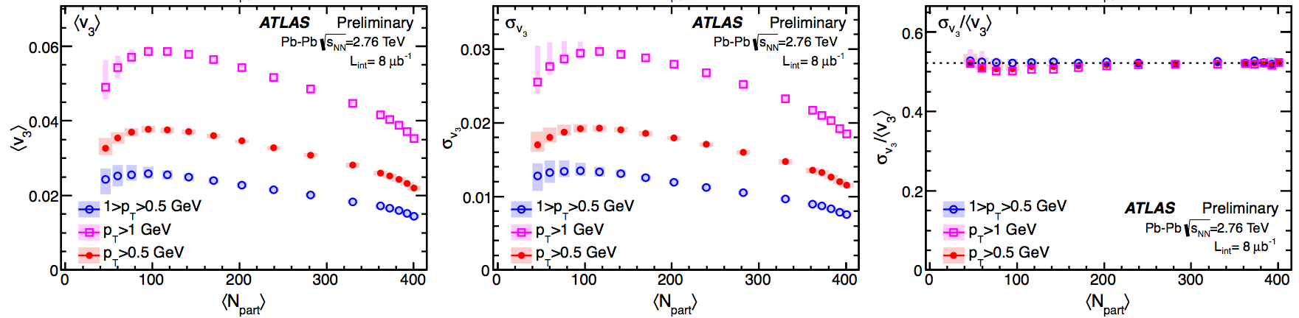
Relative fluctuations of v₃

Slide 17
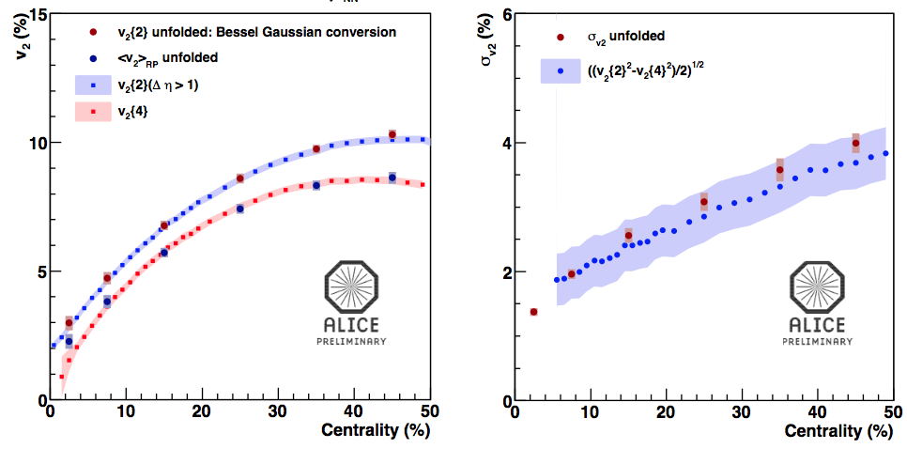
Comparison to cumulant results
A. Timmins
Hot Quarks 2012
Extracted v₂{2}, v₂{4} and sigma from EbE distributions are consistent with cumulant measurements

Slide 18
Non-flow bias on fluctuation measurements
Non-flow effects can bias the cumulant and EbE results
For cumulant the main effect is to enhance v_{n}{2}
  Can use v_{n}{2} with Δη gap as substitute
v_{n}{4} and higher cumulants relatively unaffected by non-flow
Can estimate non-flow from MC (ALICE EbE Measurements)
  Not data driven
For EbE v_{n} measurement the unfolding procedure can be used to remove non-flow (ATLAS Measurements)
  Data driven procedure

Slide 19
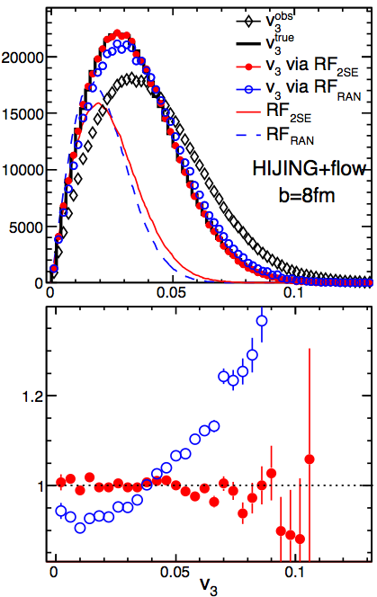
Non-flow effects : ATLAS EbE
Non-flow effects are mostly uncorrelated between sub-events
  They are removed during unfolding
HIJING+Flow afterburner test demonstrates this
  Get response function by dividing tracks with η>0 and η<0 into sub-events
  Get response function by randomly dividing tracks into sub-events
  Do unfolding with both response functions and compare to input vn distribution
arXiv:1304.1471
Events
Unfolded/True

Slide 20

Comparison to initial geometry: v₂
For Glauber and CGC mckln
  Rescale ε_{n} distribution to the mean of data
0-1%
5-10%
20-25%
30-35%
40-45%
55-60%
Both models fail describing p(v₂) across the full centrality range
Notes:
Measure the response directly

Slide 21
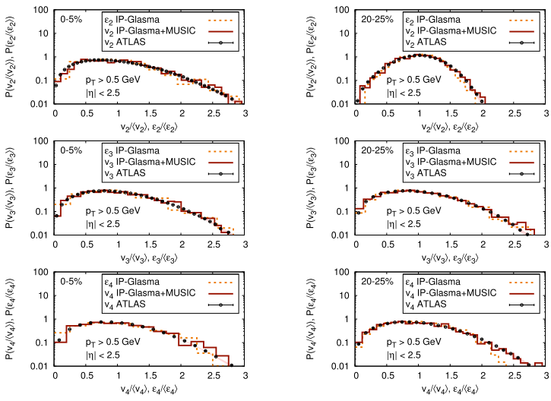
Comparison to IP-Glasma model
arXiv:1301.5893
1209.6330 (Gale, Jeon, Schenke, Tribedi, Venugopalan)
Talk tomorrow by Bjorn Schenke
Notes:
Measure the response directly

Slide 22
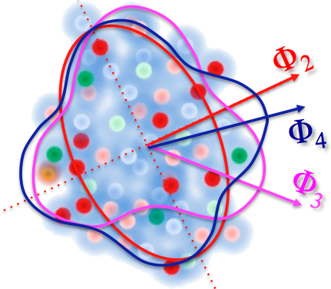
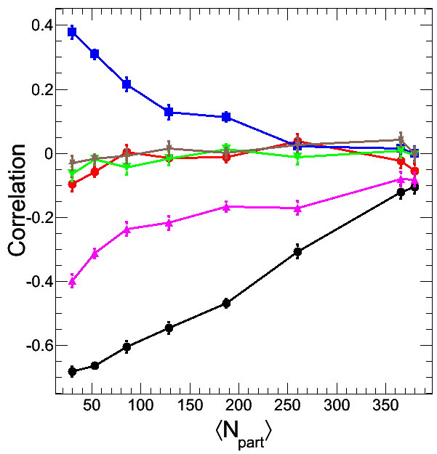
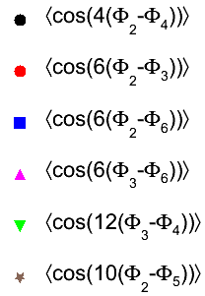
Correlation between phases of harmonic flow
Complementary observables to v_{n}
Correlation can exist in the initial geometry and also generated during hydro evolution
The correlation can be quantified via a set of correlators
This can be generalized into multi-plane correlations
^{arXiv:1205.3585}
^{arXiv:1203.5095}
Glauber
arXiv:1208.1200
Notes:
Centrality dependence

Slide 23


Event plane correlations
Initial geometry
+ hydrodynamic
ATLAS-CONF-2012-049
arXiv:1208.1200
Heinz & Qui
geometry only
EbE hydro qualitatively reproduces features in the data

Slide 24
Compare with EbE hydro calculation: 3-plane
Initial geometry
+ hydrodynamic
ATLAS-CONF-2012-049
arXiv:1208.1200
Heinz & Qui
geometry only
N_{part}
EbE hydro qualitatively reproduces features in the data

Slide 25
Summary
Cumulants provide overview into nature of fluctuations
  v₂{2} used to probe average geometry+fluctuations.
  v₂ {4}=v₂ {6}=v₂ {8}=v₂^{RP} and LYZ probe average geometry.
  Dependence of v_{n} on p_{T} and initial geometry factorizes.
EBE measurements of v₂, v₃ and v₄ distributions done by ATLAS and ALICE(v₂).
  EbE measurement handles non-flow.
  Does not assume a particular form of the EbE distributions.
  Distributions look Bessel-Gaussian like (deviations in the tail).
  Distributions for v₂, v₃ and v₄ well reproduced by IP-Glasma+MUSIC, but not by Glauber.
EP Corrs give further insight into initial geometry as well as hydro-evolution
  Can differentiate hydro-effects from initial geometry effects.
  Also gives information on initial geometry.

