Slide 1
Combined analysis of RHIC to LHC
suppression & Geometry
Roy A. Lacey
Chemistry Dept.,
Stony Brook University
Primary focus:
Scaling properties of flow & Jet quenching

Slide 2
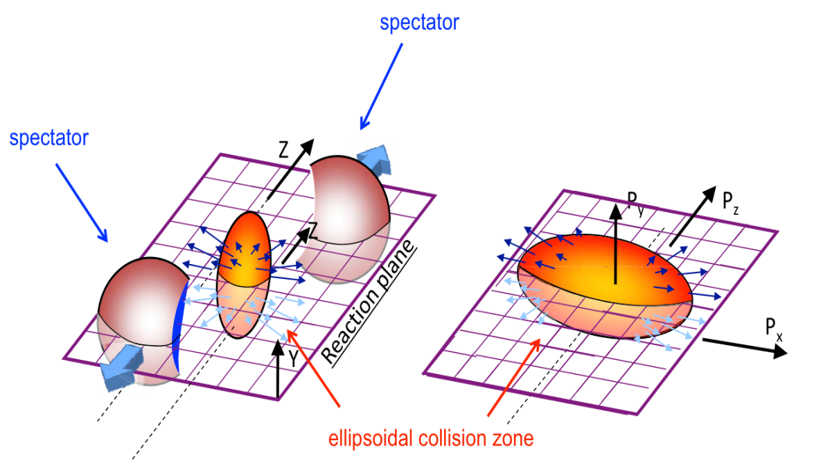
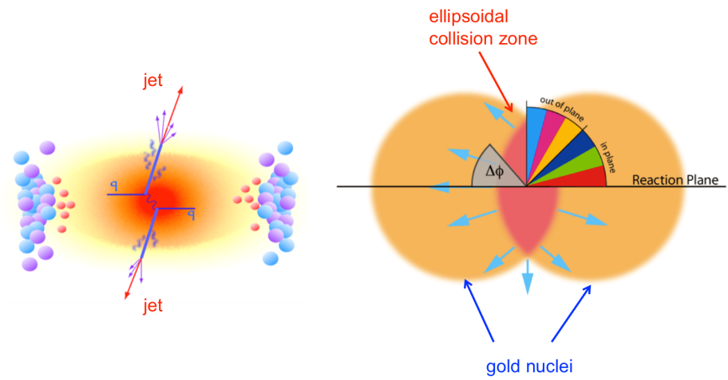
Flow & Jet quenching are important probes of the QGP!
3-4 < pT < 8-10 GeV/c
Transition
Region
pT < 3 - 4 GeV/c
Flow
pT > 8 -10 GeV/c
Jet suppression
More
suppression
Less
suppression
Path length (L & ∆L) driven
Eccentricity driven
& acoustic
Flow and Jet suppression are linked to
Geometry & the interactions in the QGP
This implies very specific scaling properties for flow and jet suppression (respectively), which can be tested experimentally
Scaling validation provide important insights, as well as straightforward probes of transport coefficients

Slide 3
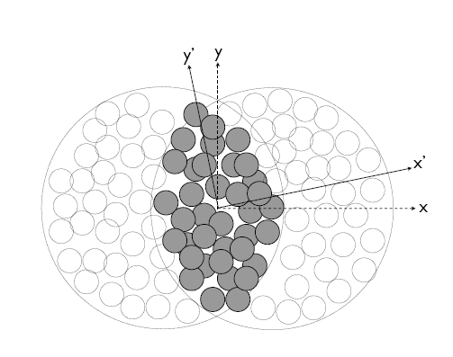
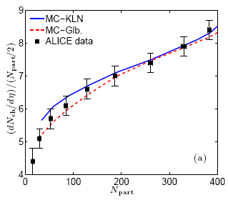
Geometric Quantities for scaling
Phys. Rev. C 81, 061901(R) (2010)
A
B
arXiv:1203.3605
σ_{x} & σ_{y} → RMS widths of density distribution
Geometric fluctuations included
Geometric quantities constrained by multiplicity density.

Slide 4
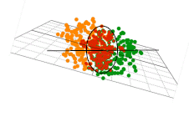
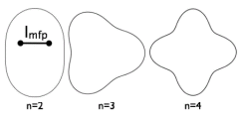
The Flow Probe
Initial Geometry characterized by many shape harmonics (ε_{n}) → drive v_{n}
Acoustic viscous modulation of v_{n}
Staig & Shuryak arXiv:1008.3139
Scaling expectations
Particle Distribution
Note that v_{n} is related to v₂

Slide 5
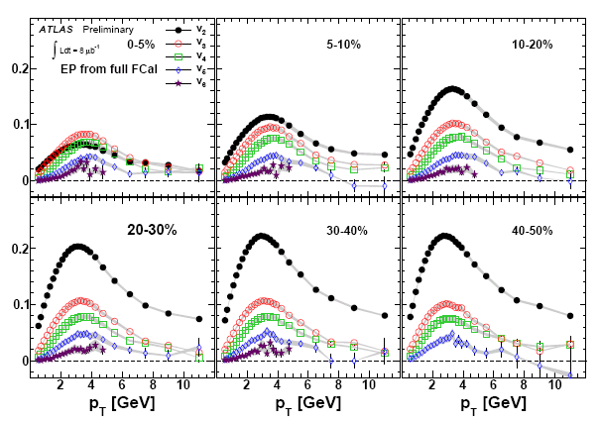
v_{n}(ψ_{n}) Measurements - ATLAS
ATLAS data - Phys. Rev. C86, 014907 (2012) & ATLAS-CONF-2011-074
Note v_{n} increase
from central
to peripheral
collisions
High precision double differential Measurements for Pb+Pb are pervasive → Do they scale?

Slide 6
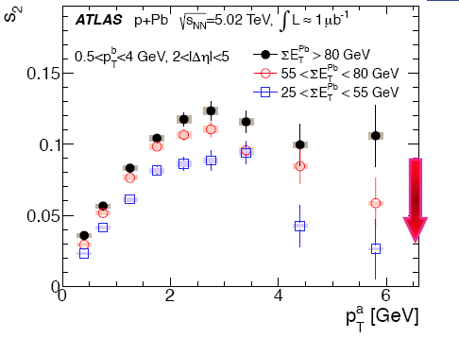
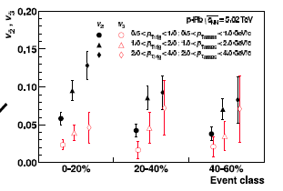
v_{n}(ψ_{n}) Measurements - LHC
Recent p+Pb measurements
ATLAS Data - arXiv:1212.5198.
ALICE Data - arXiv:1212.2001
Note increase of v₂ (or s₂) from peripheral to central collisions
Double differential Measurements for p+Pb are pervasive → Do they scale?

Slide 7
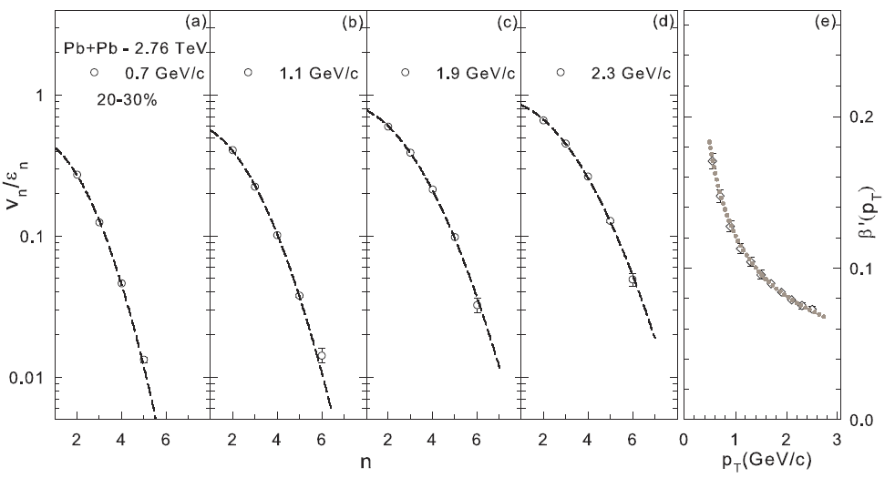
Acoustic Scaling – n²
ATLAS data - Phys. Rev. C86, 014907 (2012)
arXiv:1301.0165
Characteristic n² viscous damping validated
Characteristic 1/(p_{T})^{α} dependence of extracted β values validated
Constraint for η/s and δf

Slide 8
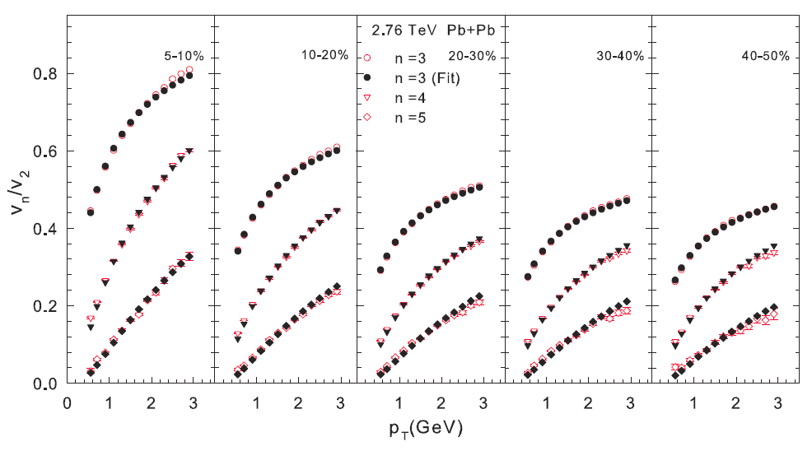
Acoustic Scaling - Ratios
arXiv:1301.0165
Characteristic (n² – 4) viscous damping validated
Characteristic 1/(p_{T})^{α} dependence of β validated
Constraint for η/s

Slide 9
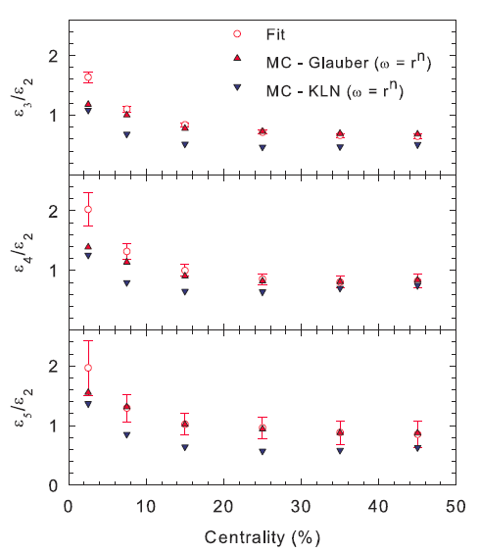
Acoustic Scaling - Ratios
arXiv:1301.0165
Fits performed
for each
centrality
Extracted ratios for $\frac{\text{ε}\text{n}}{\text{ε}\text{2}}$provide straightforward constraints for eccentricity models

Slide 10
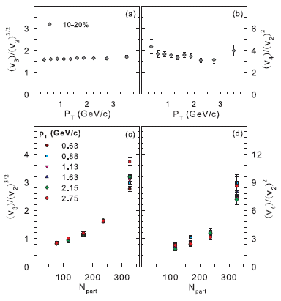
Acoustic Scaling - Ratios
arXiv:1105.3782
The expected relation between v_{n} and v₂ is validated

Slide 11
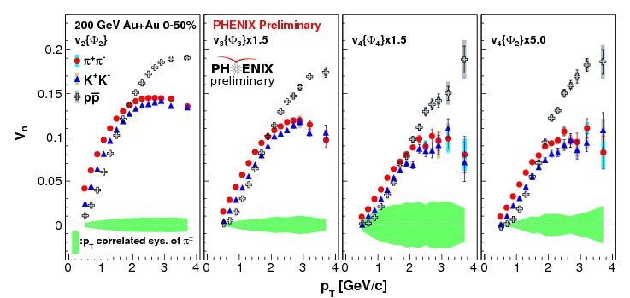
Flow is partonic & Acoustic?
arXiv:1211.4009
Note species dependence for all v_{n}
For partonic flow, quark number scaling expected
→ single curve for identified particle species v_{n}

Slide 12
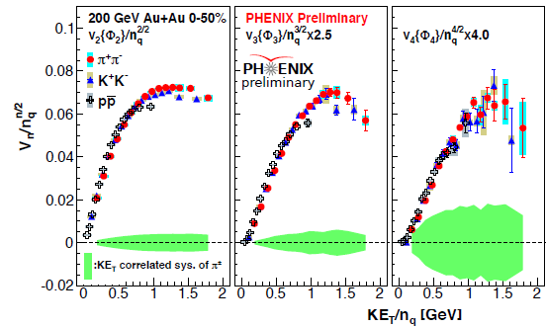
Flow is partonic & acoustic
J.Phys. G38 (2011) 124048
arXiv:1211.4009
v_{n} PID scaling
KE_{T} & scaling validated for v_{n}
→ Partonic flow

Slide 13
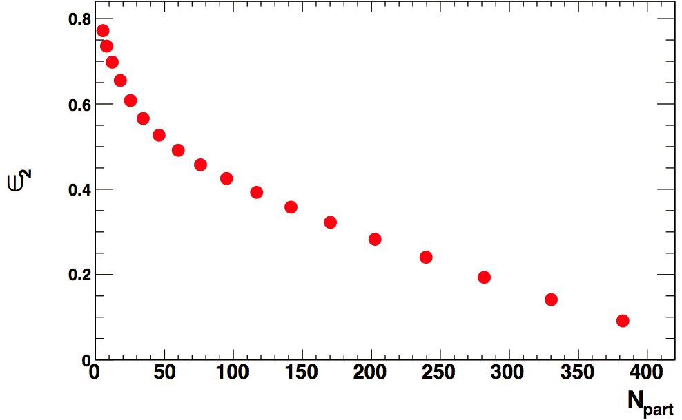
Acoustic Scaling – 1/R
ATLAS data - Phys. Rev. C86, 014907 (2012)
Specific dependence dictated
by sound attenuation
Centrality
5-70%
Eccentricity change alone is not sufficient
To account for the N_{part} dependence of v_{n}
Transverse size ($\overline{R}$ ) influences viscous damping
Characteristic $1/\overline{R}$ scaling prediction is
non-trivial

Slide 14
Acoustic Scaling – 1/R
CMS Data - JHEP 1108,141 (2011)
Characteristic $1/\overline{R}$viscous damping validated
A further constraint for η/s δf

Slide 15
Acoustic Scaling – 1/R
STAR Data - PhysRevC.81.044902
slope →
β constraint
Characteristic $1/\overline{R}$ viscous damping validated for light system
A further constraint for η/s

Slide 16
Acoustic Scaling – 1/R
ATLAS data - Phys. Rev. C86, 014907 (2012)
Note slope difference
Characteristic $1/\overline{R}$ viscous damping validated
A further constraint for η/s and δf

Slide 17
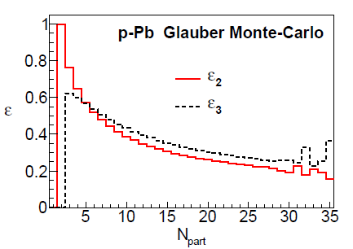
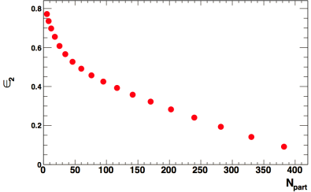
Acoustic Scaling – 1/R
ATLAS Data - arXiv:1212.5198.
v₂ increases
with centrality
e₂ decreases
with centrality
Increase of s₂ (v₂) with centrality
for p+Pb collisions is to be expected
If the mechanism is similar!
→ Effects of system size (R) dominates

Slide 18
Acoustic Scaling – 1/R
Compare system size @ RHIC
Slope difference encodes viscous coefficient difference
Viscous coefficient larger for more dilute system

Slide 19
Acoustic Scaling – 1/R
Characteristic $1/\overline{R}$ viscous damping validated across systems
→ Similar mechanism
Clear system size dependence of β → signature of dilute fluid?
This is very important

Slide 20
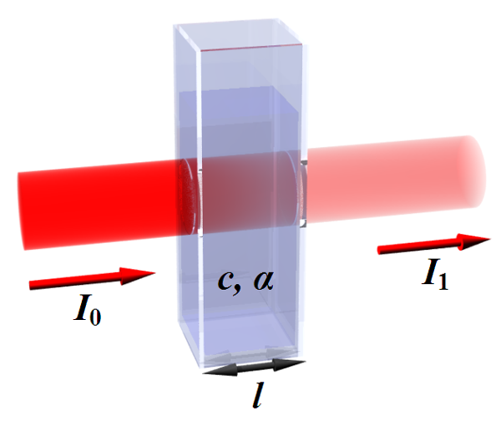
Fixed Geometry
Jet suppression Probe
More
suppression
Modified jet
Less
suppression
Suppression (∆L) – pp yield unnecessary
Suppression (L)
For Radiative Energy loss:
Path length
(related to collision
centrality)
, Phys.Lett.B519:199-206,2001
Jet suppression drives R_{AA} & azimuthal anisotropy with specific scaling properties
Notes:
20

Slide 21
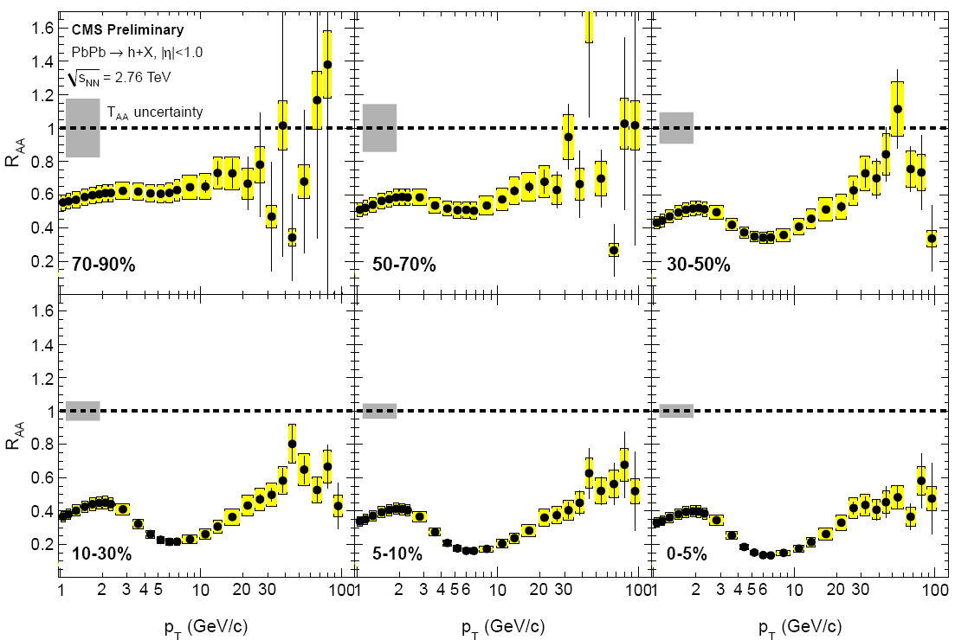
R_{AA} Measurements - CMS
Eur. Phys. J. C (2012) 72:1945 arXiv:1202.2554
Centrality
dependence
p_{T} dependence
Specific p_{T} and centrality dependencies – Do they scale?
Notes:
21

Slide 22
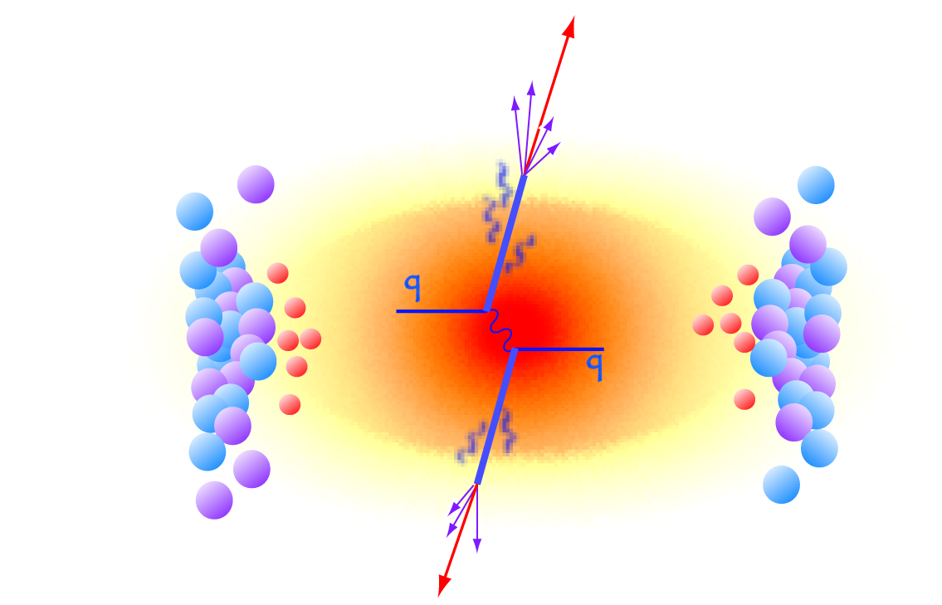
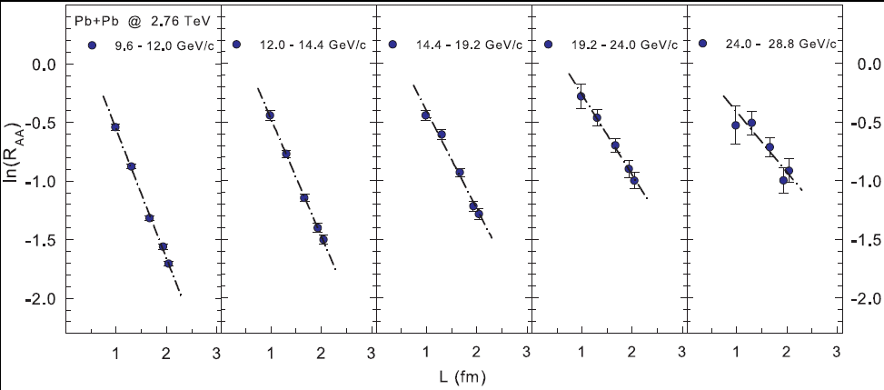
L scaling of Jet Quenching - LHC
, Phys.Lett.B519:199-206,2001
arXiv:1202.5537
ˆ
R_{AA} scales with L, slopes (S_{L}) encodes info on α_{s} and q
Compatible with the dominance of radiative energy loss
Notes:
22

Slide 23
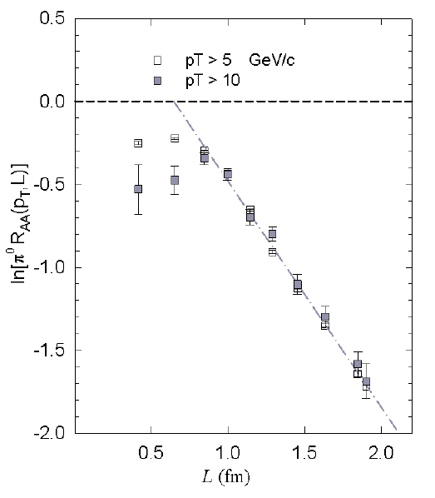
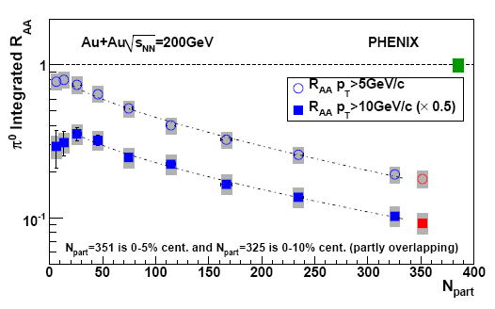
L scaling of Jet Quenching - RHIC
Phys.Rev.C80:051901,2009
R_{AA} scales with L, slopes (S_{L}) encodes info on α_{s} and q
Compatible with the dominance of radiative energy loss
ˆ
Notes:
23

Slide 24
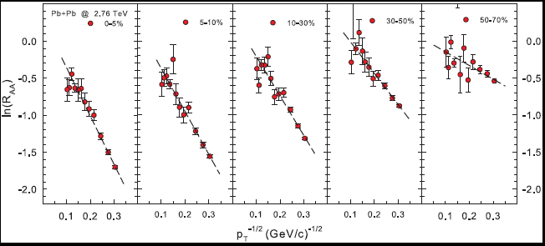
p_{T} scaling of Jet Quenching
, Phys.Lett.B519:199-206,2001
arXiv:1202.5537
ˆ
R_{AA} scales as 1/√p_{T} ; slopes (S_{pT}) encode info on α_{s} and q
L and 1/√p_{T} scaling → single universal curve
Compatible with the dominance of radiative energy loss
Notes:
24

Slide 25
Heavy quark suppression
ˆ
q_{LHC}
Consistent obtained
Notes:
25

Slide 26
High-pT v₂ measurements - PHENIX
Centrality dependence
p_{T} dependence
Specific p_{T} and centrality dependencies – Do they scale?
Notes:
26

Slide 27
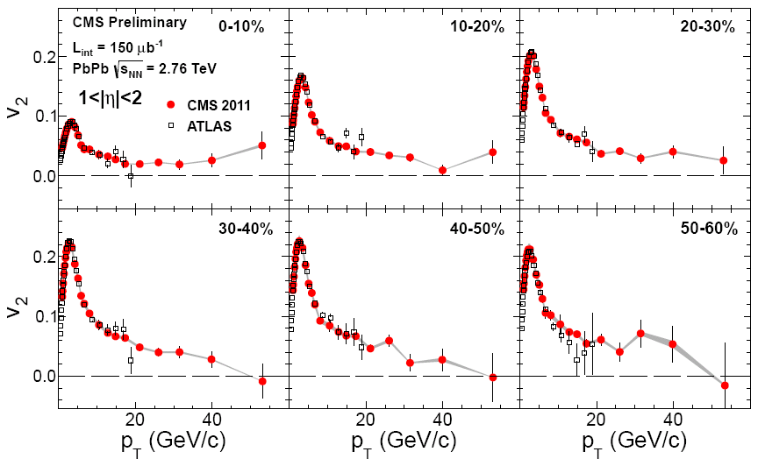
High-pT v₂ measurements - CMS
arXiv:1204.1850
Centrality
dependence
p_{T} dependence
Specific p_{T} and centrality dependencies – Do they scale?
Notes:
27

Slide 28
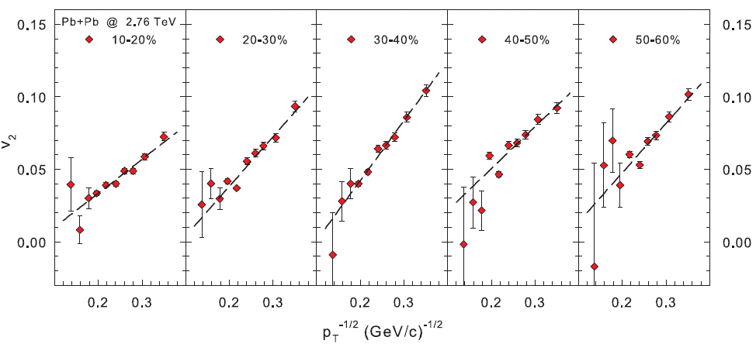
High-pT v₂ scaling - LHC
arXiv:1203.3605
v₂ follows the p_{T} dependence observed for jet quenching
Note the expected inversion of the 1/√p_{T} dependence
Notes:
28

Slide 29
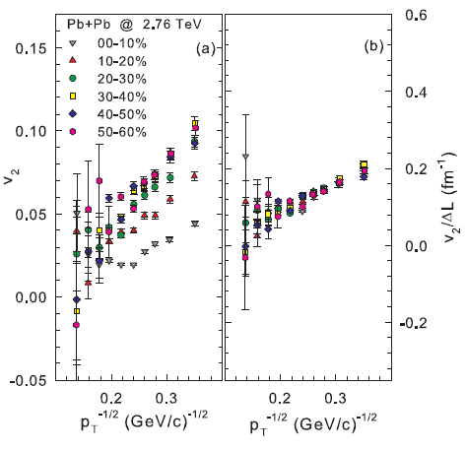
∆L Scaling of high-pT v₂ – LHC & RHIC
arXiv:1203.3605
Combined ∆L and 1/√p_{T} scaling → single universal curve for v₂
Notes:
29

Slide 30
∆L Scaling of high-pT v₂ - RHIC
Combined ∆L and 1/√p_{T} scaling → single universal curve for v₂
→ Constraint for ε_{n}
Notes:
30

Slide 31
Jet v₂ scaling - LHC
ATLAS
(z ~ .62)
v₂ for reconstructed Jets follows the p_{T} dependence for jet quenching
Similar magnitude and trend for Jet and hadron v₂ after scaling
Notes:
31

Slide 32
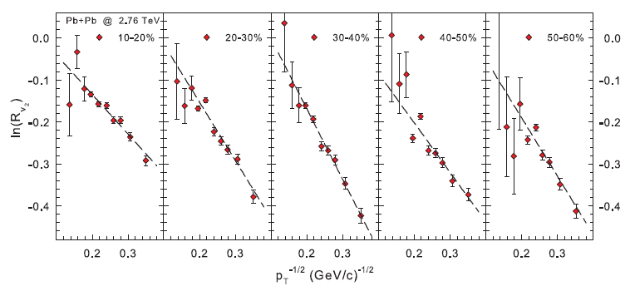
Jet suppression from high-pT v₂
arXiv:1203.3605
Jet suppression obtained directly from pT dependence of v₂
ˆ
α_{s} and q
R_{v2} scales as 1/√p_{T} , slopes encodes info on
Notes:
32

Slide 33
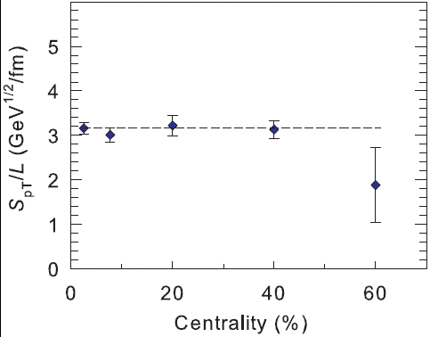
Extracted stopping power
Phys.Rev.C80:051901,2009
arXiv:1202.5537
arXiv:1203.3605
ˆ
q_{LHC}
obtained from high-pT v₂ and R_{AA} [same α_{s}] → similar
- medium produced in LHC collisions less opaque!
ˆ
q_{RHIC} > q_{LHC}
Conclusion similar to those of Liao, Betz, Horowitz,
→ Stronger coupling near T_{c}?
Notes:
33

Slide 34
Summary
Robust scaling observed for both Flow and Jet Quenching
They lend profound mechanistic insights, as well as New constraints for
estimates of the transport and thermodynamic coefficients!
What do we learn?
R_{AA} and high-pT azimuthal anisotropy stem from the same energy loss mechanism
Energy loss is dominantly radiative
R_{AA} and anisotropy measurements give consistent estimates for <ˆq >
R_{AA} for D’s give consistent estimates for <ˆq >
The QGP created in LHC collisions is less opaque than that produced at RHIC – Note density increase from
RHIC to LHC
Flow is acoustic
Flow is pressure driven
Obeys the dispersion relation for sound propagation
clear system size dependence
Flow is partonic
exhibits
scaling
Constraints for:
ε, β, and δf
η/s @ RHIC (~ 1/4π)
η/s @ LHC a bit larger than at RHIC

Slide 35
End

Slide 36
Acoustic Scaling – 1/R
ATLAS data - Phys. Rev. C86, 014907 (2012)
Centrality – 5-70%
Characteristic $1/\overline{R}$viscous damping validated
A further constraint for η/s and δf

Slide 37
Acoustic Scaling – 1/R
ATLAS data - Phys. Rev. C86, 014907 (2012)
STAR Data - PhysRevC.81.044902
Eccentricity change alone is not sufficient
To account for N_{part} dependence of v₂
In light & heavy systems

Slide 38
Acoustic Scaling – 1/R
Compare RHIC & LHC
p_{T} dependence
of slope →
δf constraint
Larger Slope
for LHC
→ Viscosity larger @ LHC than @ RHIC
Characteristic $1/\overline{R}$ viscous damping validated
A further constraint for η/s

