Slide 1
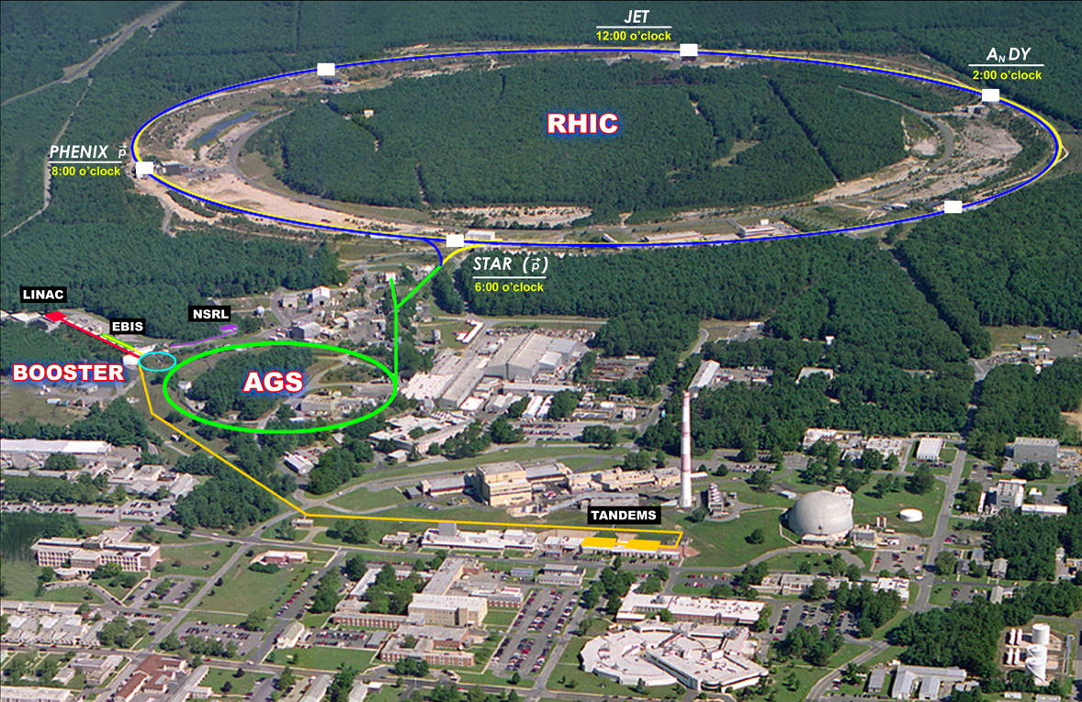
Future p-A: RHIC machine perspective Wolfram Fischer
15 April 2013
Jet Quenching RBRC Workshop, BNL
Notes:
14:30, 30 min

Slide 2
Relativistic Heavy Ion Collider 1 of 2 ion colliders (other is LHC), only polarized p-p collider
2 superconducting 3.8 km rings
2 large experiments
100 GeV/nucleon ions up to U
255 GeV polarized protons
Performance defined by
1. Luminosity L
2. Proton polarization P
3. Versatility (species, E)

Slide 3
Content
What do we have for p+Au collisions?
What do we still need for p+Au collisions?
Luminosity projection

Slide 4
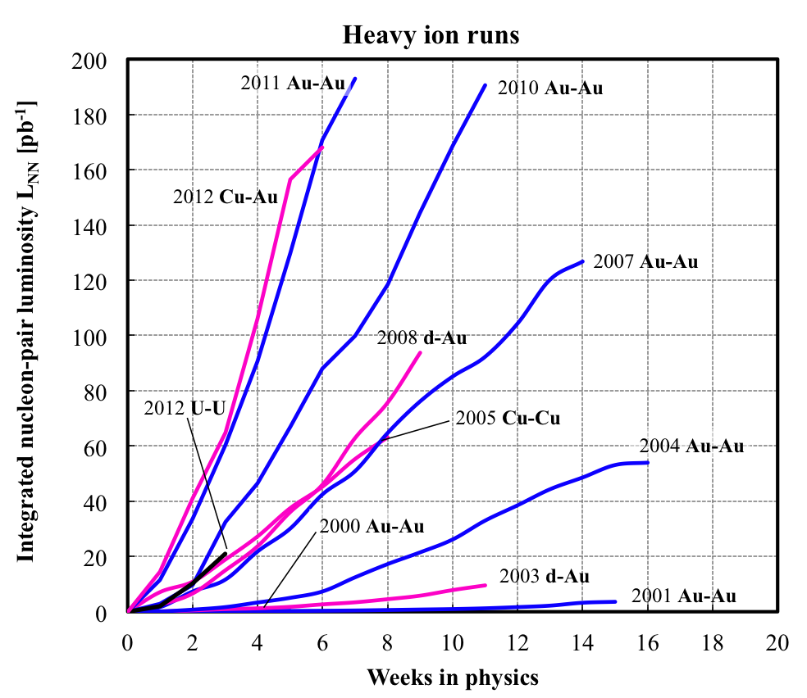
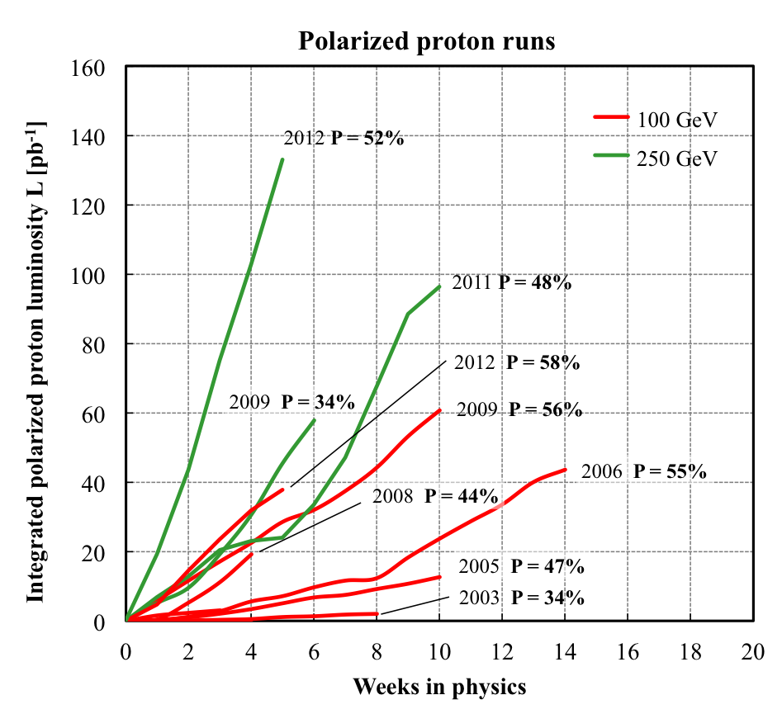
Delivered Integrated Luminosity and Polarization
--- RHIC-II performance is here ---
Heavy ion runs
Polarized proton runs
Integrated nucleon-pair luminosity L_{NN} [pb⁻¹]
Integrated luminosity L [pb⁻¹]
Nucleon-pair luminosity: luminosity calculated with nucleons of nuclei treated independently; allows comparison of luminosities of different species; appropriate quantity for comparison runs.

Slide 5
RHIC luminosity and polarization goals
parameter |  | unit | achieved |  | goals
Au-Au operation |  |  | 2011 |  | ≥ 2014 3D stochastic cooling + 56 MHz SRF
energy | GeV/nucleon |  | 100 |  | 100
no colliding bunches | … |  | 111 |  | 111
bunch intensity | 10⁹ |  | 1.3 |  | 1.3
avg. luminosity | 10²⁶ cm⁻²s⁻¹ |  | 30 |  | 40
p↑-p↑ operation |  |  | 2012 |  | ≥ 2013 source |  | ≥ 2014 source + e-lenses
energy | GeV |  | 100 | 255 | 100 | 250 | 100 | 250
no colliding bunches | … |  | – 107 – |  | – 107 – |  | – 107 –
bunch intensity | 10¹¹ |  | 1.6 | 1.7 | 1.6 | 2.0 | 1.8 | 2.5
avg. luminosity | 10³⁰ cm⁻²s⁻¹ |  | 33 | 105 | 30 | 150 | 60 | 300
avg. polarization* | % |  | 59 | 52 | – 60 – |  | – 65 –
*Intensity and time-averaged polarization as measured by the H-jet. Luminosity-averaged polarizations, relevant in single-spin colliding beam experiments, are higher. For example, for intensity-averaged P = 48% and R_{x} = R_{y} = 0.2 (250 GeV, 2011), the luminosity-averaged polarization is P = 52%.

Slide 6
Asymmetric ion species under consideration in RHIC (to date)
proton-gold (p-Au)
not yet done, part of the design
requires moving IR6 and IR8 DX magnets horizontally by ~1 cm
deuteron-gold (d-Au)
operated in 2003 and 2008
copper-gold (Cu-Au)
operated in 2012
Polarized proton-polarized ³He (ph-³Heh)
likely request when ³Heh is available
RBRC Workshop on ³Heh at BNL, 28-30 September 2011

Slide 7
What do we have for p+Au collisions?
RHIC was designed for p+Au collisions
Independent rings except DX magnets
DX magnets movable (~1 shift)
With stochastic cooling initial Au beam size is at its maximum
Allows for DX move in IR6 and IR8 only (~1 shift)
Solutions for lattice, injection and acceleration
Lattice takes advantage of stochastic cooling
Machine with fast setup (beam-based feedbacks)
Experience with asymmetric collisions (d+Au, Cu+Au)
Proton beam with N_{b} = 2x10¹¹, P = 55% with upgrades (OPPIS): N_{b} = 3x10¹¹, P = 65%
Au beam with N_{b} = 1.3x10⁹
with upgrades (EBIS/Booster/AGS/RHIC): 2.0x10⁹ (emittance?)

Slide 8
RHIC Design Manual
Run-11: L_{avg} = 30×10²⁶cm⁻²s⁻¹
Run-12: L_{avg} = 10.5×10³¹cm⁻²s⁻¹ (with P_{avg} = 53%)

Slide 9
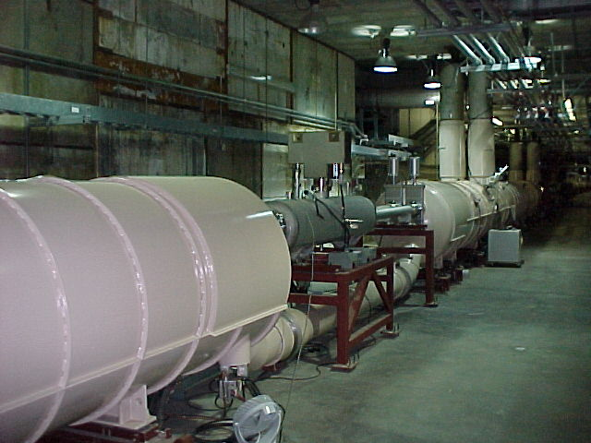
RHIC Design Manual (July 1998)
IR design with beam splitting DX dipoles first
DX dipoles
L_{mag} = 3.7 m, B_{max} = 4.3 T
large aperture (18 cm coil ID)
only magnets that need training (~5 for IR6/8 only)
D0,Q1—Q3
DX dipole
Notes:
MAKE REAL CALCULATION FOR DX MOVE

Slide 10
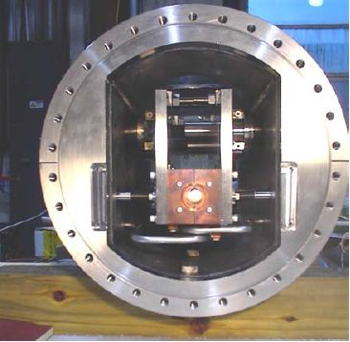
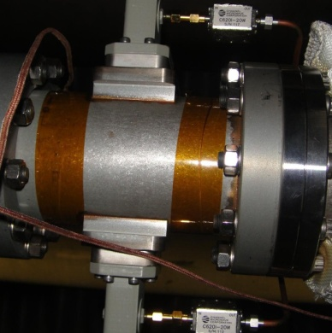
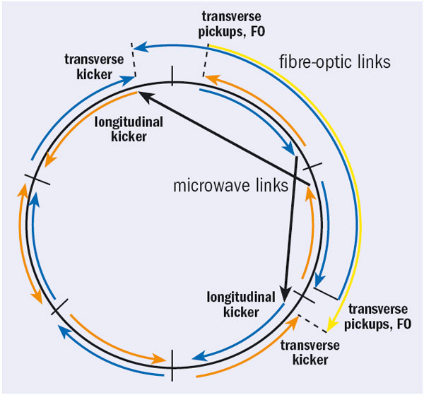
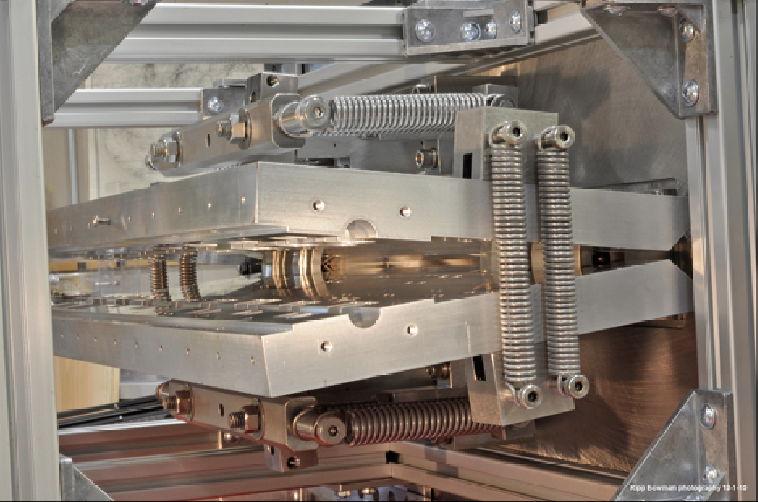
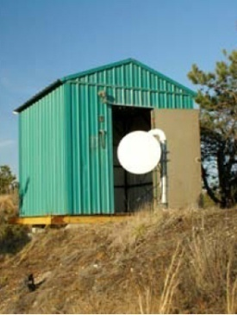
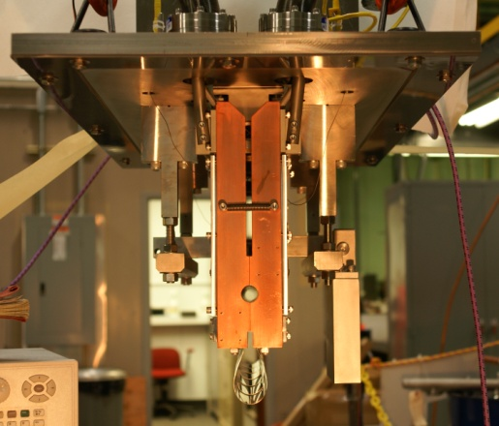
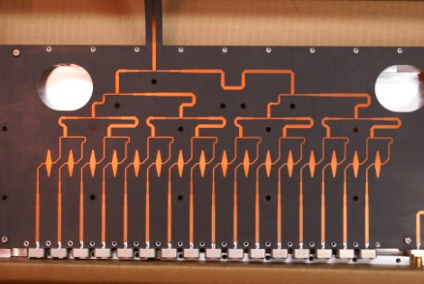
Now have full 3D stochastic cooling for heavy ions
longitudinal pickup
longitudinal kicker (closed)
horizontal kicker (open)
horizontal and vertical pickups
vertical kicker (closed)
5-9 GHz, cooling times ~1 h
M. Brennan, M. Blaskiewicz, F. Severino, PRL 100 174803 (2008); PRSTAB, PAC, EPAC
Notes:
Frequency range: 5-8 GHz transverse, 6-9 GHz longitudinal

Slide 11
Stochastic cooling in U—U operation

Slide 12
Cu-Au store – new mode in 2012
10%/h
Cu and Au have different - intrabeam scattering growth rates (~Z⁴N_{b}/A²) r_{IBS,Au} ≈ 2x r_{IBS,Cu}
- cooling rates (~1/N_{b}) r_{SC,Au} ≈ 3x r_{SC,Cu}
beam loss rates
25 mm.mrad
Stores start with large ε after undergoing instability at transition
Possible with stochastic cooling
Increase bunch intensity until loss at transition
transverse emittances
120x10²⁶cm⁻²s⁻¹
luminosities
Notes:
Fillno 16991 06/15/12, last night

Slide 13
p+Au easier with stochastic cooling
only need to accommodate initial Au emittances
sufficient to move IR6 and IR8 DX magnets
colliding IR move DX by 1cm
S. Tepikian, D. Trbojevic, C-A/AP/447 (Jan. 2012)

Slide 14
p+Au easier with stochastic cooling
non-colliding IR
no DX move
S. Tepikian, D. Trbojevic, C-A/AP/447 (Jan. 2012)

Slide 15
Beam control improvement – feedbacks on ramp
0.3
M. Minty, A. Marusic et al.
Blue orbits
x,y_{rms} ≈ 20 μm ≈ 3% of rms size
x_{mean}
x_{rms}
Orbit [mm]
Orbit feedback on every ramp allows for
Smaller y_{rms} (smaller imperfection resonance strength)
Ramp reproducibility (have 24 h orbit variation)
Tune/coupling feedback on every ramp allows for
Acceleration near Q_{y} = 2/3 (better P transmission compared to higher tune)
y_{mean}
y_{rms}
-0.2
0.7
Q_{x}
Tune
Q_{y}
ΔQ_{y} = 0.006
Q_{y} = 2/3
0.66
Notes:
Fillno 15443, one of best stores

Slide 16
Time-in-store as fraction of calendar time
85%
60%
Run-12 with low failure rates in all systems
Highest time-in-store ratios to date even with increased APEX time during 255 GeV protons, and few weeks per species
Have higher failure rates in Run-13 so far

Slide 17
What do we still need for p+Au?
Demonstrate DX move by 1 cm
Can be done at end of Run-13
Move for p beam in Yellow, Au beam in Blue (different from d-Au)
If p beam in Blue is needed (and Au beam in Yellow)
Modify vacuum pump stands in IR6 and IR8
Modify shielding IR6 and IR8
Operate with new injection and acceleration scheme
Inject and accelerate Au to intermediate level above transition Then inject p and accelerate both beams
Ensure that luminosity can be measured
Study DX aperture and possible experimental background

Slide 18
Moving IR6 and IR8 DX magnets by 1cm
Bellows allow for 1 cm movement
Installed shielding creates tight spaces but acceptable “6:00 the bellows and ion pump stand were swapped to make space for the shielding, … cannot be moved because of the ion pump stand” (M. Mapes)
Easier to have p in Yellow, Au in Blue (different from d-Au!)
=> Clear preference for Au beam in Yellow ring.
(Workshop on Physics of p+A Collisioins in RHIC, 7-9 Jan 2013)
Can be done in ~ 1 shifts (i.e. during a run) when properly prepared in previous shut-down

Slide 19
p+Au injection and acceleration
maintains same f_{rev} for both beams
Lorentz factor γ
collision p+Au
107.4
injection p⬆
store Au (close to γ_{tr})
acceleration p, Au
injection Au
25.4
10.5
acceleration Au (cross transition)
time
Note: now tolerate ion beam instabilities at transition to obtain higher intensity (can be cooled down again), not possible with p+Au since have smaller aperture available

Slide 20
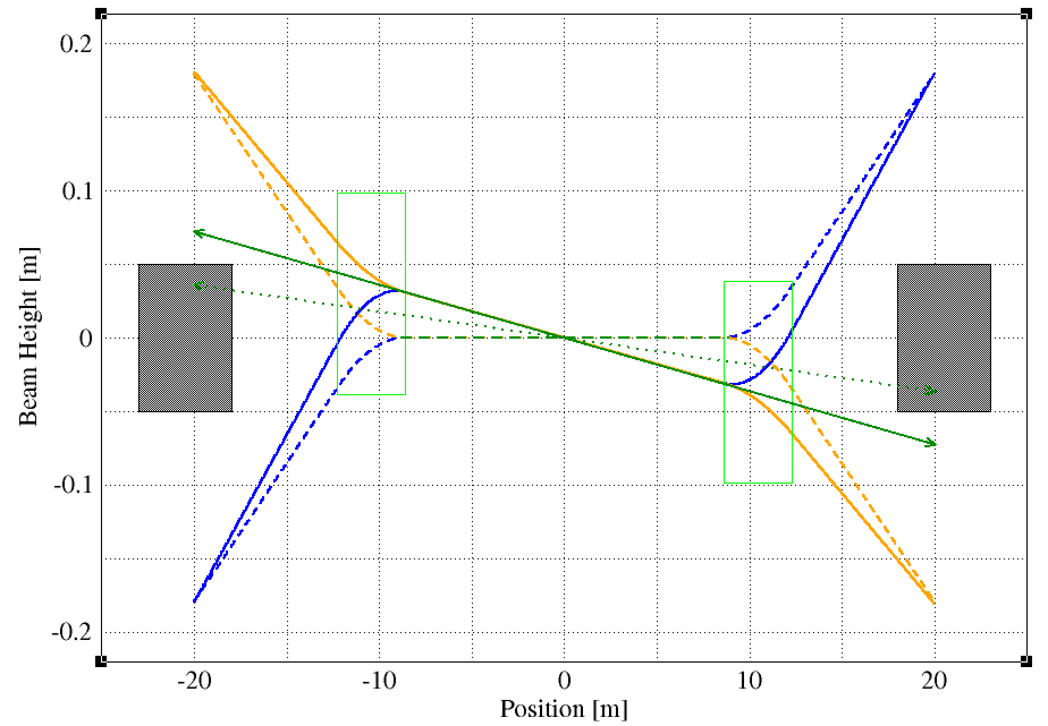
ZDC Lumi Monitor Acceptance (M. Bai)
The 3.58 mrad common angle through IP for head-on collisions can blind the ZDC detector right behind DX magnet
Au
p
neutron
DX
ZDC
ZDC
DX
neutron
p
Au

Slide 21
ZDC Lumi Monitor Acceptance (M. Bai)
Layout between DX and D0
DX magnet
D0 magnet
Move ZDC downstream?
neutron
ZDC

Slide 22
ZDC Lumi Monitor Acceptance (M. Bai)
If not enough room to move ZDC downstream, need to find a way to reposition ZDC
move not only DX magnet but also the beam pipe between DX and D0
Difficult but could be explored

Slide 23
DX aperture measurement with beam, Y. Luo, A. Marusic, S. Tepikian
04/10/13

Slide 24
DX aperture measurement with beam, Y. Luo, A. Marusic, S. Tepikian
04/10/13
Analysis pending.

Slide 25
Asymmetric collisions (p+Au)
p+Au energies: 100.8 GeV p on 100.0 GeV/nucleon Au (γ_{p} = γ_{Au} = 107.4)
For energy scan need to match Lorentz factor γ of both beams
L_{NN}/week, min/max pb⁻¹ 15 37

Slide 26
Summary
p+Au is possible max energy 100 GeV/nucleon for both beams
Stochastic cooling for ion beams helps: DX move only in IR6 & IR8, no Au beam growth
DX move in ~1 shifts possible upgrade for pp2pp in IR6 requires change of DX bellows will reduce flexibility, cannot move DX magnets during run
New injection/acceleration scheme store Au beam above transition for ~15 min
Luminosity estimate based on p⬆ beam available (anticipated), and Au beam available (anticipated)
L_{NN} = 15 pb/week min (now) L_{NN} = 37 pb/week max (few years)

