Slide 1
Opportunities for RHIC Spin in the coming decade
E.C. Aschenauer

Slide 2
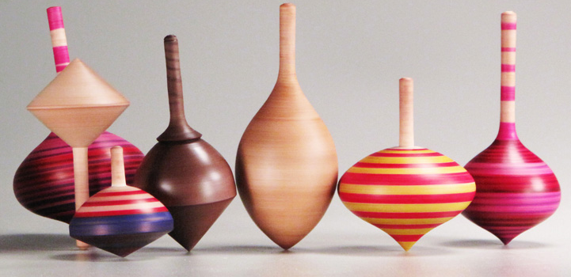
SPIN: Fundamental quantum Number
SPIN is one of the fundamental properties of matter
all elementary particles, but the Higgs carry spin
Studying Spin revealed many surprises in physics
→ proton anomalous magnetic moment → substructure
cannot be explained by a static picture
of the proton
Proton Spin:
It is more than the number ½ ! It is the interplay between
the intrinsic properties and interactions of quarks and gluons
If we do not understand the proton spin in QCD,
we do not fully understand QCD !
need a polarized collider to have full access
to the proton dynamics

Slide 3
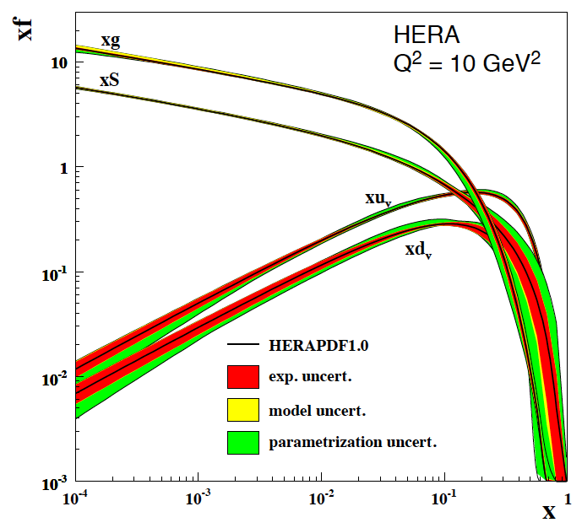
Fundamental questions
How do quarks and gluons conspire to provide the proton’s spin 1/2
gluon spin
Gluons account for 50% to the proton’s
momentum
Gluons and sea quarks dominate the proton structure at x<0.2
Can quarks and gluons explain all the spin?
→ what is the role of gluons?
→ what is the role of sea quarks?
→ How much orbital angular momentum is
needed?
total quark
spin
angular
momentum
RHIC SPIN
What is the dynamic structure of the proton
2D+1 picture in momentum and coordinate space
Visualize color interactions in QCD
collective phenomena and correlations in fragmentation

Slide 4
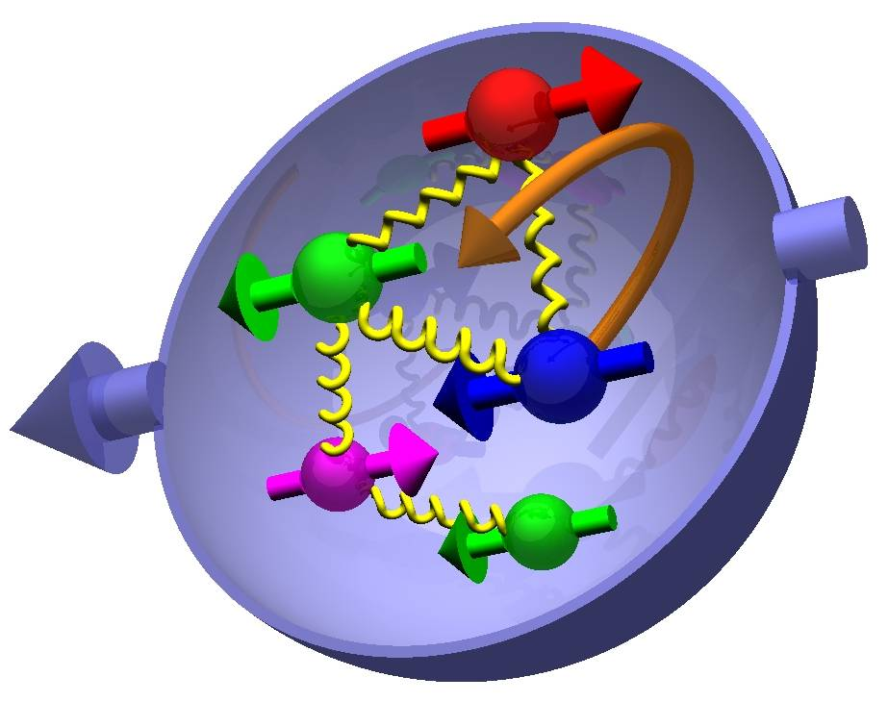

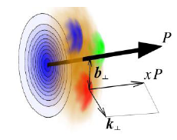
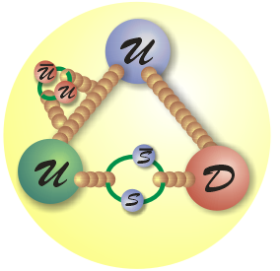
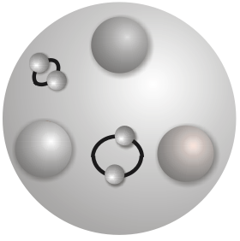
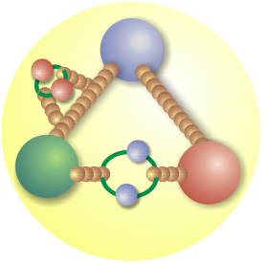
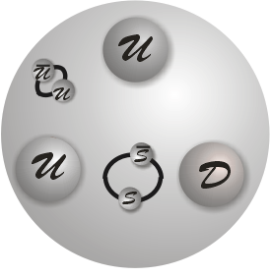
Fundamental Questions
How are sea quarks and gluons and their spin distributed
in space and momentum inside the nucleon?
How are these quark and gluon distributions correlated with the
over all nucleon properties, such as spin direction?
What is the role of the motion of sea quarks and gluons
in building the nucleon spin?
How do quarks and gluons hadronize
into final-state particles
To separate interaction dependent phenomena from intrinsic properties
UNIVERSALITY
different complementary probes are needed
RHIC-SPIN <-> EIC
EM interaction
Photon
Sensitive to electric charge²
Insensitive to color charge
Strong interaction
Gluon
Sensitive to color charge
Insensitive to flavor
Weak Interaction
Weak Boson
Sensitive to weak charge
~flavor
Insensitive to color

Slide 5

The Spin of the proton

Slide 6

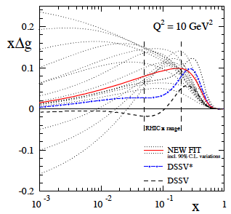
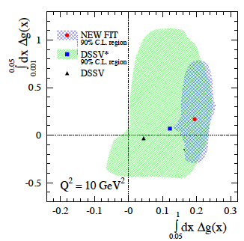
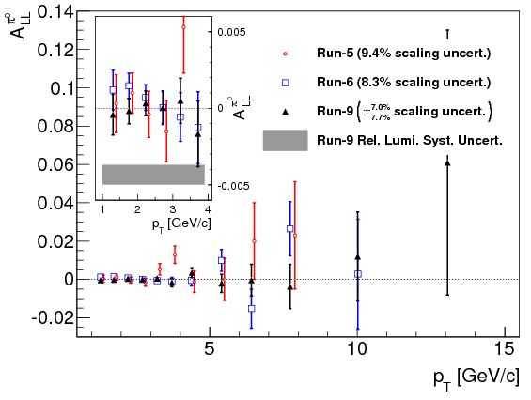
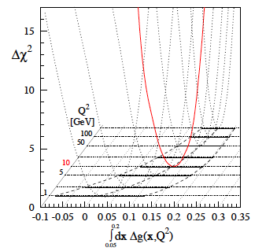
High Precision 2009 RHIC DATA→∫Δg(x)
DSSV: arXiv:0904.3821
DSSV*: DSSV + all new (SI)DIS
DSSV: DSSV* & RHIC 2009
Getting significantly closer to understand the gluon contribution to the proton spin
BUT
need to reduce low-x (<10⁻²) uncertainties for ∫Δg(x)
arXiv:1405.5134
strong constrain on
first
completely consistent with
DSSV* in 90% C.L.
can be accessed
through jets/di-jets
at √s=500 GeV and
forward rapidity η > 1
QCD
fit
arXiv: 1404.4293, PRL 113, 012001
First time a significant
non-zero Δg(x)
arXiv:1402.6296

Slide 7
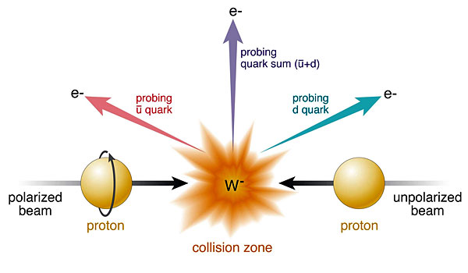
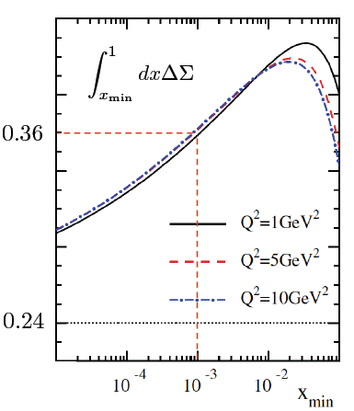
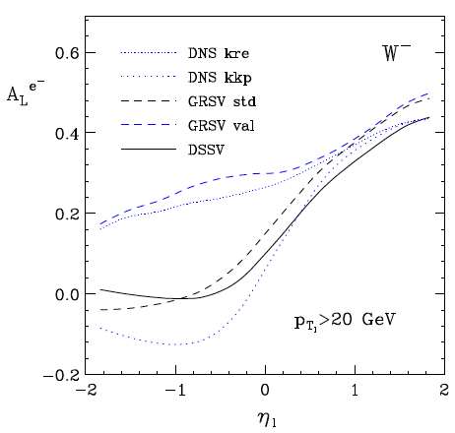
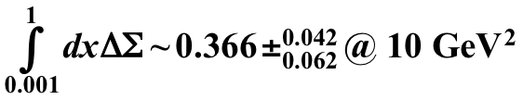
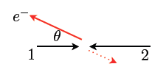
Δq: W Production Basics
Since W is maximally parity violating
→ W’s couple only to one parton helicity
large Δu and Δd result in large asymmetries.
Why is separating quarks flavors important?
understand dynamics of the quark-antiquark fluctuations
flavor asymmetry in the light quark sea in the proton
unpolarised: ubar ≠ dbar polarised case ?
sea-quark polarizations critical for quark contribution to spin
Complementary to SIDIS:
very high Q²-scale 6400 GeV²
extremely clean theoretically
No Fragmentation function
stringent test on theory approach
for SIDIS
UNIVERSALITY of PDFs
backward
forward
x₁ small
t large
x₁ large
u large

Slide 8
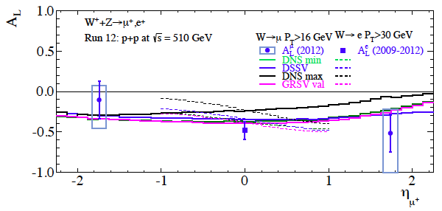
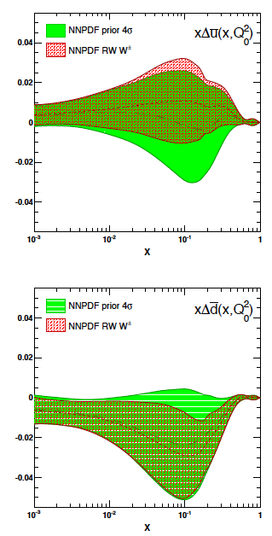
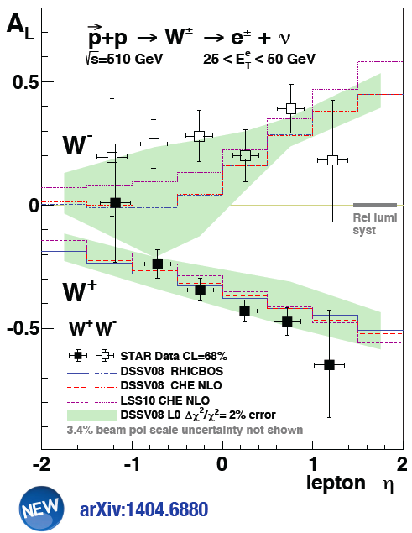
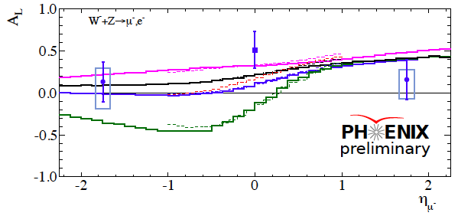

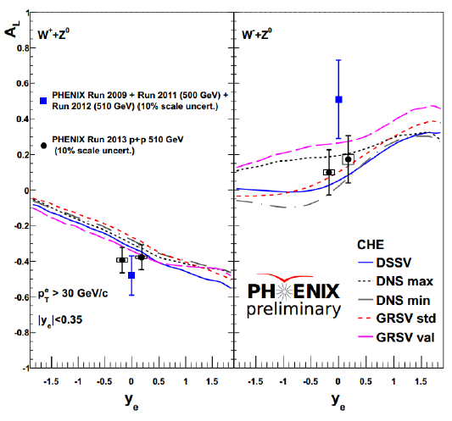
Current W-Results
PHENIX Run 2009 to 2012
first result from muon arms
arXiv:1406.5539

Slide 9

Future Measurements

Slide 10
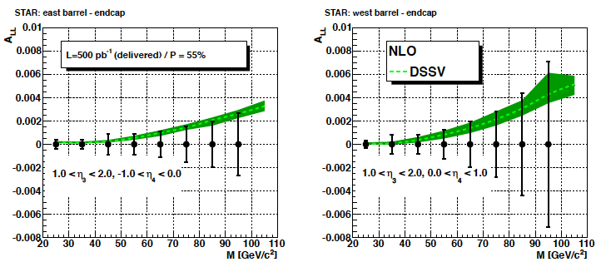
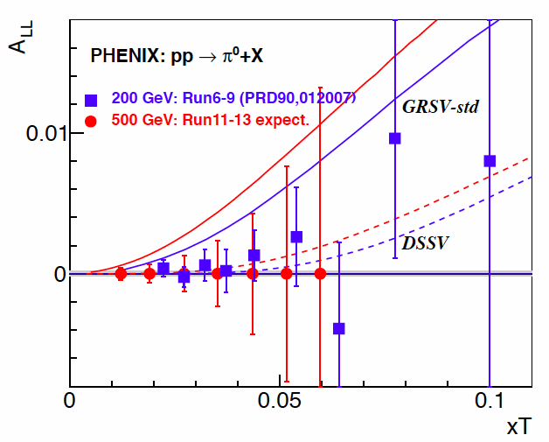
How to constrain ∫Δg(x) further
Reduce uncertainties and go to low x
measure correlations (di-jets, di-hadrons)
→ constrain x-shape of Δg(x)
A_{LL} π⁰ and jet at √s = 500 GeV → x_{min} > 0.005
measure A_{LL} at forward rapidities → x_{min} > 0.001
forward η
RHIC
500 GeV
DIS
RHIC
200 GeV

Slide 11
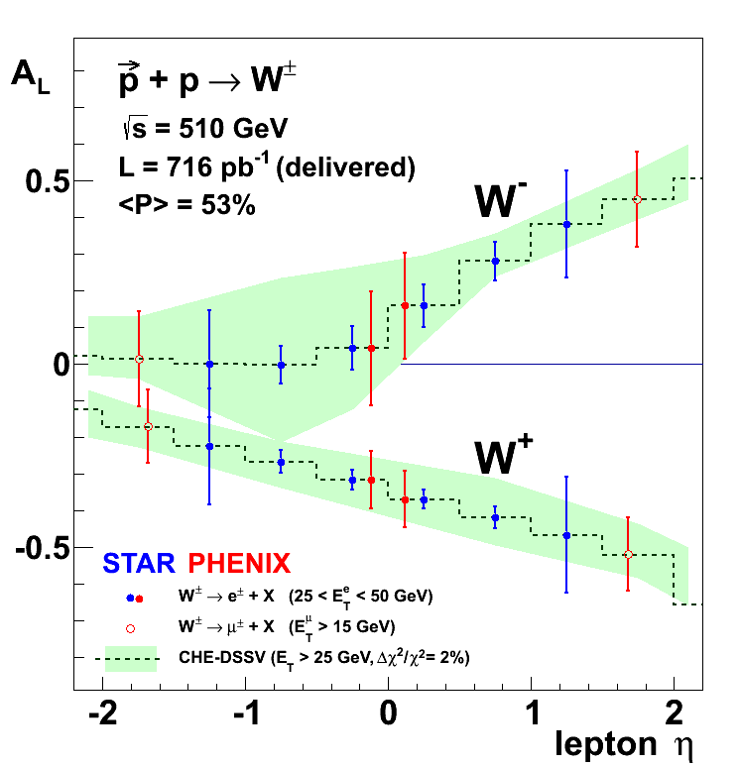
Future W-Results
pseudo-data randomized around DSSV
uncertainties correspond to 2009-2013
RHIC W±-data will be a
strong constraint for
and
arXiv:1304.0079

Slide 12
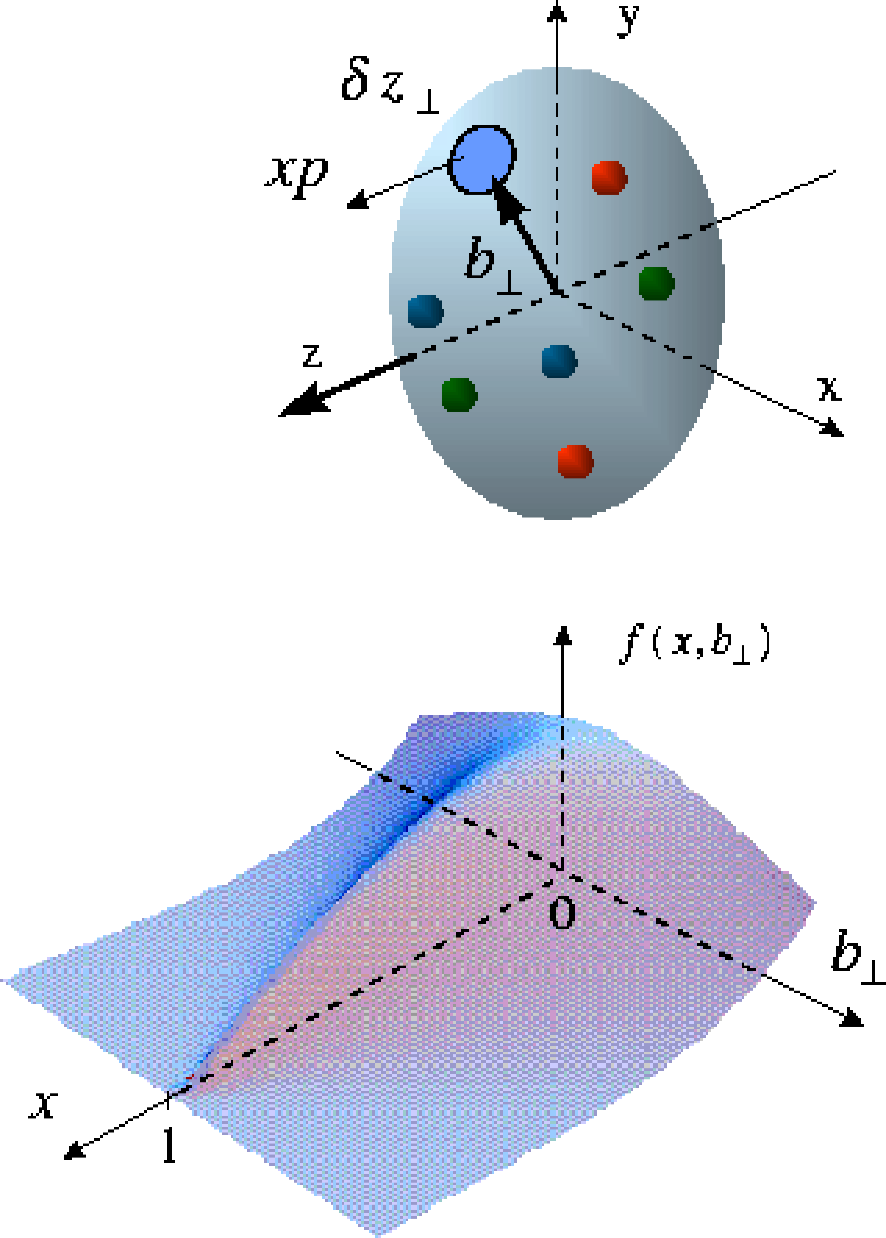
The Missing Piece: orbital angular momentum
exclusive reactions the vehicle to access L_{q} & L_{g}
golden channel: J/Ψ
new theoretical concept required
Generalized Parton Distributions
Spin-Sum-Rule in PRF:
quark contribution
GPDs: PDFs that
correlated parton momentum
and their distributions in
transverse space
responsible for orbital angular momentum

Slide 13
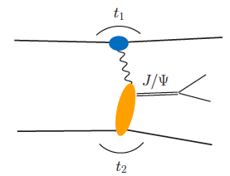
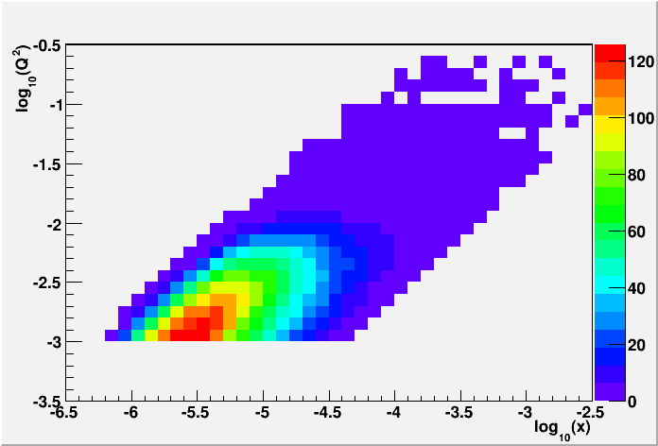
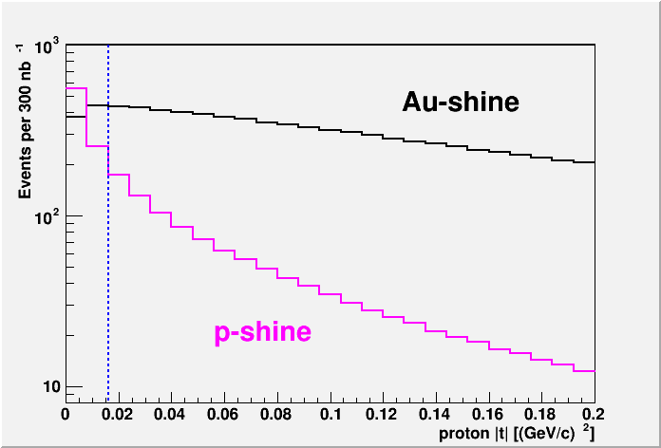
From ep tO pp to γ p → UPC
Get quasi-real photon from one proton / nucleus
Final state lepton pair not from γ* (timelike DVCs
but from J/ψ
  Done already in AuAu
  Estimates for J/ψ (hep-ph/0310223)
transverse target spin asymmetry → calculable with GPDs
information on helicity-flip distribution E for gluons
golden measurement for EIC
Z²
A²
RHIC the only place in the world to have a look
on E_{g} for gluons before EIC
Gain in statistics using polarized p↑A
UPC in p+Au:
Required:
2015 p+A 300 nb⁻¹
STAR Roman Pot-Phase II*
→ 7k J/ψ

Slide 14
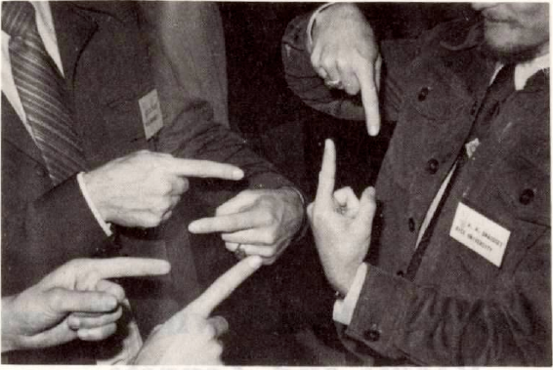

Transverse SPin Structure
using spin to unravel
the secrets / dynamics of QCD
Resolving the new spin puzzle
of the 21st century
The legacy of transverse polarised pp
What causes A_{N} at forward rapidities?

Slide 15
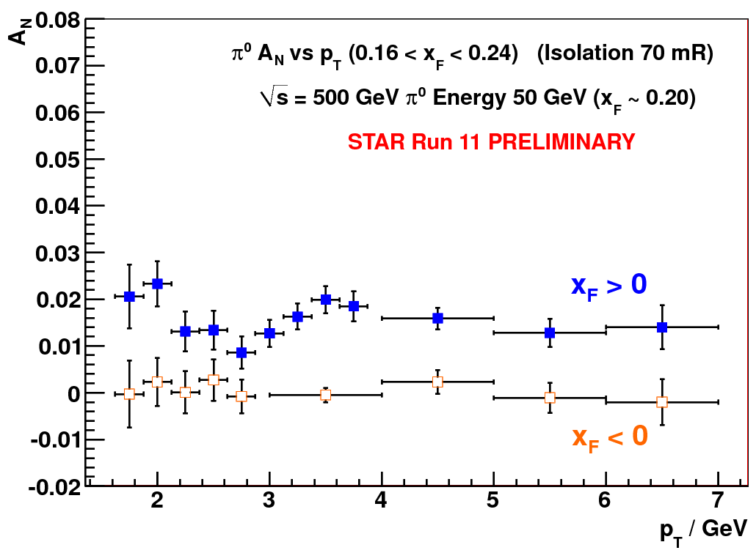
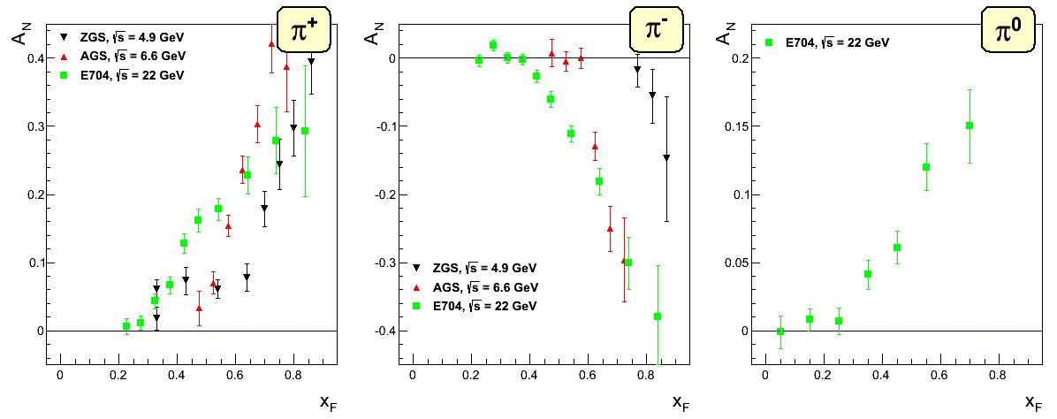
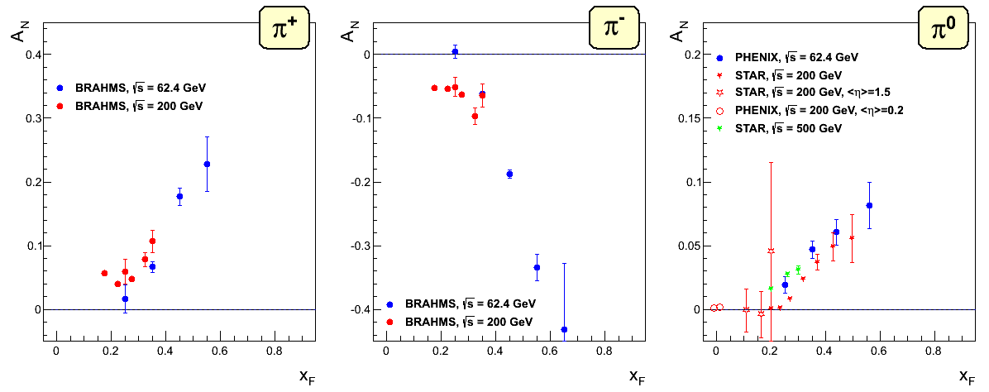
New Surprise in Spin: large A_{N} at high √s
Single-spin transverse asym.
1
N↑/L↑ − N↓/L↓
Big single spin asymmetries in pp !!
Naive pQCD (in a collinear picture)
predicts A_{N} ~ α_{s}m_{q}/sqrt(s) ~ 0
Do they survive at high √s ? YES
Is observed p_{t} dependence as expected
naively from p-QCD? NO
What is the underlying process?
A_{N} ≡
P₁
N↑/L↑ + N↓/L↓
where ↑ (↓) are defined with respect to reaction plane
Stat. Unc. ~ (P₁² ∫L dt )^{−1/2}
left
right
RHIC:

Slide 16
A_{N}: How to get to THE underlying Physics
measure less inclusive
Initial State
Final State
SIVERS/Twist-3
Collins Mechanism
A_{N} for jets, direct photons
A_{N} for heavy flavour → gluon
A_{N} for W^{+/-}, Z⁰
asymmetry in jet fragmentation
  π^{+/-}π⁰ azimuthal distribution in jets
  Interference fragmentation function
S_{P}
S_{P}
Novel FF Mechanisms
k_{T,q}
p
p
p
p
S_{q}
k_{T,π}
Sensitive to correlations
proton spin –
parton transverse motion
not universal between SIDIS & pp
Sensitive to
transversity x spin-dependent FF
universal between SIDIS & pp & e+e-

Slide 17
A_{N} for different # photons in EM-Jets
1-photon events, which include a large π⁰ contribution in this analysis, are similar to 2-photon events
Three-photon jet-like events have a clear non-zero asymmetry, but substantially smaller than that for isolated π⁰’s
A_{N} decreases as the event complexity increases (i.e.,the "jettiness”
A_{N} for #photons >5 is similar to that for #photons = 5
The STAR RP phase-II will be the key detector component to investigate
A_{N} for π⁰ is dominated by hard diffraction
p↑+p → π⁰+ p’+p’ or p↑+p → π⁰+ p’+X
new surprise in spin physics
asymmetry moderated through 2g (pomeron) or 3g exchange
theory assumption: pomeron no spin effects
Jettier events
Several other Asymmetries for jettier events are also very small
these dependences raise serious questions how much of the large forward π⁰ A_{N} comes from 2 → 2 parton scattering

Slide 18
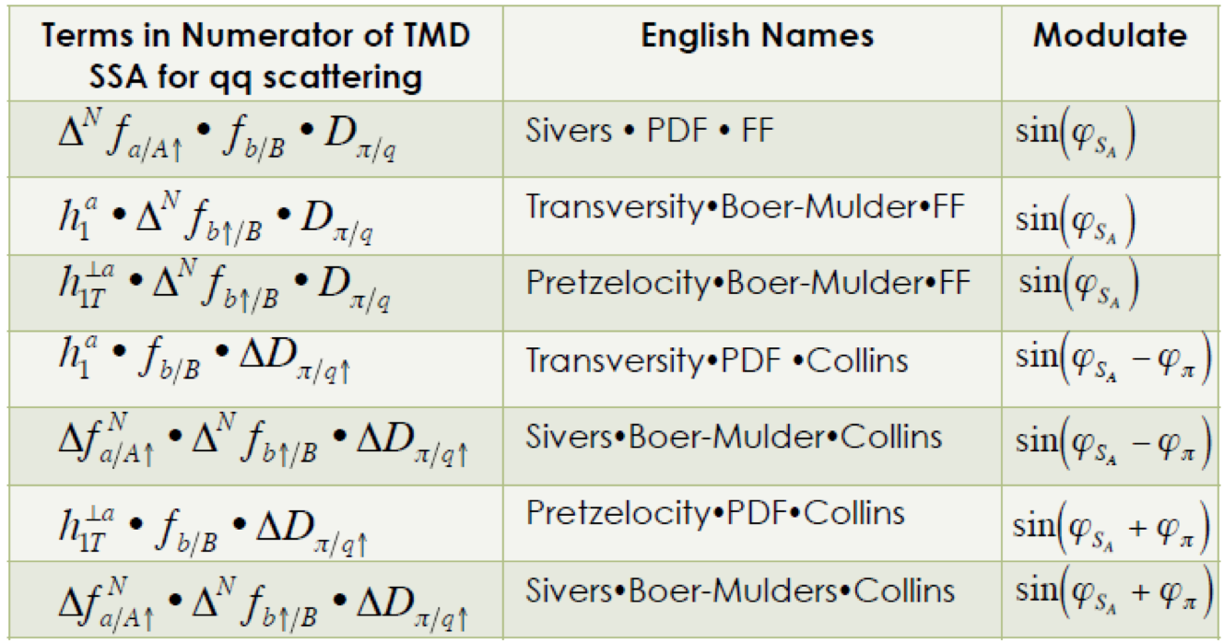
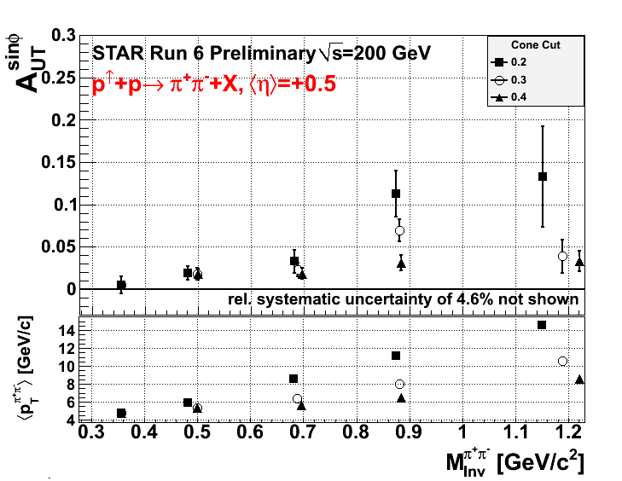

Transverse PHYSICS through jets
Utilizing STAR’s mid-rapidity jet
capabilities to study
transverse momentum dependent
distribution fct.s (TMDs)
till today all observables are
consistent with zero in uncertainties
Transversity • Boer-Mulders • FF
Pretzelocity • Boer-Mulders • FF
Sivers • Boer-Mulders • Collins
F. Yuan, PRL 100, 032003 (2008)
D’Alesio et al., PRD 83, 034021 (2011)
Sivers
One exception: transversity x IFF

Slide 19
FUTURE:
Visualize Color interactions in QCD
Test TMD evolution

Slide 20
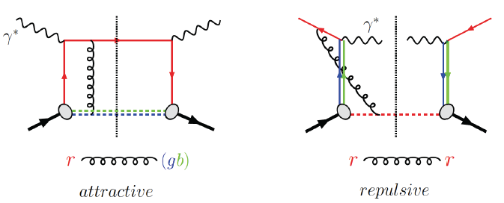
Visualize Color interactions in QCD.
Measure non-universality of sivers-function
DIS:
γq-scattering
attractive FSI
pp:
qqbar-anhilation
repulsive ISI
QCD:
Critical test of factorization in QCD
no sign change
→ need to rethink QCD factorization
Sivers_{DIS} = - (Sivers_{DY} or Sivers_{W} or Sivers_{Z0})
A_{N}(direct photon) measures the sign change in the Twist-3 formalism
All three observables can be approached
at 500 GeV at RHIC

Slide 21
A_{N}(W±,Z⁰,Dy): Present and Future
Future:
Present:
Results 2011: recorded lumi 25 pb⁻¹
Projected results with a long 500 GeV Run 2015+:
Measuring the sign change through DY
Both PHENIX and STAR have studied in detail that DY measurements are possible at forward rapidities (η>3) Experimentally challenging:
needs QCD-bckgrd suppression of 10⁶-10⁷
→ requires upgrades

Slide 22
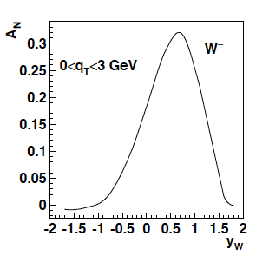
Surprise: TMD evolution
Z.-B. Kang & J.-W. Qui arXiv:0903.3629
Z. Kang: original paper arXiv:1401.5078
much stronger then
any other know
evolution effects
needs input from
data to constrain
non-pertubative
part in evolution
current data extremely limited
cannot come from fixed
target SIDIS
→ lever arm Q² & p_{t}
before evolution
after evolution
Ο(10)
Can RHIC SPIN provide the solution ?
access TMDs (Sivers) through collinear observables → DGLAP evolution
A_{N}(γ) for η > 2 at √s = 200 GeV and 500 GeV → capabilities exit 2015++
access TMDs (Sivers) through
A_{N}(DY) and A_{N}(W±,Z⁰) Q²: ~ 16 GeV² vs. 6400 GeV²
<p_{t>}: 1-2 GeV vs. 3-4 GeV
Comparison of extracted TMD (Sivers) will provide
strong constraint on TMD evolution

Slide 23
FUTURE: 2020+

Slide 24
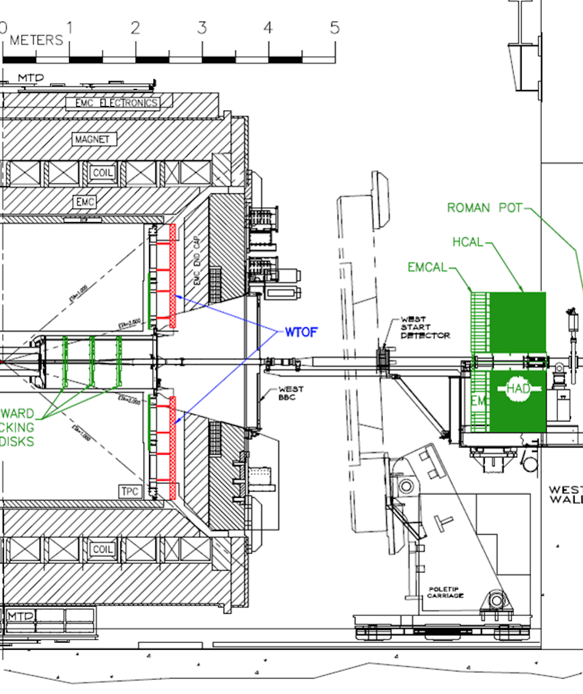
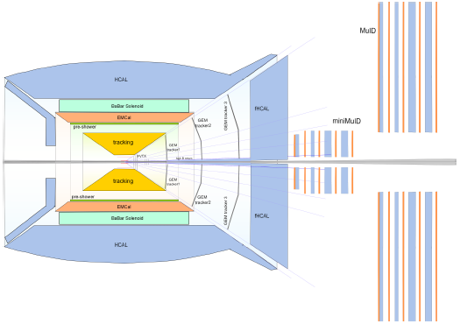
PHENIX and STAr Forward upgrades
STAR
fsPHENIX
Physics to be addressed with the upgrades
Helicity structure:
further constrain ∫g(x,Q²) and its functional form down to x~0.001 through di-jets
Transverse Momentum Distributions:
precision measurements of TMDs through jets
precision A_{N}(DY) → Sivers fct.
several physics topics utilizing p+A collisions not discussed here
forward upgrade integrated in the
sPHENIX detector
ECal:
Tungsten-Powder-Scintillating-fiber
HCal:
Lead and Scintillator tiles
Tracking:
Silicon mini-strip detector or GEM-Tracker

Slide 25






Summary
RHIC SPIN Program:
spin to study how a complex many-body
system such as the proton arises
from the vacuum structure of QCD
uniquely tied to a polarized pp-collider
never been measured before & never without
ΔG
Σ_{q}L_{q}
L_{g}
Σ_{q}Δq
Σ_{q}L_{q}
δq
δq
Σ_{q}Δq
ΔG
Achievements at the next LRP:
the best constraint on Δg(x,Q²) before EIC
strong constraints on the light sea quark polarizations
a first look to orbital angular momentum of gluons
mystery on what is the underlying process of forward A_{N} will be solved
tests of TMD evolution and color interactions in QCD
L_{g}

Slide 26
ADDITIONAL Material

Slide 27
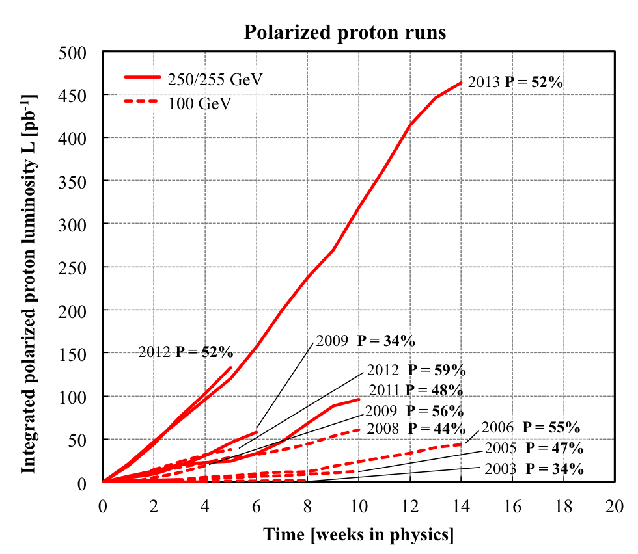
RHIC polarised p+p performance
2013:
golden year for polarized
proton operation
2012: 100 GeV:
new records for L_{peak}, L_{avg}, P
2012 & 2013: 255 GeV:
new records for L_{peak}, L_{avg}, P
highest E for pol. p beam
2015++ P: 60%
with upgrades
What will come:
increased Luminosity and
polarization through
OPPIS new polarized source
Electron lenses to
compensate beam-beam
effects
many smaller incremental
improvements
will make luminosity hungry processes,
i.e. DY, easier accessible

Slide 28
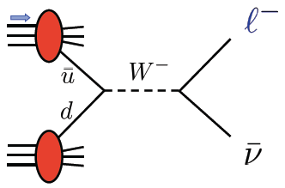



THE Beauty of Colliders: Kinematic Coverage
novel electroweak
probe
0.05<x<0.4
Evolution
RHIC pp data
constraining Δg(x)
0.01 < x < 1
data plotted at x_{T}=2p_{T}/√s

Slide 29
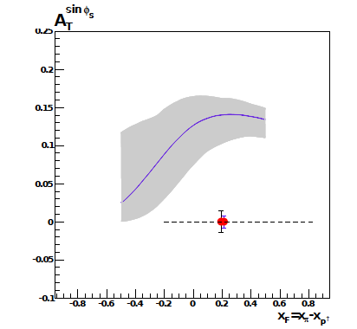
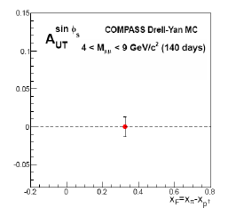
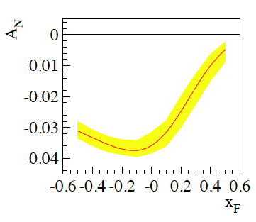
DY at COMPASS
pion beam on a polarized proton target
approved, reviewed program
planned for starting 2015
before evolution
theory expectation
after evolution

Slide 30
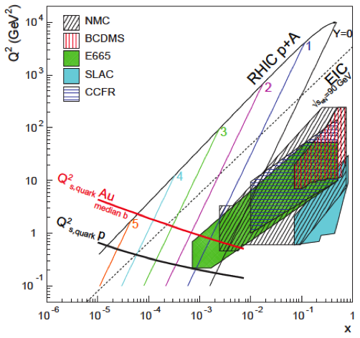
Do Gluons Saturate
Gluon density dominates at x<0.1
Rapid rise in gluons described naturally by linear pQCD evolution equations
This rise cannot increase forever - limits on the cross-section
  → non-linear pQCD evolution equations provide a natural way to tame this growth and lead to a saturation of gluons, characterised by the saturation scale Q²_{s}(x)
Notes:
Counter-intuitively the best way is through an EM process: DIS
y = inelasticity = fraction of the incoming electron energy carried by photon in the rest frame of the nucleon
The structure function F2 is sensitive to the sum of quark and anti-quark momentum distribution in the nucleon.
The apparent scaling of the data with Q2 at large x in early DIS data from SLAC was termed “Bjorken scaling” and motivated the parton model.
In the parton model, FL = 0, while in QCD, it is directly proportional to the gluon structure function, FL(x,Q2) ~ aS xG(x,Q2), at low x.
DGLAP: fixed x -> evolution along Q2
sigma (gamma N) = sig_T + sig_L
sig_L ~ FL
sig_tot ~ F2/Q^2
\frac{d^2 \sigma^{ep \rightarrow eX}}{dx dQ^2} = \frac{4 \pi \alpha^2_{e.m.}}{xQ^4} \left[ \left(1-y+\frac{y^2}{2} \right ) F_2(x,Q^2) - \frac{y^2}{2} F_L(x,Q^2) \right]

Slide 31
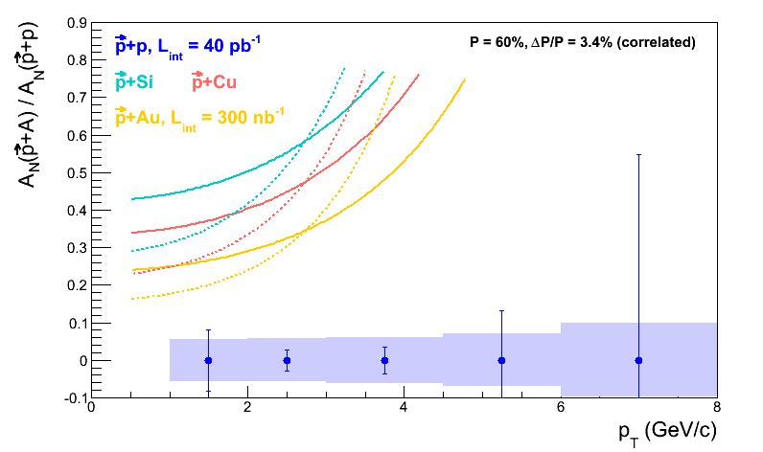
A_{N} in p↑A or Shooting Spin Through CGC
Y. Kovchegov & M.D. Sievert arXiv:1201.5890.
strong suppression of odderon STSA in nuclei.
Q_{s}=1GeV
Very unique RHIC possibility p↑A
Synergy between CGC based
theory and transverse spin physics
A_{N}(direct photon) = 0
The asymmetry is larger for
peripheral collisions
r=1fm
r=1.4fm
r=2fm
π⁰
STAR: projection for upcoming pA run
Curves: Feng & Kang arXiv:1106.1375
solid: Q_{s}^{p} = 1 GeV
dashed: Q_{s}^{p} = 0.5 GeV

Slide 32
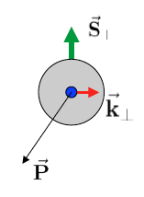
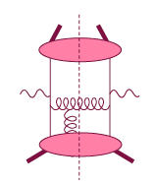
Theory: TMDs vs. Twist-3
Intermediate Q_{T}
Q>>Q_{T}/p_{T}>>Λ_{QCD}
Transverse
momentum
dependent
Q>>Q_{T}>=Λ_{QCD}
Q>>p_{T}
Collinear/
twist-3
Q,Q_{T}>>Λ_{QCD}
p_{T}~Q
Efremov, Teryaev;
Qiu, Sterman
Sivers fct.
Q_{T}/P_{T}
Λ_{QCD}
<<
Q_{T}/P_{T}
<<
Q
Need 2 scales
Q² and p_{t}
Remember pp:
most observables one scale
Exception:
DY, W/Z-production
Need only 1 scale
Q² or p_{t}
But
should be of reasonable size
should be applicable to
most pp observables
A_{N}(π⁰/γ/jet)

Slide 33
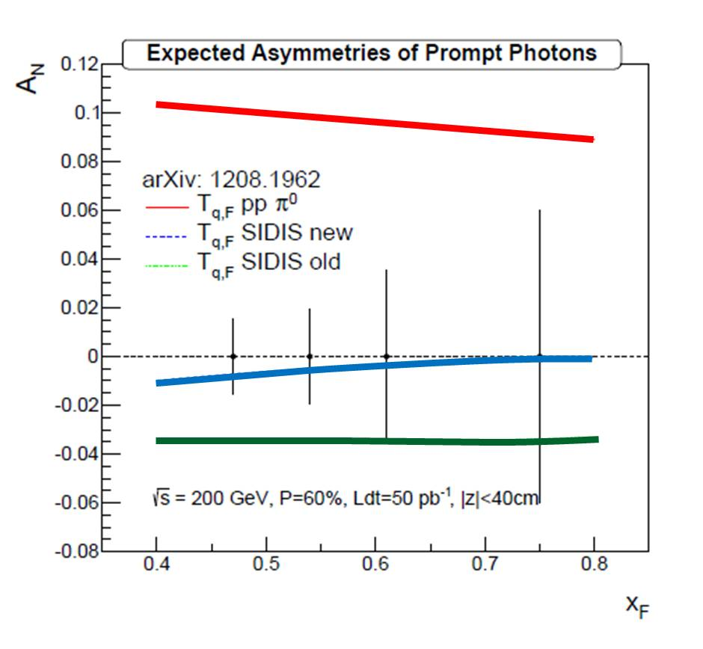

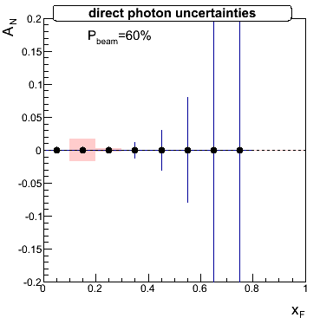
Direct Photons at forward rapidities
Test evolution: 200 GeV vs 500 GeV
How much does Sivers contribute to A_{N}
500 GeV
Gamberg and Kang
200 GeV
factor 2.5 decrease in asymmetry from evolution
500 GeV

Slide 34



A_{N} : different channels and rapidity
Eta:
PRD86 (2012) 051101
arXiv:1309.1800
A_{N} π⁰ and eta behave similar
STAR & PHENIX results are
consistent
A_{N} π⁰~0 for 0.8<η<2

Slide 35




Hints for Gluon Sivers /Twist-3
Mid Rapidity A_{N}(π⁰) dominated by gg and qg
PHENIX 200 GeV
no hint of a
non-zero
A_{N}(π⁰), A_{N}(J/Ψ)
and
A_{N}(μ)
gluon Sivers ~ 0
Twist-3 gg correlator ~0 ?
Forward Rapidity A_{N}(μ) dominated by
gg through D-production:
arXiv:1312.1995
Forward Rapidity A_{N}(J/Ψ) only gg:

Slide 36




Transversity X IFF
Transversity x Interference FF:
Non-zero signal for higher rapidity (STAR)
→ the only non zero transverse single spin
asymmetry at mid rapidity

Slide 37

Transverse PHYSICS through jets
STAR: Jets reconstructed
with Anti-k_{t} algorithm
pbeam
S⊥
ΦS
Data jets MC jets
Detector
GEANT
Asymmetry moments sensitive to various contributions
(analogous moments sensitive to gluon scattering)
A_{UT} – Transverse single-spin asymmetry (also written A_{N})
pπ
jT
π⁺
e⁺
π⁰
Φh
π⁻
–pbeam
Particle
e⁻
Κ⁰
PJET
PYTHIA
F. Yuan, PRL 100, 032003 (2008)
D’Alesio et al., PRD 83, 034021 (2011)
Parton
Transversity • Boer-Mulders • FF
Pretzelocity • Boer-Mulders • FF
Use PYTHIA + GEANT to quantify detector response
Trigger Bias (bias for specific processes)
Reconstruction smearing/bias (unfolding)
Reconstruction of partonic variables, parton matching
Underlying event/pileup effects
Sivers • Boer-Mulders • Collins

Slide 38
Collins AsymmetrY
Increased gluonic subprocesses at √s = 500 GeV lead to expectation of small Collins asymmetry until larger z
D’Alesio et al.
Present data do not have sufficient statistics at high-z
to observe Collins asymmetry of order 1%
→ 2016 Run
Notes:
[Anselm]
mention (maybe verbally) connection between jT and k\perp
----- Meeting Notes (9/26/13 11:10) -----
highlight z-ranges

Slide 39
Collins like AsymmetrY
Maximized contribution
for √s = 500 GeV
D’Alesio et al.
Model predictions shown for “maximized” effect,
saturated to positivity bound
Until now, Collins-like asymmetries completely unconstrained
→ Sensitive to linearly polarized gluons

Slide 40

Sivers Through Jets
Asymmetries shown as function of particle-jet p_{T}
Corresponding parton-jet p_{T} lower by 0.6-1.4 GeV
Horizontal errors include uncertainties from statistics, calorimeter gains, efficiencies, track momentum, and tracking efficiency
No sign of sizable azimuthal asymmetry in jet production at √s = 500 GeV
Consistent with expectation from inclusive jets, di-jets, and neutral pions at √s = 200 GeV
p_{T} [GeV/c]
Notes:
----- Meeting Notes (9/26/13 11:10) -----
specify p_T range on left-hand plot
specify eta range

Slide 41


A_{N}DY: DY feasibility test @ IP-2
Final configuration 2013
Idea: have DY feasibility test
at IP-2
  staged measurements over
  3 years
  re-use as much detector
  equipment as possible to
  finish till summer 2014
Measurement:
  why IP-2
    transverse polarization
    measure parallel to
    √s = 500 GeV W-program
  η > 3, M>4 GeV
  0.1<x_{f}<0.3
  optimizes
  Signal / Background & DY rate
  measure dA_{N}^{DY} ~0.015 for
  Σ L~100 pb⁻¹
  L. Bland and A. Ogawa
Left/right symmetric HCal
Trigger/DAQ electronics
A_{N}DY Timeline:
2010 – Letter of Intent reviewed by program advisory committee and endorsed
2011 – model apparatus operated in RHIC run 11; full proposal endorsed by PAC
data taking and the designing A_{N}DY in 2011 gave many lessons learned,
which are critical for the PHENIX & STAR forward upgrades
Immediate Spin-off:
Final Preshower design will be used in front of STAR FMS for photon-lepton-
hadron separation
2012 – BNL initiated DOE requested readiness review
→ A_{N}DY terminated due to funding, manpower and scheduling issues
Left/right symmetric
ECal
Blue-facing BBC
Left/right symmetric preshower
RUN-11
Beryllium vacuum pipe

Slide 42



A_{N}DY: Hcal and Ecal at η>3
2013 Final configuration
2011 Configuration
Theory: arXiv:1103.1591 A_{N}(jet)
√s=200 GeV
from p↑+p→π
Remember:
“new” Sivers function SIDIS fit
“old” Sivers function SIDIS fit
arXiv: 1304.1454
Determine A_{N}(jet) at same rapidity of big A_{N}(π⁰) η>3
RUN-11: A_{N}DY collected ~ 6.5/pb

Slide 43

A_{N} vs. EM-Jet Energy
π⁰-Jets –
2γ-EM-Jets with
m_{γγ} <0.3 and Z_{γγ} <0.8
2γ-EM-Jets (η +continuum) – with m_{γγ} > 0.3
EM-Jets –
with no. photons >2
Isolated π⁰’s have large asymmetries consistent with previous observation (CIPANP-2012 Steven Heppelmann)
https://indico.triumf.ca/contributionDisplay.pycontribId=349&sessionId=44&confId=1383
Asymmetries for jettier events are much smaller

Slide 44
A_{N} correlated with midrapidity activities
Near and away side
BEMC
EEMC
FMS
2.6<η<4.2
1 < η < 2.
-1 < η < 1
forward EMJets
central EMJets
Uncorrelated
central EM-Jet
Correlated
central EM-Jet
Midrapidity EM Jets
Jet algorithm : anti-k_{T}, R = 0.7
p_{T}^{EM-Jet} > 2.0 GeV/c, -1.0<η^{EM-Jet}<2.0
Inputs for central EMJets : towers from BEMC and EEMC
Leading central EM-Jets : Jet with highest p_{T}
Case-I : having no central jet
Case-II : having a central jet

Slide 45
A_{N} for with and without a central EM-Jet
0.06
An EM-jet in the central rapidity region reduces the asymmetries for the forward isolated π⁰

Slide 46
A_{N} for Forward jet with near and away in Φ central jet
Uncorrelated central EM-Jet is separated out

Slide 47

STAR: A_{N}^{W}
Analysis Strategy to fully reconstruct Ws:
Follow the analysis steps of the A_{L}
→ W candidate selection via high p_{t} lepton
Data set 2011 transverse 500 GeV data set (25 pb⁻¹)
In transverse plane:
Recoil reconstructed using tracks and towers:
Part of the recoil not within STAR acceptance
→ correction through MC (Pythia)
W Rapidity reconstruction:
W longitudinal momentum (along z) can be calculated from the invariant mass:
Neutrino longitudinal momentum component from quadratic equation
GOOD data/MC agreement after P_{T} correction

Slide 48



Upgrades at PHENIX and STAR
PHENIX MPC-EX:
Gamberg and Kang
8 layer Silicon minipad Tungsten sandwich pre-shower
in front of lead-tungstate MPC electromagnetic
calorimeter (3.1<|η|<3.8)
  Reconstruct and reject π⁰ mesons
  ⇒ enhances π⁰/γ separation (up to >80GeV)
STAR FMS-PreShower:
3 layer preshower in front of the FMS,
distinguish photons, electrons/positrons
and charged hadrons.

Slide 49
Transverse PHYSICS: What else do we know
Collins / Transversity:
  conserve universality in hadron hadron interactions
  FF_{unf} = - FF_{fav} and δu ~ -2δd
  evolve ala DGLAP, but soft because no gluon contribution (i.e. non-singlet)
Sivers, Boer Mulders, ….
  do not conserve universality in hadron hadron interactions
  k_{t} evolution → can be strong
    till now most predictions did not account for evolution
  FF should behave as DSS, but with k_{t} dependence unknown till today
  u and d Sivers fct. opposite sign d >~ u
  Sivers and twist-3 are correlated
    global fits find sign mismatch, possible explanations,
    like node in k_{t} or x don’t work

Slide 50




Correlation p_{T} – x and √s
contributing sub-processes:
changing vs p_{T} and rapidity
low p_{T} → low x
  scale uncertainty
high √s → low x
forward rapidity → low x
2-2.5 GeV/c
4-5 GeV/c
9-12 GeV/c
2-2.5 GeV/c
4-5 GeV/c
9-12 GeV/c
η=3.3, √s=200 GeV

Slide 51





π⁰-Cross Sections
√s=62 GeV (PRD79, 012003)
√s=200 GeV (PRD76, 051106)
√s=500 GeV (Preliminary)
PRL 97, 152302
arXiv: 1309.1800
Data compared to NLO pQCD calculations:
√s=62 GeV calculations may need inclusion of NLL (effects of threshold logarithms)
√s=200 and 500 GeV: NLO agrees with data within ~30%
good agreement also for η>1
Input to qcd fits of gluon fragmentation functions → DSS

Slide 52




Jet-Cross Sections
√s=200 GeV inclusive jets
√s=200 GeV Di-jets
√s=500 GeV Di-jets
Data compared to NLO pQCD calculations:
Inclusive jet and di-jet cross section results in
p+p collisions are consistent with NLO pQCD calculations
after Had+UE corrections

Slide 53




Forward Proton Tagging Upgrade
at 55-58m
at 15-17m
This will be the key detector component to investigate
A_{N} for π⁰ is dominated by hard diffraction
p↑+p → π⁰+ p’+p’ or p↑+p → π⁰+ p’+X
Follow PAC recommendation to develop a solution to run pp2pp@STAR with
std. physics data taking → No special β* running any more
should cover wide range in t → RPs at 15m & 17m
Staged implementation
  Phase I (currently installed): low-t coverage
  Phase II (proposed) : for larger-t coverage
  1st step reuse Phase I RP at new location only in y
  full phase-II: new bigger acceptance RPs & add RP in x-direction
    full coverage in φ not possible due to machine constraints
Good acceptance also for spectator protons from
deuterium and He-3 collisions
Phase-II: 1st step
1st step
full Phase-II

Slide 54




“Spectator” proton from deuteron with the current RHIC optics
Study: JH Lee
generated
Passed DX aperture
Accepted in RP
Rigidity (d:p =2:1)
The same RP configuration with the current RHIC optics (at z ~ 15m between DX and D0)
needs full PHASE-II RP

Slide 55



Spectator proton from ³He with the current RHIC optics
Momentum smearing mainly due
to Fermi motion + Lorentz boost
Angle [rad]
Study: JH Lee
generated
Passed DX aperture
Accepted in RP
The same RP configuration with the current RHIC optics (at z ~ 15m between DX-D0)
Acceptance ~ 92% with full PHASE-II RP

Slide 56
Predictive power of pQCD
q(x₁)
Hard Scattering Process
X
g(x₂)
“Hard” (high-energy) probes have predictable rates given:
    Partonic hard scattering rates (calculable in pQCD)
    Parton distribution functions (need experimental input)
    Fragmentation functions (need experimental input)
Universal non-perturbative functions
DIS, pp
pQCD
e+e-

