Slide 1
eRHIC:
New Scientific and Technology Frontiers
TO DO Parton femtoscopy
Thanks to
BNL EIC-Taskforce
and eRHIC –CAD-TEAM
arXiv: 1212.1701 & 1108.1713

Slide 2
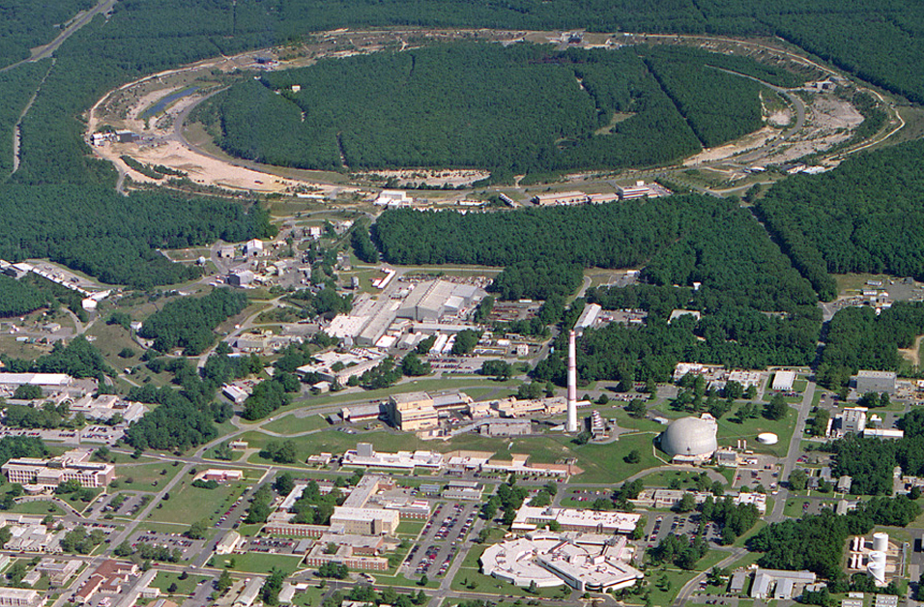
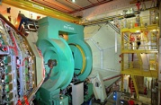
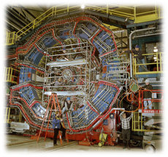
RHIC @ Brookhaven National Lab
1st Collisions: 13/06/2000
Jet/C-Polarimeters
12:00 o’clock
RHIC
CeC-TF
2:00 o’clock
PHENIX
8:00 o’clock
RF
4:00 o’clock
STAR
6:00 o’clock
What do we collide ?
LINAC
NSRL
EBIS
Booster
ERL Test Facility
Polarized protons
24-250 GeV
p
AGS
Light ions (d,Si,Cu)
Heavy ions (Au,U)
5-100 GeV/u
Tandems
soon
Polarized light ions He³ 16 – 166 GeV/u

Slide 3
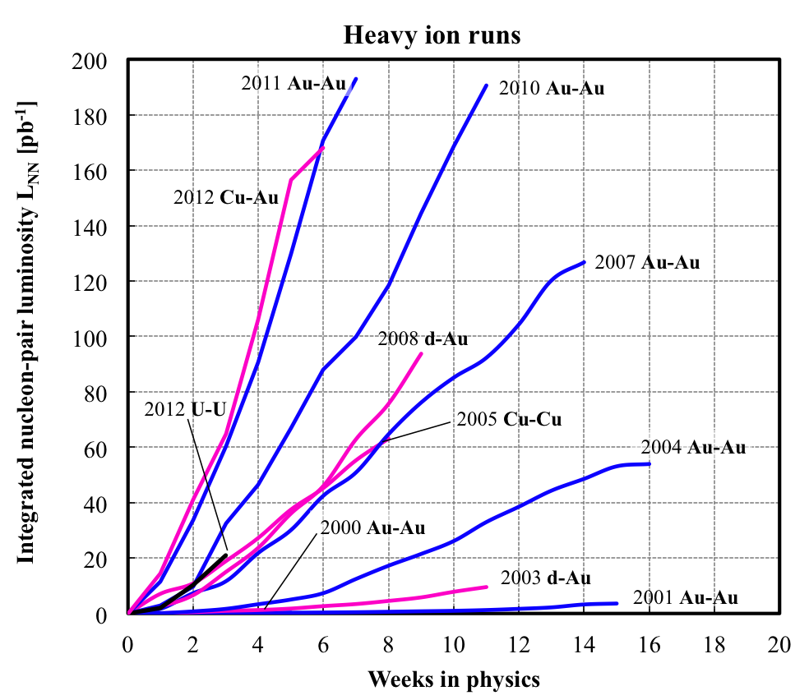
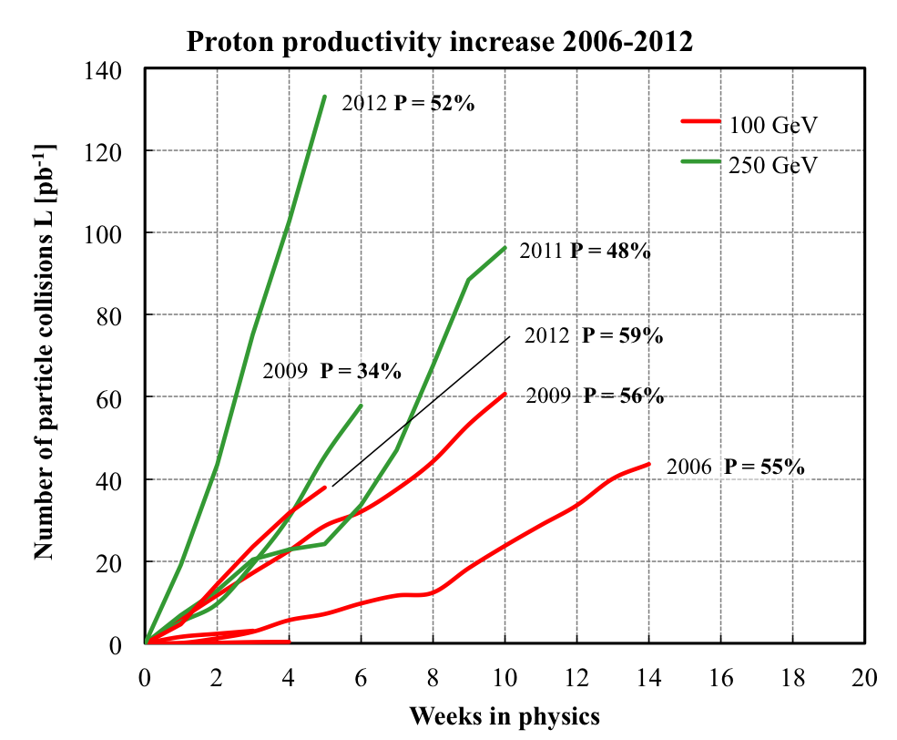
A few years in the life of RHIC
L_{avg}: +15%
P_{avg}: +8%
Operated modes (beam energies):
Au–Au 3.8/4.6/5.8/10/14/32/65/100 GeV/n
d–Au* 100 GeV/n
Cu–Cu 11/31/100 GeV/n
U – U 100 GeV/n
Cu – Au* 100 GeV/n (*asymmetric rigidity)
p↑–p↑ 11/31/100, 250 GeV
Planned or possible future modes:
Au – Au 2.5 GeV/n (~ SPS cm energy)
p↑ – Au* 100 GeV/n
Achieved peak luminosities (100 GeV, nucl.-pair):
Au–Au 195x10³⁰ cm⁻² s ⁻¹
p↑–p↑ 60x10³⁰ cm⁻² s ⁻¹
Other large hadron colliders (scaled to 100 GeV):
Tevatron (p – pbar) 43x10³⁰ cm⁻² s ⁻¹
LHC (p – p) 37x10³⁰ cm⁻² s ⁻¹

Slide 4

What is eRHIC
RHIC
Existing = $2B
Electron accelerator
to be build
p
Polarized protons
50-250 GeV
Unpolarized and
polarized leptons
5-20 (30) GeV
e⁻
Light ions (d,Si,Cu)
Heavy ions (Au,U)
50-100 GeV/u
e⁻
e⁺
70% e⁻ beam polarization goal
polarized positrons?
Polarized light ions He³ 166 GeV/u
Center mass energy range: √s=30-200 GeV; L~100-1000xHera
longitudinal and transverse polarization for p/He³ possible
protons
electrons

Slide 5
From RHIC to eRHIC
eLenses
10:00 o’clock
Jet/C-Polarimeters
12:00 o’clock
eRHIC-Detector
& Polarimeters
12:00 o’clock
CeC
2:00 o’clock
RHIC
eRHIC
e
PHENIX
8:00 o’clock
RF
4:00 o’clock
e
STAR
6:00 o’clock
LINAC
NSRL
EBIS
Booster
ERL Test Facility
AGS
Tandems

Slide 6

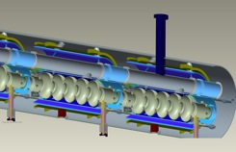
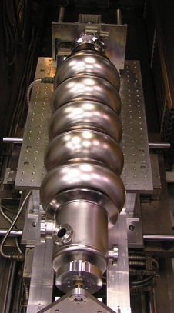

Electron beam evolution in eRHIC’s ERL
0.60 GeV
All energies scale proportionally by adding SRF cavities to the injector
0.6 GeV
Polarized
e-gun
0.6 GeV
Beam
dump
27.55 GeV
E/Eo
0.0200
0.1017
0.1833
0.2650
0.3467
0.4283
0.5100
0.5917
0.6733
0.7550
0.8367
0.9183
1.0000
New
detector
Linac 2.45 GeV
Coherent e-cooler
0.1017 GeV E₀
Linac 2.45 GeV
0.1833 GeV Eo
0.2650 GeV E₀
0.3467 GeV E₀
0.4283 GeV E₀
0.5100 GeV E₀
0.5917 GeV E₀
0.6733 GeV E₀
0.7550 GeV E₀
0.8367 GeV E₀
0.9183 GeV E₀
30 GeV
1.0000 GeV E₀
ePHENIX
All magnets would be installed from the day one and we would be cranking power supplies up as energy is increasing
100 m
ERL:
energy recovery linac
eSTAR
30 GeV
Animation is by N. Tsoupas

Slide 7
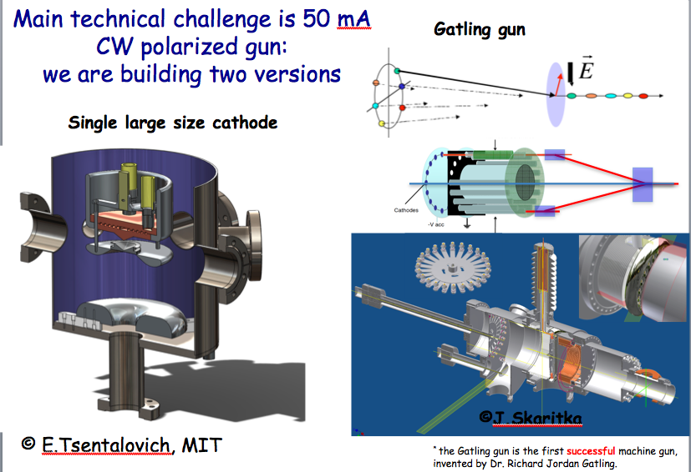
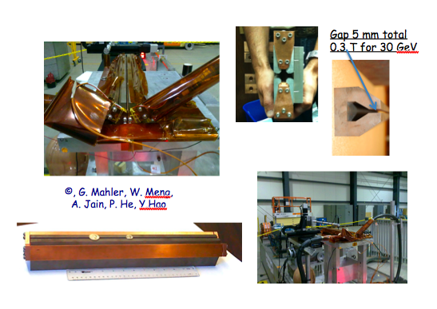
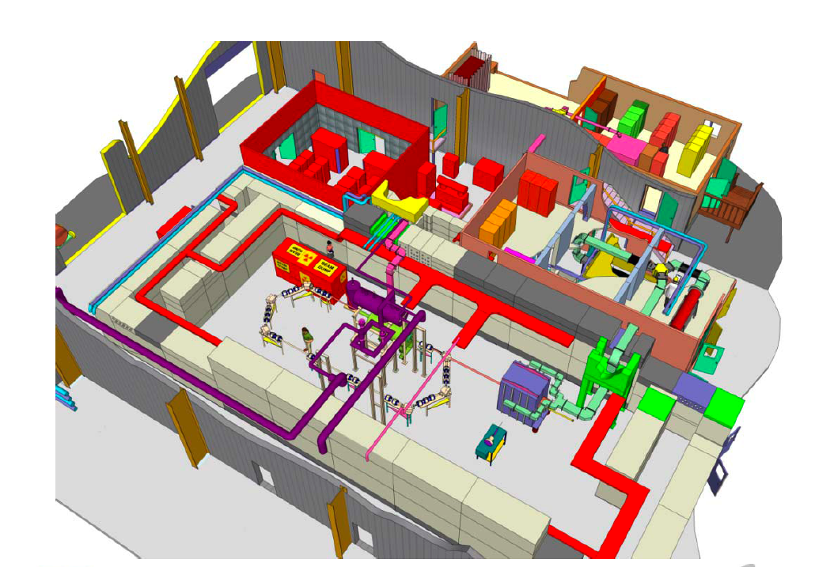
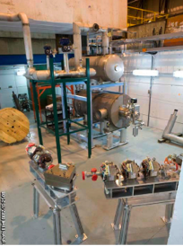
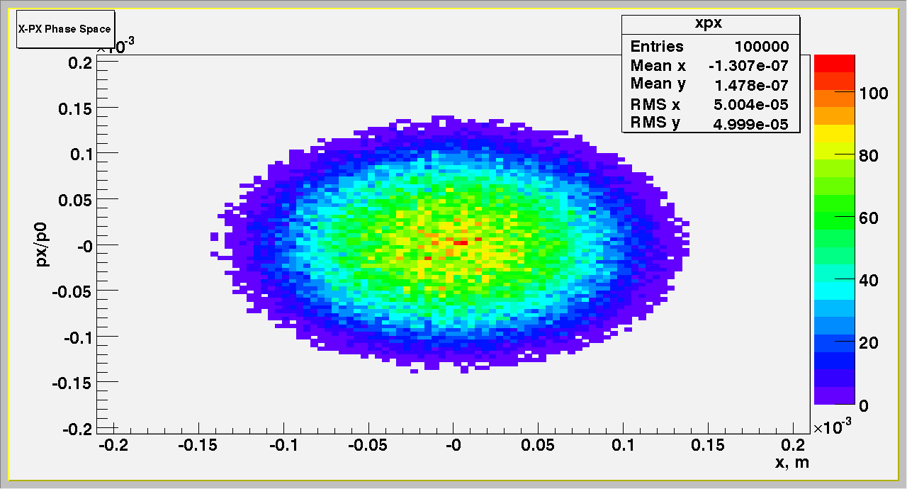
eRHIC R&D highlights
Polarized gun for e-p program – LDRD at BNL + MIT
→ prototype under construction
Development of compact magnets - LDRD at BNL → first prototyes
SRF R&D ERL – TF ongoing
Beam-beam effects, beam disruption, kink instability suppression, etc.
Polarized He³ source - Workshop: https://indico.bnl.gov/conferenceDisplay.py?confId=405
Coherent Electron Cooling: TF for PoP by ~2016
Challenge | Increase/reduction beyond the state of the art
Polarized electron gun | 10 x increase
Coherent Electron Cooling | New concept
Multi-pass SRF ERL | 5 x increase in current 30 x increase in energy
Crab crossing | New for hadron colliders
Understanding beam-beam effects | New type of collider
β*=5 cm | 5x reduction
Multi-pass SRF ERL | 2-3 x in # of passes
Feedback for kink instability suppression | Novel concept
Space charge effect compensation | Novel concept

Slide 8
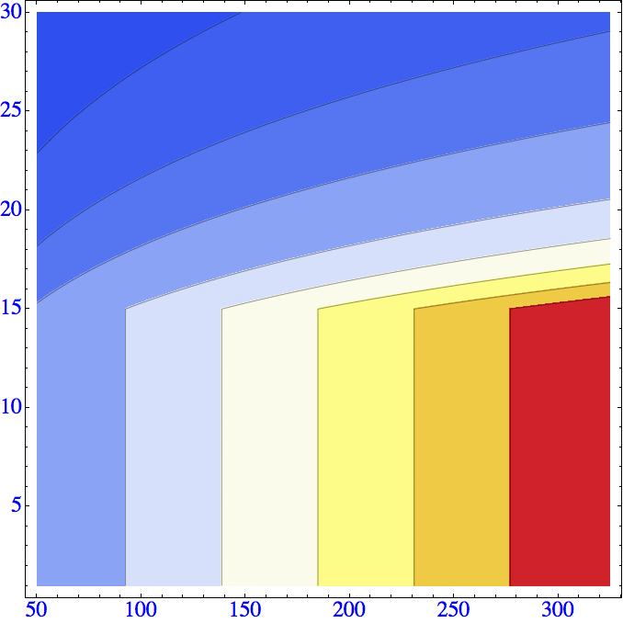

eRHIC: design luminosity
 | e | p | ²He³ | ⁷⁹Au¹⁹⁷ | ⁹²U²³⁸
Energy, GeV | 20 | 250 | 167 | 100 | 100
CM energy, GeV |  | 100 | 82 | 63 | 63
Number of bunches/distance between bunches | 107 nsec | 111 | 111 | 111 | 111
Bunch intensity (nucleons) ,10¹¹ | 0.36 | 4 | 6 | 6 | 6
Bunch charge, nC | 5.8 | 64 | 60 | 39 | 40
Beam current, mA | 50 | 556 | 556 | 335 | 338
Normalized emittance of hadrons , 95% , mm mrad |  | 1.2 | 1.2 | 1.2 | 1.2
Normalized emittance of electrons, rms, mm mrad |  | 16 | 24 | 40 | 40
Polarization, % | 80 | 70 | 70 | none | none
rms bunch length, cm | 0.2 | 5 | 5 | 5 | 5
β*, cm | 5 | 5 | 5 | 5 | 5
Luminosity per nucleon, x 10³⁴ cm⁻²s⁻¹ |  | 2.7 | 2.7 | 1.6 | 1.7
E_{e}, GeV
L., cm⁻² sec⁻¹
>3.10³⁴
0.1.10³⁴
3.10³⁴
0.25.10³⁴
2.5.10³⁴
0.5.10³⁴
2.10³⁴
1.5.10³⁴
1.10³⁴
1.10³⁴
1.5.10³⁴
2.10³⁴
2.5.10³⁴
3.10³⁴
0.5.10³⁴
0.25.10³⁴
0.1.10³⁴
Hourglass the pinch effects are included. Space charge effects are compensated.
Energy of electrons can be selected at any desirable value at or below 30 GeV
The luminosity does not depend on the electron beam energy below or at 20 GeV
The luminosity falls as E_{e}⁻⁴ at energies above 20 GeV
The luminosity is proportional to the hadron beam energy: L ~ E_{h}/E_{top}
E_{p}, GeV

Slide 9
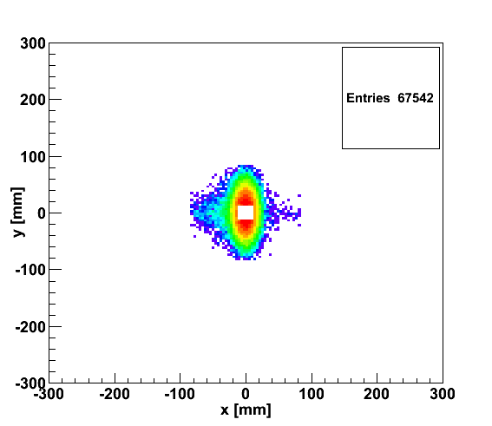
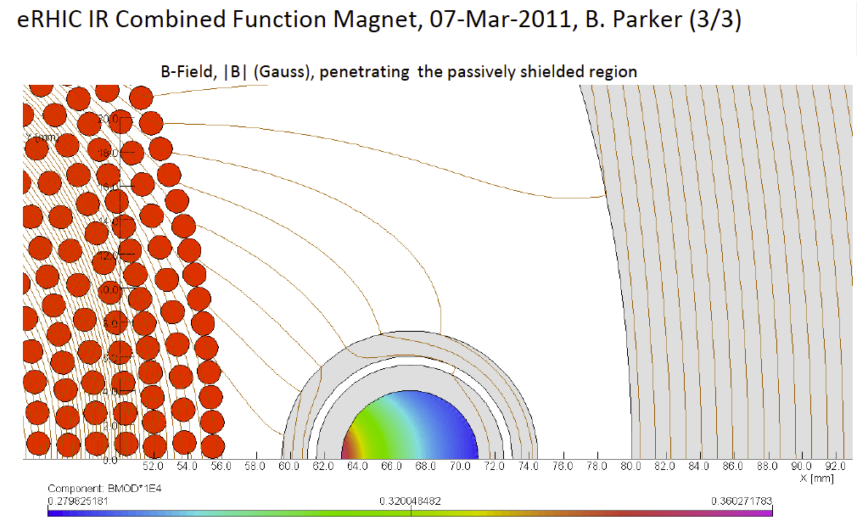
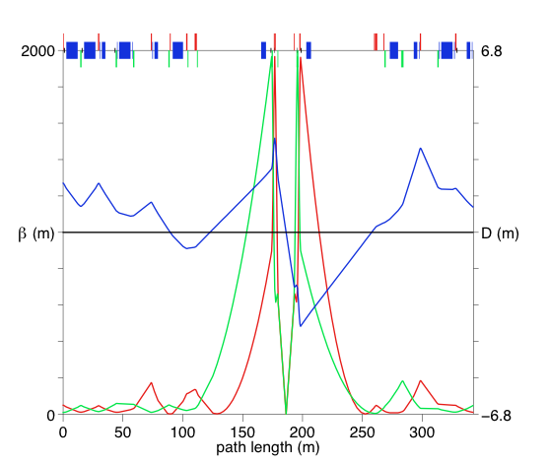
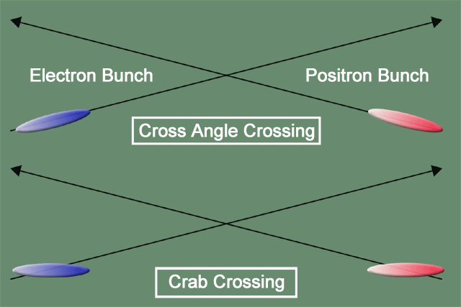
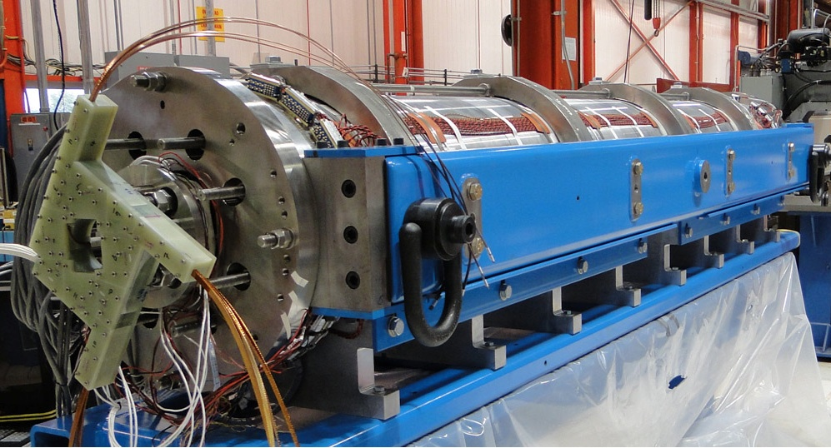
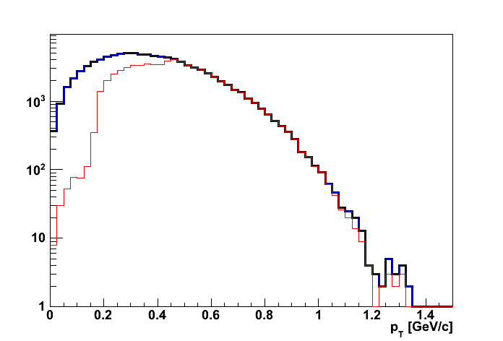
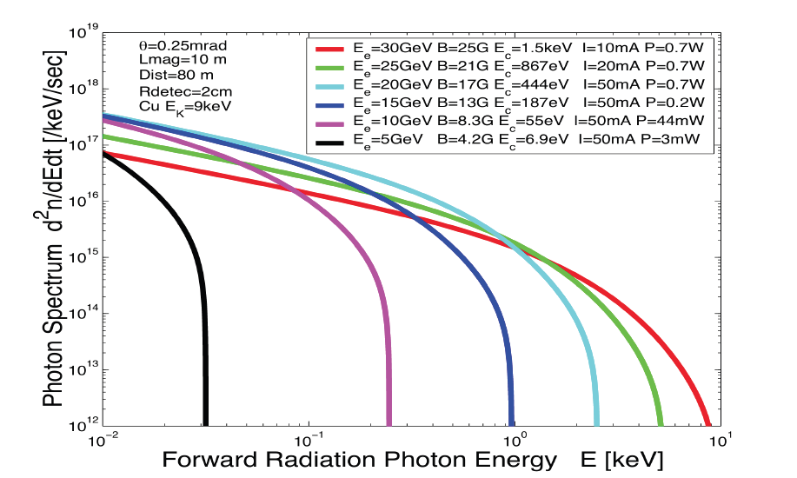
eRHIC: high-luminosity IR
20x250
p
Proton beam lattice
G.Ambrosio et al., IPAC’10
e
Nb₃Sn
20x250
200 T/m
eRHIC - Geometry high-lumi IR with β*=5 cm, l*=4.5 m
and 10 mrad crossing angle → 10³⁴ cm⁻² s⁻¹
Generated
Quad aperture limited
RP (at 20m) accepted
10 mrad crossing angle and crab-crossing
High gradient (200 T/m) large aperture Nb₃Sn focusing magnets
Arranged free-field electron pass through the hadron triplet magnets
Integration with the detector: efficient separation and registration of low angle collision products
Gentle bending of the electrons to avoid SR impact in the detector
© D.Trbojevic, B.Parker, S. Tepikian, J. Beebe-Wang

Slide 10
BNL: 1st Detector Design Concept
ECAL W-Scintillator
Upstream
low Q²
tagger
ECAL PWO
ECAL WScin
To
Roman Pots
HCAL
RICH
RICH
HCAL
DIRC/proximity RICH
−η
η
PID:
-1<η<1: DIRC or proximity focusing Aerogel-RICH
1<|η|<3: RICH
Lepton-ID:
-3 <η< 3: e/p
1<|η|<3: in addition Hcal response & γ suppression via tracking
|η|>3: ECal+Hcal response & γ suppression via tracking
-5<η<5: Tracking (TPC+GEM+MAPS)

Slide 11
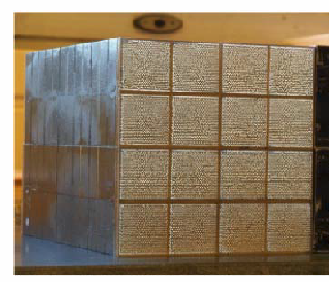
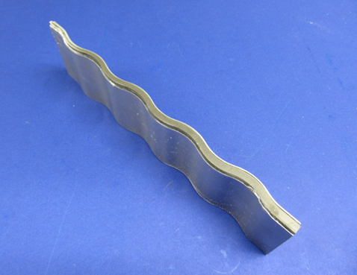
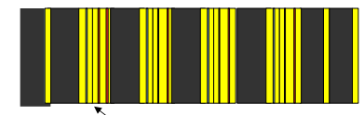
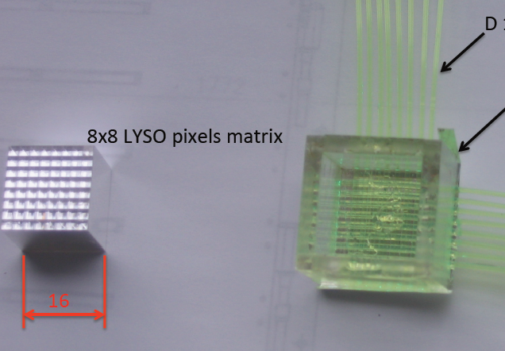
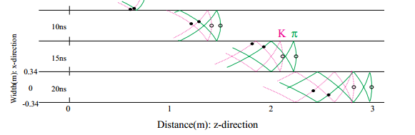
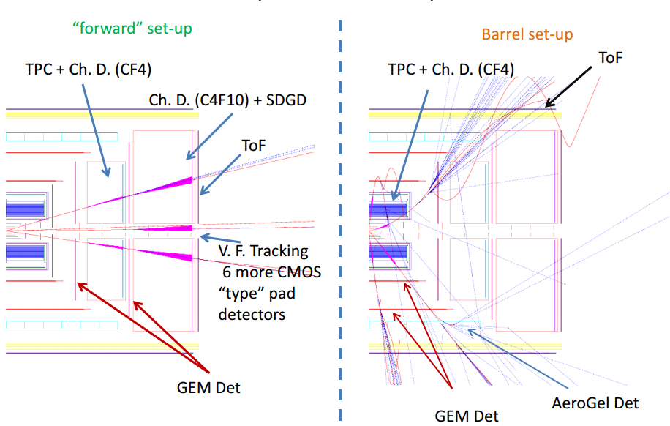
Vibrant Detector R&D Program
Calorimetry
  W-Scintillator & W-Si
    compact and high resolution
  Crystal calorimeters PbW & BGO
BNL, Indiana University, Penn State Univ., UCLA, USTC, TAMU
Pre-Shower
  W-Si
  LYSO pixel array with
  readout via X-Y WLS fibers
Univ. Tecnica Valparaiso
More Info on EIC-Detector R&D:
https://wiki.bnl.gov/conferences/index.php/EIC_R%25D
“Cartesian PreShower”
PID via Cerenkov
  DIRC and timing info
  Catholic Univ. of America, Old Dominion, South Carolina, JLab, GSI
  RICH based on GEM readout
  e-PID: GEM based TRD → eSTAR
BNL, Indiana Univ., USTC, VECC, ANL
Tracking
BNL, Florida Inst. Of Technology, Iowa State, LBNL, MIT, Stony Brook, Temple, Jlab, Virginia, Yale
  μ-Vertex: central and forward based on MAPS
  Central: TPC/HBD provides low mass,
  good momentum, dE/dx, eID
  Fast Layer: μ-Megas or PImMS
  Forward: Planar GEM detectors

Slide 12

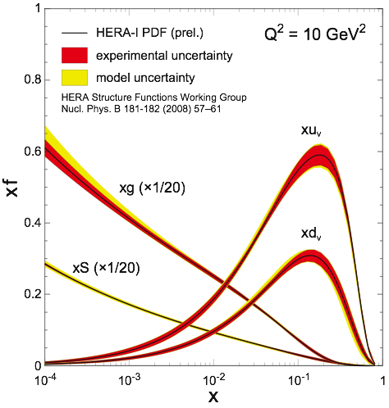
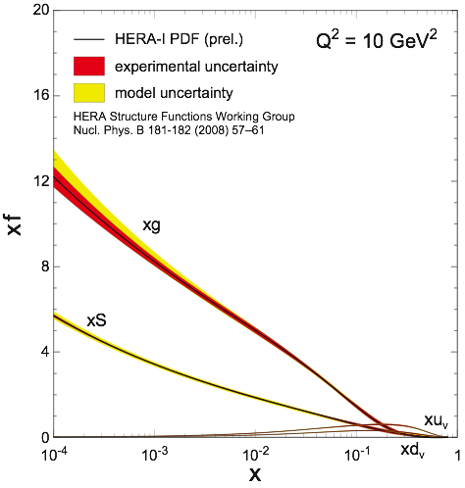


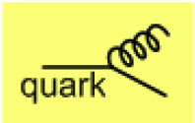
What do we know
small x
x=10⁻⁵
quark density
valence quarks
gluon density
Observation of large scaling violations
Gluon density dominates
Strong increase of sea quarks towards
low x
Density increases with Q²
  more partons by magnified view
Dynamic creation
of partons
at low x
large x
x=1
eA-coverage
Notes:
Counter-intuitively the best way is through an EM process: DIS
y = inelasticity = fraction of the incoming electron energy carried by photon in the rest frame of the nucleon
The structure function F2 is sensitive to the sum of quark and anti-quark momentum distribution in the nucleon.
The apparent scaling of the data with Q2 at large x in early DIS data from SLAC was termed “Bjorken scaling” and motivated the parton model.
In the parton model, FL = 0, while in QCD, it is directly proportional to the gluon structure function, FL(x,Q2) ~ aS xG(x,Q2), at low x.
DGLAP: fixed x -> evolution along Q2
sigma (gamma N) = sig_T + sig_L
sig_L ~ FL
sig_tot ~ F2/Q^2
\frac{d^2 \sigma^{ep \rightarrow eX}}{dx dQ^2} = \frac{4 \pi \alpha^2_{e.m.}}{xQ^4} \left[ \left(1-y+\frac{y^2}{2} \right ) F_2(x,Q^2) - \frac{y^2}{2} F_L(x,Q^2) \right]

Slide 13
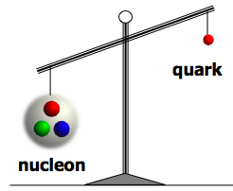
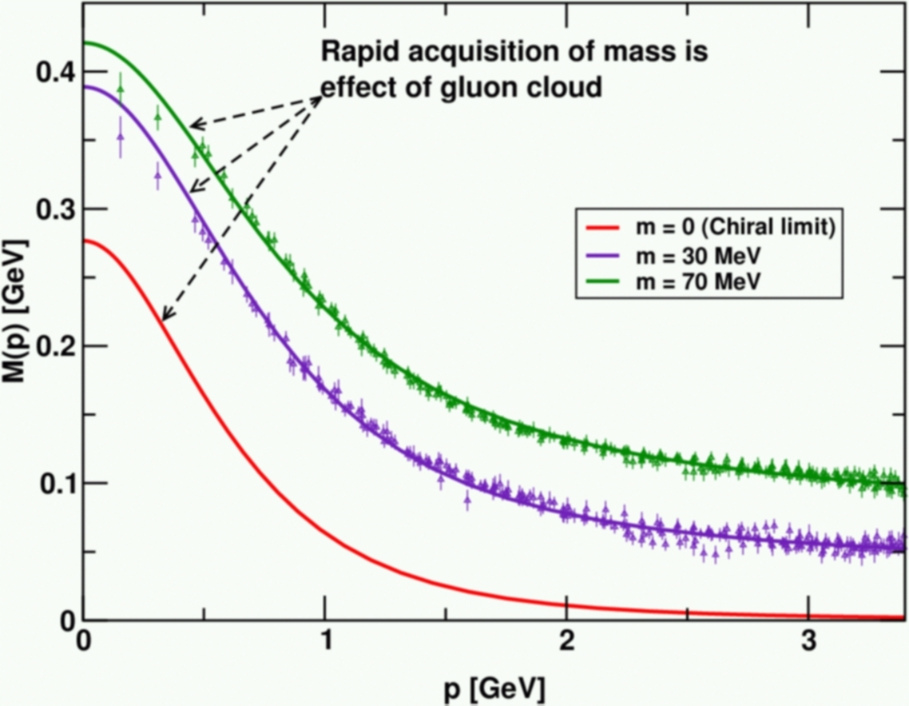
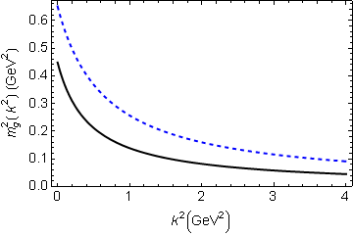
The Hadronic Mass Puzzle
are
C.D. Roberts, Prog. Part. Nucl. Phys. 61 (2008) 50
M. Bhagwat & P.C. Tandy, AIP Conf.Proc. 842 (2006) 225-227
In QCD, all “constants” of quantum mechanics are actually strongly momentum dependent: couplings, number density, mass, etc.
So, a quark’s mass depends on its momentum.
Mass function can calculated and is depicted here.
in agreement: the vast bulk of the light-quark mass comes from a cloud of gluons, dragged along by the quark as it propagates.
Continuum- and Lattice-QCD
Running gluon mass
  Gluon is massless in UV, in agreement with pQCD
  Massive in infrared
    m_{G}(0) = 0.67-0.81 GeV
    m_{G}(m_{G}²) = 0.53-0.64 GeV
DSE prediction confirmed by numerical simulations of lattice-regularised QCD
Mass from nothing!
m_{G}²(k²) ≈ m_{G}⁴/(k²+m_{G}²)
Qin et al., Phys. Rev. C 84 042202 (Rapid Comm.)

Slide 14
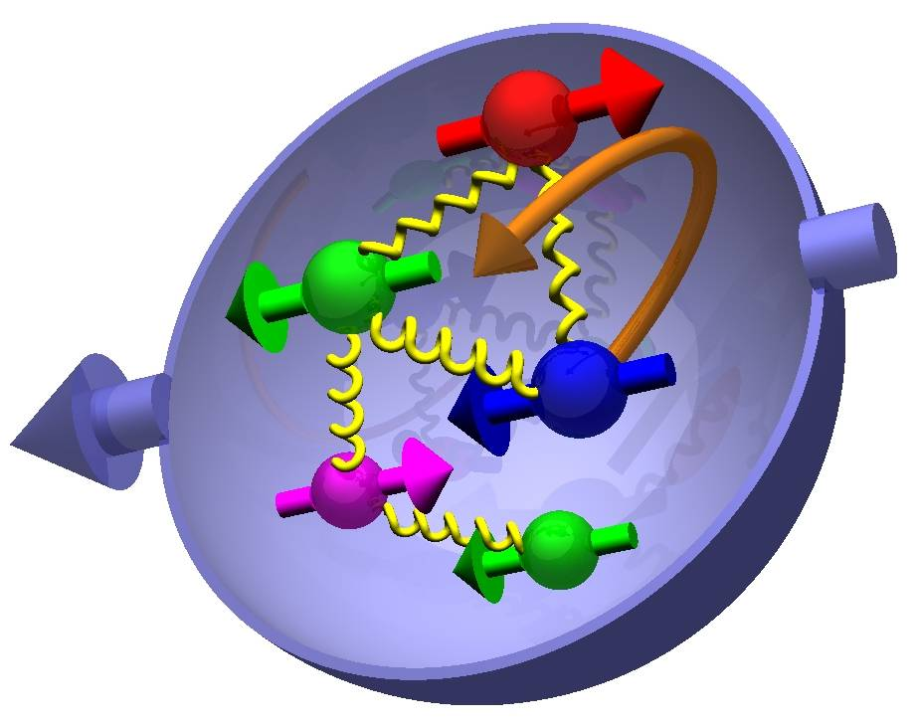

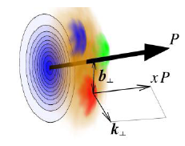
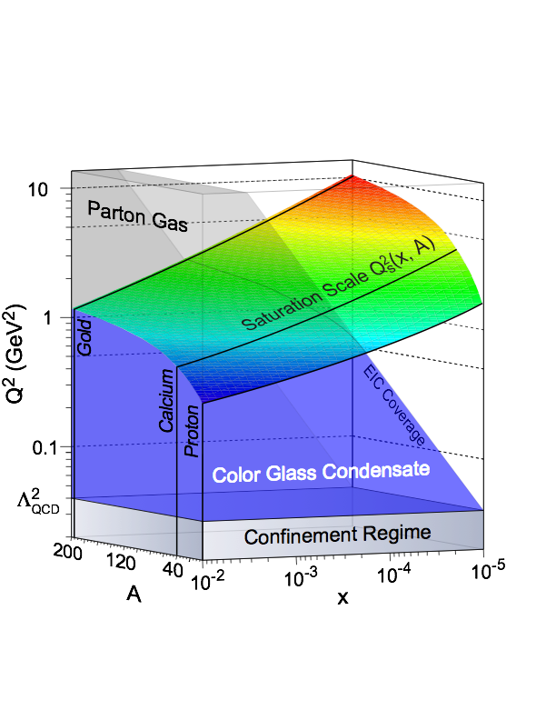
Most Compelling EIC SCIENCE Questions
How are sea quarks and gluons and their spin distributed
in space and momentum inside the nucleon?
How are these quark and gluon distributions correlated with the
over all nucleon properties, such as spin direction?
What is the role of the motion of sea quarks and gluons
in building the nucleon spin?
How does the nuclear environment affect the distribution
of quarks and gluons and their interaction in nuclei?
How does the transverse spatial distribution of gluons compare to that in the nucleon?
How does matter respond to fast moving color charge passing through it?
Is this response different for light and heavy quarks?
γ*
h
e’
q
e
Where does the saturation of gluon densities set in?
Is there a simple boundary that separates the region from the more dilute quark gluon matter? If so how do the distributions of quarks and gluons change as one crosses the boundary?
Does this saturation produce matter of universal properties in
the nucleon and all nuclei viewed at nearly the speed of light?

Slide 15
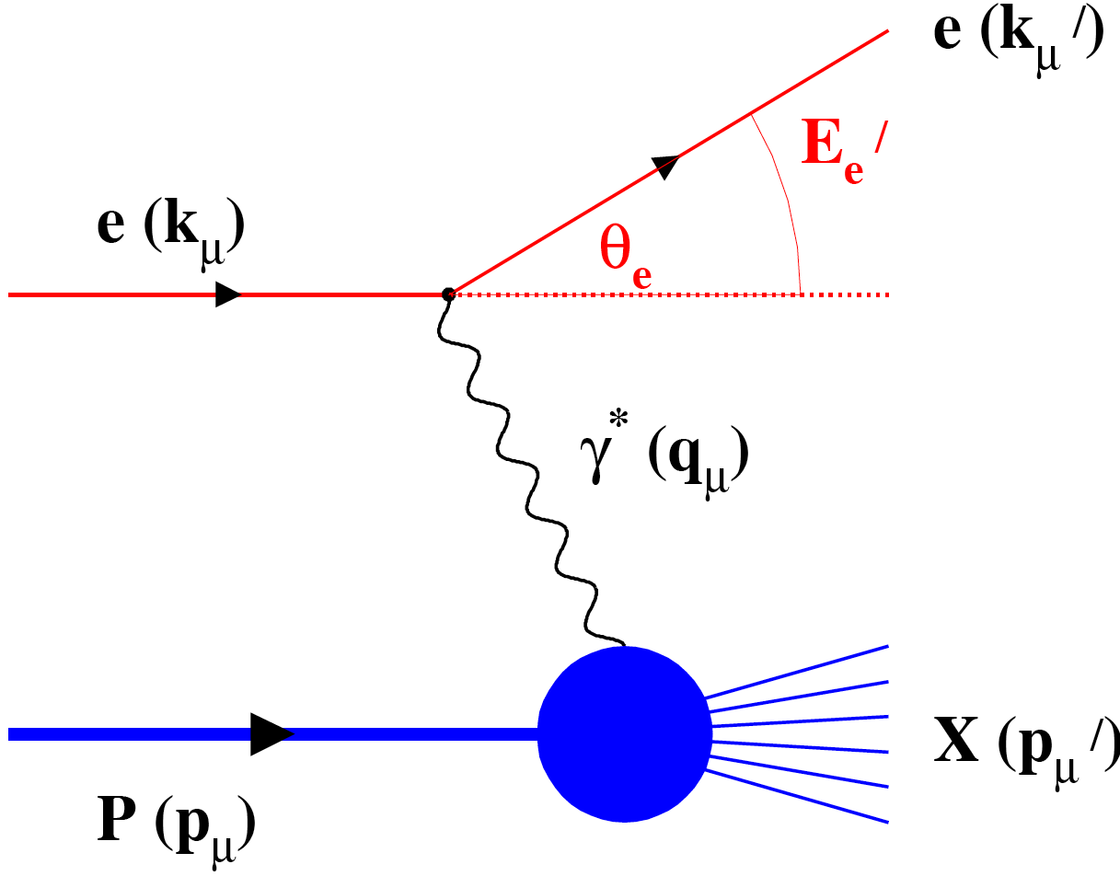
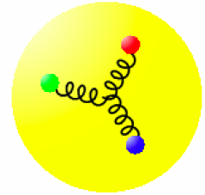
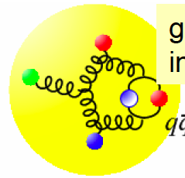
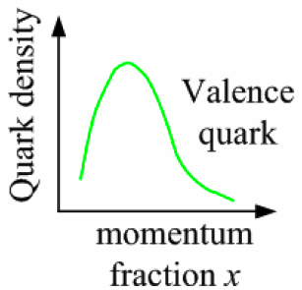
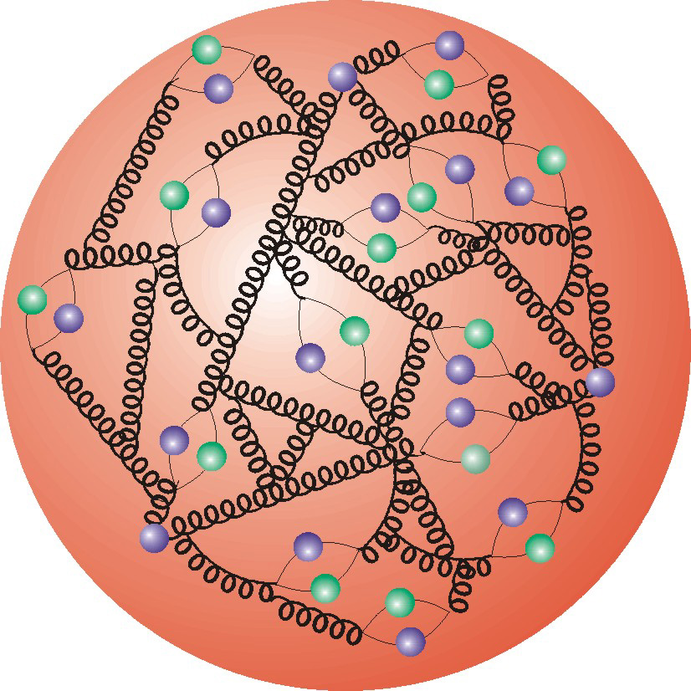
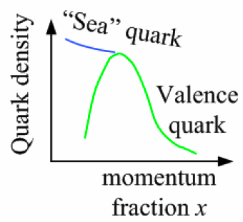
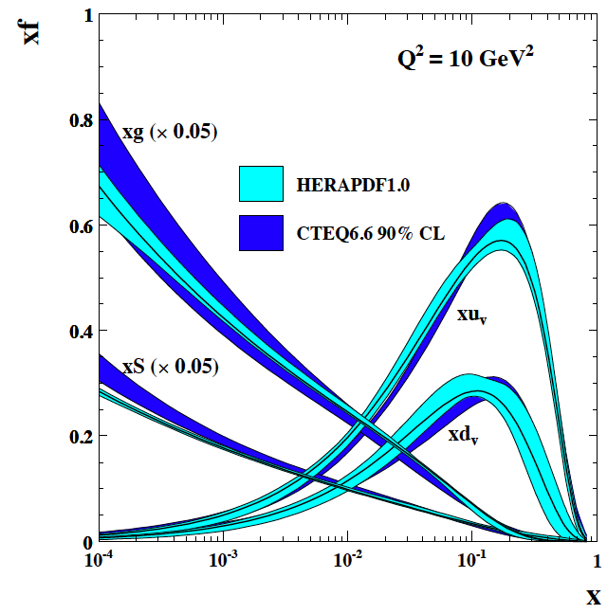
Deep Inelastic Scattering
Kinematics:
Measure of resolution power
Measure of inelasticity
Measure of momentum fraction of struck quark
Gluon splits
into quarks
Quark splits
into gluon
splits
into quarks …
10⁻¹⁶m
10⁻¹⁹m
higher √s
increases resolution

Slide 16


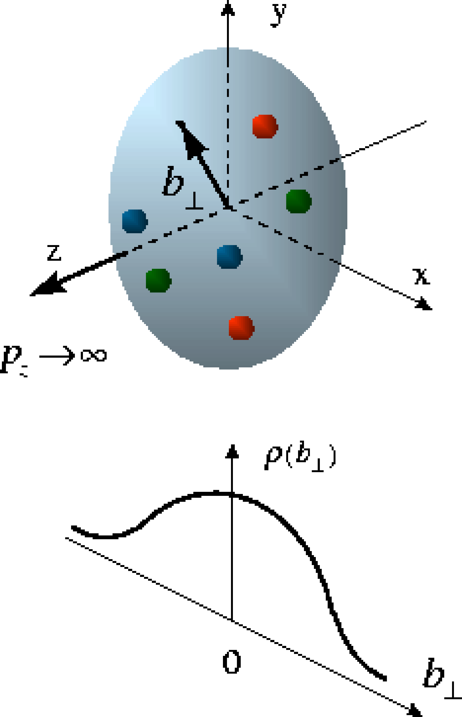
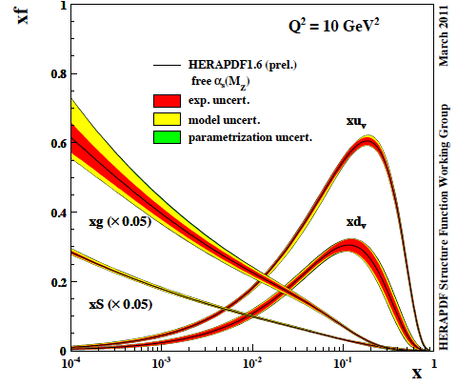


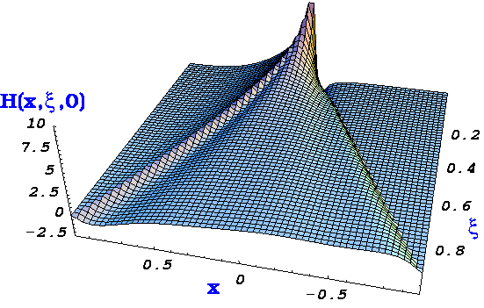
the path to imaging quarks and gluons
PDFs do not resolve transverse momenta or positions in the nucleon
transverse
plane
fast moving nucleon turns into a `pizza’ but transverse size remains about 1 fm
compelling questions
how are quarks and gluons spatially distributed
how do they move in the transverse plane
do they orbit and do we have access to spin-orbit correlations
→ required set of measurements & theoretical concepts
1-D
form factor
parton densities
not related by
Fourier transf.
2+1-D
transv. mom. dep. PDF
impact par. dep. PDF
generalized PDF
semi-inclusive DIS
exclusive processes
Wigner function
high-level connection
4+1-D
measurable ?
important in other branches of Physics

Slide 17

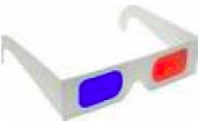
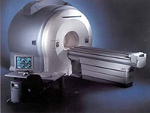
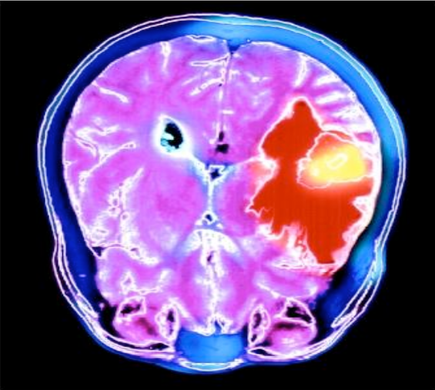
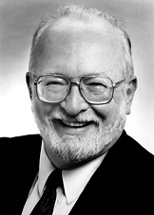

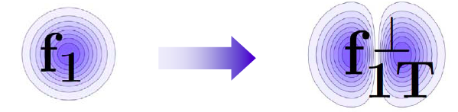
Quantum tomography of the nucleon
Join the real
3D experience !!
TMDs
GPDs
Spin as vehicle to do tomography of the nucleon
We do this daily in medicine
2D+1 picture in momentum space 2D+1 picture in coordinate space
  transverse momentum generalized parton distributions
  dependent distributions → exclusive reaction like DVCS
Quarks
unpolarised polarised
Paul C. Lauterbur
Sir Peter Mansfield
Nobel Prize, 2003: "for their discoveries concerning magnetic resonance imaging"

Slide 18
More insights to the proton
Transversity distribution function δq(x)
Correlation between and
Single Spin Asymmetries
Unpolarized distribution φυνχτιον q(x), G(x)
beyond collinear picture
Explore spin orbit correlations
Helicity distribution function Δq(x), ΔG(x)
Boer-Mulders distribution function
Correlation between and
Sivers distribution function
Correlation between and
Similar for gluons

Slide 19


Azimuthal angles and asymmetries
angle of hadron relative to final quark spin (Collins)
Collins
angle of hadron relative to initial quark spin (Sivers)
Sivers
SIDIS allows to study subprocesses individually

Slide 20
Quark TMDs @ EIC
Sivers asymmetry for π+:
√s=140 GeV / 45 GeV / 15 GeV
Sivers fct. before and after
What is the influence of evolution
on the size of the asymmetry?
Other quarks look similar
what about the gluon ?

Slide 21




The Gluon Sivers Function: γ*N⇑ → h+h+X
e
k⊥<<p_{t}
qqbar interacts like g
“Correlation limit”
Measure a pair of D mesons
k⊥ = |k1T + k2T|
PT = (k1T - k2T) / 2
study charm to tag PGF
Statistically challenging
N⇑
EIC INT proceedings
arXiv:1108.1713v1
section 2.3
~8 months with 50% efficiency and
L = 10³⁴cm²s⁻¹
Beam Energies: 20 GeV x 250 GeV
Q²: 1 – 10 GeV², y: 0.01 – 0.95, z>0.25
no cut on k⊥ and p_{t,}
but on k⊥/p_{t} < 0.5 for “correlation limit”

Slide 22


Beyond form factors and quark distributions
Generalized Parton Distributions
X. Ji, D. Mueller, A. Radyushkin (1994-1997)
Proton form factors, transverse charge & current densities
Structure functions,
quark longitudinal
momentum & helicity
distributions
Correlated quark momentum
and helicity distributions in
transverse space - GPDs

Slide 23



SMALL GPD Primer
How are GPDs characterized?
unpolarized polarized
conserve nucleon helicity
flip nucleon helicity
not accessible in DIS
quantum numbers of final state select different GPD
Spin-Sum-Rule in PRF:
from g₁
DVCS
pseudo-scaler mesons
vector mesons
π⁰ | 2Δu+Δd
η | 2Δu−Δd
ρ⁰ | 2u+d, 9g/4
ω | 2u−d, 3g/4
φ | s, g
ρ⁺ | u−d
J/ψ | g
Q²= 2E_{e}E_{e}’(1-cosθ_{e’})
x_{B} = Q²/2Mν ν=E_{e}-E_{e’}
x+ξ, x-ξ long. mom. fract.
t = (p-p’)²
ξ ≅ x_{B}/(2-x_{B})

Slide 24
The DVCS Phase Space
HERA results on GPDs
very much limited by
lack of statistics
imaging in
valence region
but limited t-range

Slide 25


DVCS at eRHIC
e’
γ
e
γ_{L}*
(Q²)
DVCS: Golden channel
theoretically clean
wide range of observables
(σ, A_{UT}, A_{LU}, A_{UL}, A_{C})
to disentangle different GPDs
x+ξ
x-ξ
~
~
p
H, H, E, E (x,ξ,t)
p’
t
D. Mueller, K. Kumericki
S. Fazio, and ECA
arXiv:1304.0077
DVCS data at end of HERA
Fourier
Transform
large t
small t

Slide 26

Constrain J_{q} via GPD E
observables sensitive to E:
(J_{q} input parameter in ansatz for E)
DVCS A_{UT} : HERMES
nDVCS A_{LU} : Hall A
Hermes DVCS-TTSA [arXiv: 0802.2499]:
VGG
eRHIC:
HERMES like A_{UT}
20 GeV x 250 GeV
Lumi: 2x50fb⁻¹
Notes:
AHLT: Ahmad, Honkanen, Liuti, Taneja PRD75(2007)

Slide 27
Different DVCS Asymmetries
arXiv:1304.0077

Slide 28
What will we learn about 2d+1 structure of the proton
GPD H and E as function of t, x and Q²
GPD H and E 1d+1
A global fit over all pseudo data was done, based on the GPDs-based model:
[K. Kumerički, D Müller, K. Passek-Kumerički 2007]
Known values q(x), g(x) are assumed for H^{q}, H^{g} (at ξ=0, t=0 forward limits E^{q}, E^{g} are unknown)
Excellent reconstruction of H^{sea}, H^{sea} and good reconstruction of H^{g} (from dσ/dt)
GPD H and E 2d+1 structure for sea-quarks and gluons

Slide 29
GPD H^{g}: J/ψ
M. Diehl & ECA
To improve imaging on gluons
add J/ψ observables
cross section
A_{UT}
…..
Fourier
Transform

Slide 30


What else can be done
Xiangdong Ji
The Spin Sum Rules
Jaffe & Manohar
The Holy Grail

Slide 31





helicity structure - open questions
significant experimental and theoretical progress in past 25+ years, yet many unknows …
Δg(x,Q²)
found to be small at 0.05 < x < 0.2 [RHIC, COMPASS, HERMES]
RHIC can slightly extend x range & reduce uncertainties
[500 GeV running & particle correlations]
can hide one
unit of here
yet, full 1st moment [proton spin sum]
will remain to have significant uncertainties
from unmeasured small x region
DIS
&
pp
RHIC
pp
Δq’s (x,Q²)
x
known: quarks contribute much less to proton spin
than expected from quark models
large uncertainties in ΔΣ from unmeasured small x
surprisingly small/positive Δs from SIDIS: large SU(3)
breaking?
_
_
flavor separation not well known, e.g., Δu - Δd

Slide 32



Δg from inclusive DIS and polarized pp
xΔg
RHIC
200 GeV
DIS
Scaling violations of g₁
(Q²-dependence) give indirect access to the gluon distribution via DGLAP evolution.
RHIC polarized pp collisions at midrapidity direct access to gluons (gg,qg)
Rules out large ΔG for 0.05 < x < 0.2
Integral in RHIC x-range:

Slide 33


High Precision 2009 RHIC DATA→∫Δg(x)
DSSV: arXiv:0904.3821
DSSV+: DSSV+COMPASS
DSSV++: DSSV+ & RHIC 2009
strong constrain on
first
completely consistent with
DSSV+ in Δ𝛘²/𝛘²=2%
QCD
fit
PHENIX & STAR
fully consistent

Slide 34

What is the Impact on ∫Δg(x)
DSSV: arXiv:0904.3821
DSSV+: DSSV+COMPASS
DSSV++: DSSV+ & RHIC 2009
DSSV
Getting significantly closer to understand the gluon contribution to the proton spin
BUT
need to reduce low-x (<10⁻²) uncertainties for ∫Δg(x)
Do things add up?
First time a significant
non-zero Δg(x)
Spin of the proton
forward η
RHIC
500 GeV
DIS
RHIC
200 GeV

Slide 35



Δq : W Production Basics
Since W is maximally parity violating
→ W’s couple only to one parton helicity
large Δu and Δd result in large asymmetries.
Complementary to SIDIS:
very high Q2-scale
extremely clean theoretically
No Fragmentation function
backward
forward
x₁ small
t large
x₁ large
u large

Slide 36
2012 ReSULTS
DSSV
Already Run-2012 data alone
have a significant impact on
and
DSSV+: DSSV+COMPASS
DSSV++: DSSV+ & STAR-W 2009
DSSV++: DSSV+ & RHIC-W proj.

Slide 37
present vs EIC kinematic coverage
RHIC pp data
constraining Δg(x)
in approx. 0.05 < x <0.2
data plotted at x_{T}=2p_{T}/√S
likewise for Q²
5 x 100 GeV eRHIC stage-1
20 x 250 GeV eRHIC
EIC extends x coverage
by up to 2 decades
(at Q²=1 GeV²)
lowest x so far 4.6 x10⁻³ COMPASS

Slide 38



example: projected DIS data for g₁^{p}
hep-ph:1206.6014
cross section:
pQCD scaling violations
5 x 250 starts here
5 x 100 starts here
COMPASS data
start here
taken from
Blumlein,
Bottcher

Slide 39

impact of EIC data on helicity PDFs
DIS scaling violations mainly determine Δg at small x
in addition, SIDIS data provide detailed flavor separation of quark sea
yet, small x behavior completely
unconstrained
→ determines x-integral,
which enters proton spin sum
includes only “stage-1 data”
[even then Q²_{min} can be 2-3 GeV²]
can be pushed to x=10⁻⁴ with
20 x 250 GeV data
[still one can play with Q²_{min} ]
dramatic reduction
of uncertainties:
uncertainties determined with
both Lagrange mult. & Hessian
“issues”:
(SI)DIS @ EIC limited by
systematic uncertainties
need to control rel. lumi, polarimetry,
detector performance, … very well

Slide 40
progress towards spin sum rule
combined correlated uncertainties for ΔΣ and Δg
“Helicity sum rule”
gluon
spin
✔
current data
results obtained with two
Lagrange multipliers
Hessian method consistent
access through
Twist-3 GPDs
more theoretical
work needed
✔
angular
momentum
total
quark spin
“X. Ji sum rule”
w/ EIC data
similar improvement
for 0.0001-1 moments
needs 20 x 250 GeV data
✔
difficult,
but should be
possible in
GPD models
can expect approx. 5-10%
uncertainties on ΔΣ and Δg
but need to control systematics

Slide 41


The eA Physics program
time
Hard Processes
(pQCD)
FF/coal.
CGC
JIMWLK/BK
I
Hadron
Transport
Hydro (EoS)
Our understanding of some fundamental
properties of the Glasma, sQGP and
Hadron Gas depend strongly on our
knowledge of the initial state!
The Initial Conditions
3 conundrums of the initial state:
What is the spatial transverse distributions
of nucleons and gluons?
2. How much does the spatial distribution
fluctuate? Lumpiness, hot-spots etc.
3. How saturated is the initial state of the
nucleus?

Slide 42




Is the sQGP a perfect fluid?
IP-GLASMA
AdS/CFT predicts for a perfect fluid:
η/s = 1/(4π) ~ 0.08
Schenke, Tribedy, Venugopalan arXiv:1202.6646
KLN-CGC
Glauber
Wood-Saxon
Different initial states =
different fluctuation scales
Different initial states=
different fluctuation scales
Different initial states=
different fluctuation scales

Slide 43

How many gluons have space in A proton?
at small x linear evolution gives strongly
rising g(x)
  cannot go on forever
BK/JIMWLK non-linear evolution includes
recombination effects → saturation
  Dynamically generated scale
  Saturation Scale: Q²_{s}(x)
    Increases with energy or decreasing x
  Scale with Q²/Q²_{s}(x) instead of x and Q²
small x / higher energy
x = P_{parton}/P_{nucleon}
Terra Incognita
Bremsstrahlung
~ α_{s}ln(1/x)
Recombination
~ α_{s}ρ
Saturation must set in at
low x → high occupancy
α_{s}~1 α_{s} << 1

Slide 44

What Do We Know About xG in Nuclei?
99% of all h± have p_{t} < 2 GeV/c
“Bulk Matter” → x < 0.01
Other than in p:
G(x,Q²) for nuclei is little known
Key: F_{L} (x,Q²) ~ xG(x,Q²)

Slide 45

h-h Forward Correlation in p(d)A at RHIC
side-view
beam-view
large-x1 (q dominated)
p
p
A
π
low-x2 (g dominated)
Low gluon density (pp):
pQCD predicts 2→2 process ⇒ back-to-back di-jet
High gluon density (pA):
2 → many process
⇒ expect broadening of away-side
  Small-x evolution ↔ multiple emissions
  Multiple emissions → broadening
  Back-to-back jets (here leading hadrons) may get broadening in pT with a spread of the order of QS
First prediction by: C. Marquet (’07)
Latest review: Stasto, Xiao, Yuan arXiv:1109.1817 (Sep. ’11)
Notes:
Raju: Di-hadron correlations are a test of universality because the same measurement in p+A and e+A is sensitive to "dipole" and "quadrupole" operators which are the same for both processes.

Slide 46





Forward Correlations in dA at RHIC
1 question, 2 answers
Initial state saturation model
“Non-initial state” shadowing model
Away side parton randomized
by strong color field
Albacete, Marquet
+offset
+offset
Kang, Vitev, Xing arXiv:1112.6021v1
B. Xiao et al. 2012
How saturated is the initial state?

Slide 47


eRHIC: Reaching the Saturation Region
HERA (ep):
Despite high energy range:
F2, Gp(x, Q²) outside the
saturation regime
Need also Q² lever arm!
Only way in ep is to
increase √s
Would require an ep
collider at √s ~ 1-2 TeV
Different approach (eA):
L ~ (2m_{N} x)⁻¹ > 2 R_{A} ~ A^{1/3}
Probe interacts
coherently with all nucleons
Gold: A=197, effective x 197 times smaller!

Slide 48

Dihadron Correlations in eA at EIC
EIC:
  Extract the spatial multi-gluon correlations and study their non-linear evolution
    essential for understanding the transition from a deconfined into a confined state.
Advantage over p(d)A:
  eA experimentally much cleaner
    no “spectator” background to subtract
    Access to the exact kinematics of the DIS process (x, Q²)
Perfect saturation signature:
Either jets or use leading hadrons from jets (dihadrons)
Notes:
Raju: Di-hadron correlations are a test of universality because the same measurement in p+A and e+A is sensitive to "dipole" and "quadrupole" operators which are the same for both processes.

Slide 49
EIC: eA Dihadron Correlations Studies
Exp: Saturation versus
“conventional” scenario
Theory: Saturation
Dominguez, Xiao, Yuan, Lee, Zheng ‘11/12
J.H. Lee, L. Zheng (CCNU) ‘11/12
eA-MC: Pythia6.4 + nPDF (EPS09) + nuclear geometry from DPMJetIII without PS
Here for 10 fb⁻¹/A (~ 20 weeks), std. experimental cuts
Clear signal, pronounced differences between sat and no-sat

Slide 50



Hard Diffraction in DIS at Small x
e+p
t = (p-p’)²
β is the momentum fraction of the struck parton w.r.t. the Pomeron
x_{IP} = x/β: momentum fraction of the exchanged object (Pomeron) w.r.t. the hadron
  Diffraction in e+p:
    coherent ⇔ p intact
    incoherent ⇔ breakup of p
    HERA: 15% of all events are hard diffractive
Diffraction in e+A:
  coherent diffraction (nuclei intact)
  breakup into nucleons (nucleons intact)
  incoherent diffraction
  Predictions: σdiff/σtot in e+A ~25-40%

Slide 51


Why is DiFfraction So Important
Sensitive to spatial gluon distribution
  Hot topic:
    Lumpiness?
    Just Wood-Saxon+nucleon g(b)
  Incoherent case: measure fluctuations/lumpiness
  in g_{A}(b)
Sensitive to gluon momentum distributions
  σ ~ g(x,Q²)²

Slide 52

Ratio of Diffractive to Total Cross-Section
Black disc limit characterized by σdiff/σtot = 1/2 (Hera sees 1/7)
Large fraction of diffractive event is unambiguous signature for reaching the saturated limit
Fraction of low-mass coherent diffraction in ep and eA at EIC:
Find:
w/o non-linear effects eA/ep ratio stays roughly one
Day-1 signature for Saturation
non-linear effects enhance σdiff in eA scattering

Slide 53


Exclusive Vector Meson Production
  Unique probe - allows to measure momentum transfer t in eA diffraction
  → in general, one cannot detect the outgoing nucleus and its momentum
Dipole Cross-Section:
small size (J/Ψ): cuts off saturation region
large size (φ,ρ, ...): “sees more of dipole amplitude” → more sensitive to saturation
J/ψ
ϕ

Slide 54

Spatial Gluon Distribution Through Diffraction
  Goal: going after the source distribution of gluons through Fourier transform of dσ/dt
  Find: Typical diffractive pattern for coherent (non-breakup) part
  As expected: J/Ψ less sensitive to saturation effects than larger Φ-meson

Slide 55









Spatial Gluon Distribution Through Diffraction
  Idea: momentum transfer t conjugate to transverse position (b_{T})
    coherent part probes “shape of black disc”
    incoherent part (dominant at large t) sensitive to “lumpiness” of the source (fluctuations, hot spots, ...)
Spatial source distribution:
t = Δ²/(1-x) ≈ Δ² (for small x)
ϕ, nosat
Golden eA measurement for EIC

Slide 56

Deep Inelastic Scattering - Vacuum
h
e’
γ*
q
e
What happens if we add a nuclear medium
Observables:
Broadening:
Attenuation:
Δp_{t}² linked directly with saturation scale
ratio of hadron production in A to d
modifications of nPDF cancel out
Notes:
Example here is DIS in vacuum
Propagating quark is colored, thus emits gluons. “Free.” “Lifetime of deconfined quark.” Universal for light quarks?
Dipole is a color singlet object, thus no gluon emission. “Prehadron.” Formation time depends on hadron formed.
Heuristic arguments and models: Formation time is longer, ~ 1 order of magnitude for pions.
One of the goals of the studies I will be describing is to directly measure these two time parameters. Another is to understand the detailed mechanisms of how the hadron gets formed. The method of determining these quantities consists of studying this process embedded in a nuclear medium of well-known properties such as size and density.
Make point here - whole process is hadronization? or make that point later?

Slide 57
What do we know and what can EIC do
Hermes:
E_{e} = 27 GeV → √s = 7.2 GeV
E_{h} = 2-15 GeV
Unprecedented precision to distinguish between different models
large ν range
hadronization in and out of nucleus
first time for charm
EIC:

Slide 58

Take Away Message
The EIC will profoundly impact
our understanding of QCD
with its high energy, high luminosity
eA and polarized ep collisions
ACHIEVED
if
eRHIC is built
  ep: precision studies of PDFs, TMDs,
  and GPDs will lead to the most
  comprehensive picture of the nucleon ever:
  its flavor, spin, and spatial structure
  eA: unprecedented study of matter in
  a new regime where physics is not
  described by “ordinary” QCD:
  non-linear QCD/saturation/higher twist
  effects, properties of glue
  (momentum & space-time),
  understand how fast partons interact
  as they traverse nuclear matter,
  new insight into fragmentation processes,
  clarification of the nature of pomerons.
entire science program uniquely tied to a
future high energy electron ion collider
never been measured before & never without

Slide 59
BACKUP

Slide 60

Possible Schedule To Realize eRHIC

Slide 61

International context
Electron-“Ion” colliders in the past and future:

Slide 62
an Electron Ion Collider in the US
Requirements:
High Luminosity > 10³³ cm⁻²s⁻¹
Flexible center of mass energies
Electrons and protons/light nuclei polarised
Wide range of nuclear beams
a wide acceptance detector with good PID (e/h and π, K, p)
wide acceptance for protons from elastic reactions and
neutrons from nuclear breakup

Slide 63





Modeling the Detector in Geant
μ-vertex detector:
6 layers with [30..160] mm radius
0.37% X₀ in acceptance per layer simulated precisely;
digitization: single discrete pixels, one-to-one from MC points
Forward/backward μ-vertex detector:
3+5+3 silicon disks with up to 280 mm radius
N sectors per disk; 200 μm silicon-equivalent thickness
digitization: discrete ~20x20 μm² pixels
TPC
~2m long; gas volume radius [300..800] mm
1.2% X₀ IFC, 4.0% X₀ OFC; 15.0% X₀ aluminum endcap
digitization: assume known (gaussian) resolutions in “rφ” and “Z” and 1x5 mm GEM pads (up to 100 points per track)
Forward tracking:
3 disks behind the TPC endcap
rather precise START FGT design implemented
digitization: 100 μm resolution in X&Y; gaussian smearing

Slide 64

The Pillars of the eRHIC Physics program
Electro Weak
physics of
strong color
fields
spin Physics
2D+1 Imiging
Hadronisation
Wide physics program with high requirements on detector and machine performance

Slide 65


Hard Diffraction in DIS at Small x
e+p
t = (p-p’)²
β is the momentum fraction of the struck parton w.r.t. the Pomeron
xIP = x/β: momentum fraction of the exchanged object (Pomeron) w.r.t. the hadron
Diffraction Analogy: plane monochromatic wave incident on a circular screen of radius R
  Diffraction in e+p:
    coherent ⇔ p intact
    incoherent ⇔ breakup of p
    HERA: 15% of all events are hard diffractive
Diffraction in e+A:
  coherent diffraction (nuclei intact)
  breakup into nucleons (nucleons intact)
  incoherent diffraction
  Predictions: σdiff/σtot in e+A ~25-40%

Slide 66


Large Rapidity Gap Method (LRG)
  Identify Most Forward Going
  Particle (MFP)
    Works at HERA but at higher √s
    EIC smaller beam rapidities
Diffractive ρ⁰ production at EIC:
η of MFP
M. Lamont ’10
DIS
Hermeticity requirement:
needs just to detector presence
does not need momentum or PID
simulations: √s not a show stopper for EIC
(can achieve 1% contamination, 80% efficiency)
Diffractive

Slide 67
Best Knowledge of QS in eA
Model-I: IPSat dipole model
Model-II: BK + higher order corr.
Enhancement of Q_{S} with A
⇒ saturation regime reached at significantly lower energy in nuclei

Slide 68

Measuring FL with the EIC (I)
quark+anti-quark
momentum distributions
gluon momentum distribution
In practice use reduced cross-section:
How to extract F_{L}
  Need different values of y²/Y⁺
  FL slope of σr vs y²/Y⁺
  F2 intercept of σr vs y²/Y⁺ with y-axis
  σr
  y²/Y⁺
0
Notes:
\begin{eqnarray*}\sigma_r = \left( \frac{d^2 \sigma}{dx dQ^2}\right)\ \frac{x Q^4}{2 \pi \alpha^2 [1 + (1-y)^2]}
&=& F_2(x, Q^2) - \frac{y^2}{\color{red}{1+(1-y)^2}} F_L(x, Q^2) \\
{} &=& F_2(x, Q^2) - \frac{y^2}{{\color{red}Y^+}} \ F_L(x, Q^2) \\\end{eqnarray*}

Slide 69



Measuring FL with the EIC (II)
In order to extract F_{L} one needs at least two measurements of the inclusive cross section with “wide” span in inelasticity parameter y (Q² = sxy)
F_{L} requires runs at various √s ⇒ longer program
Need sufficient lever arm in y²/Y⁺
Limits on y²/Y⁺:
At small y:
detector resolution for e’
At large y:
radiative corrections and charge symmetric background
EIC studies:
Statistical error is negligible
in essentially whole range
Systematical Error
Calibration
Normalization
Experiment
Radiative Corrections
Notes:
Lowest value of x and Q2 :
y y2/Y+ proton p
0.7 0.44 100
0.54 0.24 130
0.28 0.28 250

Slide 70


preparation of DIS and SIDIS mock data
PEPSI MC to generate σ⁺⁺ and σ⁺⁻ with LO GRSV PDFs
DIS
SIDIS
inclusive final-state
identified charged pions and kaons
assume modest 10 fb⁻¹ for each energy, 70% beam polarizations
Q² > 1 GeV² , 0.01 < y < 0.95 , invariant mass W² > 10 GeV²
depolarization factor of virtual photon D(y,Q²) > 0.1 (cuts on small y)
scattered lepton: 1º < θ_{elec} < 179º and p_{elec} > 0.5 GeV
hadron: p_{hadr} > 1 GeV, 0.2 < z < 0.9,
1⁰ < θ_{hadr} < 179º
use rel. uncertainties of data to generate mock data by randomizing around
DSSV+ by 1-σ
SIDIS: incl. typical 5% (10%) uncertainty for pion (kaon) frag. fcts (from DSS analysis)

Slide 71


scaling violations at small x
rough small-x approximation to Q²-evolution:
spread in Δg(x,Q²) translates into
spread of scaling violations for g₁(x,Q²)
need x-bins with a least two Q² values to compute derivative (limits x reach somewhat)
smallest x bins require 20 x 250 GeV
5 x 250 starts here
error bars for moderate 10fb⁻¹ per c.m.s. energy; bands parameterize current DSSV+ uncertainties

Slide 72

DVCS ASYMMETRIES
→ different charges: e⁺ e⁻:
~
Δσ_{C} ~ cosφ ∙Re{ H + ξH +… }
H
→ polarization observables:
~
Δσ_{LU} ~ sinφ∙Im{H + ξH + kE}
H
Δσ_{UT}
~
~
Δσ_{UL} ~ sinφ∙Im{H + ξH + …}
H
beam target
Δσ_{UT} ~ sinφ∙Im{k(H - E) + … }
H, E
ξ = x_{B}/(2-x_{B} ) k = t/4M²
kinematically suppressed

Slide 73
BH Fraction
5 GeV x 100 GeV
BH subtraction will be relevant in stage 1, at large y, depending on the x-Q² bin
BUT…
5 GeV x 100 GeV
and
5 GeV x 250 GeV
are overlapping:
x-sec. measurements at 5x250 at low-y can
crosscheck the BH
subtrac. made for 5x100
20 GeV x 250 GeV
BH subtraction will be not an issue for y<0.6

Slide 74



Kinematics of Breakup Neutrons
Results from GEMINI++ for 50 GeV Au
Results:
With an aperture of ±3 mrad we are in relative good shape
• enough “detection” power for t > 0.025 GeV²
• below t ~ 0.02 GeV² we have to look into photon detection
‣ Is it needed?
Question:
For some physics rejection power for incoherent is needed ~10⁴
→ How efficient can the ZDCs be made?
by Thomas Ullrich
+/-5mrad acceptance seems sufficient

Slide 75


Diffractive Physics: p’ kinematics
Diffraction:
t=(p4-p2)² = 2[(mp^{in}.mp^{out})-(E^{in}E^{out} - pz^{in}pz^{out})]
→ “ Roman Pots” acceptance studies see later
?
5x50
p’
5x100
5x250
Simulations by J.H Lee

Slide 76




proton distribution in y vs x at s=20 m
without quadrupole aperture limit
20x250
5x50
with quadrupole aperture limit
20x250
5x50

Slide 77


Accepted in“Roman Pot”(example) at s=20m
25x250
5x50
25x250
5x50
Generated
Quad aperture limited
RP (at 20m) accepted

