Slide 1

eRHIC Detector R&D and Design

Slide 2
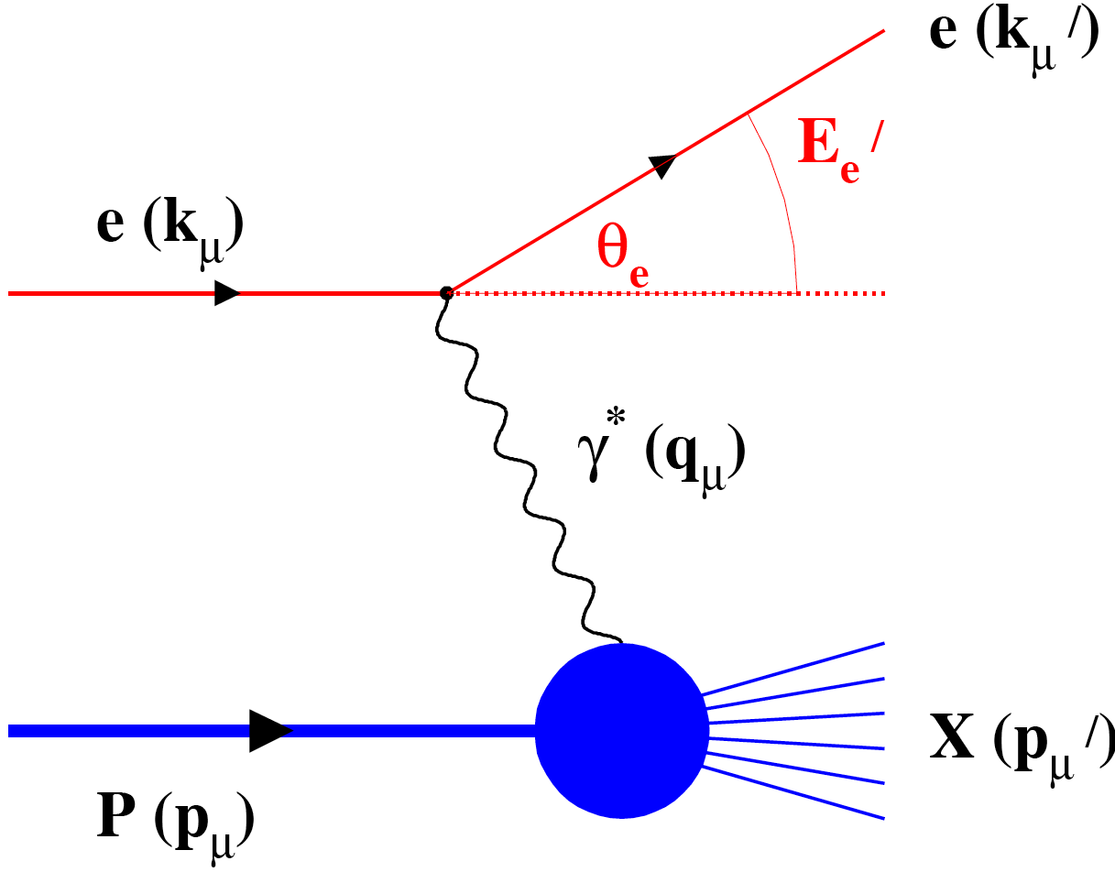
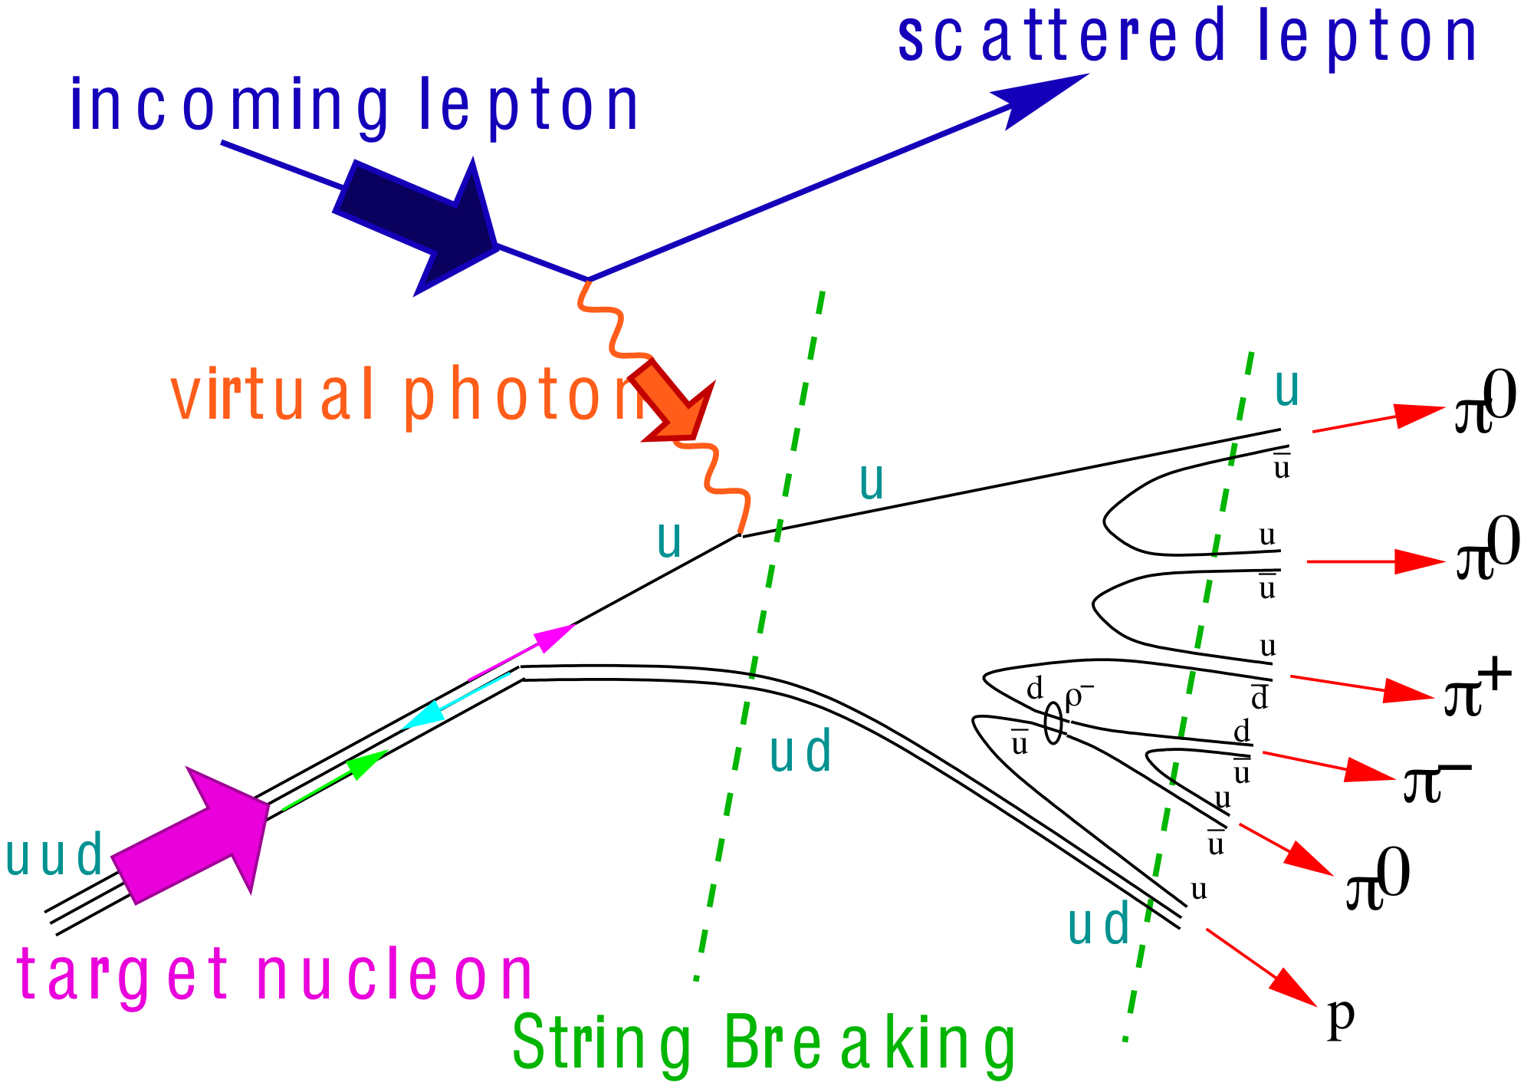
What needs to be covered BY THE DETECTOR
e’
γ, π,J/Ψ
e
γ_{L}*
(Q²)
x+ξ
x-ξ
~
~
H, H, E, E (x,ξ,t)
p
p’
Inclusive Reactions in ep/eA:
Physics: Structure Fcts.: F₂, F_{L}
Very good electron id → find scattered lepton
Momentum/energy and angular resolution of e’ critical
scattered lepton → kinematics
t
Semi-inclusive Reactions in ep/eA:
Physics: TMDs, Helicity PDFs → flavor separation, dihadron-corr.,…
→ Kaon asymmetries, cross sections
Excellent particle ID: π±,K±,p± separation over a wide range in η
full Φ-coverage around γ*
Excellent vertex resolution → Charm, Bottom identification
Exclusive Reactions in ep/eA:
Physics: GPDs, proton/nucleus imaging, DVCS, excl. VM/PS prod.
Exclusivity → large rapidity coverage → rapidity gap events
↘ reconstruction of all particles in event
high resolution in t → Roman pots

Slide 3
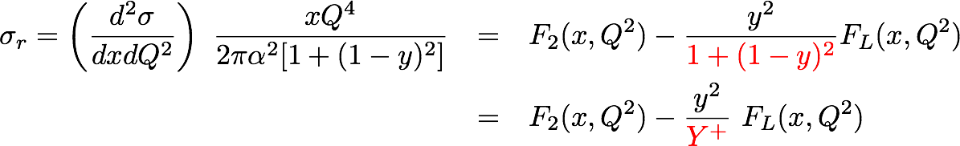
Measuring FL with the EIC
In practice use reduced cross-section:
How to extract F_{L}:
Measure σ_{r} at different √s → vary y
  → F_{L} slope of σ_{r} vs y
  F₂ intercept of σ_{r} vs y with y-axis
Issues:
Lever arm in y
Value of y
  At low y: detector resolution for e’
  At high y: radiative corrections and
  charge symmetric background
  σr
  y²/Y⁺
0
Notes:
\begin{eqnarray*}\sigma_r = \left( \frac{d^2 \sigma}{dx dQ^2}\right)\ \frac{x Q^4}{2 \pi \alpha^2 [1 + (1-y)^2]}
&=& F_2(x, Q^2) - \frac{y^2}{\color{red}{1+(1-y)^2}} F_L(x, Q^2) \\
{} &=& F_2(x, Q^2) - \frac{y^2}{{\color{red}Y^+}} \ F_L(x, Q^2) \\\end{eqnarray*}

Slide 4
EIC: σ_{r} and F_{L}
Statistics:
5 GeV x 50 GeV: 2fb⁻¹
5 GeV x 75 GeV: 4fb⁻¹
5 GeV x 100 GeV: 4fb⁻¹
Systematics: 1%

Slide 5
EIC: σ_{r} and F_{L}
Statistics:
5 GeV x 50 GeV: 2fb⁻¹
5 GeV x 75 GeV: 4fb⁻¹
5 GeV x 100 GeV: 4fb⁻¹
Systematics: 3%

Slide 6

The Helicity Distributions in the Proton
EIC: DIS scaling violations mainly determine Δg at small x
Q² = 10 GeV²
Need systematics better than 2%

Slide 7
Inclusive DIS
Measure of resolution power
Measure of inelasticity
Note:
to measure x, y, and Q² at low Q² ~ 1 GeV²
  Electron method
    precise energy and angular resolution for θ’_{e} → 180º and high y
  At low y use hadron method
e-
p/A
Measure of momentum fraction of struck quark
0º 180º
+η
-η
diverges for
y_{e}→0
depends on E’_{e}
Hadron method:
diverges for
θ’_{e}→180º
depends on
E’_{e} and θ’_{e}

Slide 8
DIS Kinematics
Possible limitations in kinematic coverage:
high y limited by
radiative corrections
can be suppressed by
requiring hadronic
activity
HERA
y>0.005
low y-coverage:
limited by E’_{e} resolution
→ hadron method
Even for colliders: Strong x-Q² correlation
  high x → high Q²
  low x → low Q²

Slide 9
Lepton Kinematics
Increasing Lepton Beam Energy:
5 GeV: Q² ~ 1 GeV → η ~ -2
10 GeV: Q² ~ 1 GeV → η ~ -4
highest E’_{e} at most negative rapidities
independent of E_{h}
low Q² coverage
critical for
saturation physics
√s

Slide 10
Scattered Lepton Kinematics
CUTS: Q²>0.1GeV² && 0.01<y<0.95
higher √s:
scattered lepton has
small scattering angle
→ negative rapidities

Slide 11
Pion Kinematics
Cuts: Q²>1 GeV, 0.01<y<0.95, z>0.1
√s
Increasing Hadron Beam Energy: influences max. hadron energy at fixed η
Increasing 30 GeV < √s < 170 GeV
hadrons are boosted from forward rapidities to negative rapidities
no difference between π±, K±, p±

Slide 12
Hadron, lepton, Photon Separation
5 GeVx50 GeV
hadron
photon
electron
no cuts applied
hadron/photon suppression factor
needed for p_{e’}>1GeV:
-3<η<-2: ~10
-2<η<-1: > 100
-1<η<0: ~1000
p_{max} hadron for PID:
-5<η<-1: < 10 GeV
-1<η<-1: < 5 GeV
1<η<5: < 50 GeV

Slide 13
Lepton Identification
20 GeVx250 GeV
hadron
photon
electron
no cuts applied
hadron/photon suppression factor
needed for p_{e’}>1GeV:
-4<η<-3: >100
-3<η<-2: ~1000
-2<η<-1: > 10⁴
p_{max} hadron for PID:
-5<η<-1: < 30 GeV
-1<η<-1: < 10 GeV
1<η<5: < 100 GeV

Slide 14
BNL: 1st Detector Design Concept
ECAL W-Scintillator
Upstream
low Q²
tagger
ECAL PWO
ECAL WScin
To
Roman Pots
HCAL
RICH
RICH
HCAL
DIRC/proximity RICH
−η
η
PID:
-1<η<1: DIRC or proximity focusing Aerogel-RICH
1<|η|<3: RICH
Lepton-ID:
-3 <η< 3: e/p
1<|η|<3: in addition Hcal response & γ suppression via tracking
|η|>3: ECal+Hcal response & γ suppression via tracking
-5<η<5: Tracking (TPC+GEM+MAPS)

Slide 15
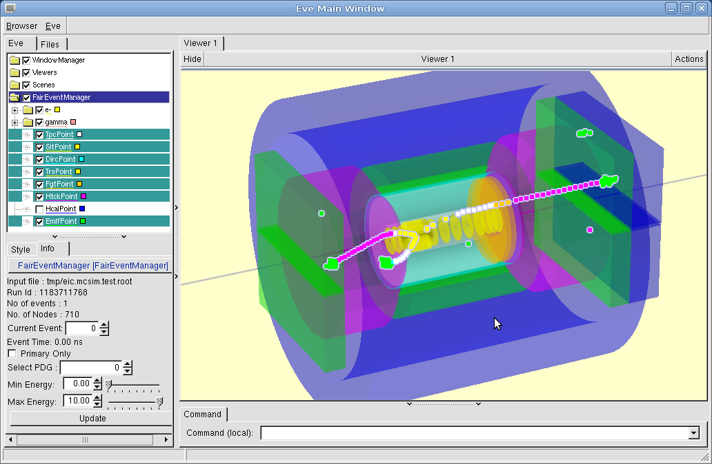
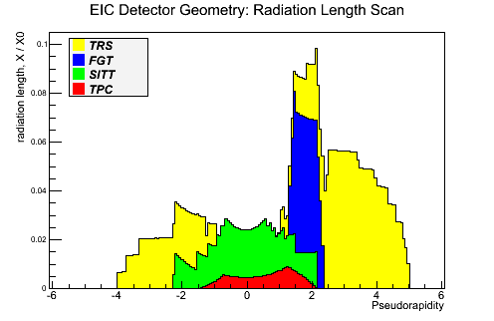
Start full Geant Simulations
BNL-Framework: virtual MC using FairRoot (→ GSI: 5 developers)
  versatile in geometry format definitions
Jlab-Framework: GEMC@Jlab (← can exchange geometries)
EIC Detector in FairRoot Browser

Slide 16
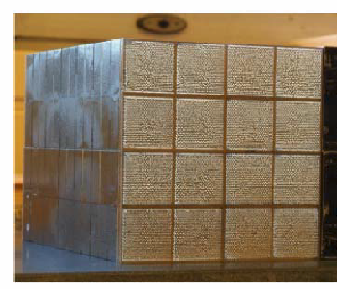
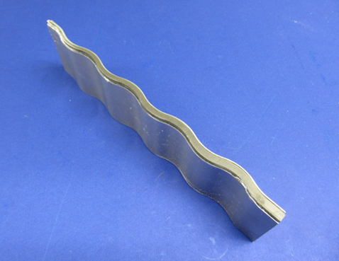
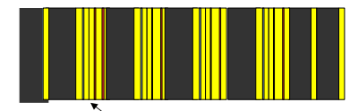
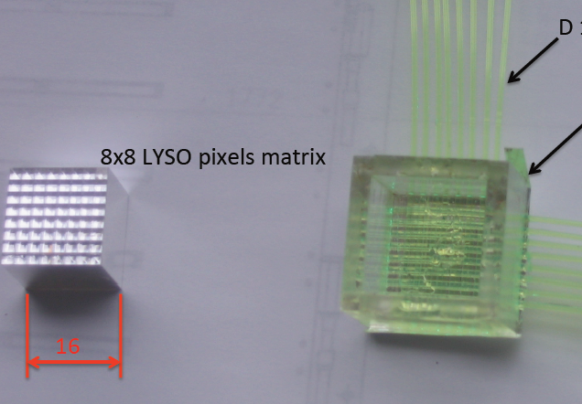
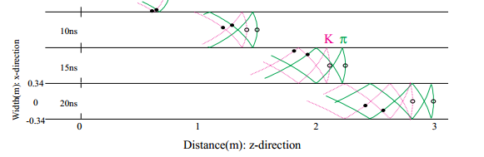
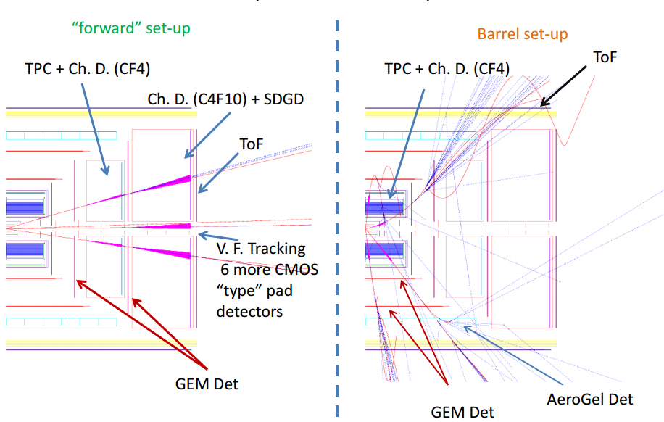
Vibrant Detector R&D Program
Calorimetry
  W-Scintillator & W-Si
    compact and high resolution
  Crystal calorimeters PbW & BGO
BNL, Indiana University, Penn State Univ., UCLA, USTC, TAMU
Pre-Shower
  W-Si
  LYSO pixel array with
  readout via X-Y WLS fibers
Univ. Tecnica Valparaiso
“Cartesian PreShower”
PID via Cerenkov
  DIRC and timing info
  Catholic Univ. of America, Old Dominion, South Carolina, JLab, GSI
  RICH based on GEM readout
  e-PID: GEM based TRD → eSTAR
BNL, Indiana Univ., USTC, VECC, ANL
Tracking
BNL, Florida Inst. Of Technology, Iowa State, LBNL, MIT, Stony Brook, Temple, Jlab, Virginia, Yale
  μ-Vertex: central and forward based on MAPS
  Central: TPC/HBD provides low mass,
  good momentum, dE/dx, eID
  Fast Layer: μ-Megas or PImMS
  Forward: Planar GEM detectors

Slide 17
Fast Simulator: What was modeled
Magnetic field: Solenoid with 3.0 Tesla
Tracking:
  “Central” +/-1: TPC-like:
    45 fit points; 0.03 radiation length, position resolution: 80 μ
  “Forward/Backward” 1-3: GEM-like:
    6 planes; 0.03 radiation length, position resolution: 80 μ
  “Far Forward/Backward” 3-4.5: Si-Pixel-like:
    12 planes; 0.03 radiation length, position resolution: 20 μ
  radiation length needs to be checked
  no bremsstrahlung for electrons yet
Ecal
  “Central” +/-1:
    10%√E+1.5% hadron: MIP + 0.4E_{h} with σ=0.2E_{h} (50:50)
  “Forward” 1-5:
    10%√E+1.5% hadron: MIP + 0.4 with σ=0.2E_{h} (50:50)
  “Backward” -1 to -5: PWO crystal calorimeter
    2.5%/√E + 0.9% + 1%/E hadron: MIP + 0.4E_{h} with σ=0.2E_{h} (50:50)
“Hcal:
  “Forward/Backward” 1<|η|<5: assumed current STAR forward R&D project
    38%√E+3%

Slide 18
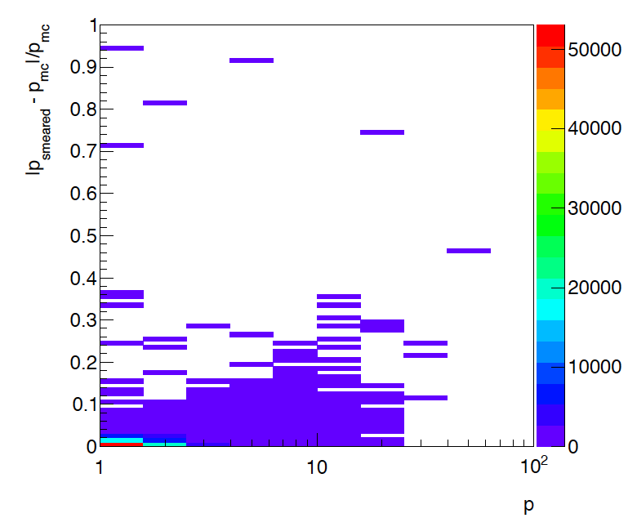
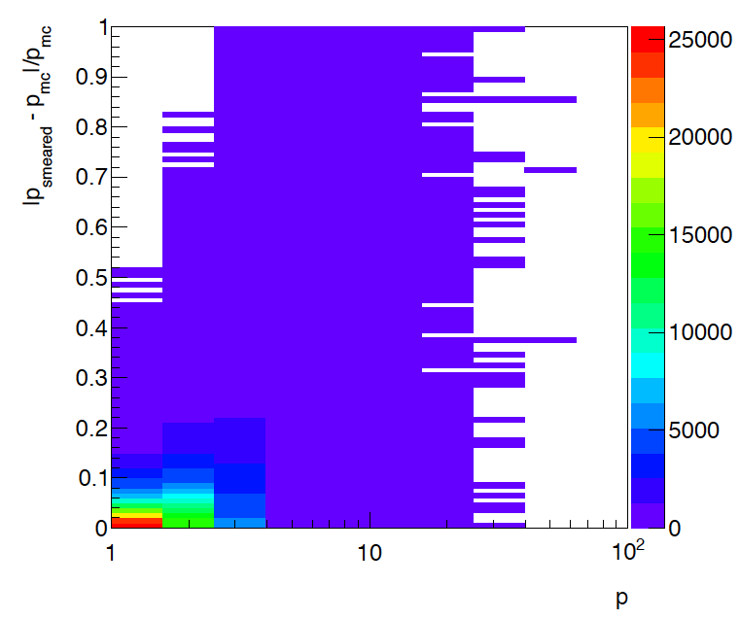
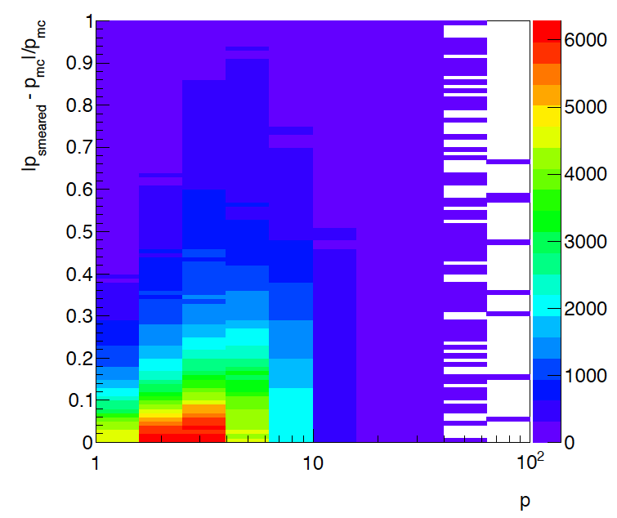
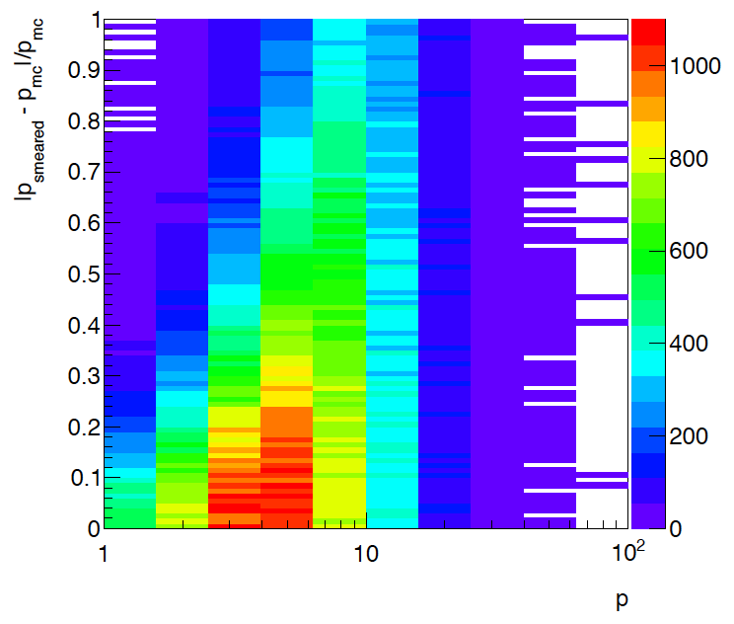
Momentum resolutions
0.5<η<1.5
1.5<η<2.5
    To improve momentum resolution for η>3
    need to look in Magnet design
    increase radial field
    current studies involve
      Dipole field on top of solenoidal field
      Solenoid made out of different coils with
      increasing field and radius
2.5<η<3.5
3.5<η<4.5

Slide 19
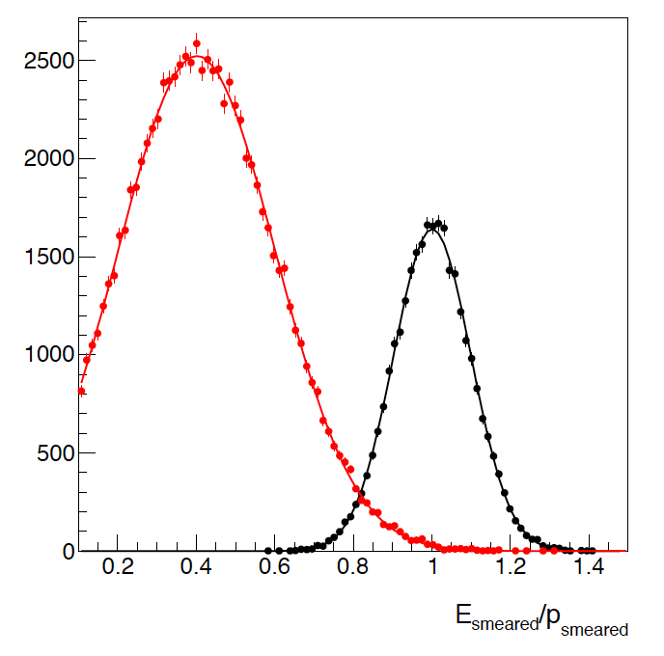
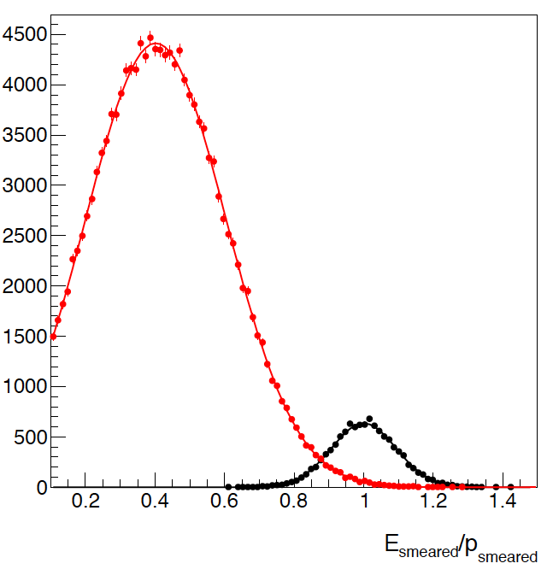
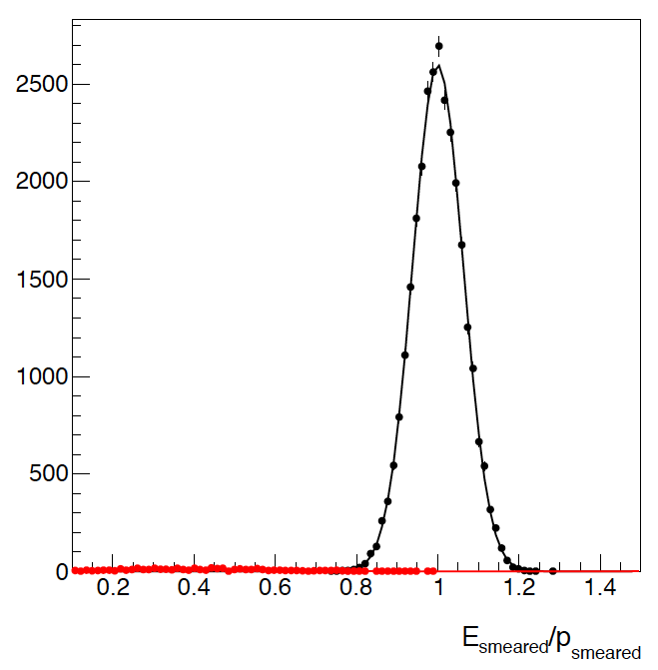
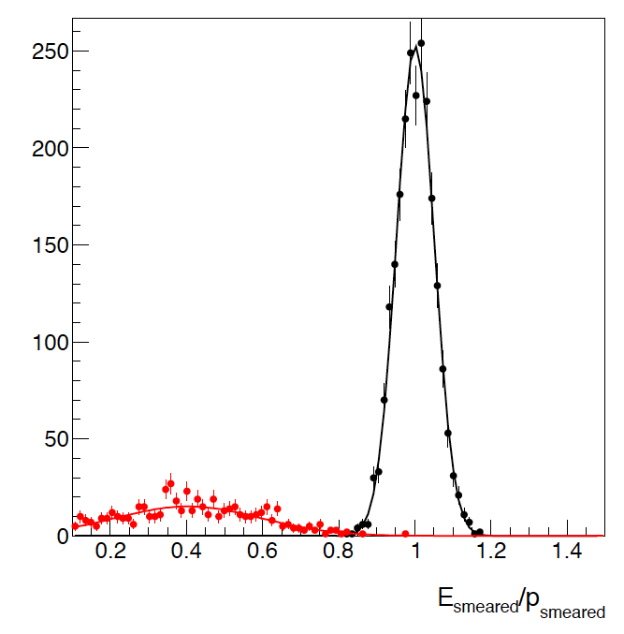
Resolution for E/p
E_{e}: 5 GeV Q²>1 GeV -1<η<1
E_{e}: 20 GeV Q²>1 GeV -1<η<1
1<p<2
Hadron
electron
1<p<3
lepton-hadron
separation at
-1<η<1 seems
to be okay
4<p<5
7<p<9

Slide 20
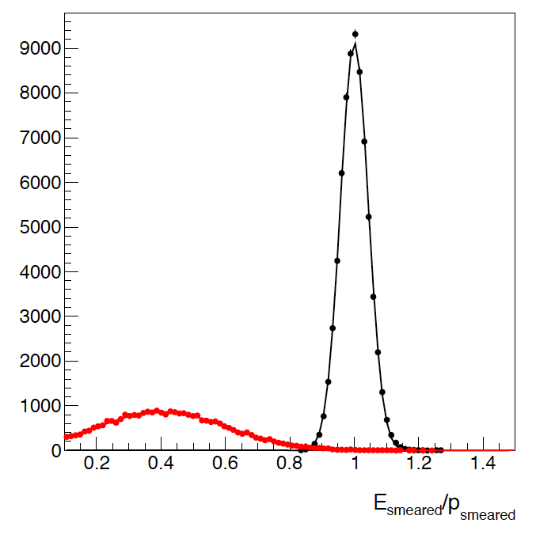
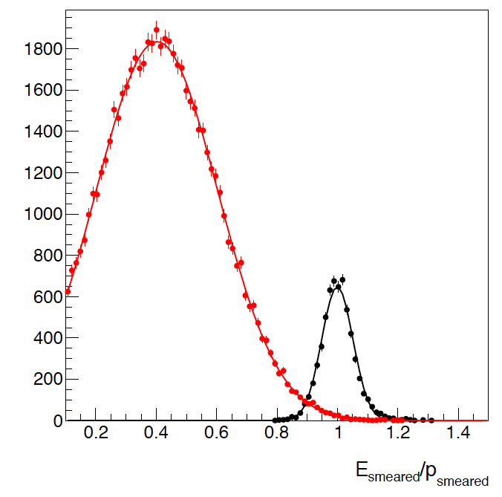
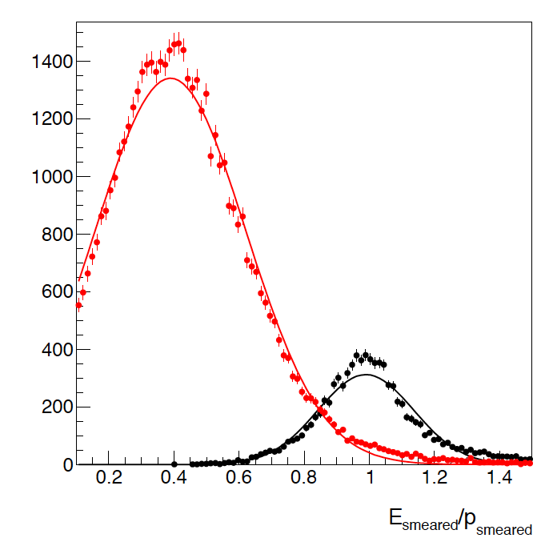
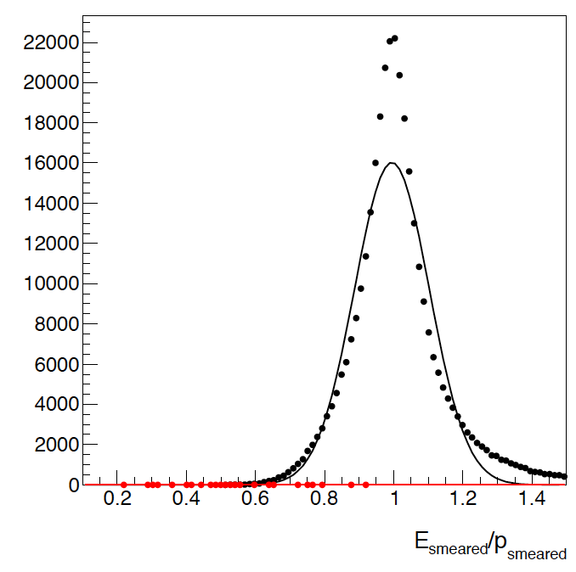
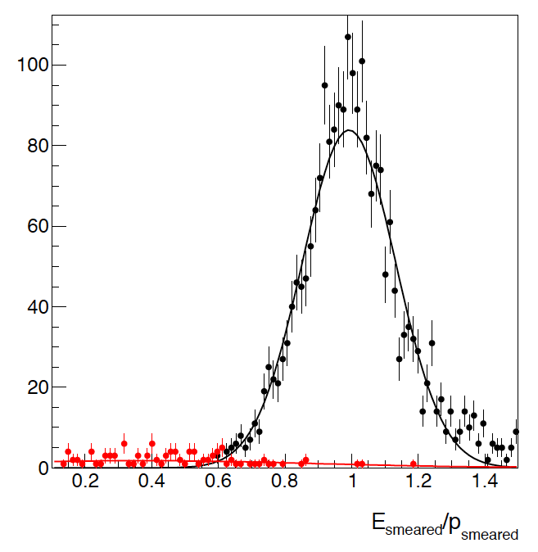
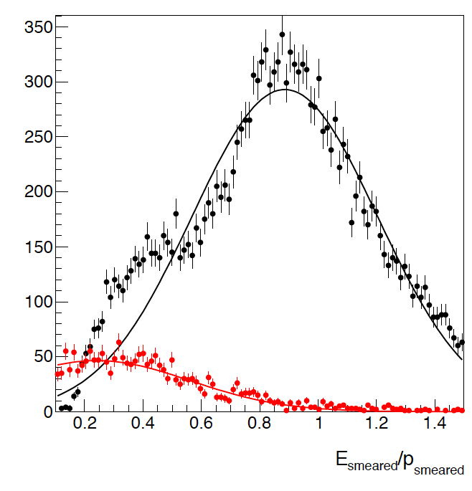
Resolution for E/p
E_{e}: 5 GeV Q²>1 GeV
-2.2<η<-1
E_{e}: 20 GeV Q²>1 GeV
-2<η<-1 -3.7<η<-2
1<p<2
1<p<3
1<p<3
For η > 3 e/p not good enough
need to use ECal and HCal to separate
leptons and hadrons
4<p<5
7<p<9
7<p<9

Slide 21
Hadron Coverage
Cuts: Q²>1 GeV², 0.01<y<0.95, p>1GeV
-3<η<3 covers entire p_{t} & z-region important for physics

Slide 22
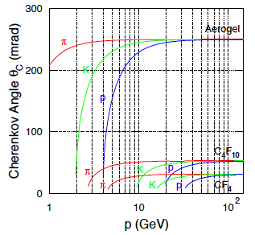
LHC-b: possible RICH design concepts
RICH-1 (modern HERMES RICH) RICH-2
2<p<60 GeV 17<p<100 GeV
25-300 mrad 10-120 mrad
5cm Aerogel (n=1.030) ~200 cm CF₄ (n=1.0005)
85 cm C₄F₁₀ (n=1.0014)

Slide 23
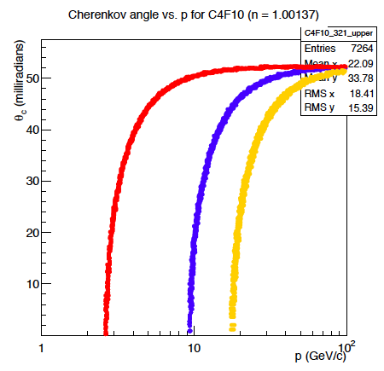
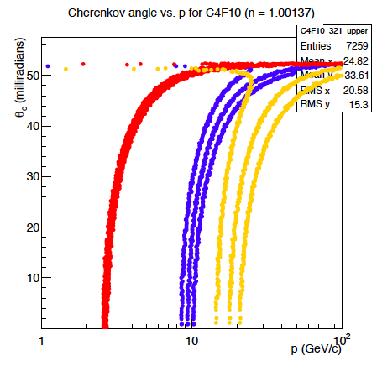
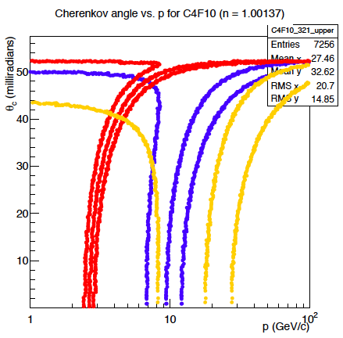
Cerenkov and momentum resolution
δp/p<0.1%
δp/p< 1.0%
δp/p< 3.0%
π
Κ
p
no resolution due to photon detector is yet modeled
momentum resolution absolutely critical for good π, K, p separation

Slide 24
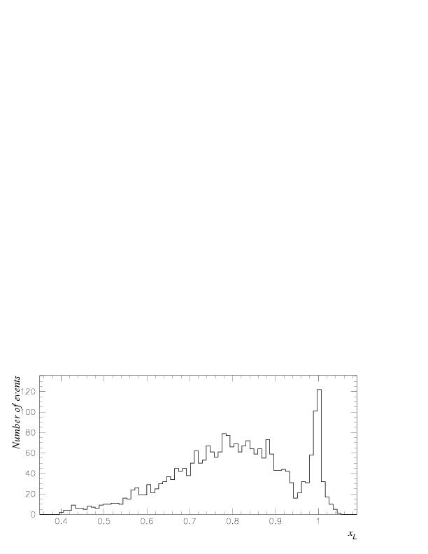
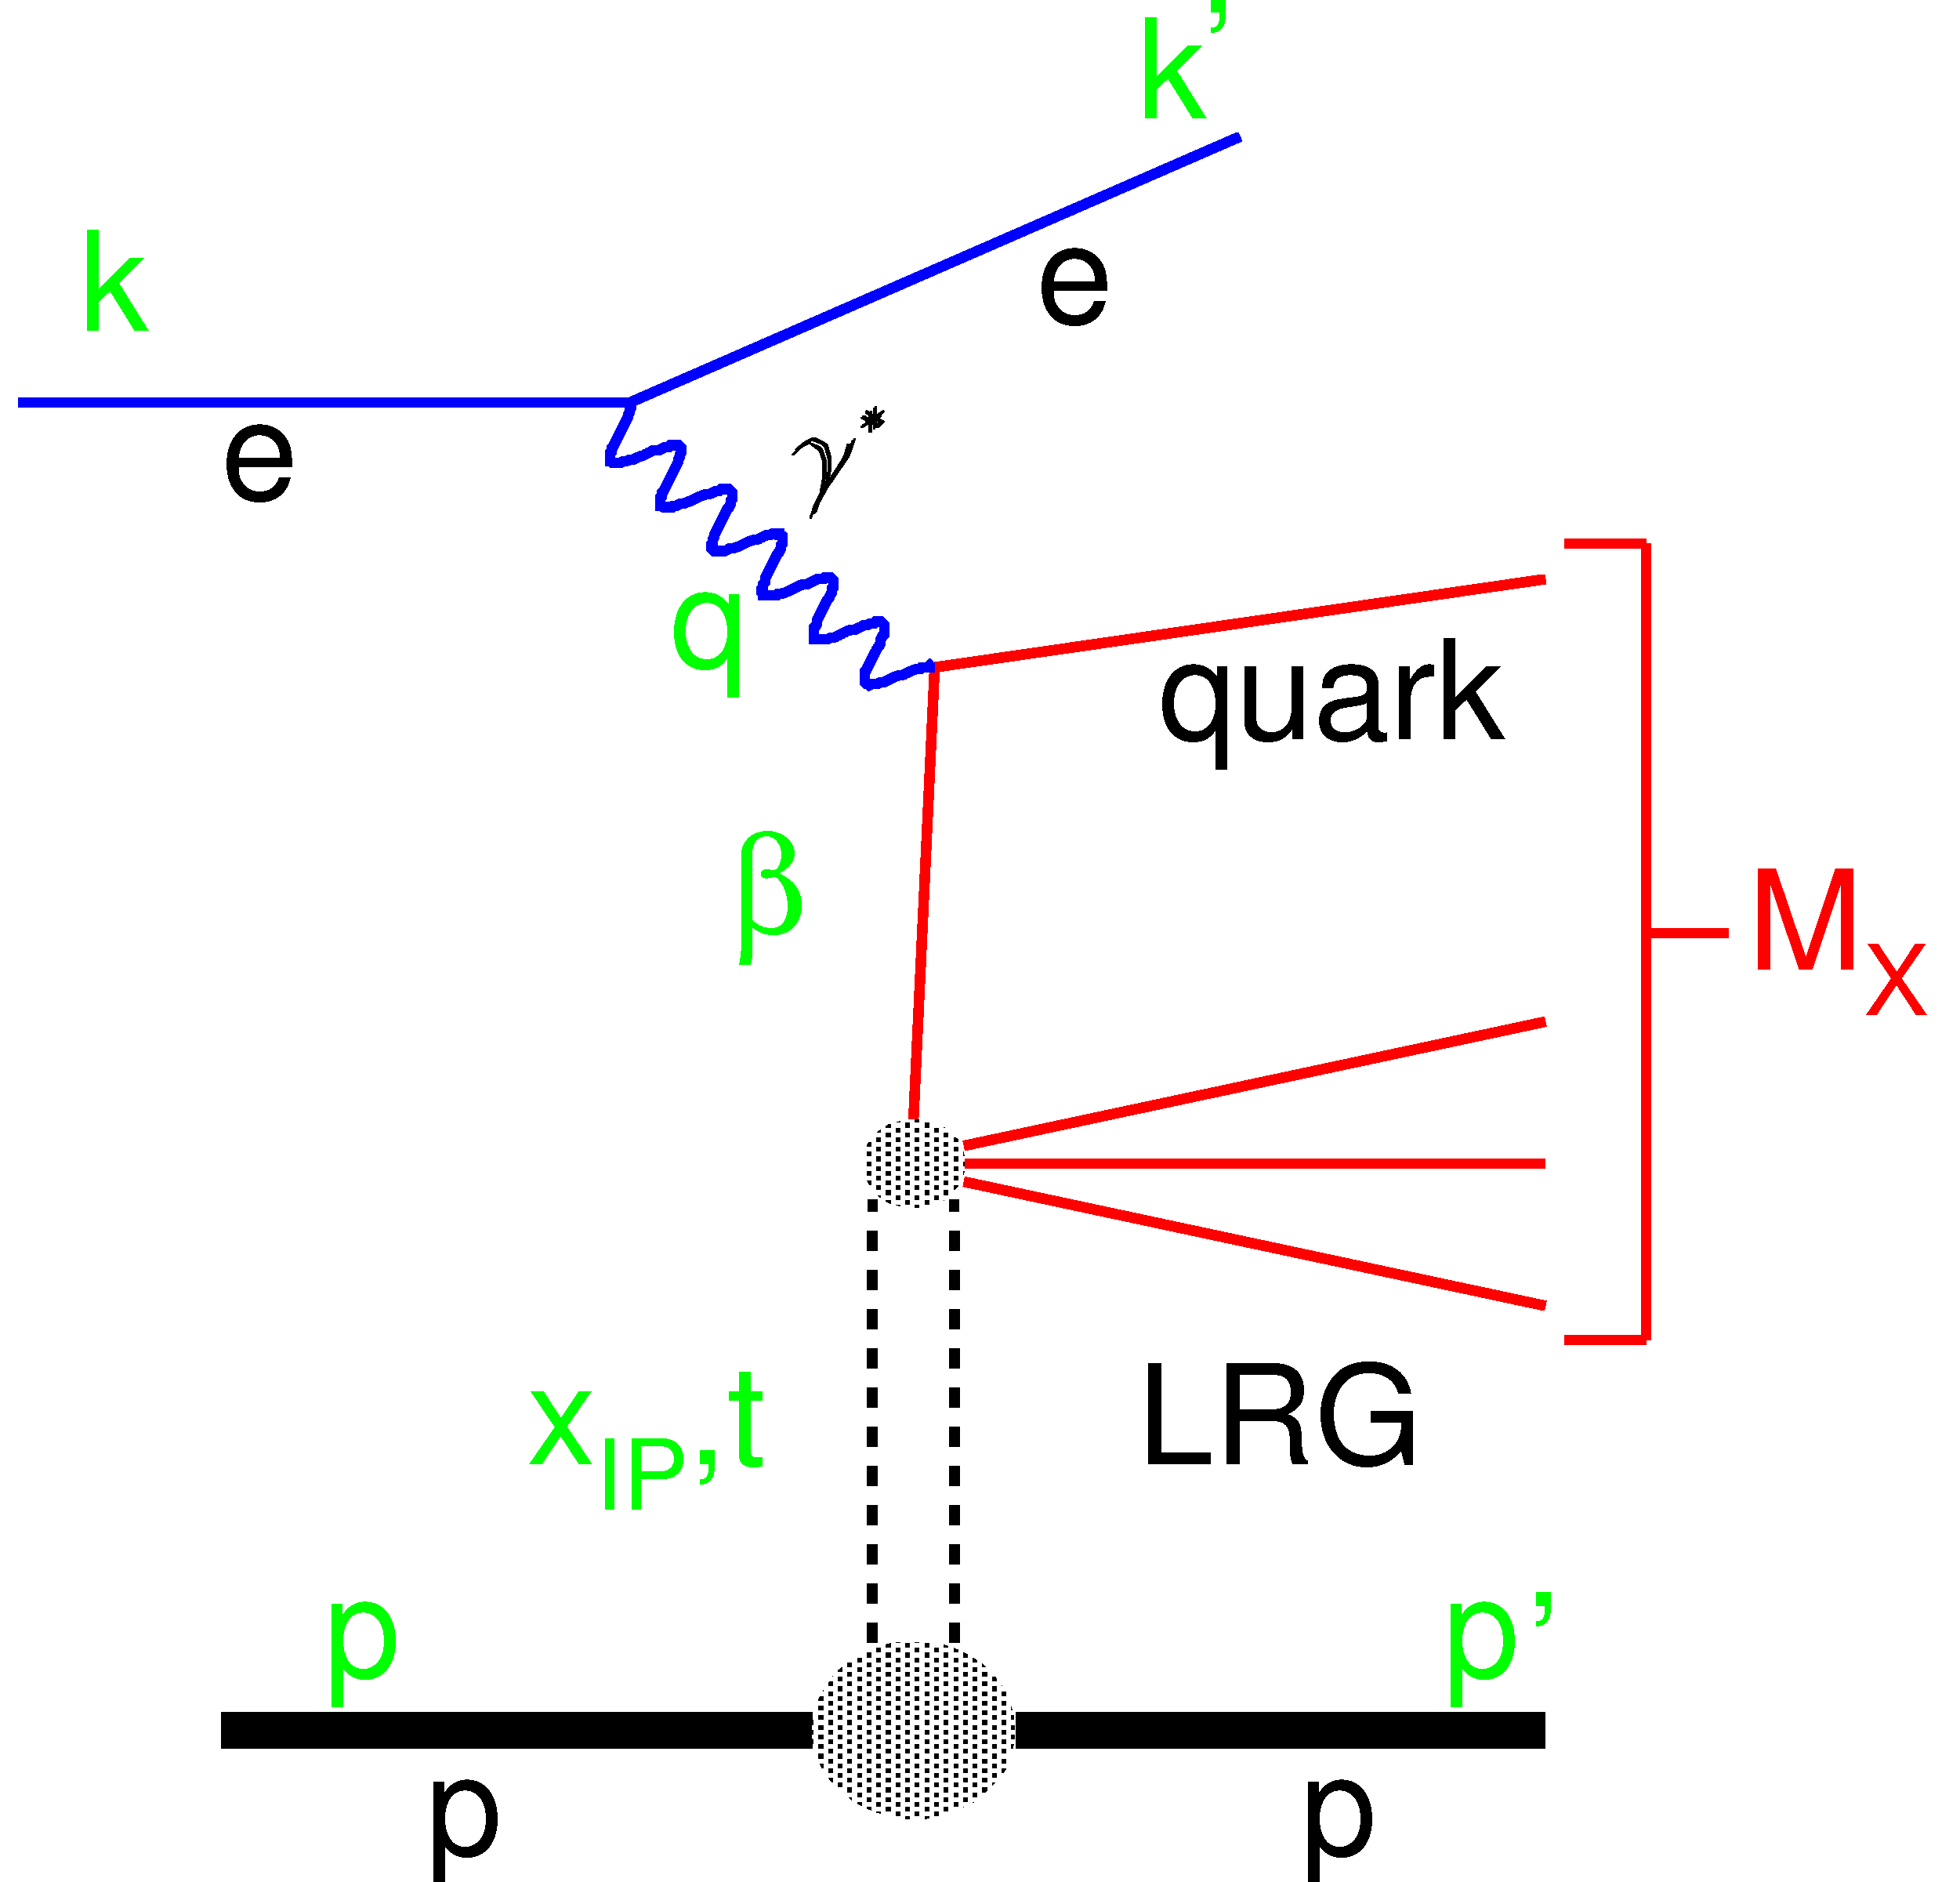
Exclusive Reactions: Event Selection
How can we select events: two methods
proton/neutron tag method
Measurement of t
Free of p-diss background
Higher M_{X} range
to have high acceptance for
Roman Pots / ZDC challenging
→ IR design
Diffractive peak
Need for
roman pot spectrometer
AND
ZDC
Q²
Large Rapidiy Gap method
X system and e’ measured
Proton dissociation background
High acceptance
Need for
Hcal in the forward region
W
M_{Y}

Slide 25
DVCS Kinematics
leading protons are never
in the main detector acceptance at
EIC (stage 1 and 2)
e’
γ
e
γ_{L}*
(Q²)
x+ξ
x-ξ
~
~
p
H, H, E, E (x,ξ,t)
p’
eRHIC detector acceptance
t
DVCS - photon
Cuts: Q²>1 GeV, 0.01<y<0.95, E_{γ}>1 GeV
Increasing Hadron Beam Energy:
influences max. photon energy at fixed η
Increasing 30 GeV < √s < 170 GeV
photons are boosted from symmetric
to negative rapidities

Slide 26
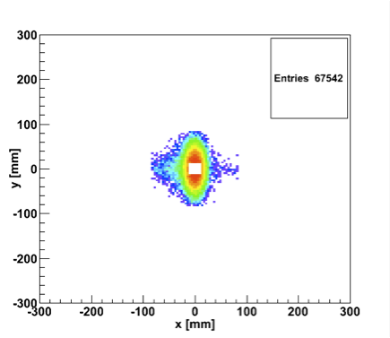
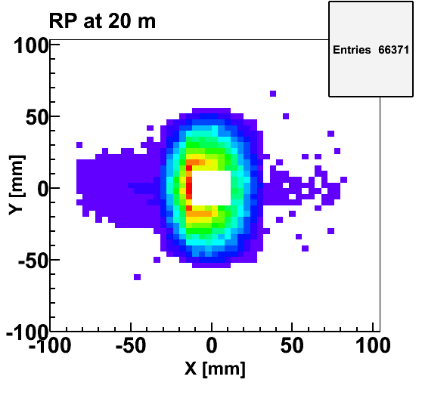
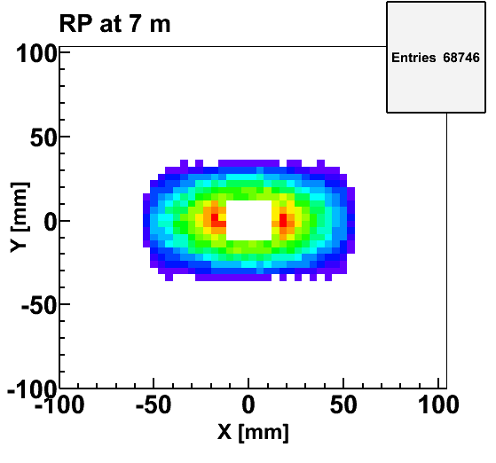
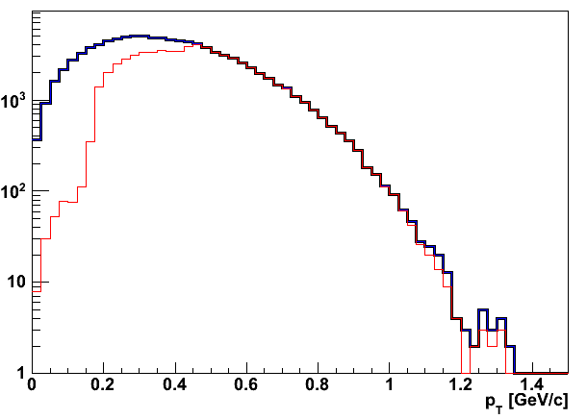
t-Measurement using RP
Accepted in“Roman Pot” at 20m
20x250 GeV
Quadrupoles acceptance
5x100 GeV
5x100 GeV
Simulation based on eRHIC-IR
10s from the beam-pipe
20x250
• high‐|t| acceptance mainly limited by magnet aperture
• low‐|t| acceptance limited by beam envelop (~10σ)
• |t|‐resolution limited by
  – beam angular divergence ~100μrad for small |t|
  – uncertainties in vertex (x,y,z) and transport
  – ~<5-10% resolution in t (follow
  RP at STAR)
Generated
Quad aperture limited
RP (at 20m) accepted

Slide 27
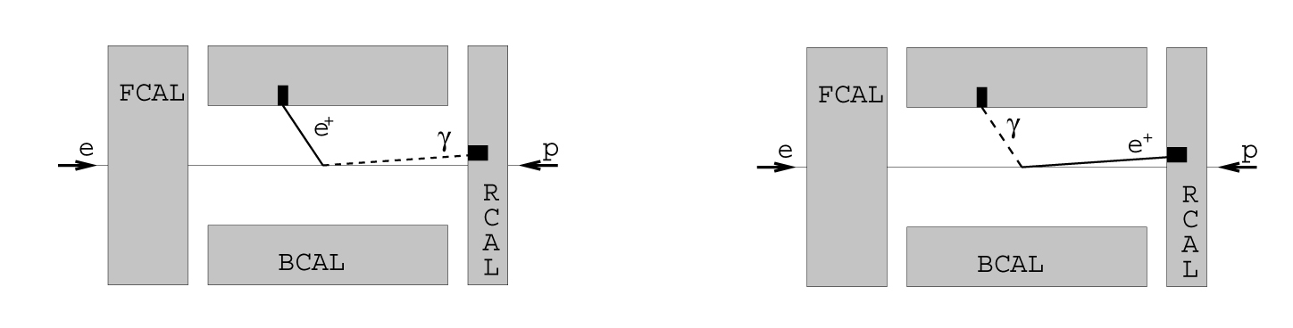
DVCS: Photon-Lepton Kinematics
γ
Δθ
e
N.B. - Need for a ECal with a granularity
to distinguish clusters down to Δθ=1 deg
This is also important for Δφ calculation in asymmetries measurement an for BH rejection in the xsec measurement

Slide 28
BH rejection
BH dominated
BH and DVCS
In DVCS most of the photons are less
“rear” than the electrons:
(θ_{el}-θ_{γ}) > 0 → rejects most of the BH

Slide 29
BH Rejection
BH
DVCS
BH electron has very low energy (often below 1 GeV)
Photon for BH (ISR) goes mostly forward
(into the beam pipe)
Important: ECal must discriminate clusters above noise down to 1 GeV

Slide 30
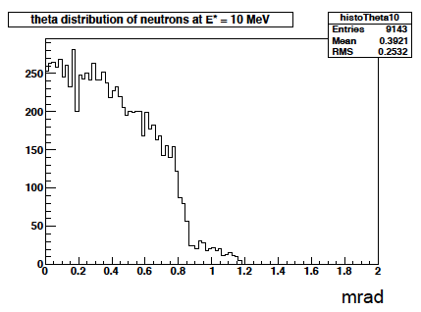
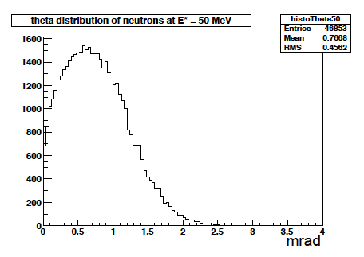
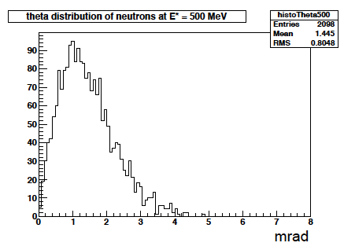
Kinematics of Breakup Neutrons
Results from GEMINI++ for 50 GeV Au
Results:
With an aperture of ±3 mrad we are in good shape
• enough “detection” power for t > 0.025 GeV²
• below t ~ 0.02 GeV² photon detection in very forward direction
Question:
For some physics needed rejection power for incoherent: ~10⁴
→ Critical: ZDC efficiency
+/-5mrad acceptance totally sufficient

Slide 31
Other Critical Systematics
Luminosity Measurement → Relative Luminosity
Polarization measurements

Slide 32
RHIC Polarimetry
Polarized hydrogen Jet Polarimeter (HJet)
  Source of absolute polarization (normalization of other polarimeters)
  Slow (low rates ⇒ needs looong time to get precise measurements)
Proton-Carbon Polarimeter (pC) @ RHIC and AGS
  Very fast ⇒ main polarization monitoring tool
  Measures polarization profile (polarization is higher in beam center) and lifetime
  Needs to be normalized to HJet
Local Polarimeters (in PHENIX and STAR experiments)
  Defines spin direction in experimental area
  Needs to be normalized to HJet
All of these systems are necessary for the proton beam polarization measurements and monitoring

Slide 33
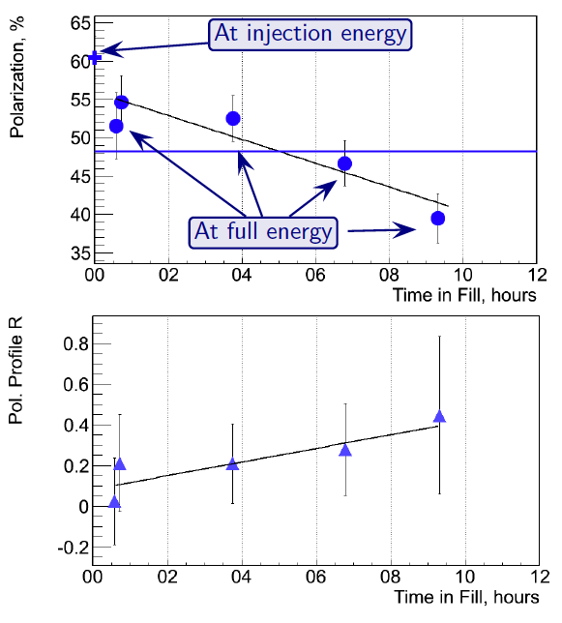
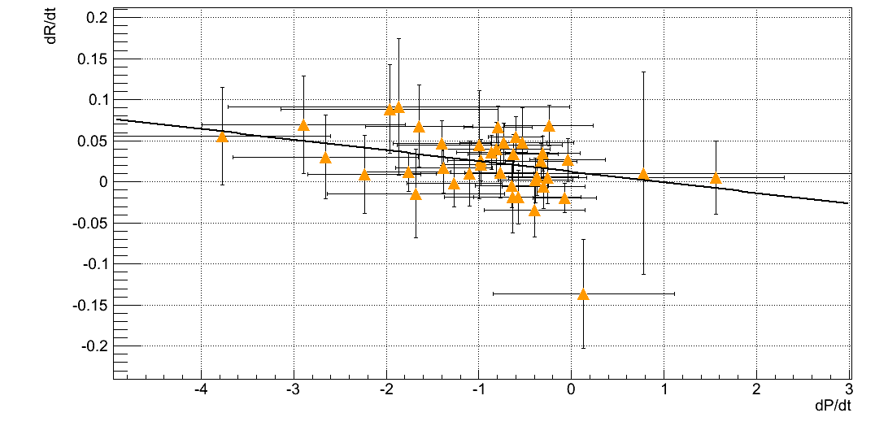
Hadron Polarisation
Account for
beam polarization decay through fill → P(t)=P₀exp(-t/τ_{p})
growth of beam polarization profile R through fill
pCarbon
polarimeter
Collider
Experiments
x=x₀
Result:
Have achieved 6.5% uncertainty for DSA and 3.4 for SSA
correlation of
dP/dt to dR/dt
for all 2012 fills
at 250 GeV
Polarization lifetime has consequences for physics analysis
different physics triggers mix over fill
  → different <P>

Slide 34
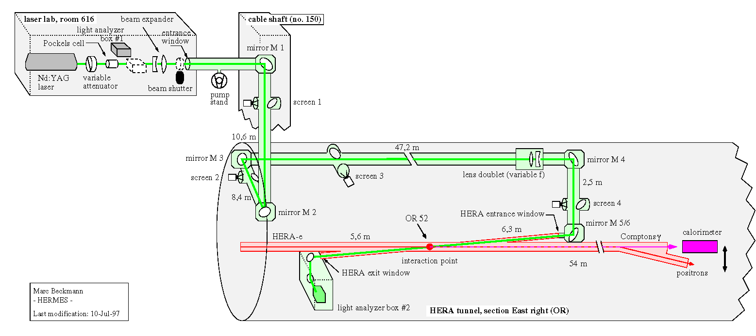
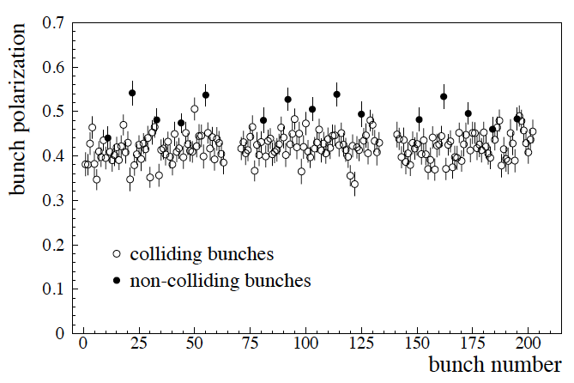
Lepton Polarization
Method: Compton backscattering
Questions, which need still answers
  how much does the polarization vary from bunch to bunch
    yes: need a concept to measure bunch by bunch polarisation in an ERL
    no: measure the mean of all bunches → what is done now at JLab
  is there the possibility for a polarization profile
    yes: how can we measure it ?
    no: makes things much easier
572 nm pulsed laser
laser transport system: ~80m
laser light polarisation measured
continuously in box #2

Slide 35
Luminosity Measurement
Concept:
Use Bremsstrahlung ep → epγ as reference cross section
  normally only γ is measured
  Hera: reached 1-2% systematic uncertainty
BUT:
coupling between polarization measurement uncertainty and uncertainty achievable for lumi-measurement
have started to estimate a with the help of Dieter Mueller
  hopefully a is small

Slide 36
Summary
A lot of work was done, but far from complete
  could need help
Basic Detector Performance Requirements determined
All tools in place to optimize overall detector performance
  optimize tracking performance vs. ECal /Hcal performance
    lepton hadron separation
    scattered lepton kinematics
  study momentum resolution impact on π,K,p separation
  perform full analysis of golden bench mark physics channels
Study on relative luminosity requirements and polarization measurements underway
  impact on systematic uncertainties
Note:
having huge luminosity means there is the need to control the systematic uncertainties to very low levels.

Slide 37
BACKUP

Slide 38
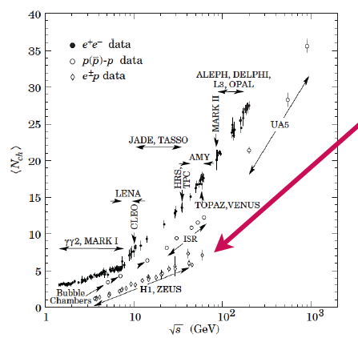
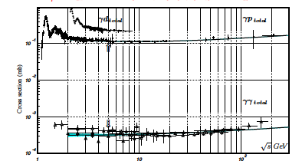
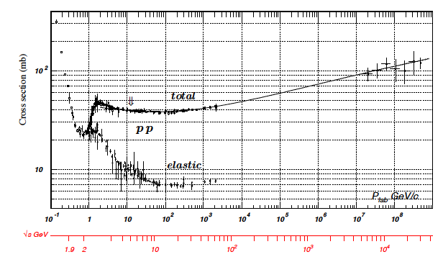
Some thought about rates
low multiplicity
4-6 √s = 40-65 GeV
N_{ch} (ep) ~ N_{ch} (eA) < N_{ch}(pA)
→ no occupancy problem
Cross section:
Pythia σ_{ep}: 0.030 – 0.060 mb
Luminosity: 10³⁴ cm⁻¹ s⁻¹ ⁼ 10⁷ mb⁻¹ s⁻¹
Interaction rate:
300 -600 kHz

Slide 39
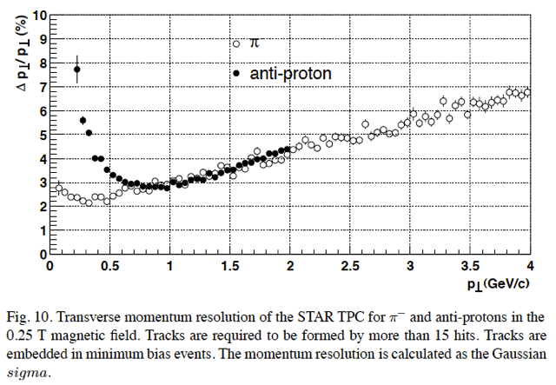
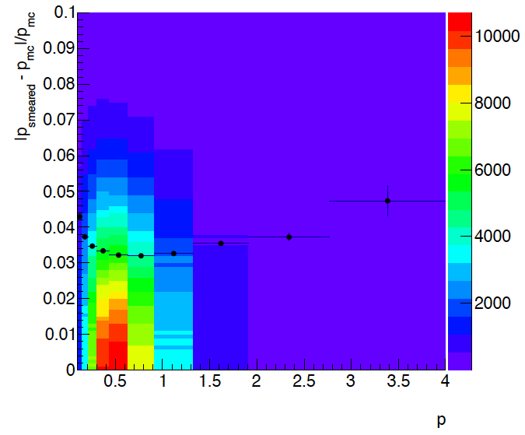
Fast Simulator: Check
Used fast smearing simulator
  multiple scattering and momentum smearing included according to PDG
  check against STAR results at central region → looks okay
  for details: https://wiki.bnl.gov/conferences/images/d/d1/R%26DOctoberSmearing.pdf
-1< η <1
assumed 0.05 radiation lengths

Slide 40
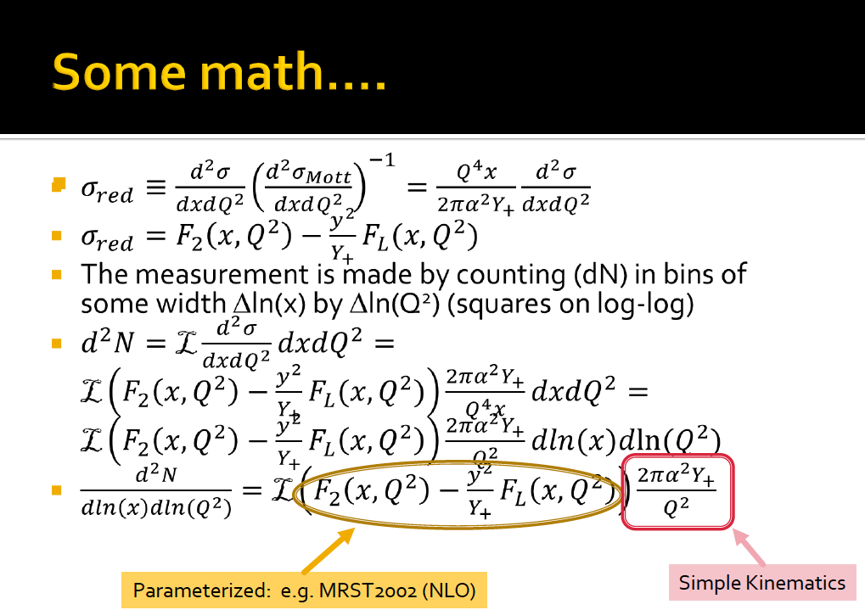
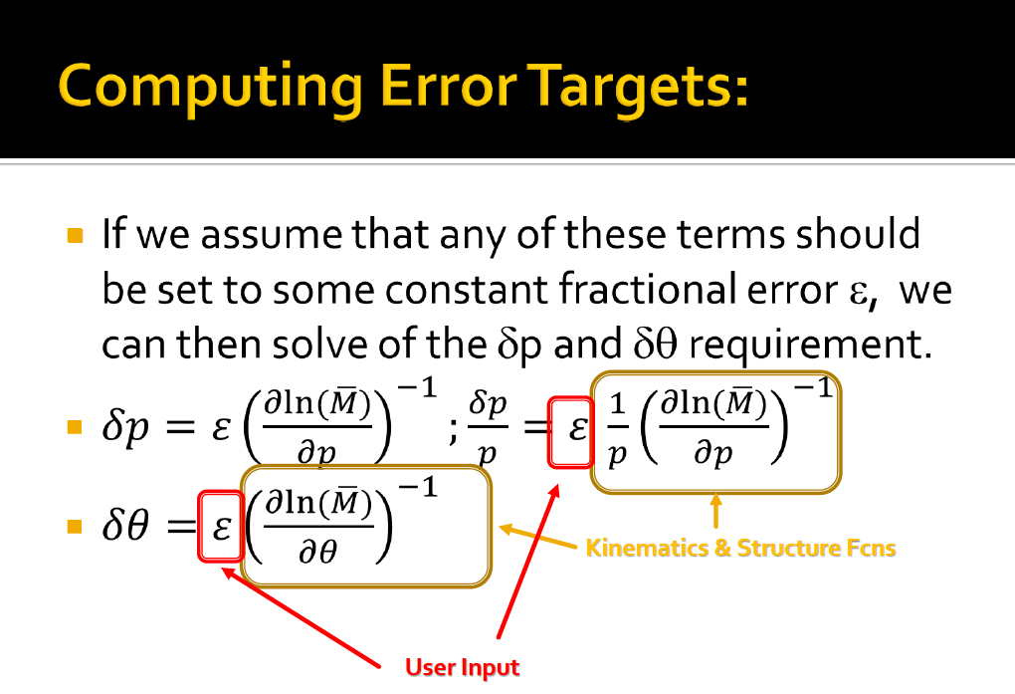

CHIPAS
Chiapas does semi-analytical calculation of detector resolution
and coverage necessary to achieve physics goals.
  Simple extensions to Chiapas will allow for material budget calculations as well
T. Hemmick: https://wiki.bnl.gov/conferences/images/0/09/Chiapas-Sim.pdf

Slide 41



CHIPAS-Results
5 GeV x 100 GeV
ε=0.20
5 GeV x 100 GeV
ε=0.05

Slide 42



Measuring FL with the EIC (II)
In order to extract F_{L} one needs at least two measurements of the inclusive cross section with “wide” span in inelasticity parameter y (Q² = sxy)
F_{L} requires runs at various √s ⇒ longer program
Need sufficient lever arm in y²/Y⁺
Limits on y²/Y⁺:
At small y:
detector resolution for e’
At large y:
radiative corrections and charge symmetric background
EIC studies:
Statistical error is negligible
in essentially whole range
Systematical Error
Calibration
Normalization
Experiment
Radiative Corrections
Need to combine bins according to the detector resolution
Final y-range needs full MC study
Notes:
Lowest value of x and Q2 :
y y2/Y+ proton p
0.7 0.44 100
0.54 0.24 130
0.28 0.28 250

Slide 43

HERA: σ_{r} and F_{L}
H1

Slide 44

Integration into Machine: IR-Design
Outgoing electron direction currently under detailed design
detect low Q² scattered leptons
want to use the vertical bend to separate very low-Θ e’ from beam-electrons
can make bend faster for outgoing beam → faster separation
for 0.1º<Θ<1º will add calorimetry after the main detector
space for
low-Θ e-tagger

Slide 45
lepton kinematics

Slide 46
Simulation Example
Cuts: Q²>1 GeV, 0.01<y<0.95, z>0.1

Slide 47

Emerging Detector Concept
Magnet 2-3T
Backward Spectrometer
For very low Q²-electrons:
space for low-Θ
e-tagger
high acceptance -5 < η < 5 central detector
good PID (π,K,p and lepton) and vertex resolution (< 5μm)
tracking and calorimeter coverage the same → good momentum resolution, lepton PID
  Barrel: MAPS & TPC, Forward: MAPS & GEM
low material density → minimal multiple scattering and brems-strahlung
very forward electron and proton/neutron detection → Roman Pots, ZDC, low e-tagger

Slide 48


Diffractive Physics: p’ kinematics
Diffraction:
t=(p4-p2)² = 2[(mp^{in}.mp^{out})-(E^{in}E^{out} - pz^{in}pz^{out})]
→ “ Roman Pots” acceptance studies see later
?
5x50
p’
5x100
5x250
Simulations by J.H Lee

Slide 49




proton distribution in y vs x at s=20 m
without quadrupole aperture limit
20x250
5x50
with quadrupole aperture limit
20x250
5x50

Slide 50



Accepted in“Roman Pot”(example) at s=20m
20x250
5x50
Summary:
Still a lot of work to be done
  But we have started to address all the important issues
    integration of detector and forward particle reconstruction into
    machine design
    Synchrotron radiation
    ………
20x250
5x50
Generated
Quad aperture limited
RP (at 20m) accepted

Slide 51


Detection efficiency of Breakup Neutrons
Results:
With an aperture of ±3 mrad we are in relative good
shape even for 50 GeV Au beams
• enough “detection” power for t > 0.025 GeV²
• below t ~ 0.02 GeV² we have to look into photon detection
‣ Is it needed?
Assumptions:
• Gemini++ is correct, was verified by SMM
• E* ~ -t/2mN
• Can we make a ZDC 100% (>99.9999%) efficient
‣ do we understand neutron detection on the 10⁻⁴ level?

Slide 52


Principle of P_{e} Measurement with the LPOL
λ (2.33 eV)
e (27.6GeV)
back scattered
Compton photons
Calorimeter (Eγ)
Calorimeter position
Compton Scattering:
e+λ g e’+γ
Cross Section:
dσ/dE_{γ} = dσ₀/dE_{γ}[1+ P_{e}P_{λ}A_{z}(E_{γ})]
dσ₀, A_{z}: known (QED)
P_{e}: longitudinal polarization
of e beam
P_{λ}: circular polarization (±1)
of laser beam
NaBi(WO₄)₂ crystal calorimeter
Compton edge:
Asymmetry:
Segmentation:
position detection of Compton photons

Slide 53


Polarimeter Operation
Laser Compton scattering off HERA electron Pulsed Laser – Multi Photon Flip laser helicity and measure energy sum of scattered photons
Multi-Photon Mode
Advantages: - eff. independent of brems. bkg and photon energy cutoff - dP/P = 0.01 in 1 min Disadvantage: - no easy monitoring of calorimeter performance
A_{m} = (Ι_{3/2} – Ι_{1/2}) / (Ι_{3/2} + Ι_{1/2}) = P_{e} P_{λ} A_{p}
A_{p} = (Σ_{3/2} – Σ_{1/2}) / (Σ_{3/2} + Σ_{1/2}) = 0.184 (if detector is linear)

