Slide 1
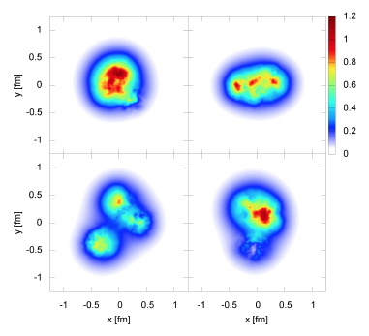
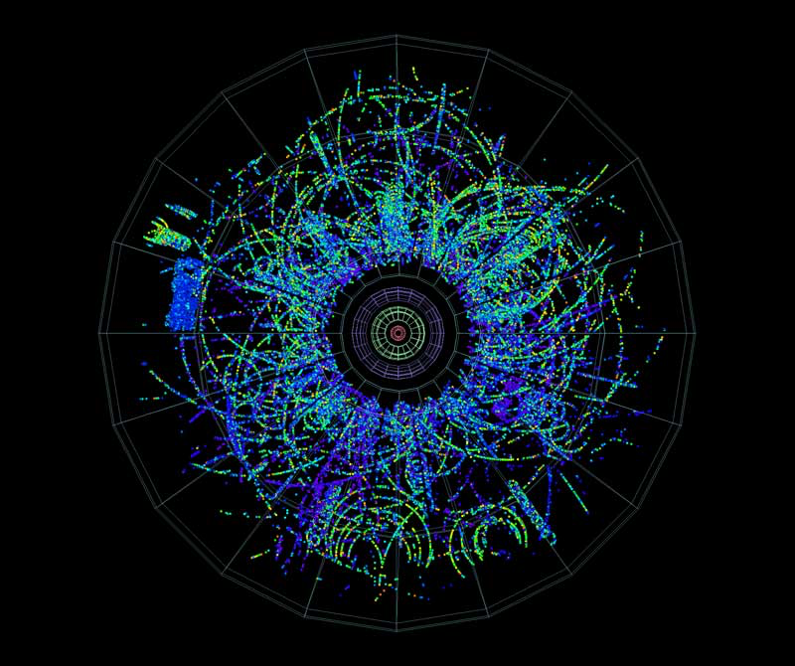
Parton model description of multiparticle azimuthal cumulants in p+A collisions
Raju Venugopalan
Brookhaven National Laboratory
ALICE Collaboration: p+A collision event
Mantysaari,Schenke,arXiv:1603.043049
RBRC pA workshop, June 26-28, 2017

Slide 2
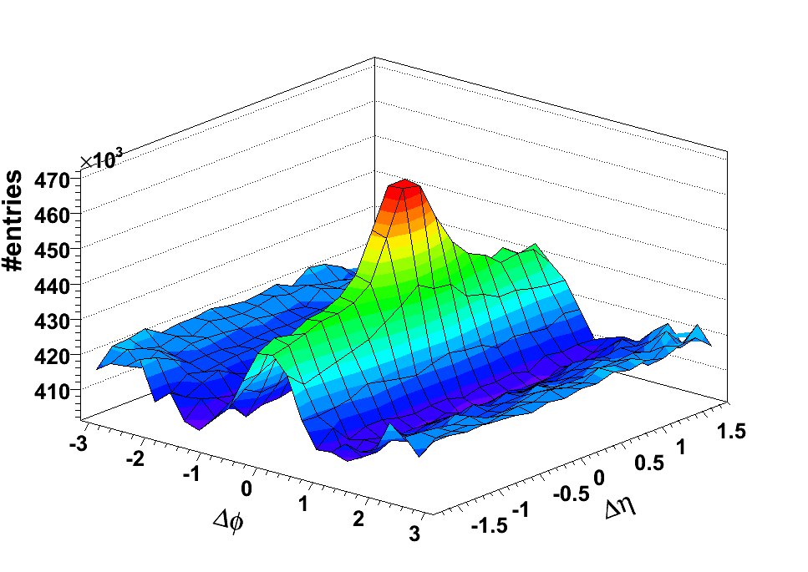
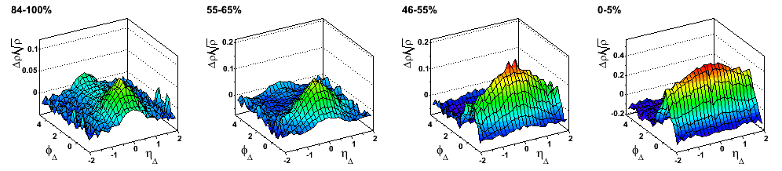
Azimuthal correlations in A+A collisions: the ridge
Di-hadron
correlations
Au+Au 0-10%
STAR arXiv:0909.0191
Novel long range “near-side”
(Δϕ≈0) collimation
Long range “away-side”
(Δϕ≈π) correlations
suppressed…jet quenching
associated
Δϕ
trigger
3 < p_{t,trigger} < 4 GeV
p_{t,assoc.} > 2 GeV
Also seen in untriggered correlations
83-94%
55-65%
46-55%
0-5%
STAR Preliminary
STAR Preliminary
STAR Preliminary
STAR Preliminary
η_{Δ} width
First seen by RHIC Au+Au experiments: STAR, PHOBOS, PHENIX

Slide 3
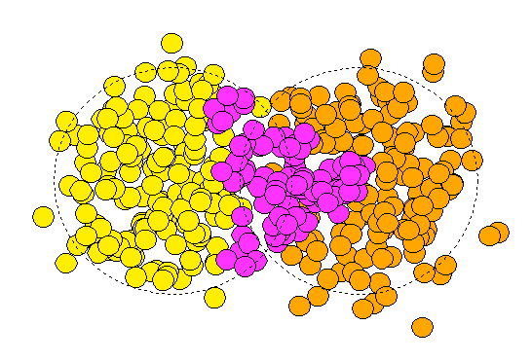
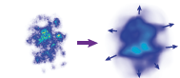
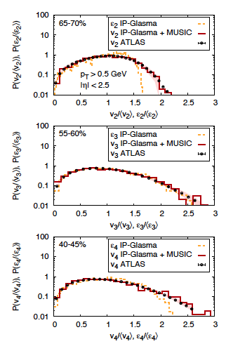
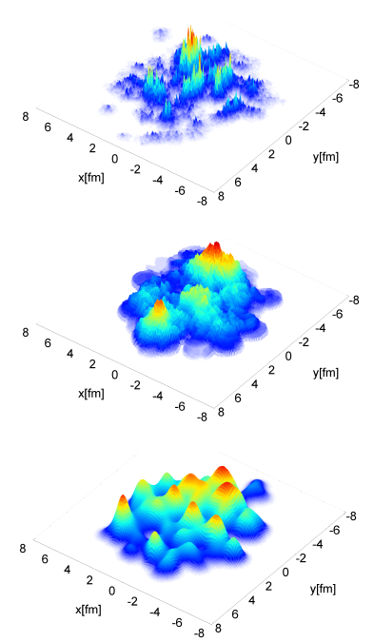
The A+A ridge and “collectivity”
ψ₃
Alver,Roland, PRC81(2010)054905
Alver, Gombeaud, Luzum, Ollitrault,
PRC82 (2010) 03491
Structure of ridge correlations: hydrodynamic flow driven by
event-by-event ``eccentricity” fluctuations in nucleon positions
In hydro: multi-particle correlations factorize into product of single particle distributions that are commonly correlated to an “event plane”
IP-Glasma
η/s=0.2
Some evidence of sensitivity of data to sub-nucleon scale fluctuations
Gale,Jeon,Schenke,Tribedy,Venugopalan, PRL110 (2013) 012302

Slide 4
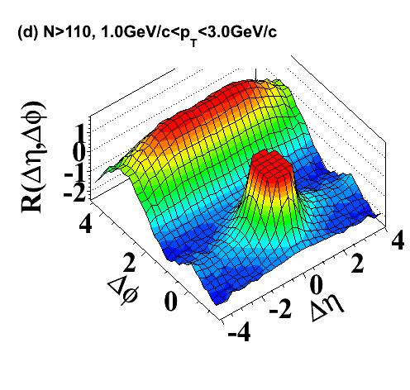
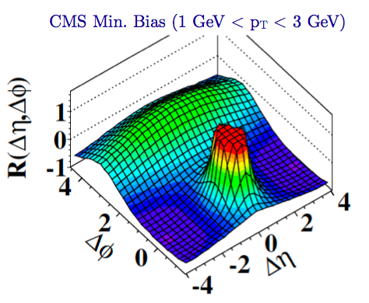

Two particle correlations: CMS results
Di-hadron
correlations
“Discovery”
associated
Δϕ
trigger
Observation of Long-Range Near-Side Angular Correlations in Proton-Proton Collisions at the LHC CMS Collaboration (Vardan Khachatryan (Yerevan Phys. Inst.) et al.). JHEP 1009 (2010) 091
Cited by 566 records
5th most cited CMS physics paper to date!

Slide 5
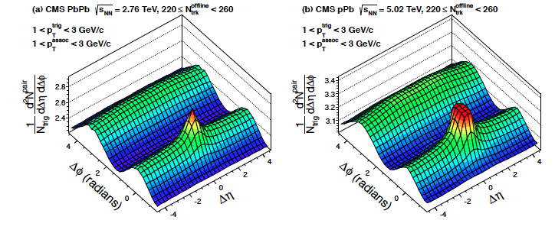
Striking results from LHC p+A collisions
p+A ridge much large than p+p at same multiplicity
and nearly as large as that in peripheral Pb+Pb collisions

Slide 6
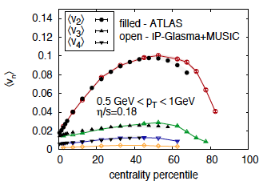
What’s the smallest sized QGP droplet?
IP-Glasma: CGC based framework employing Yang-Mills evolution of two lumpy light cone sources
MUSIC: Event-by-event relativistic viscous hydrodynamics
Schenke, Venugopalan, PRL 113 (2014) 102301
Where does the hydro paradigm break down?

Slide 7
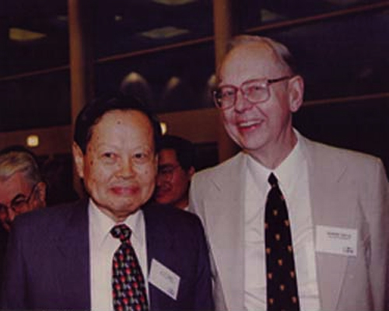
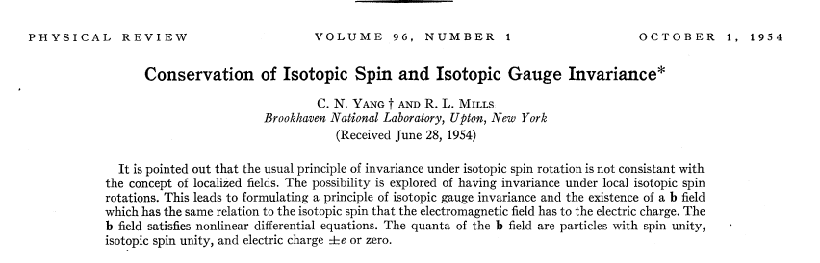
Fundamental feature of QCD: Yang-Mills Theory
Possibly the most important paper from BNL…yet not mentioned in the
APS plaque on BNL’s historic achievements … outside in the Lounge
The J (aka J/ψ) discovery--November revolution, 1974--didn’t make it in either…

Slide 8
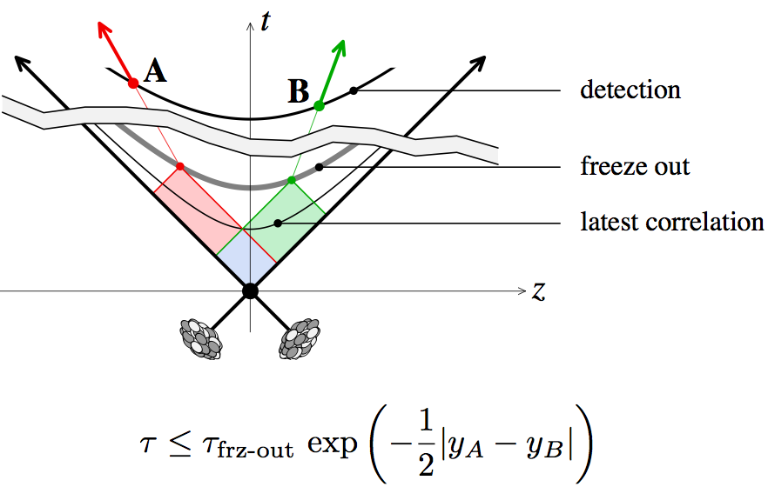
Long range rapidity correlations as a chronometer
Long range correlations sensitive to very early time (fractions of
a femtometer ~ 10⁻²⁴ seconds) dynamics in collisions
Dumitru,Gelis,McLerran,Venugopalan, arXiv:804.3858

Slide 9
What’s the underlying QCD dynamics?
Is it final state collective flow of the world’s smallest droplets?
Is it the initial state dynamics arising from rare configurations in the hadron wavefunctions?
Or, is it some combination, where there is a smooth transition from one description to the other?
Option 1 stretches to the limit -- the applicability of thermodynamic and
hydrodynamic concepts in high energy physics
Option 2 stretches to the limit -- our understanding of the quark-gluon
sub-structure of hadrons

Slide 10
Sensitive measure of collectivity: azimuthal cumulants
2m-particle azimuthal cumulants
Borghini,Dinh,Ollitrault, nucl-th/0105040
If cumulants factorize into product of correlations relative to a reaction plane,
define flow coefficients:
Spatial eccentricities:
A number of simple “Gaussian” models give
Hydro linear response:
Gardim,Grassi,Luzum,Ollitrault, PRC (2012)024908; Niemi,Denicol,Holopainen,Huovinen, PRC87 (2013)054901
Bzdak,Bozek,McLerran, arXiv:1311.7325, Bzdak, Skokov, arXiv: 1312.7349
Yan, Ollitrault, arXiv:1312.6555, Basar,Teaney, arXiv:1312.6770

Slide 11
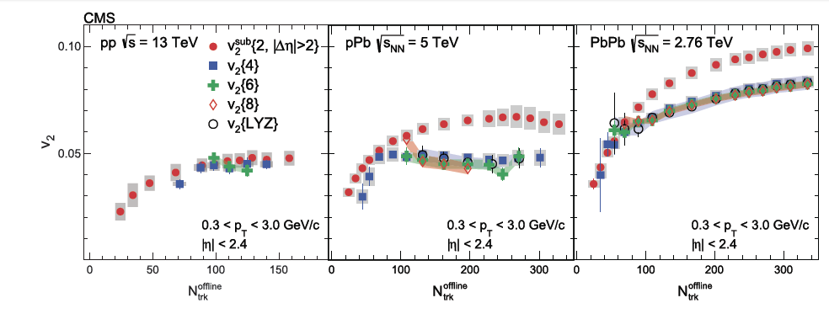
Collectivity across system size

Slide 12
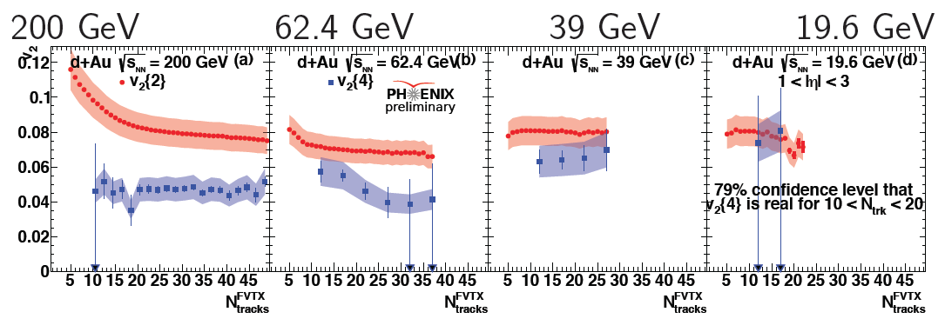
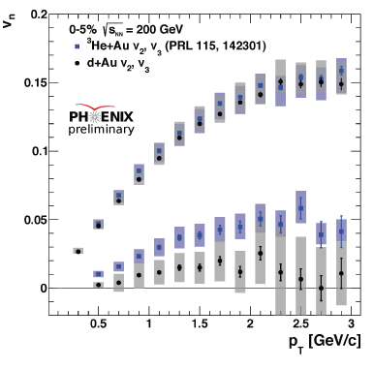
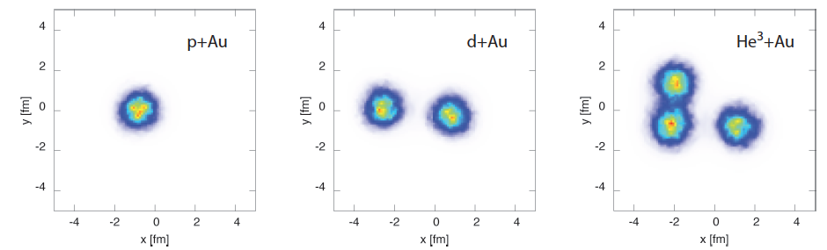
Collectivity across wide energy scales
Schenke, RV:1407.7557

Slide 13
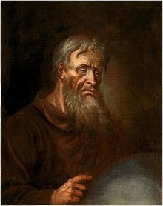
Panta Rhei?
Heraclitus of Ephesus
535-475 BC
Natural in hydro – yet, very few ab initio hydro computations of 4-particle
cumulants for p+A -- none for p+p
Problems with hydro interpretation for small systems:
i) Absence of “jet” quenching
ii) Lack of convergence of hydro expansion (large Knudsen numbers)
iii) Effects seen for small multiplicity and high p_{T} (9 GeV)

Slide 14
Can we understand multiparticle correlations in an ab initio approach ?
Review: Dusling,Li,Schenke, arXiv:1509.07939

Slide 15
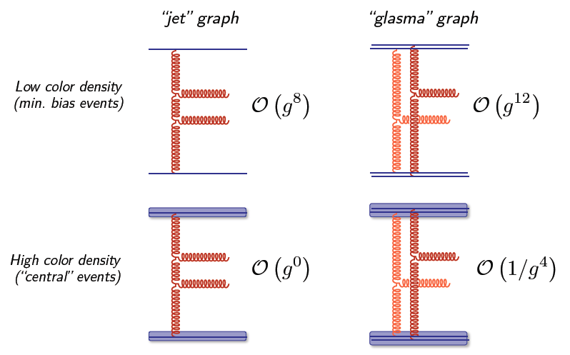
Glasma graph approximation: power counting
Gluons with k_{T} ~ Q_{S} resolve
n ~ 1/g² color sources
Effective coupling: g*n ~ 1/g
Huge enhancement of Glasma graphs for
high parton densities…
Dumitru,Dusling,Gelis,Jalilian-Marian,
Lappi,Venugopalan, PLB697 (2011)21
Dusling,Venugopalan,PRL108 (2012)262001

Slide 16
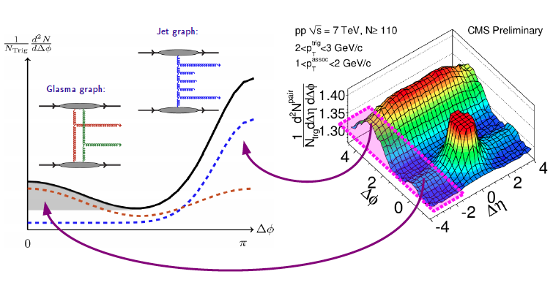
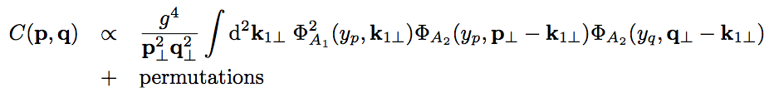
Anatomy of long range collimations
RG evolution of Glasma graphs:
RG evolution of the mini-jets:
Good agreement with data for p_{T}> Q_{S}
However no odd harmonics v₃, v₅ for gluons
because C(p,q) = C(p,-q)
Dusling,RV, PRD 87, 051502 (R) (2013); PRD87 (2013) 094034
Dusling,Tribedy,RV,PRD93 (2016) 014034

Slide 17
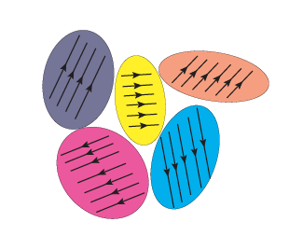
Tracing azimuthal initial state correlations
Simple ab initio initial state model:
Multi-particle correlations from Eikonal scattering of partons off color domains in a nuclear target
Lappi, arXiv:1501.05505
Lappi,Schenke,Schlichting,RV, arXiv:1509.03499
Dusling,Mace,RV, arXiv:1705.00745
1/Q_{S}
Color domain model:
Kovner,Lublinsky,arXiv:1012.3398,1109.0347
Dumitru,Gianini, arXiv:1406.5781
Dumitru,Skokov,arXiv:1411.6630,
Dumitru,McLerran,Skokov,arXiv:1410.4844

Slide 18
Eikonal scattering: the parton model
Color rotation of parton in external field by a lightlike Wilson line
Parton distribution after coherent multiple scattering off nucleus:
Wigner function
Dipole correlator
B is transverse area of proton
Bjorken, Kogut, Soper, Phys. Rev., D3:1382, (1971)
Dumitru, Jalilian-Marian, Phys. Rev. Lett., 89:022301, (2002)

Slide 19
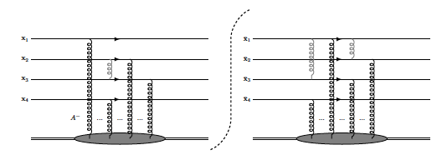

Multiparton Eikonal scattering
Two partons:
Four partons:
and so on …
Oversimplification: n-particle Wigner distributions factorize

Slide 20
Averaging over color representations in the target
Dipole correlator is evaluated in the MV model where color correlations in the target are Gaussian (random walk in color)
gives

Slide 21
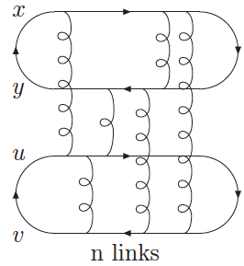
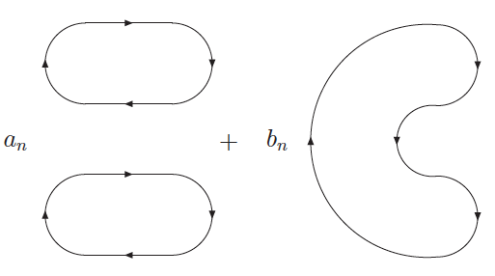
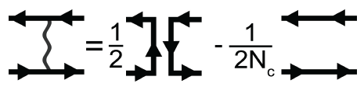
Averaging over multi-point dipole correlators
To compute the 2-dipole correlator:
dipoles
quadrupole
Use
This gives
Equivalently,
Kovner, Wiedemann, Phys. Rev., D64:114002, (2001)
Fujii, Nucl. Phys., A709:236 (2002).
Blaizot, Gelis, Venugopalan. Nucl. Phys., A743:57, (2004)
Dominguez, Marquet, Wu, Nucl. Phys., A823:99, (2009)
Iterate, diagonalize,exponentiate,
to compute correlator

Slide 22
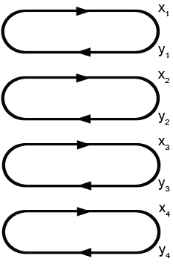
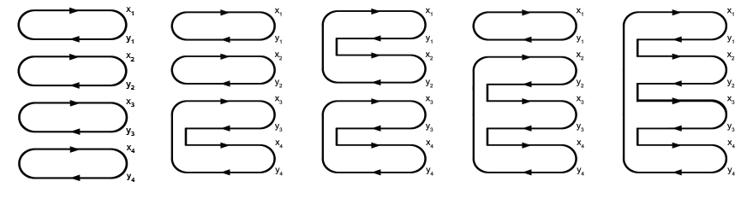
Averaging over multi-point dipole correlators
4-dipole correlator:
To compute n-gluon
exchange,
diagonalize 24×24 matrix
and exponentiate
dipoles
quadrupoles
sextupole
octupole
Dusling,Mace,Venugopalan, arXiv:1705.00745 & 1706.06260

Slide 23


Results for azimuthal anisotropies from multiparton eikonal scattering
Dusling,Mace,Venugopalan,arXiv:1705.00745
Dusling,Mace,Venugopalan, arXiv:1706.06260
My hard working collaborators…

Slide 24
Objects to be computed
N-particle distributions:
Two-particle cumulants:
Four-particle cumulants:

Slide 25
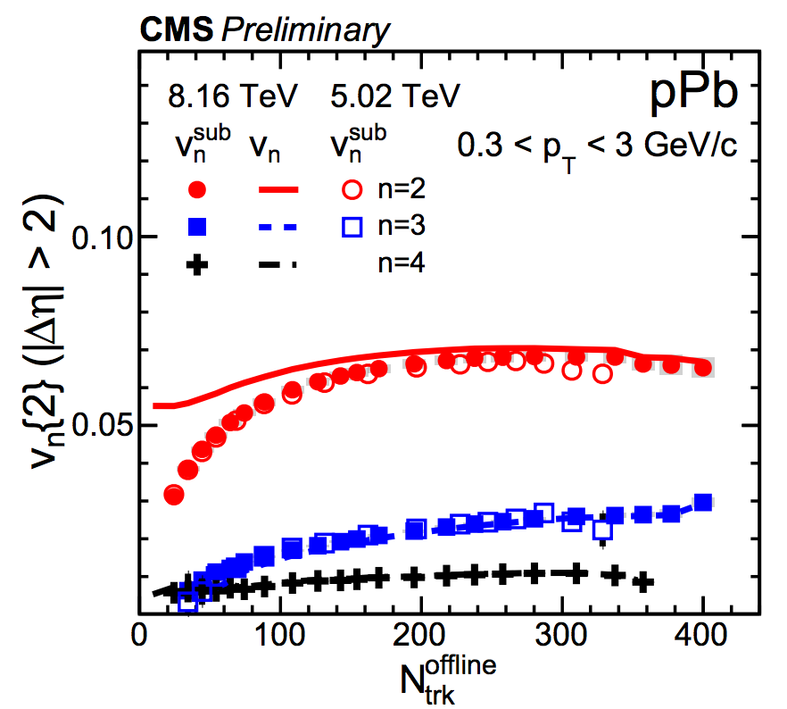
Integrated anisotropy coefficients
Similar ordering of “Flow” coefficients as seen in the data
Important caveat: No simple map between theory and experiment
Theory results are for quarks, Q_{s}² is the saturation scale in the target
Lappi, Phys. Lett., B744:315, (2015)
Lappi, Schenke, Schlichting, Venugopalan. JHEP, 01:061, (2016)

Slide 26
Integrated anisotropy coefficients

Slide 27
p_{T} dependence of anisotropy coefficients

Slide 28
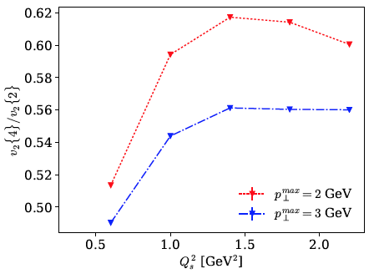
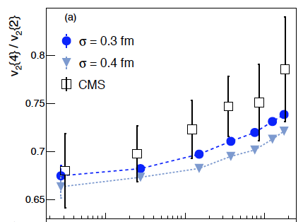
Ratio v₄/v₂ of Fourier harmonics
p+Pb at 5.02 TeV
From Giacalone,Noronha-Hostler,Ollitrault,
arXiv:1702.01730
Overall magnitude in ball-park of CMS data

Slide 29
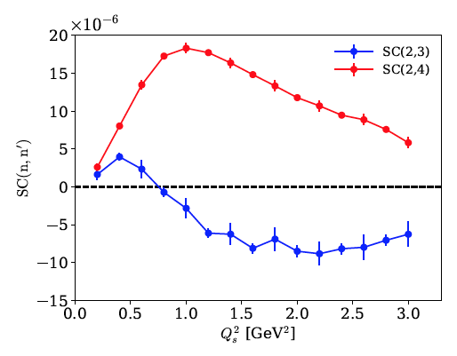
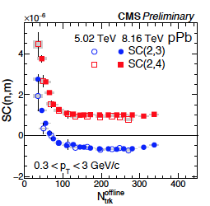
Symmetric cumulants
Mixed cumulants of Fourier harmonics
Bilandzic et al., PRC 89 (2014) 064904
In hydrodynamics, linear response of flow to correlations/anti-correlations
of spatial eccentricities
For e.g., Qian, Heinz, arXiv:1607.01732

Slide 30
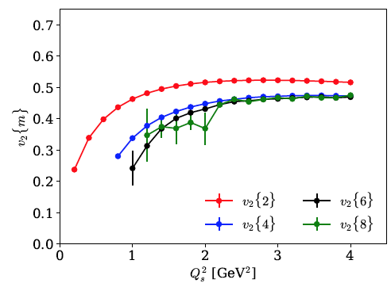
Higher cumulants from scattering off coherent Abelian fields
Replace N_{C}×N_{C} trace with simple path ordered exponentials (N_{C}=1)
2m-particle collectivity reproduced in this simple parton model…

Slide 31
Exegesis

Slide 32
Power counting
Three dimensionful scales:
Saturation scale in the target (inverse domain size): Q_{S}
Transverse overlap area: B_{p}
Maximal momentum kick to projectile: p_{T}^{max}
Dimensionless ratios are
# of color domains, Q_{S}² B_{p}
Resolving power of projectile, Q_{S}²/(p_{T}^{max})²

Slide 33
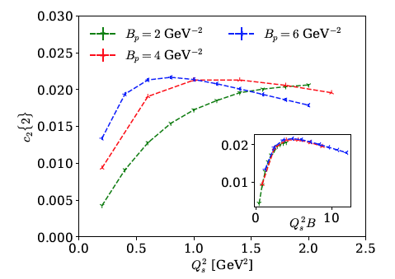
Scaling with # of color domains
“Independent cluster” model: fluctuation driven v_{n}’s scale with # of clusters
Basar,Teaney, arXiv:1312.6770

Slide 34
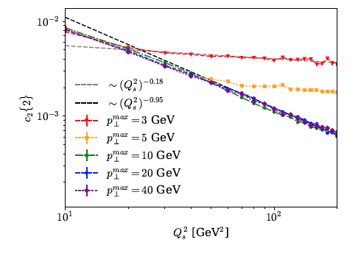
Scaling with # of color domains
For (p_{T}^{max})² >> Q_{S}², projectile partons resolve individual domains, cumulant
scales as ~ 1/(Q_{S}² B_{p})
For (p_{T}^{max})² << Q_{S}², partons see fewer domains, weak dependence of cumulant on
# of domains.
Moral: scaling analyses/conclusions sensitive to p_{T} window probed in experiments

Slide 35
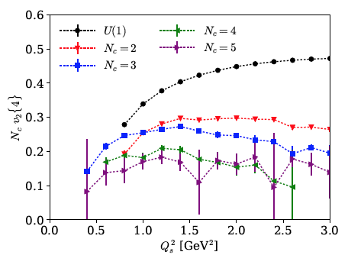
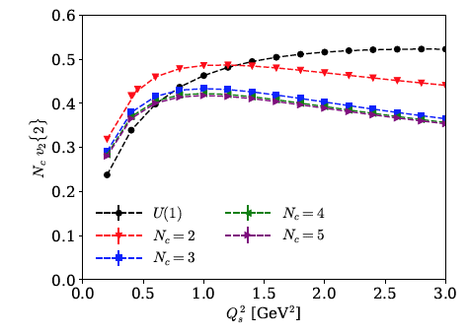
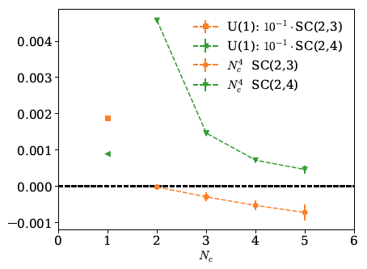
Scaling with N_{C}
v₂{2}, v₂{4}
scale as 1/N_{C}
Symmetric cumulants
show correlations/anti-correlations
seen in experiment only for N_{C} ≥ 3

Slide 36
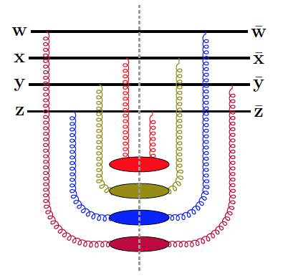
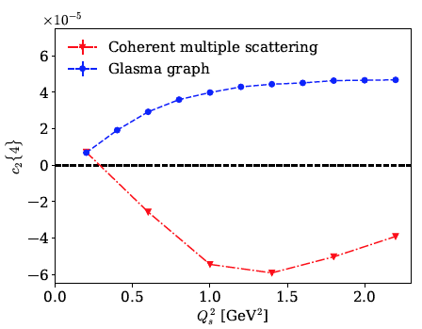
Back to glasma graphs
Glasma graph (single scattering) correlations
are very strong – the n-particle distribution
is close to a Bose distribution – as in a laser
Gelis,Lappi,McLerran, arXiv:0905.3234
But v₂{4} is imaginary…
For real v₂{4}, must have dominance of
first two moments of distribution
-- achieved by coherent multiple scattering…
Dusling,Mace,Venugopalan, 1706.06260

Slide 37
Towards a more realistic initial state description

Slide 38
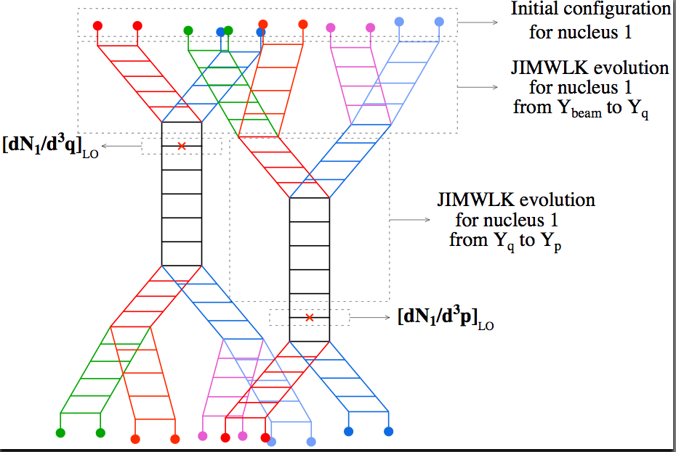
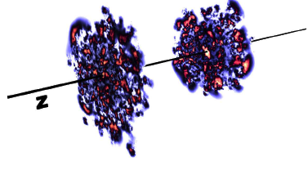
Two-parton azimuthal correlations in the CGC
JIMWLK evolution for nucleus 2
JIMWLK evolution
Solution of Yang-Mills for
dense-dense systems (as in A+A)
Dumitru,Gelis,McLerran,Venugopalan: 0804.3858
Gelis, Lappi, Venugopalan, arXiv: 0807.1306
Dusling,Gelis,Lappi,Venugopalan, arXiv:0911.2720

Slide 39
Beyond glasma graphs
Coherent multiple scattering is of the same order in the coupling:
power suppressed for p_{T} >> Q_{S}, important for p_{T} < Q_{S}
Compute (numerically) by solving Yang-Mills equations in presence of two
light cone sources: IP-Glasma model
Schenke,Tribedy,Venugopalan, arXiv:1202.6646, 1206.6805
C(p,q) ≠ C(p,-q)
-- all harmonics contribute
Lappi,Srednyak,Venugopalan, arXiv:0911.2068

Slide 40
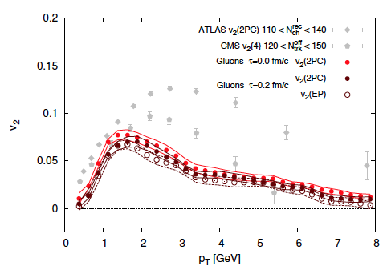
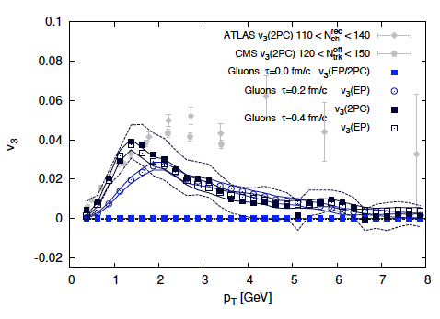
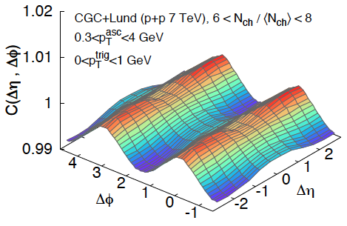
Azimuthal anistropy from Yang-Mills dynamics
Schenke,Schlichting,RV, PLB747(2015)76
Recent analytical work in dilute-dense approx:
Kovchegov,Wertepny,NPA906 (2013)50
McLerran, Skokov arXiv:1611.09870
Kovner,Lublinsky,Skokov, arXiv:1612.07790
Combining gluon distributions from CGC
with PYTHIA reproduces ridge distributions
However, 4-particle collectivity is
computationally challenging at present…
Schenke,Schlichting,Tribedy,Venugopalan, PRL117 (2016)162301

Slide 41
Summary-I
Hydrodynamic paradigm appears to describe
multi-particle correlations even in the smallest systems
There are however puzzling features of the data,
questions about the the validity of hydro, fine tuning of initial conditions (requiring implicitly strong initial state correlations), absence of jet quenching,… and explanation of anisotropies for p_{T} > few GeV
Initial state QCD frameworks now also able to explain many features of
the data but systematic treatments are still in their infancy
Despite much progress, no completely satisfactory explanation of the data
-- the problem is still wide open

Slide 42
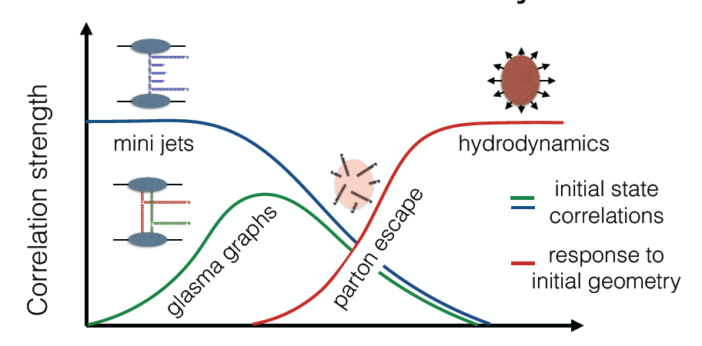
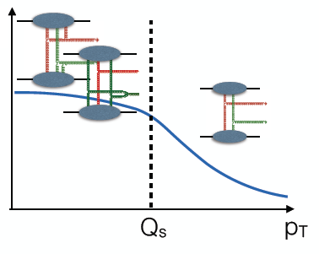
Summary-II
N_{charge}
Event engineering across system sizes, energies, and varieties of probes:
Offers exciting possibility of exploring dynamical evolution of strongly correlated
quark-gluon matter from high occupancy, out of equilibrium, dynamics…
to hydrodynamics
Figures: S. Schlichting at Quark Matter 2015

Slide 43
Thanks for listening!

Slide 44

Effect of correlations amongst projectile partons

Slide 45


Shape fluctuations essential to generate flow-I
Gaussian impact parameter profile:
(charged hadron multiplicity in event)
Schenke,Venugopalan,PRL113 (2014)102301

Slide 46

Shape fluctuations essential to generate flow-I
Incoherent exclusive vector meson (J/ψ) production is sensitive to fluctuations
in transverse spatial profile of proton – compute in dipole picture

Slide 47

Shape fluctuations essential to generate flow-III
(charged hadron multiplicity in event)
Mantysaari,Schenke,Shen,Tribedy,arXiv:1705.03177

Slide 48

High multiplicities + small systems = gluon saturation
What does it take to produce~ 150 hadrons per 5 units of rapidity in a single p+p event ?
For λ=0.14, get about 13 gluons produced in 5 units ~ min.bias hadron multiplicity
λ=0.3: ~45 gluons in 5 units,
λ=0.4: ~90 gluons in 5 units, in ball park…
Very rapid growth of gluon dist. in such events…

Slide 49
High multiplicities + small systems = gluon saturation
What does it take to produce~ 150 hadrons per 5 units of rapidity in a single p+p event ?
Such rapid growth, in an “independent parton”
picture lead to very large gluon radii, R_{g} > 1 fm

Slide 50
High multiplicities + small systems = gluon saturation
What does it take to produce~ 150 hadrons per 5 units of rapidity in a single p+p event ?
Saturation regulates this by adding increasingly “smaller” gluons of size 1/Q_{s}(x) with decreasing x (increasing energy)
π
π
π
Lappi:
arXiv 0711.3039
π
N_{g} ~ 100 in 5 units for Q_{S}² ~ 2 GeV² : a semi-hard scale !
π

Slide 51
High multiplicities + small systems = gluon saturation
What does it take to produce~ 150 hadrons per 5 units of rapidity in a single p+p event ?
Saturation regulates this by adding increasingly “smaller” gluons of size 1/Q_{s}(x) with decreasing x (increasing energy)
π
π
π
Event generators (such as EPOS) that describe data in high multiplicity events, build in a saturation scale …
π
π

Slide 52


Issues with the hydrodynamic paradigm: I
Two frequently used measures: Reynolds # and Knudsen #
Dumitru,Molnar,Nara,arXiv:0706.2233
Denicol, Niemi, arXiv:1404.7327
Bzdak ,Schenke,Tribedy, Venugopalan, arXiv:1304.3403
Hydro good for Kn < 0.5,
marginal for K < 1 transient regime;
K > 1 free streaming

Slide 53

Issues with the hydrodynamic paradigm: II
No (mini-) jet quenching seen in the smaller systems
Pb+Pb

Slide 54


Issues with the hydrodynamic paradigm: III
Large anistropies at larger p_{T} and smaller N_{ch} than one might reconcile with a
hydrodynamic description
Four-particle collectivity seen in minimum bias events…

Slide 55




Collectivity in 3He+Au collisions
A. Adare et al. (PHENIX Collaboration)
Phys. Rev. Lett. 115, 142301 (2015)
Schenke, Venugopalan
Nucl. Phys. A931 (2014) 1039-1044
J.L. Nagle, et al.
Phys. Rev. Lett. 113, 112301
Bożek, Broniowski
Physics Letters B 747 (2015) 135–138

Slide 56
Freeze-out corrections in p+Pb as function of p_{T}
η/s=0.2
Plot by Bjoern Schenke
For m_{T} = 1 GeV, 26% of hydro cells have a 100% correction
For m_{T} = 1.5 GeV, 43% have a 100% correction
Mantysaari,Schenke,Shen,Tribedy, arXiv:1705.03177

Slide 57


IP-Glasma+Lund fragmentation
Pattern of mass splitting of <p_{T}> and v₂
seen in high multiplicity events is
reproduced
Schenke,Schlichting,Tribedy,RV, PRL117(2016)162301
What about 4-particle collectivity?
Numerically very challenging-in progress
Schenke,Schlichting,Tribedy,RV

Slide 58

Predictions for p+A symmetric cumulants

Slide 59



Higher cumulants in the color domain model
Dumitru,McLerran,Skokov, 1410.4844
Color domain model: express intrinsic higher point
correlators as correlators of produced particles
with a target field in a color domain,
averaged over all orientations of the field.
“A” term is the correlation induced between projectile particles due to color field orientation of target (more generically, non-Gaussian correlations)
The N_{c} term is the “connected Glasma graph” (Gaussian correlations)
N_{D} is # of color domains – few in p+A, several in A+A

