Slide 1
Small x Asymptotics of the Gluon Helicity Distribution
Yuri Kovchegov
The Ohio State University
work with Dan Pitonyak and Matt Sievert,
arXiv:1706.04236 [nucl-th] and 5 other papers

Slide 2
Outline
Quark helicity evolution: re-derivation and review in the operator form. Quark helicity TMD and PDF asymptotics at small x.
Gluon helicity TMDs at small x.
Small-x evolution equations for the gluon helicity TMDs at large N_{c}.
Solution of the evolution equations and the small-x asymptotics of the gluon helicity distribution:
For comparison, quark helicity PDF asymptotics is

Slide 3
How much spin is at small x?
E. Aschenaur et al, arXiv:1509.06489 [hep-ph]
Uncertainties are very large at small x!

Slide 4
Quark Helicity Evolution at Small x flavor-singlet case
Yu.K., M. Sievert, arXiv:1505.01176 [hep-ph]
Yu.K., D. Pitonyak, M. Sievert, arXiv:1511.06737 [hep-ph],
arXiv:1610.06197 [hep-ph], arXiv:1610.06188 [hep-ph],
arXiv:1703.05809 [hep-ph]

Slide 5
Quark Helicity Observables at Small x
One can show that the g₁ structure function and quark helicity PDF (Δq) and TMD at small-x can be expressed in terms of the polarized dipole amplitude (flavor singlet case):
Here s is cms energy squared, z_{i}=Λ²/s,

Slide 6
Polarized Dipole
All flavor singlet small-x helicity observables depend on one object, “polarized dipole amplitude”:
Double brackets denote an object with energy suppression scaled out:
unpolarized quark
polarized quark (“polarized Wilson line”):
eikonal propagation, non-eikonal
spin-dependent interaction

Slide 7
“Polarized Wilson line”
To obtain an explicit expression for the “polarized Wilson line” operator due to
a sub-eikonal gluon exchange (as opposed to the sub-eikonal quarks exchange), consider
multiple Coulomb gluon exchanges with the target:
-
+
Most gluon exchanges are eikonal spin-independent interactions, while one of them
is a spin-dependent sub-eikonal exchange. (cf. Mueller ‘90, McLerran, Venugopalan ‘93)

Slide 8
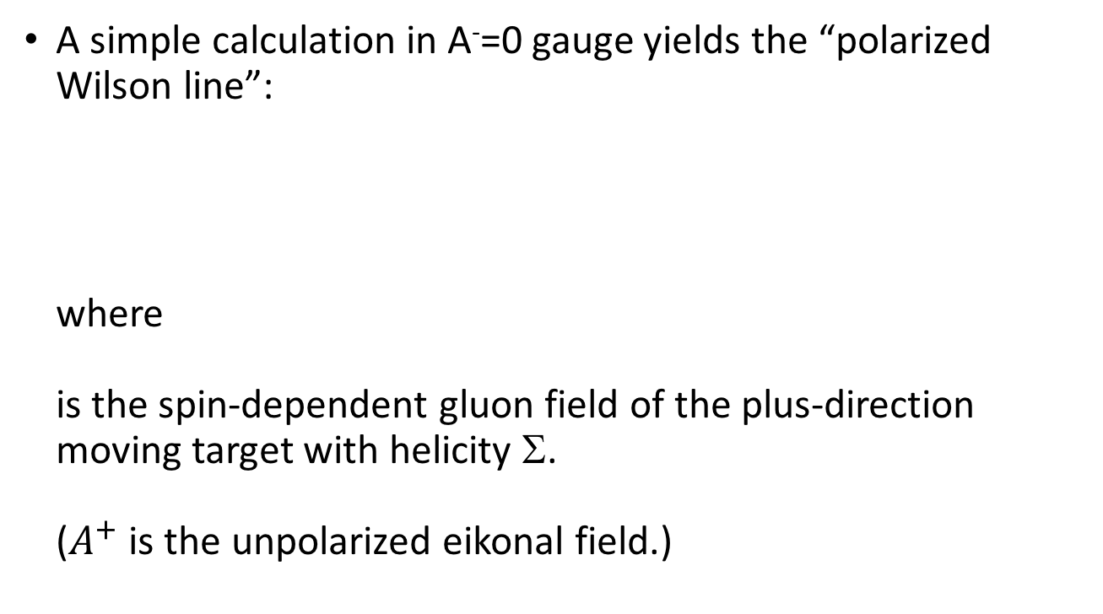
“Polarized Wilson line”
A simple calculation in A⁻=0 gauge yields the “polarized Wilson line”:
where
is the spin-dependent gluon field of the plus-direction moving target with helicity Σ.
($A^{+}$ is the unpolarized eikonal field.)

Slide 9
Polarized Dipole Amplitude
The polarized dipole amplitude is then defined by
with the standard light-cone
Wilson line

Slide 10
Cross-check: evolution
One can cross-check the operator and/or the evolution equation we derived for it earlier:
From the first two graphs on the right we get
in agreement with our earlier work on quark helicity evolution (‘15-’16).

Slide 11
Resummation Parameter
For helicity evolution the resummation parameter is different from BFKL, BK or JIMWLK, which resum powers of leading logarithms (LLA)
Helicity evolution resummation parameter is double-logarithmic (DLA):
The second logarithm of x arises due to transverse momentum (or transverse coordinate) integration being logarithmic both in UV and IR.
This was known before: Kirschner and Lipatov ’83; Kirschner ’84; Bartels, Ermolaev, Ryskin ‘95, ‘96; Griffiths and Ross ’99; Itakura et al ’03; Bartels and Lublinsky ‘03.

Slide 12
Polarized Dipole Evolution in the Large-N_{c} Limit
In the large-N_{c} limit the equations close, leading to a system of 2 equations:
S = found from BK/JIMWLK, it is LLA

Slide 13
Your friendly “neighborhood” dipole
There is a new object in the evolution equation – the neighbor dipole.
This is specific for the DLA evolution. Gluon emission may happen in one dipole, but, due to transverse distance ordering, may ’know’ about another dipole:
We denote the evolution in the neighbor dipole 02 by

Slide 14
Large-N_{c} Evolution
In the strict DLA limit (S=1) and at large N_{c} we get (here Γ is an auxiliary function we call the ‘neighbour dipole amplitude’)
The initial conditions are given by the Born-level graphs

Slide 15
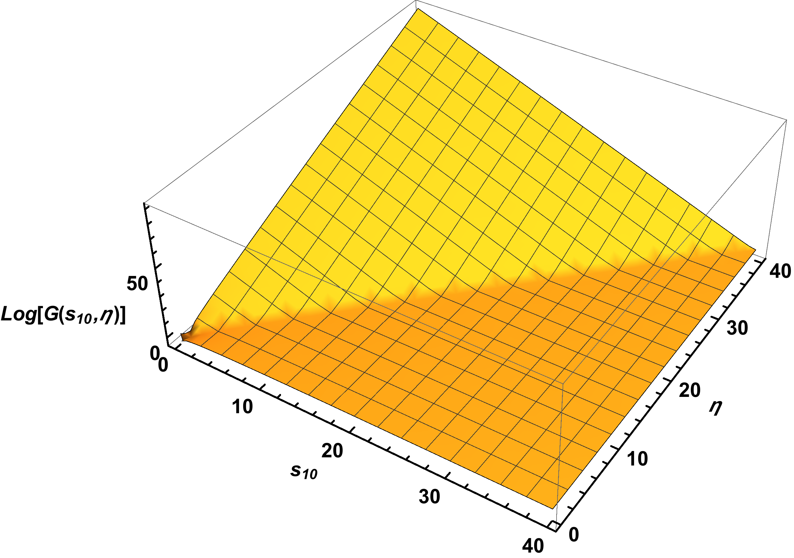
Scaling
One can solve the helicity
evolution equations numerically:
The solution is well
approximated by
This motivated us to look for the solution in the following scaling form:

Slide 16
Scaling Equations
The large-N_{c} evolution equations can be rewritten in terms of the scaling variables (not a trivial property, does not work for the large-N_{c}&N_{f} equations):
For simplicity, pick the following initial conditions:

Slide 17

Analytic Solution
These scaling equations can be solved exactly via Laplace transform + a few clever tricks, yielding
As usual, the high-energy asymptotics is given by the right-most pole in the complex ω-plane: the pole is at$ω=+\sqrt{3}$.

Slide 18
Analytic Solution and Intercept
The (dominant part of the) scaling solution is
The corresponding helicity intercept is
This is in complete agreement with the numerical solution!

Slide 19
Quark Helicity at Small x
The small-x asymptotics of quark helicity is

Slide 20
Impact of our ΔΣ on the proton spin
We have attached a curve to the existing hPDF’s fits at some ad hoc small value of x labeled x₀ :
“ballpark”
phenomenology

Slide 21
Impact of our ΔΣ on the proton spin
Defining we plot it for x₀=0.03, 0.01, 0.001:
We observe a moderate to significant enhancement of quark spin.
More detailed phenomenology is needed in the future.

Slide 22
Gluon Helicity TMDs

Slide 23
Dipole Gluon Helicity TMD
Now let us repeat the calculation for gluon helicity TMDs.
We start with the definition of the gluon dipole helicity TMD:
Here U^{[+]} and U^{[-]} are future and
past Wilson line staples (hence
the name `dipole’ TMD,
F. Dominguez et al ’11 – looks
like a dipole scattering on a
proton):

Slide 24
Dipole Gluon Helicity TMD
At small x, the definition of dipole gluon helicity TMD can be massaged into
Here we obtain a new operator, which is a transverse vector (A⁻=0 gauge):
Note that can be thought of
as a transverse curl acting on
and not just on -- different
from the polarized dipole amplitude!

Slide 25
Dipole TMD vs dipole amplitude
Note that the operator for the dipole gluon helicity TMD
is different from the polarized dipole amplitude
We conclude that the dipole gluon helicity TMD does not depend on the polarized dipole amplitude! (Hence the ‘dipole’ name may not even be valid for such TMD.)
This is different from the unpolarized gluon TMD case.

Slide 26
Dictionary
We seem to have two operators:
Quark helicity
Gluon helicity

Slide 27
Gluon Helicity TMDs: Small-x Evolution

Slide 28

Evolution Equation
To construct evolution equation for the operator $G^{i}$ governing the gluon helicity TMD we resum similar (to the quark case) diagrams:

Slide 29
Large-N_{c} Evolution: Diagrams
At large-N_{c} the equations are

Slide 30
Large-N_{c} Evolution: Diagrams
and

Slide 31
Large-N_{c} Evolution: Equations
This results in the following evolution equations:

Slide 32
Large-N_{c} Evolution: Equations
Here
is an object which we know from the quark helicity evolution, as the latter gives us G and Γ.
Note that our evolution equations mix the gluon (G^{i}) and quark (G) small-x helicity evolution operators:

Slide 33
Initial Conditions
Initial conditions for this evolution are given by the lowest order t-channel gluon exchanges:
Note that these initial conditions have no ln s, unlike the initial conditions for the quark evolution:

Slide 34

Large-N_{c} Evolution: Power Counting
The kernel mixing G^{i} or Γ^{i} with G and Γ is LLA:
But, the initial conditions for G and Γ have an extra $\ln{s}$as compared to G^{i} and Γ^{i}, making the two terms comparable (order-$α_{S}^{2}$ in $α_{S} \ln^{2}s \sim 1$ DLA power counting).
LLA
DLA

Slide 35
Gluon Helicity TMDs: Small-x Asymptotics

Slide 36
Large-N_{c} Evolution Equations: Solution
To solve the equations, first decompose the relevant object as follows:
It turns out that only G₂ and Γ₂ contribute to evolution and to the gluon helicity TMD.

Slide 37
Large-N_{c} Evolution Equations: Solution
Plugging in the analytic solution for the quark helicity operator, we get

Slide 38
Large-N_{c} Evolution Equations: Scaling
Just like in the quark helicity evolution case, the equations simplify once we recognize the following scaling property:
The equations become

Slide 39
Large-N_{c} Evolution Equations: Solution
These equations can be solved in the asymptotic high-energy region using a combination of ODE solving and Laplace transform, yielding
The small-x gluon helicity intercept is
We obtain the small-x asymptotics of the gluon helicity distributions:

Slide 40
Scaling Solution Cross-Check
One can check the scaling property of our analytic
solution in the numerical solution of our equations:

Slide 41
Impact of our ΔG on the proton spin
We have attached a curve to the existing hPDF’s fits at some ad hoc small value of x labeled x₀ :
“ballpark”
phenomenology

Slide 42
Impact of our ΔG on the proton spin
Defining we plot it for x₀=0.08, 0.05, 0.001:
We observe a moderate enhancement of gluon spin.
More detailed phenomenology is needed in the future.

Slide 43
Conclusions
We conclude that the small-x asymptotics of gluon helicity (at large N_{c}) is
while the quark helicity asymptotics is
ΔG can be measured from A_{LL} in pp and at EIC. One may use our approach to combine experiment and theory to constrain the quark and gluon spin (and OAM) at small x (in progress, a long-term goal).
Preliminary results indicate a possible enhancement of quark and gluon spin as compared to DSSV.

Slide 44


INT Program on EIC Physics,
Fall 2018
Probing Nucleons and Nuclei in High Energy Collisions (INT-18-3)
October 1 - November 16, 2018
Y. Hatta, Y. Kovchegov, C. Marquet, A. Prokudin
Institute for Nuclear Theory, Seattle, WA
Please mark
your calendars!

