Slide 1
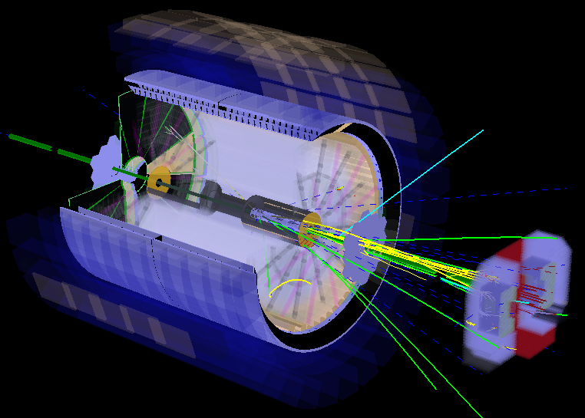

Cold QCD Physics@STAR:
A Gaze into EIC
E.C. Aschenauer

Slide 2
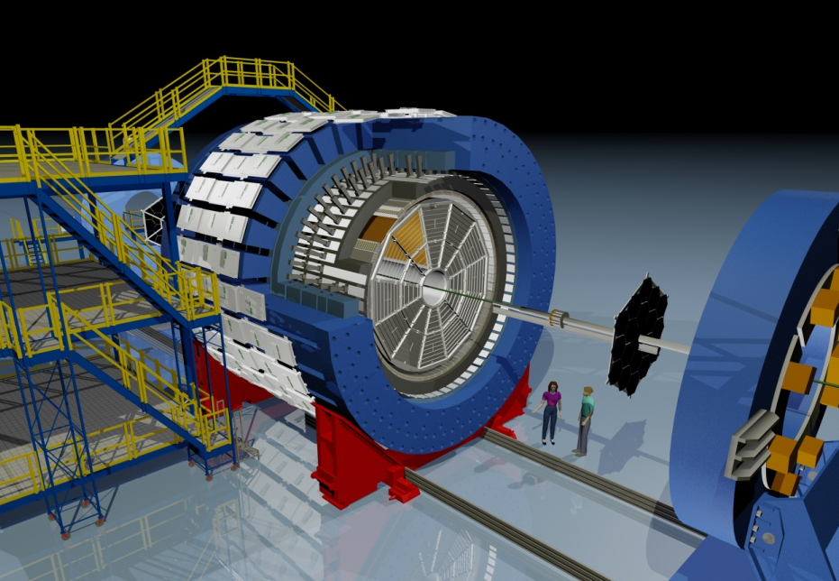
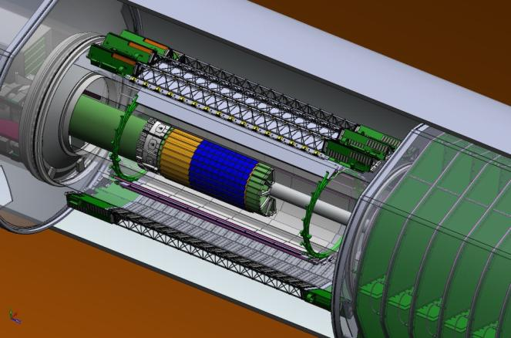
STAR in 2017
EEMCESMD
Magnet
MTD
BEMC
BSMD
TPC
TOF
BBC
FMS
Pre+Post-shower
HFT
2014-2016
RP
ZDC
Electromagnetic coverage: -1 < η < 4
Tracking: 1.4 < η < 1.4
ToF&dE/dx: -1 < η < 1
Roman Pots: 0.2 GeV² < t < 1 GeV²

Slide 3
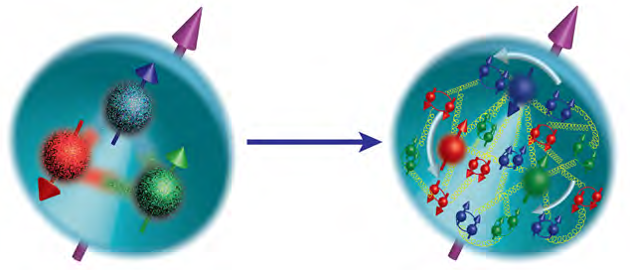
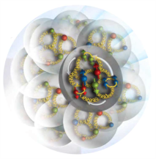
hot questions in cold QCD
How are the sea quarks and gluons, and their spins, distributed in space and momentum inside the nucleon?
How do the nucleon properties emerge from them and their interactions?
How do color-charged quarks and gluons, and colorless jets, interact with a nuclear medium?
How do the confined hadronic states emerge from these quarks and gluons?
How do the quark-gluon interactions create nuclear binding?
How does a dense nuclear environment affect the quarks and gluons, their correlations, and their interactions?
What happens to the gluon density in nuclei? Does it saturate at high energy, giving rise to a gluonic matter with universal properties in all nuclei, even the proton?
gluon
emission
gluon recombination
?
=

Slide 4

Helicity Structure
quark
spin
gluon
spin
angular
momentum
Can quarks and gluons explain all the spin?
what is the role of
  gluons?
  quarks?
  orbital angular momentum

Slide 5
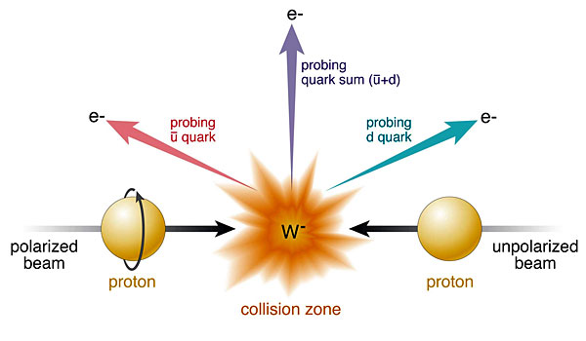
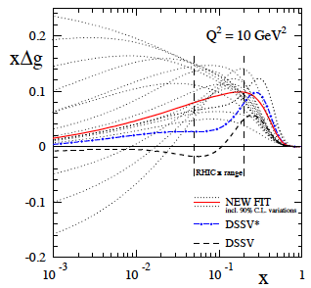
Helicity structure
light Quark Spin
Gluon Spin
Golden Channel: incl. jets & di-jets
Data:
STAR 200 GeV
incl. jets &
PHENIX π⁰
Similar expression for W⁻ to get Δ and Δd
statistics
Ws naturally separate quark flavors
rapidity: sea vs. valence quarks
Ws are maximally parity violating
→ Ws couple only to one parton helicity
Complementary to SIDIS:
very high Q²-scale 6400 GeV²
extremely clean theoretically
No Fragmentation function
stringent test on theory approach
for SIDIS
UNIVERSALITY of PDFs
Need to:
constrain x-shape of PDF
reduce uncertainty at low-x
Will provide stringent constraints
→ 2013 uncertainties 40% of 2012

Slide 6
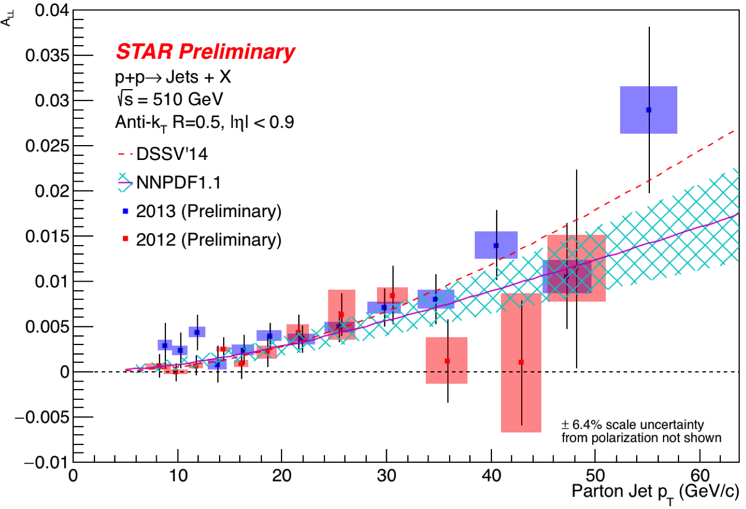
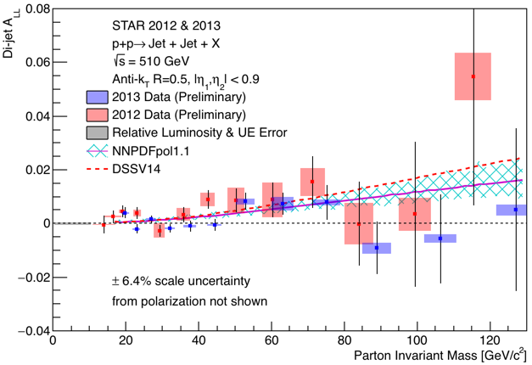
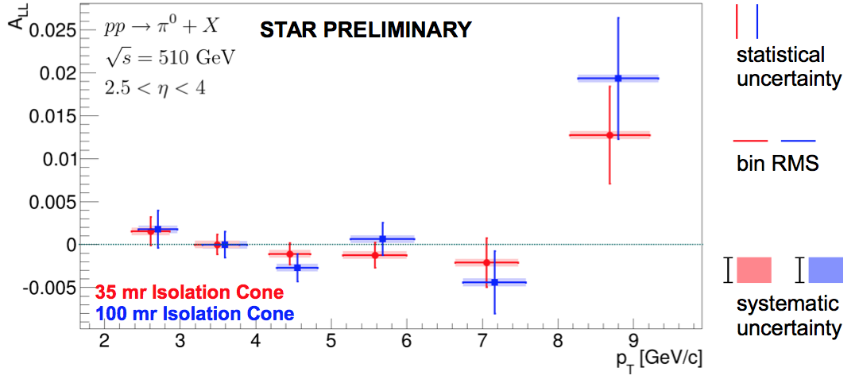
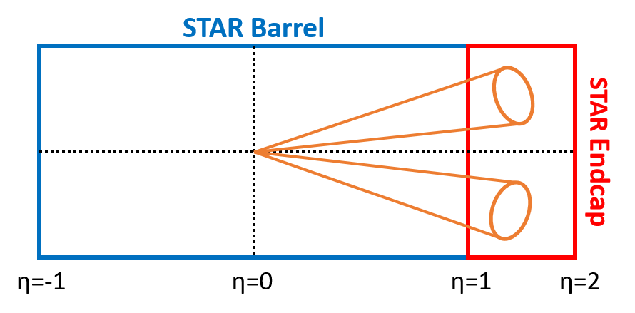
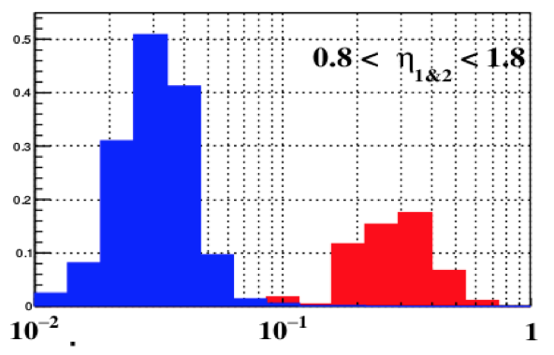
Helicity structure: Gluon
500 GeV incl. and Di-jets:
DIS +
RHIC ≤2009
factor 2
DIS +
RHIC ≤2015
200 GeV Di-jets at forward η:
500 GeV incl. π⁰ at 2.5 < η < 4:

Slide 7
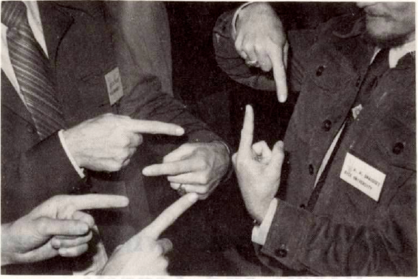
What can polarized pp tell us
Focus on physics with transversely polarized beams

Slide 8
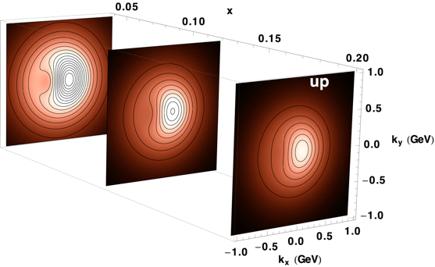
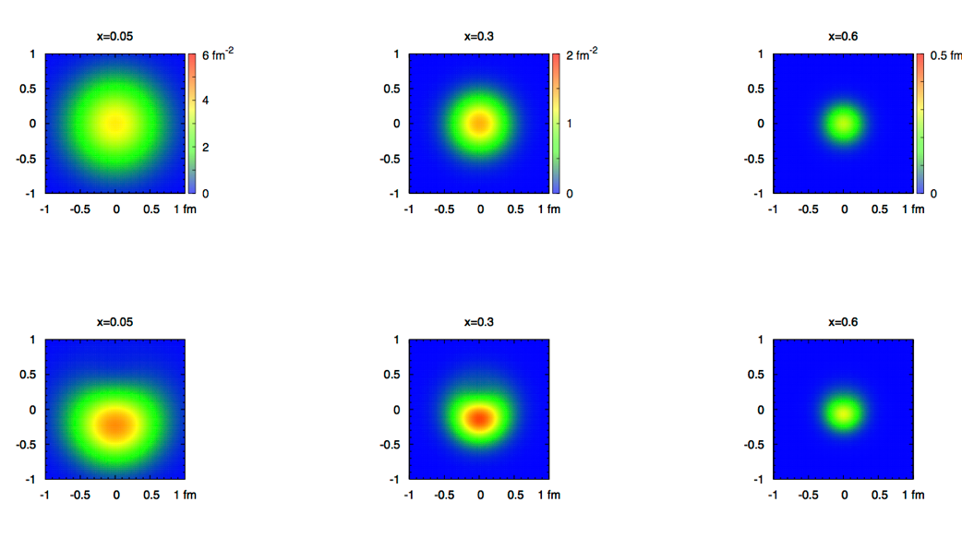
2+1 dimensional Imaging of Quarks & Gluons
Wigner function
W(x,b_{T},k_{T})
QCD genetic map
∫d²b_{T}
∫ d²k_{T}
Momentum
space
Coordinate
space
f(x,k_{T})
TMDs
f(x,b_{T})
GPDs
(Spin-dependent) 2+1D transverse momentum images
(Spin-dependent) 2+1D spatial images from exclusive scattering
down quark
x
Recent theoretical work indicates direct access to Gluon Wigner function
through diffractive di-jets in UPC (arXiv:1706.01765)

Slide 9
The STAR objectives for TMDs
Constrain TMDs over a wide x and Q² range (valence, sea-quarks & gluons)
data purely sensitive to observables in the TWIST-3 formalism
  different √s → evolution
observables purely sensitive to observables in the TMD formalism
  different √s → different p_{t} at the same x_{t} → evolution
  Test non-universality of TMDs
observables as transversity can be accessed also in collinear observables
  test of TMD factorization
Initial State
Final State
A_{N} for W^{+/-}, Z⁰, DY
  → Sivers
A_{N} for jets
  g-Sivers in Twist-3
direct photons
    → q-Sivers in Twist-3
A_{UT} π^{+/-}π⁰ azimuthal distribution in jets
  → Transversity x Collins
A_{UT} in dihadron production
  → Transversity x Interference FF
A_{N} for π+/- and π0
→ Novel Twist-3 FF Mechanisms
related through
related through

Slide 10
TMDs at STAR
Till today TMDs come only from fixed target data → high x @ low Q²
need to establish concept at high Q² and wide range in x
polarised pp at RHIC
STAR unique kinematics: from high to low x at high Q²

Slide 11
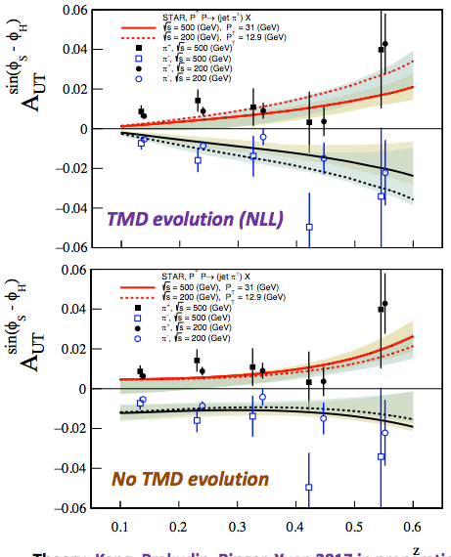
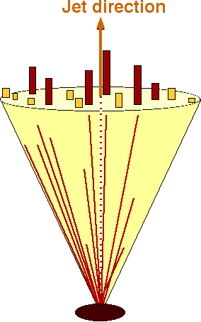
Jets to access Transversity x Collins
Detector
j_{T}
Kang et al.
arXiv:1705.08443
proof of factorization
π⁺
e⁺
π⁰
π⁻
Particle
e⁻
Κ⁰
Parton
200 vs. 500 GeV Comparison:
Evolution: 200 GeV ←→ 500 GeV factor 3 in Q
Test of factorization & Universality
→ compare with transversity from IFF
→ compare with SIDIS and e+e-

Slide 12
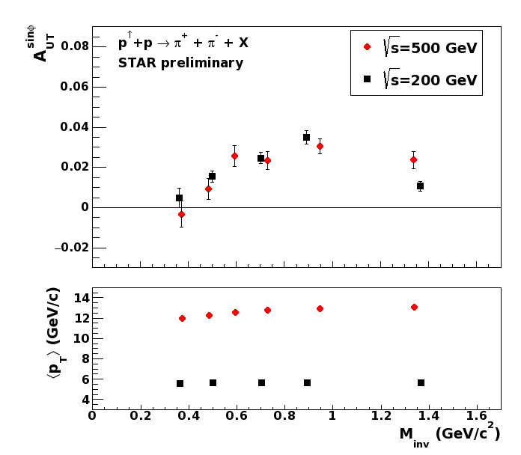
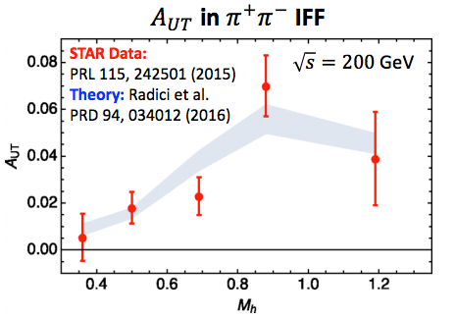
Interference Fragmentation Function (IFF)
p↑+p → π⁺π⁻+X → transversity x IFF
survives in collinear framework
Significant di-hadron asymmetries both at √s=200GeV and √s=500GeV
Increasing with p_{T}
Access to transversity with a collinear observable

Slide 13
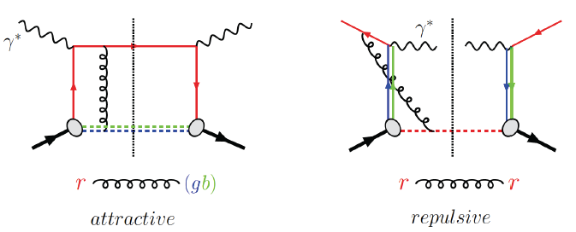
Visualize Color interactions in QCD.
Measure non-universality of sivers-function
DIS:
γq-scattering
attractive FSI
pp:
qqbar-anhilation
repulsive ISI
QCD:
Sivers_{DIS} = - (Sivers_{DY} or Sivers_{W} or Sivers_{Z0})
A_{N}(direct photon) measures the sign change in the Twist-3 formalism
All three observables can be approached
at 500 GeV at STAR
only way to access HP13

Slide 14
First Results: A_{N}^{W}
Results based on 2011 25 pb⁻¹ transversely polarized 500 GeV data
→ published in PRL 116 (2016) 132301
y and p_{t} for fully reconstructed Ws → recoil combined with MC
→ method used at Fermi-Lab and LHC
Asymmetry favors Sivers fct. sign change
and small TMD evolution for asymmetries

Slide 15
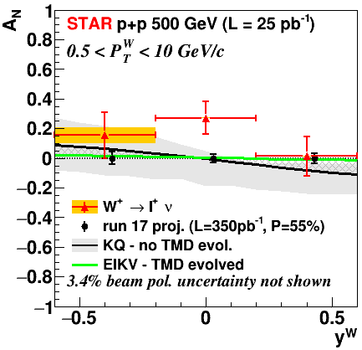
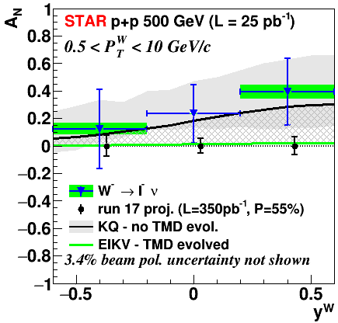
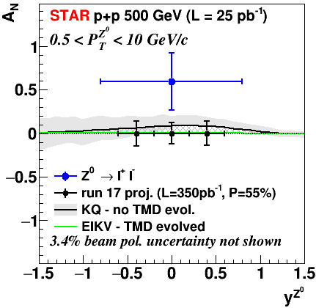
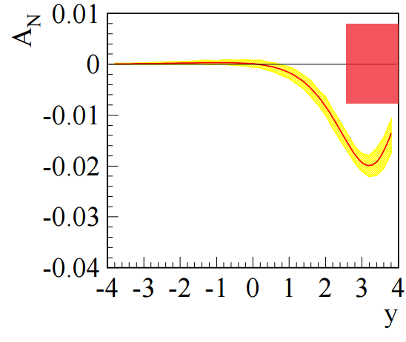
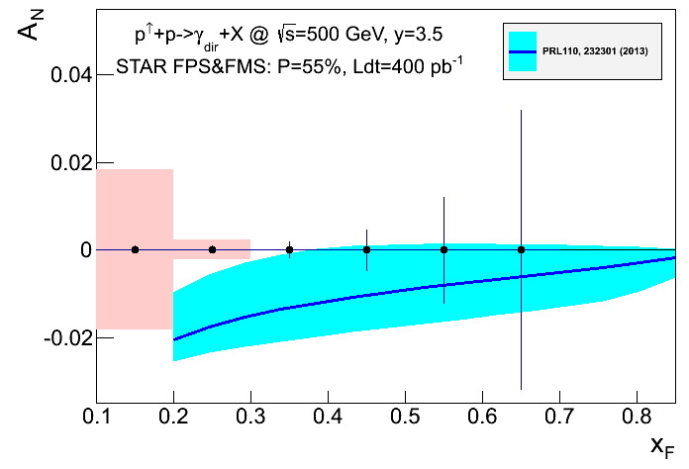
RUN-17: A goldmine for TMDs@STAR
Collected:
350 pb⁻¹ → 14 times Run-11 for -1 < η < 1.8 → A_{N} W^{+/-} & Z0, Collins, ……
250 pb⁻¹ for 2.8 < η < 4 for DY and direct photon
Will provide data to constrain
→ TMD evolution,
sea-quark Sivers fct
test of Sivers fct. non-universality
Drell Yan:
A_{N}: +/- 0.008
Direct Photon
With TMD Evolution

Slide 16
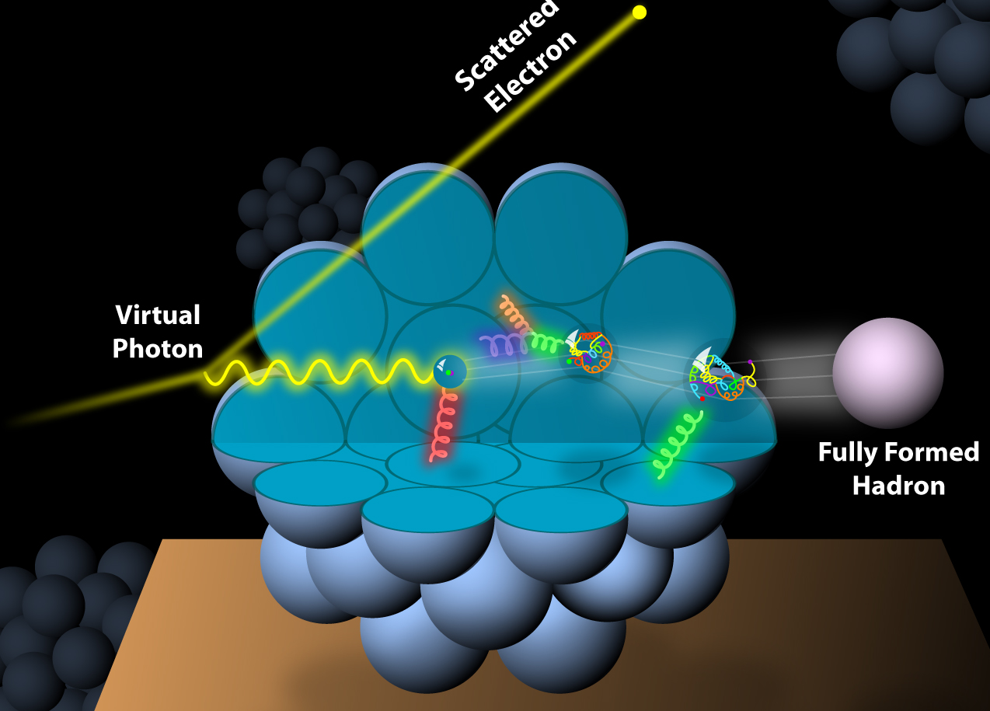
What about Nuclei?
Incoming
Electron Beam

Slide 17
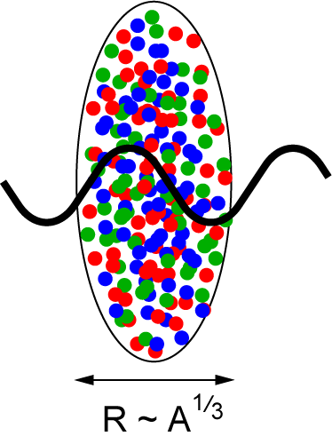
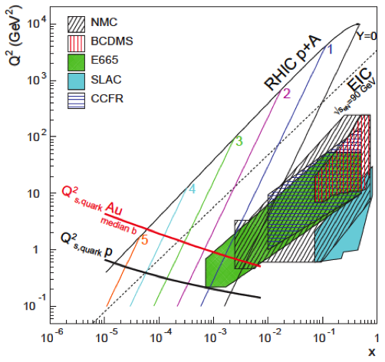
How Does The initial state IN AA Look?
3 conundrums of the initial state:
What are the nPDFs at low-x?
How saturated is the initial state of the nucleus?
What is the spatial transverse distributions
of nucleons and gluons?
  How much does the spatial distribution
fluctuate? Lumpiness, hot-spots etc.
L ~ (2m_{N} x)⁻¹ > 2 R_{A} ~ A^{1/3}
Probe interacts
coherently with all nucleons
Gold: 197 times smaller effective x !
Rapid rise in gluons described naturally by linear pQCD evolution equations
This rise cannot increase forever - limits on the cross-section
  → non-linear pQCD evolution equations provide a natural way to tame this growth and lead to a saturation of gluons, characterized by the saturation scale Q²_{s}(x)

Slide 18


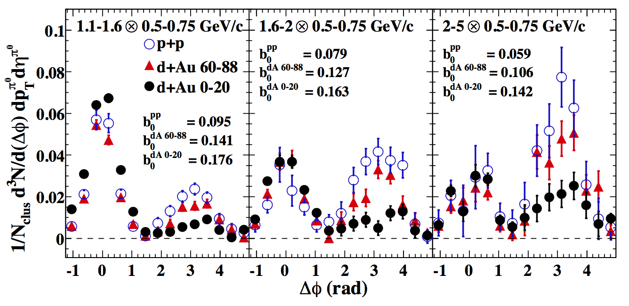
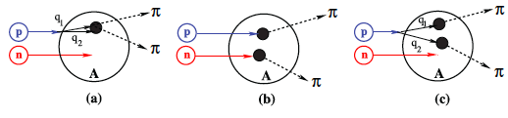
Key Observable for Saturation in pA
small x
Bremsstrahlung
~ s_{s}ln(1/x)
pQCD 2→2 process = back-to-back di-jet
Forward jet
p
p
Away side jet
Phys. Rev. Lett. 107, 172301 (2011)
With high gluon density
2→1 (or 2→many) process = Mono-jet
Recombination
~ σ_{s}ρ
p/d
dilute
parton
system
Au
dense gluon field
CGC predicts suppression of back-to-back correlation
dA: alternative explanation through double interactions

Slide 19
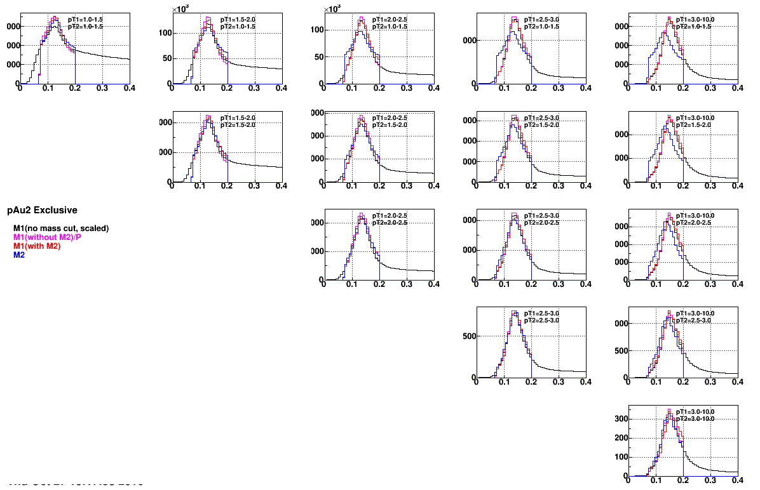
Key Observable for Saturation in pA
2015 Di-hadron correlations: scanning in x → study the evolution of Q_{s}² in x
Scan A-dependence: pAu and pAl → study the evolution of Q_{s}²(x) with A
Resolve ambiguity what causes the suppression in dAu
p_{T}^{trig}
1 GeV
>3 GeV
1 GeV
p_{T}^{assoc}
m^{trig}_{NoCut, scaled}
m^{trig}_{scaled}
m^{trig}_{withAssoc}
m^{assoc}
>3 GeV

Slide 20
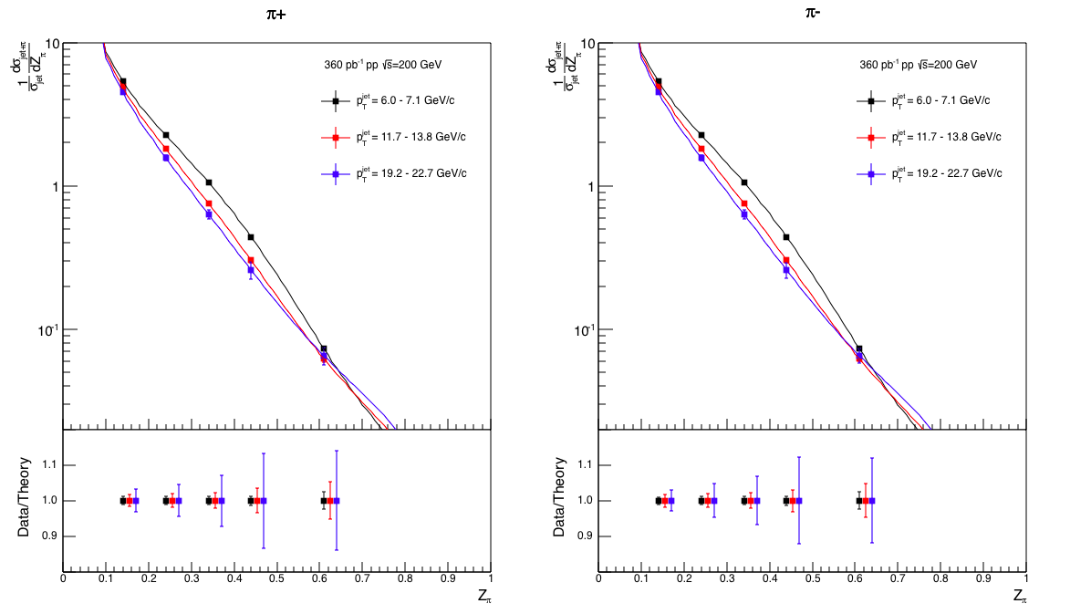
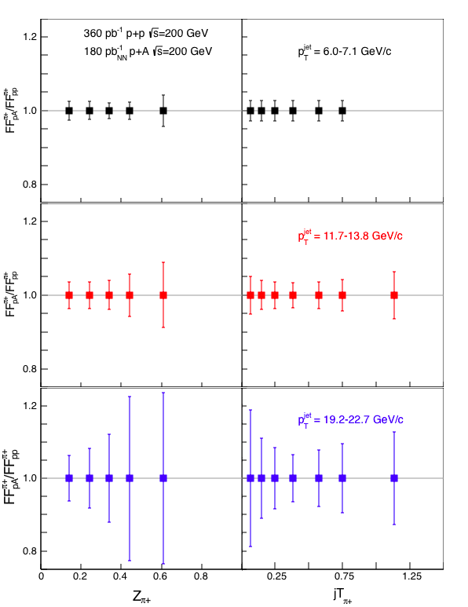
fragmentation functions in pp and pA
Observable: hadron in jet
fragmentation functions
in p+A/p+p at |η| < 0.4
p+p:
π+
π-
only at RHIC:
measure nuclear
effects for
polarized FF
→ nCollins

Slide 21
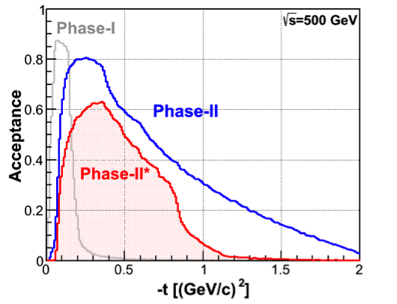
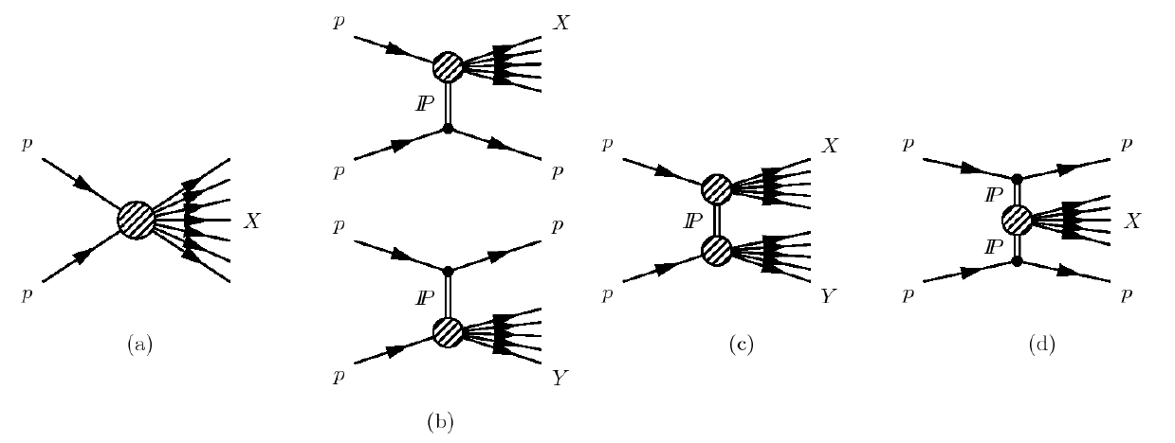
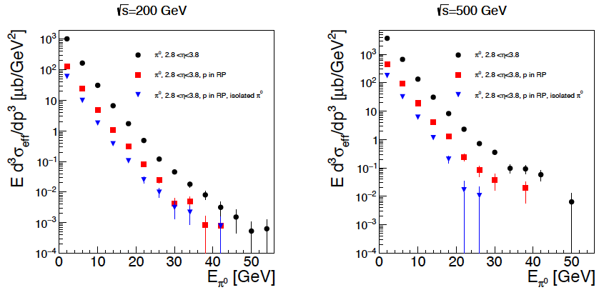
Diffraction: A neglected child at RHIC
Processes:
STAR RP the optimal
tool to tag
diffractive processes
2021+
2015+2017
inclusive cross section
Pythia-8
~20% at least
diffractive
Many more interesting physics opportunities with diffraction
SSA for UPC J/Ψ production → GPDs
Di-jets in UPC → gluon Wigner function (arXiv:1706.01765)
R_{pA} for diffractive events → saturation

Slide 22
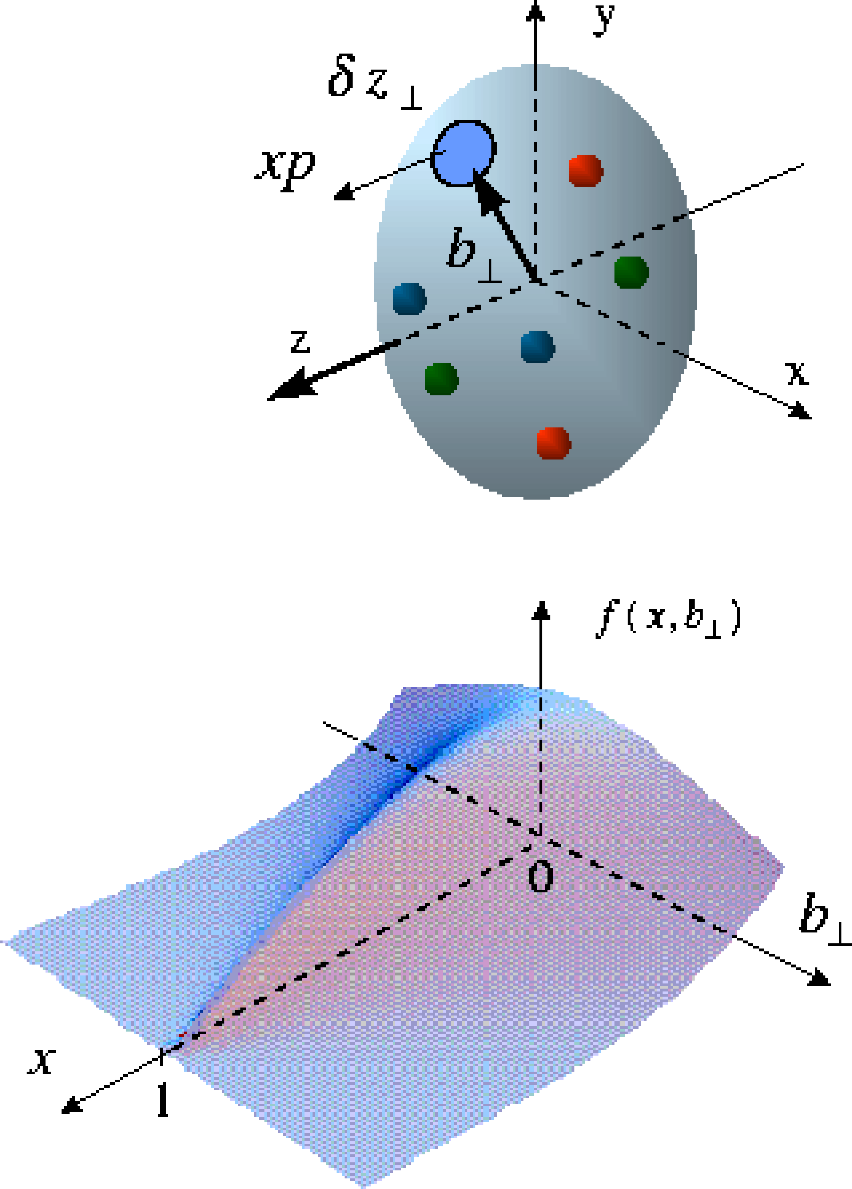
The Missing Piece: orbital angular momentum
GPDs: PDFs that
correlated parton momentum
and their distributions in
transverse space
exclusive reactions the vehicle to access L_{q} & L_{g}
golden channel: J/Ψ
new theoretical concept: Generalized Parton Distributions
Spin-Sum-Rule in PRF:
responsible for orbital angular momentum
J/Ψ production in p↑Au UPC
→ world wide only access to GPD E for gluons

Slide 23
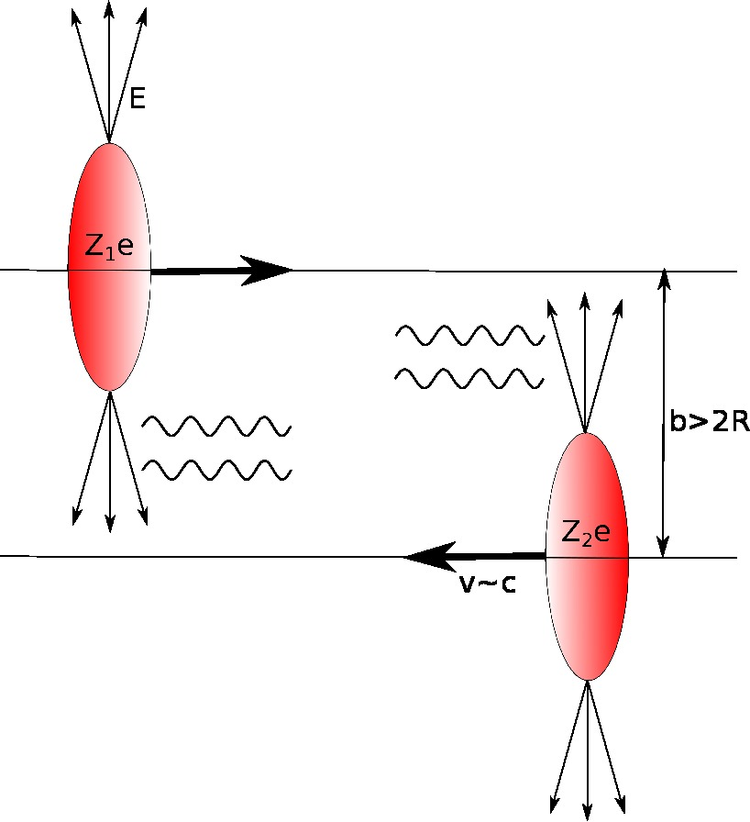
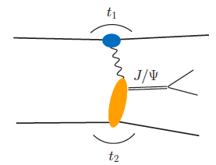
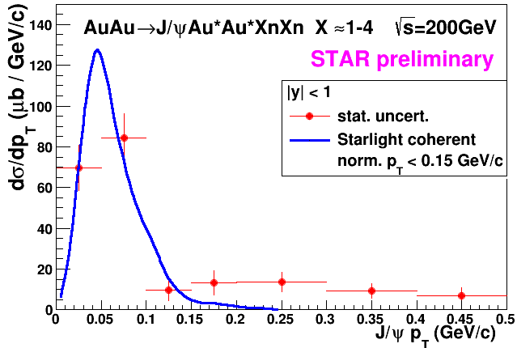
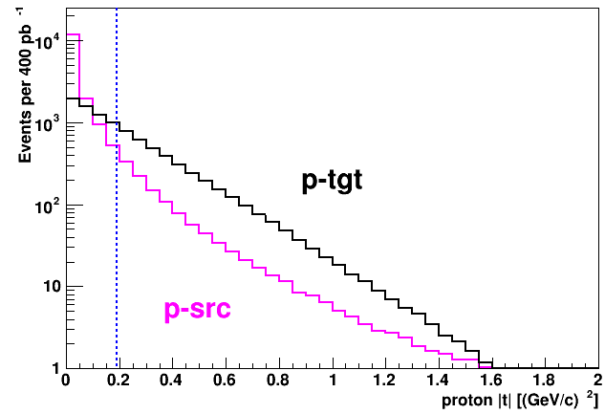
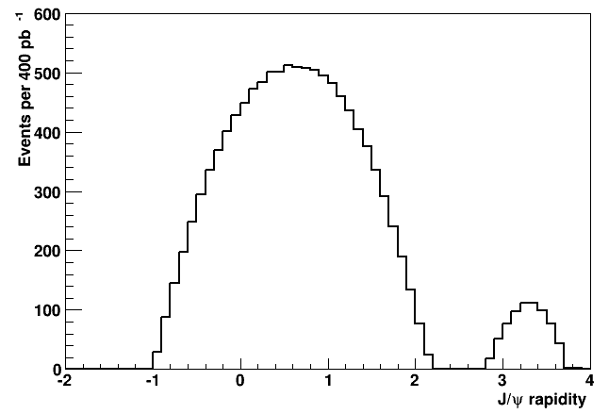
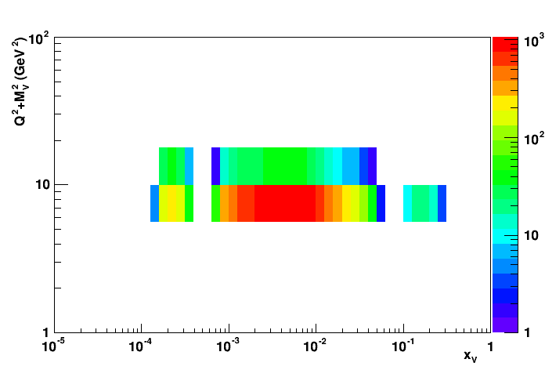
Run-15&17: J/ψ in pp/pA UPC
p/Au
p/Au’
Z²
p↑
p’↑
RP acceptance for scattered proton:
t-dist for protons (tgt & γ-src):
J/Ψ-rapidity
Required:
2017 p↑+p 400 nb-1
1k J/Ψs
δA_{UT:} +/-0.2 in 3 t-bins
Run-15: ~300 J/Ψ

Slide 24
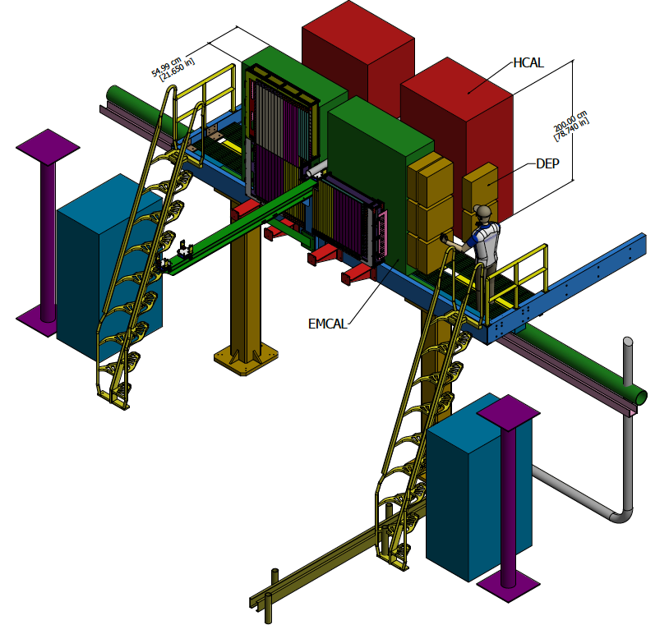
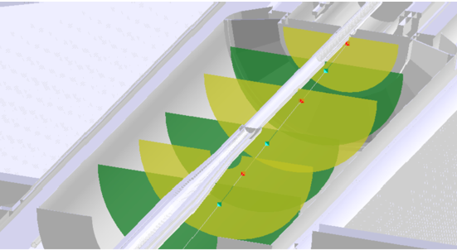
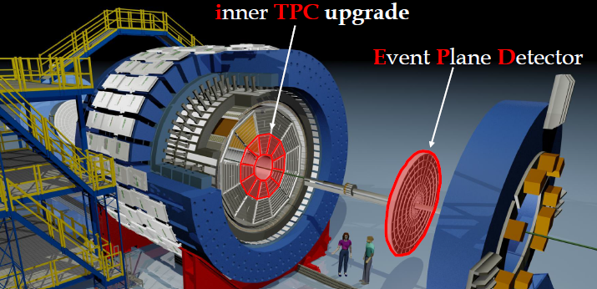
STAR in 2021
STAR forward upgrade 2.5 < η < 4.5
Ecal: reuse PHENIX Ecal
Hcal:design ala
STAR fHCal and EIC fHCal
Tracking:
4-6 Si strip-disks
Endcap TOF
iTPC:
Rebuilds the inner sectors
of the TPC
Continuous Coverage
Improves dE/dx
Extends η coverage from
1.0 to 1.5
Lowers p_{T} cut-in from
125 MeV/c to 60 MeV/c
EPD:
Improves trigger
Reduces background
Allows a better and independent reaction plane
EndCap TOF:
PID at η = 0.9 to 1.5

Slide 25

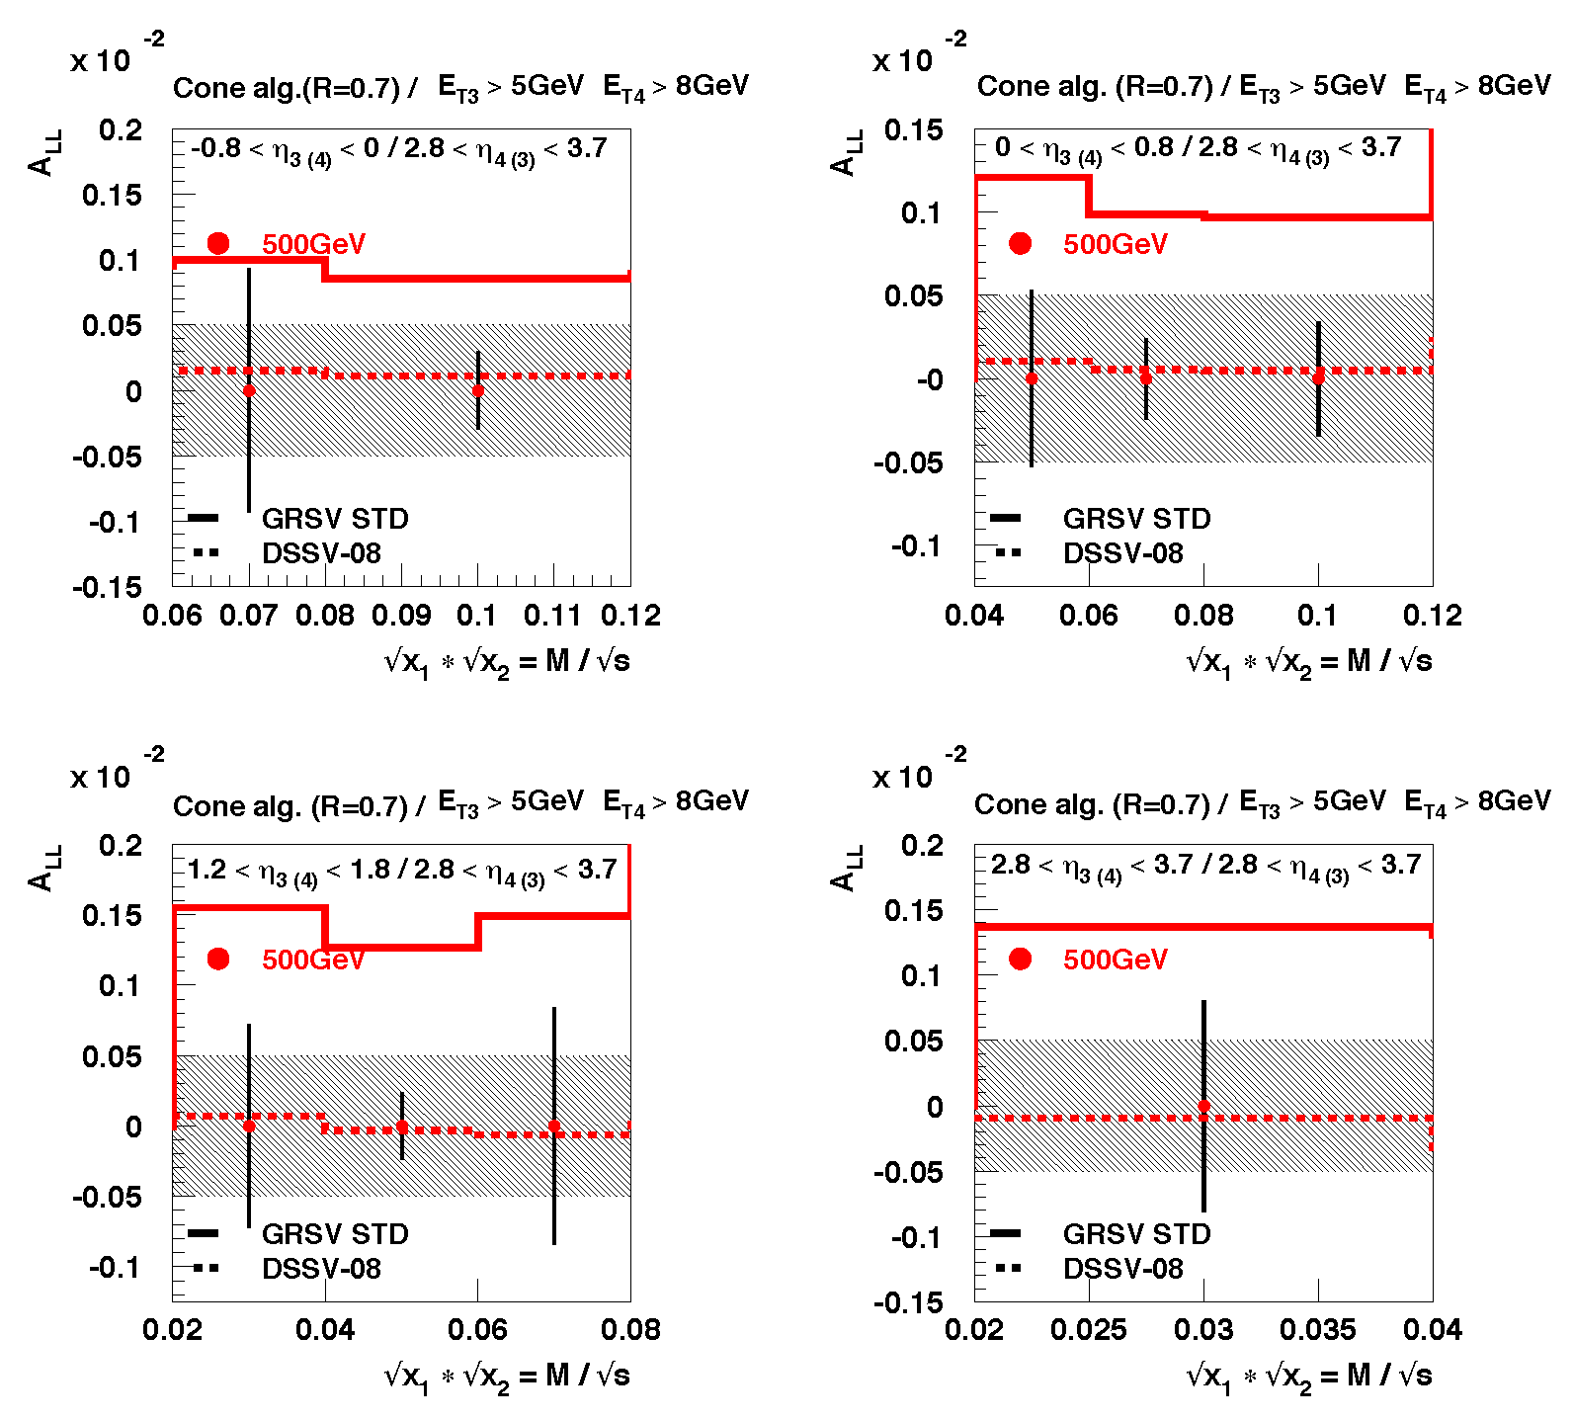
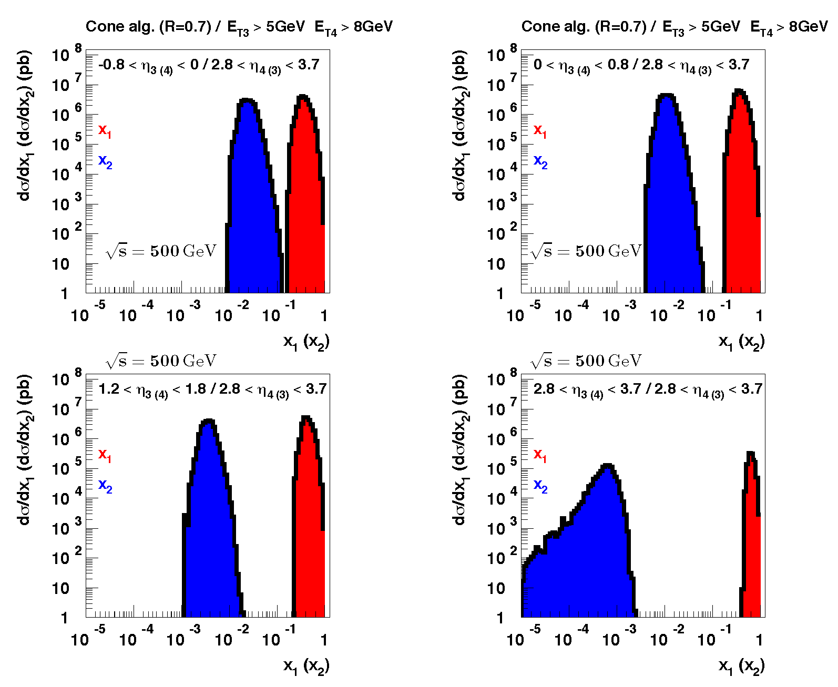
How polarized are the Gluons?
Data till 2009
DIS +
RHIC ≤2009
only way
to constrain low x
further
go forward
Di-Jets@2.5 < η < 4.0
DIS +
RHIC ≤2015
STAR and PHENIX
data till 2015
reduce uncertainties
at x ~ 10⁻³ by factor 2

Slide 26
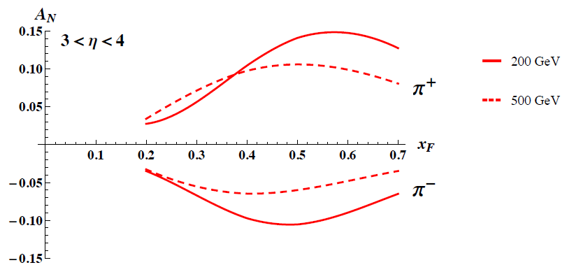
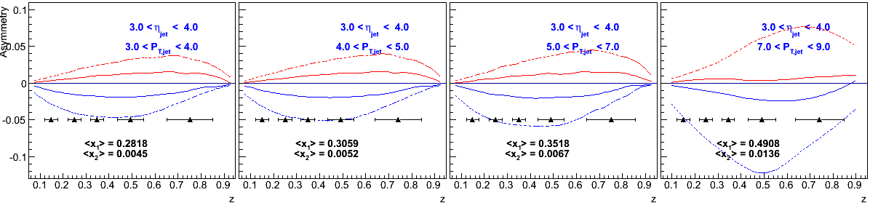
TMDs at STAR
Unique Opportunities:
constrains TMD evolution
are TMDs relevant in the gluon and sea-quark dominated regime?
high precision data sets to test QCD concepts of factorization and universality
→ answers critical to have an optimal TMD program at EIC
Goals:
Increase statistics for A_{N} DY
→ TMD evolution world best constraint ← → A_{N}(W^{+/-} Z⁰)
→ Sivers sign change
Unravel the mystery what is the underlying process of A_{N}
→ measure A_{N} for π^{+/-}
→ clear prediction of importance of special Collins like FF
flavor tagging of the Twist-3 equivalent of the Sivers fct.
→ Observable h^{+/-} with z > 0.5 in jet
measure transversity at high x
→ Observable: hadron in jet
→ constrain tensor charge
Kanazawa et al. PRD 89, 111501 (2014)
h^{+/-}
jet

Slide 27

How Does The initial state IN AA Look?
3 conundrums of the initial state:
What are the nPDFs at low-x?
How saturated is the initial state of the nucleus?
What is the spatial transverse distributions
of nucleons and gluons?
  How much does the spatial distribution
fluctuate? Lumpiness, hot-spots etc.
Current knowledge including
first LHC pA data
pA@RHIC: unique kinematics
can measure nPDF in a x-Q² region
where nuclear effects are large
  Q² > Q_{s}² over a wide range in x
Observables free of final state effects
  Gluons: R_{pA} for direct photons
  Sea-quarks: R_{pA} for DY
Scan A-dependence prediction by
saturation models
can access saturation regime at
forward rapidities
RHIC pA y≤4
direct photon
2.8 < η < 3.8

Slide 28


How Does The initial state IN AA Look?
pA: DY@2.5 < η < 4.5
pA: Direct Photon@2.5 < η < 4.5
Uncertainties:
2015 + 2023 pp&pA
direct photon:
Q²: ~p_{t}²
Q²>5 GeV²
Impact on nPDFs: → sea quarks
Impact on nPDFs: → gluons
Both DY and direct photon R_{pA} give significant constraints on nPDF
alternative observables and kinematics to EIC
DY:
Q²: ~M²
Q²>16 GeV²
Uncertainties:
2023 pp & pA

Slide 29


Saturation with the forward upgrade
Expand the number of observables:
rigorous test of theory predictions
get a handle on the different gluon distributions
provide variety of high precision data to test universality of CGC ←→ EIC
study of evolution/universality of Q_{s}² with A and x for different probes
arXiv:1101.0715
CGC prediction for
R_{pA} direct photon:
jet-hadron / jet photon correlations
→ 1M events with forward upgrade
in 2023 pAu and pAl

Slide 30

Summary
STAR forward and midrapidity pp/pA unique program addressing
several fundamental questions in QCD
essential to complete the mission of the RHIC physics program
Cost effective forward upgrade: Total 5.5 M$ including contingency and manpower
pp/pA program essential to fully realize the scientific promise of the EIC
  inform the physics program
  quantify experimental requirements
STAR pp/pA
EIC
universality
factorization
evolution
inform EIC physics program
experimental requirements

Slide 31


Slide 32
Mid-rapidIty observables
At 500 GeV in 2017:
Transversity x Collins
Sivers function through TWIST-3:
linearly polarised gluons
could be a explanation for
the ridge seen in pp and pA
To have high precision data at
different √s
→ constrain TMD evolution
→ fixed x and Q² → p_{T} different

Slide 33


The STAR Forward Upgrade
Requirements from Physics:
Calorimeter System:
Intensive R&D work on both ECal and Hcal
as part of STAR and EIC Detector R&D
several beam test and STAR in situ tests
system optimized for cost and performance
ECal:
reuse PHENIX PbSC calorimeter
with new readout on front instead of W/ScFi SPACAL
significant cost reduction ☺
uncompensated calorimeter system ☹
HCal:
sandwich iron-scintillator plate sampling Calo
Same readout for both calorimeters → cost
Cost:
ECal: 0.57 M$
Hcal: 1.53 M$
Preshower: 0.06 M$
based on extensive experience from prototypes
contingency and manpower included
Total: 2.2 M$

Slide 34





The STAR Forward Upgrade
Silicon mini-Strip Detectors only
Si + Small-strip Thin Gap Chambers
6 disks
12 wedges, each with
128 strips in ϕ at
fixed radius and 8
strips in the radial
direction at a fixed ϕ
60 – 180 cm from IP
3 Si disks + 4 sTGC
Si- disks:
90, 140, 187 cm from IP
sTGC:
270, 300, 330, 360 cm
from IP (outside Magnet)
Momentum resolution: 20-30%
for 0.2 < p_{T} < 2 GeV/c
track finding efficiency: 95%@100 tr/ev
Momentum resolution: 20-30%
for 0.2 < p_{T} < 2 GeV/c
track finding efficiency: 80%@100 tr/ev
0.2 GeV/c
pions
1 GeV/c
2 GeV/c
Cost: 4.1 M$
Cost: 3.3 M$

Slide 35

Summary of forward pp & pA measurements

Slide 36

Studying non-linear effects
Scattering of electrons off nuclei:
Probes interact over distances L ~ (2m_{N} x)⁻¹
For L > 2 R_{A} ~ A^{1/3} probe cannot distinguish between nucleons in front or back of nucleon
Probe interacts coherently with all nucleons
Nuclear “Oomph” Factor
Pocket Formula:
Enhancement of Q_{S} with A ⇒ non-linear QCD regime reached at significantly lower energy in A than in proton

Slide 37


EIC’s Physics Impact, Complementarity and Uniqueness
Complementarity
QCD has two concepts which lay its foundation
factorization and universality
To tests these concepts and separate interaction dependent phenomena from
intrinsic nuclear properties
different complementary probes are critical
Probes: high precision data from ep, pp, e+e-
Factorization
Universality
Example: Measure PDFs at HERA at √s=0.3 TeV:
Predict pp and measurements at √s=0.2, 1.96 & 7 TeV
(un)polarized cross section ~
PDF ⊗ hard-scattering ⊗ Hadronization
hard-scattering : calculable in QCD
PDFs and Hadronization: need to be determined experimentaly
Notes:
start from intrinsic part can separate inteaction by universality
real time phenomena

Slide 38



Forward Proton Tagging Upgrade
at 55-58m
at 15-17m
Follow PAC recommendation to develop a solution to run pp2pp@STAR with
std. physics data taking → No special β* running any more
should cover wide range in t → RPs at 15m & 17m
Staged implementation
  Phase I (currently installed): low-t coverage
  Phase II (proposed) : for larger-t coverage
  1st step reuse Phase I RP at new location only in y
  full phase-II: new bigger acceptance RPs & add RP in x-direction
    full coverage in φ not possible due to machine constraints
Good acceptance also for spectator protons from
deuterium and He-3 collisions
Phase-II: 1st step
1st step
full Phase-II

