Slide 1


Synergies of (UPC) pA collisions with EIC
Daniel Tapia Takaki
Synergies of pp and pA collisions with an EIC
Brookhaven National Lab
27 June 2017

Slide 2
Plan of this talk
Status of LHC analyses
Presentation of “Energy dependence of dissociative J/ψ photoproduction as a signature of gluon saturation at the LHC”
J. Cepina, J.G. Contreras and DTT
Phys. Lett. B766 (2017) 186-191
Daniel Tapia Takaki Synergies of pp and pA with an EIC – BNL, Brookhaven, NY June 27, 2017

Slide 3
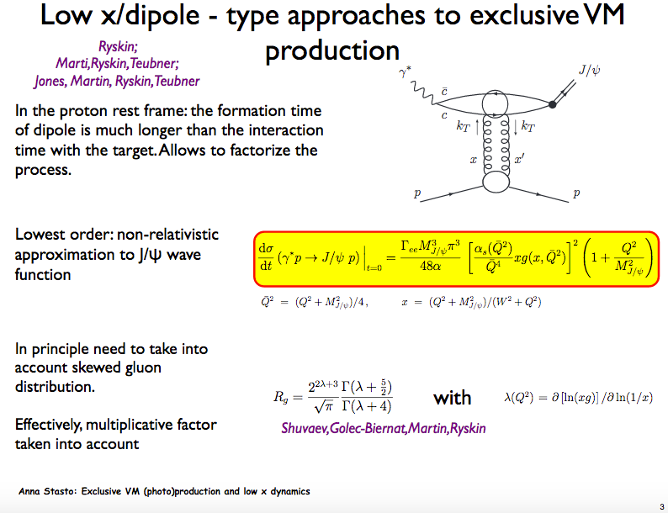
See A. Stasto
talk at
PHOTON’17
Daniel Tapia Takaki Synergies of pp and pA with an EIC – BNL, Brookhaven, NY June 27, 2017

Slide 4
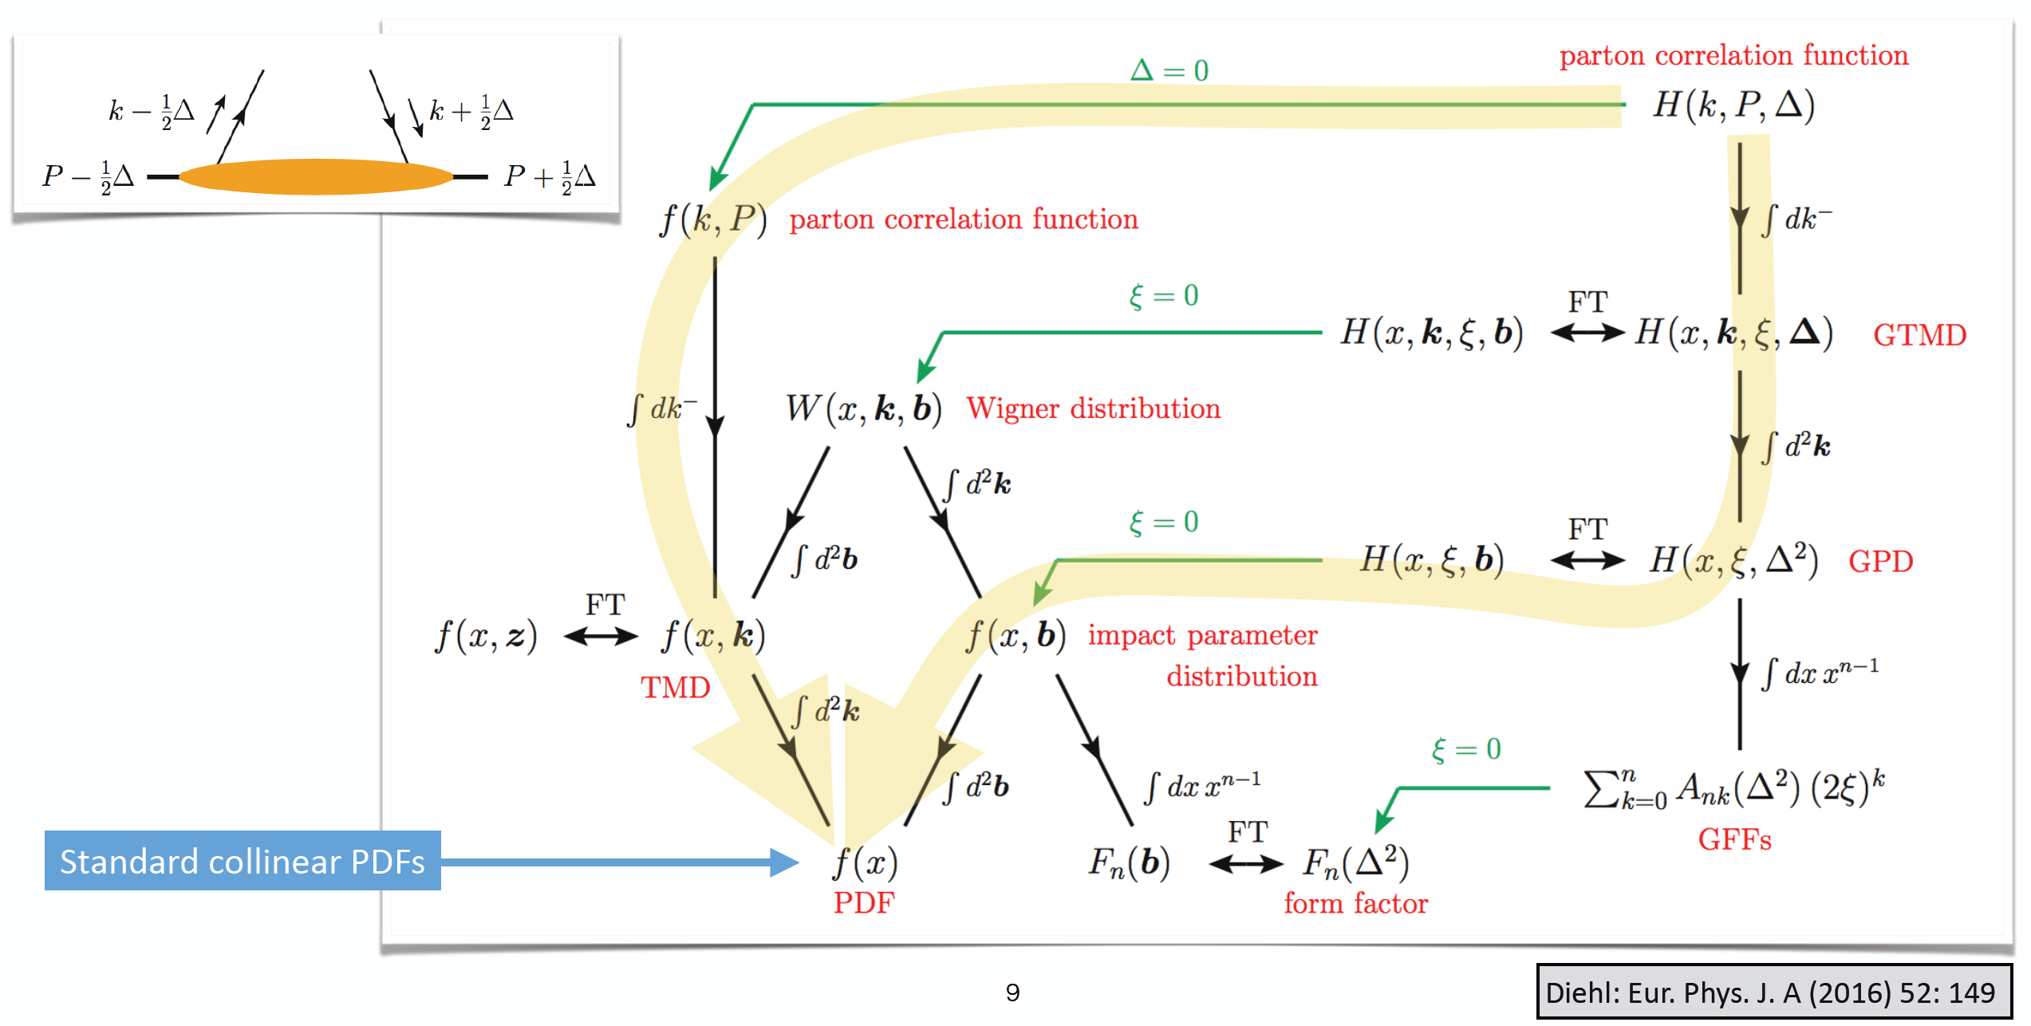
Exclusive J/ψ photoproduction
Daniel Tapia Takaki Synergies of pp and pA with an EIC – BNL, Brookhaven, NY June 27, 2017

Slide 5
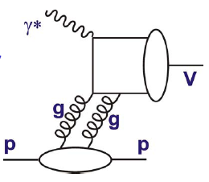
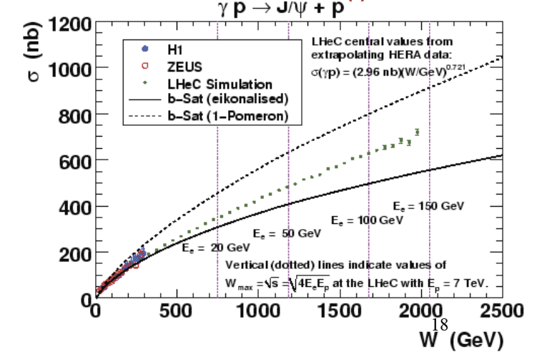
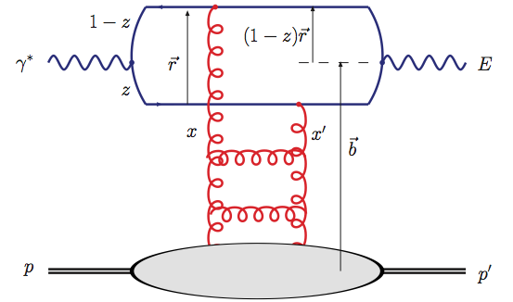
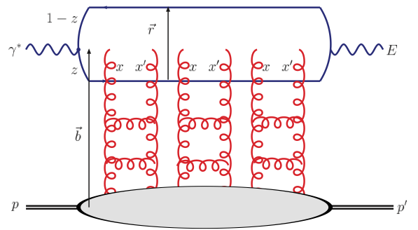
Exclusive VM photoproduction
● Elastic J/ψ production appears as a candidate to signal saturation effects at work
Linear, sensitivity to (xg)².
Non-linear, saturation.

Slide 6
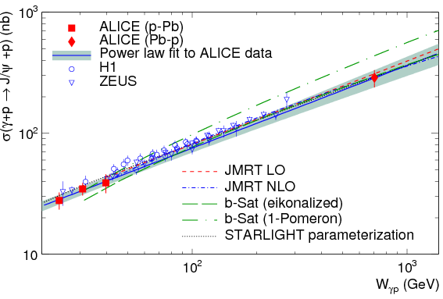
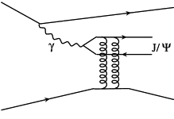
Exclusive J/ψ photoproduction
Phys.Rev.Lett. 113 (2014) 23, 232504
p,Pb
p,Pb
p
p
A natural explanation is that no change in the behaviour of the gluon PDF in the
proton is observed between HERA and LHC energies” PRL 113 (2014) 232504.
Daniel Tapia Takaki Synergies of pp and pA with an EIC – BNL, Brookhaven, NY June 27, 2017

Slide 7
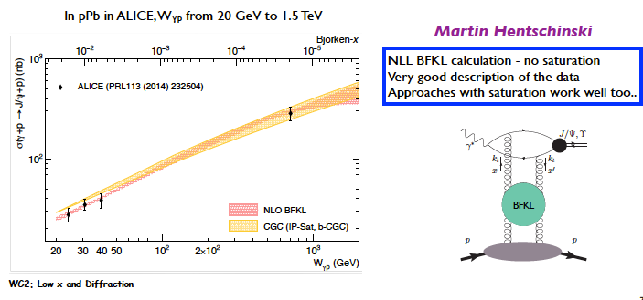
Exclusive J/ψ photoproduction
p,Pb
Daniel Tapia Takaki Synergies of pp and pA with an EIC – BNL, Brookhaven, NY June 27, 2017

Slide 8
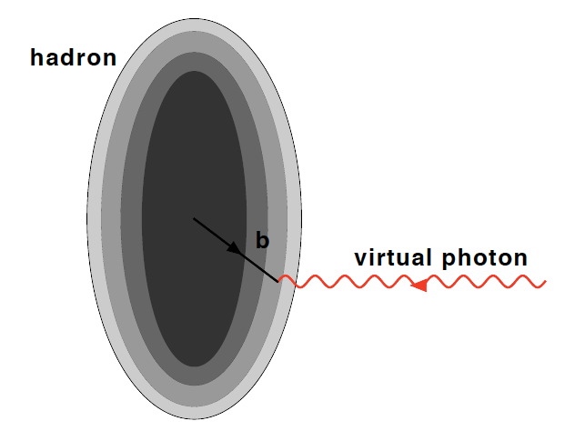
t-dependence
● t-differential measurements give a gluon tranverse mapping of the hadron/nucleus.

Slide 9
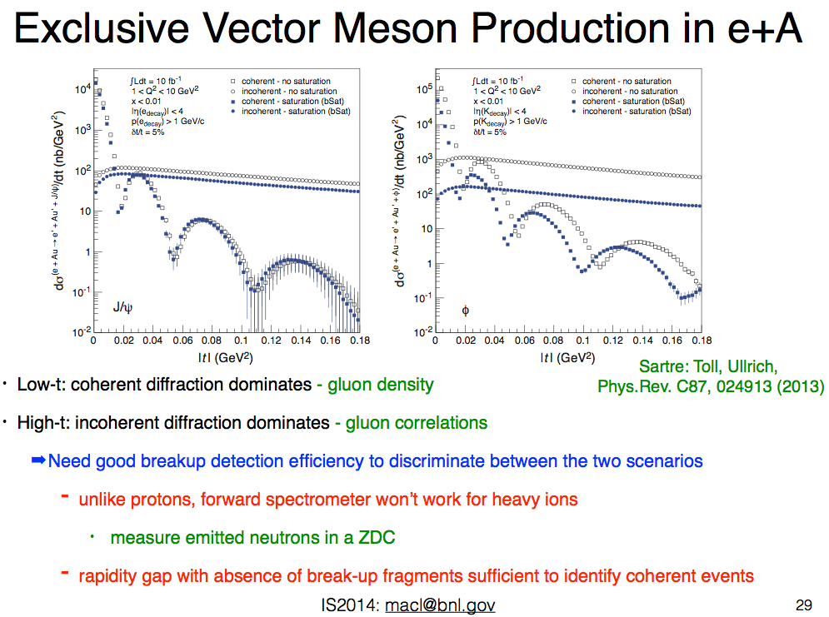
Daniel Tapia Takaki Synergies of pp and pA with an EIC – BNL, Brookhaven, NY June 27, 2017

Slide 10
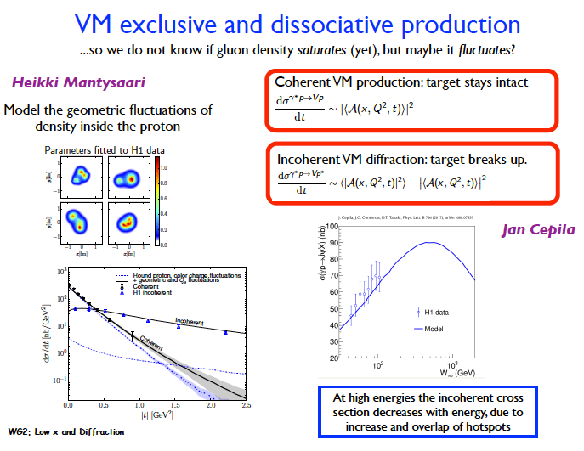
INT & DIS workshop
Daniel Tapia Takaki Synergies of pp and pA with an EIC – BNL, Brookhaven, NY June 27, 2017

Slide 11
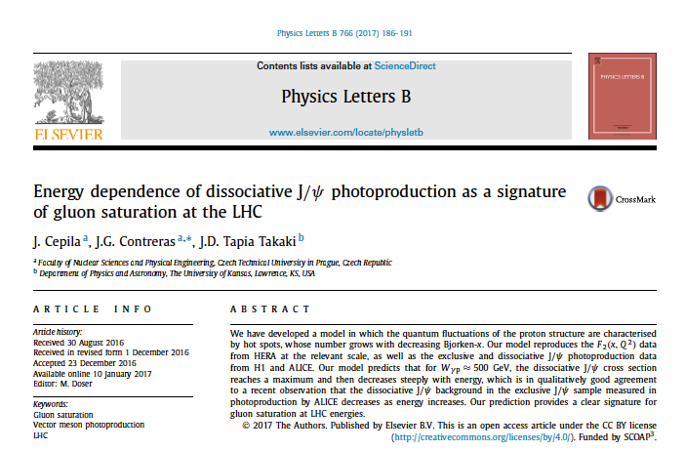
Dissociative production of J/ψ and gluon saturation
Daniel Tapia Takaki
University of Kansas
Work in collaboration with J. Cepina and J. G. Contreras
Phys. Lett. B766 (2017) 186-191

Slide 12

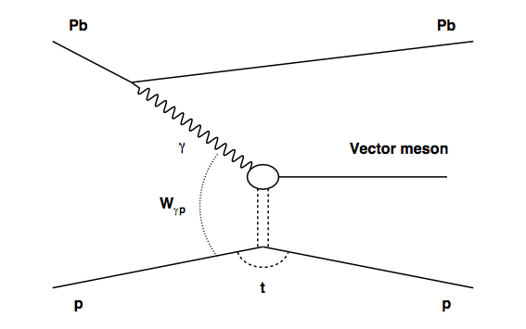

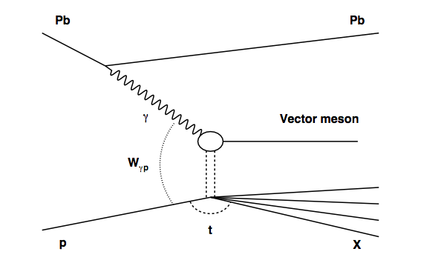
Exclusive and dissociative J/ψ production
Exclusive
dissociative

Slide 13
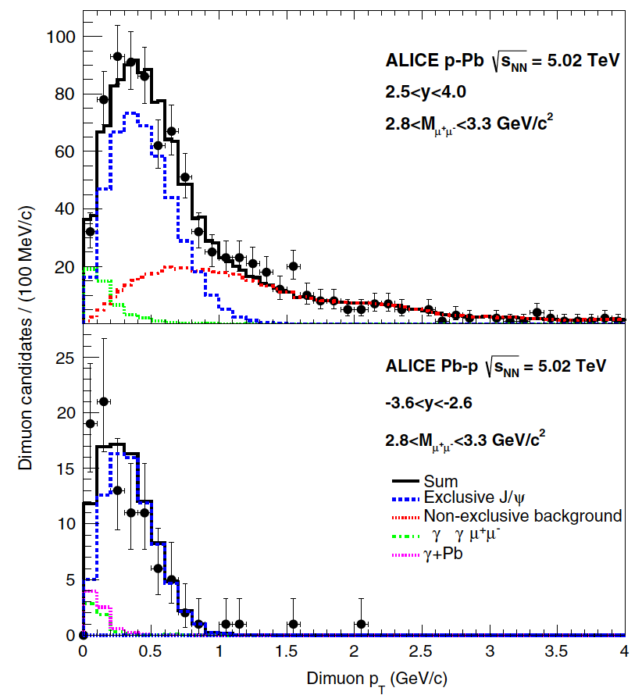
Prediction for dissociative production
Phys.Rev.Lett. 113 (2014) 23, 232504
Low W_{gp} energy point
<W_{gp}> ~ 30 GeV
High W_{gp} energy point
<W_{gp}> ~ 700 GeV

Slide 14
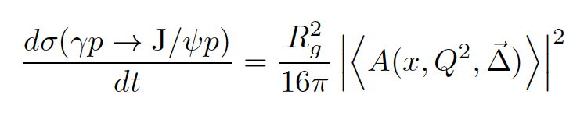


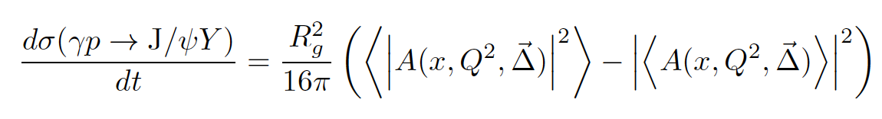
Exclusive and dissociative J/ψ production
Average over configurations
Exclusive
dissociative
Variance over configurations

Slide 15


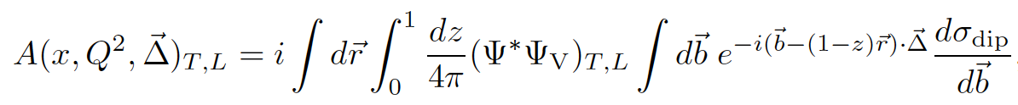









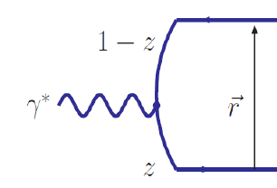

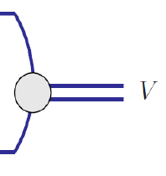
The amplitude in the dipole picture
x related to Wγp which is related to the rapidity of the vector meson V
Δ²=-t
dipole size
quark energy fraction
impact parameter
photon virtuality
Transverse, Longitudinal photons
vector meson wave function
photon-dipole wave function
Dipole-Target cross section
pQCD physics gets here!

Slide 16


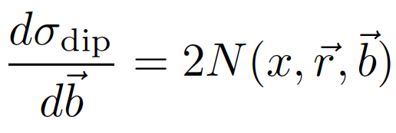
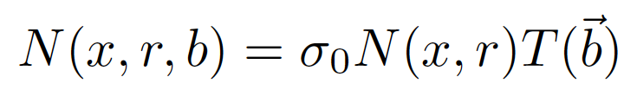

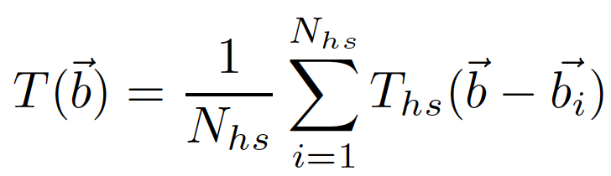

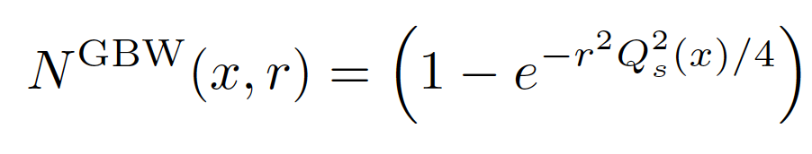
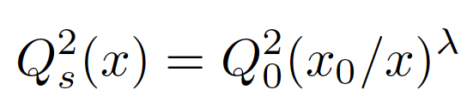
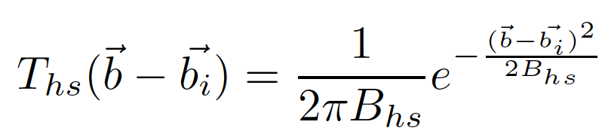
The dipole-target cross section
dipole target amplitude
Proton is a sum
of hot spots
Factorised assumption
Golec-Biernat Wuesthoff model
Gaussian hot spots

Slide 17
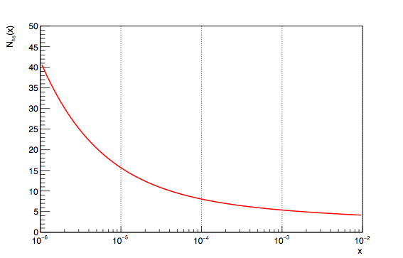


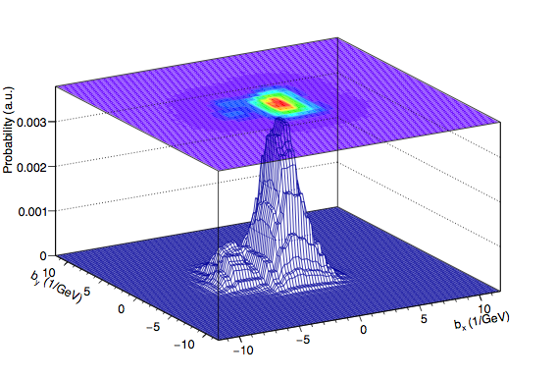
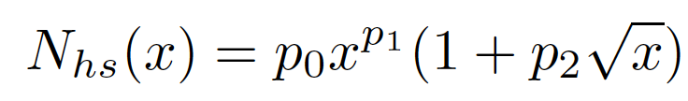
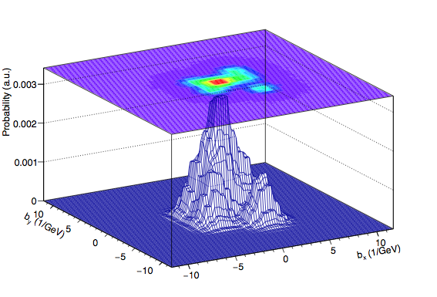
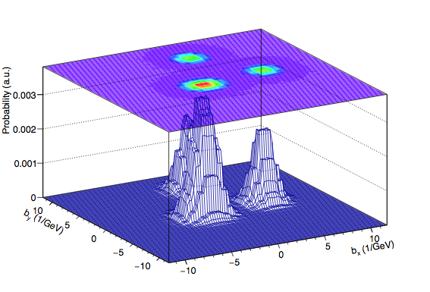
Number of hot spots
This only redistributes T(b) in impact parameter. At each x the integral of T(b) over b² is one

Slide 18
Comparison to data
Parameters fixed using data:
  λ using x dependence of exclusive vector meson production
  σ0 using t dependence of exclusive production
  x0 normalisation of x dependence of exclusive production
  hot spot width from t dependence of dissociative production
  Number of hot spots from x dependence of dissociative production

Slide 19
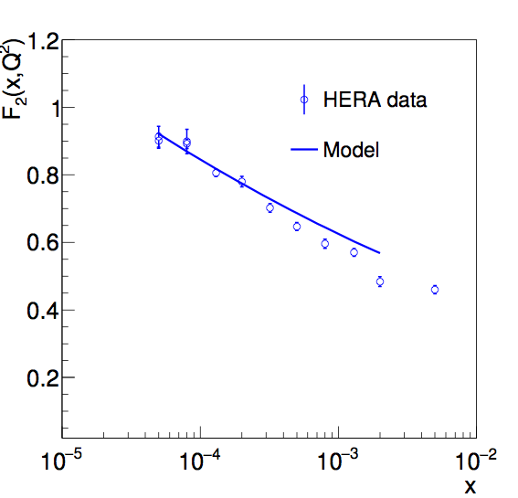
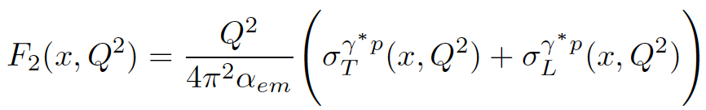
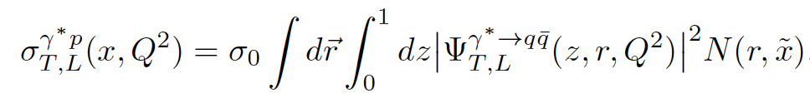
Comparison to inclusive data
Good description even though the model
was developed for vector meson production
Phys. Lett. B766 (2017) 186-191

Slide 20
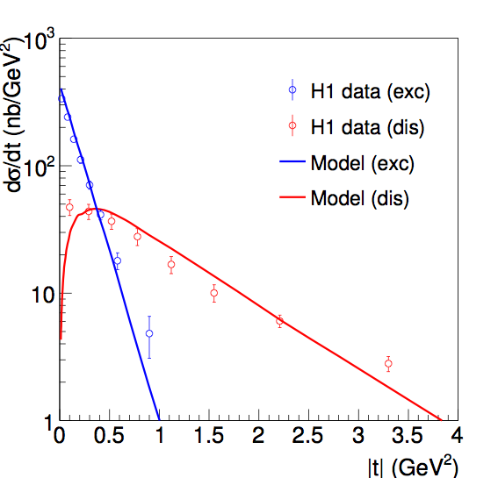
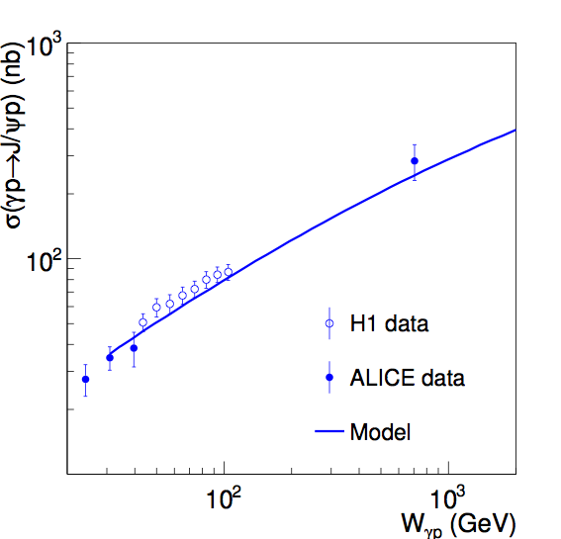
Comparison to vector meson data
Good description!
Phys. Lett. B766 (2017) 186-191

Slide 21
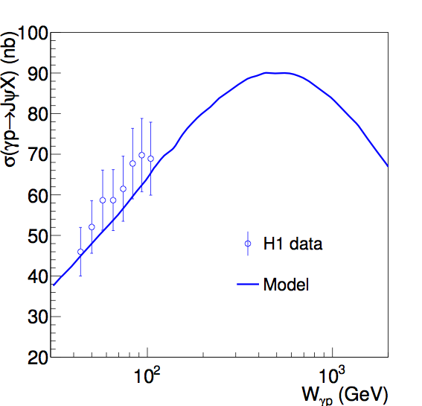
Prediction for dissociative production
Striking signature!
hint from ALICE data
PRL 113, 232504 (2014)
Phys. Lett. B766 (2017) 186-191

Slide 22
Some comments
The parameters take expected values (see discussion in the paper).
Even though the model describes reasonably well data, it is a simple model, so the main conclusion is qualitative: at large energies the dissociative production cross section turns around and decreases.
The turn around has a geometric origin reminiscent of percolation, and implies that all configurations of a black disk look the same and the variance then disappears.
Quantitatively, the turn around in the model happens at Wγp around 500 GeV
ALICE and H1 data suggest that in reality it may even happen at smaller energies

Slide 23
Summary and outlook
Dissociative photoproduction of J/ψ vector mesons can be used to look for gluon saturation
The signature is striking: the cross section rises with energy up to a maximum to decrease steeply afterwards
There are experimental and phenomenological suggestions that this is happening within the energy range accessible at the LHC
It would be very interesting if we could measure the energy dependence of the dissociative production cross section

Slide 24
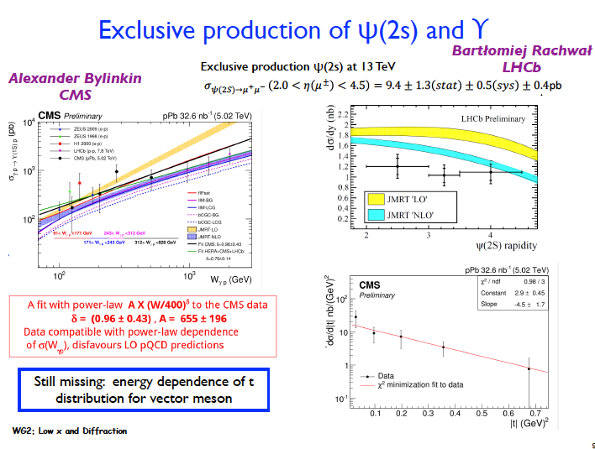
DIS 2017
Daniel Tapia Takaki Saturation: Recent developments, new measurements/ideas – BNL April 26 2017

Slide 25
One more thing …

Slide 26
Nuclear suppression factor in Pb (S)
See V. Guzey talk today
Daniel Tapia Takaki Synergies of pp and pA with an EIC – BNL, Brookhaven, NY June 27, 2017

Slide 27
Vector meson photoproduction in UPC Pb-Pb
Neutron dependence
          There is a factor 2… the emitted neutrons and the
          photoproduced J/ψ events appear to be independent processes
          within the current uncertainty (0nXn ~ Xn0n)
Daniel Tapia Takaki Synergies of pp and pA with an EIC – BNL, Brookhaven, NY June 27, 2017

Slide 28
Vector meson photoproduction in
UPC Pb-Pb
Neutron dependence
          There is a factor 2 since the neutron and the coherent J/ψ are
          independent processes (confirmed by data)
          Two components:
High-x: J/ψ and the emitted neutrons: same rapidity hemisphere
Low-x: J/ψ and the emitted neutrons: opposite rapidity hemisphere
Daniel Tapia Takaki Synergies of pp and pA with an EIC – BNL, Brookhaven, NY June 27, 2017

Slide 29
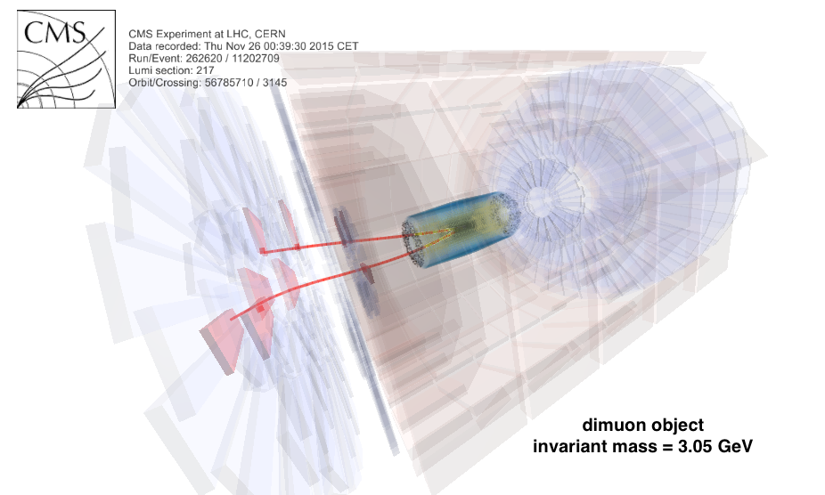
Two different type of topologies
Same direction
for J/ψ and neutrons
No
neutrons
At least one
neutrons
Opposite direction for J/ψ and neutrons
At least one
neutrons
No
neutrons
Daniel Tapia Takaki Synergies of pp and pA with an EIC – BNL, Brookhaven, NY June 27, 2017

Slide 30

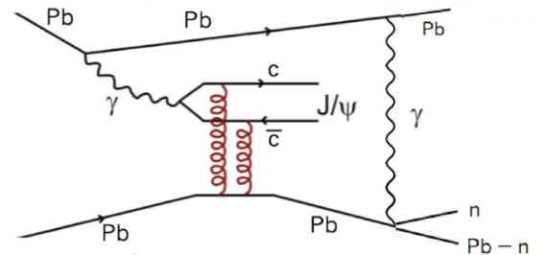
Incoherent photoproduction in
UPC Pb-Pb
Total cross section
Low W: x~ 10-2
High W: x~ 10-4
Incoherent production is expected to be more sensitive to the photon direction (energy dependence). Here 0nXn and Xn0n will unfold the two x-values
Daniel Tapia Takaki Synergies of pp and pA with an EIC – BNL, Brookhaven, NY June 27, 2017

Slide 31
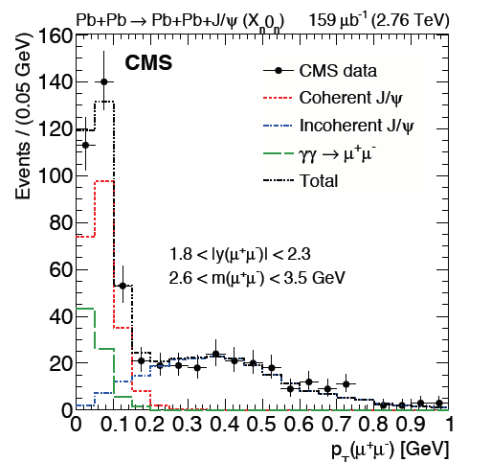
  Energy dependence of Incoherent J/ψ
Incoherent background
is the High-x region
Incoherent J/ψ background (Xn0n): Events are in the High-x region.
At Low-x, incoherent production is very strongly suppressed wrt to
High-x region - First time seen in γ+Pb interactions
Daniel Tapia Takaki Synergies of pp and pA with an EIC – BNL, Brookhaven, NY June 27, 2017

Slide 32
One more thing …

Slide 33
White paper
Following the INT workshop, a White Paper on photon-nucleus/proton will be prepared
Coordinated by DTT and in preparation…
Daniel Tapia Takaki Synergies of pp and pA with an EIC – BNL, Brookhaven, NY June 27, 2017

Slide 34
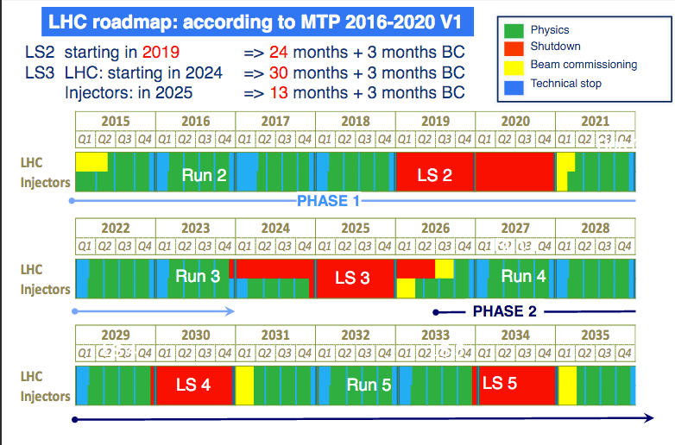
LHC schedule
CERN Yellow Report: CERN-PH-LPCC-2015-001
Daniel Tapia Takaki Synergies of pp and pA with an EIC – BNL, Brookhaven, NY June 27, 2017

Slide 35
Additional slides

Slide 36
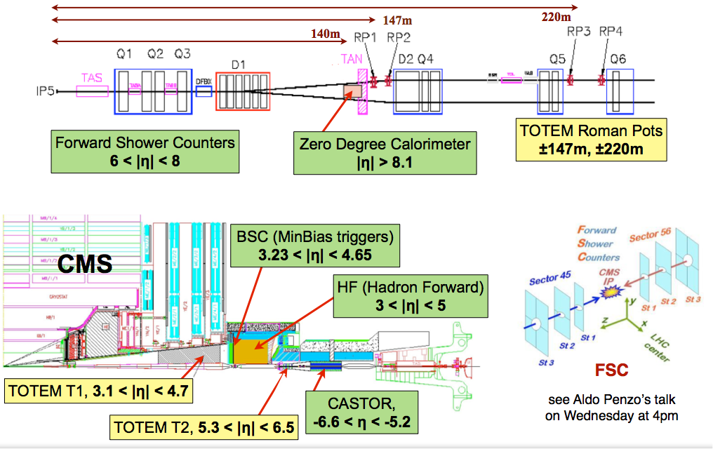
Forward detectors at CMS
Daniel Tapia Takaki Synergies of pp and pA with an EIC – BNL, Brookhaven, NY June 27, 2017

