Slide 1



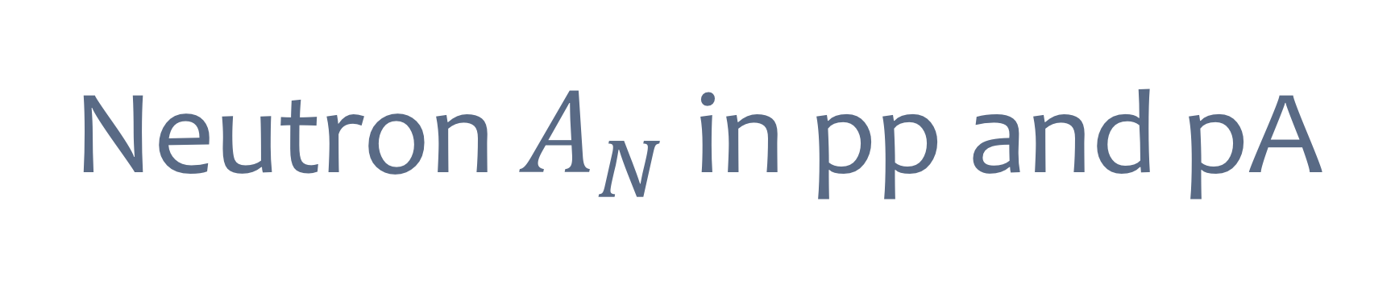
Neutron $A_{N}$ in pp and pA
Minjung Kim
for the PHENIX Collaboration
(SNU/RIKEN)
RBRC Workshop: Emerging Spin and Transverse Momentum Effects in p+p and p+A Collisions
2016-02-10 @ BNL
Notes:
Hi, I’m Minjung Kim from Seoul national university, and RIKEN.
I’m going to present forward neutron A_N in pp and pA.

Slide 2
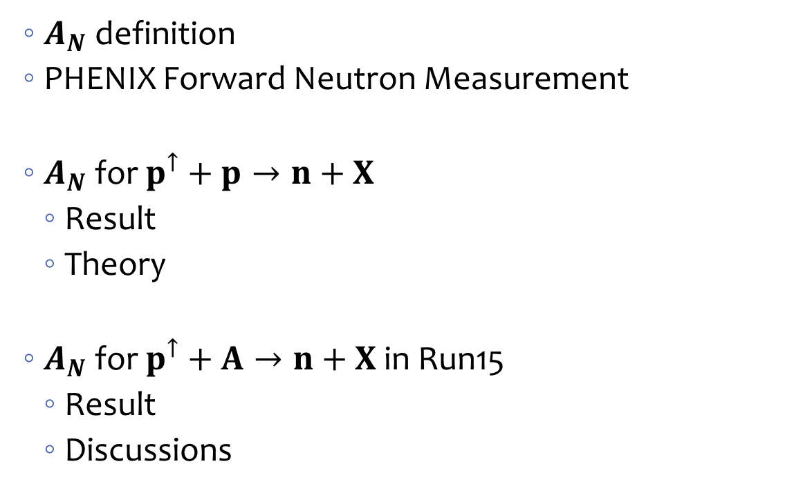
Content
  $A_{N}$ definition
  PHENIX Forward Neutron Measurement
  $A_{N}$ for $p^{↑}+p→n+X$
    Result
    Theory
  $A_{N}$ for $p^{↑}+A→n+X$ in Run15
    Result
    Discussions
Notes:
Here is the content.
First, I’ll introduce the definition of A_N, then introduce PHENIX forward neutron measurement.
Then, I will show result and theory of A_N for p+p collision
And then, I will show result of asymetry from Run15 p+A collision, and discussions about this results.

Slide 3
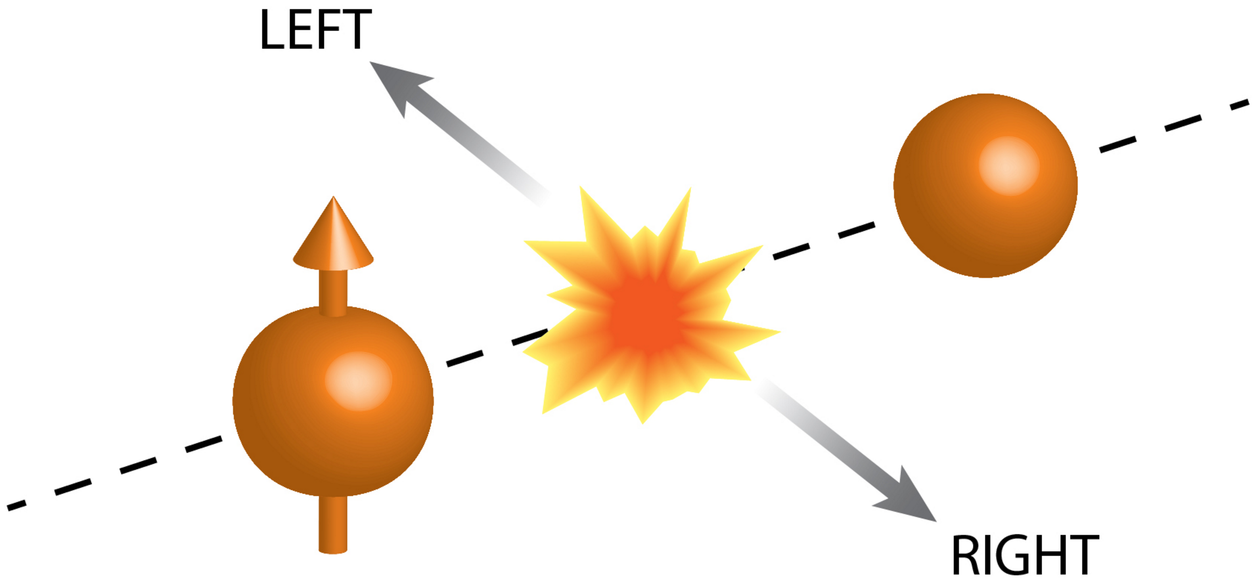
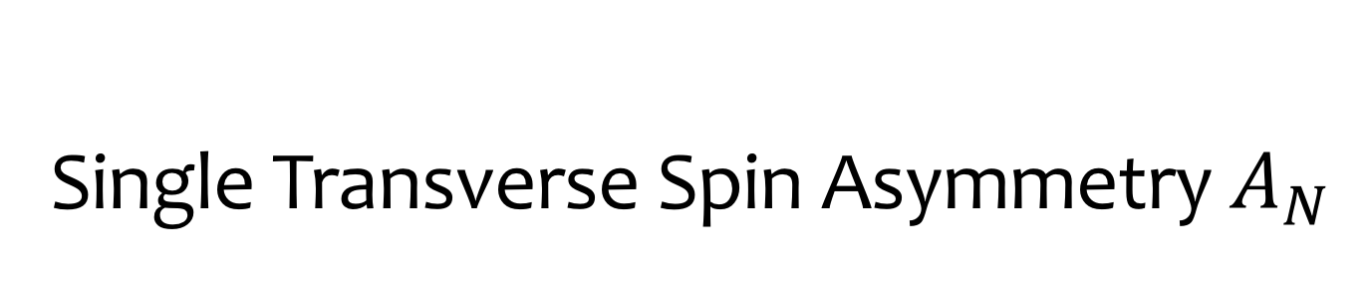
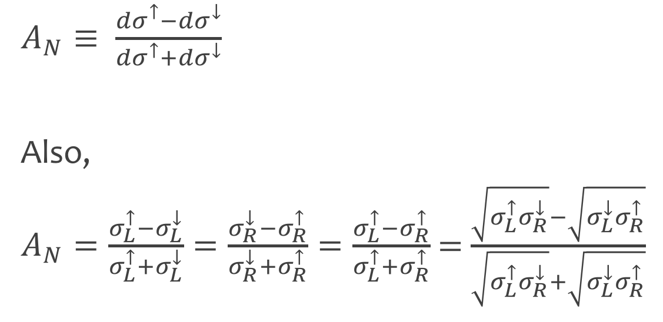
Single Transverse Spin Asymmetry $A_{N}$
$A_{N}≡ \frac{{dσ}^{↑}−{dσ}^{↓}}{{dσ}^{↑}+{dσ}^{↓}}$
Also,
$A_{N}=\frac{σ_{L}^{↑}−σ_{L}^{↓}}{σ_{L}^{↑}+σ_{L}^{↓}}=\frac{σ_{R}^{↓}−σ_{R}^{↑}}{σ_{R}^{↓}+σ_{R}^{↑}}=\frac{σ_{L}^{↑}−σ_{R}^{↑}}{σ_{L}^{↑}+σ_{R}^{↑}}$ = $\frac{\sqrt{σ_{L}^{↑}σ_{R}^{↓}}−\sqrt{σ_{L}^{↓}σ_{R}^{↑}}}{\sqrt{σ_{L}^{↑}σ_{R}^{↓}}+\sqrt{σ_{L}^{↓}σ_{R}^{↑}}}$
Notes:
You may already know, here is definition of single transverse spin asymmetry.
And using rotational symmetry, A_N can be written as these equations.
We utilize the last term for analysis to cancel out systematic from relative luminosity, and detector left-right efficiency.

Slide 4
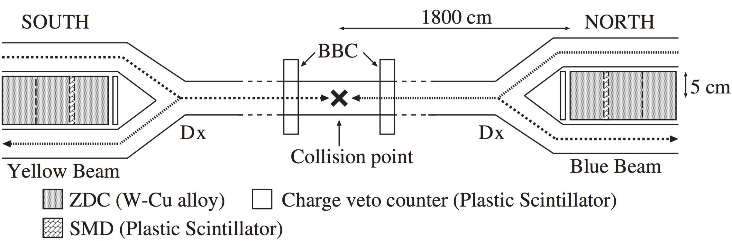
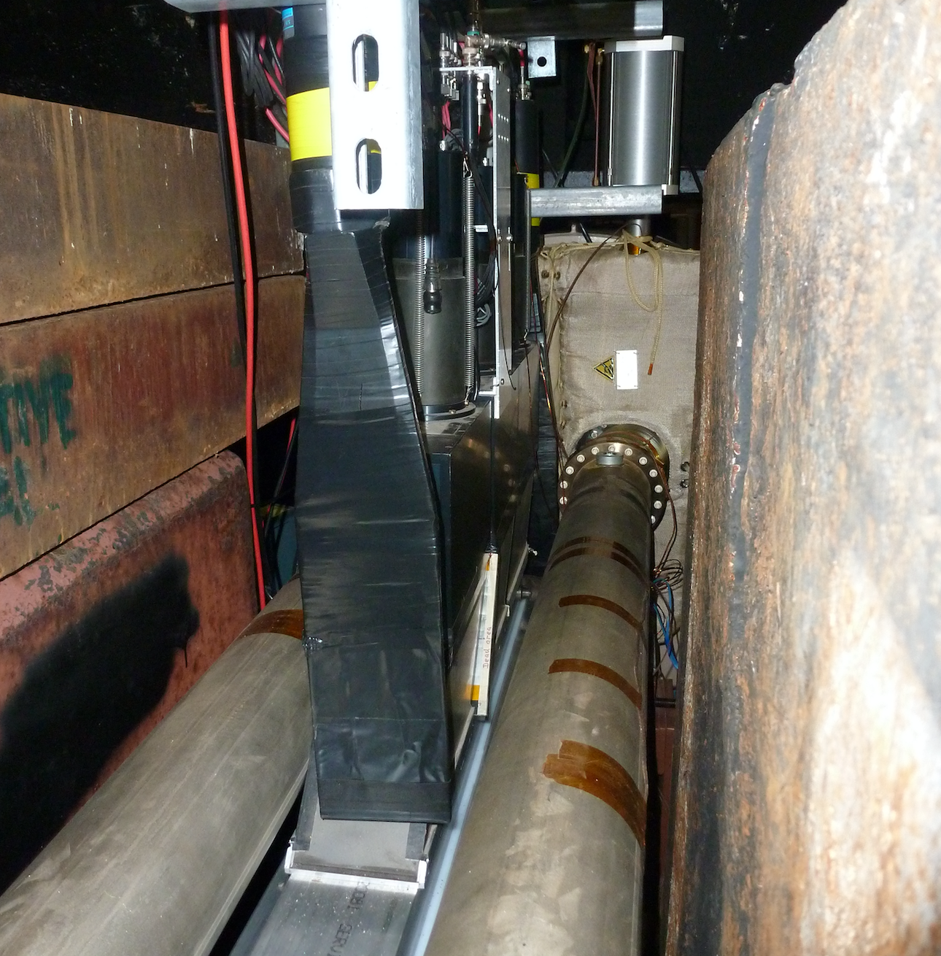
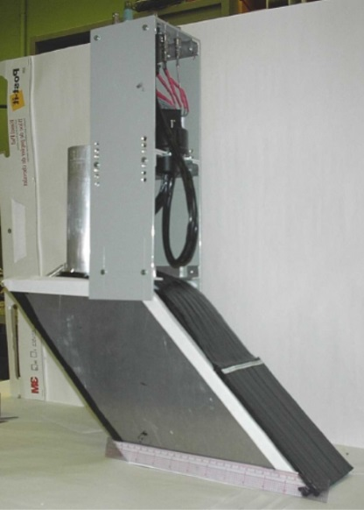
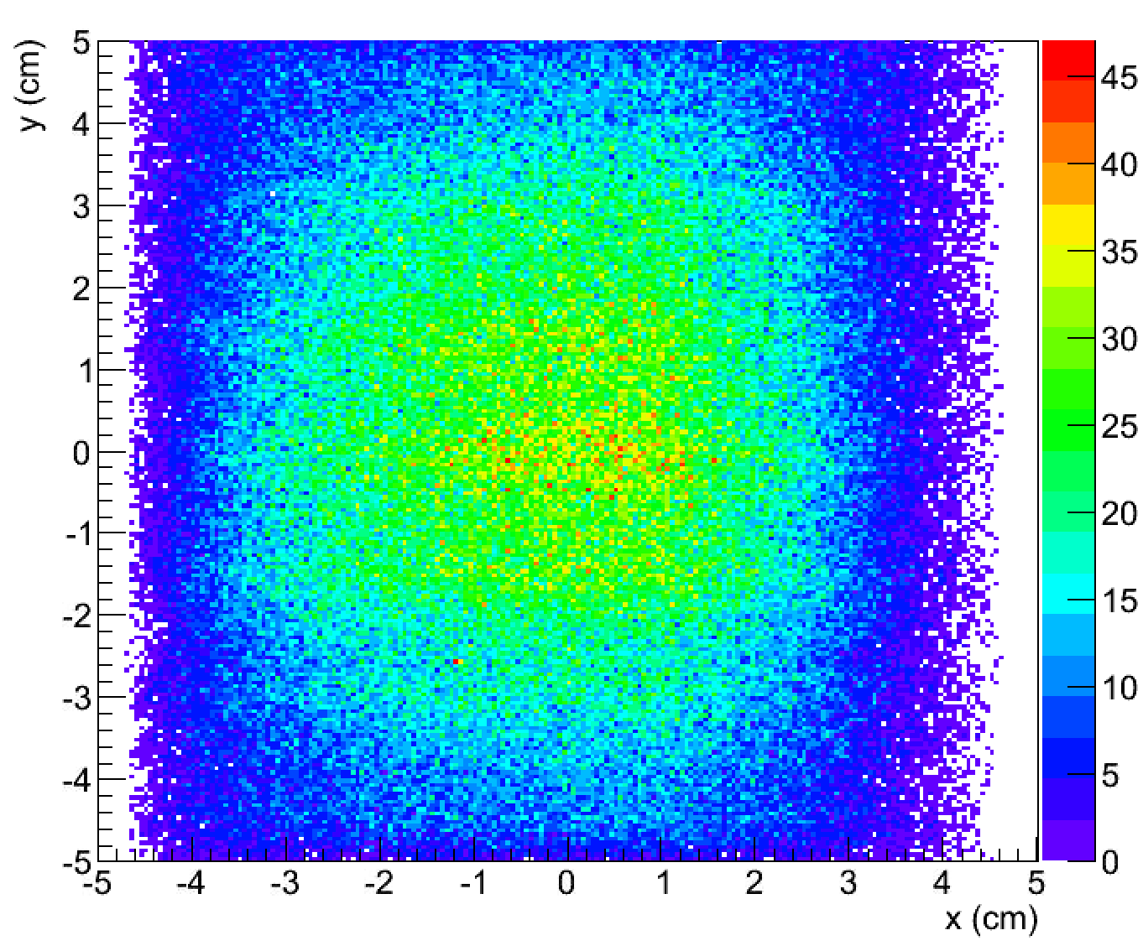
PHENIX Forward Neutron Detector
Y (cm)
Neutron position
x
7 channels (x)
Centroid of shower
SMD
8 channels (y)
2nd ZDC
X (cm)
10 cm x 10 cm
Notes:
For forward neutron detection, ZDC, SMD, and charge veto counters are used.
ZDC is a cherenkov sampling hadron calorimeter, SMD is arrays of plastic scintilator strips, and used for position reconstruction by measuring centroid of shower. Here is reconstructed position distribution.
There are charge veto counters, which are thin plastic scintillators to veto charged particles.

Slide 5
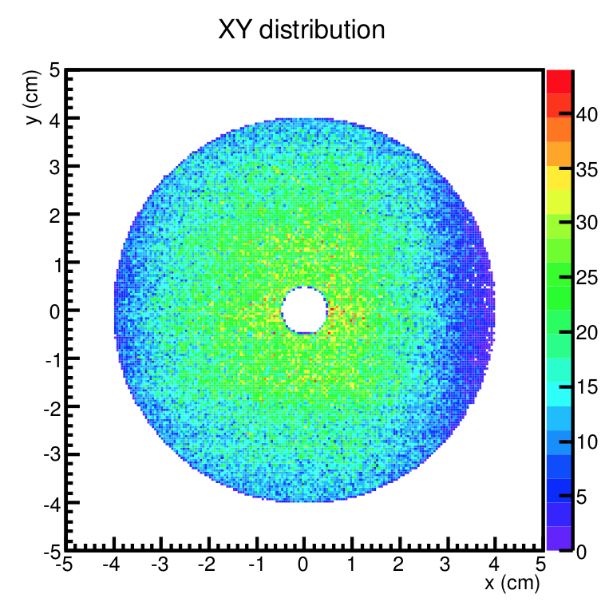
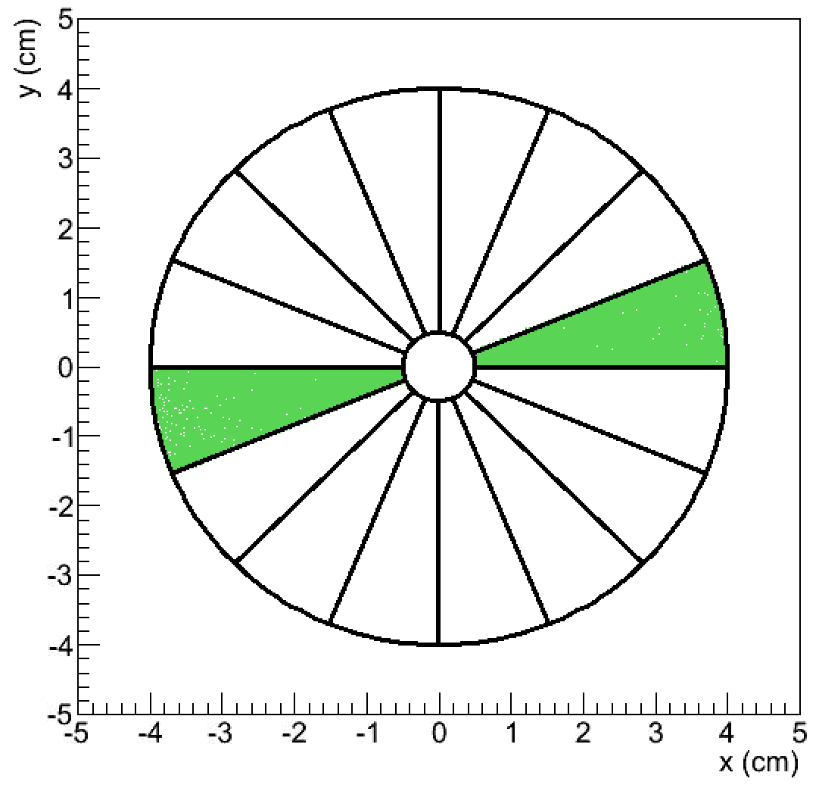
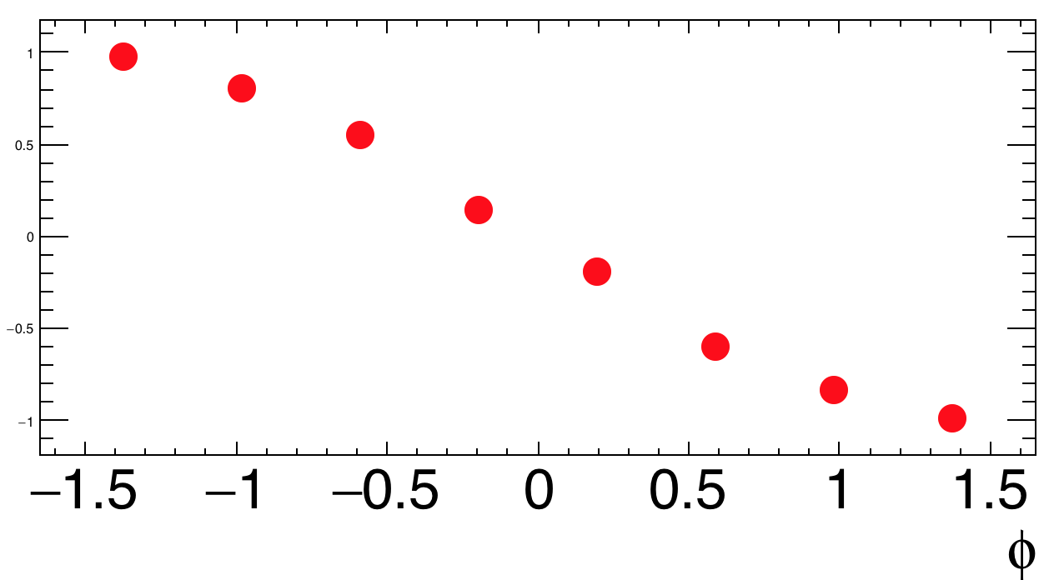
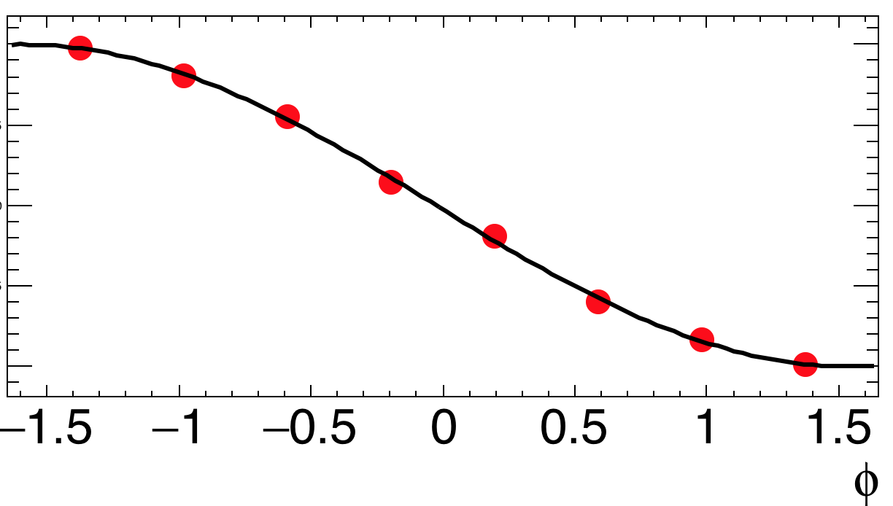

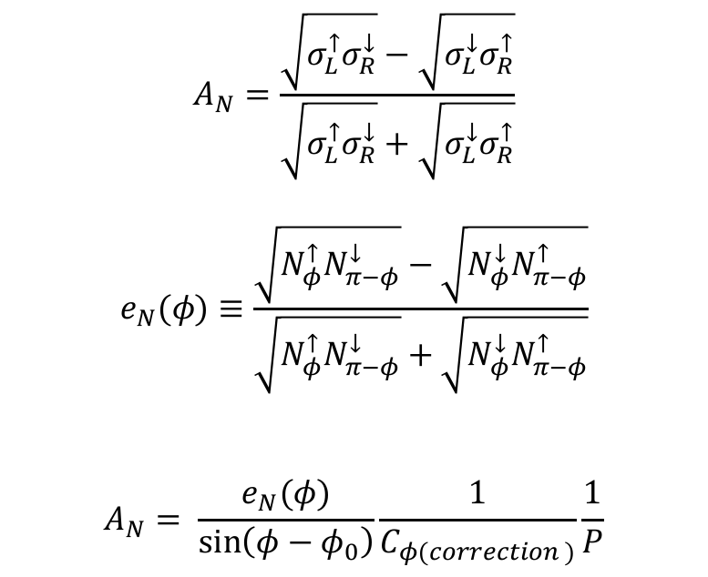


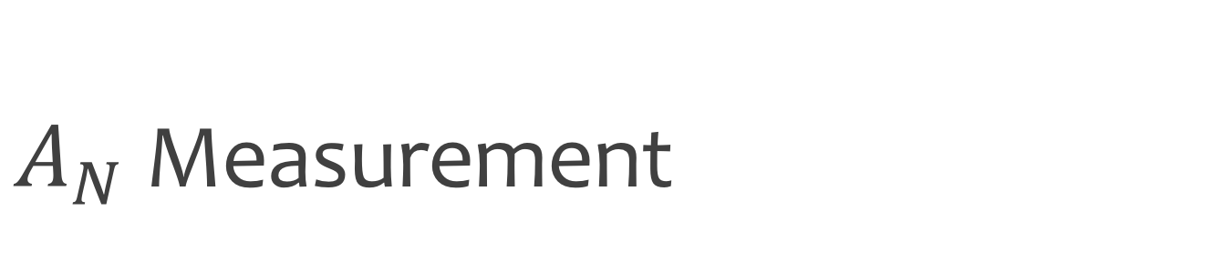


$A_{N}$ Measurement
Y
$$A_{N}=\frac{\sqrt{σ_{L}^{↑}σ_{R}^{↓}}−\sqrt{σ_{L}^{↓}σ_{R}^{↑}}}{\sqrt{σ_{L}^{↑}σ_{R}^{↓}}+\sqrt{σ_{L}^{↓}σ_{R}^{↑}}}$$
$$e_{N}(φ)≡\frac{\sqrt{N_{φ}^{↑}N_{π−φ}^{↓}}−\sqrt{N_{φ}^{↓}N_{π−φ}^{↑}}}{\sqrt{N_{φ}^{↑}N_{π−φ}^{↓}}+\sqrt{N_{φ}^{↓}N_{π−φ}^{↑}}}$$
$$A_{N}= \frac{e_{N}(φ)}{\sin\left(φ−φ_{0}\right)}\frac{1}{C_{φ(correction )}}\frac{1}{P}$$
$$φ=0$$
$$φ=\frac{π}{2}$$
$$φ=−\frac{π}{2}$$
X
$$e_{N}(φ)$$
$e_{N}(φ)$=0
Notes:
Here is measurement principle.
Here is neutron distribution. Then we cut acceptance, and divide them into 16 phi areas.
Then using this A_N formula, we define raw asymmetry with neutron yields as a function of phi.
Then we calculate raw left-right asymmetry of a phi angle, run through 8 pairs, then fit sine function to get amplitude, then do corrections from left-right smearing due to position resolution, and divide by polarization.

Slide 6
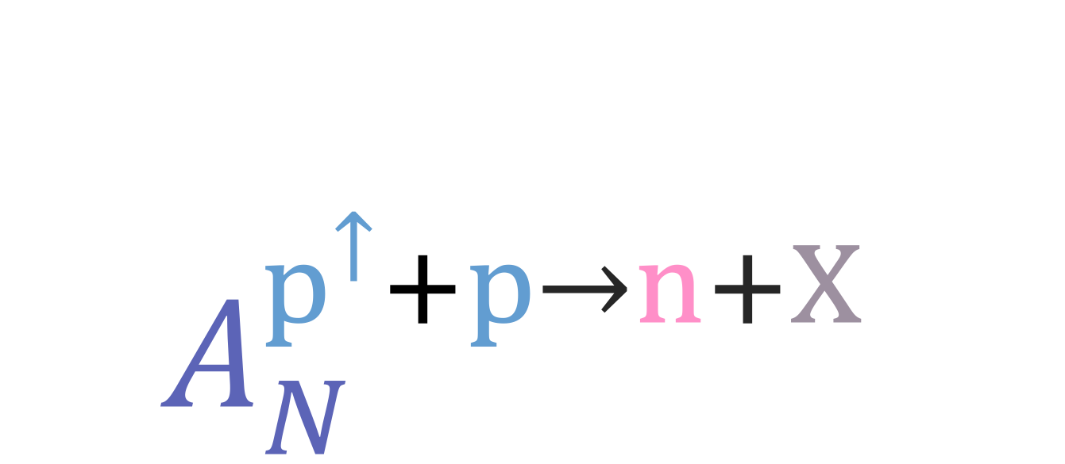
$$A_{N}^{p^{↑}+p→n+X }$$
High energy Polarized proton-proton collisions
Notes:
Now, let’s see about asymmetry of proton-proton collision.

Slide 7
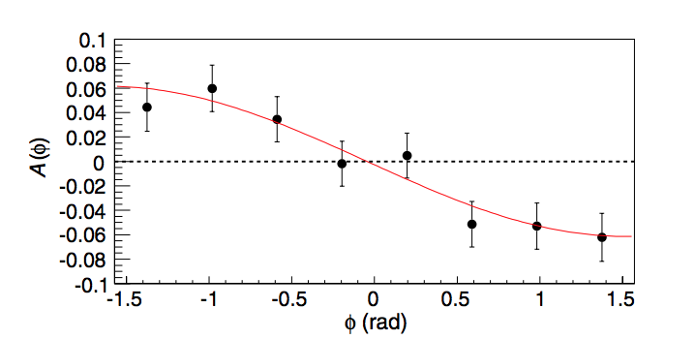

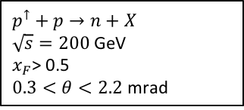
$A_{N}^{p^{↑}+p→n+X }$ Measured
Discovered @ RHIC IP12 experiment (2002)
Measured @ PHENIX with dedicated neutron detectors (2006)
Published: PRD 88, 032006 (2013)
$$p^{↑}+p→n+X$$
$\sqrt{s}=200$ GeV
$x_{F}$> 0.5
$0.3<θ<2.2$ mrad
Unexpected asymmetry before the measurements
Notes:
With the first polarized proton running at RHIC, finite A_N of forward neutron is discovered at IP12 experiment.
Then with neutron detectors, again finite A_N is measured at PHENIX, ~6% for ZDC trigger, and ~7.5% with ZDC&BBC triggers.
This asymmetry was not expected before the measurement.

Slide 8
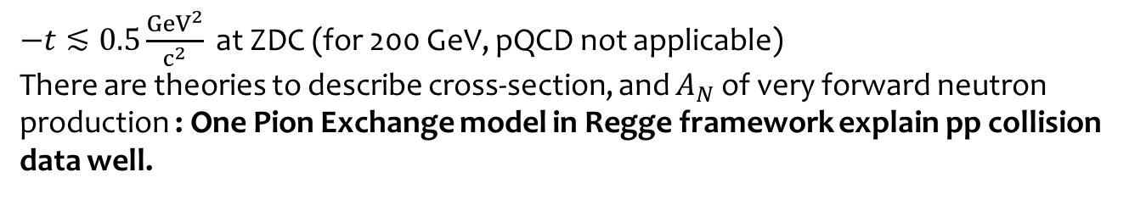
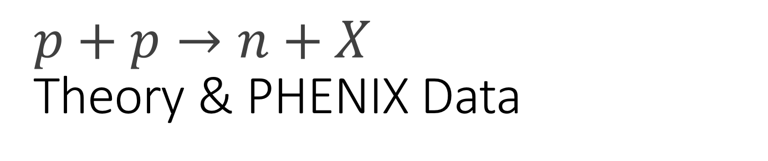
$$p+p→n+X$$
Theory & PHENIX Data
$−t≲0.5\frac{{GeV}^{2}}{c^{2}}$ at ZDC (for 200 GeV, pQCD not applicable)
There are theories to describe cross-section, and $A_{N}$ of very forward neutron production : One Pion Exchange model in Regge framework explain pp collision data well.
PRD 84, 114012 (2011)
$A_{N}$ for PHENIX $p^{↑}+p→n+X$ data & Theory
Notes:
For PHENIX ZDC, t range is very small. We cannot apply pQCD, but several theories have been developed to explain A_N and cross section of forward neutron production using one pion exchange models.
After we have preliminary results, a theoretical paper, which explains A_N of pp coliiosion of PHENIX very well was published.
In this plot at the right, colors are PHENIX data, and black stars are theoretical calculation result. We can see that this theory describe PHENIX A_N result well.

Slide 9
p↑p Forward Neutron A_{N}
Spin non-flip
Spin flip
Neutron
Neutron
proton
a₁
proton
π⁺
proton
proton
δ : phase shift
Notes:
If you write A_N with initial and final state amplitude, and evolute, then A_N can be nonzero if there is nonzero term for interference between spin-flip and nonflip interaction with different phase.
In the published paper, major contribution on A_N is came from interference between spin flip pion exchange amplitude, and spin nonflip a_1 reggeon exchange amplitude.
Let's see more details

Slide 10
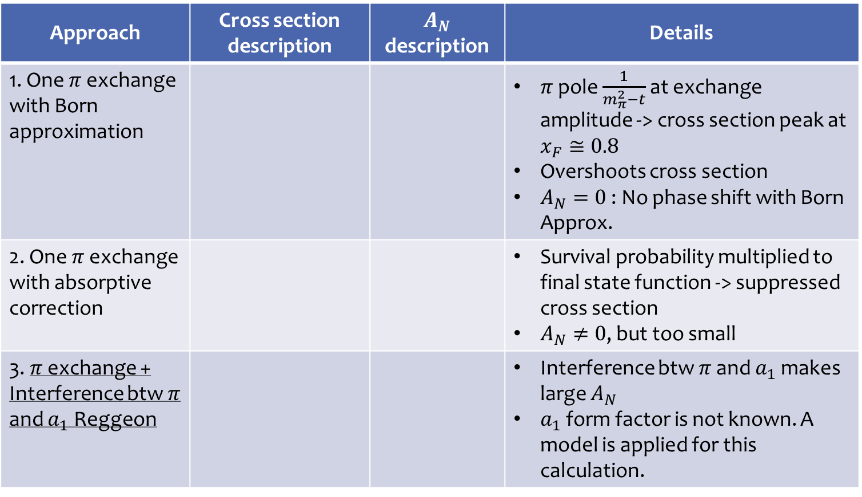
Theoretical Development
PRD 84, 114012 (2011)
Approach | Cross section description | $A_{N}$ description | Details
1. One $π$ exchange with Born approximation |  |  | $π$ pole $\frac{1}{m_{π}^{2}−t}$ at exchange amplitude -> cross section peak at $x_{F}≅0.8$ Overshoots cross section $A_{N}=0$ : No phase shift with Born Approx.
2. One $π$ exchange with absorptive correction |  |  | Survival probability multiplied to final state function -> suppressed cross section $A_{N}≠0$, but too small
3. $π$ exchange + Interference btw $π$ and $a_{1}$ Reggeon |  |  | Interference btw $π$ and $a_{1}$ makes large $A_{N}$ $a_{1}$ form factor is not known. A model is applied for this calculation.
Notes:
Here is theoretical development.
1st, there is one pion exchange with Born approximation.
It discribes cross section peak at xF=0.8, but overshoots cross section data.
And with born approximation, it has no phase shift, so A_N is zero.
2nd, One $π$ exchange with absorptive correction was used.
It corrected final state function by multiplying survival probablity, then it suppress cross section, then it match with data.
A_N is nonzero here, but value is too small compare to data.
3rd, $π$ exchange + Interference btw $π$ and $a_{1}$ Reggeon, the interference term between pion and a_1 reggeon makes large A_N, then discribe data.
So far, we saw A_N of p+p.

Slide 11
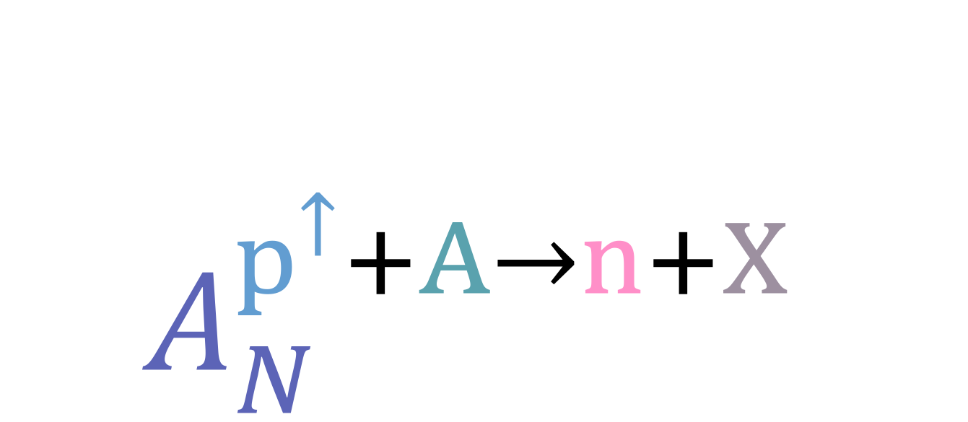
$$A_{N}^{p^{↑}+A→n+X }$$
High energy Polarized proton-nucleUS collisions
Notes:
Now, let’s move to A_N of polarized proton-neucleus scattering

Slide 12
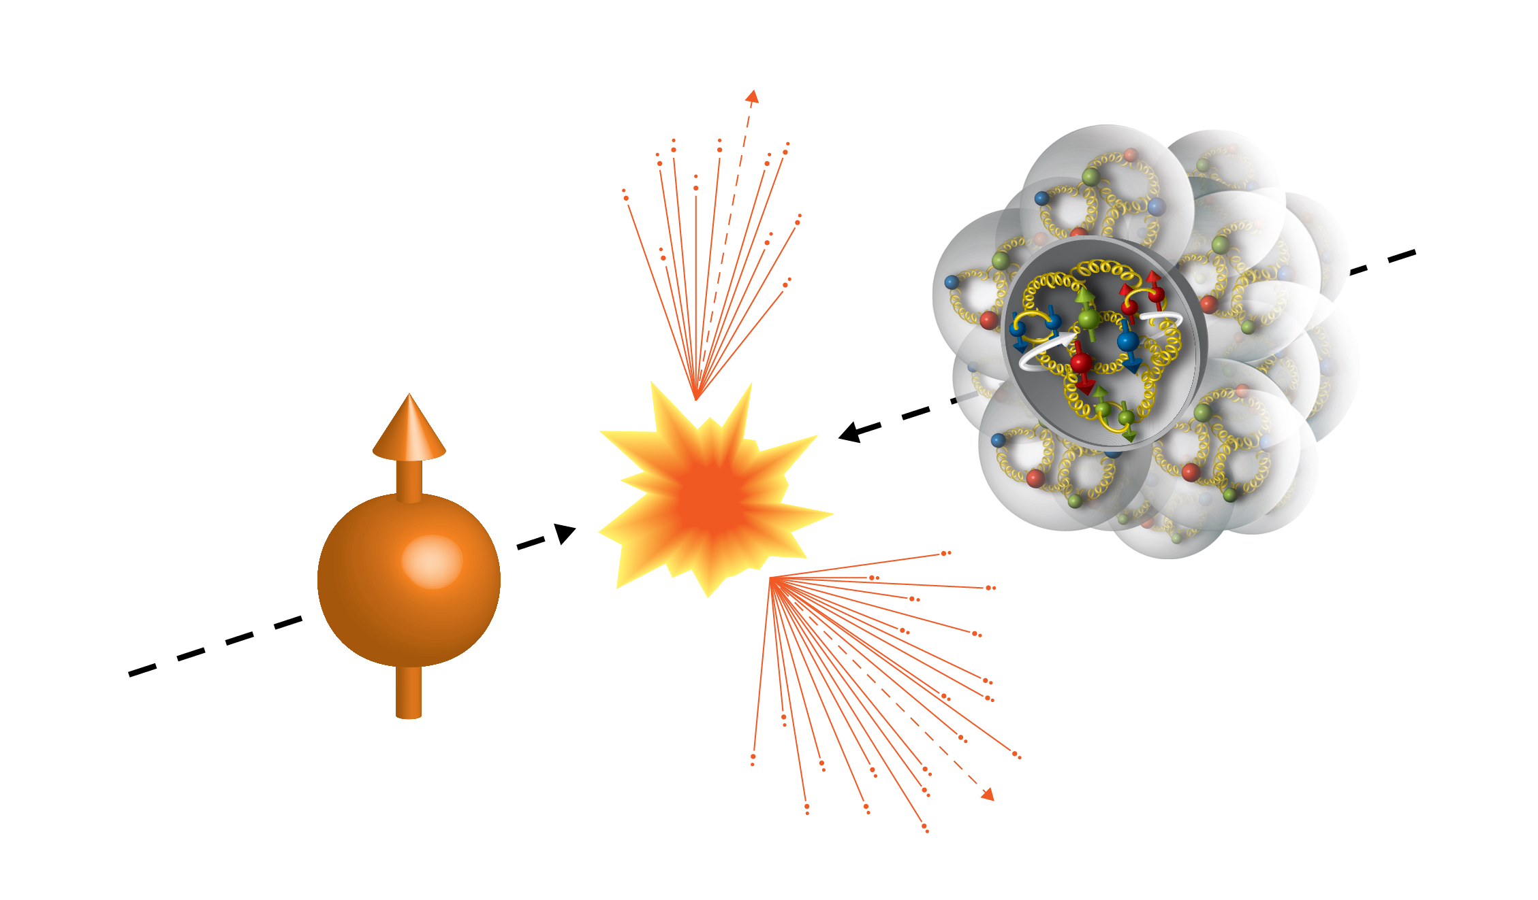
The First Attempt to Measure Asymmetries in pA Collision
2015 (Run15)
100GeV/nucelon
100GeV
Au, Al
Proton
Notes:
In Run15, we had the first opportunity of High energy Polarized proton-nucleus collisions.
It was energy frontier experiment since existing polarized proton-nucleus scatterings were done with fixed target, with order of magnitude lower energy.

Slide 13
Atomic Mass Dependence
p+p Single Spin Asymmetry A_{N}
Atomic Mass Number
PRD 84, 114012 (2011)
The first attempt in Run15 (2015) at RHIC.
Notes:
With this experiment, we were able to have the 1st attempt to measure asymmetry at high energy proton-nucleus collisions.
So, now we can explore asymmetry measurement to another dimension, which is A dependance.

Slide 14
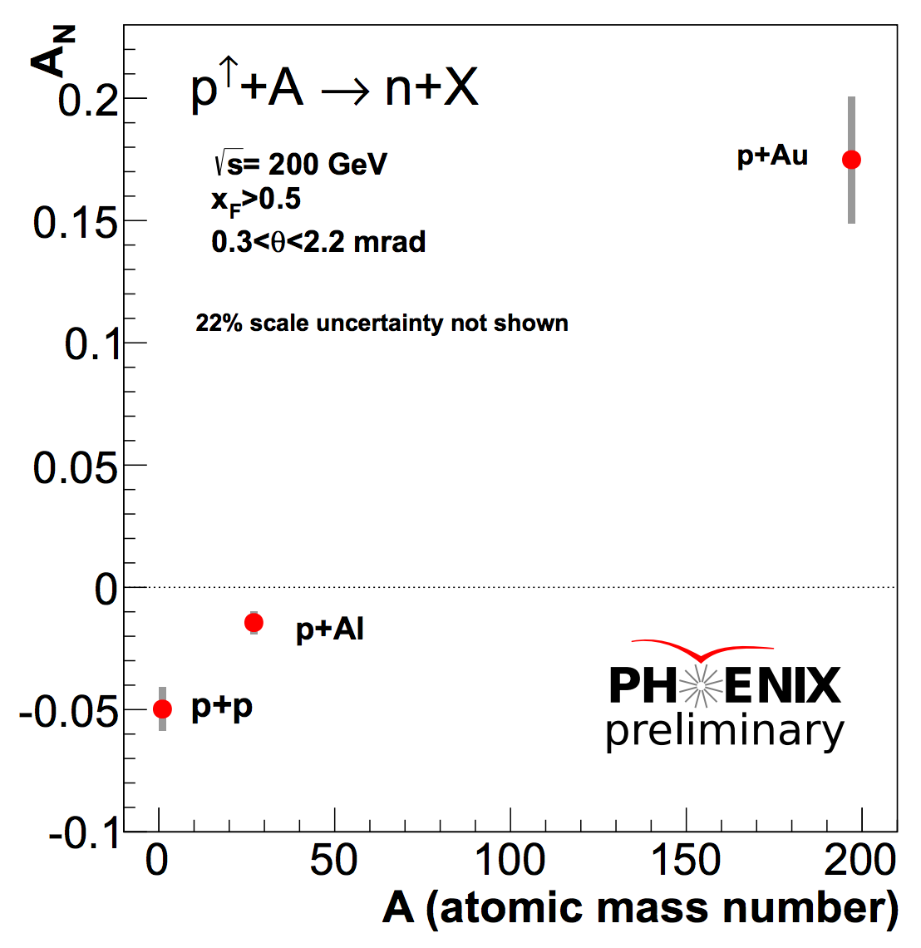
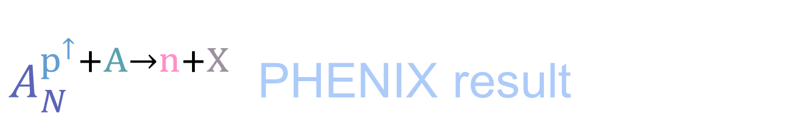
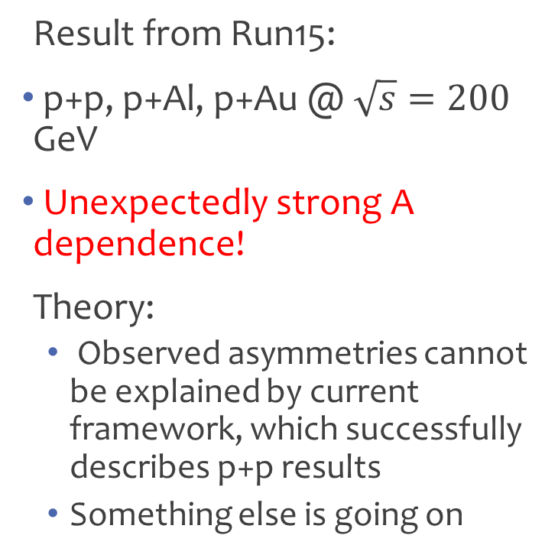
  $A_{N}^{p^{↑}+A→n+X }$ PHENIX result
Result from Run15:
p+p, p+Al, p+Au @ $\sqrt{s}=200$ GeV
Unexpectedly strong A dependence!
Theory:
  Observed asymmetries cannot be explained by current framework, which successfully describes p+p results
  Something else is going on
Notes:
Now, here is the A_N dependence on A preliminary result from Run15 experiment.
Asymmetry changes sign btw p+Al & p+Au, and whatever the reason, the size is 3 times larger.
The observed asymmetries are cannot be explained by current theoretical framework, which successfully describes p+p results.
So, something else is going on.

Slide 15
Ideas for
A dependence
Notes:
Now, let’s think what can possibly make A dependence of A_N

Slide 16

Naïve expectation
$A_{N}^{p^{↑}+p→n+X }≠A_{N}^{p^{↑}+n→n+X }$ ??
$A_{N}^{p^{↑}+p→n+X }=−A_{N}^{p^{↑}+n→n+X }$ ??
Z:79, N: 118
Z:13, N:14
Z:1, N: 0
Isospin Asymmetry?
Notes:
Naively, since Au has more neutrons and have opposite asymmetry sign, how about assuming proton neutron scattering have opposite asymmetry sign?
Then Al has excessive neutron, but it have negative sign. Then it does not work.
If pn asymmetry has opposite sign, and smaller value, then it may work.
They are not described by simple picture. To avoid isospin asymmetry, we may concern nuclear effects as well.
But, something is missing here.
So far, we stick with idea of charge exchange because final state particle is neutral.
We can get neutron in final state with photon exchange as well.

Slide 17
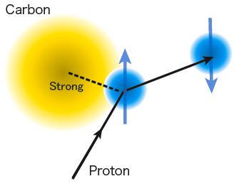
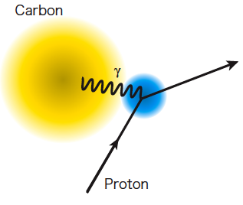
QED Process
Ultra Peripheral Collision (UPC)
neutron
A
A
In pAu case
t → 0
p
α_{EM}
Z²
p
A
γ∗
π⁺
π⁺
↑
p
n
p
↑
n
Δ
Notes:
We can get neutron from UPC.
Charged nucleus emit photons, and they can exite proton to Delta only with 300 MeV, and half of delta decays to neutron and pion. so it is not something difficult to be happen
We have ignored this process in p+p, but with large Z in gold & small momentum transfer, UPC may not be ignorable in p+A.
In pAu case, there are 6000 times more UPC events than p+p.
So, how significant are they in pAu case? We can have good hints from LHCf experiment.

Slide 18
Notes:
In LHCf experiment, they measured forward neutron yield with angle.
They observed more steep distribution at the small angle, which are not explained by their QCD simulation.
However, their UPC simulation explains this data well.
So we have motivation to study UPC at PHENIX forward neutron.
(UPC때문에 QCD가 안맞는것임. UPC/QCD시뮬레이션이 맞다는 인상을 주지 않도록 주의)

Slide 19
UPC Monte Carlo
Neutral Particle @ 200GeV
QCD(DPMJET)
ZDC
UPC
(SOPHIA)
Predicts comparable yields between QCD and UPC processes
Notes:
This is a recently published paper about UPC monte carlo simulation at PHENIX.
This is neutral partice distribution with rapidity, blck line is QCD,and red line is UPC, and PHENIX zdc rapidity corespond to here.
This simulation study predicts compariable yields between QCD and UPC process at analyzed rapidity of forward neutron
(p+A는 튠이 더 필요할수도 있음)

Slide 20
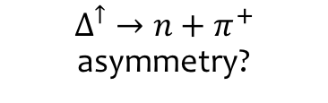
Full Description
δ : relative phase of amplitudes
Elastic (polarimeter)
$Δ^{↑}→n+π^{+}$ asymmetry?
For pp:
Notes:
Here is full discription of A_N.
We can split spin flip and non-flip amplitudes with EM interaction term, and hadronic interaction term.
So far, we have only considered this term in p+p case.
However, we may have significant UPC contribution for pA case, and this case, those terms can contribute in asymmetry also.
This interferance term is not necessarily new, CNI polarimeter elastic scattering, which have a few percent of asymmetry.
And this term, we don’t know if polarized delta decays asymmetrically.
To understand underlying mechasim, we may play with Suppressing/enhansing those terms in data, then see how asymmetry goes.

Slide 21
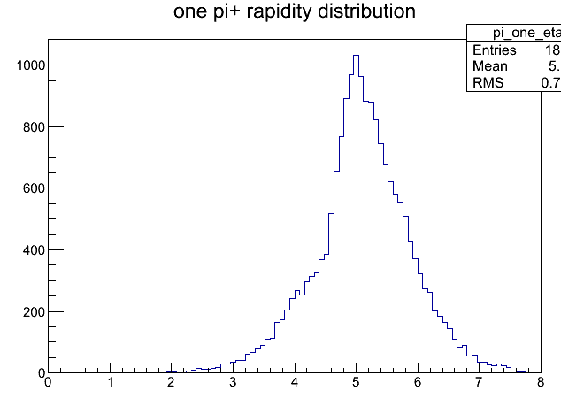
Can we identify UPC events?
+
Dipole
π
η = 3.1
η = 3.9
Δ
BBC
n
ZDC
η_{π} distribution of n+π⁺ events
Most of decayed pions go through BBC hole and will be swept away by the dipole magnet (DX).
BBC
Very little coincidence measurements of final state from resonance.
π⁺ Rapidity
Itaru’s slide
Simulation by Gaku Mitsuka
Notes:
And here is an idea about suppressing/enhancing EM terms.
From the simulation study, for most of neutrons from UPC, most of their counterpart pion goes through BBC hole, and swiped by dipole magnet.
Then requiring BBC activity will suppress those UPC events, then suppress EM terms in A_N

Slide 22
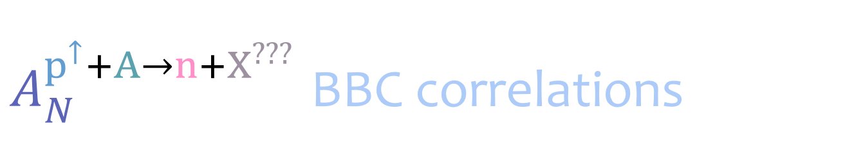
  $A_{N}^{p^{↑}+A→n+X^{???}}$ BBC correlations
ZDC inslusive
UPC enhanced
UPC suppressed
Notes:
Now, this is A_N with BBC correlations.
Green points are asymtry of events with BBC activities.
So this is UPC suppressed, If only strong force are enhanced, then it behaves quiet differently.
In here, p+Au asymmetry become very small.
Blue points are asymtry of events with veto BBC activities.
If we enhance UPC events, p+Au asymmetry become large, 20~30 % level
Also, p+Al have opposite sign, and have large asymmetry
We can Succesfully enhancing/suppressing UPC like events, and $A_{N}$ behaved quite differently for them.
However, in asymmetry full description, there are 3 UPC invloved terms, and we don’t know which term contribute how much on this BBC correlation asymmetry. Whemer EM term solely, EM and hadronic interaction term.

Slide 23
Coulomb-Nuclear Interference
π⁺
π⁺
t → 0
Huge rapidity interval, not the case for UPC?
A
A
Z²
A
A
P
π⁺
γ∗
π⁺
p
n
p
n
Δ
Pion cloud
Same Final State
Notes:
Here is one senario about explains How come UPC produce large asymetry?
1 possible senario is Coulomb-Nuclear Interference.
This is one example diagram.
If this hadronic interaction and UPC amplitue interfere, with having large phase shift, then they produce large A_N,
With small –t, QCD & UPC process may interfere but we don’t know it yet.
Theory under development.

Slide 24
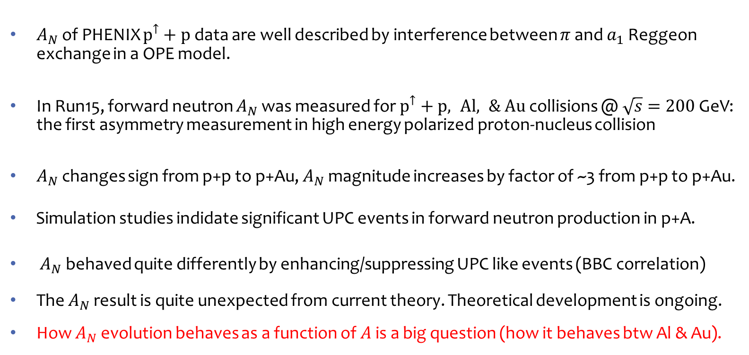
Summary
$A_{N}$ of PHENIX $p^{↑}+p$ data are well described by interference between $π$ and $a_{1}$ Reggeon exchange in a OPE model.
In Run15, forward neutron $A_{N}$ was measured for $p^{↑}+p, Al, \& Au$ collisions @ $\sqrt{s}=200$ GeV: the first asymmetry measurement in high energy polarized proton-nucleus collision
$A_{N}$ changes sign from p+p to p+Au, $A_{N}$ magnitude increases by factor of ~3 from p+p to p+Au.
Simulation studies indidate significant UPC events in forward neutron production in p+A.
$A_{N}$ behaved quite differently by enhancing/suppressing UPC like events (BBC correlation)
The $A_{N}$ result is quite unexpected from current theory. Theoretical development is ongoing.
How $A_{N}$ evolution behaves as a function of $A$ is a big question (how it behaves btw Al & Au).
Notes:
That will be interesting to see.

Slide 25
Thank you!

Slide 26
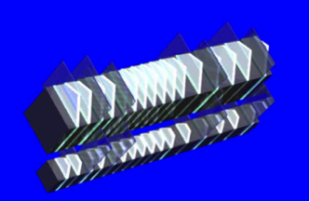
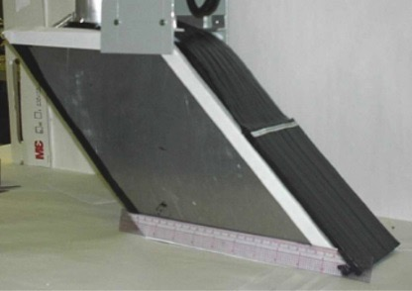
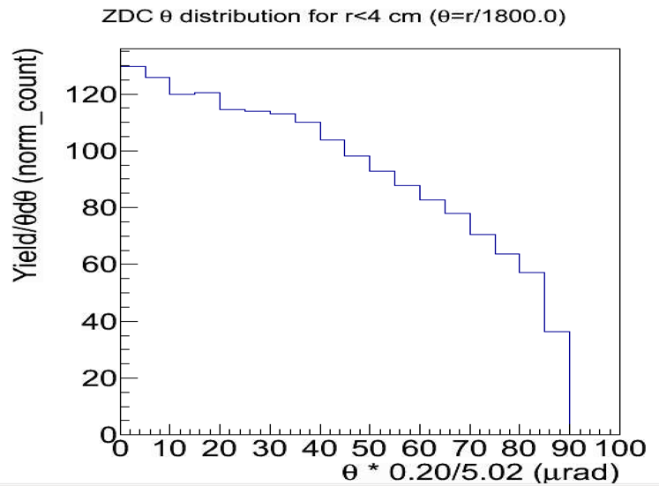
Forward Neutron Angular Distributions
LHCf
PHENIX ZDC
Δx ~ a few mm
Δx ~ 1cm
The ZDC acceptance doesn’t reach QCD dominant region.

Slide 27

UPC @ LHC
PHENIX ZDC
$$θ∗\frac{0.2}{5.02}μrad$$
Notes:
Equivalent yields of UPC (photon, red curve)
Predicted yield at RHIC: half of LHC
Not established,

Slide 28

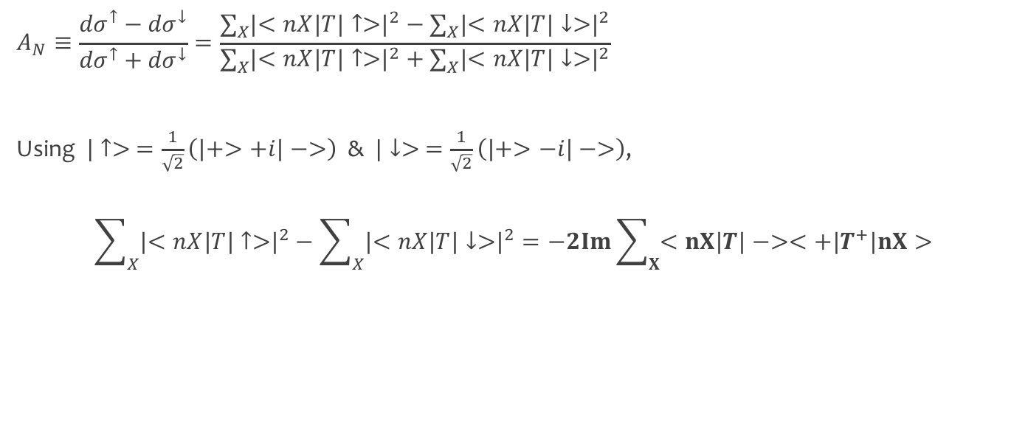
Origin of Nonzero $A_{N}$
$$A_{N}≡\frac{{dσ}^{↑}−{dσ}^{↓}}{{dσ}^{↑}+{dσ}^{↓}}=\frac{\sum_{X}{{\left|<nX\left|T\right|↑>\right|}^{2}−\sum_{X}{{\left|<nX\left|T\right|↓>\right|}^{2}}}}{\sum_{X}{{\left|<nX\left|T\right|↑>\right|}^{2}+\sum_{X}{{\left|<nX\left|T\right|↓>\right|}^{2}}}}$$
Using $|↑> =\frac{1}{\sqrt{2}}\left(\left|+>+i\right|−>\right)$ & $|↓> =\frac{1}{\sqrt{2}}\left(\left|+>−i\right|−>\right)$,
$$\sum_{X}{{\left|<nX\left|T\right|↑>\right|}^{2}−\sum_{X}{{\left|<nX\left|T\right|↓>\right|}^{2}}}=−2Im\sum_{X}{<nX\left|T\right|−><+\left|T^{+}\right|nX>}$$
$A_{N}≠0$ if
∃Nonzero term for interference between spin-flip and nonflip interaction with different phase

