Slide 1

pp Plan
A.Bazilevsky (BNL)
For RHIC Spin Collaboration
Emerging Spin and Transverse Momentum Effects in pp and p+A Collisions
RIKEN BNL Research Center Workshop
February 8-10, 2016
BNL

Slide 2
RHIC Cold QCD Plan
In response to request by DOE Associate Director of Science for Nuclear Physics, Tim Hallman, to develop and submit an updated plan (“Spin Plan”) of the key cold QCD measurements utilizing polarized p+p and p+A collisions at RHIC.
Compelling physics questions the future polarized p+p and p+A program at RHIC can address
Key measurements which are critical for the planning of the EIC physics program or are necessary as sources of critical information for the interpretation of the expected EIC data.
Unique “must-do” measurements, which require running beyond the currently planned RHIC runs (~20 weeks of Au+Au and ~10 weeks each of p+p and p+Au, all at 200 GeV)
Possible modest detector upgrades that are required to perform the proposed measurements

Slide 3

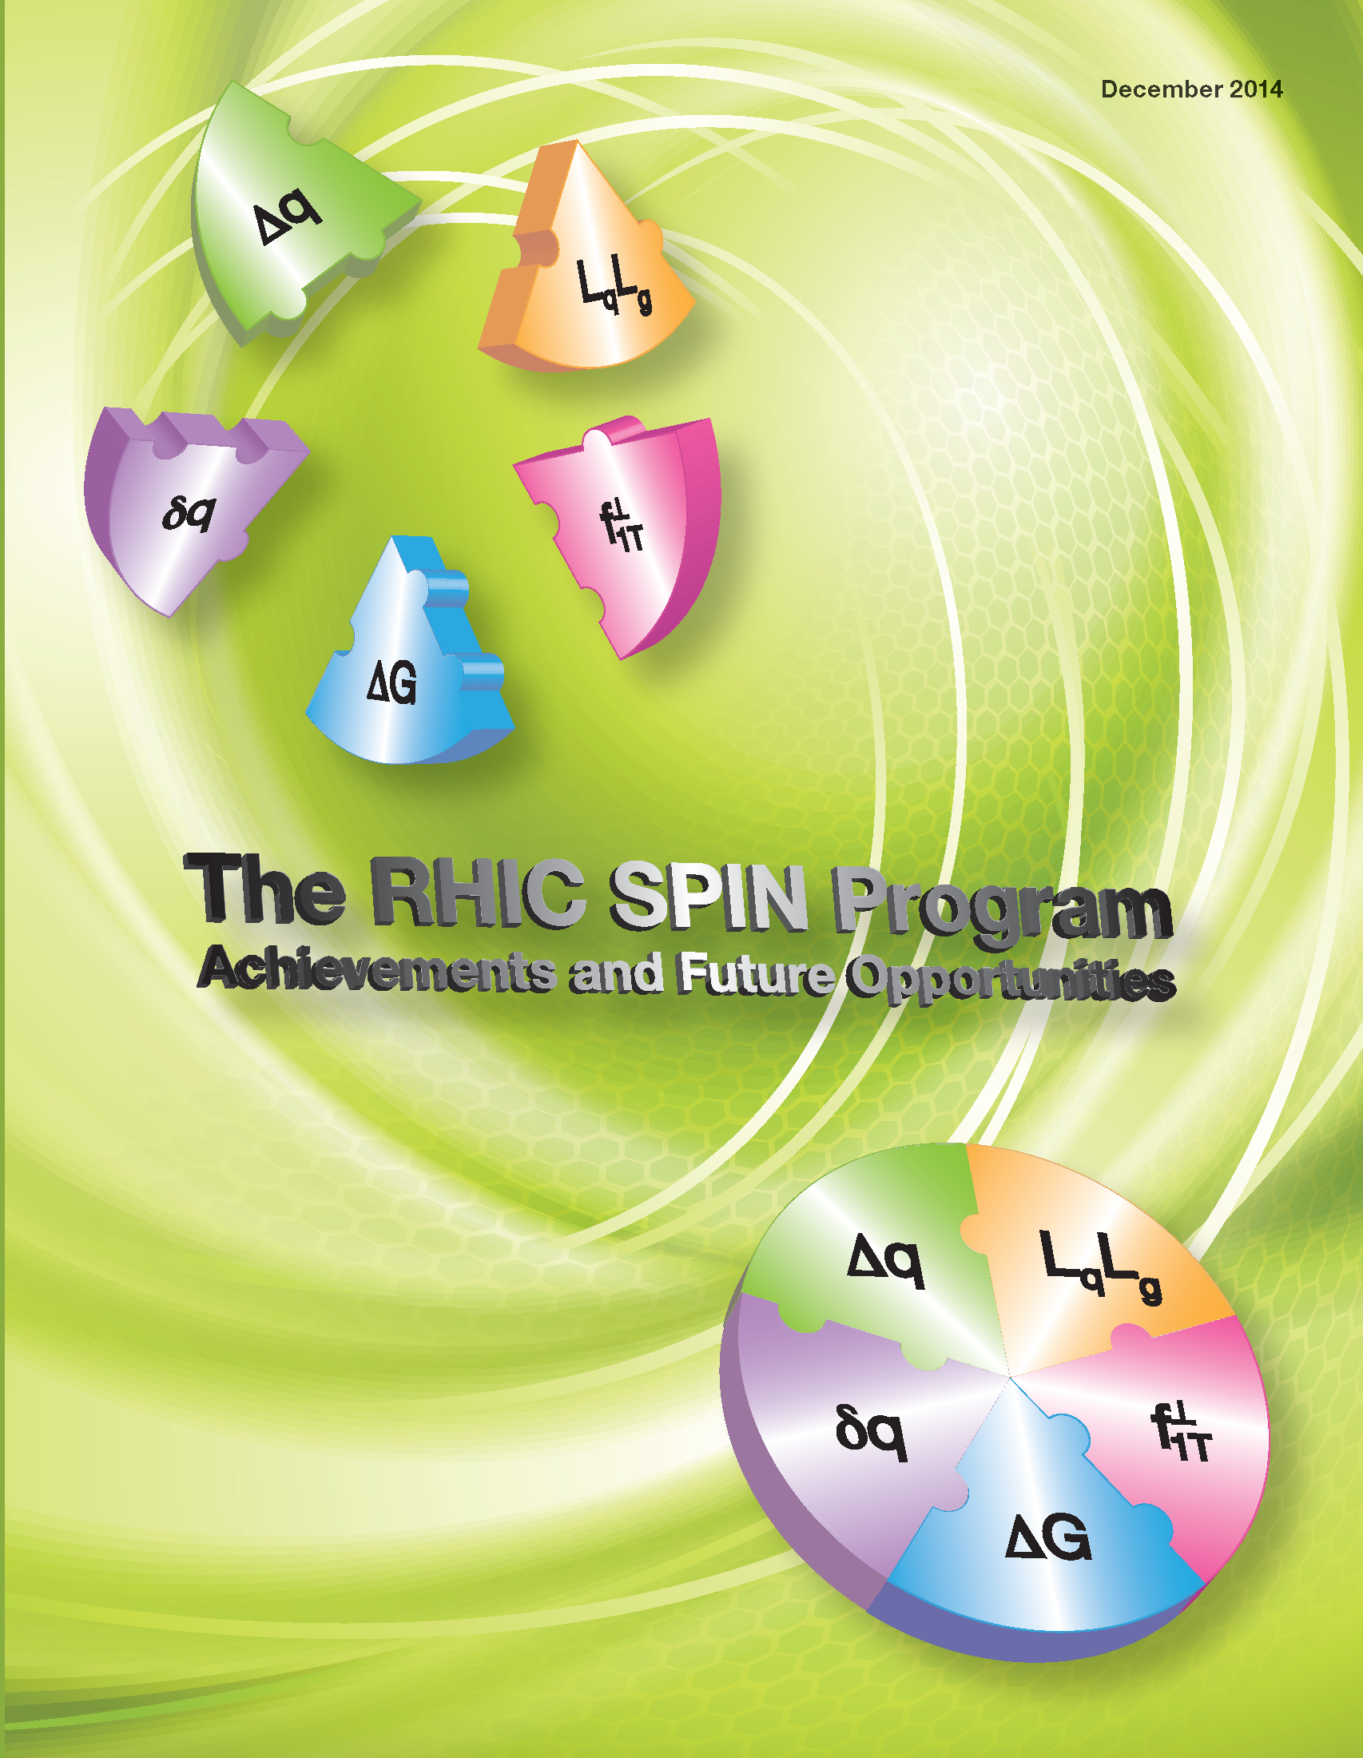
RHIC Spin Achievements
Submitted to DOE
arXiv: 1501.01220
How do quarks and gluons build the proton spin ½
What do transverse spin phenomena teach us

Slide 4
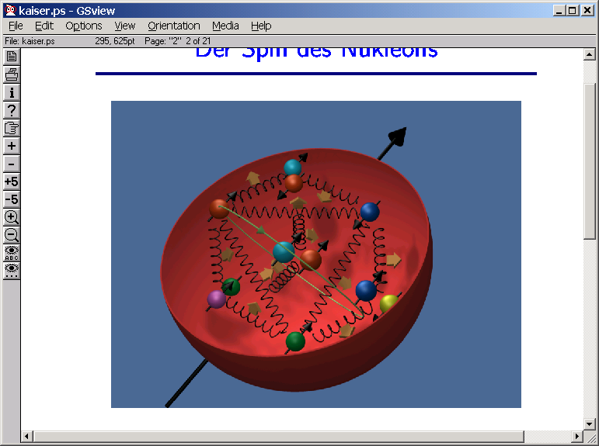
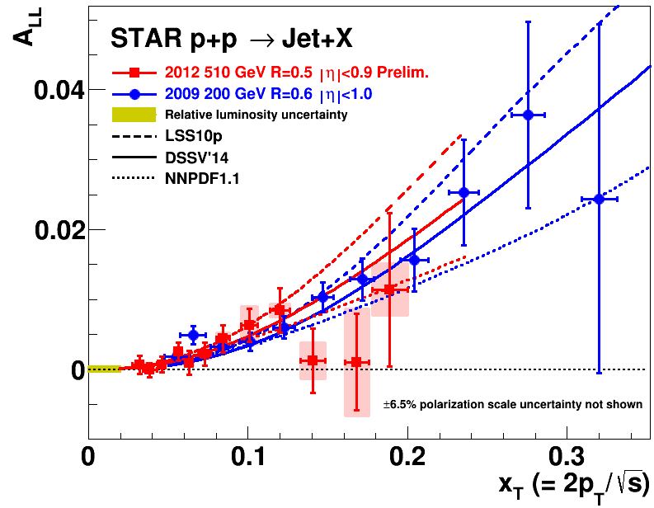
ΔG: π0 and jet A_{LL}
Are gluons polarized?
Observation of non-zero A_{LL} associated with non-zero ΔG !

Slide 5
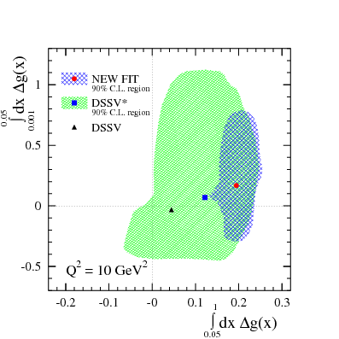
ΔG: DIS+pp global QCD fit
DSSV:
  D. de Florian
  R. Sassot
  M. Stratmann
  W. Vogelsang
DSSV: Phys Rev Lett, 101, 072001 (2008)
  Data from up to 2006
New DSSV: Phys Rev Lett, 113, 012001 (2014)
  Data from up to 2009
Significant non-zero Δg(x) in the kin. region probed by RHIC
  Similar result from another global fit NNPDF
Still huge uncertainty in unmeasured region (x<0.05)
  => Measurements at higher √s and forward rapidity

Slide 6
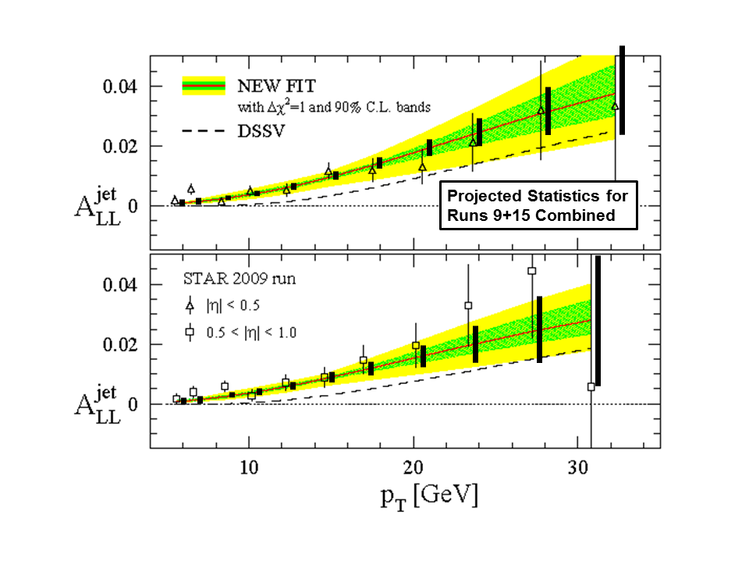
ΔG: Near Term Projections
From already available data from 2011-15
π0: 3.1<|η|<3.9
Jets: |η|<1
Other channels also being measured
(but with weaker stat. power)
  γ, η, π±, h±, heavy flavor through e and μ, jet-jet, h-h, γ-jet, γ-h
Great improvement expected
… Still not enough precision for ΔG full integral

Slide 7
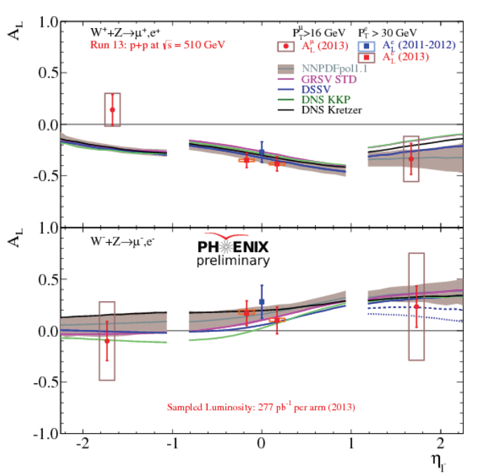
Δq-bar: W± → l±
Constrains flavor separated (anti-)quark polarization at high Q~M_{W}
at x>0.05, with no fragmentation involved (as in SIDIS)
Δu-bar tends to be more positive
=> Symmetry breaking in polarized sea?
Twice reduced uncertainties when all data analyzed

Slide 8
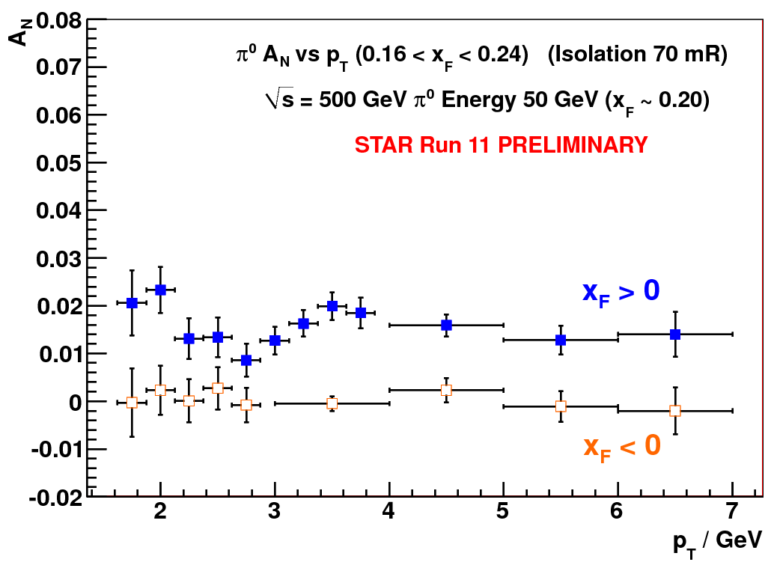
RHIC Transverse Spin
Naïve collinear pQCD predicts
A_{N} ~ α_{s}m_{q} / p_{T} ~ 0
Asymmetries survive at highest √s
  Non-perturbative regime!
Asymmetries of the ~same size at all √s
Asymmetries scale with x_{F}
Collinear (higher twist) pQCD predicts
A_{N} ~ 1/p_{T} … at what p_{T} ?
No fall off is observed out to p_{T} ~7 GeV/c
Main focus:
  Disentangle different contributors

Slide 9
Trans. Spin: To measure at RHIC
Initial State:
Sivers/Twist3 mechanism
A_{N} for jets, direct photons
A_{N} for heavy flavor ➔ gluon
A_{N} for W, Z, DY
Final State:
Collins mechanism
Hadron azimuthal asymmetry in jet
Hadron pair azimuthal asymmetry
  (Interference fragmentation function)
Sensitive to correlations
proton spin – parton transverse motion
Not universal between SIDIS & pp
Sensitive to
transversity x spin-dependent FF
Universal between SIDIS & pp & e+e-
Other mechanisms
Diffraction

Slide 10
Trans. Spin: Final State Mechanism
First Collins asymmetry in pp !
  => Access to transversity!
Asymmetry similar at 200 vs 500 GeV
  =>TMD evolution is small?
First IFF (Interference Fragmentation) asymmetry in pp !
  =>Another way to access transversity !

Slide 11
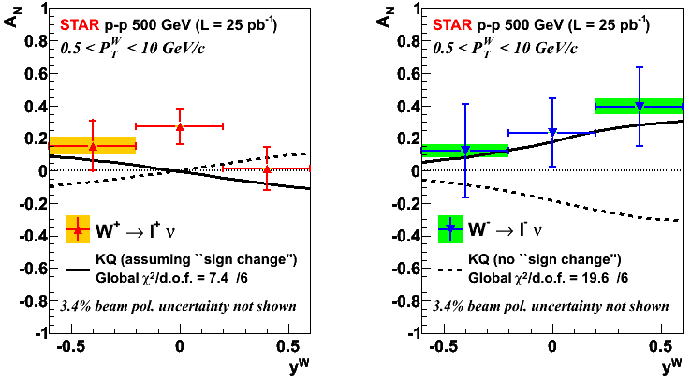
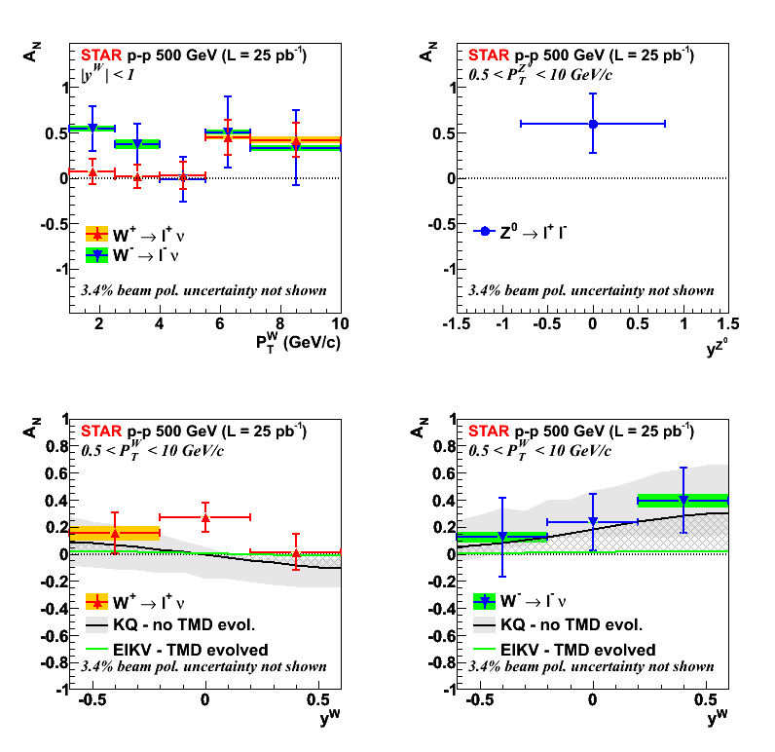
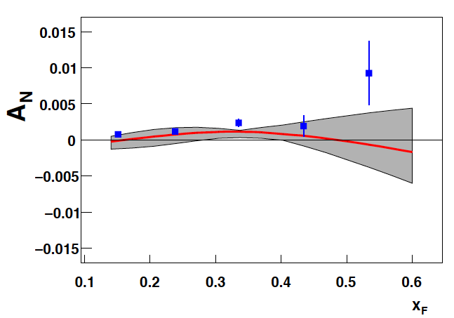
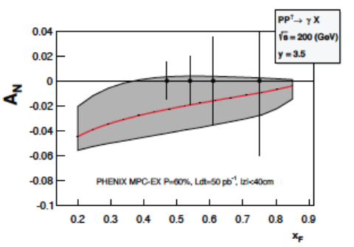
Trans. Spin: Initial State Mechanism
W+
W−
Z0
Run-2009
(arXiv:1511.06003)
First hint
for Sivers function sign change!
Jet
Photons
AnDY: PLB 750, 660
2015 proj.

Slide 12
Trans. Spin: Diffraction?
Largest A_{N} for isolated π0
Smaller A_{N} for more complex events (more activity around π0)
Smaller A_{N} with away side jet present
Does A_{N} come from 2→2 scattering?
May A_{N} come from hard diffraction:
p↑+p → π⁰+ p’+X
STAR has already collected data in 2015 with Roman Pots to tag forward scattered p

Slide 13
The RHIC pp Plan for 2017 – 2023
RHIC planned pp runs
2017 510 GeV (trans.) 12 weeks: 400 pb⁻¹
2023 200 GeV 8 weeks: 300 pb⁻¹
Additional running in >2023 @510 GeV may be requested

Slide 14
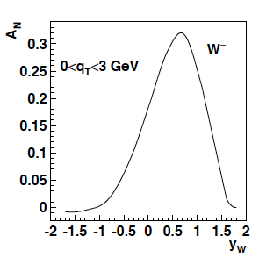
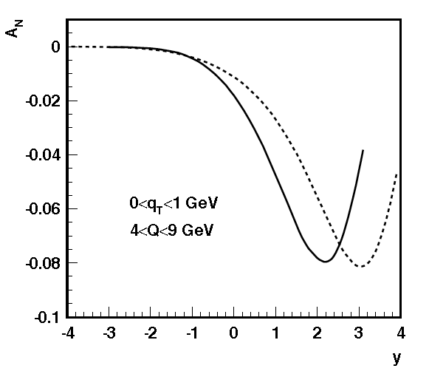
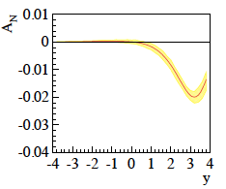
Trans. Spin: Initial state
Z.-B. Kang & J.-W. Qui arXiv:0903.3629
Z. Kang: original paper arXiv:1401.5078
before evolution
after evolution
Sivers function
non-universality
and evolution
Too strong evolution effect ?
– No consensus yet
Need experimental data!
÷ 10-15
Z.-B. Kang & J.-W. Qui Phys.Rev.D81:054020,2010
Z. Kang et al. arXiv:1401.5078
before evolution
after evolution
DY
500 GeV
÷ 3-4
200 GeV
4 < Q < 9 GeV
0 < q_{T} <1 GeV

Slide 15
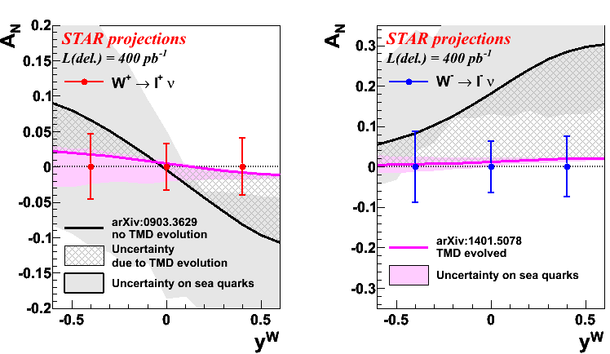
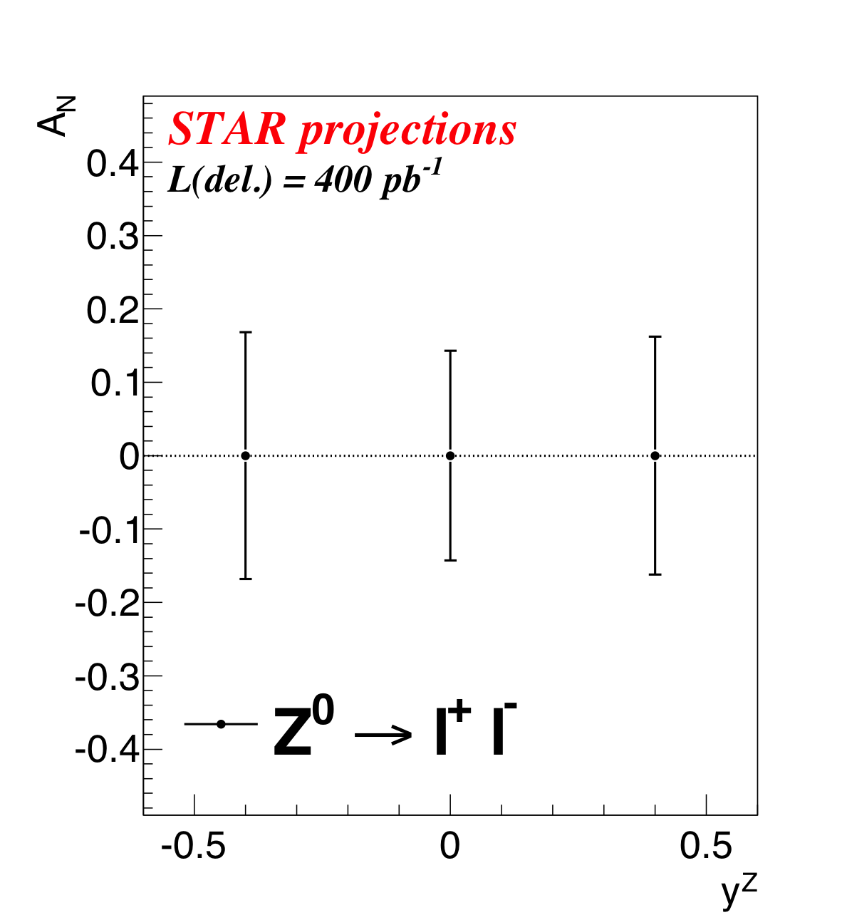
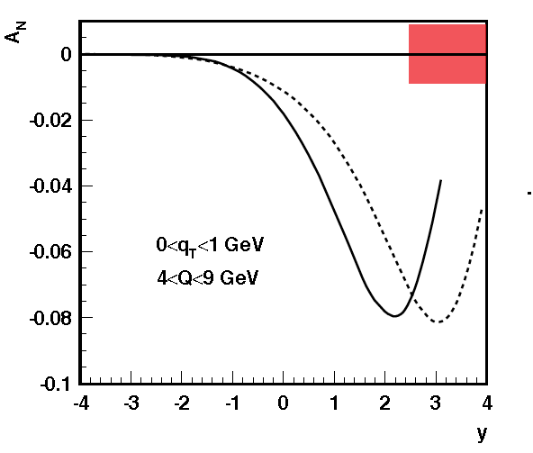
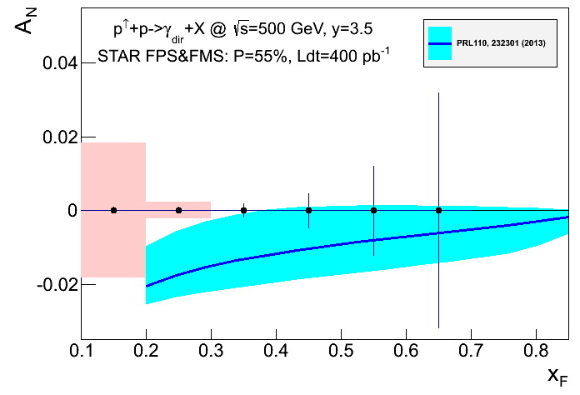
Trans. Spin: Initial state
Run 2017
W+
W−
Z0
Proj. for Run-2017
(a factor ~4 reduced uncertainties compared to Run9)
DY
Photons

Slide 16
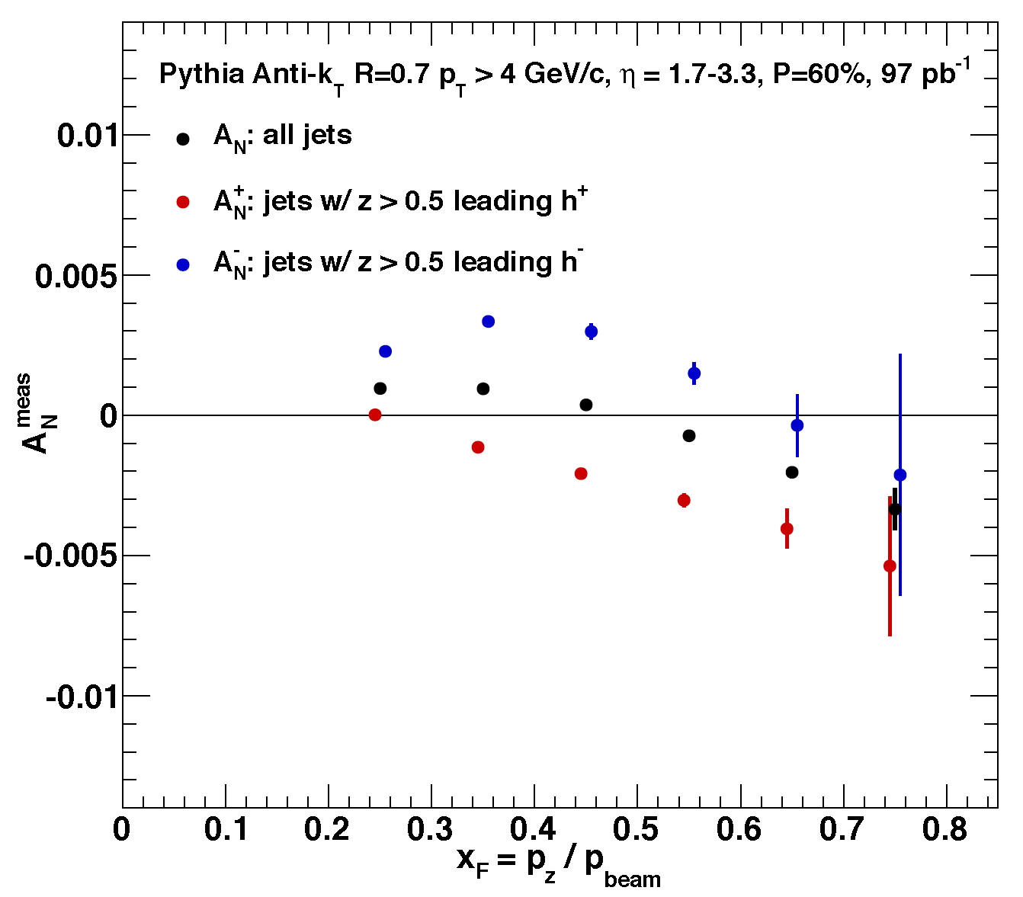
Trans. Spin: Initial state
Run 2023+
×2 reduced uncertainties for earlier measurements: W, Z, DY, γ
With forward upgrade: Calorimetry + Tracking
Charged hadron A_{N} at highest √s
Twist-3 correl. func. flavor dependence and evolution
Twist-3 FF contribution
Jet
u/d enhanced jet
AnDY: PLB 750, 660
Twist-3 correl. func. flavor dependence:
u (d) jet enhanced
by h+(-) tagging
at z>0.5

Slide 17
Trans. Spin: Final state
Run 2017
Considerably improve earlier measurements:
Transversity through Collins vs IFF
Universality and factorization breaking
√s=200 vs 500 GeV
Evolution
Linearly polarized gluon PDF through sin(ϕ_{s}-2ϕ_{h}) modulation

Slide 18
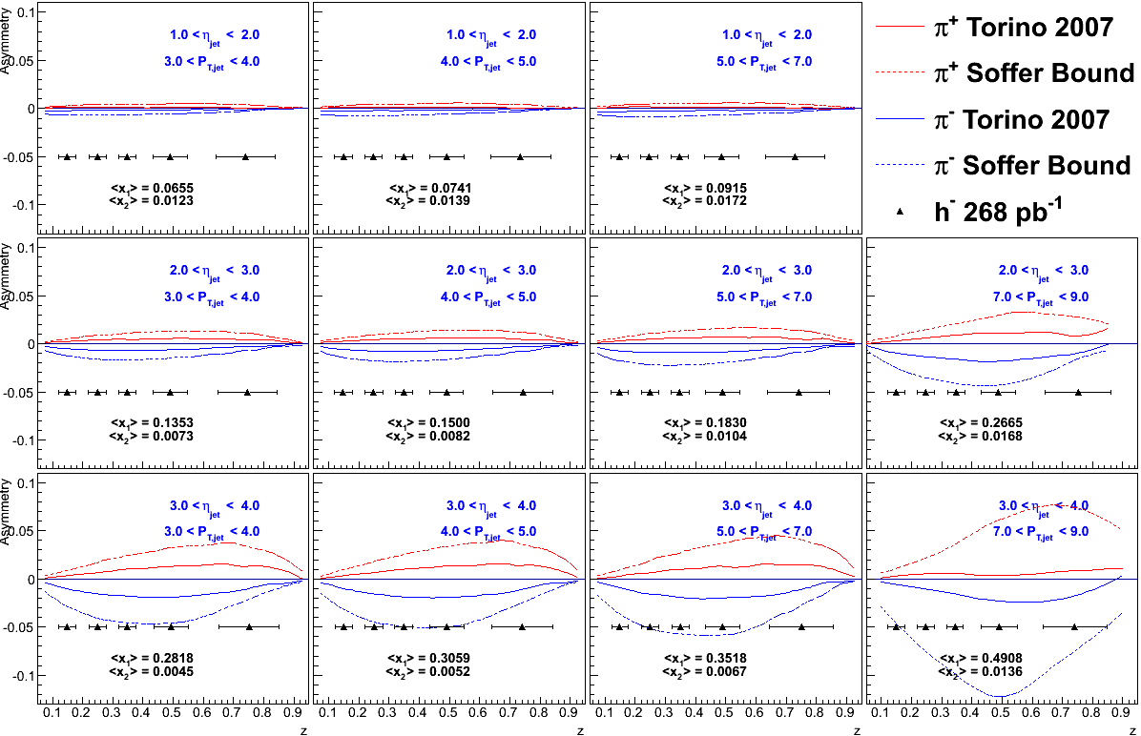
Trans. Spin: Final state
Run >2023?
×2 reduced uncertainties for earlier measurements
h± Collins asymmetry within jet
Need forward upgrade:
To understand the contribution of final state effect to hadron SSA
Need x>0.3 (for tensor charge)
Need lower x (to study gluons)

Slide 19
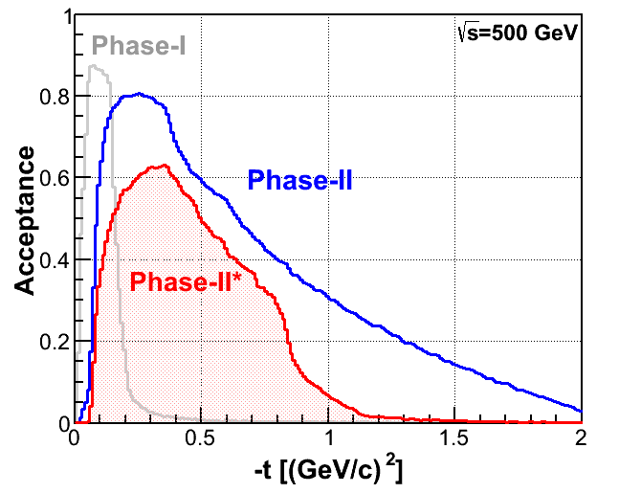
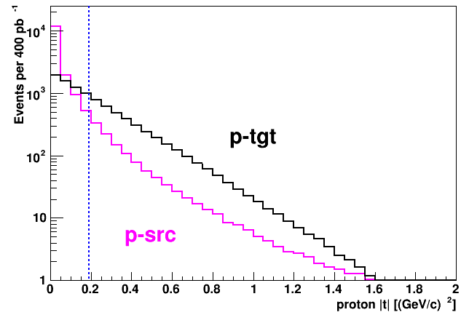
Trans. Spin: Diffraction
Run 2017+
Origin of A_{N} in pp collisions
No studies of diffractive spin effects in pp before RHIC
Forward upgrade => jet reconstruction
√s dependence => √s=200 GeV vs 500 GeV
Excl. J/ψ in Ultra-Peripheral collisions
  => GPD E

Slide 20
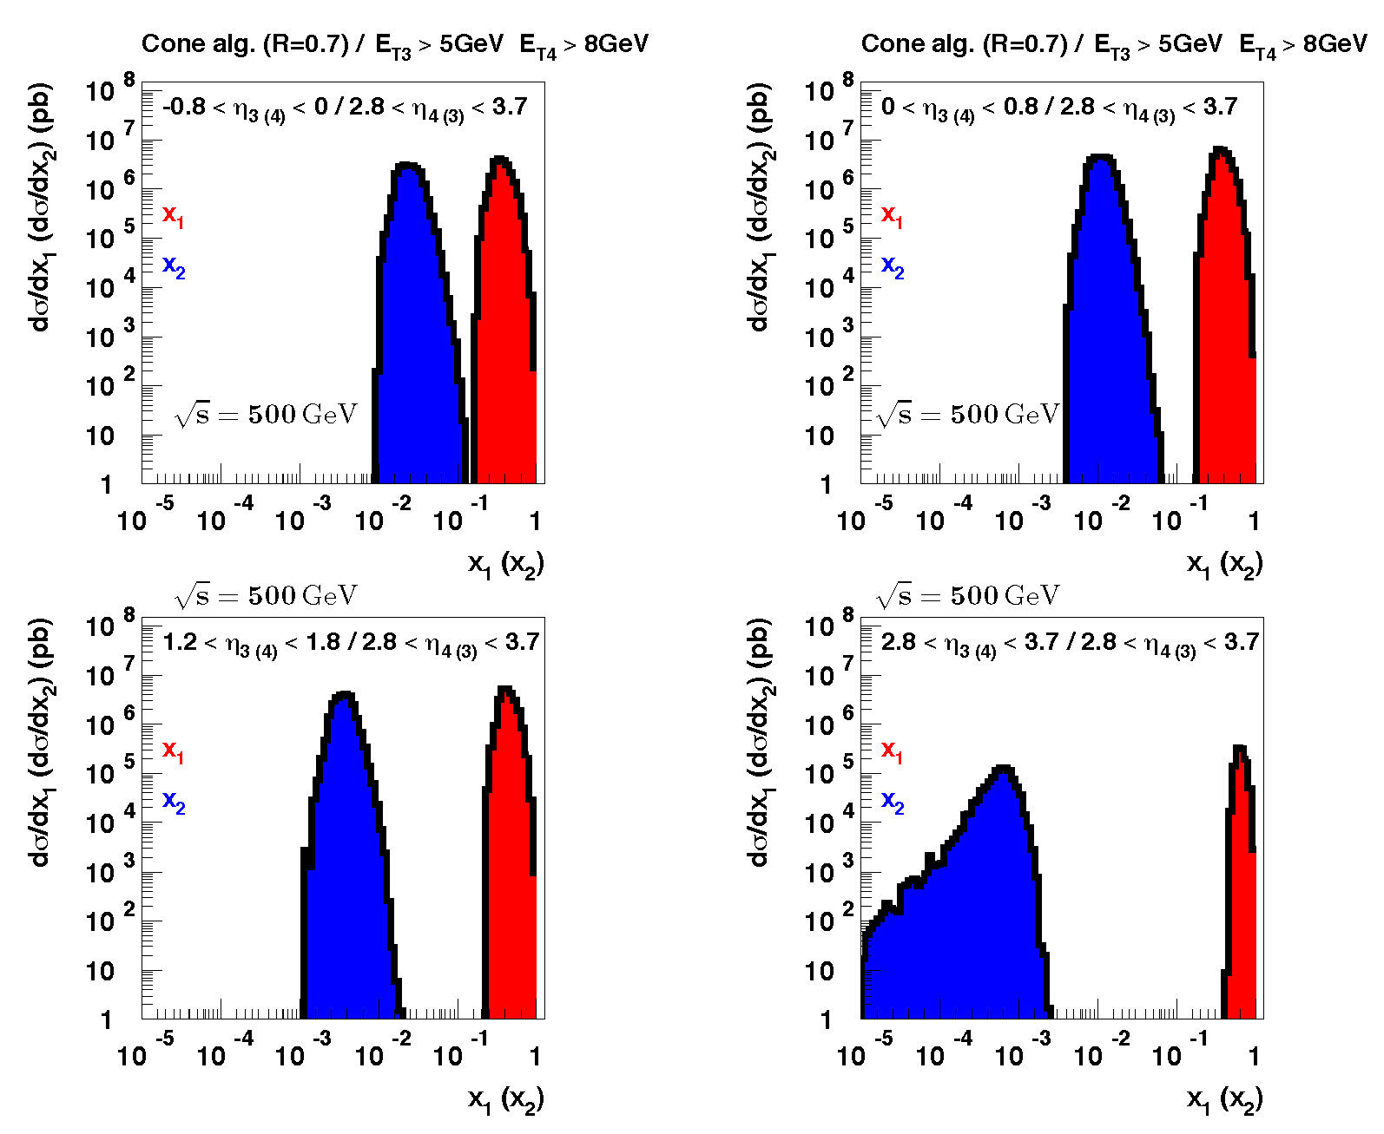
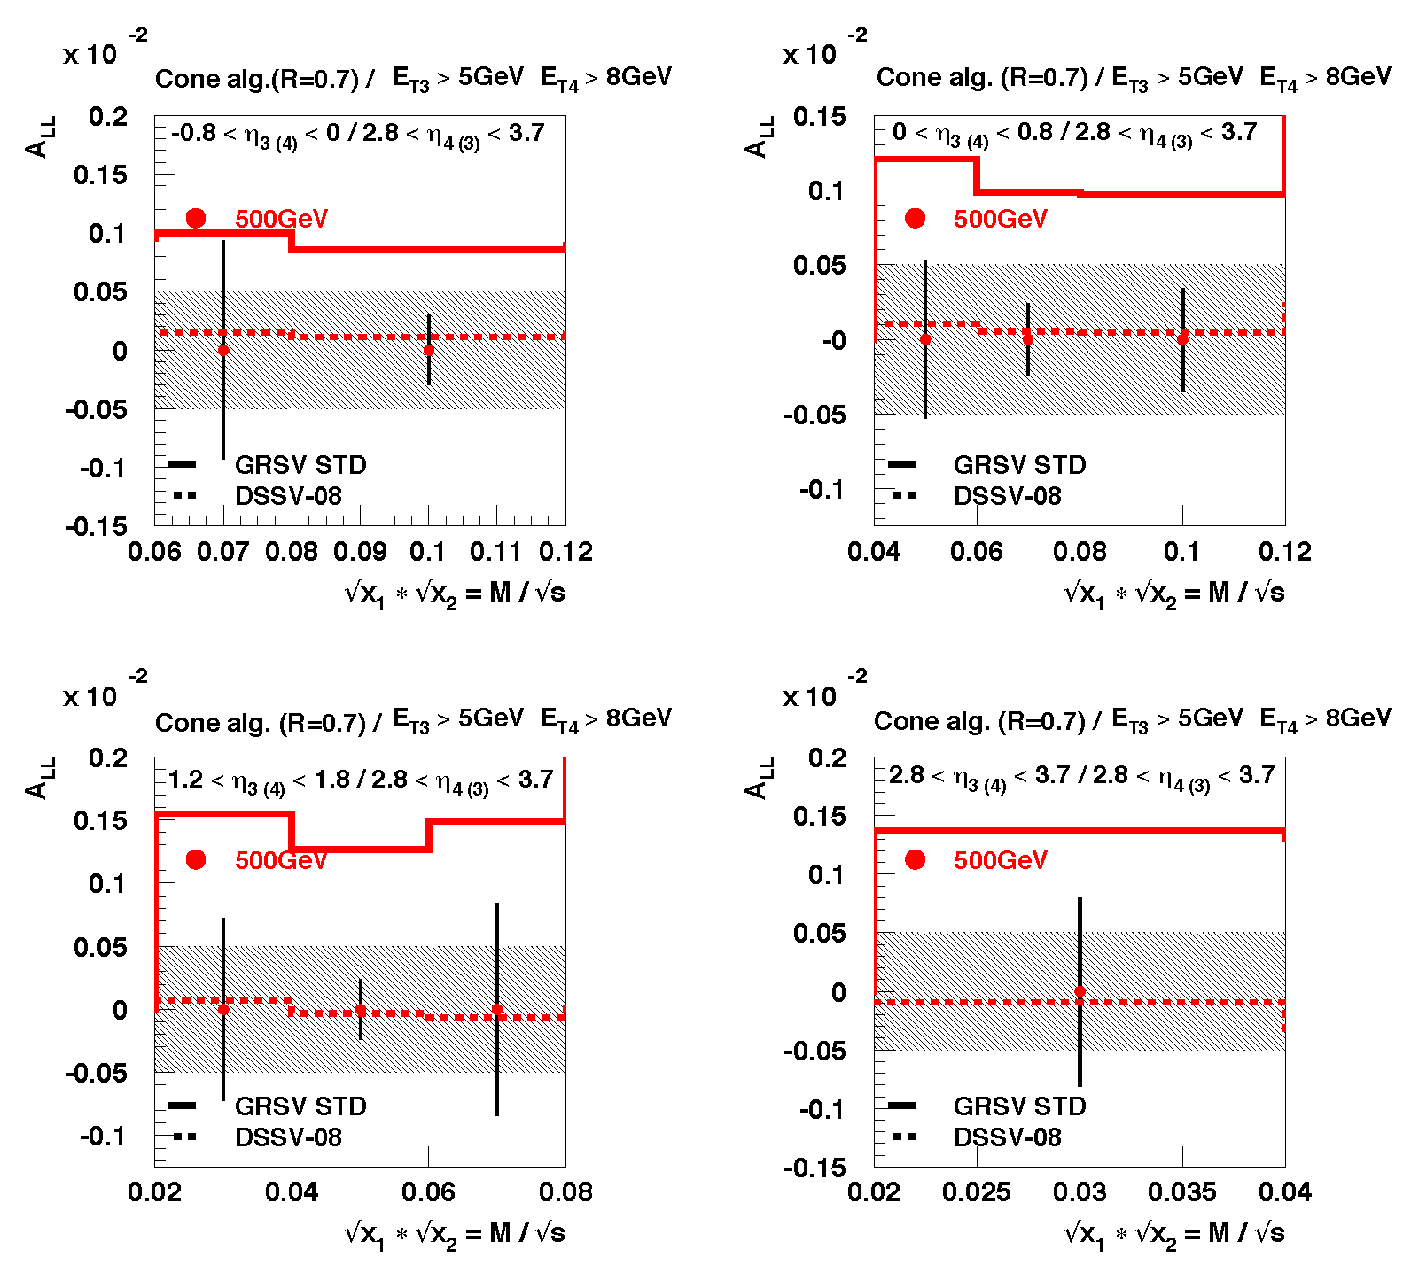
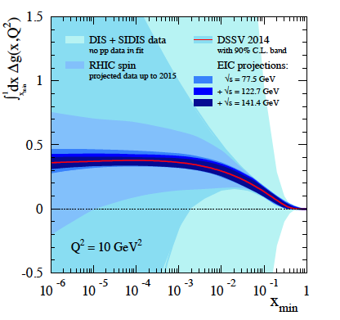
Long. Spin: ΔG
Run >2023?
×1.5 more statistics for “traditional” channels
(incl. π0 and jets)
Photons and π± will get sensitivity to non-zero ΔG
Though with smaller stat. power than incl. π0 and jets
With forward upgrade (to η~4):
Di-jets – cleaner access to lower x down to 10⁻³.
EIC can do it down to x~10⁻⁵ with considerably higher precision

Slide 21
Proposal Summary
 | Year | √s (GeV) | Goals | Observables | Upgrade
 | 2017 | 510 | Sivers non-universality TMD and Twist-3 evolution Transversity, Collins FF, lin. pol. gluons, gluon Sivers GPD Eg | A_{N} for γ, W, Z, DY A_{UT}~sin(ϕ_{s}-ϕ_{h}), sin(ϕ_{s}-2ϕ_{h}) within jet, A_{UT}~sin(ϕ_{s}) for jets A_{UT} for J/ψ in UPC | DY: Postshower to FMS@STAR None None
 | 2023 | 200 | Source of A_{N} at high xF, Twist-3 flavor dependence Diffraction | A_{N} for h± and flavor enhanced jets A_{N} for diffraction | Forward None
 | 202X | 510 | TMD at low and high x Validity and limits of factorization and universality in ep vs pp | A_{UT} for h± in jet in forward- and mid-rapidity | Forward None
 | 202X | 510 | Δg at small x | A_{LL} for jets, π0, di-jets, h/γ-jet | Forward
Scheduled RHIC Running
Proposed Running
If EIC
not realized
or delayed

Slide 22
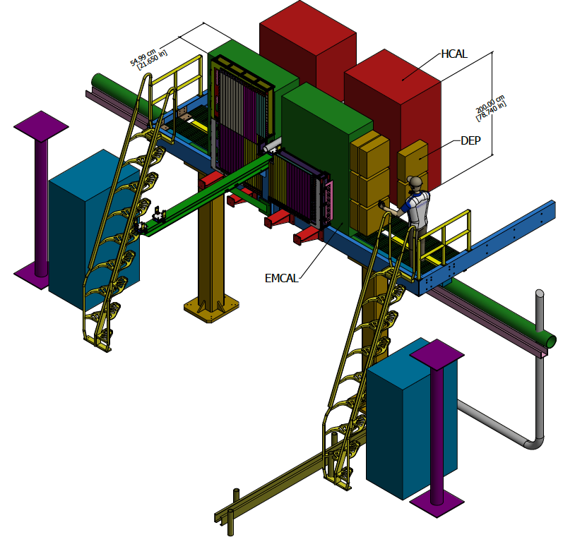
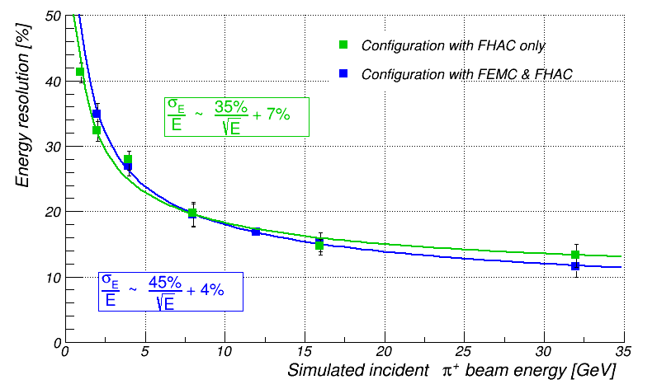
STAR forward upgrade: 2020+
η=2.5 – 4: π0, γ, e, h±, jets
EMCal (PHENIX PbSc): σ_{E}/E~8%/√E
HCal (PbSc): σ_{E}/E~70%/√E
Tracking (Si or GEM)
Upgraded Roman Pots

Slide 23
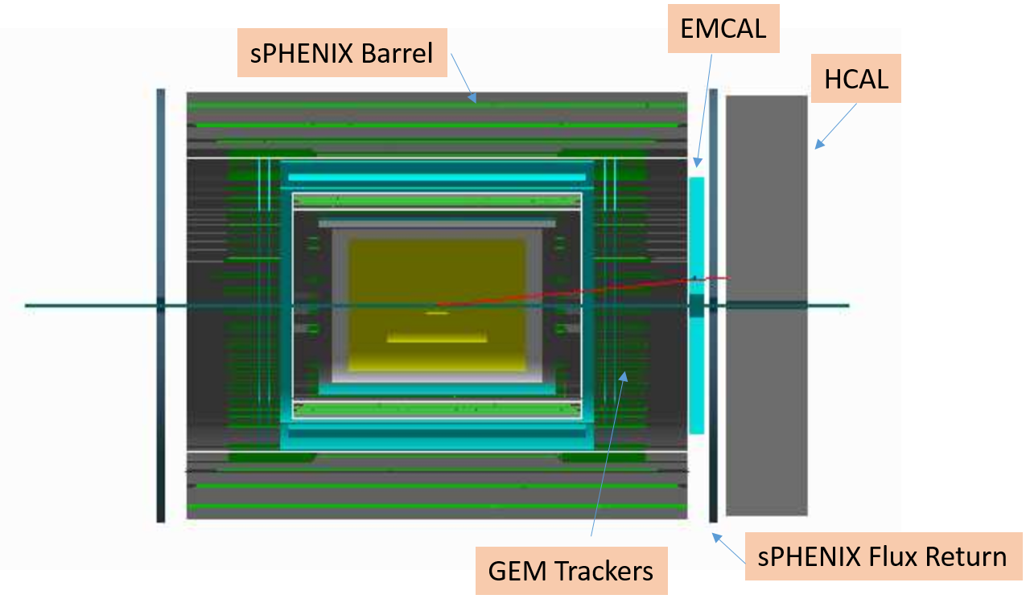
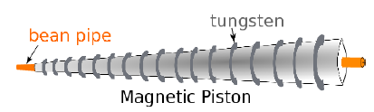
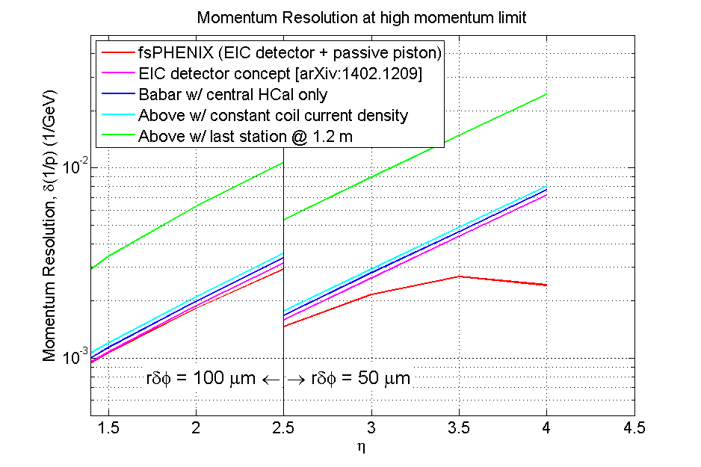
f+sPHENIX
Forward upgrade to barrel sPHENIX detector
η=1.1 – 4: π0, γ, e, μ, h±, jets
EMCal + MPC (from PHENIX): σ_{E}/E~8%/√E
HCal (PbSc): σ_{E}/E~100%/√E
Magnetic piston field shaper
Tracking (GEM): σ_{p}/p<0.3%*p
MuID (from PHENIX)
Roman Pots
The majority of the cost –
as a down payment to potential EIC detector (“ePHENIX”)

Slide 24
(Instead of) Summary
Factorization & Universality |  | => both pp and ep
Evolution |  | => different √s
Higher and lower x Also the source of large A_{N} in pp |  | => forward instrumentation
Precision |  | => more L
Unique measurements: probes and kin. ranges; e.g. W, DY, Twist-3 |  | => pp

Slide 25
Backup

Slide 26
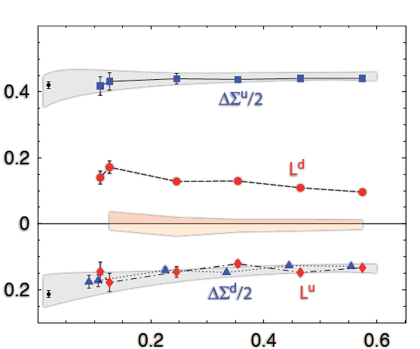
Outlook
Proton
Spin
(Anti)quark
Contribution:
0.15-0.20
Gluon
Contribution:
0.2 in x>0.05
Parton Orbital
Momentum:
???
Lattice QCD:
quark contributions to the proton spin
m_{π}² (GeV²)

Slide 27
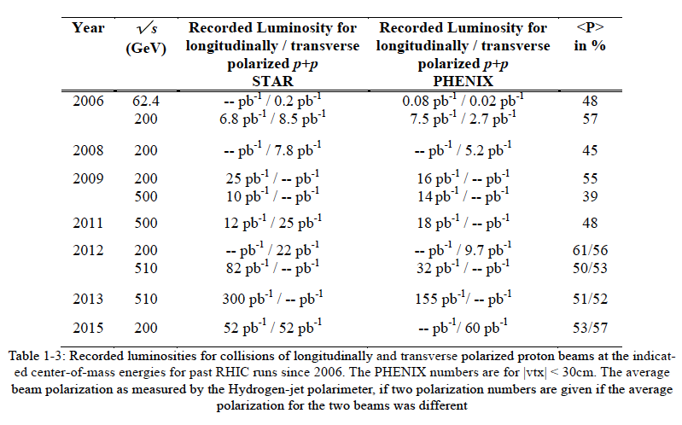

Slide 28
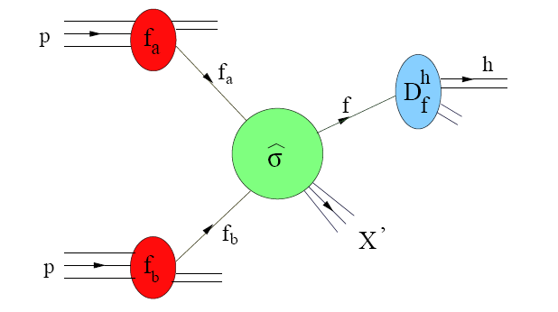
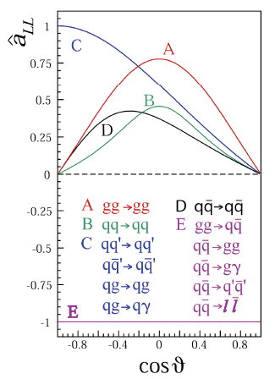
Probing ΔG in pol. pp collisions
pp → hX
Double longitudinal spin asymmetry A_{LL} is sensitive to ΔG

Slide 29
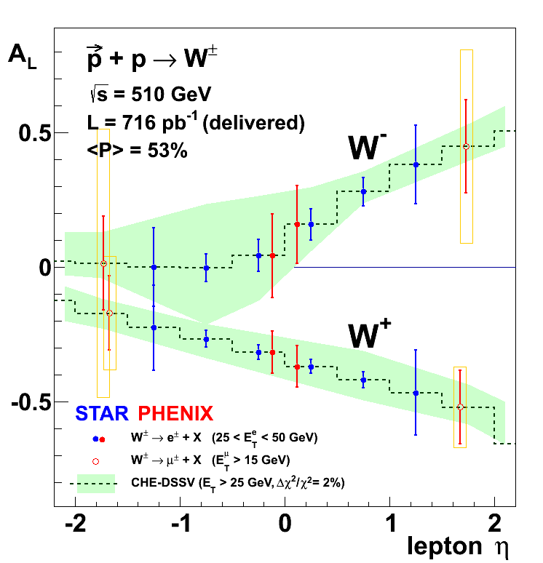
W: Projection
RHIC W-data will give a significant constraint on anti-quark polarization in the proton

Slide 30
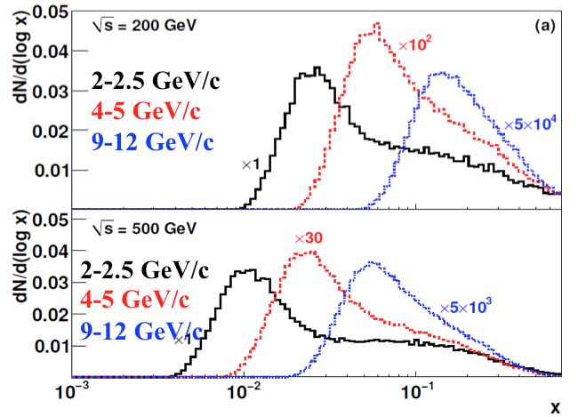
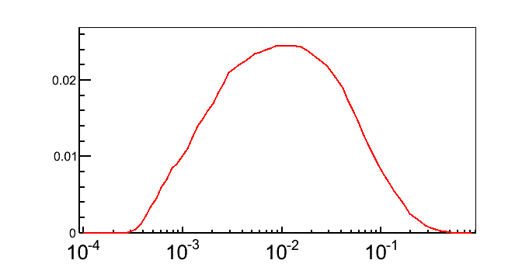
ΔG: Towards lower x
π0 at |η|<0.35
From √s=200
to 500 GeV
From central η
to forward η
π0 at 3.1<η<3.9
√s=500 GeV
p_{T}>2 GeV/c

Slide 31
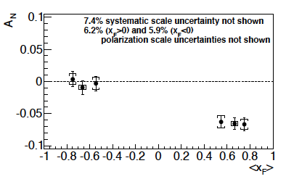
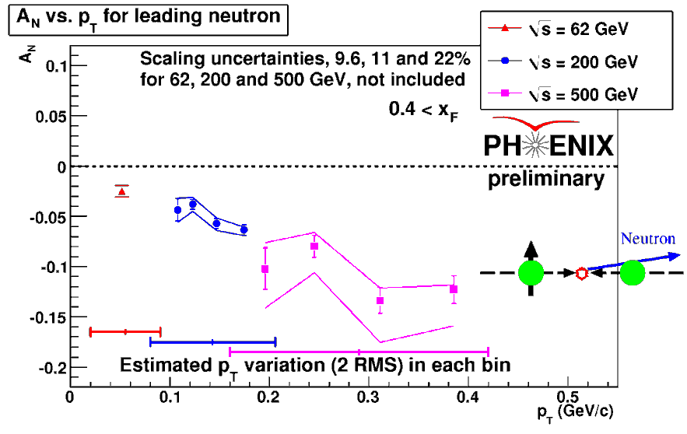
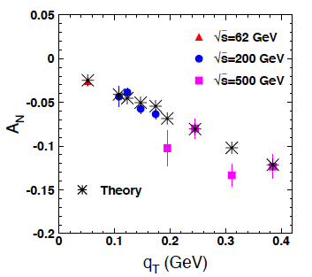
A_{N} for forward neutron
Discovered in 2002:
PLB 650, 325
pp→nX, |θ|<2.5mrad
PRD 88 (2013), 032006
B.Kopeliovich et al
PRD 84, 114012
One pion Exchange model in Regge framework model
(interference between pion and a1-reggeon exchange)
31

Slide 32
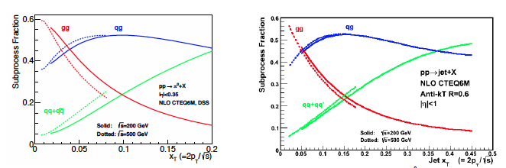

Slide 33
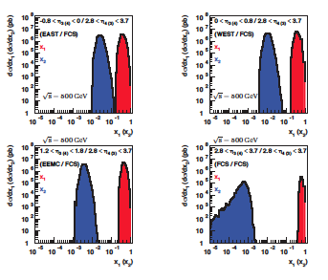
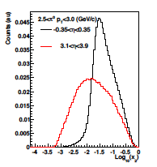
ΔG: Towards lower x
From incl. π0
From di-jets

Slide 34
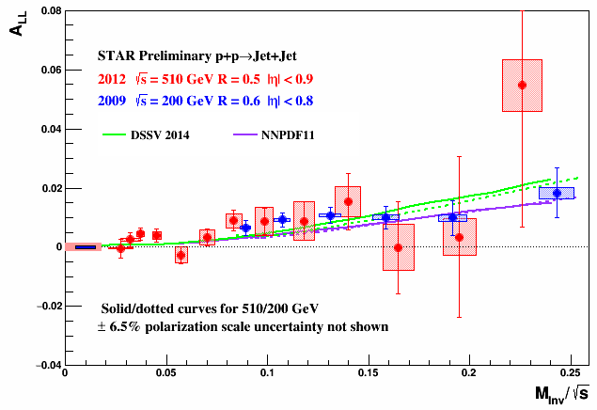
Di-jets

Slide 35
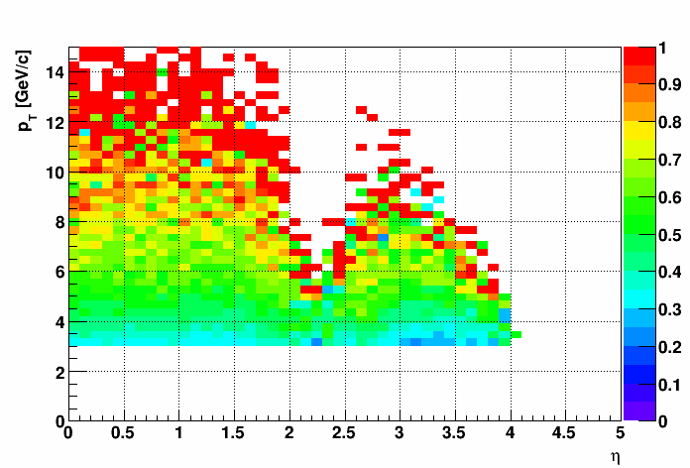
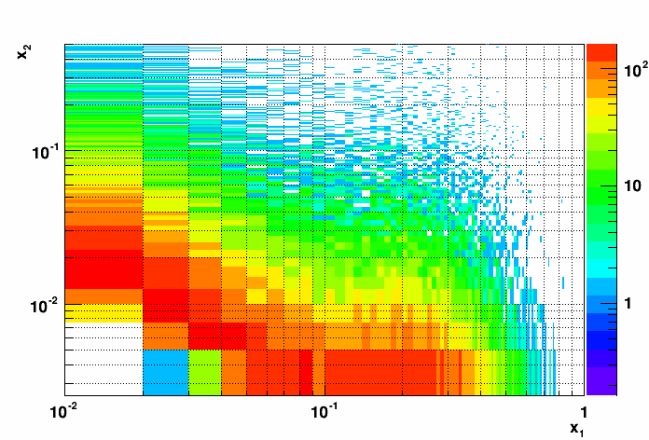
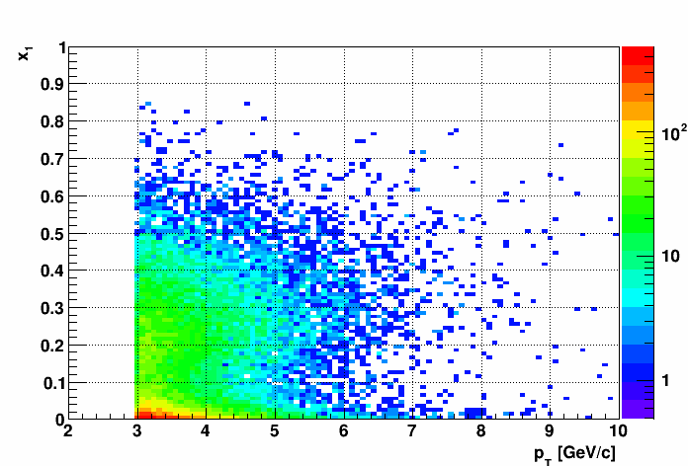
Kinematics
Distribution of the partonic variables x₁ and x₂ for events with a jet with pT > 3 GeV/c and 2.8 <η< 3.5
Matching Fraction between detector jets and partons.
x₁ versus jet p_{T}.

Slide 36
Sivers

Slide 37
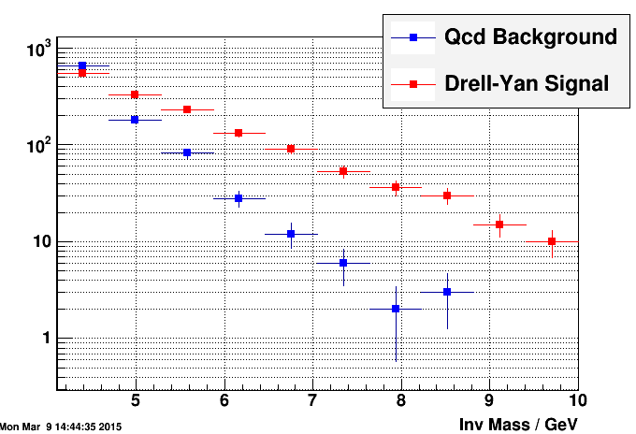
DY

Slide 38
A_{N}

Slide 39
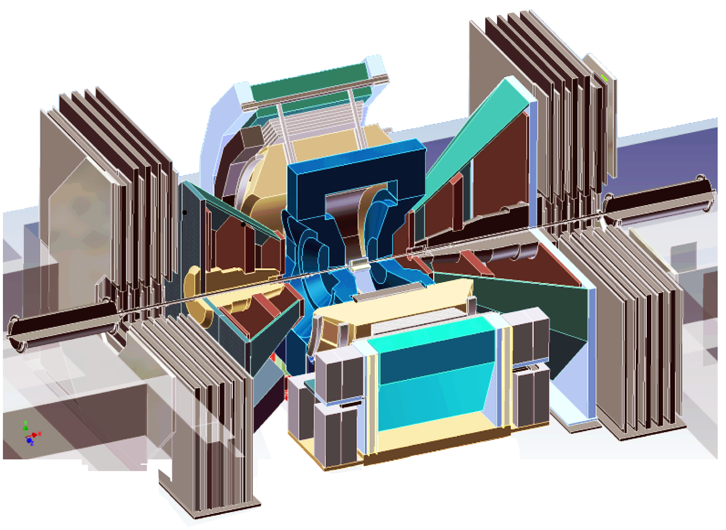
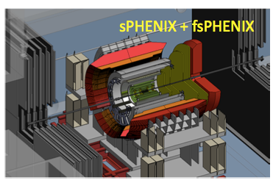


PHENIX: longer term plans
PHENIX
sPHENIX
~2021-22
By ~2025
Evolve sPHENIX (pp and HI detector) to EIC Detector (ep and eA detector)
  To utilize e and p (A) beams at eRHIC with e-energy up to 15 GeV and p(A)-energy up to 250 GeV (100 GeV/n)
  e, p, He3 polarized
  Stage-1 luminosity ~10³³ cm⁻² s⁻¹ (~1fb⁻¹ /month)
EIC detector
39
39
39
39

Slide 40

RHIC -> eRHIC
Electron – Ion Collider
~2025
Add electron ring to existing RHIC proton/heavy_ion ring or
Add proton/heavy_ion ring to existing electron ring
Back to DIS but at much higher luminosity (x100-1000 as HERA)
And much higher √s (with both beams polarized)

Slide 41


Nucleon Helicity Structure: from RHIC to EIC
arXiv: 1509.06489
1/2 -
Gluon
-
Quarks
=
Orbital angular
momentum
Spin puzzle will be solved

Slide 42

Symmetry breaking in pol. sea?
Unpolarized sea is not symmetric
Symmetry breaking in polarized sea?
42

Slide 43


Initial State: TMD vs Twist3
Intermediate p_{T}
Q>>p_{T}>>Λ_{QCD}
Transverse
momentum
dependent
Q>>p_{T}>=Λ_{QCD}
Collinear/
twist-3
Q,p_{T}>>Λ_{QCD}
Efremov, Teryaev;
Qiu, Sterman
Sivers fct.
P_{T}
Λ_{QCD}
<<
P_{T}
<<
Q
Need 2 scales
Q² and p_{t}
Remember pp:
several observables one scale
Exception:
DY, W/Z-production
Need only 1 scale
Q² or p_{t}
But
should be of reasonable size
should be applicable to
pp observables
A_{N}(π⁰/γ/jet)
Ji, Qiu, Vogelsang, Yuan, PRL. 97, 082002 (2006).
related through

Slide 44

TMD vs Twist3: Sign Mismatch?
Kang, Qiu, Vogelsang, Yuan
PRD 83 (2011), 094011
pp→π X (Twist-3)
SIDIS (TMD)
Sign mismatch!
Sivers contribution is small in pp→π X ?
=> Collins dominate?

Slide 45

Collins dominate?
A_{N} from twist-3 fragmentation functions (Kanzawa, Koike, Metz, Pitoniak, arXiv:1404.1033)
Describes data well !

Slide 46


A_{N}: pp→π X
PRD90 (2014), 012006
Anselmino et al., Eur. Phys. J. A39, 89 (2009)
u
d
PYTHIA:
π+ mainly produced from u
π- equally produced from d and u
=> |A_{N}(π+)| >>|A_{N}(π-)|
Sivers contribution is small in pp→π X ?

Slide 47

Q2 dependence
ΔG is dynamic value – Q² dependent
ΔG can be large at large Q² (and can be >>1/2) no matter how small it is at some low Q²
Large ΔG at large Q² is compensated by L_{g}

Slide 48


PHENIX forward upgrade

