Slide 1
TMDs of a Large Nucleus:
Quasi-Classical Approximation and Quantum Evolution
Yuri Kovchegov
The Ohio State University
based on work with Matt Sievert

Slide 2
Outline
Introduction and goals:
  Classical fields, Wilson lines
  Non-linear small-x evolution
TMDs in the quasi-classical approximation at large-x:
  Unpolarized quark distribution, Sivers function, Boer-Mulders distribution
  Mixing between the nuclear and nucleon TMDs
TMD evolution
  Large-x case
  Small-x: quark TMDs of an unpolarized target

Slide 3
Introduction: calculations in saturation physics

Slide 4
Two-step prescription
To calculate observables in the saturation picture one has to follow the two-step procedure:
Calculate the observable in the classical approximation.
Include nonlinear small-x evolution corrections (BK/JIMWLK), introducing energy-dependence.
(To compare with experiment, need to at least fix the scale of the running coupling, NLO corrections, etc.)

Slide 5
DIS: Quasi-Classics

Slide 6
Dipole Amplitude
The total DIS cross section is expressed in terms of the (Im part of the) forward quark dipole amplitude N:

Slide 7
Dipole Amplitude
The quark dipole amplitude is defined by
Here we use the Wilson lines along the light-cone direction
In the classical Glauber-Mueller/McLerran-Venugopalan approach the dipole amplitude resums multiple rescatterings:

Slide 8
DIS in the Classical Approximation
The dipole-nucleus amplitude in
the classical approximation is
A.H. Mueller, ‘90
Black disk
limit,
Color
transparency
1/Q_{S}

Slide 9
DIS: Small-x Evolution

Slide 10
Dipole Amplitude
The energy dependence comes in through nonlinear small-x BK/JIMWLK evolution, which resums the long-lived s-channel gluon corrections:

Slide 11
Nonlinear evolution at large N_{c}
Here N=1-S (the Im part of the forward scattering amplitude)
dashed line =
all interactions
with the target
Balitsky ‘96, Yu.K. ‘99

Slide 12
TMDs in the Quasi-Classical Approximation at Large-x
Yu.K., M. Sievert, arXiv:1310.5028 [hep-ph]
arXiv:1505.01176 [hep-ph]

Slide 13
Quark Production in SIDIS
Start with inclusive classical quark
production cross section in SIDIS.
The kinematics is standard:
The result is
Wigner distribution
LO cross sect
Wilson lines

Slide 14
Quark Production
Note: effective x
Wigner distribution
LO cross sect
Wilson lines

Slide 15
Wilson lines
Here
is the quark dipole scattering S-matrix with
denoting Wilson lines. This is the standard ‘staple’ (in a gauge where the link at infinity does not contribute).
The leading contribution to D_{xy} is x<->y symmetric and will be denoted S_{xy}.

Slide 16
Definitions
Quark TMDs are defined through the correlator
with the gauge links
The correlator is decomposed in terms of quark TMDs as

Slide 17
Quark TMDs of a Nucleus
Note: effective x
Nuclear correlator
Wigner distribution
Nucleon correlator
Wilson lines

Slide 18
Quasi-Classical Sivers Function
Yu.K., M. Sievert, arXiv:1310.5028 [hep-ph]

Slide 19
Quasi-Classical STSA in SIDIS
To generate STSA we need spin-dependence and a complex phase. They may come from three sources:
  Sivers functions of the (polarized) nucleons: transversity channel
  Orbital rotation due to OAM (just gives real OAM-dependence)
  Going beyond classical approximation in D_{xy} by including extra rescatterings per nucleon (the odderon): this gives a phase, but is A-suppressed. Hence we will drop it.

Slide 20
Quasi-Classical STSA in SIDIS
When the dust settles one gets
J = L+S = total spin of the nucleus (analogue of proton spin)
L = net OAM of the nucleons (analogue of quark and gluon OAM)
S = net spin of all nucleons (analogue of net spin of quarks and gluons)
S_{xy} = dipole rescattering S-matrix
W = Wigner distributions of nucleons, unp = unpolarized (may have <S>=0),
trans = transversity, with

Slide 21
LO TMDs
and are the LO unpolarized quark TMD (in a nucleon) and the “nucleon” Sivers function:
They can be arbitrary non-perturbative objects: we can always “run” them through the quasi-classical “grinder”. ;)
Resulting quasi-classical Sivers function can be used as initial condition for evolution equations (e.g. CSS for s ~Q² or small-x evolution if s>>Q²).

Slide 22
OAM and Transversity channels
The final formula is a sum of the contributions of the OAM and Transversity (Sivers function density) channels:
The non-perurbative input comes though the Wigner functions and LO TMDs: the dipole scattering is perturbative due to Q_{s} >> Λ_{QCD}.
OAM
channel
Transversity channel

Slide 23
Rigid Rotator Model
To get the feel for what the result is like, our main formula can be evaluated using a rigid-rotator nucleus with simple (powers of k_{T}) models of LO TMDs.
The result is (for k_{T} not much larger than Q_{s})
Note a “new” functional form for Sivers function due to the OAM channel (not a Gaussian).
OAM channel
Transversity channel

Slide 24
Rigid Rotator Model
The OAM contribution in this model (!) calculation is shown below (arbitrary units). It changes sign as a function of k_{T}.

Slide 25
Rigid Rotator Model
The transversity (Sivers density) contribution comes out to be a simple Gaussian (in this calculation); units are again arbitrary:

Slide 26
STSA at Large-k_{T}
For k_{T} >> Q_{s} we get
At high-k_{T} the transversity (Sivers density) channel dominates over the OAM one.
However, the OAM channel dominates over a fairly broad range
(if p_{T} ~ m_{N}).
OAM channel
Transversity channel

Slide 27
Quasi-Classical STSA in DY
The DY process in the quasi-classical approximation looks as follows:
Note that ordering interactions along the x⁻ direction makes the reversal of the Wilson line direction between SIDIS and DY explicit.

Slide 28
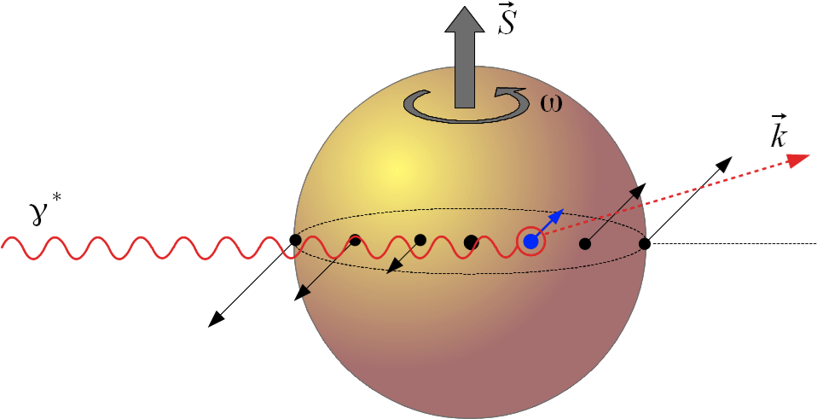
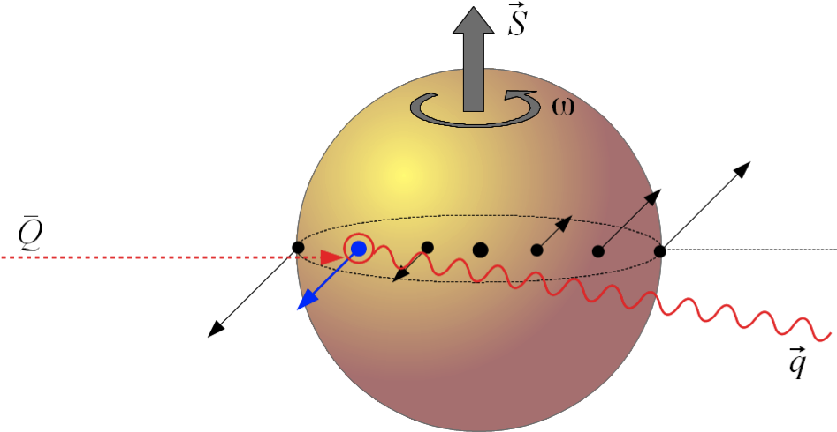
Origin of Sign Reversal
In the transversity (Sivers density) channel the origin of the sign reversal is simple: the (LO) Sivers function of the nucleon changes sign, and multiple rescatterings do not affect this.
In the OAM channel the reversal ultimately happens for the simple reason pictured here:

Slide 29
Classical picture of STSA in Drell-Yan
Think of a transversely polarized proton as a rotating disk with the axis perpendicular to the collision axis
The proton is not transparent: it has some amount of screening/shadowing (e.g. gray disk, black disk, etc.)
Incoming anti-quark (in DY) is more likely to interact near the “front” of the proton: hence, due to the rotation, the outgoing virtual photon is more likely to be produced left-of-beam, thus generating STSA.

Slide 30
Classical picture of STSA in SIDIS
Ditto for SIDIS: except now the incoming virtual photon is more likely to interact near the “back” of the proton, in order for the produced quark to be able to escape out of the proton remnants.
Owing to the same rotation, the outgoing quark is more likely to be produced right-of-beam, thus generating STSA in SIDIS with the opposite sign compared to STSA in DY!

Slide 31
Mini-Summary
It appears that STSA can be easily interpreted as a combination of OAM and some amount of
(anti-)shadowing.
Sign-flip between STSA and DY has a very simple interpretation in this framework too.
Note the mixing between the nuclear Sivers function and the nucleon unpolarized quark distribution.

Slide 32
Quasi-Classical TMD Mixing
Yu.K., M. Sievert, arXiv:1505.01176 [hep-ph]

Slide 33
Unpolarized Quark TMD
We can also calculate the unpolarized quark TMD in the quasi-classical picture at large-x:
Note again the mixing between TMDs: the nuclear unpolarized quark TMD depends on the nucleonic Sivers function !

Slide 34
Boer-Mulders Distribution
One can also calculate the Boer-Mulders function:
Now we have the mixing between the nuclear Boer-Mulders function with the transversity and pretzelocity of the nucleons.

Slide 35
Mini-Summary
We can calculate any TMD in the quasi-classical approximation, providing initial conditions for TMD evolution.
TMDs of nucleus and nucleons mix.
Calculation is done consistently in the high parton density limit of QCD.

Slide 36
TMD Evolution at Large-x
Yu.K., M. Sievert, arXiv:1505.01176 [hep-ph]

Slide 37
Evolution Corrections
We work in A⁺ =0 gauge (projectile light-cone gauge) and look for emissions
giving ln s ~ ln Q².
Such emissions and virtual corrections come only from the semi-infinite
Wilson line describing the outgoing quark:
How do we sum them up?

Slide 38
Crossing Symmetry
To sum up evolution corrections for the semi-infinite Wilson line in the amplitude and another one in the cc amplitude, use the “crossing” symmetry to reflect the cc Wilson line into the amplitude (forming the standard SIDIS light-cone staple):
We end up with a ½ a dipole with, from the standpoint of the dipole evolution, only virtual corrections.

Slide 39
Nonlinear Evolution
To sum up the gluon cascade at large-N_{C} we write the following equation
for the dipole S-matrix:
dashed line =
all interactions
with the target
Now we only need ½ of the virtual correction (last term on the right).

Slide 40
TMD Evolution at large-x
Keeping only (a half of) the virtual corrections of the dipole evolution we write
where rapidity is (s ≈ Q²)
The z-integral is UV divergent, and has to be regulated by 1/Q. The solution is
with the initial condition at Q₀ given by the quasi-classical expression (see above).

Slide 41
Sudakov Form-Factor
We reproduced the standard Sudakov form-factor, which is characteristic of the CSS evolution.
To calculate any TMD of an unpolarized nucleus, simply ‘evolve’ the classical semi-infinite dipole amplitude using the form-factor above, and use it in the quark-quark correlator to extract all TMDs
For gluon TMD evolution simply replace the Casimir, C_{F} ➔ N_{c} in S.

Slide 42
Quark TMD Evolution: small-x, unpolarized nucleus
Yu.K., M. Sievert, arXiv:1505.01176 [hep-ph]

Slide 43
Quark Production in SIDIS at Small-x
To find unpolarized target TMDs at small-x it is convenient to start by considering the quark production cross section for SIDIS on an unpolarized nucleus.
The dominant process is different, even at the lowest order:
Compared to the standard LO process,
the one above comes in with an extra factor of
and is dominant at very low x.

Slide 44
SIDIS to All Orders
SIDIS process can now be easily generalized to include all-order interactions with the shock waves:
The SIDIS cross section is
Now we have infinite
Wilson lines!

Slide 45
Quark TMD Evolution at Small-x
Taking the large-Q² limit of the SIDIS cross section we can extract the unpolarized quark TMD out of it:
Since the Wilson lines are now infinite, we have infinite dipoles, whose evolution is given by the BK equation at large-N_{c}:
Initial conditons are given by the quasi-classical Glauber-Mueller formula again.
For unpolarized gluon TMD at low-x
see F. Dominguez et al, ‘11; Balitsky & Tarasov ‘15 (next talk)

Slide 46
Conclusions
Quasi-classics:
  We can construct any TMD in the quasi-classical approximation: we have calculated the unpolarized quark TMD, Sivers and Boer-Mulders distribution
  We observed mixing between the nucleon and nuclear TMDs due to spin-orbit coupling.
TMD evolution:
  Large-x, both quark and gluon TMDs, polarized and unpolarized target: we reproduced the standard Sudakov form-factor (cf. CSS evolution).
  Small-x quark TMDs of the unpolarized target: we showed that they evolve with the BK/JIMWLK evolution.
  Small-x polarized-target TMDs: see talk by M. Sievert.

Slide 47
Outlook
Quasi-classical expressions provide initial conditions which can be used in a global fit of all the TMD data.
All is ready for a global fit of small-x evolved unpolarized-target TMDs.
Polarized-target TMD evolution: constructed for quark helicity TMDs (YK, M. Sievert, D. Pitonyak ‘15), needs to be constructed for transversity, Sivers and Boer-Mulders functions.

Slide 48
Outlook
Lensing mechanism contribution to single spin asymmetry in p+A collisions needs to be calculated in the saturation framework.

Slide 49
Backup Slides

Slide 50
Polarized Quark TMD Evolution at Small-x: an Outline
Yu.K., M. Sievert, arXiv:1505.01176 [hep-ph]
Yu.K., D. Pitonyak, M. Sievert, R. Venugopalan,
in preparation

Slide 51
Target Spin-Dependent SIDIS
To transfer spin information between the polarized target and the produced quark
we either need to exchange quarks in the t-channel, or non-eikonal gluons.
Here’s an example of the quark exchange:

Slide 52
Target Spin-Dependent SIDIS
It is straightforward to include multiple shock wave interactions into the
polarized SIDIS cross section:
=0
= the answer

Slide 53
Small-x Polarized-Quark TMD Evolution
Evolution corrections can be included into the polarized TMDs using
the diagrams below:
Interestingly the quark and non-eikonal gluon ladders mix (see the right panel),
resulting in a more complicated evolution equation.

Slide 54
Small-x Polarized-Quark TMD Evolution
A generic quark-spin dependent TMD can be written as (target spin is Σ, tagged quark spin is λ)
where R is the QCD Reggeon amplitude and f_{σ σ’} can be calculated from the light-cone wave function.
R obeys the equation like this: (Itakura, YK, McLerran, Teaney ’03),
(no gluon ladders ➔ approximation for TMD evolution!)

Slide 55
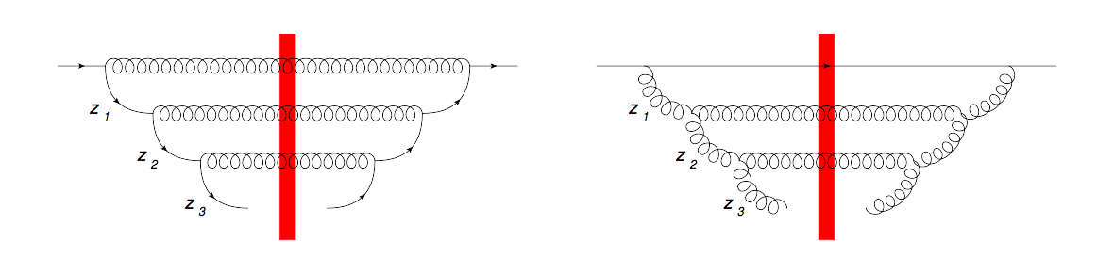
Helicity TMDs
Summing up mixing quark and gluon ladders only yields
with
The numbers are encouraging (α_{s}=0.3, N_{c}=N_{f}=3):
But: need to include the non-ladder graphs.

Slide 56
What to Expect
Without saturation effects, similar evolution for the g₁ structure function was considered by Bartels, Ermolaev and Ryskin in ‘96.
Including the mixing of quark and gluon ladders, they obtained
with z_{s} = 3.45 for 4 quark flavors.
The power is large and negative, and can easily become large enough to make the net power of x smaller than −1 for the realistic strong coupling of the order of α_{s} = 0.2 − 0.3, resulting in polarized TMDs which actually grow with decreasing x fast enough for the integral of the TMDs over the low-x region to be (potentially) large.
Can this solve the spin puzzle? To be continued…

