Slide 1
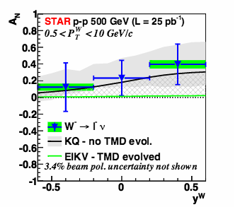
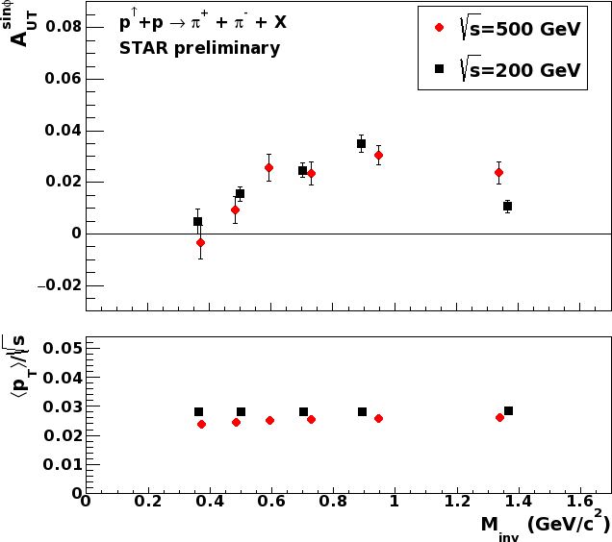
Questions
Do we expect evolution effects to effectively cancel in asymmetries (as opposed to cross-sections)?
What is the Importance of pp energy scale for evolution effects (e.g. Collins FF up to ~40GeV jets)?
What measurements, besides DY/W Sivers are best to access evolution effects in p+p?
Do we expect non-trivial evolution effects of the di-hadron FF?
Collins at 200 vs 500 GeV (top)
W A_{N} compared to theory (bottom)
IFF at 200 vs 500 GeV

