Slide 1
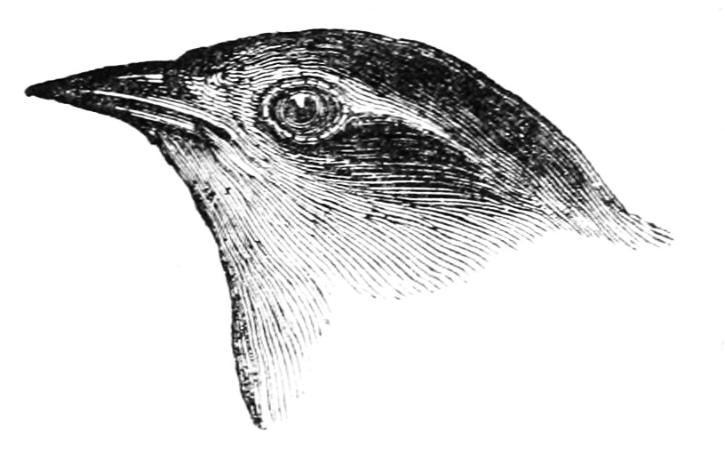

Transverse Momentum Dependent Evolution in Proton-Proton Collisions
Oleg Eyser
RIKEN/BNL Research Center Workshop
Emerging Spin and Transverse Momentum Effects in p+p and p+A Collisions

Slide 2



The Evolving Proton
QCD
structure
Our picture of the proton changes with the resolution.
$$\vec{p}$$
spin
What about spin effects, in particular those that naturally include transverse momentum dependence?

Slide 3
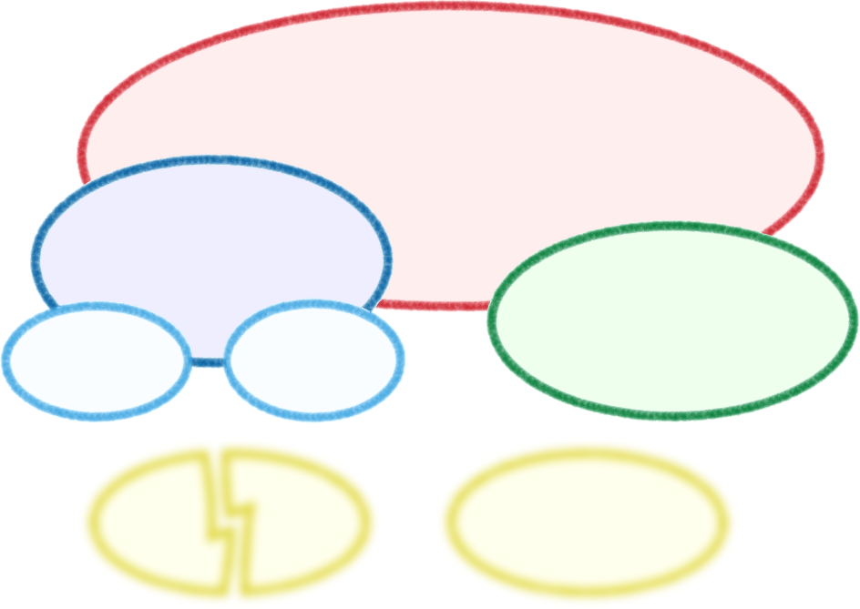
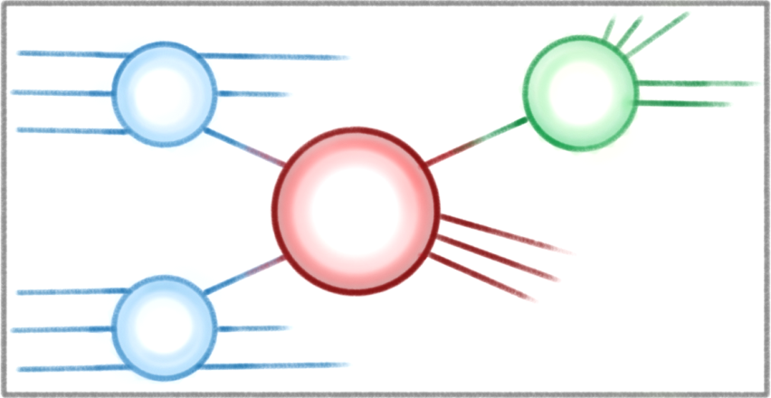




Transverse-Spin
Asymmetries
Parton Distribution
Hadronization
Spin-Orbit
Correlation
Transversity
What underlying process creates transverse-spin asymmetries?
$$f_{1}$$
$$D_{1}$$
Transverse Momentum
Dependent Effects
$$\hat{σ}$$
Twist-3 Effects
$$f_{2}$$

Slide 4

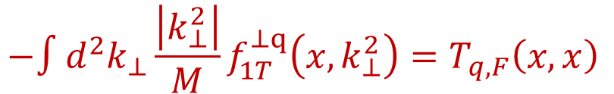


$$−∫d^{2}k_{⊥}\frac{\left|k_{⊥}^{2}\right|}{M}f_{1T}^{⊥q}\left(x,k_{⊥}^{2}\right)=T_{q,F}\left(x,x\right)$$
$$Q_{T}/p_{T}$$
$$Q≫Q_{T}≳Λ_{QCD}$$
$$Q,Q_{T}≫Λ_{QCD}$$
Transverse Momentum
Dependent Effects
Twist-3 Effects
Is the observed p_{T}-dependence consistent with theory?
What can we learn about non-DGLAP evolution effects?

Slide 5
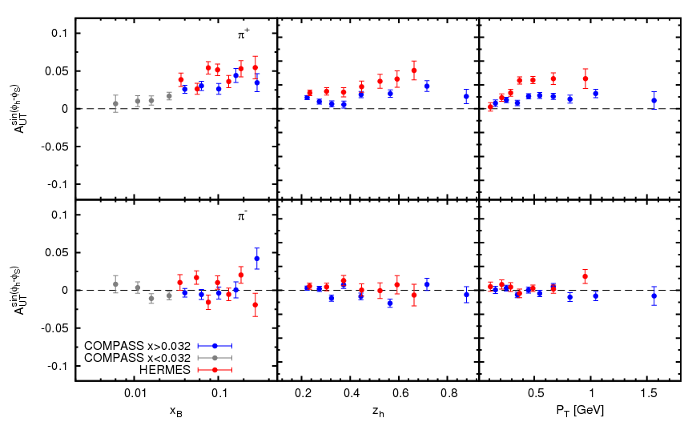
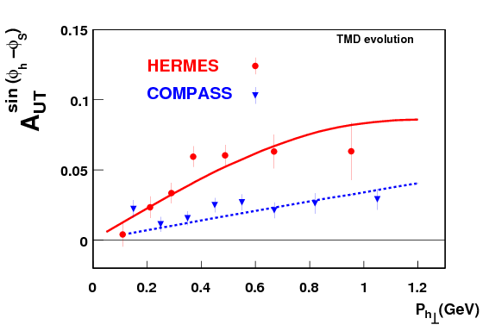

SIDIS Asymmetries: $φ_{h}−φ_{S}$
Phys Rev D86, 014028 (2012)

Slide 6
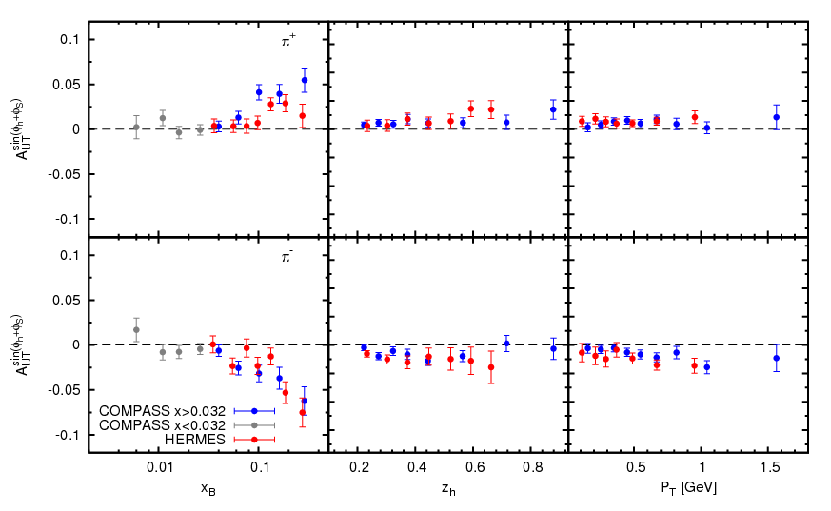

SIDIS Asymmetries: $φ_{h}+φ_{S}$

Slide 7
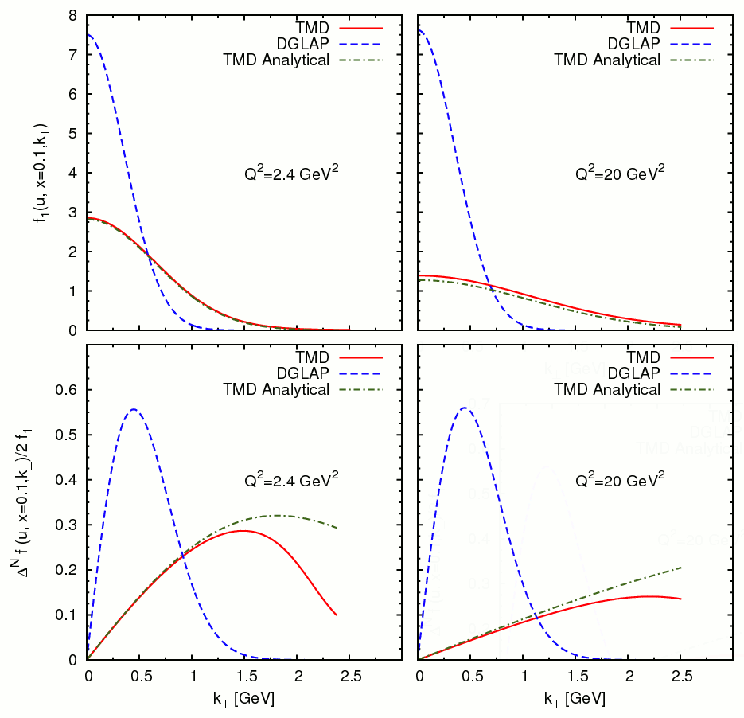
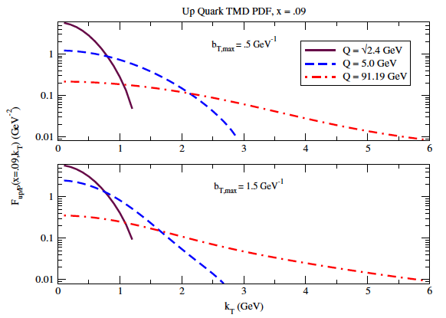
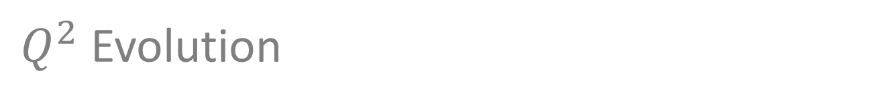

$Q^{2}$ Evolution
PDF evolution
TMD evolution
Twist-3 evolution
non-perturbative part is empirical input for evolution kernel
$$Q_{0}^{2}=1 \text{G}e{\text{V}}^{2}$$
Phys Rev D86, 014028 (2012)

Slide 8
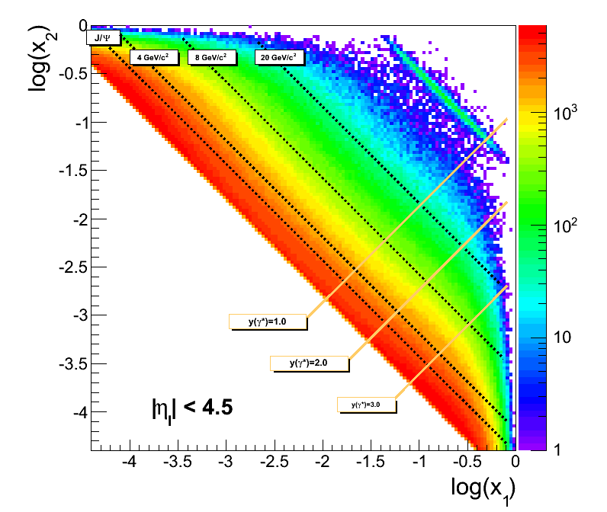
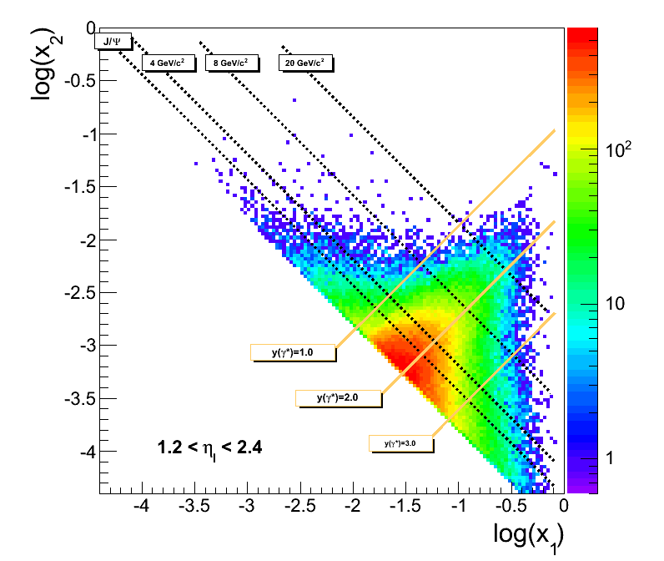
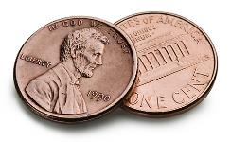
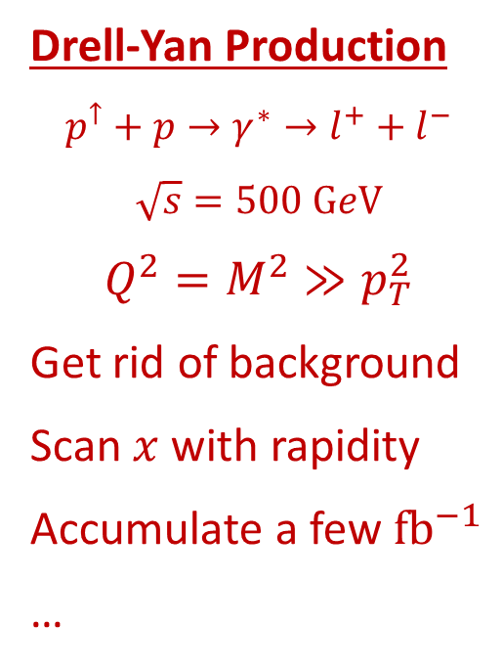
Ideally…
Drell-Yan Production
$$p^{↑}+p→γ^{∗}→l^{+}+l^{−}$$
$$\sqrt{s}=500 \text{G}e\text{V}$$
$$Q^{2}=M^{2}≫p_{T}^{2}$$
Get rid of background
Scan $x$ with rapidity
Accumulate a few ${\text{f}\text{b}}^{−1}$
…

Slide 9
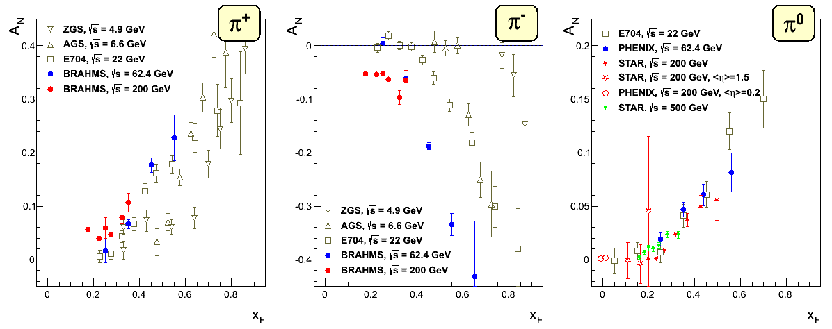

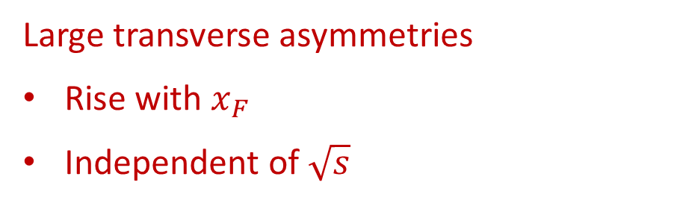
Meanwhile in the real world
$$x_{F}=2 ⋅p_{L}/\sqrt{s}$$
Large transverse asymmetries
Rise with $x_{F}$
Independent of $\sqrt{s}$

Slide 10
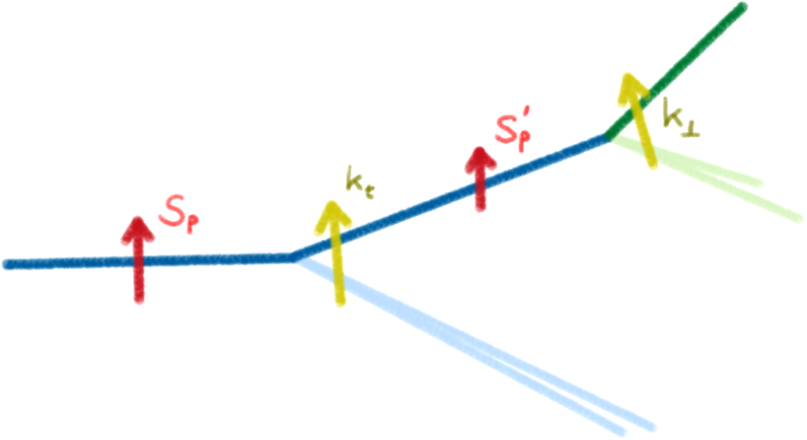
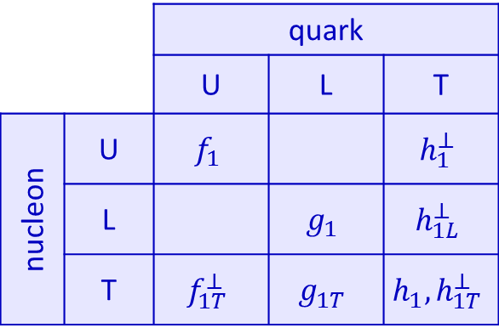
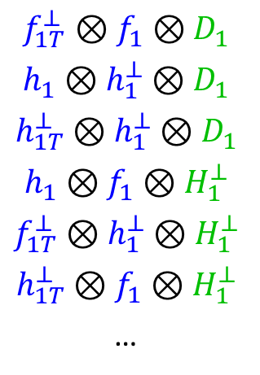
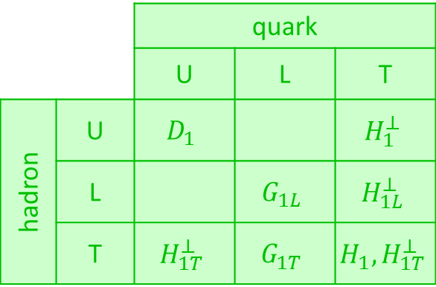
Polarization Effects in Nucleon / Parton
 |  | quark
 |  | U | L | T
nucleon | U | $$f_{1}$$ |  | $$h_{1}^{⊥}$$
 | L |  | $$g_{1}$$ | $$h_{1L}^{⊥}$$
 | T | $$f_{1T}^{⊥}$$ | $$g_{1T}^{}$$ | $$h_{1},h_{1T}^{⊥}$$
 |  | quark
 |  | U | L | T
hadron | U | $$D_{1}$$ |  | $$H_{1}^{⊥}$$
 | L |  | $$G_{1L}$$ | $$H_{1L}^{⊥}$$
 | T | $$H_{1T}^{⊥}$$ | $$G_{1T}^{}$$ | $$H_{1},H_{1T}^{⊥}$$
Possible transverse asymmetries:
Inclusive hadrons
Direct photons
Jets
Jet structure
Hadron correlations
Interference fragmentation
Drell-Yan
W-bosons
$$f_{1T}^{⊥}⊗f_{1}⊗D_{1}$$
$$h_{1}⊗h_{1}^{⊥}⊗D_{1}$$
$$h_{1T}^{⊥}⊗h_{1}^{⊥}⊗D_{1}$$
$$h_{1}⊗f_{1}⊗H_{1}^{⊥}$$
$$f_{1T}^{⊥}⊗h_{1}^{⊥}⊗H_{1}^{⊥}$$
$$h_{1T}^{⊥}⊗f_{1}⊗H_{1}^{⊥}$$
…
initial state
final state

Slide 11
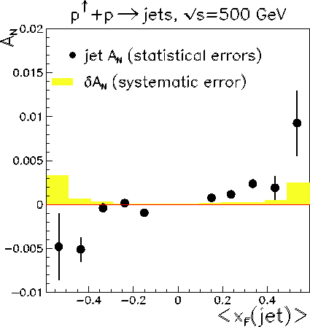
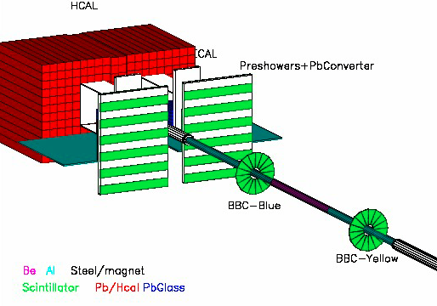
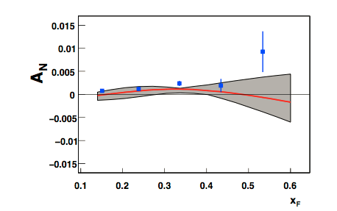
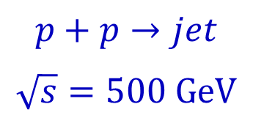
Inclusive Jets
AnDY @ RHIC
$$p+p→jet$$
$$\sqrt{s}=500 \text{GeV}$$
PRL 110, 232301 (2013)

Slide 12
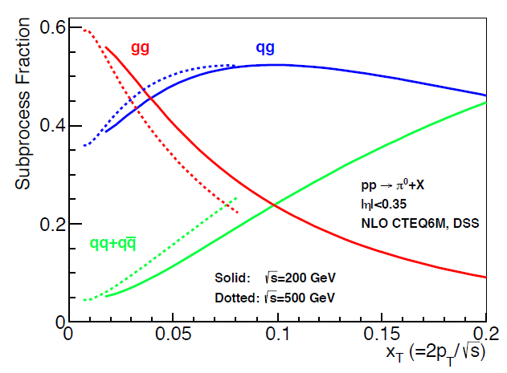
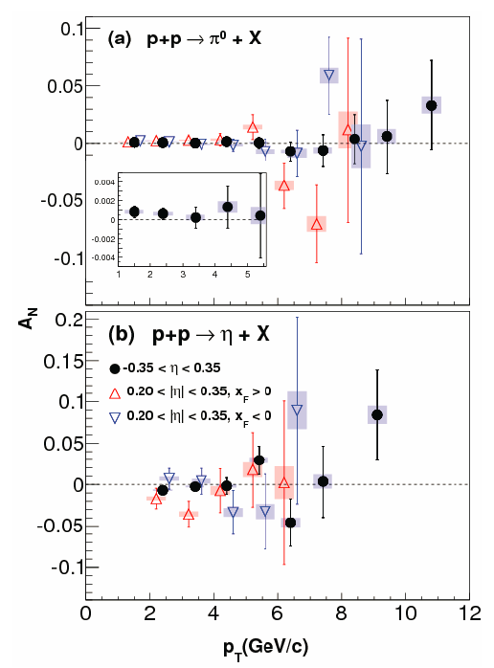
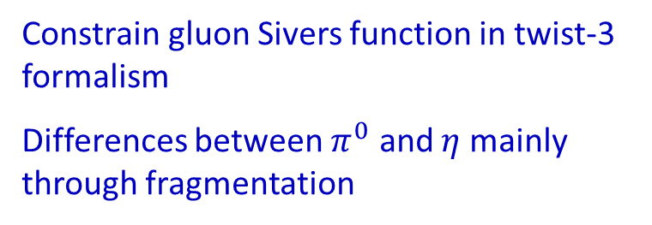
Gluon Spin-Orbit Correlation
Phys. Rev. D90, 012006 (2014)
Constrain gluon Sivers function in twist-3 formalism
Differences between $π^{0}$ and $η$ mainly through fragmentation

Slide 13
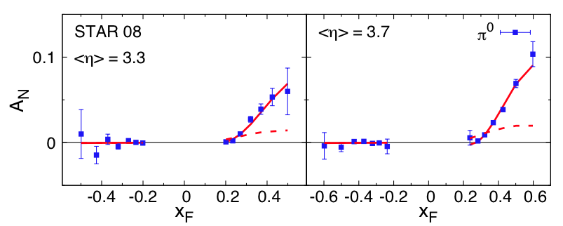
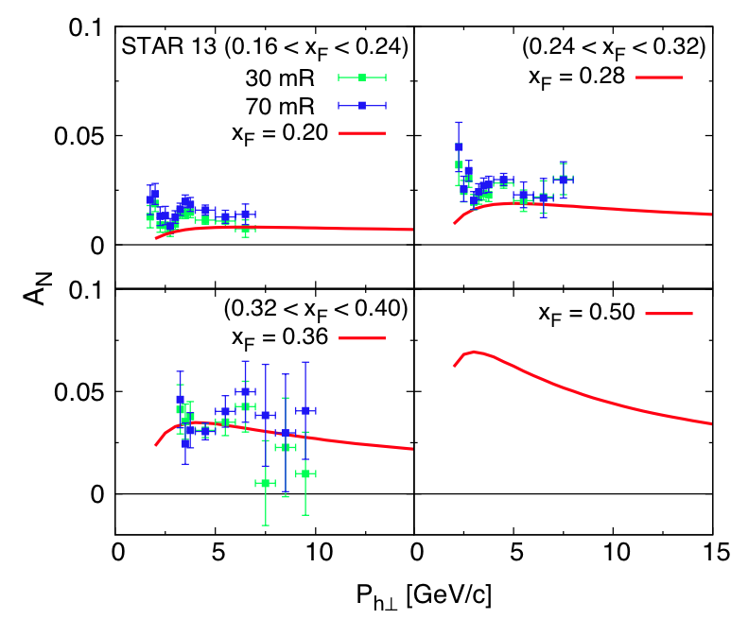
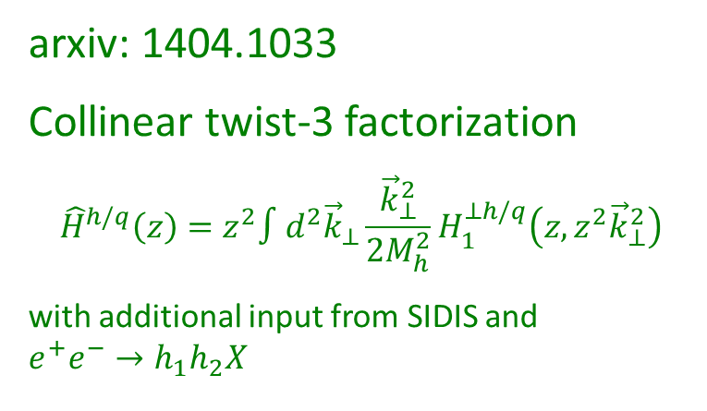



Fragmentation Effects
$$\sqrt{s}=200 \text{GeV}$$
${\hat{H}}_{FU}^{ℑ}$ switched off
arxiv: 1404.1033
Collinear twist-3 factorization
$${\hat{H}}^{h/q}\left(z\right)=z^{2}∫d^{2}{\vec{k}}_{⊥}\frac{{\vec{k}}_{⊥}^{2}}{2M_{h}^{2}}H_{1}^{⊥h/q}\left(z,z^{2}{\vec{k}}_{⊥}^{2}\right)$$
with additional input from SIDIS and
$$e^{+}e^{−}→h_{1}h_{2}X$$
$$\sqrt{s}=500 \text{GeV}$$

Slide 14
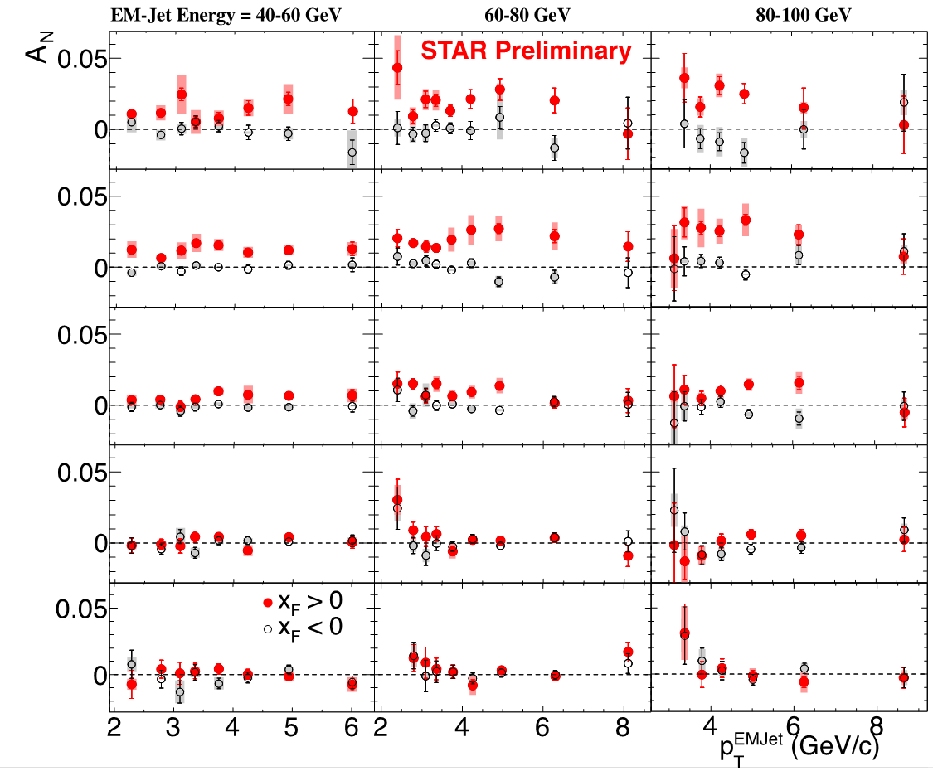









Event Topology
$$E_{jet}=40−60 \text{GeV}$$
$$60−80 \text{GeV}$$
$$80−100 \text{GeV}$$
$$\sqrt{s}=500 \text{GeV}$$
$$1γ$$
$$2γ$$
$$3γ$$
$$4γ$$
$$5γ$$

Slide 15
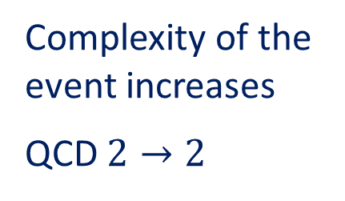
Event Topology
Complexity of the event increases
QCD $2→2$

Slide 16
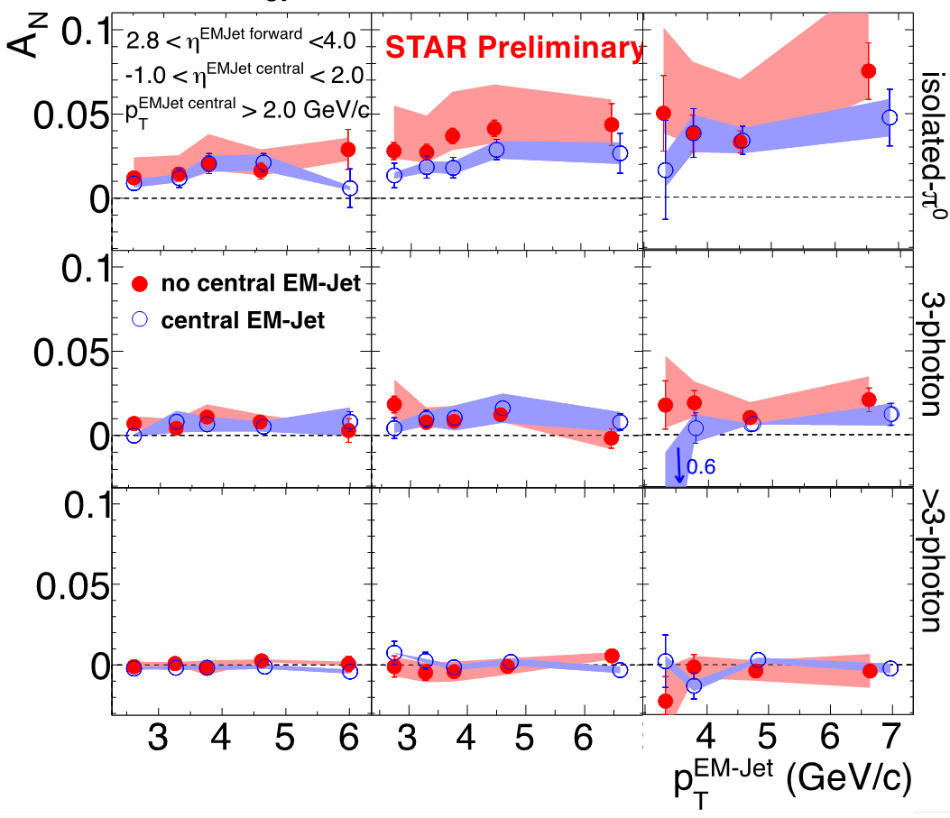
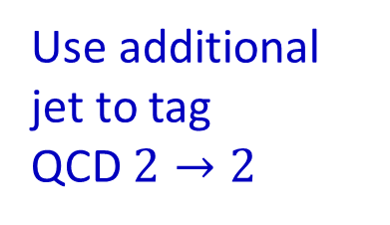





Jet Event Topology
$$E_{jet}=40−60 \text{GeV}$$
$$60−80 \text{GeV}$$
$$80−100 \text{GeV}$$
Use additional jet to tag
QCD $2→2$
Forward-central correlation:
EMC
FMS
$$2.8<η<4.0$$
$$−1.0<η<2.0$$

Slide 17

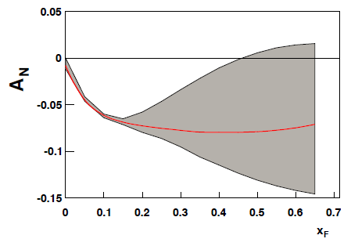
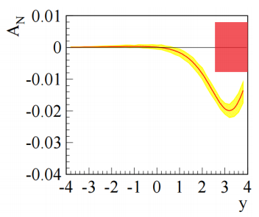

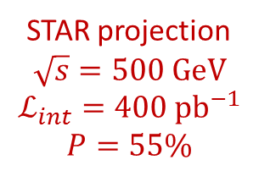

Factorization & Universality
Drell-Yan
Compare SIDIS and Drell-Yan production
expect a sign-change in the asymmetry from spin-orbit correlations
Non-universality of Sivers function (and others)
SIDIS
STAR projection
$$\sqrt{s}=500 \text{GeV}$$
$$ℒ_{int}=400 {\text{pb}}^{−1}$$
$$P=55\%$$
$$\sqrt{s}=500 \text{GeV}$$
$$4 <Q<9 \text{GeV}/c^{2}$$
$$0<q_{t}<1 \text{GeV}$$
w/o evolution
$A_{N,max}≈−0.$08
Phys. Rev. Lett. 110, 232301 (2013)

Slide 18
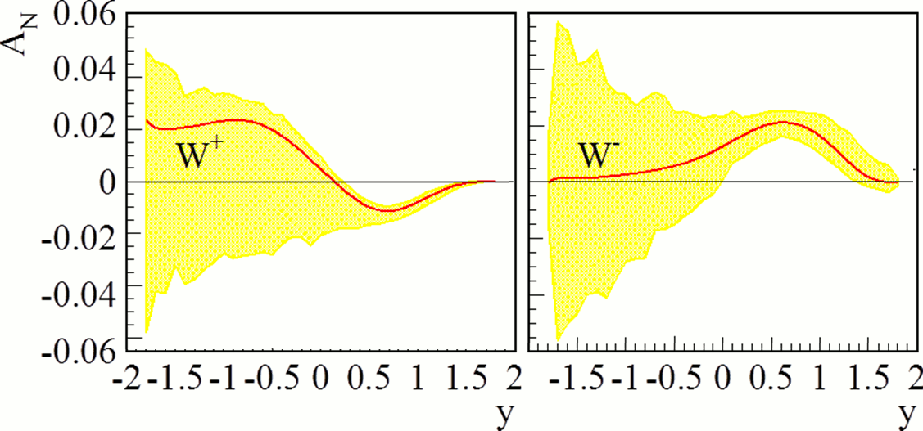
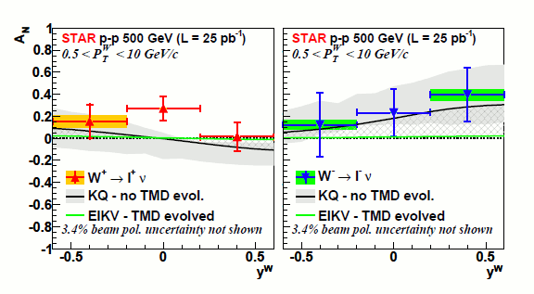
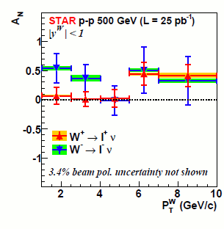
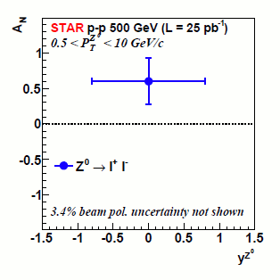


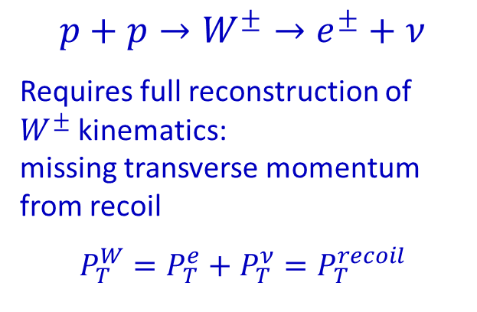
The Other Gauge Boson
w/o evolution $A_{N,max}≈0.3$
$$p+p→W^{±}→e^{±}+ν$$
Requires full reconstruction of $W^{±}$ kinematics:
missing transverse momentum from recoil
$$P_{T}^{W}=P_{T}^{e}+P_{T}^{ν}=P_{T}^{recoil}$$
arXiv: 1401.5078
$Z^{0}$ Bosons
arXiv: 1511.06003

Slide 19

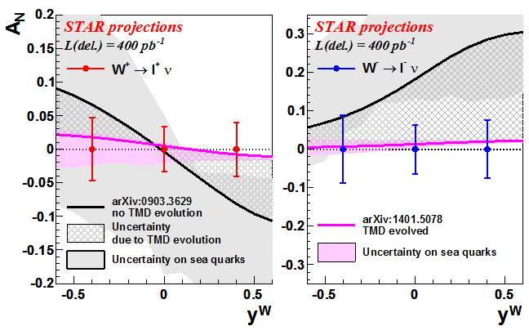
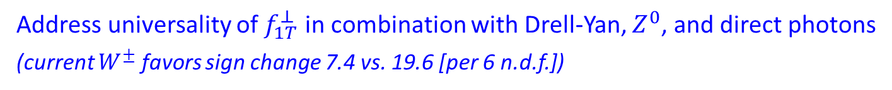
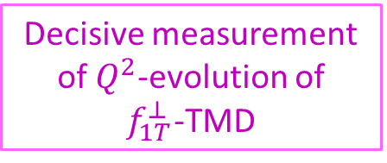
More W-Bosons in 2017…
DIS data
Decisive measurement of $Q^{2}$-evolution of
$f_{1T}^{⊥}$-TMD
Address universality of $f_{1T}^{⊥}$ in combination with Drell-Yan, $Z^{0}$, and direct photons
(current $W^{±}$ favors sign change 7.4 vs. 19.6 [per 6 n.d.f.])

Slide 20
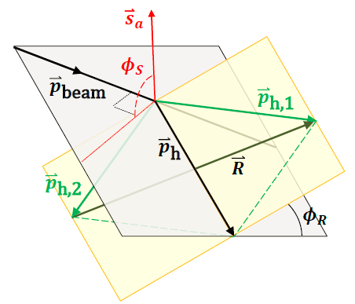
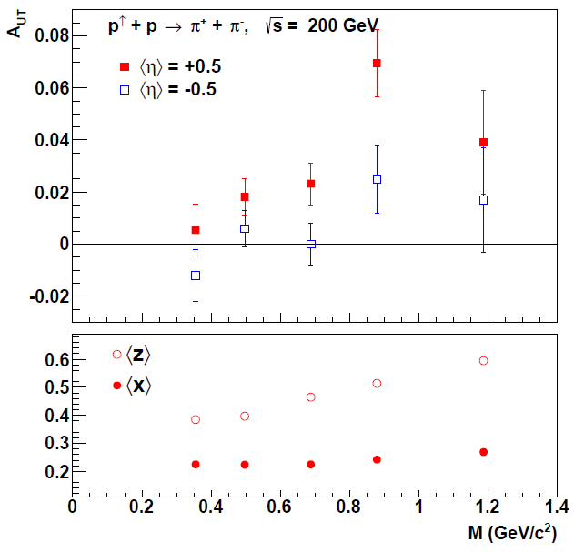
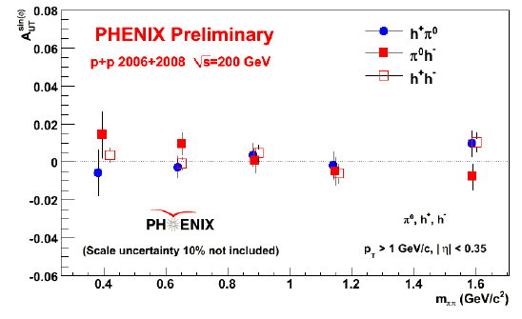
Di-Hadron Fragmentation
Collinear description with valid factorization
PRL 115, 242501 (2015)

Slide 21
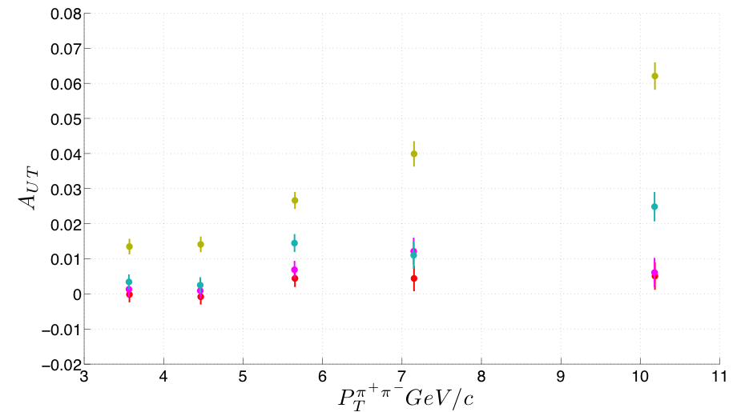






Di-Hadron Fragmentation 200/500 GeV
$$\vec{p}+p→π^{+}+π^{−}$$
$$\sqrt{s}=200 \text{GeV}$$
preliminary
$$η=0.84$$
$$η=0.25$$
$$η=−0.25$$
$$η=−0.84$$
$$\sqrt{s}=500 \text{GeV}$$
$$η>0$$
Much improved statistics
Large asymmetries at forward rapidities$→$ high-$x$
Combine with IFF results from $e^{+}e^{−}$ annihilation to extract transversity
preliminary

Slide 22



Asymmetries in Jets
With the STAR central barrel
Provides two scales that are necessary for TMD framework
$$h_{1}⊗H_{1T}^{⊥}$$
Largely unexplored high-$x$ region in $h_{1}(x)$
High-$p_{T}$ for reduced gluon contribution
Anti-$k_{T}$ algorithm ($R=0.6$)

Slide 23






$$x_{F}>0$$
$$x_{F}<0$$
$$j_{T} (GeV/c)$$
particle jet $p_{T} (GeV/c)$

Slide 24





Comparison 200/500 GeV
$$\sqrt{s}=200 \text{GeV}$$
$$\sqrt{s}=500 \text{GeV}$$
$${p+p→jet+π}^{+}+X$$
$${p+p→jet+π}^{−}+X$$
No strong effect of TMD evolution observed
Additional data at 200 GeV from 2015
Proposed run at 500 GeV in 2017
→ S. Bazilevsky
$$z$$

Slide 25






Direct Photons
PHENIX MPC-EX
STAR FPS/FMS
projection $\sqrt{s}=200 \text{GeV}$
projection $\sqrt{s}=500 \text{GeV}$
PRL 110, 232301 (2013)
PRL 110, 232301 (2013)

Slide 26





Cold Nuclear Matter
original $π^{0}$ projection
Polarized $\vec{p}+A$ collisions
Transverse asymmetries are sensitive to gluon saturation:
Phys. Rev. D84, 034019 (2011)
$$Q_{S}^{A}=A^{1/3}⋅Q_{S}^{p}$$
$$Q_{S}^{p}=1 \text{GeV}$$
(selective $x_{F}$-range)
→ R. Seto & C. Dilks

Slide 27



Summary
PROTON
universality
QCD
TMD
framework
transversity
TMD
evolution
factorization
spin-orbit
correlation
hard $2→2$,
diffraction
?
TMD evolution kernel needs empirical input
RHIC data at 200 and 500 GeV provides largest lever arm in $Q^{2}$
First results from 2008 and 2012, results from 2015 soon
Decisive measurements of $W^{±}$, Drell-Yan and $γ_{dir}$ expected from run 2017

Slide 28


Slide 29
Hydrogen Jet Polarimeter
Carbon Polarimeters
Siberian Snakes
PHENIX
Spin Flipper
STAR
Spin Rotators
Siberian Snakes
Tune Jump Quads
Polarized Source
Helical Partial Snake
LINAC
AGS
200 MeV Polarimeter
BOOSTER
Strong Snake
AGS pC Polarimeter

Slide 30


Goal for 2015: PHENIX $40 {\text{p}\text{b}}^{−1}$, STAR $50 {\text{p}\text{b}}^{−1}$

Slide 31




PHENIX
High resolution
High rate
DC / Pad Chambers
EMCal
Forward EMCal, $3<\left|η\right|<4$
STAR
Large acceptance
$$−1<η<2$$
TPC+TOF
EMCal
Forward EMCal, $2.5<η<4$

