Slide 1
Opportunities in hadron distribution inside the jet
Emerging Spin and Transverse Momentum Effects
in p+p and p+A Collisions
Brookhaven National Laboratory
February 8 - 10, 2016

Slide 2
Our field is in need of “new” data
Our field is mainly data-driven, and we are in need of “new” data
Theorists are usually “hungry”, if you are pouring “food” (data) to them, they will “bite” (at some point they will try their best to understand the existing data)
  This is what has been happening at LHC, huge amount of data of various kinds keep appearing, which has attracted almost all the attention of the entire high energy QCD community, to develop jets, jet substructure, heavy flavor, and new theoretical tools
  If we have man-power at RHIC, we should try our best to produce “NEW” data
Experimentalists at LHC tried their best to produce lots of data, in most cases, they simply compare with Pythia, as there are NO pQCD analysis/calculations available for them to compare
  One great example is hadron distribution inside the jet
  Read their introduction, they have great intuitive motivation, but not necessarily great first-handed/detailed theoretical motivation
  But the data are still beautiful, 3 or 4 years later, the pQCD theory starts to appear that describe the data

Slide 3
Hadron distribution inside the jet
Study a hadron distribution inside a fully reconstructed jet
The 1st observable is like collinear fragmentation function, while the 2nd observable is more like a TMD fragmentation function
Without knowing any theories about TMD evolution at all, LHC did a great deal of all kinds of measurements, and compared with Pythia simulation
jet
h

Slide 4
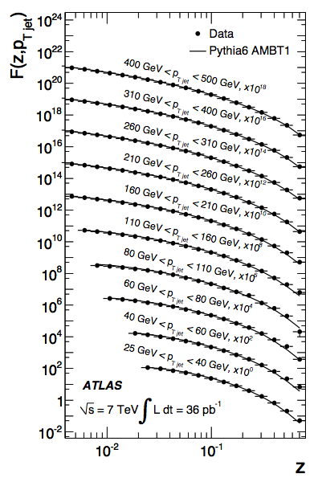
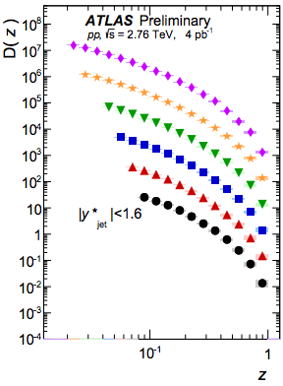
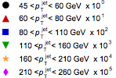
Collinear z-dependence: light hadron
ATLAS measurements at 7 TeV and 2.76 TeV
1109.5816, ATLAS-CONF-2015-022
Light hadron

Slide 5
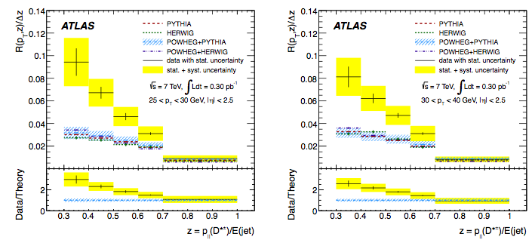
Collinear z-dependence: heavy meson
D meson production inside a jet
ATLAS, arXiv:1112.4432

Slide 6
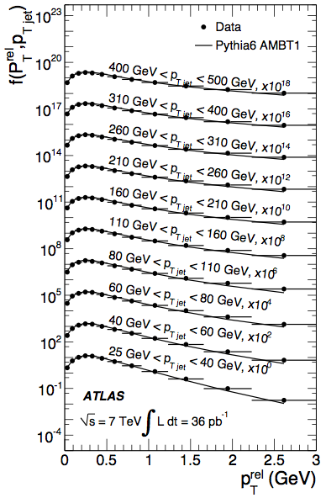
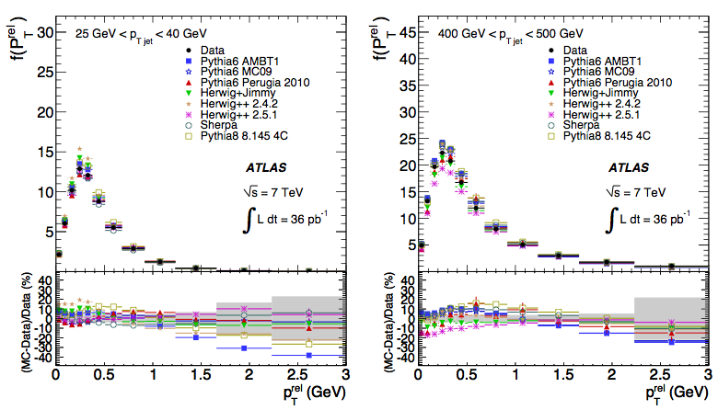
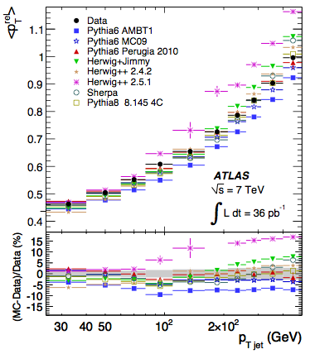
Relative momentum j_{T} dependence
j_{T} shape does not change much: how to link to TMD evolution
1109.5816
Based on Echevarria, Idilbi, Kang, Vitev, 14

Slide 7
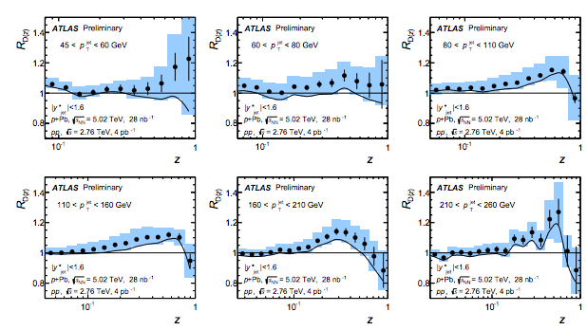
Nuclear dependence
Hadron distribution inside the jet has also been studied for p+Pb collisions
ATLAS-CONF-2015-022, also CMS

Slide 8
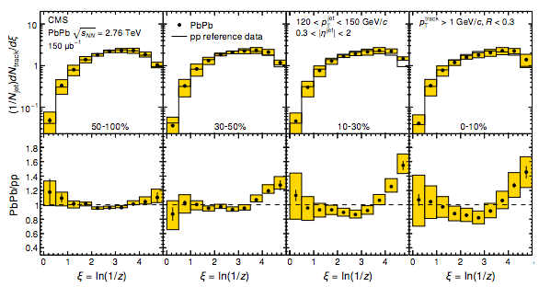
Jet fragmentation function in heavy ion collisions
Modification of jet fragmentation function in heavy ion collisions provide useful information about parton shower/QCD dynamics in the hot medium
CMS, arXiv:1406.0932

Slide 9
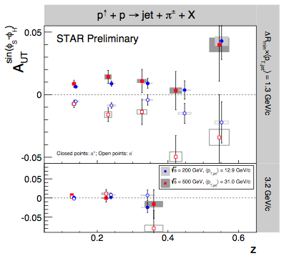
RHIC measurements
Hadron azimuthal distribution inside the jet in transversely polarized p+p collisions: spin dynamics
STAR, in arXiv:1501.01220

Slide 10
Question
Are we able to understand these data in a quantitative/precise way using perturbative QCD?
Yes, we can. At least gradually

Slide 11
Hadron distribution inside a jet
Jet fragmentation function studies at NLO
Fragmenting jet function within SCET
Jet fragmentation function in p+p using SCET: both light hadron and heavy meson
Jet fragmentation function in p+A, e+A, and A+A collisions
Hadron azimuthal distribution inside a jet:
  Sivers asymmetry
  Collins asymmetry
Arleo, Fontannaz, Guillet, Nguyen 14 (MC type)
Kaufmann, Mukherjee, Vogelsang, 15 (analytic using small-cone)
Procura, Stewart 10; X. Liu 11; Jain, Procura, Waalewijn 11&12; Bauer, Mereghetti 14
Chien, Kang, Ringer, Vitev, Xing, 1512.06851, see also closely related work by Hornig, Leibovich, Mehen, et.al.
Chien, Kang, Ringer, Vitev, Xing, in preparation
D’Alesio, Gamberg, Kang, Murgia, Pisano, PLB 11
Kang, Ringer, Prokudin, Sun, Yuan, in preparation

Slide 12
Jet fragmentation function using SCET
Factorized formalism in SCET
Two quantities: FJF and jet function
  Jet function can be computed order by order using SCET
  Fragmenting jet function can be expanded in terms of standard fragmentation function: both are dominated by the collinear phase space
Stewart et.al. 10; Waalewijn et.al. 11&12
Chien, Kang, Ringer, Vitev, Xing, arXiv:1512.06851

Slide 13

Fragmenting jet function: perturbative calculation
Quark-to-quark fragmenting jet function and fragmentation function
Matching coefficient
UV-divergence leads to RG running
IR-divergence matches onto standard FF

Slide 14
Resummation and RG running
RG equation
Solution
Anomalous dimension
RG running resums ln(R)-dependence
Ellis, Vermilion, Walsh, Hornig, Lee, 10
Jet fragmentation function is RG-invariant = independent of QCD evolution

Slide 15
Jet fragmentation function at LHC
Perfectly describe the data: no free parameters
  CT14 PDFs + DSS07 FFs for light hadron
Chien, Kang, Ringer, Vitev, Xing, arXiv:1512.06851

Slide 16
Large z resummation: hadronic threshold resummation
we will resum both ln(R) and ln(1-z), and we find that the theory uncertainty is reduced
Choose
See also Procura, Waalewijn 12

Slide 17
Jet fragmentation function for D meson
Highly sensitive to gluon-to-D fragmentation, test gluon energy loss
D meson
Chien, Kang, Ringer, Vitev, Xing, arXiv:1512.06851
Enhance gluon fragmentation
Using zero-mass-variable-number-flavor scheme (ZM-VNFS)
D-meson fragmentation function is fitted from e+e- data
Collins, Tung, 86
Kneesch, Kniehl, Kramer, Schienbein, 08

Slide 18
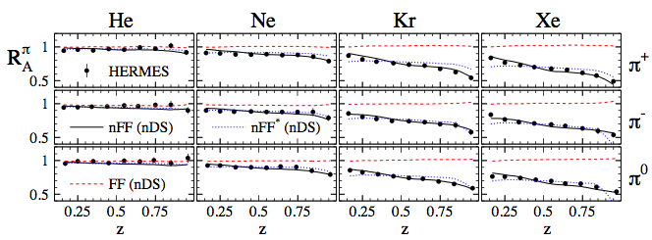

Nuclear modification of fragmentation function
Earlier evidence for nuclear modification of hadronization process
Insensitive to nuclear PDFs
HERMES, 0704.3270

Slide 19

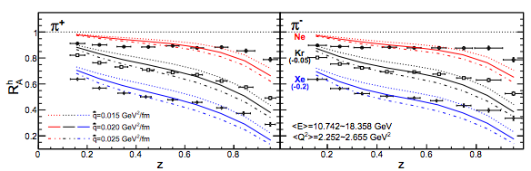
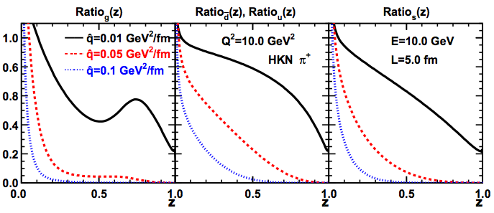
Two models describe the data
Parton energy loss in cold nuclear matter leads to an effective change of the fragmentation function
Chang, Deng, Wang, PRC 14
Deng, Wang, 10

Slide 20
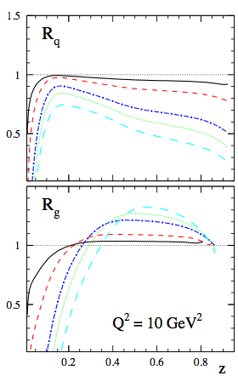
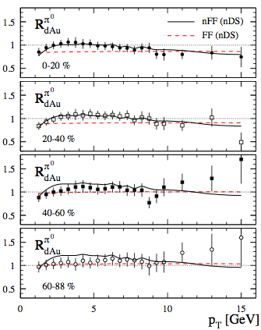

Fragmentation function in nuclei
Phenomenological model of Sassot, Stratmann, Zurita: global fitting of SIDIS as well as d+Au RHIC data
Sassot, Stratmann, Zurita, 0912.1311

Slide 21
Jet fragmentation function in p+A
Nuclear dependence at RHIC 200 GeV using nuclear FFs
  Seems to follow the feature of p+Pb at LHC
  Will see how energy loss picture works out
Kang, Ringer, Vitev, Xing, in preparation
Thanks to Marco Stratmann for nFFs

Slide 22
Looking into j_{T} dependence: Collins asymmetry
If we start to look into j_{T} and/or azimuthal dependence, so far there are some parton model calculations, i.e., treat the jet as leading parton, no QCD evolution yet
  One could study Collins azimuthal spin asymmetry
  Test the universality of Collins function
Collins functions have been shown to be universal between SIDIS and e+e- by Metz and Collins, later generalized to p+p by Yuan
Yuan, 08
h
jet
Metz 02, Collins, Metz 04, Yuan 08

Slide 23
Collins function: universal?
jet
Collins azimuthal asymmetry for hadron inside the jet
h
Kang, Prokudin, Ringer, Sun, Yuan 16
See talk by Prokudin in the morning

Slide 24
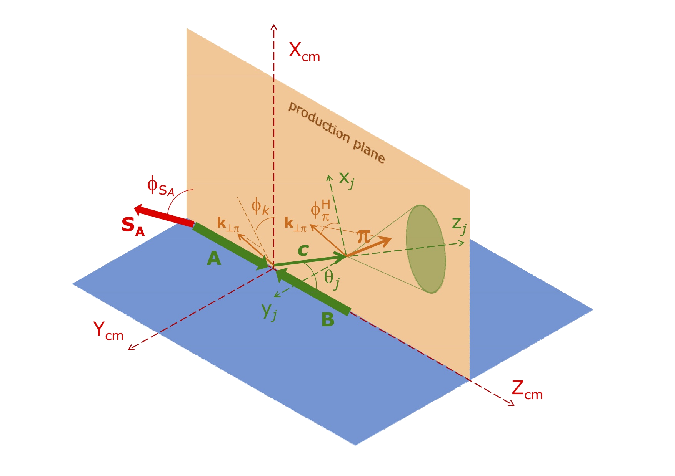
Further add k_{T}-dependence on PDF side
If one assumes both incoming proton and final produced hadron have k_{T}-dependence, there are more azimuthal correlations that can be probed, e.g., Sivers asymmetry
  Can be used to test the process-dependence of the Sivers function
Process-dependence due to initial-state and final-state interactions can be taken into account in as in
Otherwise if process-independent, then simply use the unpolarized hard part
Gamberg, Kang, 1009.1936, PLB
D’Alesio, Furgia, Pisano, 1011.2692, PRD
D’Alesio, Gamberg, Kang, Furgia, Pisano, 1108.0827, PLB

Slide 25
Process-dependence of the Sivers function
Estimate of the Sivers asymmetry for hadron inside the jet
GPM = w/o process-dependence for Sivers function
CGI = w/ process-dependence for Sivers function

Slide 26

Summary
Quite some interesting questions can be studied through hadron distribution inside the jet
  Collinear z-dependence for both light hadron and heavy meson in p+p, p+A, and A+A collisions
  j_{T}-dependence as well as azimuthal distribution of hadrons inside the jet can test non-trivial TMD-type evolution, and spin dynamics, needs further developments
These questions are not only interesting to our community, but also interesting to others such as heavy ion community
Future RHIC program on this physics is documented in “RHIC old QCD plan”
Thank you!

Slide 27
Backup

Slide 28
A bit on jet algorithms
  Different jet algorithms will lead to different matching coefficients, since they give different constrain on the jet mass
cone
anti-kt

Slide 29
Jet parameter R and algorithm dependence
Related to DGLAP evolution of the collinear FFs
cone
anti-kt

