Slide 1
Designing the eRHIC Detector
William Foreman
Anders Kirleis
BNL – August 2009

Slide 2
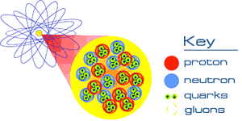
So why do we use colliders?
A major goal of physics is to understand the basic building blocks of all matter
  and the pieces that make up those building blocks
    and the pieces that make up those pieces…
      and those pieces… etc…
How did we reach this understanding?
  By smashing things together.

Slide 3
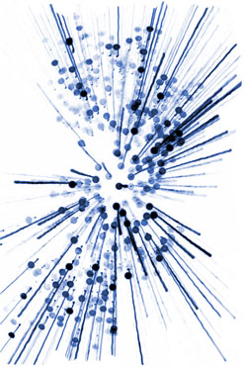
So why do we use colliders?
Proton
Proton
At collision, energy is converted to mass and particles are created
By studying the particles that fly out of these collisions, we can make inferences about the internal structure of the original particles

Slide 4
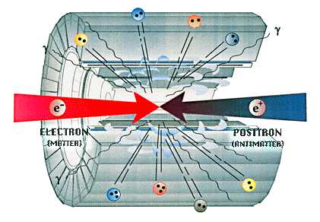
So why do we use colliders?
Large detectors are built to “see” these particles and measure their energy and direction
http://universe-review.ca/R15-20-accelerators.htm

Slide 5
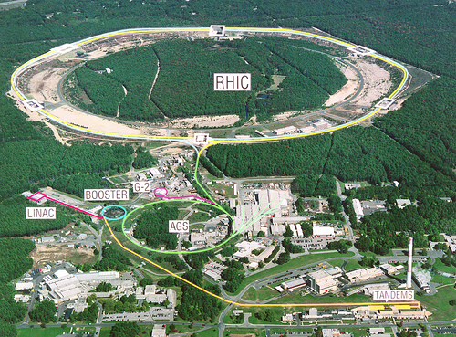
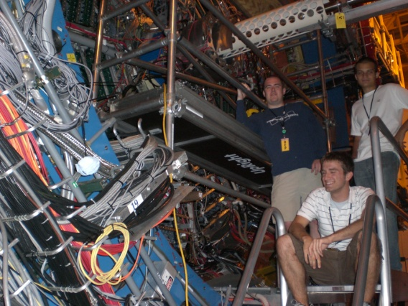
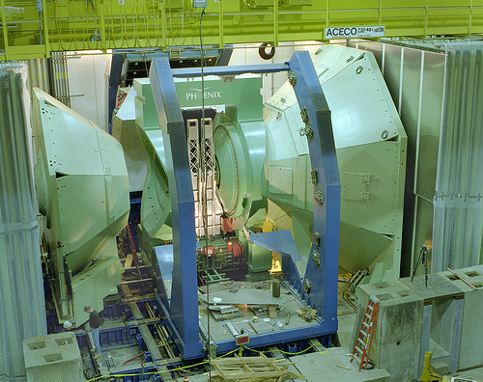
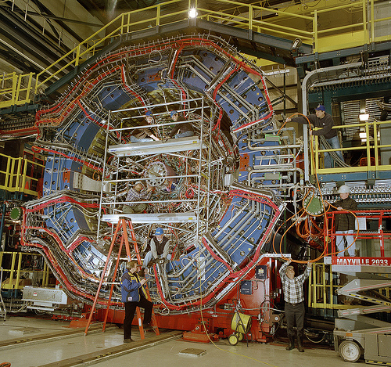
What we have now…
Relativistic Heavy Ion Collider (RHIC)
  Accelerates & collides ions (p, d, …, Au)
http://www.flickr.com/photos/brookhavenlab
PHENIX
STAR

Slide 6
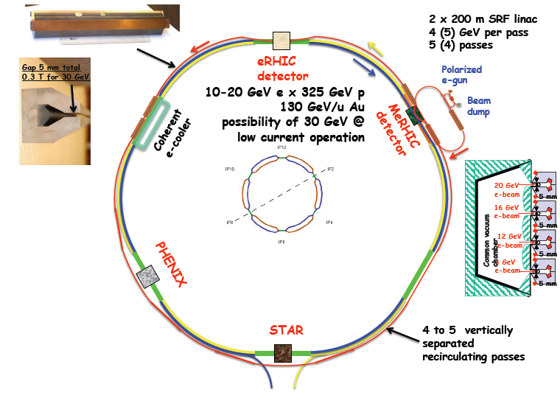
What we want…
Electron Relativistic Heavy Ion Collider (eRHIC)
  An upgrade to RHIC allowing for electron-ion collisions

Slide 7
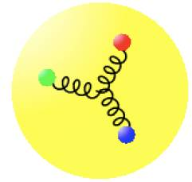
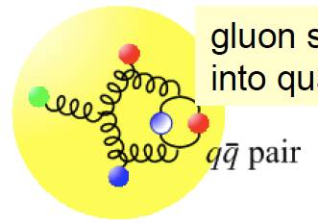
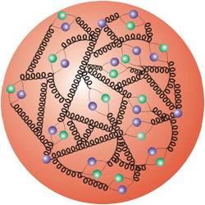
Why use electrons?
Electron scattering provides the best way to look at the distribution of gluon densities
  Electron is considered a “point particle”; interacts electromagnetically with proton (+/-) and doesn’t modify the wave function like a hadronic probe would
Three quarks held together by gluons
Some physicist lingo on the importance of high energy:
Gluon splits into “sea quarks”
Q² = virtuality of exchanged gauge boson in collision
Higher Q² equals smaller virtual boson wavelength
At smaller wavelengths, we can probe smaller partons
Quarks split into gluons split
into quarks …
Increasing Resolution (higher Q²)

Slide 8
Designing a Detector
What we need to know:
  The types of particles produced in electron-ion collisions
  Multiplicity of particles (how many?)
  Where these particles go after a collision (angle and direction)
  The momentum/energy these particles have
Scattered Electron
Proton
Electron
Particle X

Slide 9
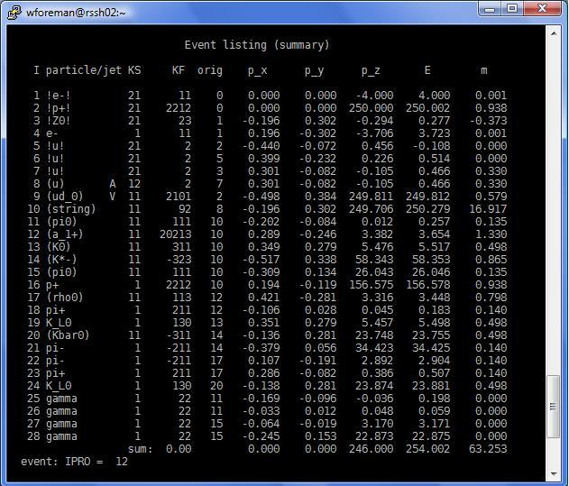
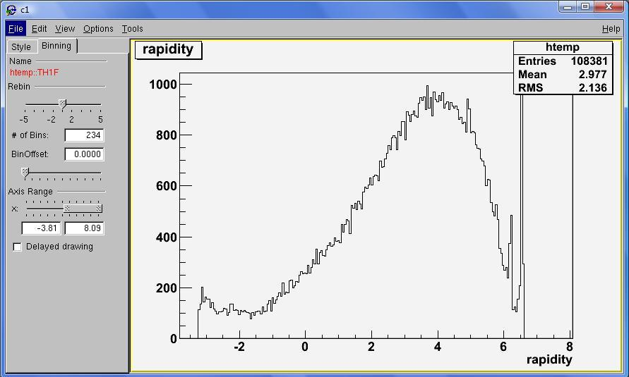
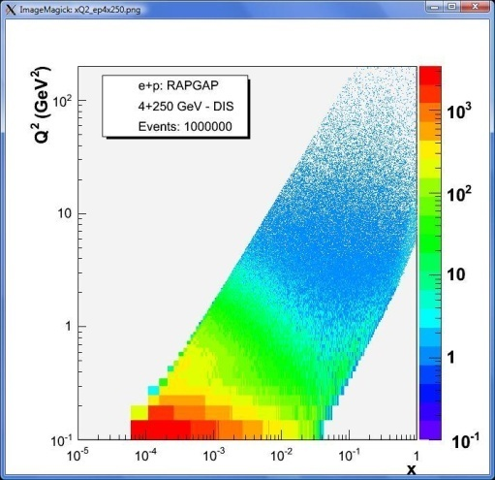
Designing a Detector
So where do we get all this information?
  Computer simulations!
Monte-Carlo Simulator
  Random sampling used to create output data distributions that mimic what is seen in real experiments
  RAPGAP simulates millions of e+p collisions
  Data output is read by C++/ROOT codes to produce plots

Slide 10
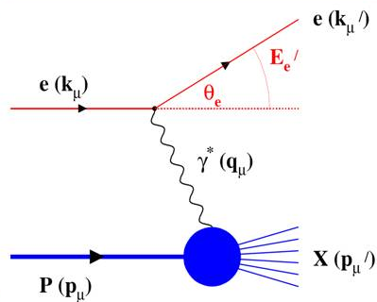
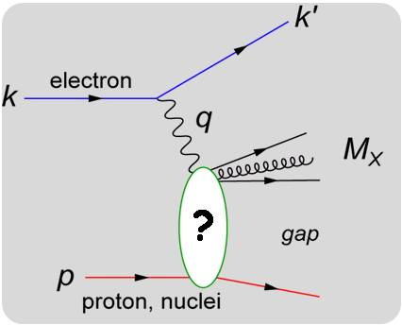
Deep Inelastic Scattering vs. Diffractive Scattering
Deep Inelastic Scattering (DIS):
A lepton (electron) interacts with a parton (quark/gluon) inside the proton and is scattered at angle θ_{e} with energy E_{e}’, proton fragments
Diffractive Scattering:
The proton remains intact during the collision and a “rapidity gap” is seen in which no particles are ejected
It is important to understand these differences so in a real experiment we can find out which process occurred based on the data we collect.

Slide 11

Making Plots and Interpreting Data…

Slide 12
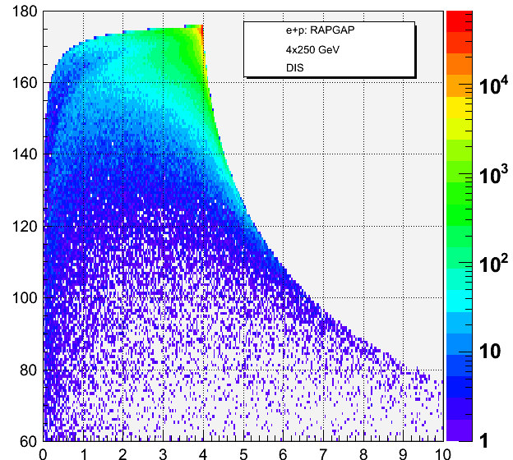
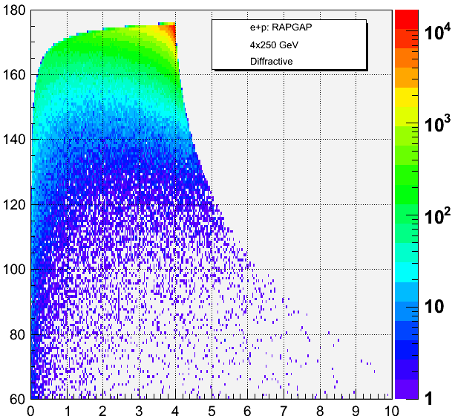
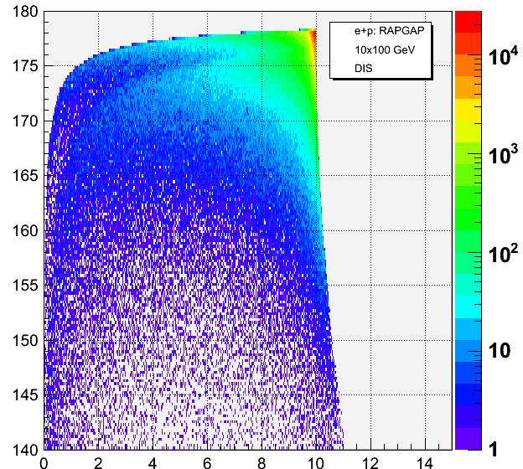
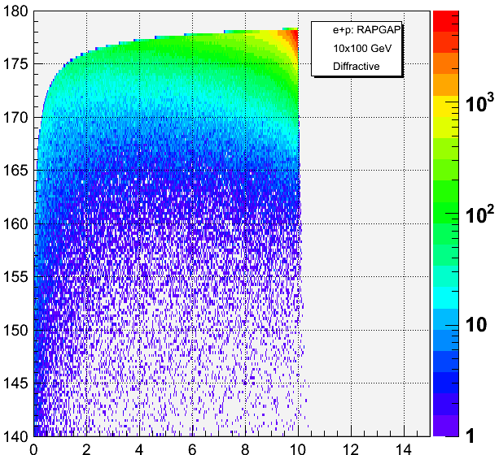
Momentum vs. Theta of Scat. Electron
4+250 GeV
DIS
4+250 GeV
Diffractive
What we do:
  Edit codes so only information for certain particles are plotted, both in DIS and diffractive
60º - 180º
Theta (degrees)
What we see:
  Differences between DIS and diffractive events
  Different angle & momentum distributions depending on electron + proton energies
140º - 180º
10+100 GeV
DIS
10+100 GeV
Diffractive
Momentum (GeV/c)

Slide 13
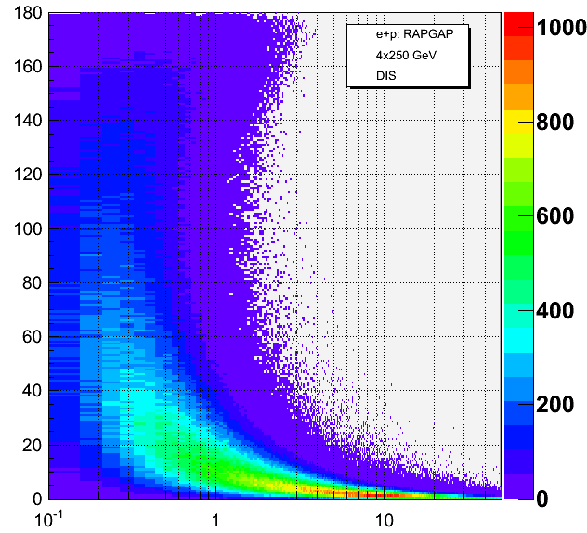
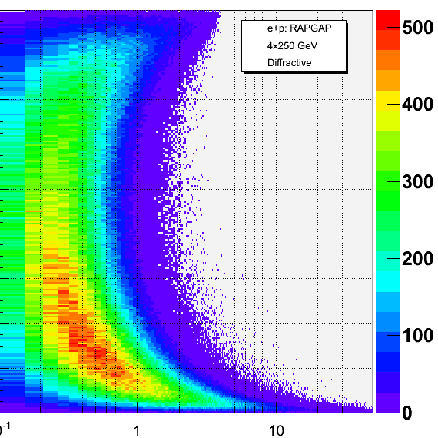
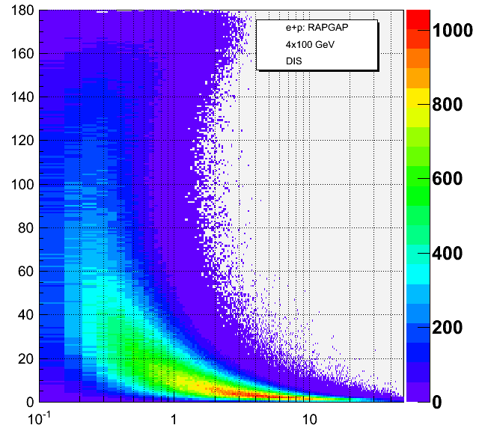
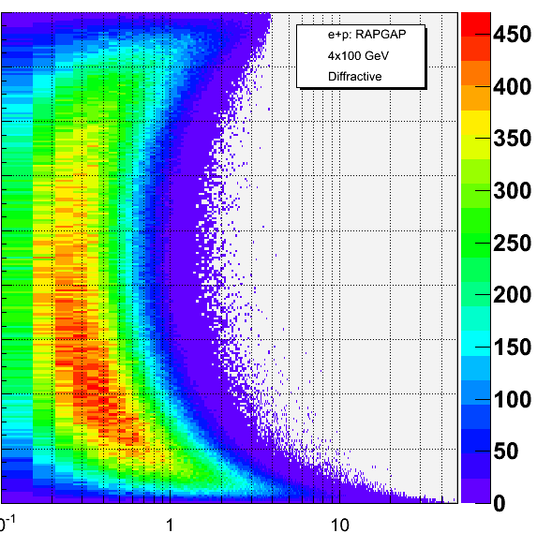
π⁺ Momentum vs. Angle
4+250 GeV
DIS
4+250 GeV
Diffractive
What we see:
  Angles at which pions are projected for different energies in both DIS and diffractive events
  In DIS events, pions tend to be sent at much smaller angles compared to diffractive events
0º - 180º
Theta (degrees)
10+100 GeV
DIS
10+100 GeV
Diffractive
0º - 180º
We use this information to design the detector!
Momentum (GeV/c)

Slide 14
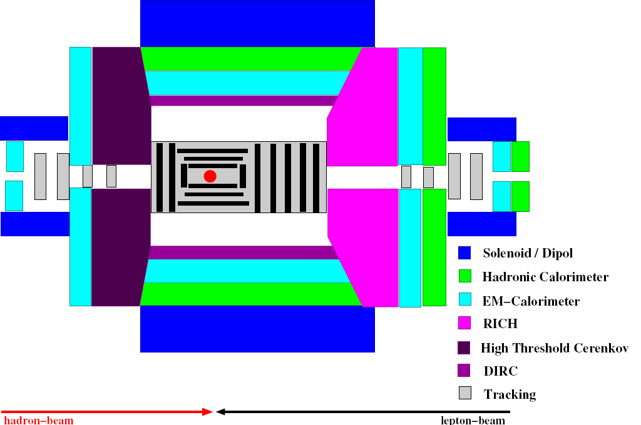
Designing the eRHIC Detector
Rough diagram of what we need:
Collision point
Forward tracking
Backward tracking

Slide 15
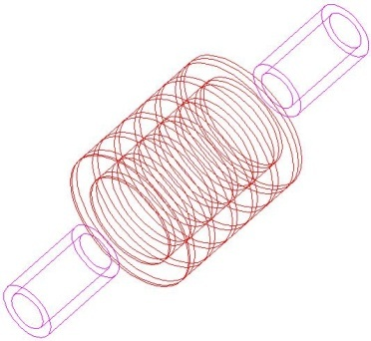
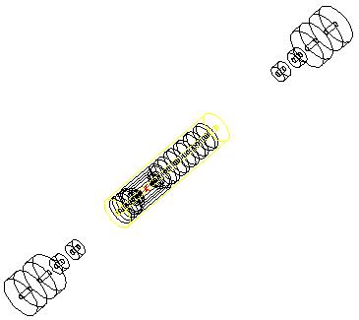
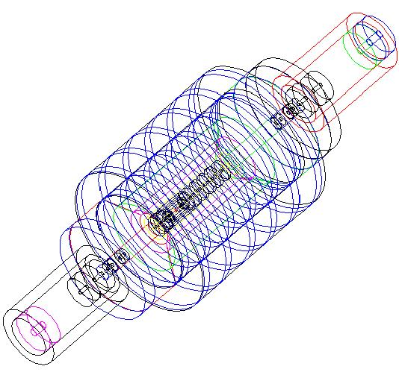
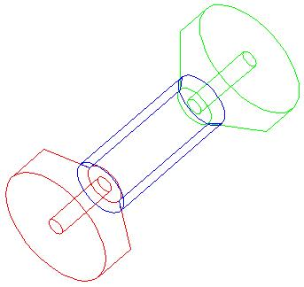
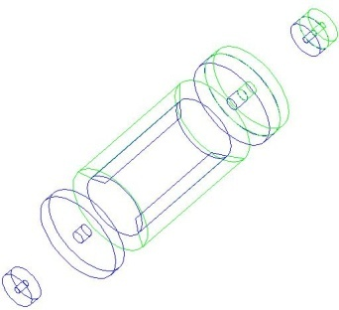
Designing the eRHIC Detector
We used a program written in Geant3 to design a virtual eRHIC detector geometry replicating current diagrams & estimations
Magnets
Tracking
Particle Identification
Calorimeters
Anders Kirleis

Slide 16
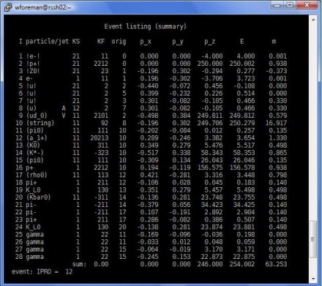



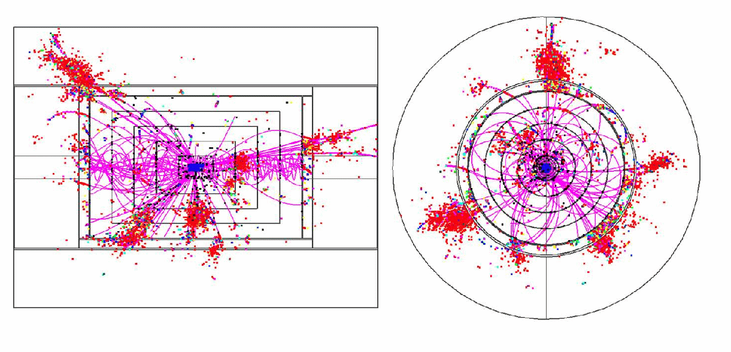
Future Plans
Emulate a magnetic field in our detector
Data from RAPGAP will be run through this virtual detector and we can determine where particles are being sensed
Ultimate goal: design a detector best suited for our target energies
http://nicadd.niu.edu/research/lcd/images/pfa/figure5a.gif

Slide 17
Thank you
Acknowledgements:
Matt Lamont & Elke-Caroline Aschenauer
Anders Kirleis
Abhay Deshpande
Michael Savastio
Physics Department of BNL
OEP Staff

