Slide 1
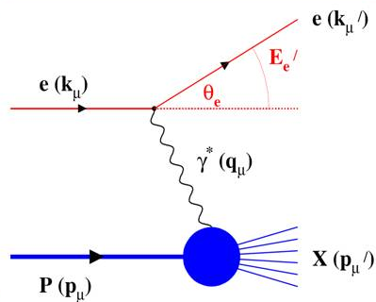
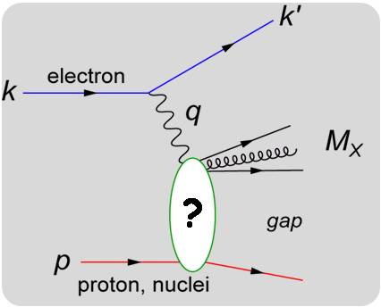
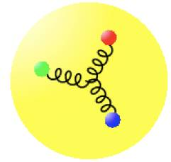
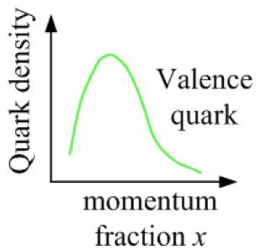
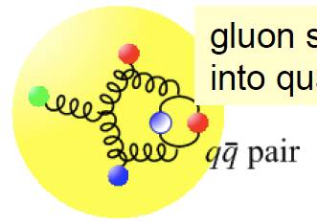
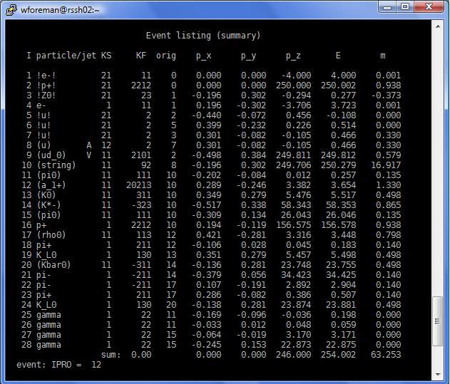
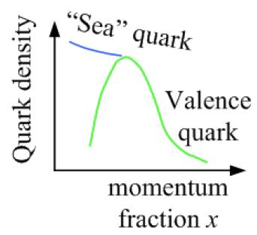
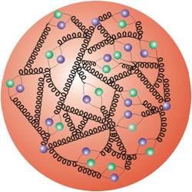
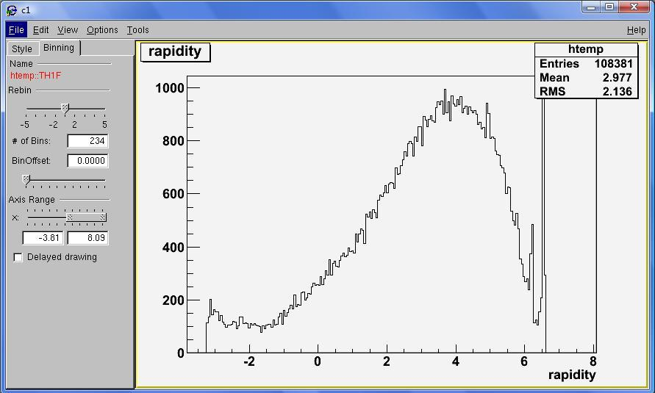
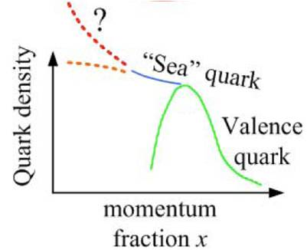
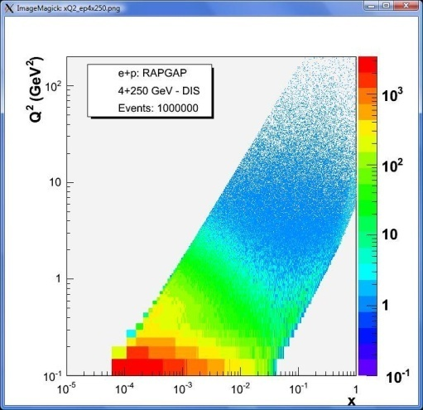
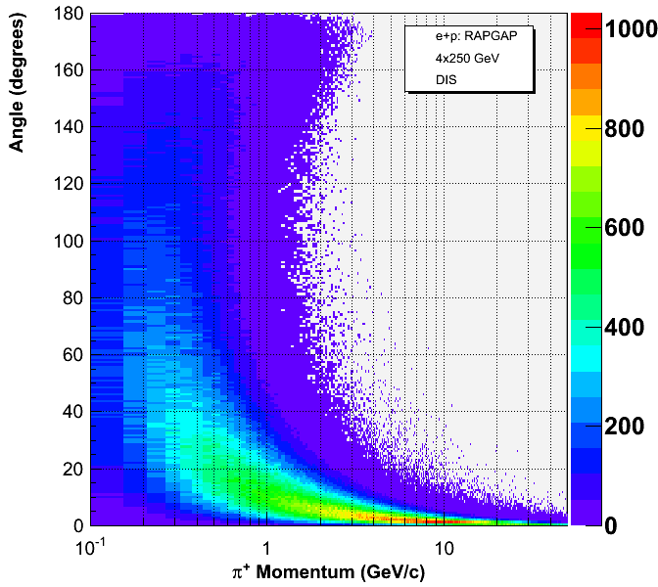
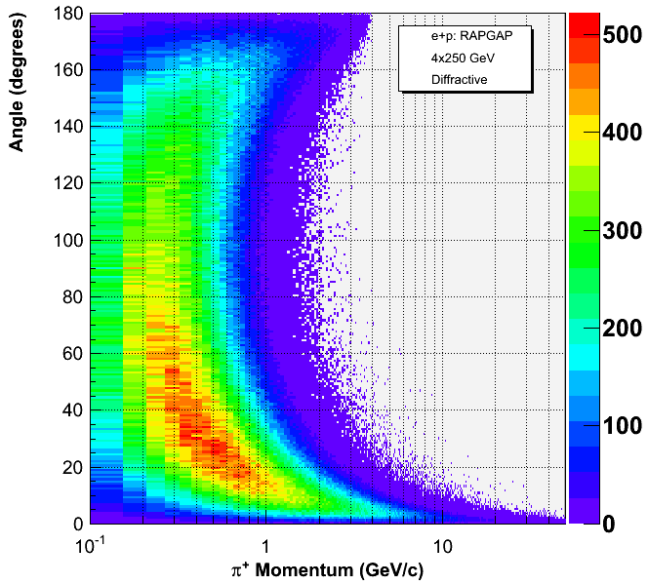
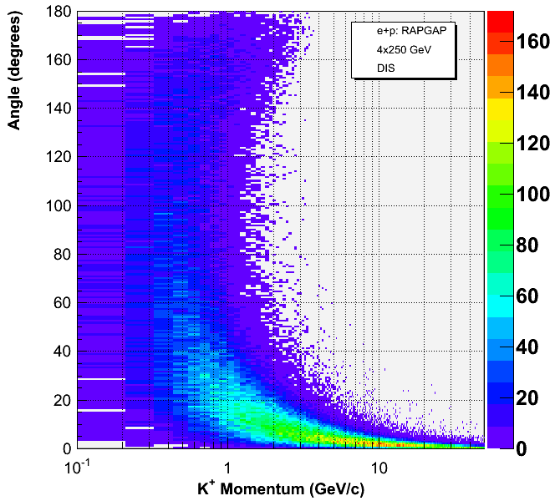
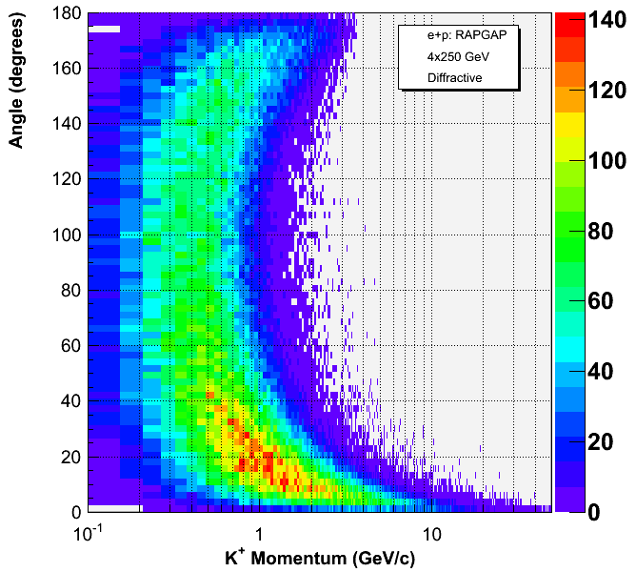
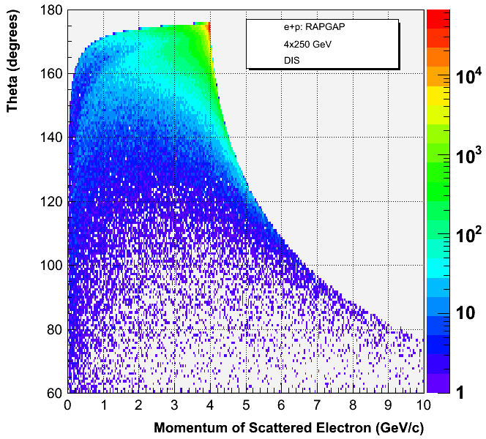
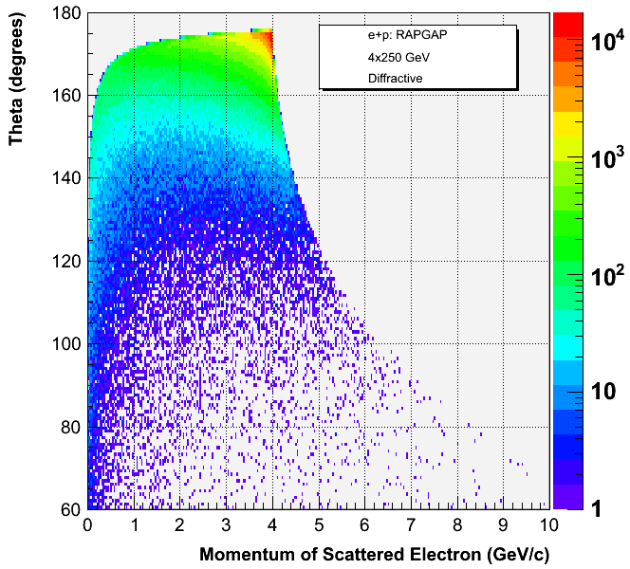
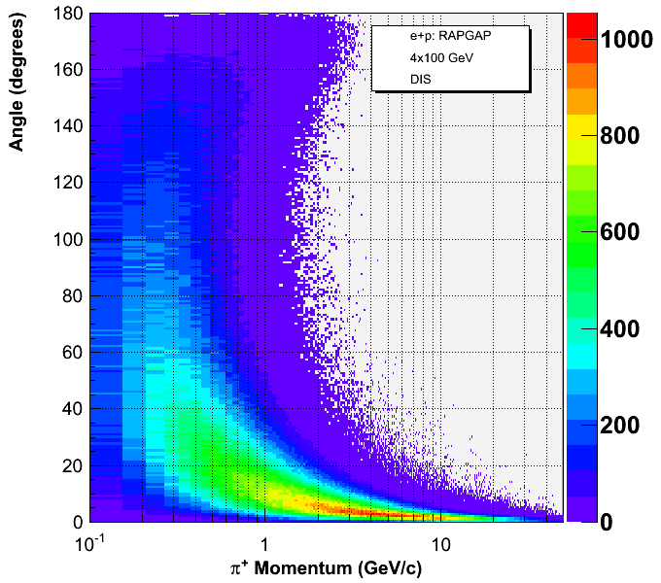
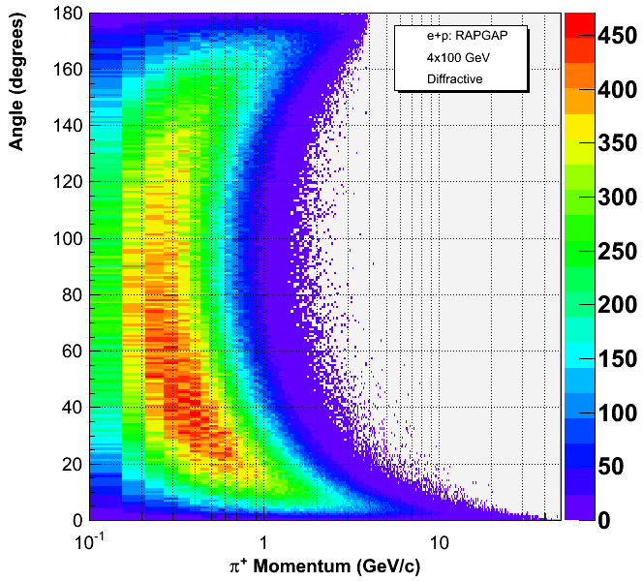
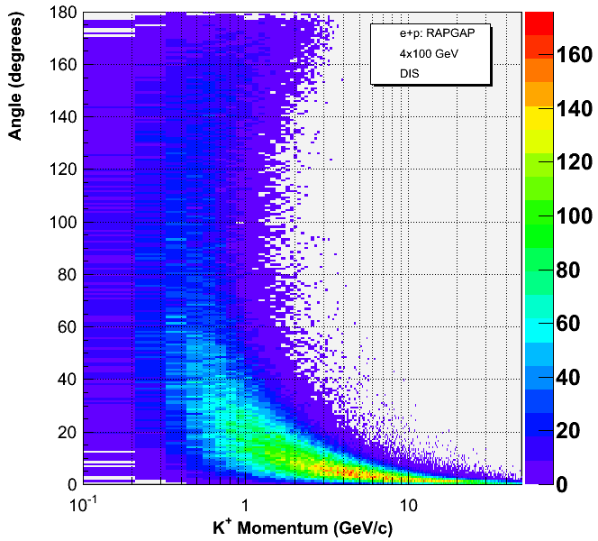
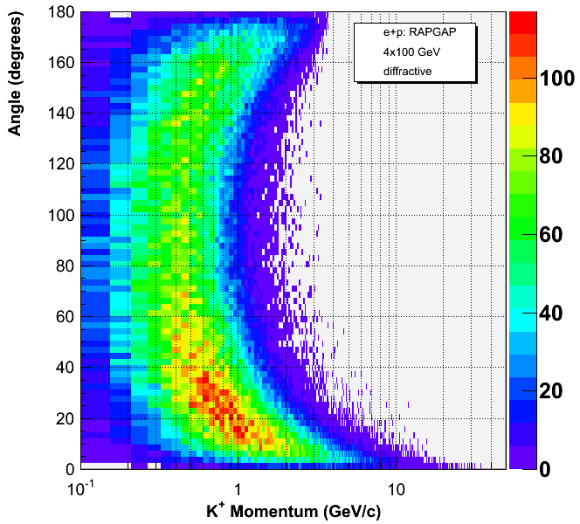
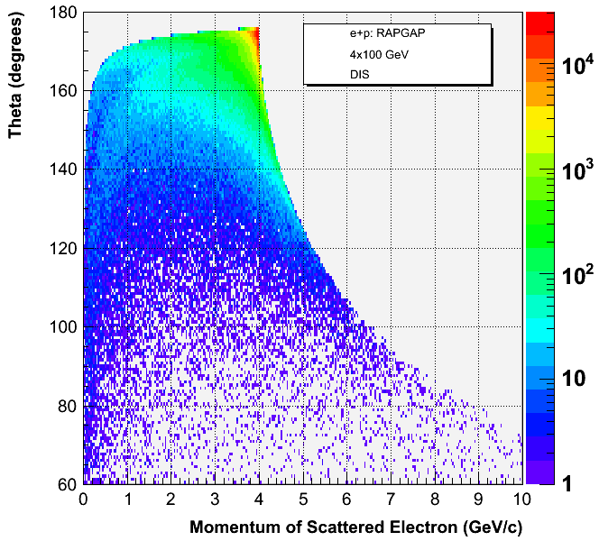
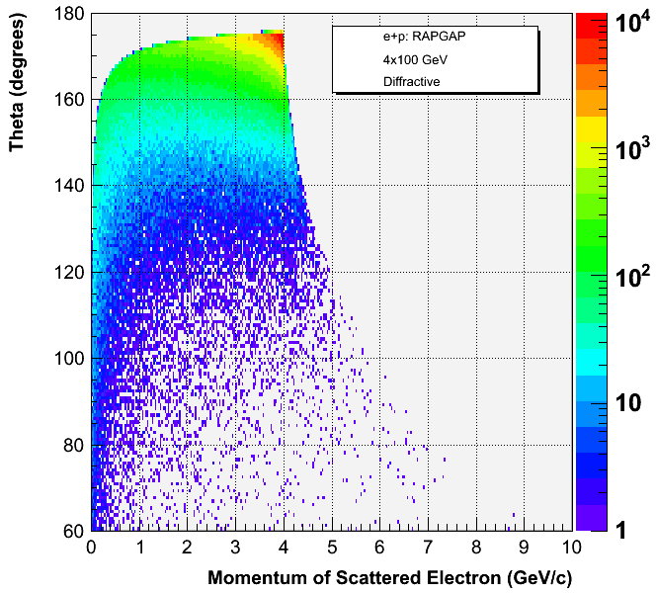
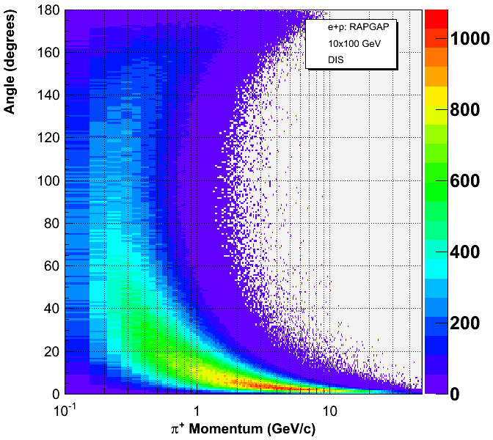
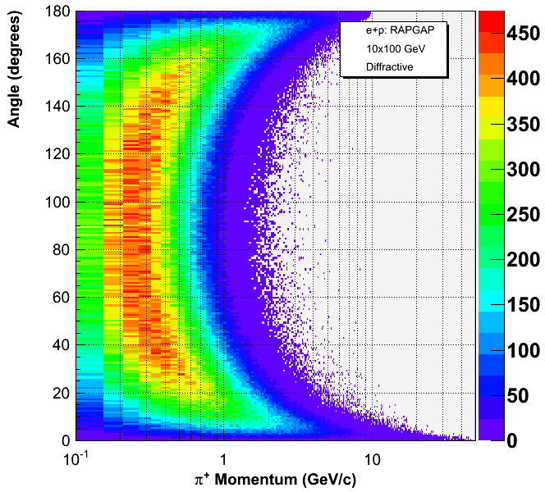
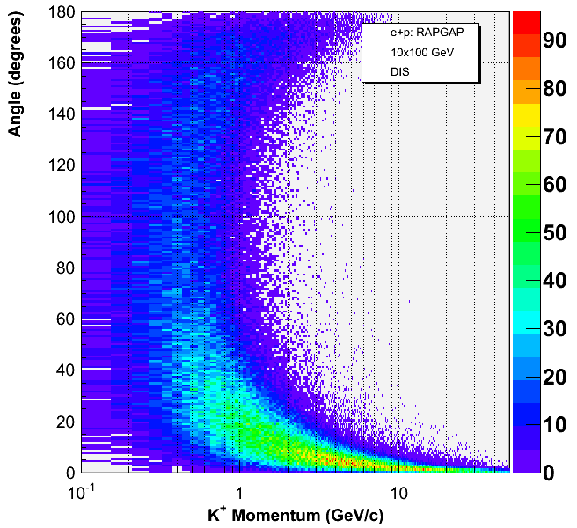
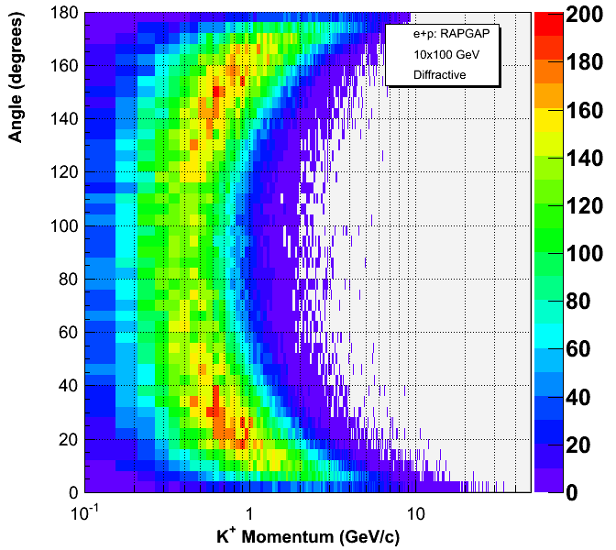
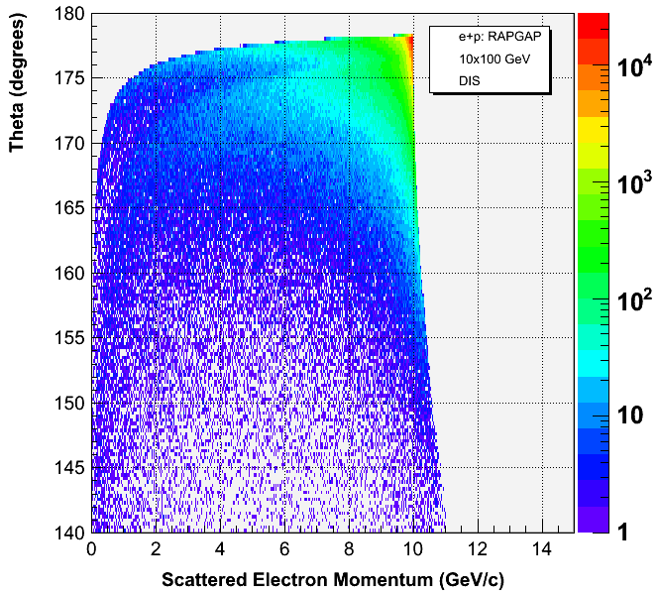
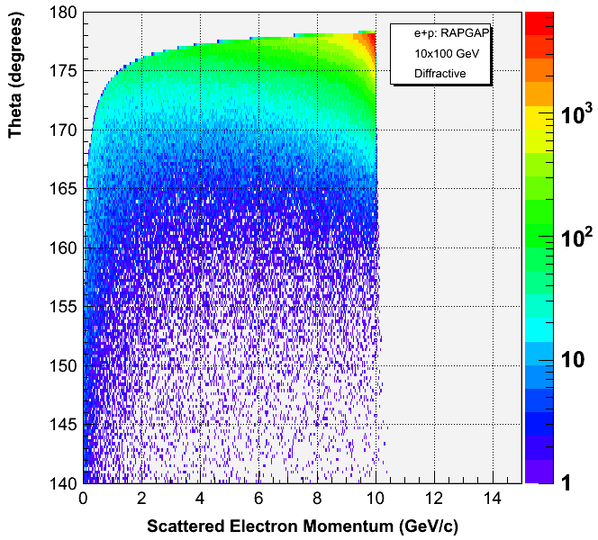






The Electron Relativistic Heavy Ion Collider:
Designing a Detector Using Simulated e+p Data Analysis
William M. Foreman¹, Anders Kirleis¹, Matthew Lamont², and Elke-Caroline Aschenauer²
¹ SUNY at Stony Brook, Stony Brook NY 11790 & ²Physics Department, Brookhaven National Laboratory, Upton, NY 11973
August 2009
Abstract
Deep inelastic scattering (DIS) and diffractive scattering are used to probe the internal structure of hadrons in accelerator physics. During the design of experiments, such high-energy processes are simulated using Monte-Carlo (MC) event generators such as RAPGAP which use random numbers to rapidly replicate the complex interactions in such collisions.
New information from these simulations is needed to design a detector for the proposed Electron Relativistic Heavy Ion Collider (eRHIC) at Brookhaven National Laboratory (BNL), set to be completed by 2020. Millions of electron-proton (e+p) collision data events were produced by RAPGAP, simulating both DIS and diffractive collisions at energies of 4 on 100, 4 on 250, 10 on 100, 10 on 200, 10 on 250, and 20 on 250 GeV, after which C++ code using intrinsic ROOT functions was edited and run to read the data, calculate kinematic variables, and organize the results into a data tree. Additional ROOT codes were modified to produce customized plots to visually represent the massive amounts of data and to help understand the realistic quality of the simulator. Over time these codes can be easily modified to plot information as needed, and can be applied to newly produced MC generator data simulating collisions between electrons and heavy ions.
Significant differences were found between DIS and diffractive physics in the distribution of momentum and scattering angle for electrons, pions, and kaons. From these results comes a better understanding of these intricate processes, and by knowing where particles go after a collision along with the energy they carry, estimates of exact positions and spatial dimensions of various particle-sensitive devices around the collision point can be better determined.
Such information is vital in designing an eRHIC detector at BNL that will most effectively collect useful and groundbreaking data in future experiments.
Deep Inelastic Scattering (DIS)
Diffractive Scattering
A high-energy electron (e) interacts with a parton (quark or gluon) through an exchange particle called the virtual photon (ɣ). E’ is the scattered electron and X is the resulting particle shower.
In diffractive events, the proton (p) remains intact and there is typically a “rapidity gap” in which no particles are radiated from the collision.
Three quarks held together by gluons
Data Simulation
We used RAPGAP to simulate millions of e+p collisions and produced data listings showing the parent particle, momentum components, energy, and mass of each particle for every event.
Larger angle scattering
Increasing Resolution
Gluon splits into “sea quarks”
Quarks split into gluons split
into quarks …
Macros written in C++/ROOT organize this output into a data tree and produce plots.
At larger energies we “see” the proton in greater detail and can study the behavior of quarks in the low-x regime.
Results for Pi⁺ & K⁺ Momentum vs. Angle Distributions
Results for E’ Momentum
vs. Theta Distributions
Pions
- Diffractive events produce a larger range in angle compared to DIS
Due to their larger mass, kaons are mainly scattered at smaller angles compared to pions
For diffractive events, 10+100 GeV, pions show a smooth, symmetric distribution between 20 and 160 degrees while kaons are projected in forward/backward jets
Kaons
DIS
Diffractive
4+250 GeV
4+100 GeV
10+100 GeV
Conclusion
From these results we obtained a better idea of the acceptance range the eRHIC detector will need to cover to best sense pions, kaons, and scattered electrons that radiate from high-energy e+p collisions.
The design of the Electron Relativistic Heavy Ion Collider is an ongoing effort and further simulations and studies are needed to determine the exact parameters for the layout and geometry of the detector.
- Electrons in DIS events are more likely to scatter at a larger angle relative to initial lepton beam direction (180 degrees) and with larger momentum
- Diffractive events show a wider range in the momentum of the scattered lepton while DIS events are more concentrated at a specific value
Acknowledgements
A special ‘thank you’ to those who provided much-appreciated guidance and who made this work possible!
Matthew Lamont
Elke-Caroline Aschenauer
Abhay Deshpande
Michael Savastio
EIC Task Force & BNL Physics Department
Samuel Aronson and Steven Vigdor
Mel Morris and the OEP Staff

