Slide 1
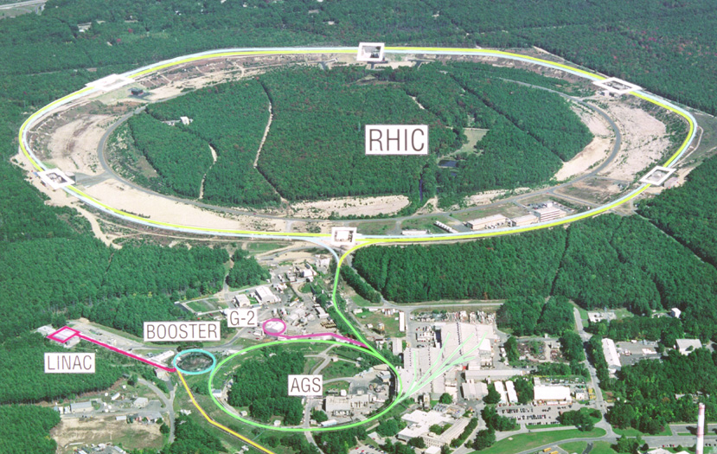
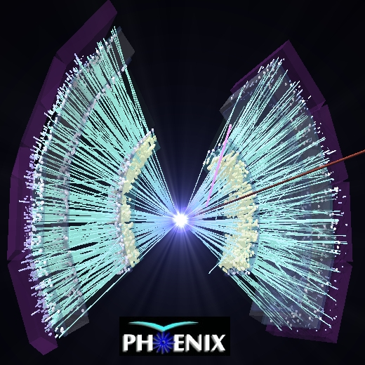
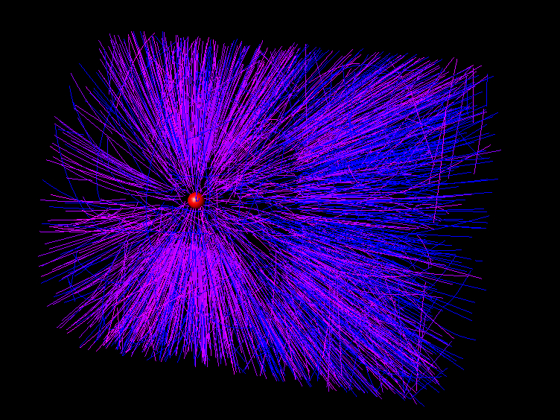

RHICで生成された
高温・高密度QCD物質
中條 達也（筑波大学物理学系）
日本物理学会 ２００８年秋季大会 山形大学 ２００８年９月２２日
シンポジウム 「RHICで切り拓くQCD物性の世界」

Slide 2
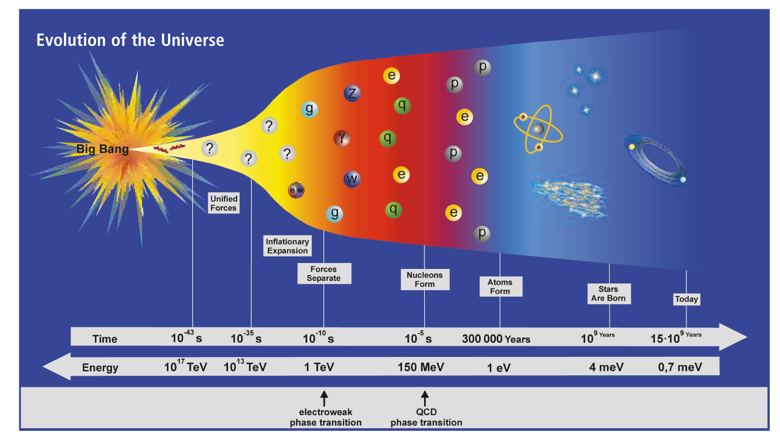
Outline
Introduction of RHIC Physics
Major (and famous) discoveries at RHIC
Towards the Characterization of QCD Matter at RHIC
Summary

Slide 3
1. Introduction

Slide 4

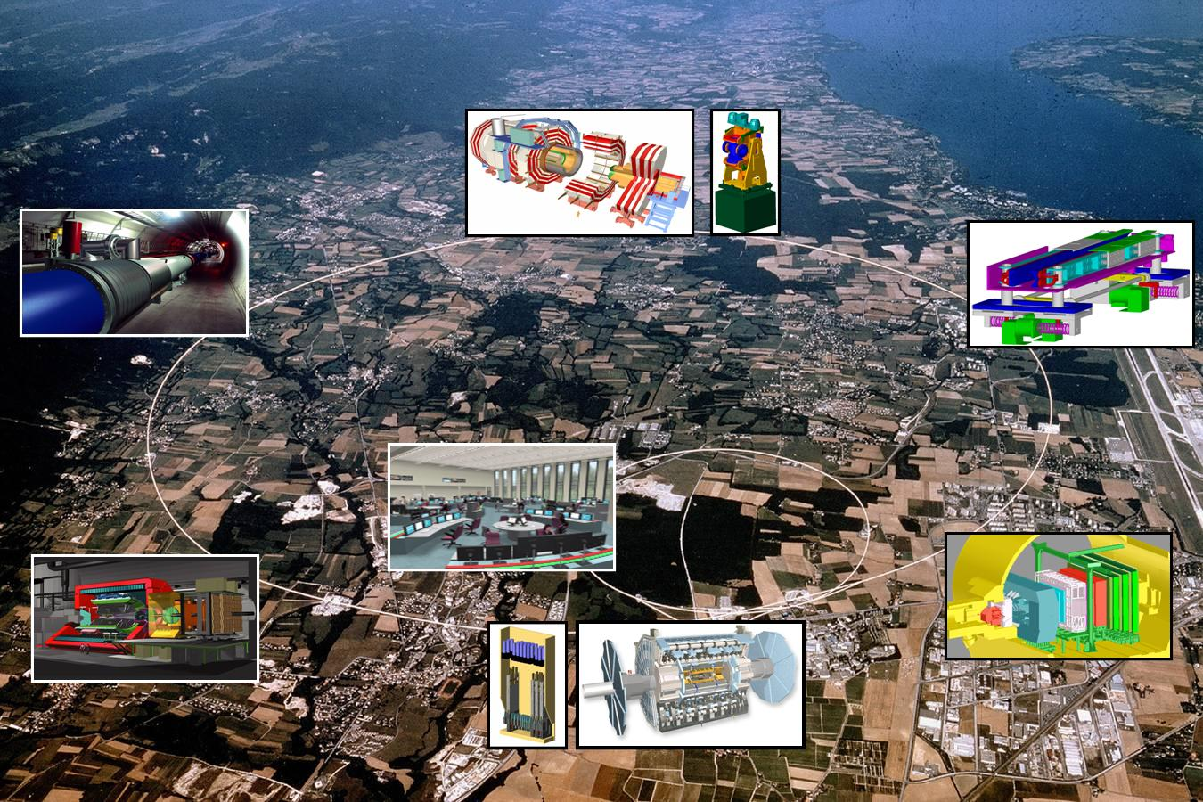

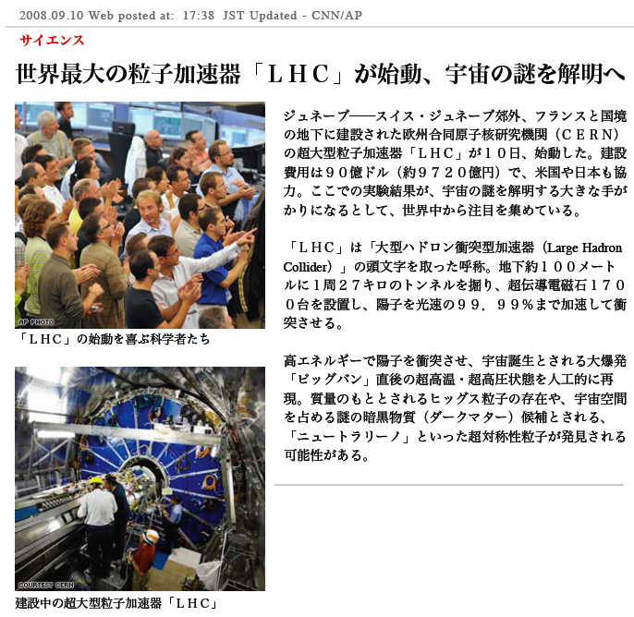
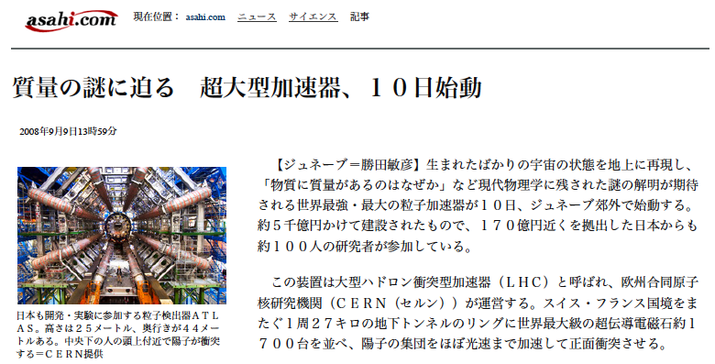

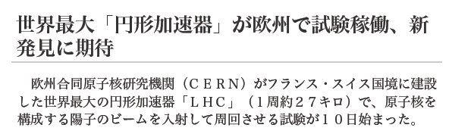
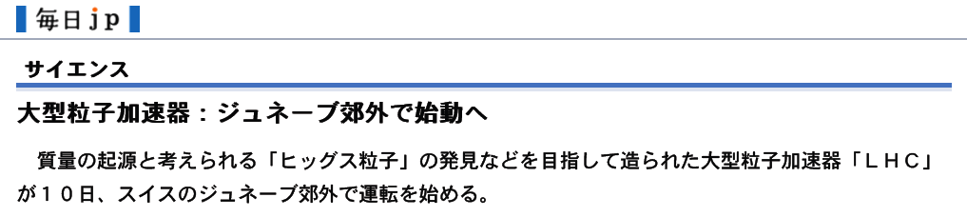
２００８年９月１０日

Slide 5
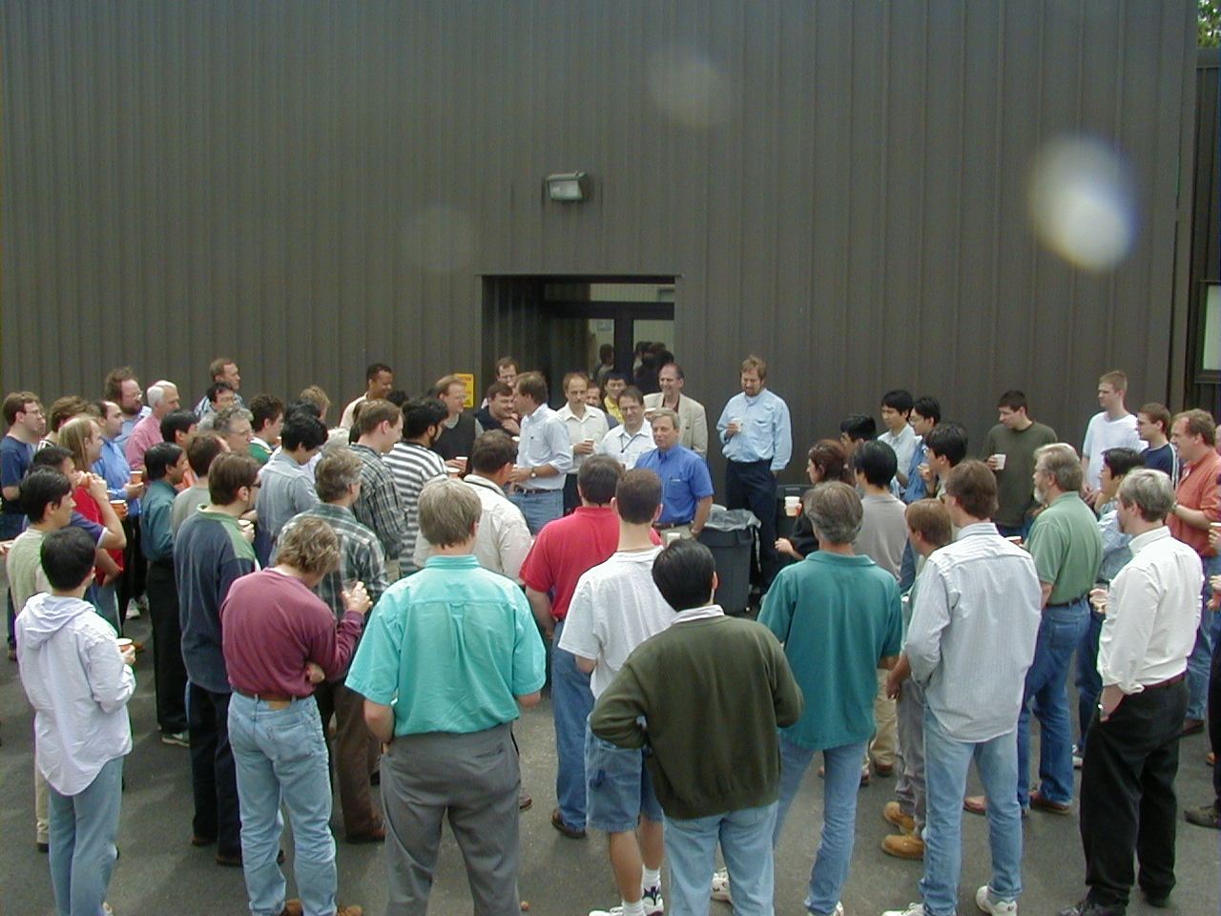
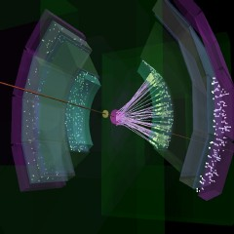
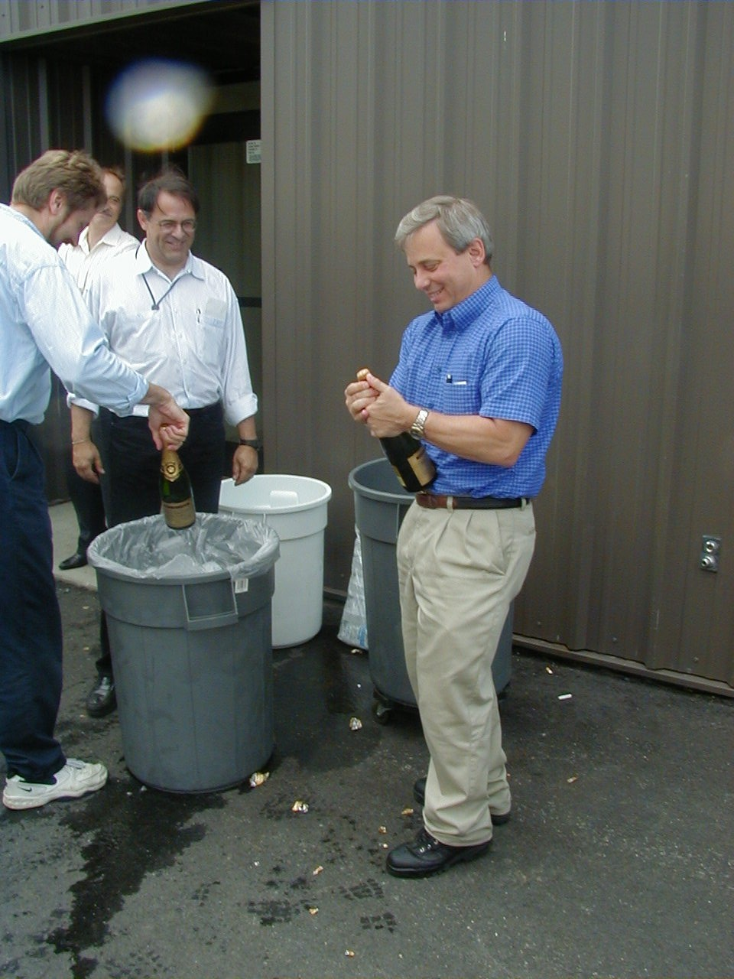
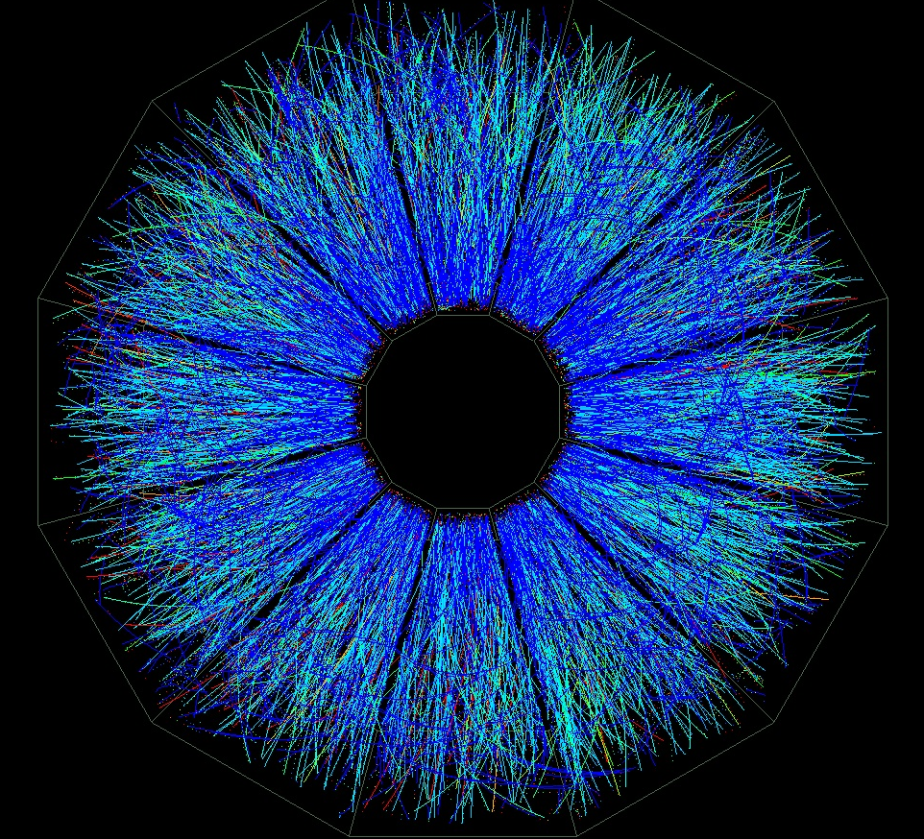
約８年前、２０００年６月１２日
June 12, 2000 @ PHENIX
First collisions at √s_{NN} = 56 GeV Au+Au

Slide 6
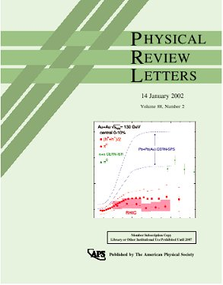
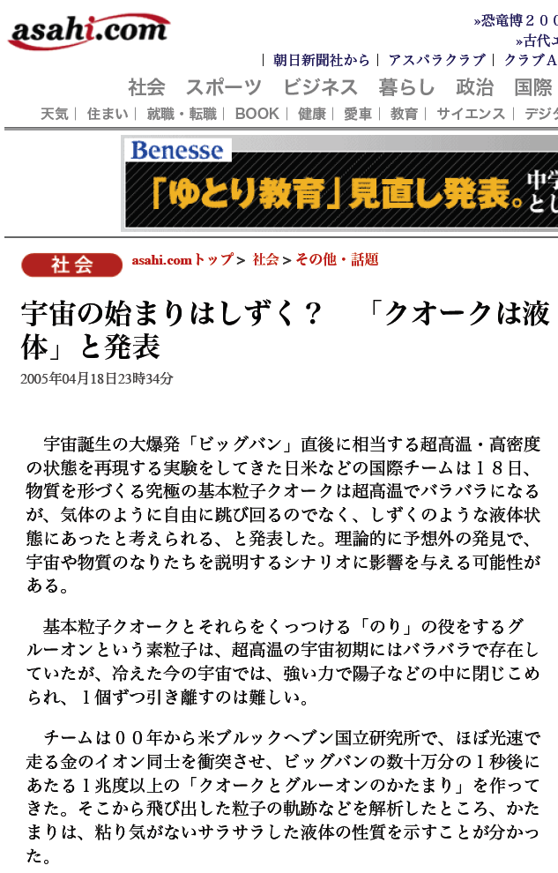
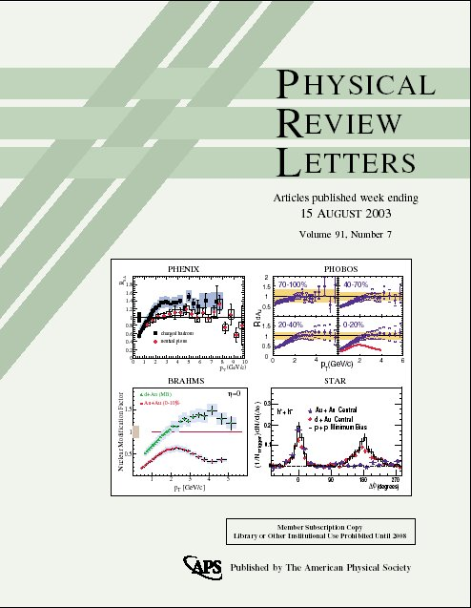
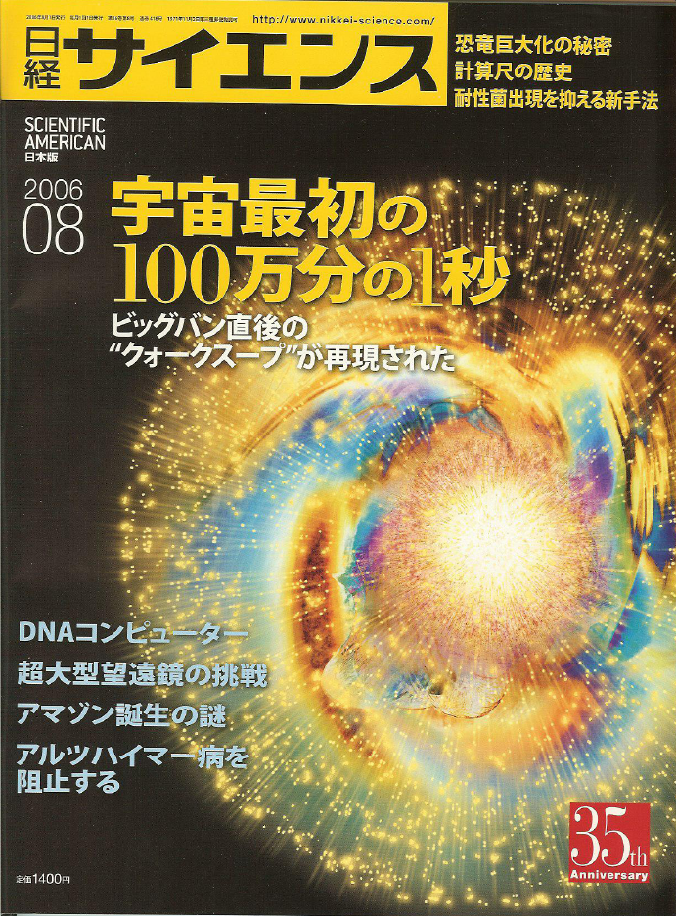
First Collision 後…

Slide 7
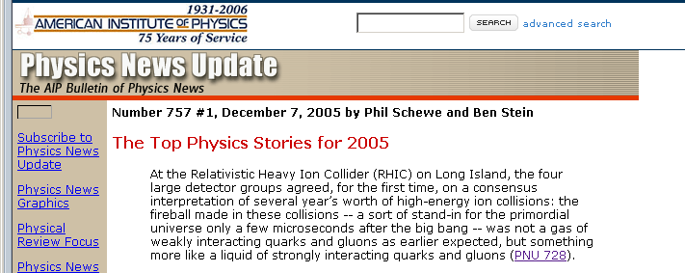
RHIC 物理のインパクト
~200 の物理論文 (102 PRLを含む)
  トータルで 15,000 以上の引用回数.
  これまで全ての原子核物理学実験分野での高い引用論文の 58% を占める。
“The 2005 AIP physics story of the year”.
RHIC 'White Papers (WP)' Reach “Renowned” Status (+ 500 citations in SPIRES), June 11, 2008.
  PHENIX WP (7TH largest number of citations of all nuclear physics experimental paper).
  STAR (8th).

Slide 8
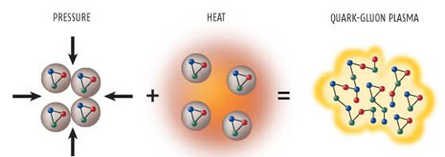
RHIC における重イオン物理
高エネルギー重イオン衝突による、高温高密度QCD物質の研究
  クォークグルーオンプラズマ (QGP)の性質の解明
  核物質相図の探索
  クォークの閉じ込め機構
  カイラル対称性の回復
Pressure Heat QGP

Slide 9
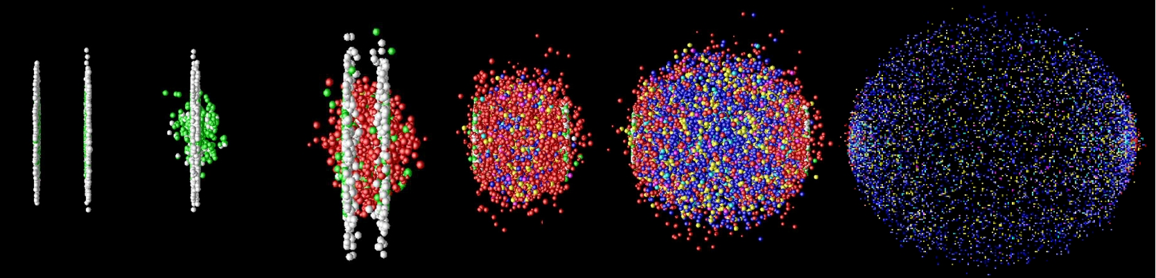
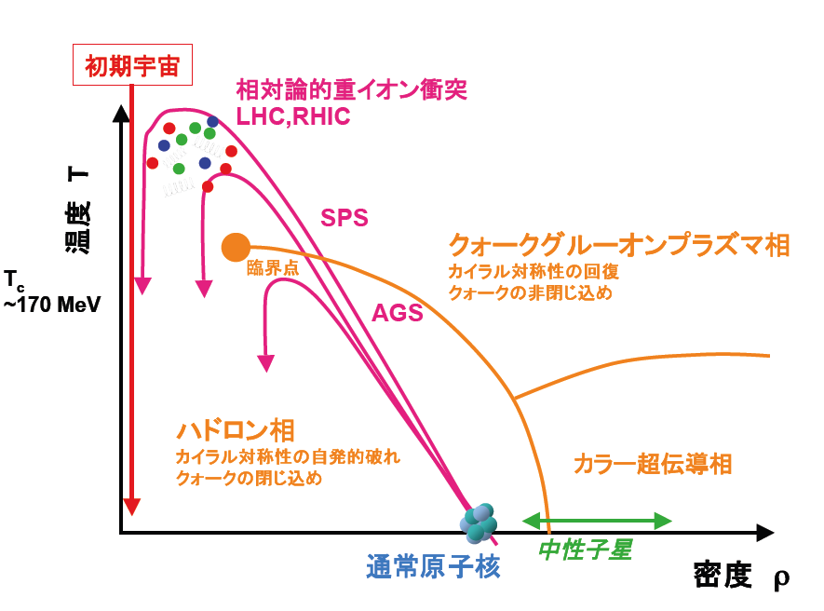

Slide 10
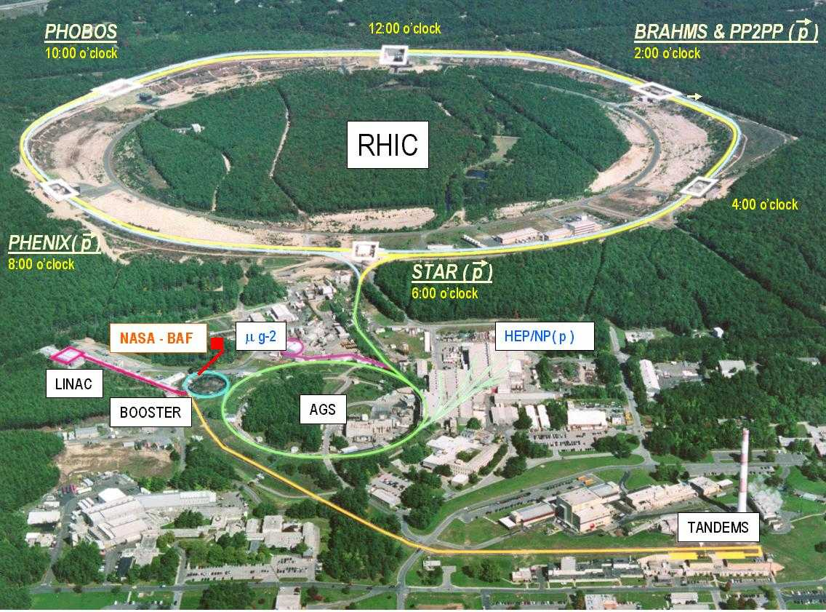
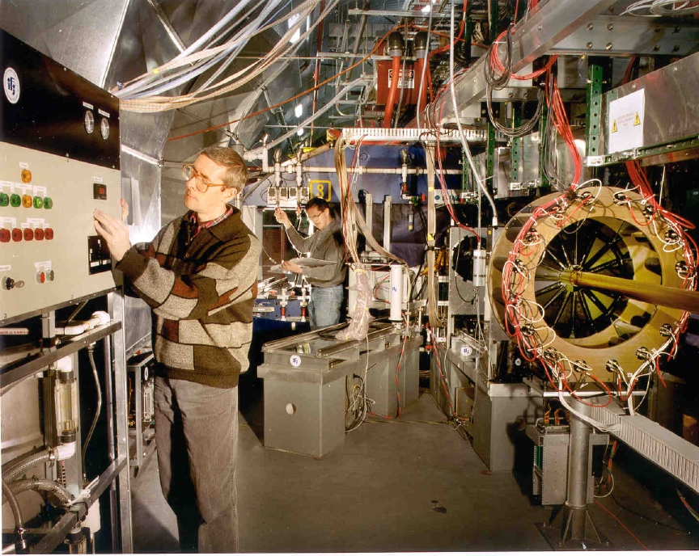

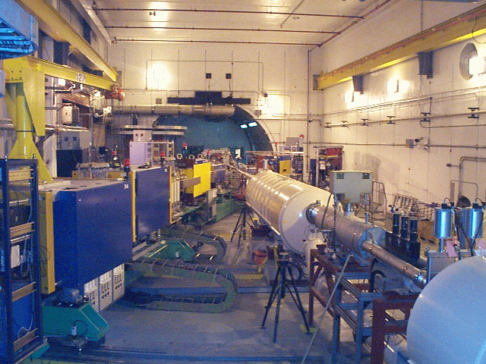

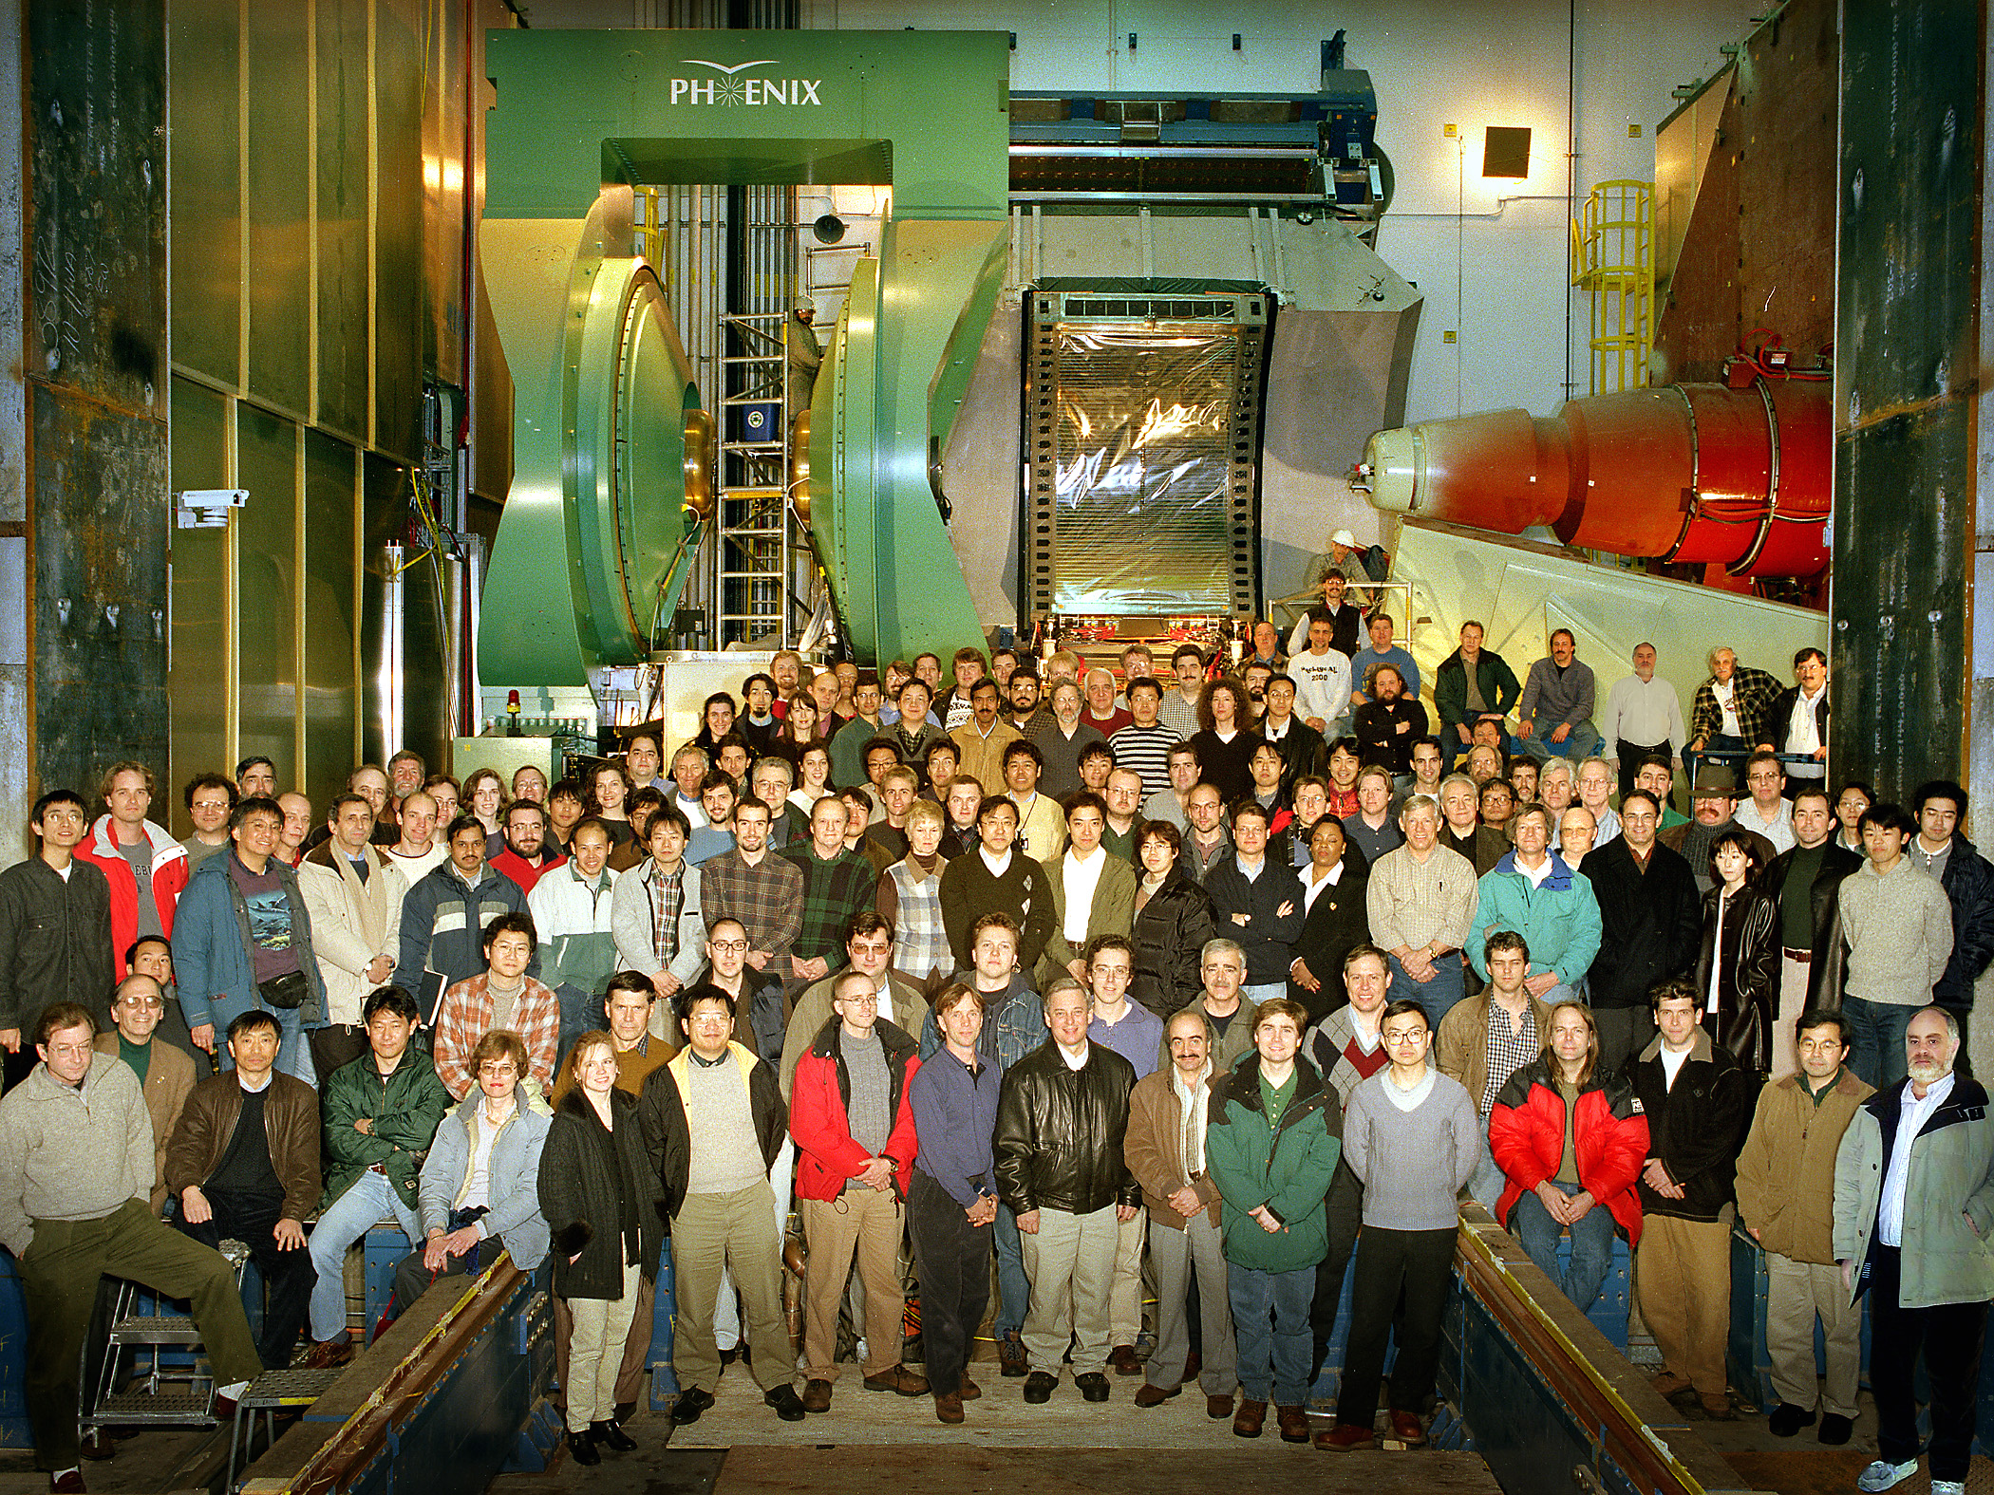
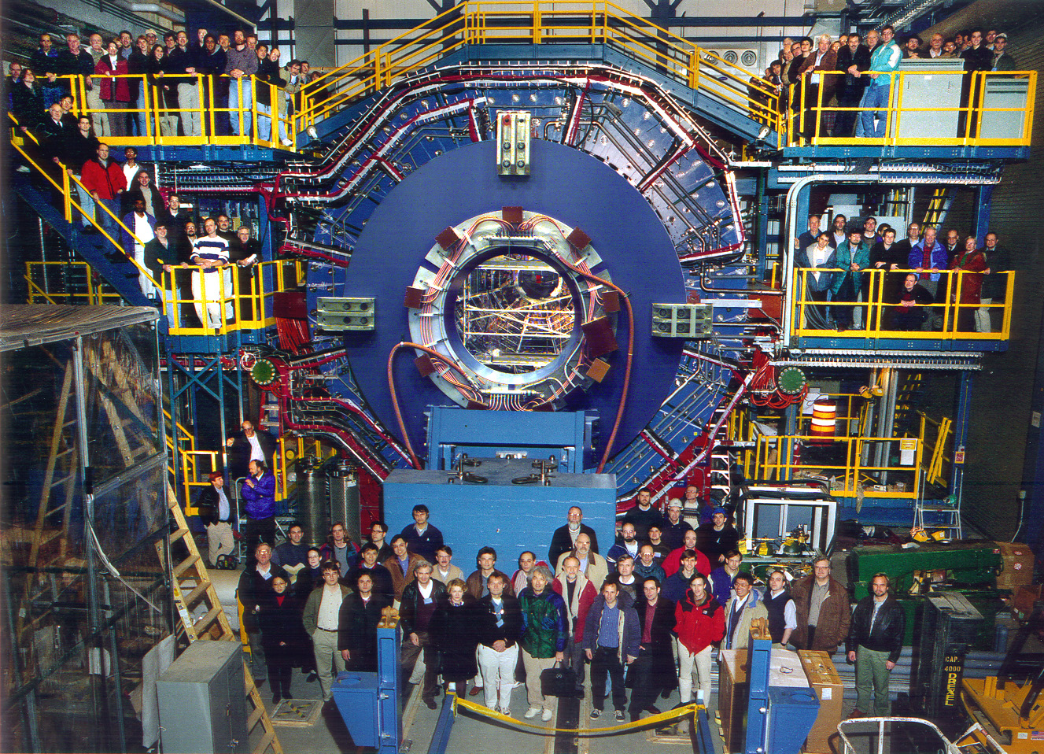

RHIC = Relativistic Heavy Ion Collider
周長 3.8 km, ２つのリング、衝突型加速器
衝突最高エネルギー：
  200 GeV Au+Au
  500 GeV 偏極 p+p
柔軟なマシン運用：
  衝突系 (p+p, d+Au, Cu+Cu, Au+Au)
  エネルギー (19, 22.5, 62.4, 130, 200 GeV)
４つの実験
STAR

Slide 11
2. Major (and famous) discoveries at RHIC

Slide 12
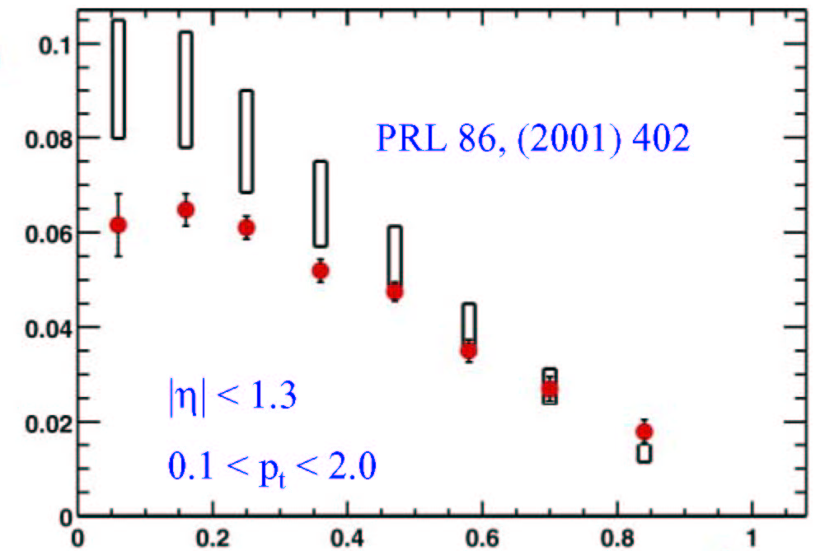

RHIC Discoveries from Run-1 (2000)
Jet Quenching
Large Elliptic Flow
Au+Au 130 GeV
PHENIX: PRL 88,(2002) 022301
SPIRES citations: 446
Most cited PRL in RHIC papers !
Au+Au 130 GeV
STAR: PRL 86, (2001) 402
SPIRES citations: 358
Charged Particles
Hydro Limit
V₂
n_{ch}/n_{max}

Slide 13
High pT hadrons; probing the density of matter by the calibrated probe.
schematic view of jet production
hadrons
leading
particle
q
q
hadrons
leading particle

Slide 14
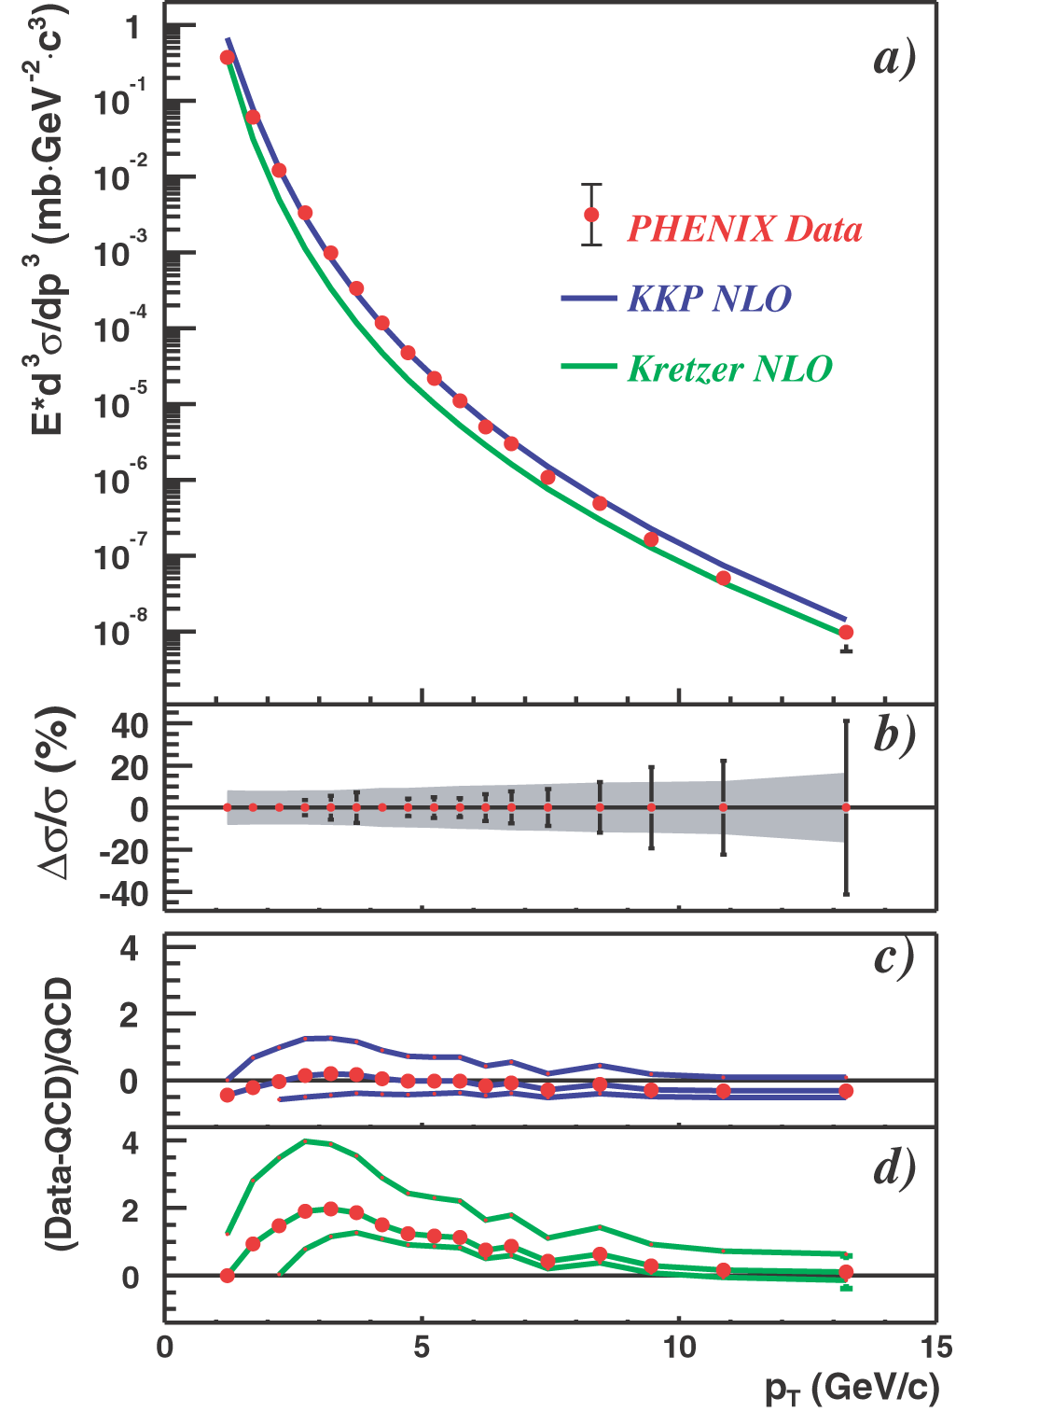

pQCD Calibrated Probes (p+p)
Baseline measurements in p+p collisions at RHIC
  Calibrated probes
  Supported by well-established theory (perturbative QCD = pQCD)
Neutral pions

Slide 15
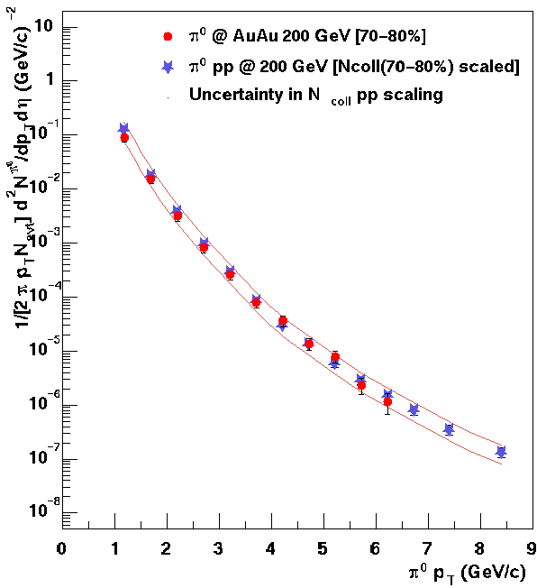
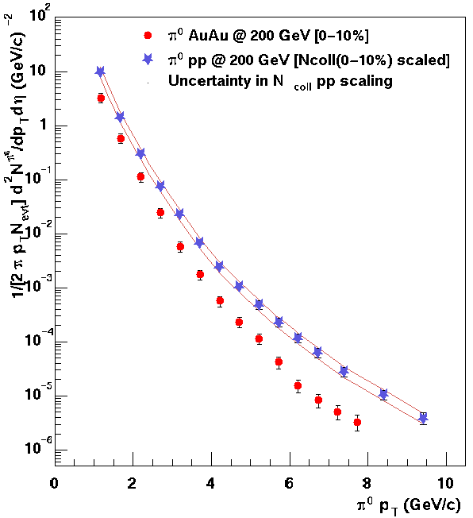

Discovery of Strong Suppression (Au+Au)
peripheral
N_{coll} = 12.3 ± 4.0
Nuclear Modification Factor
central
N_{coll} = 975 ± 94
~ Survival Probability
in medium
Scaling of calibrated probe works in peripheral Au+Au, but strong suppression in central Au+Au

Slide 16
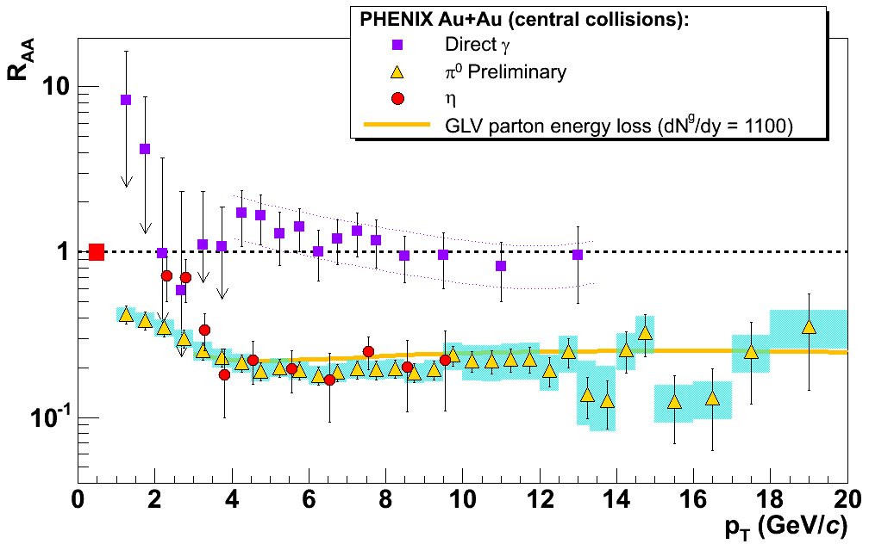
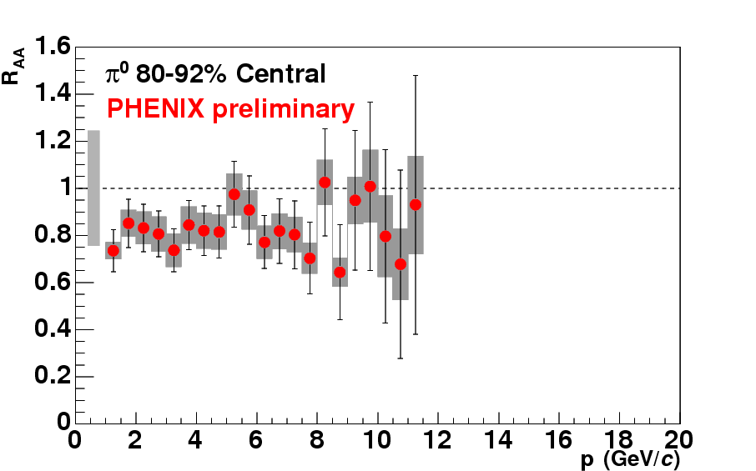
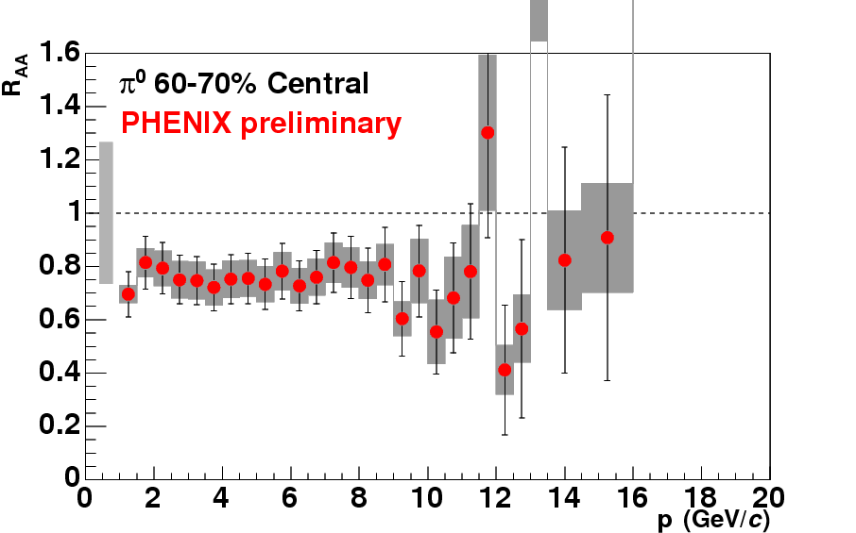
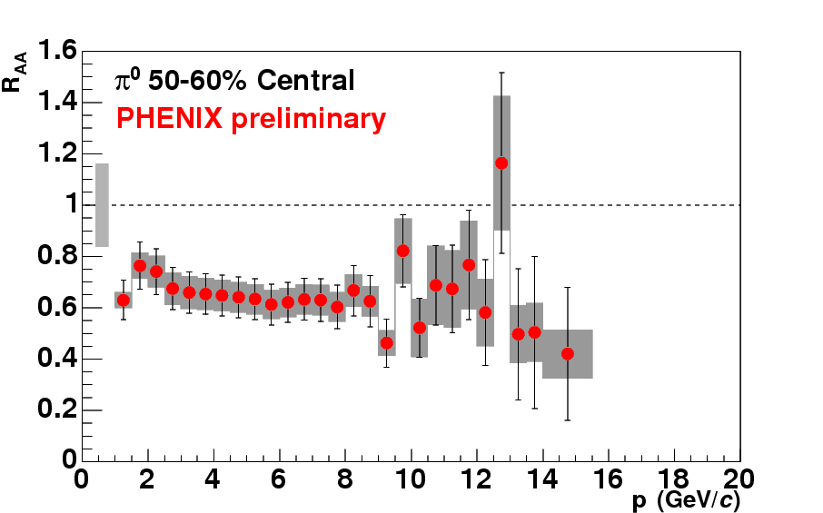
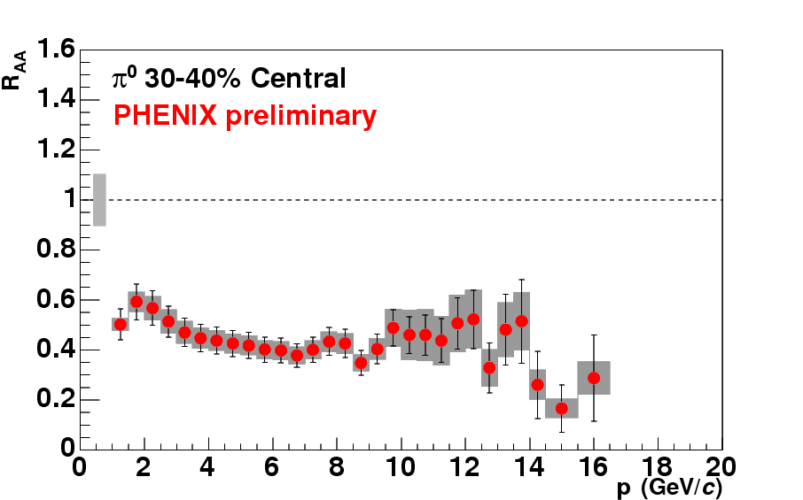
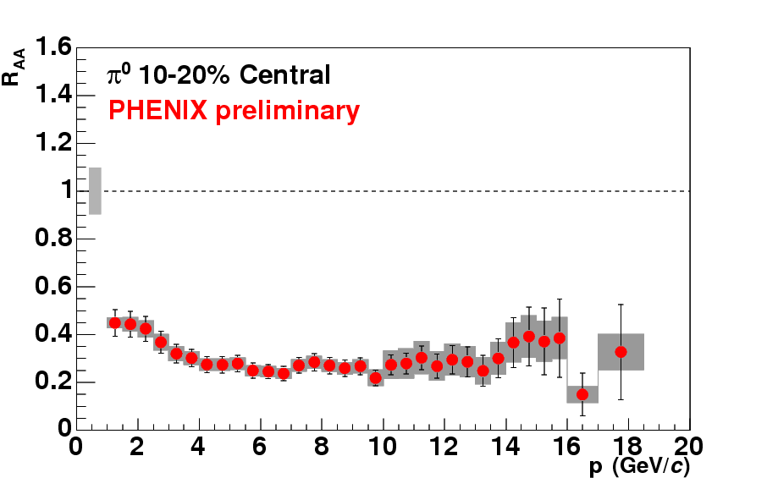
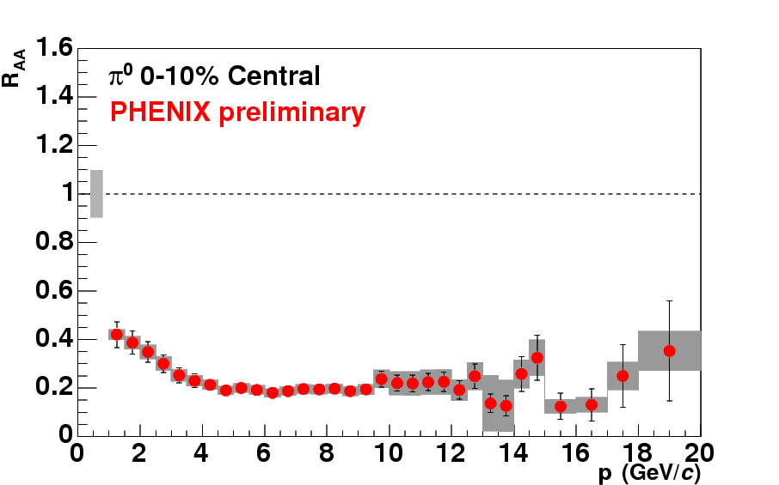
Observation of Jet Quenching
直接光子は抑制されず。ハドロンは強い抑制（~ factor 5 ）。
If R_{AA} < 1 Suppression
If R_{AA}= 1 Same as in p+p

Slide 17
Elliptic flow
z
y
Access to the early time of the collisions,
Pressure, Equation of State (EoS).
x

Slide 18
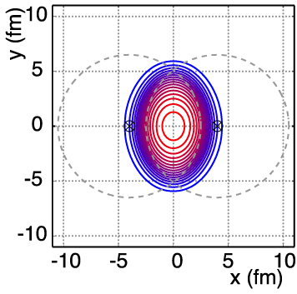
Elliptic Flow とは？
Very high degree of collectivity is seen at RHIC.

Slide 19
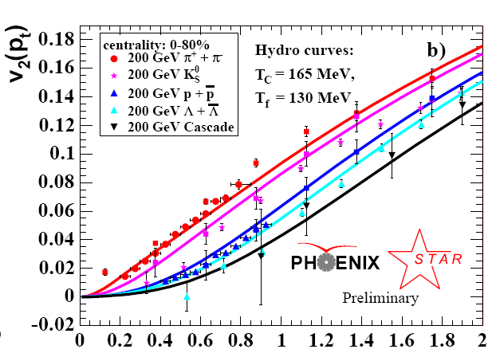
Like a Perfect Fluid?
First time hydrodynamics without any viscosity describes heavy ion reactions.
v₂
Lines:
Hydrodynamics calc. with QGP type EoS.
*viscosity = resistance of liquid
to shear forces (and hence to flow)
p_{T} (GeV)
Thermalization time t=0.6 fm/c and ε=20 GeV/fm³
Required QGP Type EoS in Hydro model

Slide 20
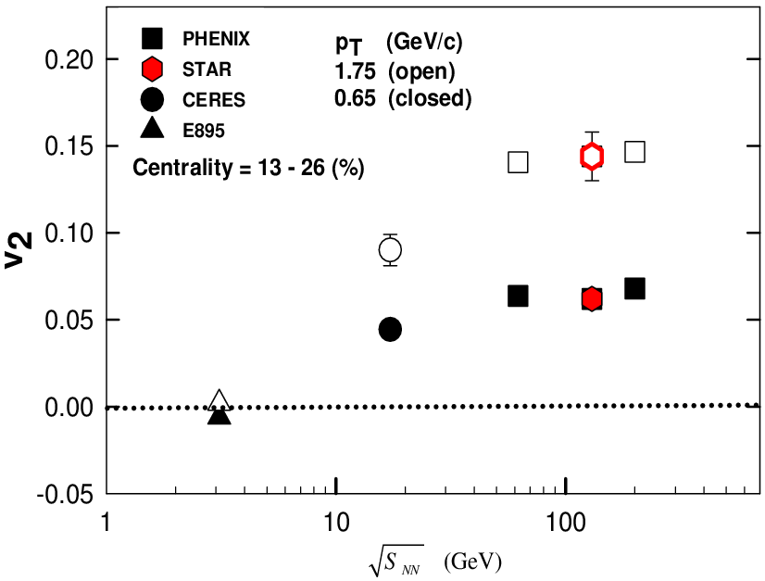
Saturation of v₂ at RHIC energies
(charged hadrons)
Au+Au
Saturation @ RHIC
AGS SPS RHIC

Slide 21
3. 発見から性質の解明へ・・・

Slide 22
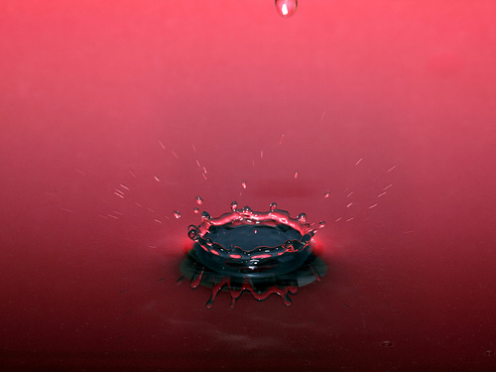
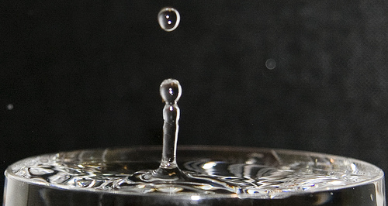
Medium response of Jet propagations

Slide 23
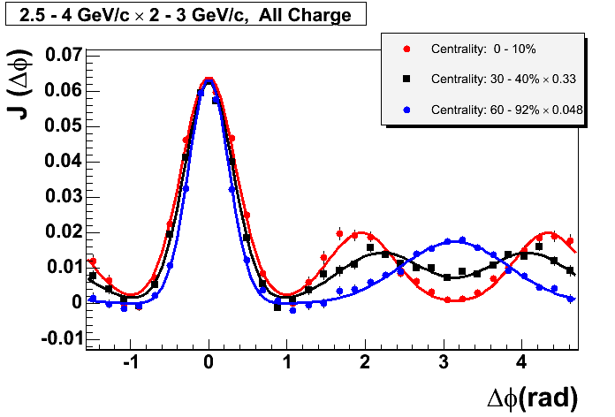
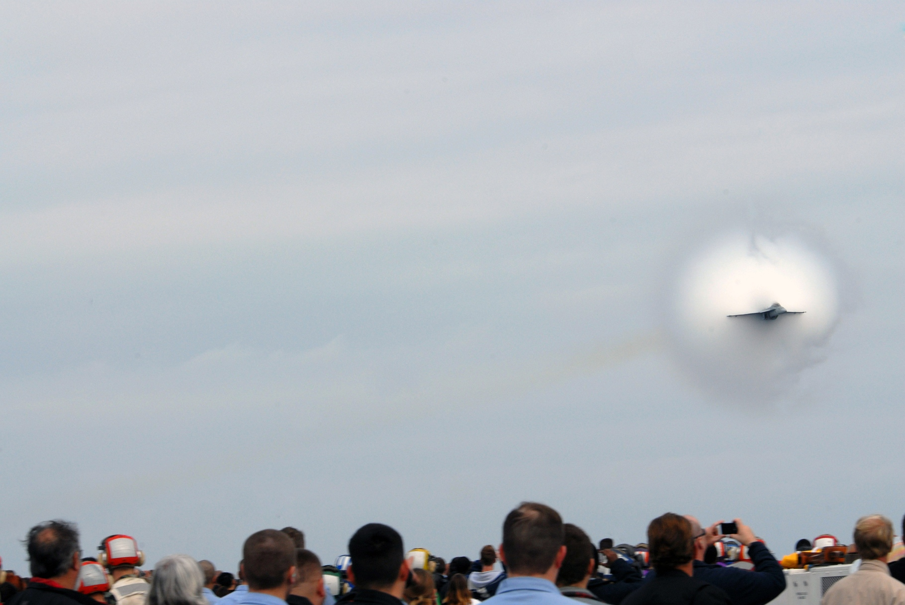
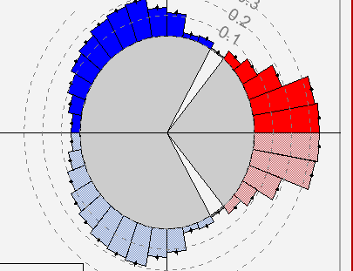
高エネルギーパートンが物質中
を通過した際に失われた
エネルギーはどこに？
どのように物質中を
伝播するのか？
Away side
Near side
Away side に２つのピーク？
Sonic shock wave?

Slide 24
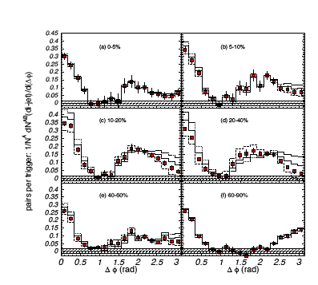
PHENIX
PRL 97 052301
    なぜ Jet modification が生じたか？
    Deflected jets due to collective radial flow?
    Conical emission due to Cherenkov gluon radiation?
    Mach-cone shock wave generated by large energy deposition in the hydrodynamic medium?
  3-particle correlation:
    Powerful tool to identify the underlying physics process.
  If it is Mach-cone shock wave:
    Speed of sound (c_{s} ).
    EOS.
Central Au+Au
peripheral
Notes:
Mach-cone shock wave
Shock waves excited by a supersonic parton.
Can be produced in different theories (Hydrodynamics, Colored plasma, AdS/CFT)
Cone angle: no dependence on a velocity of particle.
Cherenkov gluon radiation
Radiation of gluon by superluminal parton.
Angle is dependent on the emitted momentum.

Slide 25
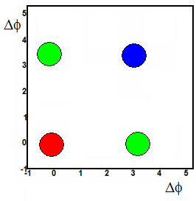
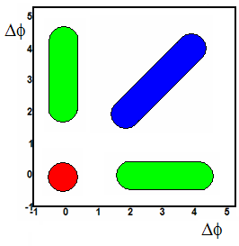
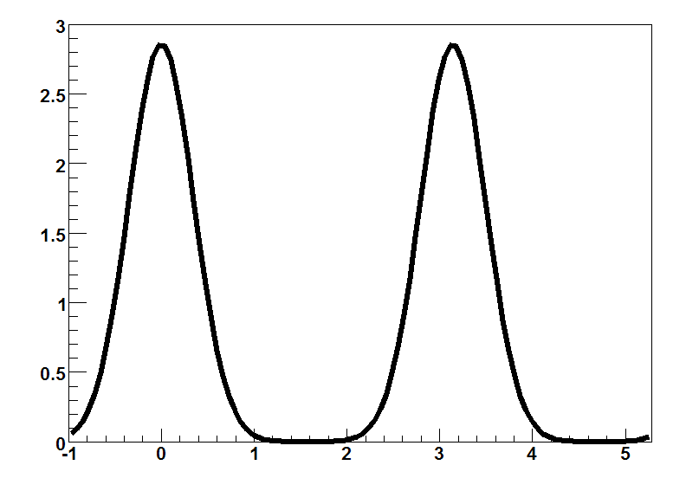
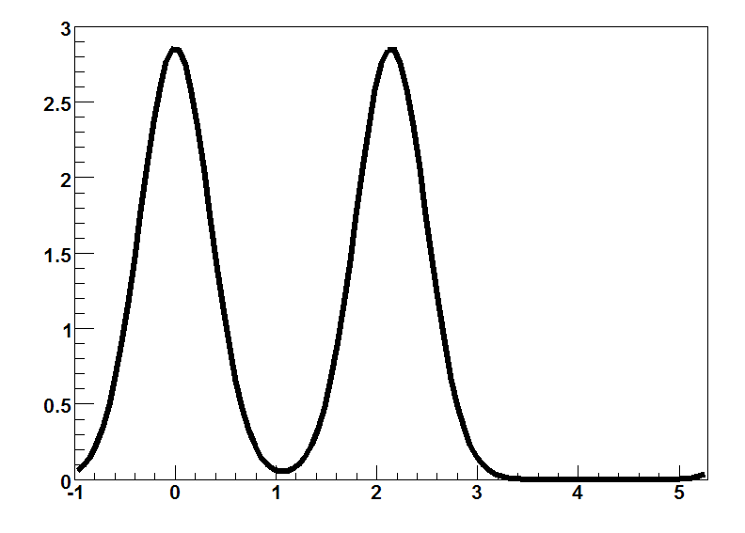




Azimuthal 3-Particle Correlations
near
near
Medium
Medium
away
deflected jets
away
near
di-jets
Medium
away
Conical Emission
From : Jason Glyndwr Ulery
(QM 2008)

Slide 26




(a) p+p
B.I. Abelve et al. (STAR),
arXiv:0805.0622v1
Trigger particle (3 < p_{T} < 4 GeV/c),
Associated particle (1 < p_{T} < 2 GeV/c) .

Slide 27

(b) d+Au
B.I. Abelve et al. (STAR),
arXiv:0805.0622v1

Slide 28

(c) Au+Au 50-80%
B.I. Abelve et al. (STAR),
arXiv:0805.0622v1

Slide 29

(d) Au+Au 30-50%
B.I. Abelve et al. (STAR),
arXiv:0805.0622v1

Slide 30

(e) Au+Au 10-30%
B.I. Abelve et al. (STAR),
arXiv:0805.0622v1

Slide 31

(f) Au+Au 0-12%
Off-diagonal成分
の出現
B.I. Abelve et al. (STAR),
arXiv:0805.0622v1

Slide 32

Observation of off-diagonal peak
B.I. Abelve et al. (STAR),
arXiv:0805.0622v1
Diagonal (Σ)
off-diagonal (Δ)
Histogram (a) :
Near side off-diagonal projection
Histogram (b):
Away side off-diagonal projection
Totally different shape between d+Au and Au+Au central!
Distinct peak at θ = 1.38 ± 0.02 (stat.) ± 0.06 (syst.) from π.
Evidence of conical emission of hadrons correlated with high p_{T} particles.

Slide 33

p_{T} dependence of θ

Slide 34


Δη-independent near-side correlation: ``The Ridge”
p_{T}^{trig}=3-6 GeV/c, 2 GeV/c <p_{T}^{assoc}< p_{T}^{trig}
STAR preliminary
“jet”
Au+Au, 200 GeV
ridge
d+Au, 200 GeV
Jana Bielciekova XLIII Rencontres de Moriond
What is the ridge?
1) Medium heating and parton recombination
2) Radial flow + high-p_{T} trigger particle
3) Parton radiation and its coupling
to the longitudinal flow
4) Momentum broadening in anisotropic QGP
5) Longitudinal broadening of quenched
6) Momentum kick imparted on partons in medium
Still unclear the relationship with away side jet
modification,
but it is observed at the similar
momentum range.
Notes:
34
What is the ridge?
1) Medium heating and parton recombination
Chiu & Hwa PRC 72 (2005) 034903
2) Radial flow + high-p_{T} trigger particle
Shuryak, Phys.Rev.C76 (2007) 047901
Voloshin, nucl-th/0312065 NPA 749, (2005) 287
3) Parton radiation and its coupling
to the longitudinal flow
Armesto, Salgado, Wiedemann, PRL 93 (2004) 242301
4) Momentum broadening in anisotropic QGP
Romatschke, PRC 75 (2007) 014901
5) Longitudinal broadening of quenched
jets in turbulent color fields
Majumder, Mueller, Bass, PRL 99 (2007) 042301
6) Momentum kick imparted on partons in medium
Wong, PRC PRC 76 (2007) 054908

Slide 35

Measurement of initial temperature

Slide 36

Need to access to low p_{T} region!
Turbide, Rapp, Gale, Phys. Rev. C 69 (014903), 2004
Huge back ground to measure thermal photons (only 10% of hadron BG).
Window for thermal photons from QGP in this calculation: p_{T} = 1 - 3 GeV/c
Limitation of the hadronic BG subtraction method.

Slide 37

A new Idea of thermal photon measurement
Use lepton pairs to measure
virtual γ
γ
π⁰
e⁺
γ∗
Two sources of virtual γ with very
low (invariant) mass:
Background from Dalitz decay
  Kroll-Wada formula
Hard photon (signal) =
thermal photon candidate
e⁻
Daliz decay
e⁺
Compton
γ∗
e⁻
q
g
q
e⁺e⁻ internal conversion
pair from hard scattering
excess over known
hadronic source

Slide 38

Direct photon yields
PHENIX, arXiv: 0804.4168
measured Ratio
Measured inclusive spectrum
NLO pQCD direct photon cal.
Power law fit to p+p data
(Au+Au; TAA scaled)
Exp. + power law fit
New measurement
(int. conversion)
Previous measurement
(subtraction)

Slide 39
Direct photon yields
PHENIX, arXiv: 0804.4168
measured Ratio
Measured inclusive spectrum
p+p: consistent with NLO pQCD, even at low pT.
Au+Au: larger than the NLO pQCD T_{AA} scaled
line for 1< p_{T}< 2.5 GeV/c.
New measurement
Previous measurement

Slide 40
Extract “T” (temperature)
PHENIX, arXiv: 0804.4168
Black line (two component fit):
Fixed by TAA scaled
Power low fit to p+p data
A, T : free parameters.
Inverse slope for Au+Au
200 GeV for central 0-20% is;
T = 238 ± 2 ± 10 MeV
Centrality | A (GeV⁻²c³) | T (MeV)
0-20 % | 41.8 ± 24.0 | 238 ± 2
20-40% | 19.2 ± 11.2 | 226 ± 2
MB | 9.5 ± 3.8 | 247 ± 2

Slide 41

Data vs. Theory
The initial temperature is 1.5 to 3 times of the slope of the photon spectrum.
A thermal photon spectrum in central Au+Au collisions at RHIC with an T_{ini} = 370 MeV in agrees with the data.
T₀^{max} ~ 500-600 MeV
T₀^{ave} ~ 300-400 MeV
D. d’Enterria and D. Peressounko, EPJ C46, 451 (2006).

Slide 42
Opacity is huge; charm stops and flows?

Slide 43

Heavy quarks lose energy & flow
Electrons from heavy quark decay have nearly same R_{AA} as pions!
Electrons from heavy quark decay flow (“stopped in medium”)?
Phys. Rev. Lett. 98, 172301 (2007)

Slide 44


Update of c,b R_{AA} and v2
Charm and bottom v2
Charm and bottom energy loss

Slide 45



Other interesting topics (experimental)
J/psi (S. Oda)
Low-mass di-electron (Y. Tsuchimoto)
Fluctuations (K. Homma)

Slide 46
4. Summary
RHIC = QGP & QCD machine !
Many (unexpected) discoveries.
Energy density.
  ε ~ 15 GeV / fm³ , i.e. ~100 normal nuclear density.
Behaving as zero viscosity “perfect” liquid, coupling is strong.
First measurement of the initial temperature via thermal photon.
  T₀^{ave} = 300-400 MeV
Away side Jet modification at intermediate p_{T} suggests the generation of shock wave.
  Access to the sound velocity, EOS?
Huge Opacity & large flow for heavy quarks.

Slide 47

Next Big Question:
Where is the Critical Point?

Slide 48

Onset of RHIC’s perfect liquid?
Cu+Cu
Emergence of opacity
Approach to constant v₂
and hydrodynamic limit?
Au+Au

Slide 49


Onset of Quark Number Scaling?
Where is the onset of quark number scaling?
Relationship to quark DOF ?

Slide 50

p-bar/π⁻ ratio vs. √s_{NN}
Increasing as a function of √s.
Indicates the onset of baryon enhancement is in between 22 GeV and 62 GeV.
Between 22.4 and 62.4 GeV.
Where? Properties? (T_{o}, etc)
Relation to QCD critical point?
Detail energy scan at RHIC should provide a critical information about CEP & Tc.
* No weak decay feed-down correction applied.

Slide 51
Thank you for your attention!
Many thanks to:
Ed O'Brien, 434th BNL Lecture (2008.3.19)
B. Jacak, DOE review (2008 July)

Slide 52

The 2nd Asian Triangle Heavy Ion Conference (ATHIC2008)
Oct 13-15, 2008
Univ. of Tsukuba
http://www.utkhii.px.tsukuba.ac.jp/athic2008/

Slide 53
BACKUP slides

Slide 54
Future HI Milestones

Slide 55

RHIC Run Plan

Slide 56

PHENIX run history

Slide 57

Conical Emission
Mach-cone shock wave
  Shock waves excited by a supersonic parton.
  Can be produced in different theories (Hydrodynamics, Colored plasma, AdS/CFT)
  Cone angle: no dependence on a velocity of particle.
Cherenkov gluon radiation
  Radiation of gluon by superluminal parton.
  Angle is dependent on the emitted momentum.

Slide 58
Mach-Cone Scenario
Trigger
θ_{M}
θ_{M}
Mach angle depends on speed of sound in medium
  Temp. dependent
Angle independent of associated p_{T}.
Away-side
PNJL Model
Mikherjee, Mustafa, Ray
Phys. Rev. D75 (2007) 094015

