Slide 1
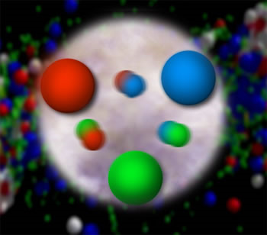
Advancing the Era of Quantitative QCD: Experiment
(Why I think it’s a really neat time to be a QCD experimentalist)
Christine A. Aidala
University of Michigan
DPF, Ann Arbor, MI
August 5, 2015

Slide 2
How do we understand the visible matter in our universe in terms of the quark and gluon degrees of freedom of quantum chromodynamics?
How can studying QCD systems teach us more about fundamental aspects of QCD as a theory?
Notes:
Goals of all of QCD research

Slide 3
QCD: How far have we come?
Three-decade period after initial birth of QCD dedicated to “discovery and development”
→ Symbolic closure: Nobel prize 2004 - Gross, Politzer, Wilczek for asymptotic freedom
Now early years of second phase:
quantitative QCD!
Notes:
[While some a generation or so ahead of me have enjoyed very exciting careers [centered on][based around] the discovery and development of QCD, …]

Slide 4
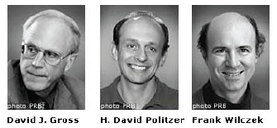
QCD: How far have we come?
Three-decade period after initial birth of QCD dedicated to “discovery and development”
→ Symbolic closure: Nobel prize 2004 - Gross, Politzer, Wilczek for asymptotic freedom
Now early years of second phase:
quantitative QCD!
Notes:
[While some a generation or so ahead of me have enjoyed very exciting careers [centered on][based around] the discovery and development of QCD, …]

Slide 5
Advancing into the era of quantitative QCD: Theory has been forging ahead!
In perturbative QCD, since 1990s starting to consider detailed internal QCD dynamics that parts with traditional parton model ways of looking at hadrons—and perform phenomenological calculations using these new ideas/tools!
E.g.:
  Various resummation techniques
  Non-linear evolution at small momentum fractions
  Spin-spin and spin-momentum correlations in QCD bound states
  Spatial distributions of partons in hadrons
Non-perturbative methods:
  Lattice QCD less and less limited by computing resources—since 2010 starting to perform calculations at the physical pion mass (after 36 years!). Plus recent new ideas on how to calculate previously intractable quantities.
  AdS/CFT “gauge-string duality” an exciting recent development as first fundamentally new handle to try to tackle QCD in decades!

Slide 6
Advancing into the era of quantitative QCD: Theory has been forging ahead!
In perturbative QCD, since 1990s starting to consider detailed internal QCD dynamics that parts with traditional parton model ways of looking at hadrons—and perform phenomenological calculations using these new ideas/tools!
E.g.:
  Various resummation techniques
  Non-linear evolution at small momentum fractions
  Spin-spin and spin-momentum correlations in QCD bound states
  Spatial distributions of partons in hadrons
Non-perturbative methods:
  Lattice QCD less and less limited by computing resources—since 2010 starting to perform calculations at the physical pion mass (after 36 years!). Plus recent new ideas on how to calculate previously intractable quantities.
  AdS/CFT “gauge-string duality” an exciting recent development as first fundamentally new handle to try to tackle QCD in decades!

Slide 7
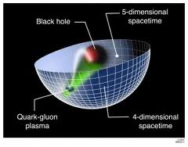
Advancing into the era of quantitative QCD: Theory has been forging ahead!
In perturbative QCD, since 1990s starting to consider detailed internal QCD dynamics that parts with traditional parton model ways of looking at hadrons—and perform phenomenological calculations using these new ideas/tools!
E.g.:
  Various resummation techniques
  Non-linear evolution at small momentum fractions
  Spin-spin and spin-momentum correlations in QCD bound states
  Spatial distributions of partons in hadrons
Non-perturbative methods:
  Lattice QCD less and less limited by computing resources—since 2010 starting to perform calculations at the physical pion mass (after 36 years!). Plus recent new ideas on how to calculate previously intractable quantities.
  AdS/CFT “gauge-string duality” an exciting recent development as first fundamentally new handle to try to tackle QCD in decades!

Slide 8
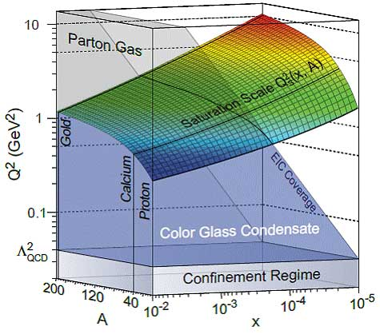
Effective field theories
QCD exhibits different behavior at different scales—effective field theories are useful approximations within these different regimes
  Color Glass Condensate – high energies, high densities
  Soft-Collinear Effective Theory – new insights into performing complicated perturbative calculations very quickly
  Heavy Quark Effective Theory, Non-Relativistic QCD, . . .
  Many effective theories for nonperturbative QCD – chiral perturbation theory, . . .

Slide 9
Effective field theories
QCD exhibits different behavior at different scales—effective field theories are useful approximations within these different regimes
  Color Glass Condensate – high energies, high densities
  Soft-Collinear Effective Theory – new insights into performing complicated perturbative calculations very quickly
  Heavy Quark Effective Theory, Non-Relativistic QCD, . . .
  Many effective theories for nonperturbative QCD – chiral perturbation theory, . . .

Slide 10
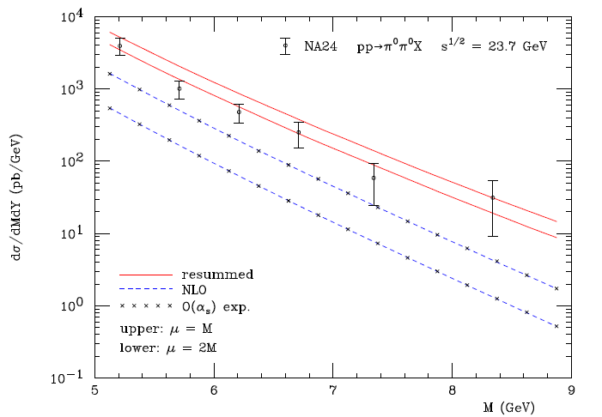
Example: “Threshold resummation” Extending perturbative calculations to lower energies
For observables with two different scales, sum logs of their ratio to all orders in the strong coupling constant
}
pp→π⁰π⁰X
}
Next-to-leading-order in α_{s} + resum.
Next-to-leading-order in α_{s}
M (GeV)
Almeida, Sterman, Vogelsang PRD80, 074016 (2009)

Slide 11
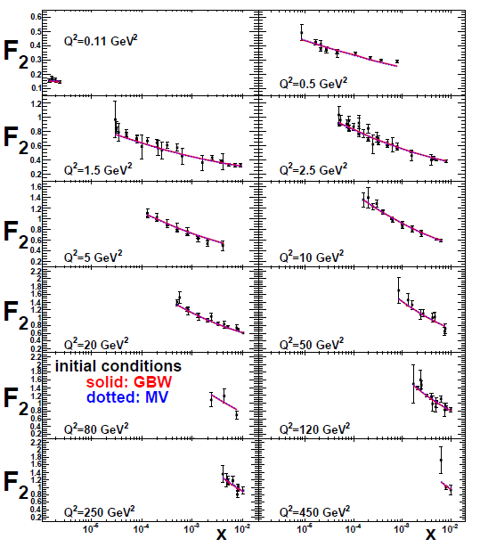
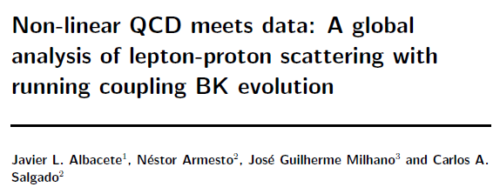
Example: Phenomenological applications of a non-linear gluon saturation regime at low x
Phys. Rev. D80, 034031 (2009)
Basic framework for non-linear QCD, in which gluon densities are so high that there’s a non-negligible probability for two gluons to combine, developed ~1997-2001. But had to wait until “running coupling BK evolution” figured out in 2007 to compare directly to data!
Fits to proton structure function data at low parton momentum fraction x.

Slide 12
Example: Spin-spin and spin-momentum correlations in QCD bound states
Unpolarized
Spin-spin correlations
Spin-momentum correlations
S•(p₁×p₂)

Slide 13
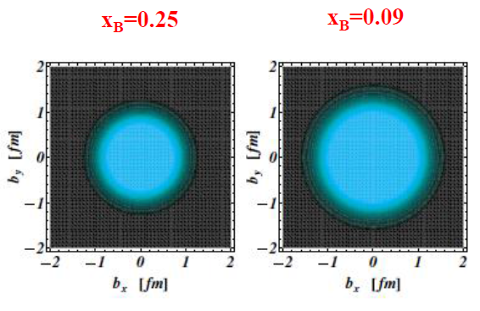
Example: Exploring spatial distributions
Guidal, Moutarde,
Vanderhaeghen,
Rept. Prog. Phys. 76 (2013) 066202
CLAS HERMES
Initial evidence that quarks carrying larger momentum fractions (25% vs. 9%) in the nucleon are distributed over a smaller volume in space
Spatial charge densities measured via deeply virtual Compton scattering in e+p

Slide 14
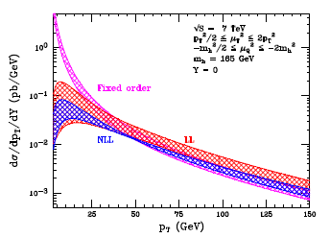
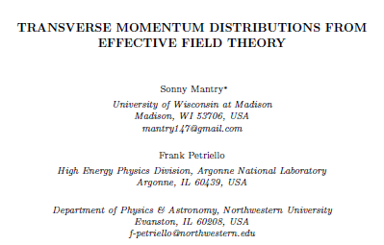
Example: Effective field theories
Soft Collinear Effective Theory
– p_{T} distribution for gg→Higgs
Higgs vs. p_{T}
arXiv:1108.3609

Slide 15
Example: Effective field theories
Soft Collinear Effective Theory
– p_{T} distribution for gg→Higgs
Higgs vs. p_{T}
arXiv:1108.3609
“Modern-day ‘testing’ of (perturbative) QCD is as much about pushing the boundaries of its applicability as about the verification that QCD is the correct theory of hadronic physics.”
– G. Salam, hep-ph/0207147 (DIS2002 proceedings)

Slide 16
Experimental advances
Ability to systematically vary collision species, energy
Ability to maintain high-energy polarized proton beams
High-luminosity facilities enable multidifferential measurements
  E.g. simultaneously in parton momentum fraction x, rapidity, Q², p_{T}, . . .
More sophisticated observables
  E.g. angular distributions, multiparticle final states, various correlations, spin dependence, . . .
  Often sensitive to parton dynamics
→ Demand more of theoretical calculations!

Slide 17
Experimental advances
Ability to systematically vary collision species, energy
Ability to maintain high-energy polarized proton beams
High-luminosity facilities enable multidifferential measurements
  E.g. simultaneously in parton momentum fraction x, rapidity, Q², p_{T}, . . .
More sophisticated observables
  E.g. angular distributions, multiparticle final states, various correlations, spin dependence, . . .
  Often sensitive to parton dynamics
→ Demand more of theoretical calculations!

Slide 18
Experimental advances
Ability to systematically vary collision species, energy
Ability to maintain high-energy polarized proton beams
High-luminosity facilities enable multidifferential measurements
  E.g. simultaneously in parton momentum fraction x, rapidity, p_{T}, Q², z, . . .
More sophisticated observables
  E.g. angular distributions, multiparticle final states, various correlations, spin dependence, . . .
  Often sensitive to parton dynamics
→ Demand more of theoretical calculations!

Slide 19
Experimental advances
Ability to systematically vary collision species, energy
Ability to maintain high-energy polarized proton beams
High-luminosity facilities enable multidifferential measurements
  E.g. simultaneously in parton momentum fraction x, rapidity, p_{T}, Q², z, . . .
More sophisticated observables
  E.g. angular distributions, multiparticle final states, various correlations, spin dependence, . . .
  Contain more information! Often sensitive to parton dynamics
→ Demand more of theoretical calculations!

Slide 20
Experimental advances
Ability to systematically vary collision species, energy
Ability to maintain high-energy polarized proton beams
High-luminosity facilities enable multidifferential measurements
  E.g. simultaneously in parton momentum fraction x, rapidity, p_{T}, Q², z, . . .
More sophisticated observables
  E.g. angular distributions, multiparticle final states, various correlations, spin dependence, . . .
  Contain more information! Often sensitive to parton dynamics
→ Demand more of theoretical calculations!

Slide 21
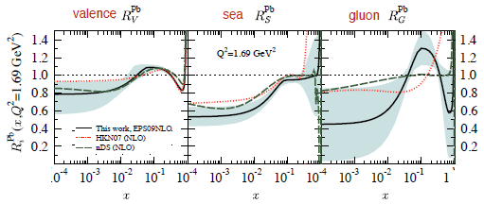
Increasing connections among historically disparate areas of QCD
As we advance, we’re building more connections among the various areas of QCD—and to other fields . . .
Nucleon structure and heavy ion communities
  Greater focus on initial-state (cold) nuclear effects
  Parton distribution functions in the proton vs. nuclei
  RHIC just ran polarized protons on gold! Use polarization to help search for gluon saturation physics
  Ultraperipheral heavy ion collisions for spatial imaging; impact-parameter-dependent nuclear distributions and collision geometry in heavy ion physics
Hadron spectroscopy and hadronization (nucleon structure) communities
  B factories as common facilities
Heavy ion and hadronization (nucleon structure) communities
  “String fragmentation” vs. binding of nearby partons in phase space
  Modified hadronization in hot or cold nuclear matter
Heavy ion and stellar structure communities
  Quark-gluon plasma and neutron stars: different corners of QCD phase diagram
Heavy ion and low-energy nuclear reaction, cosmology communities
  “Little Bang Nucleosynthesis” up to helium-4 (and antihelium-4!) in heavy ion collisions

Slide 22
Increasing connections among historically disparate areas of QCD
As we advance, we’re building more connections among the various areas of QCD—and to other fields . . .
Nucleon structure and heavy ion communities
  Greater focus on initial-state (cold) nuclear effects
  Parton distribution functions in the proton vs. nuclei
  RHIC just ran polarized protons on gold! Use polarization to help search for gluon saturation physics
  Ultraperipheral heavy ion collisions for spatial imaging; impact-parameter-dependent nuclear distributions and collision geometry in heavy ion physics
Hadron spectroscopy and hadronization (nucleon structure) communities
  B factories as common facilities
Heavy ion and hadronization (nucleon structure) communities
  “String fragmentation” vs. binding of nearby partons in phase space
  Modified hadronization in hot or cold nuclear matter
Heavy ion and stellar structure communities
  Quark-gluon plasma and neutron stars: different corners of QCD phase diagram
Heavy ion and low-energy nuclear reaction, cosmology communities
  “Little Bang Nucleosynthesis” up to helium-4 (and antihelium-4!) in heavy ion collisions

Slide 23
Increasing connections among historically disparate areas of QCD
As we advance, we’re building more connections among the various areas of QCD—and to other fields . . .
Nucleon structure and heavy ion communities
  Greater focus on initial-state (cold) nuclear effects
  Parton distribution functions in the proton vs. nuclei
  RHIC just ran polarized protons on gold! Use polarization to help search for gluon saturation physics
  Ultraperipheral heavy ion collisions for spatial imaging; impact-parameter-dependent nuclear distributions and collision geometry in heavy ion physics
Hadron spectroscopy and hadronization (nucleon structure) communities
  B factories as common facilities
Heavy ion and hadronization (nucleon structure) communities
  “String fragmentation” vs. binding of nearby partons in phase space
  Modified hadronization in hot or cold nuclear matter
Heavy ion and stellar structure communities
  Quark-gluon plasma and neutron stars: different corners of QCD phase diagram
Heavy ion and low-energy nuclear reaction, cosmology communities
  “Little Bang Nucleosynthesis” up to helium-4 (and antihelium-4!) in heavy ion collisions

Slide 24
Increasing connections among historically disparate areas of QCD
As we advance, we’re building more connections among the various areas of QCD—and to other fields . . .
Nucleon structure and heavy ion communities
  Greater focus on initial-state (cold) nuclear effects
  Parton distribution functions in the proton vs. nuclei
  RHIC just ran polarized protons on gold! Use polarization to help search for gluon saturation physics
  Ultraperipheral heavy ion collisions for spatial imaging; impact-parameter-dependent nuclear distributions and collision geometry in heavy ion physics
Hadron spectroscopy and hadronization (nucleon structure) communities
  B factories as common facilities
Heavy ion and hadronization (nucleon structure) communities
  “String fragmentation” vs. binding of nearby partons in phase space
  Modified hadronization in hot or cold nuclear matter
Heavy ion and stellar structure communities
  Quark-gluon plasma and neutron stars: different corners of QCD phase diagram
Heavy ion and low-energy nuclear reaction, cosmology communities
  “Little Bang Nucleosynthesis” up to helium-4 (and antihelium-4!) in heavy ion collisions

Slide 25
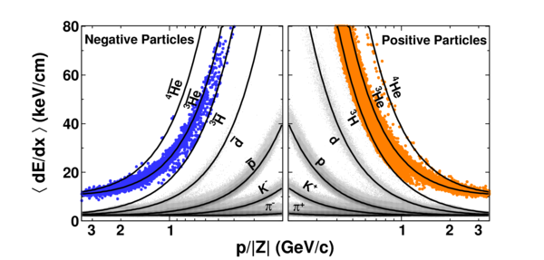
Increasing connections among historically disparate areas of QCD
As we advance, we’re building more connections among the various areas of QCD—and to other fields . . .
Nucleon structure and heavy ion communities
  Greater focus on initial-state (cold) nuclear effects
  Parton distribution functions in the proton vs. nuclei
  RHIC just ran polarized protons on gold! Use polarization to help search for gluon saturation physics
  Ultraperipheral heavy ion collisions for spatial imaging; impact-parameter-dependent nuclear distributions and collision geometry in heavy ion physics
Hadron spectroscopy and hadronization (nucleon structure) communities
  B factories as common facilities
Heavy ion and hadronization (nucleon structure) communities
  “String fragmentation” vs. binding of nearby partons in phase space
  Modified hadronization in hot or cold nuclear matter
Heavy ion and stellar structure communities
  Quark-gluon plasma and neutron stars: different corners of QCD phase diagram
Heavy ion and low-energy nuclear reaction, cosmology communities
  “Little Bang Nucleosynthesis” up to helium-4 (and antihelium-4!) in heavy ion collisions
STAR
Nature 473, 353 (2011)

Slide 26
A cyclical process
Proliferation of observations and ideas
Synthesis

Slide 27


Spin-spin and spin-momentum correlations in QCD bound states
Worm-gear
(Kotzinian-Mulders)
Unpolarized
Spin-spin correlations
Helicity
Lots of evidence from deep-inelastic lepton-nucleon scattering experiments over past ~10 years that many of these correlations are nonzero in nature!
Transversity
Sivers
Spin-momentum correlations
Boer-Mulders
S•(p₁×p₂)
Pretzelosity
Worm-gear

Slide 28
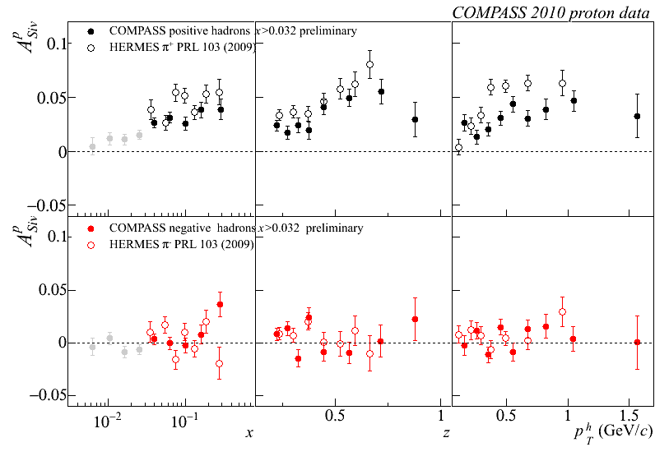
Sivers
e+p
μ+p

Slide 29
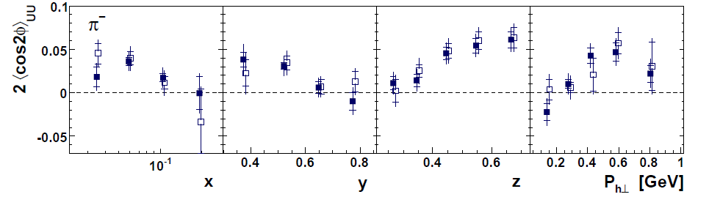
Sivers
e+p
μ+p
Boer-Mulders x Collins
e+p
HERMES, PRD 87, 012010 (2013)

Slide 30
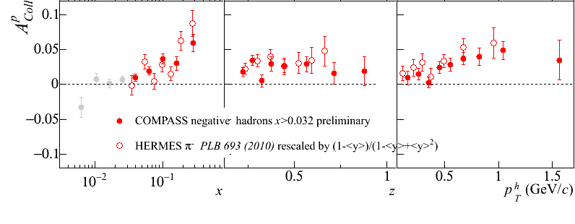
Sivers
e+p
μ+p
Boer-Mulders x Collins
e+p
HERMES, PRD 87, 012010 (2013)
e+p
μ+p
Transversity x Collins

Slide 31
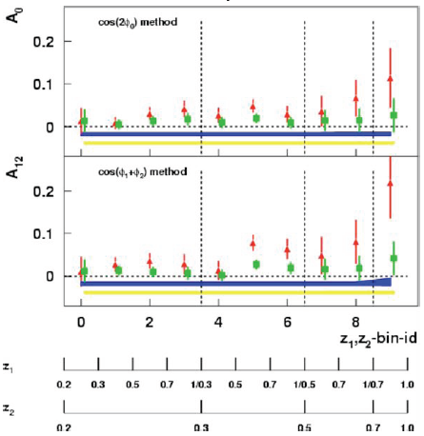
Sivers
e+p
μ+p
BELLE PRL96, 232002 (2006)
Collins x Collins
e⁺e⁻
Boer-Mulders x Collins
e+p
HERMES, PRD 87, 012010 (2013)
e+p
μ+p
Transversity x Collins

Slide 32
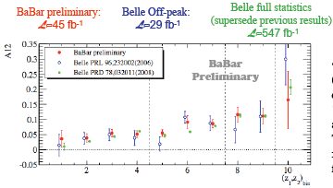
Sivers
e+p
μ+p
BELLE PRL96, 232002 (2006)
Collins x Collins
e⁺e⁻
Boer-Mulders x Collins
e+p
HERMES, PRD 87, 012010 (2013)
BaBar published ref. PRD90, 052003 (2014)
Collins x Collins
e⁺e⁻
e+p
μ+p
Transversity x Collins

Slide 33
“Naïve-T-odd” spin-momentum correlations require phase interference
Some transverse-momentum-dependent parton distribution functions odd under “naïve-time-reversal” (actually a PT transformation)
1990 – proposed by D.W. Sivers
1993 – Claimed forbidden by J.C. Collins
2002 – Demonstrated nonvanishing by Brodsky, Hwang, Schmidt if phase interference effects due to color interactions present

Slide 34
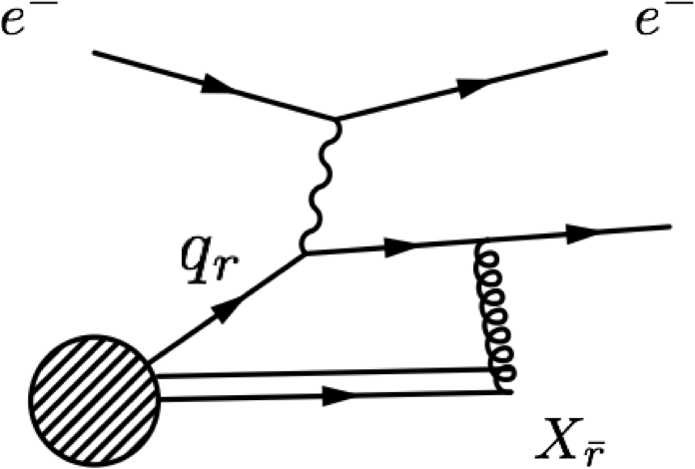
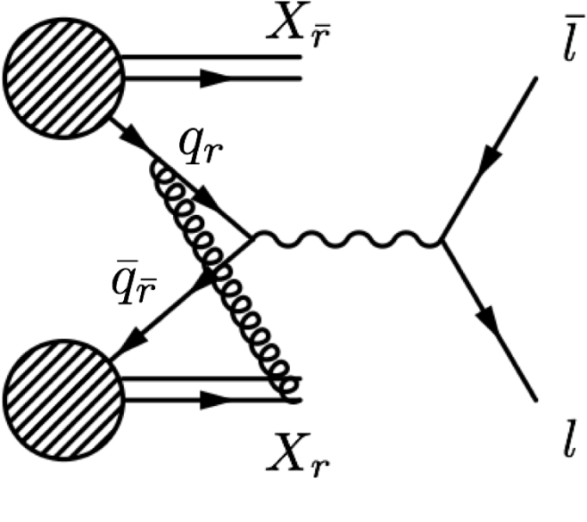
Color in action! Modified universality of certain transverse-momentum-dependent distributions
Deep-inelastic lepton-nucleon scattering:
Attractive final-state interactions
Quark-antiquark annihilation to leptons:
Repulsive initial-state interactions
Get opposite sign for Sivers transverse-momentum-dependent pdf in semi-inclusive DIS versus Drell-Yan:
process-dependent pdf! (Collins 2002)
Figures by J.D. Osborn

Slide 35
Color in action! Modified universality of certain transverse-momentum-dependent distributions
Deep-inelastic lepton-nucleon scattering:
Attractive final-state interactions
Quark-antiquark annihilation to leptons:
Repulsive initial-state interactions
Get opposite sign for Sivers transverse-momentum-dependent pdf in semi-inclusive DIS versus Drell-Yan:
process-dependent pdf! (Collins 2002)
Still waiting for a polarized quark-antiquark annihilation measurement to compare to existing lepton-nucleon scattering measurements . . .
Figures by J.D. Osborn

Slide 36

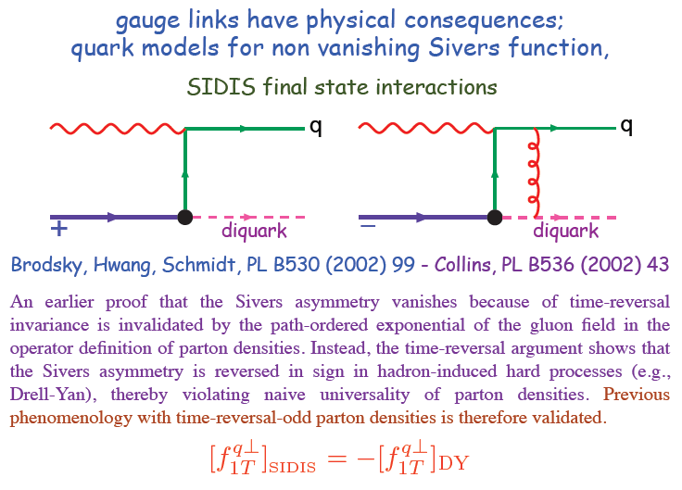
Modified universality requires full QCD:
Gauge-invariant quantum field theory
1993 claim by J.C. Collins that such processes must vanish
Slide from M. Anselmino, Transversity 2014

Slide 37
Physical consequences of a gauge-invariant quantum theory:
Aharonov-Bohm (1959)
Wikipedia:
“The Aharonov–Bohm effect is important conceptually because it bears on three issues apparent in the recasting of (Maxwell's) classical electromagnetic theory as a gauge theory, which before the advent of quantum mechanics could be argued to be a mathematical reformulation with no physical consequences. The Aharonov–Bohm thought experiments and their experimental realization imply that the issues were not just philosophical.
The three issues are:
whether potentials are "physical" or just a convenient tool for calculating force fields;
whether action principles are fundamental;
the principle of locality.”

Slide 38
Physical consequences of a gauge-invariant quantum theory:
Aharonov-Bohm (1959)
Physics Today, September 2009 :
The Aharonov–Bohm effects: Variations on a subtle theme,
by Herman Batelaan and Akira Tonomura.
“Aharonov stresses that the arguments that led to the prediction of the various electromagnetic AB effects apply equally well to any other gauge-invariant quantum theory. In the standard model of particle physics, the strong and weak nuclear interactions are also described by gauge-invariant theories. So one may expect that particle-physics experimenters will be looking for new AB effects in new domains.”

Slide 39
Physical consequences of a gauge-invariant quantum theory:
Aharonov-Bohm effect in QCD!!
Deep-inelastic lepton-nucleon scattering:
Attractive final-state interactions
Quark-antiquark annihilation to leptons:
Repulsive initial-state interactions
See e.g. Pijlman, hep-ph/0604226
or Sivers, arXiv:1109.2521
Figures by J.D. Osborn

Slide 40
Physical consequences of a gauge-invariant quantum theory:
Aharonov-Bohm effect in QCD!!
Deep-inelastic lepton-nucleon scattering:
Attractive final-state interactions
Quark-antiquark annihilation to leptons:
Repulsive initial-state interactions
Simplicity of these two processes:
Abelian vs. non-Abelian nature of the gauge group doesn’t play a major qualitative role.
BUT: In QCD expect additional, new effects due to specific non-Abelian nature of the gauge group
See e.g. Pijlman, hep-ph/0604226
or Sivers, arXiv:1109.2521
Figures by J.D. Osborn

Slide 41
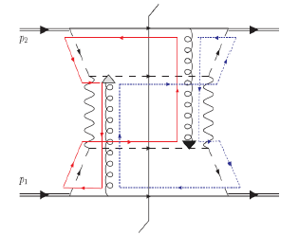
QCD Aharonov-Bohm effect:
Color entanglement
  2010: Rogers and Mulders predict color entanglement in processes involving p+p production of hadrons if quark transverse momentum taken into account
  Quarks become correlated across the two protons
  Consequence of QCD specifically as a non-Abelian gauge theory!
PRD 81, 094006 (2010)
Color flow can’t be described as flow in the two gluons separately. Requires simultaneous presence of both.

Slide 42
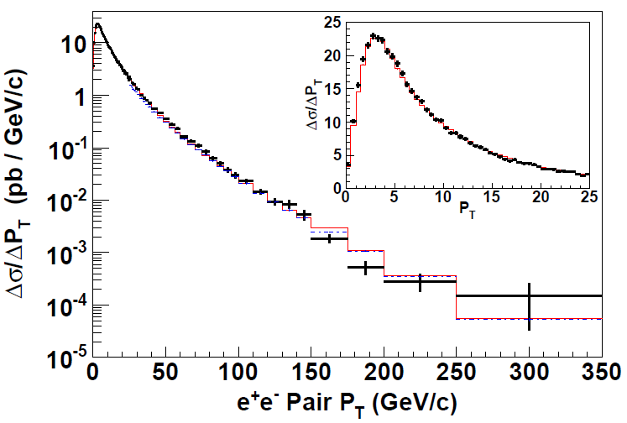
Testing Aharonov-Bohm effect in QCD as a non-Abelian gauge theory
Look for contradiction with predictions for the case of no color entanglement
But first need to parameterize (unpolarized) transverse-momentum-dependent pdfs from world data
  Better constraints on unpolarized predictions because more available data
CDF Z production
PRD86, 052010 (2012)

Slide 43
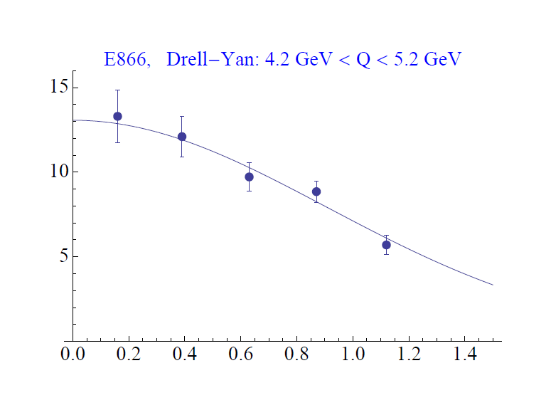
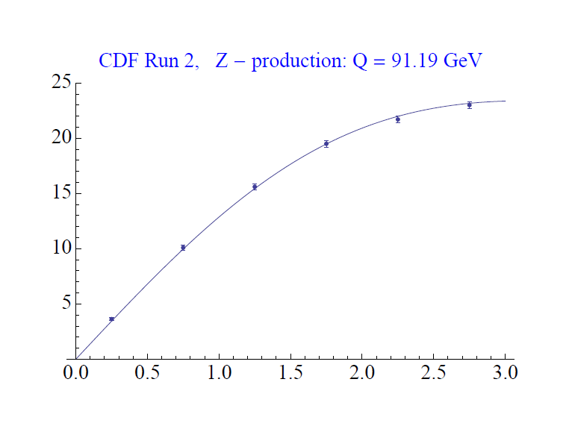
Testing Aharonov-Bohm effect in QCD as a non-Abelian gauge theory
Look for contradiction with predictions for the case of no color entanglement
But first need to parameterize (unpolarized) transverse-momentum-dependent pdfs from world data
  Better constraints on unpolarized predictions because more available data
CDF Z production
PRD86, 052010 (2012)
dσ/dp_{T}
CAA,
T.C. Rogers, in progress
dσ/dp_{T}
p+p → μ⁺+μ⁻+X
√s = 1.96 TeV
√s = 0.039 TeV
p_{T} (GeV/c)
p_{T} (GeV/c)

Slide 44
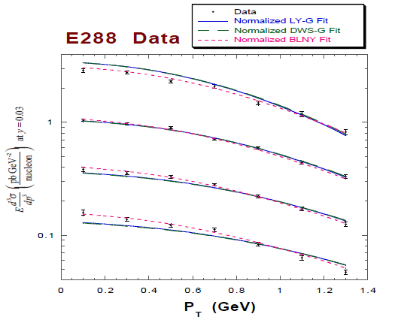
Testing the Aharonov-Bohm effect in QCD as a non-Abelian gauge theory
Quark-antiquark annihilation to lepton pairs
p+A → μ⁺+μ⁻+X
for different invariant masses:
No color entanglement expected
Landry, Brock, Nadolsky, Yuan, PRD 67, 073016 (2003)
Get predictions from fits to data where no entanglement expected

Slide 45
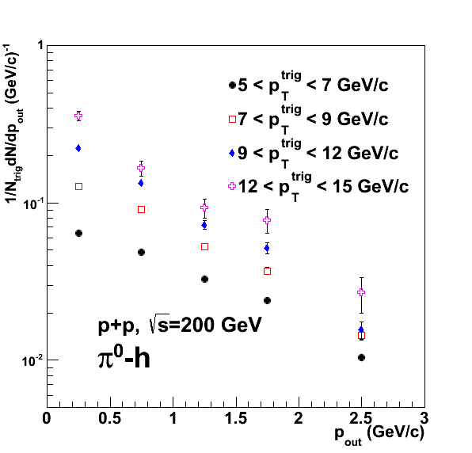

Testing the Aharonov-Bohm effect in QCD as a non-Abelian gauge theory
PRD82, 072001 (2010)
Quark-antiquark annihilation to lepton pairs
p+A → μ⁺+μ⁻+X
for different invariant masses:
No color entanglement expected
Landry, Brock, Nadolsky, Yuan, PRD 67, 073016 (2003)
Get predictions from fits to data where no entanglement expected
Out-of-plane momentum component
In progress . . .!
Make predictions for processes where entanglement is expected; look for deviation

Slide 46
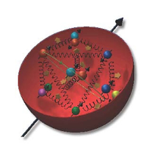
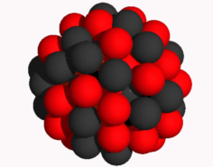
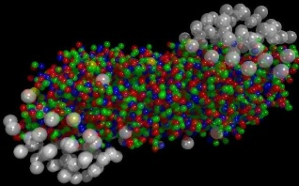
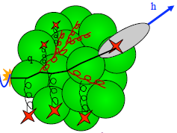
Summary
Early years of rewarding new era of quantitative basic research in QCD!
Gradually shifting to think about QCD systems in new ways, focusing on topics/ideas/concepts long familiar to the world of condensed matter physics
  All sorts of correlations within systems
  Quantum mechanical phase interference effects
  Quantum entangled systems
Disparate subfields within QCD and within particle and nuclear physics starting to converge over last ~15 years

Slide 47
Summary
Early years of rewarding new era of quantitative basic research in QCD!
Gradually shifting to think about QCD systems in new ways, focusing on topics/ideas/concepts long familiar to the world of condensed matter physics
  All sorts of correlations within systems
  Quantum mechanical phase interference effects
  Quantum entangled systems
Disparate subfields within QCD and within particle and nuclear physics starting to converge over last ~15 years

Slide 48
Summary
Early years of rewarding new era of quantitative basic research in QCD!
Gradually shifting to think about QCD systems in new ways, focusing on topics/ideas/concepts long familiar to the world of condensed matter physics
  All sorts of correlations within systems
  Quantum mechanical phase interference effects
  Quantum entangled systems
Disparate subfields within QCD and within particle and nuclear physics starting to converge over last ~15 years

Slide 49
Summary
Early years of rewarding new era of quantitative basic research in QCD!
Gradually shifting to think about QCD systems in new ways, focusing on topics/ideas/concepts long familiar to the world of condensed matter physics
  All sorts of correlations within systems
  Quantum mechanical phase interference effects
  Quantum entangled systems
Disparate subfields within QCD and within particle and nuclear physics starting to converge over last ~15 years
Taking small, initial steps along the path toward “grand unification” of QCD across different scales, from partons to neutron stars . . .

Slide 50
Extra

Slide 51

Huge spin asymmetries in p+p → hadrons: Due to color entanglement??
ANL
√s=4.9 GeV
BNL
√s=6.6 GeV
FNAL
√s=19.4 GeV
RHIC
√s=62.4 GeV
left
right

Slide 52
Huge spin asymmetries in p+p → hadrons: Due to color entanglement??
ANL
√s=4.9 GeV
BNL
√s=6.6 GeV
FNAL
√s=19.4 GeV
RHIC
√s=62.4 GeV
left
Strikingly similar effects across energies!
→ Continuum between nonperturbative/nonpartonic and perturbative/partonic descriptions of this nonperturbative structure?
right

Slide 53
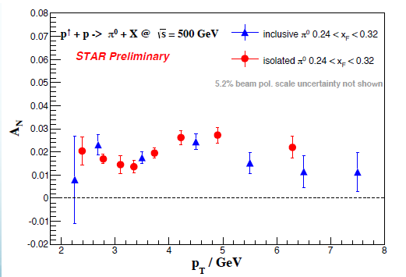
p+p → hadron asymmetries persist up to
√s=0.5 TeV and p_{T} = 7 GeV!
Effects persist to kinematic regimes where perturbative QCD techniques clearly apply
p_{T} = 8 GeV
→ Q² ~ 64 GeV²!
Note x_{F} = 0.24-0.32 here, where asymmetries approached zero on lower-energy plots—need more-forward measurements at high energies!
π⁰

Slide 54
Recent renaissance in nuclear pdfs
Renaissance in nuclear pdfs
  EPS09 483 citations!
JHEP 0904, 065 (2009)

Slide 55
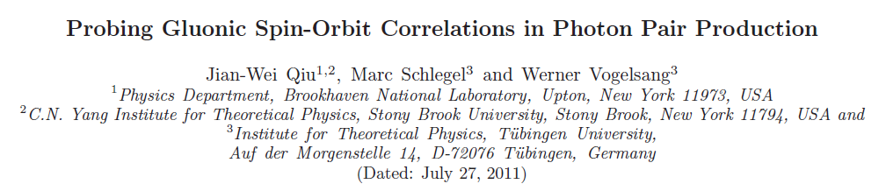
Increasing connections between heavy ion or nucleon structure physics and particle physics
Low-x/gluon saturation physics
  Onset expected in higher-energy p+p collisions, lower-energy heavy ion collisions
Transverse-momentum-dependent parton distribution functions, Q_{T} resummation, Soft-Collinear Effective Theory
  Determine transverse momentum distribution for Higgs, Z/W, Drell-Yan at low p_{T}
B factories
  Flavor physics and CP violation
  Spin-momentum correlations in hadronization
  Dihadron fragmentation functions—observe two particles fragmenting from single parton
Jets and jet substructure
  Gluon vs. quark jets and hadronization
  Search for BSM physics
  Measure parton spin-momentum correlations in hadronization via angular distributions of particles within jet
  Understand jet modification and energy redistribution in nuclear medium
Underlying event
  Soft QCD physics in p+p, nuclear collisions
Collectivity in high-multiplicity systems, regardless of system size
Searching for dark matter in heavy ion collisions

Slide 56
Increasing connections between heavy ion or nucleon structure physics and particle physics
Low-x/gluon saturation physics
  Onset expected in higher-energy p+p collisions, lower-energy heavy ion collisions
Transverse-momentum-dependent parton distribution functions, Q_{T} resummation, Soft-Collinear Effective Theory
  Determine transverse momentum distribution for Higgs, Z/W, Drell-Yan at low p_{T}
B factories
  Flavor physics and CP violation
  Spin-momentum correlations in hadronization
  Dihadron fragmentation functions—observe two particles fragmenting from single parton
Jets and jet substructure
  Gluon vs. quark jets and hadronization
  Search for BSM physics
  Measure parton spin-momentum correlations in hadronization via angular distributions of particles within jet
  Understand jet modification and energy redistribution in nuclear medium
Underlying event
  Soft QCD physics in p+p, nuclear collisions
Collectivity in high-multiplicity systems, regardless of system size
Searching for dark matter in heavy ion collisions

Slide 57
Increasing connections between heavy ion or nucleon structure physics and particle physics
Low-x/gluon saturation physics
  Onset expected in higher-energy p+p collisions, lower-energy heavy ion collisions
Transverse-momentum-dependent parton distribution functions, Q_{T} resummation, Soft-Collinear Effective Theory
  Determine transverse momentum distribution for Higgs, Z/W, Drell-Yan at low p_{T}
B factories
  Flavor physics and CP violation
  Spin-momentum correlations in hadronization
  Dihadron fragmentation functions—observe two particles fragmenting from single parton
Jets and jet substructure
  Gluon vs. quark jets and hadronization
  Search for BSM physics
  Measure parton spin-momentum correlations in hadronization via angular distributions of particles within jet
  Understand jet modification and energy redistribution in nuclear medium
Underlying event
  Soft QCD physics in p+p, nuclear collisions
Collectivity in high-multiplicity systems, regardless of system size
Searching for dark matter in heavy ion collisions

Slide 58
Increasing connections between heavy ion or nucleon structure physics and particle physics
Low-x/gluon saturation physics
  Onset expected in higher-energy p+p collisions, lower-energy heavy ion collisions
Transverse-momentum-dependent parton distribution functions, Q_{T} resummation, Soft-Collinear Effective Theory
  Determine transverse momentum distribution for Higgs, Z/W, Drell-Yan at low p_{T}
B factories
  Flavor physics and CP violation
  Spin-momentum correlations in hadronization
  Dihadron fragmentation functions—observe two particles fragmenting from single parton
Jets and jet substructure
  Gluon vs. quark jets and hadronization
  Search for BSM physics
  Measure parton spin-momentum correlations in hadronization via angular distributions of particles within jet
  Understand jet modification and energy redistribution in QCD medium
Underlying event
  Soft QCD physics in p+p, nuclear collisions
Collectivity in high-multiplicity systems, regardless of system size
Searching for dark matter in heavy ion collisions

Slide 59
Increasing connections between heavy ion or nucleon structure physics and particle physics
Low-x/gluon saturation physics
  Onset expected in higher-energy p+p collisions, lower-energy heavy ion collisions
Transverse-momentum-dependent parton distribution functions, Q_{T} resummation, Soft-Collinear Effective Theory
  Determine transverse momentum distribution for Higgs, Z/W, Drell-Yan at low p_{T}
B factories
  Flavor physics and CP violation
  Spin-momentum correlations in hadronization
  Dihadron fragmentation functions—observe two particles fragmenting from single parton
Jets and jet substructure
  Gluon vs. quark jets and hadronization
  Search for BSM physics
  Measure parton spin-momentum correlations in hadronization via angular distributions of particles within jet
  Understand jet modification and energy redistribution in nuclear medium
Underlying event
  Soft QCD physics in p+p, nuclear collisions
Collectivity in high-multiplicity systems, regardless of system size
Searching for dark matter in heavy ion collisions

Slide 60
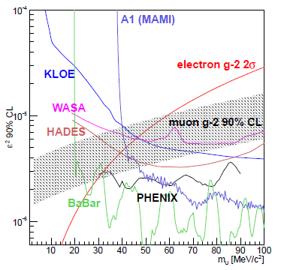
Increasing connections between heavy ion or nucleon structure physics and particle physics
Low-x/gluon saturation physics
  Onset expected in higher-energy p+p collisions, lower-energy heavy ion collisions
Transverse-momentum-dependent parton distribution functions, Q_{T} resummation, Soft-Collinear Effective Theory
  Determine transverse momentum distribution for Higgs, Z/W, Drell-Yan at low p_{T}
B factories
  Flavor physics and CP violation
  Spin-momentum correlations in hadronization
  Dihadron fragmentation functions—observe two particles fragmenting from single parton
Jets and jet substructure
  Gluon vs. quark jets and hadronization
  Search for BSM physics
  Measure parton spin-momentum correlations in hadronization via angular distributions of particles within jet
  Understand jet modification and energy redistribution in nuclear medium
Underlying event
  Soft QCD physics in p+p, nuclear collisions
Collectivity in high-multiplicity systems, regardless of system size
Searching for dark matter in heavy ion collisions
PHENIX
PRC91, 024913(R) (2015)

Slide 61
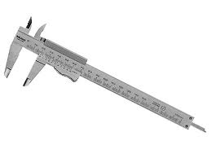
Overlapping tools and techniques
HEP, nucleon structure, and heavy ion communities sharing an increasing number of tools/techniques
  Jets—to study parton energy loss in quark-gluon plasma, in-medium modification of fragmentation functions, gluon spin contribution to spin of proton, . . .
  W/Z bosons—to calibrate parton energy loss in quark-gluon plasma, to study flavor-separated light sea quark helicity distributions, to test quantum phase interference effects due to gauge structure of QCD, . . .
  Heavy flavor/quarkonia—to probe temperature of quark-gluon plasma, color screening effects, hadron production mechanisms, spin-dependent tri-gluon correlation functions, . . .
  Bose-Einstein interferometry (Hanbury-Brown – Twiss)—to study properties and spatial extent of sources emitting radiation and particles—astronomy, heavy ions, e⁺e⁻, e+p, p+pbar, p+p

Slide 62
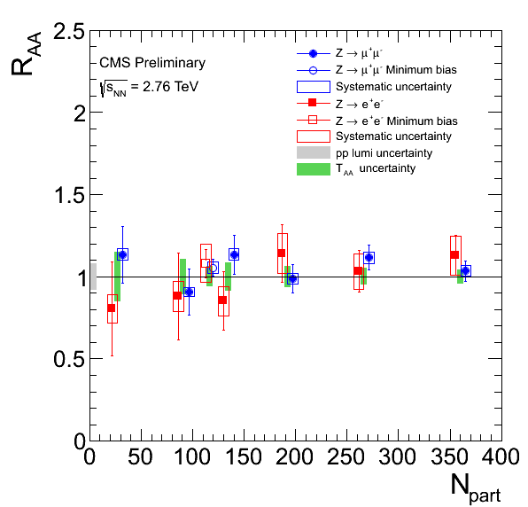
Overlapping tools and techniques
HEP, nucleon structure, and heavy ion communities sharing an increasing number of tools/techniques
  Jets—to study parton energy loss in quark-gluon plasma, in-medium modification of fragmentation functions, gluon spin contribution to spin of proton, . . .
  W/Z bosons—to calibrate parton energy loss in quark-gluon plasma, to study flavor-separated light sea quark helicity distributions, to test quantum phase interference effects due to gauge structure of QCD, . . .
  Heavy flavor/quarkonia—to probe temperature of quark-gluon plasma, color screening effects, hadron production mechanisms, spin-dependent tri-gluon correlation functions, . . .
  Bose-Einstein interferometry (Hanbury-Brown – Twiss)—to study properties and spatial extent of sources emitting radiation and particles—astronomy, heavy ions, e⁺e⁻, e+p, p+pbar, p+p
Ratio of Z production in Pb+Pb to scaled p+p
→ No modification

Slide 63
Overlapping tools and techniques
HEP, nucleon structure, and heavy ion communities sharing an increasing number of tools/techniques
  Jets—to study parton energy loss in quark-gluon plasma, in-medium modification of fragmentation functions, gluon spin contribution to spin of proton, . . .
  W/Z bosons—to calibrate parton energy loss in quark-gluon plasma, to study flavor-separated light sea quark helicity distributions, to test quantum phase interference effects due to gauge structure of QCD, . . .
  Heavy flavor/quarkonia—to probe temperature of quark-gluon plasma, color screening effects, hadron production mechanisms, spin-dependent tri-gluon correlation functions, . . .
  Bose-Einstein interferometry (Hanbury-Brown – Twiss)—to study properties and spatial extent of sources emitting radiation and particles—astronomy, heavy ions, e⁺e⁻, e+p, p+pbar, p+p

Slide 64
Overlapping tools and techniques
HEP, nucleon structure, and heavy ion communities sharing an increasing number of tools/techniques
  Jets—to study parton energy loss in quark-gluon plasma, in-medium modification of fragmentation functions, gluon spin contribution to spin of proton, . . .
  W/Z bosons—to calibrate parton energy loss in quark-gluon plasma, to study flavor-separated light sea quark helicity distributions, to test quantum phase interference effects due to gauge structure of QCD, . . .
  Heavy flavor/quarkonia—to probe temperature of quark-gluon plasma, color screening effects, hadron production mechanisms, spin-dependent tri-gluon correlation functions, . . .
  Bose-Einstein interferometry (Hanbury-Brown – Twiss)—to study properties and spatial extent of sources emitting radiation and particles—astronomy, heavy ions, e⁺e⁻, e+p, p+pbar, p+p

Slide 65
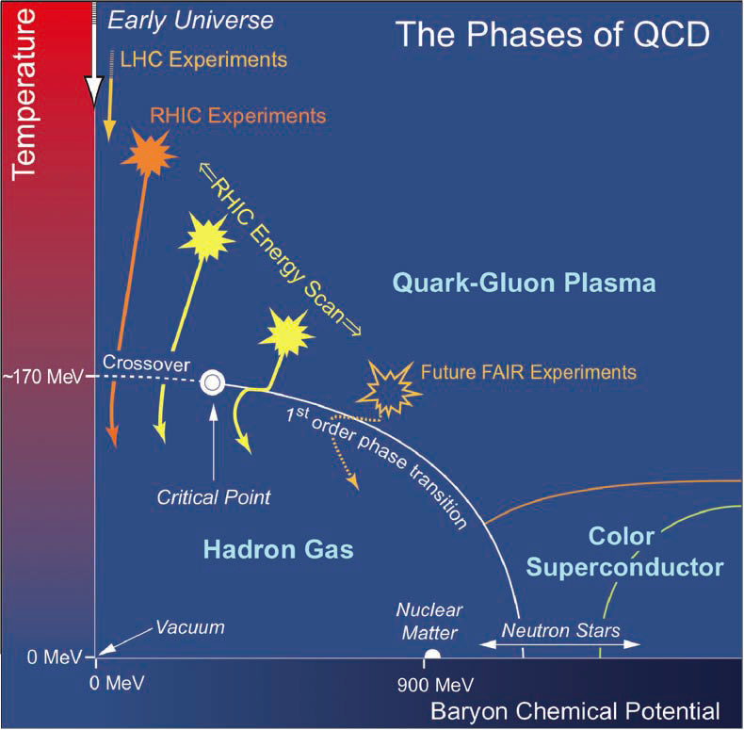
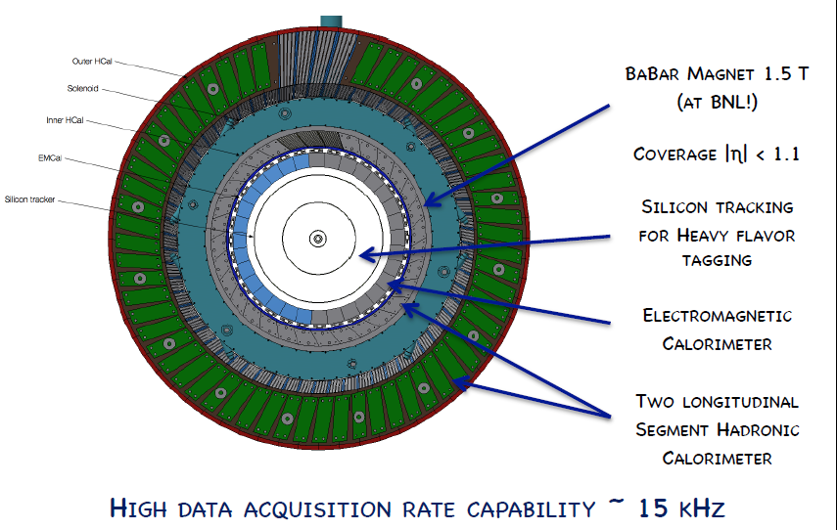
Coming up at RHIC
RHIC Beam Energy Scan II
  Search for QCD critical end point
sPHENIX
  Proposed new detector at RHIC focused on jets, jet correlations, upsilons
Many more results from recent data sets: ³He+Au, Cu+Au, U+U, p↑+Au, p↑+Al, p↑+p↑, . . .

Slide 66
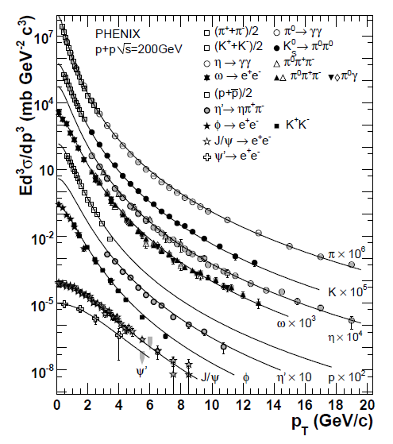
Hadronization: Eventually even “more global” global fits of fragmentation functions?
Perform fragmentation function parameterizations for even more particles simultaneously?
  Will constrain relative normalizations well
Ultimate goal: Measure jet and all particles within it!
Fit pdfs and FFs simultaneously . . .
PRD83, 052004 (2011)

Slide 67
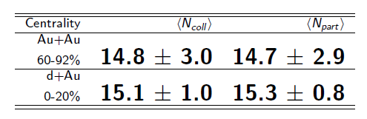
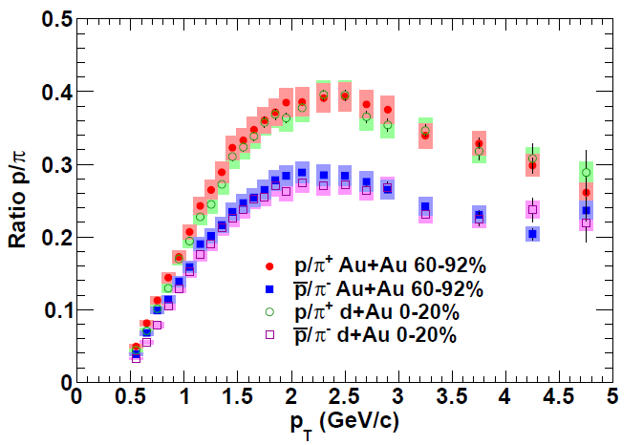
Additional hadronization mechanisms in the presence of many partons?
Both shape and magnitude of p/π ratio in d+Au and peripheral Au+Au identical!
Suggests common mechanism(s) for baryon production in the two systems—partons nearby in phase space bind?
PRC88, 024906 (2013)

Slide 68
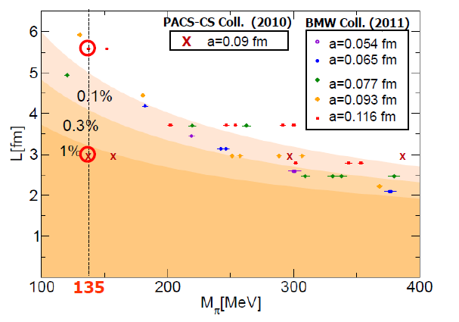
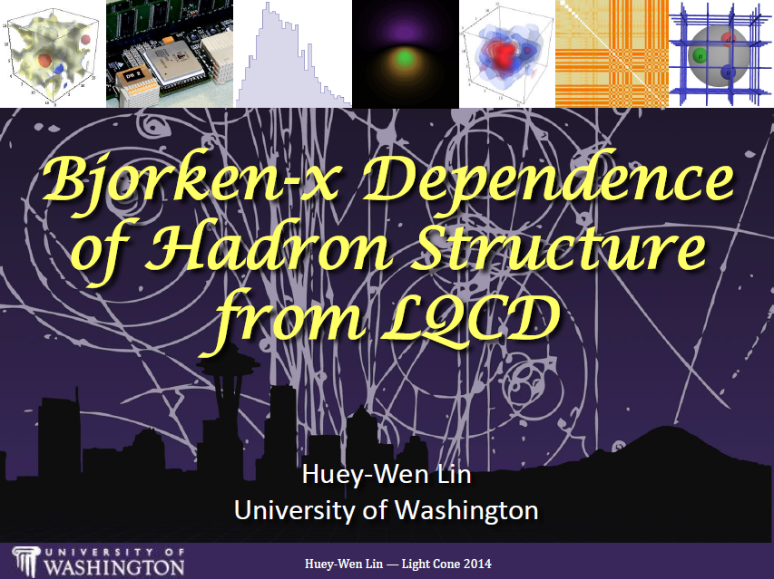
Example: Progress in lattice QCD
First calculations at physical pion mass 135 MeV
Figure from T. Hatsuda,
PANIC 2011
PACS-CS: PRD81, 074503 (2010)
BMW: PLB701, 265 (2011)
Since 2013, possibility to calculate x dependence of parton distribution functions
Slide from Huey-Wen Lin, Light Cone 2014
Notes:
Lattice calcs at pion mass: hadron spectrum, quark masses, pseudoscalar meson decay constants.

