Slide 1
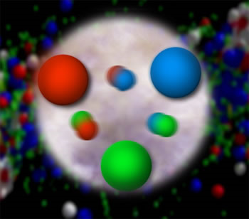
Probing the Proton:
Entangled Personal and Particle Paths
Christine A. Aidala
University of Michigan
U-M CUWiP
January 17, 2015

Slide 2
My own experiences
Since the summer after my freshman year, have woven my way through various energies and collision systems in nuclear and particle physics
Low-energy nuclear structure at Wright Nuclear Structure Lab, Yale University (nuclear fusion-evaporation cross section studies, 100 MeV beam on fixed target)
Relativistic heavy ion physics at Brookhaven National Lab (detector simulation, 200 GeV per nucleon center-of-mass)
Proton-proton particle physics at CERN (detector hardware and data acquisition, 14 TeV c.m.)
Summer, through my university
Summer REU
Summer REU

Slide 3
My own experiences
Polarized proton structure at DESY (simulations for proposed polarized proton-electron collider, 300 GeV c.m.)
e+e- particle physics at CERN (exotic physics searches, 200 GeV c.m.)
More relativistic heavy ion physics and more proton structure at Brookhaven National Lab (200 GeV c.m.)
Senior project, two semesters
Summer before grad school
Interlude teaching English and music in Italy for 1 ½ years . . .
Temporary employment,
back to grad school, and postdoc . . .

Slide 4
My career 1996-2012 in pictures . . .
You are
(back) here
BNL
DESY
WNSL
CERN
A 12-month temporary contract at BNL generated the initial conditions that set much of my course for the next 11 years
Sat in same hallway in BNL Physics Dept. for that time, supported in turn by 4 different institutions!
  Turned down multiple career opportunities to maintain geographical stability

Slide 5
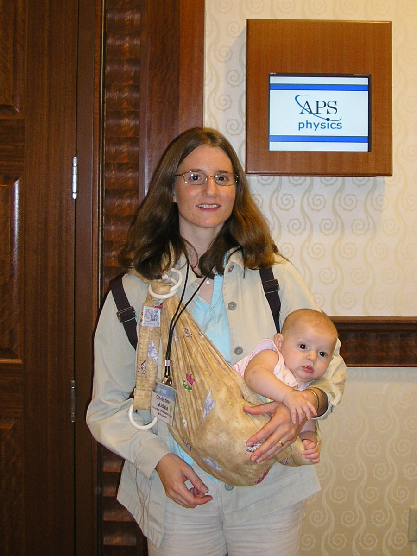
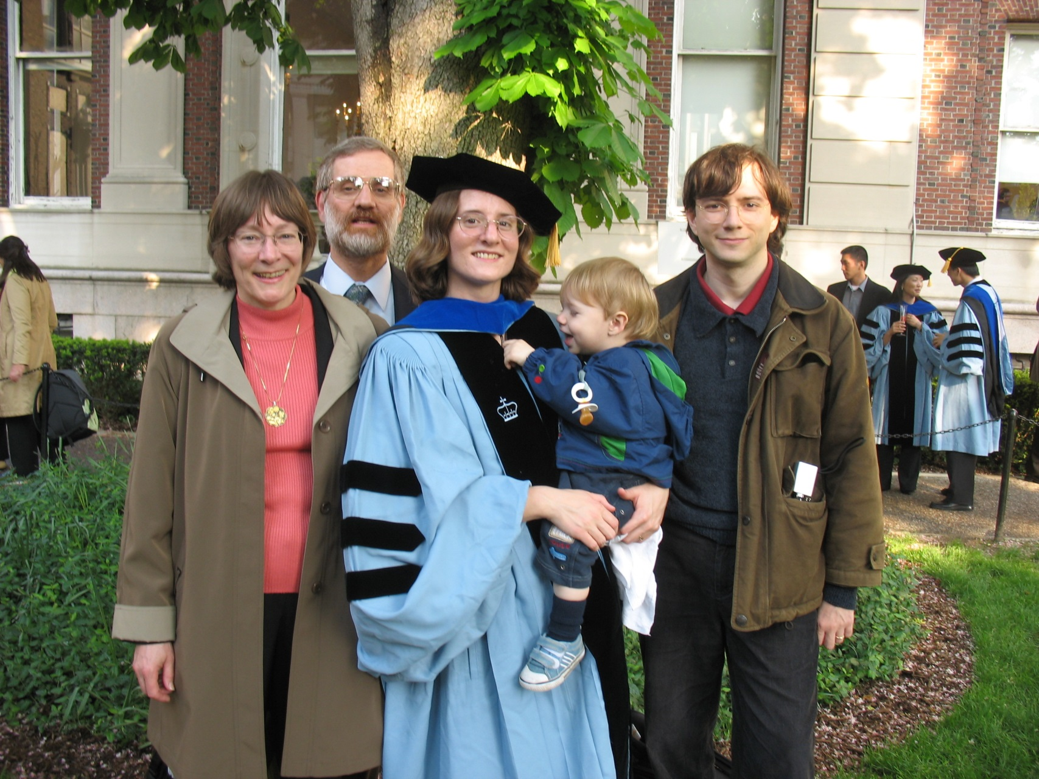

Slide 6
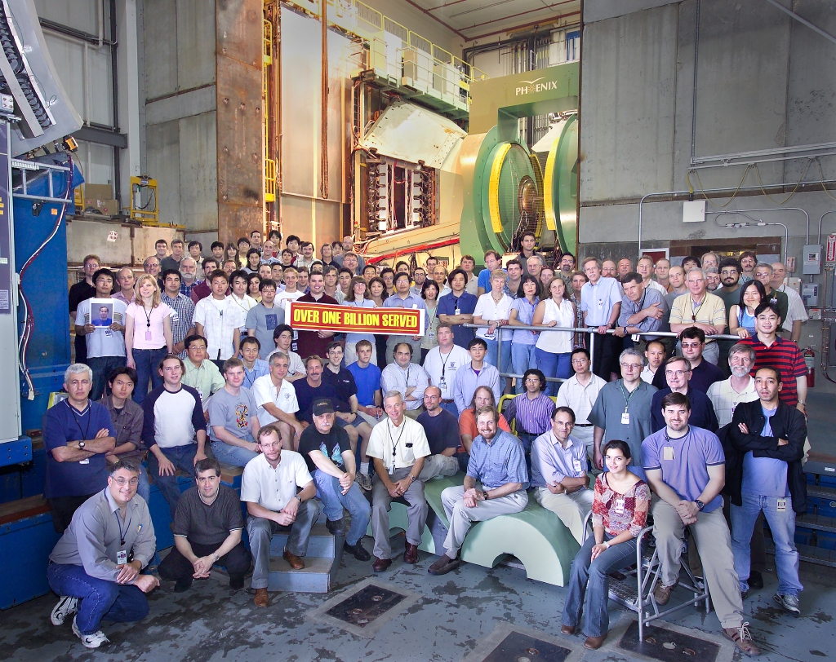
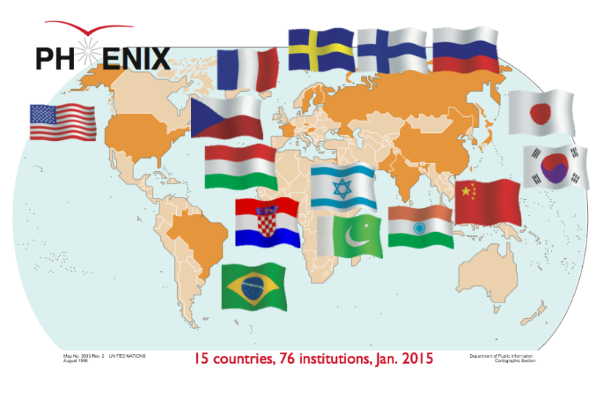
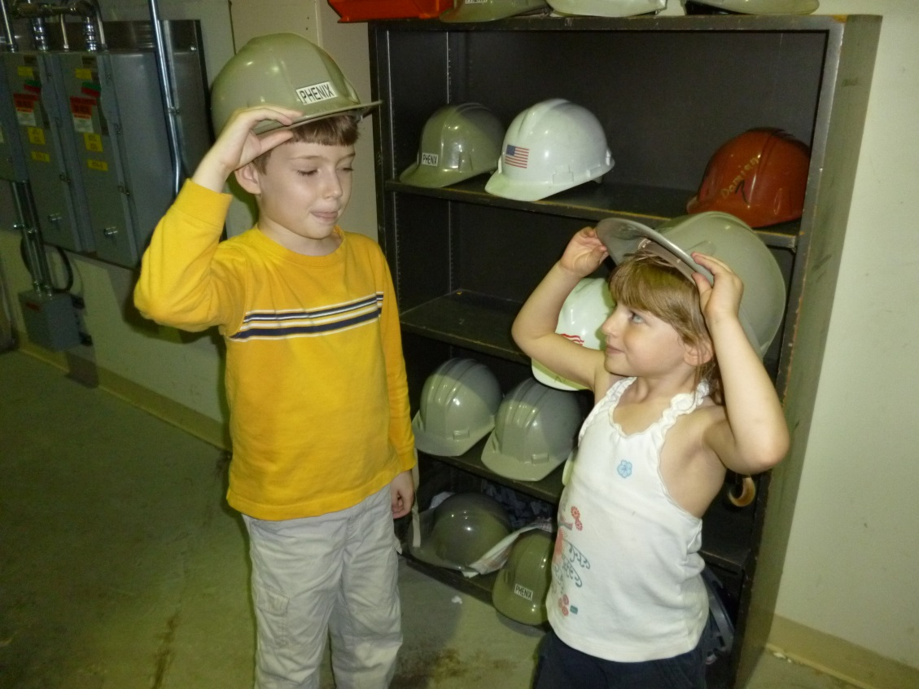

PHENIX experiment at the
Relativistic Heavy Ion Collider
15 Countries, 76 Institutions
~500 Participants
Notes:
Love the international aspect. Lots of students. I first worked on RHIC, actually on our rival experiment, for a summer as an undergrad, and four years later came back to the facility as a Ph.D. student. Training the next generation of scientists is a big part of the mission of large facilities such as colliders, and you can never start them too young . . .

Slide 7
Finding a passion . . .
Maybe I actually missed my “true” calling as a condensed matter theorist (you can never try everything!), or even as a park ranger (got a summer job offer from the National Park Service a couple weeks after I’d agreed to take my first research job!)
But among the areas I have explored, I’ve found a passion in one of them . . .

Slide 8
And finding a niche
I’ve also found a community of people that I respect and enjoy
  With comfortable room for me to make meaningful scientific contributions
I’ve come to feel at home within the community of people studying the strong force and structure of the proton

Slide 9
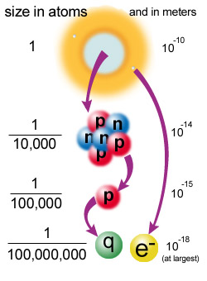
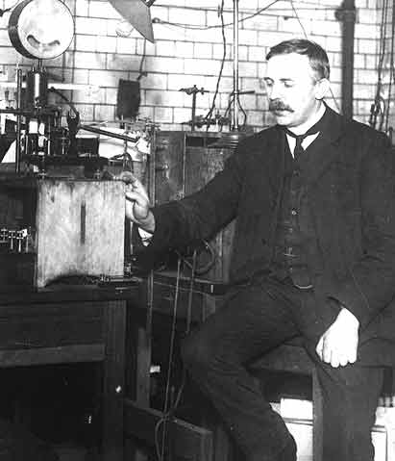
Probing inside atoms: mostly empty space!
1911: Ernest Rutherford scatters alpha particles from radioactive decay off of a thin gold foil
Most went right through!
But—about 1/8000 bounced back!
So atoms have a small, positively charged core → the nucleus
Notes:
Positive core repelled positive alphas. Millimeter grain of sand to 100 m football field (The Physics Dept. has been advocating to have the field converted to metric, but it hasn’t caught on yet!) Rutherford named the hydrogen nucleus the proton.

Slide 10
Probing inside protons . . .
Late 1960s: scatter electrons off of protons
Many bounced back sharply . . .
But weren’t bouncing off of the whole proton → subcomponents!
  Protons not solid lumps of positive charge
  Constituents that make up the proton now called “quarks”
Quark
Notes:
More than half a century later, using an electron accelerator at Stanford University.

Slide 11
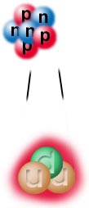
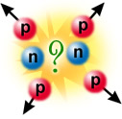
Strong force
How does the nucleus stay together? The electromagnetic force should cause the protons to repel one another
Protons and neutrons interact via the strong force, carried by gluons
  Much stronger than the electromagnetic force (~100x) and waaayyy stronger than gravity (~10³⁸x!!) (thus the name!)
  But—very very short range! (~10⁻¹⁵ m)

Slide 12
“Color” charge and
Quantum Chromodynamics
Strong force acts on particles with color charge
  Quarks, plus gluons themselves! (Contrast with photons, which are electrically neutral)
“Color” because three different “charges” combine to make a neutral particle:
Quantum Chromodynamics (QCD)—theory describing the strong force
Note that quarks also carry fractional electric charge!!
Proton = up + up + down quarks
+1 = (+2/3) + (+2/3) + (-1/3)
Neutron = down + down + up
0 = (-1/3) + (-1/3) + (+2/3)
red + blue + green =
white

Slide 13
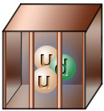
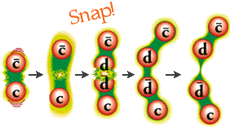
Quark confinement
Never see quarks or gluons directly!
  Confined to composite, color-neutral particles
  Groups of three quarks (rgb), called baryons, or quark-antiquark pairs (red-antired, . . .), called mesons
If you try to pull two quarks apart, energy between them increases until you produce a new quark-antiquark pair (recall good old E=mc²)
“D⁻ meson”
“D⁺ meson”

Slide 14
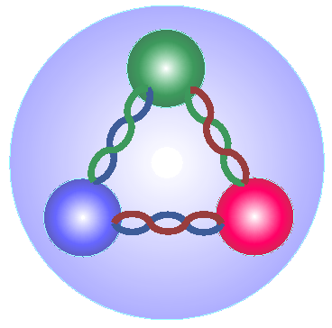
Studying proton structure
If can’t see individual quarks and gluons, how to determine the proton’s structure?
Inelastic scattering—shoot a high-energy beam (e.g. of electrons) at the proton to break it up, and try to understand what happens
  Electron exchanges a photon with quarks, because quarks carry electromagnetic charge as well as color

Slide 15
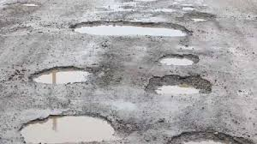

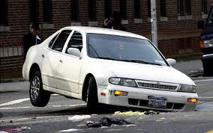


Probes sensitive to different length scales
What size potholes will bother you if you’re driving a . . .
Notes:
[Transition slide before this?]

Slide 16
High-energy particle accelerators
Molecular and atomic structure of matter: study using
  ultraviolet light (wavelengths 10-400 nanometers)
  x-rays (wavelengths 0.01-10 nanometers)
Nuclei and protons: 10,000× to 100,000× smaller than atoms → Need high-energy particle accelerators to see inside them
Notes:
Synchrotron light source facilities – 5 national facilities in the U.S.

Slide 17
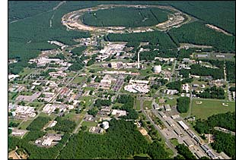
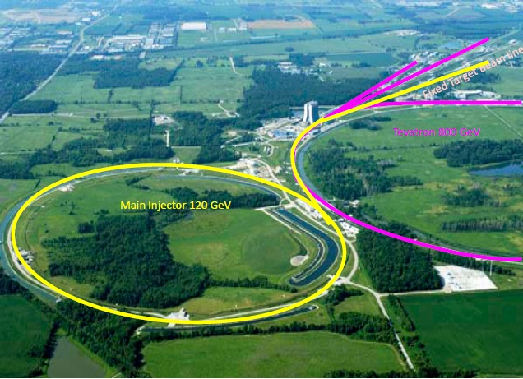
My experiments
The PHENIX experiment at the Relativistic Heavy Ion Collider at Brookhaven National Lab (BNL) on Long Island, NY
The SeaQuest experiment at Fermi National Accelerator Laboratory outside Chicago

Slide 18
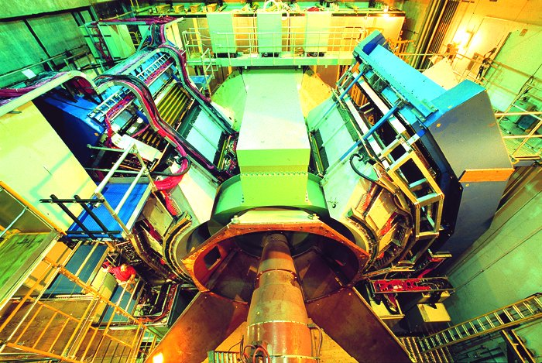
PHENIX Detector

Slide 19
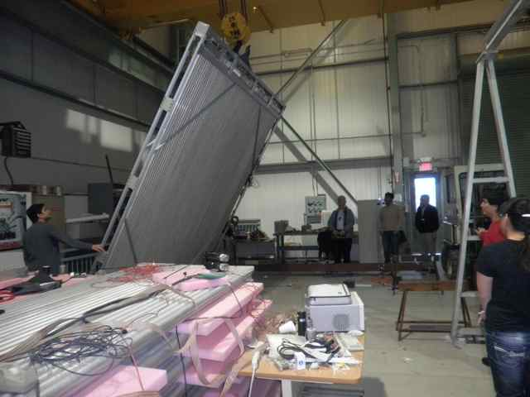
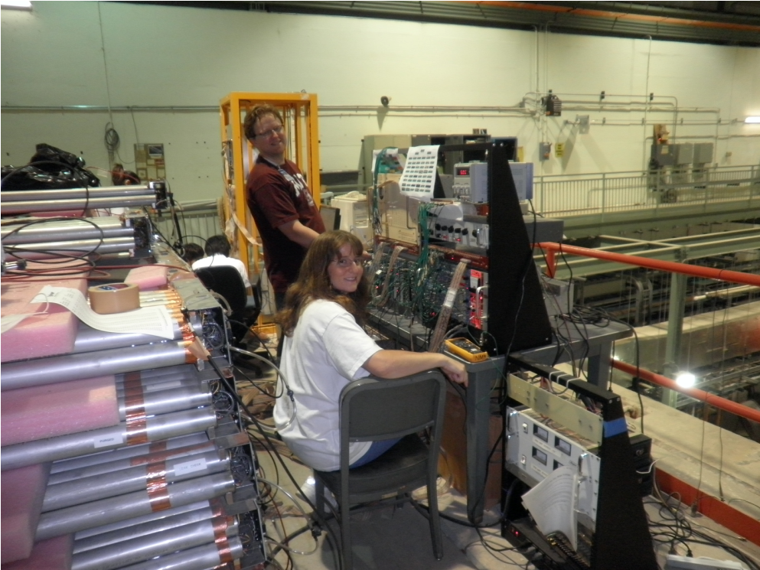
SeaQuest model: Reuse, recycle!
Station 4 tracking plane assembled from old proportional tubes scavenged from Los Alamos National Lab “threat reduction” experiments!

Slide 20
What have we learned?
Conclusions from decades of inelastic scattering data investigating proton momentum structure:
  3 “valence” quarks carry (on average) the largest single momentum fractions of the proton
  But lots of gluons and “sea” quark-antiquark pairs in the proton as well! Gluons carry ~50% of total momentum of proton.
Despite all the recent excitement about the Higgs boson, gluons are actually responsible for more than 98% of the mass of the visible universe!!

Slide 21
Focus of my current research
Spin-momentum correlations within the proton
  Can think of as spin-orbit couplings
Searching for experimental evidence of an exciting recent prediction of color entanglement of quarks across two colliding protons!

Slide 22
2012: “Landing” at the
University of Michigan
Didn’t see working remotely from my employing institution as a permanent option, and by 2012, felt it was time to move on in one way or another
Grateful to have landed where I am now . . .

Slide 23
Concluding remarks
Actively think about where you’d like your path to take you, but don’t be afraid to change directions (or have them changed by external forces) en route
  You usually have more options than are immediately obvious!
There are many paths—some more linear than others—to success (= happiness)!

Slide 24
We shall not cease from exploration
And the end of all our exploring
Will be to arrive where we started
And know the place for the first time.
T.S. Eliot

Slide 25
Extra

Slide 26
Mapping out the proton:
Other questions to ask!
What does the proton look like in terms of the quarks and gluons inside it?
Position
Momentum
Spin
Flavor
Color
Theoretical and experimental concepts to describe and access position only born in mid-1990s. Pioneering measurements over past decade.
Vast majority of past four decades focused on
1-dimensional momentum structure! Since 1990s starting to consider other directions . . .
Polarized protons first studied in 1980s. How angular momentum of quarks and gluons add up still not well understood!
Good measurements of flavor distributions in valence region. Flavor structure at lower momentum fractions still yielding surprises!
Accounted for by theorists from beginning of QCD, but more detailed, potentially observable effects of color have come to forefront since 2010.

Slide 27

Quark-Parton Model
The simplest model says a proton’s made of three “valence” quarks: 2 up “flavored” quarks and 1 down “flavored” quark.
But these quarks are not completely free in the nucleon!
  Bound by force-carrier particles called “gluons.”
  “Sea quarks” are also present: short-lived quark-antiquark pairs from quantum mechanical fluctuations.
As you hit the proton with more energy, you resolve shorter-lived fluctuations: gluons and sea quarks.

Slide 28
Nucleon structure: The early years
1932: Estermann and Stern measure proton anomalous magnetic moment → proton not a pointlike particle!
1960s: Quark structure of the nucleon
  SLAC inelastic electron-nucleon scattering experiments by Friedman, Kendall, Taylor → Nobel Prize
  Theoretical development by Gell-Mann → Nobel Prize
1970s: Formulation of QCD . . .

Slide 29
For More Information
For more info on quarks, gluons, and the strong force, see
http://www.particleadventure.org/
(Many pictures on previous pages borrowed from this site)

Slide 30
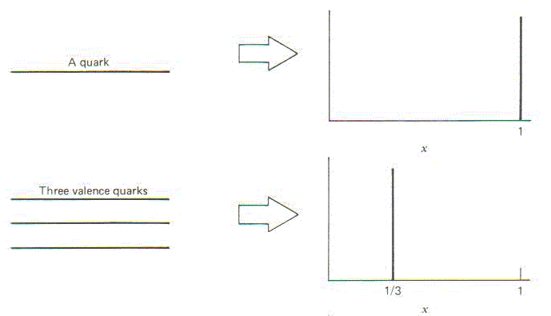
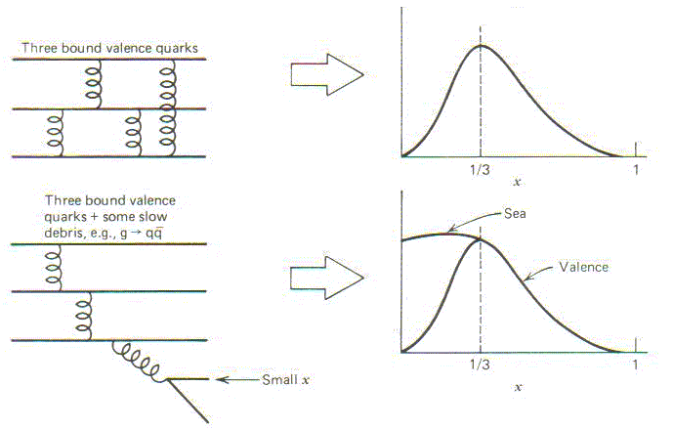
Proton structure and momentum fraction
What momentum fraction would the scattering particle carry
if the proton were made of …
3 bound valence quarks
A point particle
x_{Bjorken}
1
1/3
1
3 bound valence quarks + some
low-momentum sea quarks
x_{Bjorken}
Sea
3 valence quarks
Valence
Small x
1/3
1
x_{Bjorken}
1/3
x_{Bjorken}
1
Halzen and Martin, “Quarks and Leptons”, p. 201

Slide 31
So what do the parton distribution functions look like?
Wealth of data largely thanks to proton-electron collider, HERA, in Hamburg, Germany (1992-2007)
Up and down valence quark distributions peaked at a little less than 1/3
Lots of sea quark-antiquark pairs and even more gluons (scaled down by 20x in figure!)
parton distribution function
momentum fraction
PRD67, 012007 (2003)

Slide 32
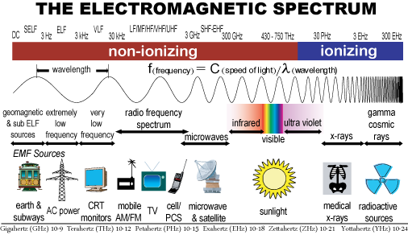
Higher energies to see smaller things
Energy

Slide 33
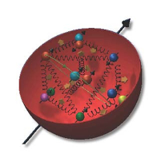
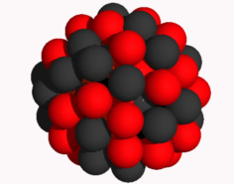
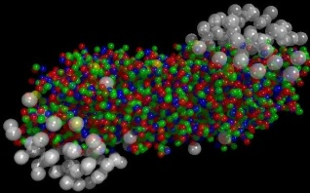
The Relativistic Heavy Ion Collider at Brookhaven National Laboratory
A great place to be to study QCD!
An accelerator-based program, but not designed to be at the energy (or intensity) frontier. More closely analogous to many areas of condensed matter research—create a system and study its properties!
What systems are we studying?
  “Simple” QCD bound states—the proton is the simplest stable bound state in QCD (and conveniently, nature has already created it for us!)
  Collections of QCD bound states (nuclei, also available out of the box!)
  QCD deconfined! (“quark-gluon plasma”, some assembly required!)
Understand more complex QCD systems within
the context of simpler ones
RHIC was designed from the start as a single facility capable of nucleus-nucleus, proton-nucleus, and proton-proton collisions

Slide 34
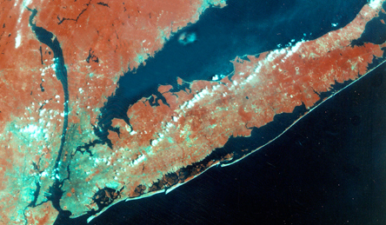

RHIC at Brookhaven National Laboratory
Long Island,
New York
Notes:
RHIC is (was) visible from space and is located on Eastern Long Island

Slide 35
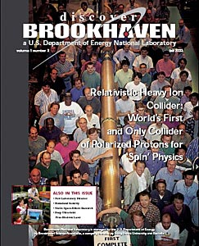
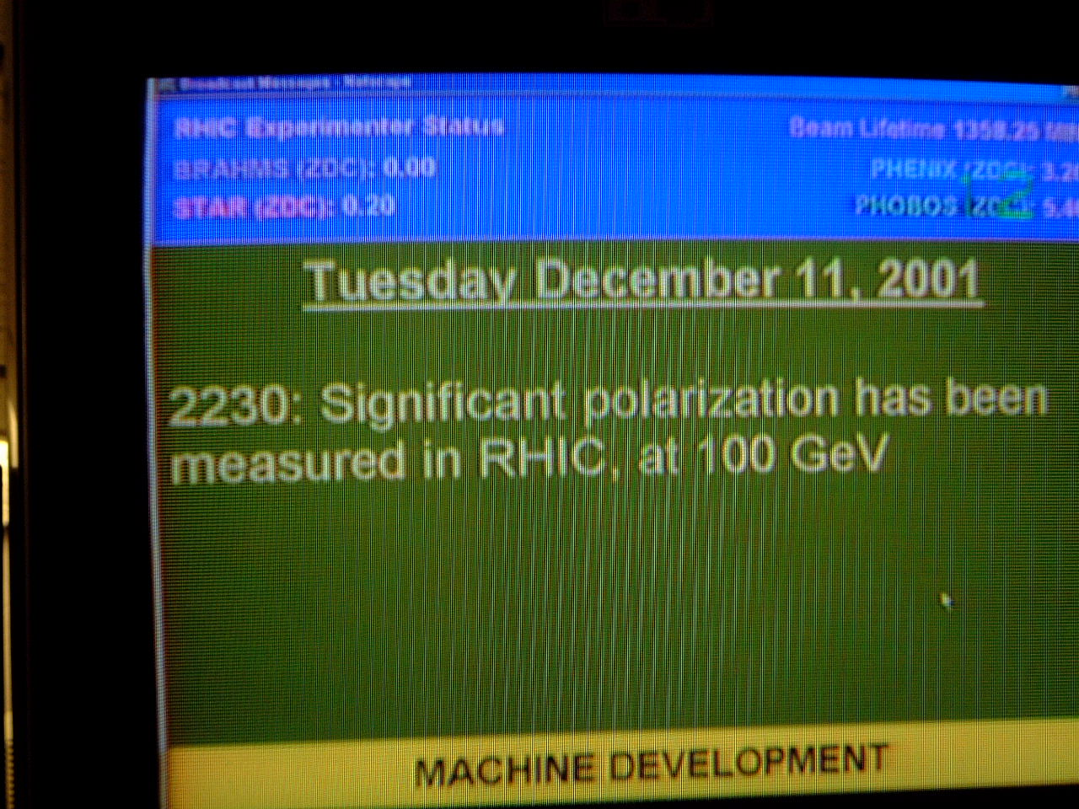
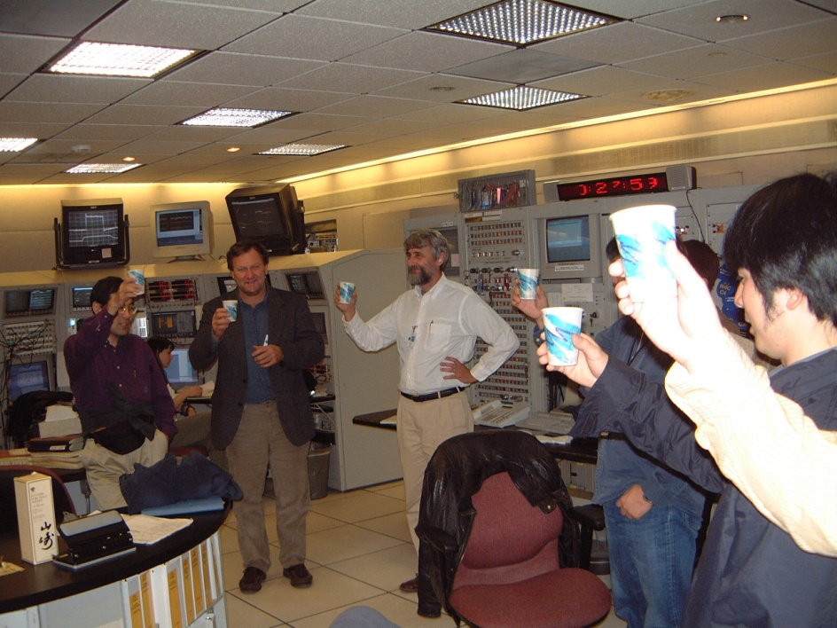

First and only polarized proton collider
35

