Slide 1
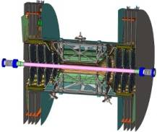
FVTX Commissioning Plan
1.71
Jon S Kapustinsky

Slide 2
Installation and Commissioning Overview
4 half-cages assembled and tested in the FVTX lab in the Physics Building (metrology and survey complete).
Full data acquisition system chain tests and cosmic runs on the bench and with bias and low voltage and cooling system, and in the IR.
Integrate the FVTX into the VTX support structure outside the IR.
Install the VTX/FVTX into the IR with PHENIX techs and engineers (Coordination with the PHENIX Integration Group led by Don Lynch).

Slide 3
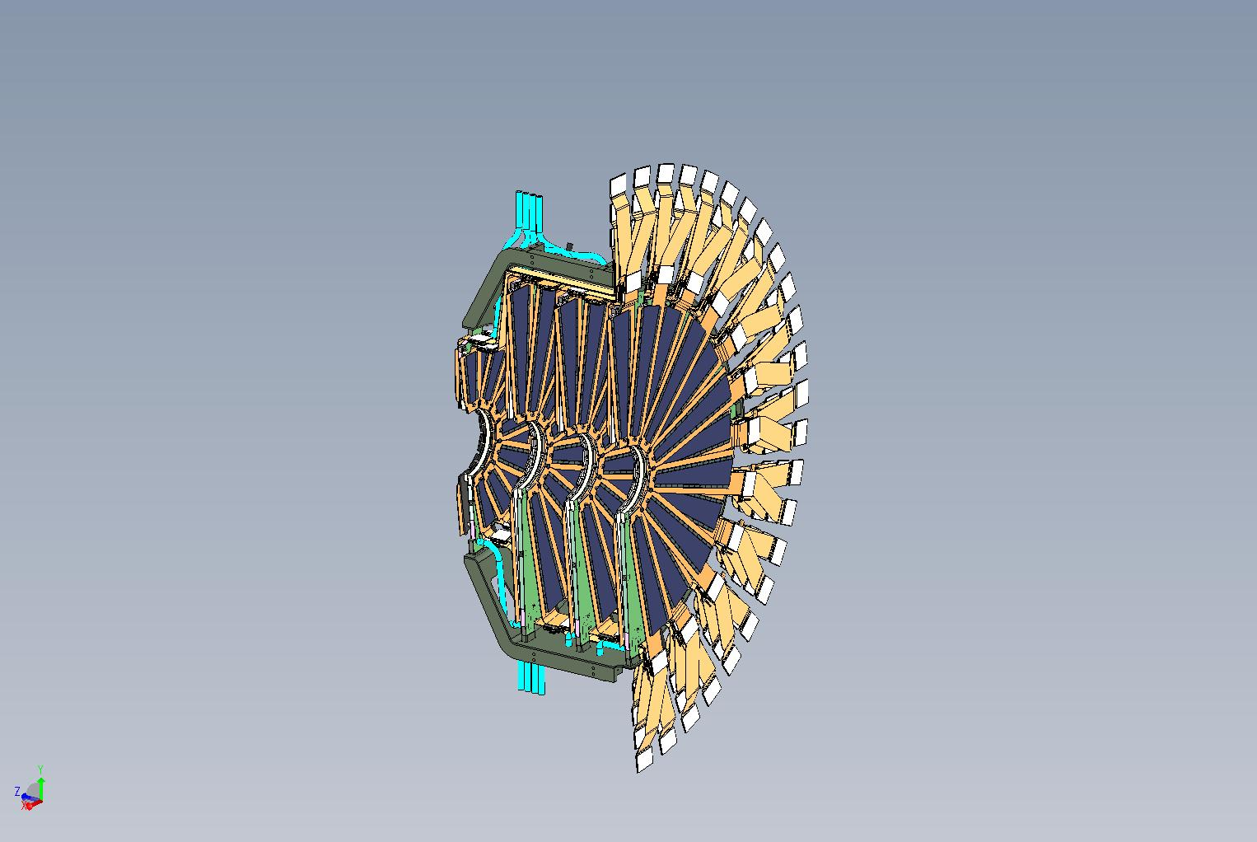
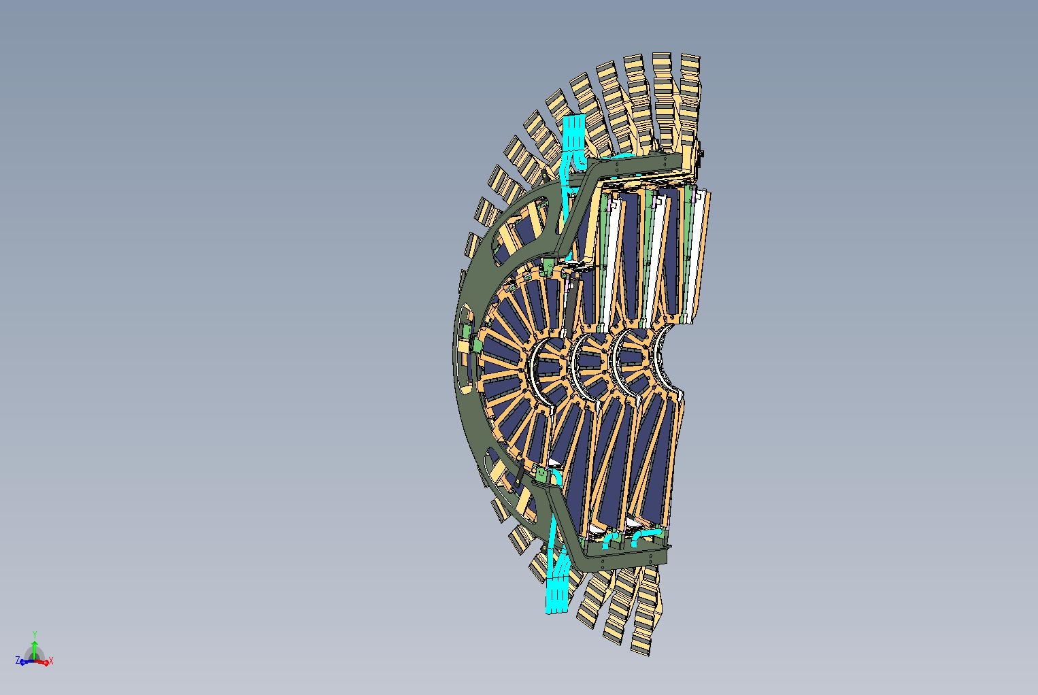
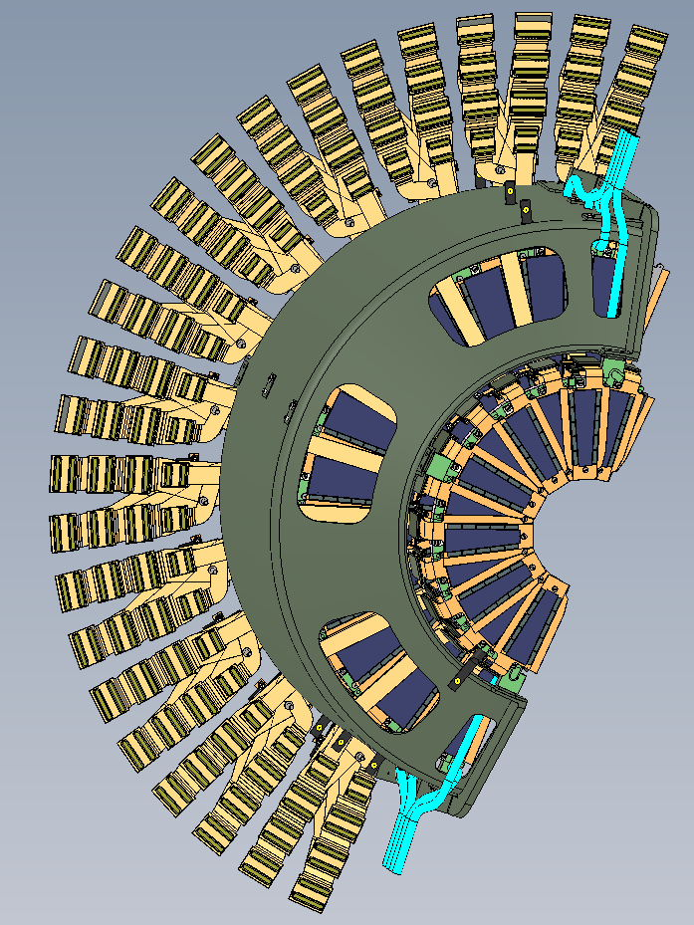
One half-cage of the FVTX – 3 views
4 detector stations per FVTX assembly, each off-set in phi.
Each station has its own cooling circuit.

Slide 4
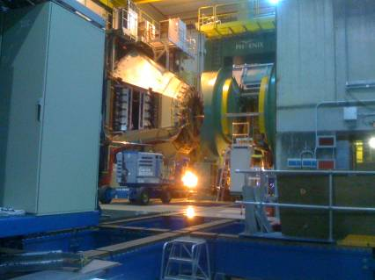
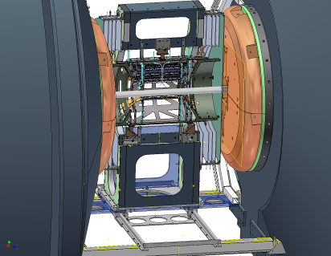
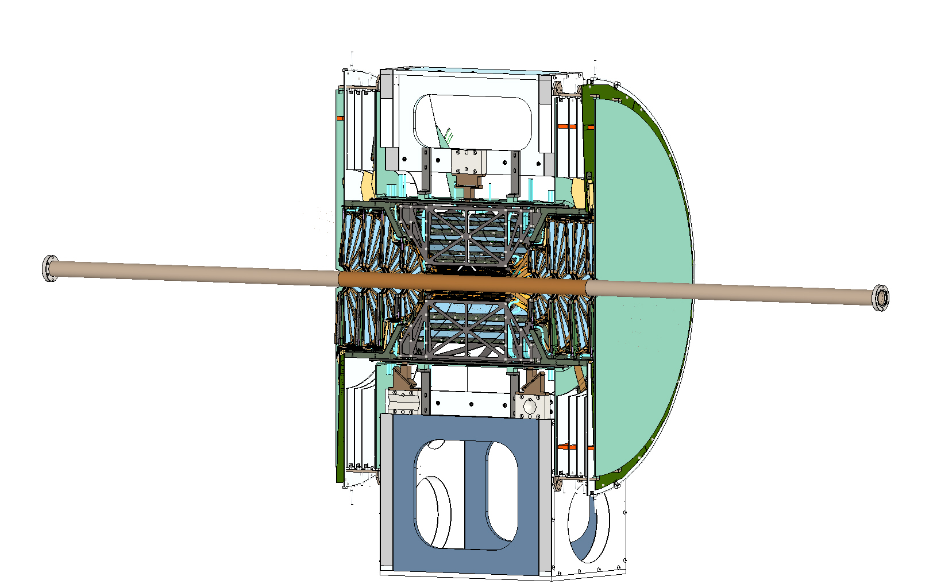
Installation FVTX/VTX in PHENIX IR
Installation procedure developed by BNL tech staff
Installation procedure approved by CAD

Slide 5
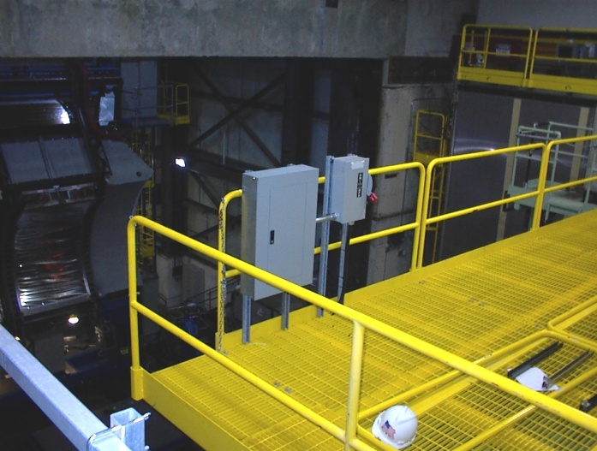
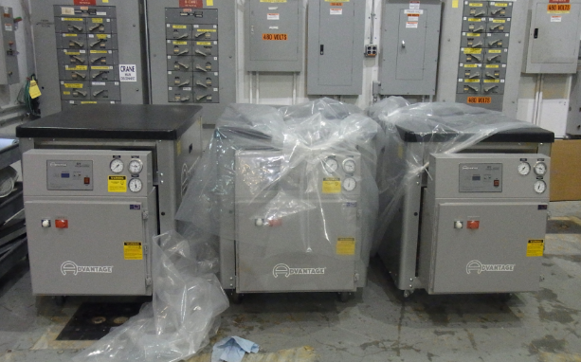
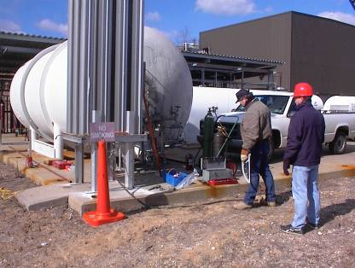
FVTX rack layout in the IR
Chillers will be installed in the assembly hall
Services installed in the IR
Dry gas storage tank outside PHENIX

Slide 6
Major tasks and personnel (1)
Timing calibration, performance optimization, pulser calibration and cosmic runs on the bench
Dave Winter, Doug Fields, Sergey Butsyk, Imran Younas, Melynda Brooks, Pat McGaughey, Hubert van Hecke, Jon Kapustinsky, Steve Pate, students and PD’s
Install and populate electronics racks in the IR with LV/HV power supplies and power distribution cards
BNL techs, Eric Mannel, Robert Pak, Walt Sondheim, Don Lynch
Connect FVTX cooling system and dry gas system and safety interlocks
BNL techs, Eric Mannel, Robert Pak, Walt Sondheim, Don Lynch
Install cabling and optical fibers from the IR to the DAQ in the PHENIX rack room
BNL techs, Eric Mannel, Robert Pak, Steve Boose

Slide 7
Major tasks and personnel (2)
Test cooling system, thermocouples and interlocks
BNL techs, Eric Mannel, Robert Pak, Walt Sondheim, Don Lynch
Test power distribution systems, bias and low voltage and interlocks
Eric Mannel, Paul Giannotti, Pat McGaughey, Steve Boose
Test fiber optics and signal integrity for all channels
BNL techs, Eric Mannel
Slow controls and integration into the PHENIX DAQ
Eric Mannel, Martin Purschke, John Haggerty, Ed Desmond
Timing calibration, performance optimization, pulser calibration and cosmic runs in the IR
Dave Winter, Doug Fields, Sergey Butsyk, Imran Younas, Melynda Brooks, Pat McGaughey, Hubert van Hecke, Jon Kapustinsky, Steve Pate, students and PD’s

Slide 8
FVTX Functional Requirements
*Requirement | Metric | Method
Mini strips active | >80% (expect ~99%) | calibration/cosmics
Hit efficiency | >85% (expect~99%) | cosmics
Radiation length per wedge | < 2.4 % | by design
Detector hit resolution | < 25 μm | cosmics
Random noise hits/chip | <0.1% | calibration (threshold:noise~5:1)
Level-1 latency | 4 μs
Level-1 Multi-Event buffer depth | 4 events
Read-out time | < 40 μs
Read-out rate | > 10 kHz
*Primary bench test requirements from the Management Plan. The last four have been validated by extensive tests of the FPGA code.

Slide 9
Additional goals to complete commissioning
FVTX fully integrated into PHENIX DAQ.
~99% channels operational, timed in and calibrated.
Fully operational on-line monitoring.
Expert shift procedures developed for beam runs, detector operations and data acquisition.
The FVTX collaboration

Slide 10
FVTX Installation and Commissioning Schedule
Task | Start-Finish | Comments
Mechanical support structure and installation hardware | Done for VTX
Cable trays in IR | Done for VTX
Chiller in Assembly Hall | Done for VTX
Dry gas system | Done for VTX
Install cables and plumbing and racks (pre-populated) | 07/01/11-08/01/11* | will start asap after the shutdown
Cages fully bench tested First cage complete Last cage complete | 04/08/11-04/22/11 06/09/11-06/16/11 | Bench system tests with cooling and power distribution
All FVTX detector, support, installation, alignment and survey parts and assemblies complete, ready for installation | 06/16/11-07/1/2011
Install FVTX into the VTX support structure | 08/01/11-08/10/11 | Assembly will be done outside the IR
Install and align FVTX/VTX assembly in the IR | 08/10/11-08/24/11 | Installation nearly identical to VTX in 2010
Connect cables and plumbing | 08/24/11-08/31/11
Test and commission | 08/31/11-09/27/11 | FVTX manpower
*Shutdown is a month later than even recently expected
Assumption is that IR will close 10/01/11

Slide 11
Summary
Before installation into the IR – FVTX personnel
Assembled, pre-surveyed, bench-tested FVTX installed into the VTX support.
Before Installation into the IR BNL techs and integration personnel
Cooling and dry gas system, HV/LV racks, cables and fibers , FVTX/VTX installation hardware installed in the IR.
After installation of the FVTX/VTX in the IR – FVTX and BNL techs and integration personnel
Services hookup and testing, cabling and testing, timing, calibration and integration into the PHENIX DAQ.

Slide 12
Backup Slides

Slide 13
On-line monitoring commissioning tasks
Histogram sensor hits
hot channels
dead channels
thresholds vs noise
update chip registers as needed
Pulser timing
adjust clock to readout (~20 ns window)
Cosmics tracking
refine alignment constants
Charge sharing/ clusters
tracking software
Much of this was already developed for the FVTX cosmic ray tests at LANL

