Slide 1
FVTX Hardware Commissioning
E.J. Mannel
FVTX Closeout
23-Apr-2012

Slide 2
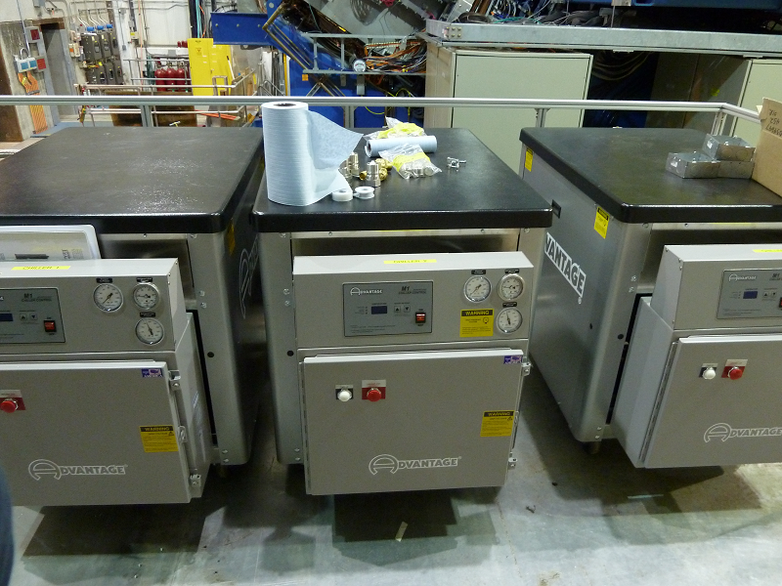
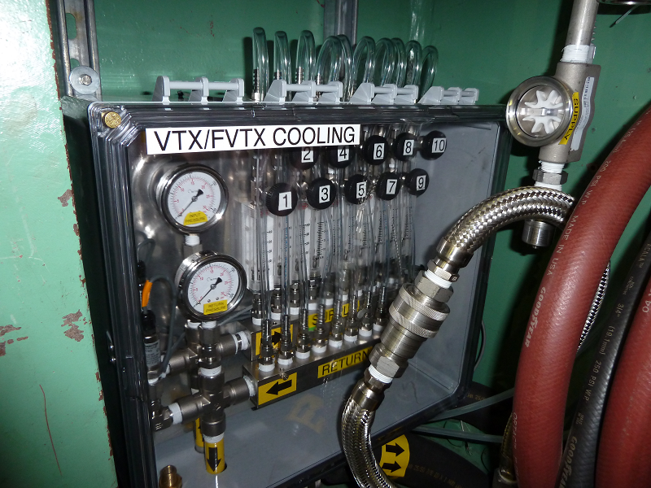
Chillers
Uses same chillers as VTX
  Were installed for RUN-11
  Manifolds were designed to include FVTX
  Only required final connections to FVTX
Based on RUN-11 Experience
  NOVEC monitored routinely for contaminates
  Filtering procedure in place to remove contamination

Slide 3
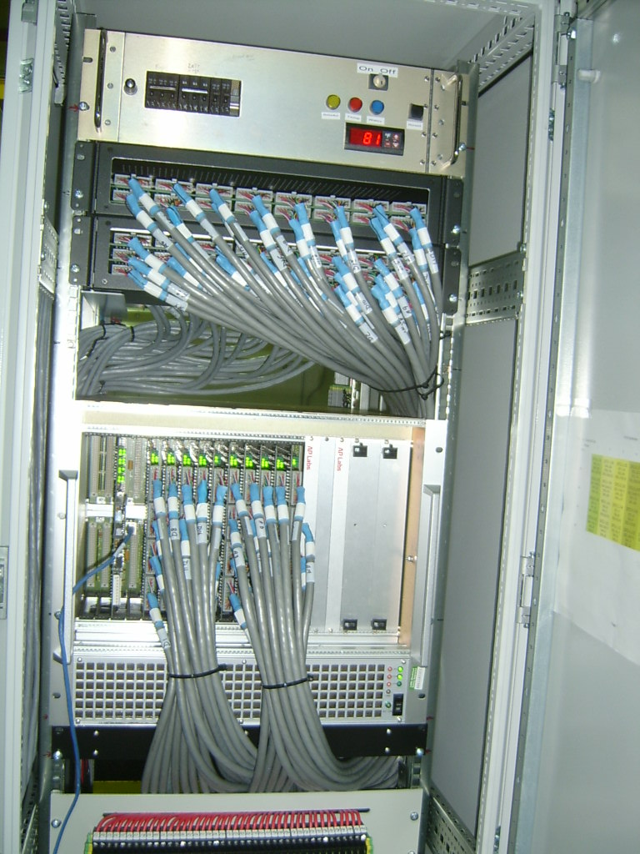
Low Voltage
Based on PHENIX “Standard” Low Voltage Distribution
  Separate systems for North/South end caps
  196 LV Channels
Additional control and filtering for wedge LV
  768 Wedge channels
Outside vendors and PHENIX techs produced, tested and installed LV Cables

Slide 4
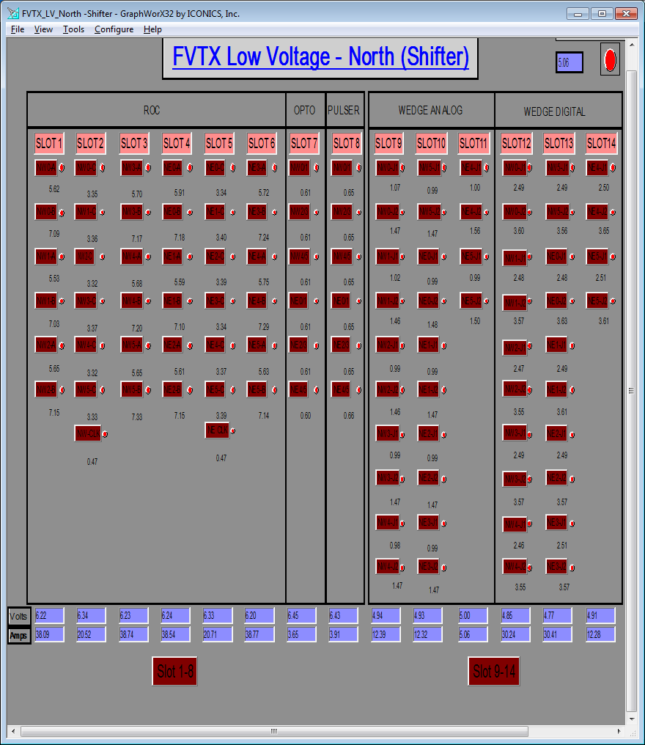
LV Control
Software control based on ADAMS interface
  Common PHENIX slow control
  Standard GUIs
  Expert and Shifter versions
  Provides voltage and current read back

Slide 5
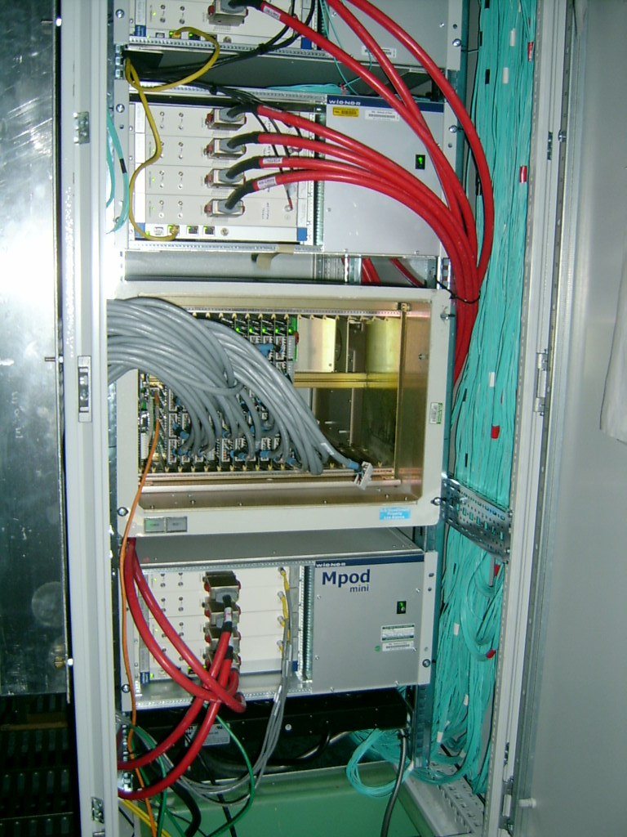
Bias System
Based on Wiener/ISEG MPOD System
  Identical system are used by the VTX
  Additional switching and filtering using FVTX distribution crate. 1 to 8 split
  Outside vendors and PHENIX Techs assembled, tested and installed Bias cables.
Software is based on software developed for VTX
Voltages and currents in database with Web interface

Slide 6
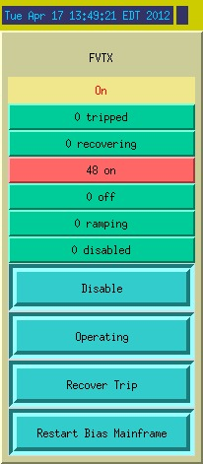
Operator Control
Current status
Set Bias to standby (off)
Set Bias to Operational (on)
Trip recovery
Reset Mainframe

Slide 7
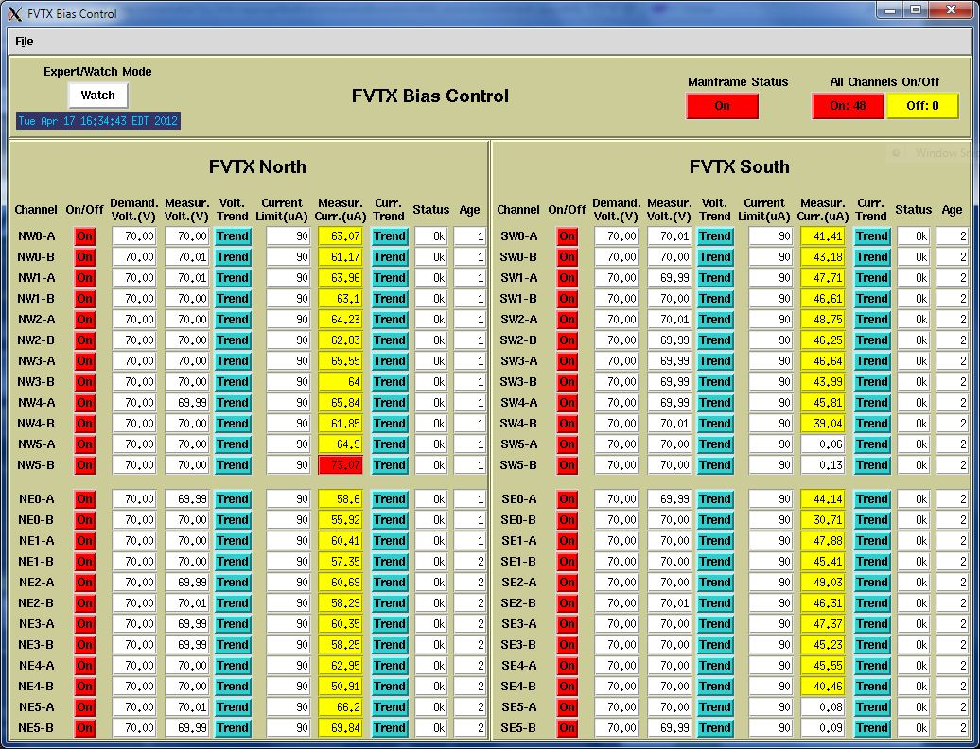
Bias Monitoring

Slide 8
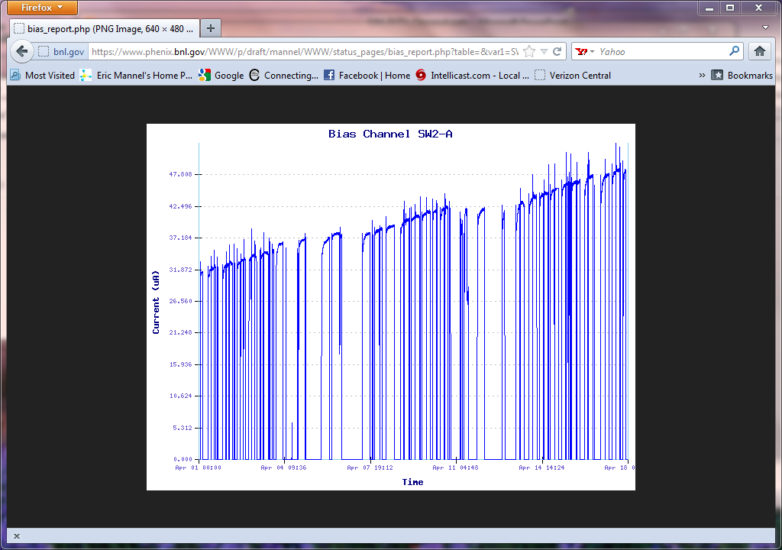
Bias Database Interface
Current for 8 wedges
Bias current increasing due to radiation
Most significant effect from p-p running
Supply limit 1mA, now at ~30uA

Slide 9
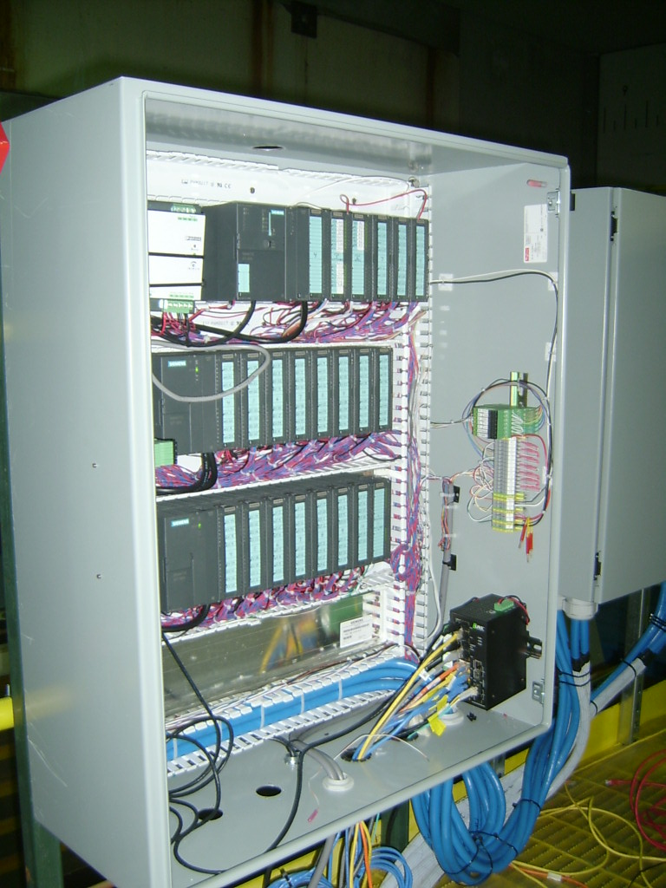
Interlocks
Fully interlocked on temperature and coolant flow
Shares same system as VTX
  Siemens PLC Based
  40 Thermal couples for FVTX
    Disk temperature
    Big Wheel temperature
Temperatures and interlock status logged to database

Slide 10
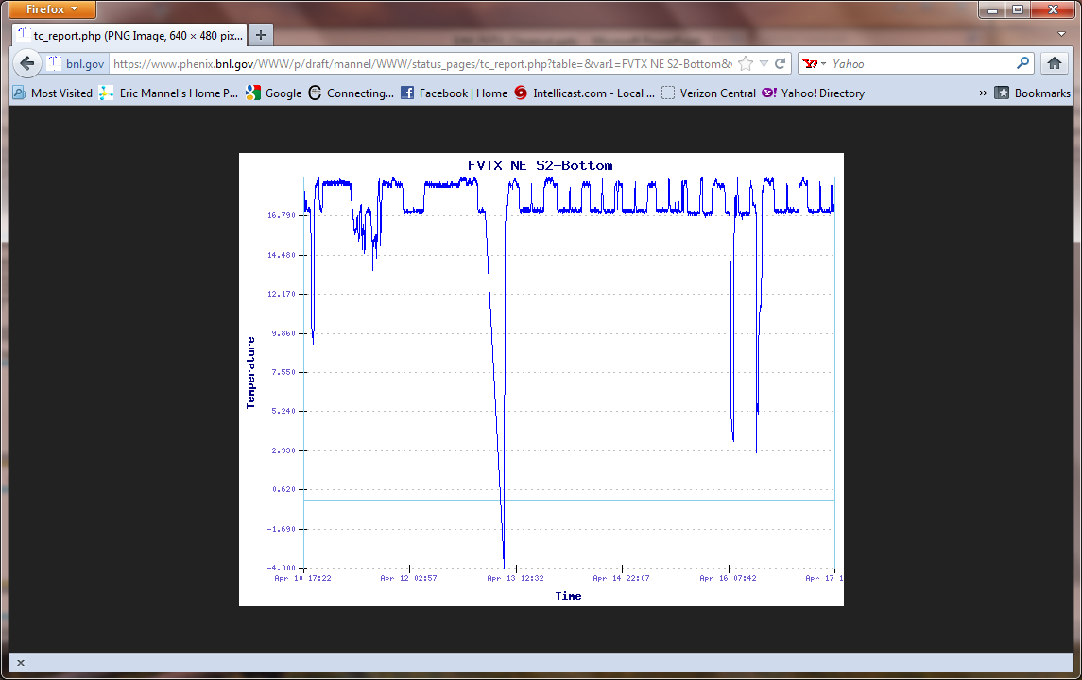
Thermal History

Slide 11
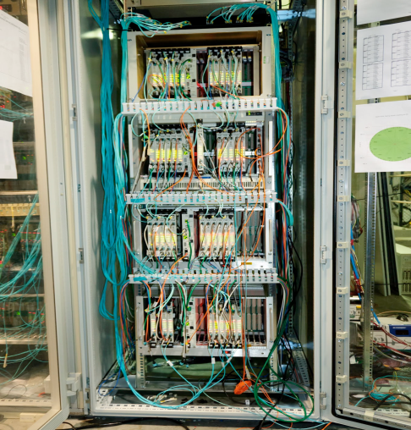
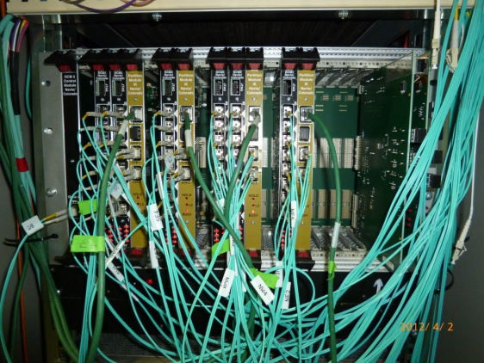
FEM/DCM-2 Crates
4 FEM crates w/ 48 FEMs installed in Rack Room
1 DCM-2 Crate w/ 6 DCM-2 modules (48 channels)
All installed and ready for FVTX installation
48 FEM
6 DCM II

Slide 12
The Major Players
Chiller
  R. Pisani
  C. Biggs
  R. Pak
Low/Bias Voltage
  F. Toldo
  S. Boose
  S. Polizzo
  P. Giannotti
Cabling
  J. LaBounty
  M. Lenz
  F. Toldo
Interlocks
  P. Giannotti
  S. Boose.
  S. Polizzo
  J. Haggerty
  M. Lenz

Slide 13
Conclusions
Chillers are installed and fully operational
LV system is installed and is fully operational
Bias system is installed and is fully functional
Interlock system is installed and is fully operational
Thanks to the PHENIX Techs whose hard work made it all possible

