Slide 1
FVTX DAQ Commissioning
Jin Huang
Los Alamos National Lab
for the FVTX Group

Slide 2
DAQ Commissioning Time-line
Oct-Dec 2011 – Detector final assembly and test
Quality check on all wedges
Late Dec 2011 – First data from PHENIX IR
Reached Dec 30 milestone
Late Jan 2012 – First full detector readout from IR
Feb 8 2012 – First data (self-triggered) with beam,
shortly after stable run 12 collision were established
Feb 24 2012 – First physics data with 1/6 acceptance
Mid March 2012 – Detector operational
with ~90% of acceptance ON
Have taken all 510 GeV p-p data
Late March 2012 – Detector operation by shift workers
FVTX → IR
200 GeV
p-p start
510 GeV
p-p start
Notes:
When 200-500GeV runs starts… Took all 510GeV data.

Slide 3
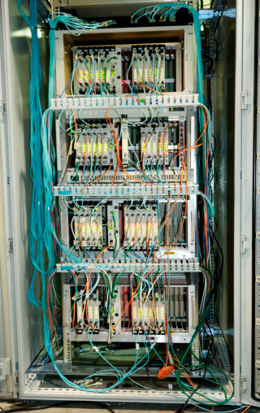
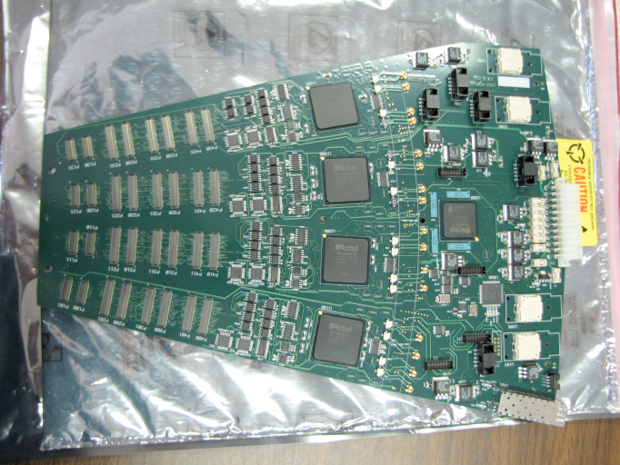
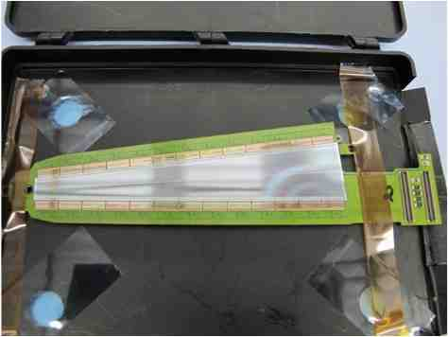
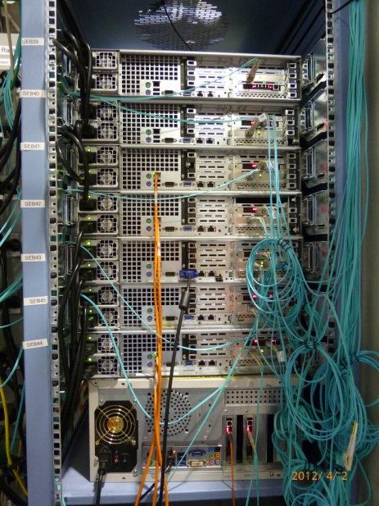
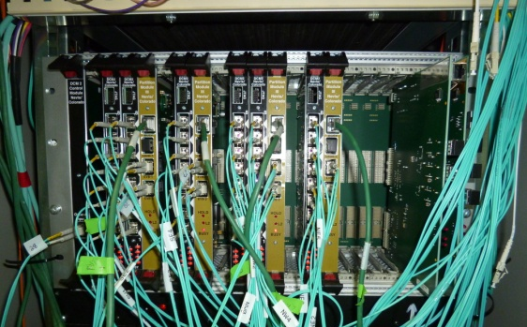
FVTX DAQ Structure
Slow Control Client
384 Wedges
1M channel
IR
Ethernet
DAQ Room
HDI
FPHX Chip
17k LVDS
3.2 Tb/s
768 fibers
1.9 Tb/s
Ionizing Hit
Sensor
24 Readout cards (ROC)
48 FEM
48 fibers
≥10kHz trigger
PHENIX event builder
/ Data storage
Online display
8 fibers
Standalone data
(calibration, etc.)
6 DCM II
5 SEB Servers
Data cable/bandwidth shown on this slide only
Notes:
SEB – sub-event builder

Slide 4
DAQ Slow-control
FVTX Slow-control
  Control parameters of FEM/ROC/each individual FPHX chips
  Read back system status
Two Slow-control interfaces
  C++ based: integrated into PHENIX run control
  FVTX Expert GUI (next page)
Slow-control commissioning
  Debugged slow-control communication to IR
  Established slow-control to all wedges
  Verified control commands functionality

Slide 5
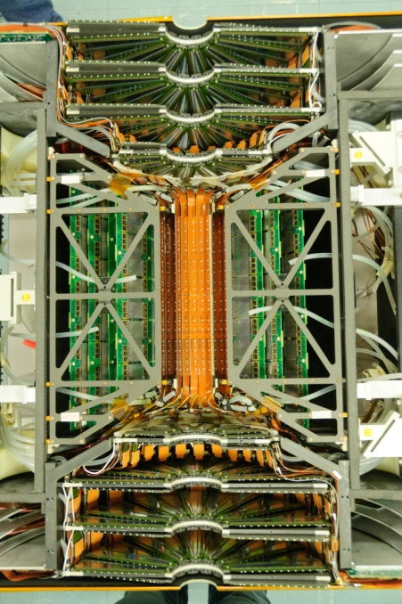
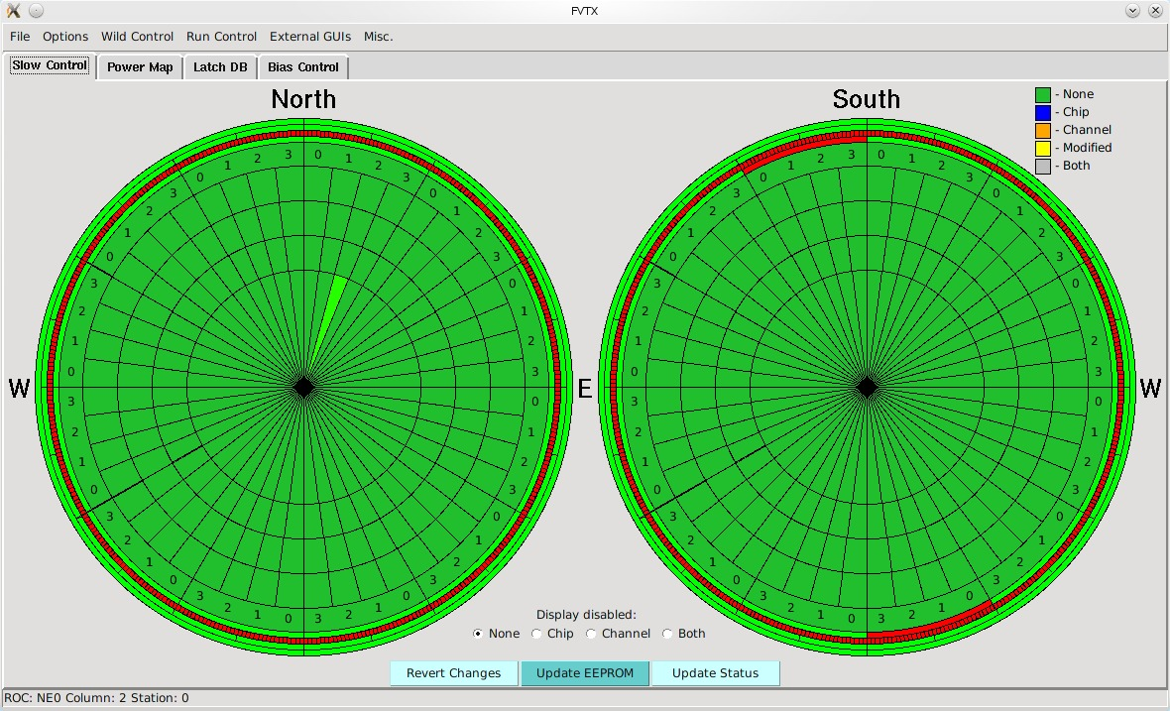
FVTX Expert GUI
Centralized super toolkit for FVTX control/monitoring
Expert GUI
Database
FVTX
LV/HV Control
Standalone run control
Specialized GUIs
e.g. GTM, bias

Slide 6
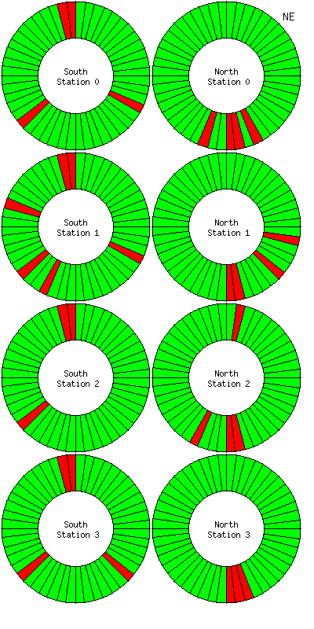
Initial DAQ commissioning
Status Monitoring Webpage
(End of Stage 2)
Stage 1: before Dec 30, 2011
  Immediately after detector installed in IR
  Using portable power supply / fiber routes to readout one ROC
  Noise level is small (≤ 500 electrons)
  1st operational experience
Stage 2: Jan 2012
  Fully power on all ROCs one by one
  Test aliveness/solve any problem
  Refinement of FPGA code
  All ROCs other than SW5 (broken transceiver) were operational

Slide 7
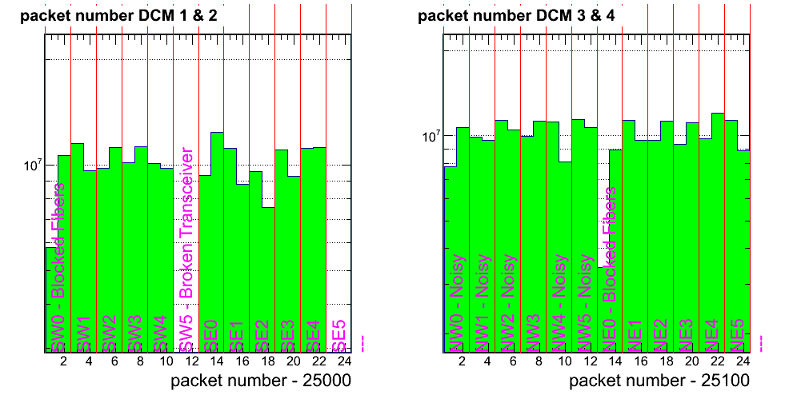
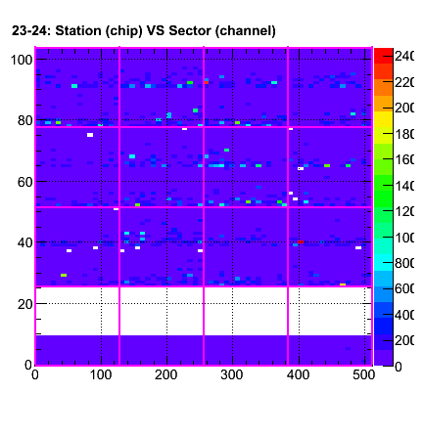
Standalone Data Taking
Packet hit map
Provide quick data readout to check detector status
Without disturbing data taking of other subsystems
Special runs:
  Calibration
  Timing scan
South
North
Station 3
Noise hit with bias OFF
All wedges have readout
Station 2
Station 1
Expected gap (station 0 has fewer channels)
Station 0 (less channels)
Sector 0
Sector 1
Sector 2
Sector 3

Slide 8
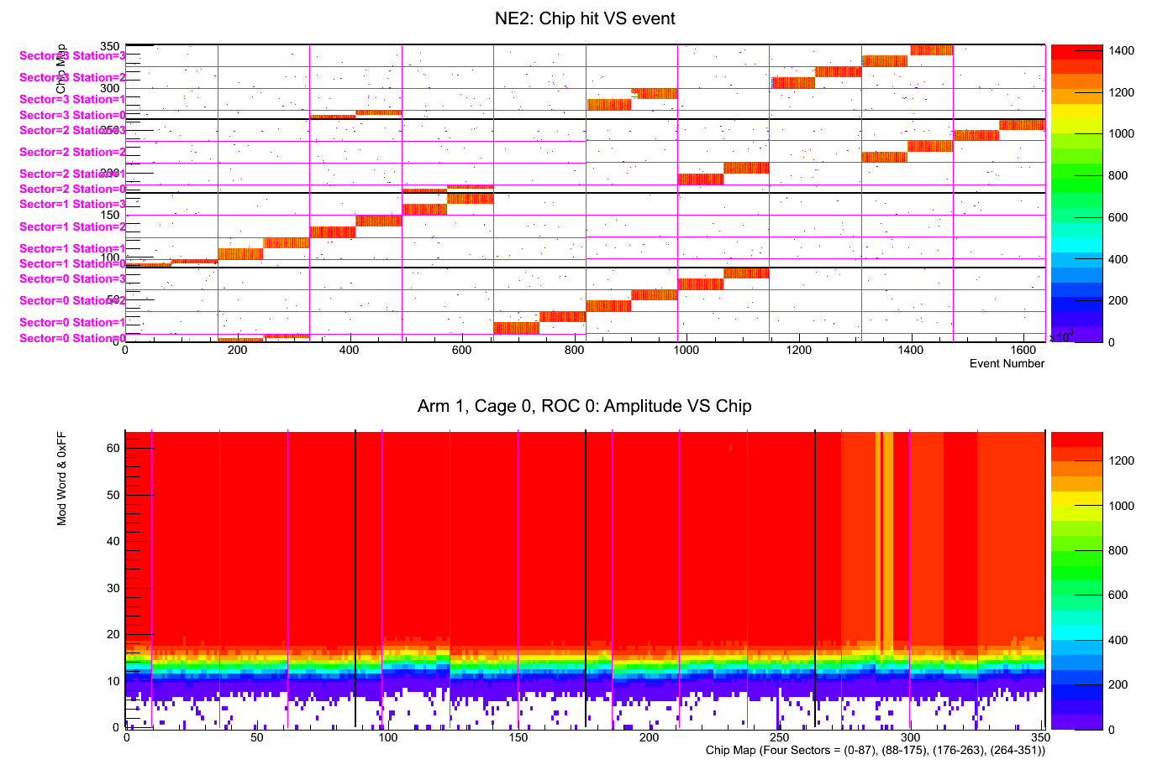
Calibration of FVTX
Inject pulse of known charge into FEE chips and vary pulse size
Measure channel status, noise level, check mapping
2.5 min of data taking @ 8kHz, 1.7M event
Wedges
Event number @ 8kHz
Calibration Amp.
Chips
Notes:
Shorten in talk

Slide 9
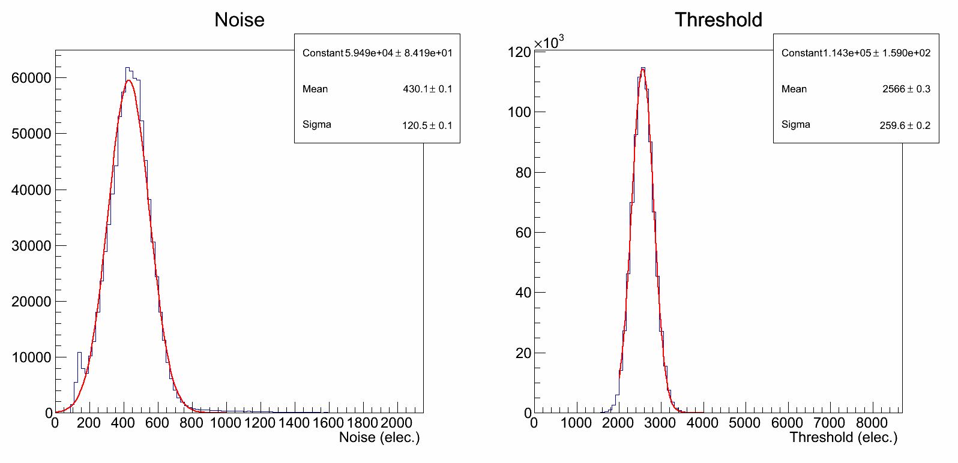
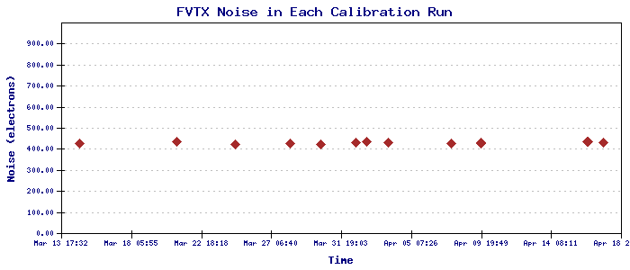
Calibration Results
https://www.phenix.bnl.gov/phenix/WWW/p/draft/fvtx/calibration/
Noise and threshold for each channel
Calibration Results
  Detector status channel by channel
  Noise level / threshold
Status
  Runs taken regularly
  Automated analysis
  HTML report generated/archived
Noise
~ 430 elec.
Threshold
> 5 × Noise

Slide 10
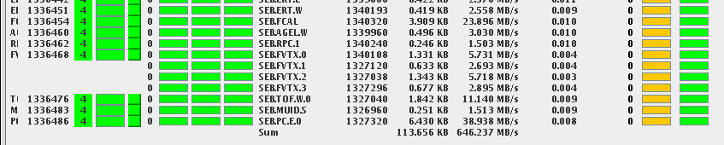
Integration into PHENIX DAQ/
Data flow and stability
Data flow
  FVTX → DCM II → SEB Server → PHENIX event builder → Storage
Joined Main DAQ smoothly
  Standalone timing (Feb 22) → Granted Joining (Feb 23)
  → Joined Main DAQ (Feb 24) → Took 100M event (Feb 24 + 28)
Stability and flexibility
  Continuous running since 510 GeV p-p run (Mid March)
  Minimal DAQ failure rate during a production run
  Can join/exit big-partition running in few minutes
  (e.g. for standalone test or debugging)
FVTX data flow shown in PHENIX Run Control
Notes:
Add : Page 11 -> one bullet

Slide 11
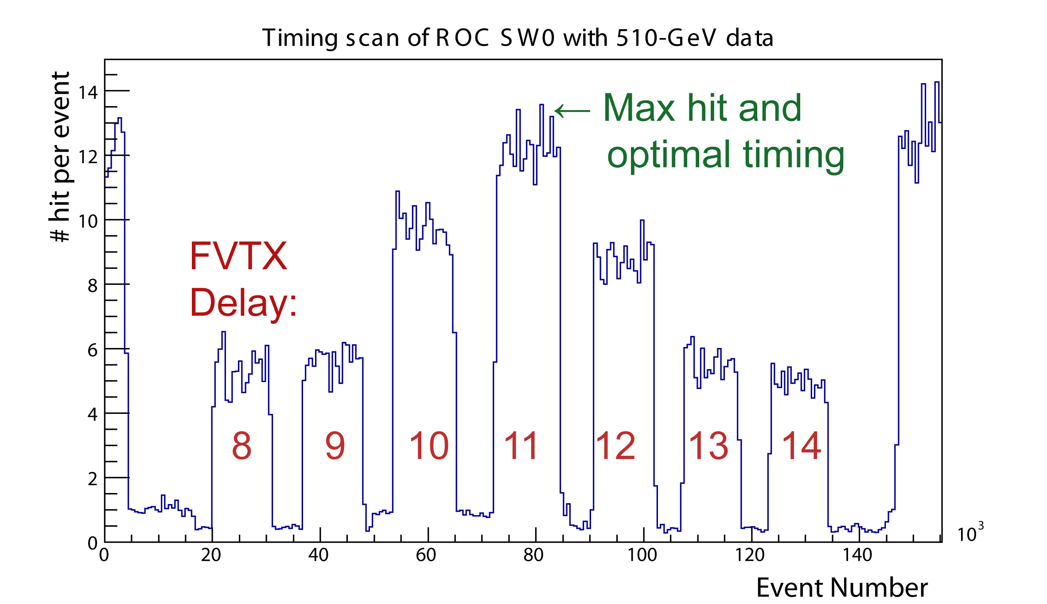
Integration into PHENIX DAQ/ Timing
Adjust delay to taking FVTX data in coherent timing with PHENIX
Scan FVTX FEM delay to find best match in time
  Special method allows the FVTX to time in much faster (~5 min)
  Optimal timing → max hit
  Side band → hits are centered in trigger window (2 beam-clock)
← High threshold
← High threshold
← High threshold
← High threshold
← High threshold
← High threshold
← High threshold
← High threshold
Notes:
Reduce the description words

Slide 12
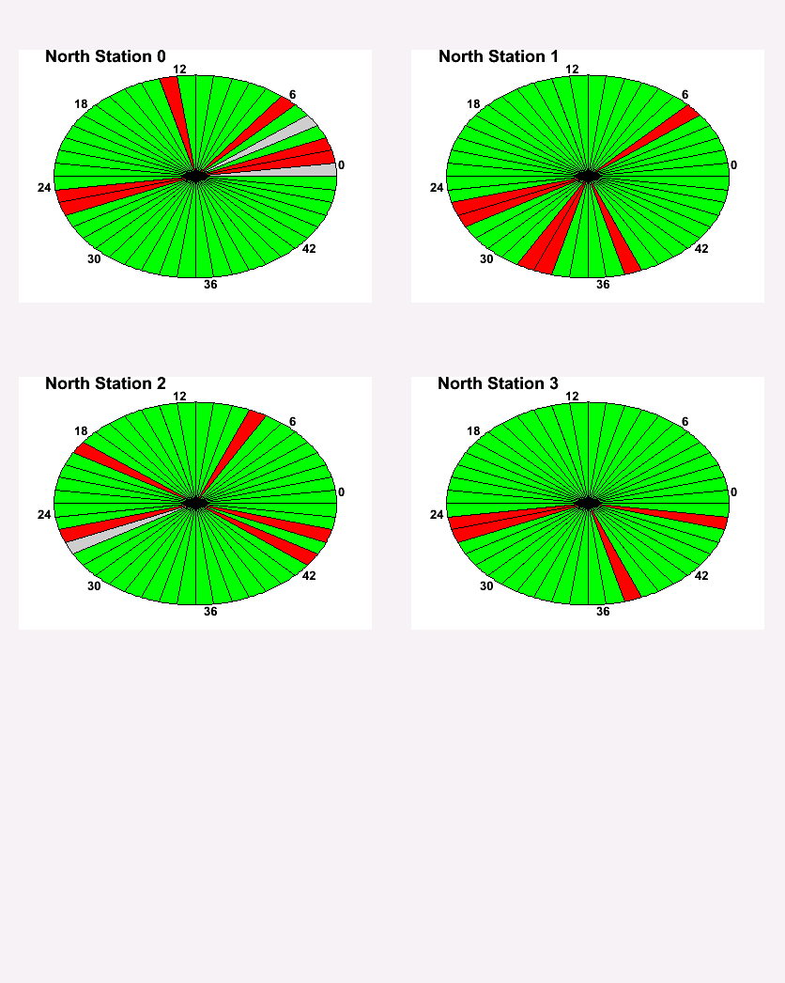
Online Monitoring
FVTX Online Monitoring
  Immediate data analysis of raw hit information
  Monitor status of detector for possible hardware problems so expert can quickly fix
  First data quality check
Online monitoring status
  Operational and integrated with PHENIX main
  Can be easily accessed by shift worker
  Mainly used by expert for now
  Provide out-of-counting house access and archiving
Typical online monitoring plot (510 p-p)
Showing most wedges in north arm is normal
Legend: Normal, Low/High yield, OFF

Slide 13
Credit
Many institutions and physicists worked on DAQ commissioning and made this work possible
  Los Alamos: Christine Aidala, Melynda Brooks, Matt Durham, Hubert van Hecke, Jin Huang, Jon Kapustinsky, Kwangbok Lee, Ming Liu, Pat McGaughey, Cesar da Silva, Walter Sondheim, Xiaodong Jiang
  University of New Mexico: Sergey Butsyk, Doug Fields, Aaron Key
  Columbia University: Cheng-Yi Chi, Beau Meredith, Aaron Veicht, Dave Winter,
  New Mexico State University: Abraham Meles, Stephen Pate, Elaine Tennant, Xiaorong Wang, Feng Wei
  Brookhaven: Carter Biggs, Stephen Boose, Ed Desmond, Paul Gianotti, John Haggerty, Jimmy LaBounty , Mike Lenz, Don Lynch, Eric Mannel, Robert Pak, Chris Pinkenburg, Rob Pisani, Sal Polizzo, Christopher Pontieri, Martin Purschke, Frank Toldo
  University of Colorado: Mike McCumber
Many other collaborators also provided crucial support

Slide 14
Conclusion
FVTX DAQ commissioning is successful
  Steady progress was made
  90% of the detector is operational
DAQ operation is stable
  Stable noise level – monitored regularly
  Stable big-partition runs
  Taken all 510 GeV p-p data
Routine data taking handed to shift worker in late March
  24/7 expert on-call and close monitoring of detector performance

Slide 15
Back up

Slide 16
First data in PHENIX Big-Partition DAQ
Evaluated it is safe to run detector with 1/6 acceptance
Timed-in Feb 22 morning in standalone mode
Granted big partition test on Feb 23
Timed-in Feb 24 in PHENIX big partition
  Identified optimal timing (Next slides)
  Smooth data taking
Took ~100M events in big partition
  Two batches of data taking on Feb 24 and Feb 28
  Almost no errors in data taking
  Data was analyzed quickly
    Online: ensured data quality
    Offline: tracking, vertex correlation to BBC and matching with Muon Arm
Notes:
Move to backup

Slide 17
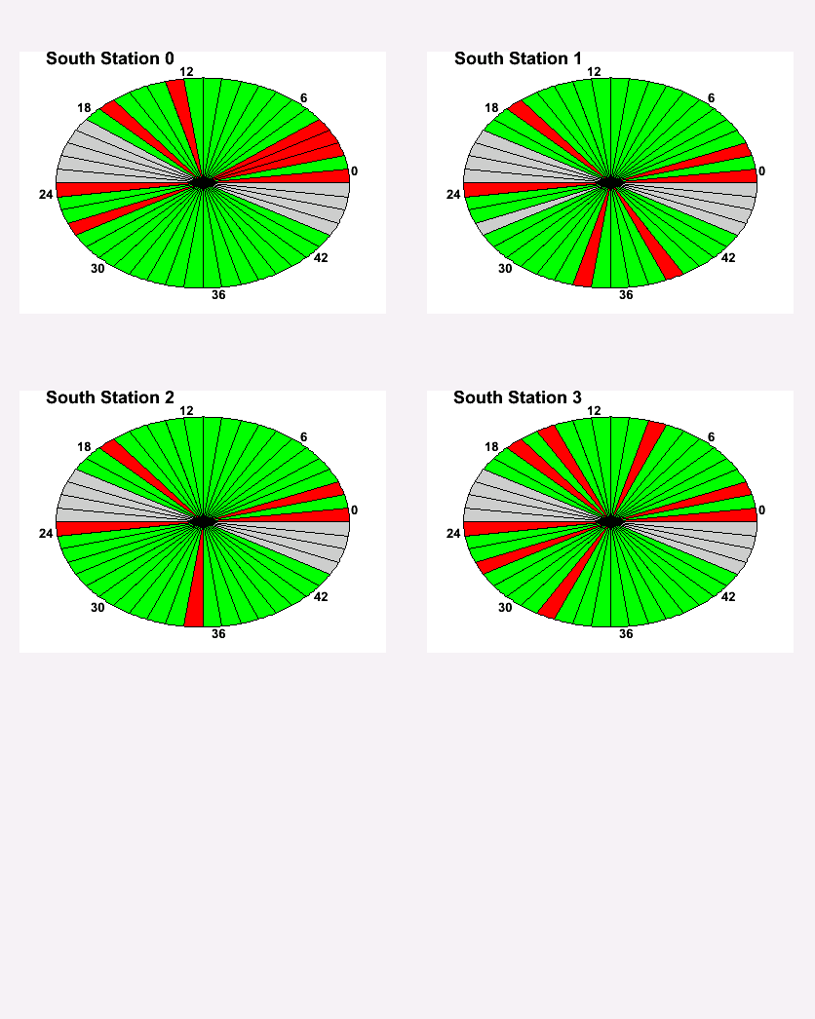
Online Monitoring
Legend: Normal, Low/High yield, OFF
Notes:
Add backup of south side

Slide 18
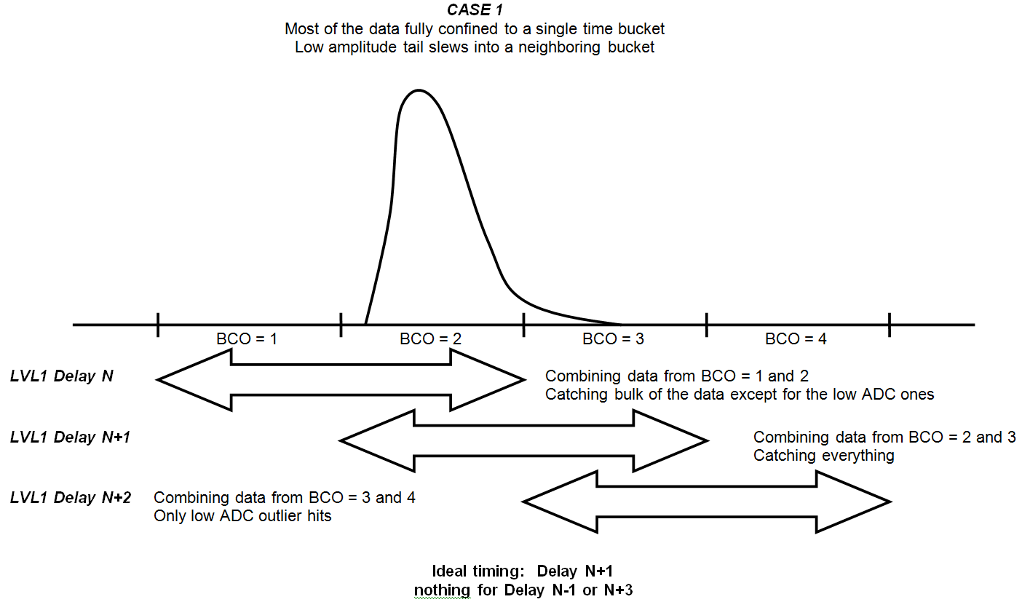
Illustration of trigger window

Slide 19
Known problems and solution
Disabled ROC
  Electrical issues, to be fixed in the summer
Missing few wedges
  Able to communicate through slow-control
  Under debugging, expect to recover
Occasional missing clock for few ROCs
  Suspect quality of clock signal to those ROCs
  Not affect majority of data taking

Slide 20
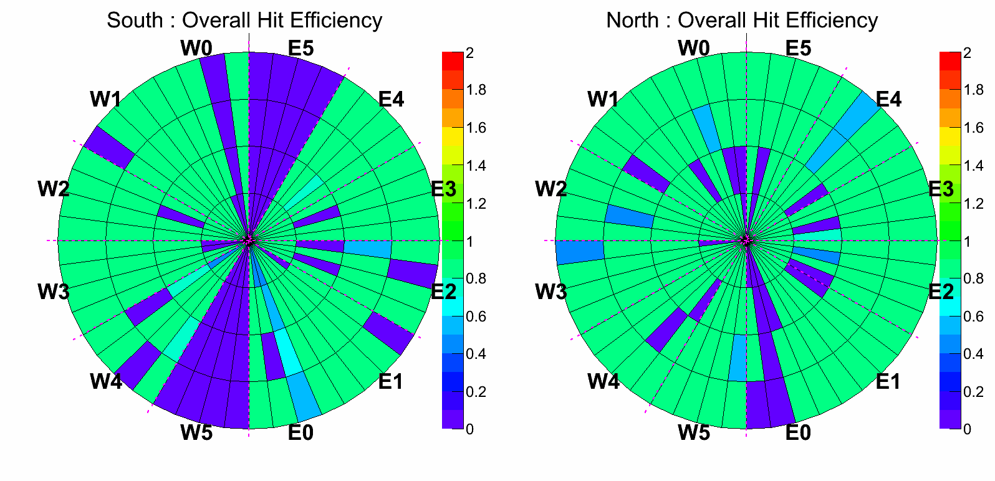
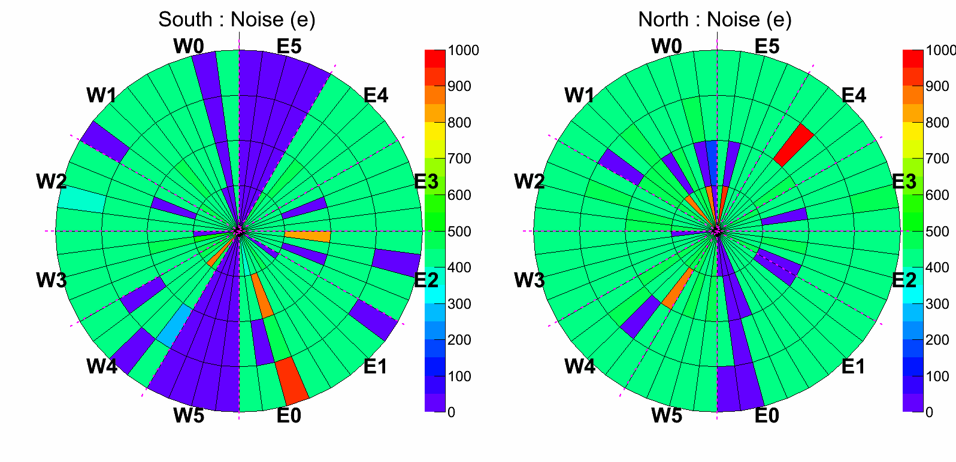
Calibration Results
FVTX Overall hit eff.
(% of chan. alive) × (eff. per chan.)
Noise for each wedge

Slide 21
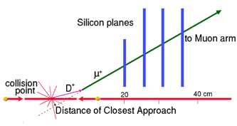
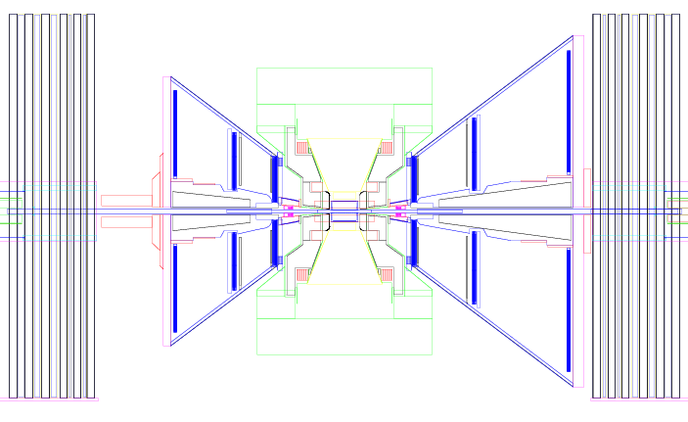
Forward vertex detector (FVTX)
Tracking in forward region and close to IP
Provide
  Differentiate primary vertex / secondary decay
  Track isolation : suppress hadrons from jet for W measurement
  Precisely measure opening angle : J/ψ mass
  Jointed tracking with MuTr : suppress delay-in-flight
η= 1.2
η = 2.4

Slide 22
Project history
2003 – 2008 LANL supported R&D
2007 – BNL / DOE / Technical reviews
2008 – prototyping
2009 – first production modules
2010 – assembly started in earnest
2011 – assembly and installation COMPLETE
2012 – first data in beam

Slide 23
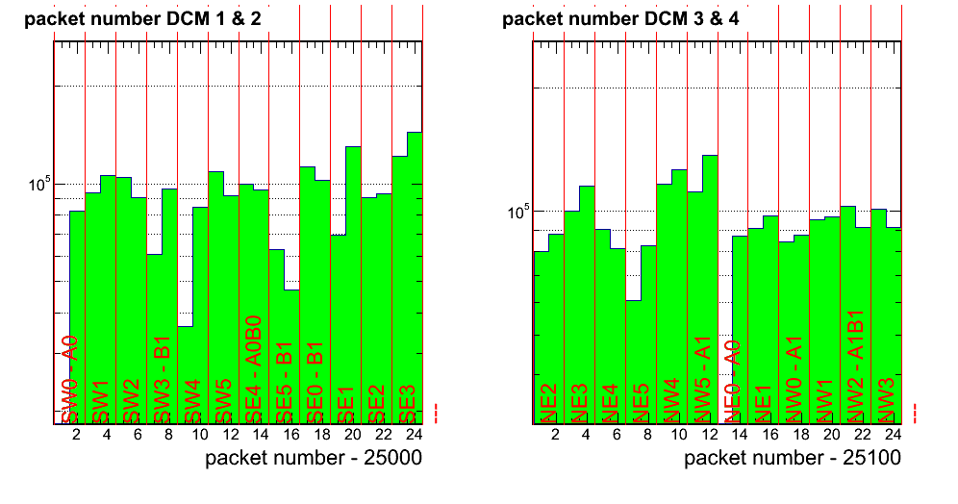
Alive test after Installation
South Arm
North Arm
ROC Hit map
Showing Data from 24 ROCs in a single run
Wedges that have data
+ Can control 95% wedges

Slide 24
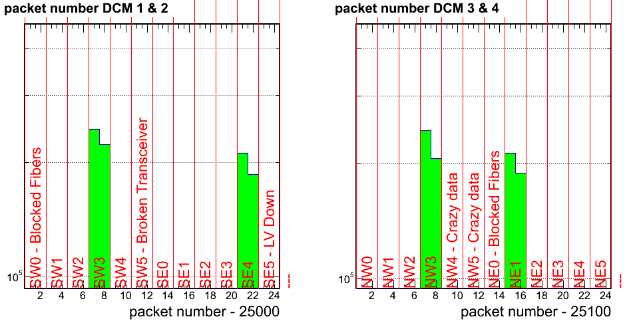
We activated 1/6 of our acceptance to control possible over heating
Packet Hit map for Run 360476, @ timing peak

Slide 25
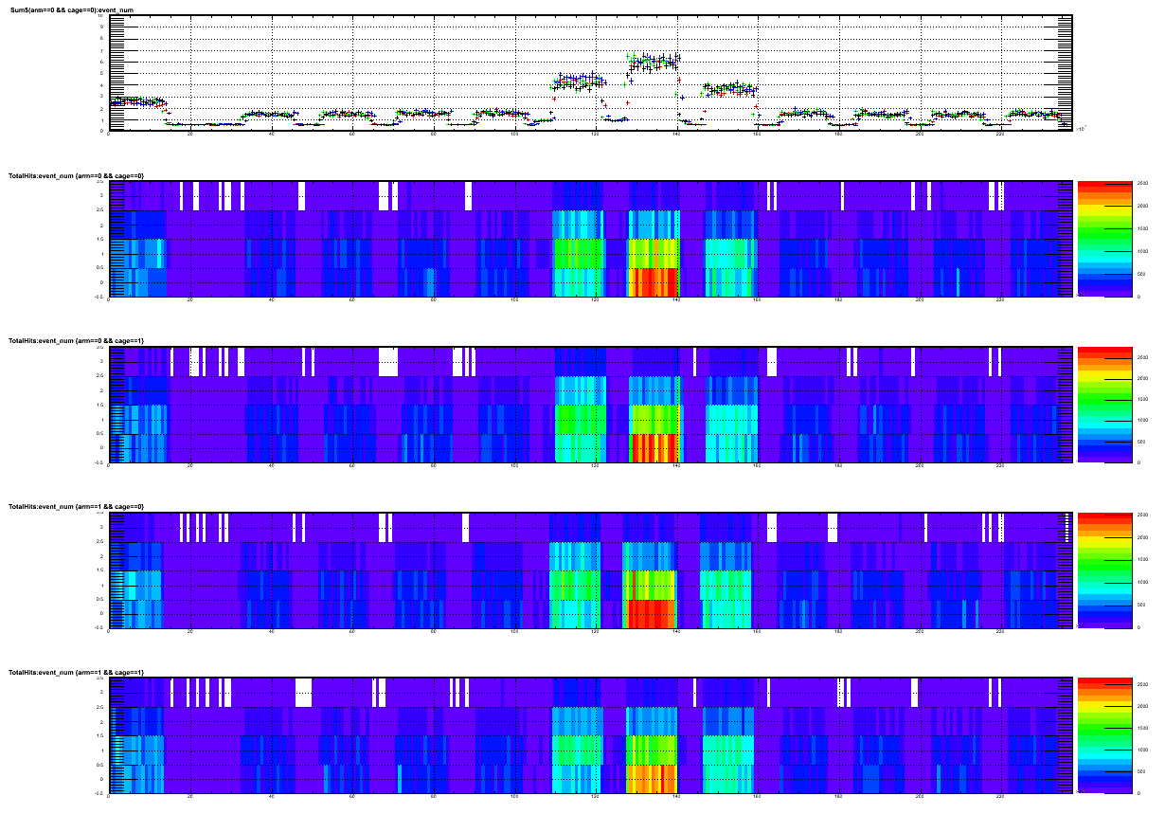
Time-in FVTX in Big Partition
Special technique to speed the scan by changing FVTX delay
FEM delay = 5 6 7 8 9 10 11 ….
@ GTM delay = 4
Expect timing delay is
FEM Delay = 10, GTM Delay = 4
FEM Delay = 9, GTM Delay = 3
FEM Delay = 11, GTM Delay = 5

Slide 26
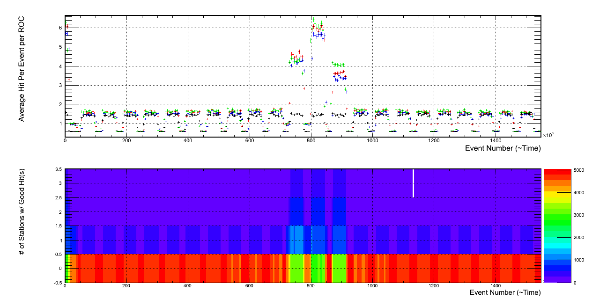
Time-in FVTX
Number of hit per event
Coincidence Peak @ 11!
Four independent data sets in color coding
Each include 16 wedges in one ROC
FEM Timing offset
0 1 2 3 4 5 6 7 …
Number of Stations with good hit(s)

Slide 27
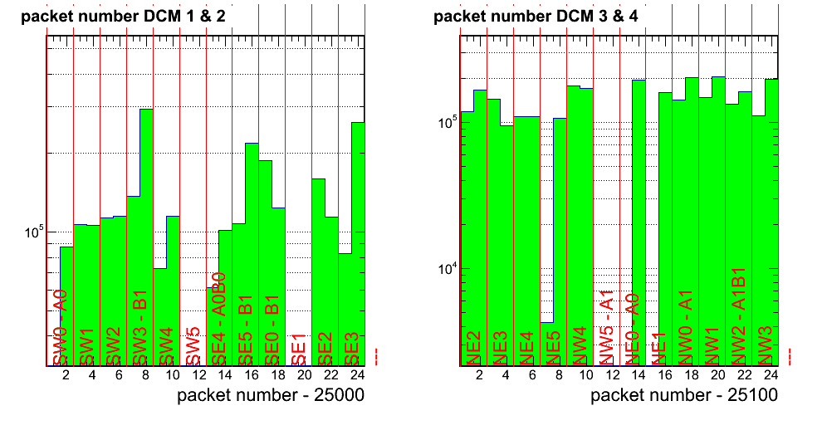
FVTX Readout using PHENIX DAQ
(aka. big partition)
ROC Hit map
Readout from PHNEX run control. Few ROCs missing which are under firmware update

Slide 28
FPGA Firmware R&D
To hear from Sergey

Slide 29
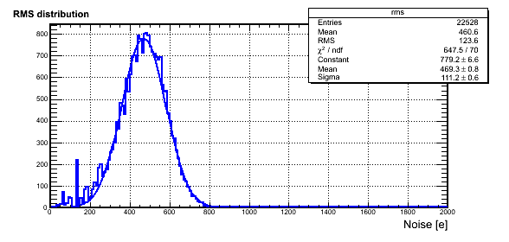
Full system calibration
Calibration map for ROC NE2 (1/12 of south arm acceptance)
Showing stable communication to all wedges and low noise level
3.5 min to calibration 1M channels using PHENIX DAQ
Noise level ~ 500 electron in PHENIX
Threshold ~ 300 elec.
Noise level ~ 500 electron

