Slide 1
Radiative Corrections
Peter Schnatz
Stony Brook University

Slide 2
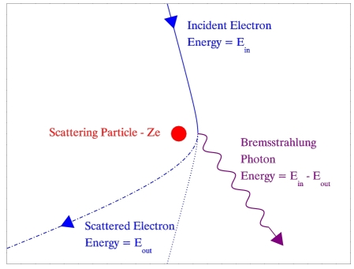
Radiative Events
In scattering experiments, a photon may be emitted by a charged particle due to Bremsstrahlung radiation.
Bremsstrahlung radiation
This type of radiation is due to the deceleration of a charged particle as it approaches the culombic field of another.
Only the scattered lepton is measured during the event, while the radiated photon usually evades detection. Therefore, there is a loss of energy in the system which is not accounted for.

Slide 3



Invariant Mass
Law of Conservation of Energy:
Einstein’s Mass-Energy Equivalance:
Invariant mass is a property of the energy and momentum of an object.
The total invariant mass of a system must remain constant .
If a scattering experiment results in numerous final-state products, the summation of the energy and momentum of these products can be used to determine the progenitor, X.
In radiative events, the energy and momentum of the photon must also be considered.

Slide 4
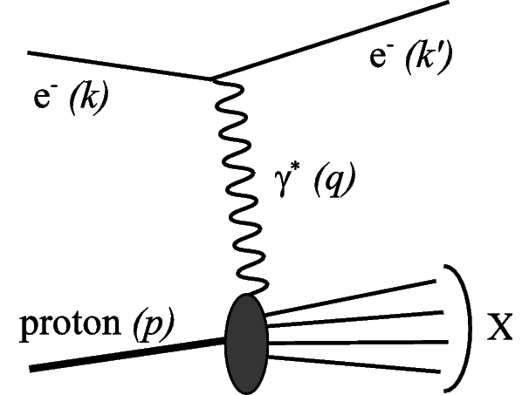

Why do we need radiative corrections?
In a radiative event the beam energy is reduced prior to its measurement.
The square of the momentum transfer, q, is denoted by Q².
Since the virtual particle cannot be measured directly, Q² is calculated using the measured quantities of the scattered lepton (i.e. energy and angle).
This approach is quite successful for non-radiative events, but fails to yield the correct value when a photon is emitted.

Slide 5
Initial and Final-State Radiation
Initial-State Radiation
The incoming lepton emits a photon before the interaction with the proton.
Reduces the beam energy prior to the momentum transfer.
Final-State Radiation
The scattered lepton emits a photon.
The momentum transfer has already occurred, so the lepton beam energy is reduced.

Slide 6


Initial-State Radiation
Actual incoming lepton beam energy:
The true value of Q² is now going to be less than that calculated from the measured lepton.

Slide 7


Final-State Radiation
Actual scattered lepton beam energy before radiating photon:
The true value of Q² is now going to be larger than that calculated from just the scattered lepton’s energy and angle.

Slide 8
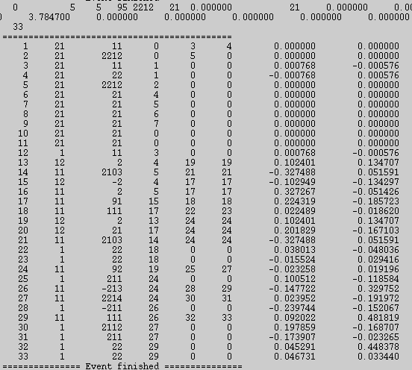
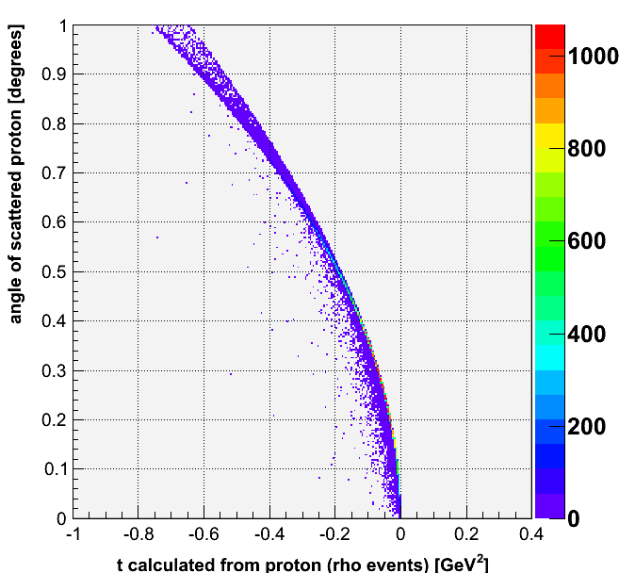
Pythia 6.4
Monte Carlo program used to generate high-energy-physics events
Using these simulations, we are able to study the events in detail by creating plots and observing relations.
Capable of enhancing certain subprocesses, such as DIS or elastic VMD.

Slide 9
Pythia 6.4
In a Monte Carlo program, the true value of Q² can be calculated from the mass of the virtual particle.
Q²_{true} = m_{γ*} ∙ m_{γ*}

Slide 10
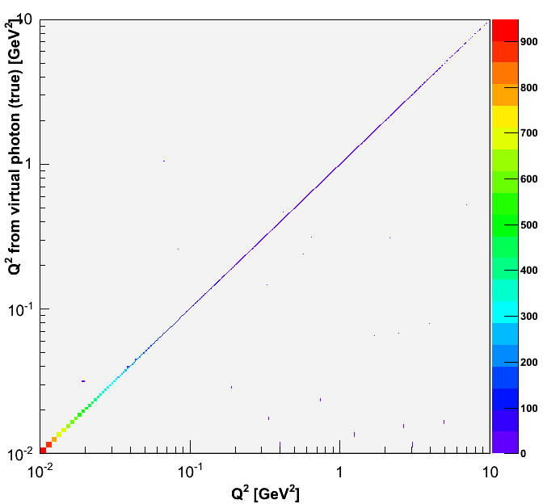


Q² vs. Q²True Non-Radiative Electron-Proton Events
There is almost perfect correlation between Q² and Q²True
A photon is not radiated by the electron.
The energy of the incoming e⁻ remains 4GeV.
The e⁻ does not lose energy after the interaction.

Slide 11
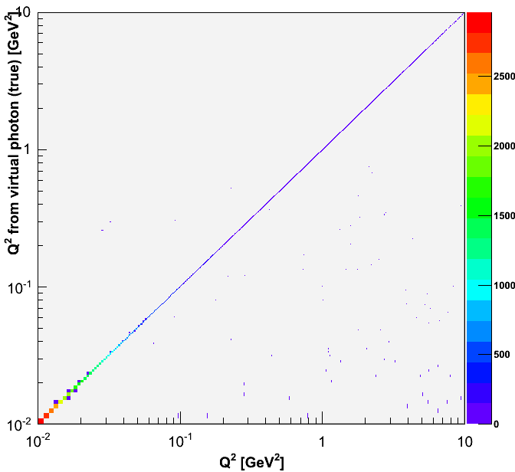
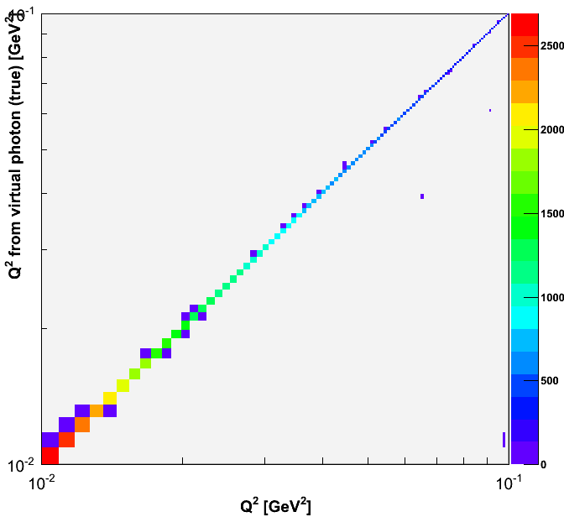
Q² vs. Q²True Radiative Electron-Proton Events
No longer a perfect correlation between Q² and Q²True
Q²True = Q² →Non-radiative
Q²True < Q² → Initial-state radiation
Q²True > Q² → Final-state radiation

Slide 12
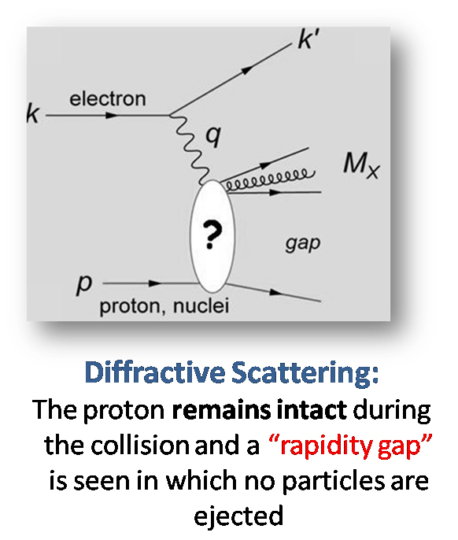
Diffractive Scattering
Proton remains intact and the virtual photon fragments into a hard final state, M_{X}.
The exchange of a quark or gluon results in a rapidity gap (absence of particles in a region).

Slide 13
Mandelstam Variable, t
t is defined as the square of the momentum transfer at the hadronic vertex.
p₃
p₁
t = (p₃ – p₁)² = (p₄ – p₂)²
p₂
If the diffractive mass, M_{X} is a vector meson (e.g. ρ⁰), t can be calculated using p₁ and p₃:
p₄
t = (p₃ – p₁)² = mρ² - Q² - 2(Eγ*Eρ - p^{x}γ*p^{x}ρ - p^{y}γ*p^{y}ρ -p^{z}γ*p^{z}ρ)
Otherwise, we must use p₂ and p₄:
t = (p4 - p2)² = 2[(mp^{in}.mp^{out}) - (E^{in}E^{out} - pz^{in}pz^{out})]

Slide 14
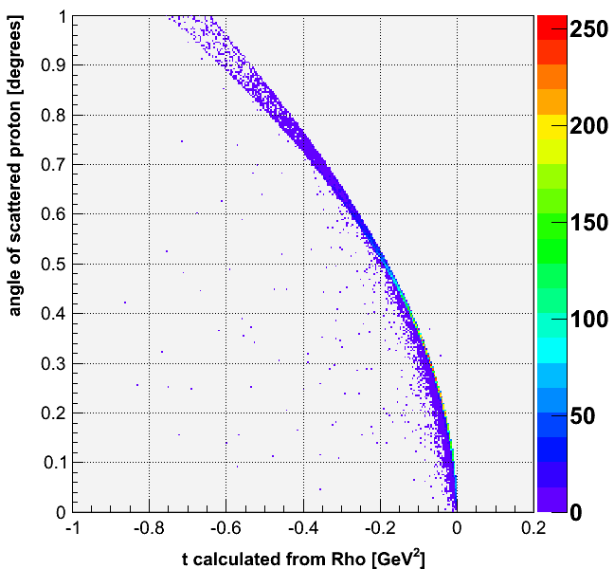
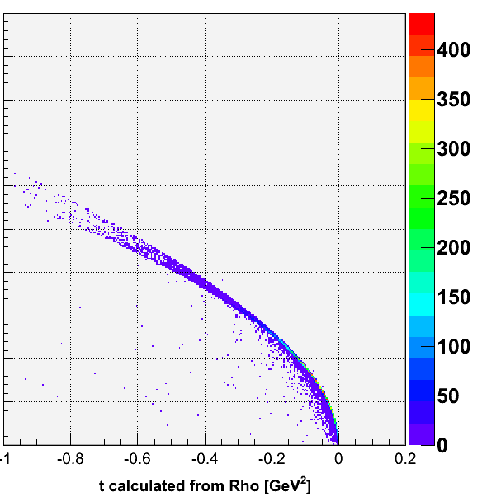
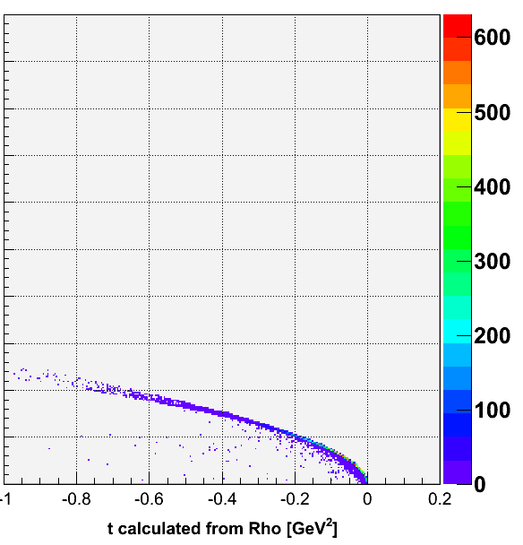
Mandelstam t Plots From events generated by Pythia Subprocess 91 (elastic VMD) Without radiative corrections
4x50
4x100
4x250
Here, t is calculated using the kinematics of the ρ⁰.
t = (p₃ – p₁)² = mρ² - Q² - 2(Eγ*Eρ - p^{z}γ*p^{z}ρ - p^{z}γ*p^{z}ρ -p^{z}γ*p^{z}ρ)

Slide 15
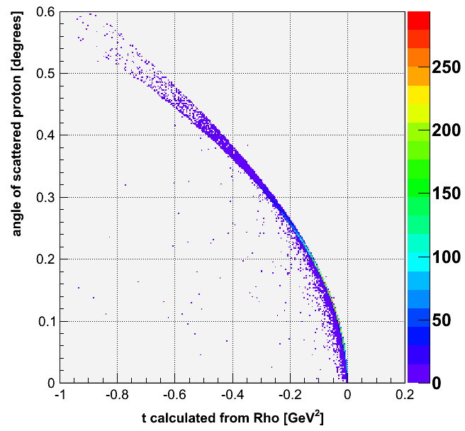
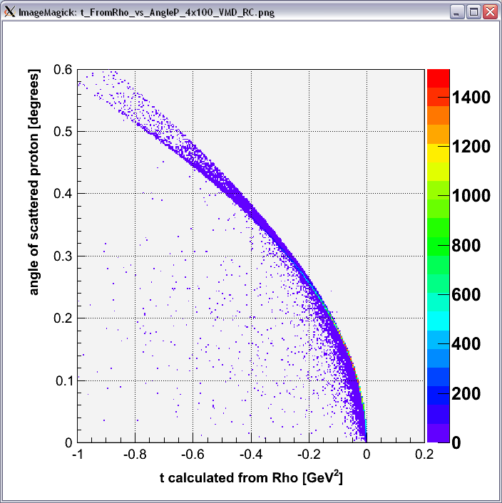
Comparison of t plots (4x100, t calculated from ρ⁰)
Without radiative corrections
With radiative corrections
Pythia allows us to simulate radiative events and determine the effects.
Smearing

Slide 16
Why is there smearing in the t plots for radiative events?
t = mρ² - Q² - 2(Eγ*Eρ - p^{x}γ*p^{x}ρ - p^{y}γ*p^{y}ρ -p^{z}γ*p^{z}ρ)
Initial-state radiation results in Q² > Q²True
t is calculated to be smaller than its actual value.
Final-state radiation results in Q² < Q²True
t is calculated to be larger than its actual value.

Slide 17
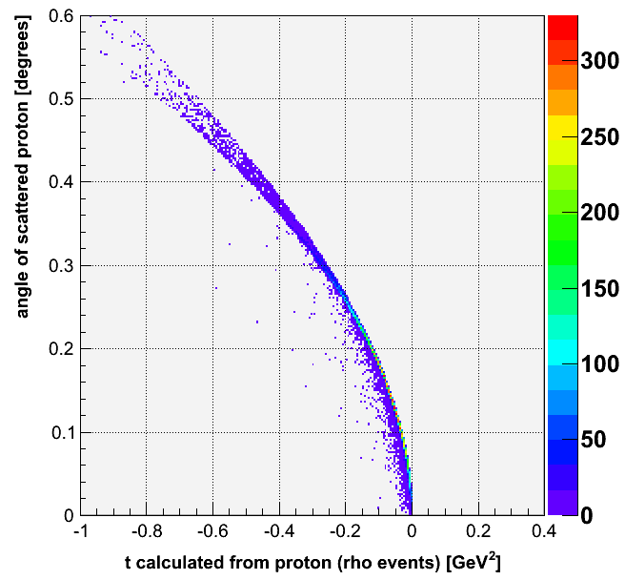
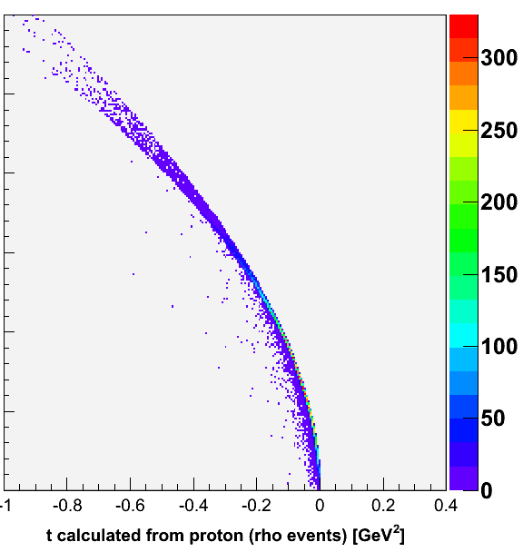
Comparison of t plots (4x100, t calculated from proton)
Without radiative corrections
With radiative corrections
No smearing!

Slide 18
Why is there no smearing when we calculate t using the proton kinematics?
In calculating t, only the kinematics of the proton are used.
t = 2[(mp^{in}.mp^{out}) - (E^{in}E^{out} - pz^{in}pz^{out})]
Also, the kinematics of the proton determine its scattering angle.
Regardless of initial and final-state radiation, the plot will consistently show a distinct relationship without smearing.

Slide 19
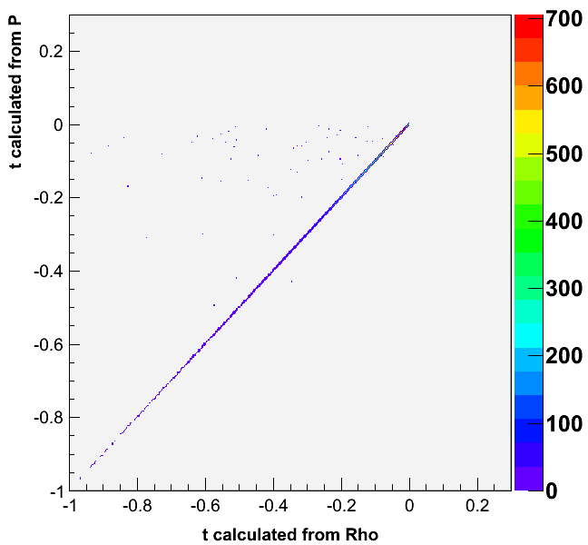
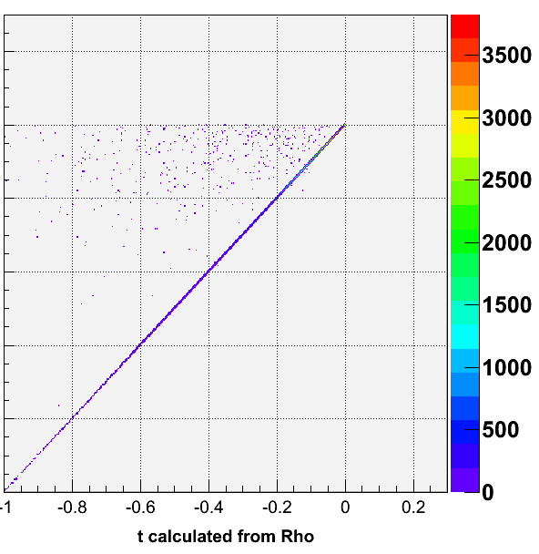
Comparison of Correlation Plots
Without radiative corrections
With radiative corrections
Smearing

Slide 20
Future Plans
Study radiative effects for DIS.
Implement methods used by HERA to study radiative corrections.

