Slide 1

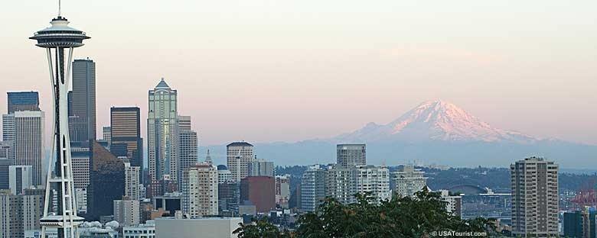
Charmonium suppression from SPS to RHIC
Raphaël Granier de Cassagnac
LLR – École polytechnique / IN2P3
PHENIX & CMS experiments
Seattle, 2009, June 17th

Slide 2
Introduction
“overview talk on experimental status of charmonium suppression.”
Setting up the firm ground of observations
Leaving on the side
Production mechanisms, polarization, feed-downs, fermilab and hera-b…
Some redundancy with at least
Rapp, Redlich, Stachel, Frawley, Lansberg, Tuchin, Faccioli, Leitch, Woehri, Linden-Levy, Lourenço…

Slide 3
The normal introduction
Matsui & Satz, PLB178 (1986) 416
In 1986, Matsui & Satz predicted an “unambiguous” signature of QGP
Onset of quarkonia melting above a certain temperature / energy density threshold
Example of assumed T_{d} (but theorists still working on it, remember yesterday):

Slide 4
0. The published situation
before new SPS and RHIC
preliminary references
shown at QM09

Slide 5
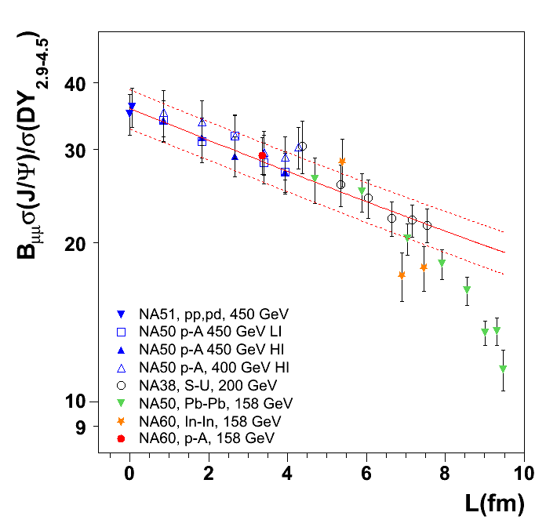
Cold and hot matter @ SPS
J/ψ
Normal nuclear absorption alone does a splendid job describing pA, SU and peripheral InIn and PbPb:
σ_{abs} = 4.18 ± 0.35 mb
Scaled from 400 to 158 AGeV
Beyond is “anomalous suppression”
InIn looks like an onset
L
σ_{abs} = 4.18 ± 0.35 mb
± 10% global systematics
NA60 preliminary
NA50, EPJ C39 (2005) 335
NA60, PRL99 (2007) 132302
Notes:
« as good on onset as the experimental resolution of centrality allows »
« the largest systematic study of a QGP signature… »

Slide 6
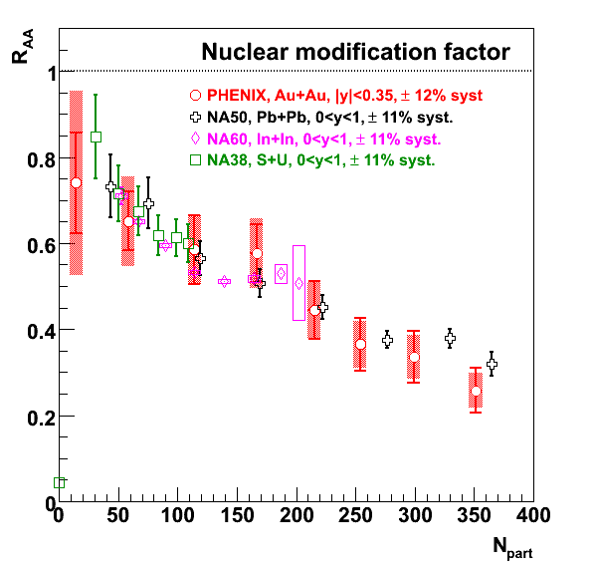
R_{AuAu} (y≈0 in PHENIX) ≈ R_{PbPb} (@ SPS)
Lower rapidity R_{AA} looks surprisingly similar, while there are obvious differences:
At a given N_{part}, different energy densities…
Cold nuclear matter effects (x_{Bjorken}, σ_{abs}…)
…
REDO
Without forward
PHENIX, PRL98 (2007) 232301
SPS from Scomparin @ QM06

Slide 7
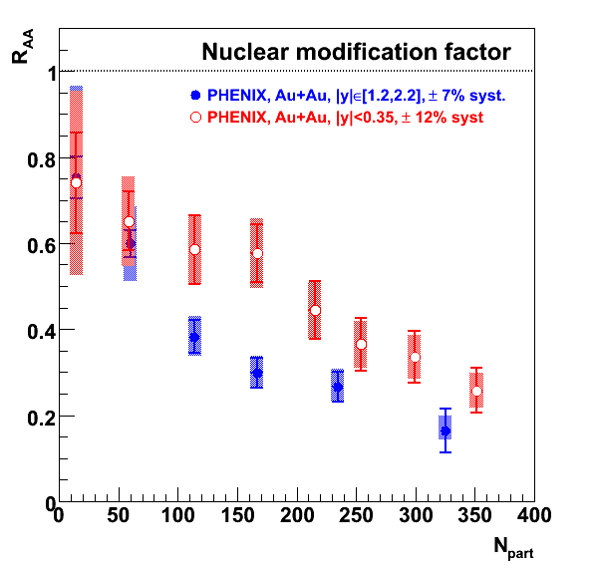
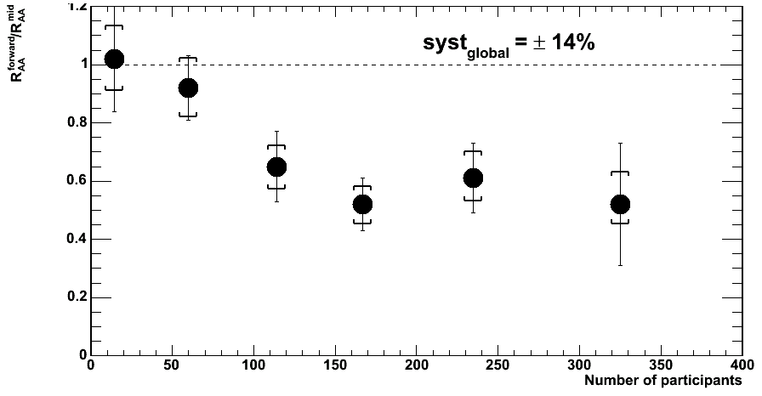
R_{AuAu} (y≈1.7) < R_{AuAu} (y≈0) in PHENIX
@ RHIC, more J/ψ suppression at forward rapidity!
While energy density should be smaller…
REDO
60%
PHENIX, PRL98 (2007) 232301
R_{AA}(y~1.7)
R_{AA}(y~0)
What is this further 40% suppression due to?

Slide 8
@ RHIC, more suppression at forward rapidity!
Two possible theoretical explanations…
A. One hot: coalescence, regeneration
B. One cold: saturation, shadowing

Slide 9
A. Hot coalescence, regeneration
Large variety of approaches, all justify:
R_{AA}(y=0) > R_{AA}(y=1.7)
(more c quarks to recombine at y=0)
As an example
Latest references
R. Thews et al, EPJ C43, 97 (2005)
Yan, Zhuang, Xu, PRL97, 232301 (2006)
A. Andronic et al., NPA789, 334 (2007)
Ravagli, Rapp, PLB655, 126 (2007)
Zhao, Rapp, PLB664, 253 (2008)
A. Capella et al., EPJ C58, (2008) →
O. Linnyk et al., NPA807, 79 (2008)
Rapp and Stachel at Seattle
(Apologies if I forgot somebody)
Capella, Ferreiro, Tywoniuk et al.
Fitting Cu+Cu, Au+Au,
Mid and forward rapidity
Notes:
R. Rapp et al, PRL 92, 212301 (2004)

Slide 10
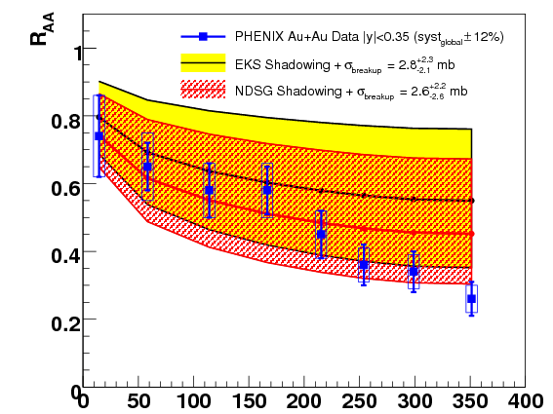
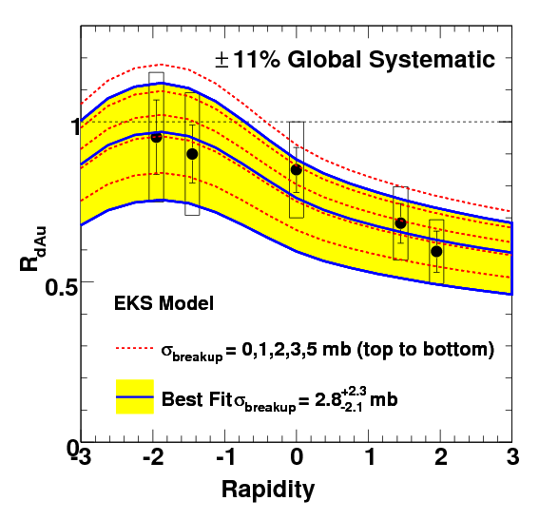
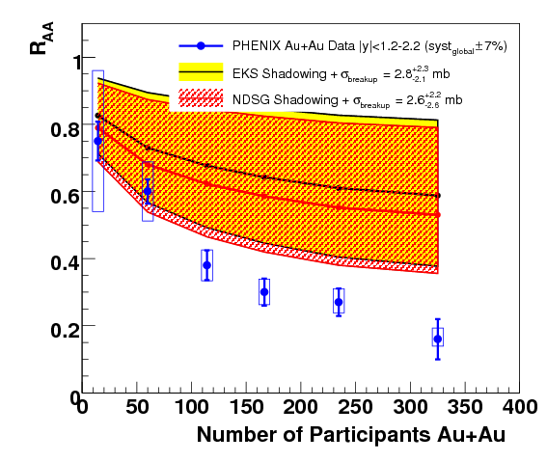
B. Cold matter
Assuming two shadowing schemes, derive breakup cross sections from R_{dA}(y)
σ_{EKS} ≈ 2.8 ^{+2.3}_{–2.1} mb
σ_{NDSG} ≈ 2.6 ^{+2.2}_{–2.6} mb
Extrapolate to AuAu →
(Also available for CuCu)
Mid and forward are correlated through shadowing scheme
If you believe this shadowing + absorption, there is anomalous suppression, larger at forward rapidity.
Midrapidity
PHENIX, PRC 77 (2008) 024912
& erratum: PRC 79 (2009) 059901
Forward rapidity

Slide 11
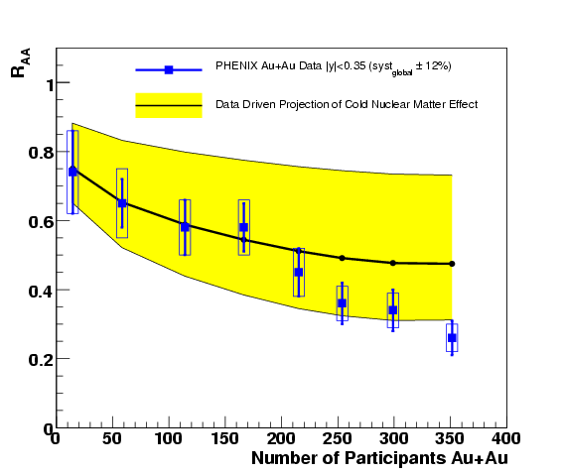
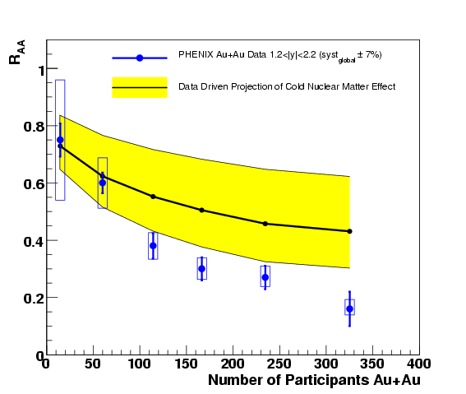
B. Cold matter
RGdC, HP06 and QM06
PHENIX, PRC 77, 024912 (2008)
More model independent…
In a Glauber data-driven model, propagate what we know from R_{dA}(y,centrality)
R_{AA}(y,b) = Σ_{i} R_{dA} (–y,b^{i}₁) x R_{dA}(+y,b^{i}₂)
No shadowing nor absorption schemes
Mid and forward are not correlated, less model dependent → larger uncertainties (especially @ y≈0)
Anomalous suppression, at least at forward rapidity!
Anomalous suppression could be identical at different rapidities
(No dCu, so no CuCu)
Midrapidity
Survival = 55 ⁺²³_{–38} %
Survival = 38 ⁺¹⁸_{– 22} %
Forward rapidity

Slide 12
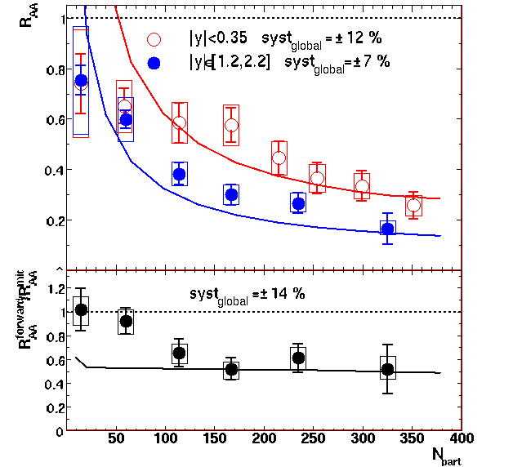
B. Recent CGC paper
Kharzeev, Levin, Nardi, Tuchin
PRL102 (2009) 152301
and arXiv: 0809.2933
Gluon saturation could further suppress forward J/ψ in AuAu
First numerical estimate
Absolute amount of suppression is fitted to the AuAu data!
Waiting forward to new dAu data to fit them first
However, rapidity dependence should be ok
But it does not reproduce peripheral data →
Anyway…
dN/dy
Again, J/ψ anomalous suppression could be identical at mid and forward rapidity!

Slide 13
How to disentangle these two scenarios experimentally? (now moving to preliminary material)
Two possible theoretical explanations…
A. One hot: coalescence, regeneration
B. One cold: saturation, shadowing

Slide 14
How to move forward experimentally?
RGdC, Quarkonia in hot and cold matters, Quark Matter 08
Calm down?
Be more open?
Get excited?
Get high?
Broaden interest?
Let it flow?
Be upset?
Give up?
(Better pA/dA reference)
(Measure cc to constrain regen.)
(ψ’, χ_{c})
(in mass, looking at upsilons)
(in transverse momentum)
(elliptically)
(and search for onset)
And move to the LHC?
Some progress on all these points at this meeting !

Slide 15
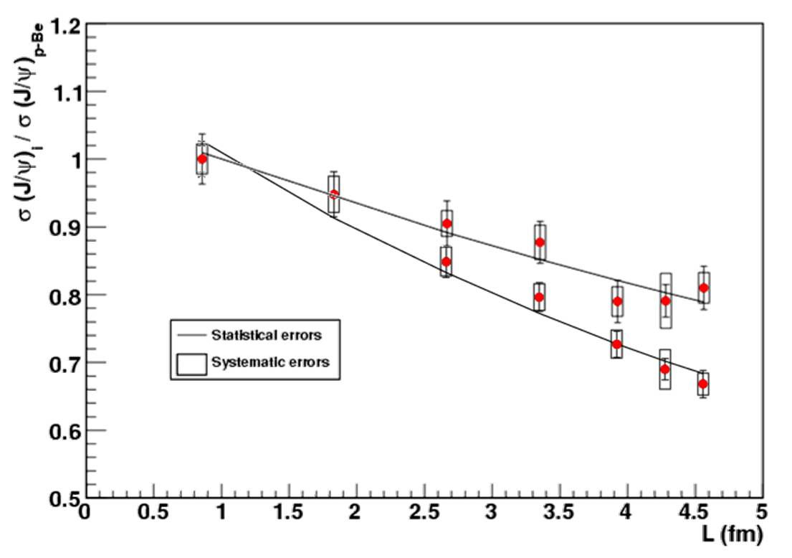
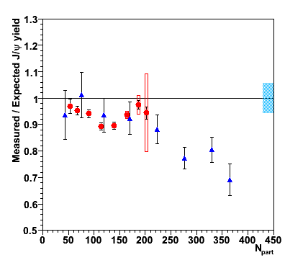
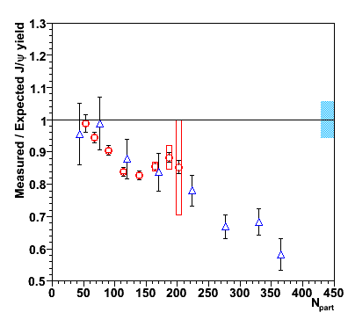
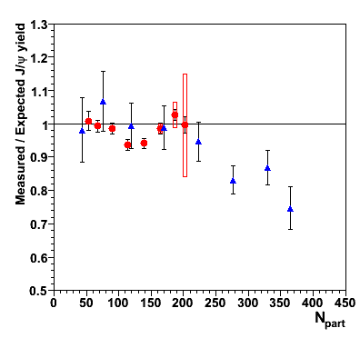
1. New preliminary reference @ SPS
NA60 pA @ 158 GeV →
New absorption, considering
also antishadowing (EKS98)…
σ_{abs} (400 GeV) = 4.3 ± 0.8 ± 0.6 mb
In-In 158 GeV (NA60)
Pb-Pb 158 GeV (NA50)
± 11% global
uncertainty
σ_{abs} (158 GeV) = 7.6 ± 0.7 ± 0.6 mb
Arnaldi, QM09
Considering shadowing ≈75%
Still anomalous suppression in Pb+Pb (of ψ’ and χ_{c}?)
Not sizeable in In+In, but such a peculiar shape…
With new absorption ≈68%
With old reference ≈58%
Notes:
80 nb –1

Slide 16
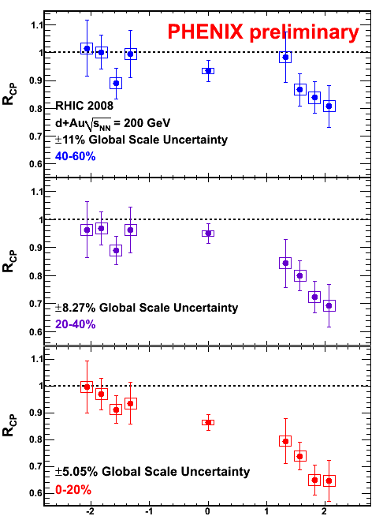
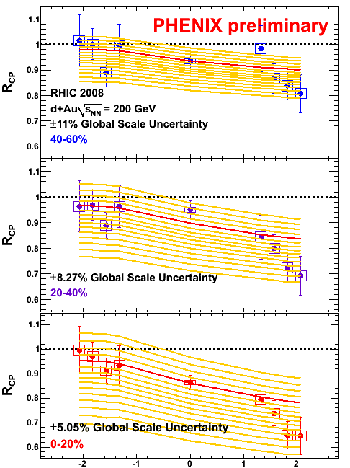
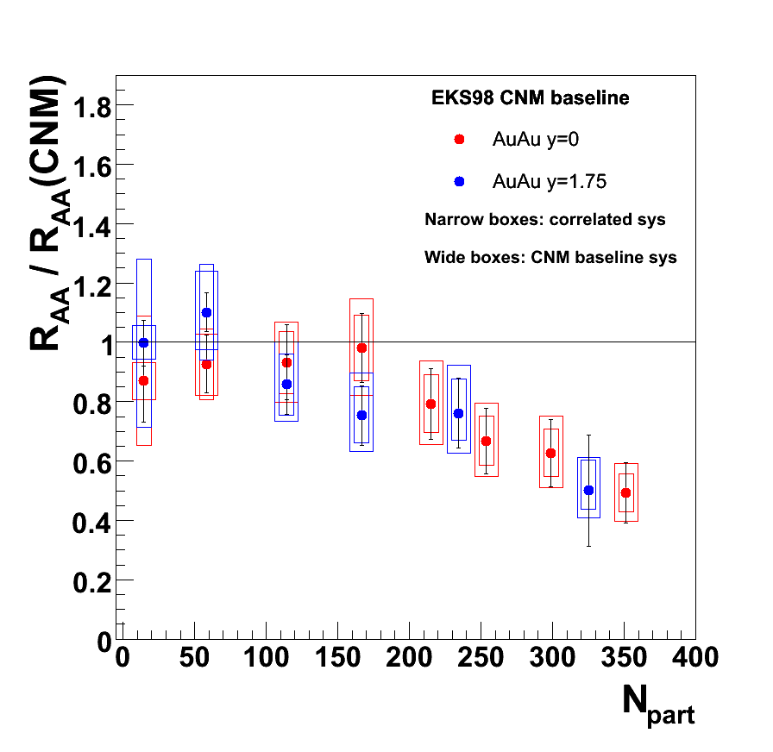
1. New preliminary reference @ RHIC
R_{dA} not yet available
No data driven method
Shadowing & σ_{abs} do not describe data anymore
One way is to use various (effective) σ_{abs} vs rapidity
EKS σ = 0,1,2,3,4,…15
EKS σ = 0,1,2,3,4,…15
Linden-Levy, QM09
Frawley, Trento & Seattle
Notes:
80 nb –1

Slide 17
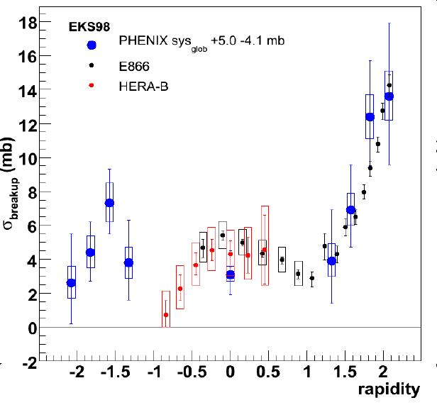
Now, a little word of caution
Tony’s extrapolation of the dAu Phenix preliminary R_{CP} does reinforce the cold hypothesis to explain the R_{AA} rapidity difference…
However, need different σ_{abs} for different rapidity
also seen at SPS, Fermilab →
So, something else or different is going on there…
Something for which the extrapolation to R_{AA} may or may not be appropriate…
So let us think!
(and wait for final R_{dA})
Lourenço, Vogt, Woehri , JHEP 0902:014
Frawley, Trento & Seattle

Slide 18
What else could bring information?
2. Open charm?

Slide 19
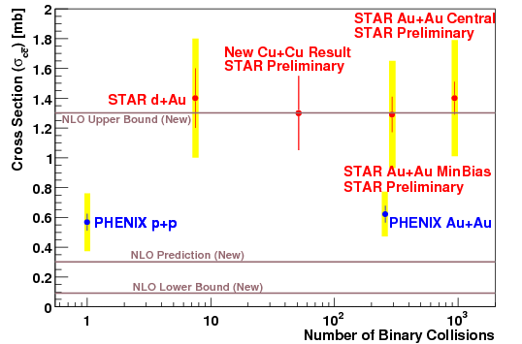
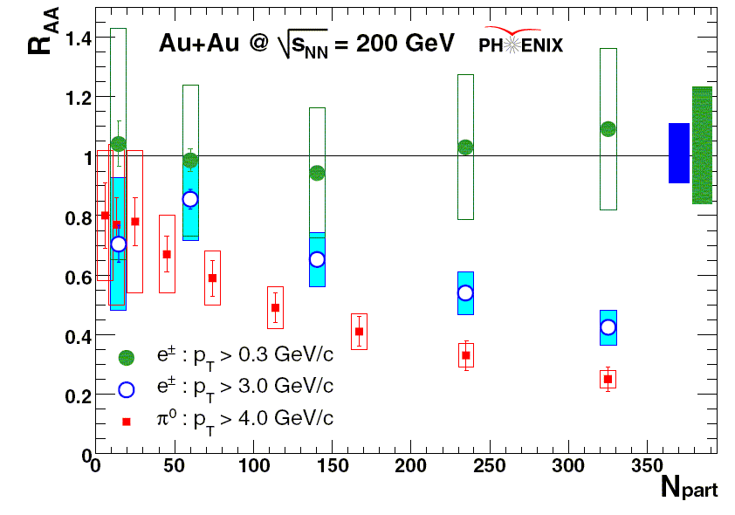
2. Measuring open charm…
… could constrain both
Regeneration α (N_{cc})²
Initial state effect (shadowing…) shared with J/ψ
A factor of 2 difference between experiments
≈25% systematic error
But binary scaling (within uncertainties…)
At SPS too: 1.16 ± 0.16
?
???
10 to 20
cc pairs
PHENIX, PRL98 (2007) 172301
NA60, EPJ.C59 (2009) 607

Slide 20
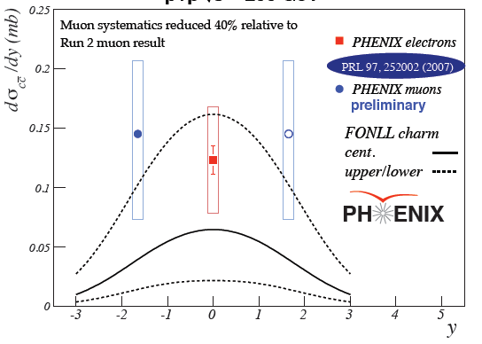
2. Open charm vs rapidity
Only pp, and very poorly known
To know more about open charm, wait for silicon upgrades in Phenix and Star
D. Hornback, PHENIX, QM08

Slide 21
Look at other quarkonia
3. Excited charmonia
4. Upsilons

Slide 22
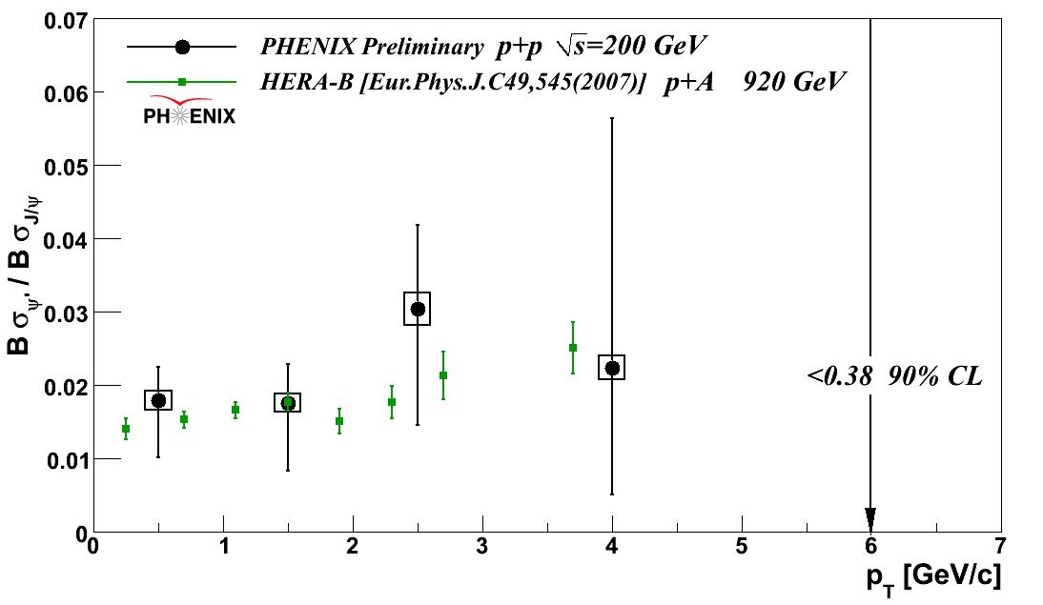
3. Excited states (feed down to J/ψ)
Excited states should…
A. melt if J/ψ suppression is cold effects + sequential melting
B. also regenerate if J/ψ do (and maybe even more)
At RHIC, unfortunately only p+p for now…
Feeddown ratio
ψ‘ dAu is feasible
ψ‘ AuAu needs new run
ψ from ψ’ = 8.6 ± 2.5%
ψ from χ_{c} < 42% (90%CL)
Beauty cross section → ψ from B = 4 ⁺ – ³₂ %
M. Donadelli @ PANIC08
Notes:
P127 Marisilvia P85 Cesar P98 Han Liu

Slide 23
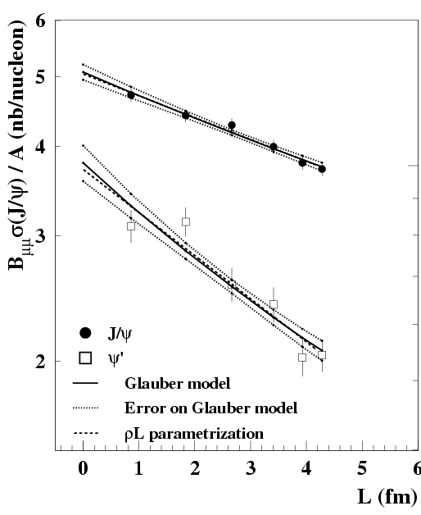
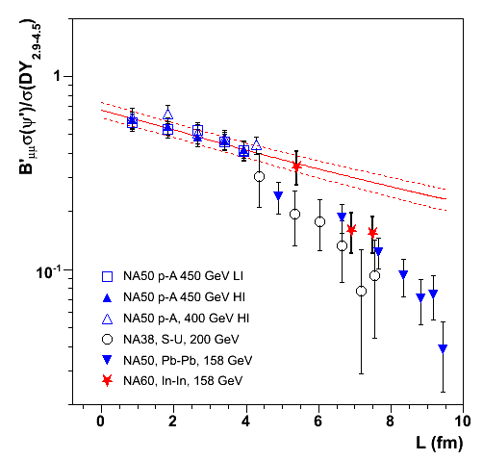
ψ’ at SPS
NA50, EPJC48 (2006) 329
NA50, EPJC49 (2007) 559
Scomparin @ Trento
ψ_{pA} / A
at 400 AGeV
ψ’/Drell-Yan
σ_{abs} = 4.2 ± 0.5 mb
J/ψ
7.3 ± 1.6 mb
σ_{abs} = 7.7 ± 0.9 mb
450, 400 and 200 GeV points
rescaled to 158 GeV
close to a
factor of 10
ψ’
19.2 ± 2.4 mb
Preliminary
ψ’ are more absorbed and suppressed than J/ψ
σ_{abs} (158 AGeV) not available
Notes:
7.3 pm 1.6
19.2 pm 2.4

Slide 24
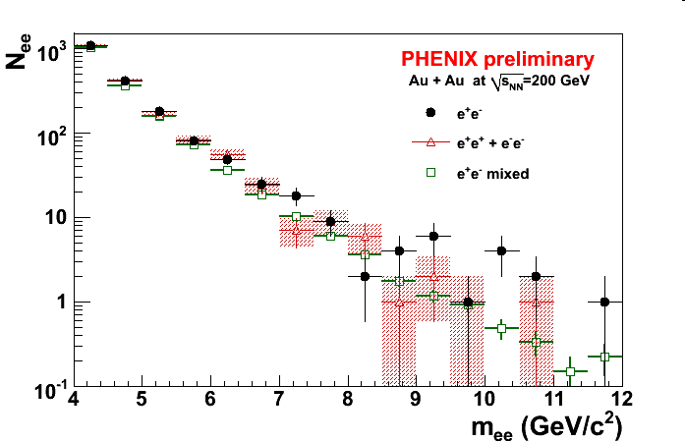
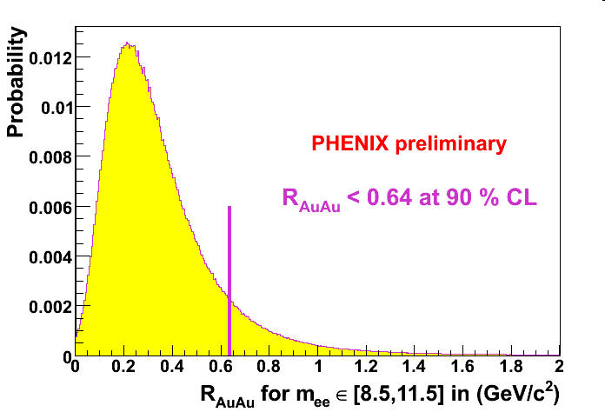
4. Beginning of a bottomonia story
Atomssa, Liu, Conesa del Valle @ QM09
R_{dAu} = 0.98 ± 0.32 ± 0.28 (from STAR)
R_{AuAu} < 0.64 @ 90% CL (from PHENIX →)
Could be cold effects
No continuum subtraction
(but < 15% from pp)
Feeddown of χ_{b} important
50% for p_{T} > 8 GeV/c at CDF
Stay tuned…
[8.5,11.5] GeV/c²

Slide 25
Look at other observables
5. p_{T} (broadening)
6. Elliptic flow

Slide 26
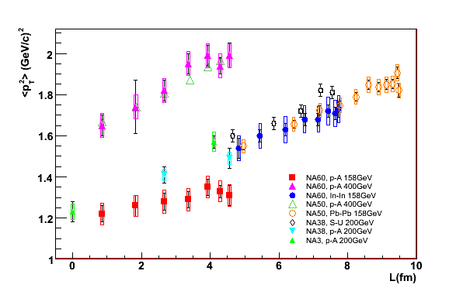
5. p_{T} broadening @ SPS ?
Tested on many systems… NA60 pA slope is unique…
Cronin goes like: <p_{T}²>_{AB} = <p_{T}²>_{pp} + α x L
SPS
Cortese (NA60), Hard probes 08
+ homemade powerpoint fits

Slide 27
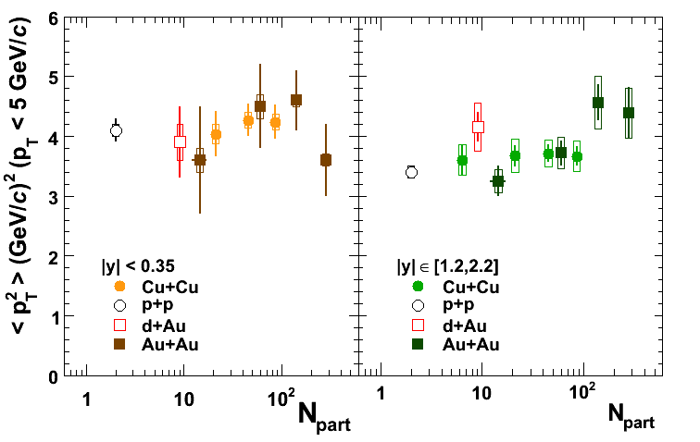
5. p_{T} broadening @ RHIC ? vs N_{part} ?
PHENIX, PRL 101, 122301 (2008)
Widely unknown initial charm production:
Recombined R_{AA} are poorly constrained…
Instead look at p_{T}:
Hot: Inherited p_{T} should be lower than initial
Cold: Cronin effect should broaden initial p_{T}
Cronin goes like:
<p_{T}²>_{AB} = <p_{T}²>_{pp} + α x L
Mid rapidity
Forward rapidity
No strong <p_{T}²> dependence…
Modest rise at forward rapidity
Could be broadening
No need for recombination here
Notes:
No pA, single dA point, CuCu and AuAu

Slide 28
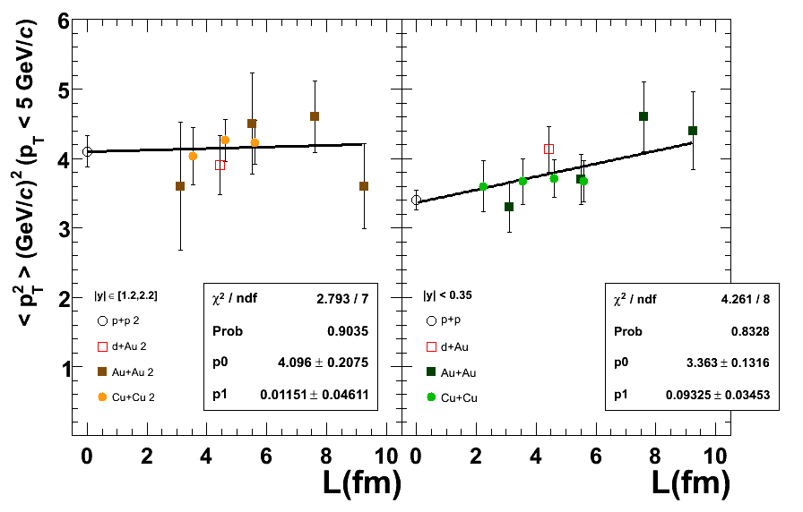
5. p_{T} broadening @ RHIC ? vs thickness ?
Widely unknown initial charm production:
Recombined R_{AA} are poorly constrained…
Instead look at p_{T}:
Hot: Inherited p_{T} should be lower than initial
Cold: Cronin effect should broaden initial p_{T}
Cronin goes like:
<p_{T}²>_{AB} = <p_{T}²>_{pp} + α x L
Mid rapidity
Forward rapidity
2.7 sigma slope
1.2<|y|<2.2
|y|<0.35
No strong <p_{T}²> dependence…
Modest rise at forward rapidity
Could be broadening
No need for recombination here
Notes:
No pA, single dA point, CuCu and AuAu

Slide 29
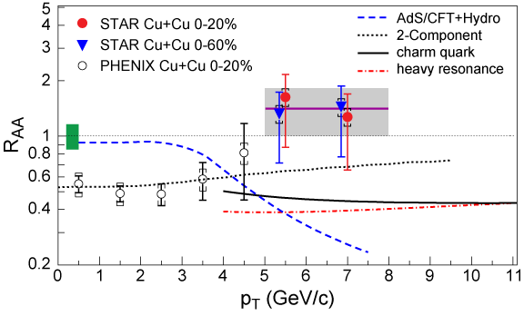
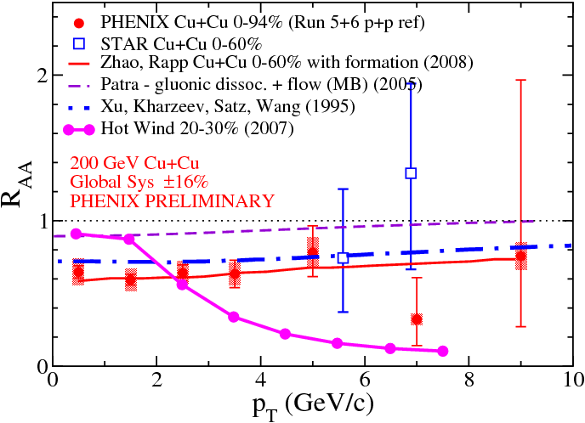
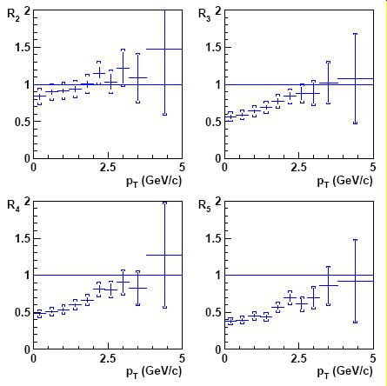
5. Reaching higher p_{T}
STAR, arXiv:0904.0439
Rapp & Zhao, arxiv:0806.1239
STAR’s R_{CuCu} (high p_{T}) ≈ 1
Hot wind scenario → 0
Screening length from AdS/CFT…
But several reasons for R_{AA} to grow at high p_{T}
Cronin effect,
Bottom contribution,
Leakage,
(Anti)shadowing…
Already seen at SPS!
R_{CP} of Pb-Pb data →
IMHO, not a big deal…
NA50, L. Ramello, QM05
Notes:
Between 5 and 6 : 12 – 6 = 6 pm 4.2 is a 1.4 sigma signal (upper limit) 2 10^{–1} pm 10^{–1}
Between 6 and 8 : 17 – 7 = 10 pm 4.9 is a 2 sigma signal

Slide 30
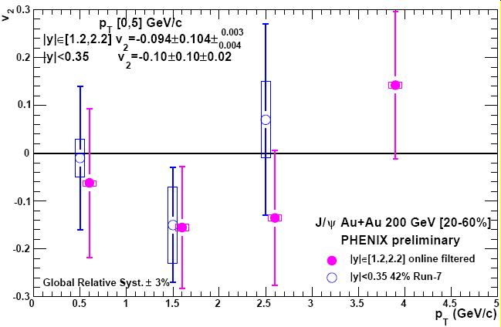
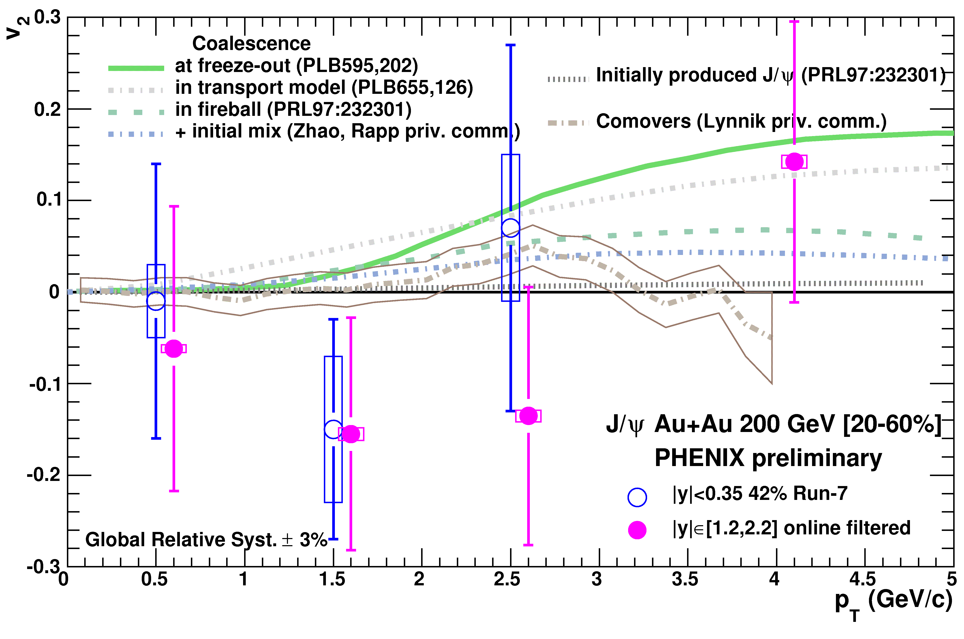
6. J/ψ elliptic flow in PHENIX
If recombined, J/ψ should inherit the (rather large) charm quark elliptic flow. First measurement:
C. Silvestre @ QM08
E.T. Atomssa @ HP08
Various levels of
recombination…
Will require
RHIC2 for a
discriminating
measurement

Slide 31
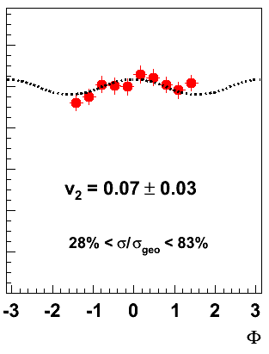
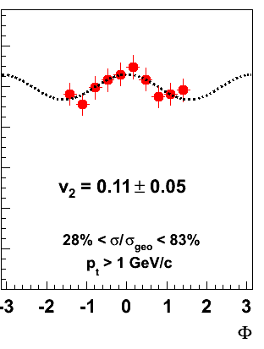
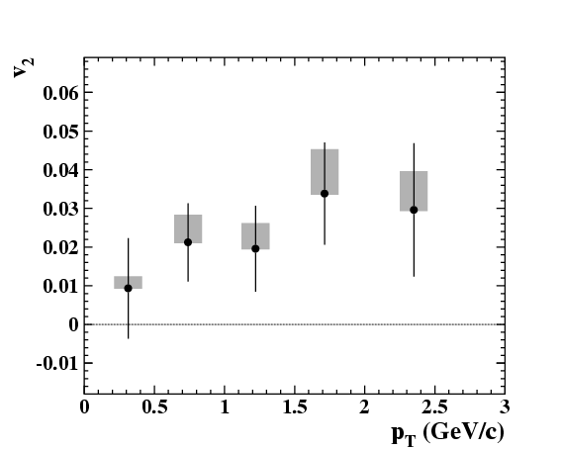
6. But also J/ψ elliptic flow @ SPS
R. Arnaldi @ QM08
F. Prino @ HP08
Eccentric In+In collisions
MinBias Pb+Pb collisions
Cannot be due to recombination
(≈0.05 cc pairs in In+In)
Needs confirmation and understanding

Slide 32
What else ?
7. Look for onsets
8. Go to LHC, the uncharted territory

Slide 33
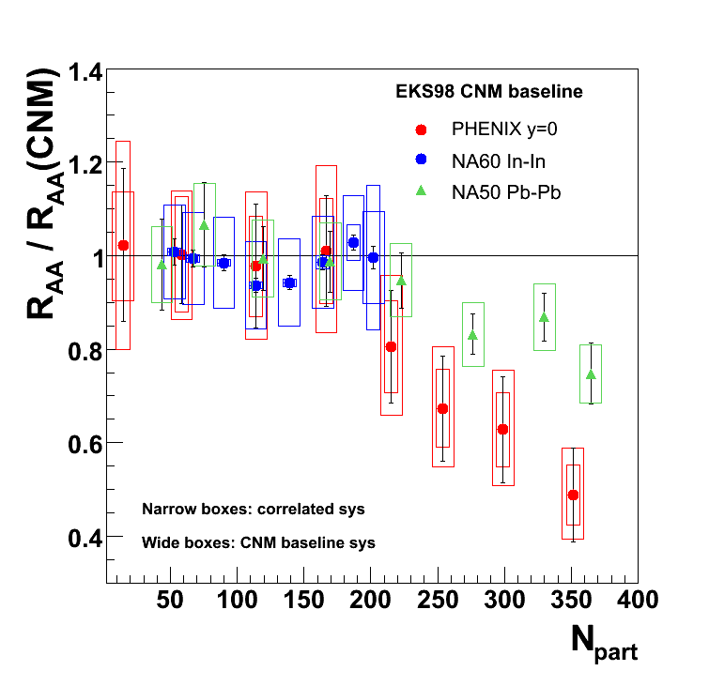
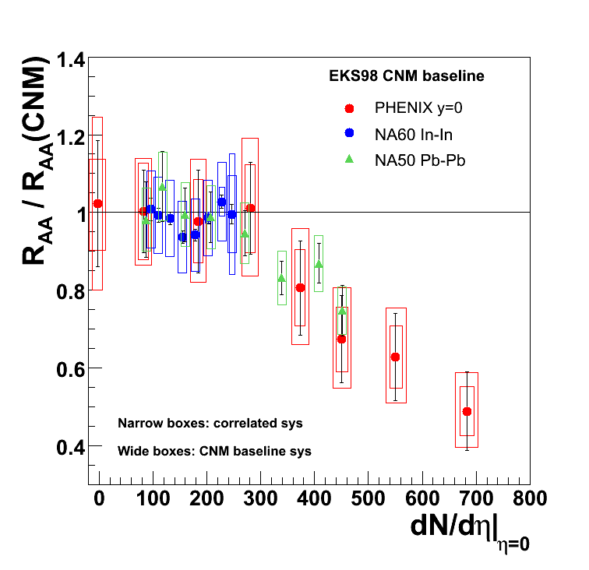
7. Common onset at SPS and RHIC?
Clear misalignment wrt N_{part}
Better wrt dN/dη
R. Arnaldi + T. Frawley, Trento
More next week…
Getting closer to energy density, more next week…

Slide 34
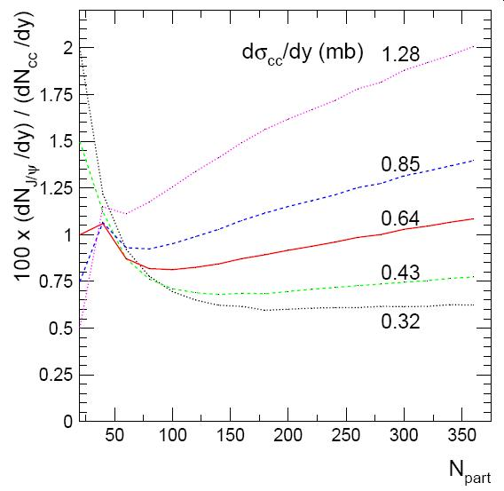
8. J/ψ at LHC ?
A new story will begin
↓ More J/ψ melting
↓ Larger shadowing / saturation effects
↑ Larger recombination (maybe 200 cc pairs)
If recombination prevails → golden signal
If not, expect same or worse difficulties as at RHIC…
Example of prediction
That would be hot !
A. Andronic et al., NPA789 (2007) 334
J. Stachel, Seattle

Slide 35
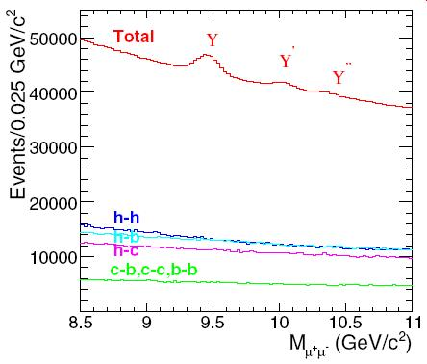
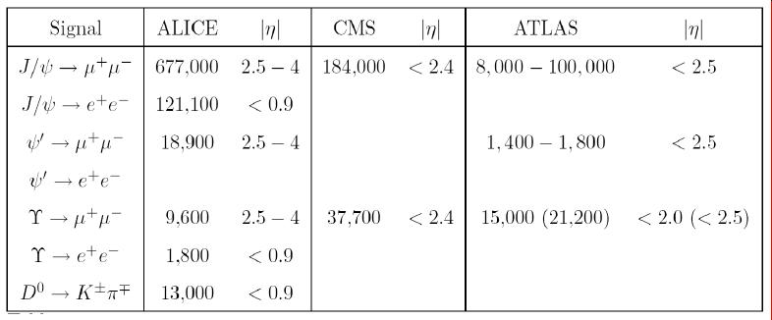
8. More quarkonia @ LHC
CMS
A lot of Upsilons
Y’ and Y’’ should be suppressed
Y shouldn’t (apart from 50% χ_{b} feeddown)
Pb-Pb 0,5 nb^{–1}
≈ 3,700 (10 σ) ?
Frawley, Ullrich, Vogt, Phys Rept 462 (2008) 125

Slide 36
Anomalous conclusions
One strong conclusion:
“J/ψ suppression is not (well and yet) understood”
Cold and hot effects going in the same direction…
Forward/mid rapidity difference could be due to:
Regeneration / coalescence of cc pairs?
Cold effects? ← more and more favored (next talk)
However, conservative cold matter approaches still give significant anomalous suppression at least at SPS and at forward rapidity…
The hot matter is deconfining some quarkonia
Could be only ψ’ and χ_{c} at SPS…
New data helps further understanding
dAu and pA data, ψ’ and Upsilon, RHIC2 and LHC…

Slide 37
That’s all folks

Slide 38
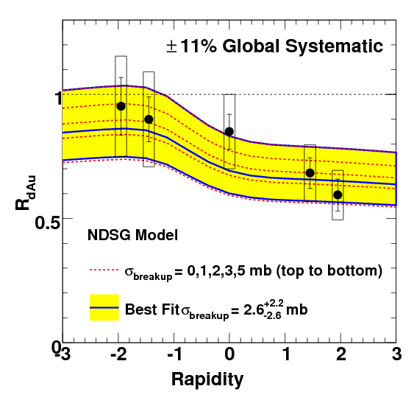
1. R_{dAu} versus rapidity

Slide 39
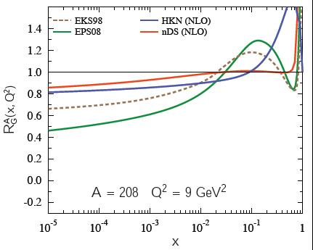
8. Quick look at shadowing on J/ψ
(emitted gluons and p_{T} are neglected)
A factor of ≈2x2 uncertainty on charm production from current shadowing knowledge
Pb/p
2.5 < y <
4
C
M
S
-0.9
< y <
0.9
-4
< y <
-2.5
ALICE
Notes:
ALICE central : 0.001385 0.000229 0.000229 0.001385
ALICE dimuon : 0.000046 0.000010 0.006860 0.030744
CMS central : 0.006207 0.000051 0.000051 0.006207

Slide 40
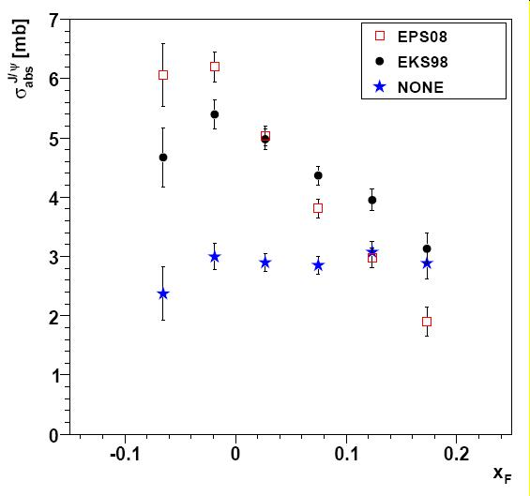
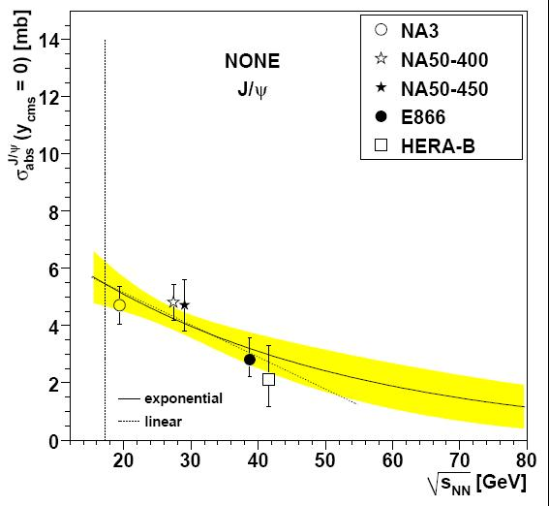
Lourenço et al, arxiv:0901.3054
E866 : flat with x_{F} if no shadowing is assumed…
Even with no shadowing, little √s dependence of σ_{abs}

Slide 41
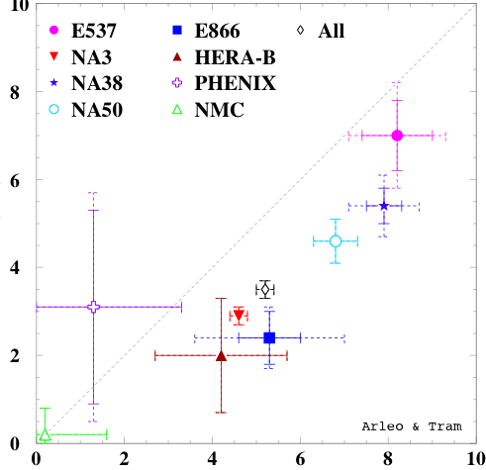
Still open questions at SPS…
σ^{nDS}(mb)
Interplay shadowing – absorption →
√s dependence of absorption?
Lourenço et al, arxiv:0901:3054.
NA60, pA @ 168 GeV?
HP08? QM09?
Unexplained rapidity dependence in pA?
Eur.Phys.J.C48:329,2006
σ^{EKS}
Tram & Arleo, EPJ. C 55, 449-461 (2008)

Slide 42
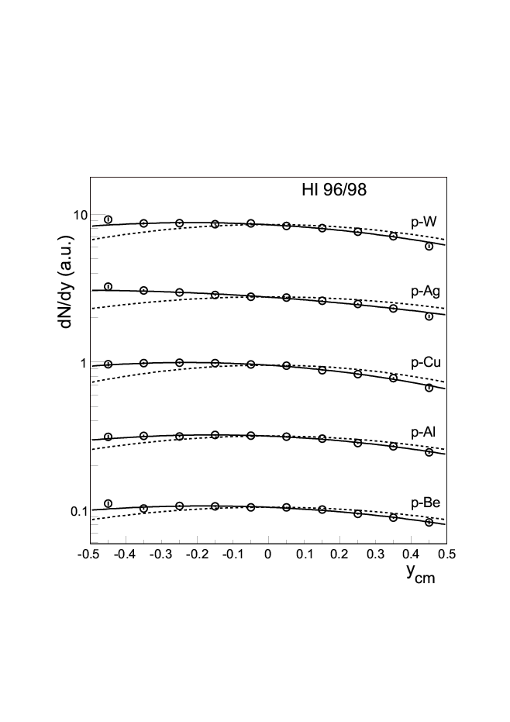
J/ψ in pA, NA50
In pA, an unsolved rapidity dependence…
EPJ…
+50%
+30%

Slide 43
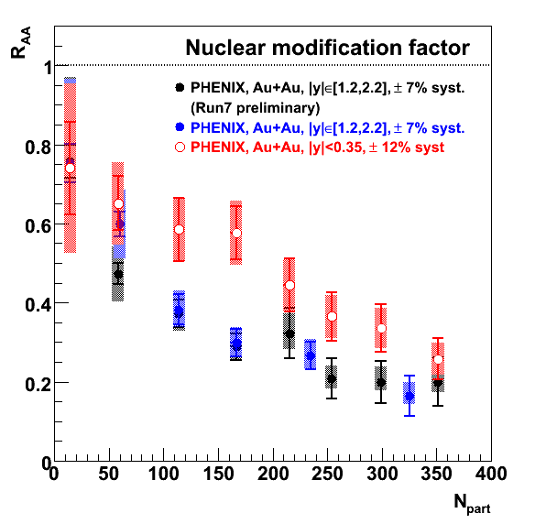
R_{AuAu} (run 4) = R_{AuAu} (run 7)
Forward rapidity only (for now)
More bins at higher centrality
Confirm the trend
R_{AA}(y≈1.7) < R_{AA}(y≈0)

Slide 44



R_{AuAu} vs R_{CuCu} @RHIC
Final CuCu analysis
Slightly below 1 in CuCu
R_{AA}(y~1.7)
R_{AA}(y~0)
PHENIX, arXiv:0801.0220

Slide 45




R_{CuCu} (STAR, high p_{T}) ≈ 1
2 sigma J/ψ signal in Cu+Cu
STAR = PHENIX charm spectra ☺
R_{CuCu} raising with p_{T}
← *
← *
← *
Rapp & Zhao, arxiv:0806.1231
* These are not phenix results yet, but could become
as soon as the two experiments talk to each others ☺
Notes:
Between 5 and 6 : 12 – 6 = 6 pm 4.2 is a 1.4 sigma signal (upper limit) 2 10^{–1} pm 10^{–1}
Between 6 and 8 : 17 – 7 = 10 pm 4.9 is a 2 sigma signal

Slide 46


Various R_{XY}(p_{T})
1
2
Several (hints of) raising R_{AA}(p_{T})
R_{CP} PbPb (NA50)
R_{AuAu} (PHENIX)
R_{dAu} (PHENIX)
Several potential reasons:
Leakage effect, J/ψ escape
High p_{T} J/ψ forming beyond QGP
Cronin effect
Raising x_{Bj} = less shadowing
0.02 to 0.05 from 0 to 9 GeV/c
See discussion in →
Think about it…
3
PHENIX, arxiv:0711.3917 compared to
Ferreiro, Fleuret, Rakotozafindrabe,
arxiv: 0801.4949
Notes:
Ramello :
0708.1488

Slide 47

2. Cold matter again ?
Fitting an effective break-up cross section (depending on y) and extrapolate to CuCu and AuAu…
Do you agree that we have poor handle on the cold nuclear matter effect?
STOP
PHENIX, arxiv:0801.0220

Slide 48


7. Search for an onset?
Onset curves fit the midrapidity AuAu data…
Chaudhury, nucl-th/0610031
Gunji et al, hep-ph/0703061
(after CNM subtraction)
But so do smooth curves !
Nagle nucl-ex/0705.1712
Density threshold @ y=0 is incompatible with SPS onset
Linnyk & al, nucl-th/0705.4443
No onset @ y=1.7 ?
Wait for run7 analysis & CNM constraints!
Gunji et al, PRC 76 (2007) 051901
STOP
A.K. Chaudhury, nucl-th/0610031

Slide 49

Density threshold ? No !
Onset curves fit the midrapidity data…
Chaudhury, nucl-th/0610031
Gunji et al, hep-ph/0703061
(after CNM subtraction)
So do smooth curves !
Nagle nucl-ex/0705.1712
Density threshold @ y=0 is incompatible with SPS onset or larger suppression @ y=1.7
Linnyk & al, nucl-th/0705.4443
J. Nagle, nucl-ex/0705.1712

Slide 50
From dA to AA @ RHIC
For a given A+A collision at b_{AA}, Glauber provides a set of N+N collisions occurring at b_{i}¹ and b_{i}²
One minimal assumption is rapidity factorization: R_{AA}(|y|,b_{AA}) =
Σ_{collisions} [R_{dA}(-y,b_{i}¹) x R_{dA}(+y,b_{i}²)] / N_{coll}
Works (at least) for absorption & shadowing since production
~ pdf1 x pdf2 x exp –ρσ(L₁+L₂)
b₁
b₂
b_{AA}
J/ψ
= x
J/ψ
J/ψ
= x
RGdC, hep-ph/0701222

Slide 51


Heavy flavor elliptic flow
Also a surprise!
Now, do bees fly?
Need the b/c+b in AA to properly estimate the b flow…
(todo : average the 2 datasets cause they have different stat/syst balance)

Slide 52

NA60 In+In
new reference curve (σ_{abs}=7.6mb)
old reference curve (σ_{abs}=4.2mb)

Slide 53


