Slide 1
Heavy flavor results from PHENIX at RHIC
Raphaël Granier de Cassagnac
on behalf of the PHENIX collaboration
LLR – École polytechnique / IN2P3
Deep Inelastic Scattering
Madrid, 2009, April 27th

Slide 2
As an introduction
Phenix primary goal is the study of the quark gluon plasma, through A+A collisions
Need good references from… p+p and d+A collisions ← this talk, outlining:
Open charm and beauty in p+p collisions
From single electron at y ≈ 0, single muon at y≈1.7,
From dielectron, e-h and e-μ correlations…
Quarkonia in p+p collisions
J/ψ, ψ’ and Y at y=0, J/ψ at y≈1.7, J/ψ polarisation
J/ψ in d+Au collisions

Slide 3
The PHENIX apparatus
Electron in RICH and EMCAL
|η| < 0.35
p_{e} > 0.2 GeV/c
Δφ = 2 x 90°
(also hadrons)
Muon in tracker and identifier
1.2 < |η| < 2.4
p_{μ} > 2 GeV/c
Δφ = 360°
(stopped hadrons)

Slide 4
Open charm and beauty
ν_{l}
K⁺
D⁰
lepton–
…
c
c
…
ν_{l}
D⁰
K–
Single leptons, dilepton correlations, or hadron-lepton kinematics
lepton⁺

Slide 5
Total heavy flavour from single electrons
Subtract the cocktail of known (measured) sources:
π⁰ and η Dalitz decays, conversion, etc.
Crosscheck by inserting a converter
Agreement with FONLL calculation, with uncertainties
Charm xsection derived:
σ_{cc} = 567 ± 57 ± 224 μb
PRL97 (2006) 252002

Slide 6
Open heavy flavour from single electrons
New: Subtract J/ψ, Upsilon and Drell-Yan
< 20% decrease for p_{T} > 5 Gev/c
Better agreement with FONLL calculation
Low p_{T} dominated by charm
Does not allow to separate b contribution
A. Dion, QuarkMatter09

Slide 7
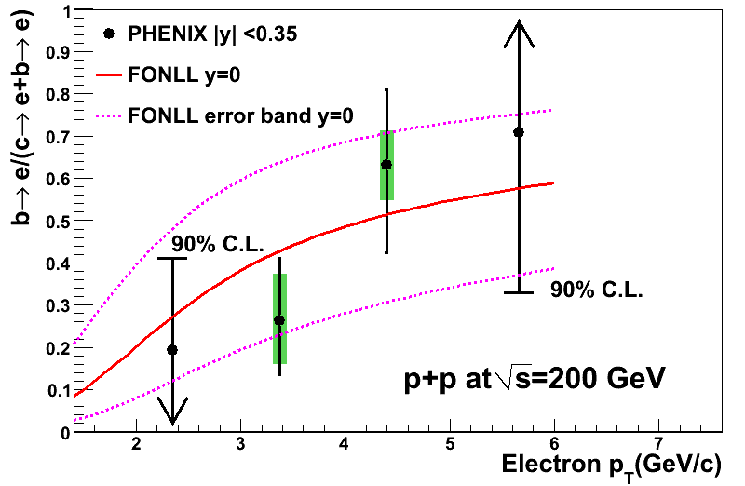
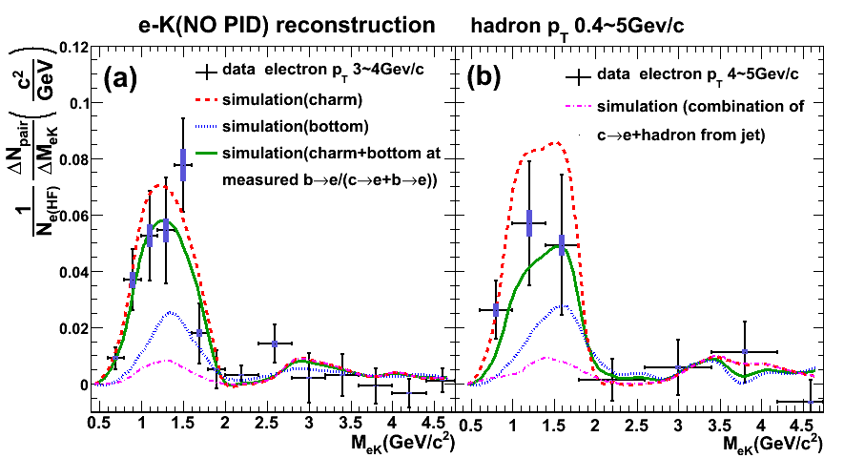
b/c+b from e-K correlations
e-K invariant mass per electron is different for c and b decays
ν_{l}
K⁺
D⁰
lepton–
Contribution from b large above 4 GeV/c
arXiv:0903.4851, submitted to PRL

Slide 8
b/c+b from e-h correlations
Together with single electron, provide individual b and c spectra
σ_{bb} = 3.2 _{–1.1}^{+1.2} _{–1.3}^{+1.4} μb
arXiv:0903.4851, submitted to PRL

Slide 9
c and b from dielectron
σ_{cc} = 518 ± 47 ± 135 ± 190 μb
(stat) (sys) (model)
σ_{bb} = 3.9 ± 2.4 +3/–2 μb
PLB 670 (2009) 313

Slide 10
c and b cross sections
σ_{cc} and σ_{bb} from single electron and dielectron agree with each other, and with NLO pQCD

Slide 11
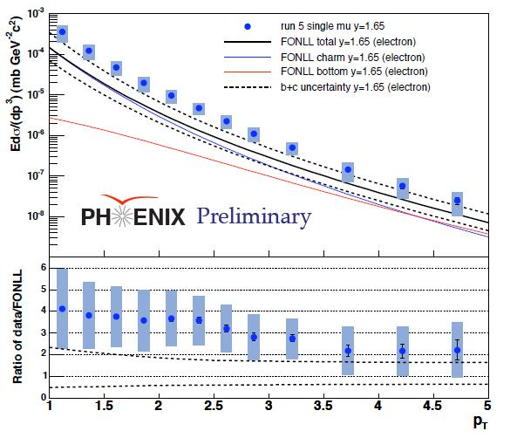
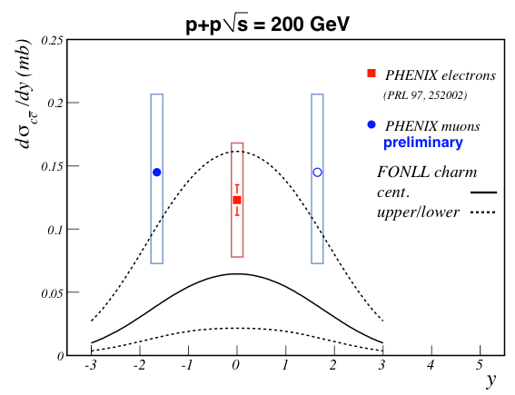
Charm from single muon at forward rapidity
Use vertex distribution and stopped hadrons to control backgrounds
Extrapolation to low p_{T}
D. Hornback, QuarkMatter08

Slide 12
Midrapidity e + forward μ correlations
Long awaited golden channel for heavy flavors
Angular correlation→
Proof of principle for future charm cross section (intermediate rapidity)
T. Engelmore, QuarkMatter09

Slide 13
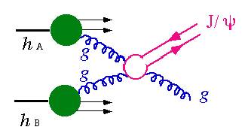
Quarkonia
J/ψ vs p_{T} and y, J/ψ polarisation, ψ’ and Y, J/ψ in d+Au collisions…

Slide 14
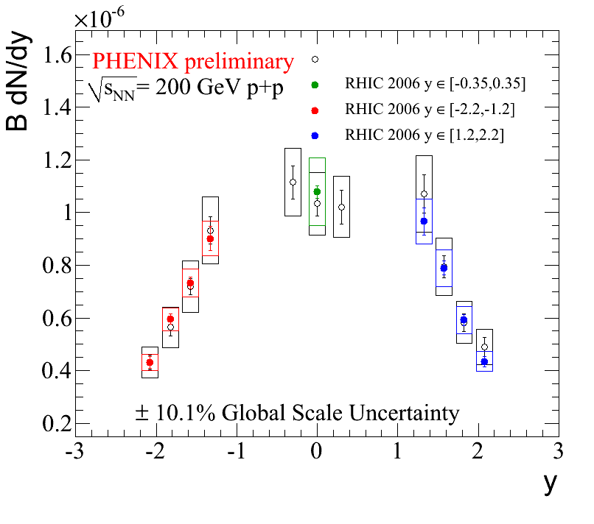
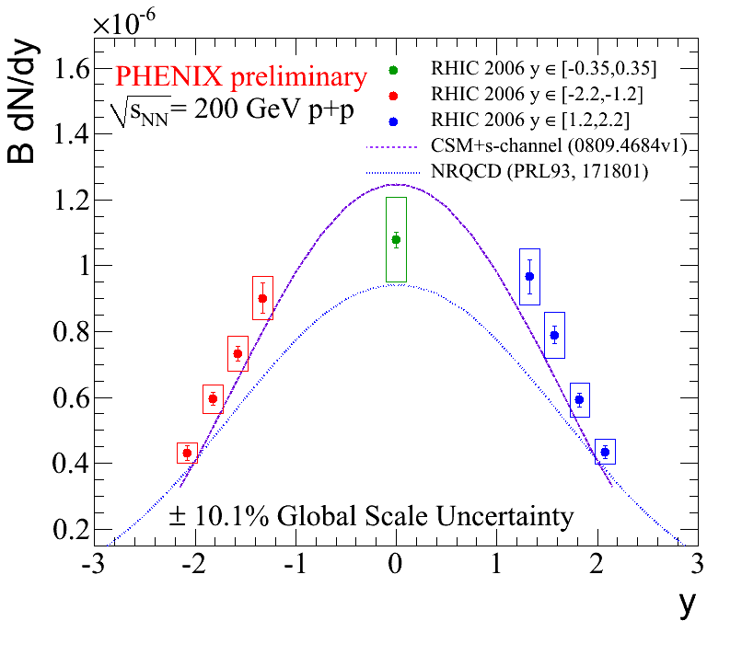
J/ψ versus rapidity
Improved statistics
Reducing systematics…
o PRL98 (2007) 2002
C. da Silva, QuarkMatter09

Slide 15
J/ψ versus p_{T}
Extended p_{T}
C. da Silva, QuarkMatter09

Slide 16
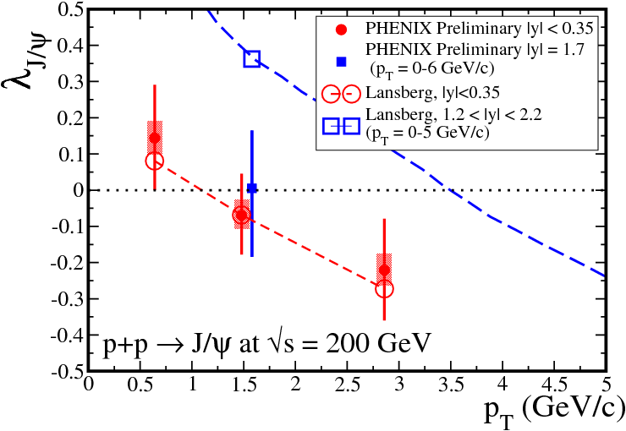
J/ψ polarization
λ_{J/ψ}
New colour singlet model + s-channel cut (off shell charm quarks)
Adjusted to Tevatron
working well for:
rapidity and (low) p_{T}
polarization at y≈0
less (≈2σ) for:
Polarization at y≈1.7
(in the helicity frame)
λ<0 longitudinal
λ>0 transverse
Habersettl and Lansberg
PRL100 (2008) 032006
M. Donadelli, PANIC08
Notes:
Lambda negative means longitudinal
Lambda positive means transverse

Slide 17
Other quarkonia @ y=0
C. da Silva, QuarkMatter09

Slide 18
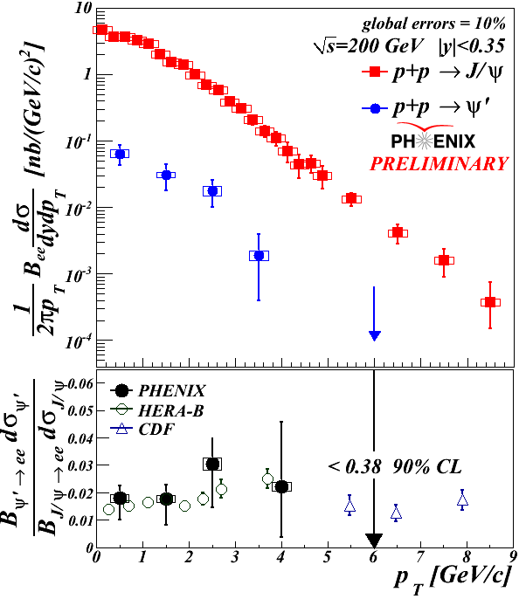
ψ’ @ midrapidity
ψ ’/ψ ratio
Of the order of 2%
No strong p_{T} dependence
Feed down to J/ψ
= 8.6 ± 2.5 % from ψ
< 42 % (90 % CL) from χ_{c}
≈ 1 to 4 % from B
M. Donadelli, PANIC08
Notes:
HERA-B: EPJC49 (2007) 545
CDF: PRL 79 (1997) 572.

Slide 19
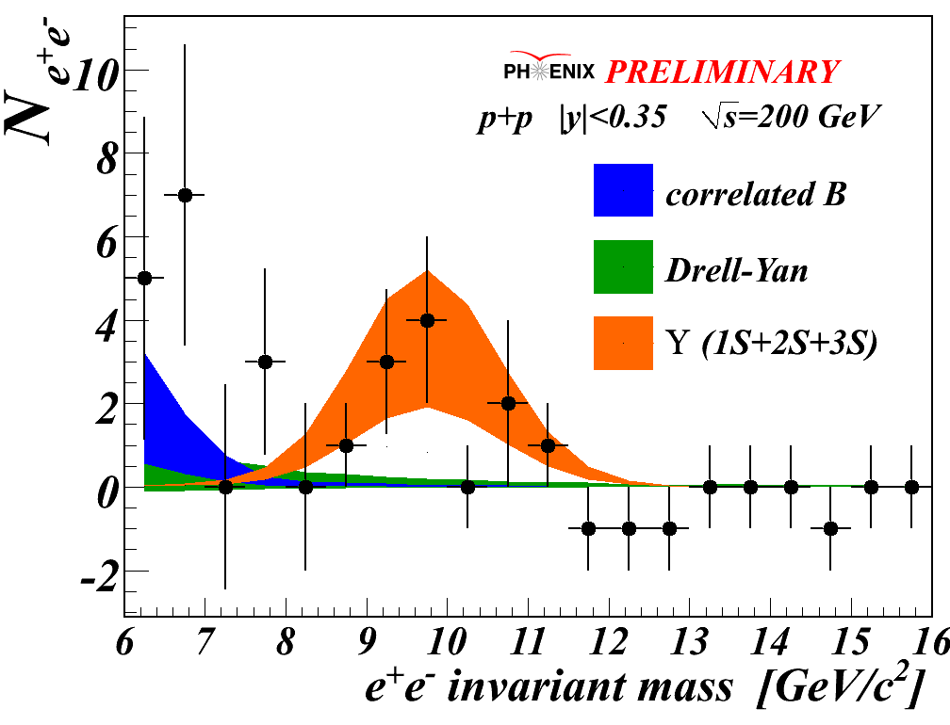
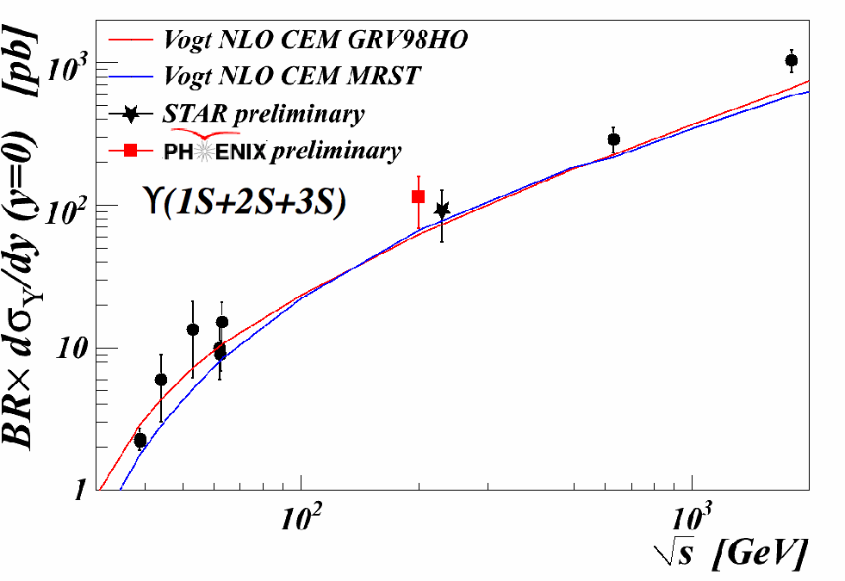
New: Upsilon @ midrapidity
12 unlike and 1 like sign pairs in [8.5;11.5] GeV/c²
Background < 15%
(1.6 counts)
Drell-Yan and B decays
Derived xsection:
… follows world trend
)
dσ +46
B = 114 pb
dy _{|y|<0.35} –45
C. da Silva, QuarkMatter09
Notes:
Redo formula

Slide 20
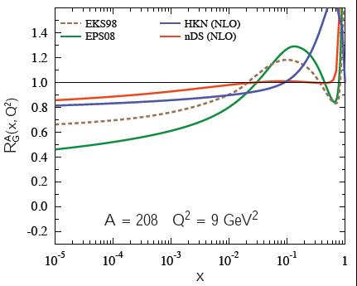
J/ψ in d+Au collisions
At RHIC, we expect two normal nuclear effects:
Gluon pdf modification, various models…
J/ψ absorption on nucleons (σ_{abs})
As an example, a fit to data assuming the EKS shadowing scheme →
Large uncertainties
> 2 mb on σ_{abs}
x ≈ 0.09 x ≈ 0.003
PRC77 (2008) 024912
Erratum: arXiv/0903.4845

Slide 21
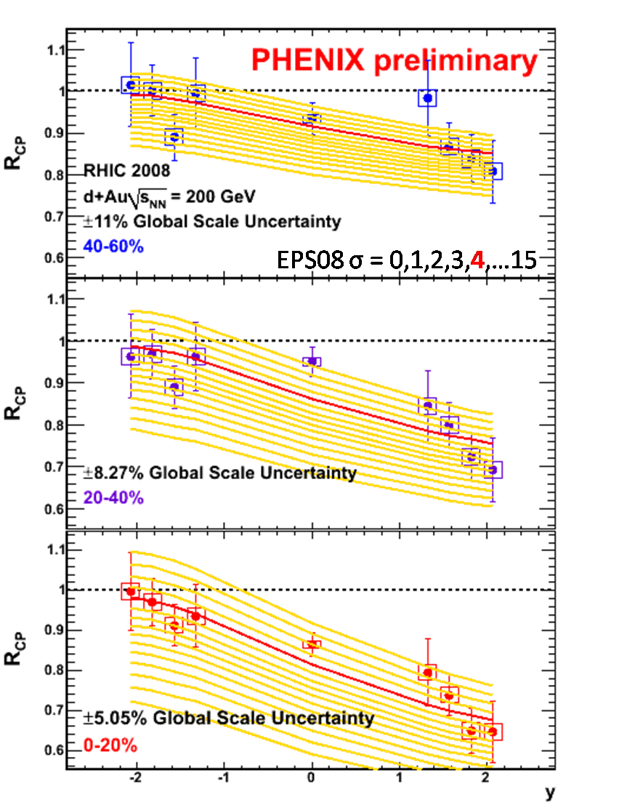
J/ψ in d+Au collisions
Analysis of run 8
(30 x run3)
Allows more binning
R_{CP} for now (systematic cancelling out)
R_{dA} underway…
C. da Silva, A. Linden-Levy, QuarkMatter09

Slide 22
Other quarkonia in d+Au ?
Work in progress…
ψ’ from dielectrons
Upsilon from dielectrons and dimuons…
→ RHIC also providing p+p collisions @ 500 GeV this year

Slide 23
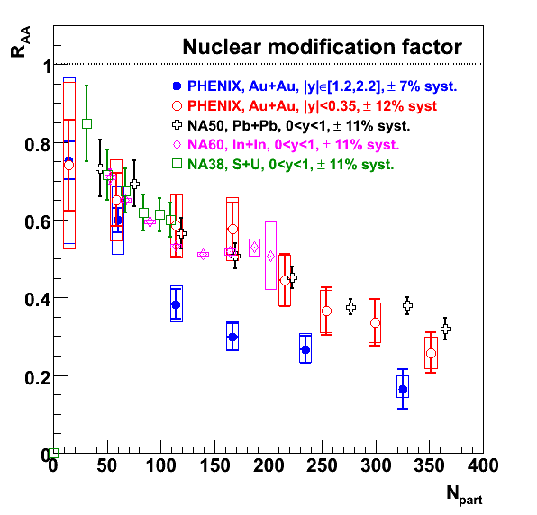
As an outlook…
All of the above are important inputs to understand the quarkonia suppression observed in Au+Au collisions @ RHIC, which is indeed puzzling:
Why are J/ψ more suppressed at forward rapidity?
At midrapidity, why are they suppressed as at lower energy?

Slide 24
Back up slides

Slide 25
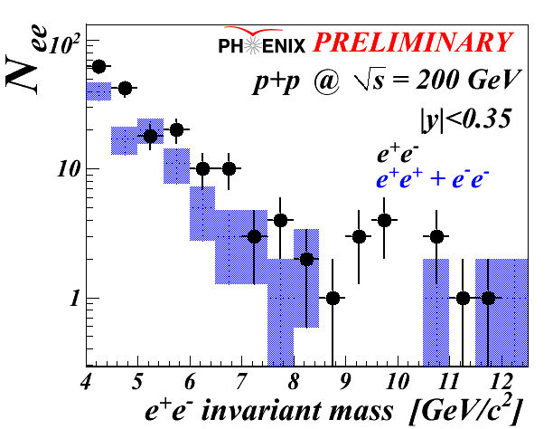
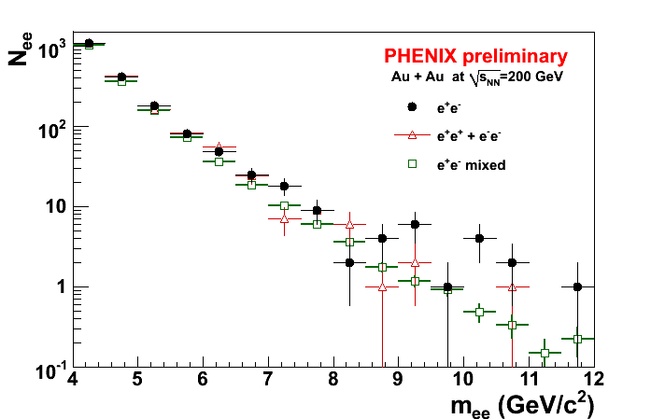
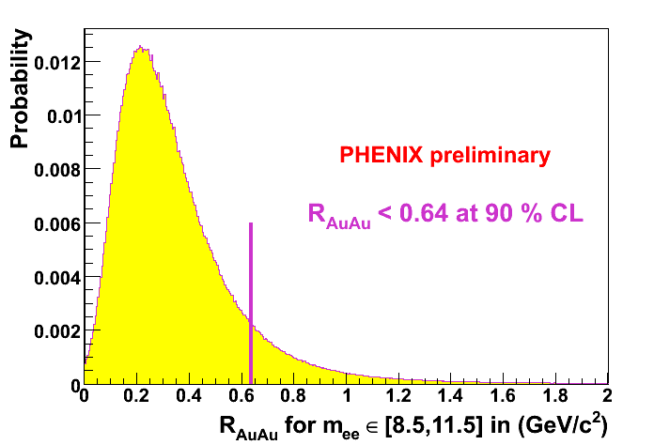
Upsilon in Au+Au
R_{AA} < 0.64 @ 90%
In [9.5;11.5]GeV/c²
Whatever it is…

Slide 26
Single electron cocktail

Slide 27
e-h correlations
e-K (no PId)
Unlike sign near-side pairs
Subtract like sign pairs
Tagging efficiency for c and b from Pythia
ν_{l}
K⁺
D⁰
lepton–

Slide 28
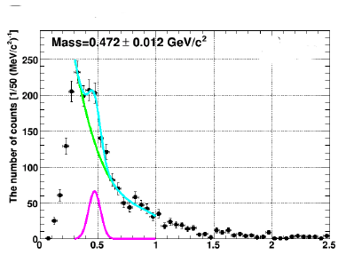
χ_{c}
mass(e⁺e⁻γ)-mass(e⁺e⁻) [GeV/c²]

Slide 29
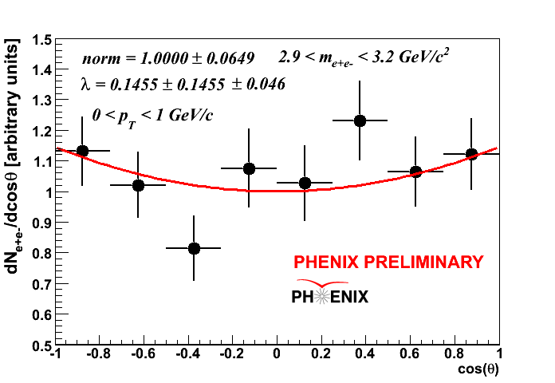
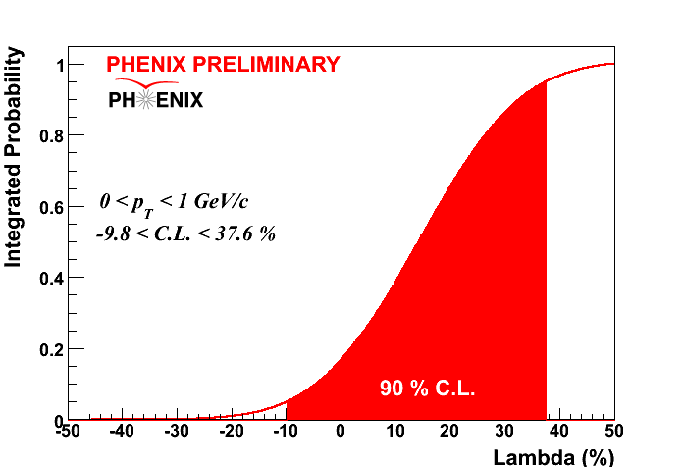
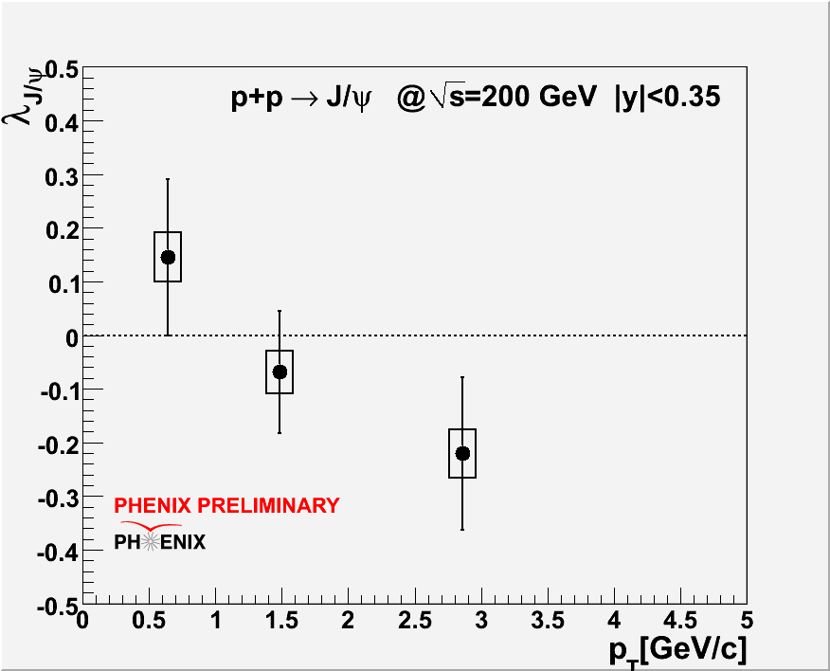
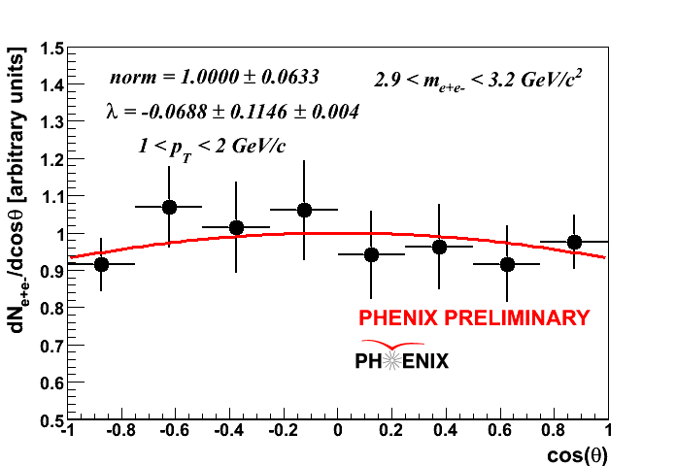
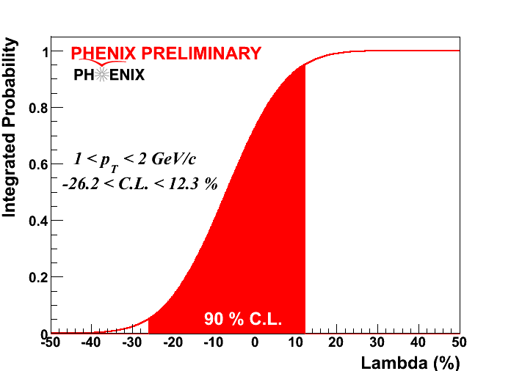
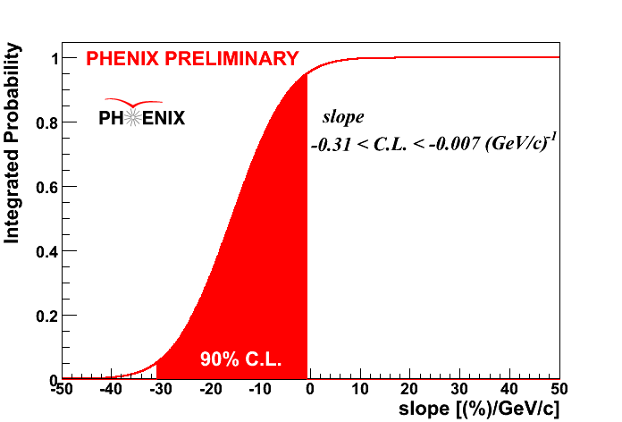
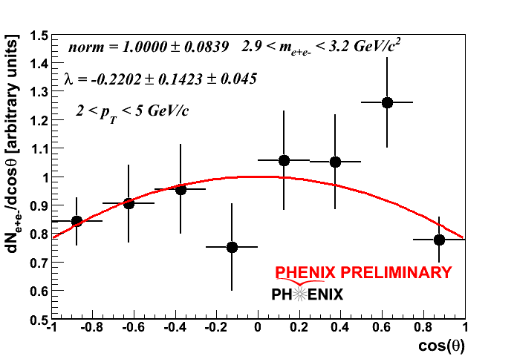
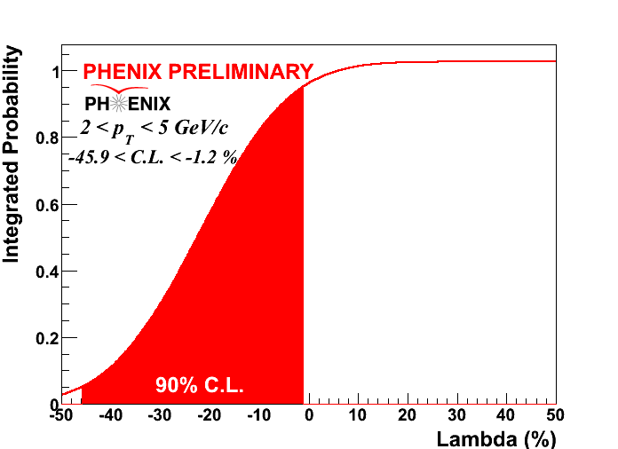
J/ψ polarisation
90%CL
90%CL
90%CL

