Slide 1
What’s the matter at RHIC ?
LHC Conference, IPM, Isfahan, 20-24 April 2009
Raphaël Granier de Cassagnac
Laboratoire Leprince-Ringuet
PHENIX and CMS experiments

Slide 2
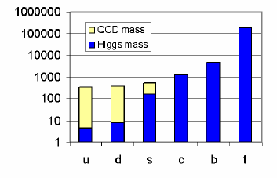
☺ The origin of (my) mass…
“The world is massless” Guido, Monday
Atomic mass =
≈ 02% from Higgs
+ 98% from QCD!
≈ 02% not yet seen…
+ 98% poorly understood
We are then mostly made of confinement…
This talk is all about deconfinement…
“Hey guys, it’s only ≈5% of the universe!” ☹
Yannick, Tuesday

Slide 3
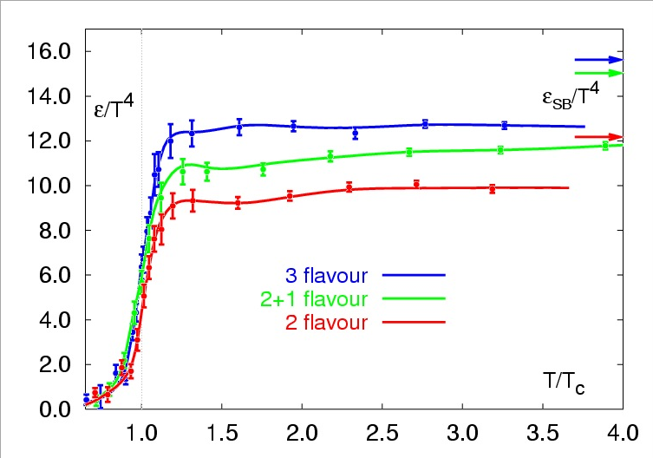
What tells QCD? (on the LATTice)
Strong interaction is strong at low energies but weak at high energies
Asymptotic freedom
Lattice QCD predicts a phase transition from a Hadron Gas to a Quark Gluon Plasma (QGP)
T_{c} ≈ 190 MeV (2x10¹² K)
ε_{c} ≈ 1 GeV/fm³
Energy density / T ⁴
Karsch et al, hep-lat/0106019
Lect. Notes Phys.583 (2002) 209
Doesn’t tell us much about the matter’s properties
(equation of state, order of phase transition…)

Slide 4
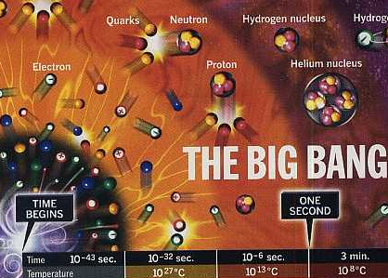
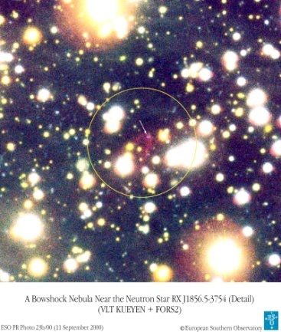
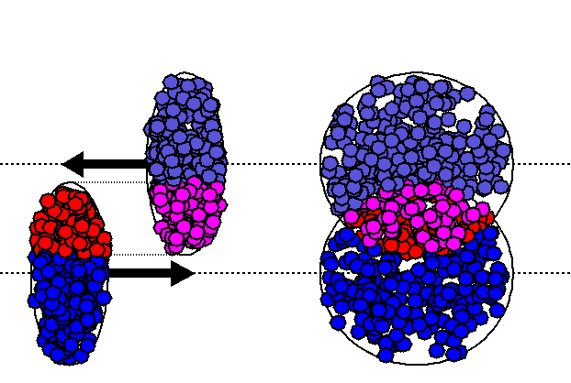
Where/when can we find the QGP?
Early in the universe (t < 10 μs)
But very little chance to leave relics
Cold dark matter clumps?
Inhomogeneous nucleosynthesis?
Baryonic CDM (strange nuggets)?
Core of a compact star
But no smoking gun candidate so far
In the lab, by colliding heavy ions
Freedom for the quarks…
… for some 10^{–23} s

Slide 5
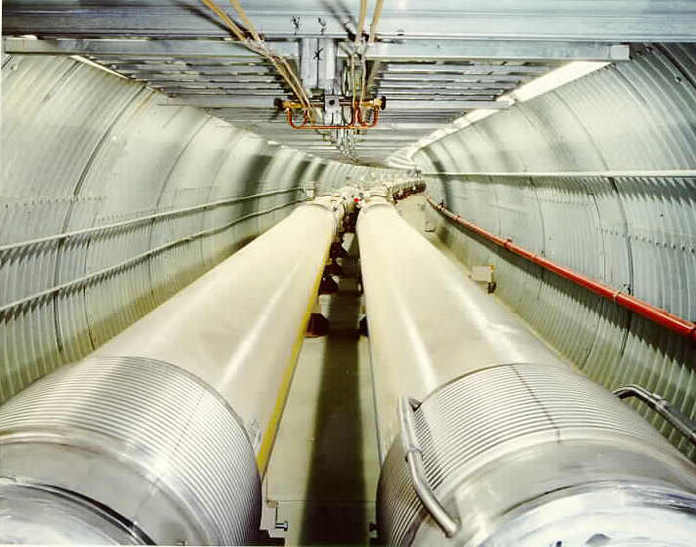

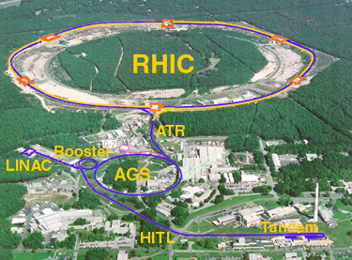
WHAT’s RHIC?
Relativistic Heavy Ion Collider
@ Brookhaven National Lab.
First collisions in 2000, running…
2 large (STAR & PHENIX) >2x600
+ 2 smaller (PHOBOS & BRAHMS) experiments
Can collide anything from p+p (up to 500GeV, in 2009)
to Au+Au (up to 200GeV per nucleon pairs)
PHOBOS
BRAHMS
PHENIX
STAR
Notes:
Before to answer to the question “what is the matter at RHIC?” let me tell you what is RHIC

Slide 6
What is the strategy? (and jargon)
Predict a QGP signature
Look at it versus A+A collision centrality →
Compare to p+p
Nuclear modification factor
Without QGP, hard probes should have R_{AA} = 1
Compare to p+A (or d+A)
Check that normal nuclear matter cannot account for deviations…
Non zero impact parameter
Number of spectators
Number of participants N_{part}
Number of NN collisions N_{coll}
dN^{AuAu}
R_{AA} =
dN^{PP}
x
<N_{coll}>
z
y
x
Derive a QGP property
(temperature, density…)

Slide 7
Which signatures?
Total multiplicity
High p_{T} suppression
Back to back jets
Elliptic flow
Baryon/meson
Heavy flavour
≈ “Color Glass Condensate”
≈ “Perfect fluid”
J/ψ suppression
Thermal radiation
≈ “Jet quenching”
But they are not the only ones!
“There was a general feeling that if the quark-gluon plasma was indeed produced, it would manifest itself in a variety of unknown but dramatic ways, including…
H. Satz @ Lattice 2000 hep-ph/0009099

Slide 8
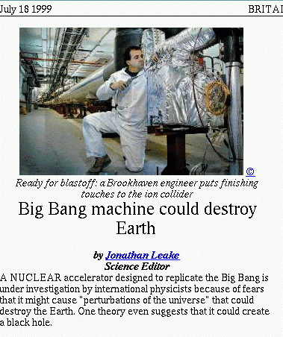
Which signatures?
“LHC is less dangerous than RHIC”
Albert, Wednesday, about strangelets
Total multiplicity
High p_{T} suppression
Back to back jets
Elliptic flow
Baryon/meson
Heavy flavour
≈ “Color Glass Condensate”
≈ “Perfect fluid”
J/ψ suppression
Thermal radiation
≈ “Jet quenching”
But they are not the only ones!
“There was a general feeling that if the quark-gluon plasma was indeed produced, it would manifest itself in a variety of unknown but dramatic ways, including… the end of the world”
H. Satz @ Lattice 2000 hep-ph/0009099

Slide 9
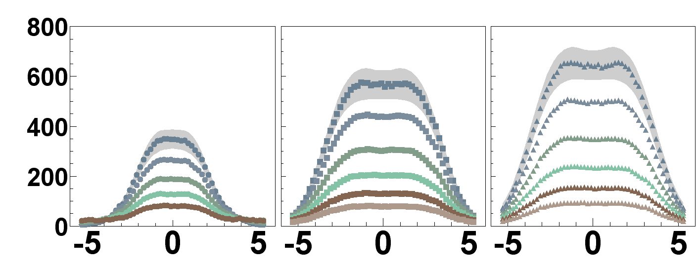


1. Total multiplicity (and E_{T})
dN_{ch}/dη|_{η=0} ≈ 670
(6000 particles total)
Less than expected!
1000 from p+p fragmentation
Low x_{Bj} gluon start to overlap, recombine, saturate…
(even more at forward rapidity)
“Color Glass Condensate”
C
E
N
T
R
A
L
I
T
Y
dN_{ch}/dη
PRL 91 (2003) 052303
η
dE_{T}/dη|_{η=0} related to energy density
ε > 6 GeV/fm³ > ε_{c} !
The (initial) matter saturates
@ LHC, even worse! x_{Bj} < 10^{–3}
dN_{ch}/dη|_{η=0} ≈ 1600 – 2100

Slide 10
Jet quenching
The smoking gun…

Slide 11

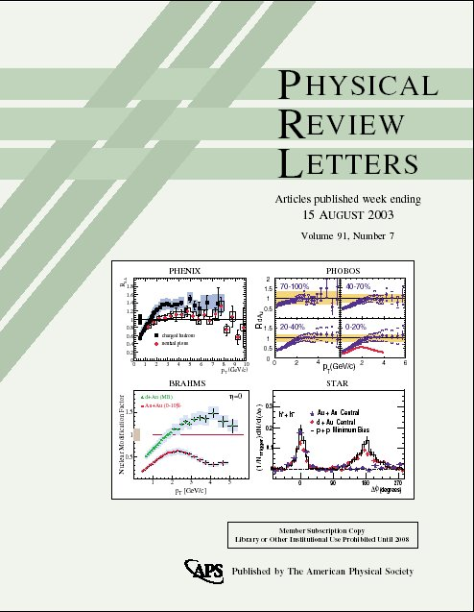
2. High p_{t} suppression
RHIC smoking gun signature !
Two PRL covers
Energy loss in the matter, looking at “high” p_{T} (>2GeV/c) hadrons
Mostly from jet fragmentation
“Jet quenching”
p-p
hadrons
leading
particle
q
q
hadrons
leading particle
hadrons
leading
particle
A-A
q
q
hadrons
leading particle
11

Slide 12
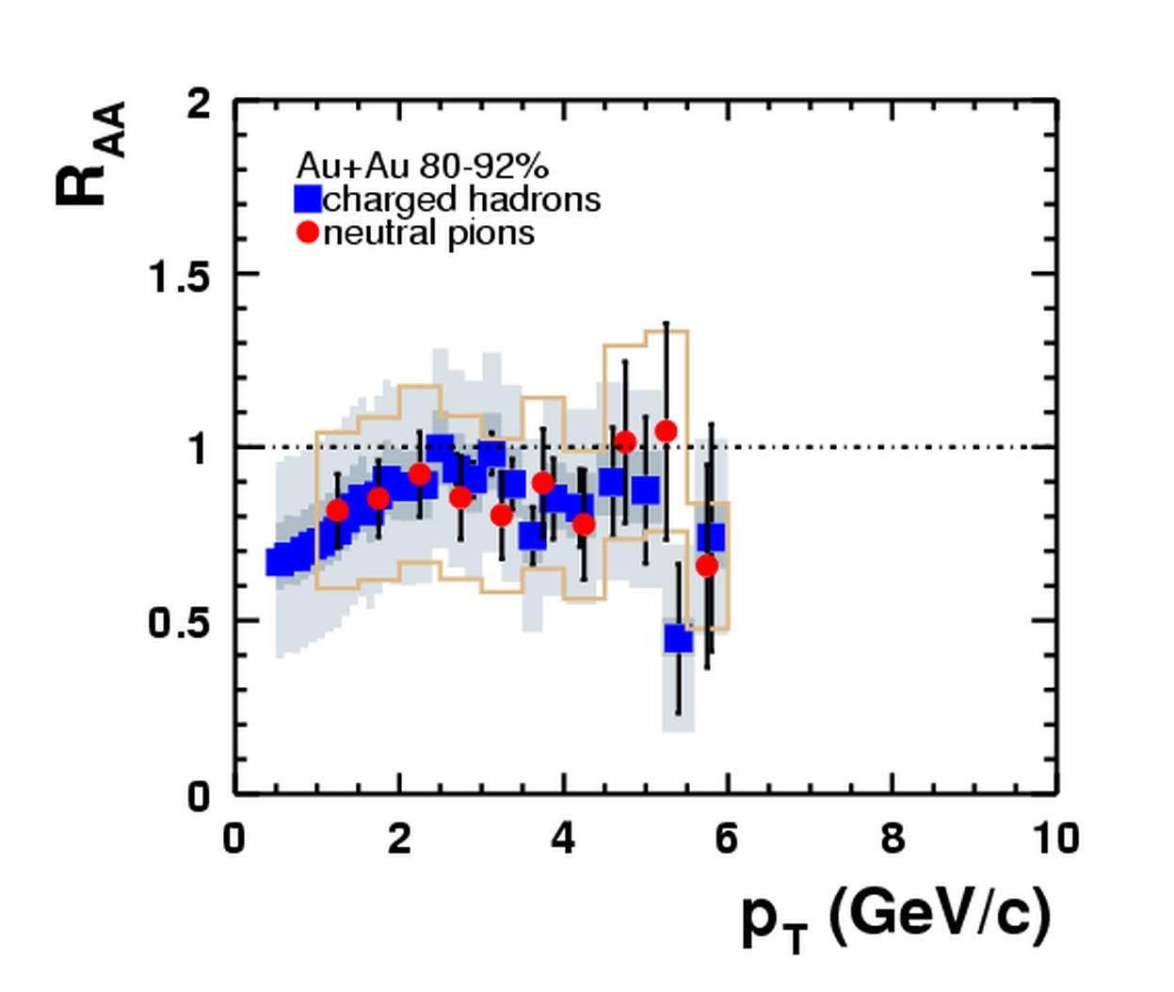
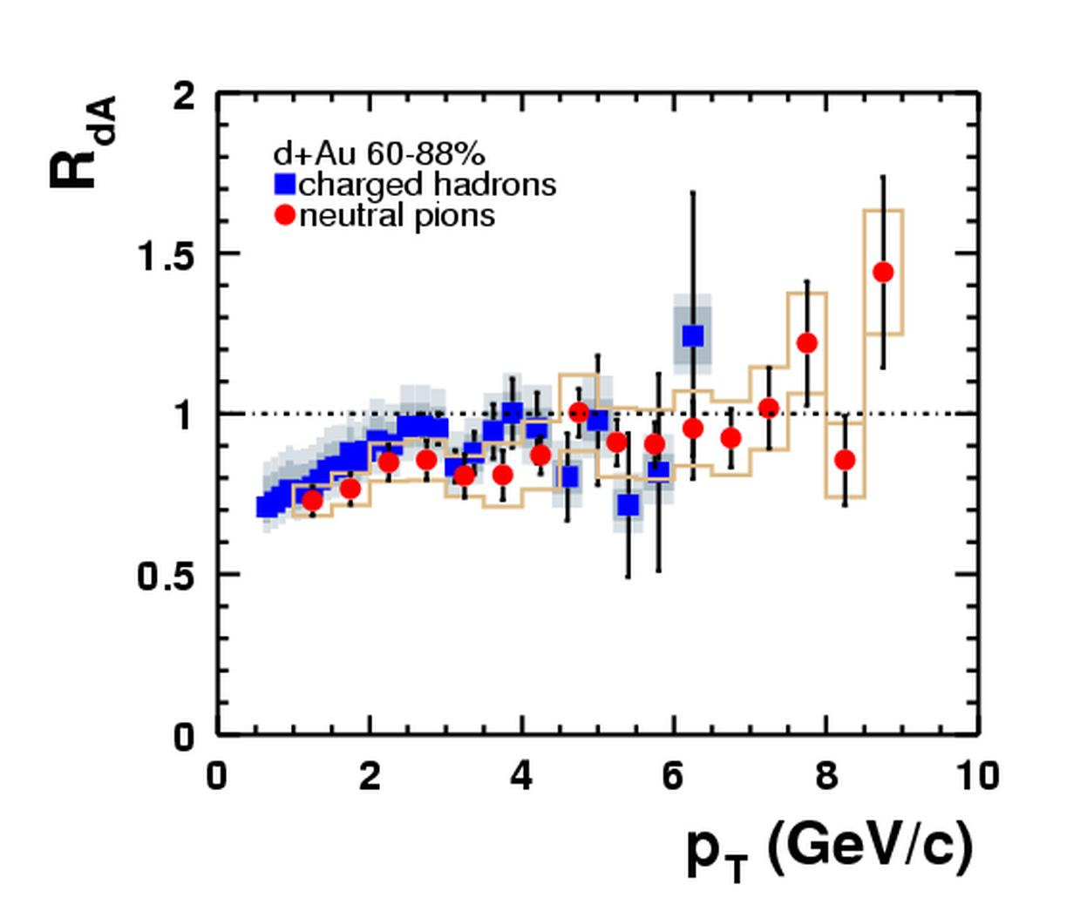
Most peripheral collisions…
Au-Au (80-92%)
d+Au (60-88%)
(slightly old, but pedagogical, data)
PHENIX, PRL 91 (2003) 072303

Slide 13
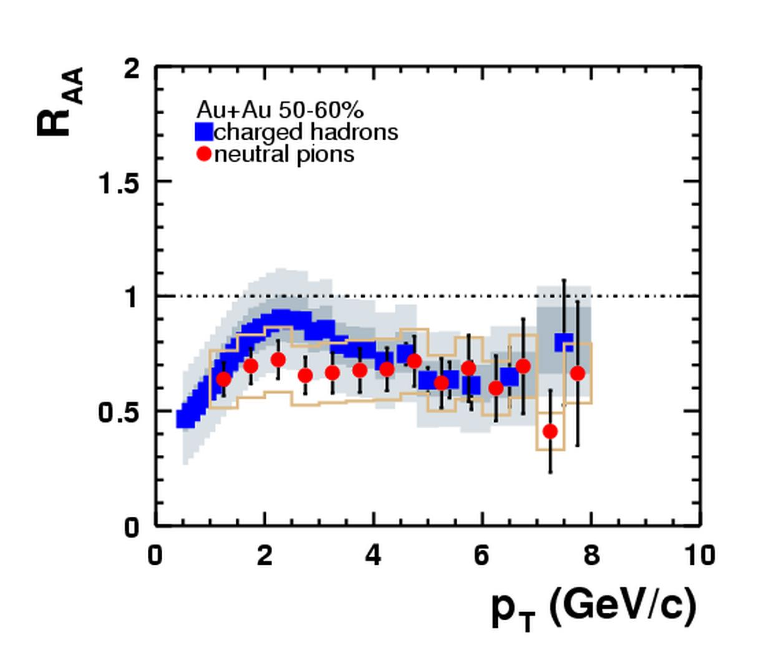
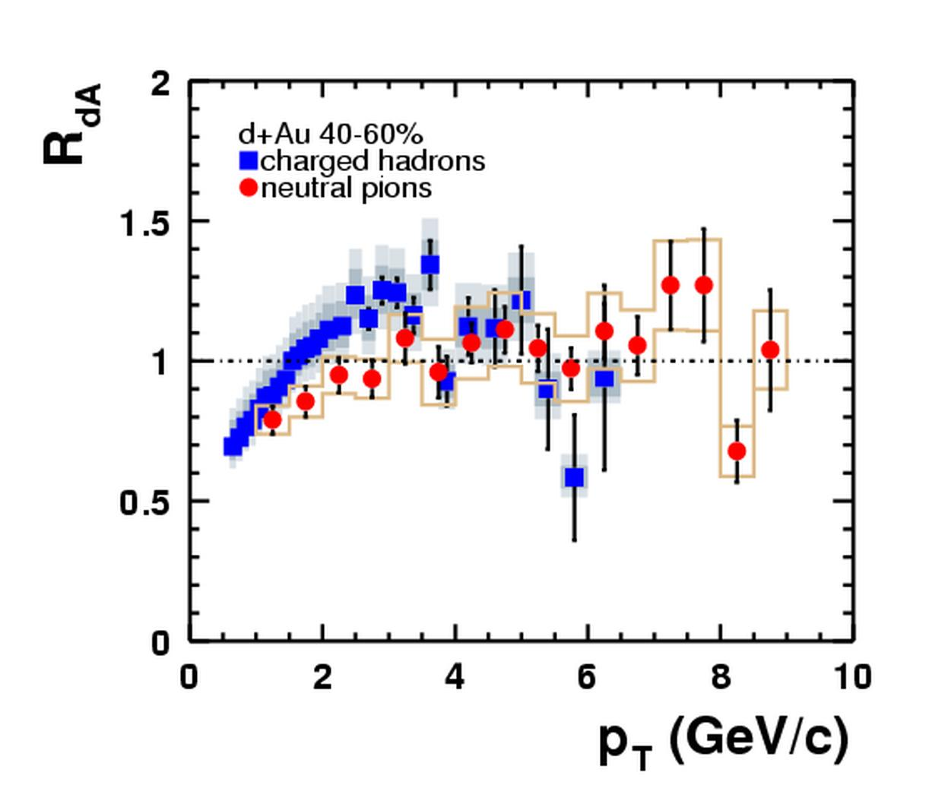
LEss peripheral collisions…
Au-Au (50-60%)
d+Au (40-60%)
(slightly old, but pedagogical, data)
PHENIX, PRL 91 (2003) 072303

Slide 14
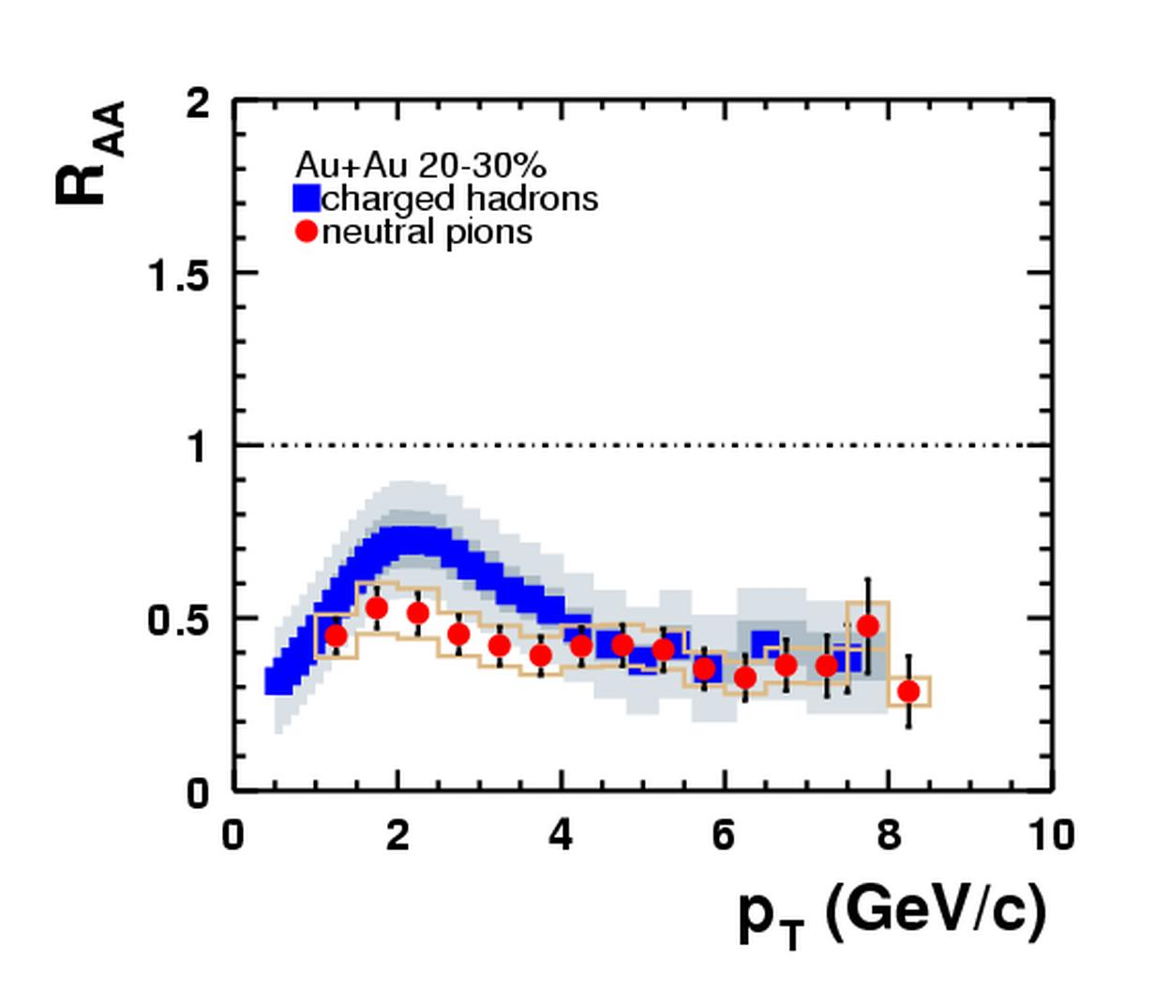
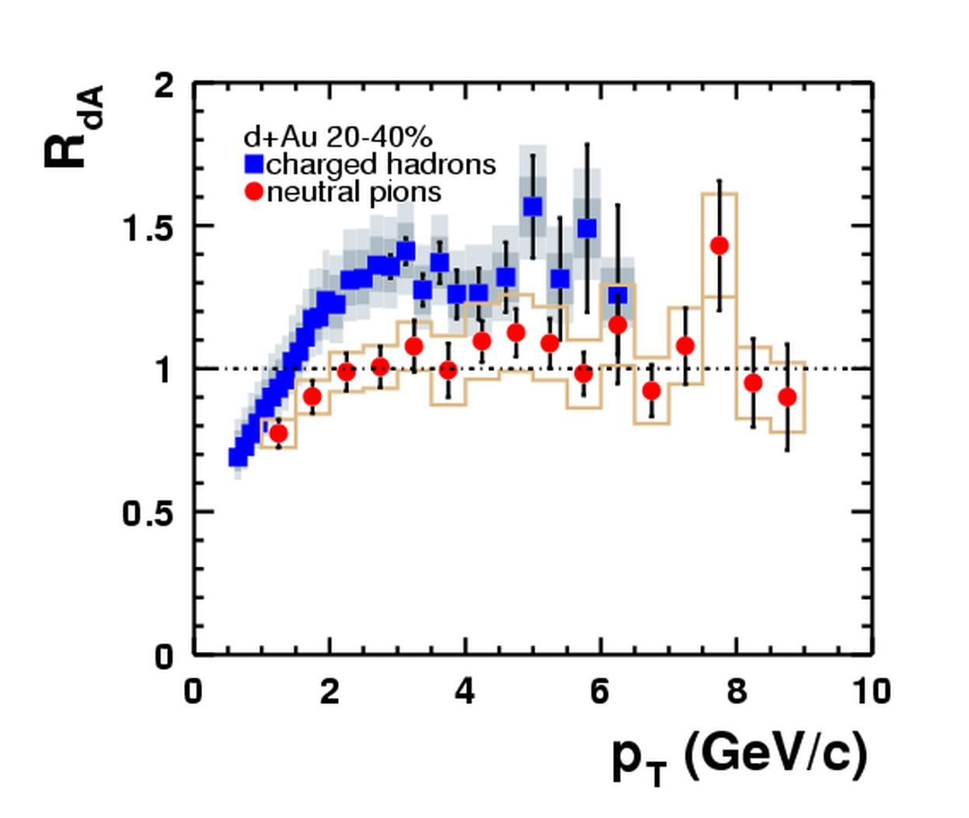
MoRE CeNTRAL collisions…
Au-Au (20-30%)
d+Au (20-40%)
(slightly old, but pedagogical, data)
PHENIX, PRL 91 (2003) 072303

Slide 15
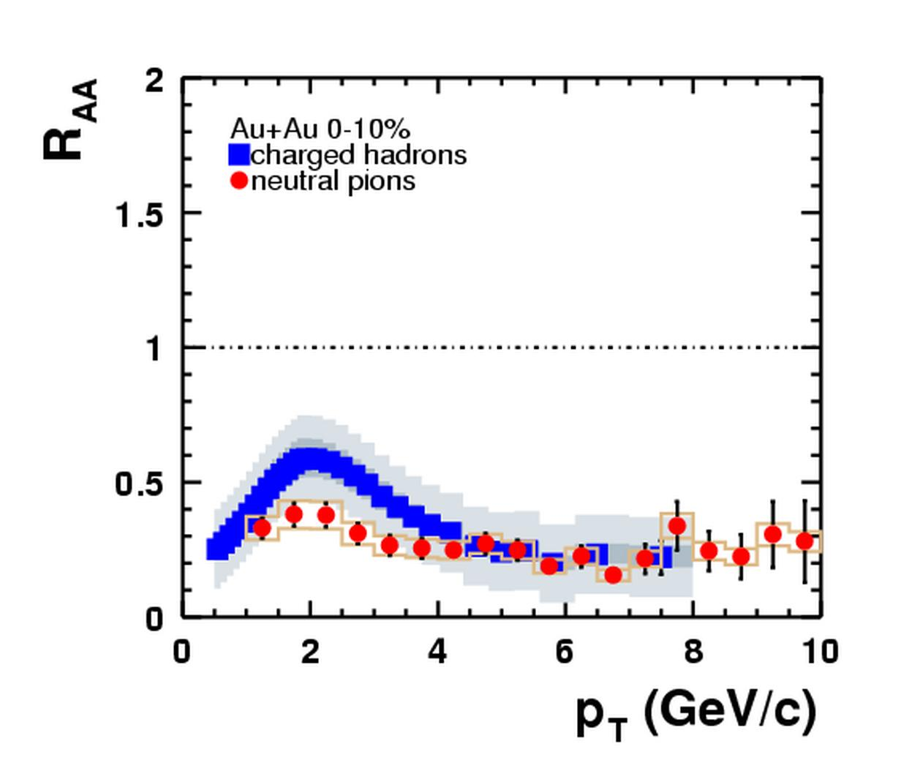
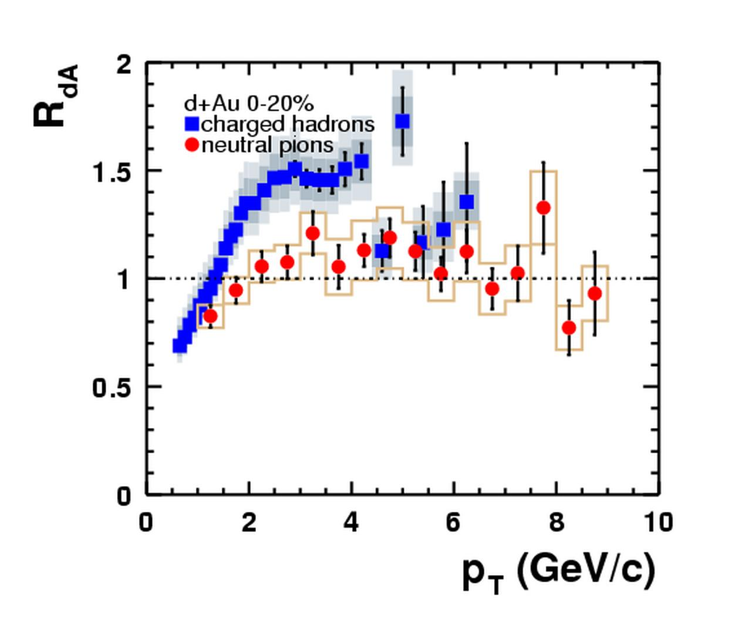
Most CENTRAL collisions!
Au-Au (0-10%)
d+Au (0-20%)
Suppression
by a factor 5 !
« Cronin effect »
Multiple scattering
of initial partons
(slightly old, but pedagogical, data)
PHENIX, PRL 91 (2003) 072303

Slide 16
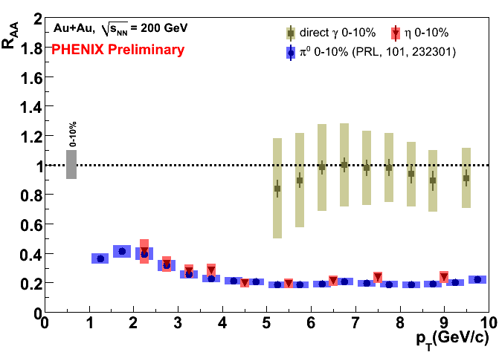
2. High p_{T} suppression
PHENIX, PRC77 (2008) 064907
Comparisons to models, including experimental errors provide physical properties, e.g. dN_{gluons}/dy = 1400 ⁺–²₃⁰₇⁰₅
Blind photons!
→ The matter is dense ! >1000 gluons per Δy
@ LHC, should be even denser…

Slide 17

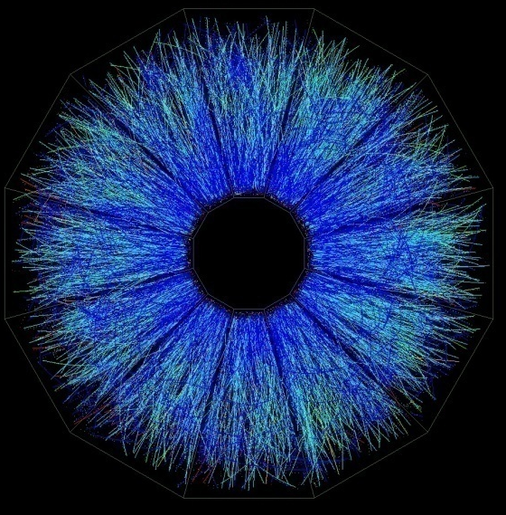
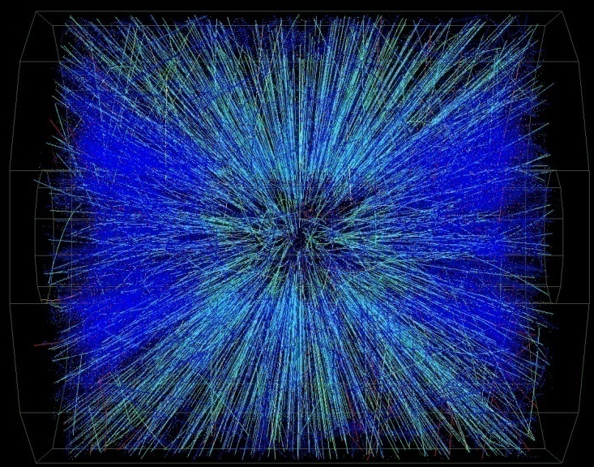
3. Back to back jets
Easy in 200 GeV proton+proton collisions
?
Quite difficult in Au+Au central collisions @ 200 GeV

Slide 18
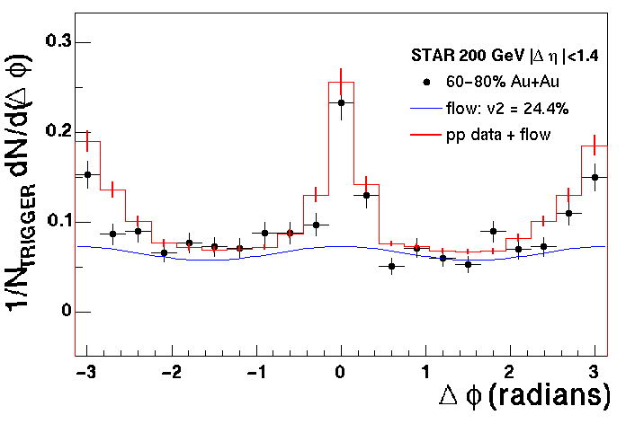
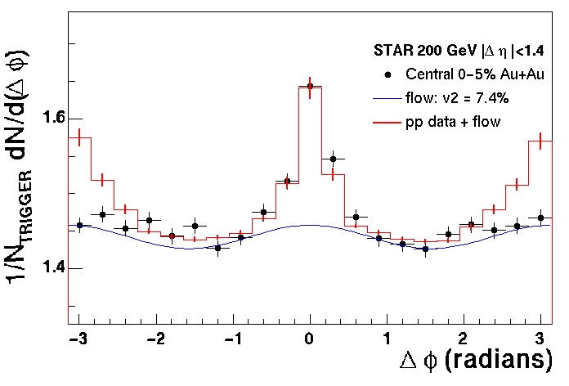
3. Back to back jets Another look to jet quenching…
Peripheral collisions (60-80%)
Central collisions (0-5%)
near side
away
side
trigger
Same jet
Opposite jet
Take a “trigger” particle (p_{T}>4GeV/c) and look at the others (p_{T}>2GeV/c) azimuth
In central collision, opposite jets disappear because of jet quenching

Slide 19
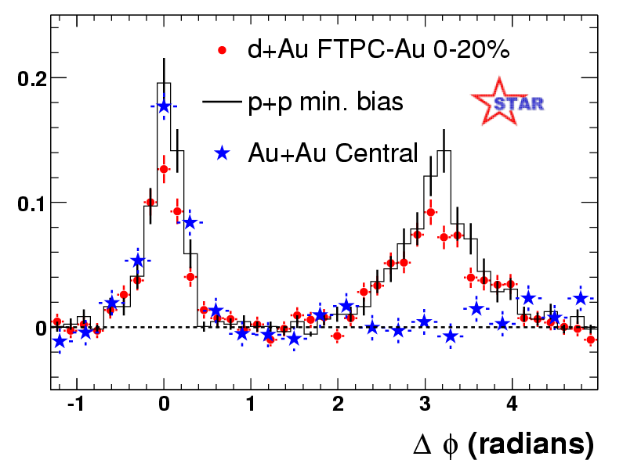
3. Back to back (d+Au)
STAR, PRL 91 (2003) 072304
As always, it is very important to check for d+Au
→ The matter is opaque!
@ LHC, full jet reconstruction…

Slide 20
Other jets observables and tools
From these seminal observations,
a lot more jet-related observables…
And new tools are showing up….

Slide 21
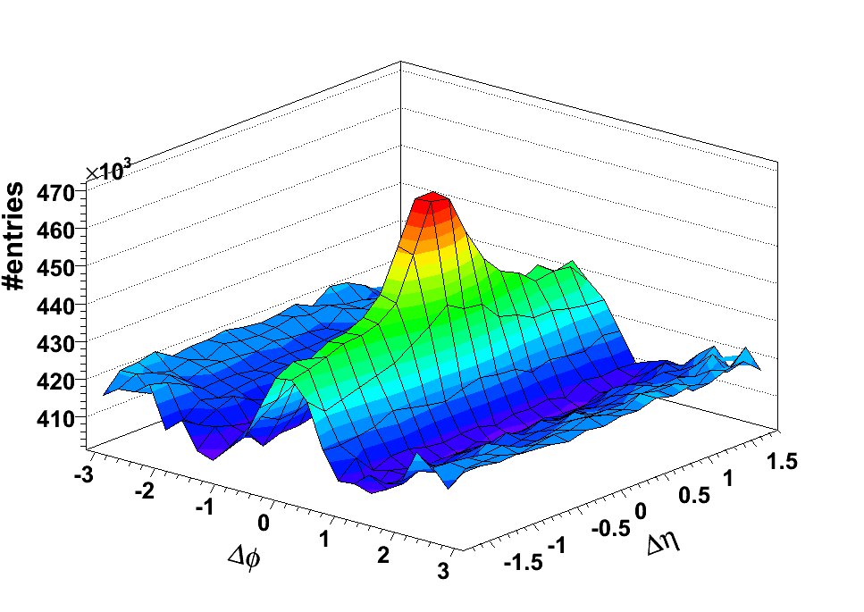
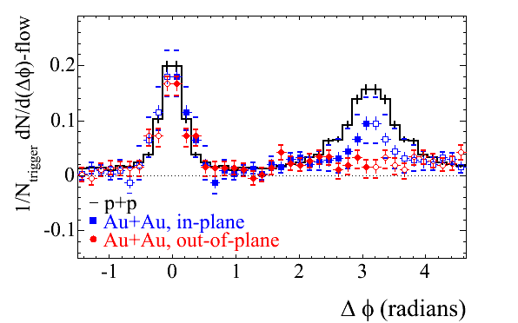
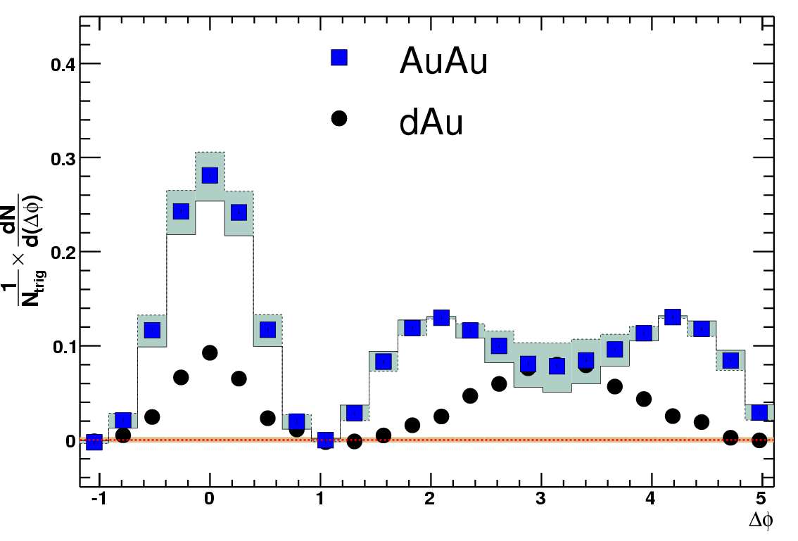
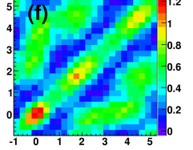
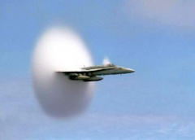
3. Much More correlation…
Here, all plots from STAR, see also PHENIX: PRC78 (2008) 014901
The ridge…
beams
In or out ?
Δφ
Δη
→Mach cone ?
Three particles (central Au+Au)
Δφ₁₂
Speed of
sound ≈ 0.45 ?
STAR: PRL102
(2009) 052302
Δφ
Δφ₁₃
Notes:
20 minutes here !
STAR, PRL93 (2004) 252301
0801.4545 : Phys. Rev. C 78, 014901 (2008)
0805.0622 : Phys.Rev.Lett.102:052302,2009

Slide 22
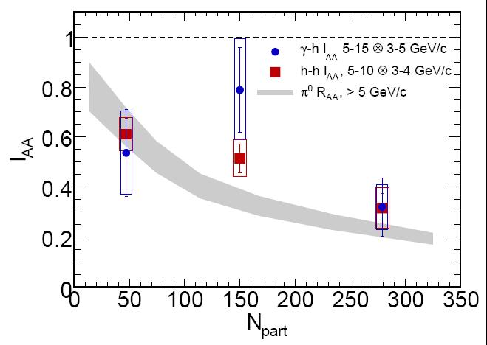
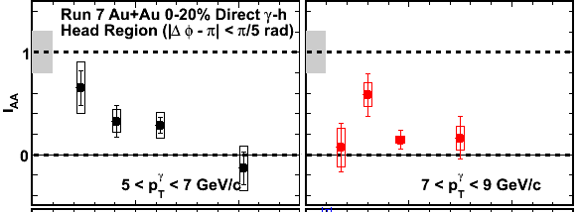
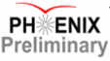
new tool: Gamma-jet
away
side
photon
Photon ≈ unmodified “reconstructed” jet
Suppression is similar
Yield per trigger particle
Normalized to p+p
Can start addressing the question of modified fragmentation function
z_{T}=p_{hadron}/p_{photon} →
N_{part}
PHENIX: arXiv/0903.3399
M. Connors, QuarkMatter09
z_{T}
Notes:
proton-proton !
pta 2 to 3 GeV
ptt 7 to 9 GeV

Slide 23

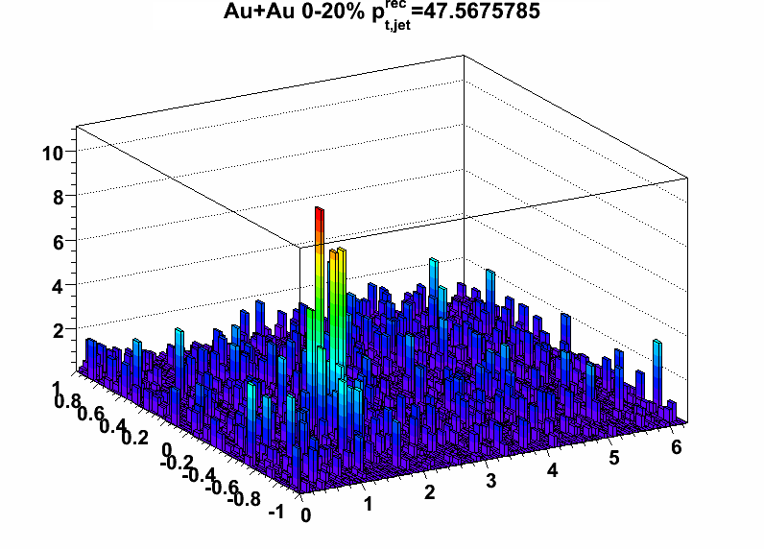
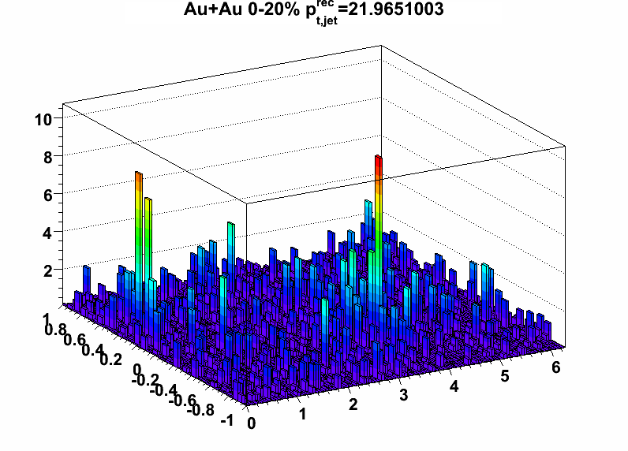
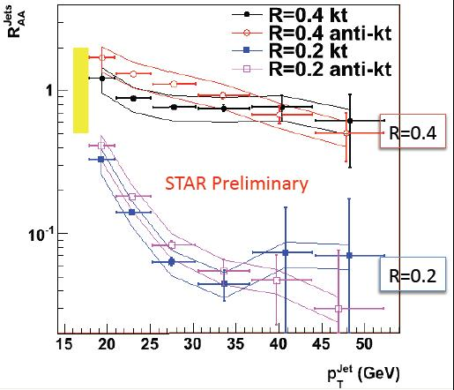
NEW tool: Jet reconstruction?
R
First reconstructed jets in AA
Use of fastjet algorithms
R_{AA}≈1 for large cone R=0.4
Jet broadening R_{AA}<<1 for R=0.2
Promising preliminary data
Au+Au 0-20%
pt per grid cell [GeV]
p_{T} ≈ 47 GeV
Easier
@ LHC
p_{T} ≈ 21 GeV
η
ϕ
STAR preliminary
M. Polskon, Quark Matter 09
http://www.lpthe.jussieu.fr/~salam/fastjet
Notes:
STAR ! 0-20%

Slide 24
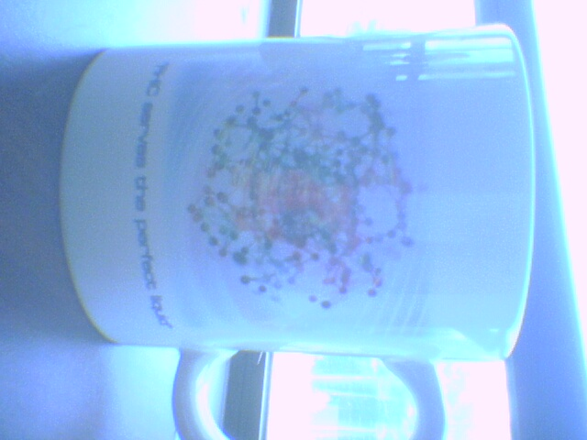
Partonic Collective behaviour
RHIC serves the perfect liquid…

Slide 25
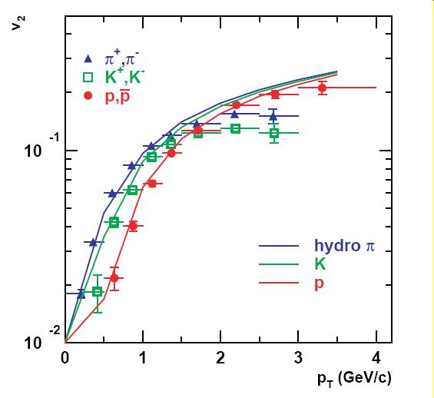
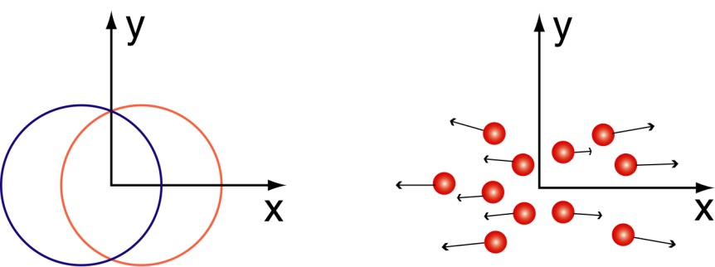
4. Elliptic flow “V₂”
PHENIX, PRL 91 (2003) 182301
Huovinen & al, PLB 503 (2001) 58
reaction plane
z
y
x
Pressure gradient
v₂ = <cos 2φ>
φ
Strong collective behavior
Notes:
(plot shinichi)

Slide 26
4. IDEAL HYDRODYNAMICS
Ideal hydrodynamics…
QGP equation of state,
Early thermalization
(0.6 fm/c)
High density
(≈30 GeV/fm³)
Little need for viscosity!
First estimations are
approaching the quantum limit η/s = /4π
lower than Helium at T_{c}
… reproduces fairly well
Single hadron p_{T} spectra
(mass dependence)
<β_{T}> ≈ 0.6
Elliptic flow
Not the foreseen ideal partonic gas!
→ “sQGP” (s stands for strong, not super ☺)
→ “Perfect fluid”
→ The matter is strongly interacting and liquid like
@ LHC, could it approach a quark gluon gas?

Slide 27
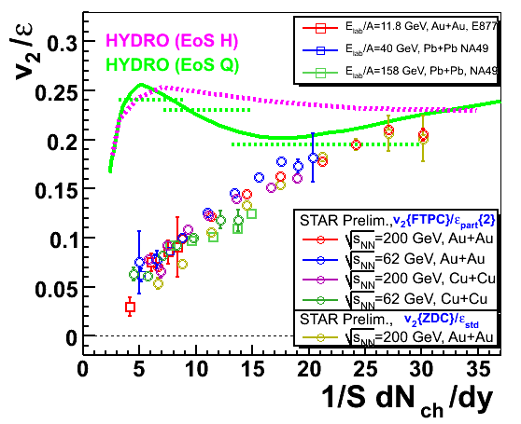
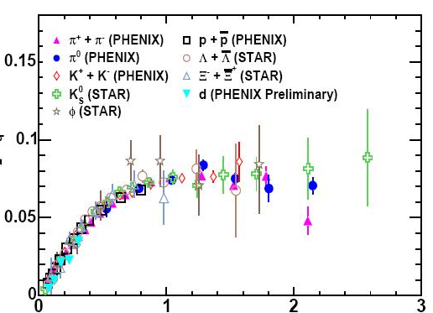
4. Elliptic flow (SCALINGS)
With eccentricity vs N_{ch} density
ε = <y² – x²> / <y² + x²>
With the kinetic energy
per constituent quarks
V₂/n_{q}
KE_{T}/n_{q}
PHENIX, PRL98 (2007) 162301
(and other particles)
Voloshin & Pokskanzer, PLB 474 (2000) 27
Notes:
nucl-ex/0608033 : Phys. Rev. Lett. 98, 162301 (2007)

Slide 28
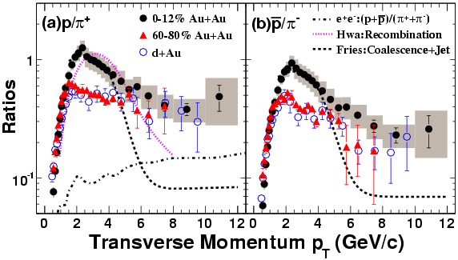
5. Baryons/Mesons
STAR, PRL 97 (2006) 152301
Spectrum cartoon
Coalescence
Fragmentation
Baryon favored
Not fragmentation!
Coalescence or recombination
→ The matter is partonic
(constituent scaling, coalescence…)
Notes:
David a des modèles en plus la-dessus…

Slide 29
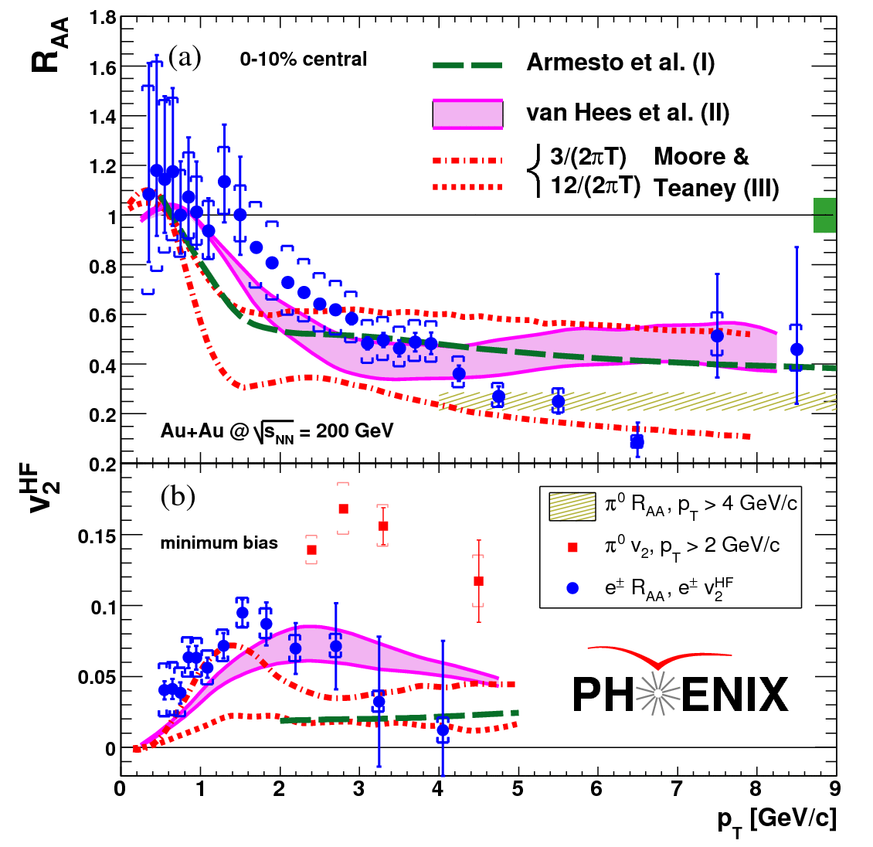
6. Heavy quarks?
PHENIX, PRC76 (2007) 034904
Note that R_{AA}=1 for most of charm
Electrons from heavy flavour's decay (D,B → e…) suffer (large) quenching and flow! Was a surprise!
Thermalization?
What makes the charm quench ?
Gluon density is to low!
Beauty contribution?
Elastic energy loss?
Not well understood yet
→ The matter is tough…
@ LHC, more thermalization?
Notes:
Nucl-ex/0611018 : Phys. Rev. C 76, 034904 (2007)

Slide 30
Quarkonia suppression
The originally thought “unambiguous signature”

Slide 31
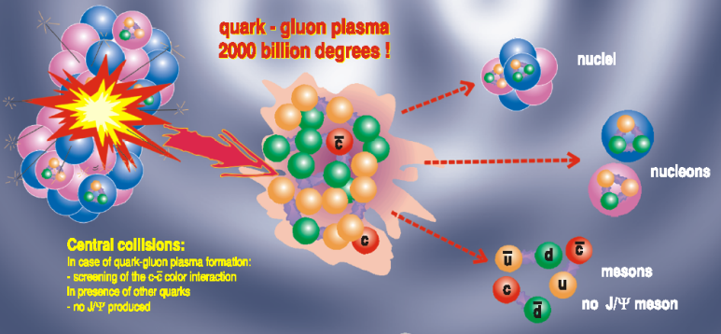
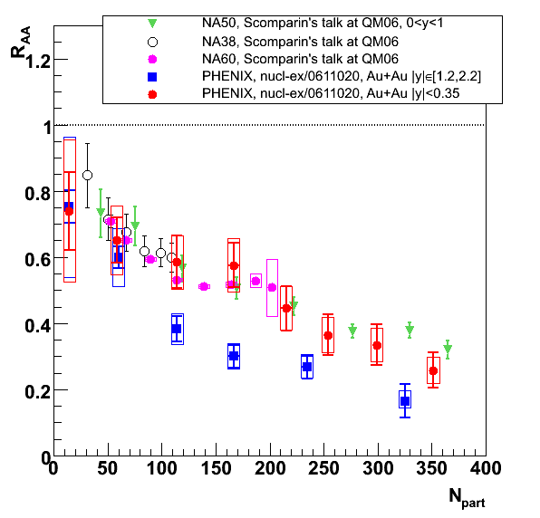
7. J/ψ suppression
J/ψ (cc¯) can melt in QGP
Golden signature @ SPS
(@ CERN √s ≈ 20 GeV)
→ QGP discovery claim!
@RHIC, same rapidity, suppression looks surprisingly similar
While density is higher
Stronger @ forward
While density is lower
But beware of nuclear matter!
Matsui & Satz, PLB178 (1986) 416
PHENIX, PRL98 (2007) 232301

Slide 32
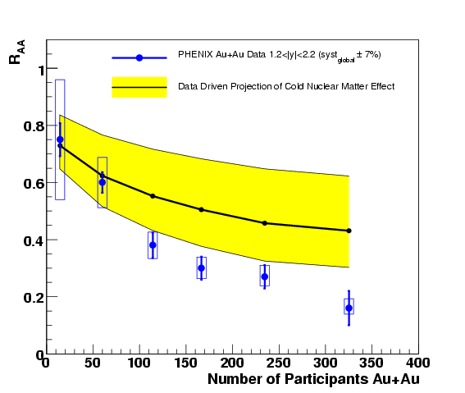
7. J/ψ suppression (from d+Au)
Cold nuclear matter can also suppress J/ψ
pdf modifications?
absorption?
Extrapolation from d+Au
Data driven, mostly model independent
Large uncertainty
More d+Au on tape
(2008 = 30 x 2003)
Preliminary @ QM09
Survival = 38 ⁺–¹₂⁸₂ %
Forward rapidity
RGdC, J.Phys.G34 (2007) S955
PHENIX, PRC 77 (2008) 024912

Slide 33
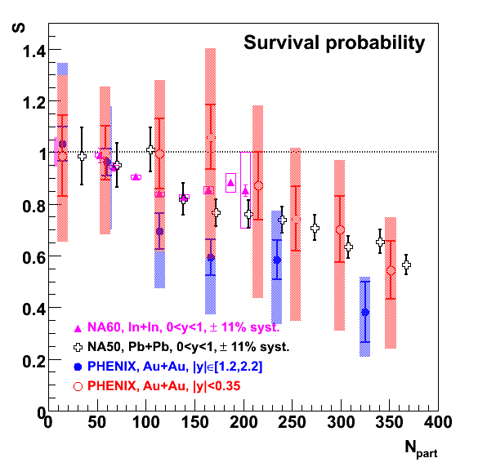
7. J/ψ “anomalous” suppression
Survival beyond (safe) nuclear extrapolation:
Anomalous suppression could be the same at both rapidity
Alternate explanation: uncorrelated c+c¯ recombination (>10 pairs in a central collision)
However, J/ψ do melt!
→ The matter is deconfining
@ LHC recombination R_{AA} >1?
@ LHC Upsilon studies !
PHENIX, PRL98 (2007) 232301
divided by
PHENIX, PRC77 (2008) 024912
(data driven method)

Slide 34
Thermal radiation
Still one or two slide to go…

Slide 35
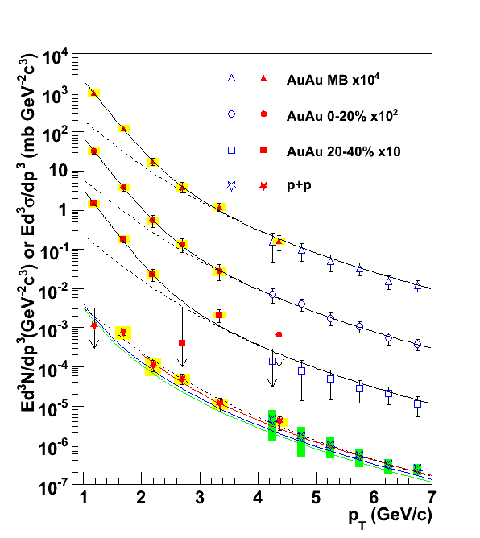
8. THERMAL RADIATION
The matter is hot !
@LHC, T ≈ 1 GeV ?
Direct photon from
Real (p_{T} > 4 GeV/c)
Virtual (m_{ee} < 300 MeV/c²)
In p+p pQCD works well down to p_{T}=1 GeV/c →
In Au+Au, excess below p_{T}=2.5 GeV/c
Simple fit:
<Temperature> ≈ 220 MeV
Hydrodynamical fits:
Initial temp. 300 to 600 MeV
Time 0.15 to 0.6 fm/c
pp fit scaled
by N_{coll}
pp and NLO pQCD
PHENIX, arXiv:0804.4168
Notes:
(not yet published)

Slide 36
In summary…
Even if we have
Neither seen an order parameter of the phase transition
Nor counted its degrees of freedom
The RHIC Au+Au matter is:
Gluon saturated, dense and opaque, strongly interacting and liquid-like, partonic and deconfining, tough and hot…
… thus likely to be a quark-gluon plasma
LHC Pb+Pb matter to come (see Olga’s talk)
Bibliography:
Experimental “white papers”:
Quark matter 2009 conference
(Knoxville, March 30, April 4th)
Interesting reviews, for instance:
NPA757 (2005), PHENIX:
nucl-ex/0410003
http://www.phy.ornl.gov/QM09/
RGdC, arXiv:0707.0328
IJMP A22(2008)6043

Slide 37
Back up slides…

Slide 38
Historhic
[1] PRC69 (2004) 014901 [4] PRL98 (2007) 232301
[2] PRL92 (2004) 051802 [5] PRL98 (2007) 232002
[3] PRL96 (2006) 012304 [6] PRL101 (2008) 122301
Année | Ions | √s_{NN} | Luminosité | Statut (J/ψ) | J/ψ (ee + μμ)
2000 | Au-Au | 130 GeV | 1 μb⁻¹ | Central (elec.) | 0
2001/02 | Au-Au | 200 GeV | 24 μb⁻¹ | Central (elec.) + 1 muon arm | 13 + 0 [1]
 | p-p | 200 GeV | 0,15 pb⁻¹ |  | 46 + 66 [2]
2002/03 | d-Au | 200 GeV | 2,74 nb⁻¹ | Central + 2 muon arms | 360 + 1660 [3]
 | p-p | 200 GeV | 0,35 pb⁻¹ |  | 130 + 450 [3]
2003/04 | Au-Au | 200 GeV | 241 μb⁻¹ | Published | ≈ 1000 + 4500 [4]
 | Au-Au | 63 GeV | 9 μb⁻¹ | Preliminary | ≈ 13
2004/05 | p-p | 200 GeV | 3.8 pb⁻¹ | Published | ≈ 1500 + 10000 [5]
 | Cu-Cu | 63 GeV | 190 mb⁻¹ | (unlooked) | ≈ 10 + 200
 | Cu-Cu | 200 GeV | 3 nb⁻¹ | Published | ≈ 1000 + 10000 [6]
2006 | p-p | 200 GeV | 10,7 pb⁻¹ | Preliminary | > 2000 + 27000
2007 | Au-Au | 200 GeV | 813 μb⁻¹ | Preliminary (v₂) | > 3400 + 15000
2008 | d-Au | 200 GeV | 80 nb ^{–1} | QM 2009 ? | ≈ 10000 + 40000
Notes:
(Run4 CuCu 22.5 2.7 ub-1 is missing)

Slide 39
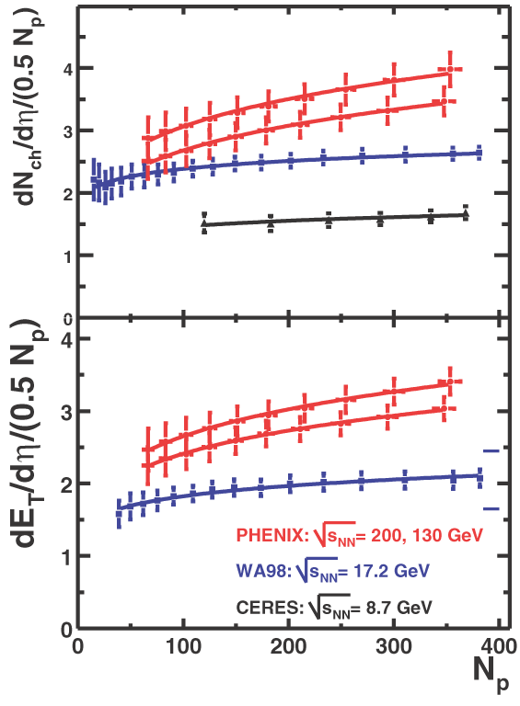
Energy density estimation
Transverse energy @ y=0
Bjorken formula
τ₀ formation time 0,35 à 1 fm/c
R = nuclear radius 1.18 A^{1/3} fm
1
dE_{T}
ε=
x
πR²τ₀
dy
y=0
ε > 6 GeV/fm³
Bjorken, PRD27 (1983) 140
Participants number

Slide 40
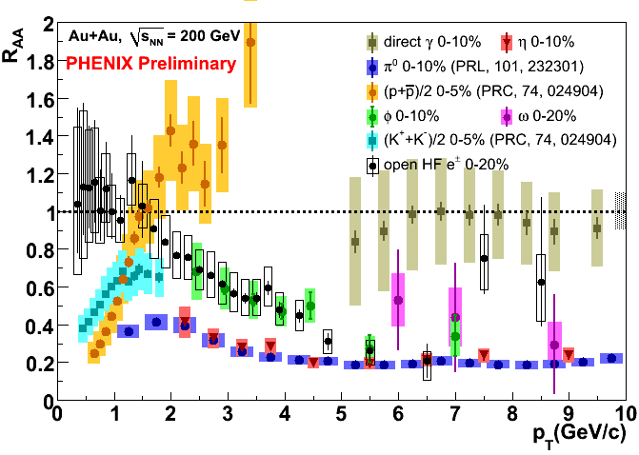
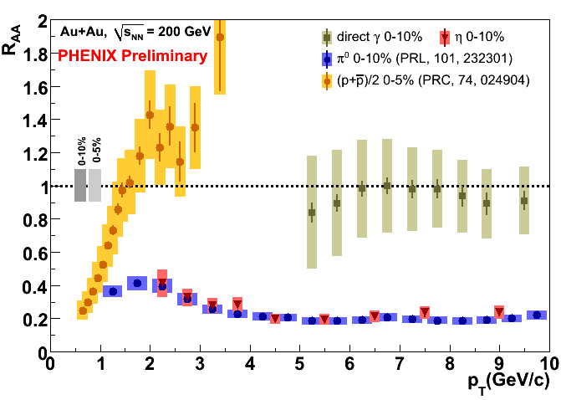


More nuclear modifications…

Slide 41

Higher pt

Slide 42

Hydro fit of spectra
P. Kolb and R. Rapp,
PRC 67 044903 (2003)

Slide 43

Vicosity/entropy ratio
G. Wang @ QuarkMatter09

Slide 44


OPEN CHARM
10 to 20 cc pairs
N_{coll} scaling
25% systematics
(need for a vertex detector)
PHENIX, PRL 94 (2005) 082301
PHENIX, PRC76 (2007) 034904

Slide 45

a link to string theory?
Juan Maldacena,
ATMP 38 (1999) 1113
(>4500 citations)
Anti de Sitter/Conformal Field Theory correspondence
Strongly coupled N=4 super Yang Mills theory
Super QCD
Super QGP
Weakly coupled type IIB string theory on AdS₅xS⁵
Dual gravity
Black hole
Can predict
some properties
(viscosity/entropy,
quenching …)

