Slide 1


Review on J/ψ suppressions
Raphaël Granier de Cassagnac
LLR – École polytechnique / IN2P3
PHENIX & CMS experiments
Santiago de Compostela
2009, February 4th

Slide 2
The normal introduction
Matsui & Satz, PLB178 (1986) 416
In 1986, Matsui & Satz predicted an “unambiguous” signature of QGP
  Onset of quarkonia melting above a certain temperature / energy density threshold
Example of assumed T_{d} (but theorists still working on it):

Slide 3
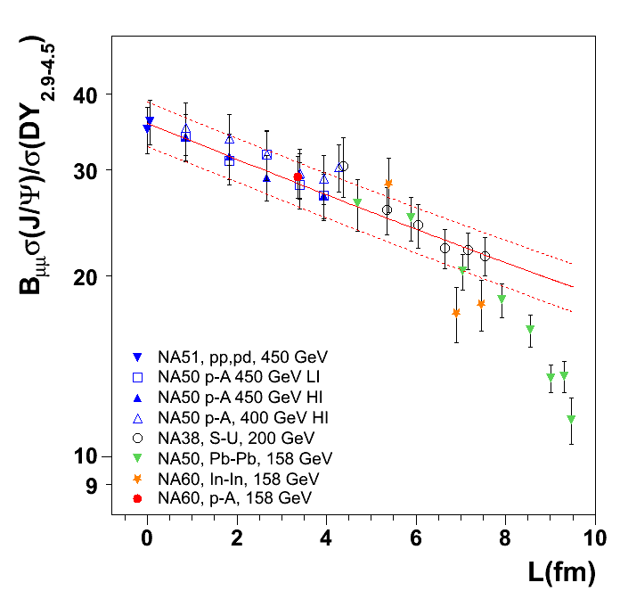
Cold and hot matters @ SPS
J/ψ
Normal nuclear absorption alone does a splendid job describing pA, SU and peripheral InIn and PbPb:
  σ_{abs} = 4.18 ± 0.35 mb
Beyond is “anomalous suppression”
  InIn looks like an onset
L
  σ_{abs} = 4.18 ± 0.35 mb
± 10% global systematics
NA60 preliminary
NA50, EPJ C39 (2005) 335
NA60, PRL99 (2007) 132302
Notes:
« as good on onset as the experimental resolution of centrality allows »
« the largest systematic study of a QGP signature… »

Slide 4
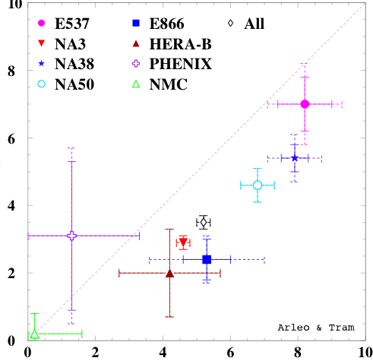
Still open questions at SPS…
C. Lourenzo
P. Faccioli,
P. Martins
σ^{nDS}(mb)
Interplay shadowing – absorption →
√s dependence of absorption?
  Lourenço et al, arxiv:0901:3054.
NA60, pA @ 168 GeV?
  HP08? QM09?
Unexplained rapidity dependence in pA?
  Eur.Phys.J.C48:329,2006
σ^{EKS}
Tram & Arleo, EPJ. C 55, 449-461 (2008)

Slide 5
However, J/ψ behave pretty much like the predicted golden QGP signature @ SPS
What about RHIC?

Slide 6
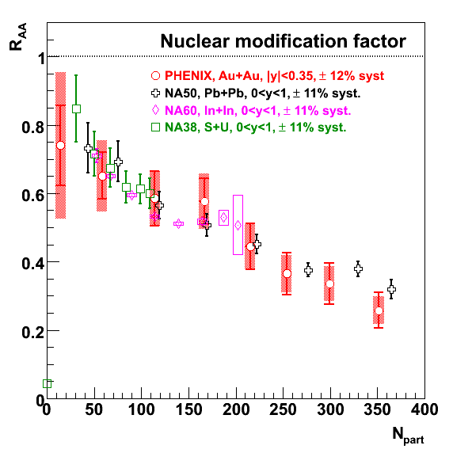
R_{AuAu} (y≈0 in PHENIX) ≈ R_{PbPb} (@ SPS)
Lower rapidity R_{AA} looks surprisingly similar, while there are obvious differences:
  At a given N_{part}, different energy densities…
  Cold nuclear matter effects (x_{Bjorken}, σ_{abs}…)
  …
REDO
Without forward
PHENIX, PRL98 (2007) 232301
SPS from Scomparin @ QM06

Slide 7
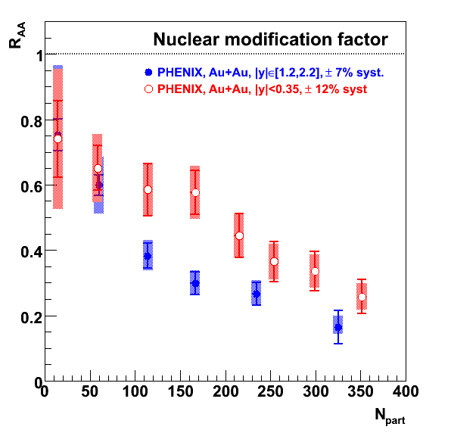
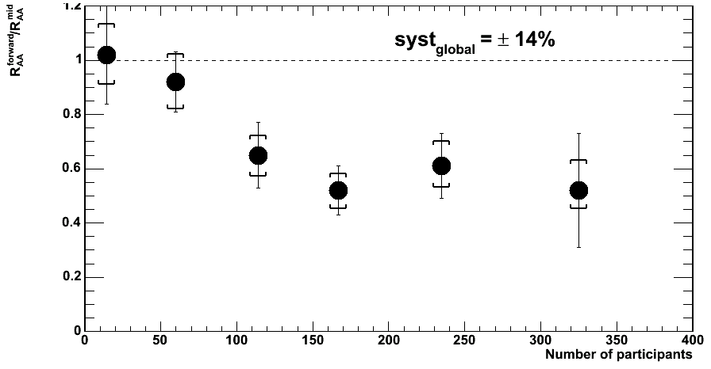
R_{AuAu} (y≈1.7) < R_{AuAu} (y≈0) in PHENIX
@ RHIC, more J/ψ suppression at forward rapidity !
While energy density should be smaller…
REDO
60%
PHENIX, PRL98 (2007) 232301
R_{AA}(y~1.7)
R_{AA}(y~0)
What is this further 40% suppression due to ?

Slide 8
@ RHIC, more suppression at forward rapidity!
Two possible theoretical explanations…
A. One hot: coalescence, regeneration
B. One cold: saturation, shadowing

Slide 9
A. Hot coalescence, regeneration
Large variety of approaches, all justify:
  R_{AA}(y=0) > R_{AA}(y=1.7)
  (more c quarks to recombine at y=0)
As an example
Latest references
R. Thews et al, EPJ C43, 97 (2005)
Yan, Zhuang, Xu, PRL97, 232301 (2006)
A. Andronic et al., NPA789, 334 (2007)
Ravagli, Rapp, PLB655, 126 (2007)
Zhao, Rapp, PLB664, 253 (2008)
A. Capella et al., EPJ C58, (2008) →
O. Linnyk et al., NPA807, 79 (2008)
(Apologies if I forgot somebody)
Capella, Ferreiro, Tywoniuk et al.
Fitting Cu+Cu, Au+Au,
Mid and forward rapidity
Notes:
R. Rapp et al, PRL 92, 212301 (2004)

Slide 10
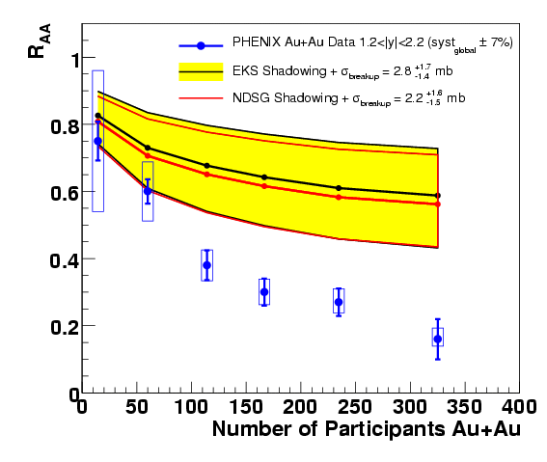
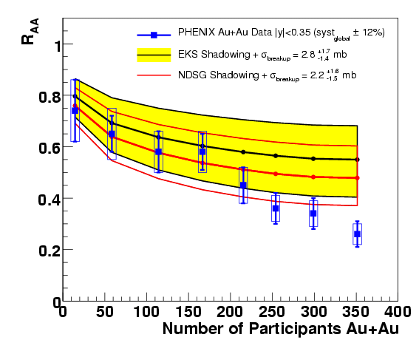
B. Cold matter
More with
E. Ferreiro
Assuming two shadowing schemes, derive a breakup cross sections from R_{dA}(y)
  σ_{EKS} ≈ 2.8 ^{+1.7}_{–1.4} mb
  σ_{NDSG} ≈ 2.2 ^{+1.6}_{–1.5} mb
  ¡ Error is underestimated !
  (A. Linden-Levy @SQM08)
  Proper error on σ is > 2 mb
And extrapolate to AuAu collisions →
  (Also available for CuCu)
  Mid and forward are correlated through shadowing scheme
  If you believe this shadowing, large anomalous suppression, larger at forward rapidity.
Forward rapidity
Midrapidity
PHENIX, PRC 77, 024912 (2008)

Slide 11
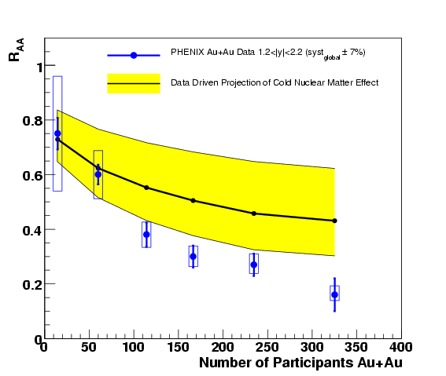
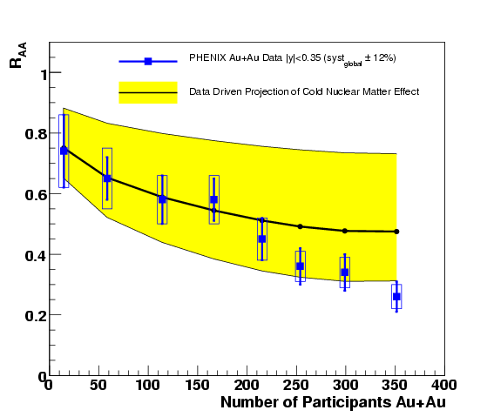
B. Cold matter
RGdC, HP06 and QM06
PHENIX, PRC 77, 024912 (2008)
Survival = 38 ⁺¹⁸_{– 22} %
More model independent…
In a Glauber data-driven model, propagate what we know from R_{dA}(y,centrality)
  R_{AA}(y,b) = Σ_{i} R_{dA} (–y,b^{i}₁) x R_{dA}(+y,b^{i}₂)
  No shadowing nor absorption schemes
  Mid and forward are not correlated, less model dependent → larger uncertainties (especially @ y≈0)
Anomalous suppression, at least at forward rapidity!
Anomalous suppression could be identical at midrapidity
(No dCu, so no CuCu)
Forward rapidity
Midrapidity
Survival = 55 ⁺²³_{–38} %

Slide 12
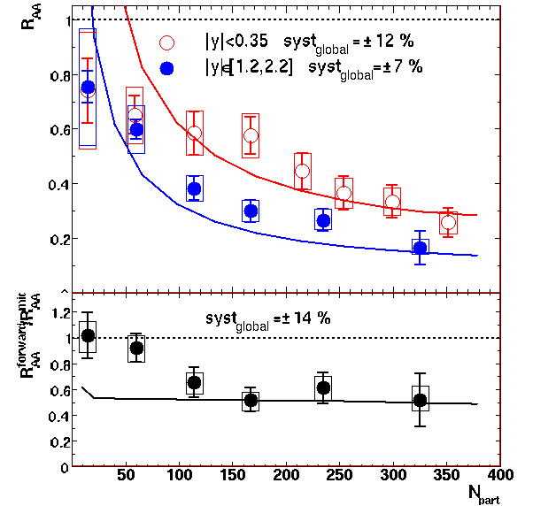
B. Recent CGC news
Kharzeev, Levin, Nardi, Tuchin
arXiv: 0808.2954 & 0809.2933
Gluon saturation could further suppress forward J/ψ in AuAu
  First numerical estimate
  Absolute amount of suppression is fitted to the AuAu data!
  Waiting forward to new dAu data to fit them first
  However, rapidity dependence should be ok
  But it fails to reproduce peripheral data →
  Anyway…
dN/dy
Not proven that J/ψ anomalous suppression is different at mid and forward rapidity!

Slide 13
How to disentangle these two scenarios experimentally?
Two possible theoretical explanations…
A. One hot: coalescence, regeneration
B. One cold: saturation, shadowing

Slide 14
How to move forward experimentally?
RGdC, Quarkonia in hot and cold matters, Quark Matter 08
Calm down?
Be more open?
Broaden interest?
Let it flow?
Get excited?
Get high?
Be upset?
Give up?
(Better pA/dA reference)
(Measure cc to constrain regen.)
(in transverse momentum)
(elliptically)
(ψ’, χ_{c})
(in mass, looking at upsilons)
(and search for onset)
And move to the LHC?
Some progress on all these points at this meeting !

Slide 15
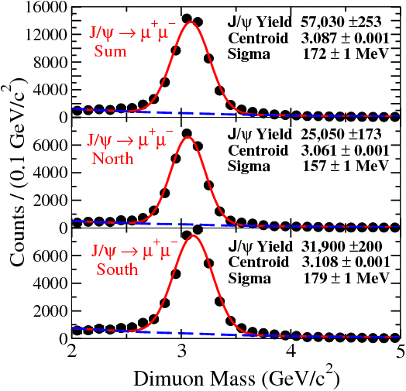
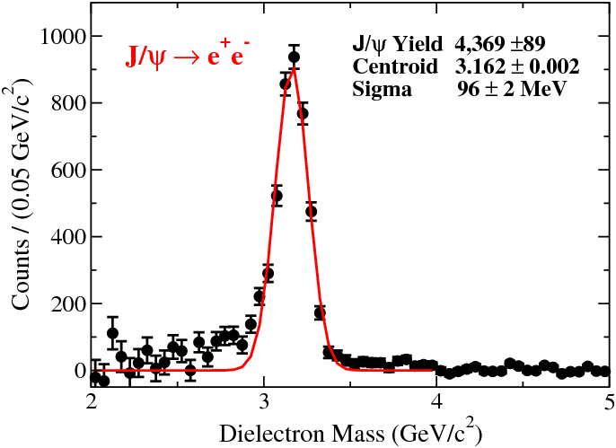
1. We need a better reference
Already a lot more dAu data on tape (run8 ≈ 30 x run3) that should further help constraining cold matter effects
RdA not available yet
Maybe @ QM09 ?
Notes:
80 nb –1

Slide 16
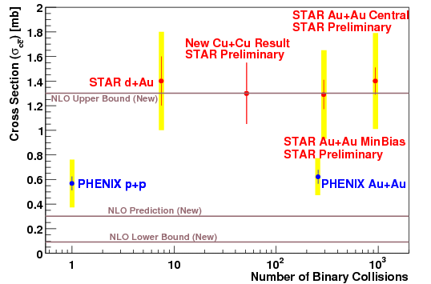
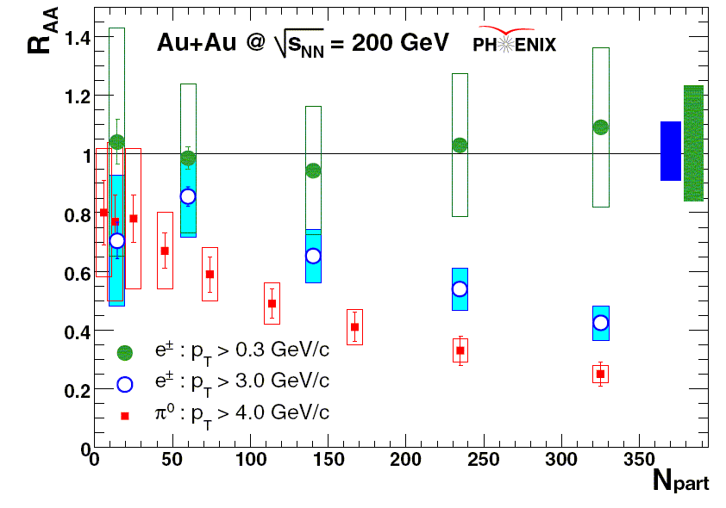
2. Measuring open charm…
?
… could constrain both
  Regeneration α (N_{cc})²
  Initial state effect (shadowing…) common to J/ψ
A factor of 2 difference between experiments
≈25% systematic error
But binary scaling (within uncertainties…)
???
10 to 20
cc pairs
PHENIX, PRL98 (2007) 172301

Slide 17
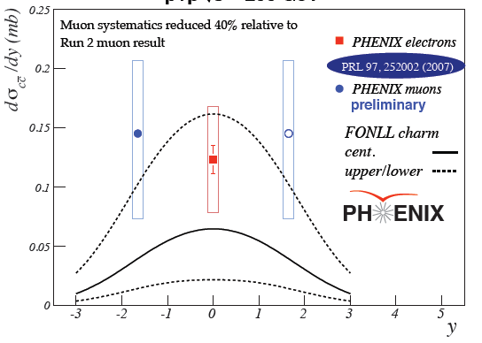
2. Open charm vs rapidity
Only pp, and very poorly known
To know more about open charm, wait for silicon upgrades in Phenix and Star
D. Hornback, PHENIX, QM08

Slide 18
Look at other observables
3. p_{T} (broadening)
4. Elliptic flow

Slide 19
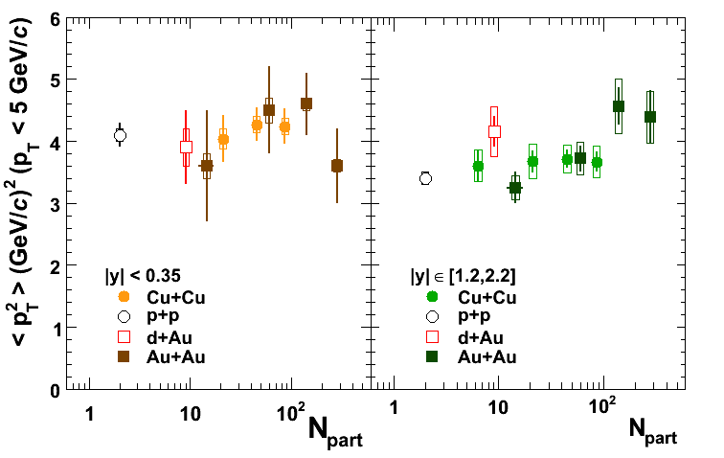
3. p_{T} broadening @ RHIC ? vs N_{part} ?
PHENIX, PRL 101, 122301 (2008)
Widely unknown initial charm production:
  Recombined R_{AA} are poorly constrained…
Instead look at p_{T}:
  Hot: Inherited p_{T} should be lower than initial
  Cold: Cronin effect should broaden initial p_{T}
Cronin goes like:
  <p_{T}²>_{AB} = <p_{T}²>_{pp} + α x L
Mid rapidity
Forward rapidity
No strong <p_{T}²> dependence…
Modest rise at forward rapidity
Could be broadening
No need for recombination here
Notes:
No pA, single dA point, CuCu and AuAu

Slide 20
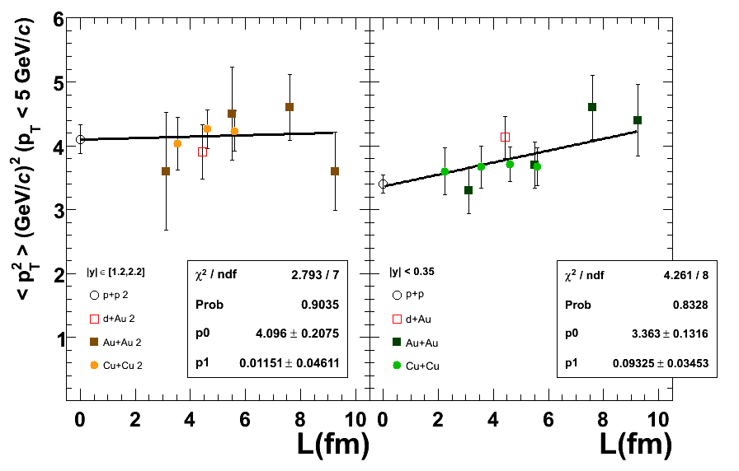
3. p_{T} broadening @ RHIC ? vs thickness ?
Widely unknown initial charm production:
  Recombined R_{AA} are poorly constrained…
Instead look at p_{T}:
  Hot: Inherited p_{T} should be lower than initial
  Cold: Cronin effect should broaden initial p_{T}
Cronin goes like:
  <p_{T}²>_{AB} = <p_{T}²>_{pp} + α x L
Mid rapidity
Forward rapidity
2.7 sigma slope
1.2<|y|<2.2
|y|<0.35
No strong <p_{T}²> dependence…
Modest rise at forward rapidity
Could be broadening
No need for recombination here
Notes:
No pA, single dA point, CuCu and AuAu

Slide 21
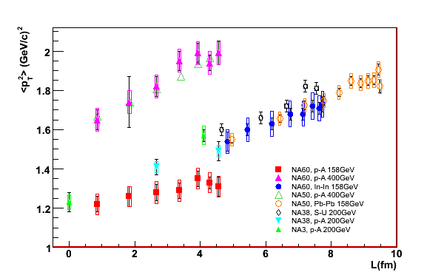
3. p_{T} broadening @ SPS ?
Tested on many systems…
SPS
Cortese (NA60), Hard probes 08
+ homemade powerpoint fits
Notes:
To give a feeling of what it could be…

Slide 22
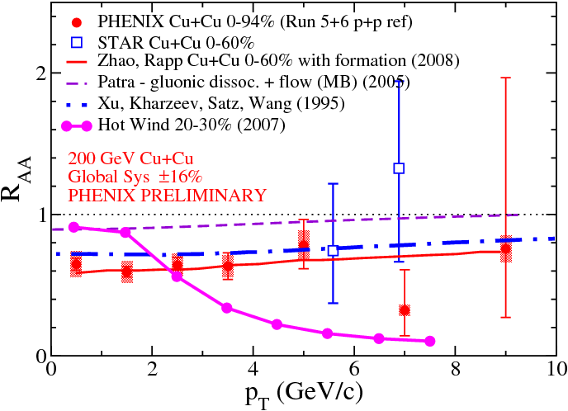
3. Reaching higher p_{T}
At QM08, some excitement about STAR’s high p_{T} R_{CuCu} (high p_{T}) ≈ 1
Hot wind scenario → 0
  Screening length from AdS/CFT
Several reasons for RAA to grow at high p_{T}
  Cronin effect
  Bottom contribution
  Leakage
  (Anti)shadowing
Notes:
Between 5 and 6 : 12 – 6 = 6 pm 4.2 is a 1.4 sigma signal (upper limit) 2 10^{–1} pm 10^{–1}
Between 6 and 8 : 17 – 7 = 10 pm 4.9 is a 2 sigma signal

Slide 23
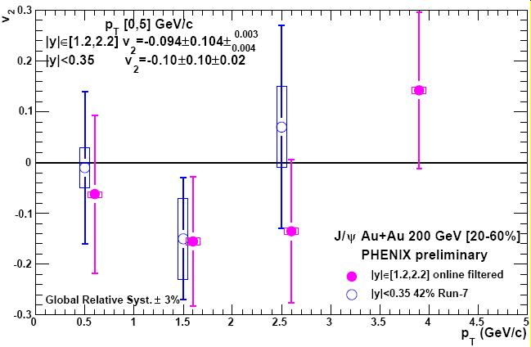
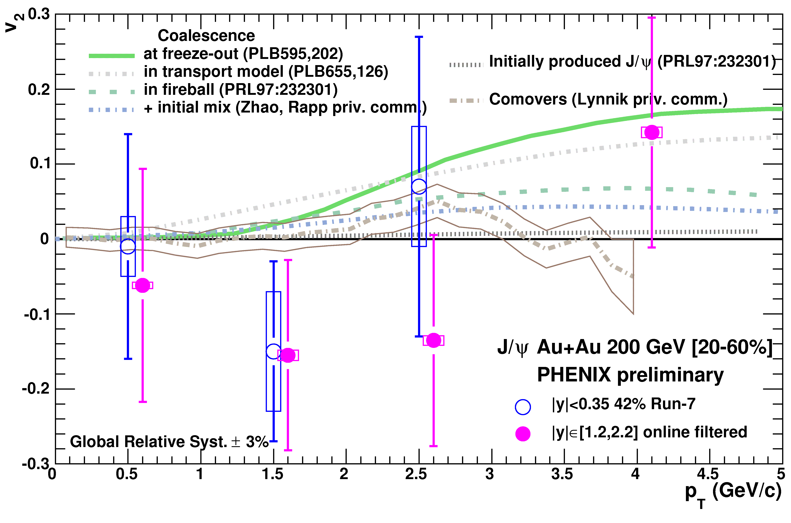
4. J/ψ elliptic flow in PHENIX
If recombined, J/ψ should inherit the (rather large) charm quark elliptic flow. First measurement:
C. Silvestre @ QM08
E.T. Atomssa @ HP08
Various levels of
recombination…
Will require
RHIC II for a
discriminating
measurement

Slide 24
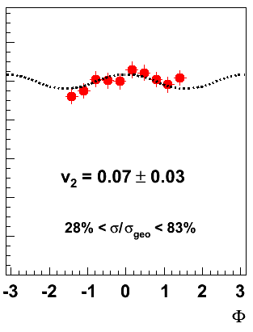
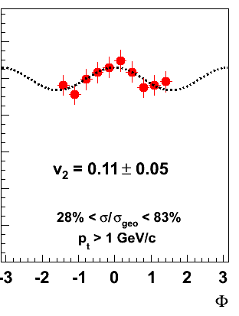
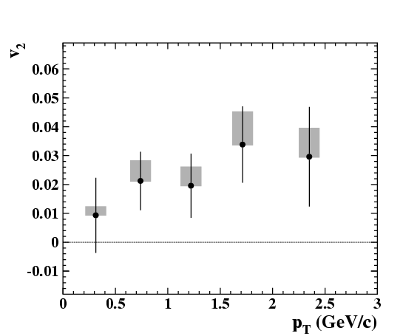
4. But also J/ψ elliptic flow @ SPS
R. Arnaldi @ QM08
F. Prino @ HP08
Eccentric In+In collisions
MinBias Pb+Pb collisions
Cannot be due to recombination
  (≈0.05 cc pairs in In+In)
Needs confirmation and understanding

Slide 25
Look at other quarkonia
5. Excited charmonia
6. Upsilons

Slide 26
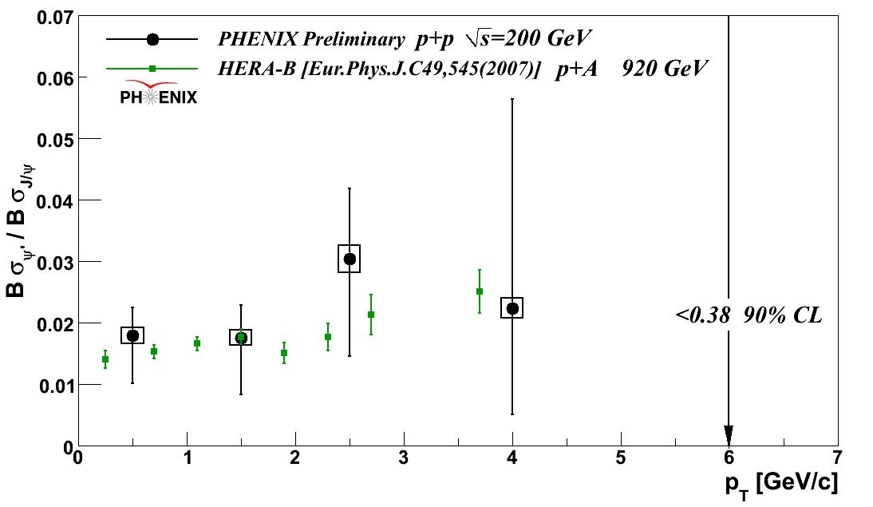
5. Excited states (=feed down to J/ψ)
Excited states should…
  A. melt if J/ψ suppression is cold effects + sequential melting
  B. also regenerate if J/ψ do (and maybe even more)
Unfortunately only pp
  → Feeddown ratio
ψ from ψ’ = 8.6 ± 2.5%
ψ from χ_{c} < 42% (90%CL)
Beauty cross section → ψ from B = 4 ⁺ – ³₂ %
M. Donadelli @ PANIC08
Notes:
P127 Marisilvia P85 Cesar P98 Han Liu

Slide 27
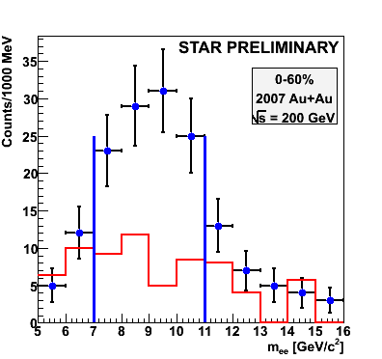
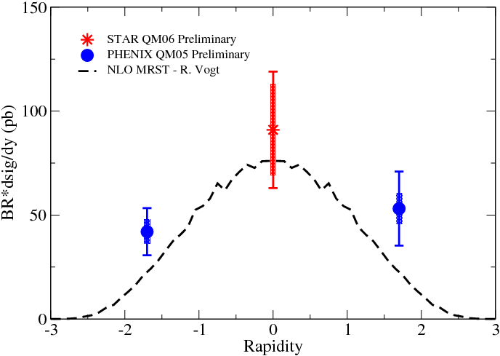
6. Bottomonia
D. Das @ QM08
pp collisions
AuAu
collisions
Suffer less from cold matter
  (x=0.02 to 0.1=EKS antishadowing)
  can be checked with run8 d+Au
Should measure (unseparated) excited states melting…
Some news on
on ψ’ and Upsilons
in AA collisions
at QM09?

Slide 28
What else ?
7. Look for onsets
8. Go to LHC, the uncharted territory

Slide 29
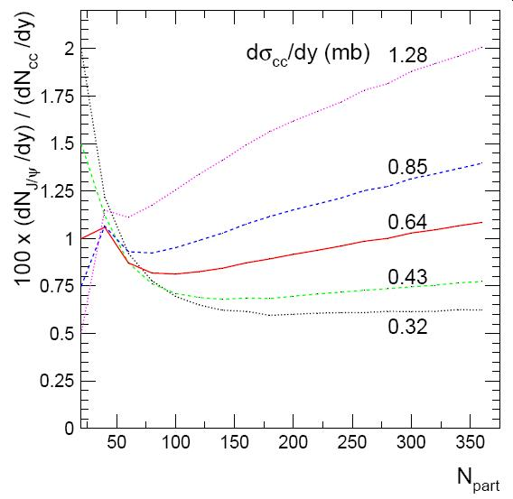
8. J/ψ at LHC ?
A new story will begin
  ↓ More J/ψ melting
  ↓ Larger shadowing / saturation effects
  ↑ Larger recombination (maybe 200 cc pairs)
If recombination prevails → golden signal
If not, expect same or worse difficulties as at RHIC…
Example of prediction
That would be hot !
A. Andronic et al., NPA789, 334 (2007)
A. Andronic, Quark Matter 2008

Slide 30
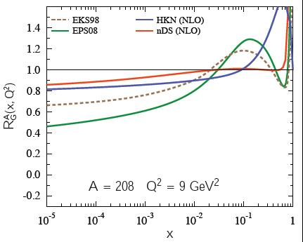
8. Quick look at shadowing on J/ψ
(emmited gluons and pT are neglected)
A factor of ≈2x2 uncertainty on charm production from current shadowing knowledge
Pb/p
2.5 < y <
4
C
M
S
-0.9
< y <
0.9
-4
< y <
-2.5
ALICE
Notes:
ALICE central : 0.001385 0.000229 0.000229 0.001385
ALICE dimuon : 0.000046 0.000010 0.006860 0.030744
CMS central : 0.006207 0.000051 0.000051 0.006207

Slide 31
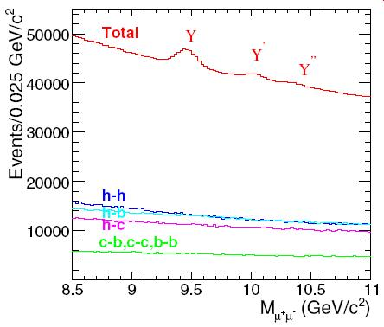
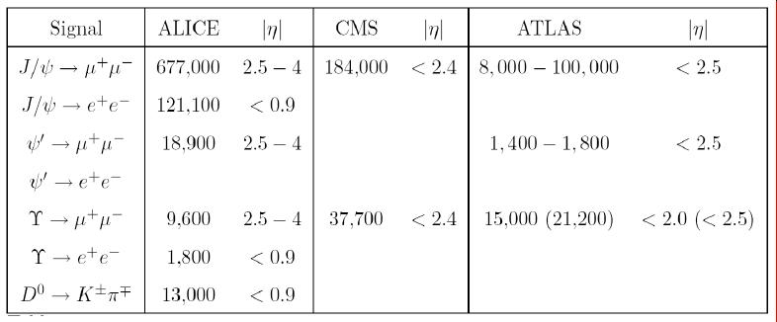
8. More quarkonia @ LHC
CMS
A lot of Upsilons
  Y’ and Y’’ should be suppressed
  Y shouldn’t (apart from 50% χ_{b} feeddown)
Pb-Pb 0,5 nb^{–1}
≈ 3,700 (10 σ) ?
Frawley, Ullrich, Vogt, Phys Rept 462 (2008) 125

Slide 32
Anomalous conclusions
Three years ago, in Santiago (Feb 10th 2006)
  “No strong conclusion” we had the RHIC preliminary Au+Au result, but the rapidity dependence of R_{AA} was not clear yet…
Today, one strong conclusion:
  “J/ψ production is not (well and yet) understood at RHIC”
Forward/mid rapidity difference could be due to:
  Regeneration / coalescence of cc pairs?
  Gluon shadowing / saturation?
However, conservative cold matter approaches still gives significant anomalous suppression at least at forward rapidity…
  The hot matter is deconfining some quarkonia
More to come soon
  dAu data ! Upsilon, ψ’ in AA collisions and LHC…

Slide 33

That’s all folks
And the next speaker is…

Slide 34
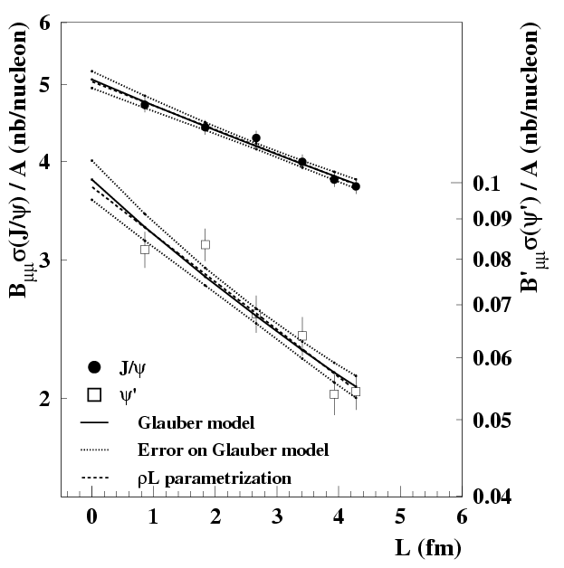
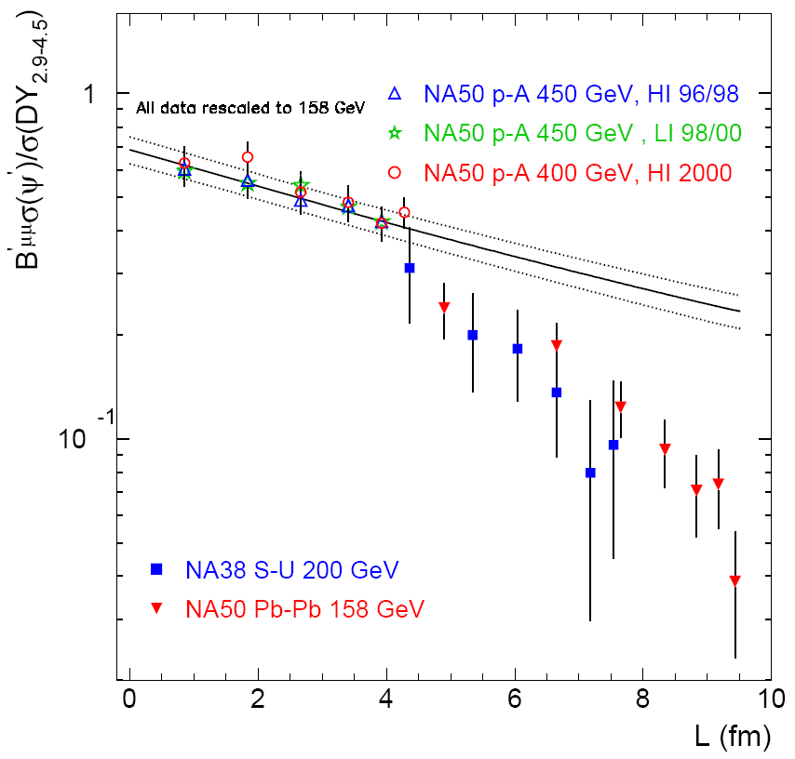
What about ψ’ ?
ψ_{pA} / A
ψ’/Drell-Yan
  σ_{abs} = 4.2 ± 0.5 mb
J/ψ
  7.7 ± 0.9 mb
  σ_{abs} = 7.7 ± 0.9 mb
ψ’
ψ’ are more absorbed than J/ψ
NA50, EPJC48 (2006) 329
NA50, EPJC49 (2007) 559

Slide 35
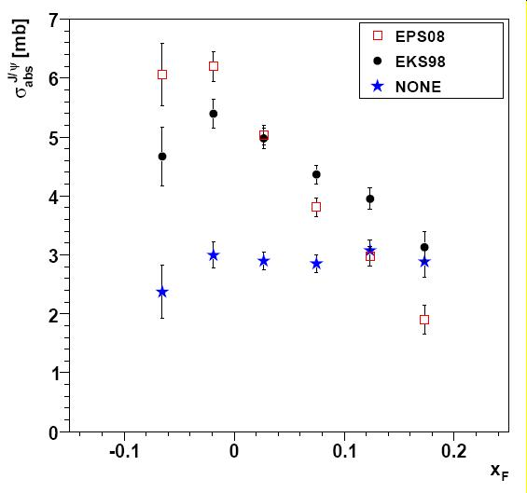
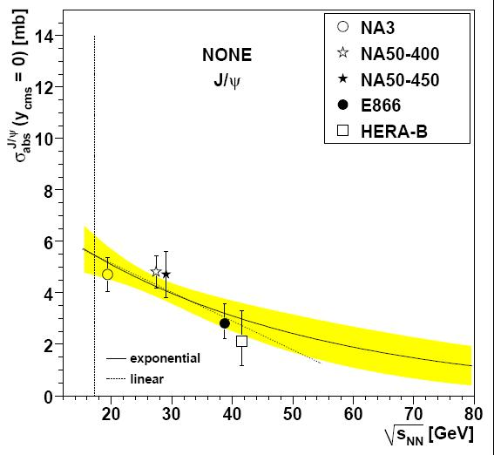
Lourenço et al, arxiv:0901.3054
E866 : flat with x_{F} if no shadowing is assumed…
Even with no shadowing, little √s dependence of σ_{abs}

Slide 36
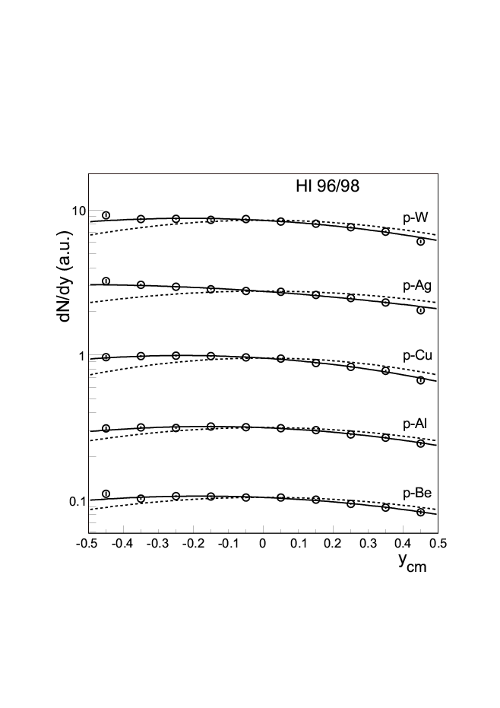
J/ψ in pA, NA50
In pA, an unsolved rapidity dependence…
EPJ…
+50%
+30%

Slide 37
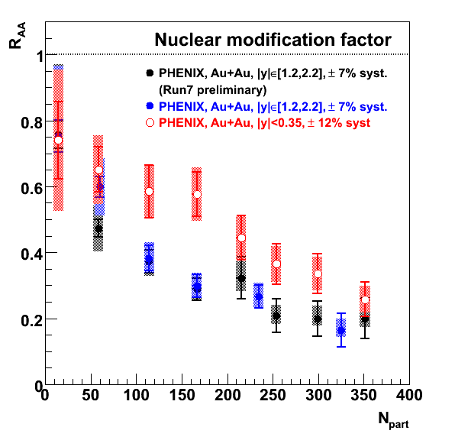
R_{AuAu} (run 4) = R_{AuAu} (run 7)
Forward rapidity only (for now)
More bins at higher centrality
Confirm the trend
  R_{AA}(y≈1.7) < R_{AA}(y≈0)

Slide 38
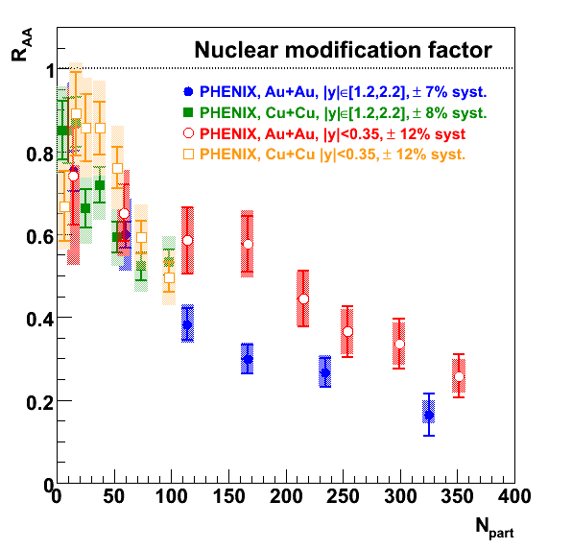
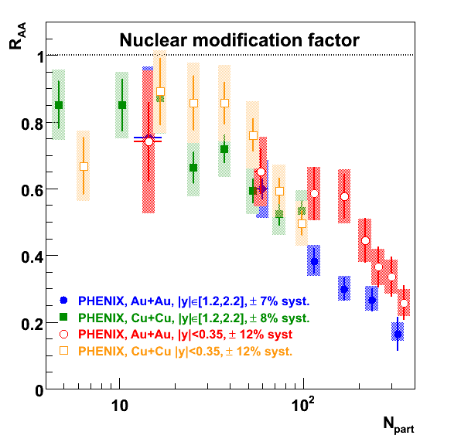
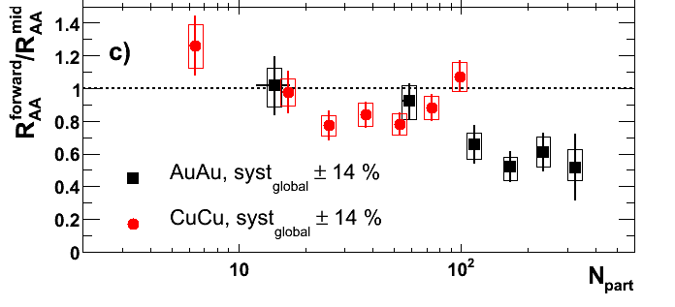
R_{AuAu} vs R_{CuCu} @RHIC
Final CuCu analysis
Slightly below 1 in CuCu
R_{AA}(y~1.7)
R_{AA}(y~0)
PHENIX, arXiv:0801.0220

Slide 39
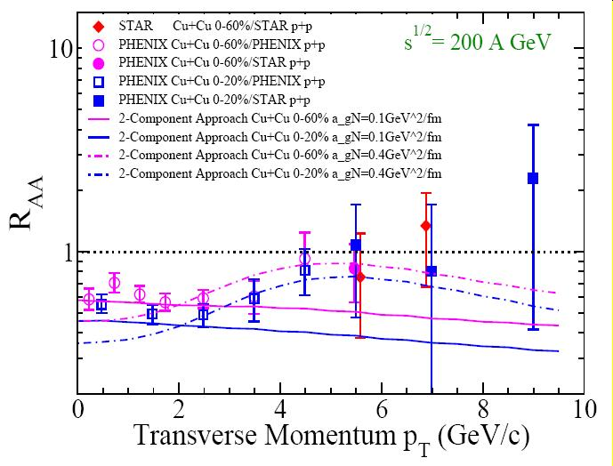
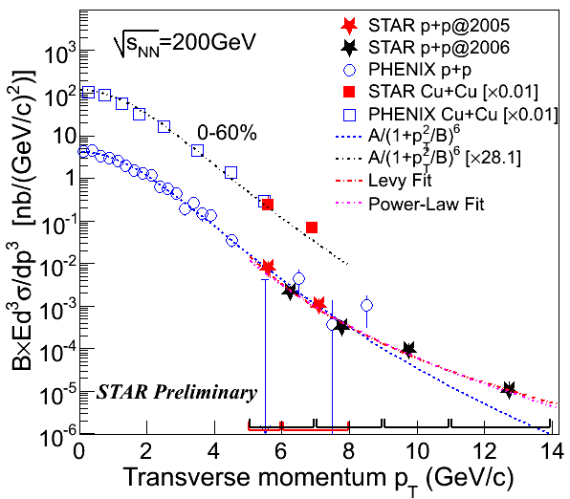
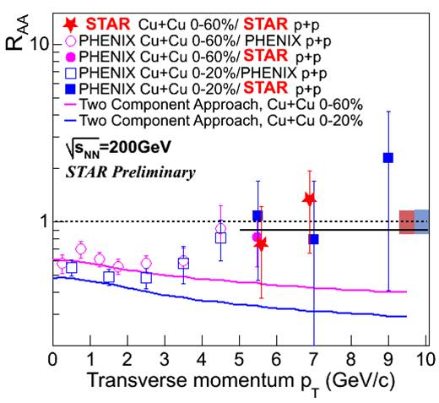
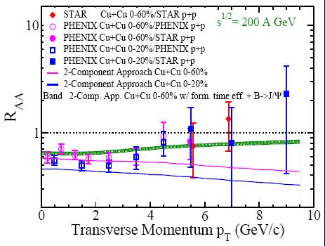
R_{CuCu} (STAR, high p_{T}) ≈ 1
Plus loin, et avec les plots de Ralf and Co.
+ PHENIX !
2 sigma J/ψ signal in Cu+Cu
STAR = PHENIX charm spectra ☺
R_{CuCu} raising with p_{T}
← *
← *
← *
Rapp & Zhao, arxiv:0806.1231
* These are not phenix results yet, but could become
as soon as the two experiments talk to each others ☺
Notes:
Between 5 and 6 : 12 – 6 = 6 pm 4.2 is a 1.4 sigma signal (upper limit) 2 10^{–1} pm 10^{–1}
Between 6 and 8 : 17 – 7 = 10 pm 4.9 is a 2 sigma signal

Slide 40
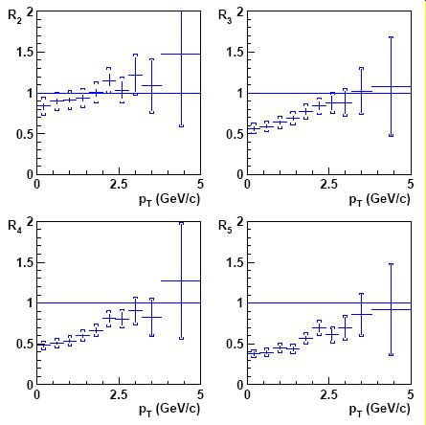
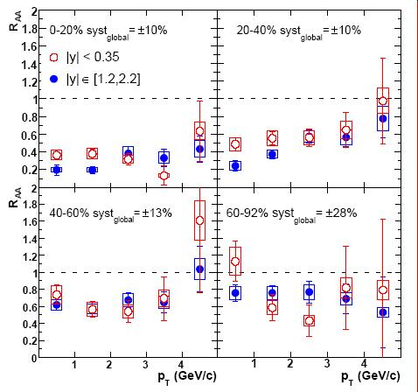
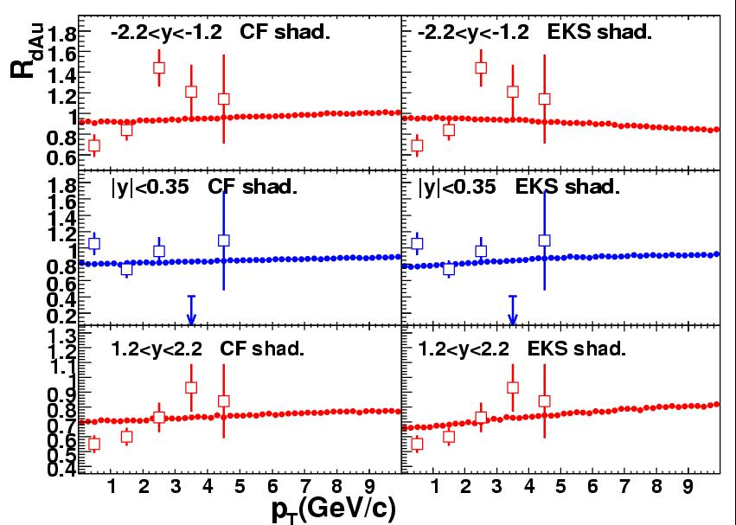
Various R_{XY}(p_{T})
1
2
Several (hints of) raising R_{AA}(p_{T})
  R_{CP} PbPb (NA50)
  R_{AuAu} (PHENIX)
  R_{dAu} (PHENIX)
Several potential reasons:
  Leakage effect, J/ψ escape
    High p_{T} J/ψ forming beyond QGP
  Cronin effect
  Raising x_{Bj} = less shadowing
    0.02 to 0.05 from 0 to 9 GeV/c
    See discussion in →
Think about it…
3
PHENIX, arxiv:0711.3917 compared to
Ferreiro, Fleuret, Rakotozafindrabe,
arxiv: 0801.4949
Notes:
Ramello : 0708.1488

Slide 41
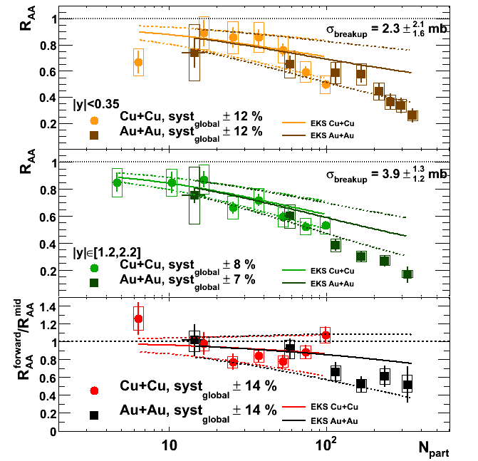
2. Cold matter again ?
Fitting an effective break-up cross section (depending on y) and extrapolate to CuCu and AuAu…
Do you agree that we have poor handle on the cold nuclear matter effect?
STOP
PHENIX, arxiv:0801.0220

Slide 42
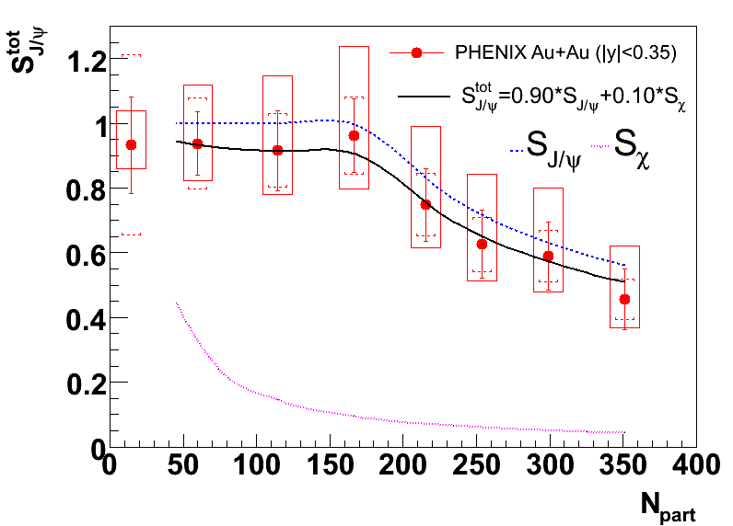
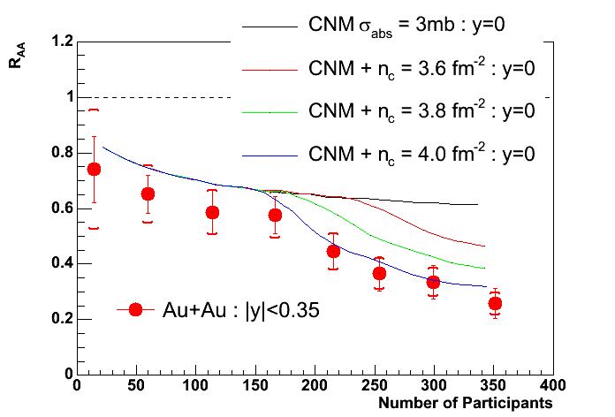
7. Search for an onset?
Onset curves fit the midrapidity AuAu data…
  Chaudhury, nucl-th/0610031
  Gunji et al, hep-ph/0703061
    (after CNM subtraction)
But so do smooth curves !
  Nagle nucl-ex/0705.1712
Density threshold @ y=0 is incompatible with SPS onset
  Linnyk & al, nucl-th/0705.4443
No onset @ y=1.7 ?
Wait for run7 analysis & CNM constraints!
Gunji et al, PRC 76 (2007) 051901
STOP
A.K. Chaudhury, nucl-th/0610031

Slide 43

Density threshold ? No !
Onset curves fit the midrapidity data…
  Chaudhury, nucl-th/0610031
  Gunji et al, hep-ph/0703061
    (after CNM subtraction)
So do smooth curves !
  Nagle nucl-ex/0705.1712
Density threshold @ y=0 is incompatible with SPS onset or larger suppression @ y=1.7
  Linnyk & al, nucl-th/0705.4443
J. Nagle, nucl-ex/0705.1712

Slide 44


RdAu(y)

Slide 45

RdAu(centrality,y)

Slide 46
From dA to AA @ RHIC
For a given A+A collision at b_{AA}, Glauber provides a set of N+N collisions occurring at b_{i}¹ and b_{i}²
One minimal assumption is rapidity factorization: R_{AA}(|y|,b_{AA}) =
Σ_{collisions} [R_{dA}(-y,b_{i}¹) x R_{dA}(+y,b_{i}²)] / N_{coll}
Works (at least) for absorption & shadowing since production
~ pdf1 x pdf2 x exp –ρσ(L₁+L₂)
b₁
b₂
b_{AA}
J/ψ
= x
J/ψ
J/ψ
= x
RGdC, hep-ph/0701222

Slide 47


Heavy flavor elliptic flow
Also a surprise!
Now, do bees fly?
  Need the b/c+b in AA to properly estimate the b flow…
(todo : average the 2 datasets cause they have different stat/syst balance)

