Slide 1
EIC simulation under PHENIX Geant4 framework
Jin Huang
(BNL)

Slide 2
Overview

Slide 3
Overview
PHENIX software framework (Fun4All)
Compact C++/STL framework, driving the analysis cycles
Same framework to handle simulation and real data analysis
Allow save/readback data object at any given breakpoint of analysis flow through formatted ROOT TTree files (DST)
Software packages and expertise available in PHENIX internal repository
PHENIX Geant4 framework was systematically introduced around 2010 to drive Geant4 under PHENIX software framework
PHENIX upgrade project has been heavily using this framework (sPHENIX proposal, “ePHENIX” concept and fsPHENIX concept)
Large scale simulation production >6TB data for sPHENIX DOE scientific review alone
Beyond PHENIX
Decision to relocate the framework and Geant4 part to GitHub for wider access/collaboration
Continue evolving the framework
Merge features from EICROOT or GEMC? Suggestions? Comments?

Slide 4
Three major detector proposal/concept currently developed under PHENIX Geant4
sPHENIX proposal submitted to DOE
An EIC detector concept on top of sPHENIX
forward sPHENIX to bridge these two concepts

Slide 5
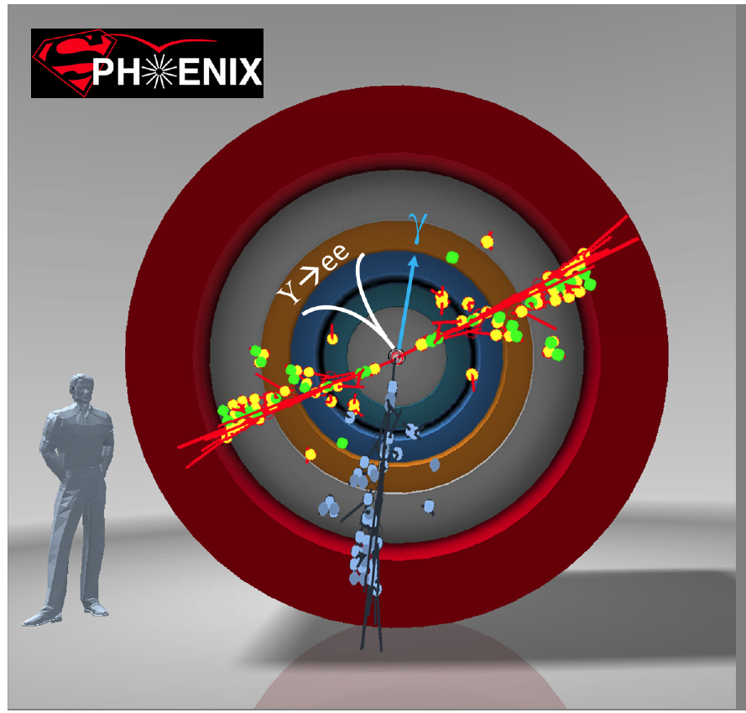
The sPHENIX detector
sPHENIX: major upgrade to the PHENIX experiment aim for data @ 2020
Physics Goals: detailed study QGP using jets and heavy quarks at RHIC energy region
Baseline consists of new large acceptance EMCal+HCal built around recently acquired BaBar magnet. Additional tracking also planned
Successful DOE scientific review last month
A good foundation for future detector upgrades
Baseline detectors for sPHENIX
sPHENIX MIE, http://www.phenix.bnl.gov/plans.html

Slide 6
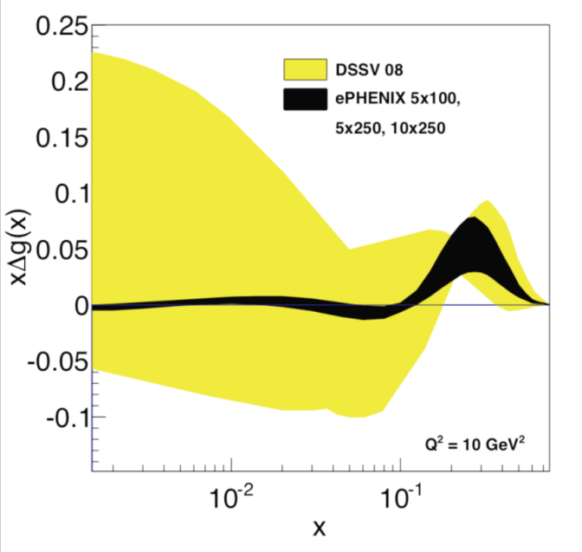
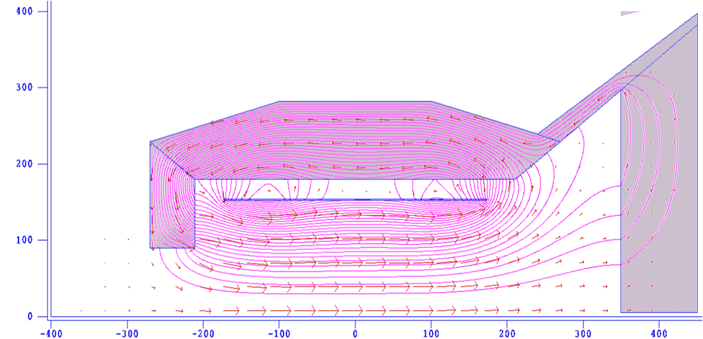
An EIC detector concept
arXiv:1402.1209
-1<η<+1 (barrel) : sPHENIX + Compact-TPC + DIRC
-4<η<-1 (e-going) : Crystal calorimeter + GEM trackers
+1<η<+4 (h-going) :
1<η<4 : GEM tracker + Gas RICH
1<η<2 : Aerogel RICH
1<η<5 : EM Calorimeter + Hadron Calorimeter
Along outgoing hadron beam: ZDC and roman pots
Cost: sPHENIX MIE + 75M$ (including overhead + contingency)
ePHENIX Δg projection
η=+1
R (cm)
R (cm)
η=-1
HCal
HCal
Aerogel
EMCal
-1.2
z ≤ 4.5m
DIRC
EMCal & Preshower
RICH
Outgoing
hadron
beam
TPC
EMCal
η= 4
p/A
e⁻
BBC
GEMs
GEMs
Station1
GEM
Station2
GEM
Station3
GEM
Station4
z (cm)
ZDC
z≈12 m
Roman Pots
z≫10 m

Slide 7
Implementation in sPHENIX Geant4 An event display for SIDIS @ x≈5×10⁻³ and Q²=10 (GeV/c)² Integrated in PHENIX software framework Material and field map implemented in details
Hadron Calo.
Aerogel
Babar coil
EM Calo.
EM Calo.
Gas RICH
Hadron Calo.
DIRC
TPC
GEMs
e⁻, 10 GeV/c
DIS e⁻
p, 250 GeV/c
IP
BBC
EMCal
Detailed layer structure implemented according to HBD NIM

Slide 8
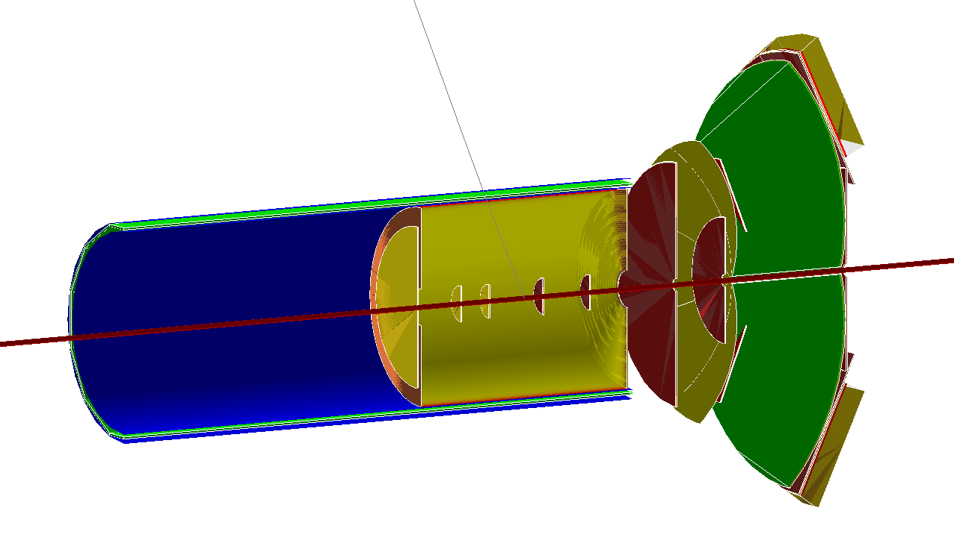
Or you can turn on/move a subset of detector on the macro level
e-going GEMs
-4.0<η<-1
TPC
-1<η<+1
DIRC
-1<η<+1
h-going GEMs
1<η<2
gas RICH
1<η<4
Aerogel RICH
1<η<2
Geant4 model of detectors inside field region
TPC
GEMs
e⁻
p/A
eGEM
IP
RICH
Fringe field
1.5 T main field
Fringe field
Tracking
p/A
Hadron PID
e⁻
η

Slide 9
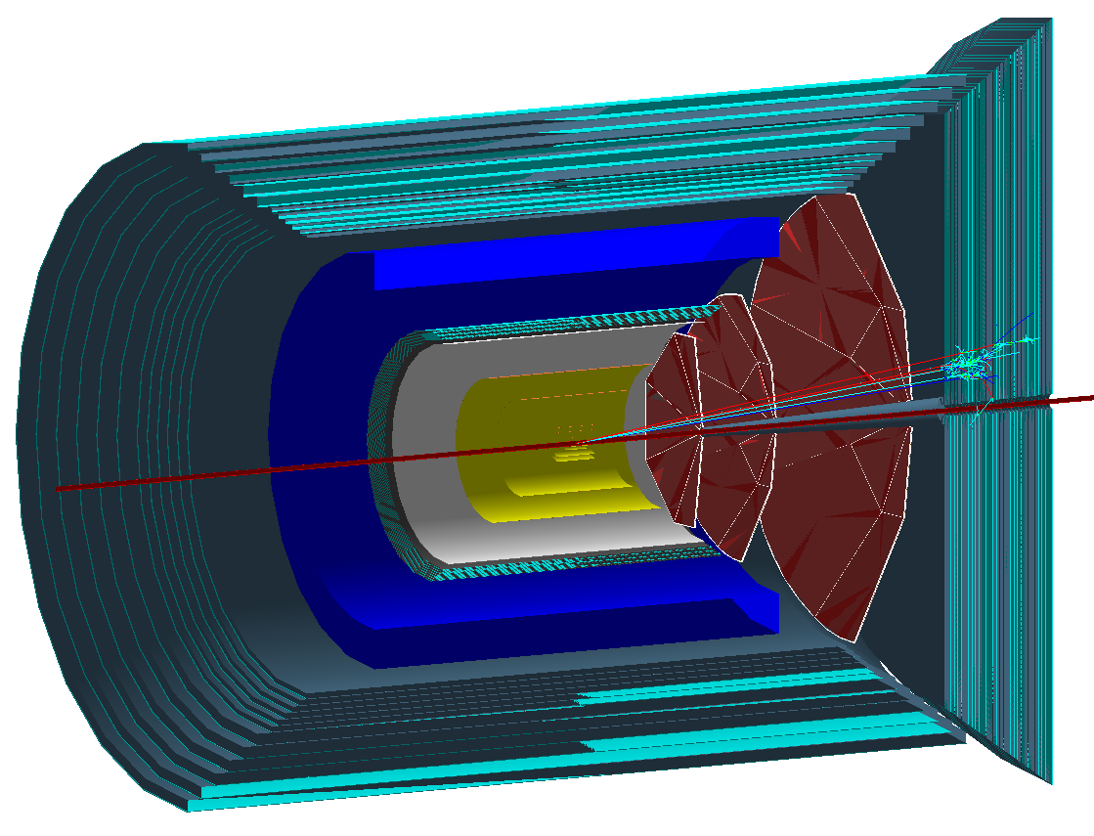
Physics before the EIC era:
The ePHENIX forward detector can be constructed earlier → a unique forward program with RHIC’s pp/pA collision
White paper submitted to BNL in Apr 2014
ePHENIX GEM + H-Cal
→ Forward jet with charge sign tagging
→ Unlock secrets of large A_{N} in hadron collisions
+ reuse current silicon tracker & Muon ID detector
→ polarized Drell-Yan with muons
→ Critical test of TMD framework
+ central detector (sPHENIX)
→ Forward-central correlations
→ Study cold nuclear matter in pA
Single jet in GEANT4
p_{T} = 4.1 GeV/c, eta = 3
p/A
p↑
IP
GEMs
Hadron Calo.

Slide 10
More features

Slide 11
Structure of PHENIX analysis framework (Fun4All)
ROOT Command line
Output/Readback at any stage
Input Managers
Fun4AllServer
Output Managers
Formatted ROOT file (DST)
Formatted ROOT file (DST)
Analysis
Module 1
…..
Analysis
Module N
Raw Data (PRDF)
Raw Data (PRDF)
Simulated Raw Data
G4/G3 Simulation
Histogram Manager
Root File of histograms
From Dr. Chris Pinkenburg (BNL)

Slide 12
Implementation of Geant4
PHENIX framework link and use Geant4 like many other external packages (e.g. DB, fast jet, etc.)
Detector configurable from ROOT macros
Detector choose how to import data from Geant4 to data nodes (integrated G4Steps out-of-box)
Easy configure for different input formats, Geant4 physics list, etc.
Run Geant4 event display and control through ROOT command lines. A GUI will be nice
Real data
Analysis modules 1
...
Digitalization
Data nodes
Analysis modules n
Outputs
Event generator
Pythia/HEPMC/…
Detector Module 1
...
Detector Module n
PHENIX Analysis Framework
w/ interface to configuration macro in ROOT
Geant4 libs
Geometry +Materials
Geant4 Tracking
Initial particles

Slide 13
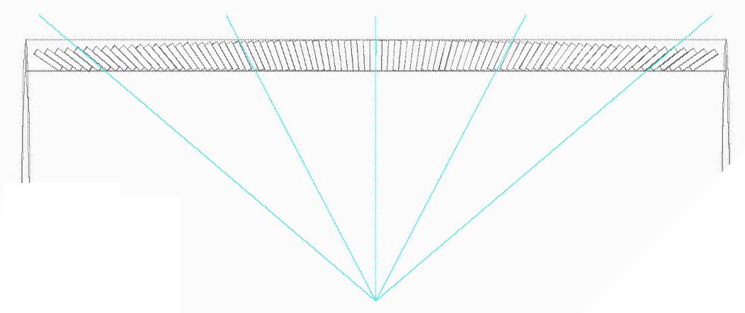
SPACAL simulation
SPACAL implemented in sPHENIX simulation framework, in reference to Alexander Kiselev’s work in EICROOT for EIC RD1 and BeAST simulation
Covered full azimuthal and |η|<1.1 in s/ePHENIX
Large scale (TBs) simulation run with full Geant model of 20M fibers
Fibers :
diameter of 0.5mm
Spacing of 1mm
Side view
2 cm
10GeV, e+
s/ePHENIX implementation of SPACAL
Hermetic and projective design in progress
Elec. E ΔE/E
1 GeV 16%
4 GeV 8%
10 GeV 6%
R = 95cm
1-D projective SPACAL towers
Energy resolution by Z. Liang

Slide 14
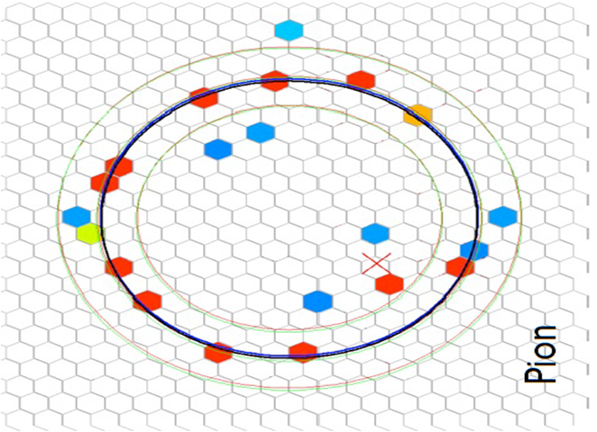
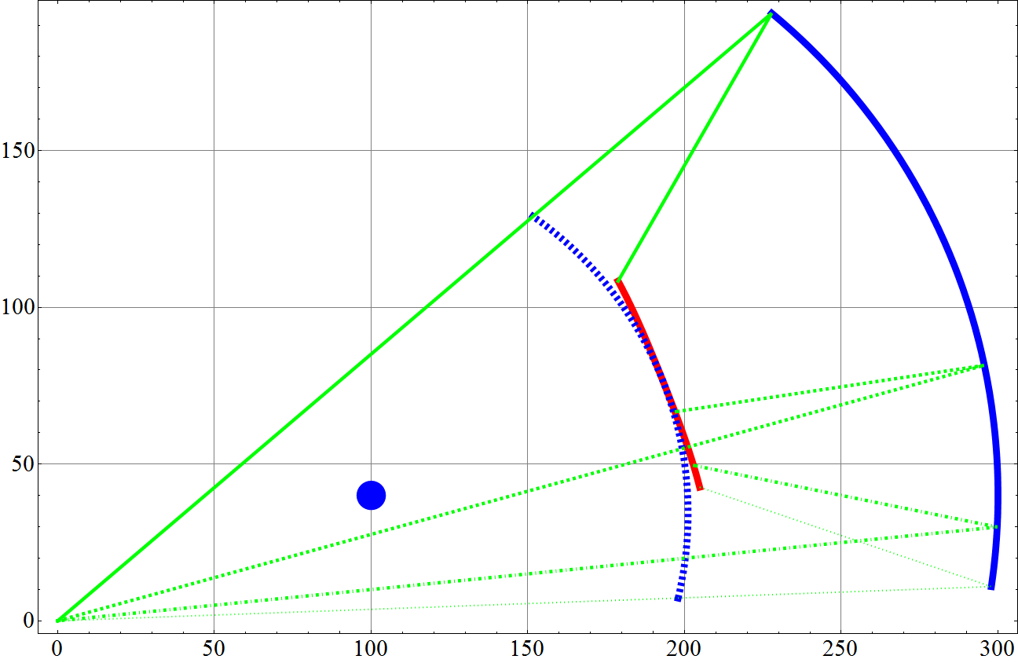
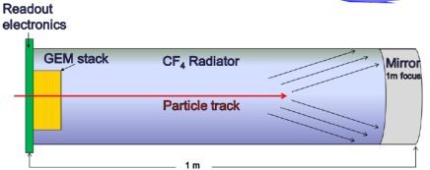
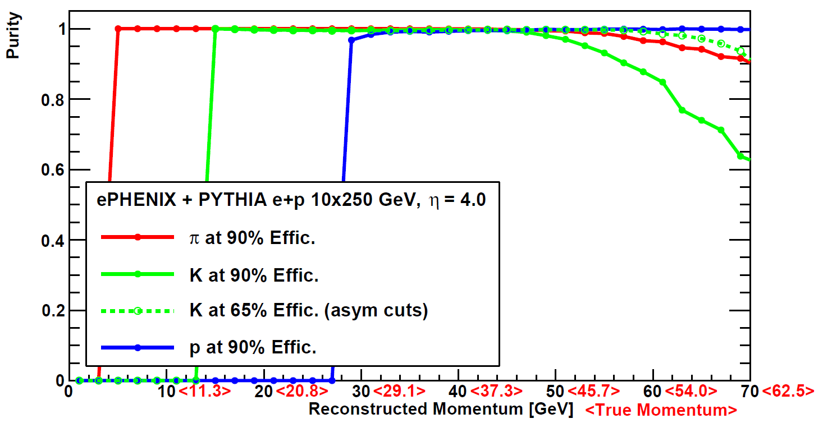
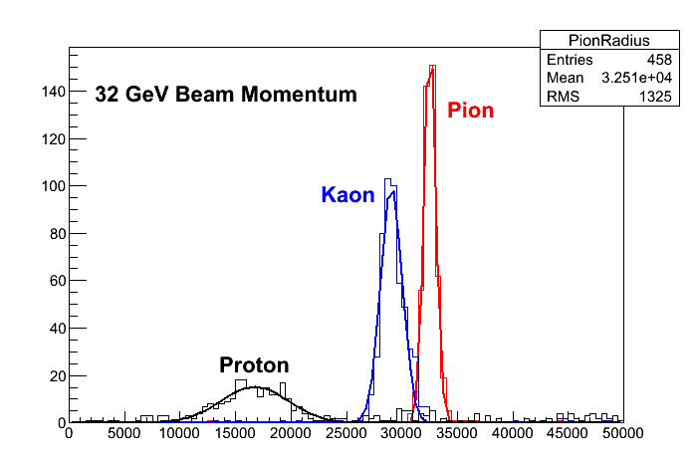
ePHENIX Gas RICH
Beam test data
StonyBrook group
R (cm)
η=1
RICH Mirror
RICH Gas
Volume (CF₄)
High momentum hadron ID require gas Cherenkov
CF₄ gas used, similar to LHC_{b} RICH
Beautiful optics using spherical mirrors
Photon detection using CsI−coated GEM in hadron blind mode
Magnetic field line most along track within the RICH volume → minor ring smearing due to track bending
Active R&D: recent beam test by the stony brook group
Focal plane
HBD detector
η=2
spherical
mirror
center
η=3
Entrance
Window
η=4
IP
Z (cm)
PID purity at η=4 (most challenging region w/ δp)
Courtesy: Stonybook group
Purity
Fermilab T-1037 data
Ring size (A.U.)

Slide 15
Some RICH event display Courtesy: Nils Feege <nils.feege@stonybrook.edu>
photon tracking in full event
RICH Ring @ focal plane

Slide 16
Final words
PHENIX analysis framework adopted Geant4 simulation around ~2010
All detector/analysis configuration are scriptable (through ROOT interface)
Three full detector proposal/concepts developed, large scale multi-TB simulation run
Framework is evolving, looking forward to adopting new features, new ideas and welcoming new users
Looking forward to a forum for discussing simulation issues in EIC community

Slide 17
Backup

Slide 18
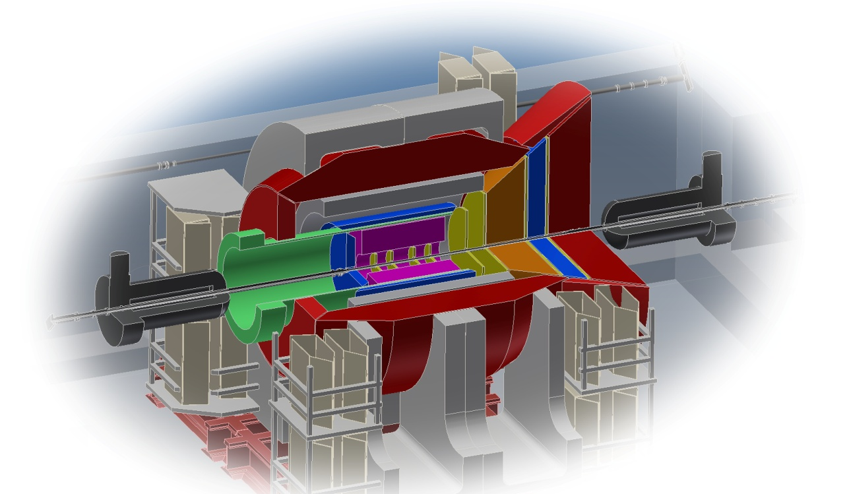
Summary
Plan: PHENIX → sPHENIX → ePHENIX
ePHENIX : a comprehensive detector concept for 10x250 GeV EIC
h-going arm of ePHENIX perfect for forward pp/pA measurement (fsPHENIX), if constructed earlier
Talk: CG.00003 Cesar da Silva
Active study on going : detector R&D, full simulation
Read more: https://www.phenix.bnl.gov/plans.html
Tracking
Hadron PID
EM and hadron calorimeter
η

Slide 19
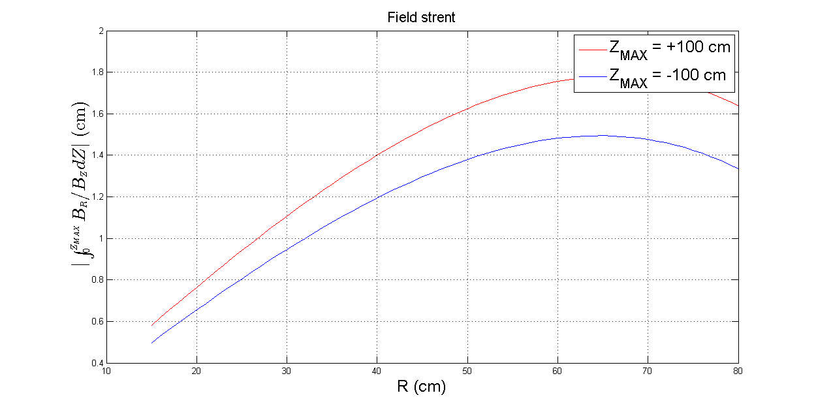
TPC resolution: Caveat - Magnetic Field Effect and Correction
Ideally, magnetic field along z axis for TPCs. B_{X/Y} terms → corrections
Field map can reach quoted uniformity for Babar (±3% for central tracking volume) by some tuning on the yoke
But is it good enough for TPC? – Further optimization needed
Assumption in LOI: we can deal with it in the end
→ Field correction ~ few mm in Rφ

Slide 21
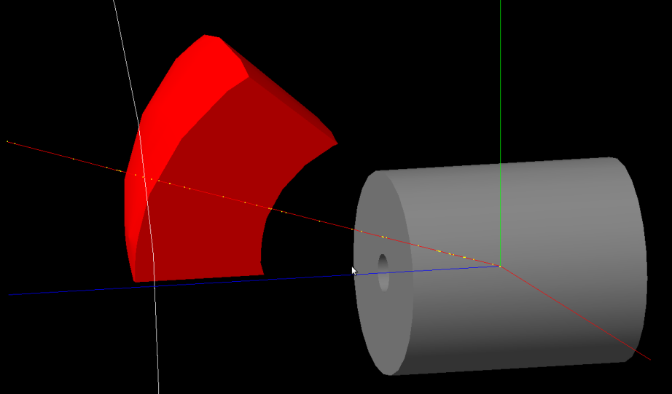
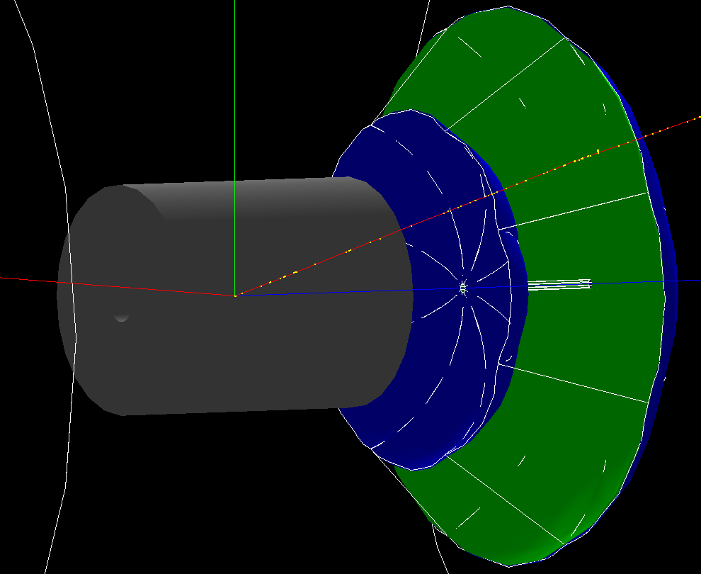
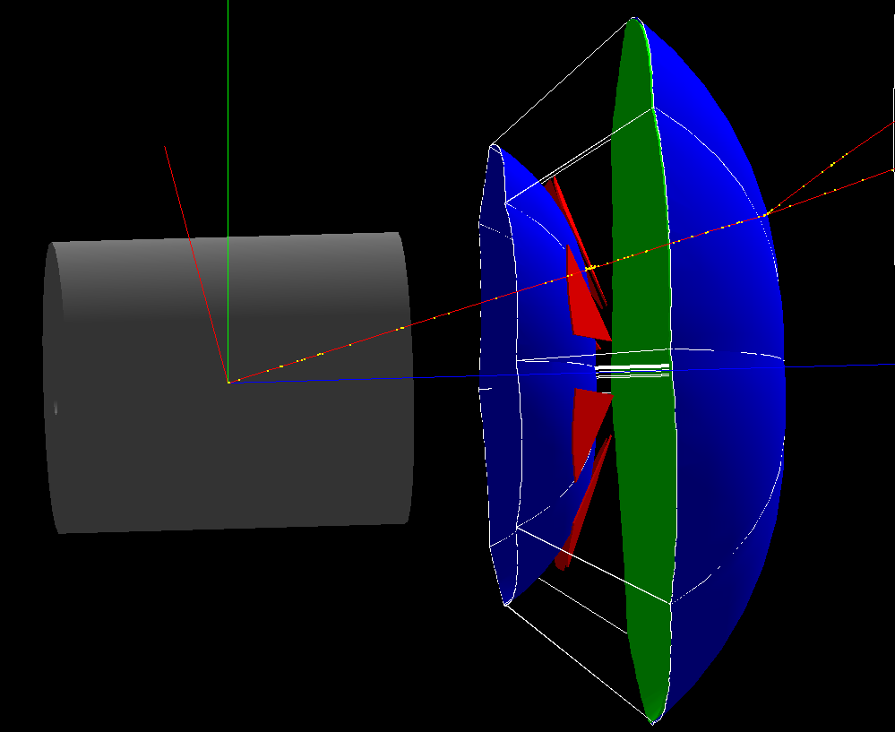
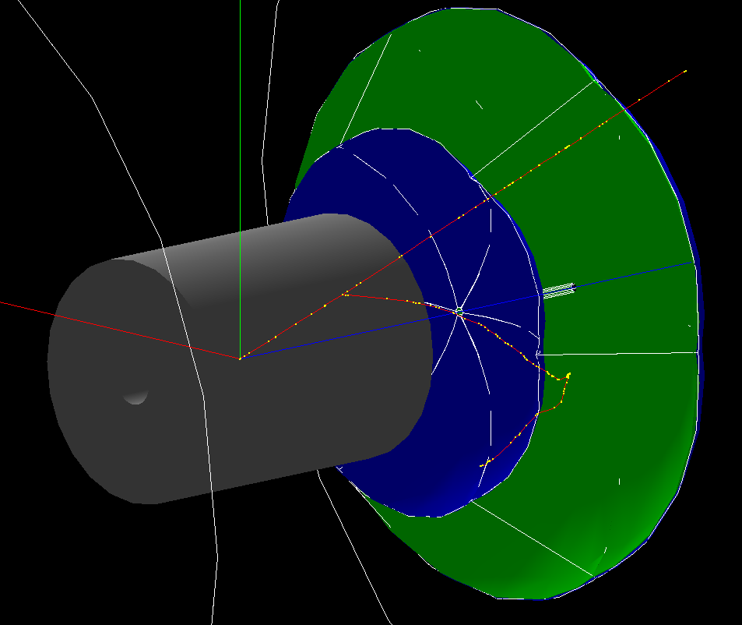
Implementing most complex geometry in current PHENIX G4 simulation
RICH Gas Container
Eight azimuthal sector
TPC
TPC
RICH Windows
spherical mirror
Six azimuthal sector
TPC
TPC
Full HBD w/ readout
RICH Windows
spherical mirror
RICH Windows
spherical mirror

