Slide 1
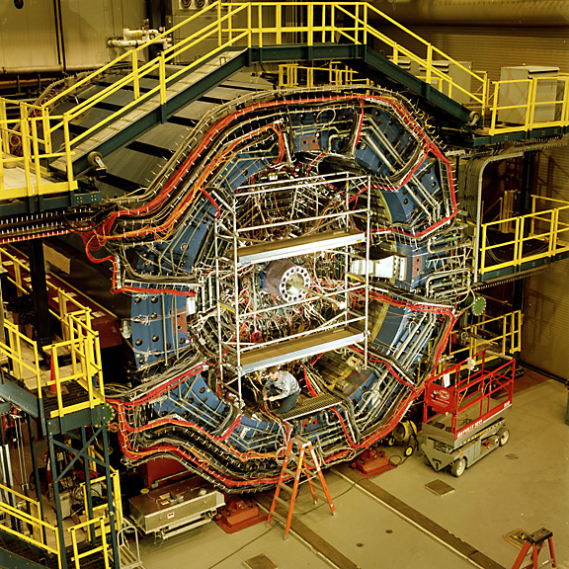
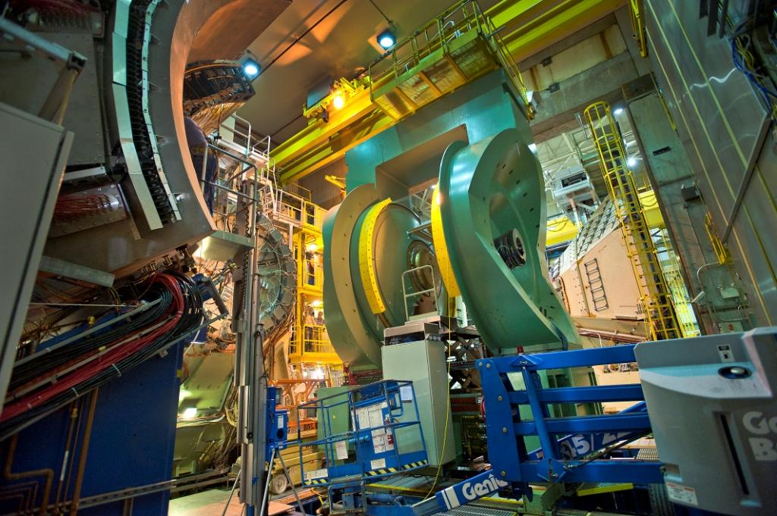
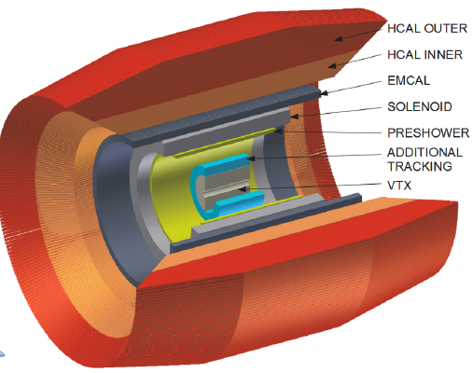
Jets at RHIC
Barbara Jacak
Future Trends
in High-Energy Nuclear Collisions
Beijing August 19, 2013

Slide 2
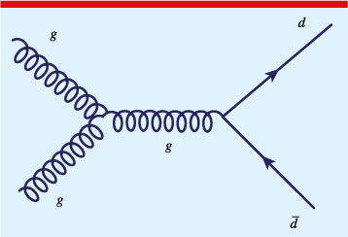
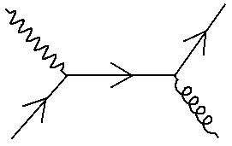
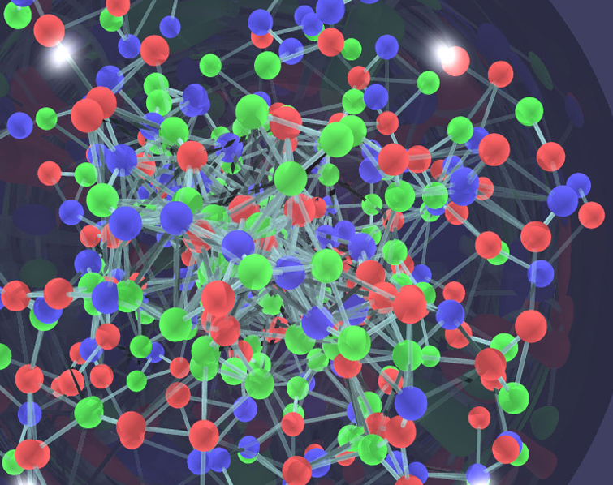
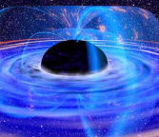
How opaque is the quark gluon to partons?
Parton energy loss in dense medium:
radiative vs. collisional?
  pQCD vs. AdS/CFT?
Where does the lost energy go?
  Thermalized in medium?
  Jet broadening?
In plasma: interactions among charges of multiple particles
charge is spread, screened in characteristic (Debye) length, λ_{D}
also the case for strong, rather than EM force

Slide 3
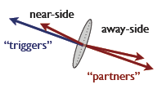
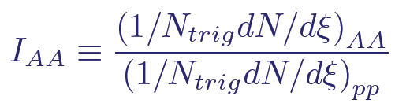
Jet probes of QGP
Hadrons
  Single high p_{T} hadrons (leading jet fragments)
  di-hadron correlations
Reconstructed jets (reconstructed jets depend on algorithm)
  Single jets
  <di-jets> or jet-h correlations
Gamma-jet correlations (photon tags jet energy)
  γ-h correlations
  <γ-reconstructed jet>
Construct the variables: R_{AA}, I_{AA}, A_{J}, q-hat
  Nuclear modification:
  Jet asymmetry:
Jet transport coefficient: q= μ²/λ; μ= <p_{T} transfer> in 1 scattering
<

Slide 4
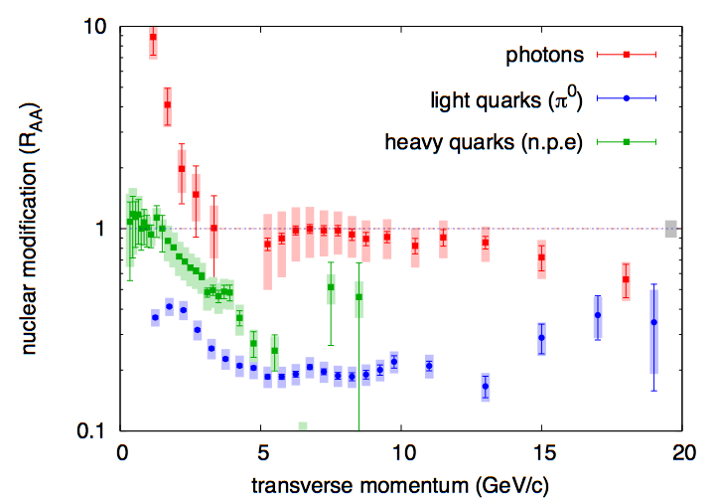

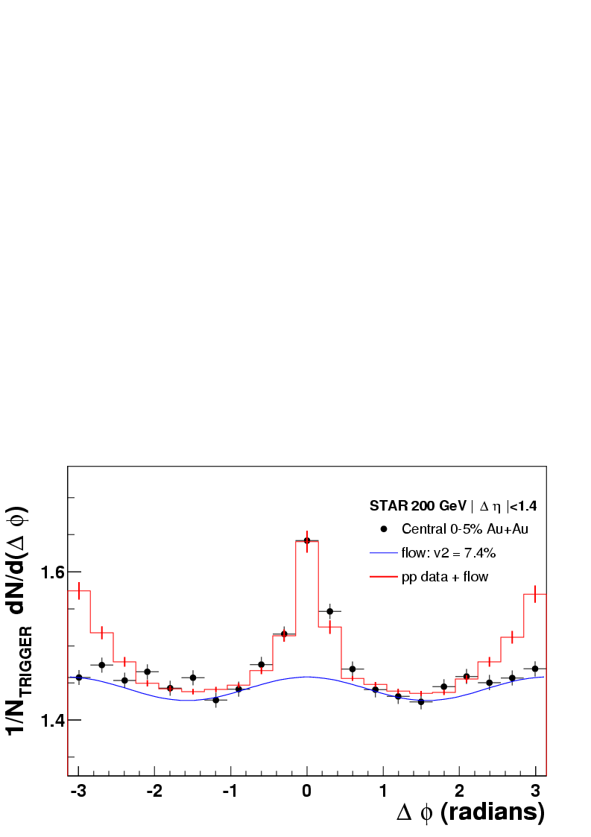

Early RHIC result: jets are suppressed!
Colored particles suffer large energy loss
to high p_{T} (very high at LHC)
same jet
opposite side jet
pQCD (g radiation dominated) works fine for light hadrons
Heavy quarks: not
radiation + collisional energy loss?
or a different mechanism?
# of pairs
Pair opening angle (radians)

Slide 5
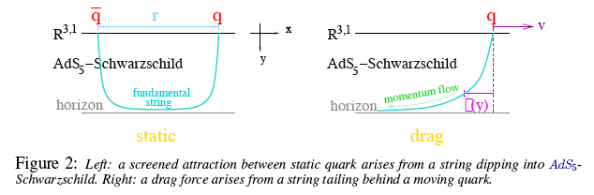
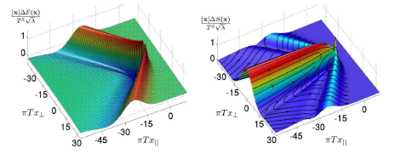
Energy loss when ∞ strong coupling
S. Gubser
Δ
T_{μν} is calculable, so can look at dynamical properties
Chesler & Yaffe, PRD78, 045013 (2008)

Slide 6
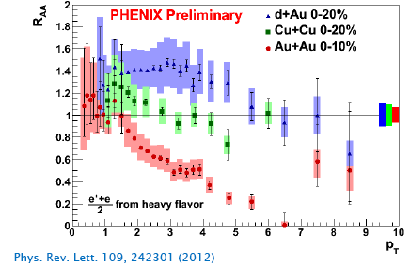
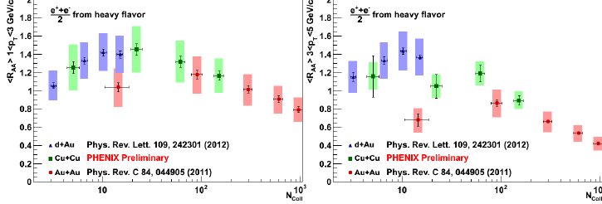
Heavy quarks have a different baseline!
Enhancement in cold nuclear matter
Then suppression in hot medium in A+A

Slide 7

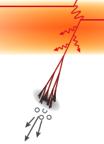
Where does the lost energy go?
We don’t know!
Medium enhances gluon radiation/splitting:
  extra gluons at small
  angles (in/near jet cone)
  radiated gluons thermalize in medium (i.e. they’re gone!)
  remain correlated with leading
  parton, but broaden/change jet

Slide 8
Di-jet energy imbalance: Au+Au vs. d+Au
3 particle correlation functions: T1+T2 are back-to-back to trigger on dijets
Particle 3 inside jet
ΣE_{T} in 0.5 Δη & Δφ
PRC87, 44903 (2013)
Trigger 1:
10-15 GeV
8-10 GeV
More asymmetric triggers: longer path in medium, more imbalance
Imbalance < theoretical expectations: stronger
surface bias & path length dependence!
Particle 3:
Lost energy goes to softer particles?
perhaps outside the selected jet cone area…

Slide 9
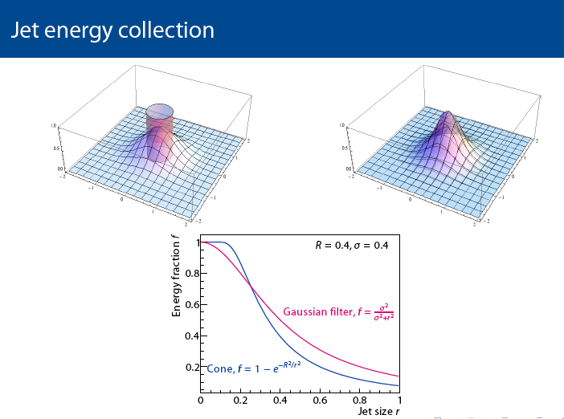
Timescales according to AdS/CFT
Horizon of black hole in AdS at distance 1/πT from boundary
  Sets light arrival time
  Black holes form by gravity
  Gravitons travel at c
Timescale for black hole formation is τ = 1/πT
  For T=318 MeV, τ = hbar c /1 GeV = 0.2 fm
Decay rate for non-hydro modes
  τ_{e-fold} ~ 1/8.6T_{init} yielding τ~0.3 fm/c
still need to separate τ and T_{init}
Of course, the coupling is NOT ∞
Anti-k_{T} algorithm: d_{1i} = min(1/k_{T1}², 1/k_{Ti}²) Δ_{1i}²/R²
Distance between hard particle 1 and soft particle i is determined
by the p_{T} of the hard particle and the separation distance
Soft particles don’t modify jet shape – algorithm is infrared safe
Gubser & Karch, Ann Rev. Nucl. Part. Sci. 59, 145 (2009)
Friess, Gubser, Michalogiorgakis, Pufu, JHEP 04, 80 (2008))

Slide 10
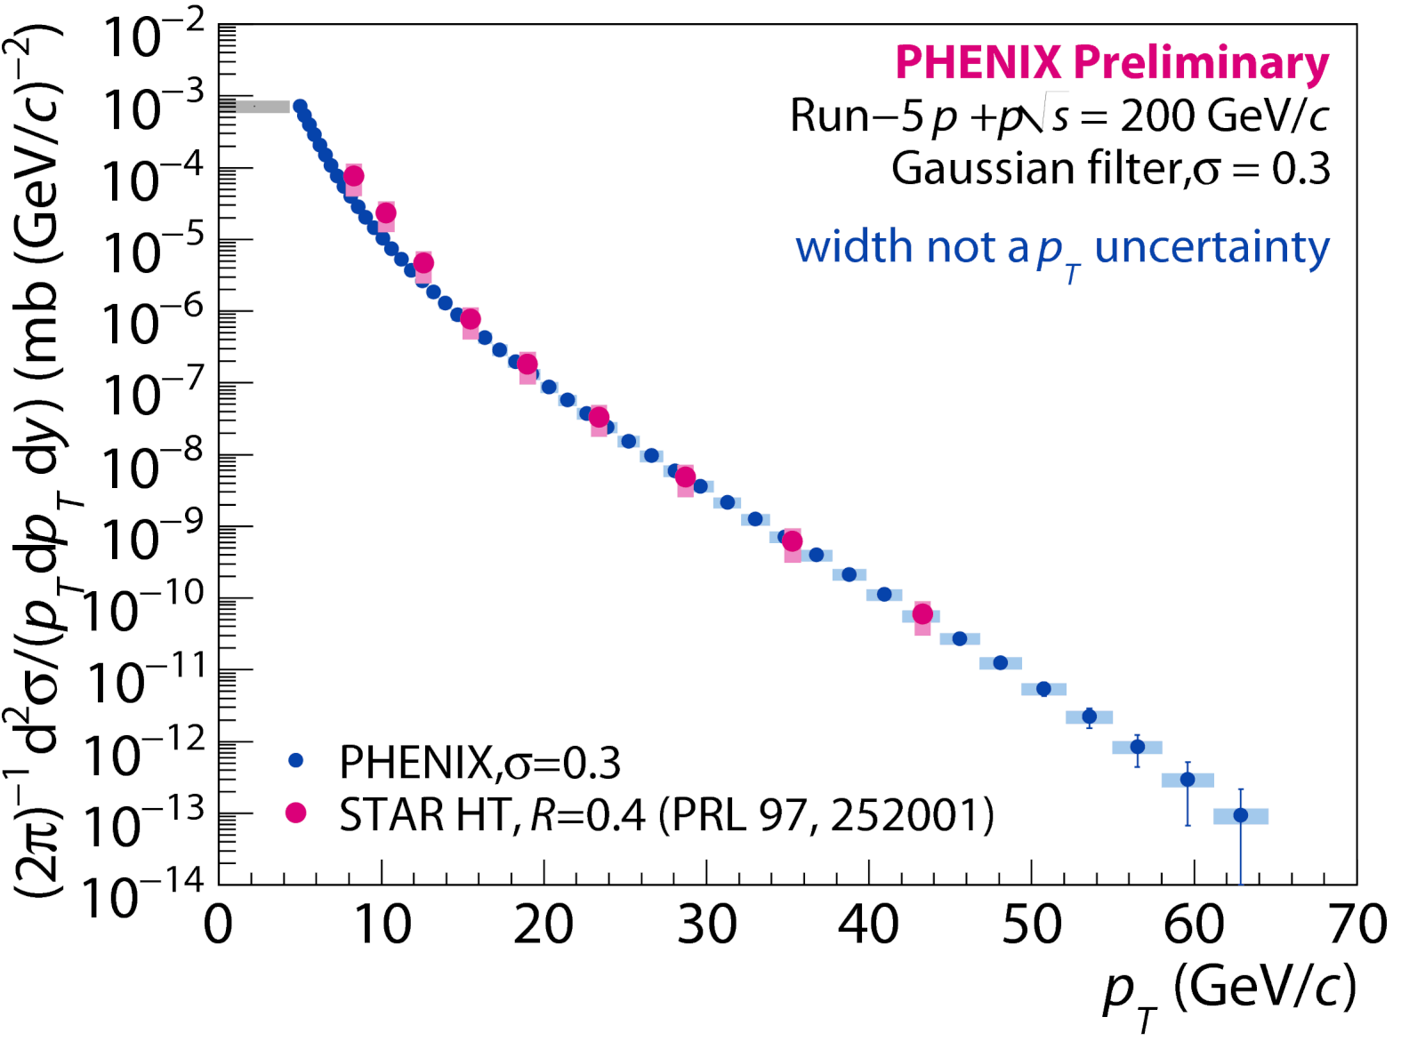

Reconstructed jets in p+p collisions
PRL 97, 252001 (2006)
* STAR uses reconstructed jets in p+p for a beautiful spin measurement!
STAR jets using cone algorithm; PHENIX with Gaussian Filter

Slide 11
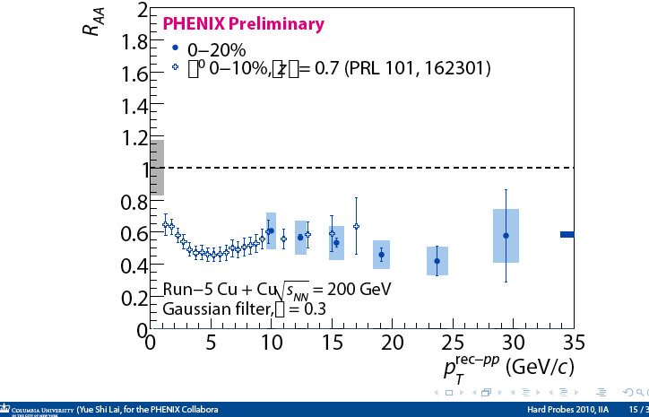
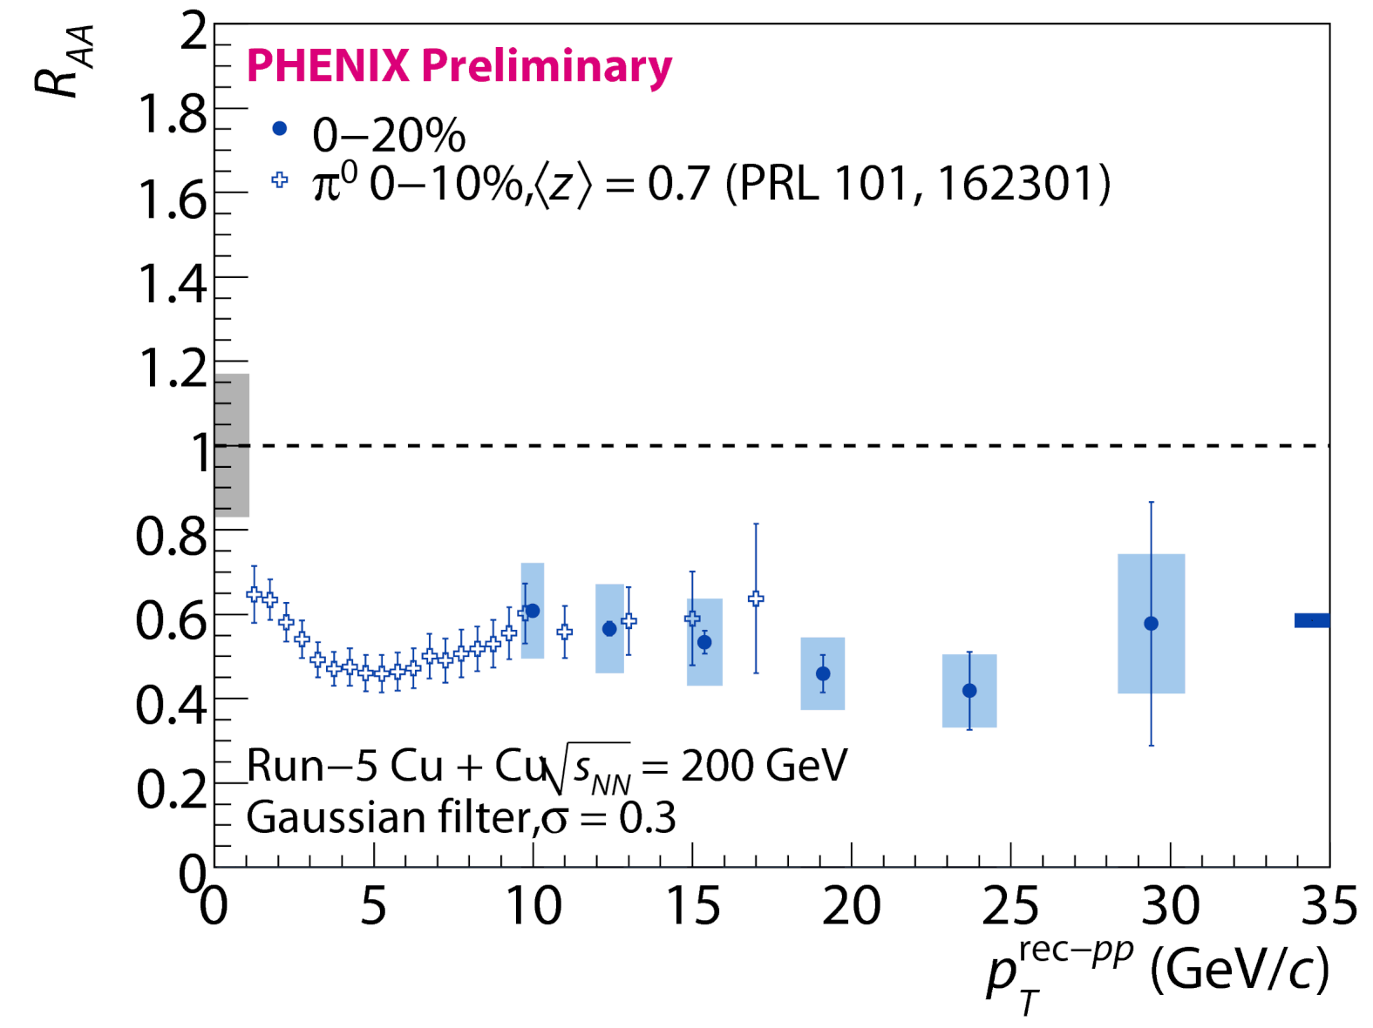
Reconstructed jets in Cu+Cu
Requiring a narrow jet ➔
same suppression as leading hadron
Hard to reconcile if eloss = g splitting inside jet cone

Slide 12
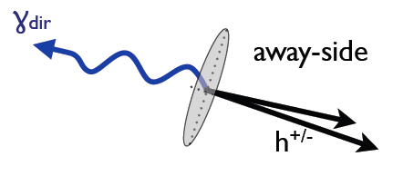
Jet Fragmentation function
D(z) = 1/N_{jet} dN(z)/dz; z = p_{had}/p_{jet}
Measure: count partners per trigger as fraction of trigger momentum
z_{T} = p_{Ta}/p_{Tt} ~ z for γ trigger
ξ = ln(1/z_{T})
Modification factor similar to R_{AA}:
FFn experimental challenge:
measure the parton p
Use trigger γ or jet

Slide 13
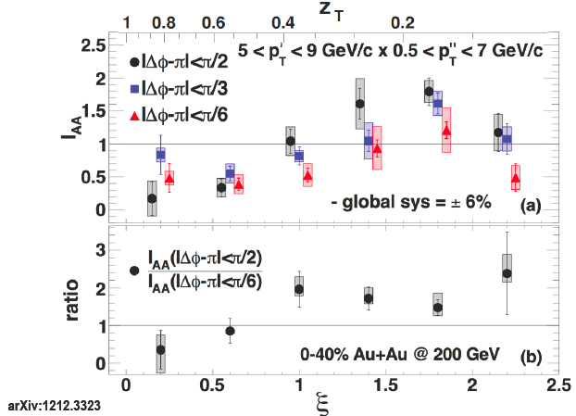
PHENIX: FFn via γ-h correlation
γ: parton energy, h: fragmentation fn.
“Extra” soft particles at larger angles near the away side jet
Au+Au/
p+p
Provide constraints on gluon splitting
Perturbative?
PRL 111, 032301 (2013)

Slide 14
but not in CMS γ-h (p_{T}>60 GeV)

Slide 15
STAR: FFn via recon. jet-h correlation
arXiv:1302.6184
Away-side high p_{T} width unmodified
  Energy loss in medium observed
D_{AA} (p_{T} weighted yield) shows high p_{T} suppression & low p_{T} enhancement
anti-k_{T} algorithm; R=0.4; Tracks, towers > 2 GeV; fluctuations corrected using embedding

Slide 16
What have we learned so far?
Large energy loss in QGP
  Radiative energy loss can reproduce light hadron R_{AA}
  Radiative energy loss can reproduce jet R_{AA}
  But not charm suppression
  collisional energy loss, but collisions with what?
Jet shapes ~ unchanged in HI collisions
  To what extent might this be due to the algorithm?
  LHC finds unchanged opening angle
    & away side jet (just less energetic)
  Both RHIC & LHC see rearranged particle p_{T} in jet
Jet fragmentation function is modified in QGP
  High z (high p_{T}) fragments suppressed by energy loss
  Soft particles enhanced at larger angles in/around jet

Slide 17
What can we learn next with jets at RHIC?
At what scales(distance, E, M) is QGP coupling strong?
  What happens to the deposited energy?
    (either gluons or plasma excitations)
What are the constituents of the plasma?
  Length/time/mass scale for (quasi-)particle appearance?
How does the medium evolve?
  What is the parton-plasma interaction?
    Radiative + collisional eloss vs. AdS/CFT?
    Effect on jet’s evolution?
  Is there a plasma response?
  At RHIC jet virtuality ~ medium scale
  Jets are a well-matched probe

Slide 18
Control the medium & the probe

Slide 19
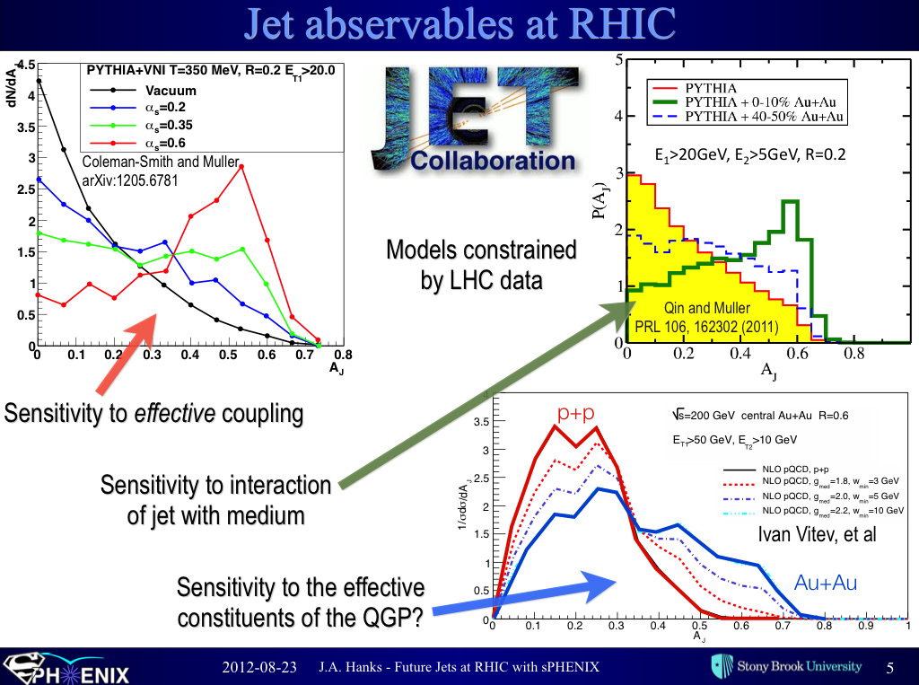
New goal di-jet observables for RHIC

Slide 20
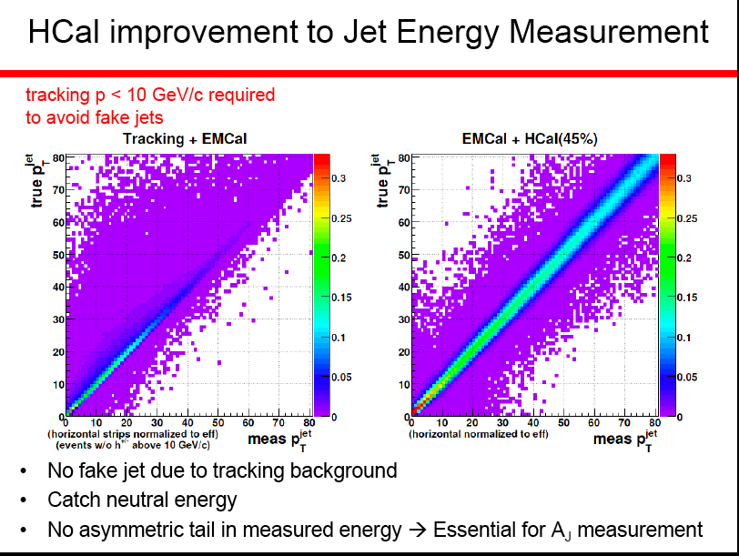

Slide 21
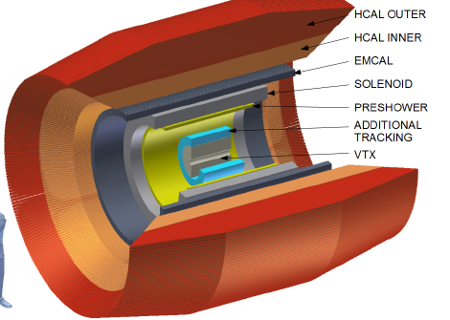
sPHENIX upgrade
Jet, di-jet and γ-jet physics
Additional tracking layers (RIKEN)
  ➔high-z fragmentation fn.
Add pre-shower to EMCAL
  ➔π⁰ R_{AA} to 40 GeV/c
  ➔eID for ϒ states; tag c,b jets
Forward upgrade for spin &
cold nuclear matter
(NSF, RIKEN)
Dave Morrison will present in more detail

Slide 23
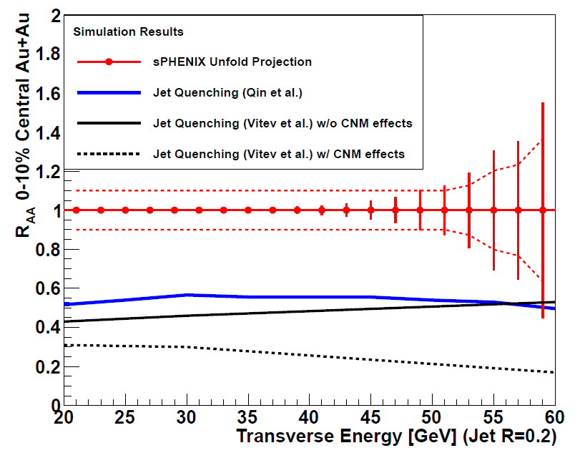
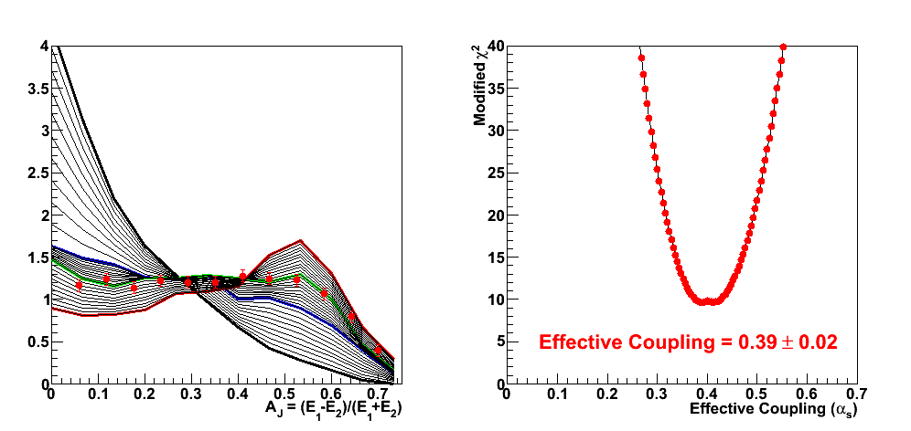
Jet and Di-jet performance
Dijet Asymmetry
E_{T1} > 35 GeV
Varying medium coupling
Theory (Coleman-Smith)
50B events sampled
200 GeV Au+Au
Add also heavy quark jets

Slide 24
Expected jet reconstruction performance

Slide 25
Conclusion
Jets are excellent probes of the QGP
  Understanding the jet-medium interaction will tell us a lot about the nature of the medium
We have only scratched the surface of jets at RHIC
Many opportunities await
  New jet analyses in STAR
  sPHENIX upgrade with first HCAL at RHIC

Slide 26
Backups

Slide 27
Jet energy unfolding performance
di-jet
γ-jet

Slide 28
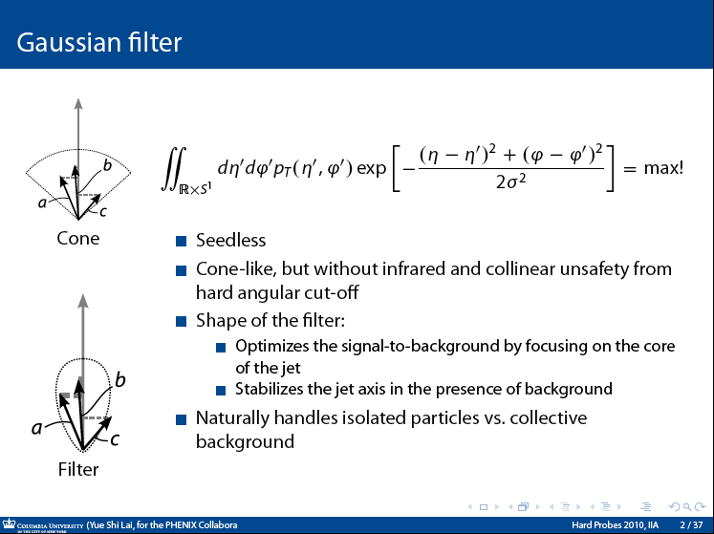

Slide 29
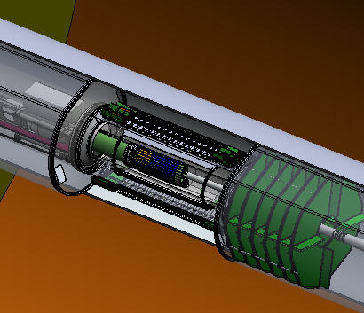
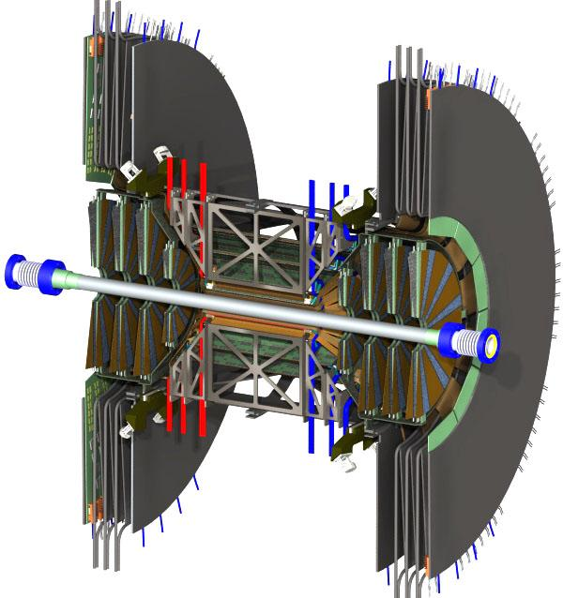
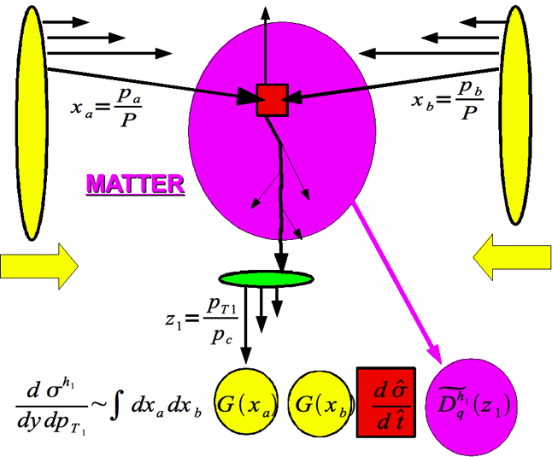
Use RHIC’s key capabilities*
Coupling scale & quasiparticle search
  charm hard(not thermal) probe @ RHIC
  c vs. b in QGP
parton-plasma interaction
  Jets ≤ 50 GeV, γ-jet
  E_{jet}, l, q_{mass}, angle dep. of dE/dx
  Jet virtuality ~ medium scale
Screening length
  study as function of √s, p_{T}, r_{onium}
Thermalization mechanism
  γ_{dir} yield, spectra & flow
QCD in cold, dense (initial) state
  y dependence in d+Au
  Gluon saturation scale?
  EIC
Au+Au
Cu+Au
U+U
*In the era of Pb+Pb at the LHC

Slide 30
Suprising behavior of jets in d+Au
Central
Peripheral
Enhancement in peripheral, slight suppression in central
Surprisingly strong centrality dependence in nuclear PDFs
Competing cold nuclear matter effects? Auto-correlations between high p_{T} processes & centrality measure?

Slide 31
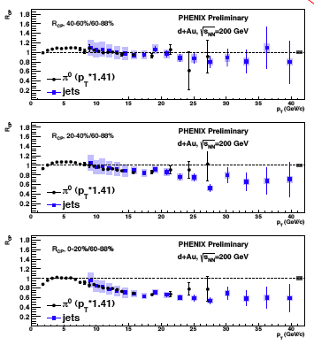
Do the π⁰ and jets agree?
Scale π⁰ by 1/0.7
  i.e. 1/<Z_{leading}>
Agreement is excellent
R_{cp} shows strong
centrality dependence
Autocorrelation?
How does the presence of a jet with p_{T}>10 GeV/c modify definition of a “peripheral d+Au collision”?

Slide 32
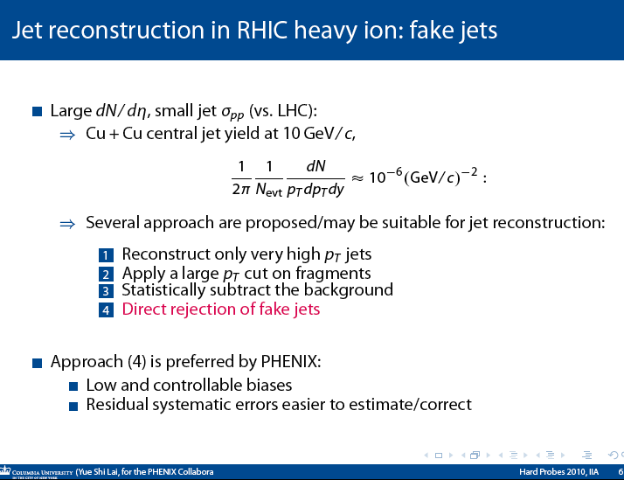
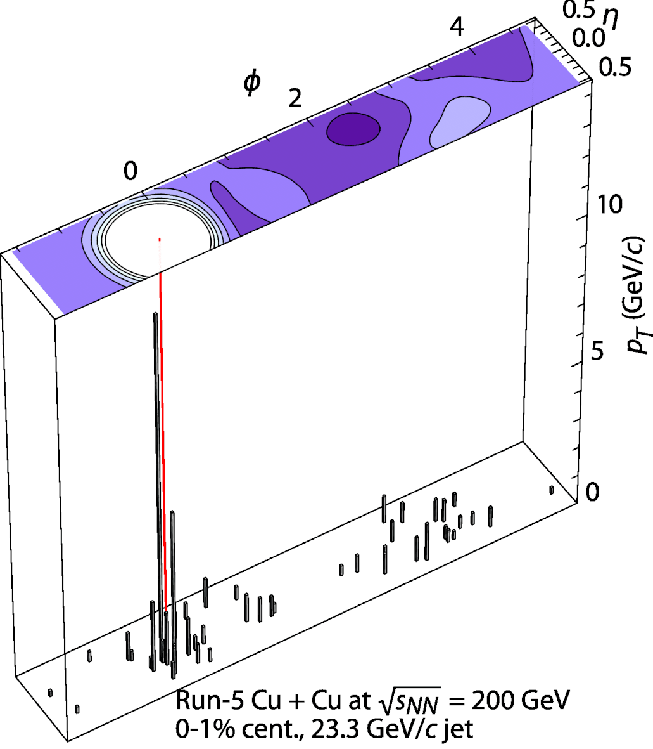

Slide 33
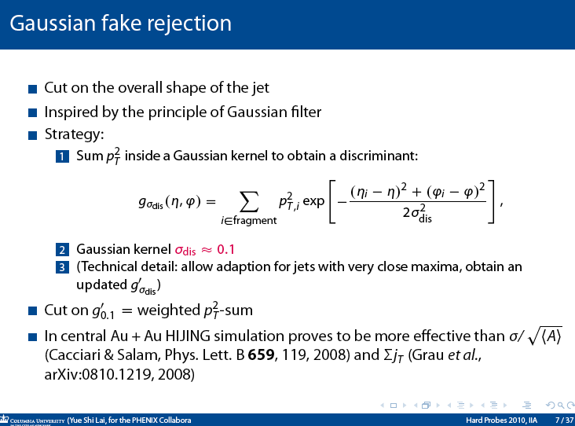
Key issue is event-to-event fluctuations!

Slide 34
