Slide 1
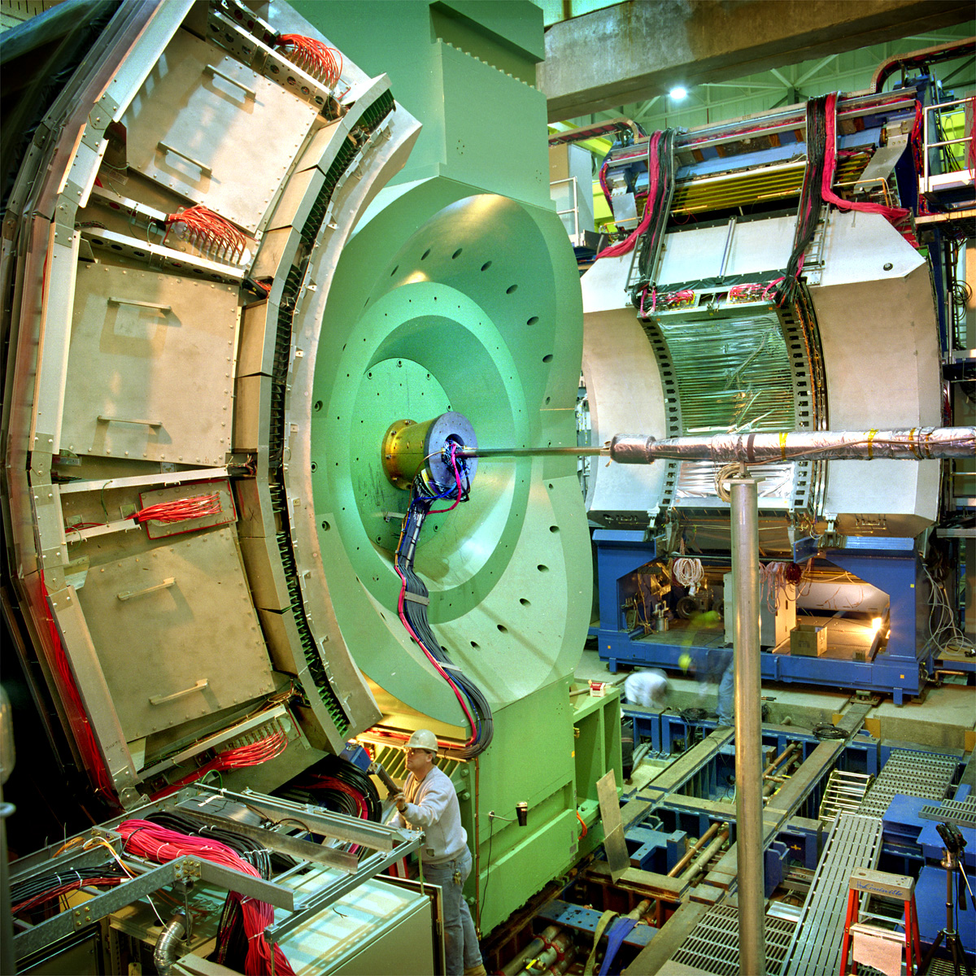
PHENIX studies of correlations and the initial state in d+Au collisions at RHIC
Barbara Jacak
For the PHENIX Collaboration
2nd Workshop on Initial Fluctuations and Final Correlations
Chengdu, China
August 13, 2013

Slide 2
Outline
Hadron correlations in d+Au
  Flow in d+Au?*
Heavy flavor production
  Quarkonia
  Open heavy flavor
  Saturation, shadowing, anti-shadowing, parton energy loss, parton (re)scattering in cold nuclear matter
Direct photons
  Nuclear gluon distribution
* With thanks to Anne Sickles & Shengli Huang

Slide 3
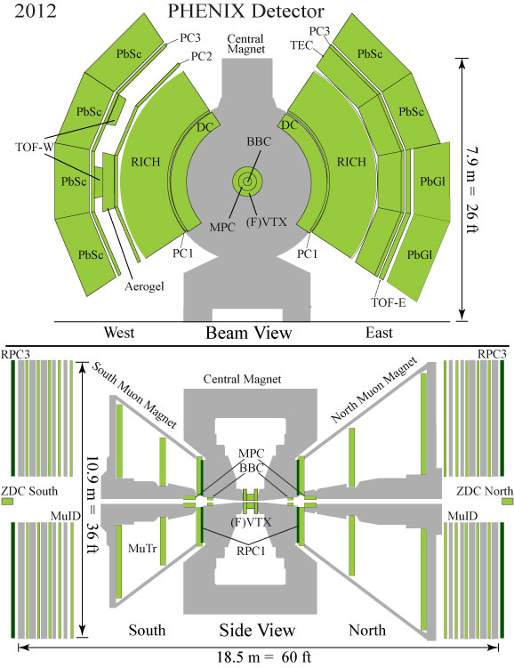
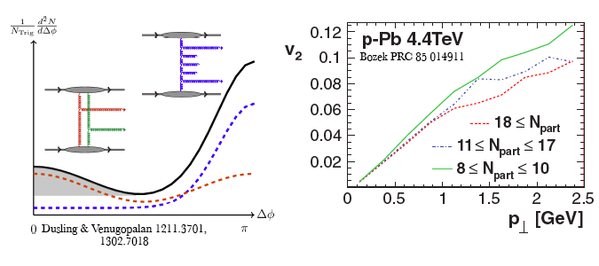
Di-hadrons in d+Au: initial or final state effect?
Jet correlations
  High p_{T:} maximize jet signal/minimize combinatorial bkgd
  Near side/same jet produces small Δη correlation
Correlations in underlying event
  ≥1 low p_{T} particle for sensitivity to underlying event
  Select maximum Δη
  In PHENIX central arms: 0.48 < |Δη| < 0.7
  MPC-central correlations: 3.0 < |Δη| < 4.0

Slide 4
Di-hadrons in the central arms
  0.48 < |Δη| < 0.7
Central - peripheral to remove remaining jet
Looks awfully flow-like!
Opposite sign enhances jet contribution; subtraction works!

Slide 5
Fourier coefficients & v₂ value
Extract v₂ using factorization:
C₂(p_{Ta}, p_{Tb})= v₂(p_{Ta}) v₂(p_{Tb})
v₂ > v₂ at LHC
ε₂ d+Au > ε₂ p+Au
v₂ agrees with hydro
v₃ ~ 0

Slide 6
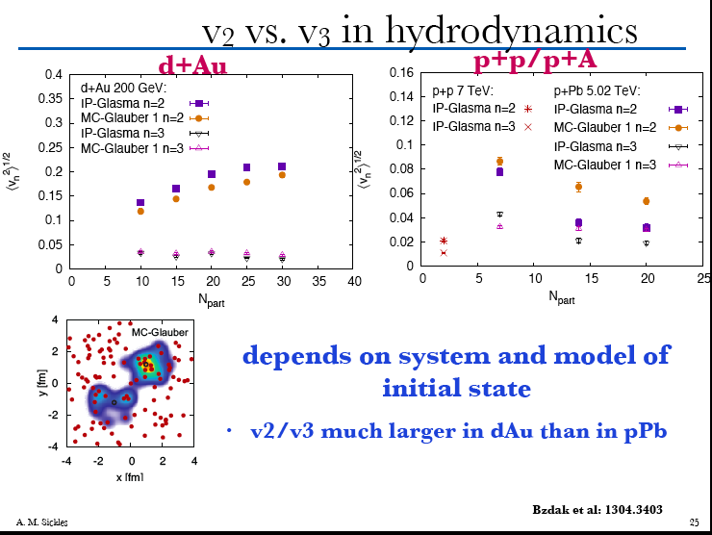

Slide 7
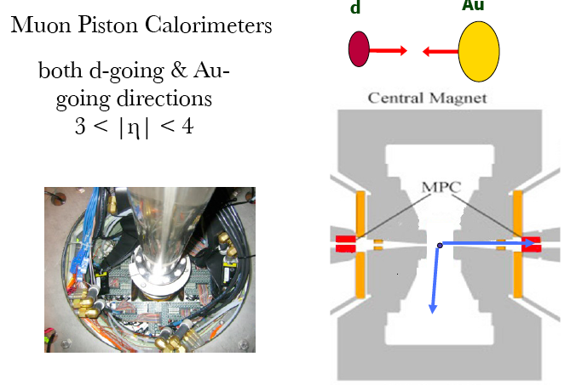
Use larger rapidity gap to ensure no jets
Look at E_{T} ≥ 300 MeV/c clusters
partner
trigger

Slide 8
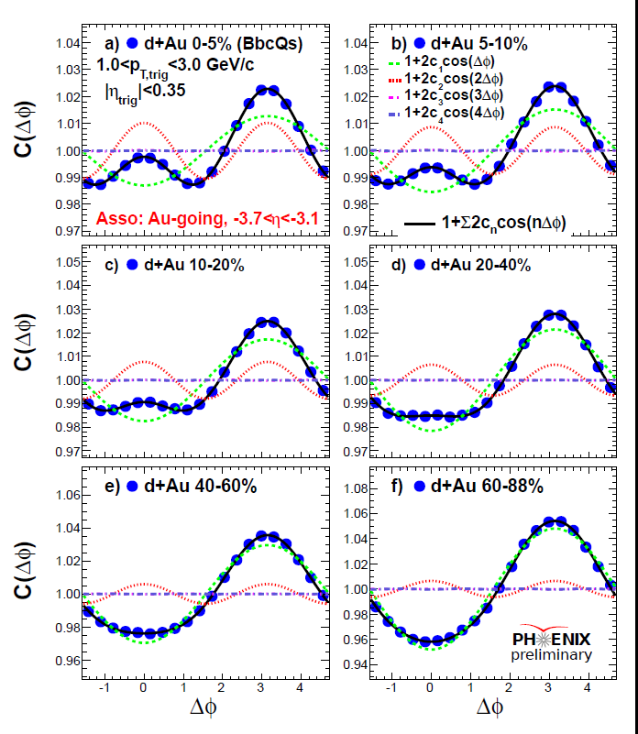
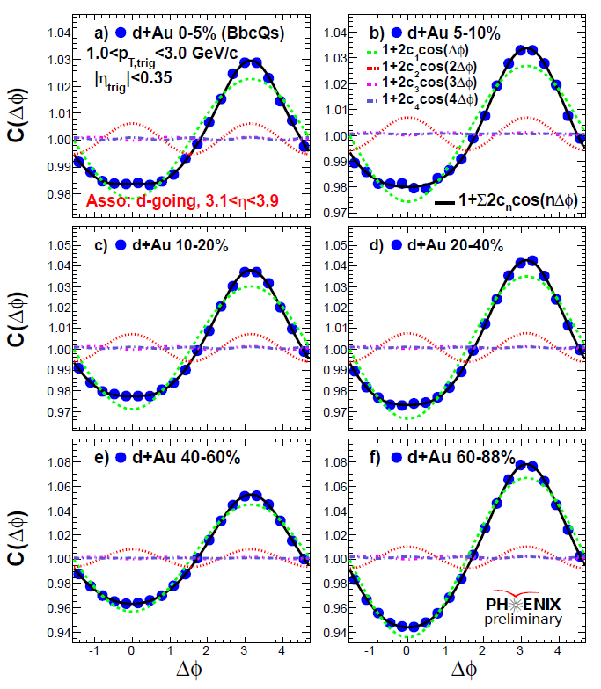
Long range correlations in d+Au at RHIC!
centrality
  real effect – not remnant jets

Slide 9
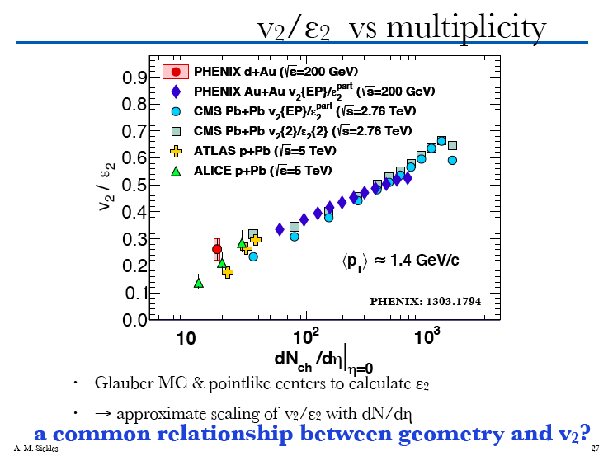
Returning to central-central:

Slide 10
Might systematic effects confuse us?
BVJ: I’d expect difference in viscous effects in d+Au vs. Au+Au to modify the scaling. Data might have room for that?

Slide 11


Switching gears
J/ψ ➔

Slide 12
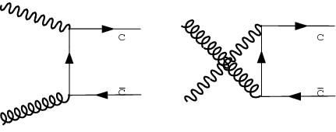
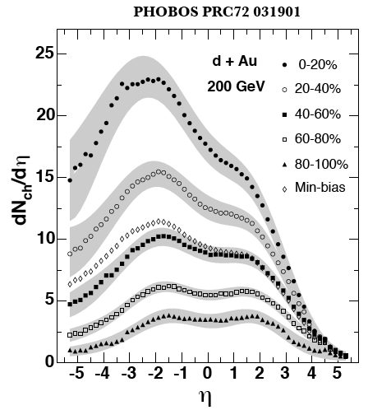
Heavy Flavor
Production of c+cbar and b+bbar
  Probes nuclear gluon distribution in d+Au
  initial state effects:
  saturation
  shadowing, anti-shadowing
  parton energy loss
  parton (re)scattering
  quarkonia, open heavy flavor
Quarkonia survival probability
  Sensitive to surrounding
  medium in d+Au
  J/ψ vs. ψ’ vs. Υ

Slide 13
Initial State: what’s where?
Au
Forward + y
d-going
Backward - y
Au-going
d
8/13/12
Au

Slide 14
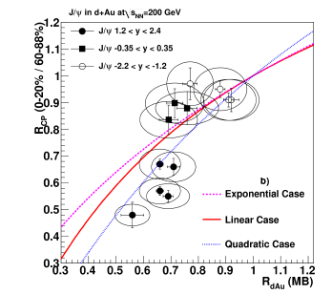
J/ψ in d+Au
PRL107, 142301 (2011)
forward rapidity probes low-x in Au
saturation predicts suppression
forward data: non-linear suppression vs. density weighted longitudinal thickness
EPS09 nPDF’s: linear
break-up w/fixed σ_{br}: exponential
data: ~quadratic
increased suppression at forward rapidity also expected from initial state parton energy loss…
Centrality dependence
Suppression level

Slide 15
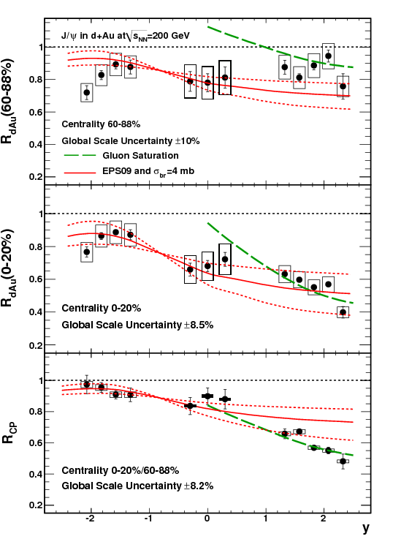
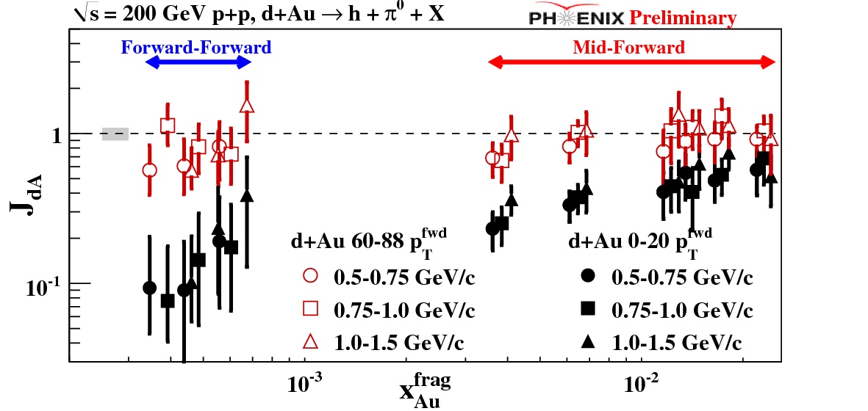
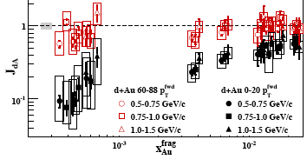
Dense gluonic matter effects observed
PRL107, 142301 (2011)
PRL107, 172301 (2011)
Di-hadron suppression at low x
pocket formula (for 2➔2):
Shadowing/absorption stronger than linear w/nuclear thickness
As expected for CGC …

Slide 16
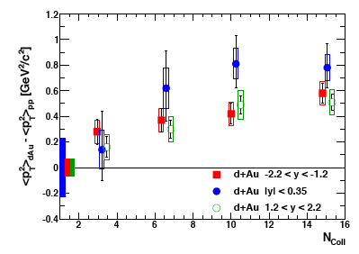
Shadowing, breakup & Cronin effect
PRC87, 034911 (2013)
J/ψ
p_{T} broadens (multiple scattering) w/N_{coll}; effect stronger at y=0
J/ψ suppression to higher p_{T} @ mid & forward y (lower x in Au);
R_{dA}>1 at high p_{T} backward (Cronin effect in Au nucleus )
p_{T}, y, centrality dependence was not reproduced by the models

Slide 17
but
Arleo, et al 1304.090
coherent parton energy loss and p_{T} broadening is consistent with data!
ˆq₀ = 0.075 GeV²/fm
Saturation: better rapidity dependence
(for min bias, p_{T} integrated J/ψ)

Slide 18
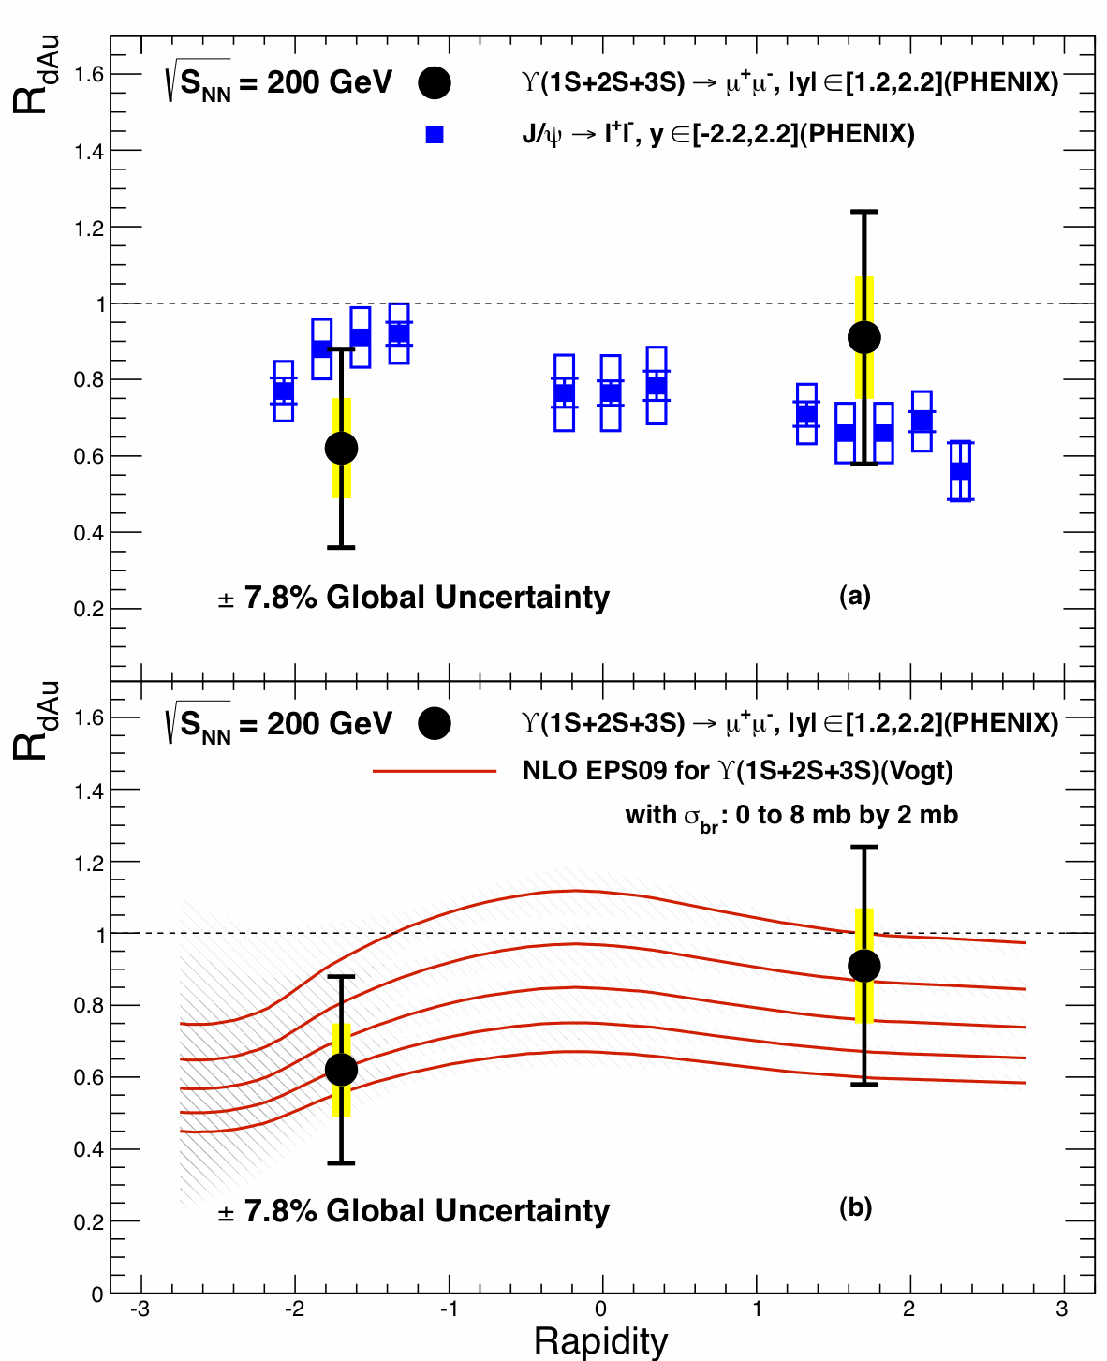
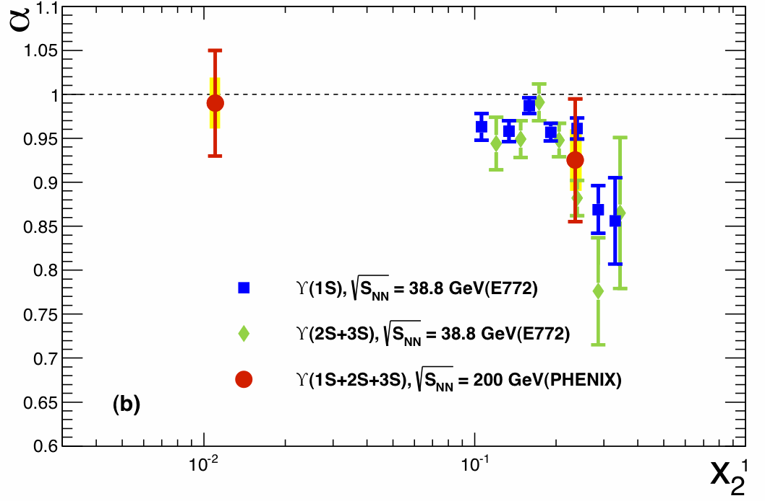
Smaller, more tightly bound probe
PRC87, 044909 (2013)
Hard to quantify comparison
Υ in line with data at lower √s
Consistent with EPS09 shadowing + some nuclear breakup (recall: backward rapidity = Au-going)

Slide 19
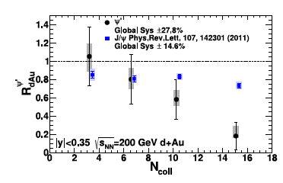
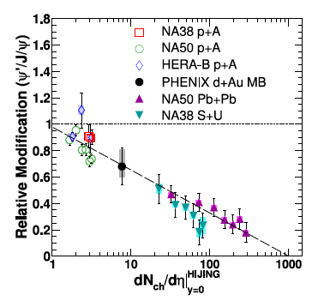
Larger, less tightly bound ψ’
arXiv: 1305.5516
Clearly more suppressed than J/ψ
Cannot be shadowing or parton energy loss
  These are initial state effects
ψ’/ J/ψ decreases linearly with dN_{ch}/dη
Break-up of some sort!
  early or late?

Slide 20
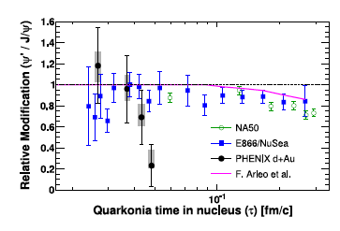
√s dependence is a key tool!
Time in nucleus is short at √s = 200 GeV
  Shorter than bound state formation time! Late final state effect?
Suppression vs. dN_{ch}/dη suggests breakup by comoving hadrons
  dN_{ch}/dη=15 in central d+Au; ψ’ easier to break up than J/ψ (R. Vogt)

Slide 21
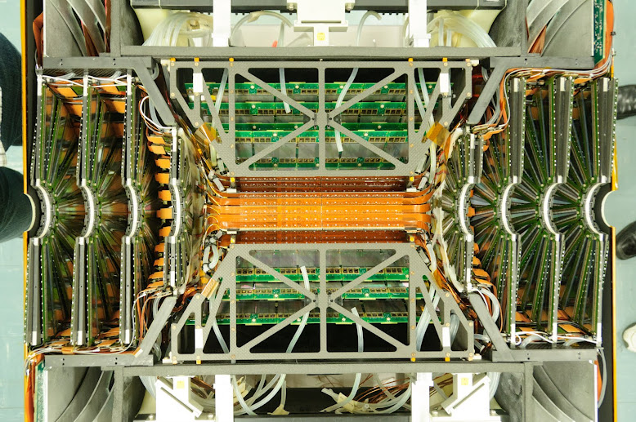
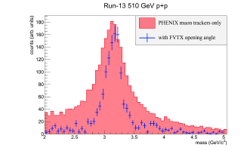
Rapidity dependence is coming
Forward vertex detector FVTX
improves mass resolution ➔
Ψ’ at forward rapidity!

Slide 22
Open heavy flavor
  PHENIX measures:
  non-photonic single leptons
  intermediate mass lepton pairs
Clear enhancement in Au-going direction sensitive to high-x in Au (Anti-shadowing regime)
Suppression in d-going direction sensitive to low-x (shadowing)
Enhancement also at mid-rapidity

Slide 23
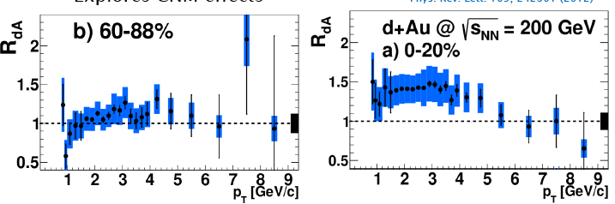
At mid-rapidity
PRL109, 242301 (2012)
R_{dA}=1 for peripheral collisions
Enhancement at low p_{T} in central collisions
  Recall J/ψ p_{T} evidence for parton multiple scattering
  “classic” reason for Cronin Effect

Slide 24
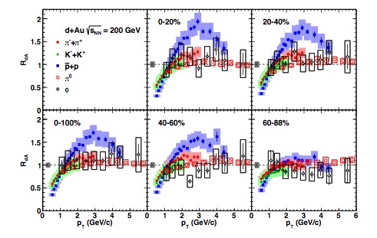
NB: Classic does not always mean right!
👿 “old” problem with “Cronin effect = parton multiple scattering”
  How does the parton know it will produce a proton?

Slide 25
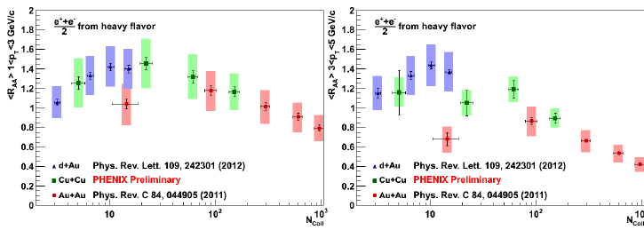
<R_{AA}> vs. Ncoll
Enhancement in cold nuclear matter
Then suppression in hot medium in A+A
NB: CNM effects influence final state correlations!

Slide 26
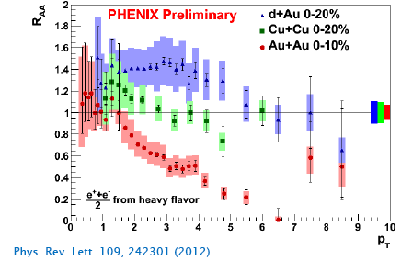
Should take both into account!
PRC84, 044905 (2011)
👿 CNM baseline differs for π⁰ & e±

Slide 27
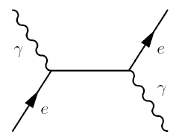
γ_{direct} in d+Au
No modification of direct photons in initial hard scattering and PDF compared to p+p at mid-rapidity

Slide 28
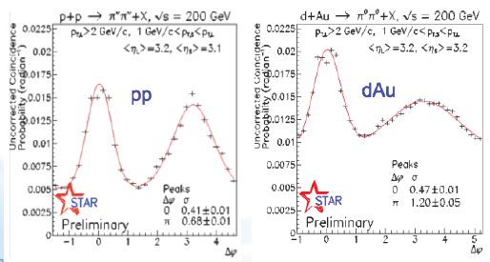
Initial State: shadowed or CGC?
Dilute parton system (deuteron)
P_{T} is balanced by many gluons
Dense gluon
field (Au)
Use direct photons!

Slide 29
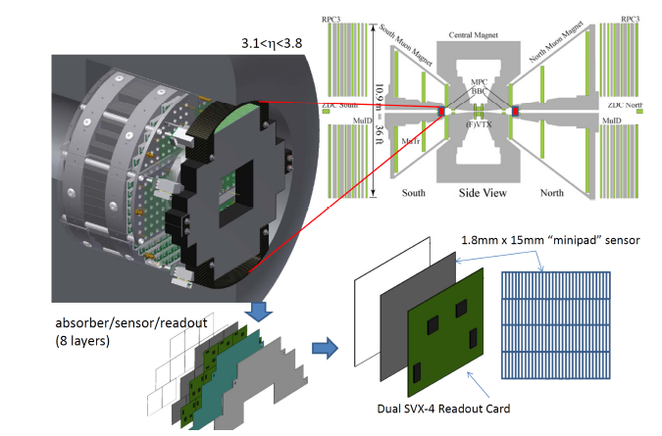
MPC-EX upgrade
3.1 < η < 3.8
Reconstruct prompt γ and π⁰ to 80 GeV: low & high x!

Slide 30
Will measure p+A in 2015
MPC-EX preshower: γ vs. π⁰ decay
Substantially improve nPDFs!
  to x ~ 10⁻³ and also at high x
2-4 weeks running per species

Slide 31
Conclusions
Di-hadron correlations look hydrodynamic at RHIC
  As at LHC. v₂/ε₂ slope vs. dN/dy reflects viscous effects?
Evidence for (expected) shadowing & antishadowing
  Suppression of J/ψ and di-h beyond shadowing at low x!!
Heavy Flavor indicates
  parton multiple scattering (Cronin effect)
  parton energy loss; interplay w/other initial state effects?
  sensitivity to fluctuations? Impact on correlations!
  final state effects break up quarkonia, too
Cronin effect: modifies charm suppression in A+A!
No strong evidence for direct photon modification at mid-y
  Need forward rapidity to probe low-x and pin down nPDFs
NEED data vs. y, p_{T}, centrality, √s, species to sort it all out!

Slide 32
Backup slides

Slide 33
Control the geometry:
³He + Au
increase the triangularity of the initial state! what happens to v3?
d+Au & He³+Au in 2015
increased acceptance relative to previous d+Au run (VTX/FVTX)
compare with p+A

Slide 34
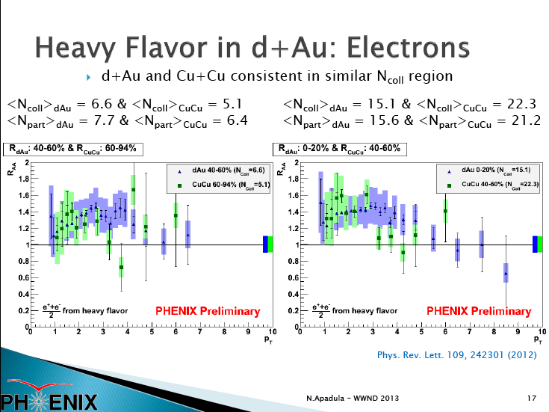

Slide 36
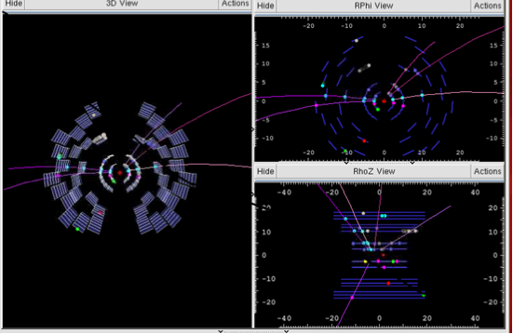
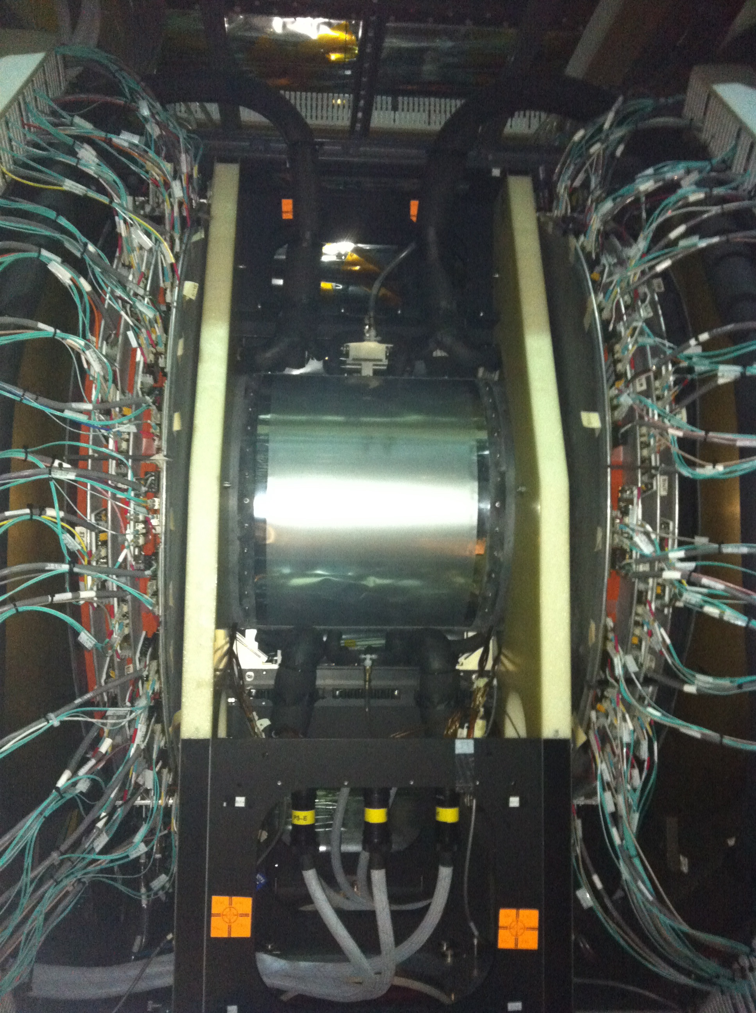
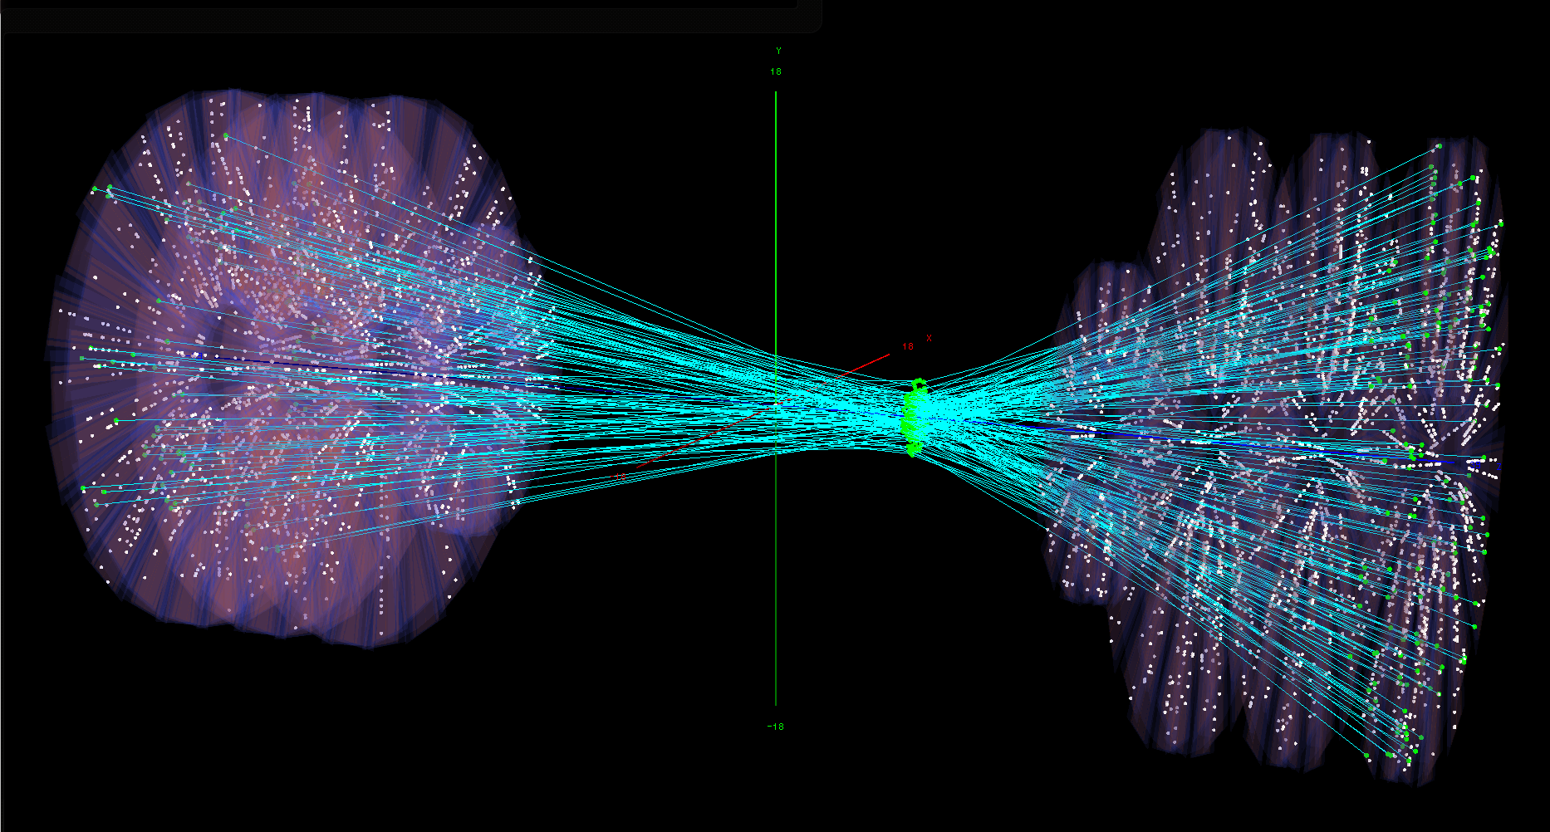
VTX & FVTX

Slide 37
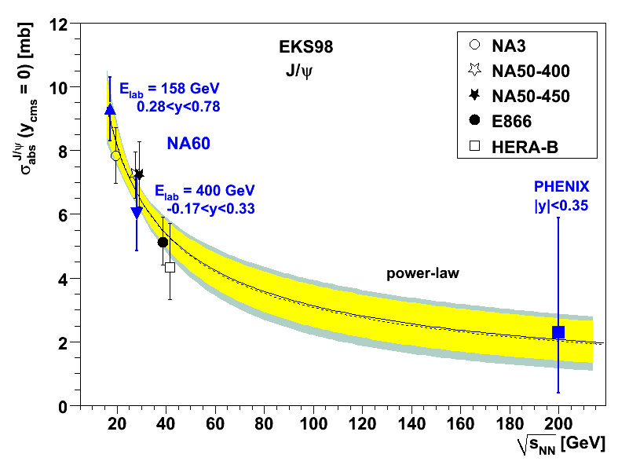
NEED y, p_{T}, b, √s, species to understand J/ψ
Shadowing, etc. in CNM
Suppression
Cold matter
“effective absorption”
√s
Final state recombination
Screening in QGP
Suppression
Suppression
√s
√s

Slide 38
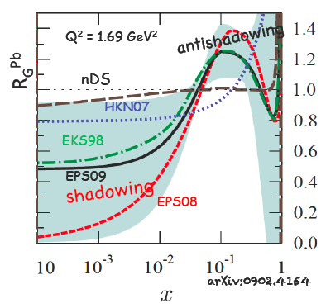
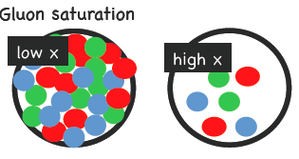
The big question in p+A physics
Then (the pre-RHIC era):
  What do subsequent p-nucleon collisions in p+A have to do with one another?
Now (the RHIC and LHC era):
  What do gluons at small x inside a nucleus have to do with one another?

Slide 39
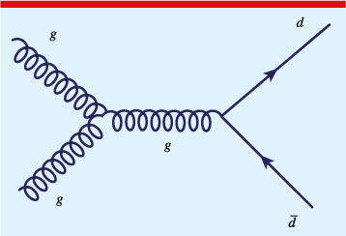
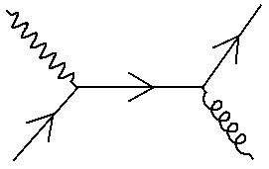
To answer this: PHENIX studies
Heavy flavor production:
  g+g ➔ c + cbar
Jet and di-jet production:
  g+g ➔ di-jet
Direct photon production:
  (QCD Compton process)
  q+g ➔ γ + hadrons

Slide 40
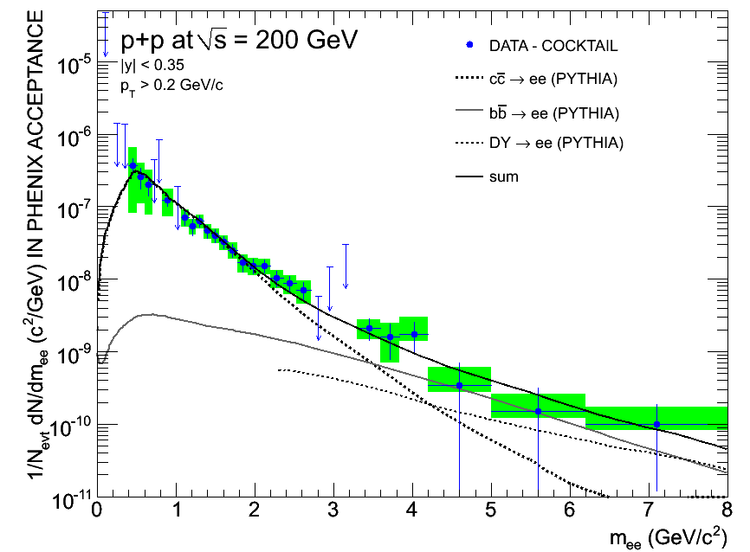
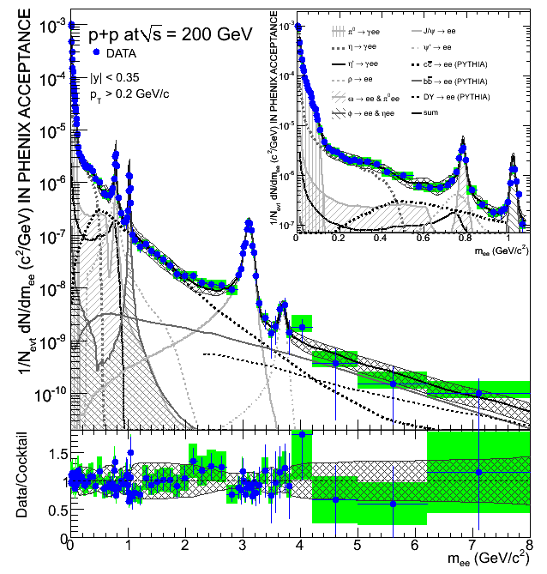
Another handle: di-electrons
PLB 670, 313 (2009)
p+p
σ_{charm} in p+p: 544μb ±39(stat)
±142(syst) ± 200 (model)
σ_{bot}: 3.9μb ±2.5(stat) ⁺³₋₂(syst)

Slide 41
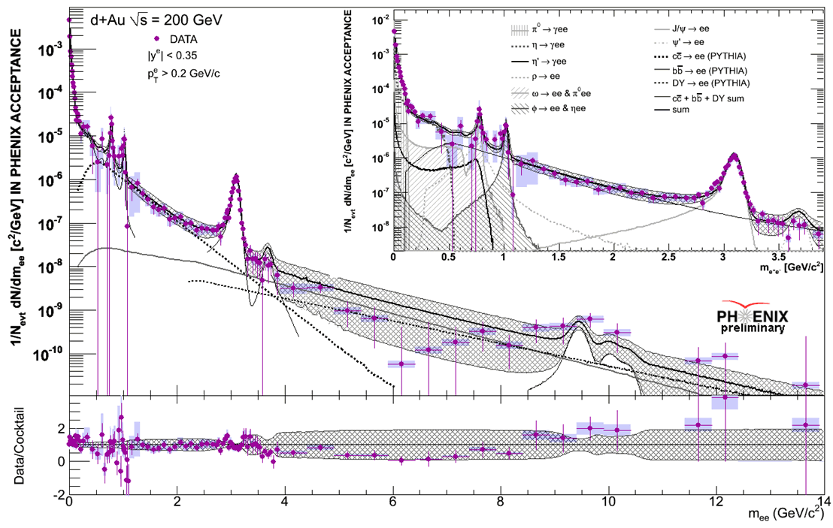
Di-electrons in d+Au

Slide 42
Good statistics in d+Au 2008 run
differential distributions in mass and p_{T}!

Slide 43
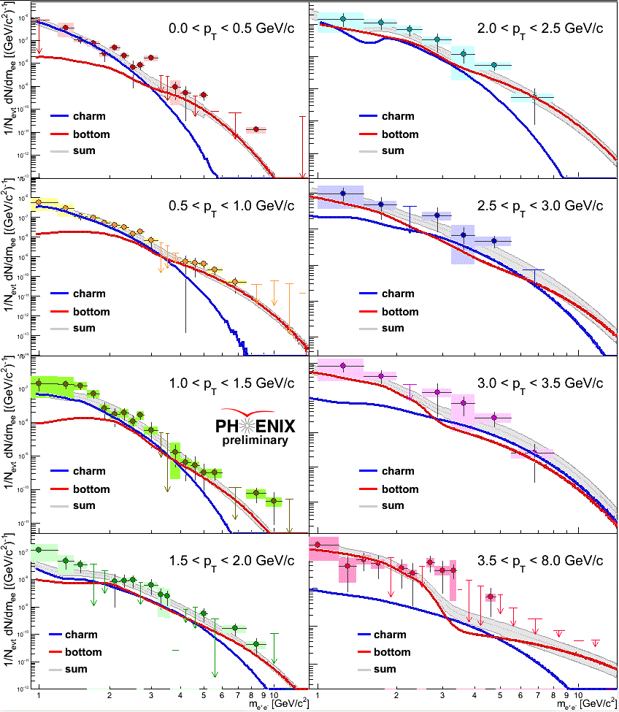
Separate charm and bottom
Charm dominates
b dominates

Slide 44
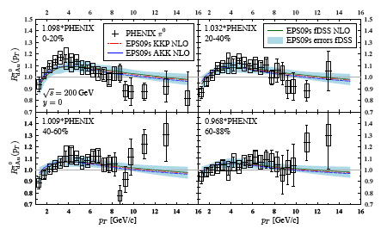
Turn now to jets and direct photons
arXiv 1205.5359
Hellenius, Eskola, et al
Fit data, including PHENIX π⁰ R_{dAu}
Get b-dependent
nPDFs

Slide 45
Suprising behavior of jets in d+Au
Central
Peripheral
Enhancement in peripheral, slight suppression in central
Surprisingly strong centrality dependence in nuclear PDFs
Competing cold nuclear matter effects? Auto-correlations between high p_{T} processes & centrality measure?

Slide 46
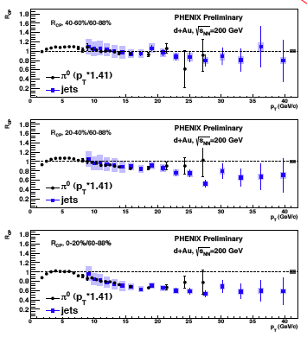
Do the π⁰ and jets agree?
Scale π⁰ by 1/0.7
  i.e. 1/<Z_{leading}>
Agreement is excellent
R_{cp} shows strong
centrality dependence
Autocorrelation?
How does the presence of a jet with p_{T}>10 GeV/c modify definition of a “peripheral d+Au collision”?

