Slide 1
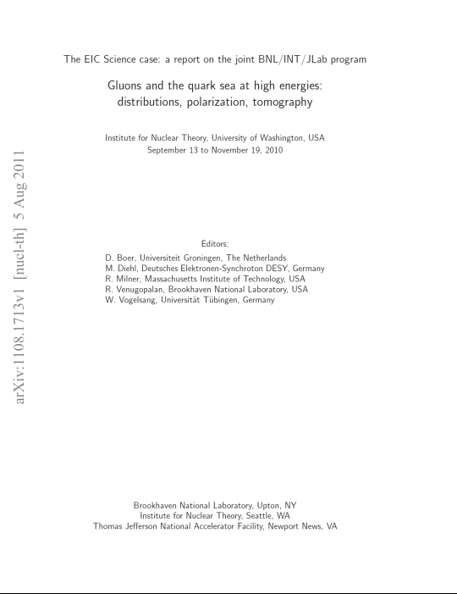
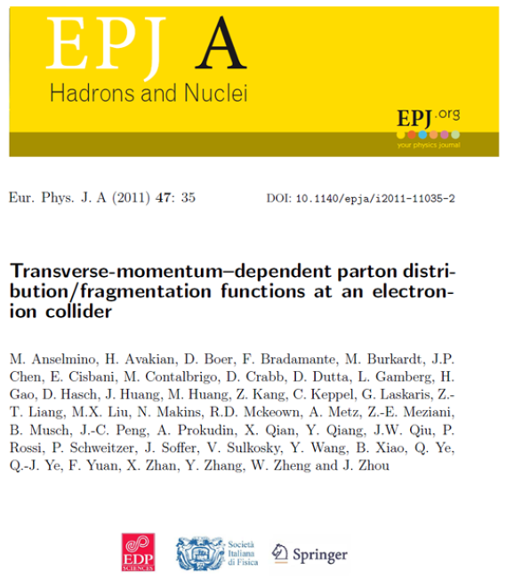


EIC Physics Goals
“A view from Jefferson Lab”
+ a few slides on the accelerator/interaction region efforts
Rolf Ent – Jefferson Lab
PHENIX Workshop, September 9th 2011

Slide 2
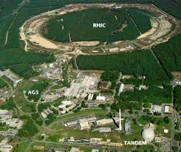


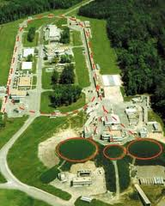
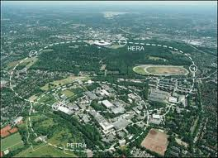
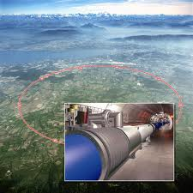
Electron Ion Colliders on the World Map
RHIC ➔ eRHIC
FAIR ➔ ENC
CEBAF ➔ MEIC
HERA
LHC ➔ LHeC

Slide 3
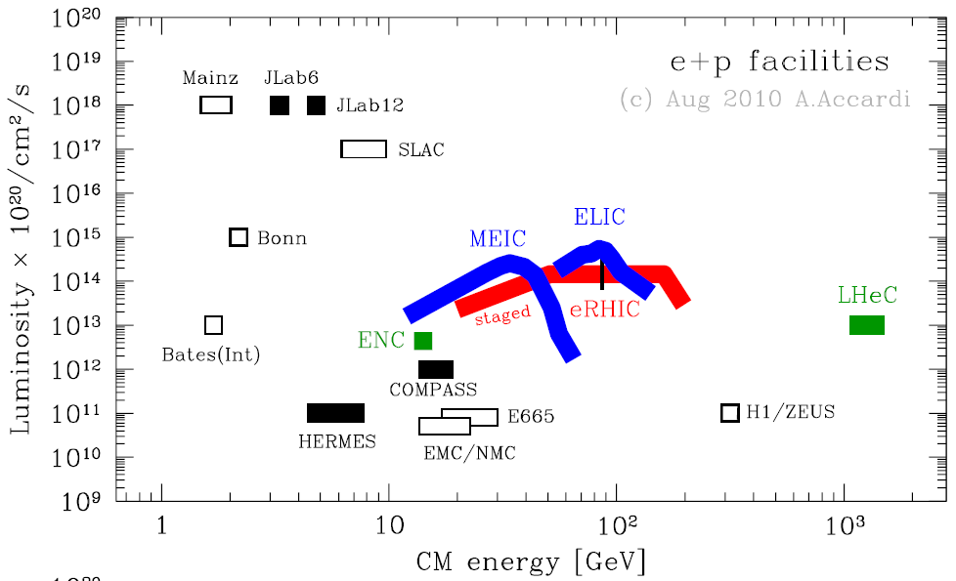
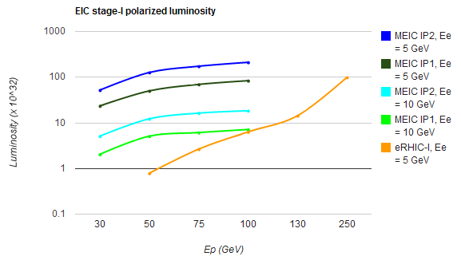
EIC: Critical Capabilities
Base EIC Requirements per Executive Summary INT Report:
    range in energies from s ~ 400 to s ~ 5000 & variable
    fully-polarized (>70%), longitudinal and transverse
    ion species up to A = 200 or so
    high luminosity: about 10³⁴ e-nucleons cm⁻² s⁻¹
    multiple interaction regions
    upgradable to higher energies
Input passed on to INT10-03 program:
But we get there in different ways:
JLab science point of view:
High luminosity at appropriate s and
proton energy, over large range
t range of 0-2 should not correspond
to infinitesimally small angles
→ Minimize reliance on Roman Pots
full acceptance of detector (do not
hit peak fields in focusing quads)
Ease of particle identification
Ease of polarized beam
Luminosity x 10³²/cm²/s

Slide 4
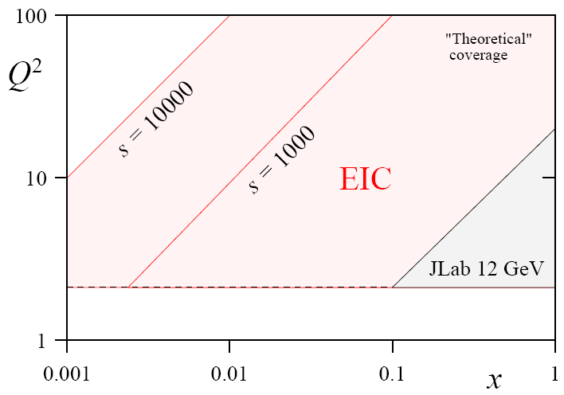
JLab assumptions on EIC
s
x = Q²/ys
s
(x,Q²) phase space directly correlated with s (=4E_{e}E_{p}) :
@ Q² = 1 lowest x scales like s⁻¹
@ Q² = 10 lowest x scales as 10s⁻¹
C. Weiss
Detecting only the electron y_{max} / y_{min} ~ 10
Also detecting all hadrons y_{max} / y_{min} ~ 100
C. Weiss
(“Medium-Energy”) EIC@JLab option driven by:
access to sea quarks (x > 0.01 (0.001?) or so)
deep exclusive scattering at Q² > 10 (?)
any QCD machine needs range in Q²
→ s = few 100 - 1000 seems right ballpark
→ s = few 1000 allows access to gluons, shadowing
Requirements for deep exclusive and high-Q² semi-inclusive reactions also drives request for (lower &) more symmetric beam energies.
Requirements for very-forward angle detection folded in IR design

Slide 5
The Science of an EIC
Nuclear Science Goal: How do we understand the visible matter in our universe in terms of the fundamental quarks and gluons of QCD?
Overarching EIC Goal: Explore and Understand QCD
Three Major Science Questions for an EIC (from NSAC LRP07):
What is the internal landscape of the nucleons?
What is the role of gluons and gluon self-interactions in nucleons and nuclei?
What governs the transition of quarks and gluons into pions and nucleons?
Or, Elevator-Talk EIC science goals:
Map the spin and spatial structure of quarks and gluons in nucleons
(show the nucleon structure picture of the day…)
Discover the collective effects of gluons in atomic nuclei
(without gluons there are no protons, no neutrons, no atomic nuclei)
Understand the emergence of hadronic matter from color charge
(how does M = E/c² work to create pions and nucleons?)
+ Hunting for the unseen forces of the universe?

Slide 6
The Physics Program of an EIC
I) Map the spin and spatial structure of quarks and gluons in nucleons
Sea quark and gluon polarization
Transverse spatial distributions
Orbital motion of quarks/gluons
Parton correlations: beyond one-body densities
II) Discover the collective effects of gluons in atomic nuclei
Color transparency: Small-size configurations
Nuclear gluons: EMC effect, shadowing
Strong color fields: Unitarity limit, saturation
Fluctuations: Diffraction
III) Understand the emergence of hadronic matter from color charge
Materialization of color: Fragmentation, hadron breakup, color correlations
Parton propagation in matter: Radiation, energy loss

Slide 7



Beyond form factors and quark distributions –
Generalized Parton and Transverse Momentum Distributions
X. Ji, D. Mueller, A. Radyushkin (1994-1997)
Proton form factors, transverse charge & current densities
Structure functions,
quark longitudinal
momentum & helicity
distributions
Correlated quark momentum
and helicity distributions in
transverse space - GPDs
Extend longitudinal quark momentum & helicity distributions to transverse momentum distributions - TMDs
2000’s

Slide 8
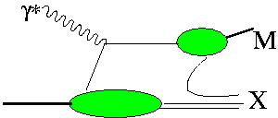
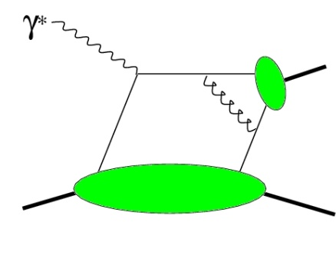
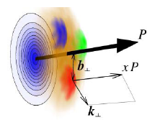
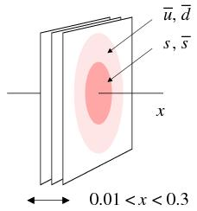
Towards a “3D” spin-flavor landscape
W^{u}(x,k,r)
(Wigner Function)
m
m
d³r
d²k_{T}
p
x
p
TMD
GPD
B
Transverse-Momentum Dependent Parton Distributions
TMD^{u}(x,k_{T})
f₁,g₁,f_{1T} ,g_{1T}
h₁, h_{1T} , h_{1L} , h₁
Link to Orbital Momentum
GPD^{u}(x,ξ,t)
H^{u}, E^{u}, H^{u}, E^{u} + 4“_{T}”s
Link to Orbital Momentum
Generalized Parton Distributions
~
~
Want P_{T} > Λ but not too large!
d²k_{T}
ξ = 0, t = 0
dx
f₁(x)
g₁, h₁
u(x)
Δu, δu
F₁^{u}(t)
F₂^{u},G_{A}^{u},G_{P}^{u}
Parton Distributions
Form Factors

Slide 9
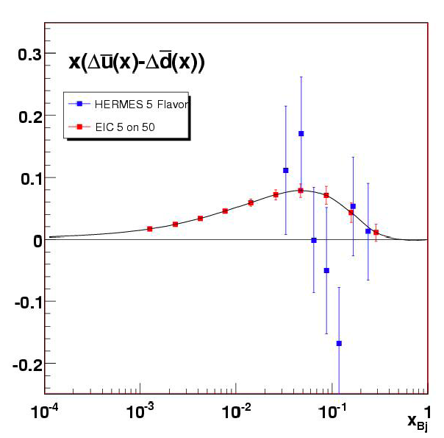
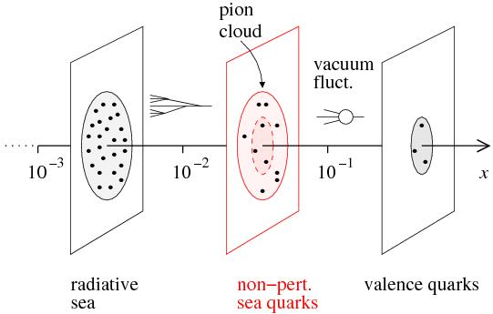
Sea Quark Polarization
Spin-Flavor Decomposition of the Light Quark Sea
}
100 days, L =10³³, s = 1000
Access requires s ~ 1000 (and good luminosity)
Kinney, Seele
u
u
u
Many models predict
Δu > 0, Δd < 0
>
u
d
| p = + + + …
u
u
u
u
d
d
d
d

Slide 10
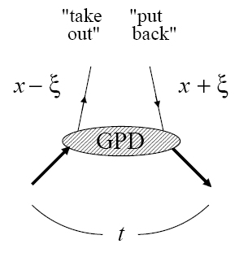
Transverse Quark & Gluon Imaging
Deep exclusive measurements in ep/eA with an EIC:
diffractive: transverse gluon imaging J/ψ, φ, ρº, γ (DVCS)
non-diffractive: quark spin/flavor structure π, K, ρ⁺, …
Are gluons uniformly distributed in nuclear matter or are there small clumps of glue?
Are gluons & various quark flavors similarly distributed?
(some hints to the contrary)
Describe correlation of longitudinal momentum and transverse position of quarks/gluons →
Transverse quark/gluon imaging of nucleon
(“tomography”)

Slide 11
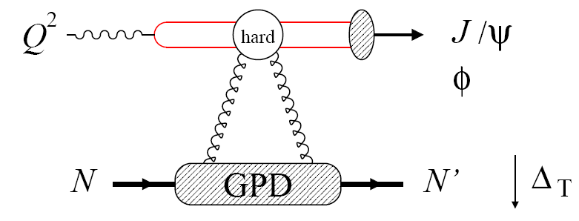
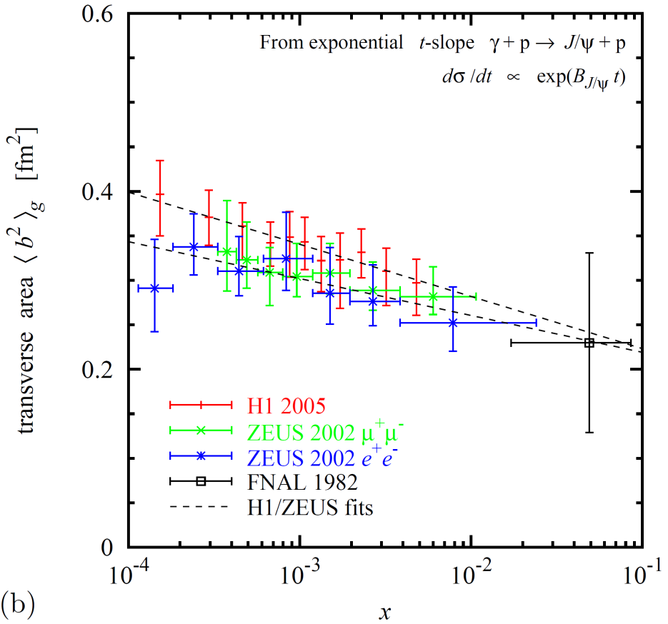
Gluon Imaging with J/Ψ (or φ)
Transverse spatial distributions from exclusive J/ψ, and φ at Q²>10 GeV²
  Transverse distribution directly from Δ_{T} dependence
  Reaction mechanism, QCD description studied at HERA [H1, ZEUS]
Physics interest
  Valence gluons, dynamical origin
  Chiral dynamics at b~1/M_{π}
  [Strikman, Weiss 03/09, Miller 07]
  Diffusion in QCD radiation
Existing data
  Transverse area x < 0.01 [HERA]
  Larger x poorly known [FNAL]
[Weiss INT10-3 report]

Slide 12
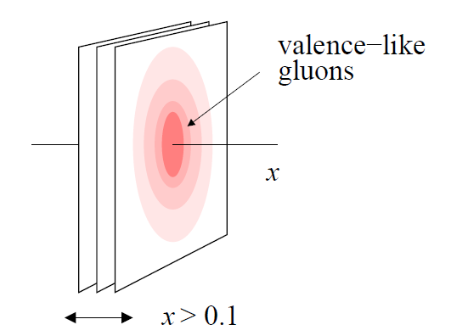

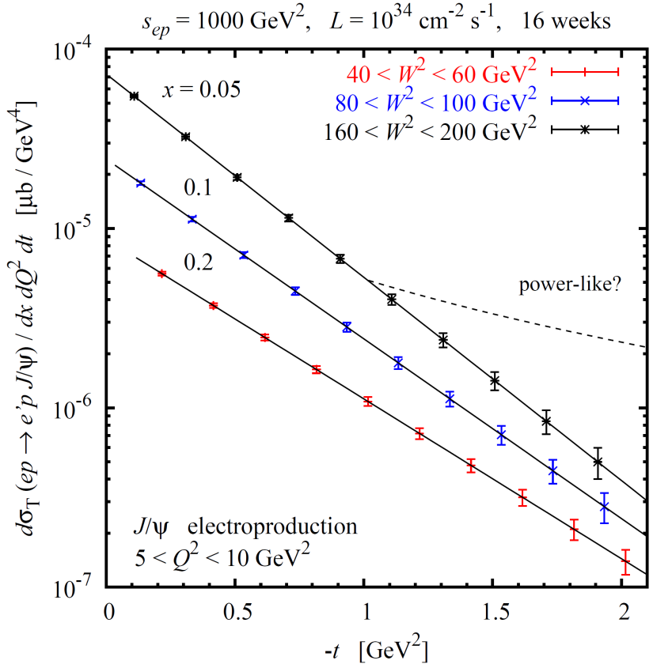
Gluon Imaging: Valence-like Gluons
EIC: Precise Gluon imaging through exclusive J/Ψ and φ (Q² > 10 GeV²)
valence-like gluons
~100 days, ε=1.0, L=10³⁴ s⁻¹cm⁻²
Transverse distribution derived directly from Δ_{T}-dependence
EIC: Map unknown region of non-perturbative gluons at x > 0.01
Needed for imaging
  Full t-distribution to allow Fourier transform, and distinguish e.g. between exponential (solid) and power-like (dashed) fall-off
  Q² > 10 GeV², various channels
1st gluonic images of nucleon @ large x
√s~30 GeV
[Weiss INT10-3 report]

Slide 13
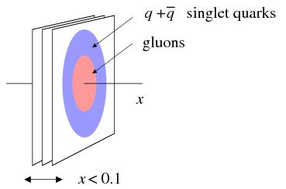
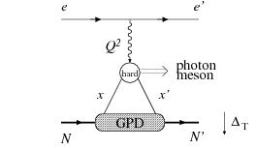
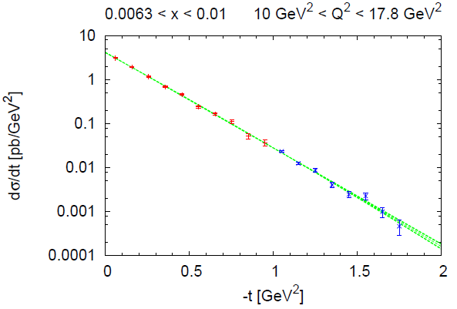
Gluon Imaging: Gluon vs Quark Size
Do singlet quarks and gluons have the same transverse distribution?
Hints from HERA:
Area (q + q) > Area (g)
Dynamical models predict difference:
pion cloud, constituent quark picture
-
EIC: Gluon size from J/Ψ electroproduction,
singlet quark size from deeply virtual
compton scattering
~12 and 150 fb⁻¹, respectively
[Fazio, Aschenauer INT10-03 Report]

Slide 14
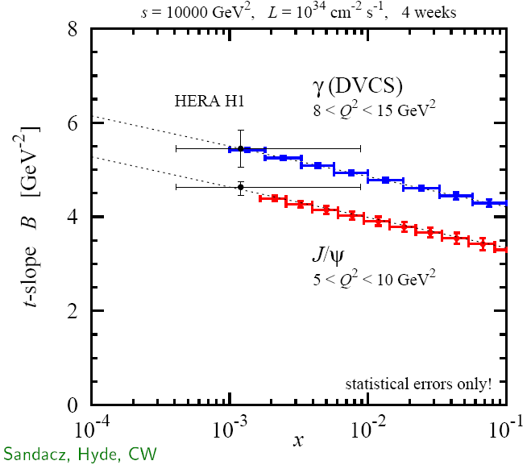
Gluon Imaging: Gluon vs Quark Size
Do singlet quarks and gluons have the same transverse distribution?
Hints from HERA:
Area (q + q) > Area (g)
Dynamical models predict difference:
pion cloud, constituent quark picture
-
EIC: Gluon size from J/Ψ electroproduction,
singlet quark size from deeply virtual
compton scattering
~30 days, ε=1.0, L =10³⁴ s⁻¹cm⁻²
Detailed differential images of nucleon’s partonic structure
√s=100 GeV
[Sandacz, Hyde, Weiss 08+]

Slide 15
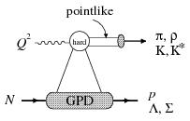
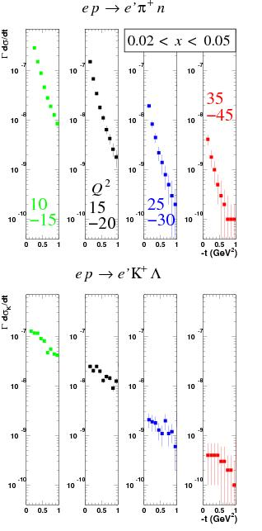
Sea Quark Imaging
Do strange and non-strange sea quarks have the same spatial distribution?
  πN or KΛ components in nucleon
  QCD vacuum fluctuations
  Nucleon/meson structure
~100 days, ε=1.0, L=10³⁴ s⁻¹cm⁻²
Accessible with exclusive π and K production!
Q² > 10(?) GeV² relevant for application of factorization
Statistics hungry
35
-45
Q²
15
-20
25
-30
10
-15
Imaging of strange sea quarks!
√s~30 GeV
[Horn et al. 08+, INT10-3 report]

Slide 16
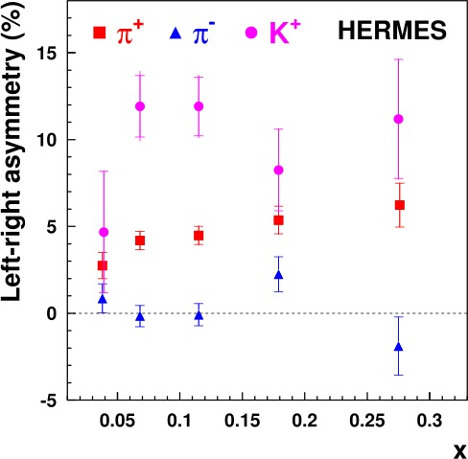
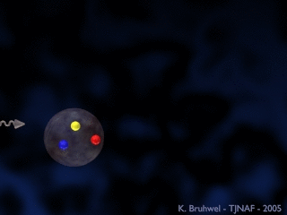
Image the Transverse Momentum of the Quarks
Swing to the left, swing to the right:
A surprise of transverse-spin experiments
The difference between the π⁺, π–, and K⁺ asymmetries reveals that quarks and anti-quarks of different flavor are orbiting in different ways within the proton.
dσ^{h} ~ Σe_{q}²q(x) dσ_{f} D_{f}^{h}(z)
Sivers distribution

Slide 17
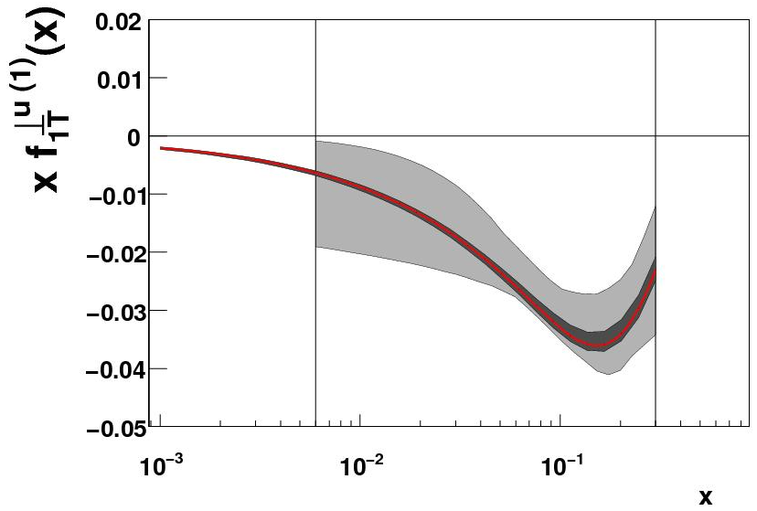
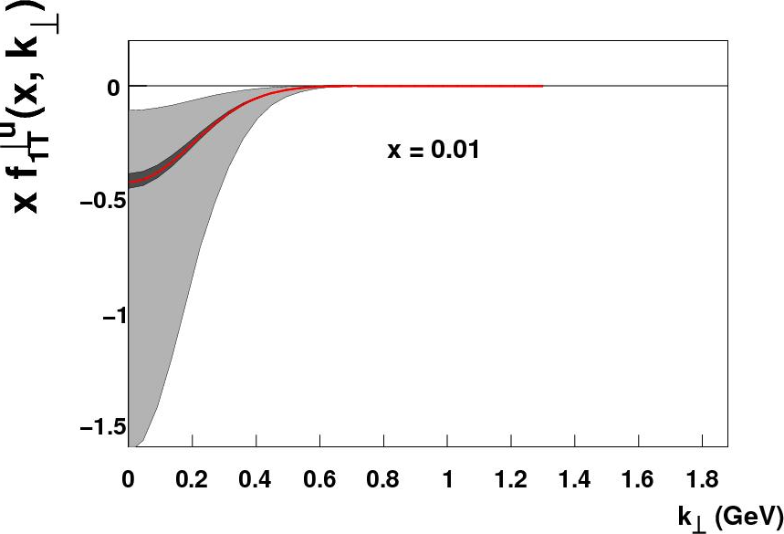
Image the Transverse Momentum of the Quarks
Prokudin, Qian, Huang
Only a small subset of the (x,Q²) landscape has been mapped here: terra incognita
Gray band: present “knowledge”
Red band: EIC (1σ)
(dark gray band: EIC (2σ))
Prokudin
Exact k_{T} distribution presently unknown!
“Knowledge” of k_{T} distribution at large k_{T} is artificial!
(but also perturbative calculable limit at large k_{T})
An EIC with good luminosity & high transverse polarization is the optimal tool to to study this!

Slide 18
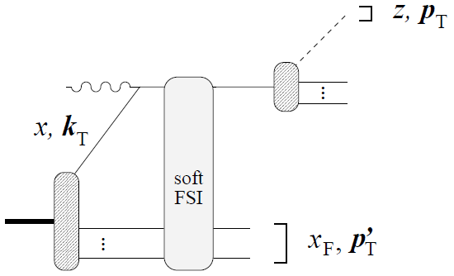
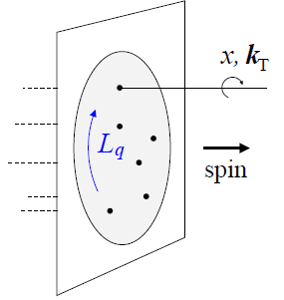
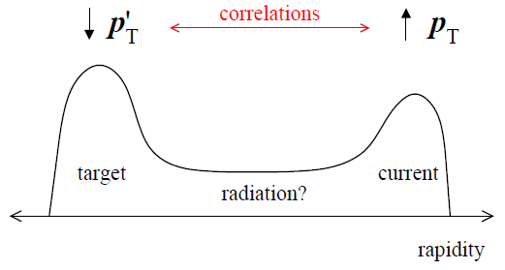
Nucleon Structure: Orbital Motion
Goal: explore quark/gluon orbital motion and its polarization dependence through both deep exclusive and semi-inclusive multi-dimensional processes
Semi-inclusive DIS with p_{T} dependence? But, can not separate intrinsic k_{T} in wave function from soft final-state interactions and fragmentation: TMDs combine intrinsic k_{T} and FSI.
Potential new insight from jets or p’_{T} of target fragmentation?
EIC: wide kinematic range
low to high p_{T}
Can we learn about orbital motion from a comprehensive approach based on TMDs, GPDs, etc., even if model-dependent?

Slide 19
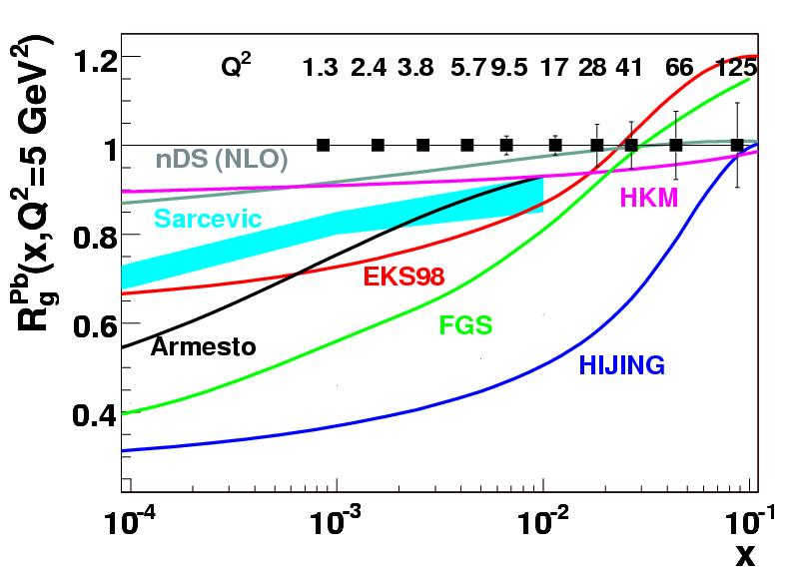
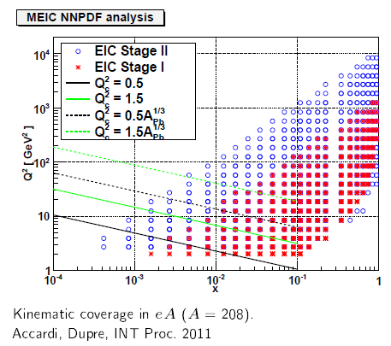
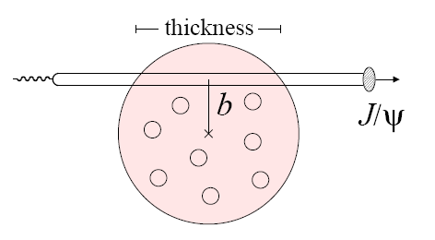
Gluons in Nuclei
What do we know about
gluons in a nucleus?
Ratio of gluons in lead to deuterium
NOTHING!!!
Large uncertainty in gluon distributions
need range of Q² in shadowing region, → x ~ 10⁻²-10⁻³ → s_{EIC} = 1000+
+ Transverse distribution of gluons on light nuclei from coherent Deep-Virtual Compton Scattering and coherent J/Ψ production
Gluon radius of a nucleus?

Slide 20
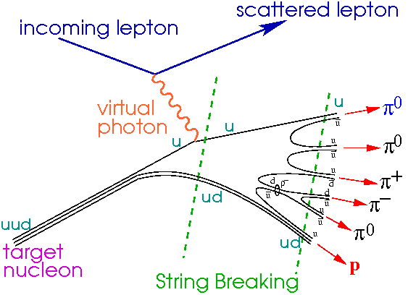
Hadronization
EIC: Understand the conversion of color charge to hadrons through fragmentation and breakup
un-integrated parton distributions
current
fragmentation
+η ∼ 4
EIC
Fragmentation from
QCD vacuum
target
fragmentation
-η ∼ −4
EIC: Explore the interaction of color charges with matter

Slide 21
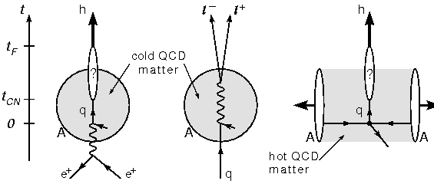
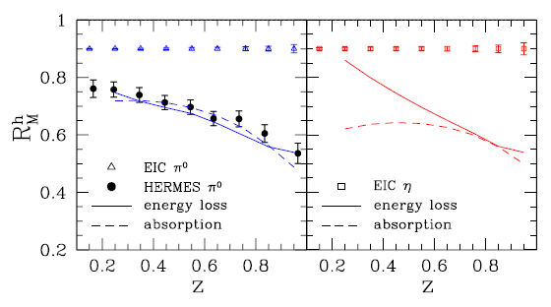
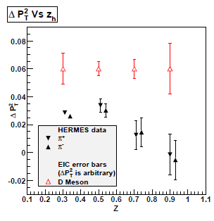
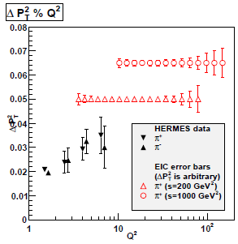
Hadronization: Parton propagation in matter
EIC: Explore the interaction of fast color charges with matter
Time scales for color neutralization
t_{CN} and hadron formation t_{F}
eA/γA complementary to jets in AA:
cold vs. hot matter
EIC: Understand the conversion of color charge to hadrons through fragmentation and breakup
Δp_{T}²
Comprehensive studies possible:
wide range of energy v = 10-100 GeV
→ move hadronization inside//outside nucleus,
distinguish energy loss and attenuation
wide range of Q²: QCD evolution of
fragmentation functions and medium effects
Hadronization of charm, bottom
→ Clean probes with definite QCD predictions
High luminosity
→ Multi-dimensional binning and correlations
s > 1000: jets and their substructure in eA
[Accardi, Dupre INT10-03 Report]

Slide 22
22
22
22
22
22
22
22
22
22
Completed, planned, and possible EIC measurements
“Hunting for the unseen forces of the universe”
Tension!
EIC allows to probe the electro-weak
mixing angle over a wide range of Q

Slide 23
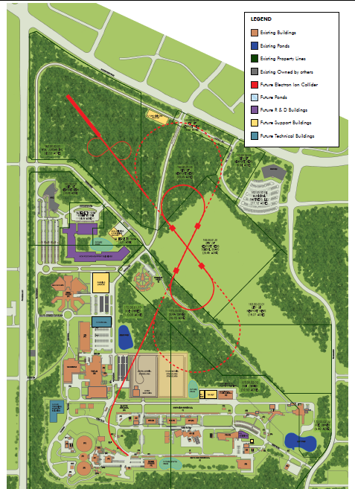
Accelerator Team’s Roadmap
Major Events/Accomplishments
Held an internal machine design review (Sep. 15 & 16, 2010)
Held an internal Workshop on the choice of RF → SRF/750 MHz
Received a grant ($900K) from DOE/NP for MEIC R&D (Nov. 2010)
Held an internal MEIC Ion Complex Design Workshop (Jan. 29 & 30, 2011)
Reported the MEIC machine design in the EICAC Meeting (April 10, 2011)
Completed extended interaction region recertification for Full Acceptance (Sep. 2011)
Ongoing priority: electron cooling design
Planning for 2nd MEIC Internal Accelerator Design Review and 1st Cost Review this Fall

Slide 24
Full Acceptance Detector
7 meters
solenoid
detectors
ion dipole w/ detectors
ion FFQs
0 mrad
IP
ions
50 mrad
electron FFQs
electrons
2+3 m
2 m
2 m
Central detector
Detect particles with angles down to 0.5º before ion FFQs.
Need 1-2 Tm dipole.
Detect particles with angles below 0.5º beyond ion FFQs and in arcs.
Solenoid yoke + Muon Detector
TOF
RICH or DIRC/LTCC
EM Calorimeter
Tracking
RICH
4-5m
HTCC
Muon Detector
Hadron Calorimeter
EM Calorimeter
Very-forward detector
Large dipole bend @ 20 meter from IP
(to correct the 50 mr ion horizontal crossing angle) allows for very-small angle detection (<0.3º)
Solenoid yoke + Hadronic Calorimeter
2m
3m
2m
Notes:
24
24

Slide 25
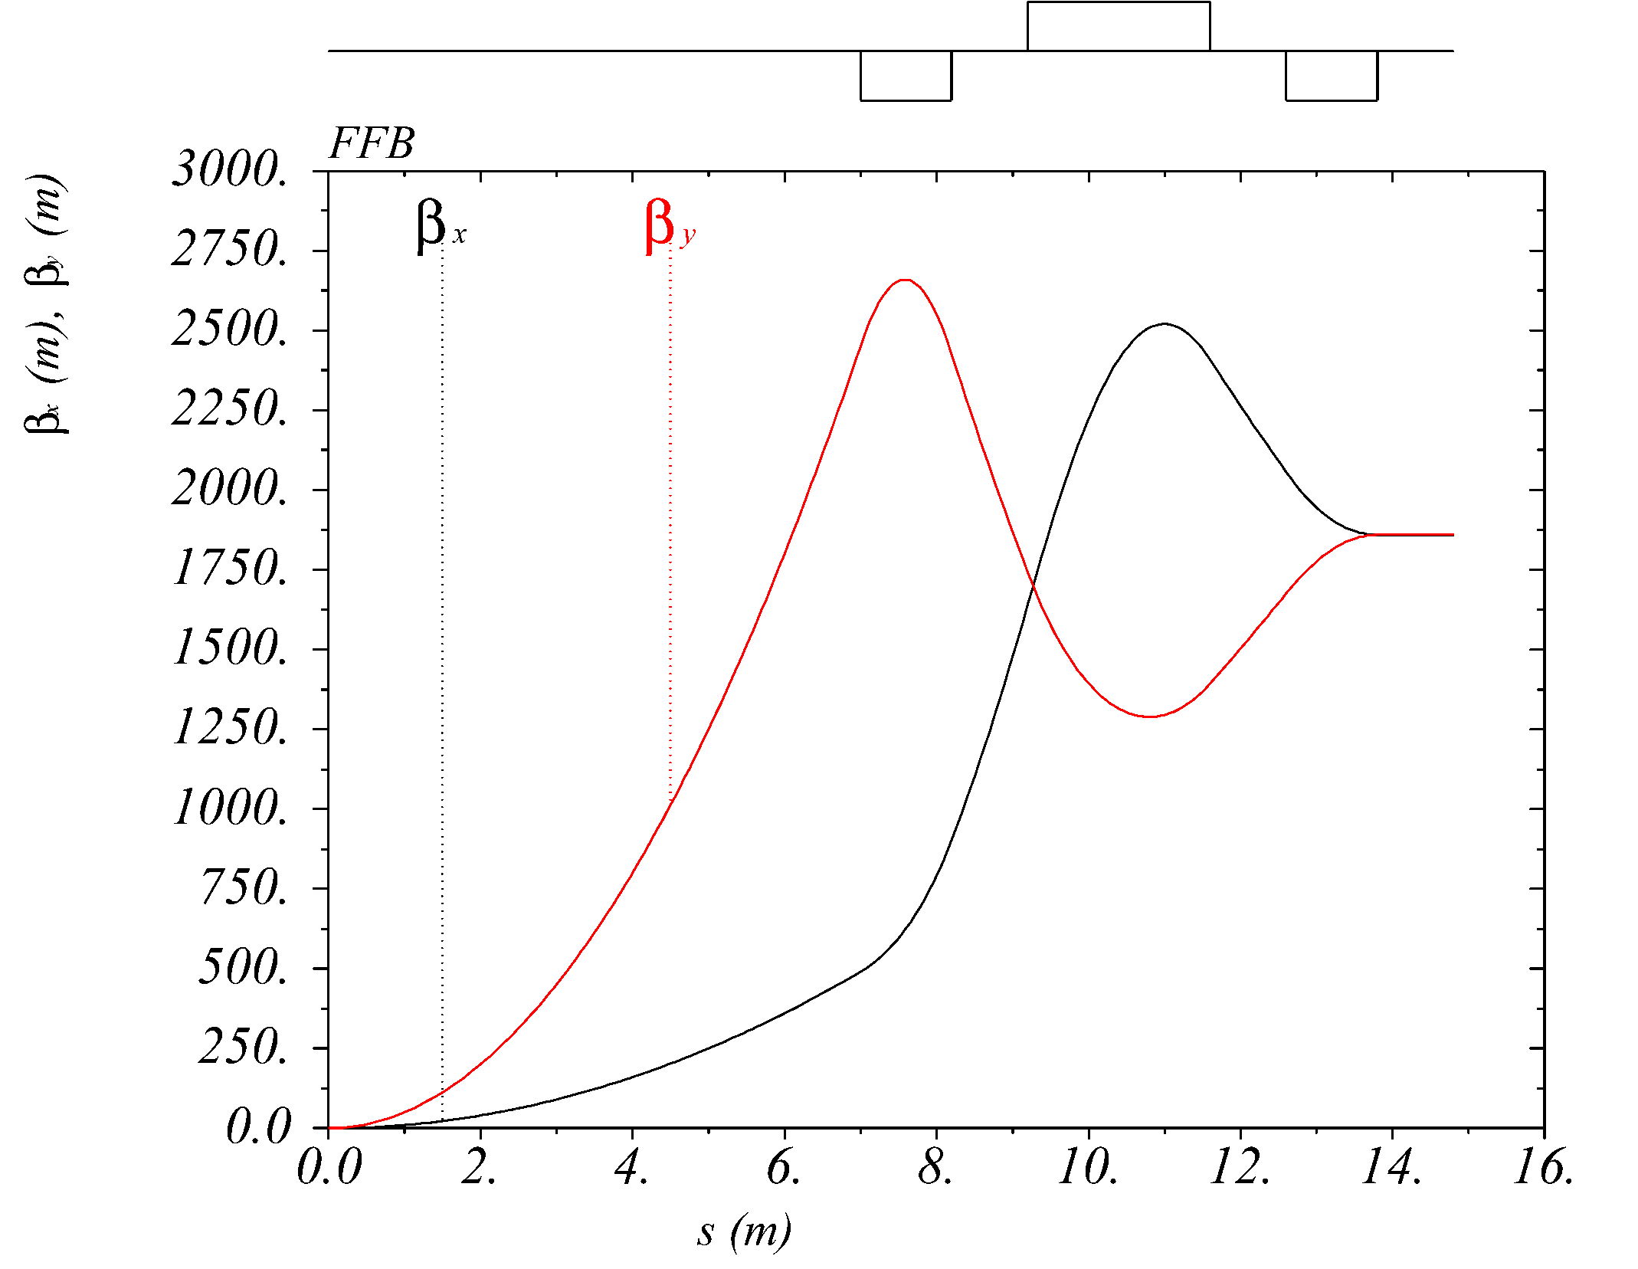
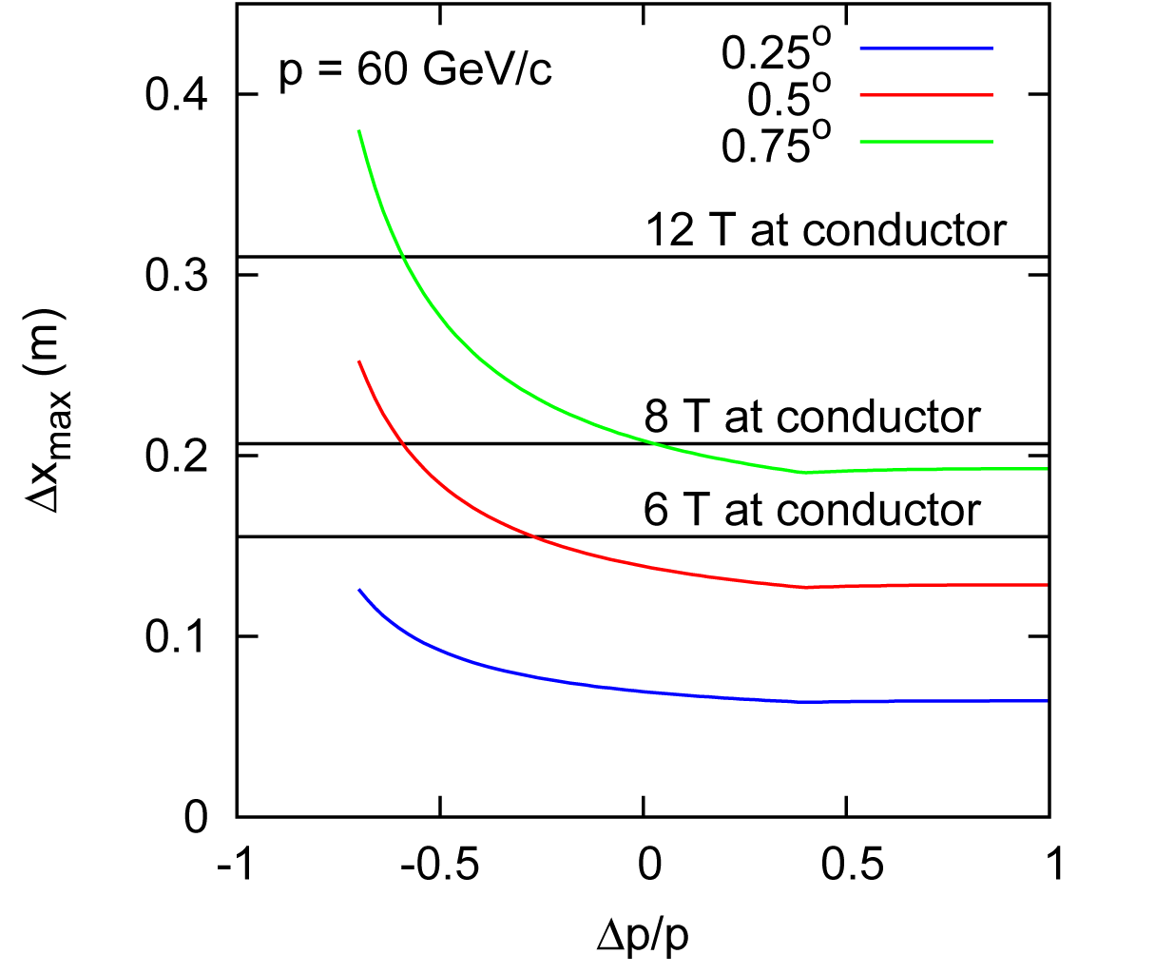
Optimized Final Focusing Block
Distance from the IP to the first quad = 7 m
Quadrupole lengths: L₁ = 1.2 m, L₂ = 2.4 m, L₃ = 1.2 m
Quad strengths @ 100 GeV/c: Q₁ = -79.7 T/m, Q₂ = 41.3 T/m, Q₃ = -23.6 T/m
Quad aperture = Field at the pole tip / maximum field gradient (@ 100 GeV)
²H beam

Slide 26
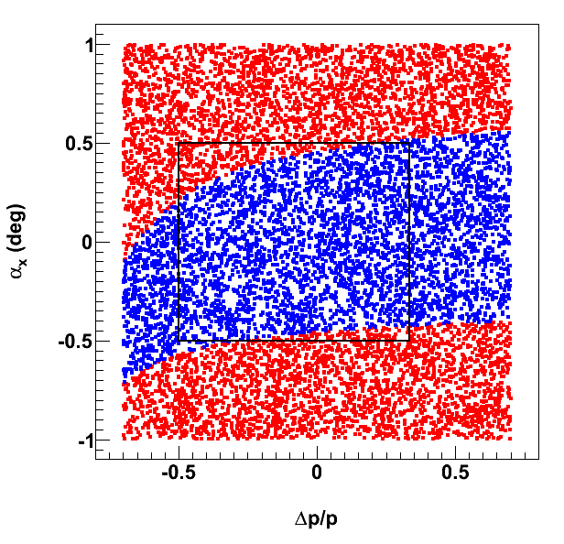
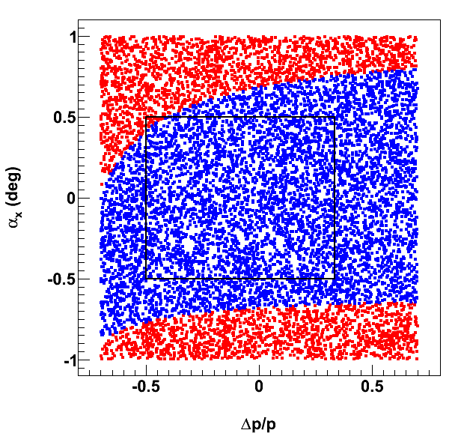
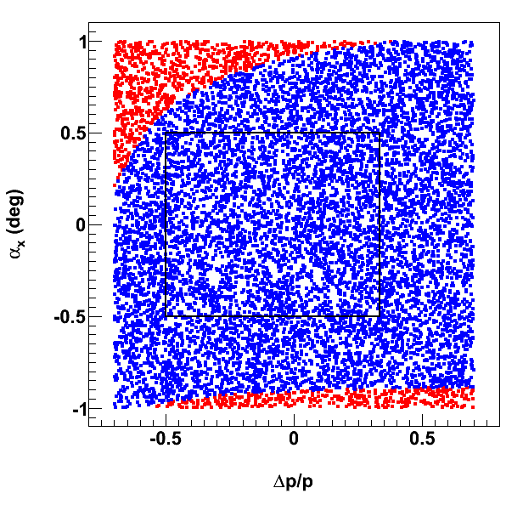
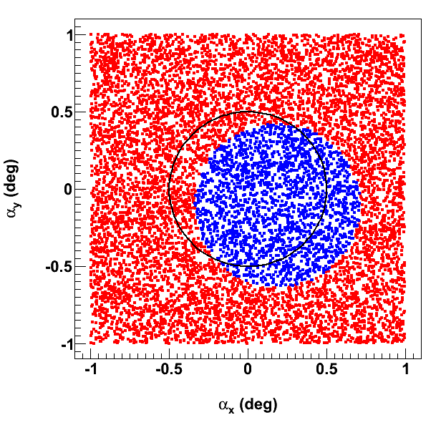
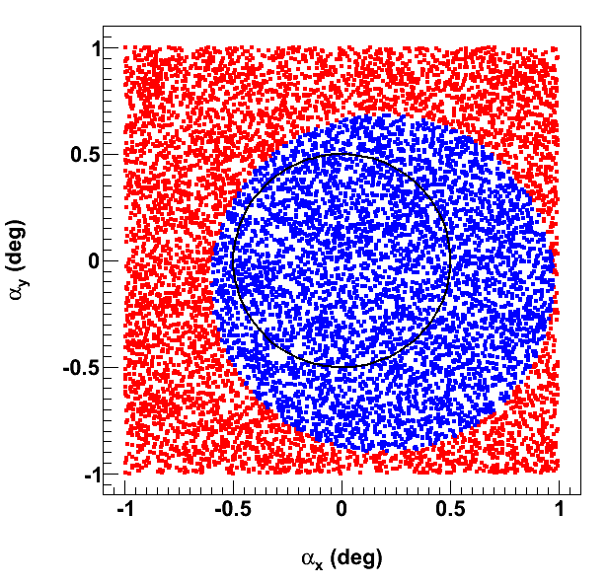
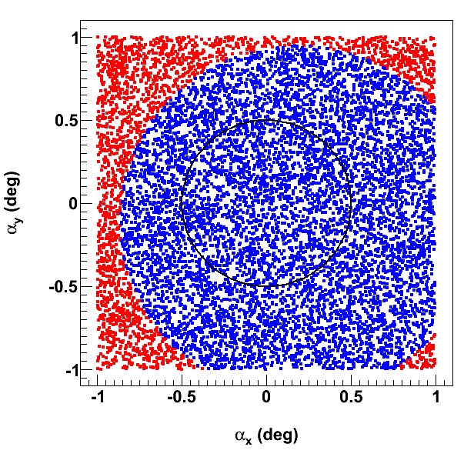
Optimized FFB Acceptance
Blue region corresponds to angles smaller than 0.5 (1.0) degrees for 60 GeV protons, top (neutrons, bottom) and large momentum spread to account for e-A. If no red in square/circle, we have full acceptance
6 T max
9 T max
12 T max

Slide 27
Summary for EIC
Close and frequent collaboration between accelerator and nuclear physicists regarding the machine, interaction region and detector requirements has taken place. The MEIC detector/IR design has concentrated on maximizing acceptance for deep exclusive processes and processes associated with very-forward going particles, over a wide range of proton energies (20-100 GeV).
Potential ring layouts for MEIC, including integrated interaction regions, have been made. Chromatic compensation for the baseline parameters has been achieved in the design. A remaining task is to quantify the dynamic aperture. Suitable electron and ion polarization schemes have been integrated.
We have unique opportunities to make a (future textbook) breakthrough in nucleon structure and QCD dynamics, including:
  the possibility to truly explore and image the nucleon
  the possibility to study the role of gluons in structure and dynamics
  the possibility to study the emergence of hadrons from color charge
BNL and JLab management, and the EIC community, closely collaborate, and some convergence has occurred on performance deliverables in terms of energy and luminosity, detector design, and the EIC realization timeline. Nonetheless, differences remain in design approach, interaction region integration, and benchmark processes.

Slide 28


Towards a “3D” spin-flavor landscape
W^{u}(x,k,r)
(Wigner Function)
(x,r)
(x,k)
m
p
x
TMD
EIC: Transverse momentum distribution derived directly from semi-inclusive measurements, plus large gain in our knowledge of transverse momentum effects as function of x.
t
EIC: Transverse spatial distribution derived directly from t dependence:
  Gluon size from J/Ψ and φ
  Singlet quark size from γ
  Strange and non-strange (sea) quark size from π and K production
Exact k_{T} distribution presently unknown – EIC can do this well
Hints from HERA:
Area (q + q) > Area (g)
-

Slide 29

Using the nuclear arena
Formation time t_{f}^{h}
Hadron is formed
Production time t_{p}
Hadron attenuation
Quark is deconfined
Time required to produce colorless “pre-hadron”, signaled by medium-stimulated energy loss via gluon emission
Time required to produce fully-developed hadron, signaled by CT and/or usual hadronic interactions
π⁺
e’
γ*
p_{T}
Δp_{T}² = p_{T}²(A) – p_{T}²(²H)
dE/dx ~ <p_{T}²>_{L}
ΔE ~ L (QED)
~ L² (QCD)?
e
L
“p_{T} Broadening”

Slide 30


Hadronization
EIC: Explore the interaction of color charges with matter
(1 month only)
EIC: Understand the conversion of color charge to hadrons through fragmentation and breakup

