Slide 1
Understanding forward particle production
Roman Pasechnik
Uppsala University, THEP group
In collaboration with
B. Kopeliovich
(USM, Chile)
Opportunities for Drell-Yan Physics at RHIC
May 13th, 2011
1

Slide 2
We will talk about...
Color neutralization and soft physics in diffractive DIS
Sudakov suppression and elastic scattering
Drell-Yan at high energies: diffractive vs inclusive
Large and small dipoles
Eikonalization of the elastic amplitude and gap survival
Summary
2

Slide 3
Color screening effects in different asymptotics
z
?
time
Soft/semihard color neutralization
Perturbative color neutralization
Both include unitarity corrections and color neutralisation
Both diffractive – nondiffractive
processes
Lack of absorptive effects!
3

Slide 4
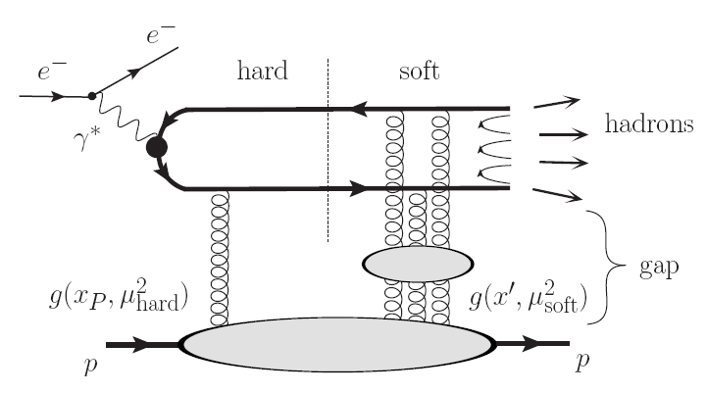
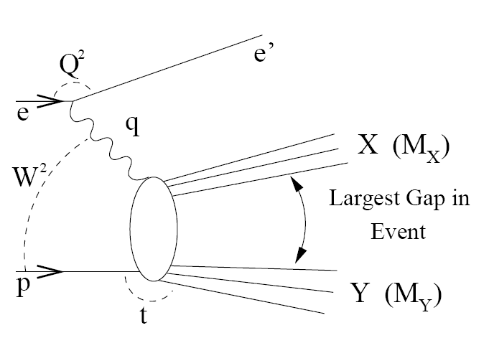
Color screening in diffractive DIS
Diffractive DIS at HERA
QCD rescattering model
Hard part
conventional
(small distance)
Soft part:
color-screening (octet)
multigluon exchange
(large distance)
Pasechnik, Enberg, Ingelman, Phys.Rev. D82 (2010) 054036
4

Slide 5
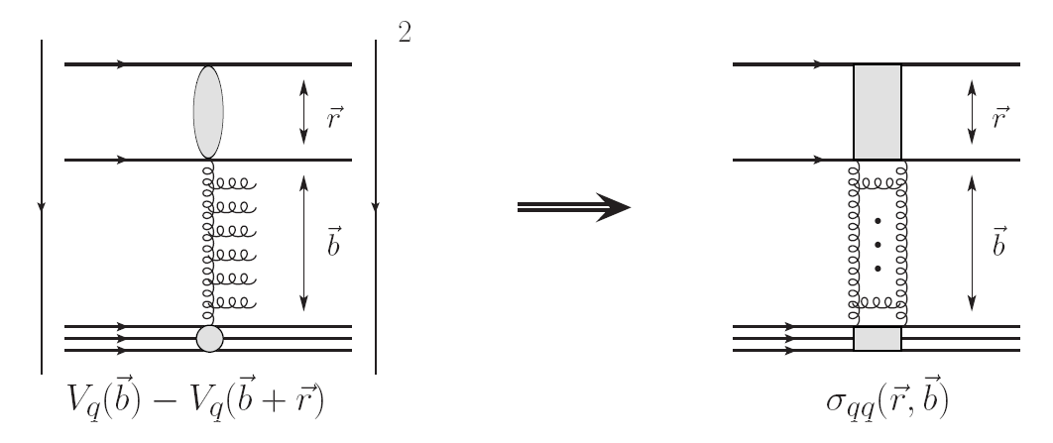
Sudakov suppression and elastic scattering
X
Color neutralization is required for diffraction
Hard gluon Bremsstrahlung
contributes at larger MX
soft gluons – a part of UGDF!
Color neutralization is automatic,
no radiation into the gap,
small MX is produced,
no need in Sudakov!
For diffractive small MX production
Sudakov suppression is needed!
5

Slide 6
Photon radiation in the forward quark scattering
…in inelastic collision
…in elastic collision
Radiation depends on the whole strength
of the kick rather on its structure
No radiation from a quark at Pt=0!
6

Slide 7
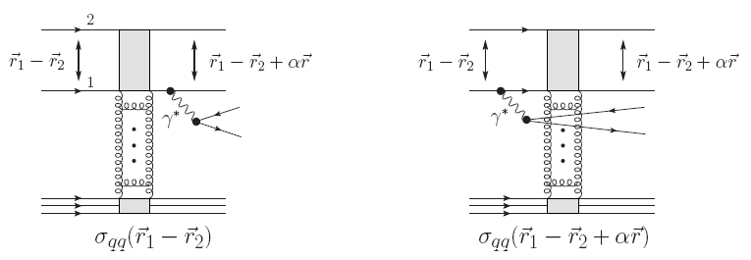
Diffractive Drell-Yan in the dipole-target scattering
By optical theorem
dipoles with different
sizes interact differently!
Amplitude of DDY in the dipole-target scattering
7

Slide 8
Diffractive Drell-Yan in pp scattering: amplitude
B. Kopeliovich, I. Potashnikova, I. Schmidt and A. Tarasov, Phys. Rev. D74, (2006) 114024
Diffractive DY amplitude
..probing large distances in the proton
8

Slide 9
QCD factorization breaking in diffractive Drell-Yan
Golec-Biernat-Wuestoff (GBW)
dipole cross section
Difference between two Fock states
Diffractive DY amplitude
Interplay between
hard and soft scales
Diffractive DIS
Diffractive DY
Dramatic breakdown
of the QCD factorization!
The QCD factorization holds!

Slide 10
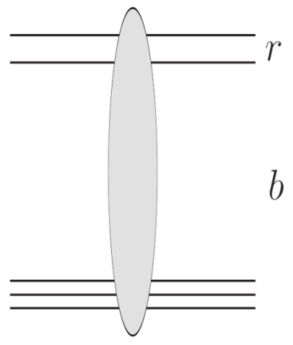
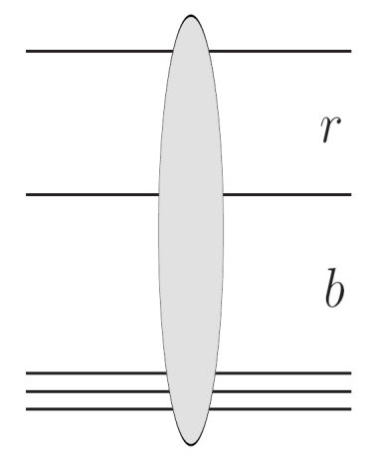
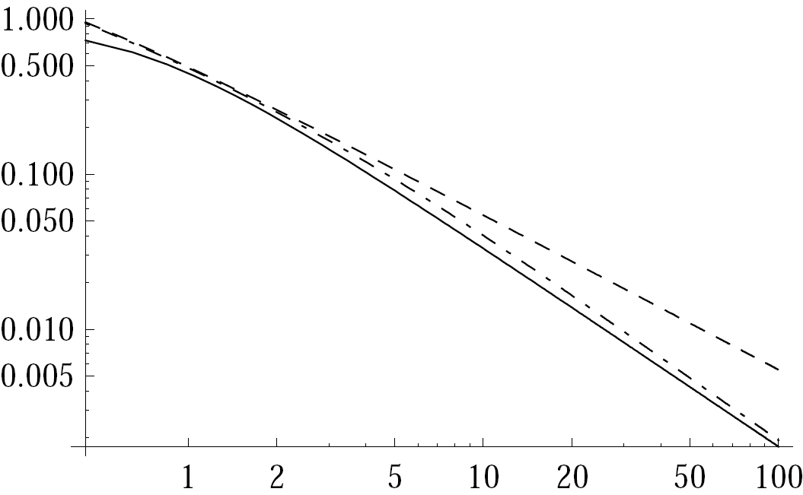
Small and large dipoles
Fitted to DIS data
Fitted to soft data
DDY!
Golec-Biernat-Wuestoff (GBW)
parameterization
Kopeliovich- Schafer -Tarasov (KST)
parameterization
Phys. Rev. D 62 (2000) , 054022
9

Slide 11
Eikonalization of the diffractive Drell-Yan amplitude
DDY eikonalized amplitude
Accounts for soft and hard components
on the same footing!
9

Slide 12
Diffractive Drell-Yan in pp scattering: cross section
In the forward limit
Proton wave function
Valence quark distribution
+ antiquarks!

Slide 13
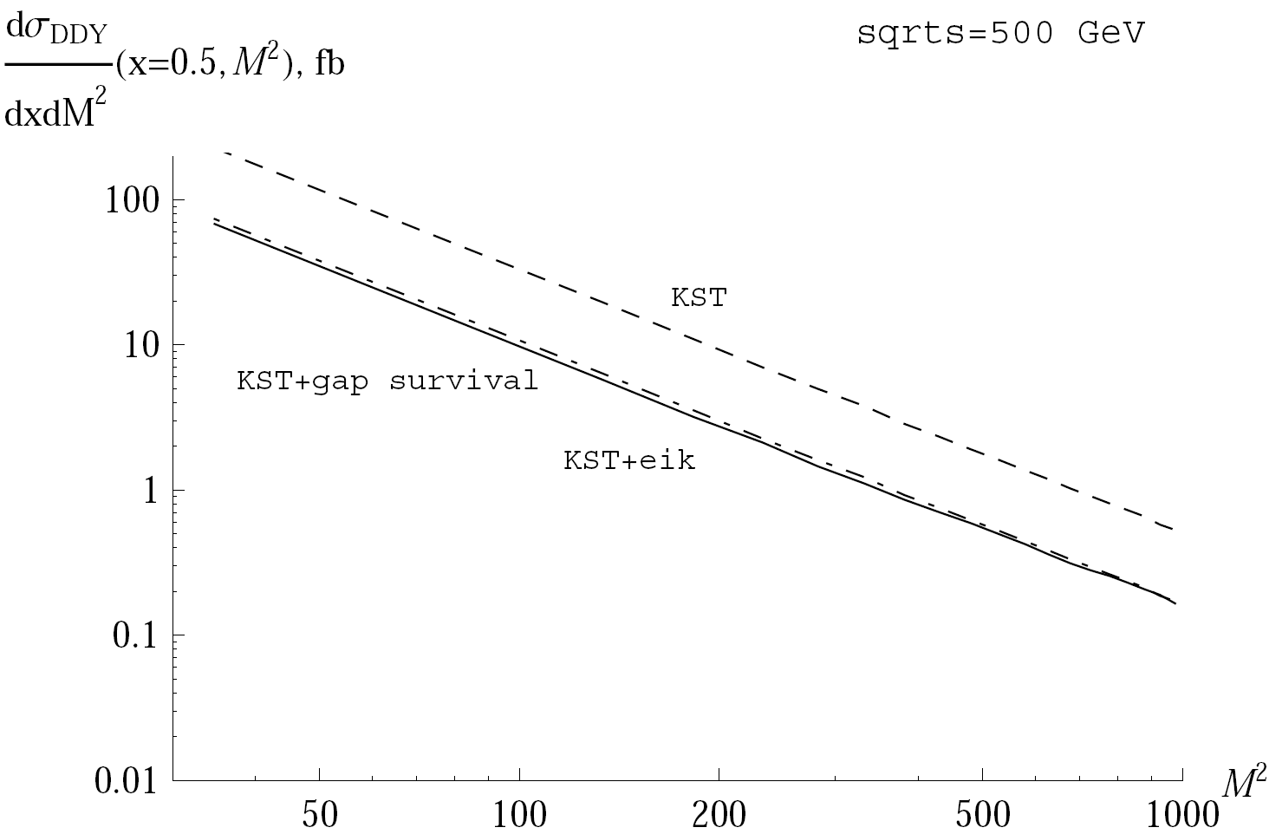
Gap survival vs. eikonalization
Regge parameterization for F2
Cudell, Soyez, Phys.Lett. B516 (2001), 77

Slide 14
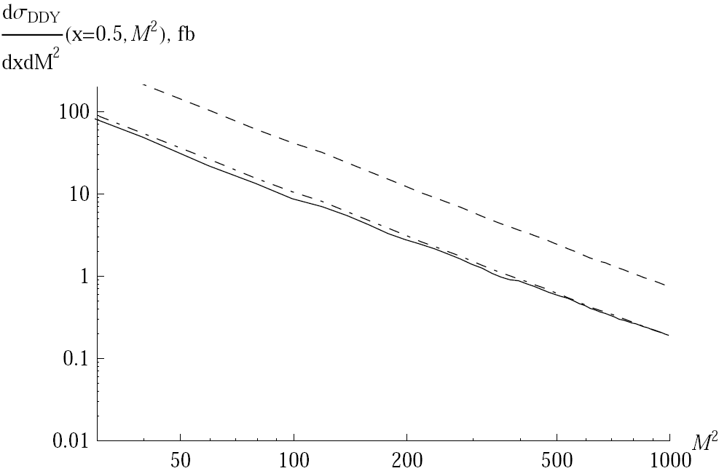
Gap survival vs. eikonalization

Slide 15
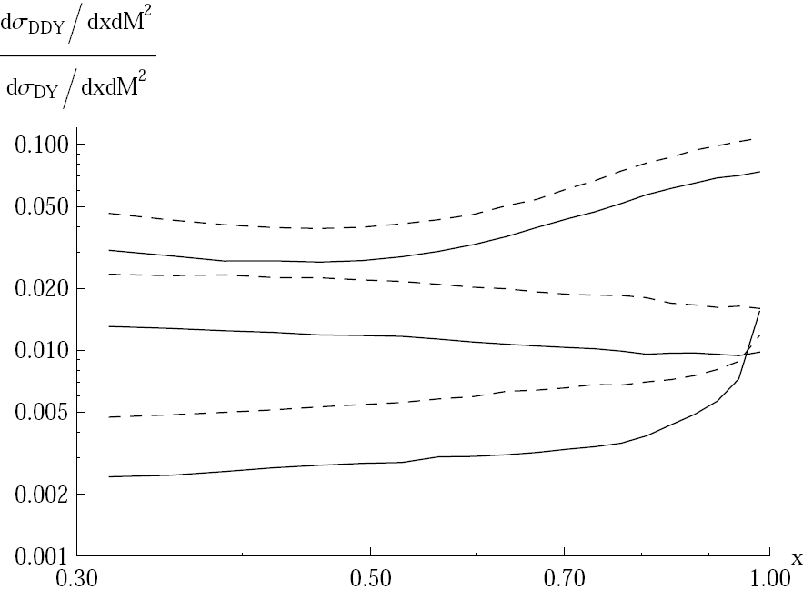
Diffractive vs. inclusive DY

Slide 16
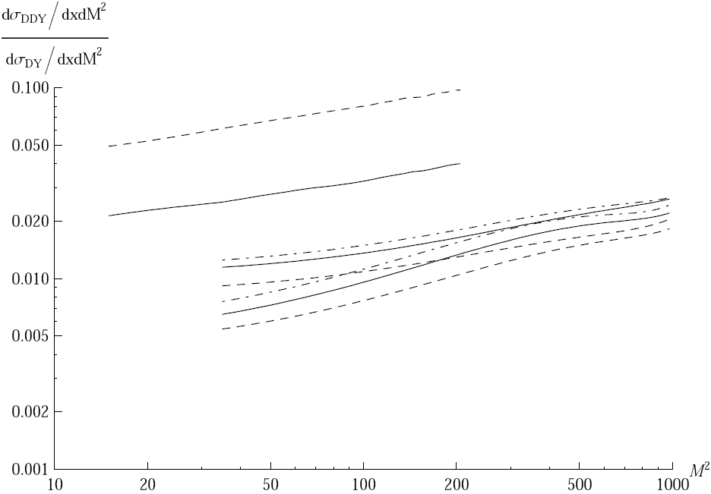
Diffractive vs. inclusive DY

Slide 17
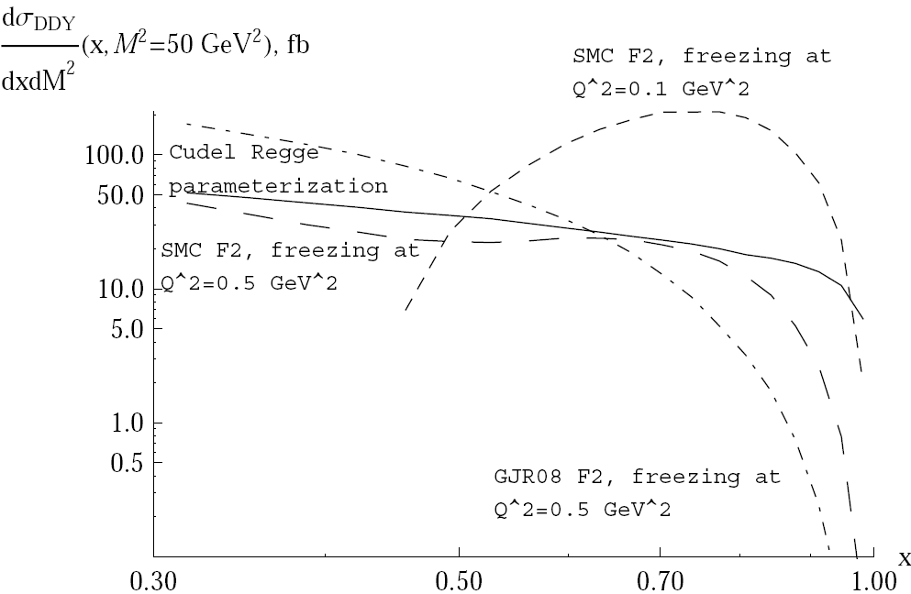
Theory uncertainties

Slide 18
Conclusions
A quark cannot radiate photon diffractively in the forward direction
A hadron can radiate photon diffractively in the forward direction because
of the transverse motion of quarks
The ratio diffractive/inclusive DY cross sections falls with energy and
rises with photon dilepton mass due to the saturated shape of the
dipole cross section
Hard and soft interactions contribute to the DDY on the same footing,
which is the dramatic breakdown of the QCD factorisation
Main features of Drell-Yan diffraction are valid for other Abelian processes
Experimental measurements of DDY would allow to probe directly the
dipole cross section at large separations, as well as the proton structure
function at soft and semihard scales, and large x
DDY is a good playground for diffractive production of heavy flavors

