Slide 1
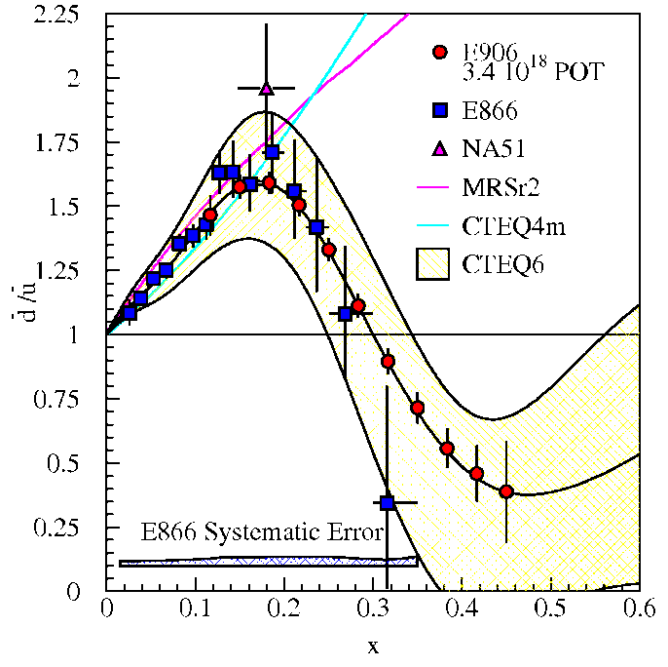
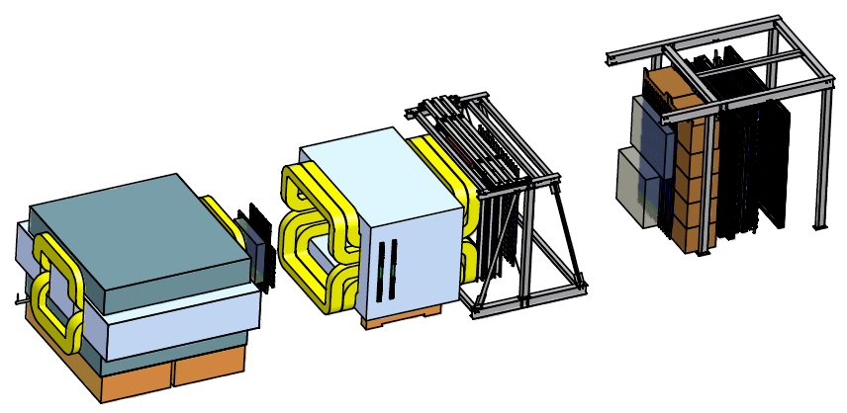
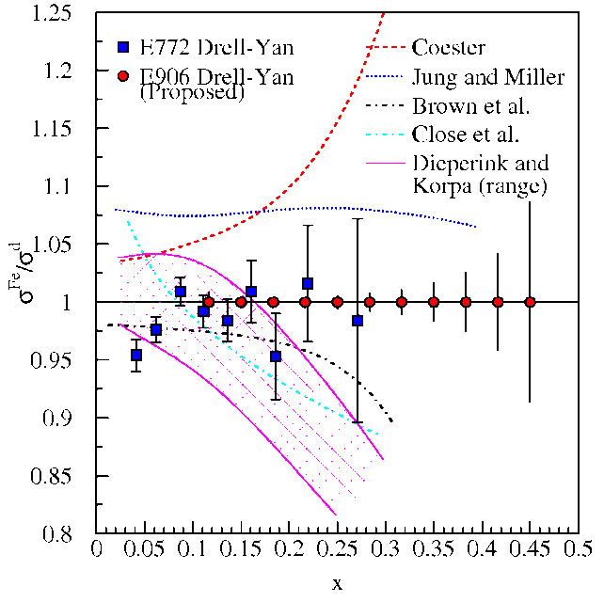
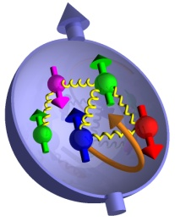
Opportunities with Drell-Yan Scattering at Fermilab
Paul E. Reimer
Physics Division
Argonne National Laboratory
The Drell-Yan Process—A Laboratory for Quark Studies
Fermilab E-906/SeaQuest Physics Program
Sea quark in the proton
Sea quarks in the nucleus
Angular distributions
What can the future hold? Polarized targets or beams?
With help from Chiranjib Dutta, Wolfgang Lorenzon, U. Michigan and Yuji Goto, RIKEN
HERMES
U. Elschenbroich
This work is supported in part by the U.S. Department of Energy, Office of Nuclear Physics, under Contract No. DE-AC02-06CH11357.

Slide 2
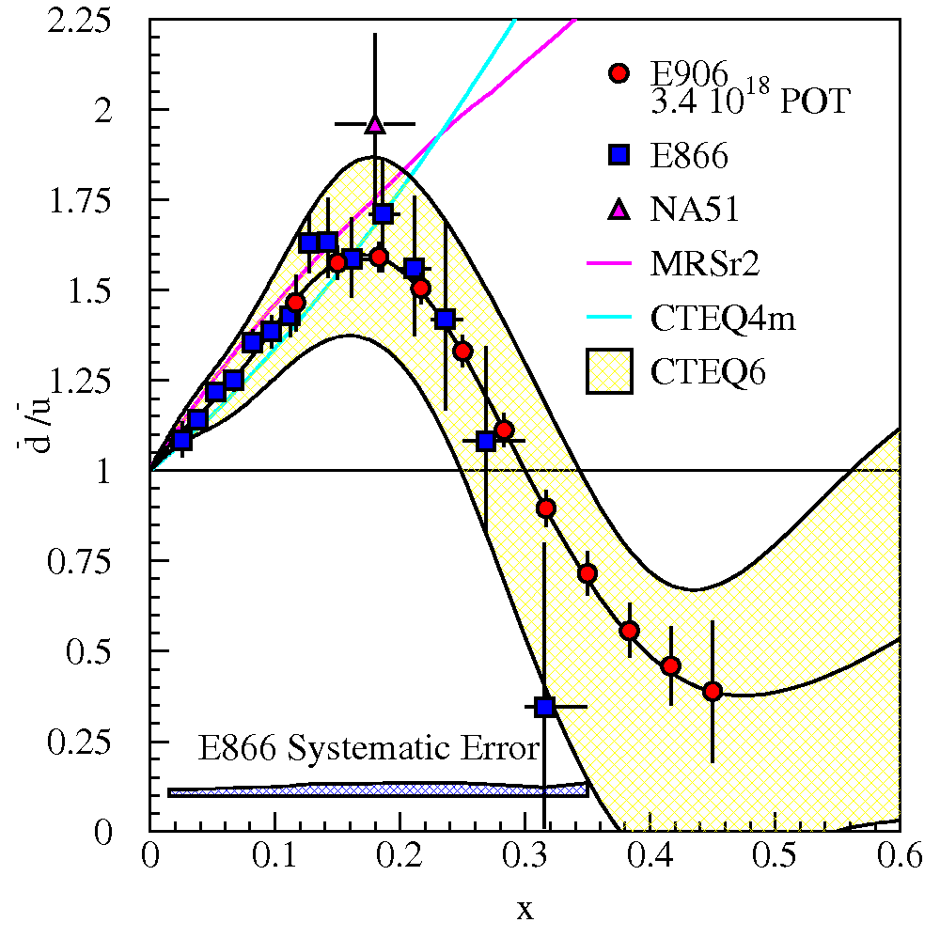
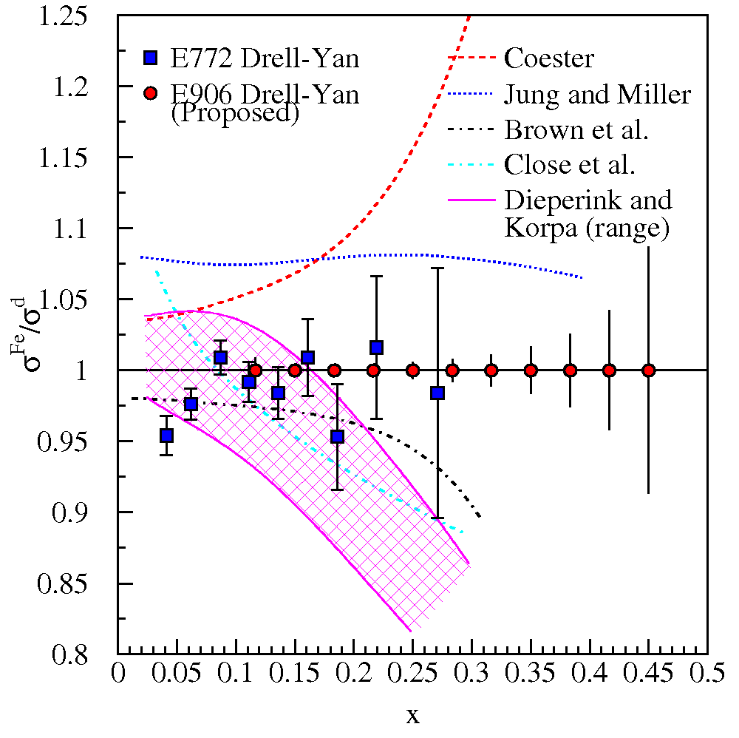
Extracting d-bar/-ubar From Drell-Yan Scattering

Slide 3
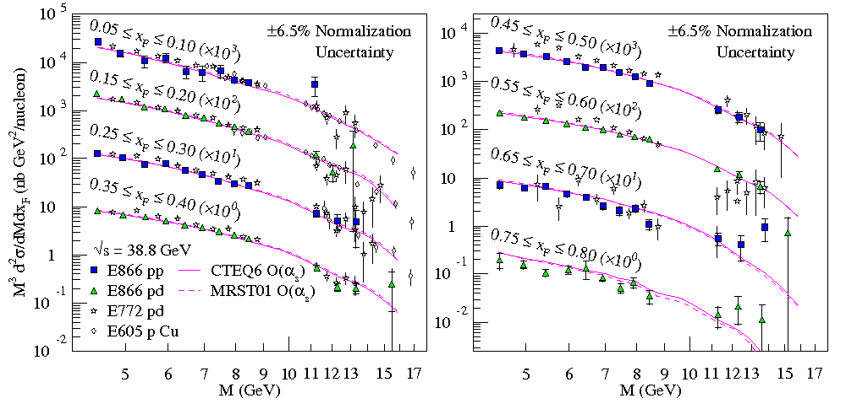
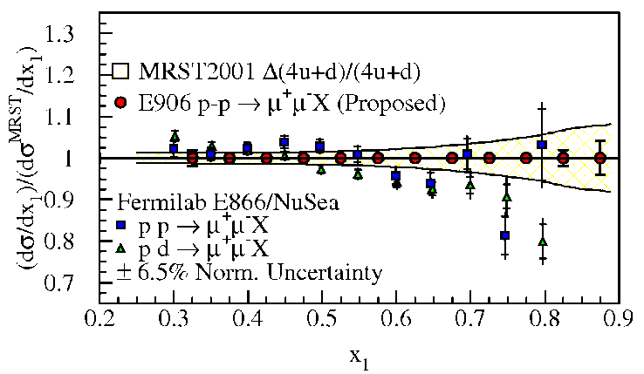
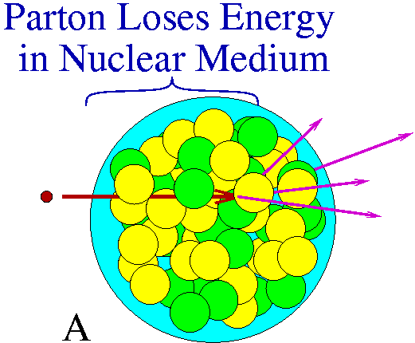
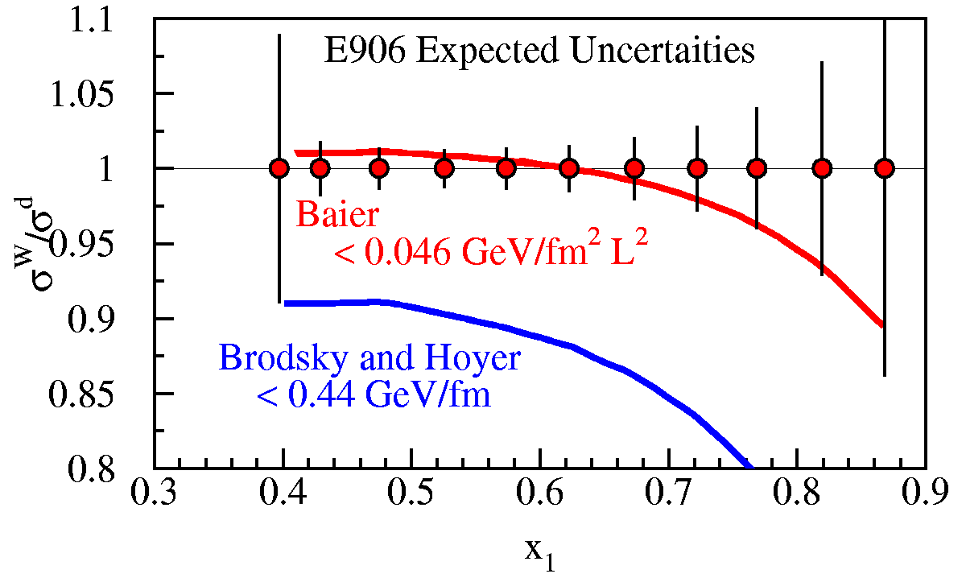
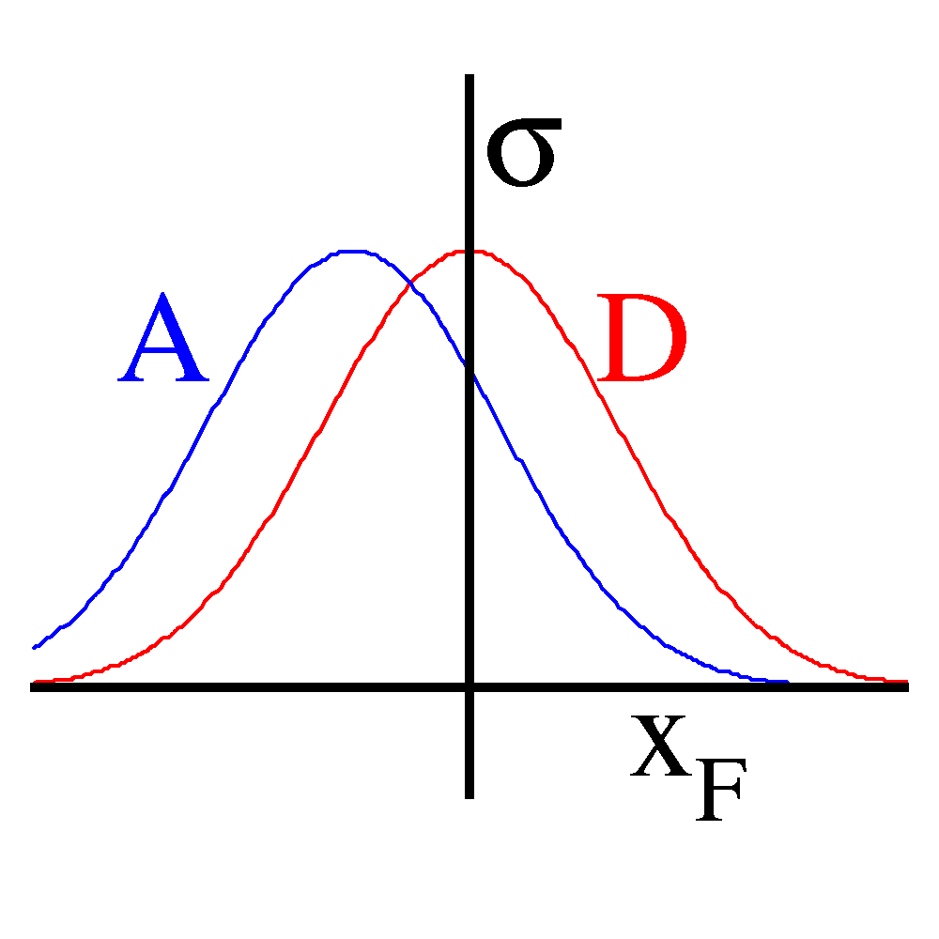
Other Physics from E-906/SeaQuest
Absolute High-x_{Bj} Parton Distributions
Partonic Energy Loss in Cold Nuclear Matter
X₁

Slide 4
E-906/SeaQuest timeline and plans
Fermilab PAC approved the experiment in 2001—but experiment was not scheduled due to concerns about “proton economics”
Fermilab Stage-II Approval granted on 24 December 2008
Expected first beam in late June 2011
Expt. Funded
Experiment
Construction
Experiment
Runs
Shutdown
2009
2010
2011
2012
2013
2014
Beam: low intensity
Station 4:
Hodoscope array
Prop tube tracking
high intensity
Station 1:
Hodoscope array
MWPC tracking
Station 2 and 3:
Hodoscope array
Drift Chamber tracking
Solid Iron Focusing Magnet, Hadron absorber and beam dump
Mom. Meas.
(KTeV Magnet)
4.9m
Hadron Absorber
(Iron Wall)
Liquid H₂, d₂, and solid targets
25m
Drawing: T. O’Connor and K. Bailey

Slide 5
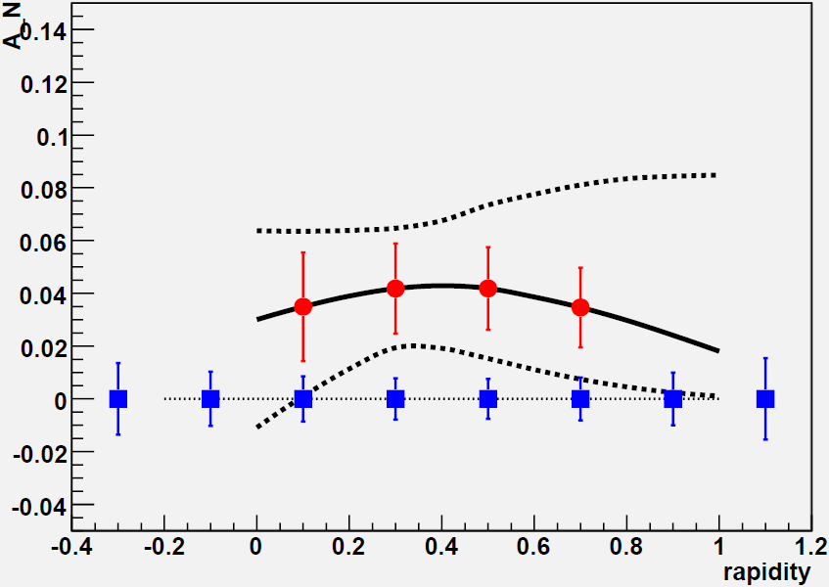
At RHIC?
Internal Cluster-jet or pellet target 10¹⁵atoms/cm²
50 times thinner than RHIC CNI carbon target
Operational modes
Parasitic
End-of-fill (HERMES)
Dedicated (in-and-out strike)
Other questions/obstacles
Competition for interaction region (AnDY, EIC)
Beam compensation for double dipole spectrometer
Beam pipe through spectrometer?
10% beam used for reaction
collider & internal-target parasitic run
~6 hours
For more details on these operation modes, please see Yuji Goto
20% beam used for reaction
collider run
Internal-target run
10% beam used for reaction
Internal-target run
~30 mins
Theory calculation:
U. D’Alesio and S. Melis, private communication;
M. Anselmino, et al., Phys. Rev. D79, 054010 (2009)
Measure not only the sign of the Sivers but also the shape of the function
What if
but
?

Slide 6
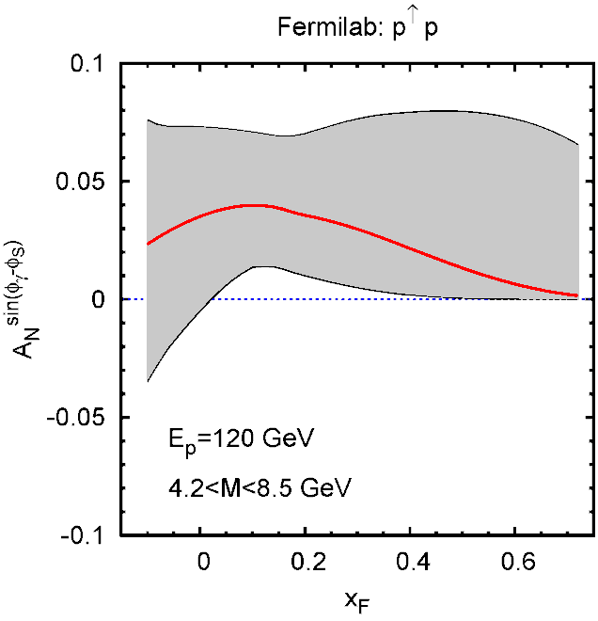
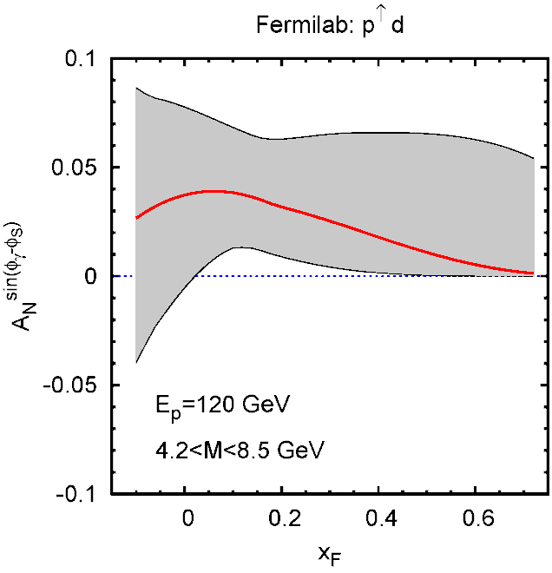
Polarized beam at Fermilab Main Injector
1 mA at polarized source delivers 8.1 x 10¹¹ p/s (=130 nA)
A. Krisch: Spin@Fermi study in 1995
Fermilab Main Injector can be polarized (not Tevatron)
Revisit study to re-evaluate cost (done in early fall 2011)
Feasibility depends on cost (both in $$ and down time of MI)
Scenarios:
SeaQuest liquid H₂ target can take ~5 x 10¹¹ p/s (=80 nA)
L = 1 x 10³⁶ /cm²/s (60% of beam delivered to experiment)
L = 2 x 10³⁵ /cm²/s (10% of beam delivered to experiment)
x-range:
x₁ 0.3 – 0.9 (valence quarks)
x₂ 0.1 – 0.5 (sea quarks)
Unpolarized SeaQuest
luminosity: L = 3.4 x 10³⁵ /cm²/s
I_{av} = 1.6 x 10¹¹ p/s (=26 nA)
N_{p}= 2.1 x 10²⁴ /cm²
2-3 years of running: 3.4 x 10¹⁸ pot
Anselmino et al. priv. comm. 2010

Slide 7
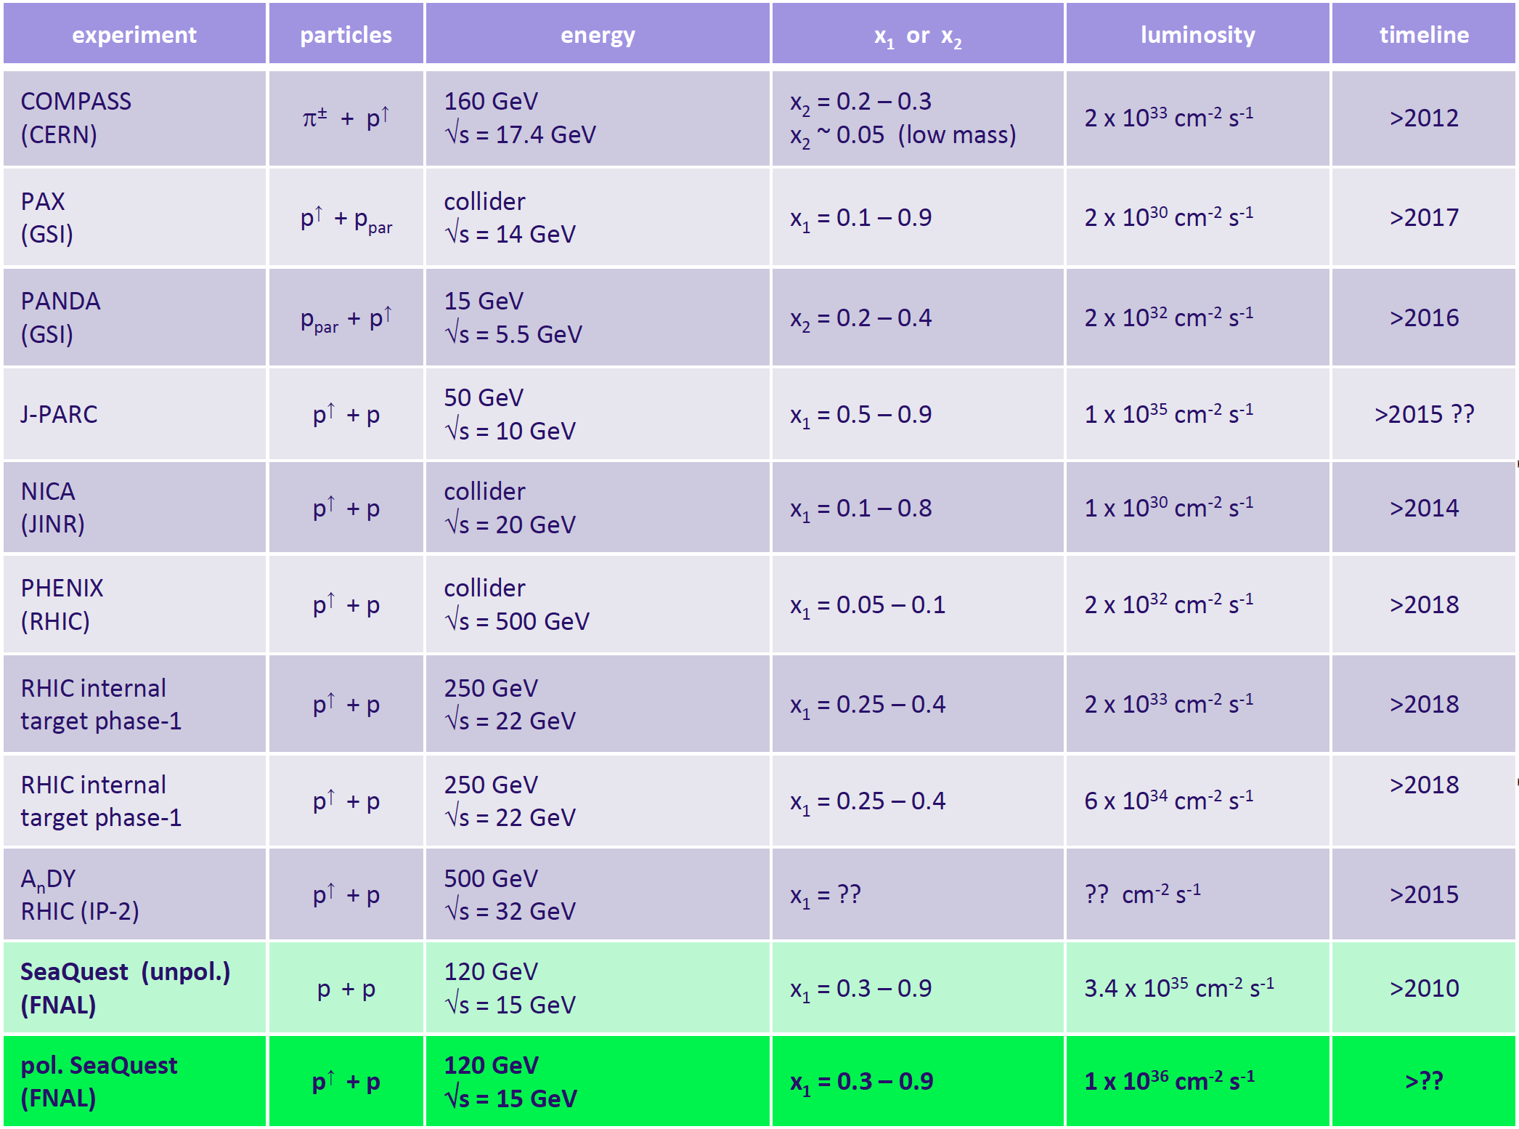

Slide 8
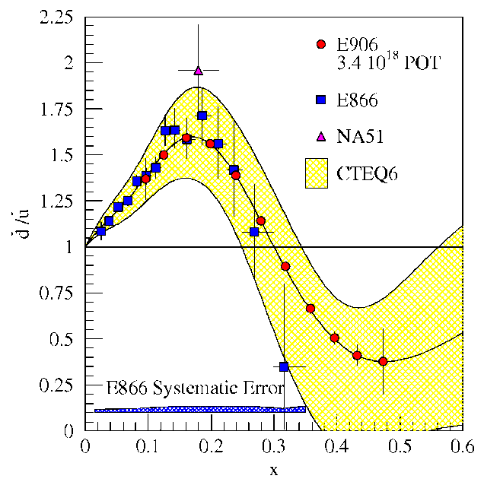
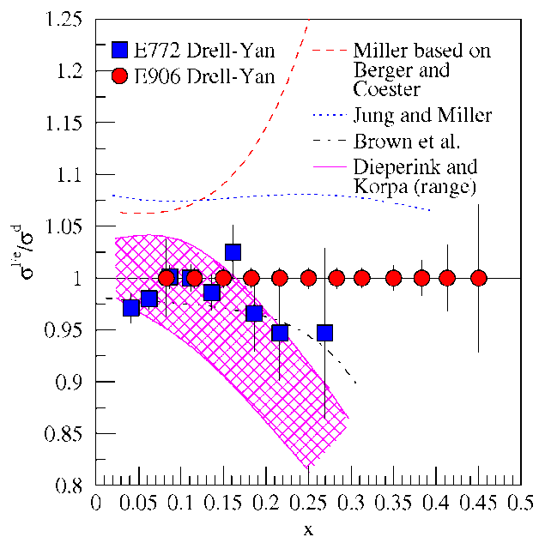
Drell-Yan at Fermilab
What is the structure of the nucleon?
What is d-bar/u-bar?
What are the origins of the sea quarks?
What is the high-x structure of the proton?
What is the structure of nucleonic matter?
Where are the nuclear pions?
Is anti-shadowing a valence effect?
What is the transverse Structure of the proton?
Polarized beam at Fermilab Main Injector
Move apparatus to RHIC or J_PARC
This work is supported in part by the U.S. Department of Energy, Office of Nuclear Physics, under Contract No. DE-AC02-06CH11357.

